Slide 1
Main priorities for the next years

Slide 2
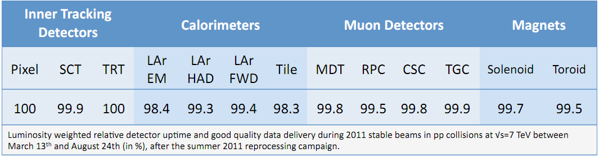
Where do we stand
Muon system in good shape (in my opinion)
  Sub-systems hardware quite robust (see later for main problems)
    All sub-systems have >97% active channels
  High data taking efficiency and rather smooth operations
    No big data loss caused by Muons
    First system in ATLAS to reduce to 1 shifter per shift
  High data quality
    In almost all data recorded the muon system is usable for physics

Slide 3
Where do we stand
  Muon software: good performance and robustness
    Situation much improved in the last years and further improvements foreseen with the Third Chain
  Muon Performance close to design level (but not yet there)
    Big improvements in Alignment and Calibration, further improvements will be slower
    Physics with muon signatures now as good or better then electrons (Z’, H→ 4 leptons)
  Very good link between Muon System and Muon Combined Performance:
    MATF and MCP working together to optimize muon performance and deliver guidelines to physics analysis
  A big Thank to all the people that have been strenuously working for the muon system and in particular to the Muon Steering Group TEAM, that made all this possible.

Slide 4
A word on muon organization
To achieve these good results the Team work of the members of the Muon Steering Group was essential.
I would keep the SG composition as it is:
  Run Coordination
  Software and DQA coordination
  Hardware and Upgrade coordination
  Sub-systems (MDT, CSC, TGC, RPC)
  Operations (DCS, Trigger, DAQ)
  Software (Core Software, Data Base, Reco.)
  Data Quality
  Performance (Calibration and alignment)
…But I’m always open to suggestions form you.

Slide 5
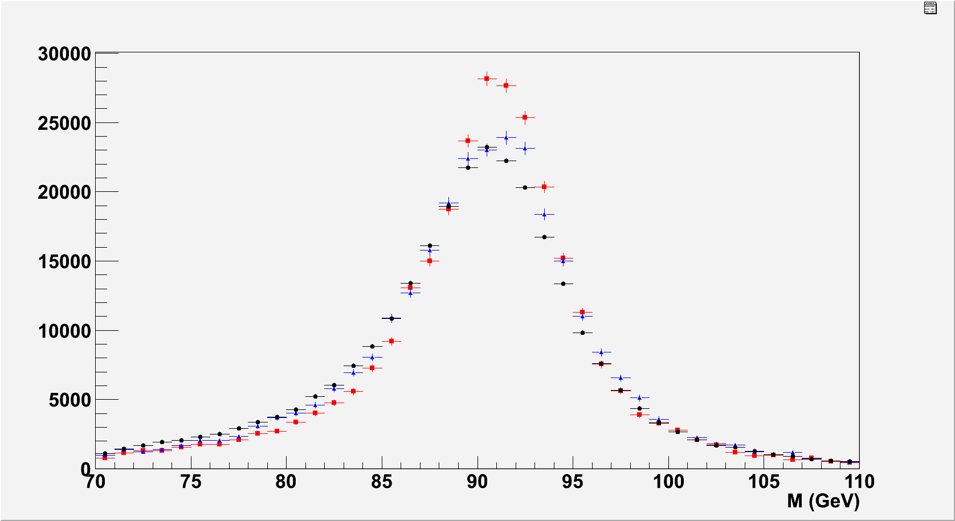
A word on muon organization
The creation of the Muon Analysis Task Force has been instrumental for the improvement of the understanding of the Muon performance.
  We should always keep this task force alive
Z mass MS-SA Barrel
+ MC with NO alignment errors
+ MC with realistic alignment
+ Data

Slide 6
Main issues for the muon spectrometer
Hardware:
  Some TGC chambers are dying
    Spare chambers being built but difficult to find the time to do the work in 2013-14.
      PL should work together with TC to get in the shut down schedule the time for chambers replacement
  RPC chambers have very fragile gas distribution
    Some Gas inlets crack and/or breaks down
    Some chambers are disconnected from HV
    Repair not possible for some chambers
    Need frequent access without toroidal field
      Ensure that technical manpower will still be available for those repairs

Slide 7
Main issues for the muon spectrometer
Hardware:
  CSC:
    ROD rate limitations not yet fully established, it might be that this will become the bottleneck for high trigger rate ( ATLAS still aim to 100 kHz) operations
      Need to take (very soon) a decision if we want to build a new ROD for the CSC to be installed during the 2013-14 shut down
  MDT:
    EO chambers gas jumpers cracking
    increase in number and magnitude of gas leaks.
      Ensure that yearly maintenance will keep this problem under control

Slide 8
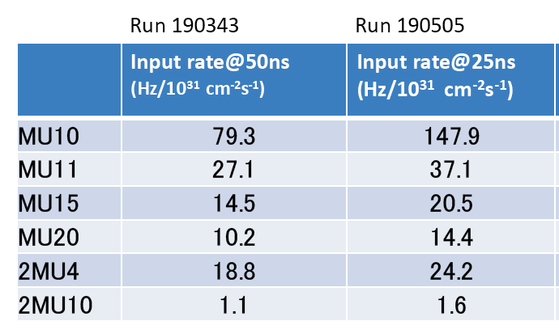
Main issues for the muon spectrometer
LVL1 trigger:
  Trigger rates higher than foreseen may exceed allowed bandwidth for muons at 25ns 8 TeV and L>10³⁴ cm⁻²s⁻¹:
  Barrel: High fake rate in low-Pt (less crucial at high L)
  EC: trigger dominated by fakes even at high-Pt – Need to find a way to reduce it (partially cured by new Small wheel)

Slide 9
Main issues for the muon spectrometer
Maintenance and operation:
  The experts that built the detector and commissioned it are moving away from the operations.
    Need to form new experts.
    Motivate people to participate in this activities (OTP, Priorities for conference talks, etc.)
  2013-2014 Shut down:
    Will have problems to find people working on the detector
    Need help from the institutes
    On the other hand, very good opportunity to form new experts and to have students to work on the hardware.

Slide 10
Upgrade(s)
Phase 0 (2013-14):
  Complete the EE wheel on side A (side C installed this winter)
  Install trigger electronics in the BOF-BOG of sector 12 and 14
  Install new chambers for the elevator holes.
  Install new alignment system for BEE-BIS7-8 chambers
  Commissioning of this new hardware
    Follow the preparation and ensure manpower for these operations
    Interact with TC to ensure both technical help and time in the schedule
    Make sure that software is ready to handle these upgrades

Slide 11
Upgrade(s)
Phase 1 (2017-18 up to 2021(?)):
  Construct Install and commission the New Small Wheel
  Install and commission the new End Cap LVL1 trigger
  Other possible upgrades:
    Improve coverage in sect 12 and 14 of the barrel
      Small and light chambers to be installed between BMFs
    Improve LVL1 trigger in the region 1.3>η>1
      Confirm the Big Wheel LVL1 trigger with fast information coming from EE region.
  Together with PL of Small Wheel project
    Take decision on chamber technology
    Form the collaborations look for the money and organize the work
    Write TDR and (I)-MOU
    +……….All the rest

Slide 12
Upgrade(s)
Phase 2 (2021(?)-2030(?)):
  Main issue is the trigger !
  Very probably we will need to rebuild all the trigger electronics due to the probable increase of trigger latency in ATLAS.
  Need to sharpen the LVL1 threshold to reduce LVL1 rates
    Inclusion of MDT in the LVL1 trigger decision???
  Will the present detector and read-out electronics survive 3000 fb⁻¹ and 7*10³⁴?
  Phase 2 seems very far in time but we have to start now to plan for it and to follow what happens in ATLAS
  Many decisions have large side effects for the muons.

Slide 13
Software and Performance
Third reconstruction chain almost ready to be deployed
  By March should be used in the Tier0 together with MuonBoy and Moore
  In Rel 18 it should be the only reconstruction chain
  The third chain should bring better maintainability but we should not compromise performance: get best features from both algorithms
    Need intense commissioning and optimization work
    Ensure that milestones are met
    Ensure that new people will be injected in the software development
Continue to support the Software groups and in particular enhance the effort on simulation for the upgrade needs
Ensure that alignment and calibration will achieve the TDR level of accuracy.
  Ask at the EB and organize with Run Coordination more Toroid Off runs to improve accuracy of alignment

Slide 14
Manpower issues
Need to find a replacement for Stephanie
  One of the more difficult task of the present and next PL.
Possibly need to find replacement for other very relevant people in the steering group
  Up to now we managed quite well in rotating people and responsibilities in the SG but it might get worst due to lack of new experts and/or people resident at CERN.

