Slide 1


CMSSM and NUHM Analysis by BayesFITS
Leszek Roszkowski*
National Centre for Nuclear Research (NCBJ)
Warsaw, Poland
BayesFITS group: A. Fowlie (UoS), M. Kazana, K. Kowalska, K. Nawrocki,
L. Roszkowski, E. Sessolo, Y.-L. S. Tsai, ….
*On leave of absence from
University of Sheffield

Slide 2
Outline
Statistical approach
Bayesian posterior
LHC SUSY limits: derive likelihood maps for alphaT (1.1/fb) and razor (4.4/fb)
Impact of possible m_h~125 GeV
CMSSM – results
NUHM – results
Summary
Based on:
Fowlie, Kalinowski, Kazana, Roszkowski, Tsai (arXiv:1111.6098 -> PRD)
Roszkowski, Sessolo, Tsai (arXiv:1202.1503)
in preparation

Slide 3
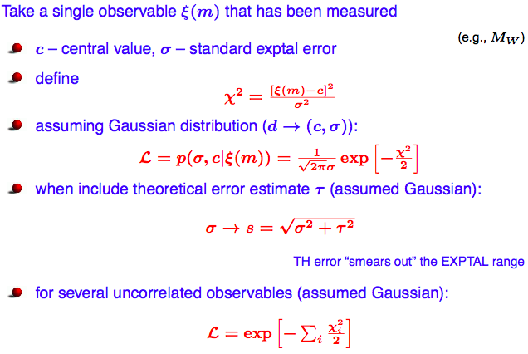
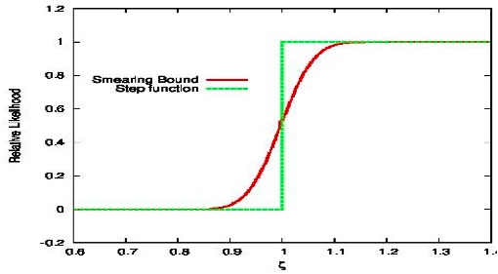
Statistical approach
Best way to go with so much data (sometimes mutually exclusive)
For positive measurements:
Central object: Likelihood function
For limits:
Smear out bounds.
Can add theory error.

Slide 4
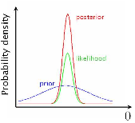

Bayesian statistics
Bayes theorem:
Prior: what we know about hypothesis BEFORE seeing the data.
Likelihood: the probability of obtaining data if hypothesis is true.
Posterior: the probability about hypothesis AFTER seeing the data.
Evidence: normalization constant, crucial for model comparison.
If hypothesis is a function of parameters, then posterior
becomes posterior probability function (pdf).

Slide 5

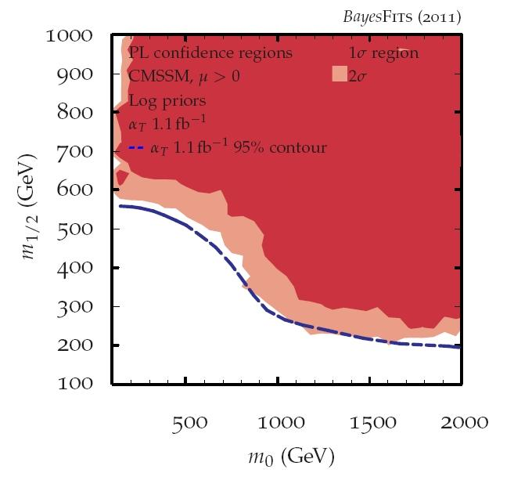
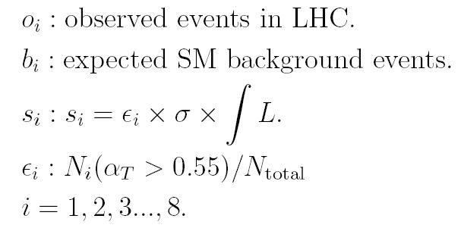
Reproducing alpha_T (1.1/fb) limit
Poisson distribution to characterize counting experiments.
(arXiv:1111.6098)
CMS alphaT 1.1/fb
95% lower limit
SUSY events: generate MC simulations ( 50 GeV x 50 GeV grid, 5k events/point -> Pythia (LO)
-> PGS4)
Apply the same kinematical cuts as CMS.
Obtain approximate efficiency and likelihood maps (combine 8 bins, rescale by ~2).
VERY GOOD AGREEMENT
WITH CMS 95% LIMIT!

Slide 6

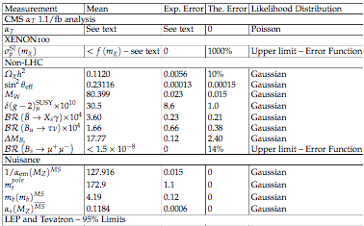
CMSSM: global scan
(arXiv:1111.6098)
Perform random scan over 4 CMSSM +4 SM parameters simultaneously
Use Nested Sampling algorithm to evaluate posterior
Very wide ranges:

Slide 7
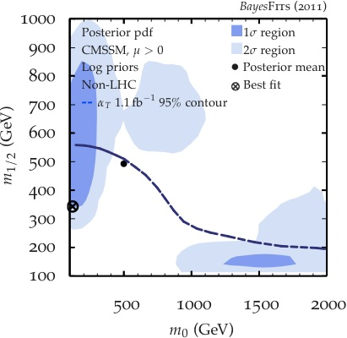
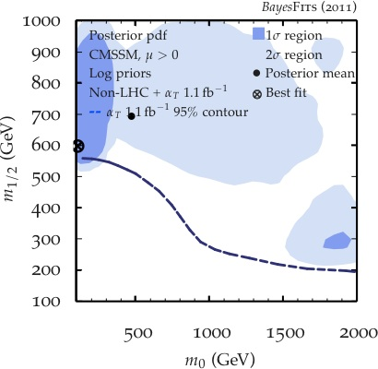
Impact of CMS alpha_T limit on CMSSM
(arXiv:1111.6098)
Before LHC (1/fb)
After LHC (1/fb)
A-funnel
Stau coannihilation
FP/HB
h-funnel
Favored (high posterior) regions (stau coan., A-funnel) are pushed up.
Light Higgs funnel region is excluded.
Focus point/horizontal branch region gets enhanced and pushed out.
Best-fit point pushed up but remains in the stau coannihilation region, tanb(BF)~11 (but location of BF is very sensitive to input from bsgamma).

Slide 8
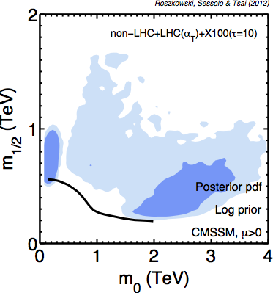
CMSSM: extend mass range
Increased importance of the FP/HB region.
Somewhat decreased importance of A-funnel region.

Slide 9
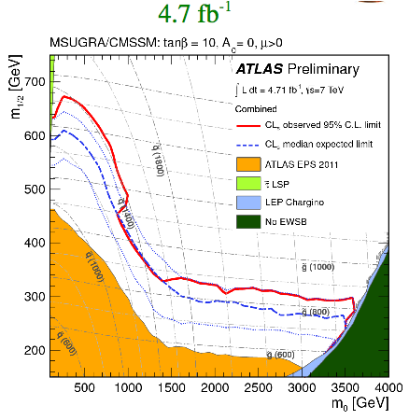
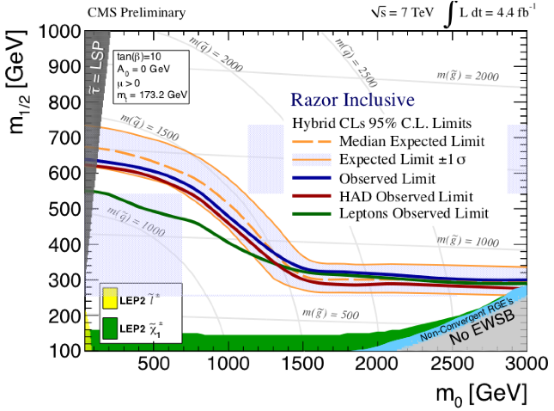
Current hadronic limits
ATLAS
CMS
ATLAS-CONF-2012-037
SUS-12-005

Slide 10
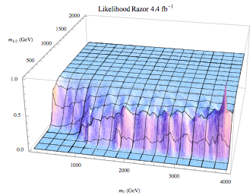
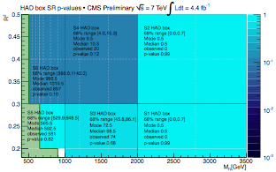
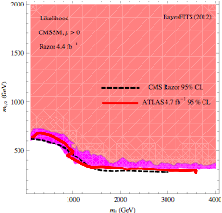
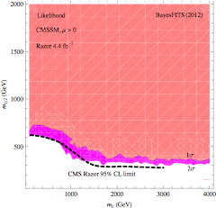
Reproducing Razor (4.4/fb) limit
Follow CMS analysis
For each SUSY point:
simulated mass spectrum
10k events with reconstructed variables
Consider 6 bins in R^2 and M_R
Efficiency after final cuts
Compute likelihood function
Need to rescale by ~7 (for 6 bins)
(Previously we could ``reproduce’’ 1.1/fb razor
limit with scale factor of ~2)
SUS-12-005
VERY GOOD AGREEMENT

Slide 11
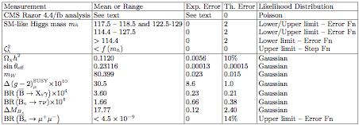
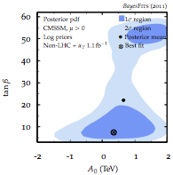
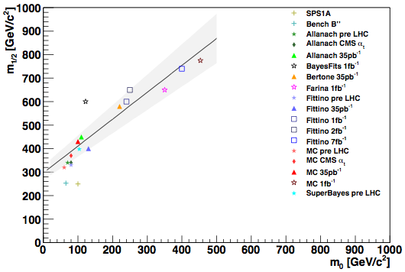
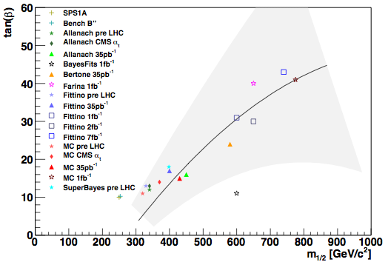
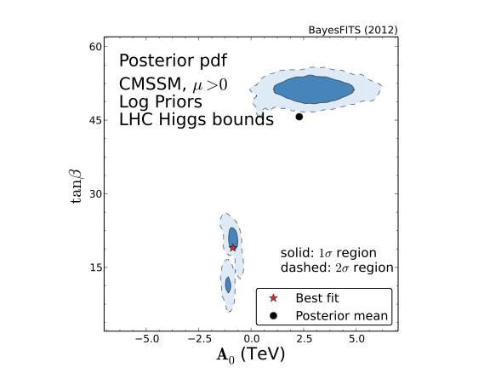
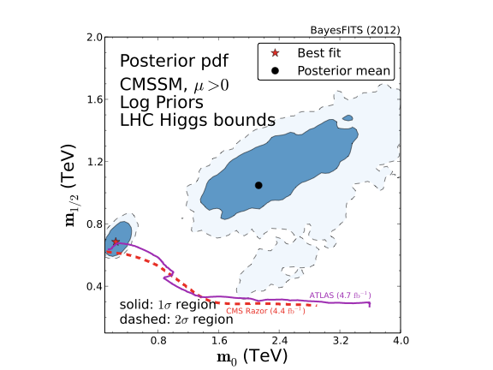
Impact of Razor(4.4/fb) limit on CMSSM
Extend range:
plus LHC higgs bounds and
Compare:
impact of alphaT (1/fb)
(arXiv:1111.6098)
FP/HB is now much larger
A-funnel region suppressed
Stau coann. region: still best fit
tanbeta(BF point)~21
1109.3859

Slide 12
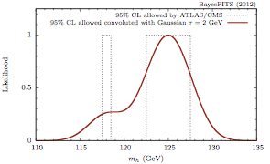
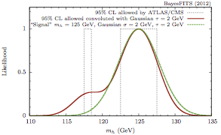
…and IF mh~125 GeV?
Currently allowed (95%)
ATLAS: 117.5-118.5 GeV and 122.5-129 GeV
CMS: 114.4 – 127.5 GeV
Add tau=2GeV th error (via Gaussian)
Construct likelihood
Assume mh~125 GeV confirmed
Add tau=2GeV (th) and sigma=2GeV (expt)
The Like-function only differs in the lower mass window where it is rather small anyway.

Slide 13
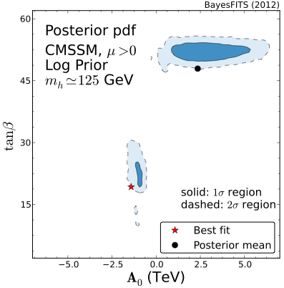
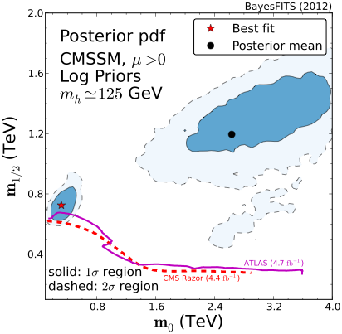
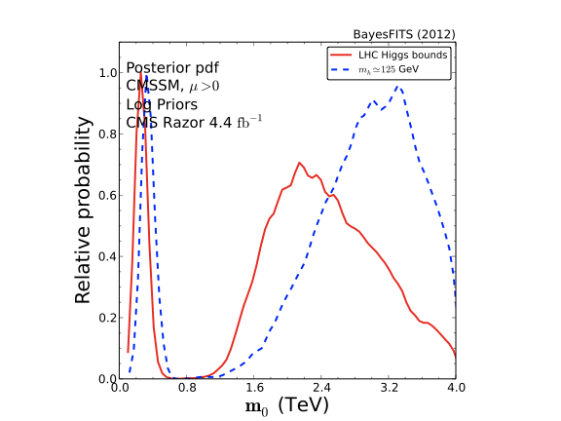
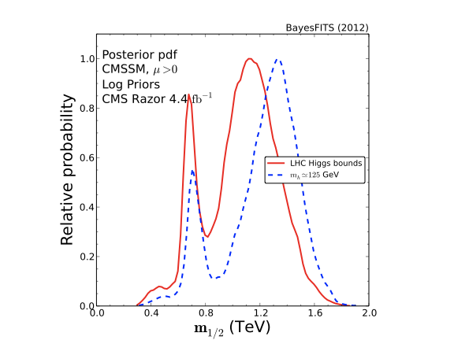
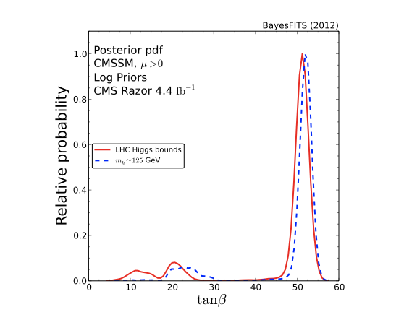
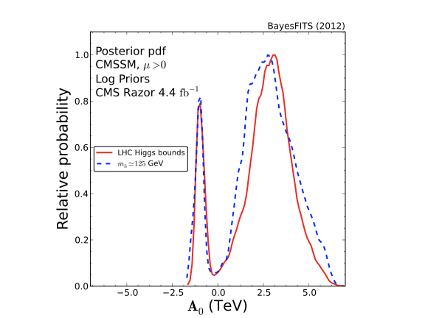
CMSSM w/o and w/ mh~125 GeV
LHC mh limits only
mh~125 GeV
Fairly similar probability maps!
m_0 pushed up if mh~125 GeV
Location of best-fit point also similar.

Slide 14
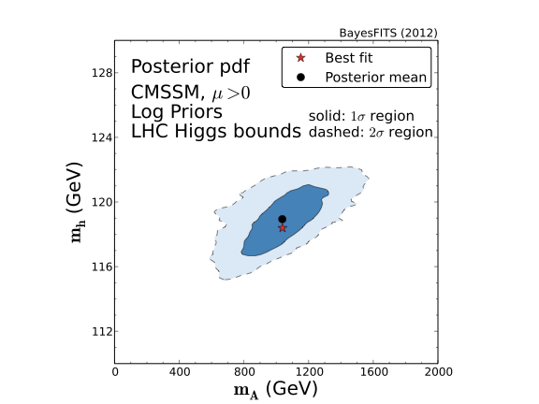
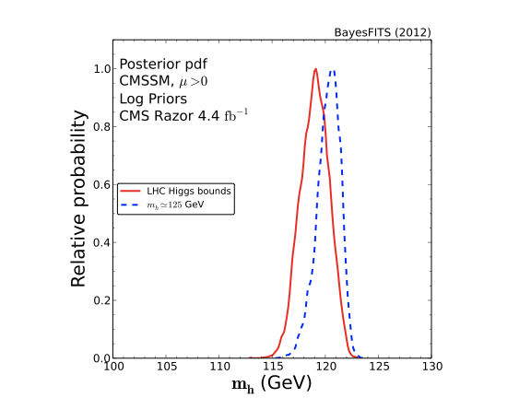
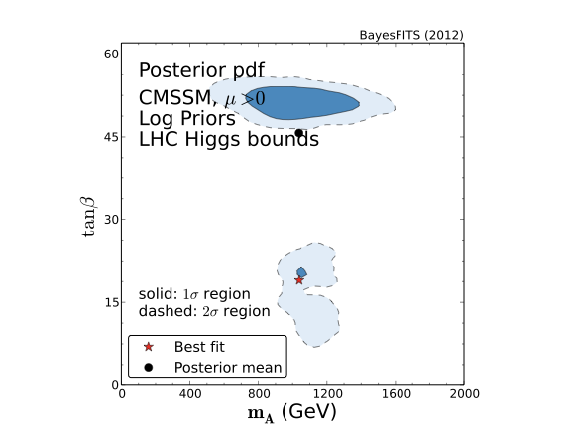
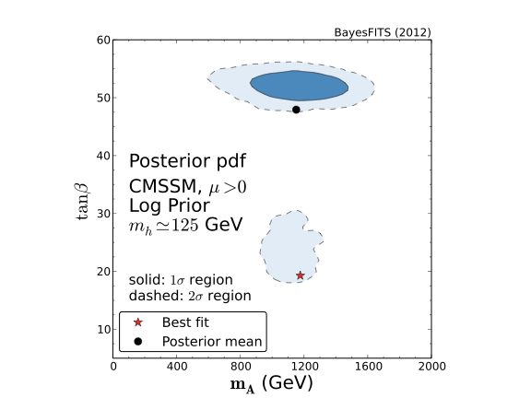
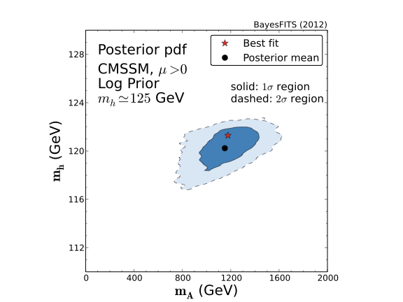
CMSSM w/o and w/ mh~125 GeV
CMSSM: short of producing m_h=125 GeV, but fine with both limits and `signal’ within realistic uncertainties!

Slide 15

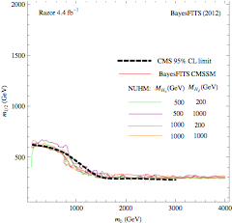
Non-Universal Higgs Model (NUHM)
Our efficiency map derived for the razor (4.4/fb) limit in CMSSM works also for NUHM

Slide 16
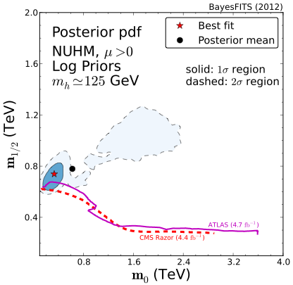
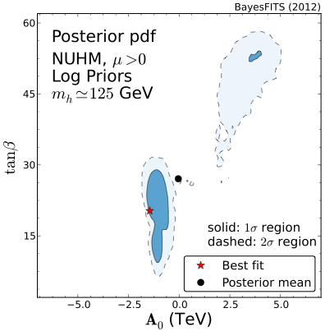
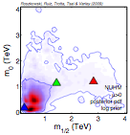
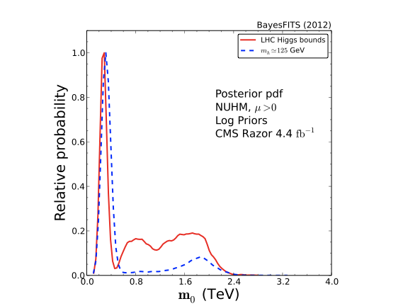
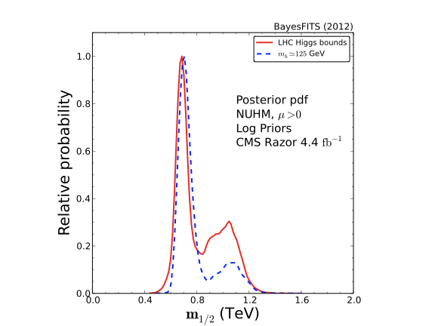
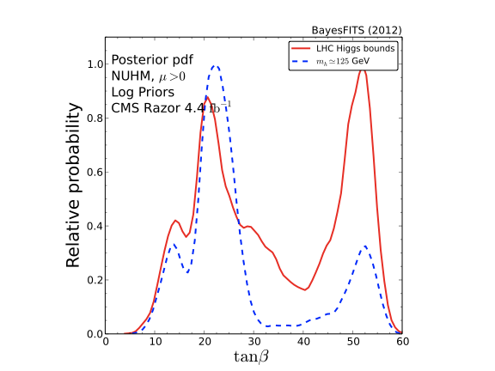
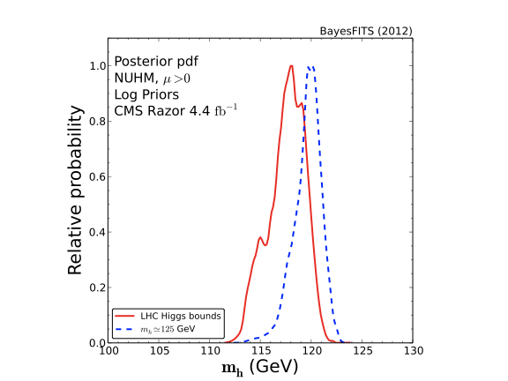
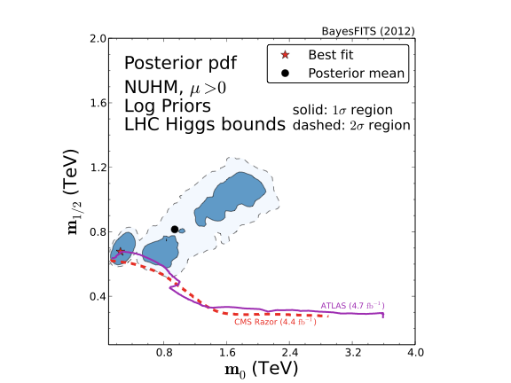
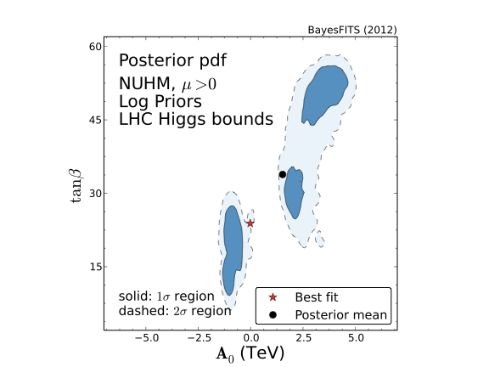
NUHM w/o and w/ mh~125 GeV
LHC mh limits only
mh~125 GeV
compare 2009:
m_h~125GeV actually prefers
lower MSUSY and tanb!

Slide 17
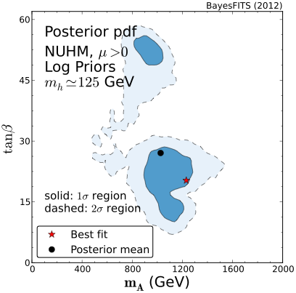
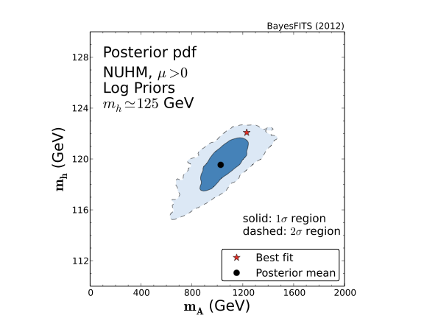
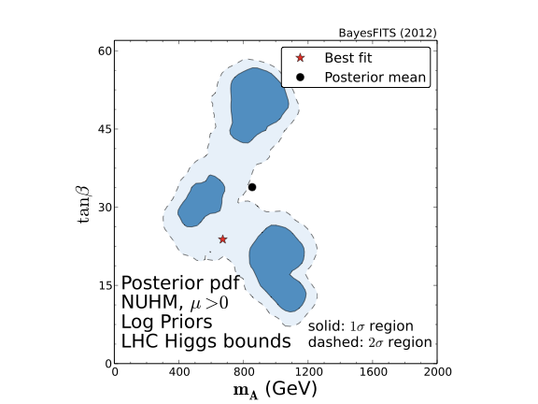
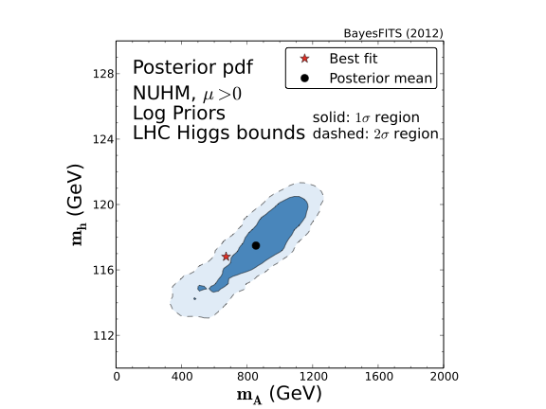
NUHM w/o and w/ mh~125 GeV
LHC mh limits only
mh~125 GeV
Fairly similar pattern
with and without m_h~125GeV

Slide 18
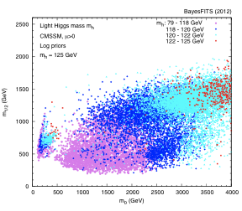
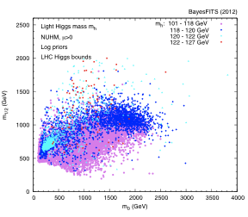


Light Higgs in CMSSM and NUHM
 | max m_h | Chi2 at max m_h | Chi2_min
CMSSM | 124.04 | 125 | 14.57
CMSSM+ m_h~125 | 123.44 | 26.3 | 15.83
NUHM | 126.28 | 101 | 12.98
NUHM + m_h~125 | 124.64 | 118 | 15.28
Can find m_h~125 GeV but poor fit to constraints!

Slide 19
Summary
Global Bayesian fits: a powerful tool to analyze SUSY models
CMS razor SUSY limit included via our approximate likelihood maps (applicable to any MSSM-based R-parity conserving model)
CMSSM is alive and reasonably well (both w/o and with mh~125 GeV, if uncertainties are taken into account)
NUHM: equally (if not more) so
NUHM: high probability regions very different from CMSSM, lighter spartners preferred
…just getting heavier, with a poorer fit

