Slide 1
RPC DQA 2011 Status and prospective
Massimo Della Pietra
on behalf of RPC & LVL1 Muon Barrel Monitoring
Working Group
ATLAS Muon Week - November 15th, 2011

Slide 2
Outline
New features in 2011:
  RPC & LVL1 Muon Barrel Online Monitoring
    Gnam;
    DQMD & OHP;
  RPC & LVL1 Offline Monitoring
    RPC Detector monitoring
  Lessons from 2011: Common (online-offline) issues
Open issues in 2012:
  Online Monitoring (Gnam & DQMD)
  Offline RPC Detector
  DCS
  Offline LVL1 Muon Barrel Monitoring

Slide 3
Online RPCGnam in 2011
Many improvements in 2011, triggered by (big or small) problems during data taking:
  New plot vs Lumiblock;
  New evaluation of Errors:
    Synchronization errors for the whole sector;
    Decoding and histogramming of all internal checks performed by CMs, PADs, SLs, RODs;
  Online trigger rate coming from SL output;
  Online check of SL firmware trigger logic;
M. Della Pietra and F. Lo Sterzo

Slide 4
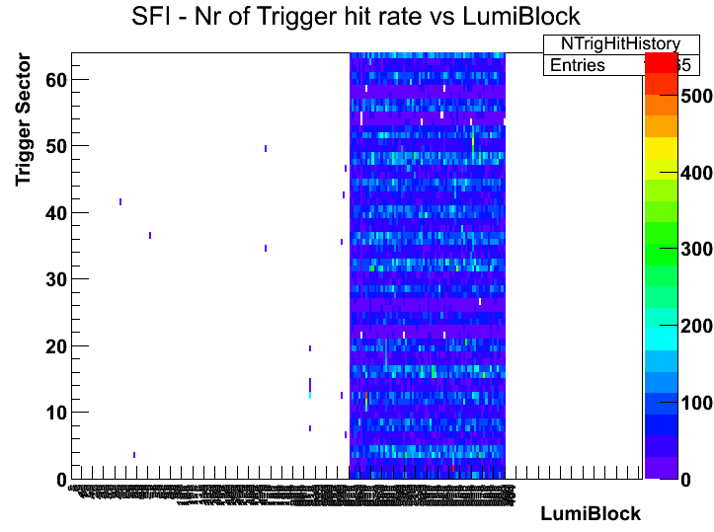
Online RPCGnam in 2011
Need to know when a problem appear (and/or disappear) during the run
New histograms implemented of several quantities vs. Lumiblock
Synchronization error (LVL1 and BCID)
Occupancy of the detector
Trigger output to the MuCTPI

Slide 5
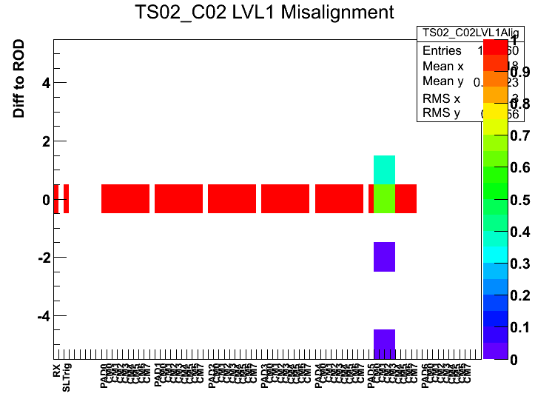
Online RPCGnam in 2011
Shifters and experts need to evaluate the fraction of events with errors (mainly synch. errors)
For each trigger sector the fraction of “out of synch” event is normalized
Red flags in DQMD are generated only if the whole sector is out of synch
Improvements on this item are needed (see next slides)

Slide 6
DQMD and OHP Online Monitoring in 2011
New DQMD segment created for LVL1 Muon Barrel Trigger with all information coming from gnam monitoring at SFI level
  Check of Synch. for each sector
  Check of data integrity
  Trigger proposal occupancy
New plots and controls have been added following the RPCGnam new features
A. Bruni and M. Romano

Slide 7
DQMD and OHP Online Monitoring in 2011
Offline tool to “emulate” (using online MDA stored data) how OHP panels would be appeared at the end of the RUN to a shifter.
  Code running on Naples Tier2 Farm
  Gnam histo root files saved by MDA application for each run taken from afs.
  Parsing of the OHP configuration file to produce an output like OHP Remote Monitoring web pages
    https://atlasop.cern.ch/tdaq/web_is/ohp/
  For each change in OHP configuration a new local installation on Naples Tier 2 should be done
  List of runs available in
      http://atlasui02.na.infn.it:8088/~romano/
A. Bruni and M. Romano

Slide 8
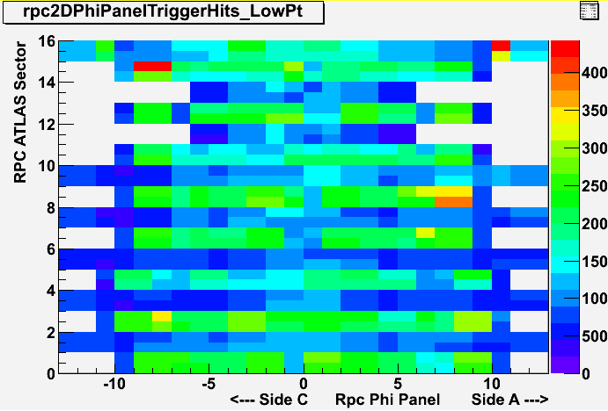
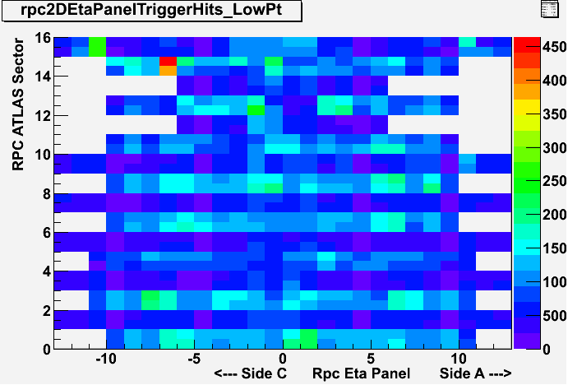
RPC Offline Monitoring
2011 Status
Slide from M. Bianco
The information generated by the DQA online and offline must be presented in the same format. (Plots, algorithm, summary, etc.. )
Several Offline Plots have been refined in order to fit the Online Layout.

Slide 9
RPC Offline Monitoring
2011 Status
Slide from M. Bianco
To facilitate shifters, the information on the same quantities coming from different sources should be presented, as far this is possible, in uniform ways
In the end of August a monitoring change not followed by a change of web display generated incorrect DQA results.
(Since July the update of RPC Monitoring Code at Tier 0 became very fast)

Slide 10
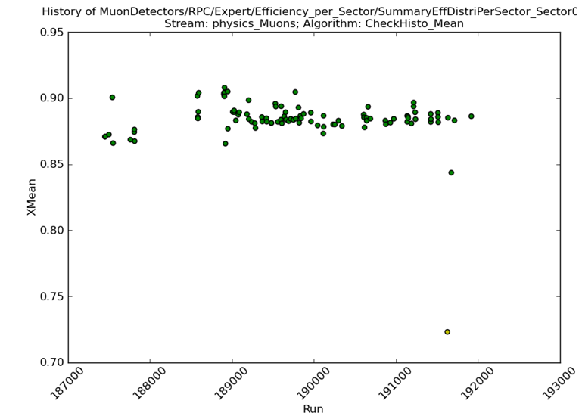
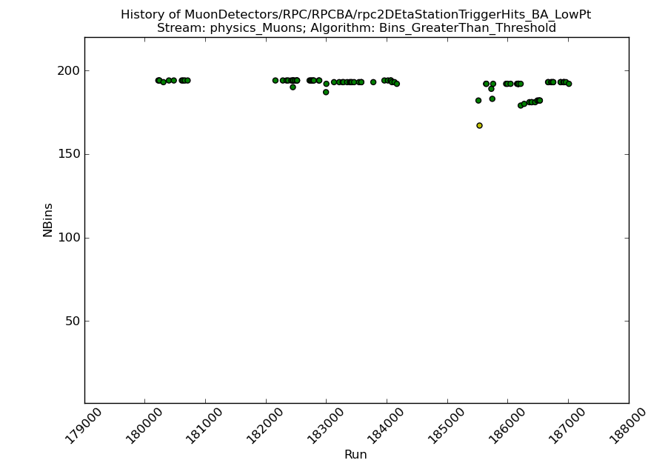
RPC Offline Monitoring
2011 Status
Slide from M. Bianco
Detector very stable and well monitored, but probably not enough, some problem (as synchronization problem) at the moment can be easily spot only at the Online level
RPC very raw efficiency
(Dead Pannel, dead strips, disconnected gas volume included)
RPC trigger coverage
(Active trigger tower (one side))

Slide 11
Online and Offline: lessons from 2011
Twiki page regularly updated but not always.
Man power issues: only 1 person for each item (if one person is not working full time, delay in the work flow)
If the experts do not want to be contacted too frequently, they have to keep updated Twiki and instruction for shifters.
Moreover:
information (both technical and that the state of the detector) must be shared as far as possible at list between the expert. The elog entries probably are not enough to propagate the information.

Slide 12
Open issues for 2012: RPC Online
Find a better way to summarize synchronization errors:
  Define the fraction of RPC detectors with synch errors:
    Look at CMs, Towers, or Global Sector?
Take into account DCS and DAQ information's about which part of the detector is inside the partition.

Slide 13
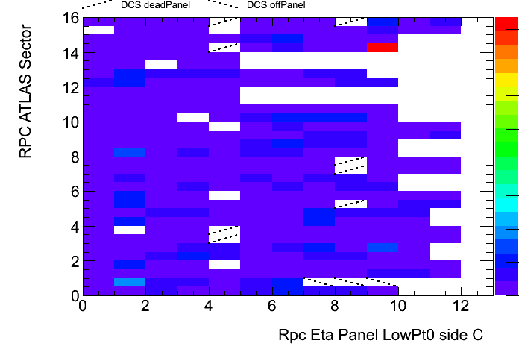
Open issues for 2012: RPC Offline
Slide from M. Bianco
Offline – DCS integration
  The idea is to use the DCS info in the Offline plots, in order to cross-check the info, help the shifter to understand the problem and validate both system.
The code, devloped by G.Chiodini, is under debug, it should be run routinely in 2012 data taking.
Actually this comparison is already done for offline analysis.

Slide 14
DCS and Offline Cross-Check
Slide from M. Bindi
First look (8/16 sectors) at the DCS information written into COOL DB via OFFLINE monitoring
The association between Trigger Towers (masked or killed during a run) and Offline ROPanels during a run seems to be correct. This has been tested only for the sectors were killed/masked towers were present.
  Ideally we may think to use a run during HI period to test the system by killing and recovering sequentially every tower and look at the data in the DB afterward.

Slide 15
DCS and Offline Cross-Check
Slide from M. Bindi
The check of DEAD ROPanels (140 /8545 due to disconnected gaps ) read out by OFFLINE algorithm have finally started.
Detector or LVL1 →OFFLINE
In the odd sectors (1-3-5-7) we found a perfect correspondence between foreseen detector holes and the OFFLINE one’s (empty bins in occupancy plots).
In the even sectors (2-4-6-8) we found some mismatches in S2-S3 special chambers and in BOS.
OFFLINE →Detector or LVL1
However we found few holes that were not foreseen by the Detector or LVL1 information available to DCS; this is exactly what we want to have under control. They maybe single ROPanels (ETA or PHI view) not properly working.
To be further investigated during the HI run!

Slide 16
DCS DQ Monitoring in 2012
Slide from M. Bindi
From 2011 data taking experience:
1) Average Detector current vs Luminosity
2) Average Trigger rate vs Luminosity
3) Trigger Tower rates vs Detector Gap Currents
4) Trigger Tower rates and Detector Gap Currents vs Lumi.
Values and panels are available; controls to be implemented
DCS FSM panels are ready to be used but not yet fully commissioned.
They will be tested and tuned during HI run (see next slide).
Already in the system

Slide 17
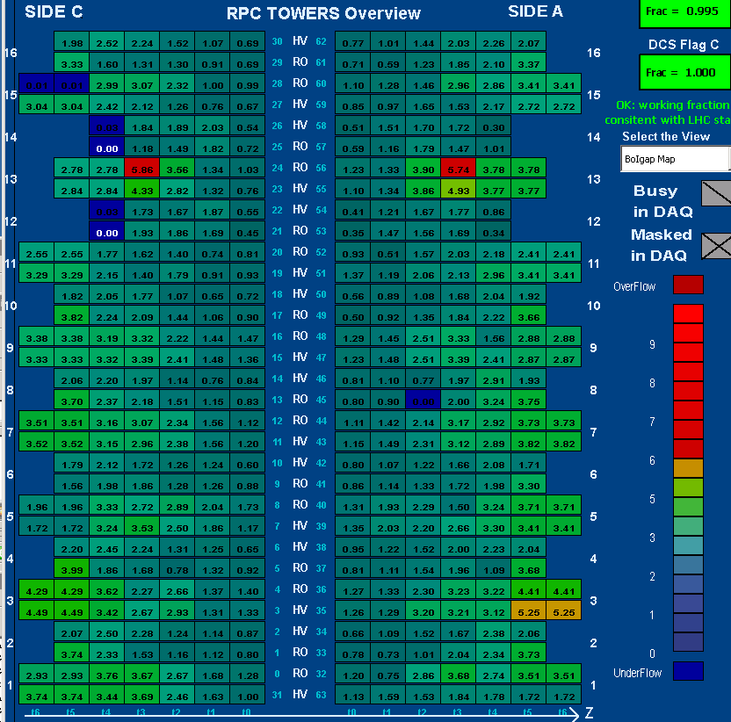
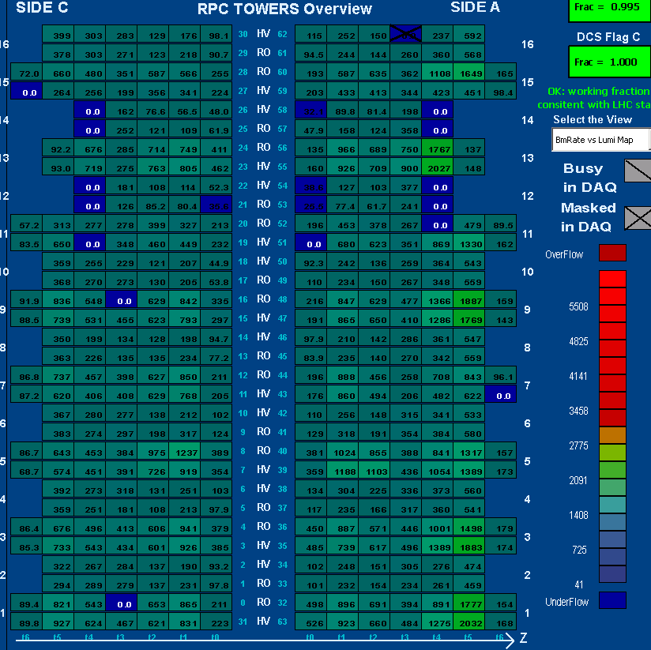
Map of Detector Currents
(μA/m²)
Barrel Outer Gap Currents
Map of LVL1 rates or Gap currents /Lumi (Hz/10³³cm⁻²sec⁻¹)
MU4 rate/ATLAS Lumi
Slide from M. Bindi
These numbers will have to be constantly monitored via DCS scripts/alarms (maybe also by MUON shifter) to spot new problems/bad behavior ( f.e. Gap currents or LVL1 rates during a fill that do not follow the luminosity trend) .
Very crucial is to check the ratio Rate/Current for each ETA-PHI region (Monitoring of background currents and LVL1 noise)!

Slide 18
Open issues for 2012: LVL1 Muon Barrel Offline
Slide from U. Schnoor, P. Anger
TU Dresden
Plan for 2012:
work in connection with enhancing the structure of offline DQ Monitoring: similar TGC and RPC monitoring in L1MU folder
our task: provide efficiency plots similar to TGC's efficiency monitoring
create new RpcLv1RawDataEfficiency algorithm in the RpcRawDataMonitoring package

Slide 19
Open issues for 2012: LVL1 Muon Barrel Offline
Slide from U. Schnoor, P. Anger
TU Dresden
Plan for 2012:
Efficiency map of Eta vs Phi for each pt threshold
Efficiency curve vs Pt for each pt threshold
Each efficiency evaluated for both positive and negative muons with both Staco or Muid reconstruction algorithms
TGC plots: to be implemented for RPC in 2012

