Slide 1
Ghosts and Satellites measured with the LHC LDM
LUMI days 2012
CERN
Adam Jeff

Slide 2

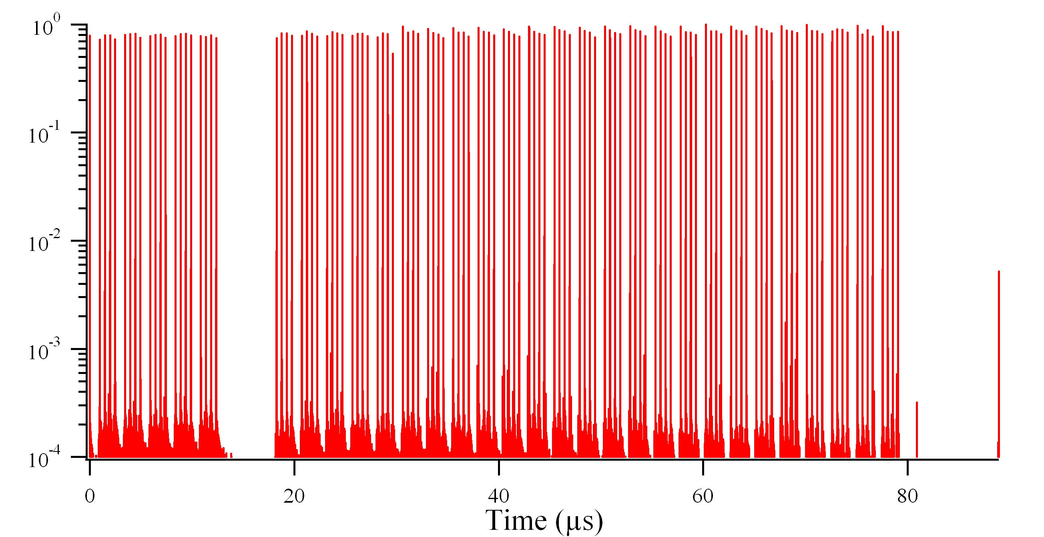
Satellites, Ghosts: definitions

Slide 3
Satellites, Ghosts: definitions

Slide 4
Satellites, Ghosts: definitions
Satellites
Ghosts
Ghosts ≠ debunched beam

Slide 5

Satellites, Ghosts: definitions
DCCT integrates all beam current
-> affects fast BCT normalisation
Fast BCT integrates some satellites
-> affects relative bunch currents

Slide 6
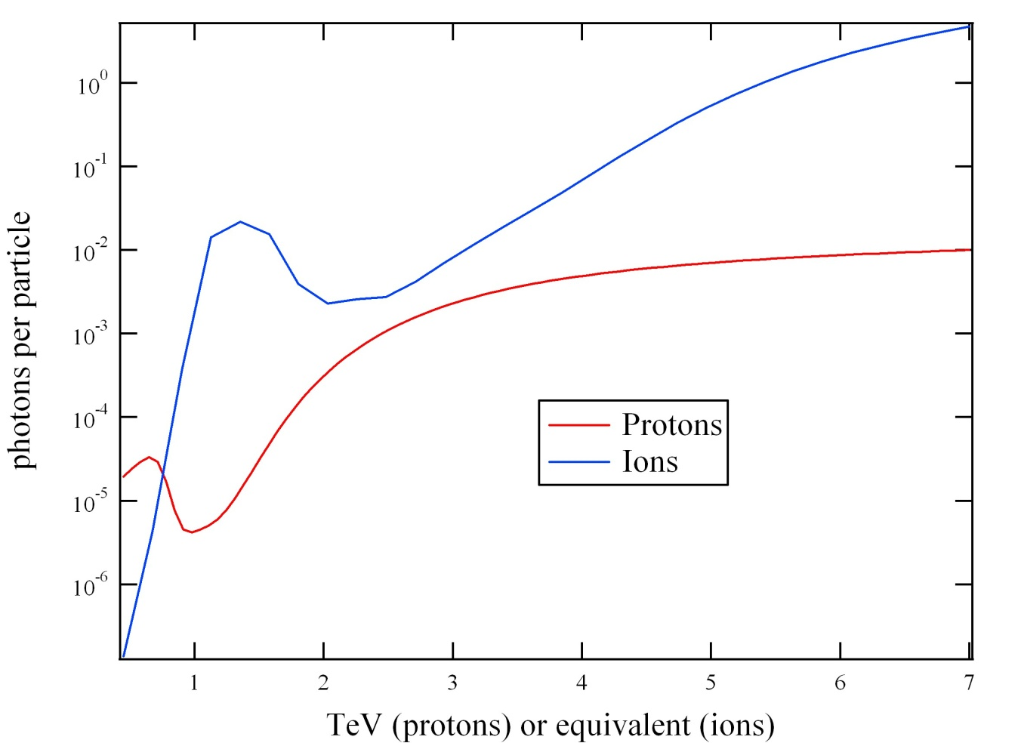
The LDM: how it works
LHC turn clock
Arrival time
TDC
synchrotron light
APD
Electrical pulse
Synchrotron light from BSRT
Dipole and undulator at point 4
Separate system for each beam
Undulator
Dipole

Slide 7
The LDM: instrument response
Histogram integrated over 1,000,000 pulses
Average 0.5 photons per pulse
Diffusion tail

Slide 8
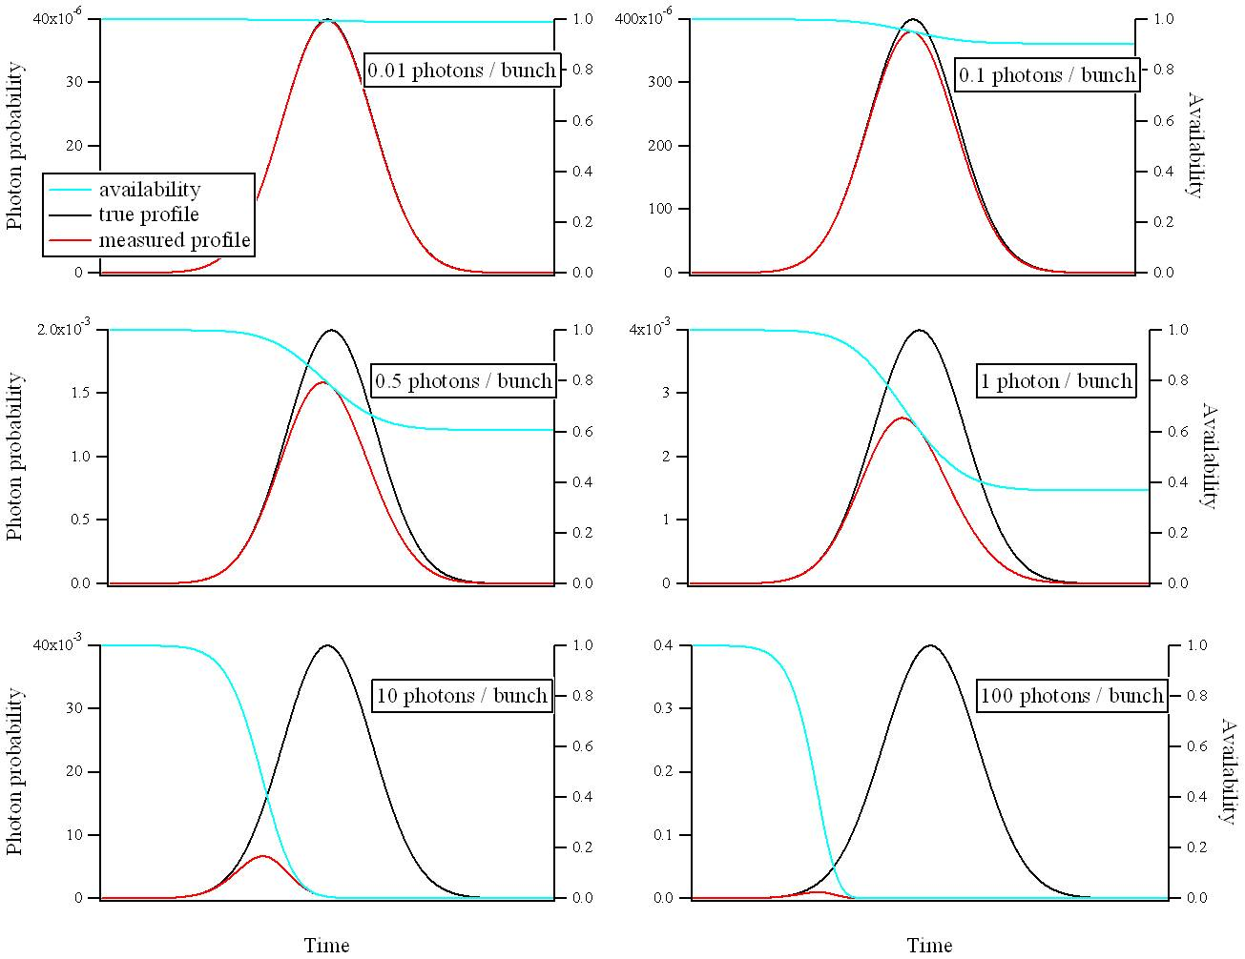
The LDM: count rate

Slide 9



The LDM: deadtime correction
Availability of the detector in bin i:
Correction for deadtime:
Correction for deadtime and pile-up:

Slide 10
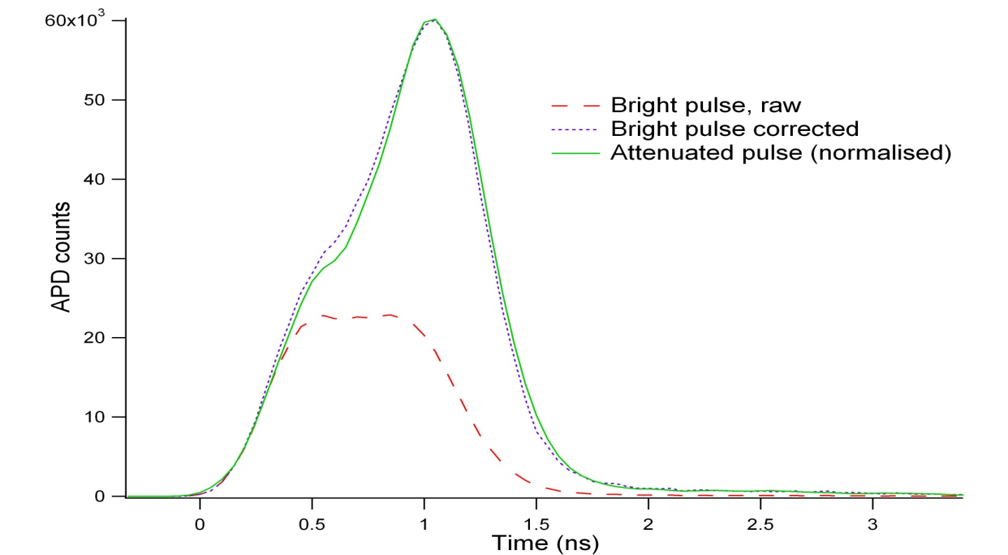
The LDM: deadtime correction
Availability of the detector in bin i:
Correction for deadtime:
Lab test with pulsed LED
Correction for deadtime and pile-up:

Slide 11
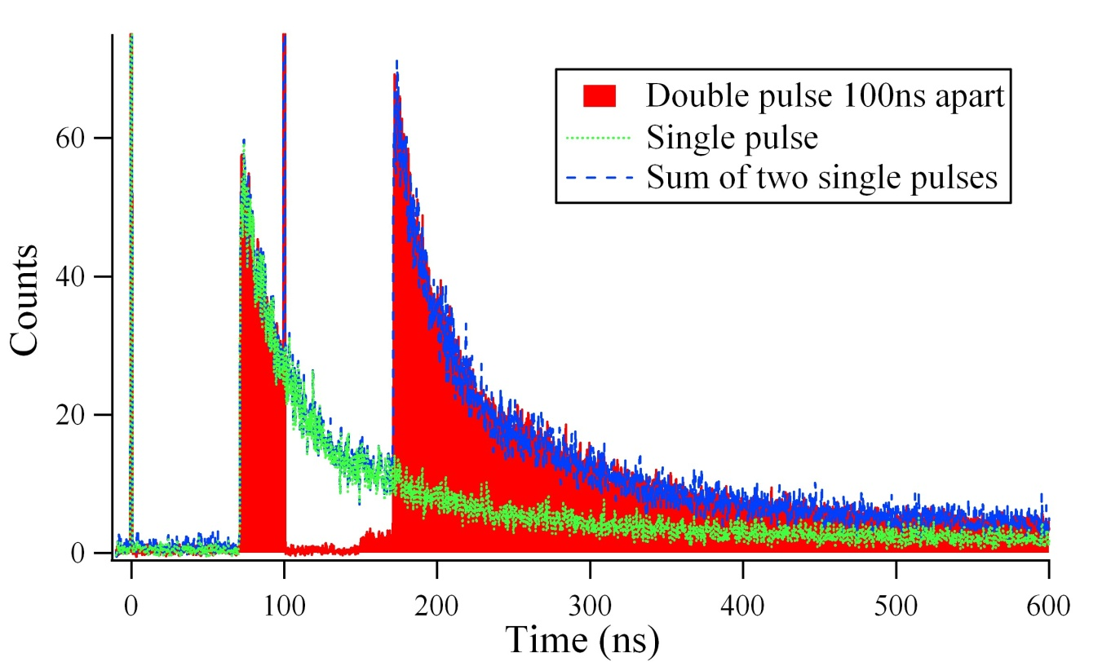
The LDM: afterpulse correction
Trapped charge carriers can generate a false avalanche
Happens at the end of the deadtime or some time after:
- multiple exponential decay, half-life 100ns to few μs
Parameters found by experiment
Correct by subtracting multiple IIRs

Slide 12
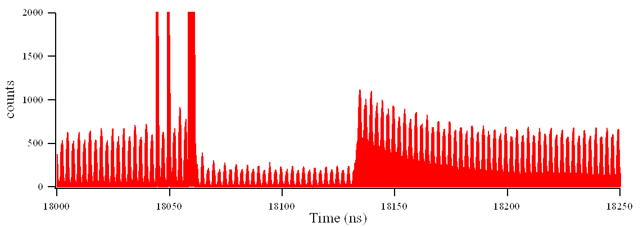
Main bunch
Satellites
Ghost bunches
Afterpulsing
Deadtime

Slide 13
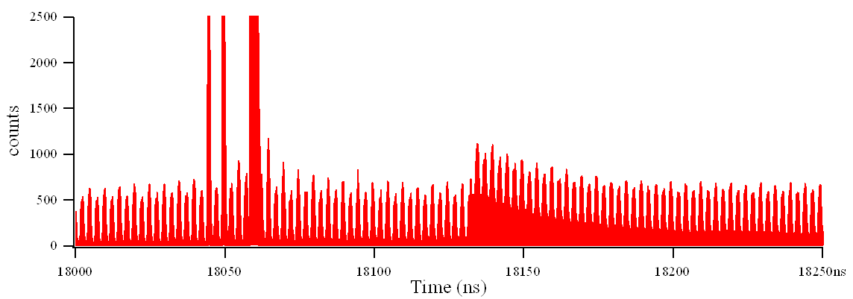
Corrected for deadtime

Slide 14
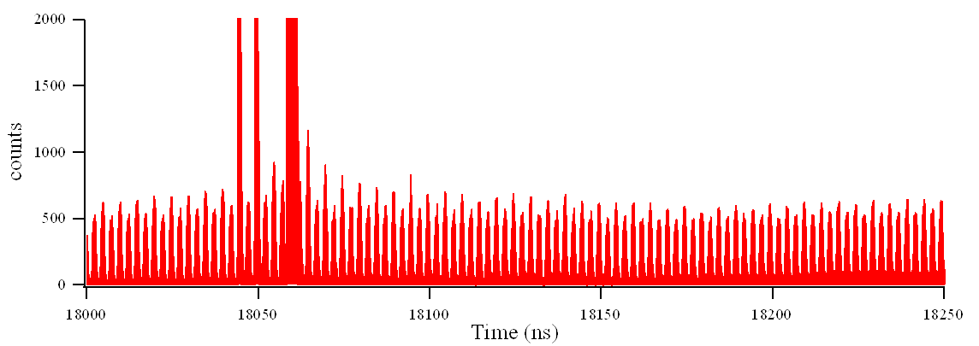
Corrected for deadtime
Corrected for deadtime and afterpulsing

Slide 15
Average slots & Baseline

Slide 16
Average slots & Baseline
Mostly due to under- / over- correction of afterpulsing
Not equal around the ring – but we are only interested in average

Slide 17
Average slots & Baseline
Average full slot:
The +1 bucket is swamped by the diffusion tail of the main bunch.
-4 to -1 and +2 to +5 are counted as satellites.

Slide 18
VdM results: ghost charge
 | Beam 1 |  | Beam 2
November 2010 | n/a |  | 2.5 | +2.5/-0.6
March 2011 | n/a |  | 0.6 | +0.6/-0.2
May | 0.18 | +0.18/-0.04 | 0.40 | +0.4/-0.1
October | 0.69 | +0.7/-0.2 | 0.71 | +0.7/-0.2
December f2335 | 3.1 | +3.1/-0.8 | 2.8 | +2.8/-0.7
December f2337 | 2.1 | +2.1/-0.5 | 2.3 | +2.3/-0.6
Definition: % of total beam population which is outside the filled slots

Slide 19
VdM results: satellites
 | Beam 1 |  | Beam 2
November 2010 | n/a |  | 0.4 | +/- 0.1
March 2011 | n/a |  | 0.1 | +0.05/-0.03
May | 0.02 | +0.03/-0.01 | 0.12 | +/- 0.03
October | 0.21 | +0.06/-0.08 | 0.57 | +0.17/-0.12
December f2335 | 0.38 | +/- 0.1 | 0.34 | +0.1/-0.08
December f2337 | 0.28 | +0.08/-0.06 | 0.29 | +0.08/-0.06
Definition: % of filled slot population which is outside the filled bucket or the following bucket
Averaged for whole time of scan and for all filled slots – results for a subset of bunches can be calculated if you ask nicely.

Slide 20
Error inventory
 | Error for ghost charge | Error for Satellites
Statistical | 10 % | 5 %
Baseline uncertainty | 12 % | 3 %
Emittance dependence | 20 % | 20 %
Debunched beam | 100 % ?! | 25 % ?!
Total | -25% / +100% | -20% / + 30%
Typical values - 68 % CL
LDM baseline correction assumes zero debunched beam
- consistent with beam gas and abort gap monitor

Slide 21
LDM vs fBCT
Disagreement between LDM and fast BCT on main bunch populations is usually <2%
Occasionally up to 5%, probably due to emittance spread.

Slide 22
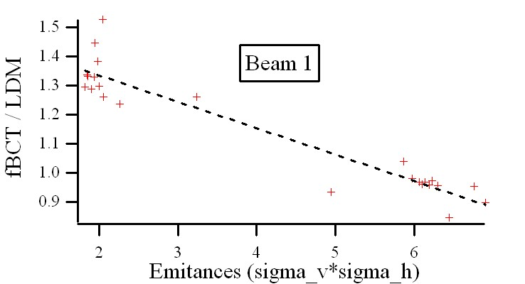
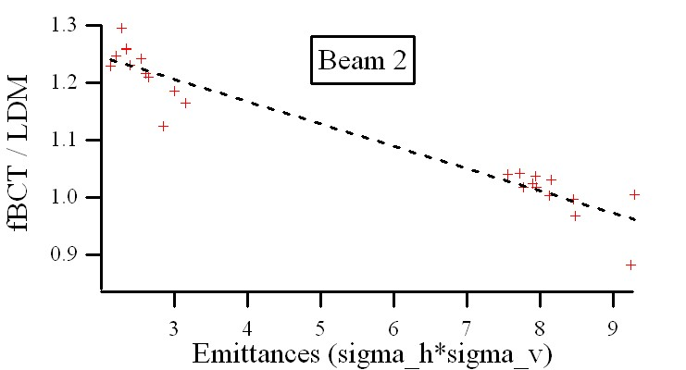
Emittance dependence
Active area of APD is only 50 microns
Beam spot size ~300 microns
Samples only part of the beam spot
>>> Measured bunch population depends on transverse size

Slide 23
Thanks for your attention

