Slide 1
Absolute L determination in 2011 – and towards 2012: first impressions & wishes from the experiments
W. Kozanecki (CEA-Saclay)
Absolute precision of L determination
  σ_{vis} calibration: a survey of achieved & projected systematic uncertainties
    the all-important bunch-current product
    van der Meer method
  long-term stability issues & extrapolation to (high-μ) physics conditions
  the low-μ regime: calibration transfer btwn ALFA / TOTEM & ATLAS / CMS?
  Heavy-Ion & low-energy pp collisions
L - calibration plans for 2012 & wishes from the experiments
  precision (and other) trade-offs
  overview of luminosity-calibration requests
Tools & procedures in 2012
  critical instrumentation
  LHC operations
In lieu of conclusion…

Slide 2
Disclaimer
This is not
  a workshop summary talk…
  a summary talk for session 2…
  an attempt at showing a few representative slides from each speaker…
  a comprehensive compendium of all important issues…
  a request for scheduling various scans (this belongs in the LPC)…
…but it is a (feeble) attempt at extracting a preliminary overview of
  the dominant systematic uncertainties, and where they may limit us
  the main issues to keep in mind when preparing 2012
  the (still evolving) wishes of the four large collaborations with respect to L calibration- & monitoring- scans, with their trade-offs & limitations
  what our LHC colleagues could do (besides delivering clean, stable, bright beams 24/7 !) to help us improve our luminosity determinations
… focussing on 7 TeV pp (most demanding in terms of precision)
I beg your indulgence for the mistakes & misunderstandings you will no doubt spot… Corrections will be gratefully implemented!

Slide 3
Bunch-current product uncertainties: major progress in 2011
 | Early 2010-11 | 2011 update
Total intensity scale: DCCT | 2.7 % | 0.2 – 0.3 %
Bunch-by-bunch fractions FBCT x-checks: BPTX, LDM | 1.3 - 1.7 % | 0.1 - 0.2 %
Satellites vertexing (ATLAS, CMS) Timing CMS ECAL ALICE ZDC LDM | ‘Only’ ATL/CMS vertexing + CMS ECAL | LDM + ALICE ZDC (Pb-Pb only) + vertexing
Ghost charge + debunched beam LDM LHCb beam-gas (BG) ATLAS BCM halo | LHCb B-G in learning curve | LDM LHCb B-G ATLAS BCM ?

Slide 4
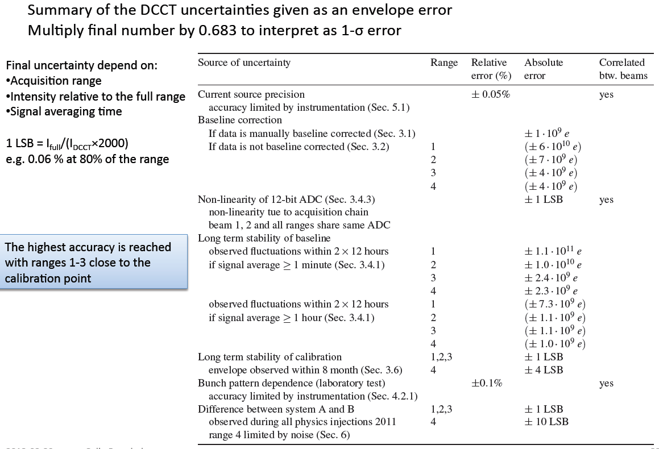
Bunch-current product uncertainties: major progress in 2011 (2)

Slide 5
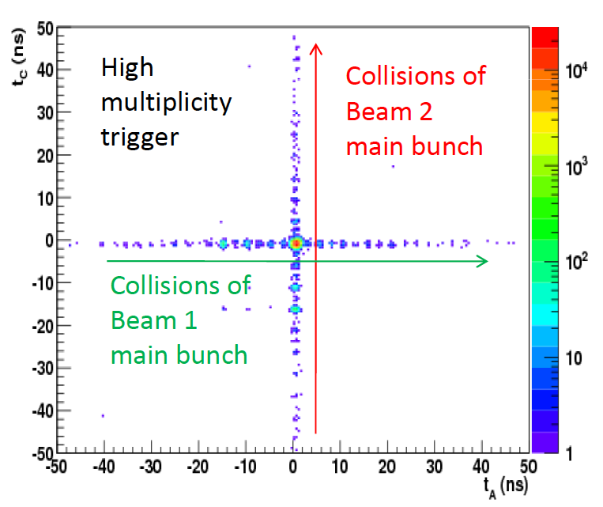
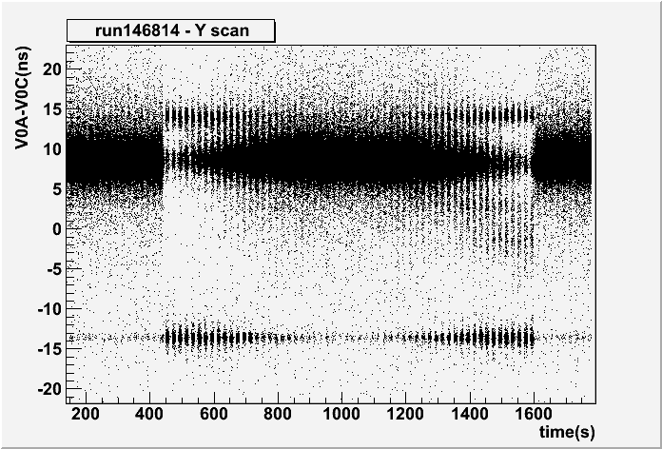

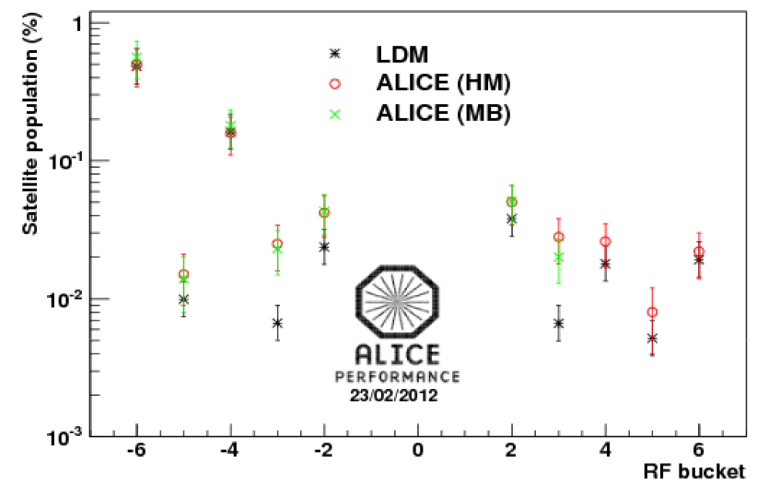

Satellites: ALICE + LDM → impressive progress in 2011
example of 2.76 TeV Mar. 2011

Slide 6
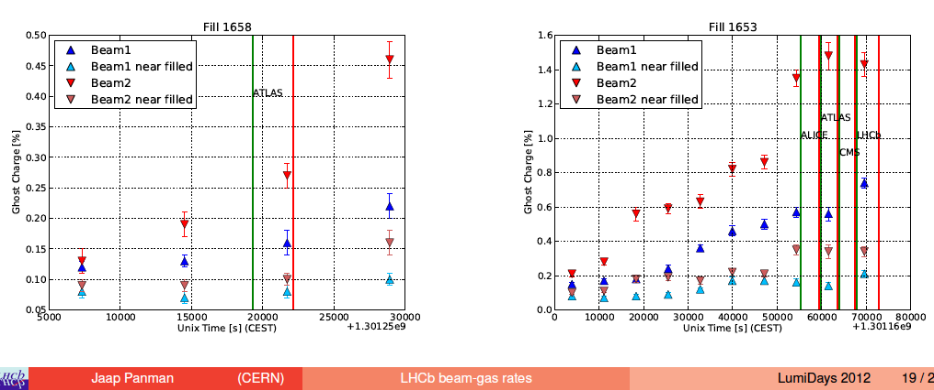
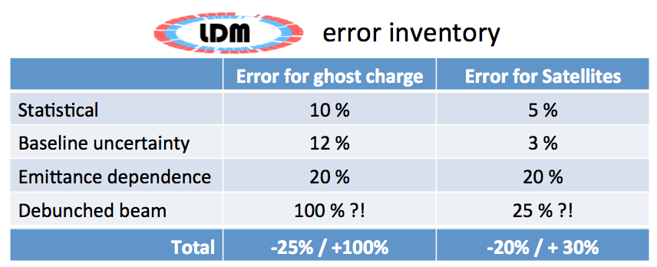
Ghosts: LHCb + LDM → impressive progress in 2011

Slide 7
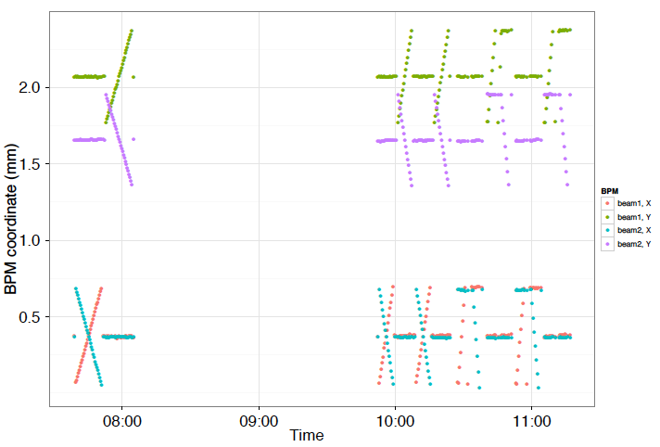
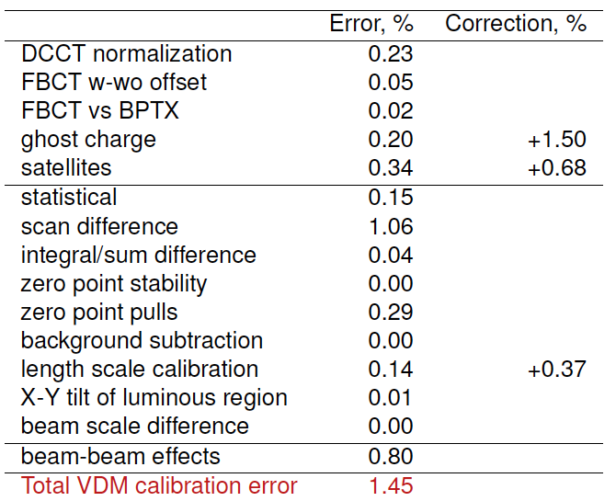
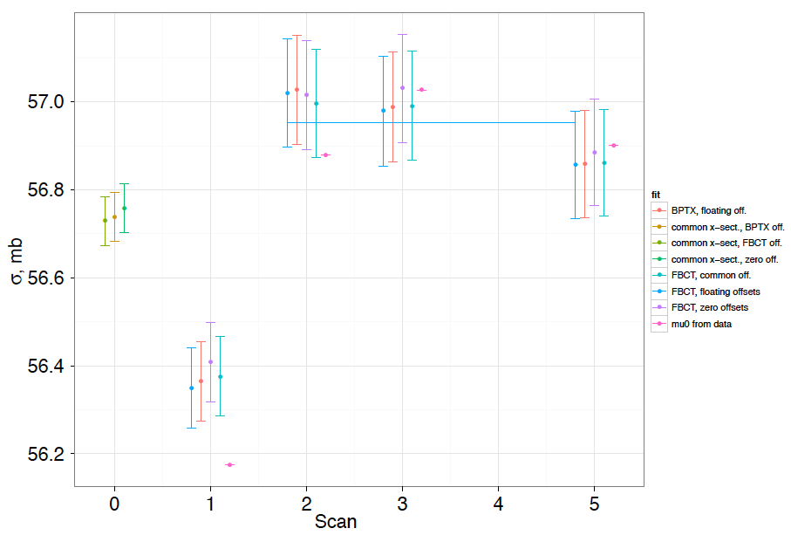
The importance of being earnest…: the LHCb example
1 %

Slide 8
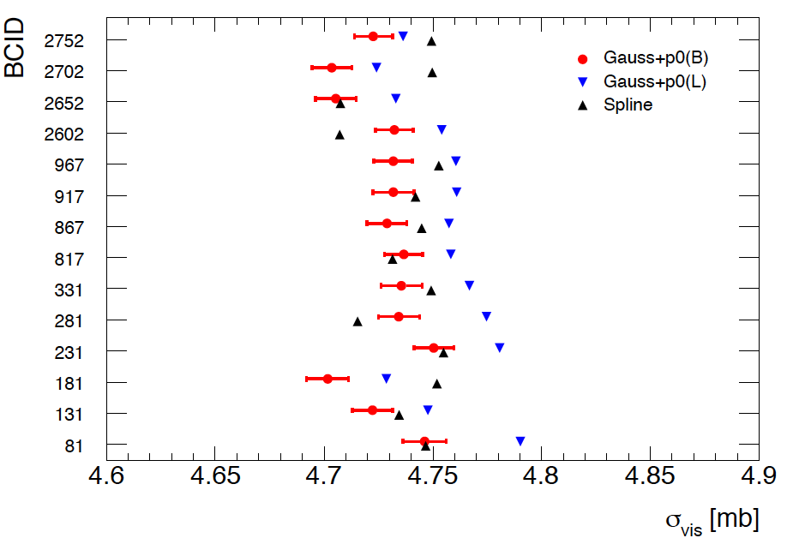
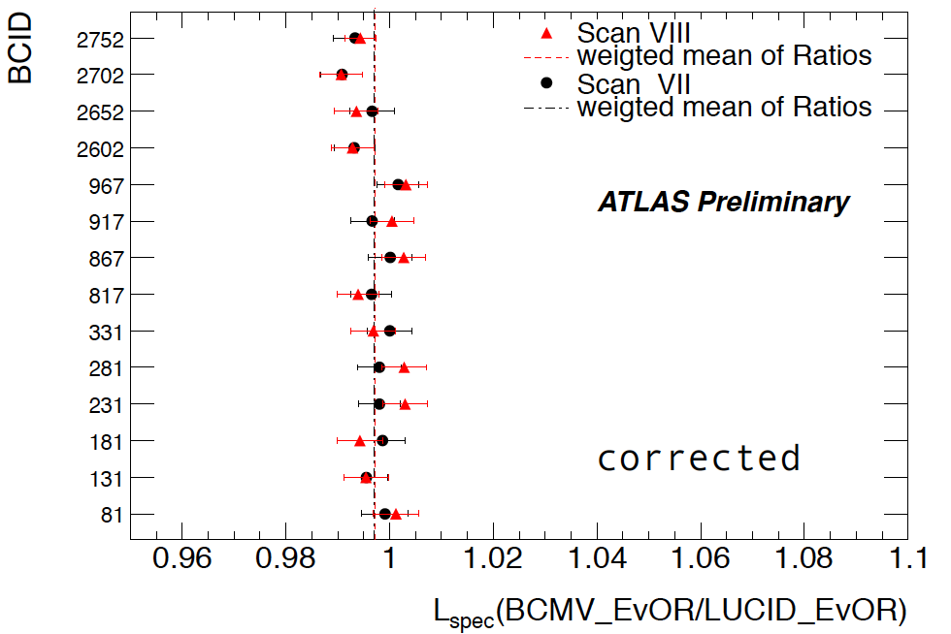
Consistency checks on ATLAS May’11 vdM scan analysis
σ_{vis}: btwn bunches within one scan
σ_{vis}: bunch-averaged btwn consecutive scans
ε-growth systematic
LUCID_EventOR
RMS = 0.4 %
χ²/DOF = 19 / 12
σ_{vis}: bunch-avrgd btwn different fit models
L_{sp} (~ 1/Σ_{x}Σ_{y}) consistency bwtn detectors or algorithms
fit-model systematic
0.3 ± 0.1_{stat} %
BCMH_EvOR
Scan VIII
Bgd-subtracted

Slide 9
Dynamic-β effect: MADX simulations for IP1
Compute dynamic β as a function of beam separation, using MADX for typical conditions during May’11 scan:
  0.85 10¹¹ p/bunch, ε_{inv} = 4 μm, Q_{x}/Q_{y} = .31/.32, scan +- 6 σ_{b} (β* = 1.5 m)
Collisions at IP1 only
Collisions at all IP’s
IP 2, 5, 8 offset by 1.4 σ_{b}
x-scan, β*_{x}
x-scan, β*_{y}
x-scan, β*_{y}
W. Herr
x-scan, β*_{x}
W. Herr

Slide 10
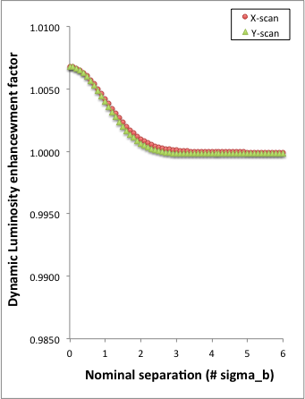
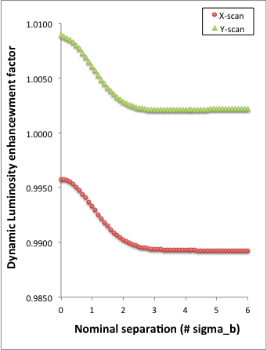
Dynamic-β effect: impact on luminosity-scan curves
Compute effect of dynamic β on x & y scans: L ~ 1 / √β*_{dyn, x} √β*_{dyn, y}
Refit gaussians and compute impact on σ_{vis} ~ Σ_{x} Σ_{y} μ_{vis,pk}
  collisions at IP1 only: Δσ_{vis /} σ_{vis} = + 0.80 %
  collisions at all IP’s (non-scanned IP’s offset): Δσ_{vis /} σ_{vis} = + 0.36 %
  ATLAS took ± 0.8 % as systematic (safe? over conservative?)
Collisions at IP1 only
2.5 %
Collisions at all IP’s
Non-scanned IP’s offset by 1 Σ in scanned plane

Slide 11
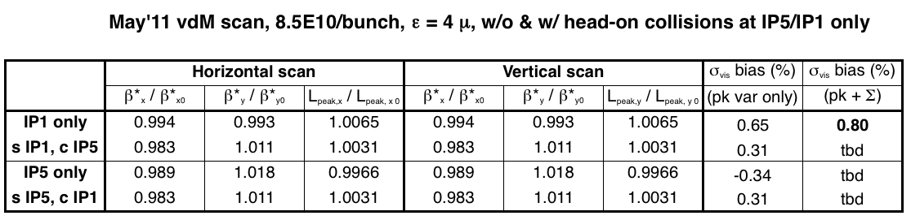
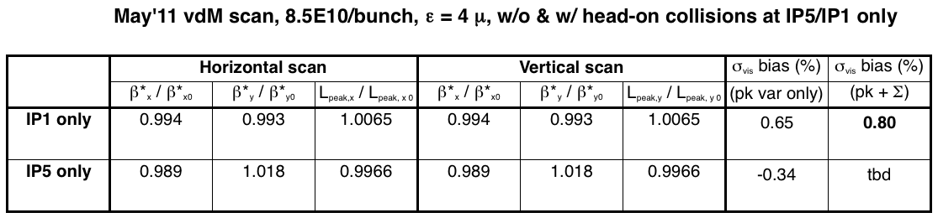
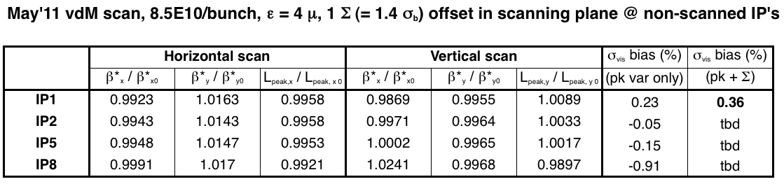
Dynamic-β effect: effect of collsions at other IP’s
Luminosity distortions scale like N_{p} / ε_{inv}

Slide 12
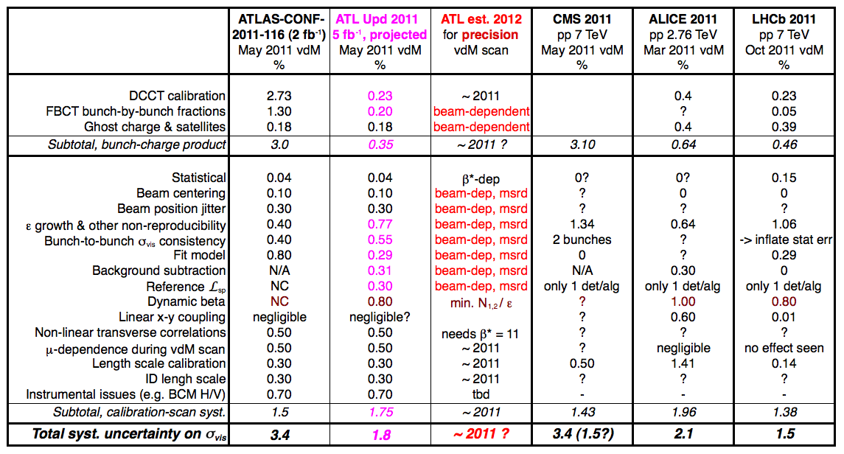
Systematic uncertainties on σ_{vis} (pp @ 7 TeV, vdM scans)
depend
on
beam
conditions
The numbers are the systematic uncertainties (%) as reported by each experiment (and regrouped to fit roughly in the same descriptive scheme)
“?” reflect this speaker’s ignorance as to how this uncertainty was treated; it does not necessarily imply that it was ignored in the analysis – only that it was unclear where to find it.

Slide 13
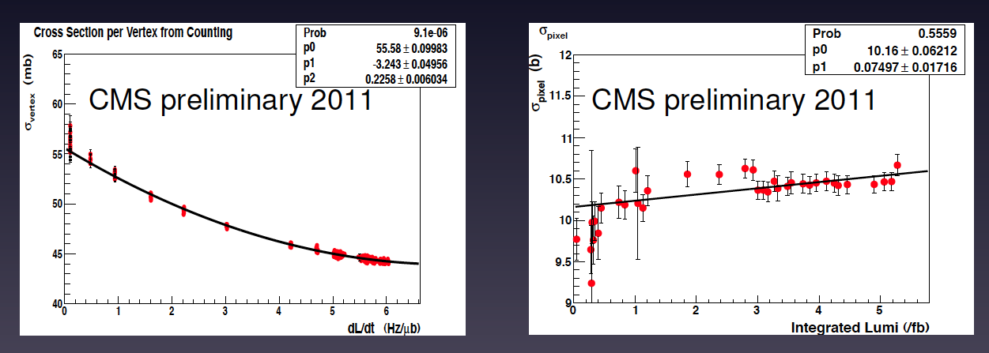
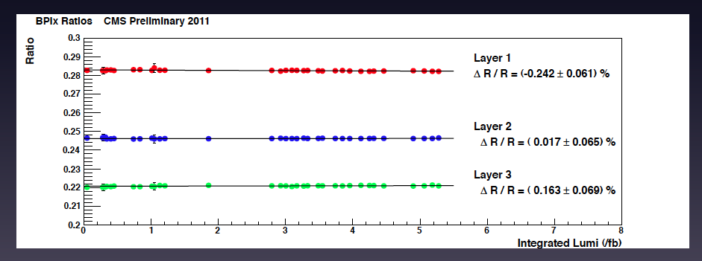
μ-dependence & long-term reproducibility: CMS examples

Slide 14
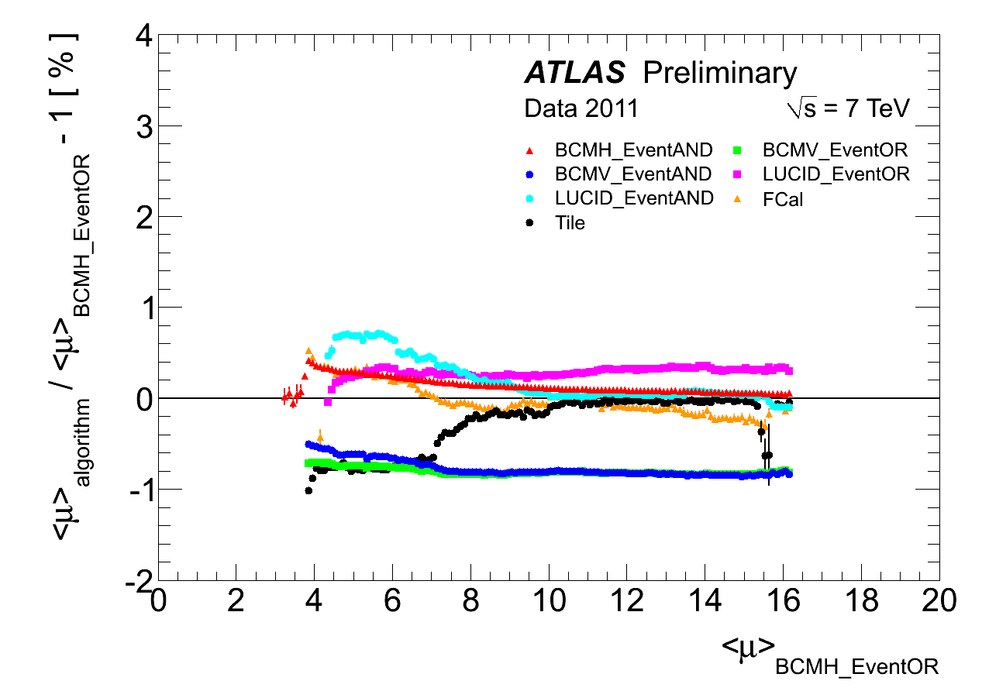
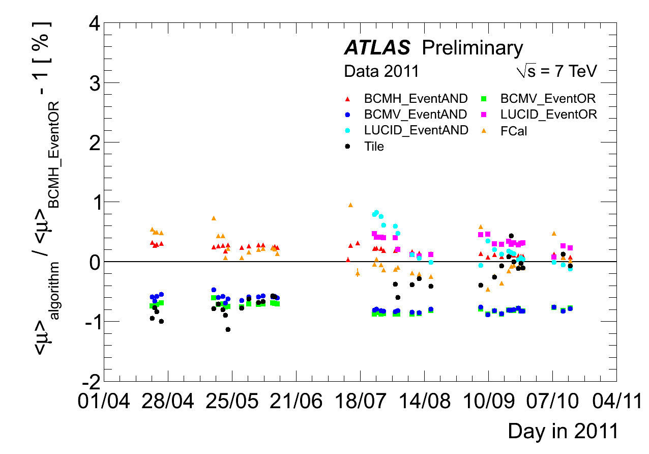
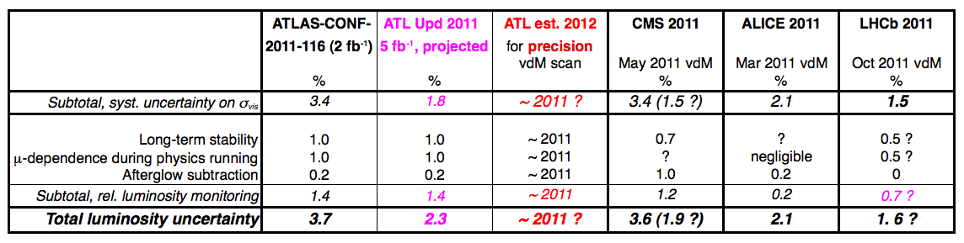
Projected total luminosity uncertainties for 2011 & 2012 (pp, 7 TeV)
± 1 %
± 1 %
TILE / FCal crucial!

Slide 15
A few (preliminary!) words about correlations
ATLAS, across vdM sessions (hence 2011 ←→ 2012)
  most systematics associated with beam conditions, hence uncorelated
  exceptions
    ID scale: 0.3 %
    perhaps BCM H/V ratio: 0.7 % (depending on actual cause) ?
CMS, across vdM sessions (hence 2011 ←→ 2012)
  see J. Hegeman’s talk
    some of the ‘correlations’ may need to be rediscussed (IMHO)
ATLAS vs. CMS
  uncorrelated when calibrated in 2 separate vdM sessions
  if calibrated within same vdM session
    bunch-intensity measurements are correlated
    other beam-related sytematics are uncorrelated in practice – even if common source
      e.g. bunch-to bunch σ_{vis} inconsistencies in May’11 vdM scans

Slide 16
Calibration transfer btwn ALFA / TOTEM ← → ATLAS / CMS
L from ATLAS/CMS luminometers to ALFA/TOTEM for σ_{tot} msmts
  LHC Fill 2232, β* = 90 m, n_{1,2} ~ 0.6 10¹¹/ bunch + pilots
    μ_{pp} ~ 0.03 - 0.05 for “nominal” bunch
    ALFA/ATLAS example using BCM (LUCID) for L measurement
      beam-gas/pp ~ 1% (0.2 %) – should be manageable…
      activation/afterglow ~ 1% (<< 1%) – should be manageable…
      …but: sizeable inconsistencies across LUCID & BCM algorithms: instrumental? Vertex methods crucial to resolve this (~ 10 kHz data stream w/ pixel+SCT only)
      similar problems observed in μ –scan: check of μ–dependence at low μ complicated by much stronger afterglow (> 800 bunches) & beam-gas background
    TOTEM/CMS: assumed Δ_{L} / L = 4% → Δσ_{tot} / σ_{tot}~ 2%
      how did/can one check consistency between L response at high μ & very low μ ?
  extrapolation to β* = 500-600 m
    μ_{pp} ~ 0.005 - 0.009 → beam-gas/pp ~ 6 % (1.5%) – or more: systematics?
    cannot push intensity too high ←→ dynamic β !
    hard to predict achievable accuracy until inconsistencies understood

Slide 17
Calibration transfer btwn ALFA / TOTEM ← → ATLAS / CMS (2)
Absolute L calibration transfer
  from ALFA/TOTEM: dσ_{el}/dt + [Coulomb interference or total rate]
  to ATLAS/CMS for normal physics running
  what is achievable precision in ALFA/TOTEM ?
    technical proposals: 2 - 3 % ?
    2012: what is realistic estimate?
  what is precision of calibration transfer?
    today: unknown? (early ALFA experience + issues at higher β*)
    achievable 2012: 0.5 – 2 % ??
  total luminosity accuracy for normal physics running: must add…
    μ-dependence uncertainty: 0.5 % ultimate?
    long-tem stabiity: 0.5 – 1.0 %
  hence σ_{L} / L ~ 2.1 – 3.7 % ? (but… I hope I am wrong here!)

Slide 18
  Heavy-Ion & low-energy pp collisions
The absolute L accuracy (1.5 - 2.5 %) achieved for high-L pp running at √s = 7 TeV doesn’t necessarily apply to other running modes!
low-L pp running at √s = 2.76 TeV, β* = 10-11 m
  larger bunch-current uncertainties (FBCT non-linearities/offsets?)
  systematic checks complicated by
    sizeable bunch-by-bunch intensity and ε variations + lower statistics/bunch
    beam aborted between 2 pairs of scans → very different beam profiles (ATLAS)
  larger (relative) beam-gas background, esp. in ATLAS very-low-μ run
HI running (2010 + 2011): e.g. ALICE, Nov 2010, σ_{L} / L = -5.2 / +6.4 %
  larger bunch-current uncertainties (DCCT in 2010; sat’s + ghost charge)
  large systematic spread in bunch intensities & emittance across trains
  faster emittance growth
  larger single-beam background that grows with time in fill (2011 HI !)
  instrumental issues (ATLAS ZDC aging)

Slide 19
vdM calibration: a random list of observations, nagging questions or potential traps
Lack of reproducibility: why?
  orbit jitter? LHCb study suggests not…
  emittance growth?
    but peak rate & convolved width should compensate !
    could it be related to the ‘chronological ordering’ problem – and to the adequacy of the fit model to the data ?
  what (anything?) can be done to control the injected-beam tails?
    non- or 2nd-gaussian signature varies fill to fill, or even x ≠ y in same fill
Satellites & ghost during vdM scans
  becoming a significant limitation to abs. precision
  LDM is crucial; the precision of its baseline subtraction is v. important
  we need ΣΜΟΓ running during vdM scans!
  would be helpful to have ALICE monitor satellites also in pp – but: Xing angle? ZDC rate?

Slide 20
vdM calibration: a random list of nagging questions & potential traps (2)
Scan with or without Xing angle?
  satellites may come back & bite us (ALICE example in Mar’11 scans)
Distance-scale calibration
  what is the magic to get it right– every time and cheaply?
Transverse correlations
  linear x-y coupling: seems OK – or is it just that we were expecting it to be small? Did we look hard enough ?
    learn more from study of luminous-centroid & -width evolution during scan?
  non-linear correlations: does the x-shape of the scan depend on y & vv?
    is it a red herring? or …
    … a real issue we are blind to?
      For ATLAS in 2010+2011, syst. uncertainty ranges from 0.5 to 3 % depending on fill considered (somewhat correlated with non-gaussian character of beam)
      Could the other experiments try to fit the naïve ATLAS model (correlated g+g) ?
      Need β* = 11 vdM scans to settle this one way or the other

Slide 21
Absolute L determination: a random list of nagging questions & potential problems
Monitoring long-term stability
  BCID-blind relative-L monitoring
    ATLAS Fcal + TILE proved invaluable
      saved early 2011 L calibrations!
      were crucial in quantifying the μ-dependence and the long-term stability
    other ideas? e.g. RPC’s, Medipix…
  automated monitoring using Z’s should be put in place in both ATLAS & CMS
Is there really a ~ 8% discrepancy between the ATLAS & CMS integrated luminosities in 2011 pp running?
  hopefully an accounting problem…
  otherwise hard to reconcile with ~ 2% absolute precision
  should reactivate the comparison of luminosity candles (track-based event counting, Z’s?)

Slide 22
L – calibration plans & wishes for 2012: overview
L-calibration transfer from 2011 to 2012 very delicate at best
  σ_{vis} changes (σ_{tot} + eff’cy) with √s significant (ATLAS: ΔL/L ~ 5 - 17 %)
  detector reproducibility/consistency problems at startup?
  … especially in view of expected achievable precision (σ_{L}/L ~ 2 % ?)
Calibration scans essential for both absolute L & μ-dependence
  vdM scans (+ distance-scale calibration for every new value of E_{b}, β*)
    trade-offs = f(β*, ε_{inv}, θ_{c}, n_{1,2}, n_{coll}, bunch pattern, schedule, …)
    early, ‘low-cost’ beam-separation scans (= before April TS)
    ‘ultimate’ vdM scans in pp (= after closing ICHEP dataset) + p-Pb (all expts)
  μ scan [ATLAS + CMS]
    essential to control systematics (pile-up + aging >> 2011!)
    ATLAS: needs L > 2 10³³ (Fcal, TILE) + μ as high as stable running permits
    CMS: ‘regular’ beam-sep scans in physics for stability checks, on request
  afterglow scan: calibrate afterglow subtraction [ATLAS + CMS]
    ≤ 4 colliding bunches > 700 BCID apart, no pilots, no interleaved unpaired
    highest possible μ to minimize data-taking time

Slide 23
van der Meer strategy in 2012: precision trade-offs
β* (m) | 0.6 | 11 | Comments
ε_{inv} (μm-rad) | 3 | 3 | Often as large as 4
Σ_{y} (μm) | 29 | 124
σ_{L} (mm) | 15 | 62 | σ(vtx) ~ 30-50 μm
N_{1,2} (10¹⁰/bunch) | (< ?) 6 - 12 | 6 - 12 | Low N_{1,2} → fewer/weaker ghosts/satellites Sparse pattern (no trains) → fewer ghosts/satellites cleaner transverse phase space (tails) ? less impact of afterpulsing, instrumental tails, reflections, etc less collsion/induced afterglow
μ (inel pp / BX) | 4.1 – 16.6 | 0.27 – 1.09
Peak counts / step [30 s] (worst case) | 2700 – 10800 | 175 - 710 | μ_{vis} (ATLAS BCM_AND) ~ 0.002
ΔL/L [dyn. β] (%) | 0.75 – 1.50 | 0.75 – 1.50 | assumes worst case: collisions @ IP1 only

Slide 24
van der Meer strategy in 2012: precision trade-offs (2)
β* (m) | 0.6 | 11 | Comments
N_{1,2} (10¹⁰/bunch) | 6 (?) - 12 | 6 (?) - 12 | see previous slide
μ (inel pp / BX) | 4.1 – 16.6 | 0.27 – 1.09
ΔL/L [dyn. β] (%) | 0.75 – 1.50 | 0.75 – 1.50 | Can do better wih compensation?
Advantages | high-stat consistency checks, bunch-by-bunch & btwn detectors/algorithms allows x-calibrtn to TILE in same fill (ATLAS) | access to imaging & non-linear correlations: is x (y)shape y- (x-) dependent ?
Disadvantages | mixes detector calib’tn & μ-correction: scan-curve distortions for some detectors (tbc) ? no lum. reg. imaging → non-linear correlation syst. (0.5 – 3 %?) from arbitrary model ⬆ afterglow (if trains) | Lowest efficiency detector/algorithm: σ_{vis} = statistics- limited dynamic-β limited: cannot buy rate with more protons some syst. checks statistics-limited low-μ inconsistencies ? | Dynamic β caps usable brightness (N_{1,2} / ε ) and makes statistics limitations @ 11 m more acute

Slide 25
van der Meer strategy in 2012: trade-offs (3)
Preferred bunch pattern: no trains!
  transverse & longitudinal phase space cleaner with individual bunches (non-gaussian tails, satellites, ghost charge, …)
    associated systematics vary from one scan period to the next, and can only be quantified with the actual scan data themselves
    all experiments insist on a sparse (no trains) pattern for “ultimate” vdM scan
  dynamic β is different for each bunch in a train (parasitic crossings)
Sparse pattern (widely separated paired bunches + a few unpaired)
  mitigates afterpulsing + reduces collision-induced afterglow
  allows to decouple collisions at IP1+5, 2, 8 (dyn. β!)
  # bunches: trade-off between
    more bunch-to-bunch consistency checks (favored by LHCb ?)
    more bunches → better statistics (average bunch-by-bunch σ_{vis} values) ?
    fewer bunches: less afterglow (favored by ATLAS - so far)
    FBCT systematics (‘all’ bunches should be colliding)
Hybrid pattern: sparse (for vdM) followed by a ‘growing’ train (for MPP validation)?

Slide 26
van der Meer scans (+ DSC) in 2012: “wish” matrix (pp only)
 | β* (m) | ε_{inv} (μm) | θ_{c}/2 | N (10¹⁰) | Pattern # b | E/U | Comments or special requests
ATLAS | 0.6 | ~ 3 | standard | 5 - 6 (ALAP) | sparse < 20 coll ? | E? | IP5 head-on; mostly private b (or separ. IP2, 8) LDM ALICE satellite + LHCb ghost trigs ATLAS BPTX timing of U being discussed
 | 11 | ~ 3 | standard (tbc) | tbd (statistics vs.dyn. β) | sparse < 20 coll ? | UE?
CMS | 0.6 |  | standard |  | sparse or hybrid | E | asar
 | 11 |  | no pref |  | sparse | U

Slide 27
van der Meer scans (+ DSC) in 2012: “wish” matrix (pp only) (2)
 | β* (m) | ε_{inv} (μm) | θ_{c}/2 | N (10¹⁰) | Pattern # b | EU | Comments or special requests
ALICE | standard |  |  | low | sparse or hybrid > 200-500 ns | E | if opportunity
 | 3 |  |  |  | sparse > 200-500 ns > 16 b | U | May request 2-d raster to study x-y correlations
LHCb | standard |  | standard |  | sparse or hybrid | E | if opportunity
 | 10 | possibly enlarged | large in 1 plane only |  | sparse ~ 36 b w/ 16 private (~ Oct ‘11) | U | LDM ATLAS BPTX several scans: reproducibility? SMOG extra running w/ head-on/separt’d beams for B-G

Slide 28
Tools & procedures for absolute L determination in 2012
Critical instrumentation
  DCCT: monitor/maintain calibration stability over long term
  FBCT + BPTX: availability of both during vdM scans
  LDM: automatic logging to TIMBER, both during vdM sessions & physics periods (satellite corrections?)
  LHCb beam-gas (SMOG active): during all vDM sessions, for all expts
  ALICE ZDC: monitor satellites in vdM sessions, p-Pb; possible in pp?
LHC operations
  Choose bunch pattern & “colliding IP’s” to minimize dyn-β distortions
    e.g. when scanning IP1, collide in IP5 but not in IP2 + 8 ?
  No lumi levelling/optimization at IP1/2/8 during vdM scan @ IP5 (and all permutations thereof, even if only private bunches are used)
  New scan software (esp. automated leapfrog)
    will make scans
      less expensive
      more robust against cockpit errors, DAQ failures, etc
    will need time to be tested (and may require adjustements to DIP folders)

Slide 29
A conclusion in 7.5 words – in order of growing importance
Dynamic β !
ghosts & satellites
Redundancy → internal consistency?
Reproducibility !

Slide 30
Additional material

Slide 31
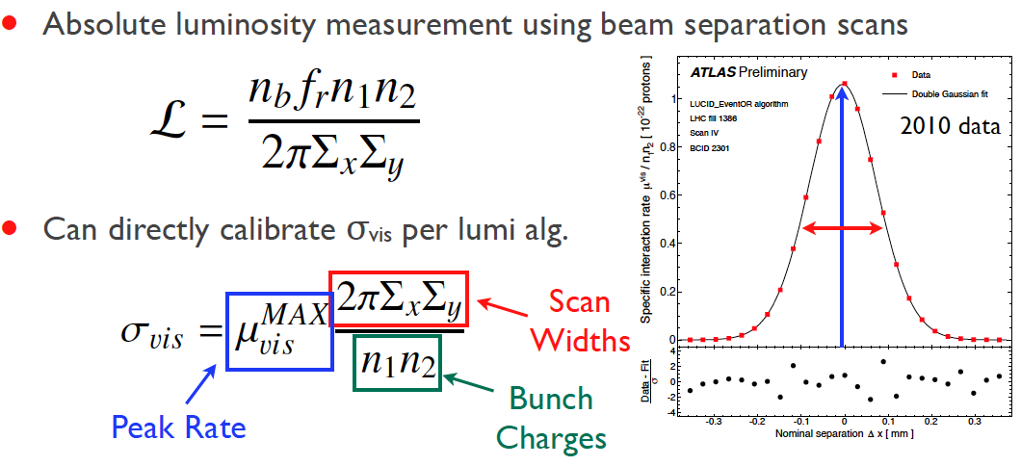
van der Meer scan: Basic Observables
n_{b} = number of colliding bunch pairs
f_{r} = LHC revolution frequency
μ_{vis} = number of detected “events” per bunch crossing = μ ε
σ_{vis} = visible cross-section = luminosity calibration constant

Slide 32
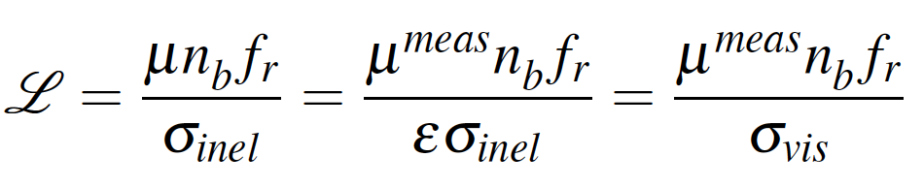
Luminosity: basic observables
vis
vis
μ = number of inelastic collisions per bunch crossing
n_{b} = number of colliding bunch pairs
f_{r} = LHC revolution frequency (11245.5 Hz)
σ_{inel} = total inelastic [pp] cross-section
μ_{vis} = number of detected “events” per bunch crossing = μ ε
ε = acceptance x efficiency of luminosity detector
σ_{vis} = visible cross-section = luminosity calibration constant

Slide 33
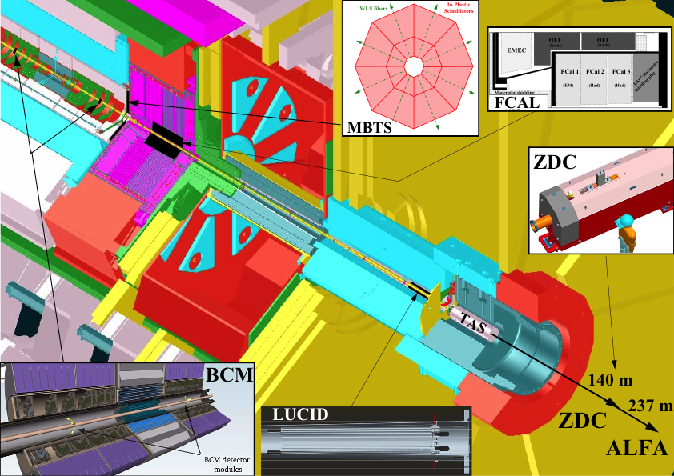
Luminosity measurements used in the ATLAS 2011 L analysis
BCM: bbb
  Event OR, AND for BCM H/V separately
LUCID: bbb
  Event OR, AND, A, C
  Hit OR/AND
vtx methods: bbb
  vtx-based event counting
  vertex counting
FCAL (fwd LAr)
  gap currents
TILE calorimeter
  PMT currents
RPC, Medipix, ZDC
bbb = bunch-by-bunch (+ bunch-integrated over colliding bunches ATLAS triggers on)
BCID-blind = sums over all BCID’s

Slide 34
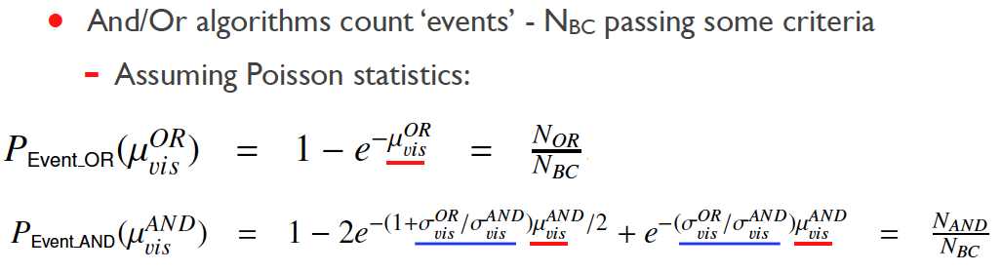
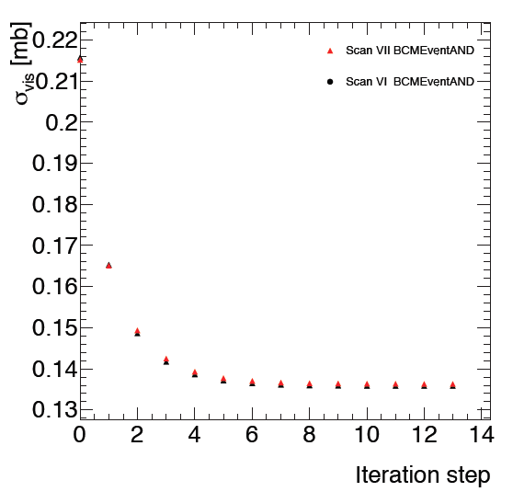
van de Meer scan analysis: formalism
From “event” counting (actually 0-counting) to μ_{vis}

Slide 35
Consistency checks on May’11 vdM scan analysis
σ_{vis}: btwn bunches within one scan
σ_{vis}: bunch-averaged btwn consecutive scans
0.4 %
ε-growth systematic
LUCID_EventOR
RMS = 0.4 %
χ²/DOF = 19 / 12
σ_{vis}: bunch-avrgd btwn different fit models
L_{sp} (~ 1/Σ_{x}Σ_{y}) consistency bwtn detectors or algorithms
0.4 %
fit-model systematic
0.3 ± 0.1_{stat} %
BCMH_EvOR
Scan VIII
Bgd-subtracted

Slide 36
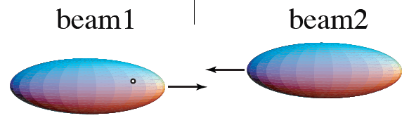
Dynamic-β effect
The electromagnetic field produced by a B1 bunch (de)focusses the particles in the B2 bunch ( & vice-versa)
  → beam-beam deflection (observed in May’11 vdM, consistent w/ exp.)
  → each beam acts as a (de)focussing quadrupole on the other. This modifies the machine optics, and in particular the β* values (hence the name ‘dynamic β’), in a manner that depends on
    the magnetic lattice – and in particular the tunes
    the bunch intensities and emittances (~ N_{1,2} / ε_{inv})
    whether the beams collide at other IP’s (more beam-beam, but with different phase advances between IP’s)
During a beam-separation scan, the dynamic-β effect may enhance (or reduce) the instantaneous luminosity, thereby distoring the scan shape slightly (first pointed out by H. Burkhardt - afaik)

Slide 37
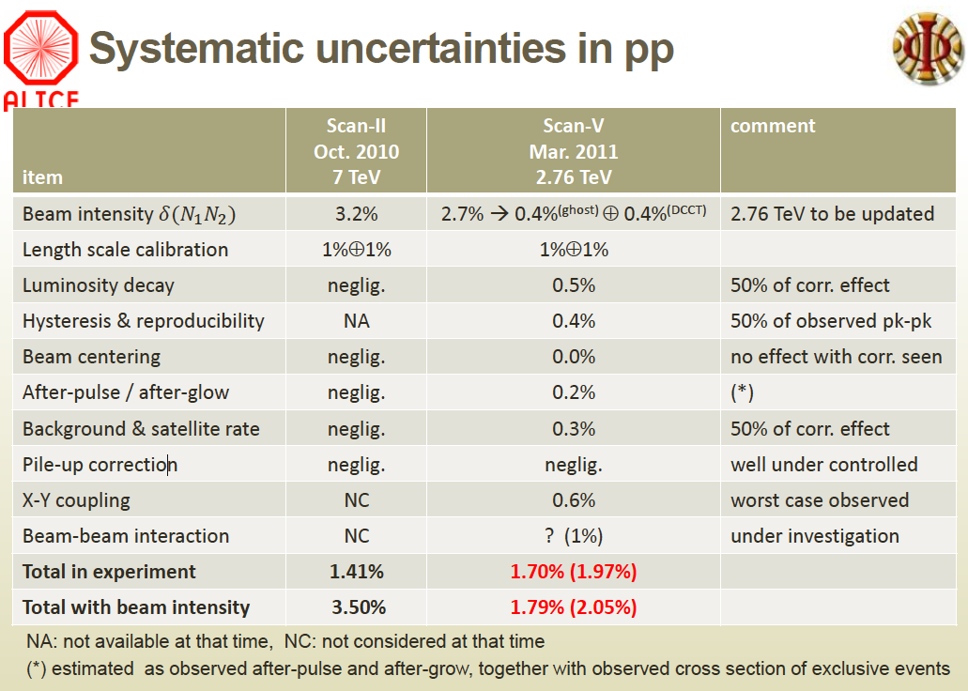

Slide 38
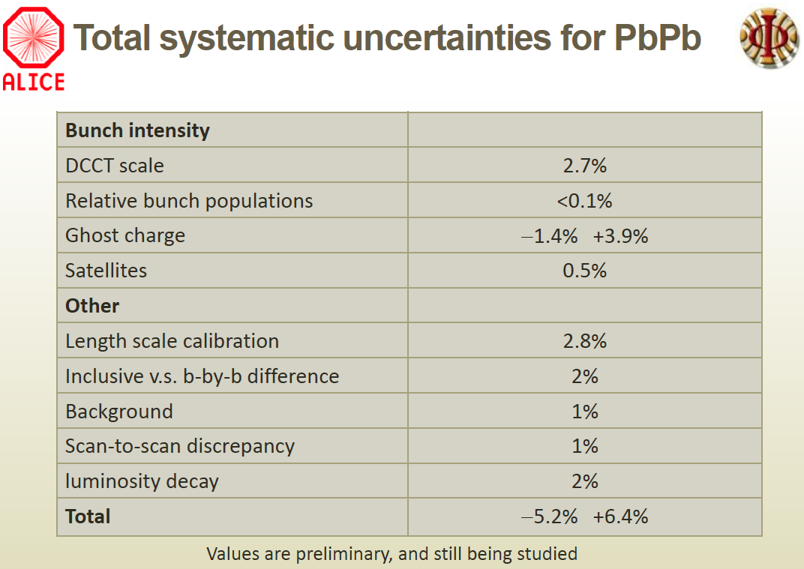

Slide 39
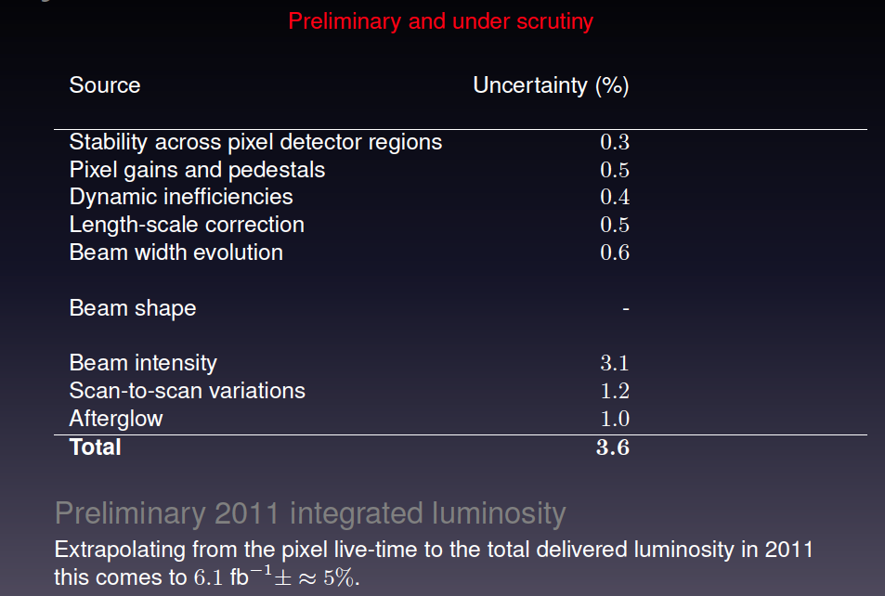
CMS systematics summary

Slide 40
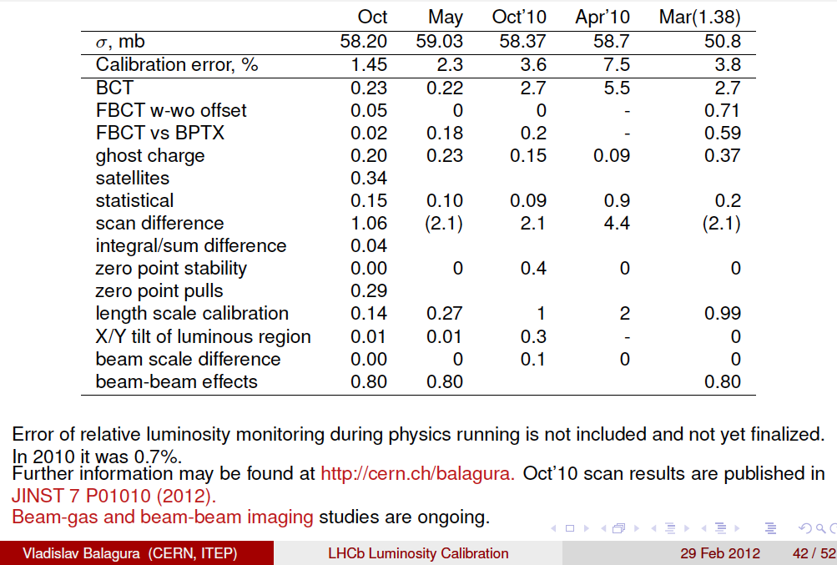
LHCb systematics summary

Slide 41
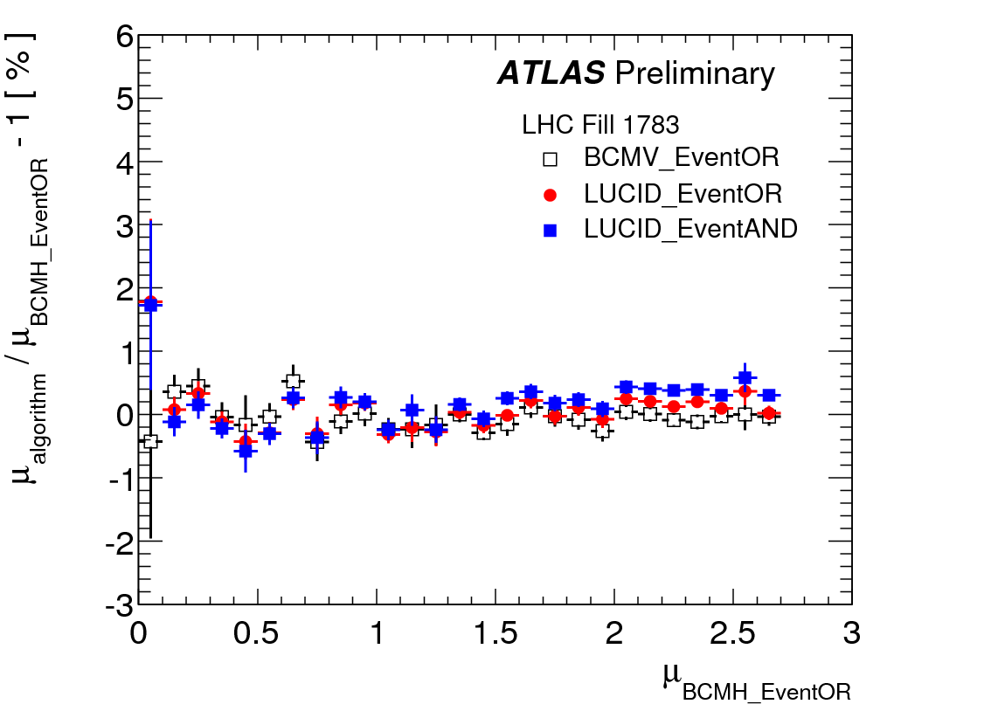
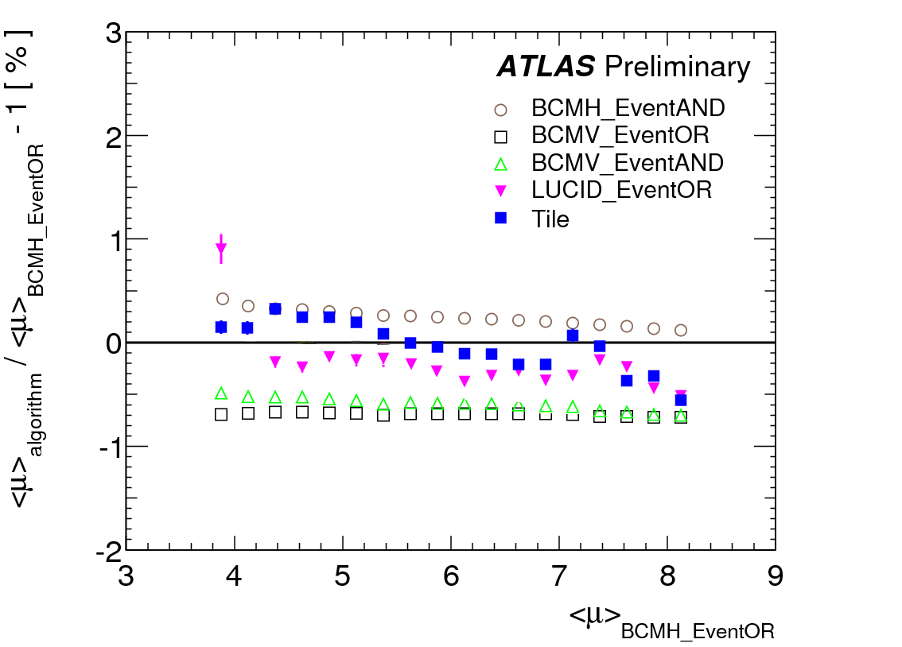
May’11 vdM analysis : self-consistency of absolute L calibration
May’ 11 vdM
Fill 1783
Apr-Jun 2011
LUCID with gas
± 0.5 %
Relative BCM H/V calibrations appear to have shifted by 0.7% shortly after vdM scan

Slide 42
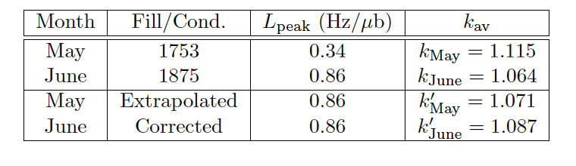
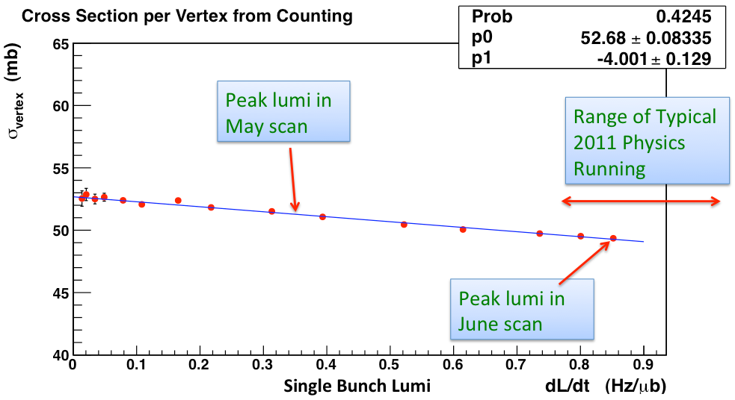

Beam-separation scan under physics conditions: CMS
A scan done in June 2011, under more or less standard data taking conditions, was used to cross-check the May’11 scan.
1.5%
The June scan also provided useful data on the HF non-linearity
(1/L) dL/dμ ~ 1%
LPC
30 Jan 12

Slide 43
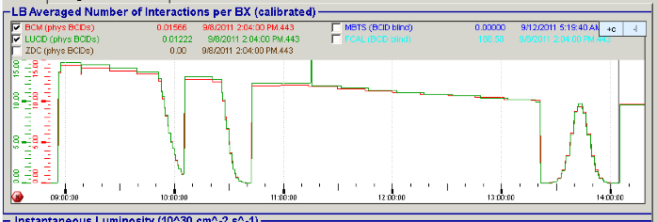
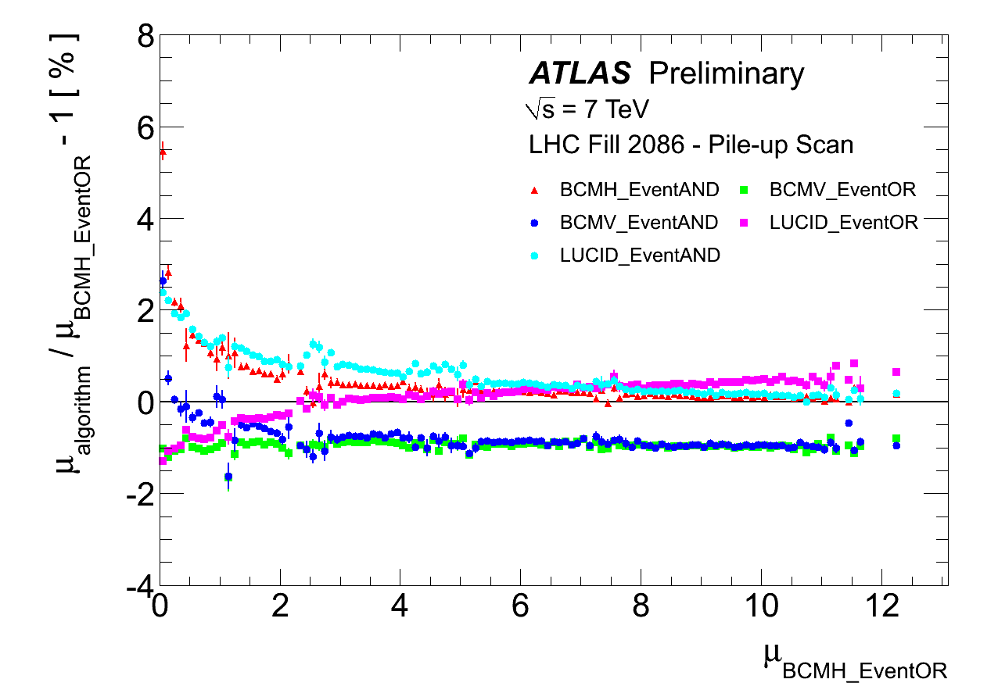
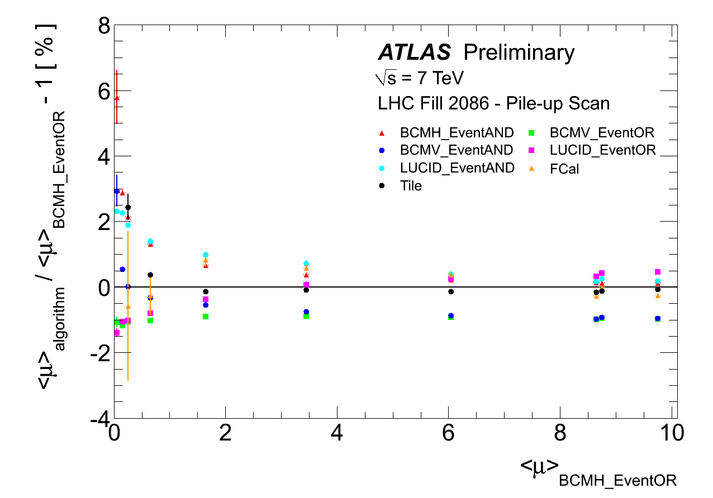
Direct measurement of μ-dependence: ATLAS pile-up (‘μ’) scan
‘μ sweep’ performed by beam-separation in F 2086 (873 b, L ~ 1.9 10³³)
  → characterize the relative μ-dep. of BCM H/V, FCal, LUCID, TILE, vtx algos
3 scans, covering
10 - 15 > μ > 0.02
i.e. all the way from
normal physics conditions
to (slightly below) the μ regime for the β* = 90 m ALFA run
± 1 %
± 1 %
TILE / FCal crucial!

