Slide 1
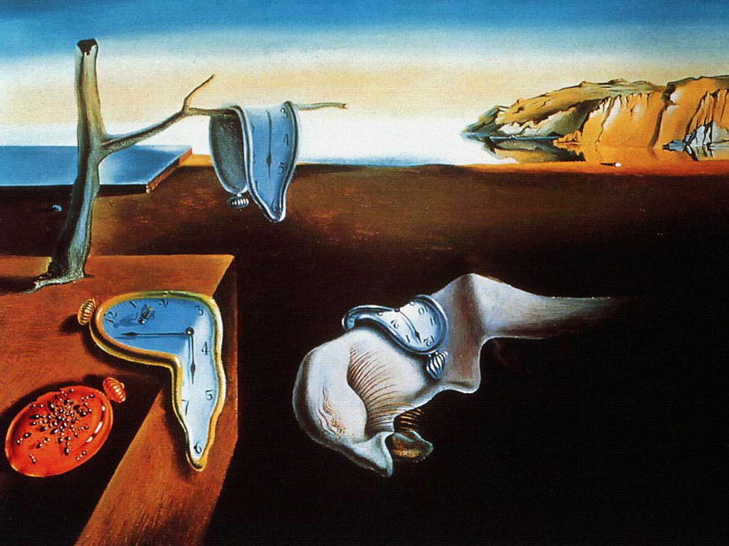


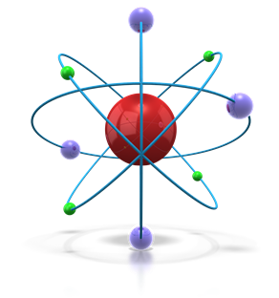
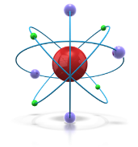

Effects of radiation in Accelerators
R. Losito, Juas, 23/02/2012

Slide 2
Nice to meet you!
I am an Electronic Engineer, specialized in Microwave Engineering!
I started my career studying (and measuring) coupling impedances.
Then, at CERN, I have been an engineer in
  the RF group for 9 years,
  then moved to Photoinjectors,
  then to Controls,
and now I lead a Group in the Engineering Department called:

Slide 3
Nice to meet you!
Sources, Targets and Interactions (STI)
  We design and operate (and dispose!!!)
  Sources: Radioactive Ion sources and Photoinjectors
  Targets: Collimators, Targets, Dumps (Beam Intercepting Devices)
  Interactions: we study the effects of beams interacting with matter in accelerators

Slide 4
Acknowledgements
I have stolen some material from different colleagues
  P. Chiggiato
  A.Ferrari
  A. Ryazanov
  D. Ricci

Slide 5
Why a seminar on Radiation effects ?
… because accelerators generate radiation!!!
Radiation influences (more and more!!!) the way we conceive our installations, accelerator components, the length and occurrence of shutdowns, the size of our teams…
… because we have ethical and legal obligations towards our staff, our Host States, and towards society in general

Slide 6
What is radiation?

Slide 7
What is radiation?
Radiation means “energy transported through space” by particles, photons, electromagnetic waves…
Energy is then deposited into matter and provokes microscopic and macroscopic changes in its structure, chemical and physical properties

Slide 8
What is radiation?
Biological effects of radiation on humans are studied by Radioprotection experts and will not be reviewed today (you will have a lecture on March 9th)
I will introduce some typical problems we face everyday with radiation in the design of accelerator components

Slide 9
What is Radiation?
Radiation is carried by Alpha, Beta, Gamma, neutrons, protons…
Are the effects different?
Yes and No, but they also depend on energy of the impacting particle, composition and purity of the target material, intensity etc…
For our purposes, we are mainly interested at the macroscopic effects: we need a macroscopic description…

Slide 10
Effect is different for different materials
Next slide from the lectures on radiation damage given at CERN by Alexander Ryazanov, from the Kurchatov Institute in Moscow

Slide 11
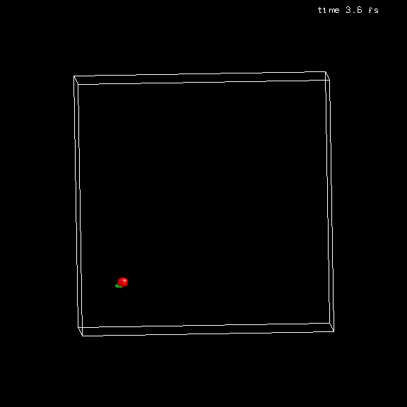
Comparison of cascade and sub-cascade formation in light and heavy materials.
Cu
Si
Atomic number 29
Atomic number 14
12-16 September 2011, CERN, Geneva

Slide 12
What is Radiation?
Radiation is carried by Alpha, Beta, Gamma, neutrons, protons…
Are the effects different?
Yes and No, but they also depend on energy of the impacting particle, composition and purity of the target material, intensity etc…
For our purposes, we are mainly interested at the macroscopic effects: we need a macroscopic description…

Slide 13
What is radiation?
Ionising Radiation
Non Ionising Radiation
Particles (Waves?), whose energy is sufficient to ionise atoms or molecules (> few eV)
  Alfas, hadrons, cosmic rays…
  Neutrons (nuclear reactions: capture, fission…)
  Electromagnetic waves (Photons), with sufficiently low wavelength
  …
Microwaves and RF

Slide 14
Why does radiation create damage?

Slide 15
Why does radiation create damage?
Ionising Radiation
Non Ionising radiation
Creates radicals (ions) that become chemically active
Modifies the structure of materials by displacing atoms of the lattice…
Fragments atoms in the material creating new interstitials
Modifies the structure of the irradiated materials
Essentially, deposes energy in form of heat.
For organic molecules (DNA), may break very low energy bonds and create Biological damage
“Accelerate Ageing of materials”
controversial

Slide 16
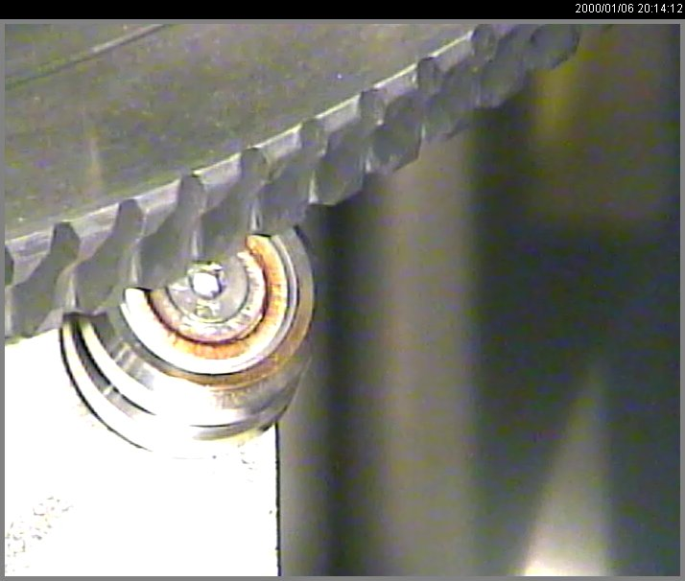
Some examples
Ionising Radiation
Ball bearings exposed to hadronic showers in air
Creates radicals (ions) that become chemically active
Modifies the structure of materials by displacing atoms of the lattice…
Fragments atoms in the material creating new interstitials
Modifies the structure of the irradiated materials

Slide 17
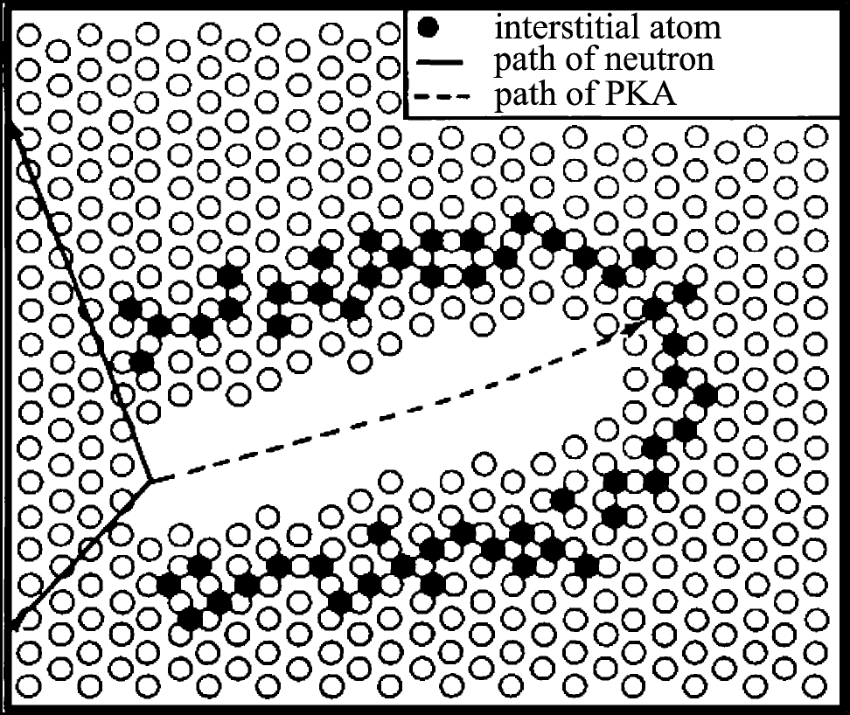
Some examples (finally!!!)
Ionising Radiation
Displacement spike as
drawn by Brinkman (1956)
Creates radicals (ions) that become chemically active
Modifies the structure of materials by displacing atoms of the lattice…
Fragments atoms in the material creating new interstitials
Modifies the structure of the irradiated materials

Slide 18
Some examples (finally!!!)
Ionising Radiation
Displacement spike as
drawn by Brinkman (1956)
Creates radicals (ions) that become chemically active
Modifies the structure of materials by displacing atoms of the lattice…
Fragments atoms in the material creating new interstitials
Modifies the structure of the irradiated materials

Slide 19
Some examples (finally!!!)
Ionising Radiation
CNGS (graphite) target
Creates radicals (ions) that become chemically active
Modifies the structure of materials by displacing atoms of the lattice…
Fragments atoms in the material creating new interstitials
Modifies the structure of the irradiated materials
Due to transmutation, 1 atom every 20 (5%) is no more Carbon, but it is transformed into:
11-C -> 11-B
10-C -> 10-B
7-Be -> 7-Li
4-He
3-H

Slide 20
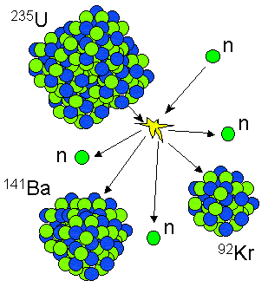
Radiation modifies materials
Ionising Radiation
http://www.astro.cornell.edu
By breaking (un)stable atoms, ionising radiation can create new unstable atoms, that generate radiation by radioactive decay!
141 Ba → 141 La (18 min)
92 Kr → 91-92 Rb (1.8 s)

Slide 21
A special case: electronics!!!
Electronics may suffer in 2 respects:
  Total dose, generating slow drift of performance due to modified doping and finally unrecoverable failure
  Deposits charge creating new electrons or vacancies and modifying the state of transistors (may even burn them!)

Slide 22
Other important Radiation effect
Gas production
  mostly due to protons, deuterons, tritons, 3He and alphas stopping in the target material.
  They can be beam particles ranging out in the target (low energy beams), or secondary particles produced by nuclear interactions in the target itself

Slide 23
radiation as an engineering parameter for the design

Slide 24
Ingredients
  How to measure “radiation”
  How to measure the radiation “effect”

Slide 25
Measurement of radiation
The way we measure radiation depends on the effect we want to measure:
  Radioprotection takes into account the “sensitivity” of biological tissues to different wavelengths/energies (equivalent dose).
  For materials, it depends on the type of radiation and on the effect to be studied (absorbed dose).
    Macroscopic description (dose)
    Microscopic description (single particle)

Slide 26
Measurement of radiation
Referred to a given period (e.g. 1 year, or lifetime of an accelerator)
  TID (Total Ionizing Dose): Energy deposited in a medium by ionizing radiation per unit mass (by whichever process)
    Measured in Grays:
    1 Gray = 1 J/kg
  For humans:
    Sievert, dose weighted with response at different energies of human tissues.
    Dose of a certain type of irradiation giving an equivalent biological effect as the same dose of gamma rays.
    1 Gray (gamma) = 1 Sv
    1 Gray (alphas) = 20 Sv

Slide 27
Measurement of radiation
Referred to a given period (e.g. 1 year, or lifetime of an accelerator)
  Fluence (or flux)
    Nb of particles /cm^2 (/sec)
    Used for Single Event Effects
    Used also for displacement damage to materials for targets, nuclear plants…

Slide 28
Measurement of radiation
Referred to a single particle
  Ionising Energy loss:
    energy lost by a particle in ionising atoms of the material
    mainly due to electronic stopping power
  NIEL: Non Ionising Energy Loss
    Rate of energy loss due to atomic displacements as a particle traverses a material (nuclear stopping power).

Slide 29
Measurement of radiation
…NIEL x Fluence = total energy deposed in the material by displacement.
...IEL x Fluence = total energy deposed in the material by ionisation.

Slide 30
Measurement of radiation effect
DPA: Displacement Per Atom
  Number of times that every atom in the lattice has moved from its original position in the lattice
  Cannot be measured!!!! Mainly a concept to anticipate failure of materials.

Slide 31
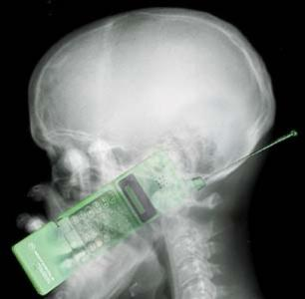
Some examples

Slide 32
Plastic
Used in cable insulations, as structural material, for plugs, lamps, electrical cubicles…
Plastics are organic materials!!!
  They are derived from petrochemicals or from natural materials (resins, rubber…)
  Contain Carbon
Sometimes used as structural elements…

Slide 33
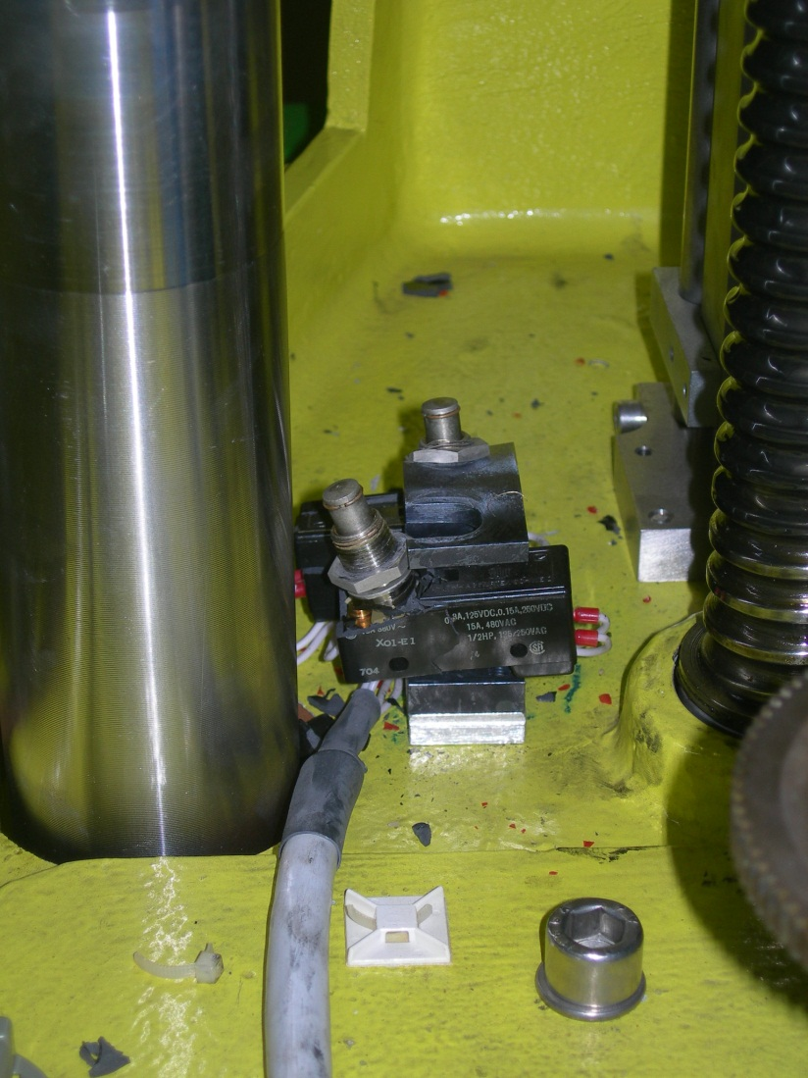
Plastic
Effect of radiation:
  Degradation of mechanical properties appears first (e.g. reduced elongation at break)
  Degradation of electrical properties

Slide 34
Plastic

Slide 35
Plastic
Can find useful information in CERN’s Yellow books (e.g. CERN 82-10, or 89-12)

Slide 36
Plastic
Can find useful information in CERN’s Yellow books (e.g. CERN 82-10, or 89-12)

Slide 37
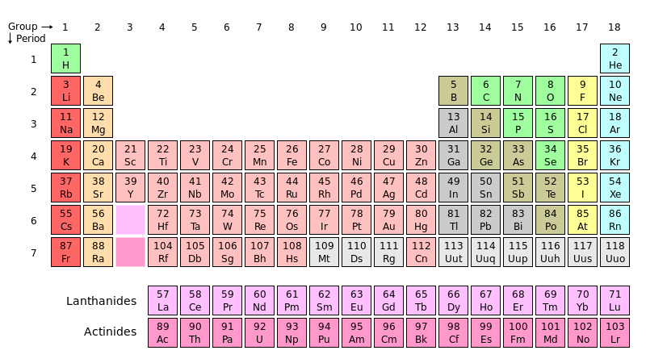
Halogens

Slide 38
Halogens
From Greek “halos genos”, salt generators
Most electronegative elements in the periodic table: easily gain an electron and become chemically active
For this reason, in sufficient quantities they can be extremely dangerous
Cl most common on earth
Becomes aggressive and attacks metallic surfaces (and F even glass!!!)

Slide 39
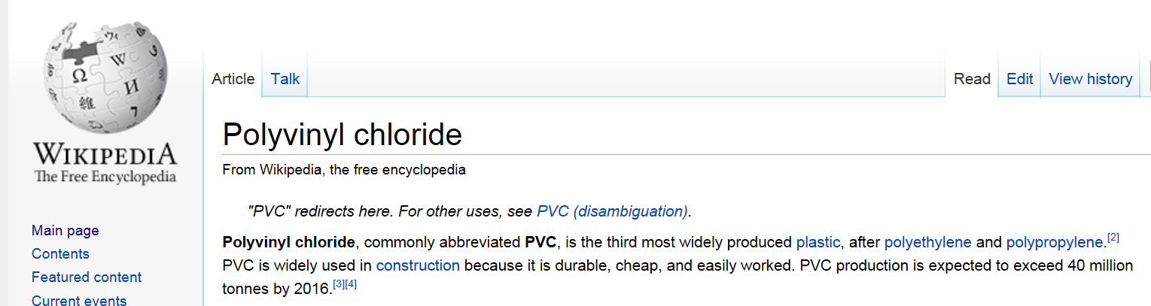
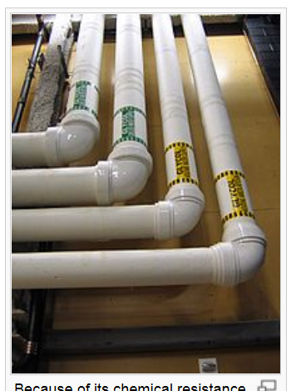
Halogens, a special case: PVC
From Wikipedia.org:

Slide 40
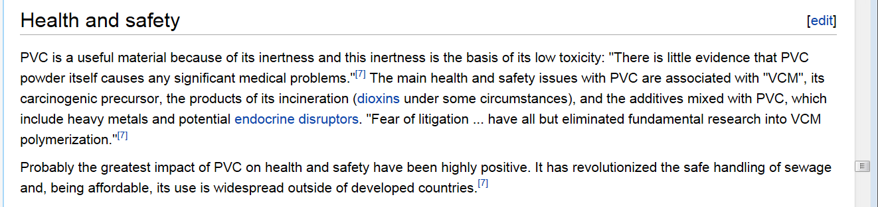
Halogens, a special case: PVC
From Wikipedia.org:
For this reason no PVC and Halogens are allowed in confined space, tunnels etc…

Slide 41
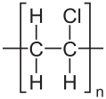
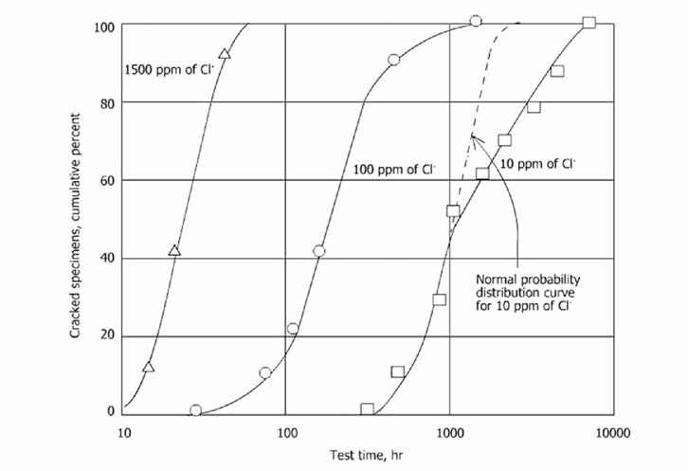
Halogens, a special case: PVC
Dehydrochlorination is the major mechanism of PVC degradation by X and γ-rays.
Cl- ions react with water droplets and create a very corrosive environment
Ahmad Zaki , Principles of Corrosion Engineering and Corrosion Control, Elsevier

Slide 42
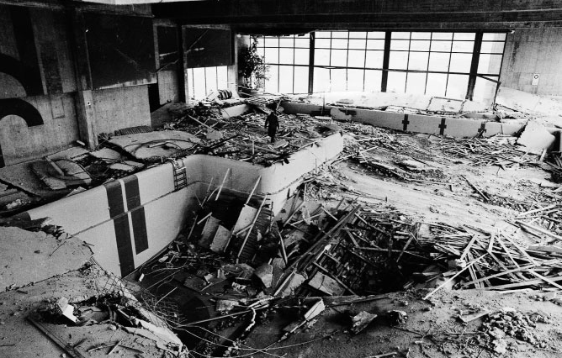
Halogens
Don’t drink water in a swimming pool before interventions in radiation areas!!!!
M. Faller and P. Richner, Materials and Corrosion 54(2003)331
On 9 May 1985, the suspended ceiling at Uster (CH)
indoor swimming pool collapsed into the pool area

Slide 43
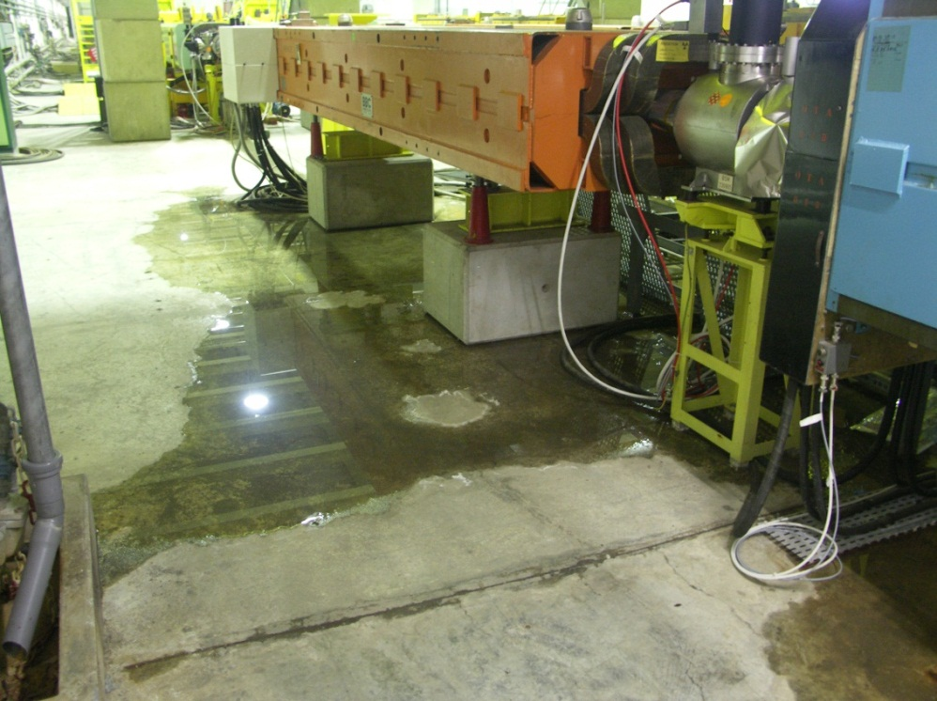
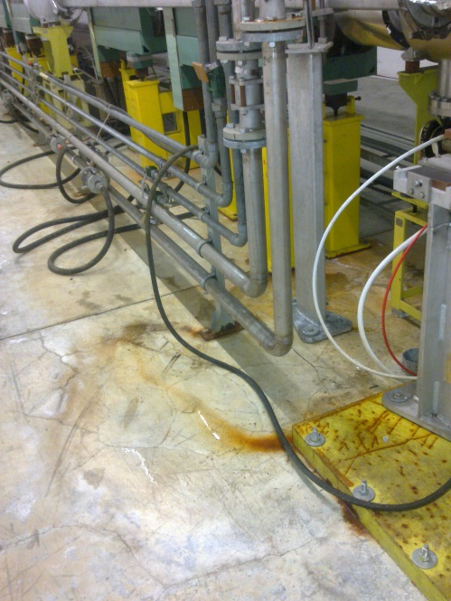
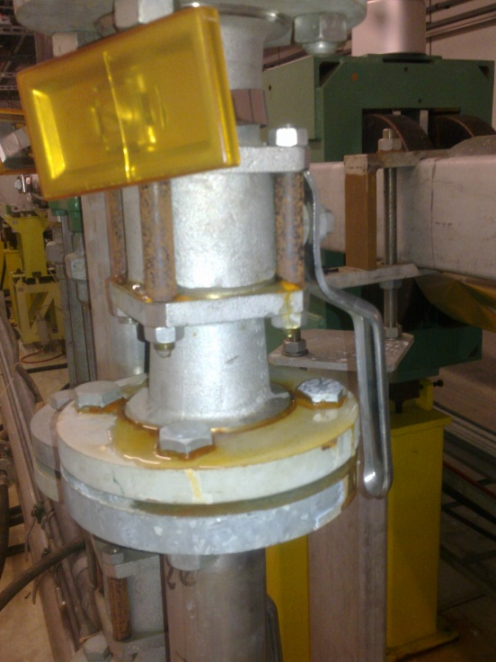
Halogens
How can it happen? … Moisture
  Leaking magnet cooling circuits
  Leaking water valves
  Infiltration from the tunnel ceiling

Slide 44
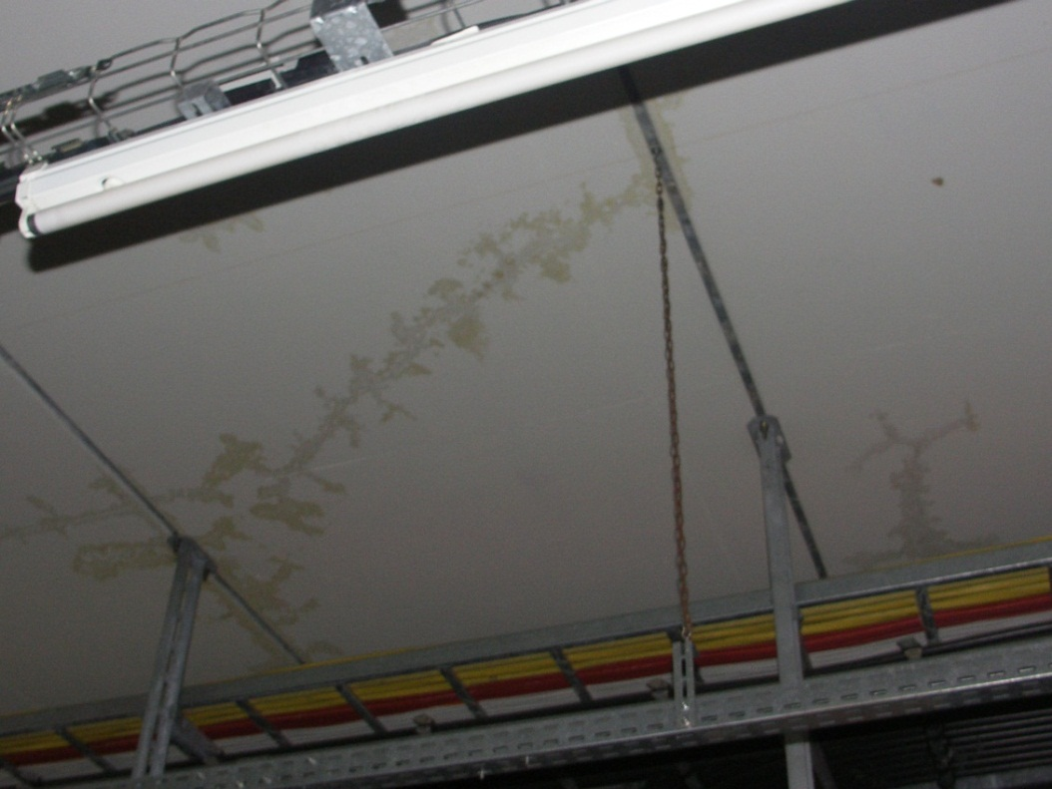
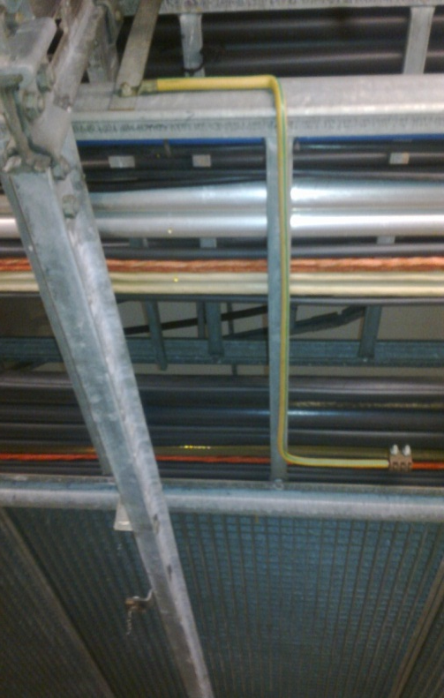
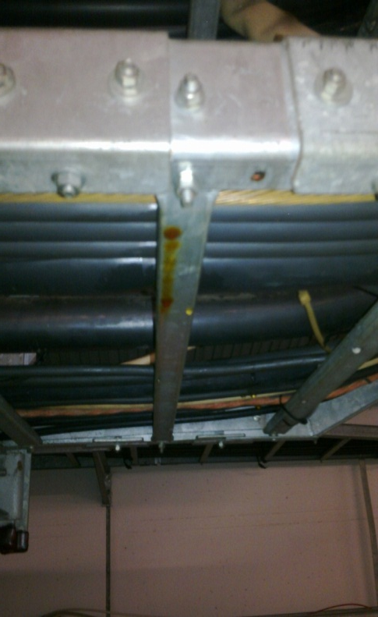
Halogens
Condensed water droplets charged with Cl⁻ ions can fall onto accelerator components, in particular welds and bellows (mechanically stressed areas) generating stress corrosion cracking in unprotected stainless steel components…

Slide 45
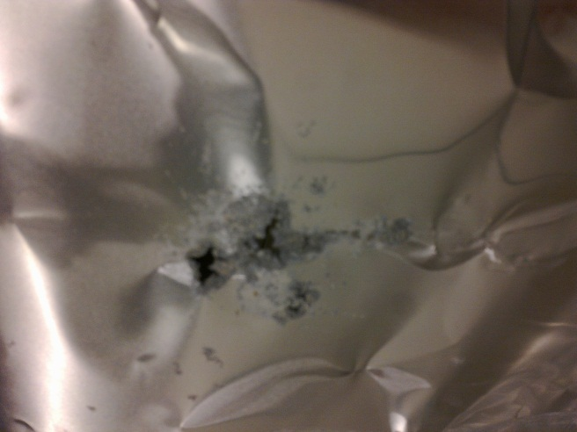
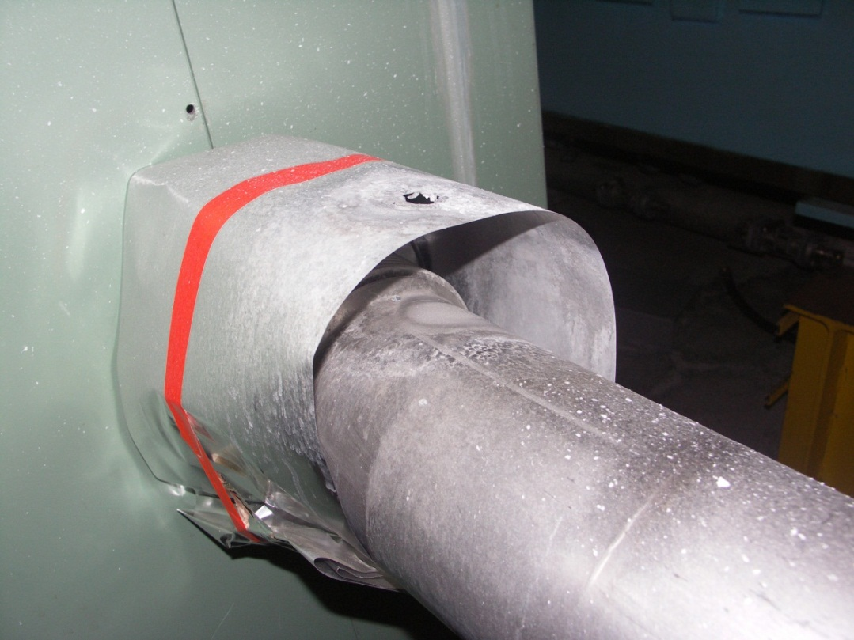
Halogens
Few droplets, maybe a single one, are enough to generate corrosion and failure
Once corrosion is there it cannot be passivated anymore!!!

Slide 46
Plastic
Conclusions:
  Plastic suffer from radiation, several compendia have been published by CERN wrt degradation of mechanical and electrical properties
  Never use PVC, and avoid Chlorine based products (widely used in lubricants and cleaning products!!!)

Slide 47
Metals
A huge amount of studies have been perform on metals, for their use in reactors.
Mechanical (macroscopic effects), are ultimately caused by formation of defects in the lattice structure
Defects are : voids, gas bubbles, dislocations…
Temperature has an effect. Annealing increases the mobility of defects, this has sometimes a positive impact by reconstructing the lattice, sometimes accelerates defects (especially if the material is subject to high stresses).

Slide 48
Metals: hardening and embrittlement
Hardness: resistance of a material to permanent (plastic) deformation under an given load curve
Brittleness: property of materials that break before showing any visible deformation
Radiation modifies the stress/strain curve: yield strength is increased slightly enlarging the elastic region, but ductility is reduced. The material becomes more fragile…

Slide 49
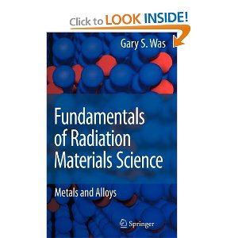
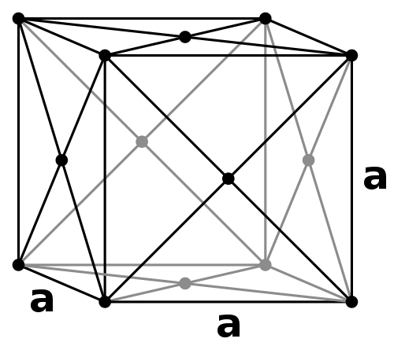
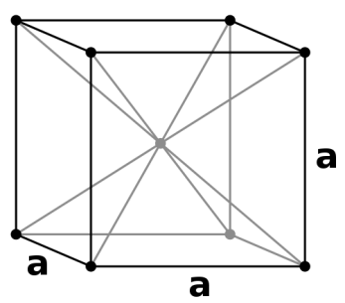
Metals: hardening and embrittlement
Austenitic Steel
(face centered cubic)
Ferritic steel
(body centered cubic)

Slide 50
Metals: deformation and creep
Bubbles, dislocations etc… are at the bases of growth in volume or deformation
If the material is subject to constant stress, creep can be initiated (or accelerated).

Slide 51
Water!!
Two effects are important in the interaction of particle beams (and radiation in general), and water
Generation of Tritium
Radiolysis

Slide 52
Tritium
Radiation induces generation of tritium by different mechanisms
    D + n → T + γ
    ¹⁰B + n → T + ⁸Be + γ
Due to its relatively long half life (12.33 years), huge quantities of tritiated water may be accumulated in the cooling circuits of accelerators.
In high radiation applications, water cooling has to be avoided!

Slide 53
Radiolysis
Energy deposited by beams (or radiation) in water breaks the water molecule, and generates H₂ and O₂:
  H2 is flammable, may provoke explosion
  O2 (or O3) may attack metallic surfaces, provoking corrosion
Water cooling circuits in high radiation areas have to include strict control of O2 and H2 concentration, and possibility to evacuate generated gas.

Slide 54
Air
Particle beams sometimes travel in air; interaction with atmosphere generate O3.
O3 accelerate corrosion!!
In highly radioactive areas, humidity has to be kept as low as possible …

Slide 55
An example of single event:
LHC collimator controls
LHC collimators are moved by stepping motors, which angular position is monitored with resolvers.
In the control system, a counter is implemented to count the steps of the motor.
Following an high intensity run, one control system installed in a relatively low radiation area has been struck by a Single event.

Slide 56
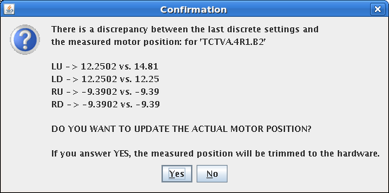
An example of single event:
LHC collimator controls
The tricky problem: the anomaly appeared while there was no beam (no source of radiation!!!)
  Sending back the collimators to “parking” position, we realised that one position sensor was not giving a correct value

Slide 57
How can a problem appear while there is no beam????
  First event
  Second event

Slide 58
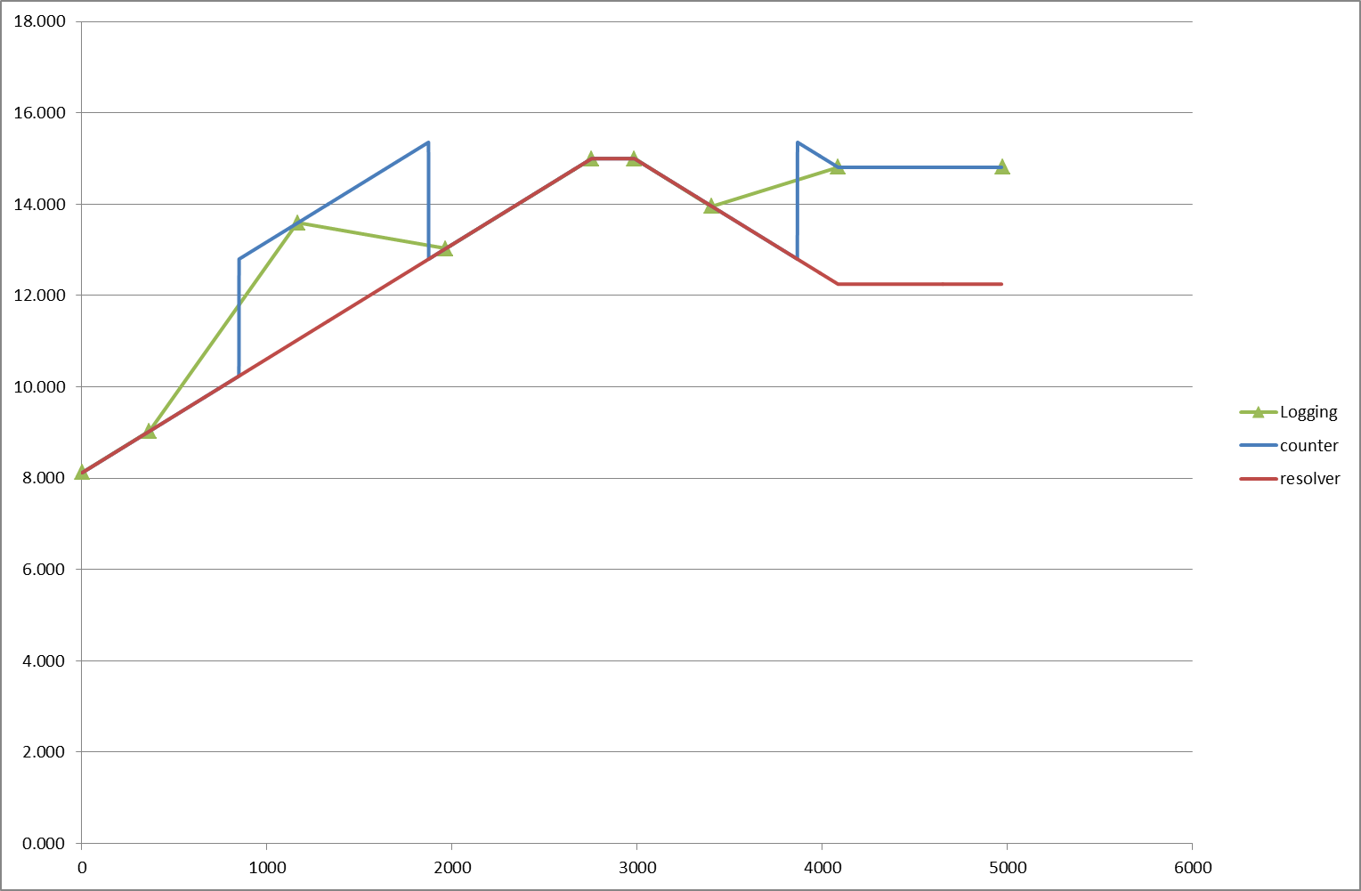
What happened on 12 September?

Slide 59
Single Events
Single Events Errors may be extremely difficult to understand and anticipate
Avoid as much as possible to install electronics close to radiation sources!!
If this is impossible, either need shielding or radiation tolerant-design!

Slide 60
Optic Fibers
Optic fibers under irradiation tend to become opaque.
In general, the effect is reduced by avoiding the presence of P in the fiber.
The main effect is an increased attenuation factor, which may or may not affect the transmission of data: most common modulations used are base on PSK modulations, which are influenced mainly by change in phase response.
When planning radiation testing of a fiber, it is important to analyse the type of signal to be passed on the fiber, to address the problem properly and measure the degradation of the relevant characteristic
Real and imaginary part of impedance are not independent variables (Paley-Wiener conditions)

Slide 61
Conclusions
Radiation provokes a lot of undesired effect
You cannot avoid them!!!
The only rule is to anticipate damage
  Think first!!!
ALARA is the magic word: involves preparation of interventions, selection of materials, mitigation measures, remote handling…

Slide 62
Conclusions
A special recommendation:
  Irradiated materials will remain so for hundreds of years!!!
  Think carefully at the materials you use]
  Ask yourself the question: is it really worth to do what I am doing?? And in the way I am going to do it?

Slide 63

Thank you for your attention!!!

Slide 64
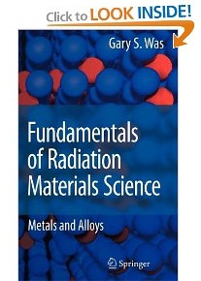
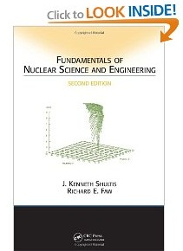
Suggested readings

