Slide 1
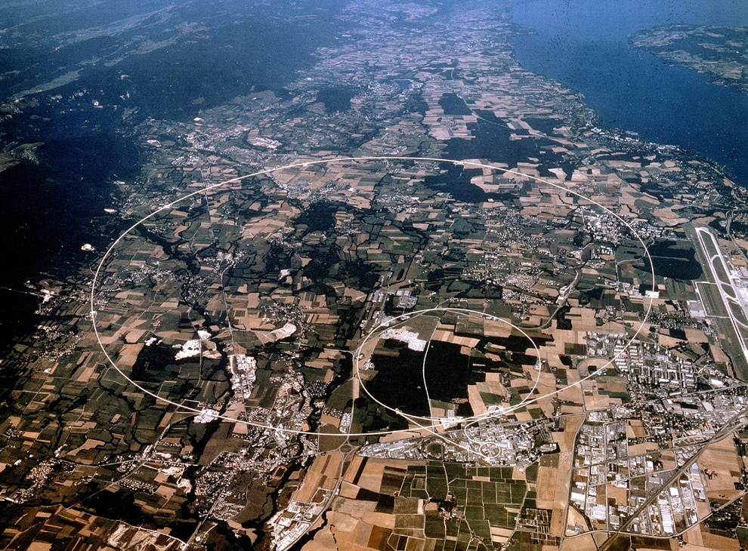
CERN
European Organization for Nuclear Research
Welcome to CERN
Louis Rinolfi
Thanks to D. Bertola, F. Briard, P. Collier

Slide 2
CERN
European Organization for Nuclear Research
Agenda of the visit
30 minutes presentation
Visit of CMS cavern and detector
Visit Linacs and CTF3
Other practical informations
Do not hesitate to ask questions
You can take pictures and shoot film everywhere
Microcosm and Globe Exhibition « A Universe of Particles »
freely accessible from 9am till 5pm from Monday till Saturday
CERN Shop from 11am till 5pm (hall)

Slide 3
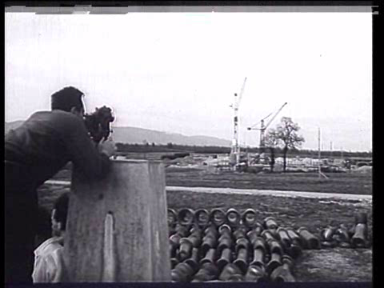
CERN
European Organization for Nuclear Research
What means « CERN»?
1954
Conseil
Européen pour la
Recherche
Nucléaire

Slide 4
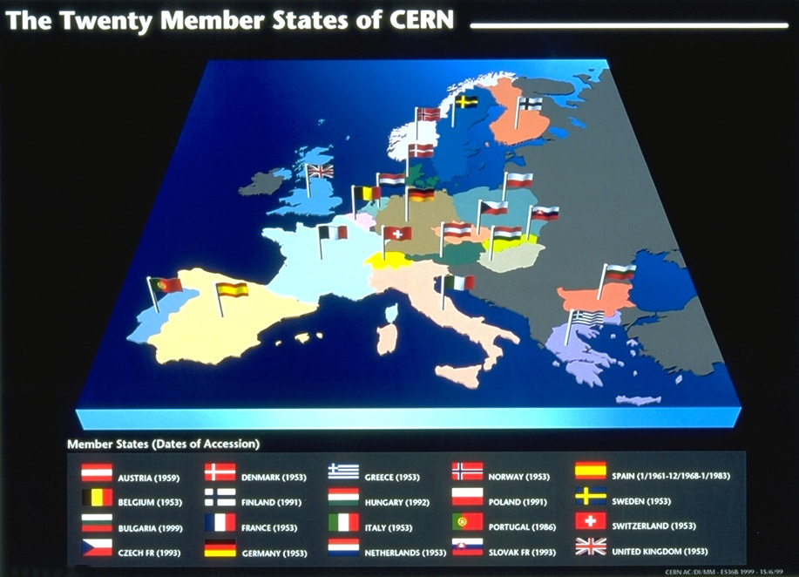
CERN member states

Slide 5
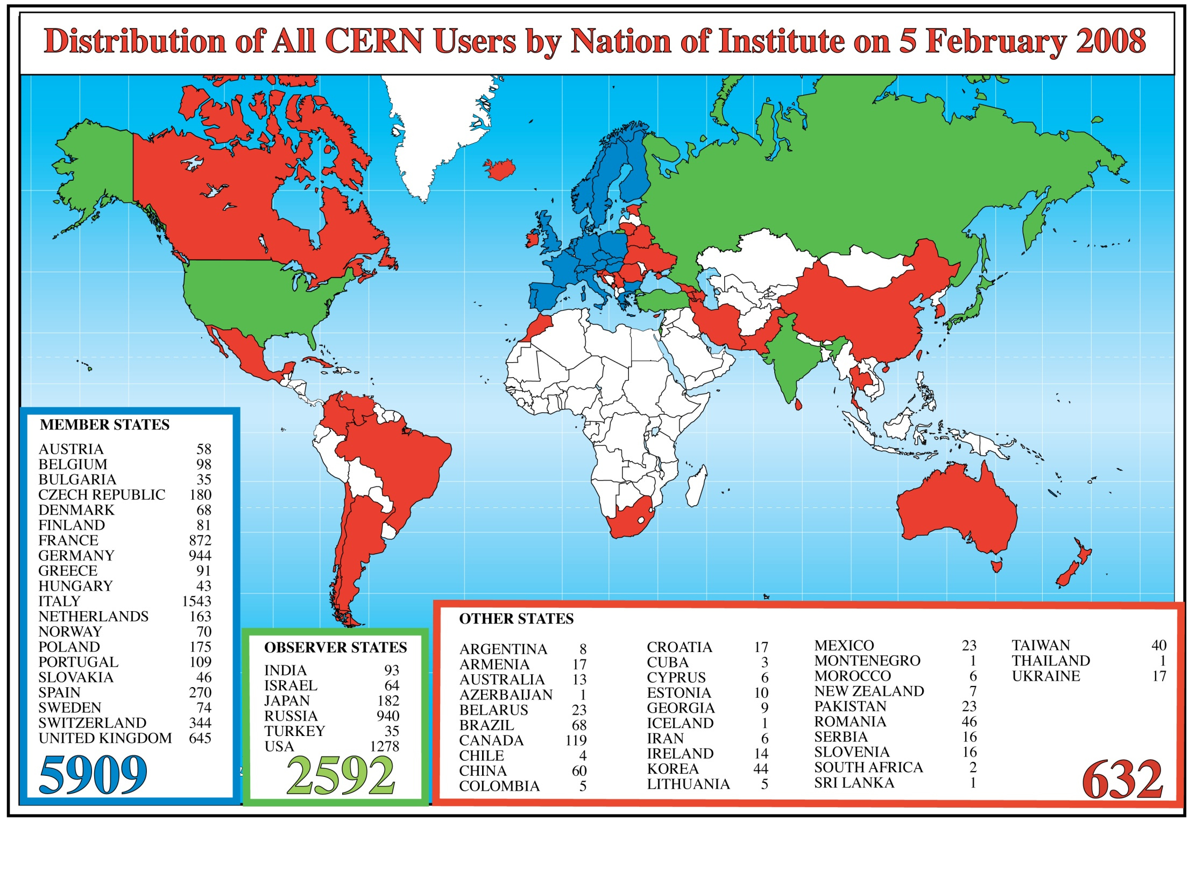
CERN users

Slide 6
CERN objectives
Fundamental research
in the Particle Physics:
- elementary constituents of the matter
- fundamental forces controlling them
- origin and structure of the Universe

Slide 7

















The Standard Model
Checking existing theories:
LEPTONS
QUARKS
ORDINARY
MATTER
ELECTRON
ELECTRON
NEUTRINO
UP
DOWN
MUON
MUON
NEUTRINO
CHARM
STRANGE
TAU
TAU
NEUTRINO
TOP
BOTTOM
GLUONS
Strong Force
PHOTONS
Electro-Magnetic Force
BOSONS
Weak Force
GRAVITONS
Gravity
4
forces
Images: www.particlezoo.net

Slide 8
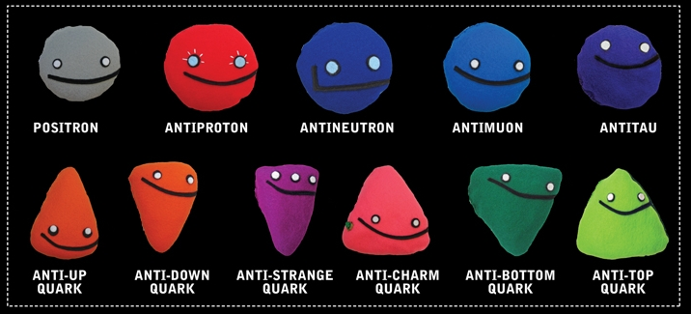
And all anti-particles ….

Slide 9
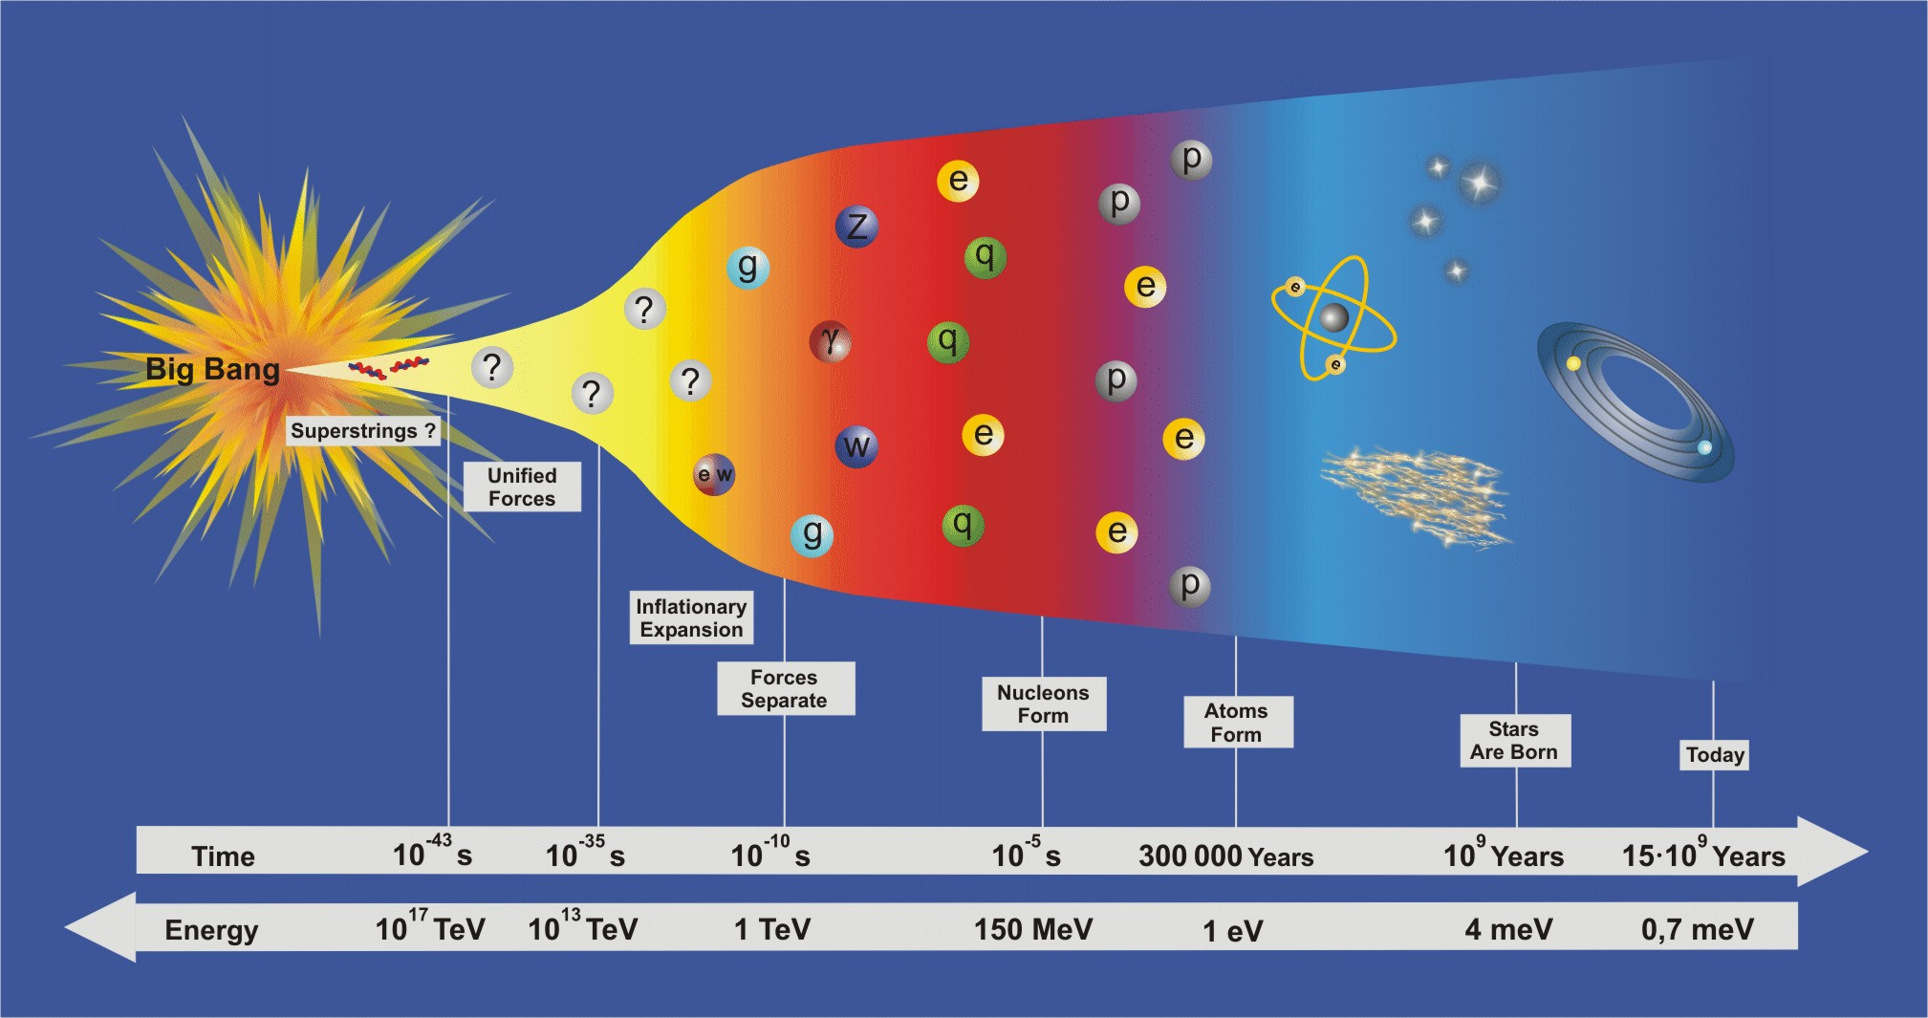
Evolution of the Universe
CERN
European Organization for Nuclear Research
C

Slide 10
CERN
European Organization for Nuclear Research
Open questions
of Particle Physics:
- the Supersymmetry (SUSY)
- the origin of mass and the Higgs boson
- the dark matter
- the matter – anti-matter asymmetry
- the quark – gluon plasma

Slide 11
CERN
European Organization for Nuclear Research

Slide 12
CERN
European Organization for Nuclear Research

Slide 13
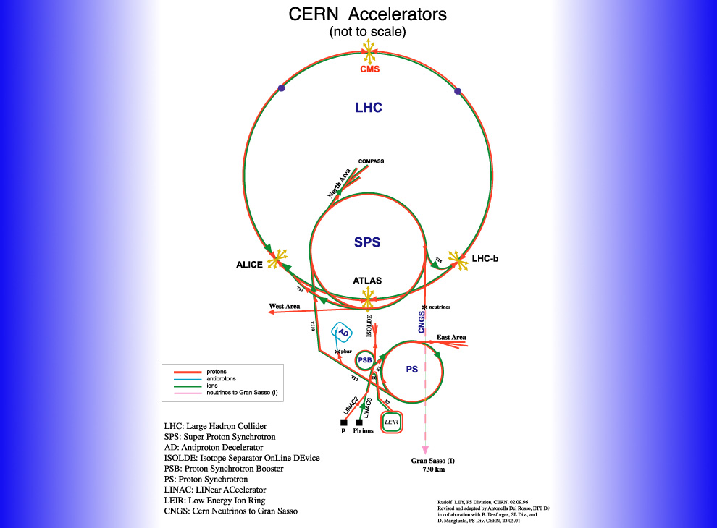
CERN Accelerators complex

Slide 14
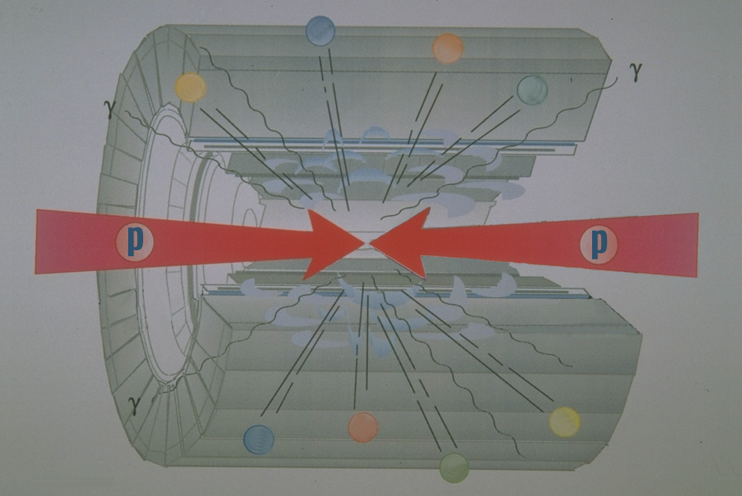
Colliding beams

Slide 15
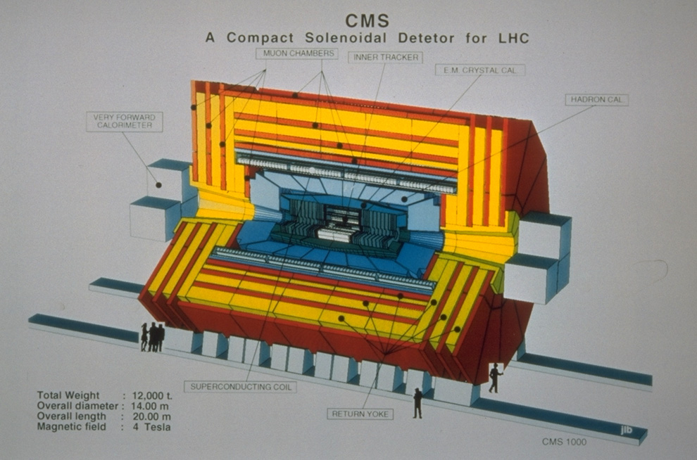
The CMS detector

Slide 16
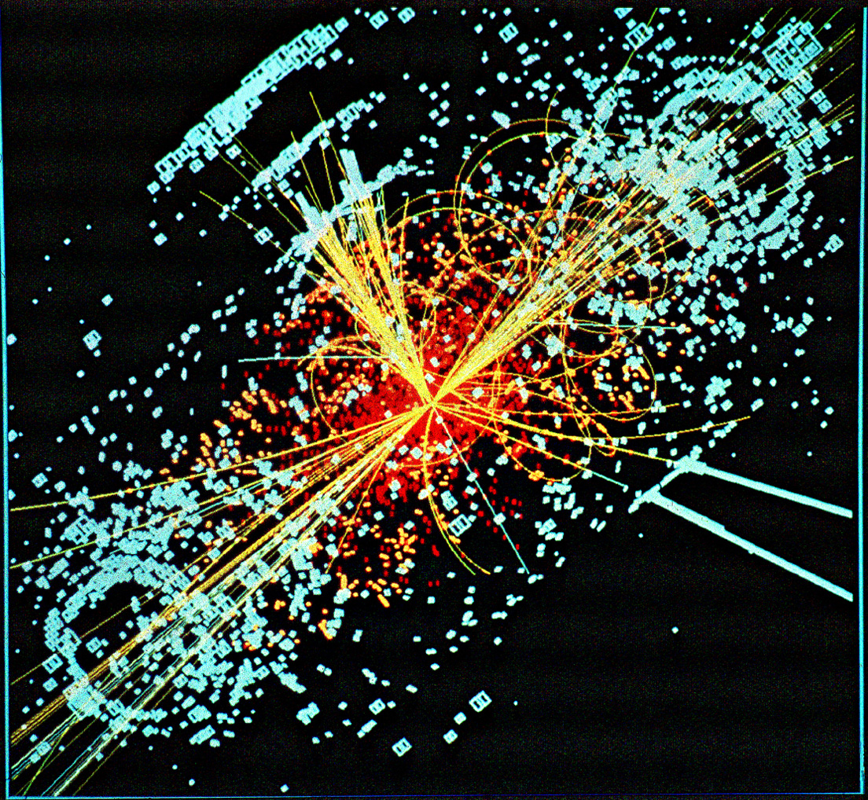
CERN
European Organization for Nuclear Research

Slide 17
Different layers in the detector

Slide 18
Towards unification ?

Slide 19
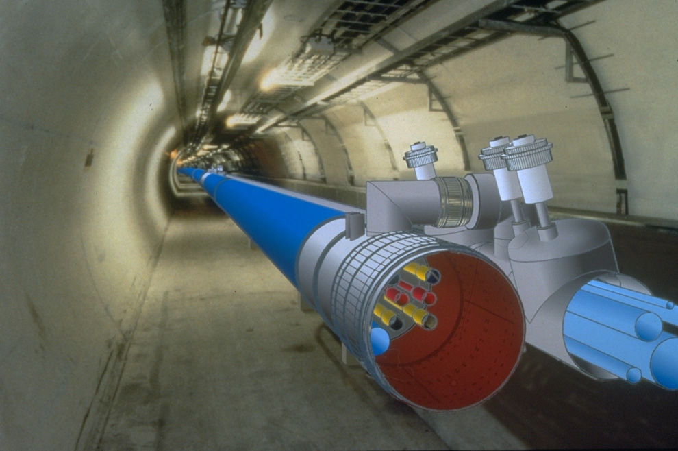
LHC model

Slide 20
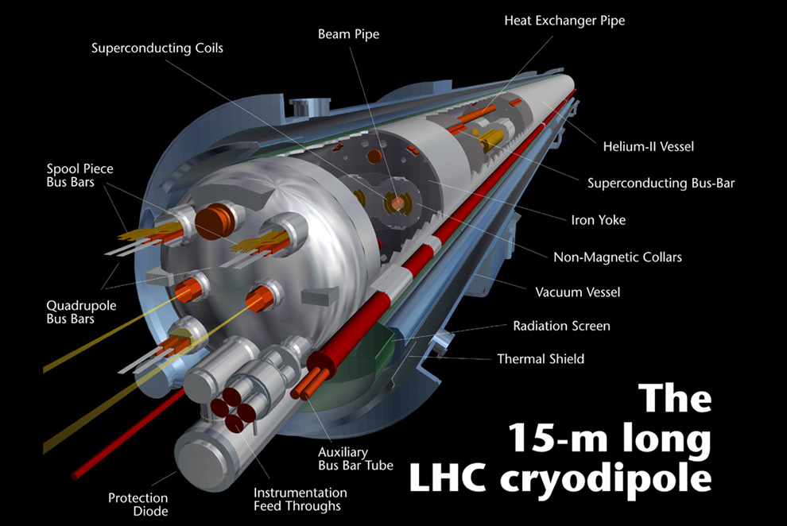
LHC dipole
CERN
European Organization for Nuclear Research

Slide 21
Approved Construction Projects
Linac4 : Approved in 2007 as a replacement to Linac2
Energy 160 MeV (cf 50 MeV in Linac2) Doubles the space charge tune shift limit at injection into the booster
H- Injection : CERN is one of the few labs still using protons
Construction well underway – Installation and Commissioning 2013-2014
Connection to PSB depends on finding a ~7 month shutdown of LHC after 2014.
HiRadMat: Materials testing Facility
Needed for LHC robustness tests – collimators etc. but generally useful.
Installation complete, initial commissioning underway.
Elena: Extra Low-Energy Antiproton ring
Post decelerator, downstream from AD
Momentum at extraction 13.7 MeV/c (Energy 0.1 MeV)
~15MCHF Materials cost + 70 MY (Men-Years)
HIE-Isolde: Energy Upgrade for Radioactive beam Post-Accelerator
Initial upgrade to 5.4 MeV/u (in 2015), Final Energy 10 MeV/u around 2018
Construction of ¼–wave cavities, cryostats and cryogenic plant for the Linac.
35MCHF total budget with ~1/2 from external sources (17.7 MCHF cost of linac)

Slide 22
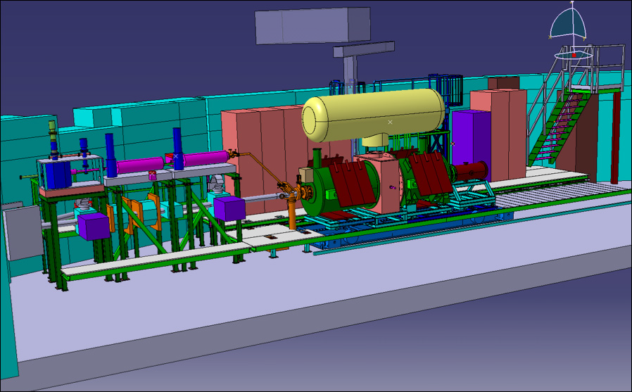
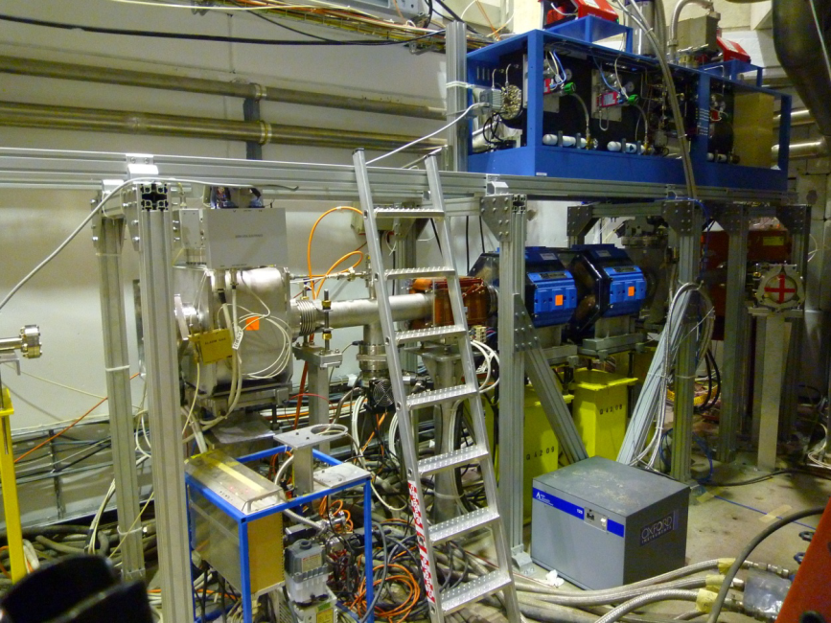
AD Highlights
AD = Antiproton Decelerator
4866 hours of physics
Beam availability: 76%, AD uptime: 82%
Good progress towards microwave spectroscopy of trapped anti-hydrogen at ALPHA
First beams delivered to the new AEgIS experiment (antimatter gravitational studies)
22

Slide 23
Future projects
Neutrinos:
LOI presented to SPSC to re-construct the PS Neutrino facility
Laguna Study starting up (EU) for a future Long baseline facility
Combination of these into one facility will also be studied
Activities on Beta Beams and Neutrino Factories continuing …
Novel Acceleration Research: Proton driven Plasma Wave Acceleration:
EUROnnac setup as a network for plasma acceleration, beam and laser
LOI submitted to SPSC
CERN Unique in having a high energy (450GeV) proton beam available
High stored energy in the beam– 100x more than SLAC e- facility
Demonstrate acceleration of an electron beam using proton drive beam
LHeC : 60/120GeV e+- on 7TeV Protons. Strongly supported by ICFA
Ring-ring and linac-ring options
Both written up (with the physics) in a conceptual design report
If agreed to continue, choice of option and directed R&D will be needed.

Slide 24
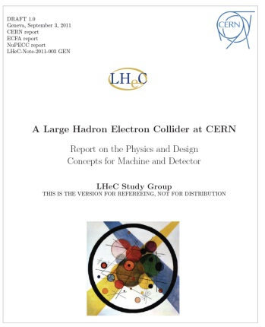
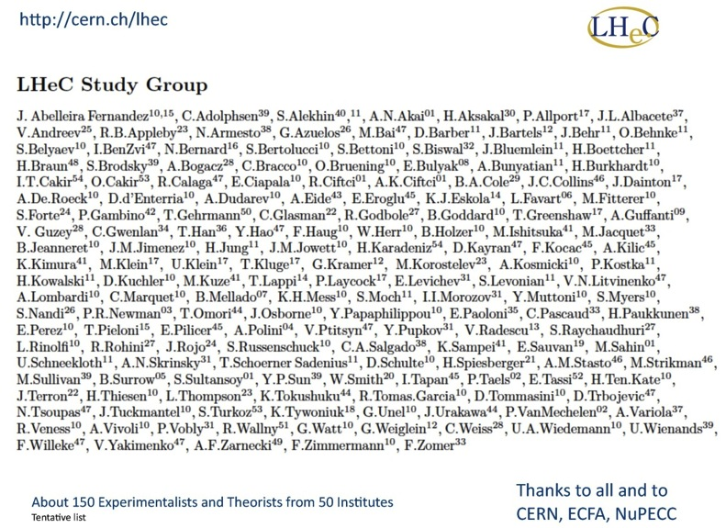
Large Hadron electron Collider (LHeC)
Draft LHeC CDR completed (~600 pages)
TDR by 2014,
Could have first beam by 2022

Slide 25
What is a fb⁻¹ ?
The number of events for a particular type of event is given by:
Number of events = L x σ_{event}
σ_{event} is the likelyhood of producing a particular event
L is a measure of the total number of interactions
The unit of the cross-section (σ_{event}) is the barn (1 barn = 10⁻²⁸m²)
1mb = 10⁻³¹m²
1μb = 10⁻³⁴ m²
1nb = 10⁻³⁷ m²
1pb = 10⁻⁴⁰ m²
1fb = 10⁻⁴³ m²
If the Cross-section to produce a given event is 1fb then we would need 1fb⁻¹ of data to get 1 event!!
5.6 fb⁻¹ of data represents: ~400 million million collision events (4x10⁺¹⁴) of which approximately:
100 million produce W and Z’s
1 million top quark events
20,000 Higgs … if it is there!
… a needle in a haystack

Slide 26
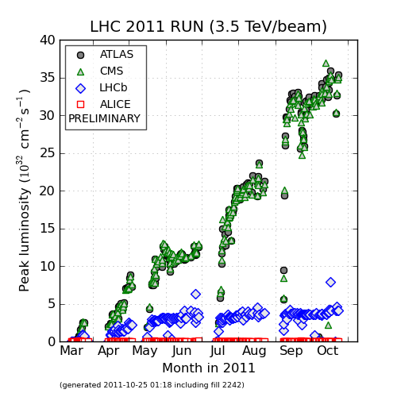
Proton Luminosity in 2011
Peak luminosity
β* 1 m
Reduce ε,
increase N
3.6×10³³ cm⁻²s⁻¹
1380 bunches
LHC operation highlights
50 ns
increase k
increase N
Stored Energy in each beam >100MJ
75 ns
LHCb luminosity limited to ~3.5×10³² cm⁻²s⁻¹ by leveling (beams collide with transverse off

Slide 27
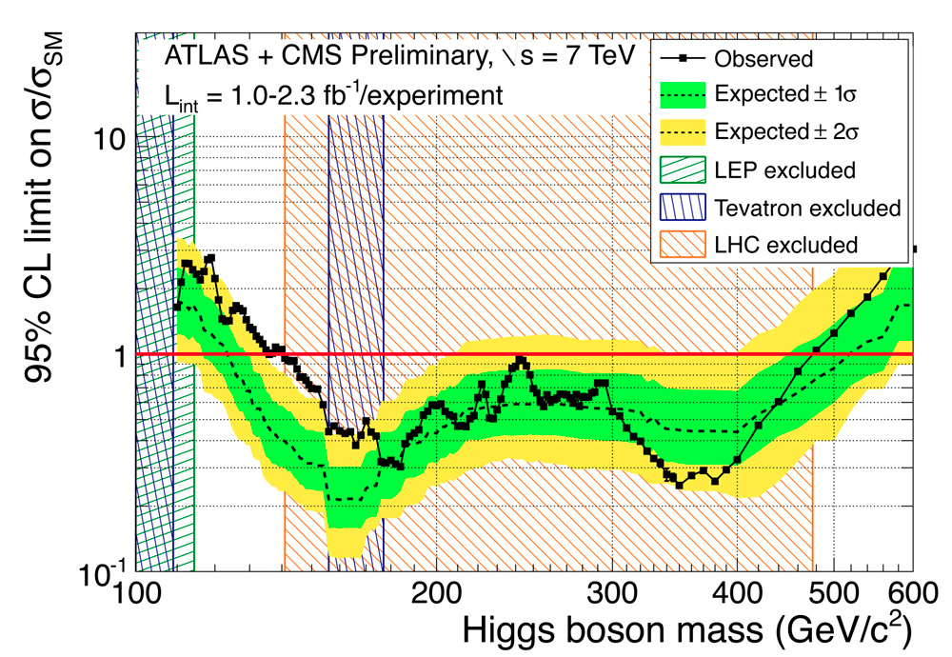
Higgs boson ?
Preliminary results at the end of 2011

Slide 28
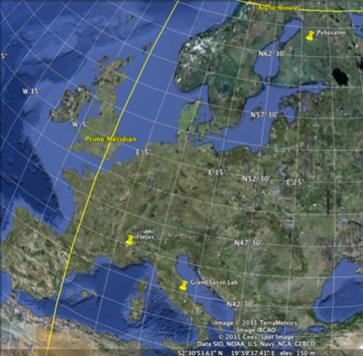

ν-Beams: Long Baseline options from CERN
Laguna design Study 2011-2014 - Large underground detectors
CN2PY (Pyhasalmi)
Initial : beam from SPS (500kW - 750kW)
Long term: LP-SPL + HPPS - 2MW
2300 km
CERN
130km
730 km
CN2FR (Frejus)
HP-SPL + accumulator ring (5 GeV – 4 MW)
CNGS - Umbria
Beam from SPS (500kW)
Synergy with β-beam (γ=100)
28

Slide 29
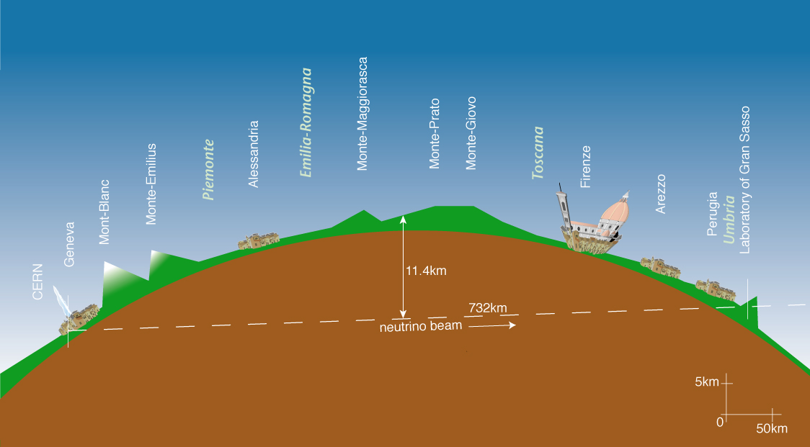
CERN Neutrino to Gran Sasso
CNGS

Slide 30
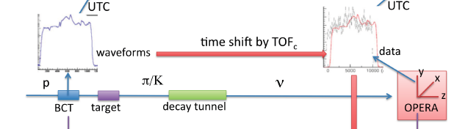
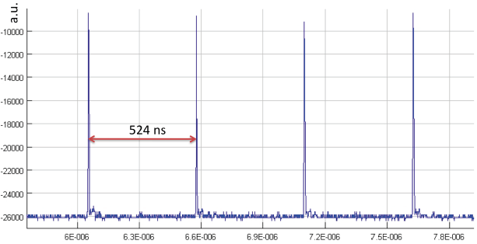
Neutrino faster than light?
CNGS activities as a consequence of the OPERA results on the neutrino velocity measurements
CERN GPS
LNGS GPS
→δt=57ns
10500ns
horns
muon detectors
CNGS nominal beam is 10500ns long
  A lot of statistics needed for time of flight analysis
  Many possible systematic effects along the secondary beam line
→ Send LHC type bunched beam to CNGS
  Precise timing of each neutrino interaction
  Many systematic effects excluded
  - bunched beam was set up very efficiently
  - operation from 21 Oct to 6 Nov 2011
  - 4 bunches, each 2ns long, separated by 524ns
  → Results included in final OPERA paper
δv = (x₂- x₁) / (t₂ – t₁)
524 ns
Courtesy E. Gschwendtner

Slide 31
Summary
Higgs or not Higgs boson ?
Neutrino faster than the light ?
96 % of the mass of the Universe unknown ?
Future is very exciting for the Sciences and for young scientists

