Slide 1
Pulsed Modulators
Concepts and trade-offs
David Nisbet
  CERN

Slide 2
Intro
Modulator specification
  Criteria and concepts
Modulator design
  Topology selection
  Commercial v in-house
  Prototyping
Conclusion

Slide 3
RF Powering
The RF specification – starting point for modulator
  example from ESS requirements
 | RFQ+DTL 352MHz | Spoke 352MHz | Elliptical 704MHz low-Beta | Elliptical 704MHz high-Beta
Max power/klystron | 2.6MW | 400kW | 700kW | 1100kW
Min power/klystron | 1.2MW | 130kW | 65kW | 700kW
Beam time | 2.9ms
Cavity fill+empty time | 0.3ms + 0.3ms
Repetition rate | 14Hz
Klystron efficiency | 58% | <60% | <60% | 60%
Phase precision | 0.5°
Nb of klystrons | 4 | 28 | 64 | 120
Max energy of arc | 20 J

Slide 4
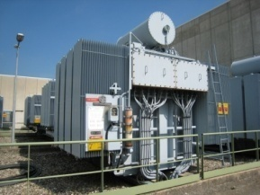
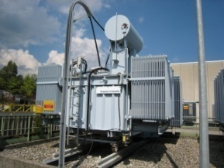
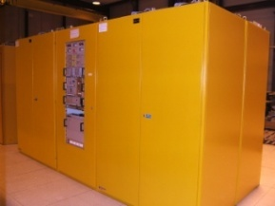
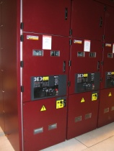
Pulsed v CW
Why a pulsed modulator?
  LEP 4MW CW Modulator: 250 m³
(4 MJ/s)
  ESS 4.5MW Pulsed Modulator: ~35 m³
(>200kJ/s)
  LINAC4 5MW Pulsed Modulator: 7 m³
(20kJ/s)

Slide 5
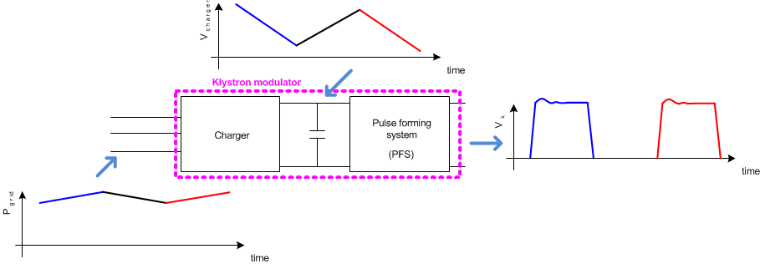
Pulsed Modulators
Can be separated into three principle sections
  AC/DC ‘Charger’
  Energy storage
  Pulse Forming system

Slide 6
Pulsed Modulators
Pulse definition
Sources of energy loss:
t_set for LLRF and modulator
t_rise and t_fall
reset of pulse transformer (if used)
t_beam + t_fill + t_empty

Slide 7
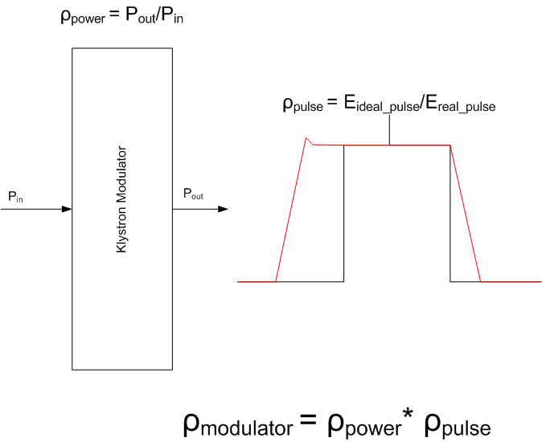
Pulsed Modulator Efficiency
Useful flat-top Energy | 4.5MW*3.5ms = 15.8kJ
Rise time energy | 4.5MW*300μs*1/3= 0.45kJ
Fall time energy* | 4.5MW*300μs*1/3= 0.45kJ
Set-up time energy | 4.5MW*300μs = 1.35kJ
Pulse efficiency | 0.88
Pulse forming system efficiency | 0.98
Charger efficiency | 0.96
Power efficiency | 0.94
Overall Modulator efficiency | 80%
*Does not include pulse transformer magnetizing energy
Modulator can optimize electrical systems
  however greatest efficiency savings from RF pulse optimization (eg klystron efficiency, control overhead, setup time, etc)

Slide 8
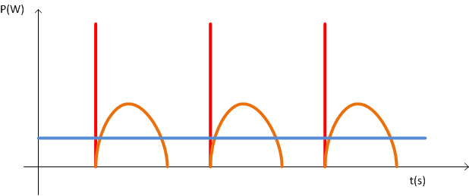
Power from distribution network
Modulator charging is usually completed before the output pulse generation.
  This will induce power fluctuations on the power network, affecting distribution power quality.
A large modulator installation should implement a constant power load consumption with good power quality.
Strategies for startup and shutdown should also be considered to limit load transients
Pin_modulator_typical
Pout_modulator
Pin_modulator_ideal
Pin_modulator_ideal
Pin_modulator_typical

Slide 9
Reliability and availability
For large installations, availability is an important criteria
  Reliability typically specified as Mean Time Between Failure (MTBF)
  Repair time defined as Mean Time To Repair (MTTR)
  Availability as a function of reliability and time to repair:
  Modular systems may have lower MTBF but higher availability due to redundant architectures that significantly reduce the MTTR. In many cases, repair can be scheduled for a future date.
  Repair time can be significant for high voltage systems unless considered at the design stage (oil, large components, etc).

Slide 10
Modulator specification
Maximise charger efficiency and power quality
  Objective: better than 95% efficiency with near unity power factor and low harmonics
Minimise rise, fall and settling time
  Objective for 3.5ms pulse: less than 750us total for rise, fall and setup time
Maximise operational reliability and availability
  Objective: design for 99.8% availability (1hour intervention every 14 days)
Design for good pulse-to-pulse voltage reproducibility
  Objective: 100ppm (?) from pulse_{n-1} to pulse_{n} (RF feedback gives long term performance)
Consider integration issues (machine layout, maintenance, etc)

Slide 11
Modulator specification
Other important specifications to consider
Voltage ripple requirement will come from LLRF requirements
  Requires to be specified in frequency and amplitude (typically 0.1%)
Parallel connection of klystrons
  Verify sharing/balancing for several klystrons per modulator
  However already done in SNS using LLRF
Operation over a wide power range required
  Pmax ≥ 10x Pmin
  Light loading may preclude some topologies (eg bouncer)
  Connection of systems in parallel will resolve most issues

Slide 12
Modulator for RF Powering
The following parameters follow from RF specification…
  example from ESS requirements
Max power/modulator | 4.5MW
Min power/modulator | 65kW ?
Nominal voltage | 110 kV
Flat top (fill + beam time + empty) | 3.5 ms
Rise/fall time | 0.3 ms / 0.3ms?
Repetition rate | 14Hz
Droop | 1% ?
Voltage Ripple (magnitude and frequency) | 0.1% above 10kHz ?
Nb of modulators | ~110
Max energy delivered to arc | <10 J
MTBF | 100 000 hrs ?
Availability | 99.8 % ?

Slide 13
Modulator topology overview
5 topologies highlighted
Topologies known to already operate with long pulse applications
Future topologies thought to be well adapted to long pulse applications
Assessment of some advantages and disadvantages of each topology
Some topologies in the market are a mix of more than one concept
I do not claim this list is exhaustive!

Slide 14
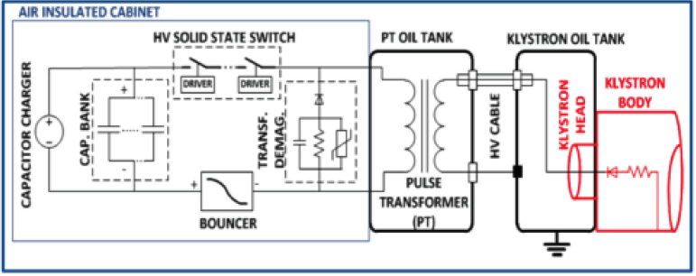
Bouncer and pulse transformer
Charger: Classical resonant topology for charging the capacitor.
Storage capacitor: The pulsed power is collected by an intermediate storage capacitor before being transmitted through the switch.
Switch: High voltage, high current solid state switch.
Pulse transformer: The pulse is generated at high current lower voltage at the primary side of the pulse transformer.
Voltage droop compensation: Voltage compensator for the droop occurring in the storage capacitor during the pulse discharge.

Slide 15
Bouncer and pulse transformer
Used by:
  Fermilab (Tevatron)
  CERN (LINAC4)
  Pulse transformer size scales with voltage and pulse width
  Primary voltage and current is mainly determined by switch technology, capacitor volume, transformer design
  Oil volume (transformer): ~800 litres

Slide 16
Bouncer and pulse transformer
Advantages
The power circuit is simple and reliable.
All electronic active devices are at medium voltage level
No voltage ripple on the flat-top
Disadvantages
Large pulse transformer and LC resonant bouncer volume for long pulses
Limited sources for pulse transformer
Slow rise and fall times
Reverse voltage on the klystron to demagnetize the pulse transformer limits the duty cycle

Slide 17
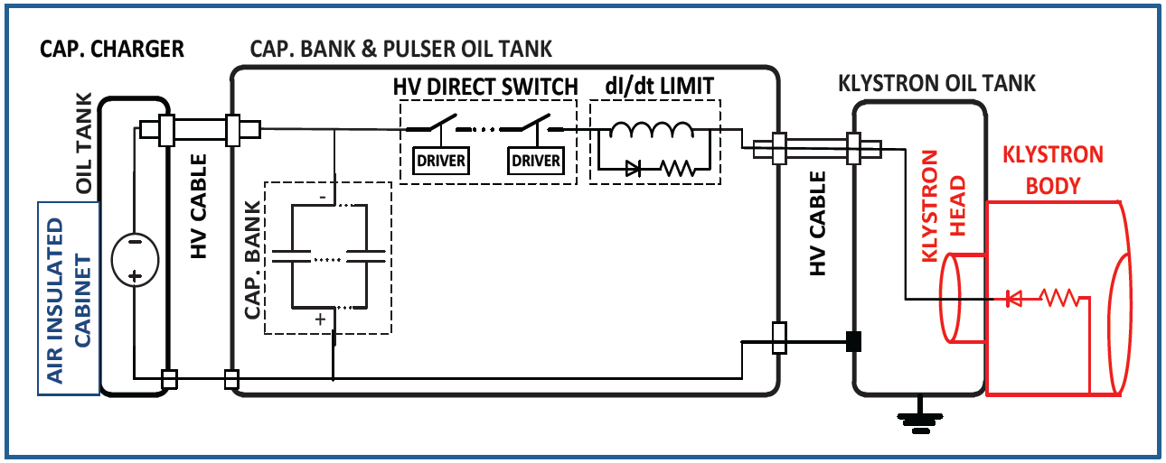
Direct switch
Charger: Very high voltage capacitor charger.
Storage capacitor: Capacitors rated for the full voltage. Very high energy storage.
Switch: Full rated voltage slid-state switch.
Voltage droop compensation: None. The droop is determined by the capacitor bank size.

Slide 18
Direct switch
Other accelerator users
  RAL
  APS
Modulator oil volume: ~2000 litres

Slide 19
Direct Switch
Advantages
Fast rise/fall times
Large range of pulse lengths and pulse repetition rate
No reverse voltage (no pulse transformer)
Relatively compact due to most parts being in oil
No voltage ripple on flat top
Disadvantages
All components immersed in oil, problematic for operation
Reliability in arc is entirely dependent on switch
100kV IGBT switch assembly required (not widely available)

Slide 20
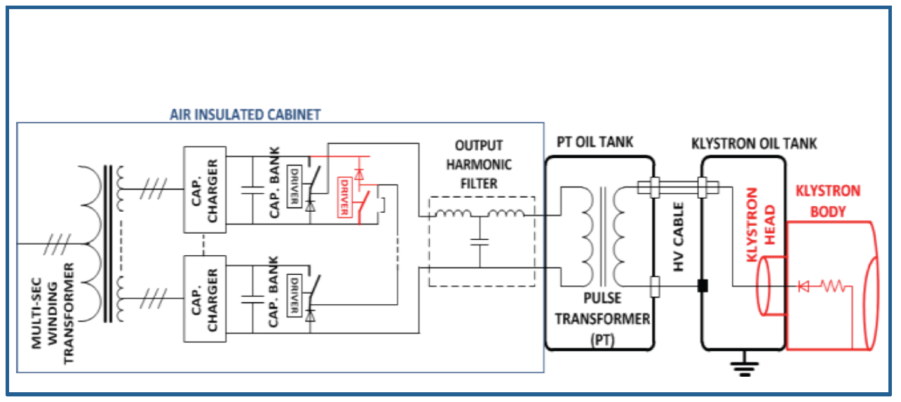
Interleaved DC/DC
Charger: Distributed across many smaller modules. Connected to multi-secondary winding interface transformer (also possible to have multiple primaries)
Storage capacitor: Smaller ~1kV rated capacitors distributed across many modules.
Switch: Standard solid-state switch.
Voltage droop compensation: Can operate without compensation, or by using a pulse-modulation technique to obtain desired output characteristics.

Slide 21
Interleaved DC/DC
Used by
  DESY (XFEL)
Oil volume (transformer): ~800 litres

Slide 22
Interleaved DC/DC
Advantages
Active demagnetization of the pulse transformer possible
Intrinsic active droop compensation
Active klystron arc extinction possible
All electronics at medium voltage
Disadvantages
HF ripple in flat-top
Thermal cycling of semiconductors in hard switching
Two special transformers (input and output)
Large pulse transformer for long pulses
Limited sources for pulse transformer

Slide 23
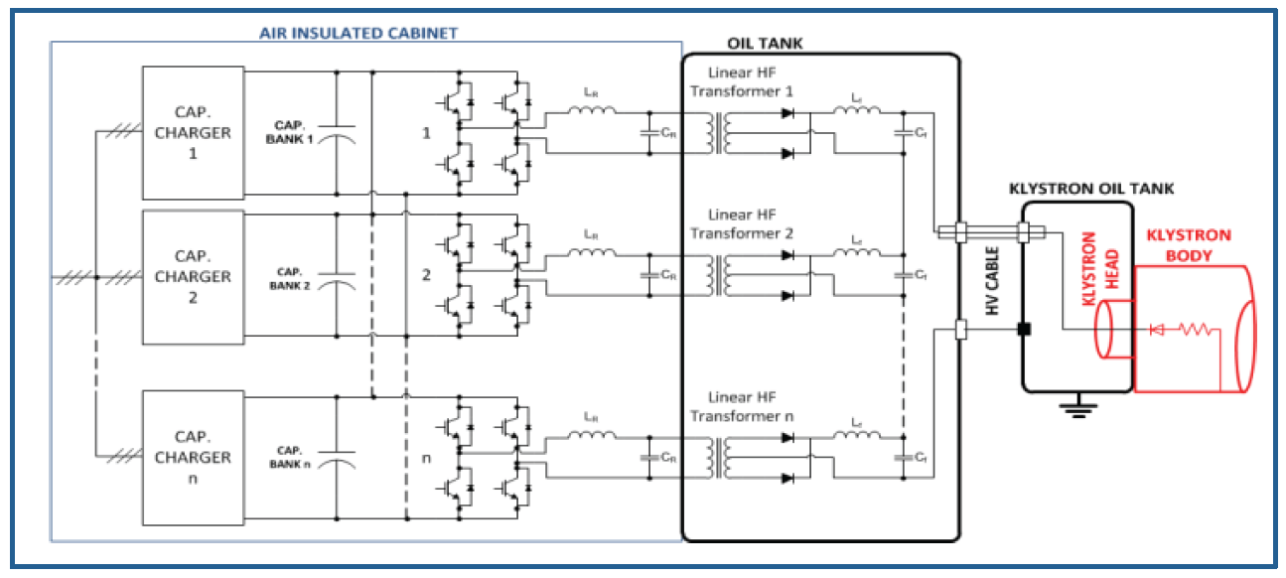
Multiple Resonant DC/AC/DC
Charger: Distributed across many smaller modules.
Storage capacitor: Smaller capacitors distributed across many modules.
Switch: Standard solid-state switch.
Voltage droop compensation: Flat-top control is inherent in topology

Slide 24
Multiple Resonant DC/AC/DC
Used by
  SNS
Oil volume (transformer): not yet known

Slide 25
Multiple Resonant DC/AC/DC
Advantages
All electronics at medium voltage
Standard semiconductor switches
No demagnetization required
Intrinsic active droop compensation
In klystron arc the resonant circuits become de-tuned
Modular
Disadvantages
High frequency transformer design difficult
Reactive power in H-bridges (some over-rating required)
Relies on IGBT soft switching but this is complex
Ripple on flat-top – to check if it meets reproducibility requirement

Slide 26
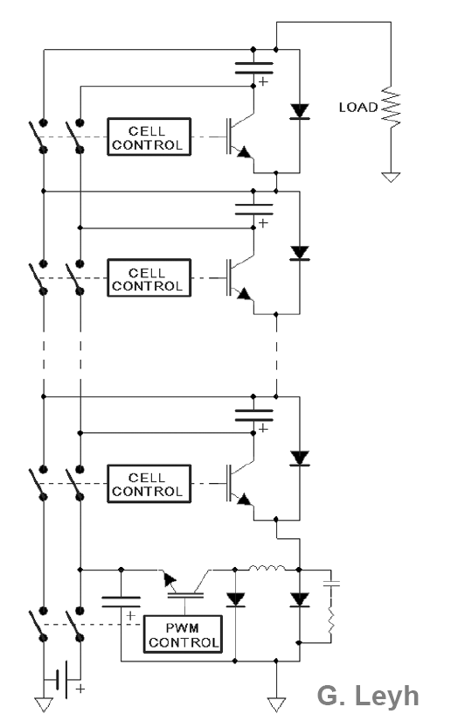
Solid State Marx
Developed for ILC project
Several years of development already completed
Charger: Normally main charger for all systems.
Storage capacitor: Capacitors distributed across many modules.
Switch: Standard solid-state switch in each module.
Voltage droop compensation: Flat-top control using switch-mode stage – creates a low amplitude ‘sawtooth’ waveform

Slide 27
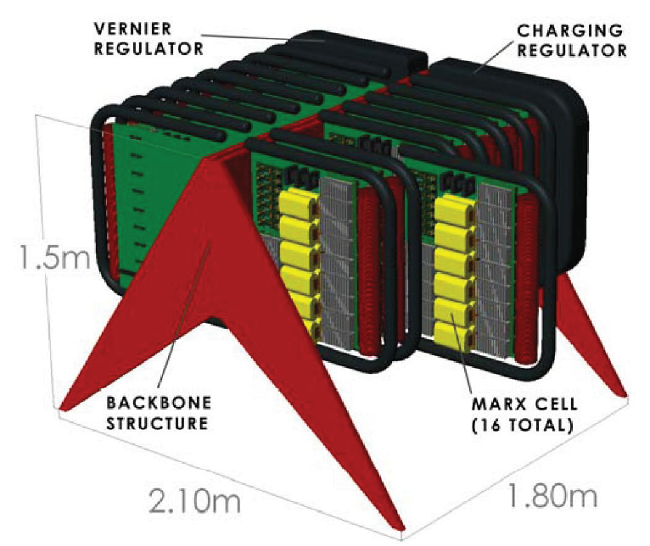
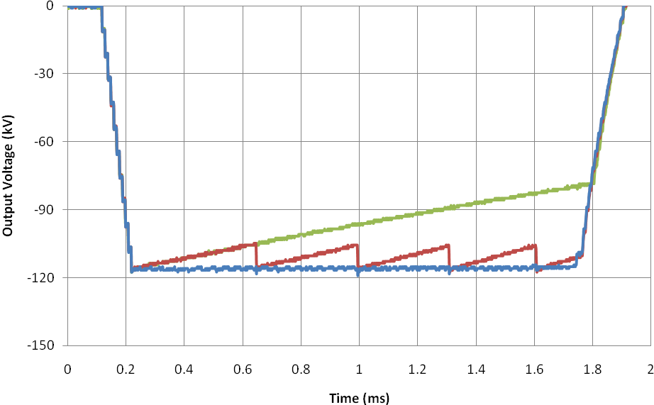
Solid State Marx
Used by
  SLAC (advanced prototype only)
Oil volume: none
120 kV, 140A, 1.6 ms, 5 Hz

Slide 28
Solid State Marx
Advantages
No oil or pulse transformer
Standard semiconductor switches
Intrinsic active droop compensation
Low arc energy due to fast turn-off
Modular and fault tolerant solution
Development almost complete
Potential to license design from SLAC?
Disadvantages
Fairly complex
Electronics are at high voltage (EMC issues)
A lot of silicon (cost?)
To be validated for (even) longer pulses

Slide 29
Cost Comparison
See some cost scaling rules presented previously
The cost of each solution should align for industrial production quantities
  Resonant topology has additional R&D costs compared to other solutions
Modular systems may benefit additionally from increased quantities
Topology | Comment
Bouncer | Conventional technology; Pulse transformer;
Direct Switch | Simplest solution; Proprietary technology;
Interleaved DC/DC | Modular; Conventional semiconductors; Special transformers;
Resonant DC/AC/DC | Modular; Conventional semiconductors; Special transformer;
Marx | Modular; Conventional semiconductors;

Slide 30
‘Spoke’ Modulators
Tetrodes and IOTs are being considered for the lower power spoke cavities, potentially several powered from the same modulator
Modulators for these generally use DC electrical power
  The power source is essentially the front half of a pulsed modulator (without pulse forming system)
  IOT’s now widely used in TV signal transmission
  Associated CW technology well proven
IOT’s and tetrodes typically operate between 10kV and 50kV
  Should be straightforward to find technical solution for powering of tetrodes/IOTs
  However important to ensure reliability and availability (and hence modularity) is considered as part of the technical solution
Typical IOT Electrical Circuit
A
RF
OUT
+
H.V supply
e.g. -36 kV / 3.2 A
_
- +
Grid supply
e.g. 150 V / 250 mA
-
Heater supply
e.g. 12V / 25 A
RF
IN
+
P Sanchez, ALBA

Slide 31
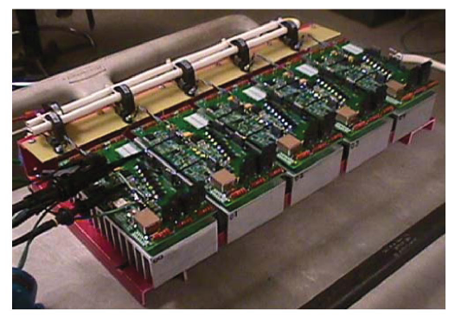
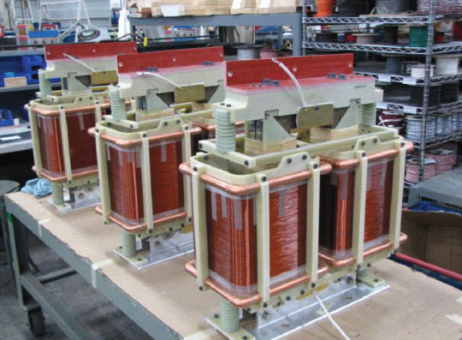
Modulator R&D
As with any project, several phases to consider
  Ensure you get what you want!
    Project management is a critical aspect to develop appropriate specifications and make prudent compromises where necessary
  Develop specific technologies (eg transformers, inverters, etc)
    Requires knowledge of HV, electromagnetics, semiconductors,…
    Domain for experts: designers, teams and companies
  Validate full scale prototype
    Requires general knowledge of complete RF system
    Develop system level electronics and software
    Initial modulator testing on a passive High Voltage load
    Subsequent testing on a klystron (without cavity)
    Final validation in compete mock-up

Slide 32
In-house v commercial development
In-house development allows facility to confidently maintain and operate equipment for the long term
  Enables personnel to be highly knowledgeable of technology in operation
  Requires investment in people and test facilities
Commercial development is protective of intellectual property and prefers ‘black box’ approach
  Can be problematic for long term operation of specialized equipment
  However ability to optimize design and cost for production facilities
LHC R&D and production model
  Impose topology (you need to know which one…)
  Allow companies to develop specific (optimized) solutions
  Competitive tender on validated prototypes
  All design data made available to buyer to allow long term support

Slide 33
Modulator and RF optimization
Further activity is encouraged to fully identify the complete RF system
  At the design stage, the transfer function for the RF High Power system should also include a model of the klystron and modulator
    Allows certain specifications to be refined and optimized
  Typically attention is given to the RF resonant frequency
    However the modulator and other components will generate perturbation (if any) in a lower frequency band
  Some activity is starting at CERN and SLAC to identify LINAC4 and CLIC type klystron structures
    Every RF system is likely to be different

Slide 34
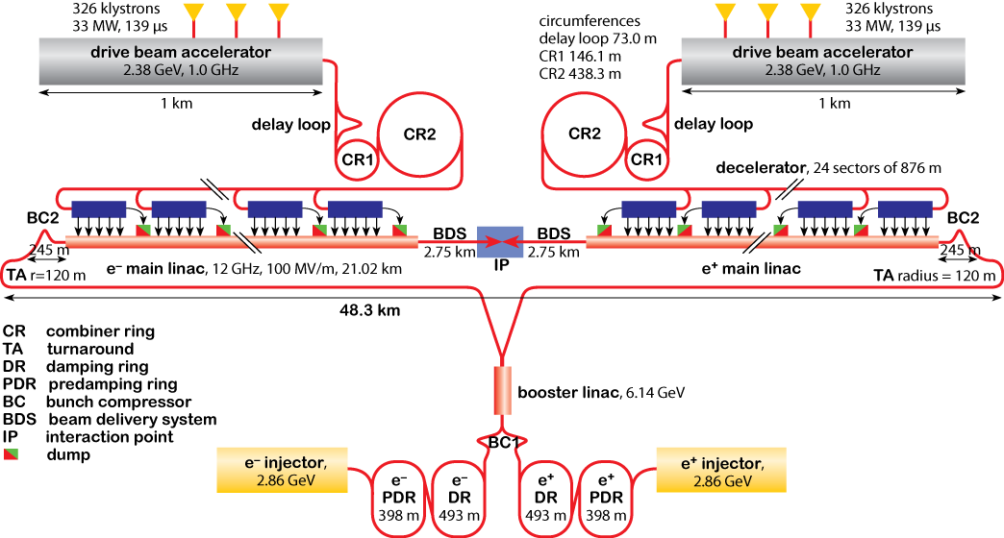
CERN CLIC Modulator Development
Challenging project with stringent specs for modulators
  Some issues common to other accelerator projects
R&D will be conducted in several centers, coordinated by CERN
Intend to evaluate at least 2 different topologies as part of TDR phase
~1600 klystron Modulators required here
2-3 years of R&D at component and sub-assembly level
2-3 years to construct and test full scale prototypes
Regular workshops with collaboration participants to share and direct progress

Slide 35
Modulator development efforts
The following labs have made, or are making, progress on modulator technology
  SLAC (ILC)
  CERN (CLIC)
  DESY (XFEL)
  Los Alamos (SNS)
While each project has specific requirements, there are many common technical challenges
The many large linear collider studies ongoing today would benefit from a coordinated approach to the modulator development
The ESS requirements for long pulse modulators is larger than all previous projects combined
  Opportunity to interact with international modulator community
  Needs an ESS representative/team to follow progress

Slide 36
Conclusion
The ESS modulator requirements represents a greater financial investment than the power systems for the entire LHC!
  The LHC powering was a 10year project from conception to installation
  Due to good concept and design, excellent availability of power systems
Experience from other large installations, such as SNS, identify the modulator as one of the key reliability/availability drivers
Development time for new systems is significant
  Both SNS and ILC developments for long pulse modulators have taken >5yrs
The modulators are a significant cost driver in long pulse LINACS
  It is in the interest of large LINAC projects to have a dedicated modulator team
The proposed strategy for initial construction with a conservative modulator design seems sensible
  For subsequent phase, recommend considering 2 (or more) alternative topologies

Slide 37
Thankyou

