Slide 1
RF Power Generation With Klystrons amongst other things
Dr. C Lingwood
Includes slides by Professor R.G. Carter and A Dexter
Engineering Department, Lancaster University, U.K.
and
The Cockcroft Institute of Accelerator Science and Technology

Slide 2
Basic Klystron Principals
Existing technology
Underrating
Modulation anodes
Other options
  IOTS
  Magnetrons

Slide 3
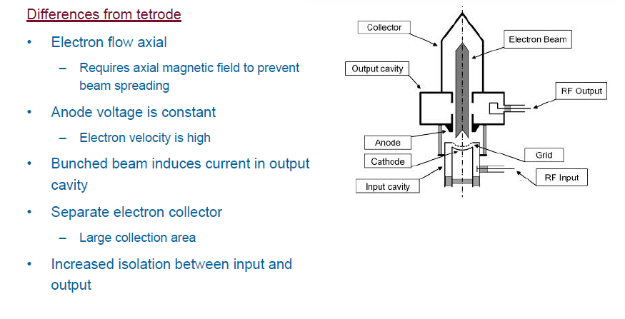
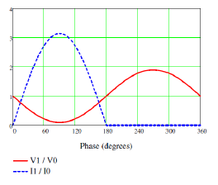
IOT

Slide 4
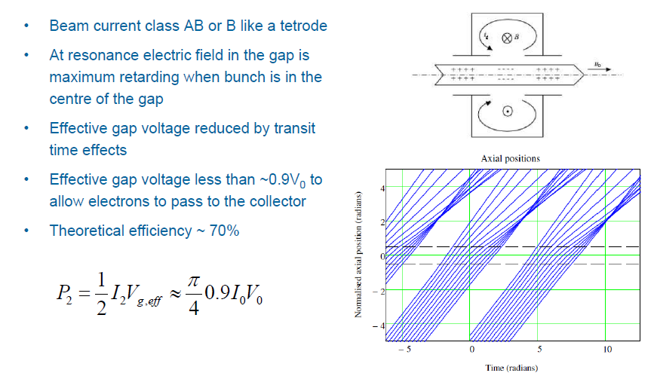
IOT Output gap

Slide 5
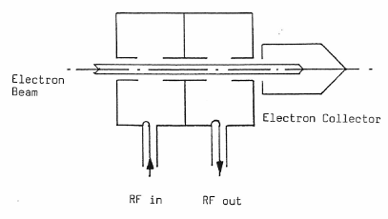
Velocity modulation
An un-modulated electron beam passes through a cavity resonator with RF input
Electrons accelerated or retarded according to the phase of the gap voltage: Beam is velocity modulated:
As the beam drifts downstream bunches of electrons are formed as shown in the Applegate diagram
An output cavity placed downstream extracts RF power just as in an IOT
This is a simple 2-cavity klystron
Conduction angle = 180° (Class B)

Slide 6
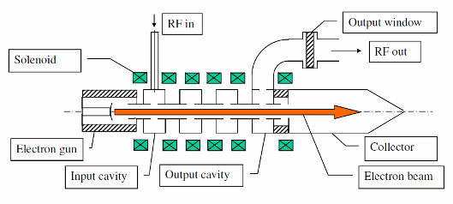
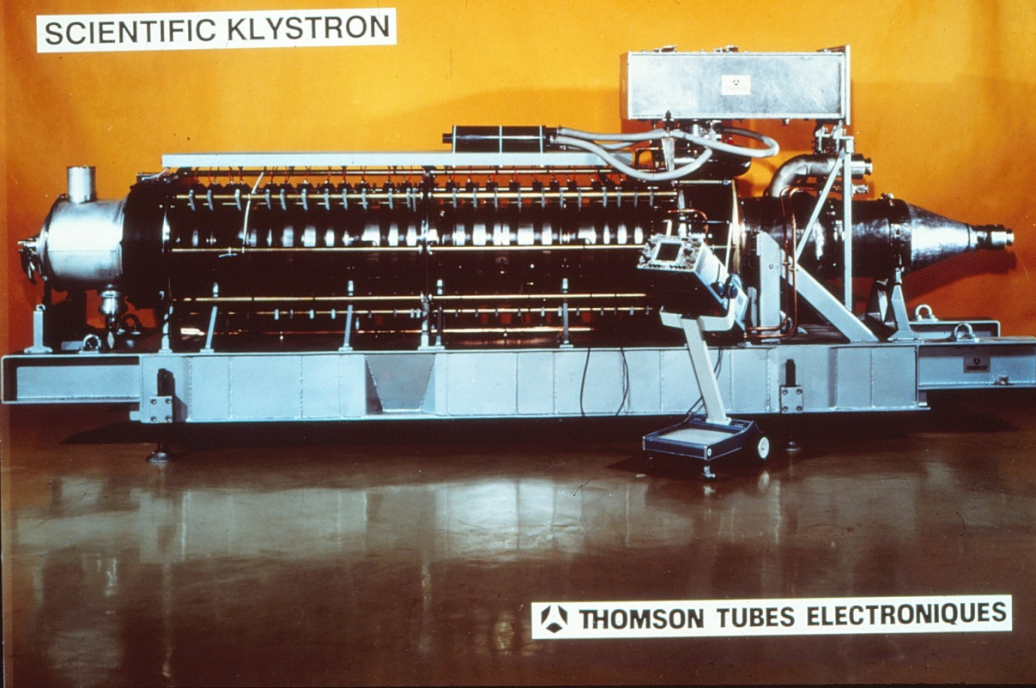
Multi-cavity klystron
Additional cavities are used to increase gain, efficiency and bandwith
Bunches are formed by the first (N-1) cavities
Power is extracted by the N^{th} cavity
Electron gun is a space-charge limited diode with perveance given by
K × 10⁶ is typically 0.5 - 2.0
Beam is confined by an axial magnetic field
Photo courtesy of Thales Electron Devices

Slide 7
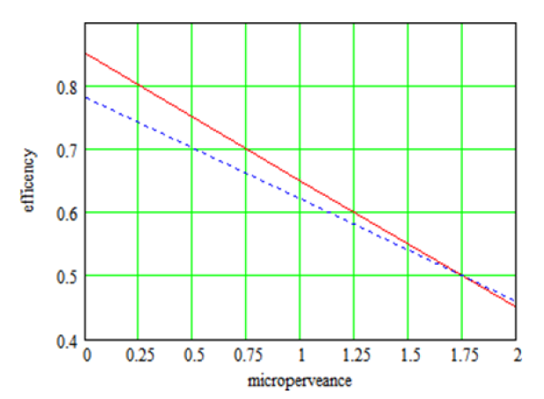

Efficiency and Perveance
Second harmonic cavity used to increase bunching
Maximum possible efficiency with second harmonic cavity is approximately

Slide 8
Typical Applegate diagram
2nd Harmonic
Distance and time axes exchanged
Average beam velocity subtracted
Intermediate cavities detuned to maximise bunching
Cavity 3 is a second harmonic cavity
Space-charge repulsion in last drift section limits bunching
Electrons enter output gap with energy ~ V₀
Image courtesy of Thales Electron Devices

Slide 9
2nd Harmonic Cavity
70s Klystron (805MHz 1.25MW) with a detunable second harmonic cavity
  With 2nd Harmonic 57.4%
  Without 2nd Harmonic 52.9%
HIGH PERFORMANCE KLYSTRONS FOR ACCELERATOR APPLICATIONS, By Paul J. Tallerico

Slide 10
Why not 100% Efficient
The simple answer is
  Imperfect bunching
  Can’t remove all energy from beam. Electrons must have residual energy > 0.1V₀ to drift clear of the output gap and avoid reflection

Slide 11
Saturation
Non-linear effects limit the power at high drive levels and the output power saturates
Point of highest efficiency

Slide 12
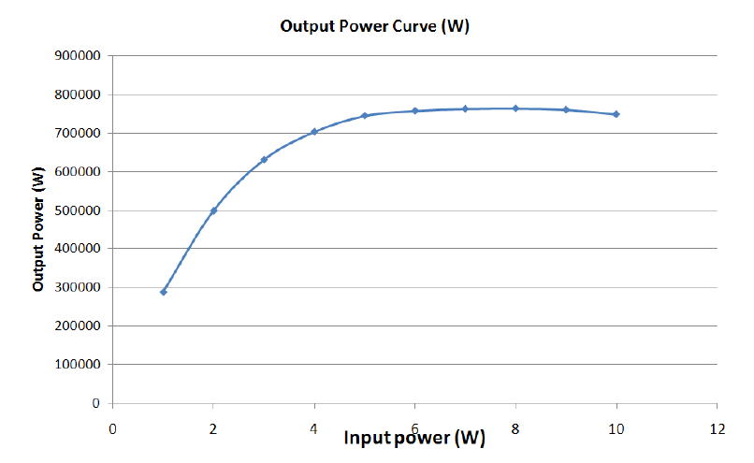
Transfer Curve
Linear region can be far from saturation

Slide 13
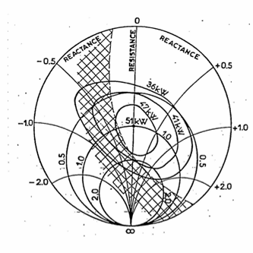
Effect of output match
Reflected power changes the amplitude and/or phase of the output gap voltage
Rieke diagram shows output power as a function of match at the output flange
Shaded region forbidden because of voltage breakdown and/or electron reflection
Output mismatch can also cause:
  Output window failure
  Output waveguide arcs
A Circulator is needed to protect against reflected power

Slide 14
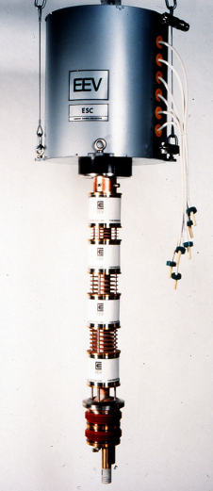
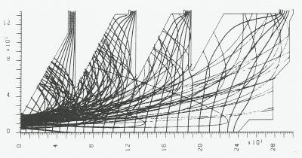
Clever things
Depressed collector
  Decelerate electrons to regain energy
  Complex
  More HV (hold sections at different voltages)
  Better optimised klystron, wider velocity spread
MBK
  Multiple beam klystron
  Complex
  Many eggs in one basket
  No advantage at ESS power level
    Need around 10MW

Slide 15
Klystron performance limited by:
Voltage breakdown
  Electron gun
  Output gap
Cathode current density
Output window failure caused by
  Reflected power
  Vacuum arcs
  Multipactor discharge
  X-ray damage
Heat dissipation

Slide 16
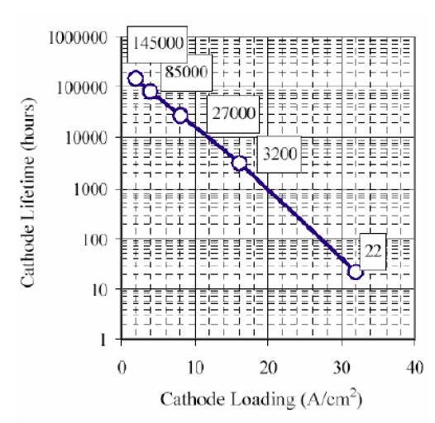
Lifetime
Baring disaster the cathode lifetime can limits the life of the tube.
This is defined by cathode loading in A/cm^2

Slide 17
Multipactor discharge
Resonant RF vacuum discharge sustained by secondary electron emission
One or two surfaces involved
Multiple modes
Signs of multipactor:
  Heating
  Changed r.f. performance
  Window failure
  Light and X-ray emission
Multipactor on dielectric surfaces does not require RF field
Multipactor can sometimes be suppressed by
  Changing shape of surface
  Surface coatings
  Static electric and magnetic fields
Secondary electron emission constants
 | δ_{m} | E_{pm} (Volts)
Copper | 1.3 | 600
Platinum | 1.8 | 800
Carbon black | 0.45 | 500
Aluminium Oxide | 2.35 | 500

Slide 18
ESS Specification
Frequency | 704.4MHz
Peak Output Power | 1.3MW
Beam Voltage | 106kV
Beam Current | 18.9A
Micro-Perveance | 0.548
Gain | 48dB
Duty Factor | 4.9%
RF Pulse Width | 3.5ms
Repetition Rate | 14Hz
Efficiency | 65%
Bandwidth (-1dB) | 4Mhz

Slide 19
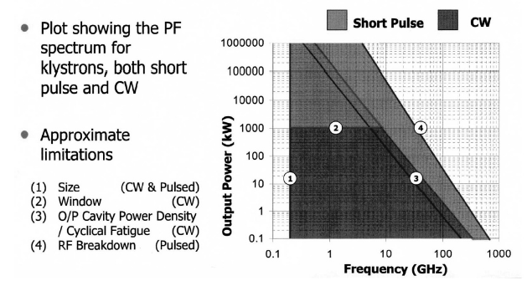
Klystron Technology Limitations

Slide 20
Klystrons: State of the art
CW Klystrons
Pulsed Klystrons
Frequency | 352 | 700 | 3700 | MHz
Beam voltage | 100 | 92 | 60 | kV
Beam current | 19 | 17 | 20 | A
RF output power | 1.3 | 1.0 | 0.5 | MW
Efficiency | 67 | 65 | 43 | %
Frequency | 2.87 | 3.0 | 11.4 | GHz
Beam voltage | 475 | 590 | 506 | kV
Beam current | 620 | 610 | 296 | A
RF output power | 150 | 150 | 75 | MW
Efficiency | 51 | 42 | 50 | %
Note: Breakdown voltage is higher for short pulses than for DC

Slide 21
Existing Klystrons LEDA (e2v K3510L)
 | Design | Measured
Frequency | 700MHz
Cavities | 6
2nd Harmonic | Yes
Pulse Length | CW | CW
Duty | CW | CW
Output Power | 1MW | 1.01MW
Voltage | 95kV | 95kV
Current | 16.5A | 16.3A
Efficiency | 65% | 65.20%
Gain | 40dB | 40.8dB
DESIGN OF A HIGH EFFICIENCY 1 MW CW KLYSTRON AT 700 MHz FOR LOW ENERGY DEMONSTRATOR ACCELERATOR, D. Bowler, LANL

Slide 22
Existing Klystrons SACLAY (CPI VPK 7952B)
 | Design | Measured
Frequency | 704MHz
Cavities | 6
2nd Harmonic | Yes
Pulse Length | CW | CW
Duty | CW
Output Power | 1MW | 1.03MW
Voltage | 95kV | 92kV
Current | 17A | 17.1
Perveance | 0.55 | 0.6
Efficiency | 65% | 66.2
Gain | 40dB | 48.4dB
NEW 1MW 704MHZ RF TEST STAND AT CEA-SACLAY
, S. Chel,

Slide 23
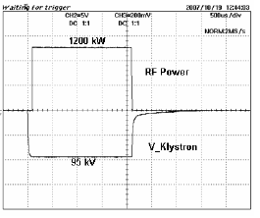
Existing Klystrons SACLAY (CPI VPK 7952C)
 | Design | Measured
Frequency | 704MHz
Cavities | 6
2nd Harmonic | Yes
Pulse Length | 2.2ms | 2.2ms
Duty | 11%
Output Power | 1MW
Voltage | 95kV | 95kV
Current | 17A | 19A
Efficiency | 65%
Gain | 50dB
NEW 1MW 704MHZ RF TEST STAND AT CEA-SACLAY
, S. Chel,

Slide 24
Existing Klystrons SNS (VKP-8291A)
 | Design | Measured (~60 units)
Frequency | 805MHz
Cavities | 6
2nd Harmonic | Yes
Pulse Length | 1.5ms
Duty | 9%
Output Power | 550kW
Voltage | 75kV | 75-77kV
Current | 11.2A
Perveance | 0.54 | 0.51-0.56
Efficiency | 67% | 63%-68%
Gain | 51dB | 50-53dB
Status of the 805-MHz Pulsed Klystrons or the Spallation Neutron Source, S. Lenci

Slide 25
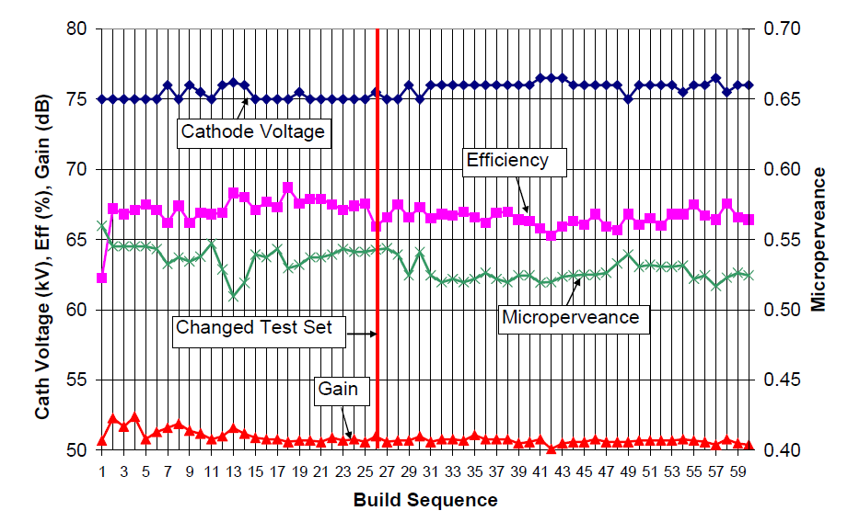
Yields
Status of the 805-MHz Pulsed Klystrons for the Spallation Neutron Source, S. Lenci

Slide 26
Existing Klystrons SNS (VKP-8291B)
 | Design | Measured (~13 units)
Frequency | 805MHz
Cavities | 6
2nd Harmonic | Yes
Pulse Length | 1.5ms
Duty | 9%
Output Power | 700kW
Voltage | 85kV | 82kV
Current | 13.7A
Perveance | 0.55 | 0.55-0.57
Efficiency | 65% | 68-72%
Gain | 50dB | 51-52dB
Status of the 805-MHz Pulsed Klystrons
for the Spallation Neutron Source, S. Lenci

Slide 27
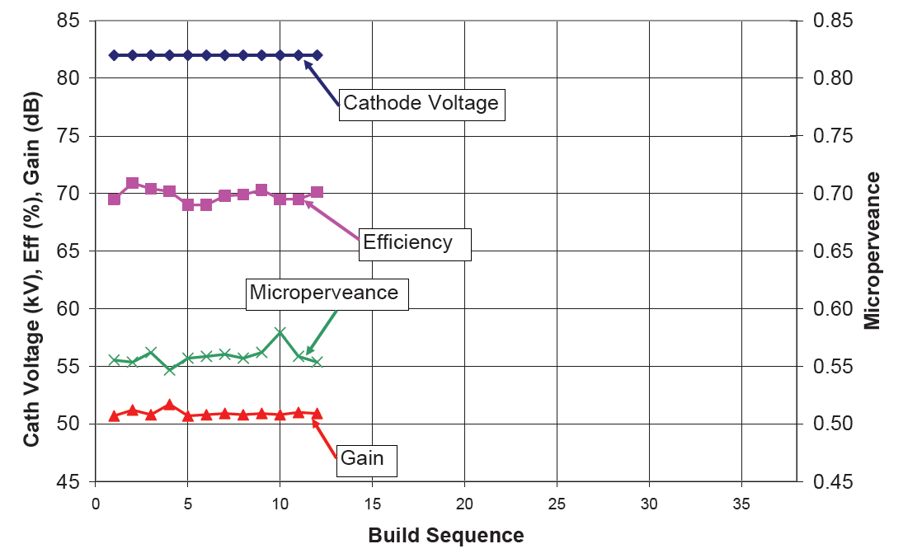
Incremental spec change
Incremental design changes allow the manufacturers to “get their eye in”
Status of the 805-MHz Pulsed Klystrons or the Spallation Neutron Source, S. Lenci

Slide 28
Pulse length
Very long pulse
  In the literature 1.5ms is often described as long pulse.
The klystron is probably OK
  Effectively CW (from the point of view of breakdown)
The modulator is challenging (although...)
  This needs to be thought of (to some extent) as a separate unit.
  Klystron manufactures assume they will get a suitably long pulse with a sufficiently flat top.
  What if you get an insufficiently flat top (or too short a pulse)
    Change in electron velocity (not relativistic enough to ignore)
    Change in output power

Slide 29
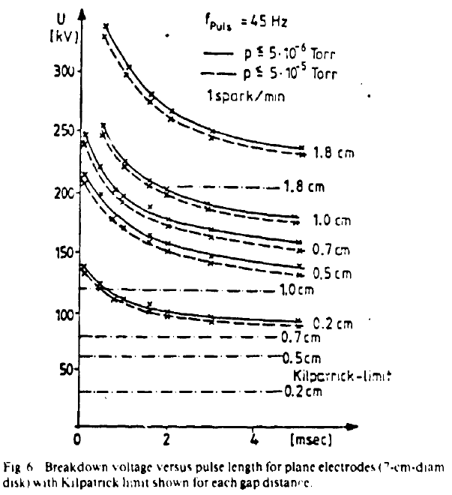
Breakdown vs pulse length

Slide 30
Modulator
Modulators not 100% efficient (this is not included in klystron efficiency)
SPL tested LEP CW Klystrons
    “Measurements were done in view of a possible application in SPL, i.e. at a pulse repetition rate of 50Hz and pulse width of 3ms up to a peak power level of 850kW.”
  Used a tetrode as a modulator
OPERATION OF THE LEP CW KLYSTRONS IN PULSED MODE D. Valuch

Slide 31
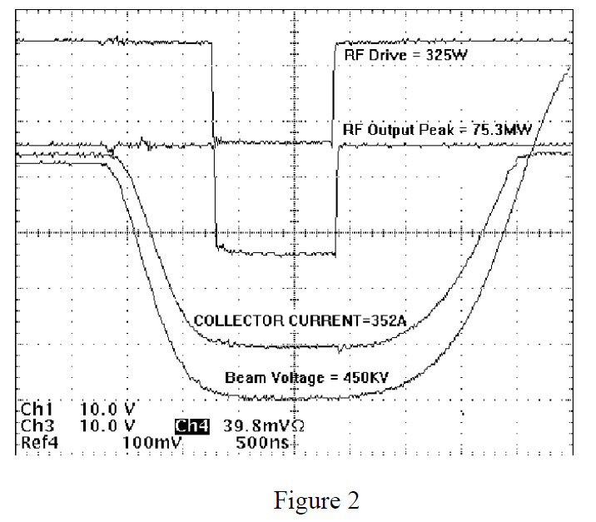
Modulator pulse compared to RF pulse
DEVELOPMENT OF X-BAND KLYSTRON TECHNOLOGY AT SLA, George Caryotakis

Slide 32
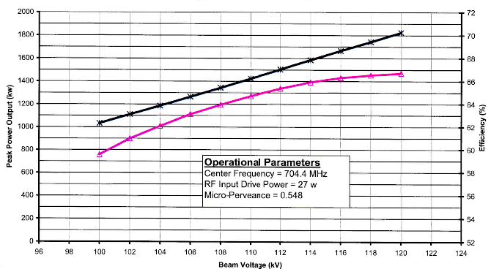
Underrating a tube
You can run a tube at lower powers by lowering the operating voltage (up to a point)
Efficiency is reduced but not as much as by lowering the signal level.
10% overhead allows you to underrate the tube
58% klystron efficiency and 26.2% total RF system efficiency.

Slide 33
Efficiency
65% efficiency at saturation does not look overly optimistic
Sadly you can’t operate here.
For 950kW to cavity you need 1.2MW at klystron output
  with 20% head room for LLRF and 95% klystron to cavity
Lets say you operate at 1.2MW saturated power and 950kW nominal klystron output power
  Attainable klystron efficiency 51.5%
Total RF efficiency ~23%
Not only that but you don’t want ~900kW for all cavities...

Slide 34
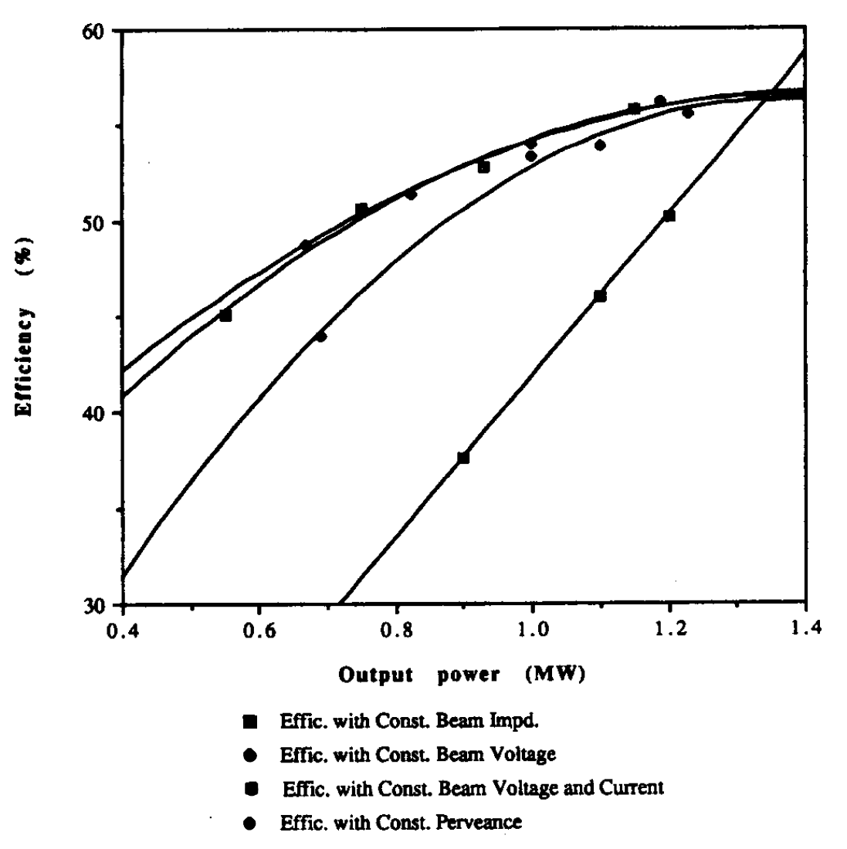
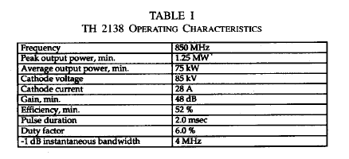
Underrate the tube
Turn down the input signal amplitude.
  Beam power remains constant
The best way to reduce power is
  Constant perveance (lower beam voltage)
  Constant impedance (lower beam voltage and current)
  Different gun voltage for each tube (adjustable modulators?)
  Lower beam current

Slide 35
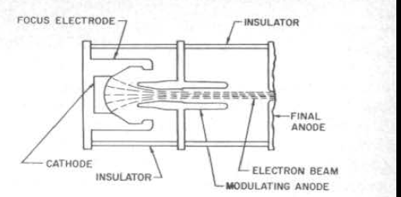
Modulating Anode
A secondary anode between the cathode and primary anode.
Higher risk of gun arcing
More complex gun design
More ceramic joints
3 interesting functions
  Some may be better performed by a grid/focus electrode but...
High power linear-beam tubes, Staprans

Slide 36
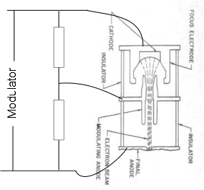
1. Reduce current
Allows you to run at a lower output power
Little power dissipated in voltage divider
Needs mechanical intervention to alter the working point (during conditioning for instance)
Tried & tested
Better to just lower beam voltage

Slide 37
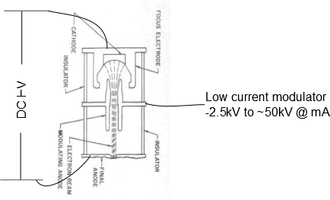
2. Pulse gun
Avoid high current modulator
Perhaps use same DC HV for multiple klystrons (easier/harder?)
Potential for active control depending on your low current modulator.
Not too brave

Slide 38
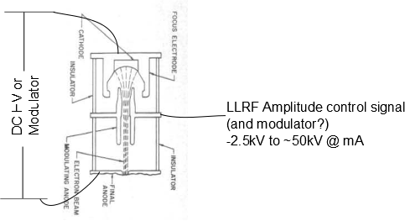
3. Modulate tube gain
Reduce beam power to reduce output power
Always run the tube at or near saturation (highest efficiency)
Complex LLRF problem
Not used in accelerators (New Modulation Techniques for Increased Efficiency in UHF-TV Transmitters ARTHUR J. BENNETT 1982)

Slide 39
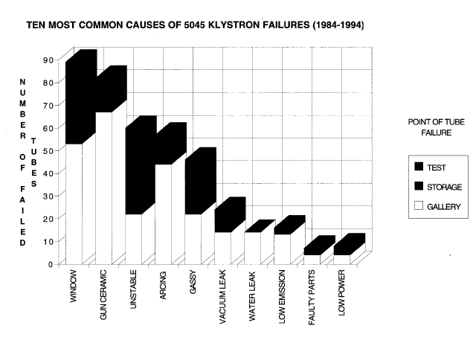
Failures (on an adventurous klystron)
SLAC Klystron Reliability G. Caryotakis

Slide 40
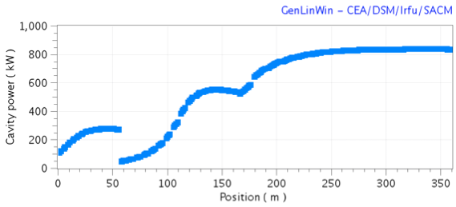
Any other options?
Klystrons are big, expensive and over specified for many of the cavities
28
spoke
cavities
64
low beta
elliptical
cavities
120
high beta
elliptical
cavities
Calculations by M. Eshraqi,
ESS AD Technical Note ESS/AD/0015

Slide 41
State of the art

Slide 42
Don’t forget the IOT!
Low gain ~20-30dB
High efficiency ~70-80%
Low power (compared to a klystron) low 100s of kWs
Cheaper (only the one cavity)
Easier to replace (1 hour vs 1 day)
To increase the power the outputs can combined.
  Diamond use 3dB hybrids and magic Ts to tolerate a failure for 400kW per cavity
  Perhaps good for spokes and low power low beta

Slide 43
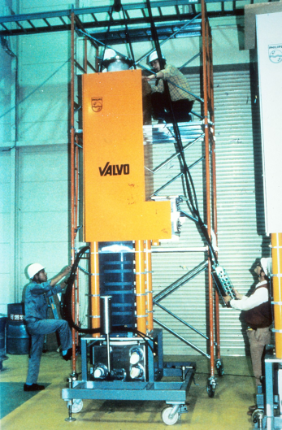
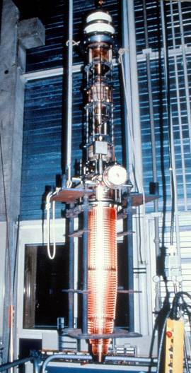
Accelerator klystrons
Frequency 508 MHz
Beam 90 kV; 18.2A
Power 1 MW c.w.
Efficiency 61%
Gain 41 dB
Quite huge
Photos courtesy of Phillips

Slide 44
Magnetrons
Compared to Klystrons, in general Magnetrons
are smaller
more efficient
can use permanent magnets (at 704 MHz)
utilise lower d.c. voltage but higher current
are easier to manufacture
Consequently they are much cheaper to
purchase and operate
BUT are oscillators
Cavity
Magnetron
Load
Circulator
Injection Source
Linacs require accurate phase control
Phase control requires an amplifier
Magnetrons can be operated as reflection amplifiers
J. Kline “The magnetron as a negative-resistance amplifier,”
IRE Transactions on Electron Devices, vol. ED-8, Nov 1961
H.L. Thal and R.G. Lock, “Locking of magnetrons by an injected r.f. signal”,
IEEE Trans. MTT, vol. 13, 1965
Notes:
The most convenient way to set up a magnetron as a reflection amplifier is with a circulator.

Slide 45
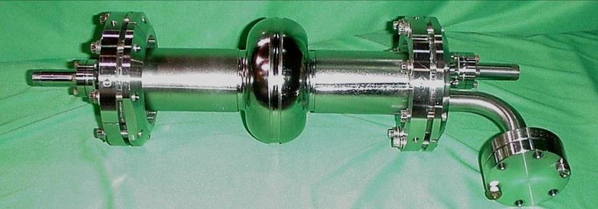

Proof of principle
Demonstration of CW 2.45 GHz magnetron driving a specially manufactured superconducting cavity in a VTF at JLab and the control of phase in the presence of microphonics was successful.
Phase shifter
Double Balance Mixer
Spectrum Analyzer 1
Oscilloscope
Spectrum Analyzer 2
2.45 GHz Panasonic 2M137 1.2 kW Magnetron
Load 3
Stub Tuner 2
Loop Coupler
Circulator 3
Stub Tuner 1
Loop Coupler
Phase shifter
1W Amplifier
Circulator 2
Load 2
Cathode heater control
Load
IQ Modulator
(Amplitude & phase shifter)
DAC
ADC
Oscilloscope
LP Filter
8 kHz cut-off
DAC
Digital Phase Detector
HMC439
Digital Signal Processor
High Voltage Transformer
÷ 2
÷ 2
42 kHz Chopper
Agilent E4428 signal generator providing 2.45 GHz
300 V DC +5% 120 Hz ripple
Pulse Width Modulator SG 2525
Control voltage
1.2 kW Power Supply

Slide 46

SCRF cavity powered with magnetron
Injection but magnetron off
Injection +
magnetron on +
control
Injection +
magnetron on

Slide 47
Layout using two magnetrons per cavity
Phasor diagram
Permits fast full range phase and amplitude control
output of magnetron 1
output of magnetron 2
Cavity
combiner / magic tee
Advanced Modulator
Advanced Modulator
440 kW Magnetron
Load
440 kW Magnetron
Fast magnetron tune by varying output current
Fast magnetron tune by varying output current
~ -30 dB needed for locking
440 W
440 W
LLRF

Slide 48
Layout using one magnetron per cavity
Permits fast phase control but only slow, full range amplitude control
Cavity
Standard Modulator
880 kW Magnetron
Load
Pulse to pulse amplitude can be varied
4 Port Circulator
Slow tuner
~ -13 dB to -17 dB needed for locking
i.e. between 18 kW and 44kW hence
between 42 kW and 16 kW available
for fast amplitude control
60 kW IOT
LLRF
Could fill cavity with IOT then pulse magnetron when beam arrives

Slide 49
Next Steps
Development of a 704MHz Magnetron (440kW – 880kW )
  Collaboration with CEERI, Pilani, India
Establish test station with Television IOT as the drive amplifier
  Could be used for conditioning ESS components
Understand locking characteristics of new magnetron
Commission advanced modulator with in-pulse current control
Establish minimum locking power
Establish two magnetron test stand
Develop LLRF for simultaneous phase and amplitude control
Frequency 704 MHz
Power 200 kW to 1 MW
Pulse length 5μs to 5 ms (for max power)
Max average power 100 kW
Efficiency > 90% above 500 kW
Magnet NyFeB (< 0.5 T)
External Q ~ 50 (for ease of locking)
Mechanical Tunability ~ 5 MHz
Cathode heating indirect and controllable

Slide 50
Conclusions
Klystrons needed are at or near the state of the art for CW
Efficiency is achievable
Pulse length is achievable
MBK/depressed collectors are too complicated/no advantage
Regulating power with beam voltage is best
but
Modulation anodes look interesting from a number of directions
Magnetrons could be interesting for the future/ the test stand.

Slide 51
Thank you for your attention

