Slide 1
RF Distribution Alternatives
R.A.Yogi & FREIA group
Uppsala University.

Slide 2
ESS : pulsed spallation source producing neutrons for scientific research
consists of proton linear accelerator, target, neutron beam lines
neutrons are extracted in fission process from their bound states in heavy atomic nuclei.
Energy required for fission process is created by bombarding nuclei with high energy protons, so proton accelerator is needed.

Slide 3
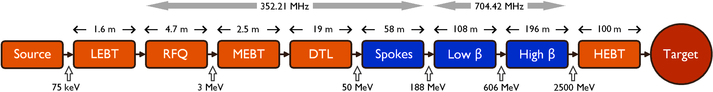
Specifications of superconducting 5 MW proton linac:
Pulse Length = 2.9 mS
Pulse Rate = 14 Hz
Beam Current = 50 mA
Energy = 2.5 GeV

Slide 4
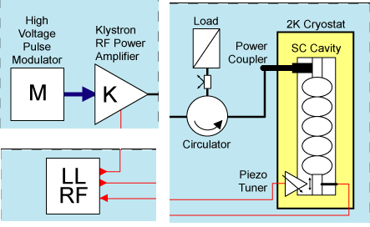
Basic layout of RF distribution system (704 MHz ) :
Wave-guide
Loop directional coupler
Waveguide designation | TE10 mode operating range | fc in MHz | Inside dimensions (inch) | Peak voltage handling capability(Vp) | Loss (dB/m)
WR 1500 | 490-750 | 393 | 15 x 7.5 | 187 kV | 0.002
WR 1150 | 640 - 960 | 513 | 11.5 x 5.75 | 144 kV | 0.003
Circulators can be made using WR1500 to avoid problem of arcing and pressurizing with SF₆.

Slide 5
Due to transit time effects, frequency of Grid tubes is limited upto 500MHz.

Slide 6
Module | Freq. in MHz | Source output power in kW | Maximum power to beam in kW | Number
RFQ | 352.21 |  | 850
DTL (type A) | 352.21 |  | 1000
DTL (type B) | 352.21 |  | 2000
Spoke | 352.21 |  | 280 | 28
Elliptical low β | 704.42 |  | 560 | 64
Elliptical high β | 704.42 |  | 850 | 120

Slide 7
Source and distribution scheme at 704 MHz.
For elliptical high β cavity, maximum power to the beam at coupler = 850 kW
For elliptical low β cavity, maximum power coupled to beam at coupler = 560kW
So at 704MHz, power required in the range 560kW – 850kW
For calculations, consider Pcoupler = 850kW

Slide 8
For calculations, consider Pcoupler = 850kW
Power loss in circulator = 2%
Power loss in wave-guide
loss in wave-guide = 0.09 dB/100 ft
length of wave-guide = 20 m (assumed)
Power loss in wave-guide = 1.38%
Power loss in joints, bends, dual directional coupler.. = 1%
Estimated power loss = 5.08%
(After knowing exact layout we can exactly estimate loss)

Slide 9
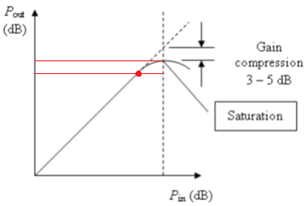
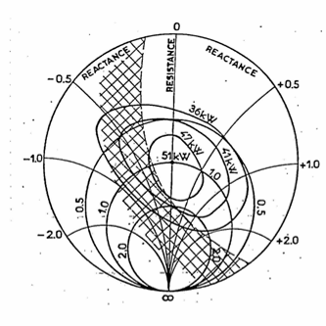
Calculation of source output power
Considering the facts that
To avoid saturation / nonlinear effects Operating point is 1.5 dB (30%) down the saturation point.
Using LLRF this overhead can be reduced. Let us assume it to be 25%
Output power of klystron is also function of match at output flange.
Hence to protect klystron from reflected power circulator is needed.
Pop
Variation of Pout with Pin for klystron
Rieke diagram shows output power of klystron as a function of match at the output flange

Slide 10
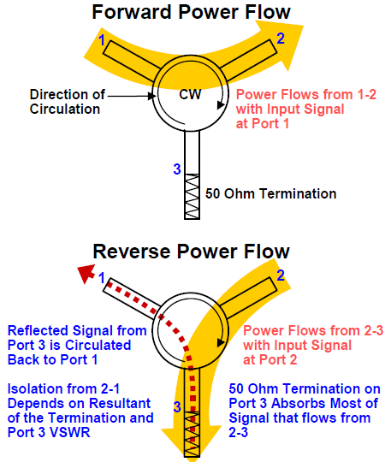
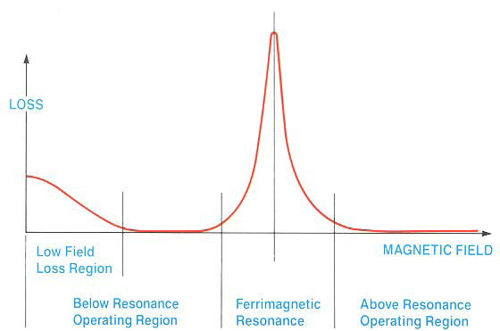
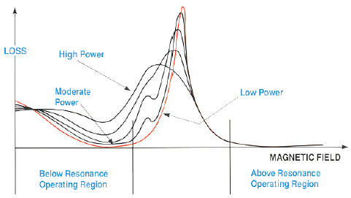
Critical component: Circulator
IL and isolation stated in catalogue related to this curve.
Specifications as well as acceptance test should include high power effects.

Slide 11
Power at saturation = (25 + 5.08 ) % of power at coupler + Pcoupler
Psat = 30.08 % of 850kW + 850kW
Psat = 1.106 MW
So for tendering purpose Klystron with saturation at 1.15 MW will be sufficient to get 850kW at coupler.

Slide 12
Possible layout schemes for RF distribution system
1. Single modulator ⇒ single klystron ⇒ cavity
2. Single modulator ⇒ klystron ⇒ cavity
        ⇒ klystron ⇒ cavity
3. Single modulator ⇒ klystron ⇒ vector modulator ⇒ cavity
⇒ vector modulator ⇒ cavity

Slide 13
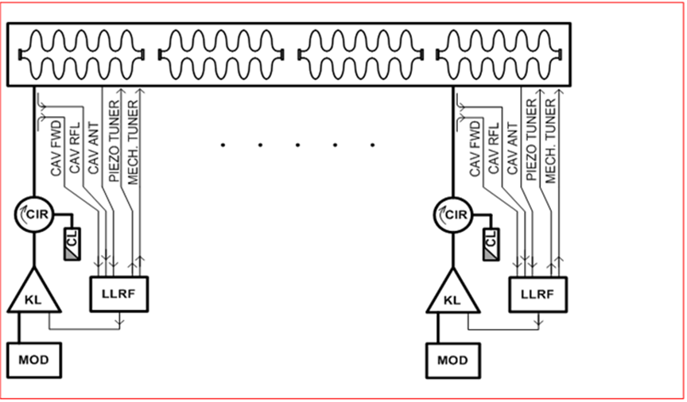

Slide 14
No. | Equipment | Cost /item in K$ | Qty. | Total k$ | Insertion loss
1. | Modulator | 660 | 184
2. | Klystron 1.15MW | 280 | 184
3. | Circulator 1.15MW | 70 | 184 |  | 2 %
4. | Circulator load | 20 | 184
 | Total | 1030 |  | 189520
Total 184 quantity of each is required.

Slide 15
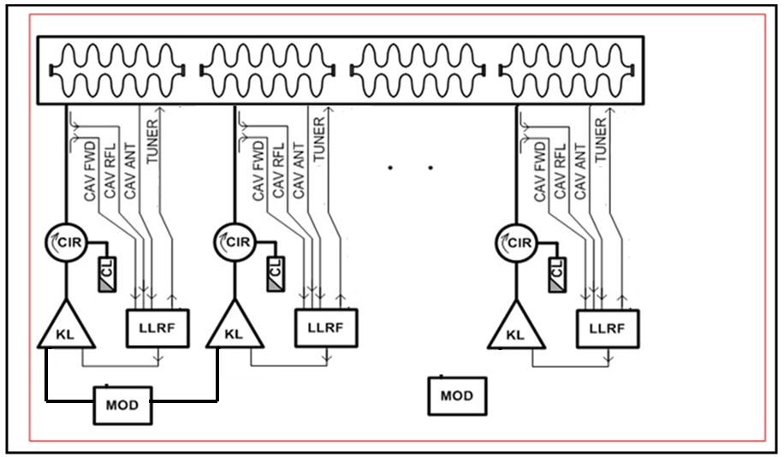

Slide 16
No. | Equipment | Cost /item in K$ | Qty. | Total k$ | Insertion loss
1. | Modulator | 990 | 92
2. | Klystron 1.15MW | 280 | 184
3. | Circulator 1.15MW | 70 | 184
4. | Circulator load | 20 | 184 |  | 2%
 | Total |  |  | 159160
Most expensive item is Modulator.
Two modulators if combined → the cost 1.5 times instead of double. (Ref. to discussions / mail David )

Slide 17
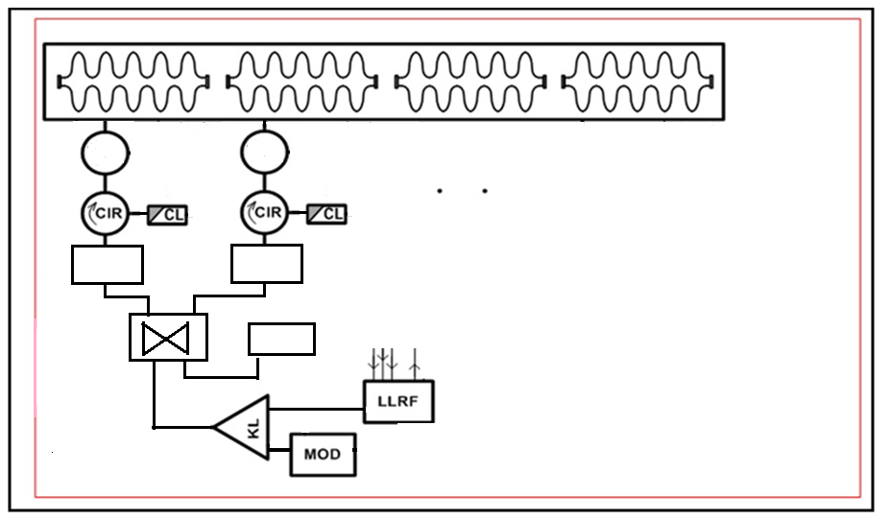
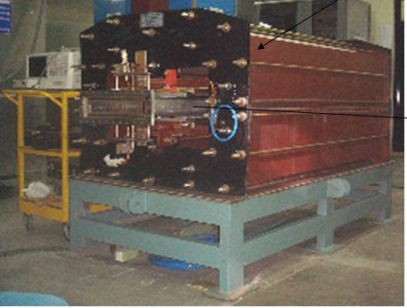
Φ
Φ
Freq. 20 – 100MHz
Response time < 6mS
Got Indian patent
A
Φ
VM
A
Φ
VM
3dB Hybrid
HPL

Slide 18
No. | Equipment | Cost /item in K$ | Qty. | Total k$
1. | Modulator | 990 | 92
2. | Klystron 2 MW | 350 | 92
3. | Circulator 1.3MW | 70 | 184
4. | Circulator load | 20 | 184
5. | Hybrid | 20 | 92
6. | Hybrid load | 20 | 184
7. | Phase shifter (mechanical) | 20 | 184
8. | Vector Modulator 1MWp | 100 | 184
 | Total |  |  | 167440

Slide 19
Parameter | One modulator – one klystron – one cavity | One modulator – two klystron – two cavities | One modulator – one klystron – two cavities (using VM)
Cost (k$) | 189520 | 159160 | 167440
Insertion loss | X% | X% | (X+5)%
Simplicity of system | Simplest
Space | Large space is required | Space saving achieved | Space saving achieved
* : all these numbers depend upon resonant modulator topology

Slide 20
RF distribution system at 352MHz
Power input to the spoke cavity = 280kW
Number of cavities = 28 (not yet finalized)
Source power = 300 – 350kW (yet to be finalized, depends on components)
Consider Psource = 350kW

Slide 21
 | Tetrode | Klystron | IOT | Dichrode | Solid state
Cost ($) | X | 10X
Power (350 kW) | Two tetrodes combined | Single | Many IOTs tobe combined | Single | Many should be combined
size | Size smaller | Bigger |  | Bigger | Very big
efficiency | 60 -70 % | High (60 – 65%) | 60 -70 %
Gain | 15 – 20 dB | 37 dB
Pre-driver | Needed. | Not needed
Life time (hrs) | 17 – 20 k hours | 40 -50 k hours
Replacibility | Very easy. | Difficult
Power supply | DC power supply | Modulator
Simplicity of system | Simple | No |  | Complex
Delivery time | 6 months | Depends on modulator

Slide 22
Tetrode TH571B, TH 18528 cavity
Tested upto150kW peak power. So not sufficient.
Tetrode TH391, can be used with cavity TH 18528
Tested upto 200kW peak power, but hasn’t tested for 3mS. Regularly produced and can be tested. Air cooled.
Output of these two systems can be combined with 3-dB hybrid.
Tetrode TH781
400kW pulse. But not tested. Cavity not available.

Slide 23
DC
Power-supply
Matched
load
TH391
200kW pulse
3dB Hybrid
400kW pulse
Pre-driver stage
TH391
200kW pulse
DC
Power-supply

Slide 24
Thank you !
Questions and suggestions are welcome.

