Slide 1


ALICE SPD COOLING
CRITICAL ISSUES
2nd SPD Cooling Workshop
Rosario Turrisi

Slide 2
In this talk
Detector’s side cooling system
Performance history
Remarkable events
Flow vs. thermal contact
Recent interventions
Final consideration

Slide 3
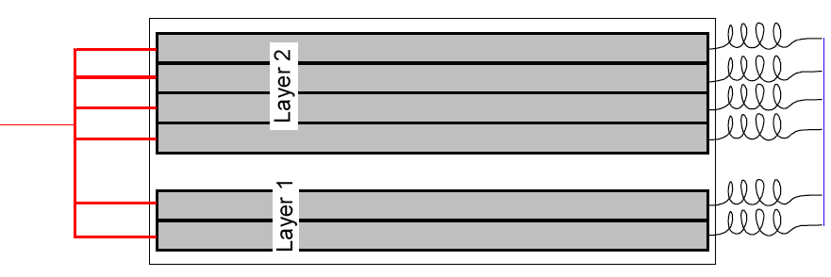
Detector’s (in)side
A side
(gas)
1sector = 1 cooling line
1 cooling line feeds 6 staves
input: collector box, 6 capillaries 550 mm × 0.5 mm i.d.
output: collector box, 6 pipes ~10 cm long, 1.1 mm i.d.
2 bellows in a row, ¼” tube diameter, 6” and 12” length
bellows
bellows
C side
(liq)

Slide 4
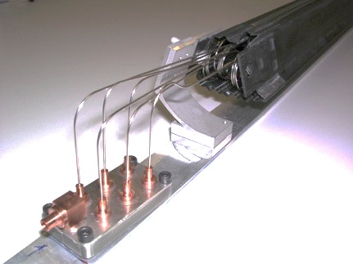
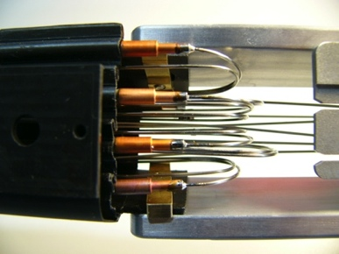
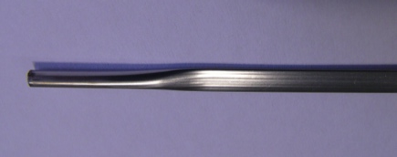
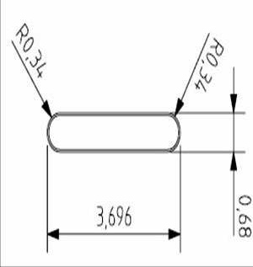
Critical components - 1
Capillaries
  used to enter the coexistence phase
  CuNi, 550 mm long, 0.5 mm i.d.
Cooling pipes
  where the heat transfer happens
  Phynox, 40 μm wall
  round 3 mm pipes squeezed to 0.6 mm inner size
Both sensitive to pollution!

Slide 5
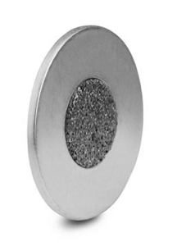
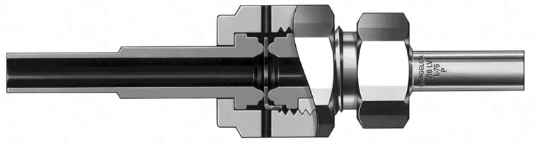
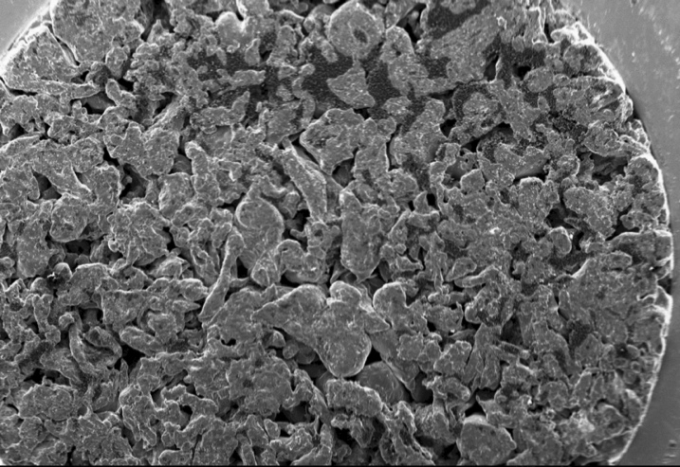
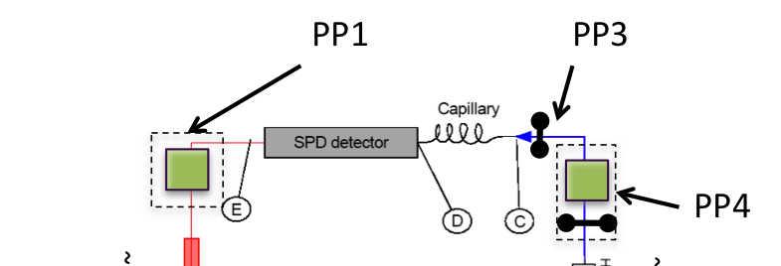

Critical components - 2
Filter Swagelok SS-4-VCR-2-60M
D = 5.6 mm
T = 11.8 mm
X = 0.7 mm (~1 mm in the filtering area)
S = 4 mm
L = ~5000 mm
X
D
T
L
S
Pipe: SS 316L 4-6 mm i-o diameter
Swagelok 316 SS VCR Face Seal Fitting, 1/4 in.
Female/Male Nut: SS-4-VCR-1 & SS-4-VCR-1
Swagelok gland 6LV-4-VCR-3-6MTB7
no access
SEM picture of the filter

Slide 6
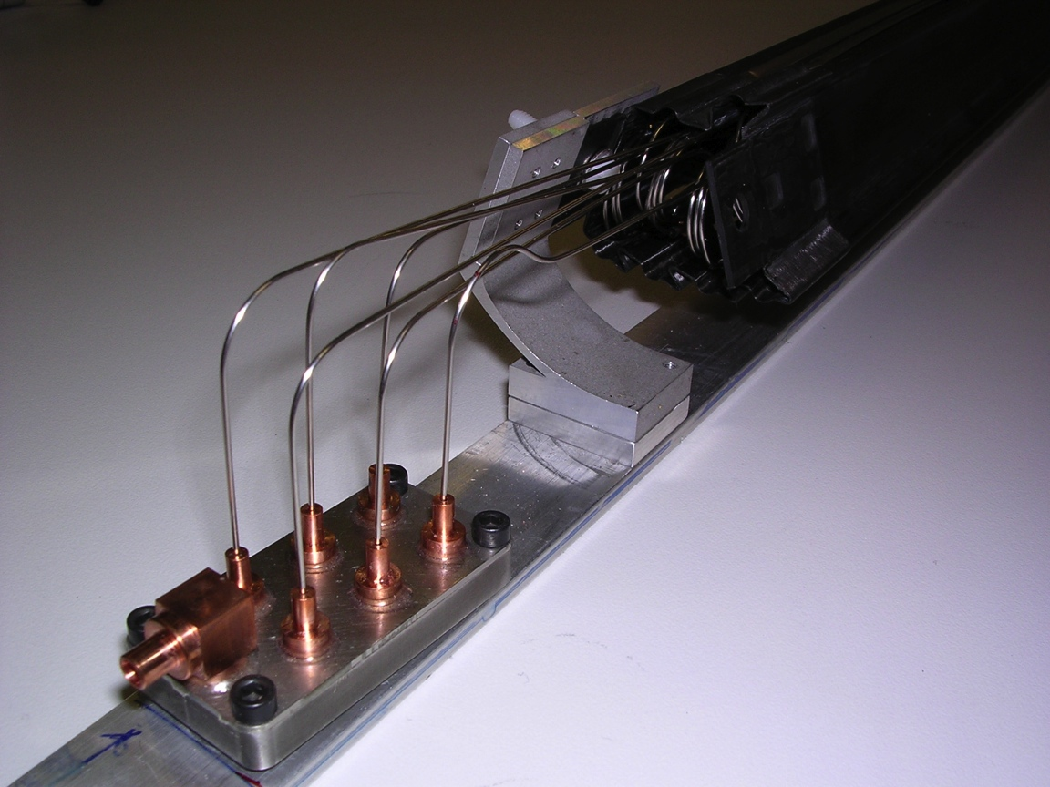
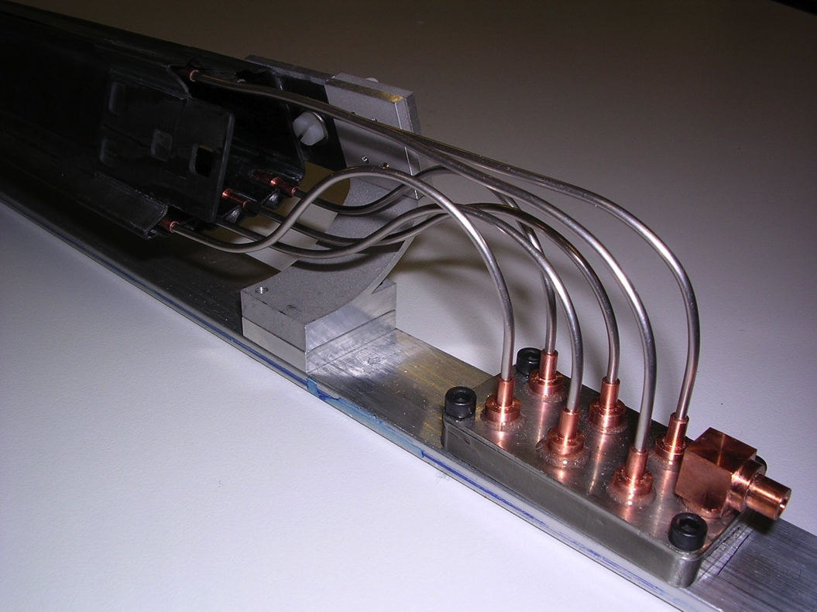
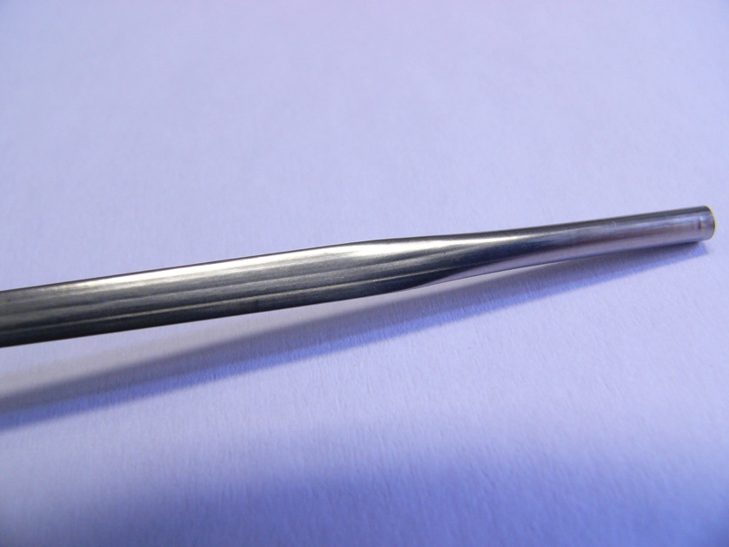
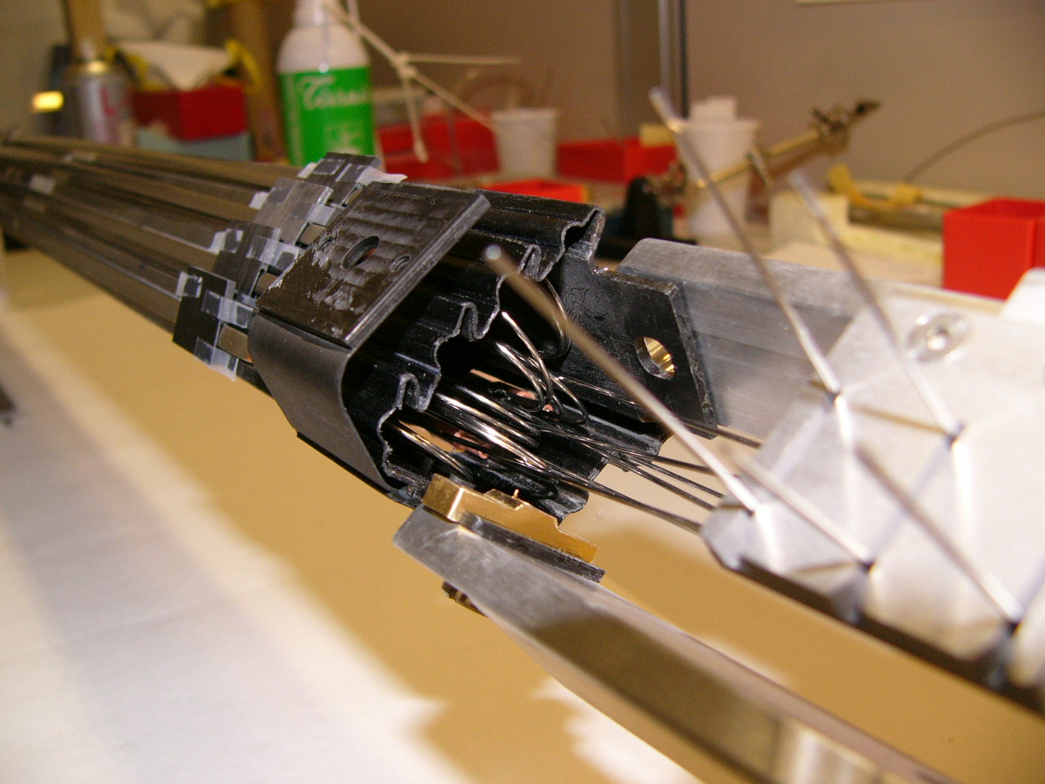
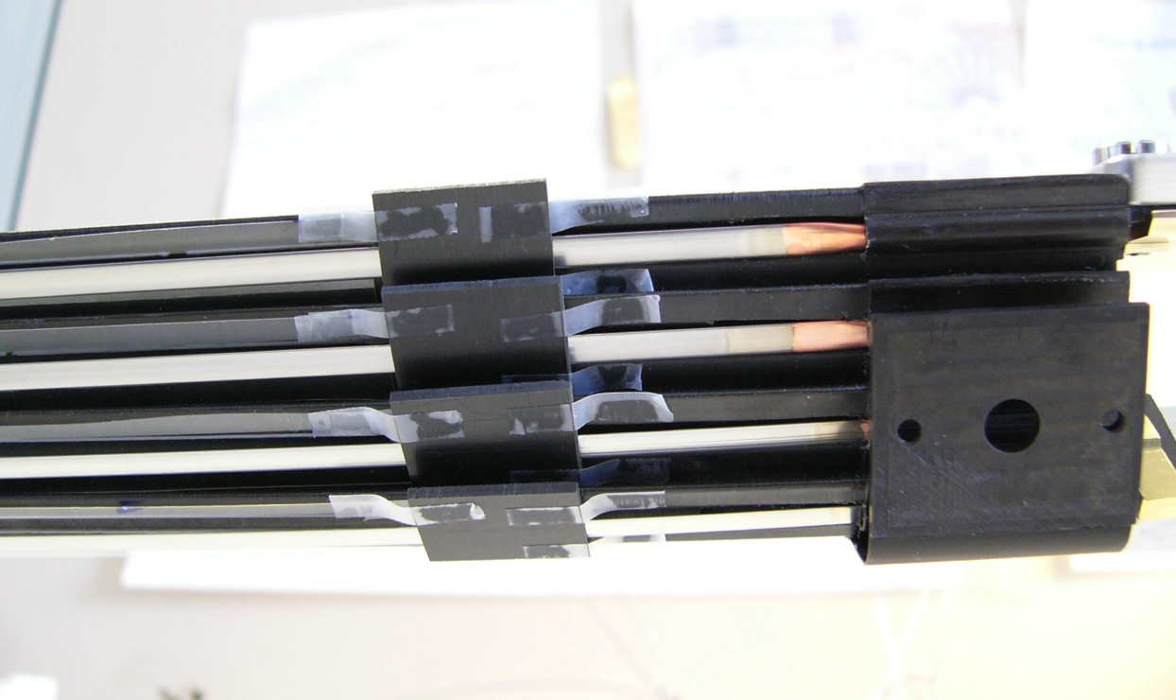
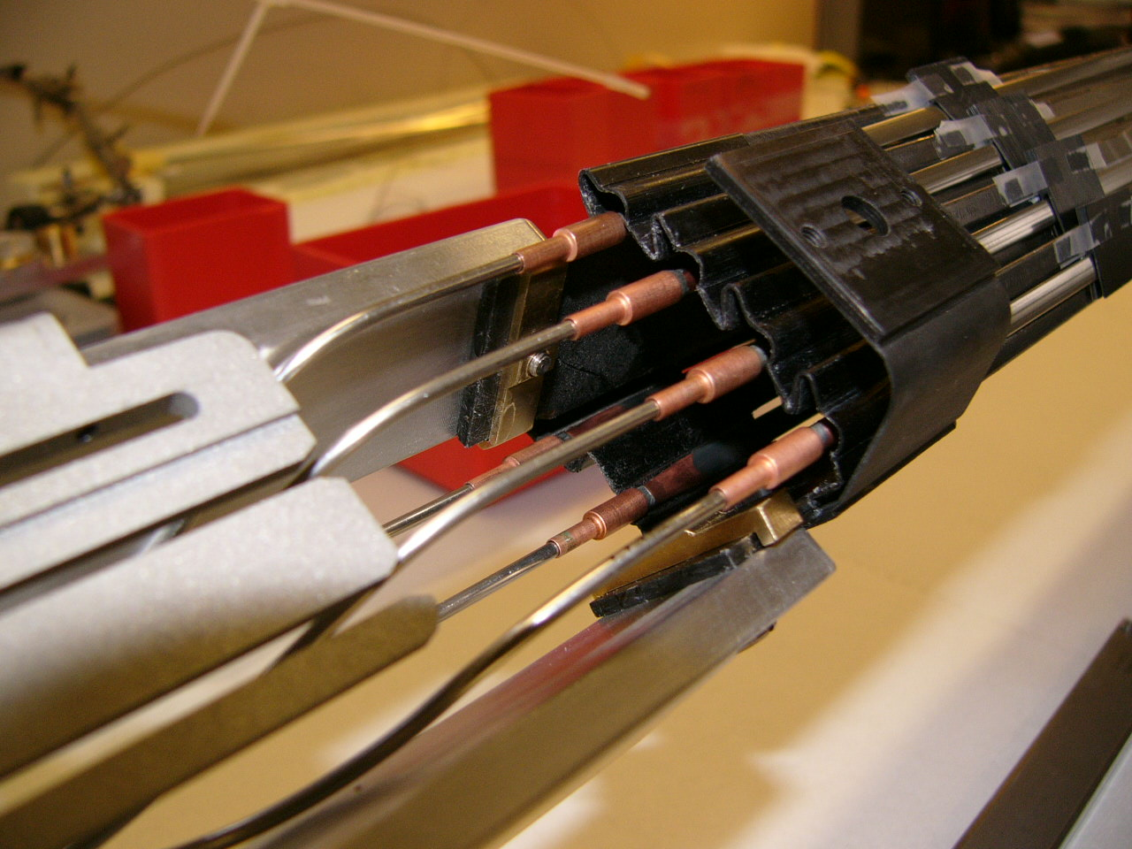

Slide 7
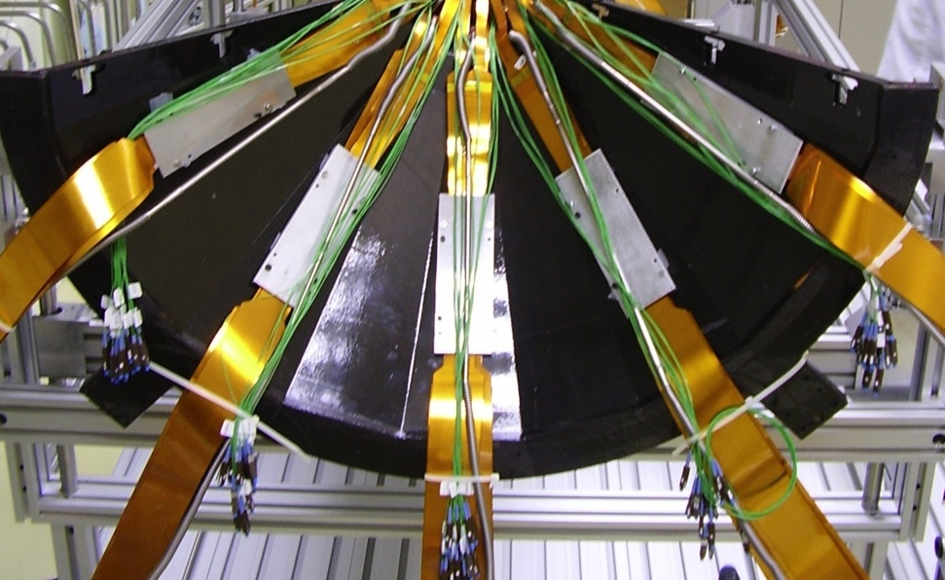
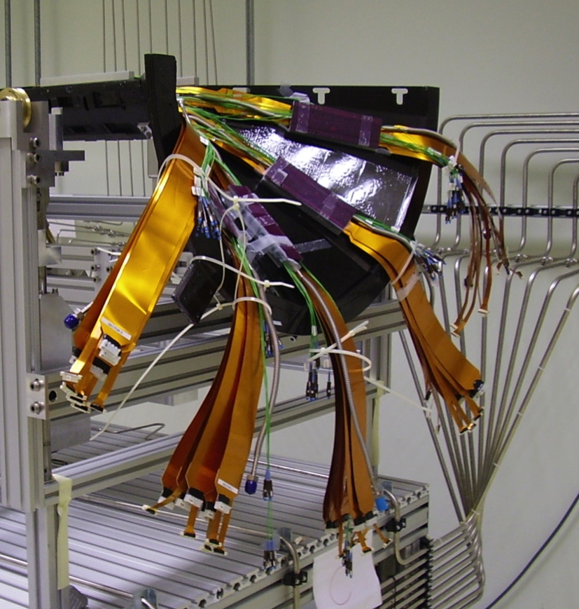
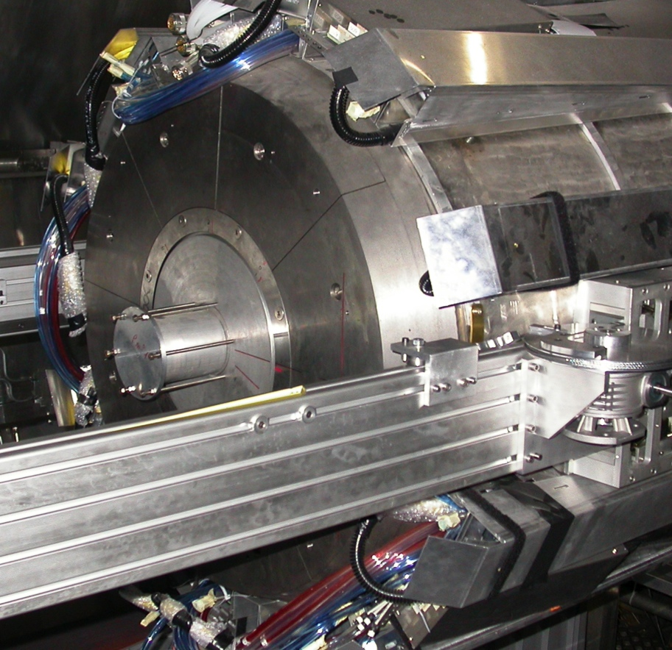

Slide 8
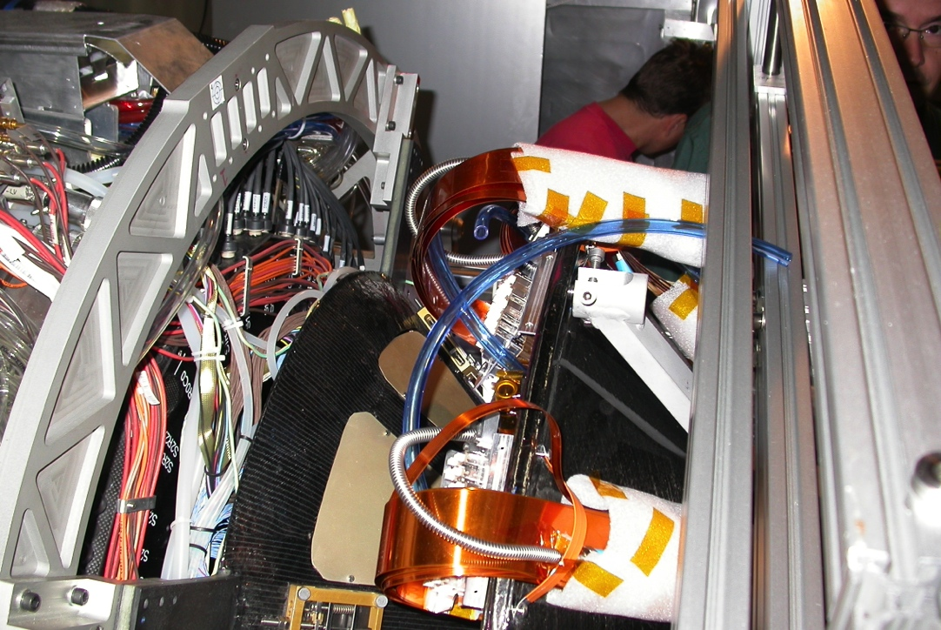
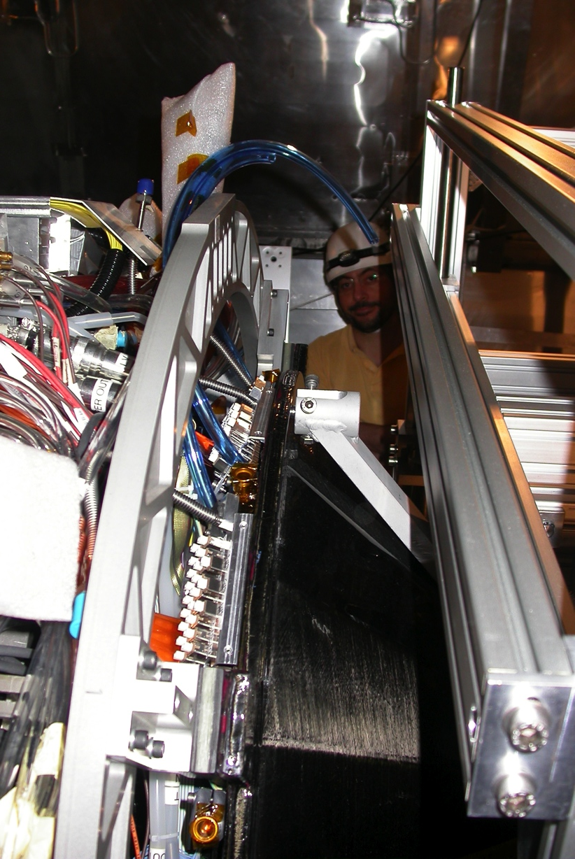
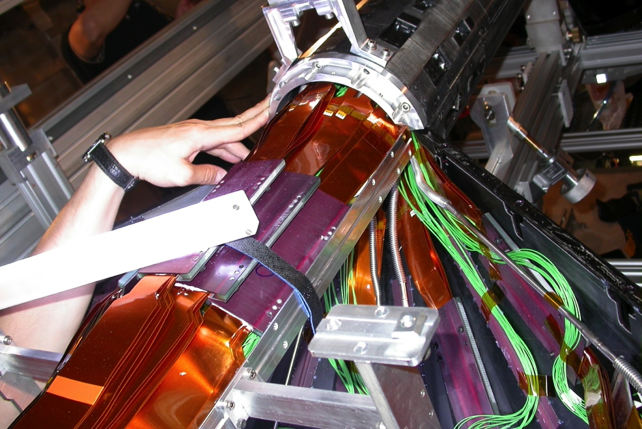

Slide 9
The picture (as we know it)
Some pollution went into the lines
It had to go through oxysorb/hydrofilter of the plant (1 μm filter was installed after 1 year run)
and/or
It had to go through the first 60 μm inline filter and deposit (and partly go through) the second inline filter
The second clogged filter cannot be replaced (have to disassembly the experiment) and causes:
  less flow
  pressure drop
The liquid heats up to room temperature along the path to the detector (~40 meters) – this was not a problem, if alone
The combination of the last two causes:
  less flow in the single line ➔ worse performance in the sector
  bubbling before the capillaries ➔ local and occasional loss of performance
Most of the effects are reproduced at the test-bench
At least one effect is difficult to reproduce and understand: post-stop/start flow reduction

Slide 10
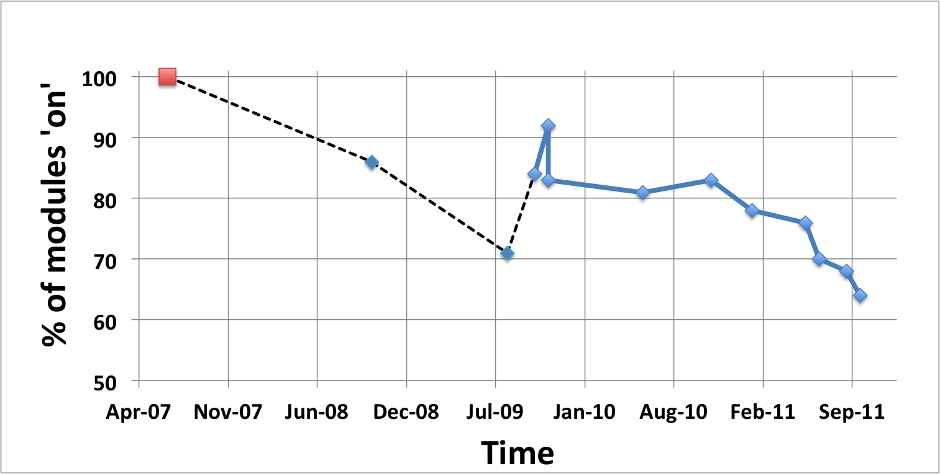
Efficiency history
DSF status (tests pre-installation): efficiency = 100%
First switch on after installation: efficiency = 87%
Long stop (you know why…) – minor rerouting of return pipes
Restart after long stop: efficiency = 71%

Slide 11
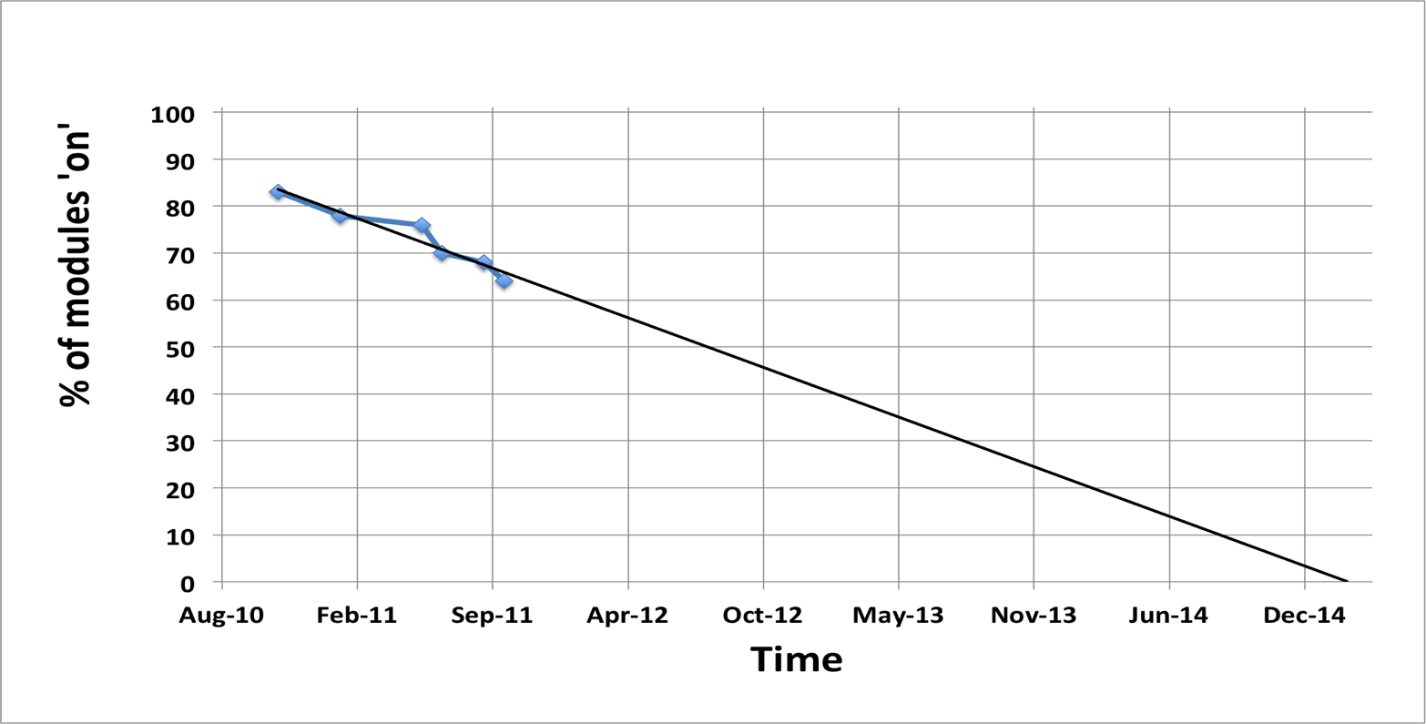

Efficiency history
Start of LS1 ➔ <45%
Interventions in fall 2009
Stable after interventions: efficiency = 83%
Last resume after tech stop: efficiency = 64%
extrapolation from last year
assumes constant trend

Slide 12
Critical issues – a list
Pump breakdown
  pressure spikes – correlated?
    we know since 2008
    why only one pump fails? working time? position?
  two-stages pumps?
    need for qualification
  other technologies?
Missing protection against unwanted (and sudden) stops
  chilled water stop
  power failure/glitch
  mixed water stop
Subcooling reliability
  in case of mixed water failure, access inside the magnet could be needed
Leaks
  bad connections & safety valves
Black holes
  where the pollution came from
  cause(s) of performance drop at (technical) stops

Slide 13

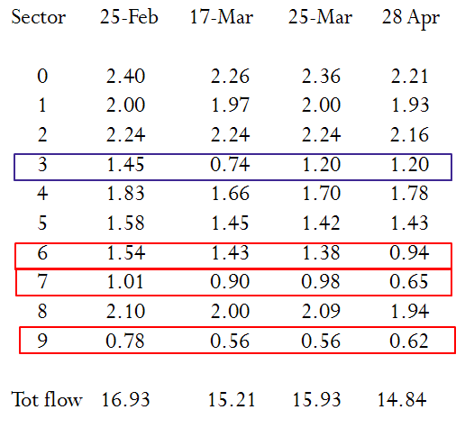
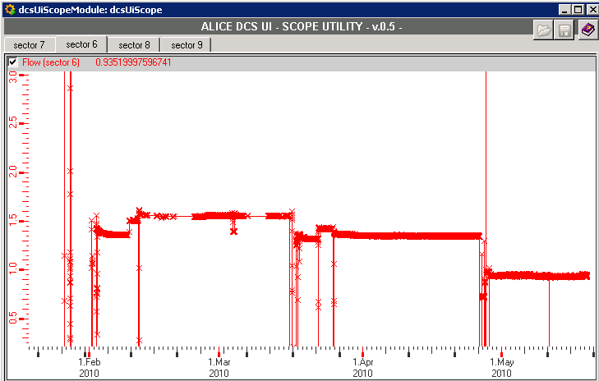
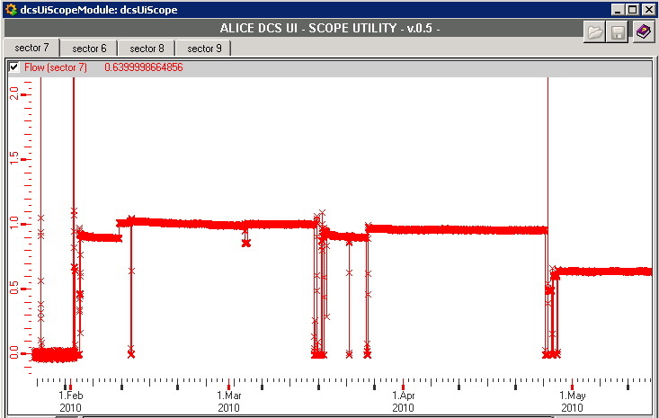
Flow instability during 2010
From:
C. Bortolin
1st Cooling Workshop
Jan. 12 2011
-11% of flow in 2 months
To vacuum the bad loops before the restart can help to recover the flow

Slide 14
Situation after 2010 WS
Cleaning of 4 sectors’ lines (sector nrs. 3,5,6,7) counter-flow
  1h flow w/nitrogen + 24h C₆F₁₄ flow + nitrogen flow to remove liquid leftover
Notes:
values ~2 have been tuned by hand , could be more
clear improvement in sector 3, 4, 5
situation stable in # 6,7
line of sector #9 is behaving normally, issue of flow between PP4 and PP1 (as we know)
SECTOR #3: ALL HS ON !!! (absolute première)
93 HS on, missing 2 from sector #9 (by-passed)
Sector # | BEFORE | NOW
0 | 1.85 | 1.98
1 | 1.95 | 2.00
2 | 2.05 | 1.99
3 | 1.16 | 1.79
4 | 1.4 | 1.56
5 | 1.1 | 1.28
6 | 0.85 | 0.9
7 | 0.68 | 0.62
8 | 1.83 | 2.01
9 | 0.49 | 1.93
By-passed by
a dummy sector
w/plastic pipes

Slide 15
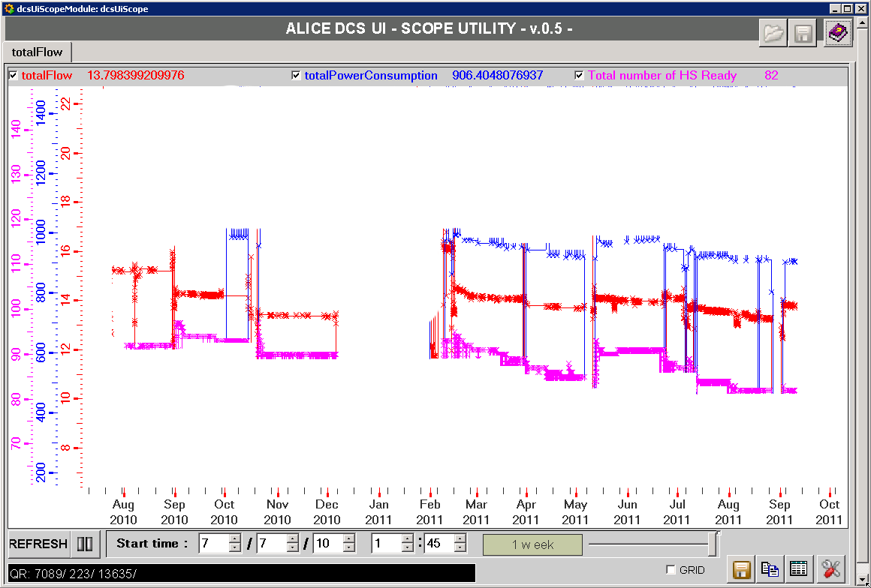
Flow/power correlation
Slowly decreasing trend of flow
The flow doesn’t tell the whole story – stable # of modules must depend on local thermodynamical conditions (not monitored)
The flow itself depends on something not understood
  start/stop’s result often in flow reduction as after last TS
-9.1%
-2.7%
after 11/2011 TS
Sector | Flow (g/s) |  | Trend (g/s) | Δp PP4 (bara) | Flow(g/s)
 | Pliq 6.1 bara |  |  |  | P liq. 6.5 bara
 | Before TS | After TS
0 | 1.98 | 2.01* | +0.03 | +0.96 | 2.09
1 | 1.94 | 1.67 | -0.27 | +0.43 | 1.82
2 | 1.93 | 1.90 | -0.03 | +0.60 | 2.02
3 | 1.24 | 1.05 | -0.19 | 0 | 1.12
4 | 1.32 | 1.15 | -0.17 | 0 | 1.24
5 | 1 | 0.93 | -0.07 | 0 | 1
6 | 0.83 | 0.78 | -0.05 | 0 | 0.84
7 | 0.37 | 0.17 | -0.20 | 0 | 0.19
8 | 1.48 | 1.35 | -0.13 | 0 | 1.45
9 | 0.28 | 0.23 | -0.05 | 0 | 0.26
TOT | 12.37 | 11.24 | -1.13 |  | 12.03
total power
total flow
number of hs ready
Aug 2010
Aug 2011

Slide 16
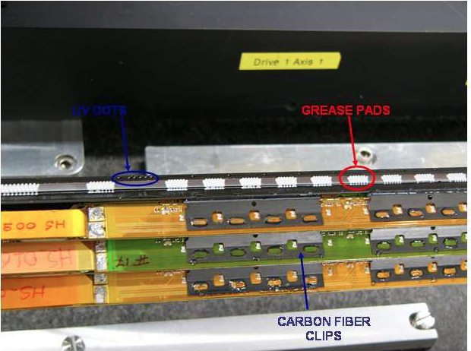
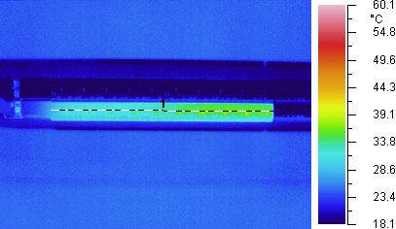
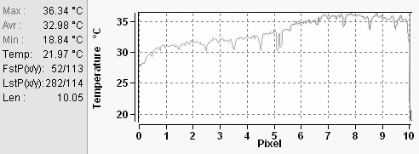
Thermal contact
Could thermal contact be another issue?
Performed with AOS 52029 thermal grease
  real K measured (slightly less than promised)
  mechanical stress tested
Long term performance?
Thermal/mechanical stress?
It is a minor issue (by now): good sectors
do not show a worse performance

Slide 17
Recent interventions
Ultrasounds cleaning
  piezoceramics brought in front of the filters
  cycles of 2 h (alternate 2 h of mechanical bumping with stainless steel wire)
  two sectors treated
  no evidence of effect
Regularly
  counterflow flushing
    last time: 4 days on same sector, gain ~10% of flow
  filters replacement
    SEM analysis on both faces of the filters show no pollution

Slide 18
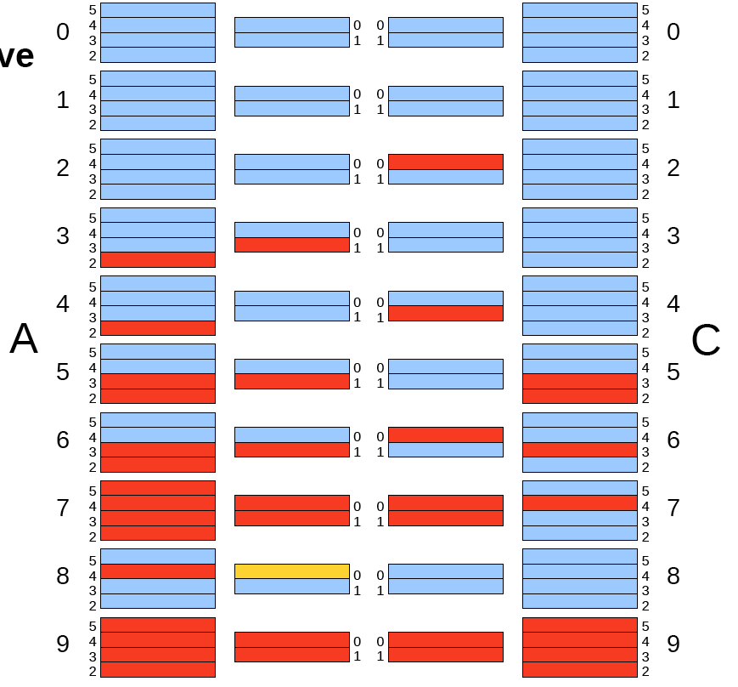
Current performance
Flow: 11.6 g/s (nominal: 18 g/s)
Modules ‘’on’’: 75/120, i.e. 62.5 % (off not because of cooling: 3)
Power consumption: 850 W (nominal: 1500 W)
Inlet pressure: 6.3 bara (with a jump to 6.5)
  was ~4 in 2008, 4.5 end of 2009, 5.5 end of 2010…
  maximum we dare to go: 7 bara at the plant
Sectors 7, 9 off – 6,5 in very bad shape

Slide 19

What’s next
Get rid of those filters ‘’the hard way’’…
  laser
  drill
Keep testing the strategy (‘’in case everything else fails’’…) on the test bench
Thanks for the attention!
see Claudio’s talk
see Andrea’s talk

Slide 20
Backups

Slide 21
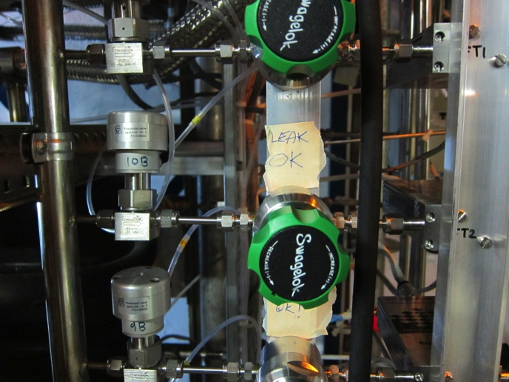
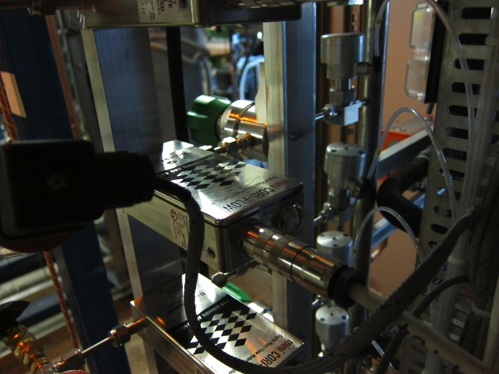
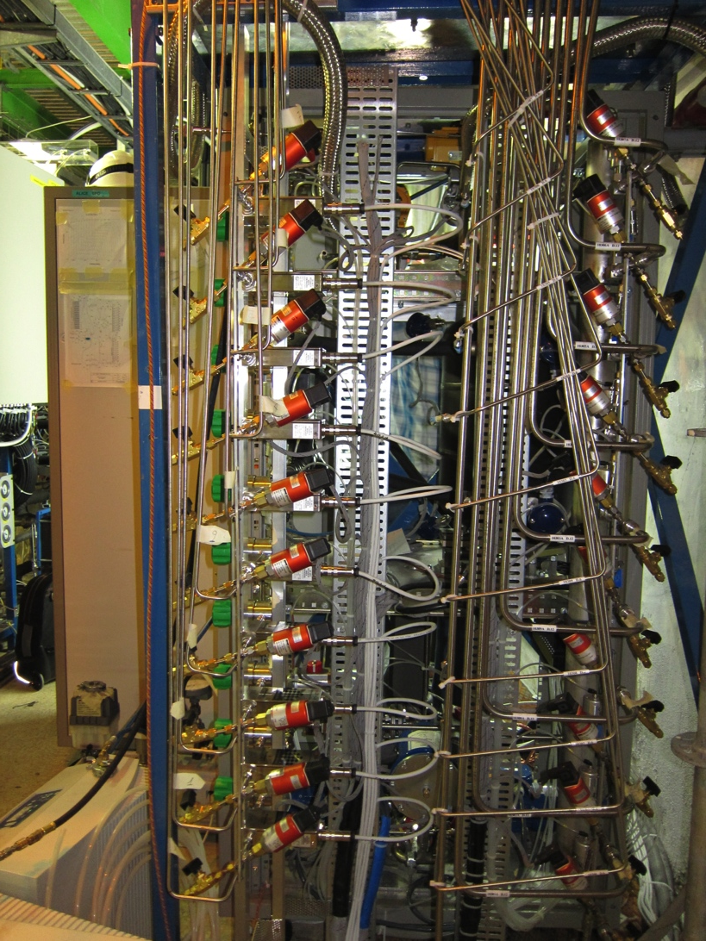
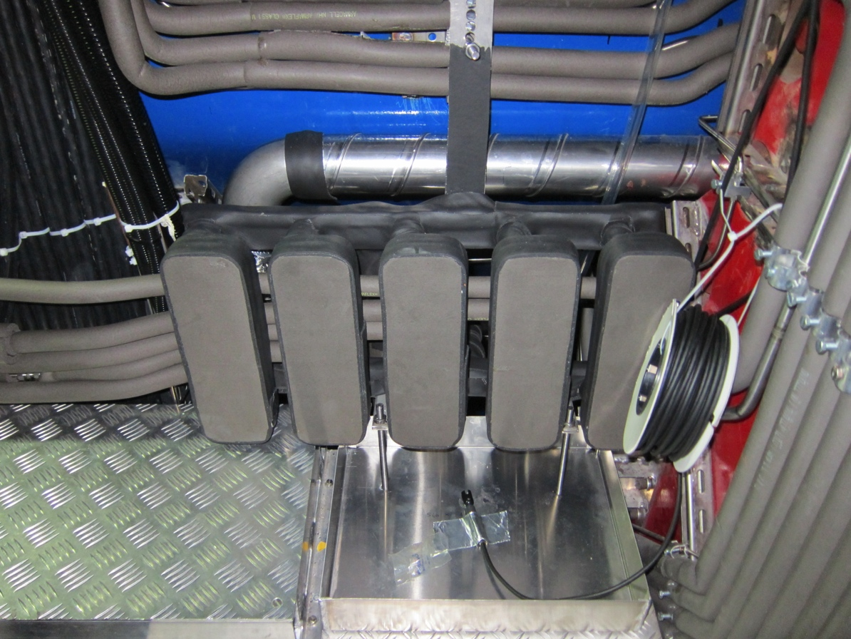

Slide 22
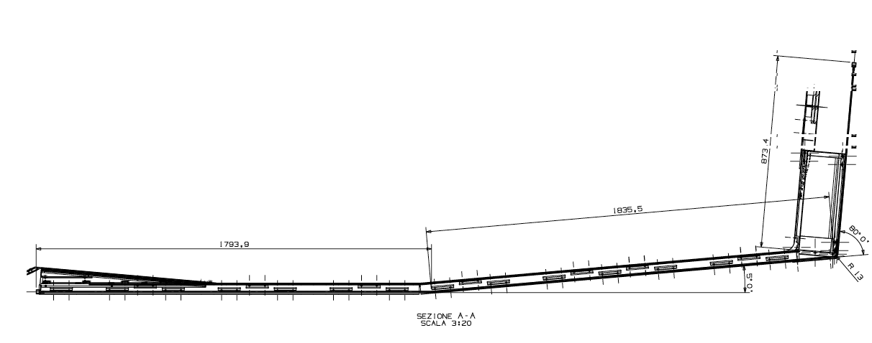
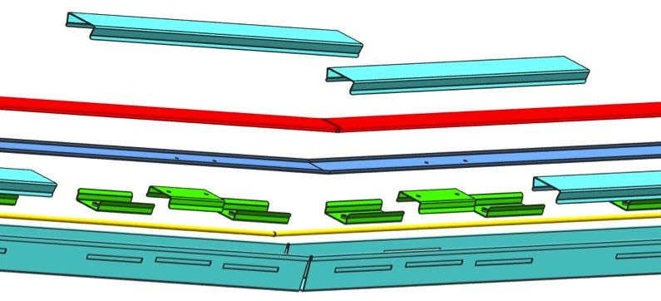
Layout of the circuit
The pipe is in yellow
The access point (1) is ~4.5 m away from the target point (2).
The pipe is not fixed but laying in the aluminium box (below the yellow pipe in the exploded view)
The pipe will be filled with liquid (C₆F₁₄) or flushed at low pressure (0.5 bar) with the same liquid
(1) Access point
(2) Target point

Slide 23
‘Ice age’ test
We installed an ‘intercooler’ on the freon line in PP4 (close to SPD)
  8 m of plastic pipe in a bucket filled with ice (many thanks to CERN Restaurant #1!)
  freon reached ~8 °C in PP4
  Test done on 2 sectors (#6 and #5)
Observed:
  increase of flow in one case (∼50%)
  clear improvement of performance
  in both cases 6/7 half-staves recovered !

Slide 24
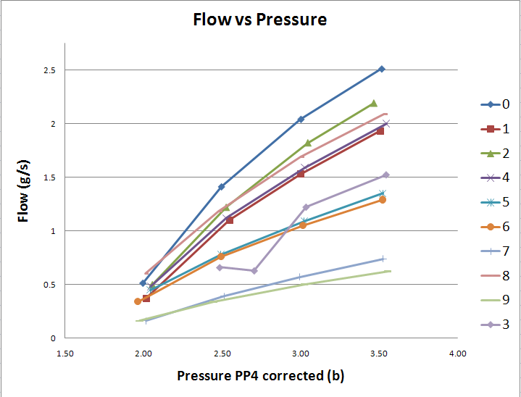
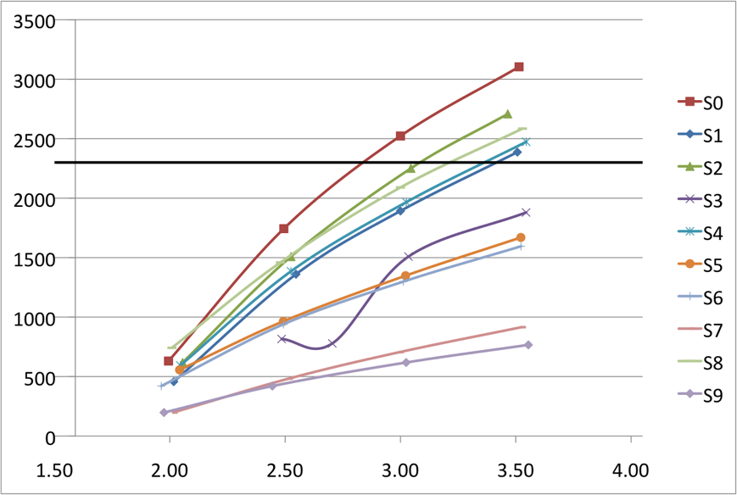
Measurement of flow
Reynold’s number vs. pressure
2300
Very low flow rate in sectors 7 and 9;

Slide 25
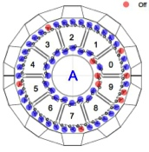
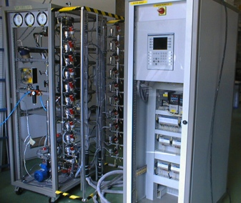
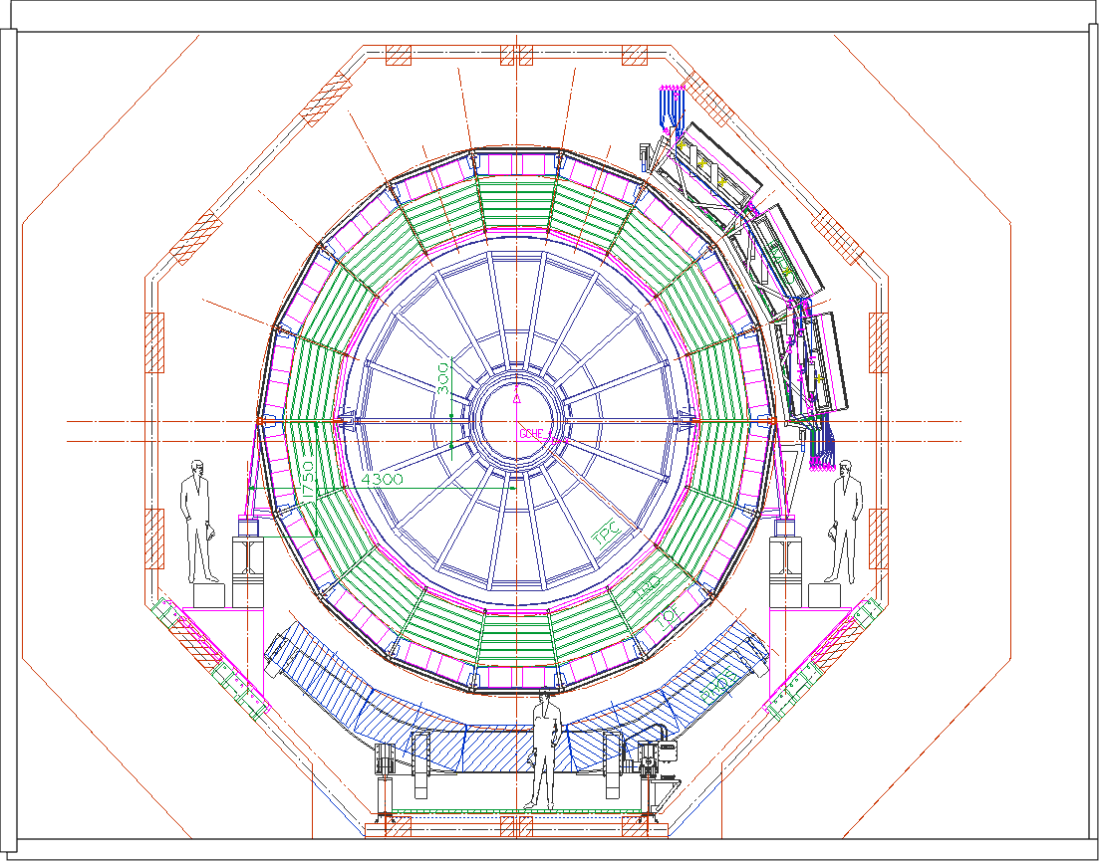
Pipes New routing (Symmetric inlet)
side ‘O’
side ‘I’
~ 10 ˚C
~ 10 ˚C
5HX
5HX
~ 20 ˚C
~ 20 ˚C
5 pipes
5 pipes
10 New pipes
Flow ~16 g/s
~ 10 ˚C
View from A side (front)

Slide 26
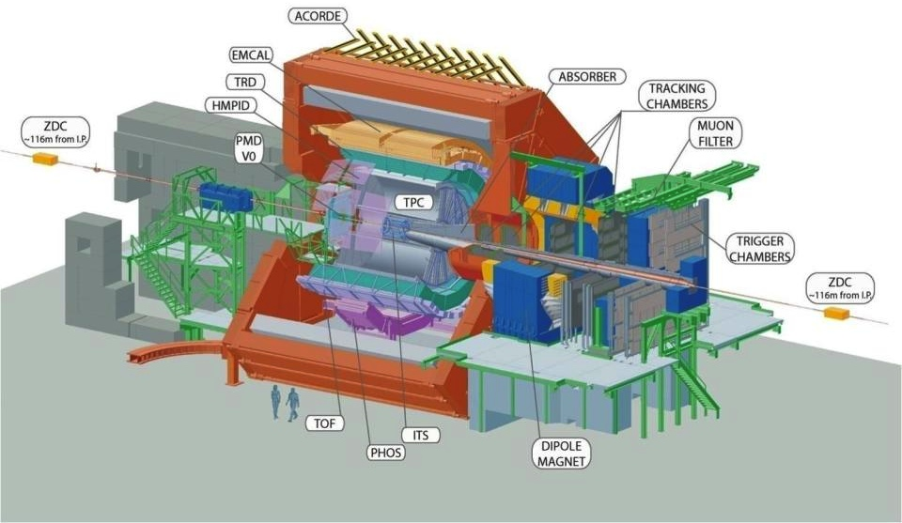
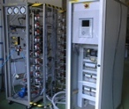
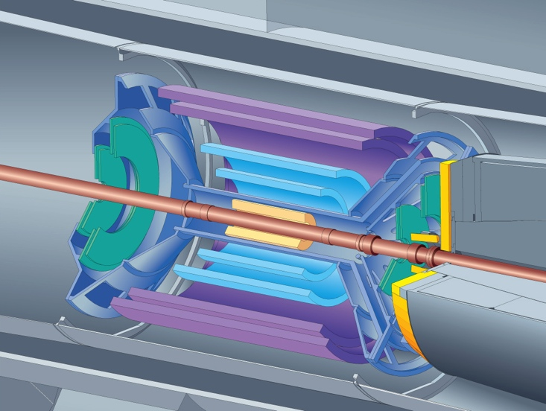
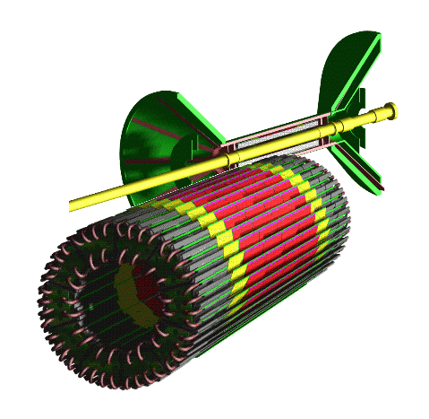
Size: 16x26 meters
Weight: 10,000 tons
SIDE A
SIDE C
~8 m
~50 m
SPD Cooling station
SPD
Silicon Pixel Detector
R_{i} = 39.3mm
SPD
R_{o}= 73.6mm
L = 282mm

Slide 27
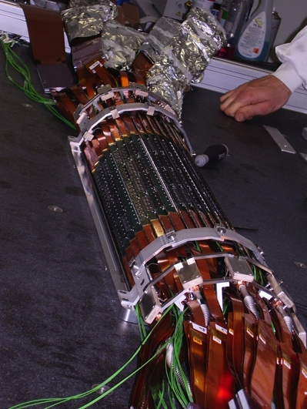
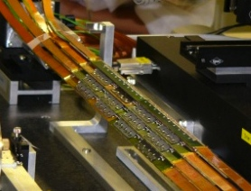
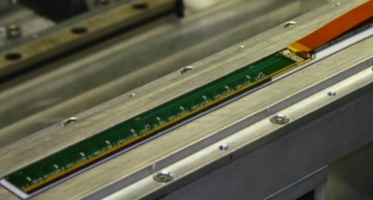
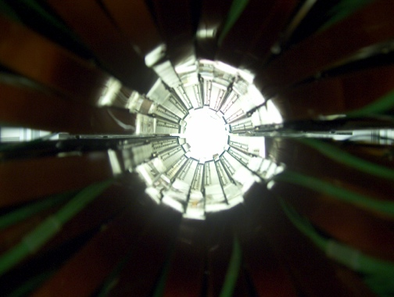


SPD structure
Total:120 half-staves
1200 ASIC
9.83 × 10⁶ channels
half-stave= basic working unit
SPD
2 half-barrels
Half-barrel
5 sectors
Sector
12 half-staves
1 multilayer bus
Half-stave
1 MCM
2 bump bonded ladders
Ladder
5 read-out chip
1 sensor

Slide 28




Principle of operation
Joule-Thomson cycle
  sudden expansion + evaporation at constant enthalpy
Fluid C₄F₁₀: dielectric, chemically stable, non-toxic, convenient eos
  Nominal evaporation: 1.9 bar, 15°C
PP=patch panels
  PP3: close to the detector, not (immediately) accessible, PP4: ~6 m upstream SPD
PP1
PP3
PP4
heaters
~35m gas pipes 12/10-10/8 mm
~40m liquid pipes 6/4 mm
capillaries
liquid pump
condenser
pressure
cooling tube
compressor
Filters (60μm)
two ‘knobs’:
liquid-side pressure flow
gas-side pressure temperature
p, T
enthalpy

Slide 29



Test in the lab
For ~ 3 years the system has been tested in the DSF at CERN
In the lab, filters where missing (60 μm in line and the final 1 μm filter on the plant)
very stable against changes in parameters settings (1-2 sectors at a time)
100% efficiency
  tested one half barrel at a time
  full power to the detector (~150 W/sector)

Slide 30
Looking for the ‘’unsub’’
Pressure increase line by line
  Check if performance can be recovered by increasing the flow
  The flow is enhanced by the pressure increase
Lines swapping
  Could be something related to the lines’ path/conditions
  Some dependence is found – replaced lines with symmetric and shorter path
Lines insulation
  Heating up the fluid can cause early bubbling
  Impossible to insulate the lines – too much surface w.r.t. the volume
SEM analysis of ‘first-stage’ filters
  Clogging material in the lines?
  Keystone test…see later
‘’Ice age’’ test
  Further subcooling to avoid early evaporation: 8 m of pipe in a bucket filled with ice (thanks Restaurant #1) in PP4 (~6 m before the detector)
  Two lines tested, flow increased, 6-7 hs/sector recovered, in one line +50% of flow

Slide 31


Pressure correlations
Principle: look at the correlation (slope) between the pressure set at the plant and the pressure close to the detector
Test done in 2009
Sector #0 (‘good’)
PLANT
P
P
liquid
SPD
gas
bad guys
Observed behaviors:
“Good” sectors have a higher pressure drop
“Bad” sectors are more “sensitive” to pressure
changes …

Slide 32





SEM analysis
Analysis of a filter taken from PP4, in place for 1 year approx.
Results and conclusions: “In the used filters several exogenous fragments were located clogging the filter. There were several fragments containing different composition elements. In addition to elements from the Stainless steel, the following traces of elements were found: O, Al, K, C, Sn, Cu, P, Ca, Cu, Na, Cl and Zn.”
Possible origin of the fragments:
pumps (graphite)
hydrofilter (aluminium oxide)
weldings (TIG weldings remnants)
NB lines: electrocleaned s.s. pipes (Sandvik), flushed after installation with liquid freon
20 μm
clean filter

Slide 33
‘’Upgrades’’
Installation of a 1 μm at the plant (in 2008)
Installation of new liquid-side pipes
  dedicated path of new lines, more straight (less elbows), shorter
  inox SS316L, 6/4 o/i diameter (same as before)
  no insulation (useless)
Additional heat exchangers to cool the fluid close to the detector
  10 HX’s (one per line), redundat exchange factor (more than 5 times)
  use leakless system with water cooled down at 7.5 °C
Flushing each line counter-flow wise
  drain particles clogging the filters outside the line
  redundant protection against overpressure: 2 safety valves (mechanical) + pressure switch (electronic)
  2 filters, stainless steel, 1 μm grid, on the “washing machine”
  1 to 4 days washing cycle per each sector

