Slide 1
Cooling plant upgrade 2012-2013
Jose Botelho Direito, Michele Battistin, Stephane Berry, Sebastien Roussee
2nd SPD Cooling Workshop

Slide 2
Outline
SPD Cooling Plant Status
Cooling Plant Upgrade Options
  Description of all possible Options:
    General scheme
    Thermodynamic cycle
Conclusions

Slide 3
ALICE SPD Cooling Plant Status
Origin of malfunction |  | Cause | Consequences | Detector Impact | Solution
1 | Power failure | Major Power cut/glitch | Cooling plant in STOP mode Detector OFF | High | Cooling plant on UPS
2 | Pumps failure | Weariness of pumps impellers | Pump Swap implies Detector Shut Down and Restart Frequent maintenance | High | Remove the pumps
3 | Chilled and Mixed Water dependence | Failure of mixed/chilled water | - Cooling Stop | Medium | Air cooled chillers or air cooled condenser
4 | High Leak Rate | Several modifications since original design Poor quality and High number of fittings | Plant refilling Expensive and frequent maintenance | Low | Improve connection fittings & use weld connections whenever possible

Slide 4
SPD Cooling Plant Upgrade Options
Option 0 – Pump replacement with a two stage pump(s).
Option 1 – Refurbishment of the present plant
  Option 1.2: Same configuration and components with new two stage pumps and new Condenser (larger capacity and higher PN requirements).
Option 2 – Water/Air Cooled Condenser in CR5 (30m height) with compressors.
  No pumps.
Option 3 – Thermosyphon: New Condenser in CR5 (30m height):
  No Pumps, no compressors.

Slide 5
Common Improvement for Options 1-3
Higher design pressure: PN16
  Liquid side service pressure < 6.5 bar(a)
  Vapour side service pressure < 2.3 bar(a)
  Expected leak rate:
    Vapour side: 2.45 x 10-6 mbar.lt/s (28 gr/year)
    Liquid side: 1.05 x 10-6 mbar.lt/s (13 gr/year)
Cooling plant on UPS (estimated power requirement of 5kW)

Slide 6
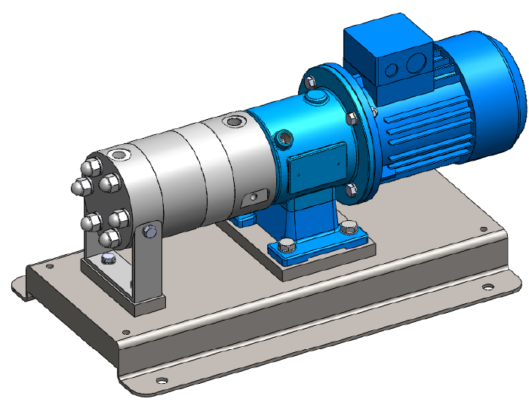
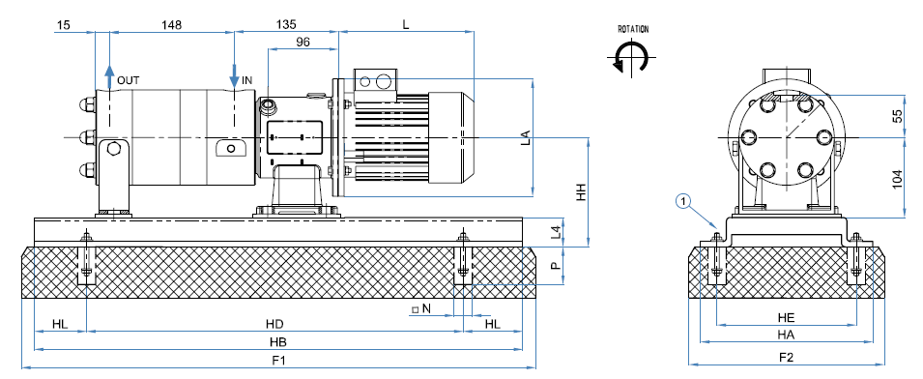
Option 0: Replacement of the pumps

Slide 7
Option 1: Refurbishment of the present plant
Recover of some components
Design of a new Tank
Design of a new rack
Same thermodynamic working principle
…

Slide 8
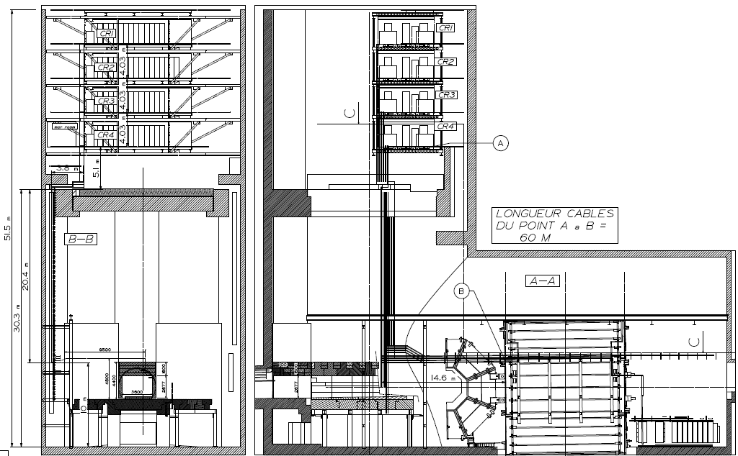
CR5 Platform

Slide 9
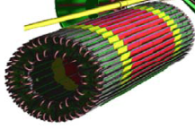
Option 2: Water/Air Cooled Condenser in CR5
Condensation pressure at 3.2bar (30°C)
in case of mixed water failure
Water cooled condenser @ 2.2bar
No Pumps
No insulation on the supply line
PT
Return Gas pressure set point of 1.4 to 1.8 bar
Mixed water
Same Supply and Return Manifolds
Height
Return Manifold (Vap.)
DUMMY LOAD
(By – Pass)
H=~8m
Supply Manifold (Liq.)
PT
Supply Liquid pressure set point of 3.5 to 6.5bar
Particle Filters

Slide 10
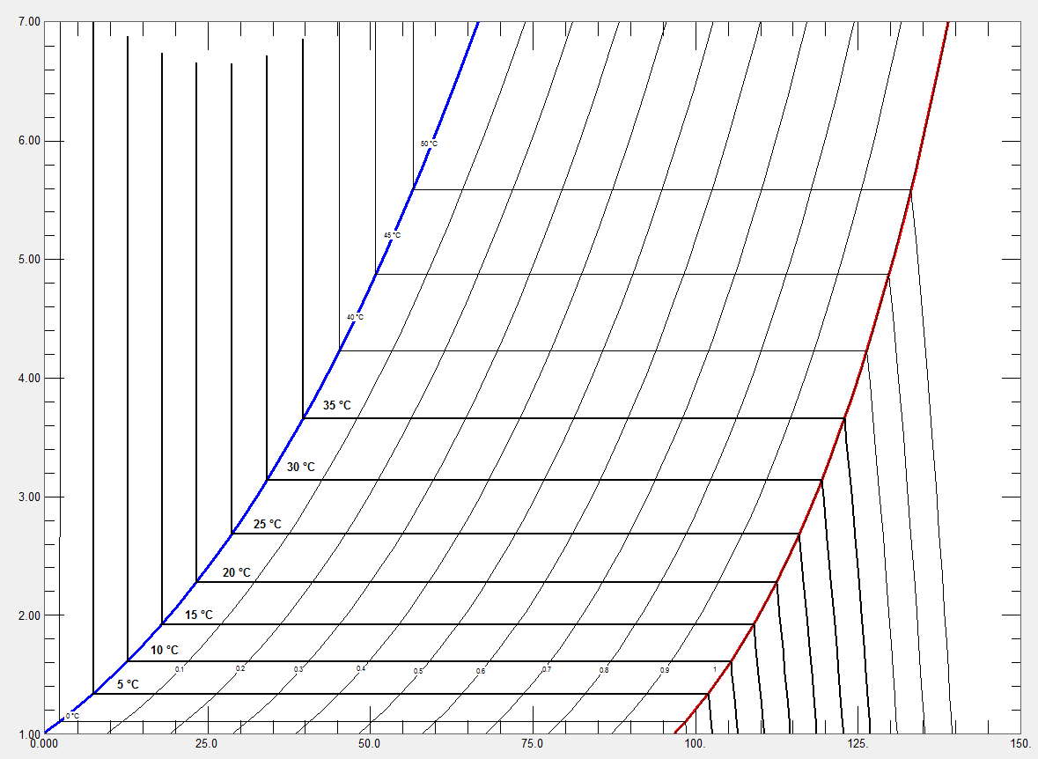
Option 2: Water/Air Cooled Condenser in CR5
D
C4F10 Liquid
C4F10 2-phase
C4F10
Vapour
E
F
Pressure [bar]
C’
B’
C
B
G
A
Enthalpy [kJ/kg]

Slide 11
Option 3: Thermosyphon
Return Gas pressure set point of 1.4 to 1.8 bar
- No Pumps
- No compressors
- Insulation on vertical supply line
PT
Main
Chiller
Redundant
Chiller
Same Supply and Return Manifolds
Height
Return Manifold (Vap.)
DUMMY LOAD
(By – Pass)
H=~8m
Supply Manifold (Liq.)
PT
Supply Liquid pressure set point of 3.5 to 6.5bar
Particle Filters

Slide 12
Option 3: Thermosyphon Set Points
Condenser Saturation Pressure:
  Dependent on the evaporation temperature and return pressure drop:
    P_{Cond} = P_{sat} – P_{height} – P_{return rack} – P_{Drop Return line}
    P_{Cond} = 1.73 bar (Evap. Temp. 12°C) – 0.046 bar (height) – 0.1 bar (return rack) – 0.015 bar (DN32, 45m) = 1.57 bar (Saturation Temperature of 9.35°C).
Condenser Liquid Temperature = 9.35 °C – 5 °C = 4.35°C -> Insulation needed on the vertical supply line.
Available Height: 32m
  Dependent on the supply pressure Set Point, Condenser pressure, and Supply Pressure Drop; Calculation of the required Hydrostatic Pressure:
    P_{supply} = P_{Hydrostatic} + P_{Condenser} – P_{drop supply pipes}
    P_{supply} = 4.9 bar + 1.57 bar – 0.01 bar (DN25, 45m length) = 6.5 bar
    Supply pressure can be increased if Condenser height is increased (150mbar/meter)

Slide 13
Option 3: C4F10 P-H Diagram
C4F10 Liquid
C
D
C4F10 2-phase
A-B: Condensation and sub-cooling
B-C: Hydrostatic Pressure difference
C-D: Heat to Ambient Temperature
D-E: Pressure regulation + Detector height
E-F: Sub-Cooling (PP4)
F-G: Capillary/Expansion
G-H: Evaporation and superheating
H-A: Return pressure drop
F
E
Pressure [bar]
C4F10
Vapour
H
G
A
B
Enthalpy [kJ/kg]

Slide 14
Conclusion
(Option 0) The implementation of two stage pumps can improve the reliability of the existing ones.
(Option 1) The refurbishment of the plant (with new pumps or not) solves the problems of leaks and power cuts but, not the dependence of mixed/chilled water.
(Option 2) The implementation of a water/air cooled condenser in CR5 solves the problems of leaks, power cuts, and pump failures.
(Option 3) The implementation of the condenser in CR5 using a low temperature redundant chiller solves the problems of leaks, power cuts, pump failure, and has no working components on the C4F10 loop.

