Slide 1




Exchange coupled donor dimers in nanocrystal quantum dots
MAP-fis PhD Research Conference – January 2012, Braga
A. J. Almeida¹, R. N. Pereira¹, A. R. Stegner², M. S. Brandt², H. Wiggers³
¹ Institute of Nanostructures, Nanomodeling and Nanofabrication, University of Aveiro, 3810-193 Aveiro, Portugal
² Walter Schottky Institut, Technische Universität München, Am Coulombwall 3, 85748 Garching, Germany
³ Institut für Verbrenung und Gasdynamik, Universität Duisburg-Essen, 47048 Duisburg, Germany
University
of Aveiro
WALTER SCHOTTKY
INSTITUT

Slide 2
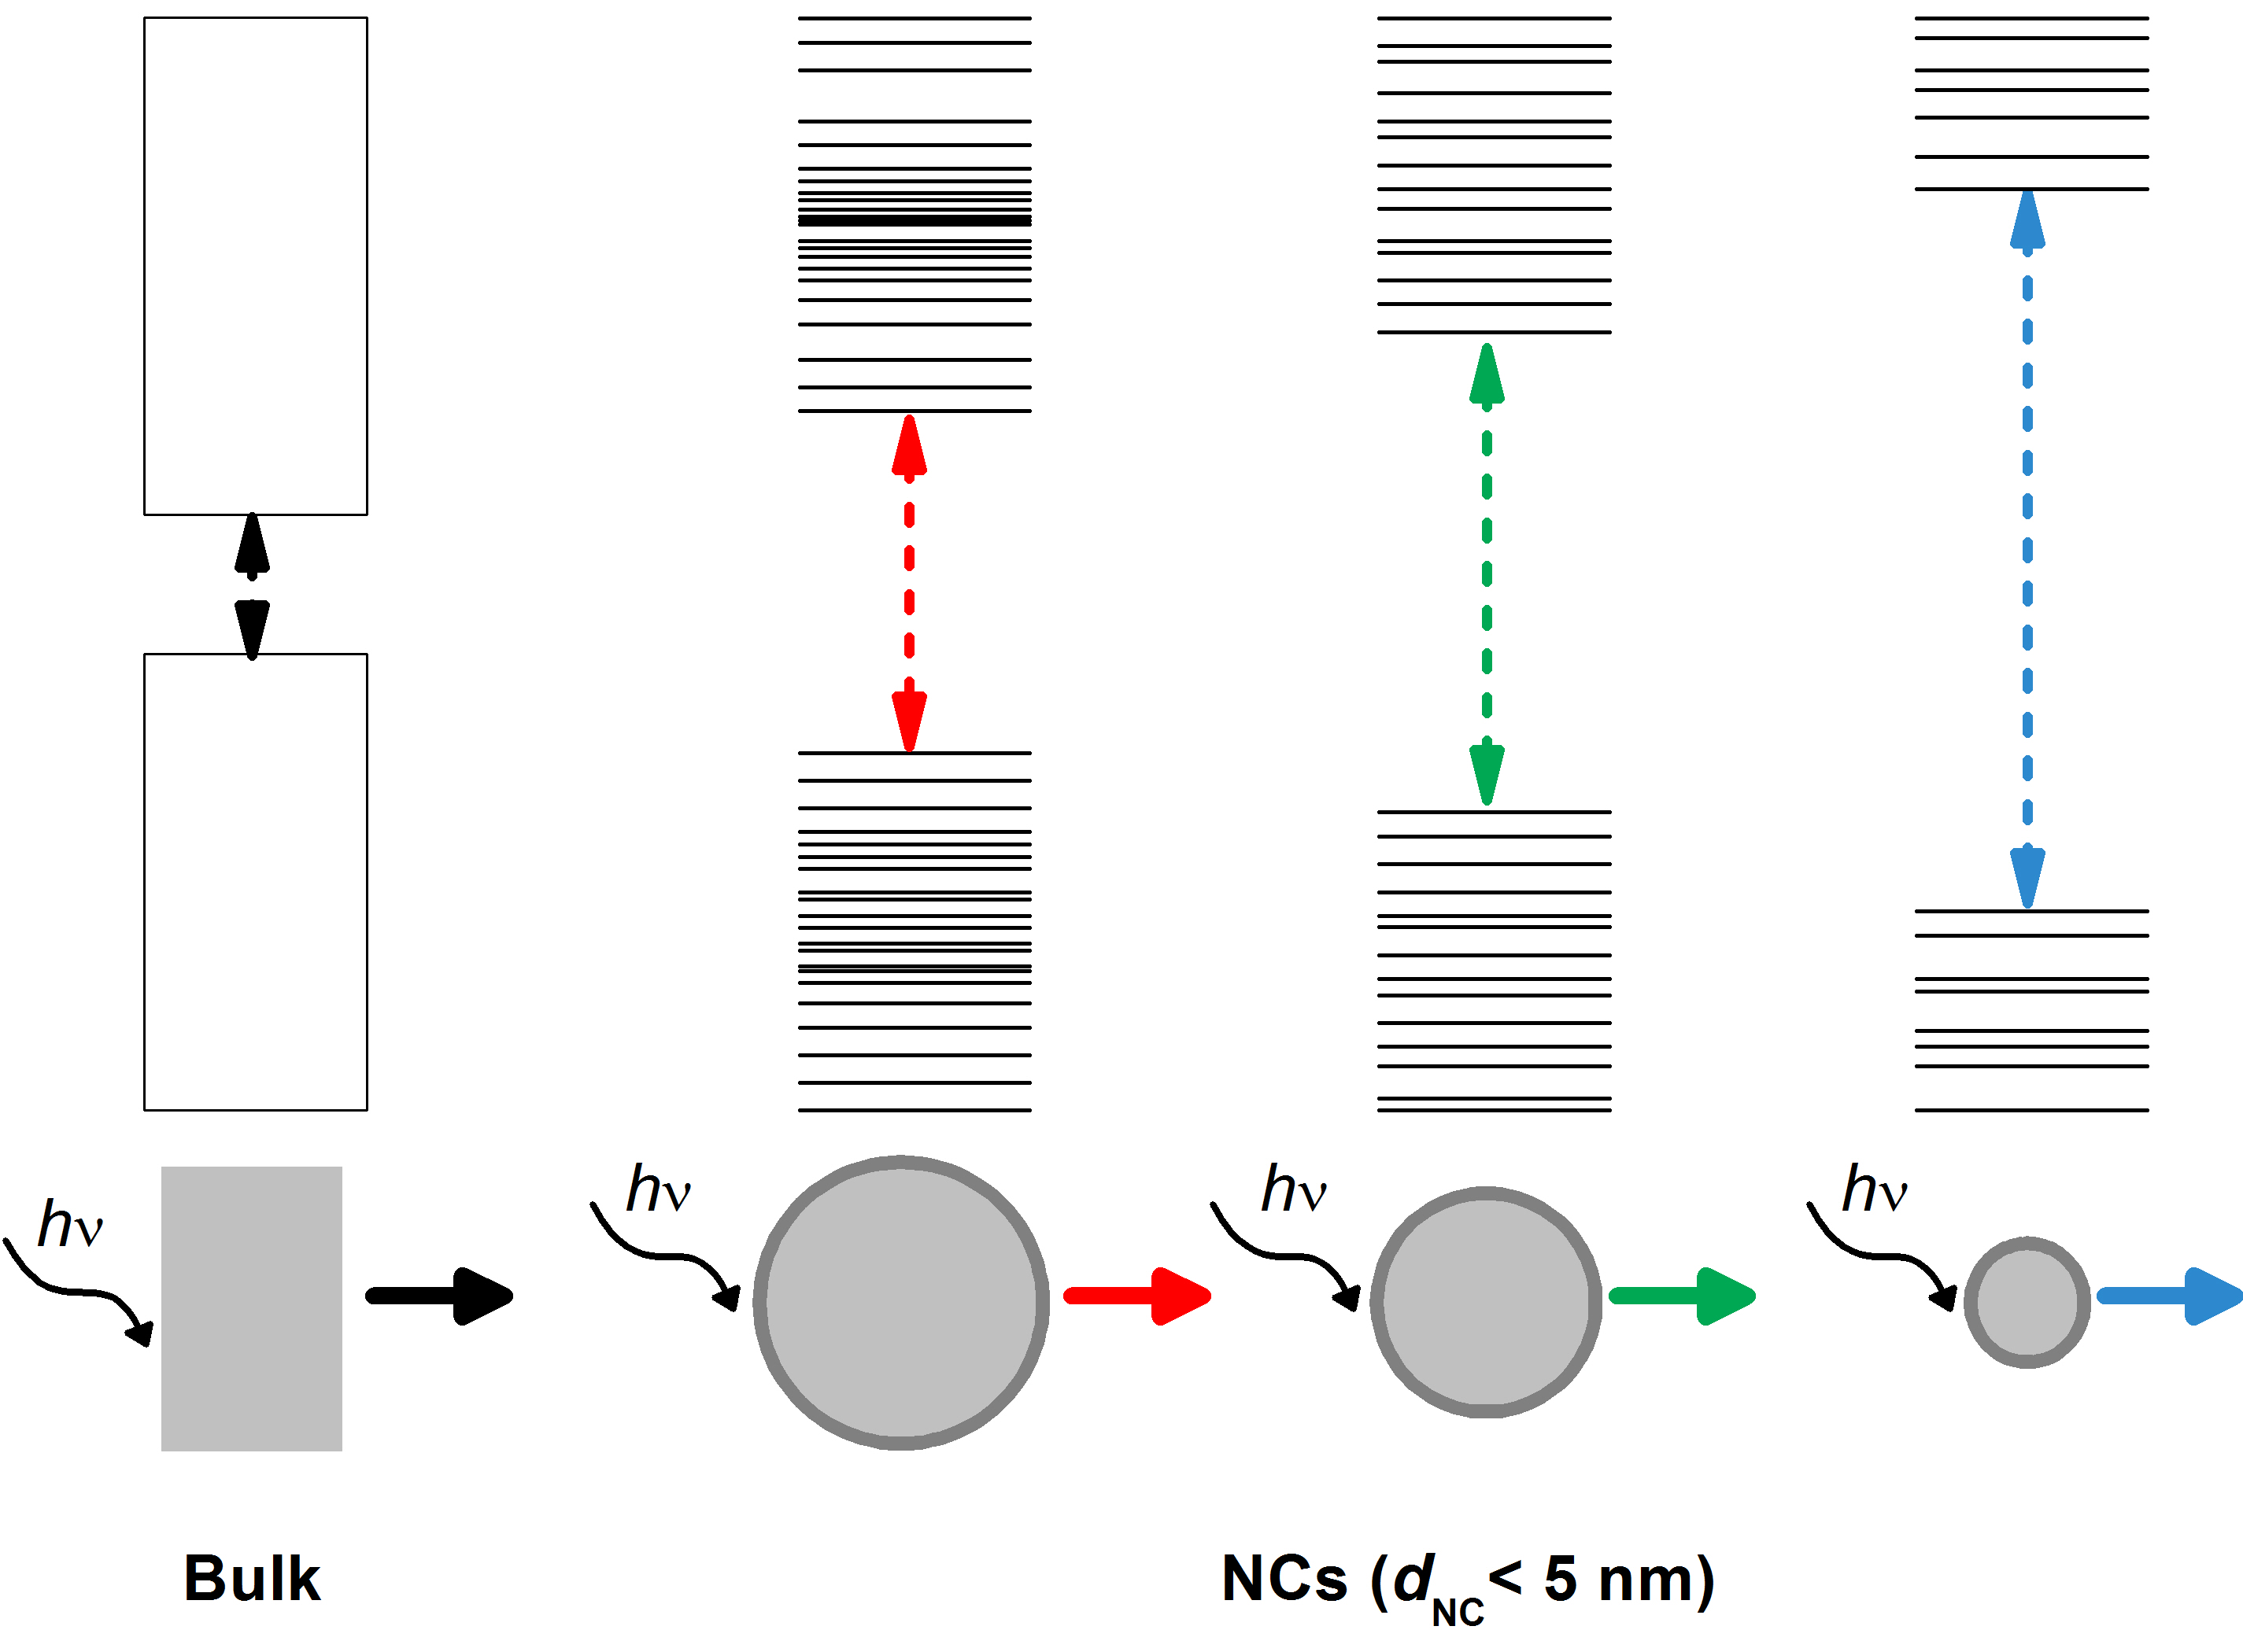
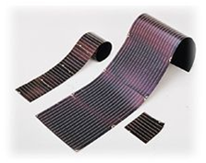
Motivation
Interesting properties:
CB
Photoluminescence for d_{NC} < 5 nm
High surface/volume ratio;
Tunable bandgap;
Intra- vs. interparticle physics.
VB
Applications:
Printable electronics;
Thermoelectric power devices;
[Lechner et al. Phys. Stat. Sol. (RRL) 1, 262 (2007)]
Solar cells;
[Lui et al., Nano Lett. 9, 449 (2009)]
Lighting;
[Cheng et al., Nano Lett. 11, 1952 (2011)]
Understanding and control of doping is crucial for many of the applications!
MAP-fis PhD Research Conference - 2012
1/16

Slide 3
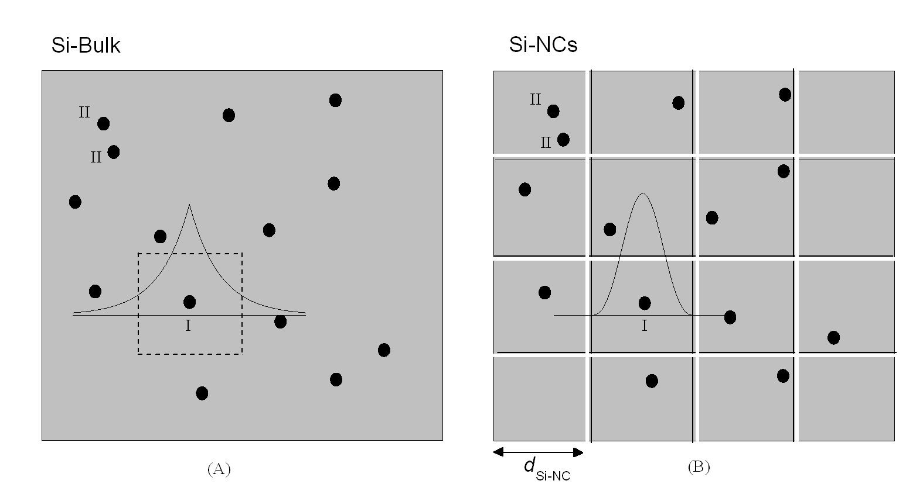
Motivation
Properties of dopants in the bulk cannot be transposed to NCs:
[P]>3.7x10¹⁸ cm⁻³
[P]>3.7x10¹⁸ cm⁻³
Confinement and
Isolation
Exchange interaction of many dopants
Exchange interaction between few dopants
CB
Impurity
subband
Impurity subband model unsuitable!
VB
MAP-fis PhD Research Conference - 2012
2/16

Slide 4
Outline
Synthesis and basic properties of P doped Si NCs ensembles
  Characteristics of our P doped Si NCs ensemble
  Only NCs with single donor electrons or dimers are statistically relevant
Probing P doping of Si NCs via low-temperature Q-band electron paramagnetic resonance (EPR) spectroscopy
Signal from surface defects, which displays Curie paramagnetism ( )
At low T, signal at g=1.998 due to exchange coupled dimers deviates
from
Theoretical framework for exchange coupled donor dimers in NCs
  Prediction of EPR spectra from electronic structure of single donor electrons and dimers
  Prediction of the variation of the EPR signal due to dimers
Conclusions
MAP-fis PhD Research Conference - 2012
3/16

Slide 5
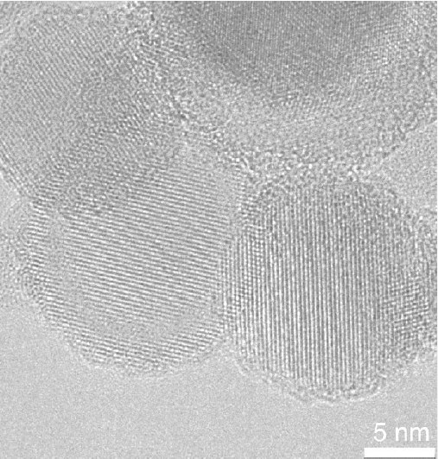
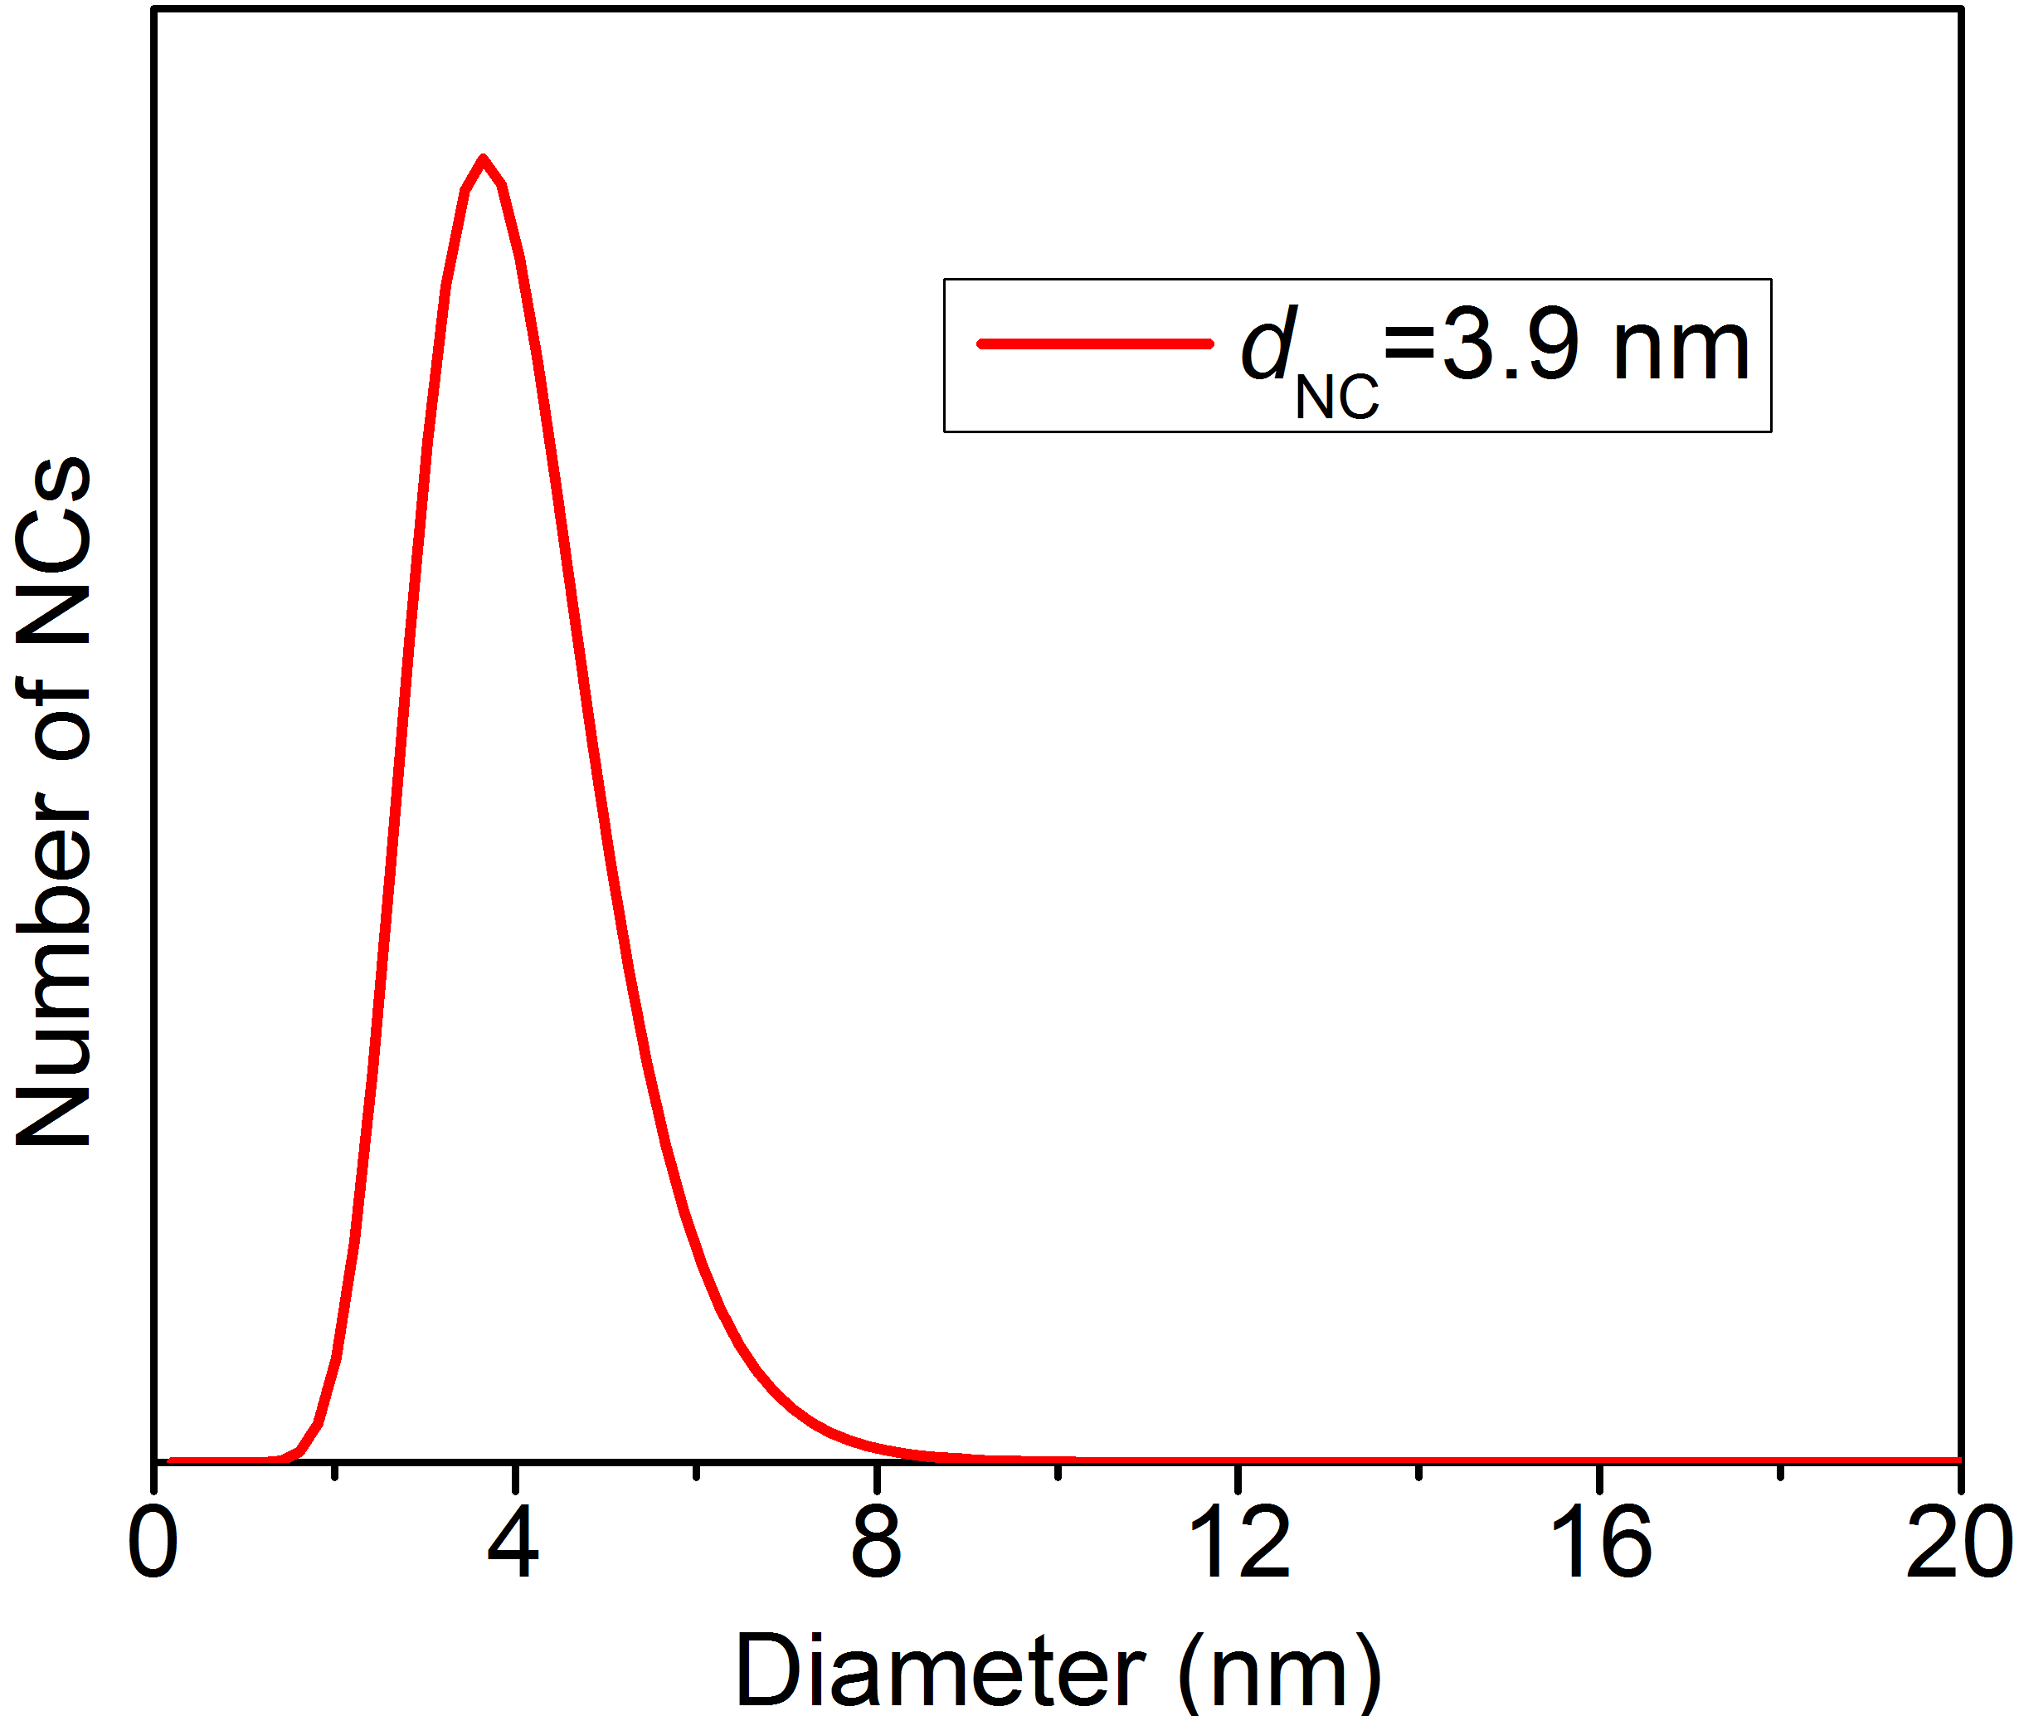
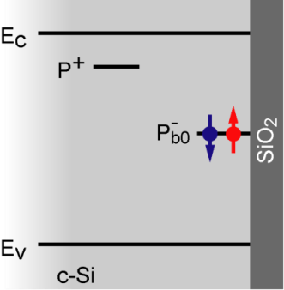
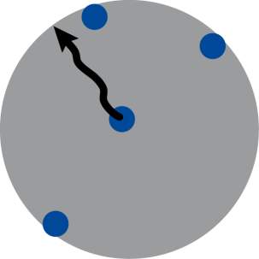
Donors in NCs
Synthesis and basic properties of measured P doped Si NCs:
Growth of Si NCs in a low pressure microwave plasma reactor;
Powder of isolated Si nanoparticles;
Lognormal size distribution with a standard deviation of σ≈1.3;
A natural oxide shell is formed upon exposure to air (oxide thickness ≈ 1.5 nm) ;
surface defects
(Si-dbs)
c-Si
core
SiO₂
shell
J. Knipping, H. Wiggers et al., J Nanoscience and Nanotechnology 4, 1039 (2004)
Segregation
Compensation
Donors incorporated during growth (substitutional doping) with efficiency ≈100%;
Segregation – 95% of the incorporated donors segregate to surface, which oxidizes;
Compensation – Some donor electrons in NCs core become trapped in surface defects;
P donor
SiO₂ shell
A. R. Stegner, R. N. Pereira et al., Phys. Rev. B 80, 165326 (2009)
MAP-fis PhD Research Conference - 2012
4/16

Slide 6
Donors in NCs
Measured P doped Si NCs:
Macroscopic amount of NC powder (NCs ensemble)
Mean NC diameter d_{NC}=3.9 nm
Ensemble density of surface defects [Si-dbs]=1.8x10¹¹ cm⁻³ (as previously measured by EPR)
Segregation
Segregation
Compensation
Nominal doping
concentration
Ensemble density of P donors in NC cores
Ensemble density
of donor electrons
[P]_{NOM}≈ 5x10²⁰ cm⁻³
[P]_{CORE} ≈ 2.5x10¹⁹ cm⁻³
[e–] ≈1.4x10¹⁹ cm⁻³
A. R. Stegner, R. N. Pereira et al., Phys. Rev. B 80, 165326 (2009)
How are these donor electrons distributed in our P doped Si NCs?
MAP-fis PhD Research Conference - 2012
5/16

Slide 7
Donors in NCs
Measured P doped Si NCs:
Macroscopic amount of NC powder (NCs ensemble)
Mean NC diameter d_{NC}=3.9 nm
Ensemble density of surface defects [Si-dbs]=1.8x10¹¹ cm⁻³ (as previously measured by EPR)
Segregation
Segregation
Compensation
Nominal doping
concentration
Ensemble density of P donors in NC cores
Ensemble density
of donor electrons
[P]_{NOM}≈ 5x10²⁰ cm⁻³
[P]_{CORE} ≈ 2.5x10¹⁹ cm⁻³
[e–] ≈1.4x10¹⁹ cm⁻³
A. R. Stegner, R. N. Pereira et al., Phys. Rev. B 80, 165326 (2009)
How are these donor electrons distributed in our P doped Si NCs?
MAP-fis PhD Research Conference - 2012
5/16

Slide 8
Donors in NCs
Measured P doped Si NCs:
Macroscopic amount of NC powder (NCs ensemble)
Mean NC diameter d_{NC}=3.9 nm
Ensemble density of surface defects [Si-dbs]=1.8x10¹¹ cm⁻³ (as previously measured by EPR)
Segregation
Segregation
Compensation
Nominal doping
concentration
Ensemble density of P donors in NC cores
Ensemble density
of donor electrons
[P]_{NOM}≈ 5x10²⁰ cm⁻³
[P]_{CORE} ≈ 2.5x10¹⁹ cm⁻³
[e–] ≈1.4x10¹⁹ cm⁻³
A. R. Stegner, R. N. Pereira et al., Phys. Rev. B 80, 165326 (2009)
How are these donor electrons distributed in our P doped Si NCs?
MAP-fis PhD Research Conference - 2012
5/16

Slide 9
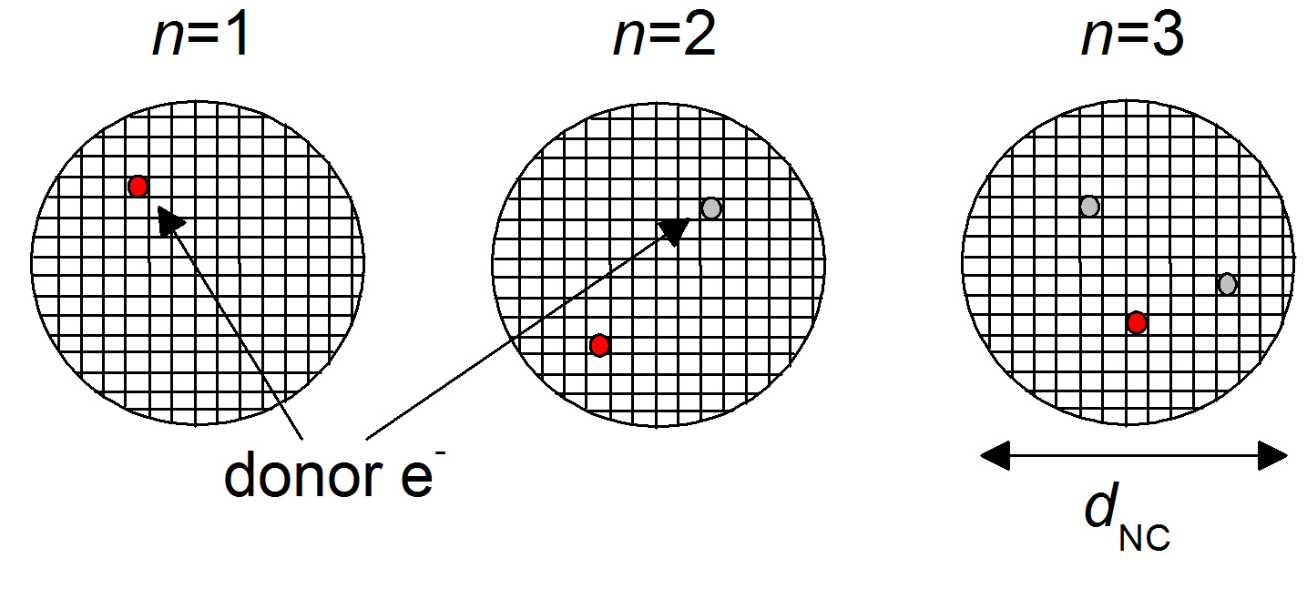
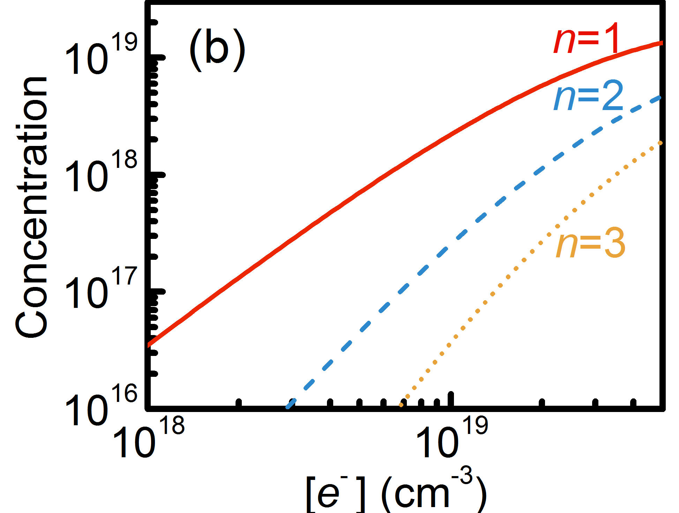
Donors in NCs
How are these donor electrons distributed in our P doped Si NCs?
We calculate the probability of one donor e– being in a NC core with n donor e⁻:
W – binomial distribution
N_{NC} – number NC lattice sites
– relative density of donor e⁻
Ensemble concentration of NCs containing a cluster of n donor e–:
d_{NC}=3.9nm
Statistically, most P doped NCs in our NCs ensemble contain:
Single donor e⁻ (n=1)
Donor dimers (n=2)
MAP-fis PhD Research Conference - 2012
6/16

Slide 10
Donors in NCs
How are these donor electrons distributed in our P doped Si NCs?
We calculate the probability of one donor e– being in a NC core with n donor e⁻:
W – binomial distribution
N_{NC} – number NC lattice sites
– relative density of donor e⁻
Ensemble concentration of donor e– clusters with n e–:
d_{NC}=3.9nm
Statistically, most P doped NCs in our NCs ensemble contain:
Single donor e⁻ (n=1)
Donor dimers (n=2)
MAP-fis PhD Research Conference - 2012
6/16

Slide 11
Outline
Synthesis and basic properties of P doped Si NCs ensembles
  Characteristics of our P doped Si NCs ensemble
  Only NCs with single donor electrons or dimers are statistically relevant
Probing P doping of Si NCs via low-temperature Q-band electron paramagnetic resonance (EPR) spectroscopy
Signal from surface defects, which displays Curie paramagnetism ( )
At low T, signal at g=1.998 due to exchange coupled dimers deviates
from
Theoretical framework for exchange coupled donor dimers in NCs
  Prediction of EPR spectra from electronic structure of single donor electrons and dimers
  Prediction of the variation of the EPR signal due to dimers
Conclusions
MAP-fis PhD Research Conference - 2012
7/16

Slide 12
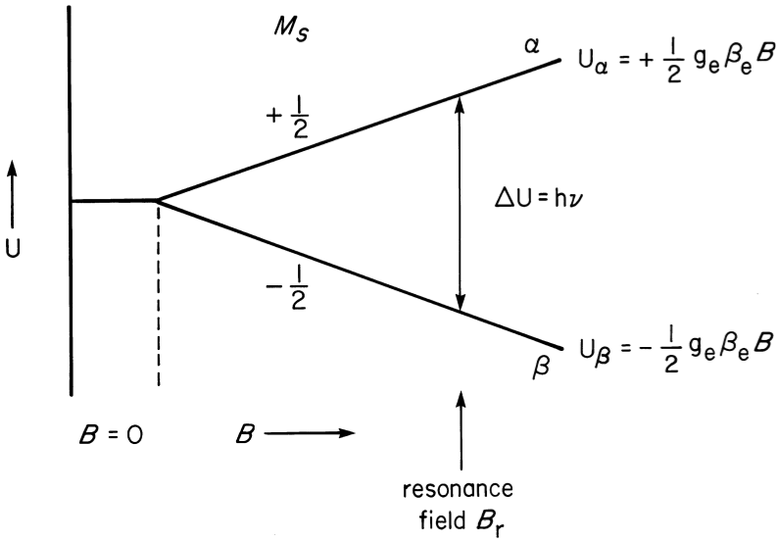
Principle of EPR spectroscopy
System with S=1/2
Ground state degeneracy equal to 2S+1=2
Applied magnetic field B lifts the degeneracy
Splitting of electronic levels ΔU=gμ_{B}B
Microwave radiation hν is applied
When ΔU=hν we have a resonant situation → EPR signal centered at B_{r}
Spectra acquired as first derivative
Microwave power below threshold for saturation
J. A. Weil, J. R. Bolton. Electron Paramagnetic Resonance: Elementary Theory and Pratical Applications. Wiley, 2nd edition, 2007
MAP-fis PhD Research Conference - 2012
8/16

Slide 13
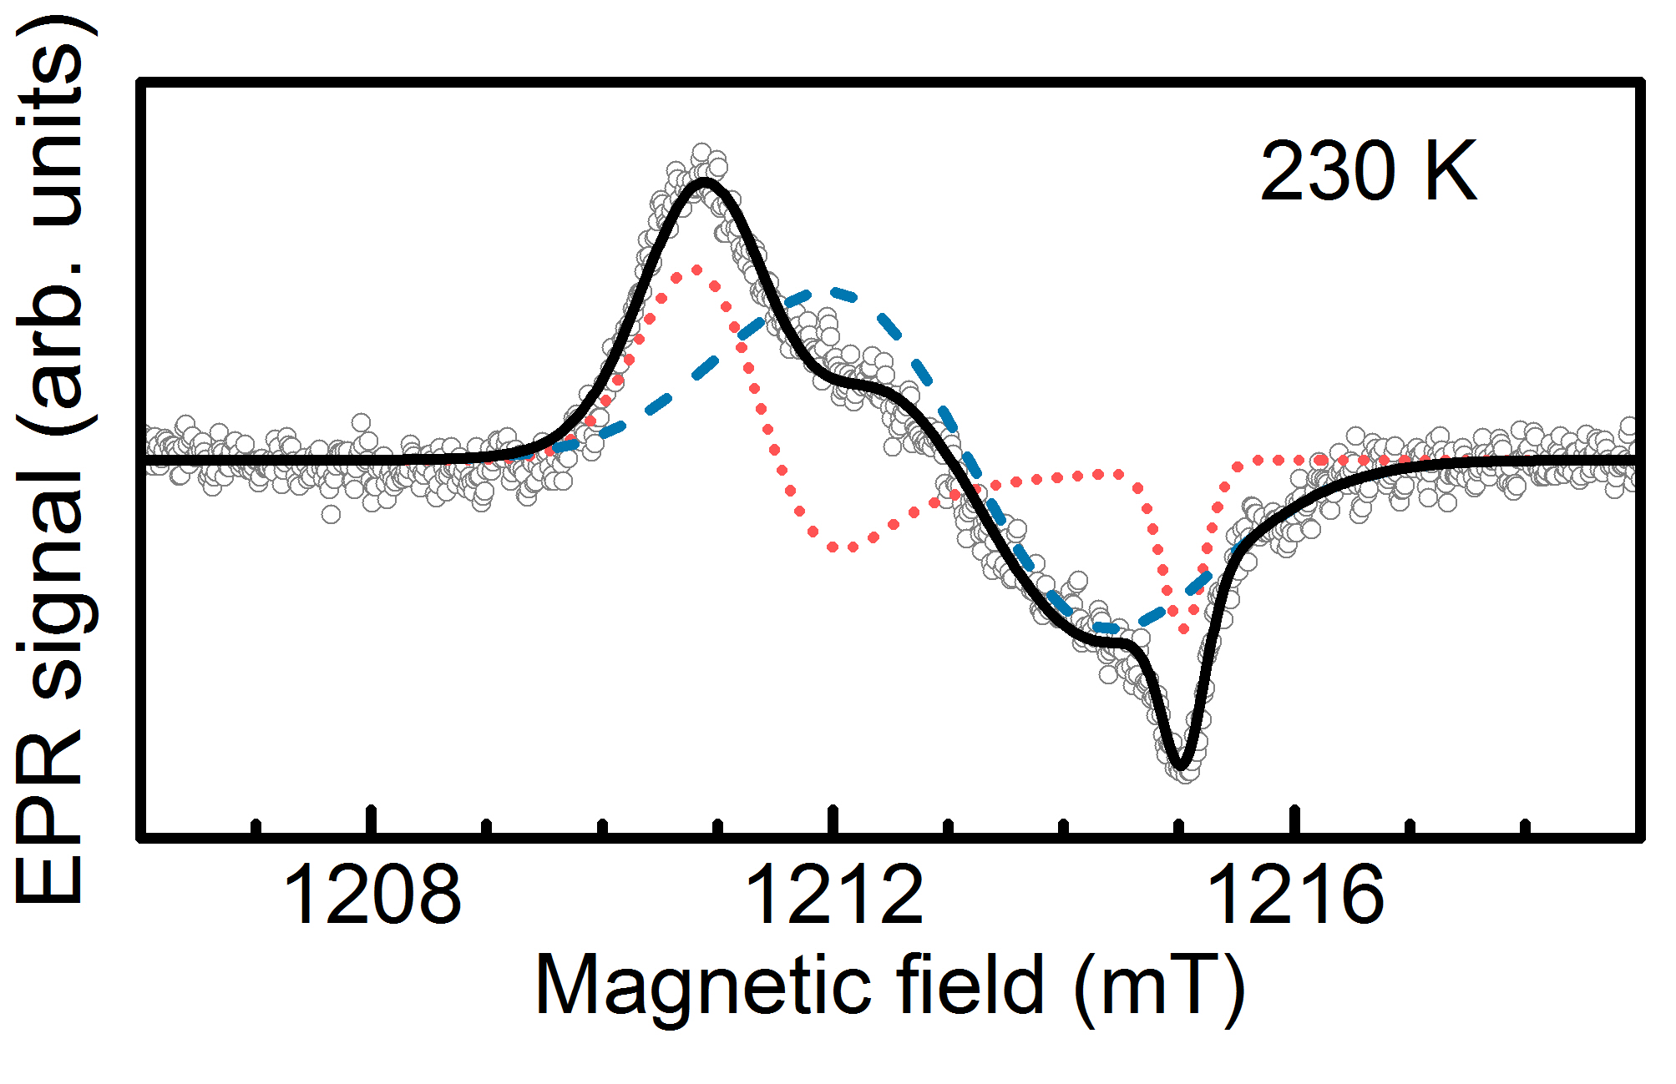
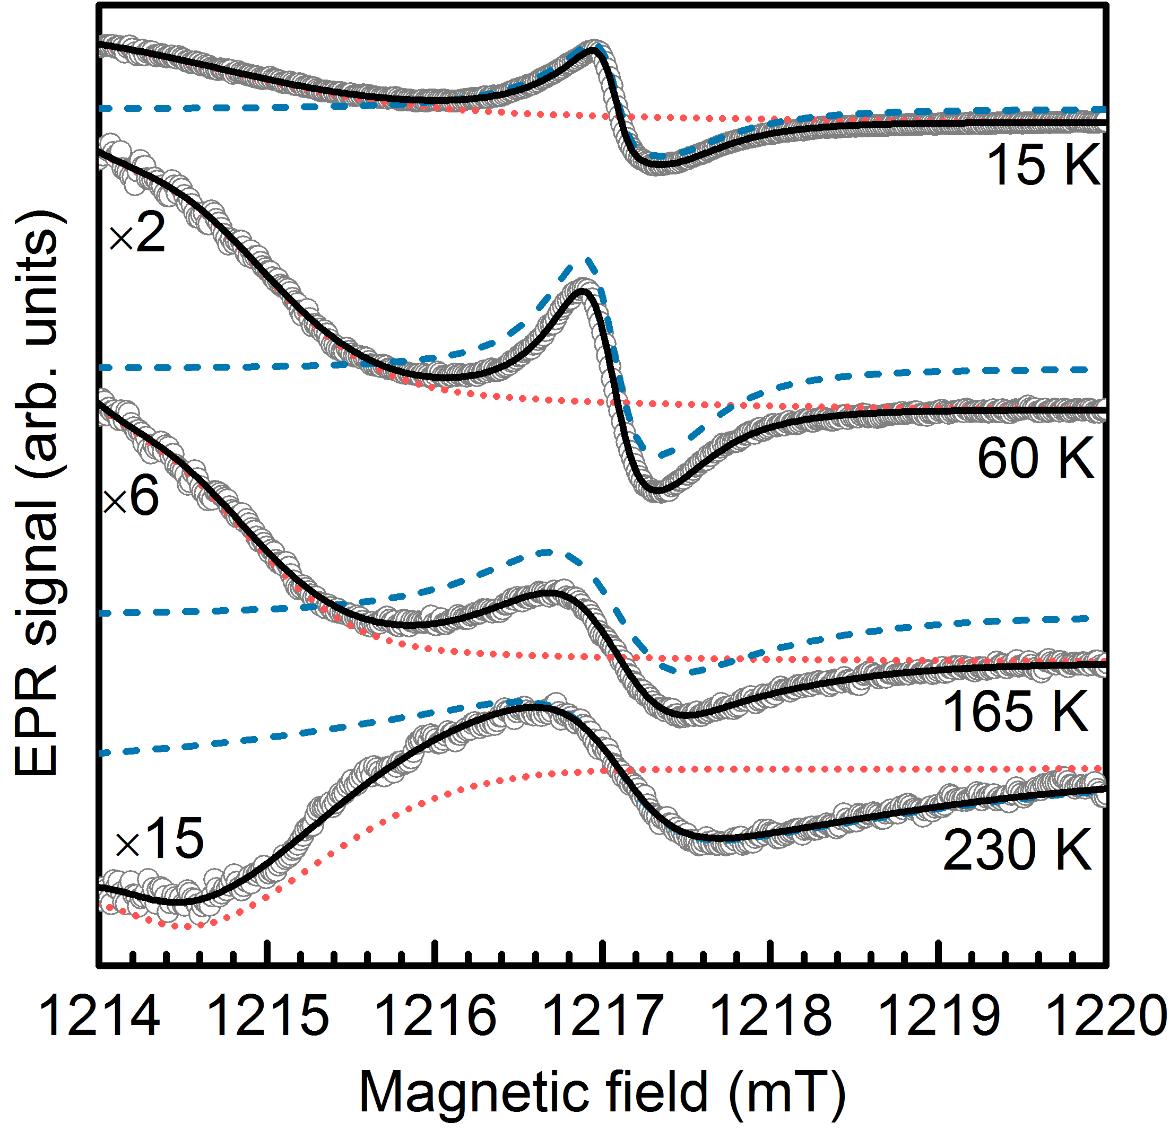
Donors in NCs: Q-band EPR spectroscopy
Low microwave power EPR spectra of P doped Si NCs:
High microwave power EPR spectra
of P doped Si NCs:
g_{anis}
g
g
Signal due to surface defects in NCs
g=1.998
Displays Curie paramagnetism
( )
Resonance at g=1.998
  Asymmetric at low T
Signal used as calibration constant for the measurement of the number of P donor states in Si NCs
Broad absorption band – saturated signal from Si-dbs
MAP-fis PhD Research Conference - 2012
9/16

Slide 14
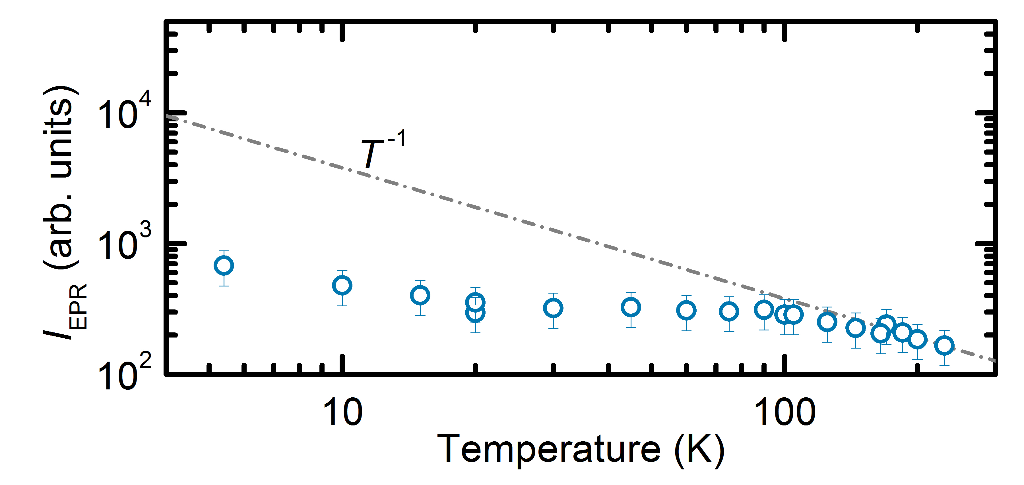
Donors in NCs: Q-band EPR spectroscopy
High microwave power EPR spectra
of P doped Si NCs:
g=1.998
At low T, signal due to dimers deviates from Curie paramagnetism
Resonance at g=1.998
  Asymmetric at low T
Density of detected donor electrons decreases with T
Broad absorption band – saturated signal from Si-dbs
MAP-fis PhD Research Conference - 2012
10/16

Slide 15
Donors in NCs: Q-band EPR spectroscopy
High microwave power EPR spectra
of P doped Si NCs:
As we have seen before from our statistical analysis, donors in our NCs are present mostly as isolated donors and donor dimers
g=1.998
To understand these spectra, we must unravel the electronic structure of dimers in NCs
Resonance at g=1.998
  Asymmetric at low T
Broad absorption band – saturated signal from Si-dbs
MAP-fis PhD Research Conference - 2012
10/16

Slide 16
Outline
Synthesis and basic properties of P doped Si NCs ensembles
  Characteristics of our P doped Si NCs ensemble
  Only NCs with single donor electrons or dimers are statistically relevant
Probing P doping of Si NCs via low-temperature Q-band electron paramagnetic resonance (EPR) spectroscopy
Signal from surface defects, which displays Curie paramagnetism ( )
At low T, signal at g=1.998 due to exchange coupled dimers deviates
from
Theoretical framework for exchange coupled dimers in NCs
  Prediction of EPR spectra from electronic structure of single donor electrons and dimers
  Prediction of the variation of the EPR signal due to dimers in P doped Si NCS
Conclusions
Conclusions
MAP-fis PhD Research Conference - 2012
11/16

Slide 17
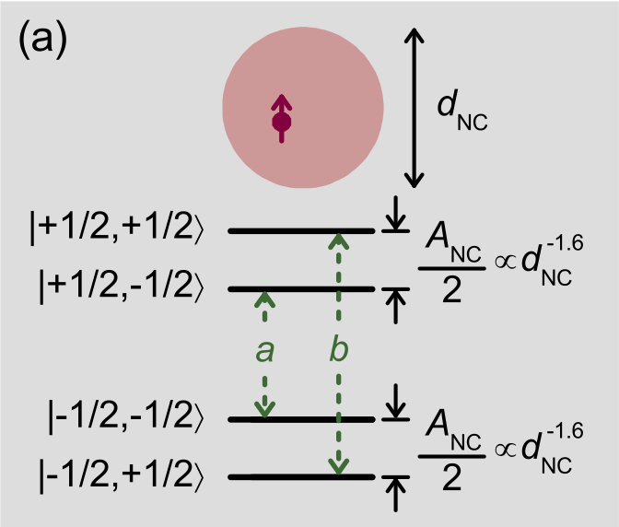
Donors in NCs: theoretical framework
Single donors
Zeeman effect
Hyperfine interaction
EPR signal: (a) and (b) – doublet with hyperfine splitting A_{NC}
Absent in measured spectra! Why:
A_{NC} is size dependent:
R. N. Pereira, A. R. Stegner et al., Phys. Rev. B, 79, 161304 (R) (2009)
Our P doped Si NCs show lognormal size distribution
Broadening and quenching of single donor signal in conventional EPR
MAP-fis PhD Research Conference - 2012
12/16

Slide 18
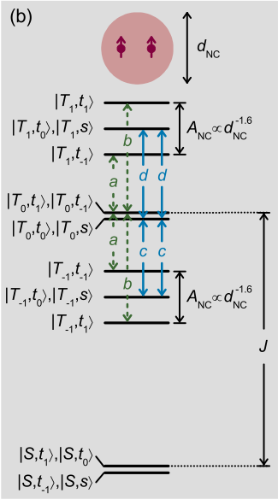
Donors in NCs: theoretical framework
Donor dimers
Zeeman effect
Hyperfine interaction
Exchange
coupling
Singlet (S=0) and triplet (S=1) states separated by J
Only dimers in triplet states are EPR-active
(these states are thermally populated)
EPR signal: (a) and (b) – hyperfine doublet separated by A_{NC}
(c) and (d) –
MAP-fis PhD Research Conference - 2012
13/16

Slide 19
Donors in NCs: theoretical framework
Donor dimers
g=1.998
For J>>A_{NC}, c and d are degenerate and centered at g=1.998
Resonance at g=1.998 should be due to transitions (c) and (d)
To confirm this assignment, we need to calculate J
MAP-fis PhD Research Conference - 2012
13/16

Slide 20
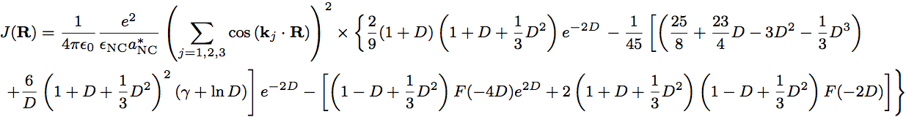
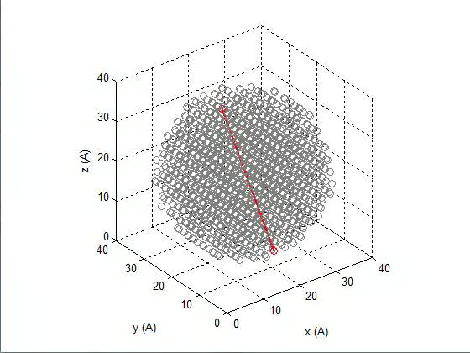
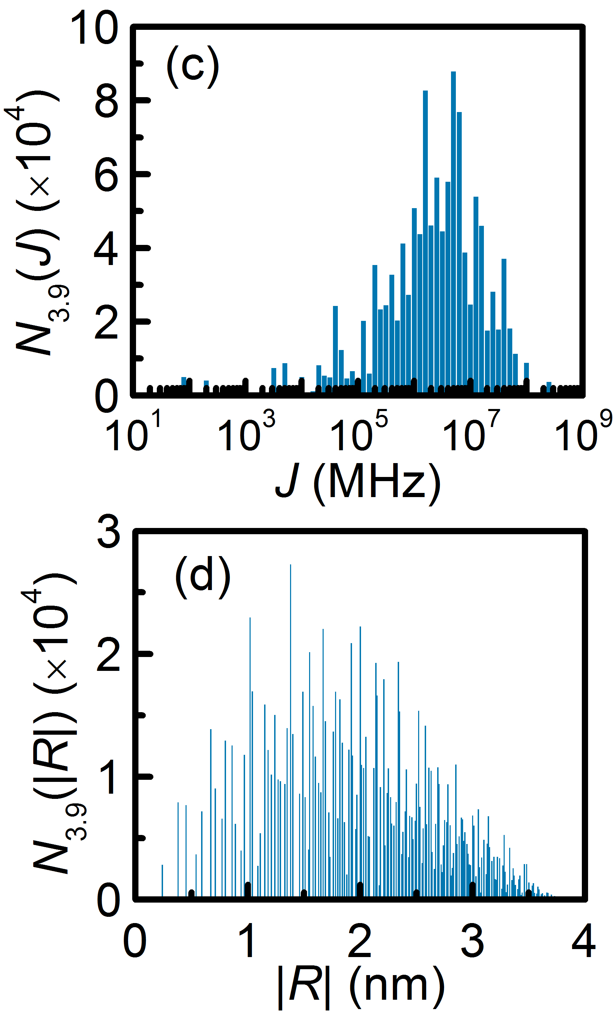
Donor dimers: theoretical framework
To calculate J we use this expression
P. R. Cullis, J. R. Marcus, Phys. Rev. B 1, 632 (1970)
Each donor wave function is described by the hydrogenic model –> effective mass theory
Computational implementation
N(J) spans over three orders of magnitude
    angular dependence
    donor separation dependence
Most J>10⁵ MHz
From N(J), we will estimate I_{EPR}(T)
MAP-fis PhD Research Conference - 2012
14/16

Slide 21
Donor dimers: theoretical framework
To calculate J we use this expression
P. R. Cullis, J. R. Marcus, Phys. Rev. B 1, 632 (1970)
Each donor wave function is described by the hydrogenic model –> effective mass theory
Computational implementation
N(J) spans over three orders of magnitude
    angular dependence
    donor separation dependence
Most J>10⁵ MHz
From N(J), we will estimate I_{EPR}(T)
MAP-fis PhD Research Conference - 2012
14/16

Slide 22
Donor dimers: theoretical framework
To calculate J we use this expression
P. R. Cullis, J. R. Marcus, Phys. Rev. B 1, 632 (1970)
Each donor wave function is described by the hydrogenic model –> effective mass theory
Computational implementation
N(J) spans over three orders of magnitude
    angular dependence
    donor separation dependence
Most J>10⁵ MHz, we confirm that J>>A_{NC}
From N(J), we will estimate I_{EPR}(T)
MAP-fis PhD Research Conference - 2012
14/16

Slide 23
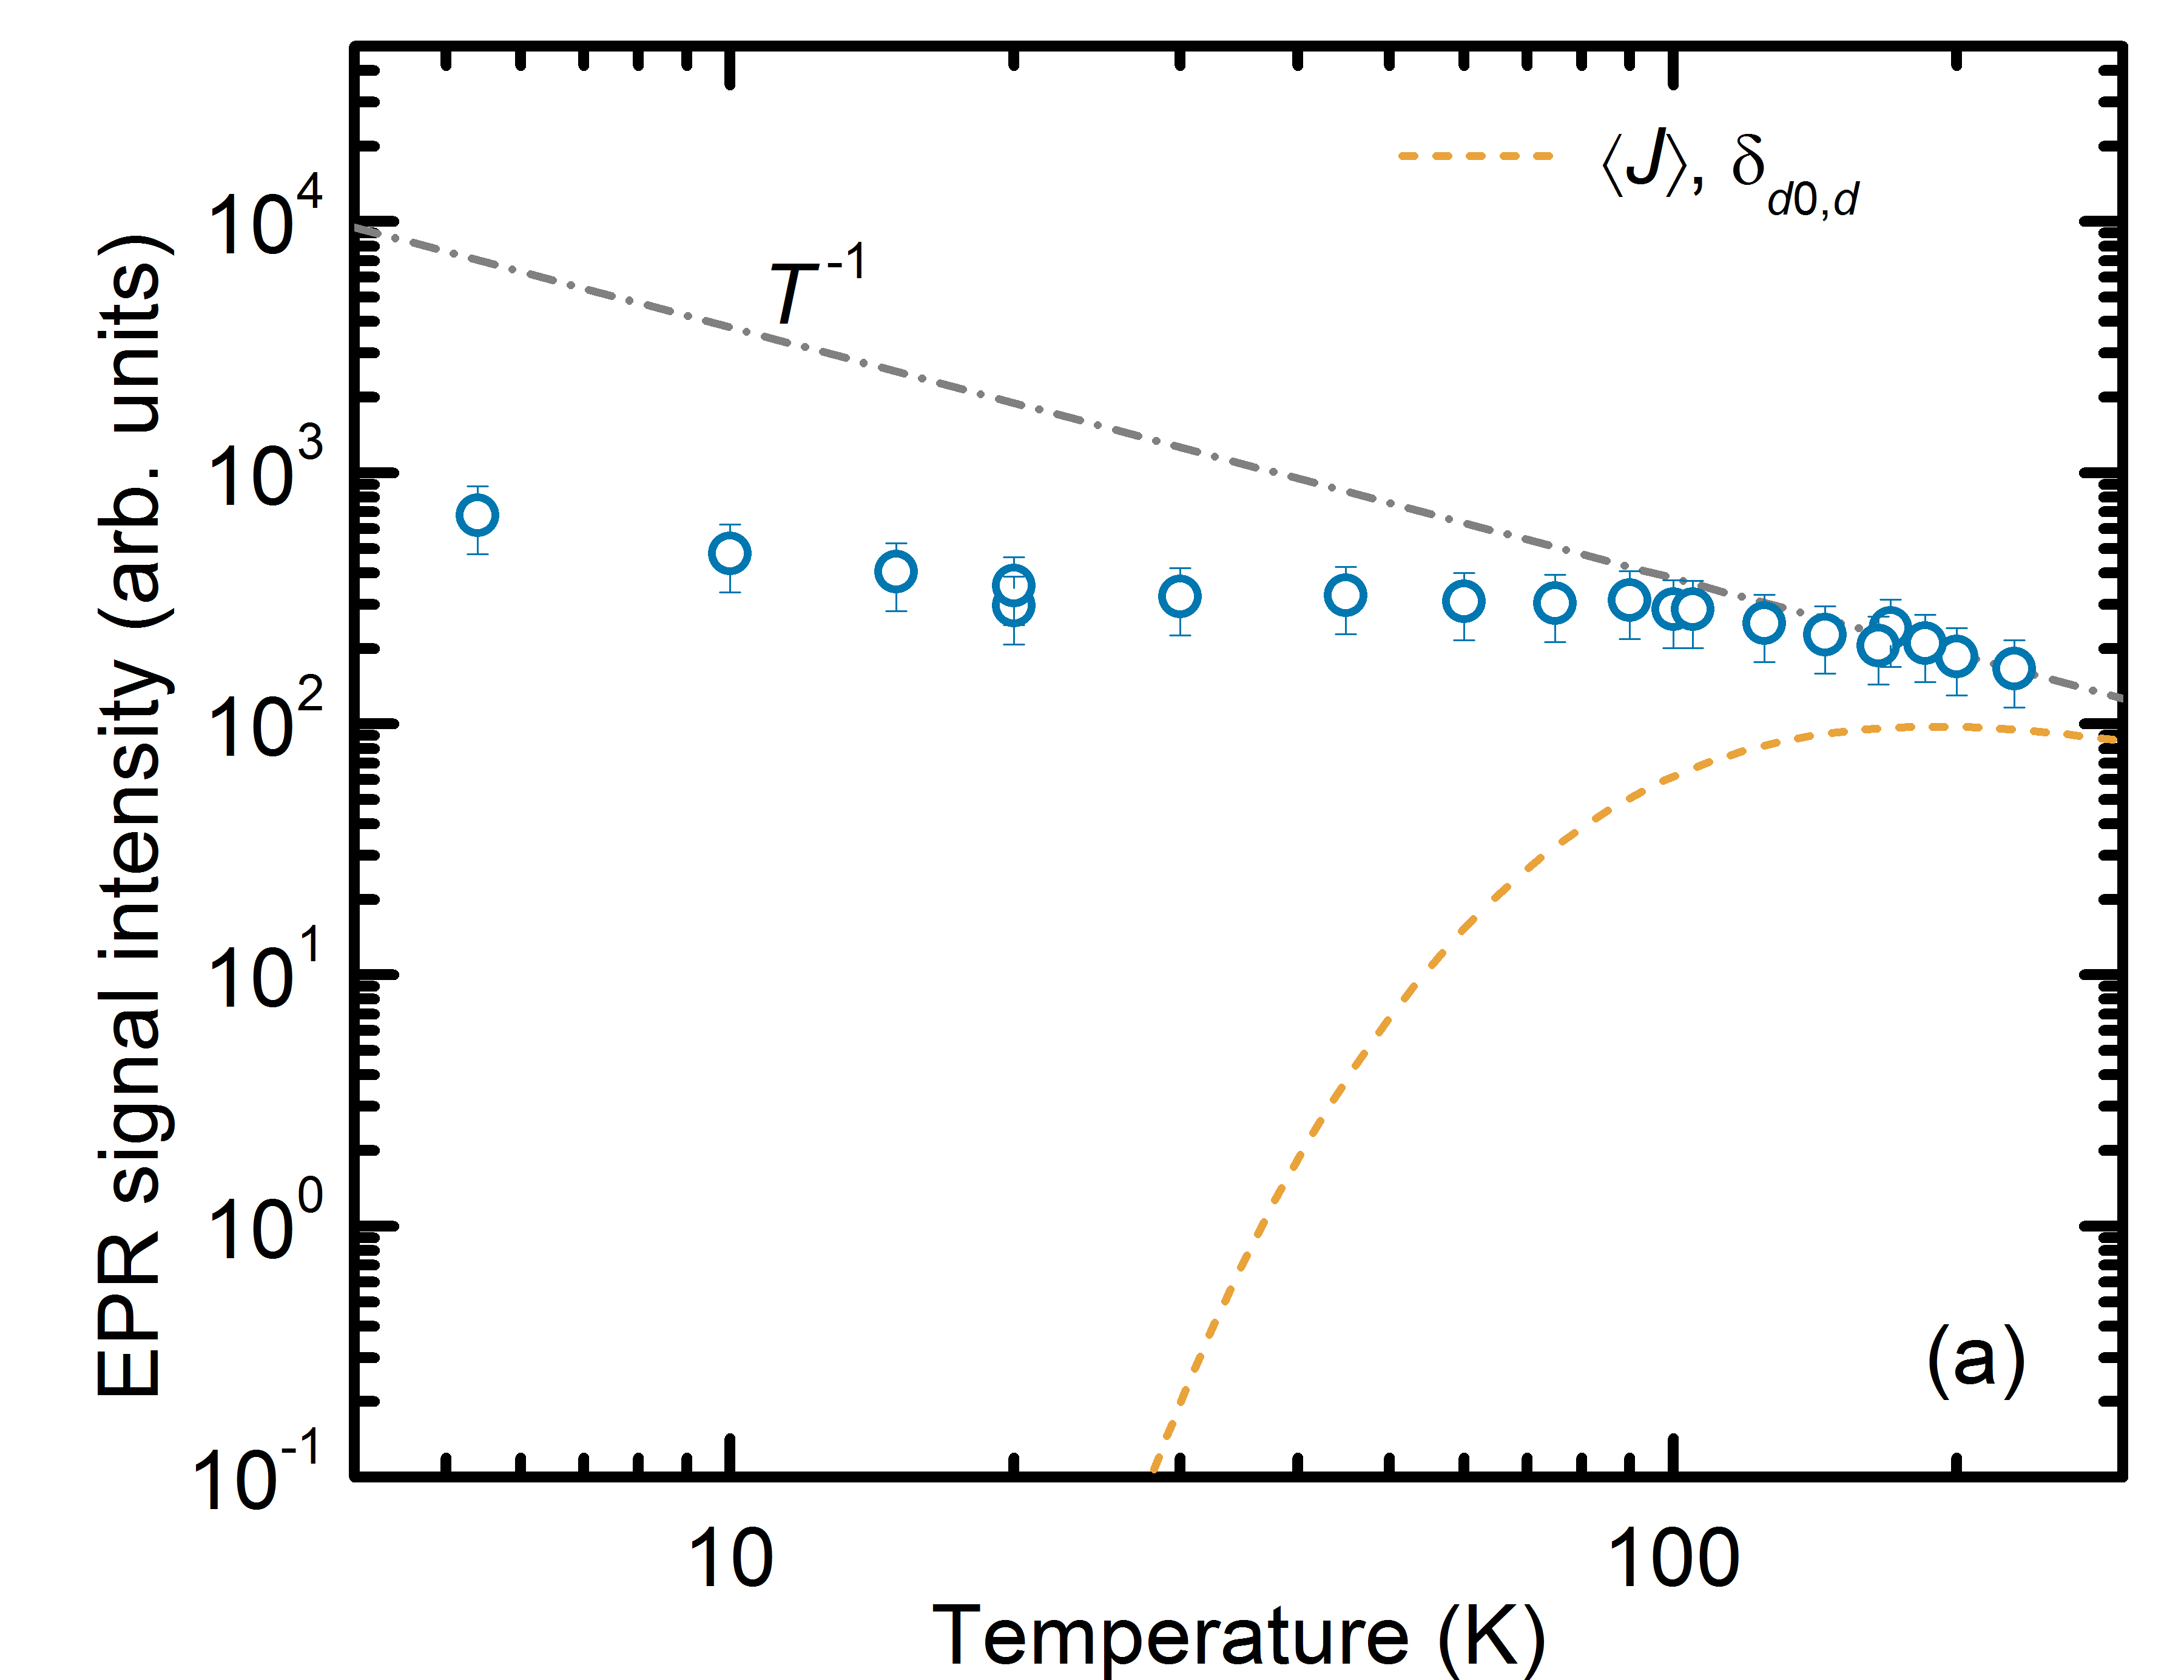
Donor dimers: theoretical framework
EPR intensity
calibration
Number of dimers in sample (fitting parameter)
This model considers:
average value of exchange energy, <J>
average radius of NCs in ensemble, δ_{d0,dNC}
N(J) gives dominant contribution to this deviation
From N_{D} we obtain [e⁻]≈1x10¹⁹ cm⁻³ and confirm that in this regime clusters with n>2 are negligible
MAP-fis PhD Research Conference - 2012
15/16

Slide 24
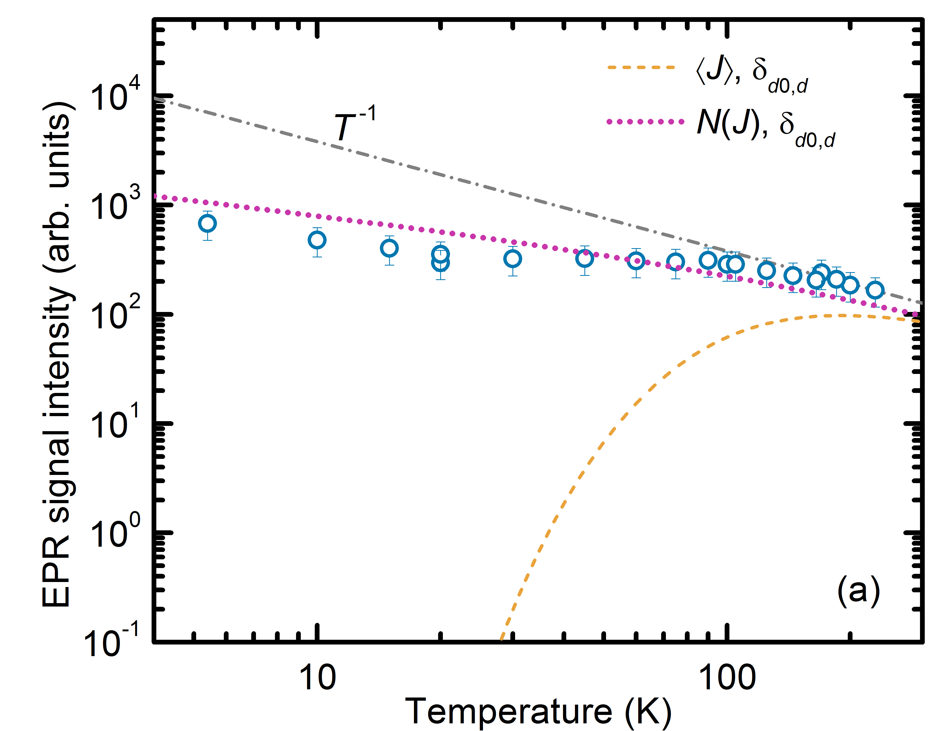
Donor dimers: theoretical framework
EPR intensity
calibration
Number of dimers in sample (fitting parameter)
This model considers:
distribution of J in our NCs ensemble, N(J)
average radius of NCs in ensemble, δ_{d0,dNC}
N(J) gives dominant contribution to this deviation
From N_{D} we obtain [e⁻]≈1x10¹⁹ cm⁻³ and confirm that in this regime clusters with n>2 are negligible
MAP-fis PhD Research Conference - 2012
15/16

Slide 25
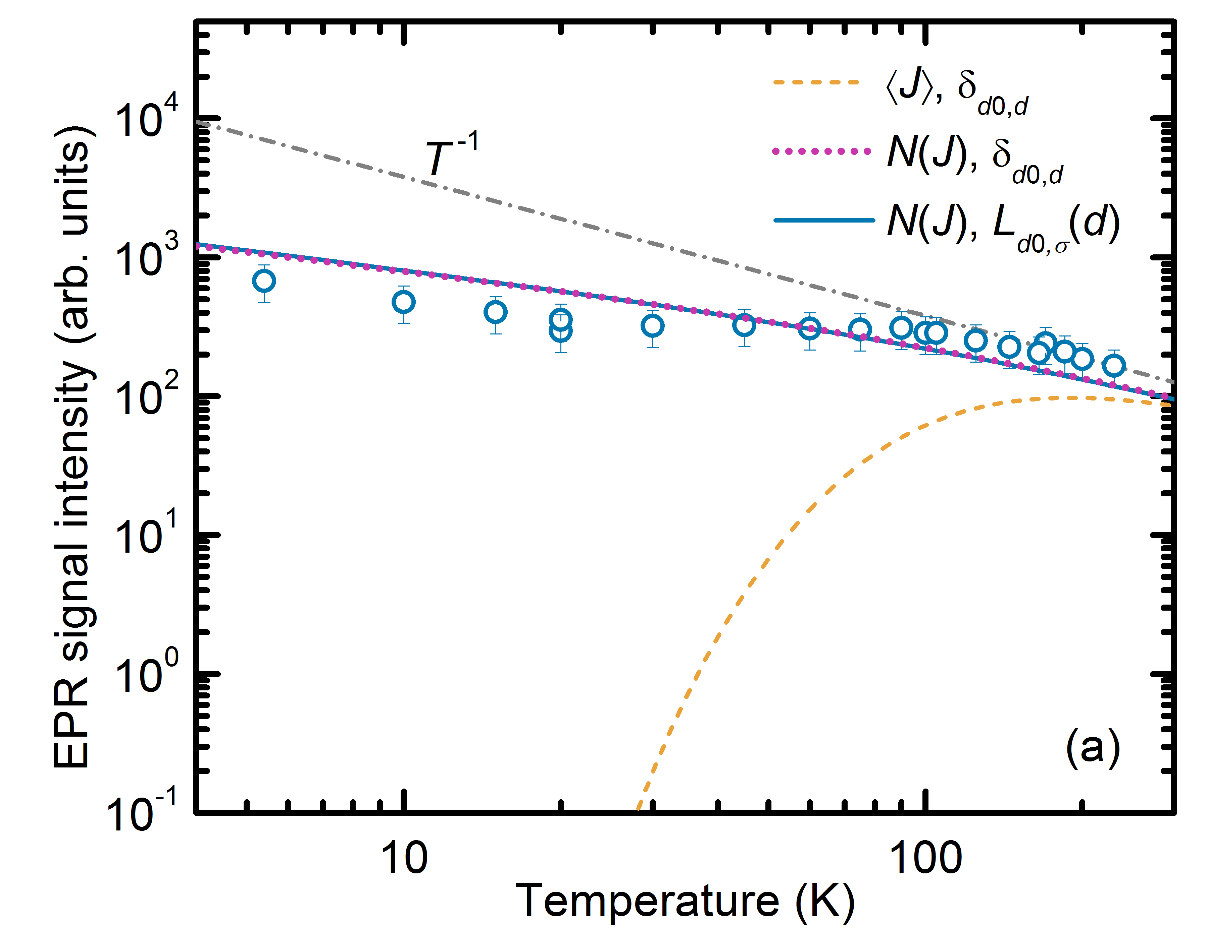
Donor dimers: theoretical framework
EPR intensity
calibration
Number of dimers in sample (fitting parameter)
This model considers:
distribution of J in our NCs ensemble, N(J)
lognormal size distribution of NCs, L_{d0,σ}(d_{NC})
N(J) gives dominant contribution to this deviation
From N_{D} we obtain [e⁻]≈1x10¹⁹ cm⁻³ and confirm that in this regime clusters with n>2 are negligible
MAP-fis PhD Research Conference - 2012
15/16

Slide 26
Conclusions
Doping in NCs is quite different from the bulk:
  Confinement and isolation of donors
  Statistical distribution of donors in NCs
Exchange coupled donors in NCs can be probed via T-dependent EPR spectroscopy (yield line at g=1.998)
Deviation of I_{EPR} from Curie behavior due depopulation of triplet state of dimers at low T
Exchange coupling of donors dimers in NCs is well described by effective mass theory
Distribution of J in NCs ensembles gives major contribution to the variation of the I_{EPR}
Only few-dopant exchange coupling is statistically relevant
For further details, see R. N. Pereira, A. J. Almeida, A. R. Stegner, M. S. Brandt, H. Wiggers. Exchange coupled donor dimers in nanocrystal quantum dots. Phys. Rev. Lett. (2012) in press.
MAP-fis PhD Research Conference - 2012
16/16

Slide 27
Thank you for your attention!
MAP-fis PhD Research Conference – January 2012, Braga

Slide 28
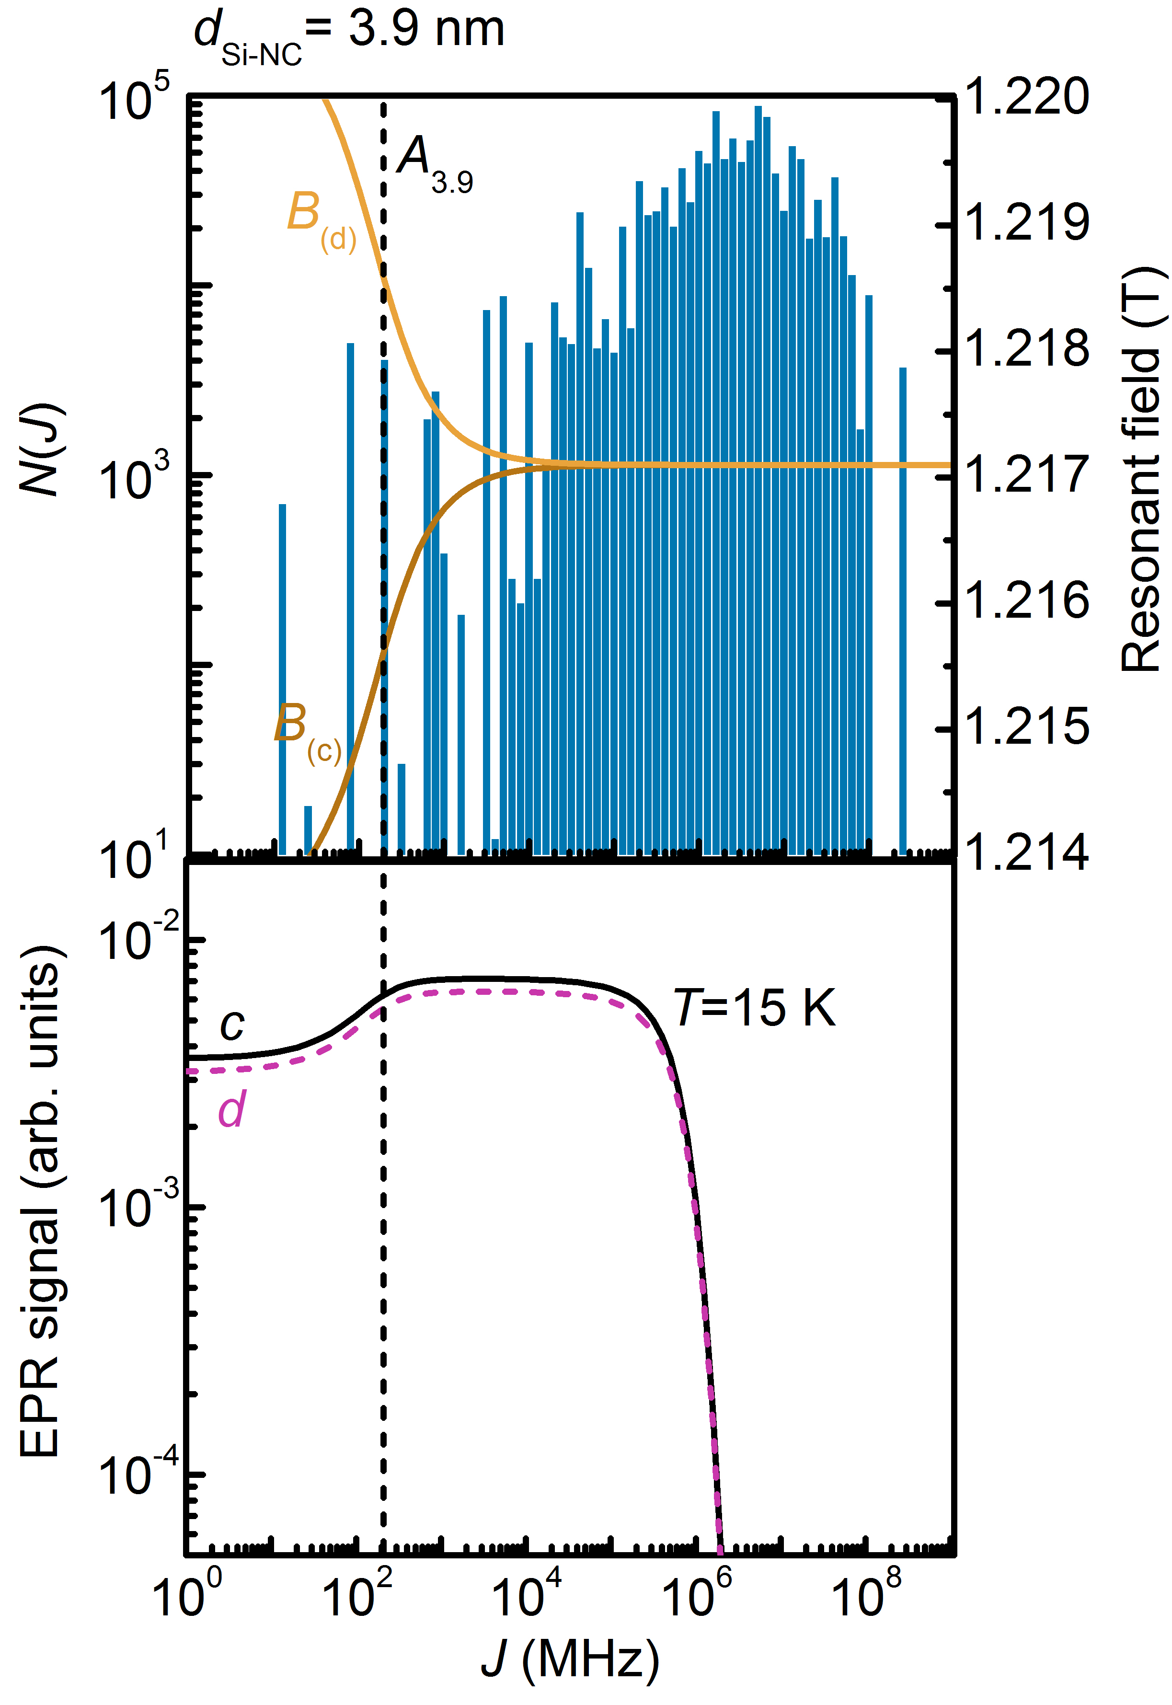
g=1.998 line asymmetry at T=15 K
N_{frozen} – dimers in the singlet state (EPR inactive)
N_{splitting} – dimers yielding ΔB_{(c),(d)}>0.1 mT
N_{splitting}
N_{frozen}
N_{active}= N_{total} – N_{frozen}
Percentage of donor dimers yielding sizable splitting (ΔB_{(c),(d)}>0.1 mT):
For T = 15K:
For T = 230K:
sizable splitting is expected for lower J
at lower T, more dimers with large J are frozen in singlet state and so contribution of dimers inducing splitting is greater
MAP-fis PhD Research Conference - 2012

Slide 29
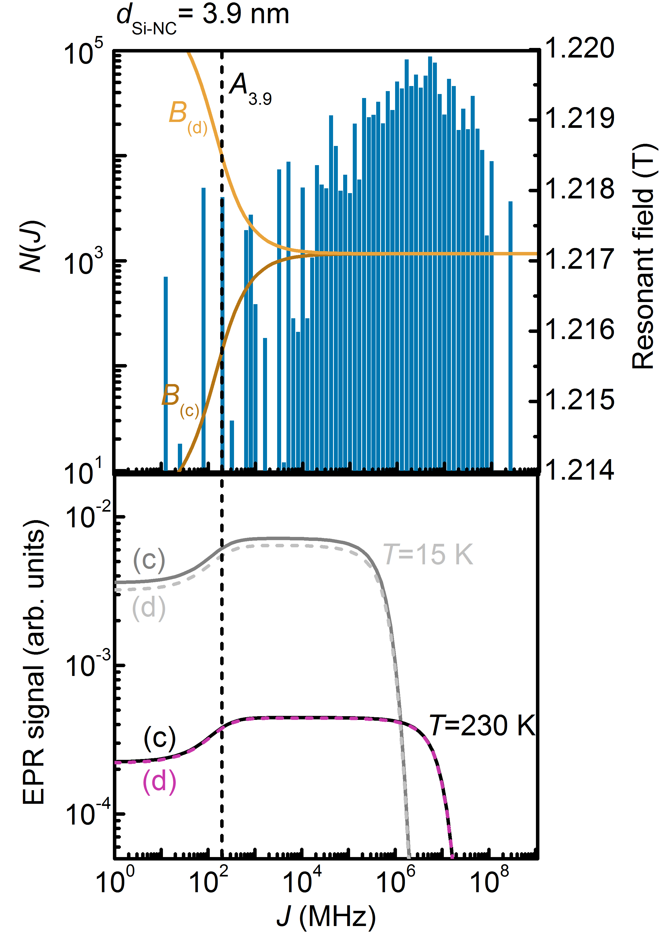
g=1.998 line asymmetry at T=230 K
N_{frozen} – dimers in the singlet state (EPR inactive)
N_{splitting} – dimers yielding ΔB_{(c),(d)}>0.1 mT
N_{splitting}
N_{frozen}
N_{active}= N_{total} – N_{frozen}
Percentage of donor dimers yielding sizable splitting (ΔB_{(c),(d)}>0.1 mT):
For T = 15K:
For T = 230K:
sizable splitting is expected for lower J
at lower T, more dimers with large J are frozen in singlet state and so contribution of dimers with lower J is greater
MAP-fis PhD Research Conference - 2012

Slide 30
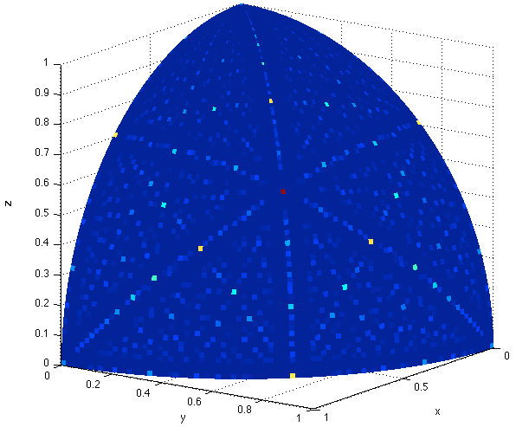
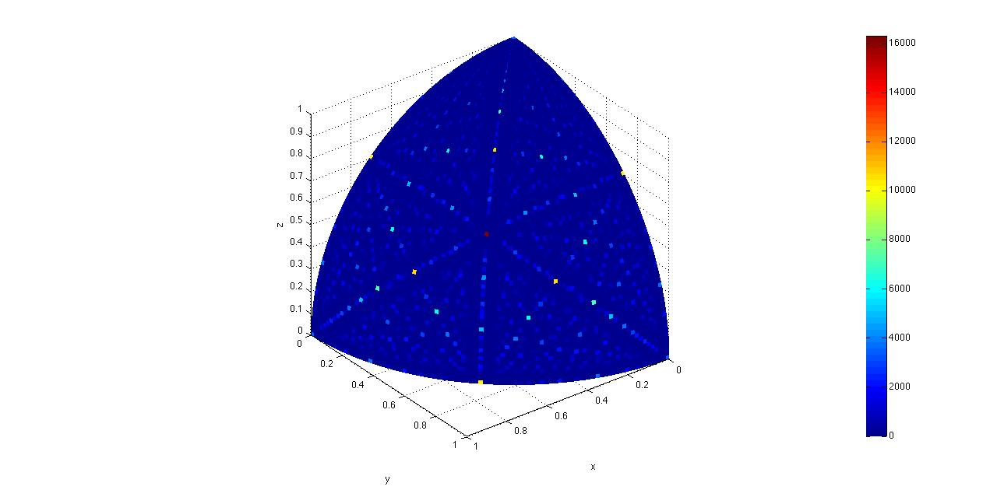
Angular dependence of J
[1 1 1] is the most common dimer orientation
For each orientation, J depends on the distance between donors
θ
θ
θ
J₁
<
J₂
<
J₃
Number of dimers
0
4
8
12
16
(x10³)
MAP-fis PhD Research Conference - 2012

