Slide 1
Loss simulations: Status, requirements for next version.
Sophie Mallows, Joachim Vollaire (Th. Otto, J. van Hoorne , E.B Holzer)

Slide 2
Contents
Loss Simulations (Made in 2010) for Radiation Protection/Damage “CDR PHASE”
Loss Simulations for Beam Loss Monitoring
  CDR Ionization Chambers (2010)
  “Post” CDR phase (2011)
Discussion and Requirements for Next Version (Time Scales/ Person Responsible)
  Losses: rescaling of results
  Scenario/geometry/material Updates: re-simulation

Slide 3
Operational Loss Limits
Loss Limit (what we have understand so far):
  Beam Dynamics Considerations (Two Beam Modules) Loss of ~10⁻³ of full intensity of the MB beam over 20km linac, or ~10⁻³ of full intensity of the DB over 875m DB decelerator) result in luminosity losses due to beam loading variations D.Schulte
  However it is also unlikely that they will be able to operate losing much less. Therefore this must define the loss limits. (activation, damage to electronics must be compatible with these limits)

Slide 4
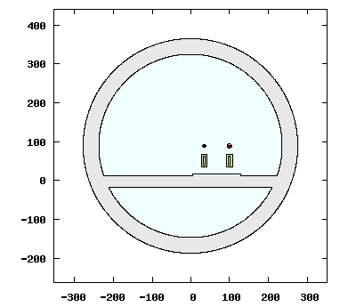
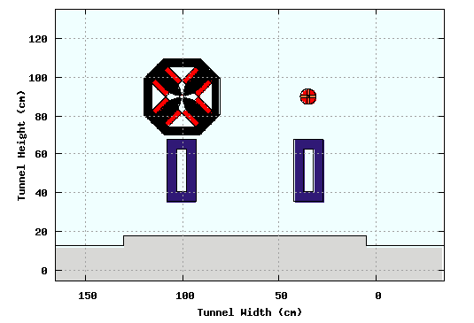
Fluka Simulations Settings
  Simulate loss scenarios using Monte Carlo Transport Code FLUKA
  Model includes tunnel, floor beam line components and silicon carbide girders
  Losses represented by electrons travelling in direction of beam, generated in circular distribution just inside PETS/AS before QP
  Losses at maximum and minimum energies for DB & MB → DB at 2.4 GeV, 0.24 GeV, MB at 1500 GeV, 9 GeV

Slide 5
Fluka Simulations Settings
Loss Scenario “operational” (used for Dose Rates, Fluences associated with damage to electronics,)
  MB: Loss distributed continuously along aperture (aperture restrictions at end of every AS (8*ASs per module))
  DB: Loss distributed regularly at the end of every PETS (location of aperture restrictions)
SCORE (in tunnel)
  Residual Ambient Dose Rates at Cooling times 4h, 1 day, 1 week (Irradiation profile of 11 year cycle, 180 days operation, 185 days shutdown) →Access Issues?
  1 MeV neutron equivalent fluence , >20MeV hadron fluence , Absorbed dose → Shielding required ?
  Absorbed Dose near beam line → BLM signal (Ionization chambers)

Slide 6
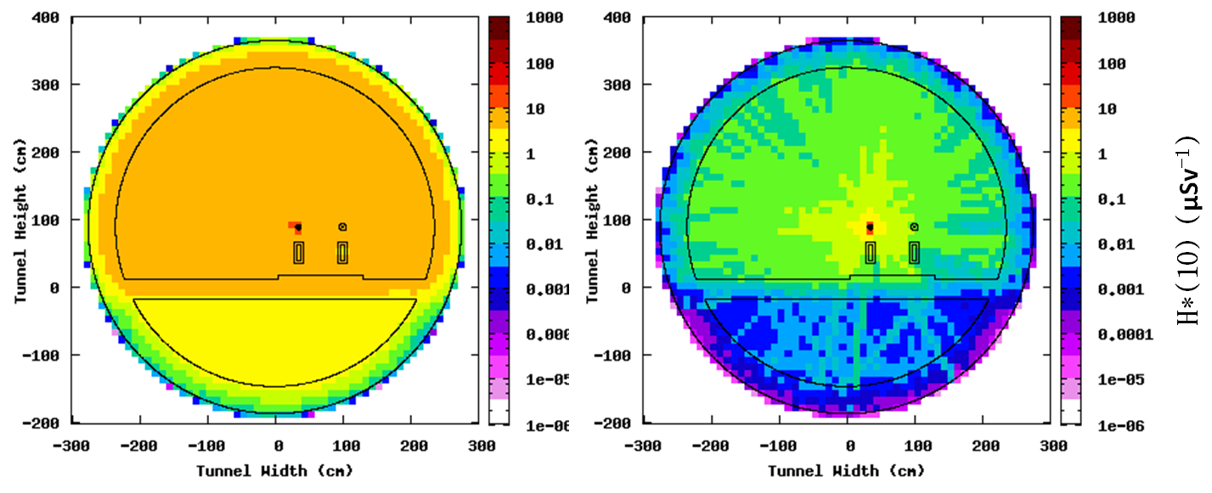
Results - Ambient dose rates
Ambient dose rate map in a plane orthogonal to the beam at the high-energy end of CLIC (E=1.5 TeV) after 1 year of exploitation at nominal beam intensity and an average beam loss of 5 10⁻⁸ m⁻¹. Ambient dose rate is evaluated for different delay times after turning off the accelerator. 4h delay 1 week delay
SCALING! Losses of 5 *10⁻⁸ m⁻¹ (180 d continuous running)

Slide 7
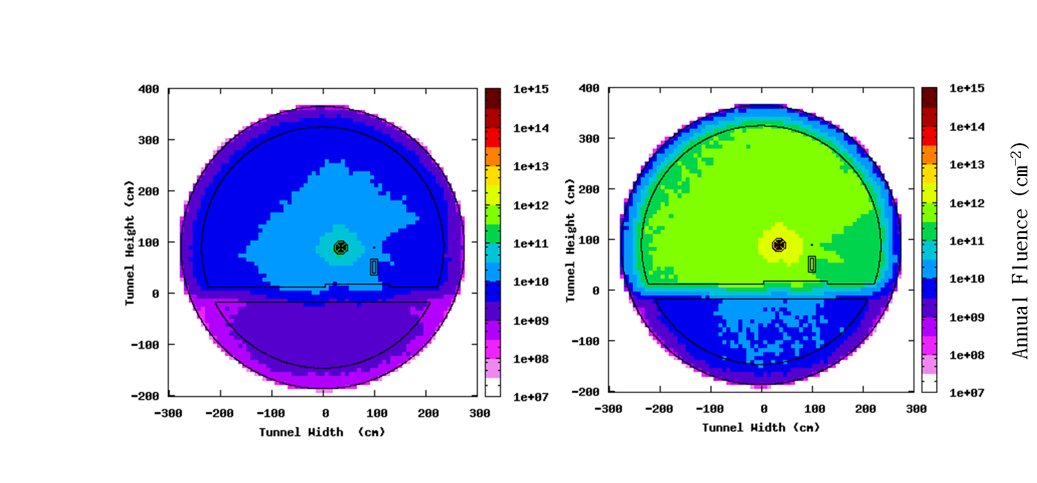
Results - ‘Electronics Damage’ 1MeV neutron equivalent fluence
LEFT: Distribution of the 1MeV neutron equivalent fluence in the tunnel cross section for beam loss in the main beam at 1500 GeV.
RIGHT: Distribution of the energetic hadron fluence in the tunnel cross section for beam loss in the main beam at 1500 GeV.
SCALING! Losses of 5 *10⁻⁸ m⁻¹ (180 d continuous running)

Slide 8
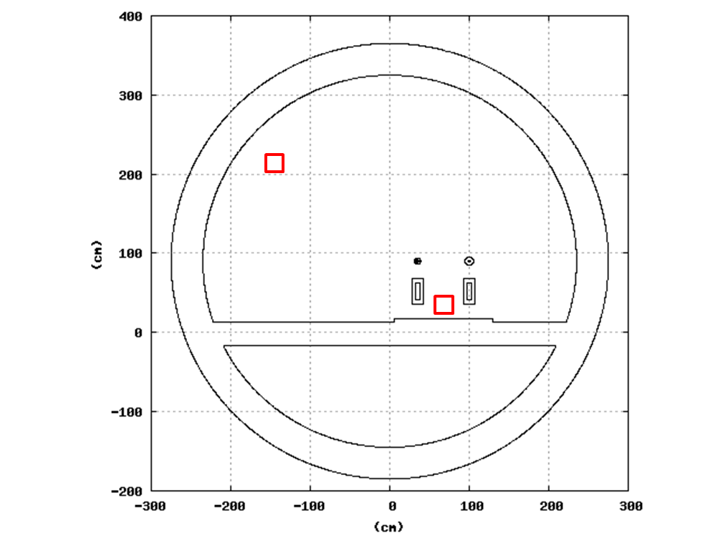
Results “ Electronics Damage”
Summary Tables
Estimated 1 MeV neutron Equivalent Fluence in 2 tunnel locations for losses from the Drive Beam (DB) and Main Beam (MB).
Estimated High Energy hadron fluence in 2 tunnel locations for losses from the Drive Beam (DB) and Main Beam (MB) assuming maximum losses permitted by beam dynamics considerations.
SCALING! Main Beam: 5 *10⁻⁸ m⁻¹ Drive Beam 1.25* 10⁻⁶ m⁻¹
 | 1-MeV neutron eq. fluence Close to accelerator (cm⁻² year⁻¹) | 1-MeV neutron eq. fluence Close to tunnel wall (cm⁻² year⁻¹)
DB – 240 MeV | 3.4e11 | 1.2e11
DB - 2.4 GeV | 3.2e12 | 1.3e12
MB – 9 GeV | 1.0e10 | 4.0e9
MB – 1500 GeV | 8.5e11 | 3.1e11
 | >20MeV hadron fluence Close to accelerator (cm⁻² year⁻¹) | >20MeV hadron fluence Close to tunnel wall (cm⁻² year⁻¹)
DB – 240 MeV | 1.0e9 | 2.3e8
DB - 2.4 GeV | 6.5e10 | 1.6e10
MB – 9 GeV | 2.3e8 | 6.1e7
MB – 1500 GeV | 2.4e10 | 7.0e9

Slide 9
Damage to Electronics Tolerable Levels
Radiation damage mechanisms and tolerable levels leading to negligible damage of accelerator components or electronics
Damage Mechanism | Relevant Estimator | Tolerable Levels
Material Damage | Total Ionizing Dose (Absorbed Dose) | <1Gy /year (COTS) <1MGy /year (epoxy resin, QP coils )
Lattice Displacement | Non ionizing energy loss scaled to “1 MeV neutron Equivalent Fluence” * | <1x10⁸cm⁻² /year (COTs)
SEEs | >20MeV Hadron Fluence | <1x10⁷cm⁻² /year** (COTs)
*Non ionizing energy loss (NIEL) is usually scaled for convenience to the NIEL of 1 MeV neutrons where any particle fluence with a specific energy distribution is expressed in terms of the ‘1 MeV neutron-equivalent fluence’ producing the same bulk damage in a specific semiconductor.
**For SEE’s only the probability of failures can be determined, electronics started to fail due to SEE’s at high energy hadron fluencies of 1x10⁷cm⁻² at CNGS

Slide 10
Damage to Epoxy Resin
Estimated fractional beam loss required to accumulate an absorbed dose of 1 MGy per year in quadrupole magnet coils (assume limit of 10MGy over lifetime)
NB Loss Scenario: Loss represented just before QP!!
 | Loss point | Fractional Beam Loss per QP – for 1 MGy/yr in coils | Fractional Beam loss (m⁻¹) for 1 MGy/yr in coils
DB – 240 MeV | End of PET (before QP) | 2.1 10⁻⁶ | 2.1 10⁻⁶
DB - 2.4 GeV | End of PET (before QP) | 2.0 10⁻⁵ | 2.0 10⁻⁵
MB – 9 GeV | End of AS (before QP) | 4.8 10⁻⁵ | 1.2 10⁻⁵
MB – 1500 GeV | Continuous in AS (1m before QP) | 4.3 10⁻⁷ | 2.4 10⁻¹⁰
However,
Simulations- just before QP. MB high energy QP spacing 18m
Limits , beam dynamics: Main Beam: 5 *10⁻⁸ m⁻¹ Drive Beam 1.25* 10⁻⁶ m⁻¹

Slide 11
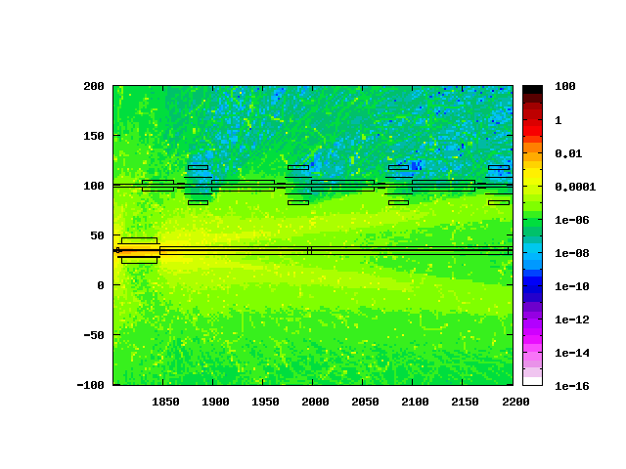
BLM Requirements Ionization Chambers
Dynamic Range – Upper Limits
  Dangerous Losses
    Should detect onset of dangerous losses, (& ideally allow for post mortem analysis). 10% of dangerous limits.
    Dangerous loss: 1.0% DB bunch train 1.53e12 electrons, 0.01% bunch train MB 1.16e8 electrons
    FLUKA: Loss at single aperture at the end of a PETS /AS before a QP
  Example: Spatial distribution of absorbed dose resulting from loss of 0.01% of 9 GeV Main Beam bunch train at a single aperture
(Gy)

Slide 12
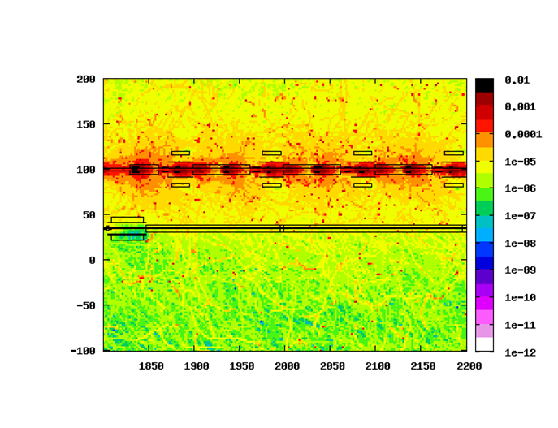
BLM Requirements Ionization Chambers
Dynamic Range – Lower Limits
  Sensitivity requirement:
    FLUKA Loss Scenario: Losses distributed regularly along the vacuum chamber at the end of every PETS (DB) or AS (MB)
    Scaling: 0.01 × loss limit for beam loading variations (to detect onset of such losses) = 10⁻⁵ bunch train distributed over MB linac, DB decelerator)
  Example: Spatial distribution of absorbed dose for maximum operational losses distributed along aperture (DB 2.4 GeV)
(Gy)

Slide 13
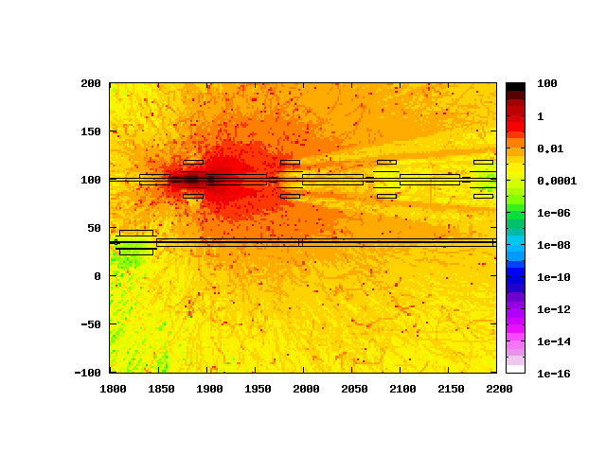
BLM Requirements Ionization Chambers
  Cross Talk Issues
  Desirable to distinguish between a failure loss from each of the beams
  Loss of 1.0% in DB provokes similar signal as a loss of 0.01% of MB in region close to MB quadrupole.
  Due to a different time structures of the two trains, a detector with adequate time resolution could be used distinguish losses from either beam
  Not a Machine Protection Issue – Dangerous loss would never go unnoticed
Destructive DB 1.0% of bunch train hits single aperture restriction
Destructive MB 0.01% of bunch train hits single aperture restriction
Spatial Distribution of prompt Absorbed Dose (Gy) resulting from
FLUKA Simulation of dangerous loss at single aperture restriction for the 2.4 GeV Drive Beam (left), 9 GeV Main Beam (right)

Slide 14
Requirements - CDR Summary Table
Machine Sub-Systems | Dynamic Range | Sensitivity (Gy/pulse) | Response time (ms) | Quantity | Recommended
Main Beam
e⁻ and e⁺ injector complex | 10⁴ | 10⁻⁷ | <8 | 85
Pre-Damping and Damping Rings | 10⁴ | 10⁻⁹ (Gy per millisecond) | 1 | 1396 | Insensitive to Synch. Rad.
RTML | 10⁴ | 10⁻⁷ | <8 | 1500
Main Linac | 10⁶ | 10⁻⁹ | <8 | 4196 | Distinguish losses from DB
Beam Delivery System (energy spoiler + collimator) | 10⁶ | 10⁻³ | <8 | 4
Beam Delivery System (betatron spoilers + absorbers) | 10⁵ | 10⁻³ | <8 | 32
Beam Delivery System (except collimators) | >10⁵ | <10⁻⁵ | <8 | 588
Spent Beam Line | 10⁶ | 10⁻⁷ | <8 | 56
Drive Beam
Injector complex | 5. 10⁴ | 5. 10⁻⁶ | <8 | 4000
Decelerator | 5. 10⁶ | 5. 10⁻⁸ | <8 | 41484 | Distinguish losses from MB
Dump lines | tbd | tbd | <8 | 48

Slide 15
CDR - Summary
15
  Ionization Chambers fulfill necessary requirements for a machine protection system (except MB Damping Rings – where Cherenkov Radiators + PMT recommended, as baseline technology choice)
  LHC Ionization Chamber + readout electronics
    Dynamic Range 10⁵ (10⁶ under investigation)
    Sensitivity 7e10⁻⁹ Gy
  The MB linac and DB decelerator could also be safely operated at a reduced dynamic range, should 10⁶ turn out to be too challenging
  Large Number BLMs Required – Cost Concern
  → Investigate Alternative Technologies for the Two Beam Modules in the post CDR phase

Slide 16
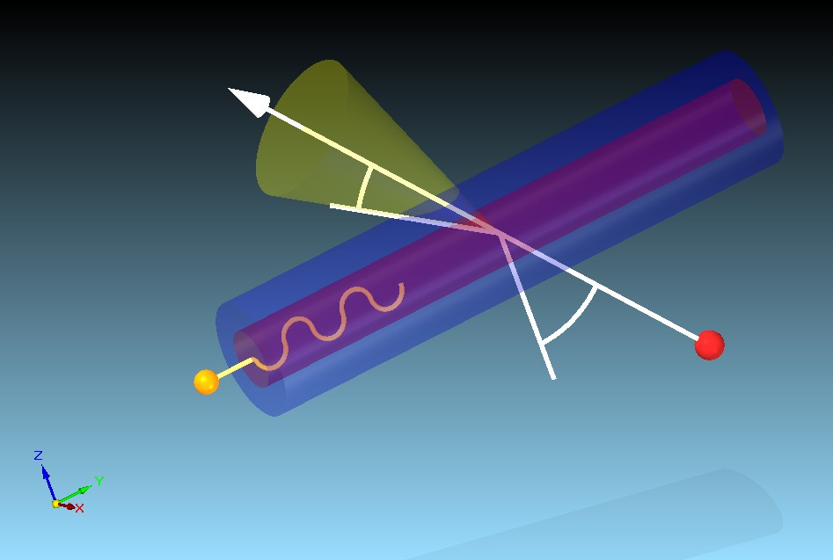
Cherenkov Fibers
Cherenkov Signal in an Optical Fiber
Cherenkov Radiation
  When a charged particle enters the fiber with v>c it produces photons along Cherenkov cone of opening angle
Fiber Cladding
θ_{C}
e-
Need to Consider Both:
  The Number of Photons generated in fiber by charged particle
  The Proportion of photons transmitted, Cerenkov Efficiency
Fiber Core
φ_{e}
NA is the ‘numerical aperture’ of the fiber

Slide 17
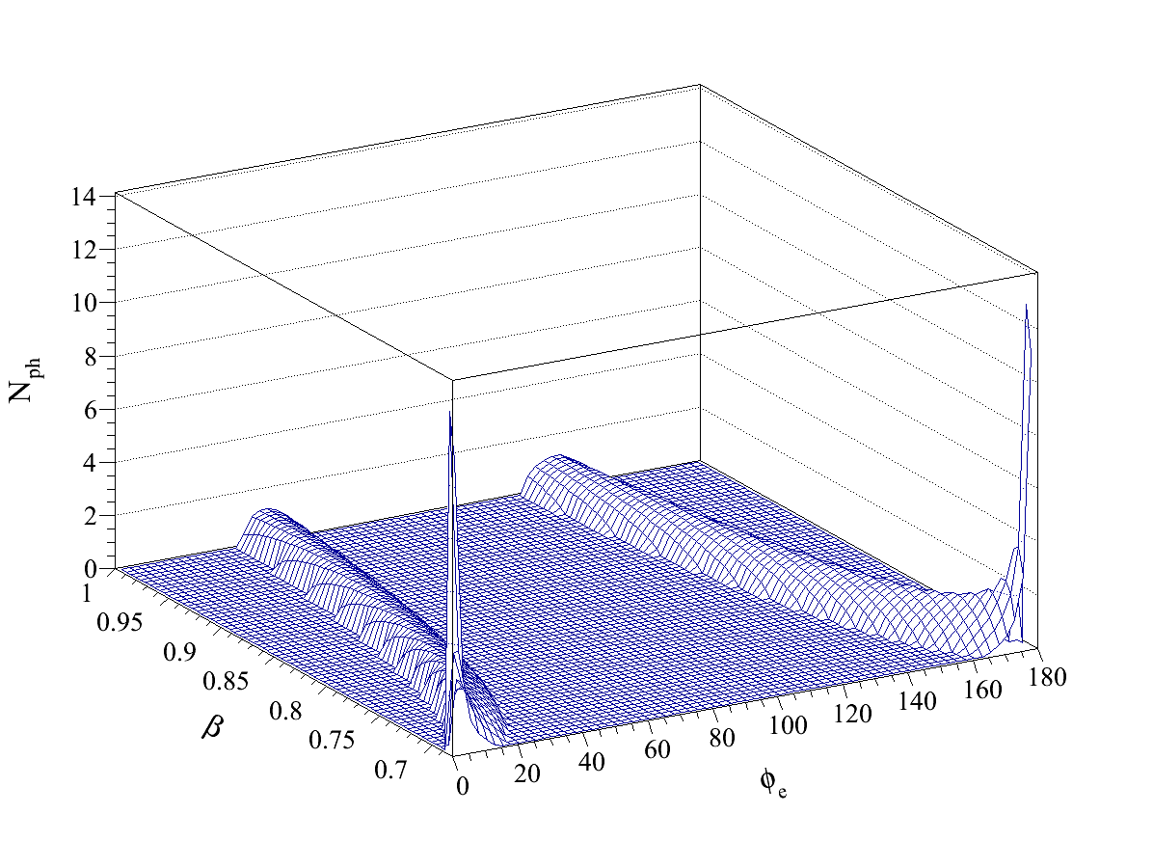
Cherenkov Fibers
J. van Hoorne
Fiber Cladding
θ_{C}
Fiber Core
φ_{e}
  Number of transmitted photons per charged particle crossing the fiber as a function of β and ϕ_{e} for a fiber of 0.365 mm diameter and NA = .22
NA is the ‘numerical aperture’ of the fiber

Slide 18
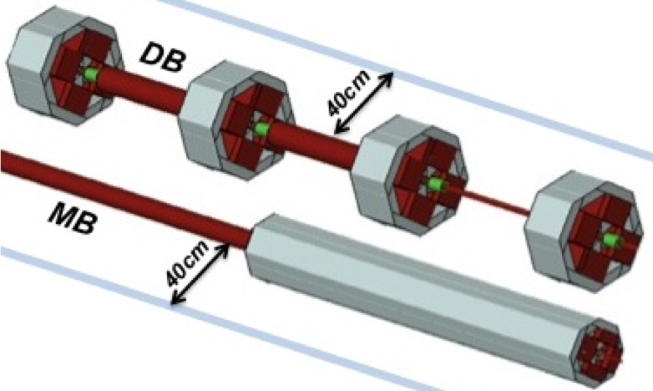
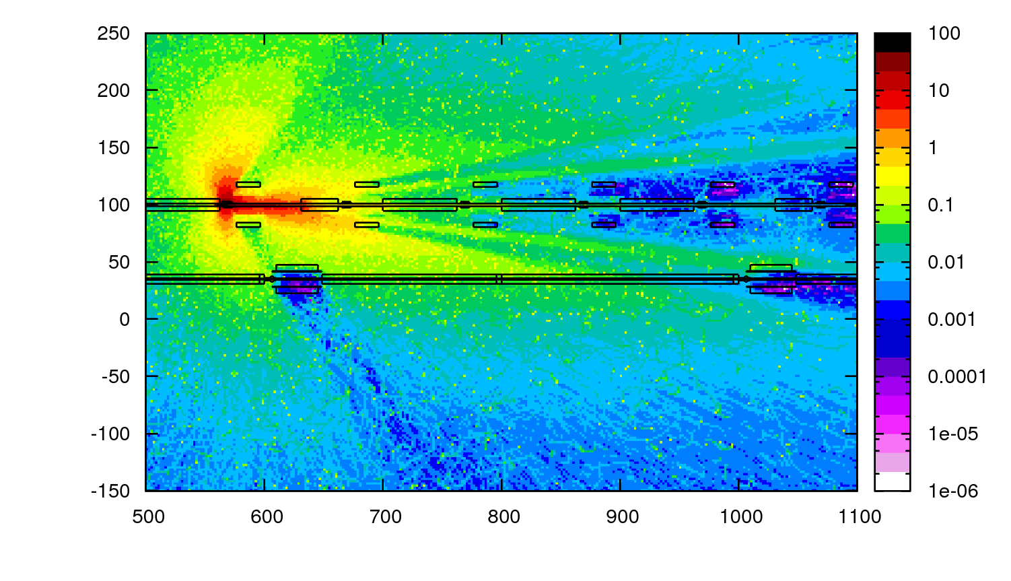
FLUKA Simulations 2011 – Cherenkov Fibers
First calculations to determine CherenkovSignal
FLUKA Settings (updates):
Removed tunnel wall/floor (CPU time)
Implemented representation of aperture restriction into FLUKA geometry
Failure loss scenario - beam directed on aperture at maximum geometrical angle permitted between focusing and defocusing QP
Score angular and velocity distribution of charged particles at possible fiber locations
Binned angular distribution and velocities of charged particles with respect to boundary (5cm high, 40cm from beamline, parallel to beamline)
Blue lines indicate location of boundaries
Spatial Distribution of absorbed dose - DB loss at 2.4 GeV

Slide 19
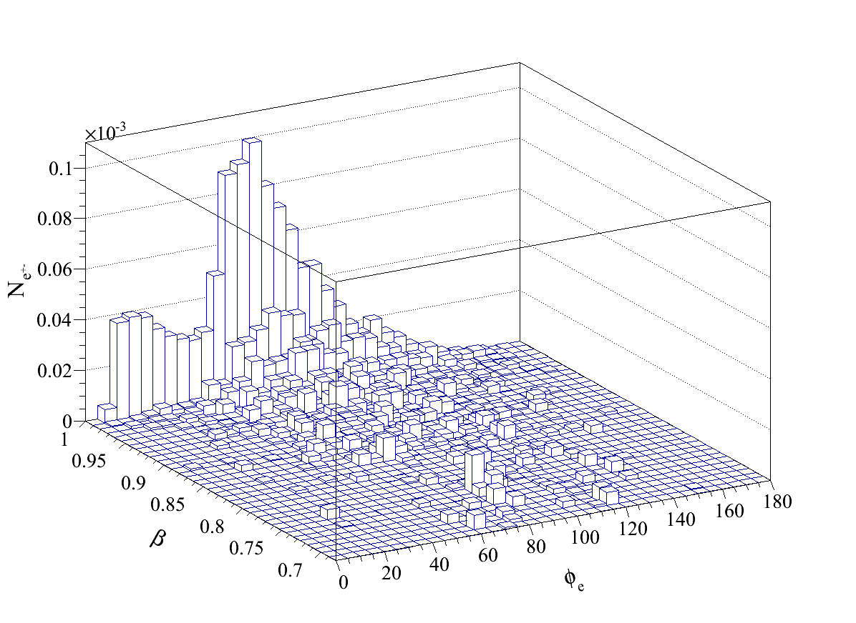
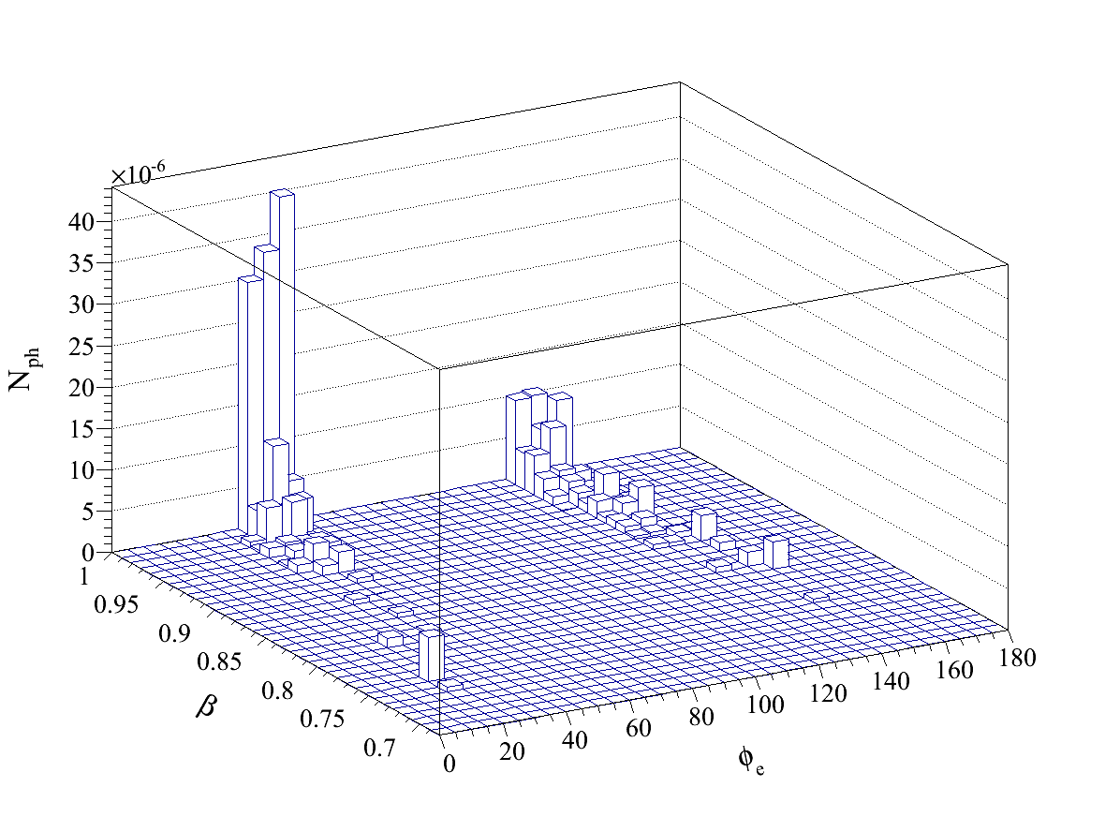
FLUKA Simulations – Cherenkov Fibers
PARTICLE SHOWER DISTRIBUTION (FLUKA)
CORRESPSONDING ‘TRAPPED’ PHOTONS
J. van Hoorne
J. van Hoorne
  Loss shower distribution, normalized to one lost beam electron, for single loss at 2.4 GeV in the DB
  Transmitted photon distribution, normalized to one lost beam electron, for single loss at 2.4 GeV in the DB.
  Not all of the charged particles crossing the fiber above the Cherenkov threshold generate transmitted or ‘trapped’ photons

Slide 20
FLUKA Simulations – Cherenkov Fibers
Sensitivity and Dynamic Range Requirements
  Based on loss limits (as before)
  Dynamic Range based on of rate of arrival of photons
  Sensitivity and dynamic range requirements for a downstream photodetector allows the use of Silicon Photomultipliers (SiPM) - 100m fiber!
  Larger diameter fiber can be used for increased photon production
 | Sensitivity* (N_{ph}/train) | Dynamic Range
DB 0.24 GeV | 5∙10² | 5∙10⁴
DB 2.4 GeV | 5∙10³ | 2∙10⁴
MB 9 GeV | 4∙10¹ | 1∙10³
MB 1.5 TeV | 8∙10² | 5∙10³
  Arrival duration of the photons 410 ns (DB) and 323 ns (MB) (100m fiber)

Slide 21
Simulations - Conclusions
RP calculations – ambient dose rates seem high
Normalization OKAY !- was double checked (September 2010), T.Otto, S Mallows
Make repeat simulations with simplified geometry (Sophie)
Damage to epoxy resin loss distribution ? Normalization OKAY. Results (stats) MB 1.5TeV to be checked. Requires a clearer way of presenting?
SCALING – How would a loss of the 10⁻³ fraction of intensity actually be distributed along the aperture? This would affect
  BLM sensitivity requirements
  All radiation related results
Sophie
Sophie
Everyone

Slide 22
Simulations - Conclusions
To Do (RP, Rad Damage)
A calculation of the radiological conditions at the shaft bottoms is required to see if (and under what conditions) these areas are accessible during operation (The tunnel being blocked by movable shielding).
The radiation maps in the tunnel have to be refined to find optimum position for electronics with respect to beam line and possibly to profit from shielding effects of the decelerator quadruples.
Simulations with shielding for electronics (Fe, Concrete )
The materials envisaged to be used in the clic machine has to be reviewed to see if these contain elements that may have radiological consequences. Include in Simulations
J. Vollaire +
Tech student?

