Slide 1
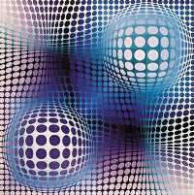
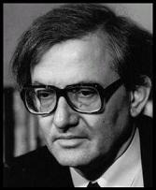
Zimányi School 2011
Gy. Vásárhelyi (V. Vasarely): Fény | 11. Zimányi WINTER SCHOOL ON HEAVY ION PHYSICS Nov. 28. - Dec. 2., Budapest, Hungary | József Zimányi (1931 - 2006)

Slide 2
56 participants | 27 students | 51 talks
16 institutions | 10 cities
Bogolyubov Institute for Theoretical Physics Budapest University of Technology CERN Eötvös University Goethe Universität Károly Róbert College KEK MTA KFKI AEKI MTA KFKI RMKI Sophia University University of Bergen University of Cape Town University of Tokyo Warsaw University of Technology Yonsei University Zrínyi Miklós National Defense University | Bergen Budapest Cape Town Frankfurt am Main Gyöngyös Kiev Seoul Tokyo Tsukuba Warsaw

Slide 3
