Slide 1
Time evolution of QGP via photon observables
Presenter: Imre Májer – Eötvös University Physics student
Supervisor: Máté Csanád – Department of Atomic Physics
Zimányi Winter School 2011

Slide 2
Rhic milestones
New, strongly interacting medium
  (Nucl.Phys., A757:184–283, 2005)
Collective behaviour
  (Phys.Rev.Lett., 91:182301, 2003)
Perfect fluid hydro
  (Phys.Rev.Lett., 98:172301, 2007)
Quark degrees of freedom
  (Phys.Rev.Lett. 98, 162301,2007)
Direct photon data, time evolution can be analyzed
  (Phys.Rev.Lett., 104:132301, 2010)

Slide 3
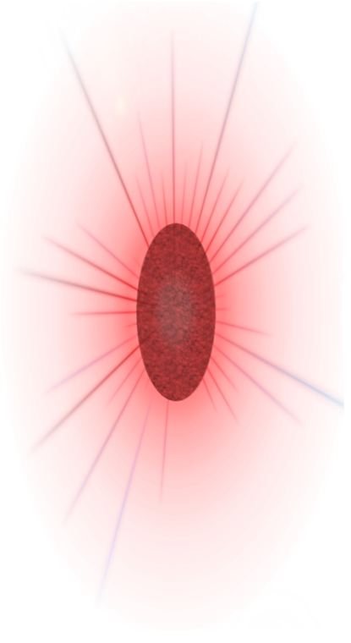
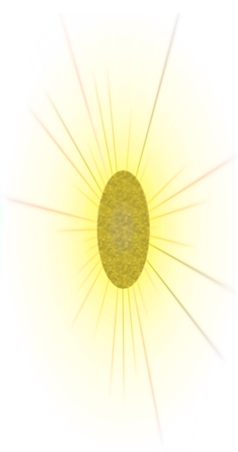
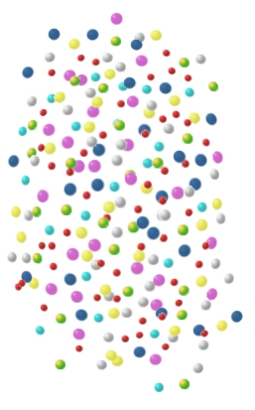
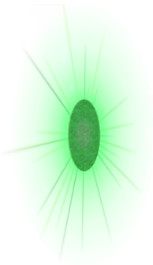

Time development - Spectra
Photon spectrum: information on the time development
Thermalization time
Equation of state
Initial temperature
thermalization
Hadronic spectrum information on the final state
Freeze-out time
Freeze-out temperature
Expansion at freeze-out
expansion, cooling
freeze-out

Slide 4
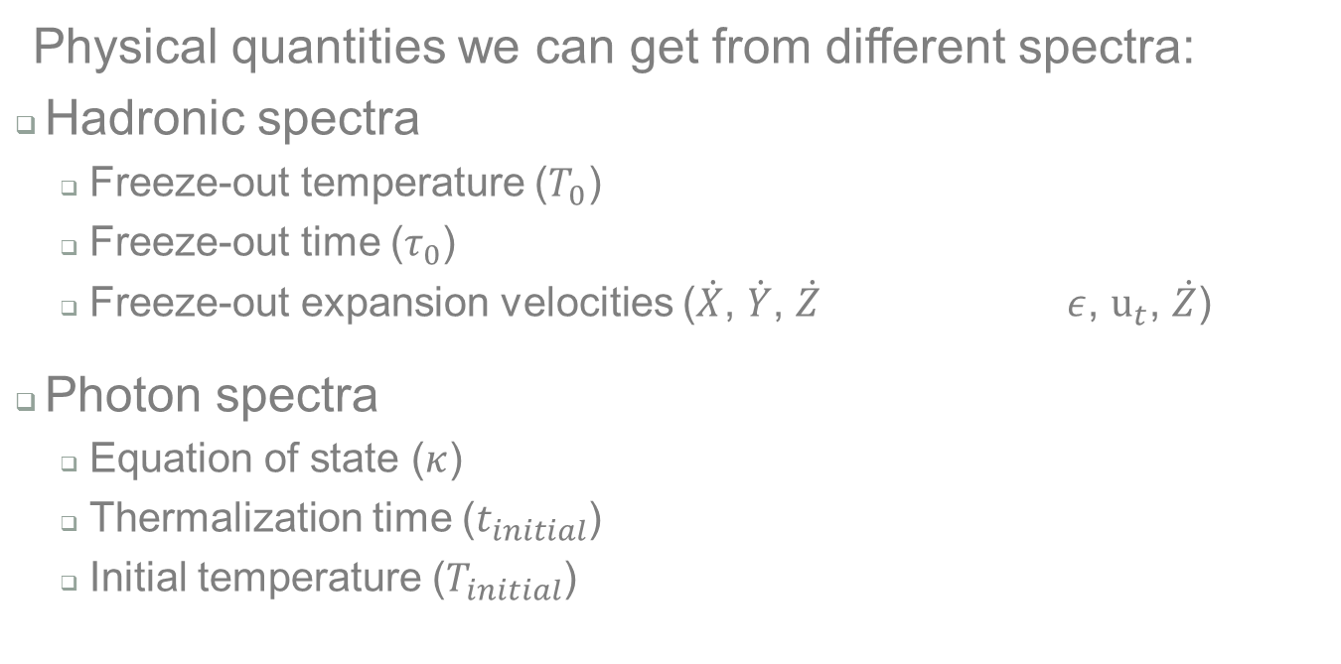
Spectra information
Physical quantities we can get from different spectra:
Hadronic spectra
  Freeze-out temperature ($T_{0}$)
  Freeze-out time ($τ_{0}$)
  Freeze-out expansion velocities ($\dot{X}$, $\dot{Y}$, $\dot{Z}$ $ε$, $u_{t}$, $\dot{Z}$)
Photon spectra
  Equation of state ($κ$)
  Thermalization time ($t_{initial}$)
  Initial temperature ($T_{initial}$)

Slide 5
Physical Quantities
How do we get the physical quantities describing the system?
1.
Source function for a particle type $S(x^{μ},p)$
Source function for a particle type 𝑆(𝑥^𝜇,𝒑)
2.
Hydrodynamic model
Observables: spectra $N_{1}\left(p\right)$
Observables: spectra 𝑁_1 (𝒑)
Fitting the spectra free parameters
4.
Free parameters are the physical quantities (eg. $κ$, $T_{0}$, $τ_{0}$, …)
Free parameters are the physical quantities (eg. 𝜅, 𝑇_0, 𝜏_0, …)
Comparing to data
3.
Unknown functions ($u^{μ}$, $n$, $T$, $p$)
Unknown functions (𝑢^𝜇, 𝑛, 𝑇, 𝑝)
We get the unknown functions ($u^{μ}$, $n$, $T$, $p$)
We get the unknown functions (𝑢^𝜇, 𝑛, 𝑇, 𝑝)

Slide 6
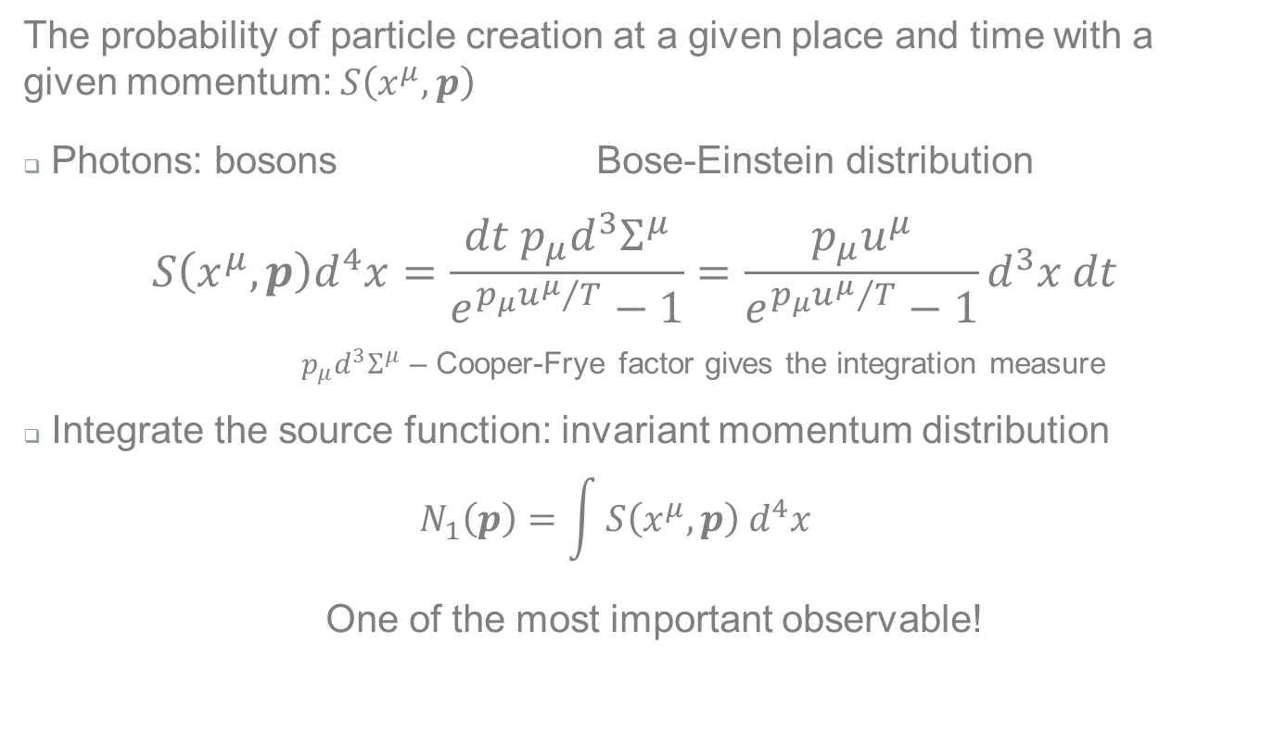
1. Source Function
2.
3.
4.
The probability of particle creation at a given place and time with a given momentum: $S\left(x^{μ},p\right)$
Photons: bosons Bose-Einstein distribution
$$S\left(x^{μ},p\right)d^{4}x=\frac{dt p_{μ}d^{3}Σ^{μ}}{e^{{p_{μ}u^{μ}}/T}−1}=\frac{p_{μ}u^{μ}}{e^{{p_{μ}u^{μ}}/T}−1}d^{3}x dt$$
  $p_{μ}d^{3}Σ^{μ}$ – Cooper-Frye factor gives the integration measure
Integrate the source function: invariant momentum distribution
  $$N_{1}\left(p\right)=\int{S\left(x^{μ},p\right) d^{4}x}$$
  One of the most important observable!

Slide 7
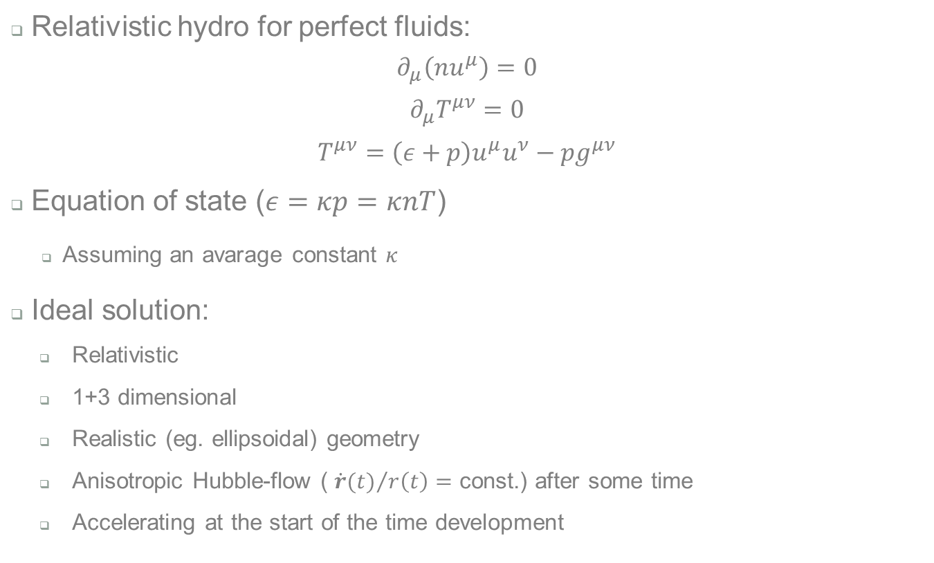
1.
2. Hydrodynamics
3.
4.
Relativistic hydro for perfect fluids:
$$∂_{μ}\left(nu^{μ}\right)=0$$
$$∂_{μ}T^{μν}=0$$
$$T^{μν}=\left(ε+p\right)u^{μ}u^{ν}−pg^{μν}$$
Equation of state ($ε=κp=κnT$)
  Assuming an avarage constant $κ$
Ideal solution:
  Relativistic
  1+3 dimensional
  Realistic (eg. ellipsoidal) geometry
  Anisotropic Hubble-flow ( ${\dot{r}(t)}/{r\left(t\right)}=$ const.) after some time
  Accelerating at the start of the time development

Slide 8
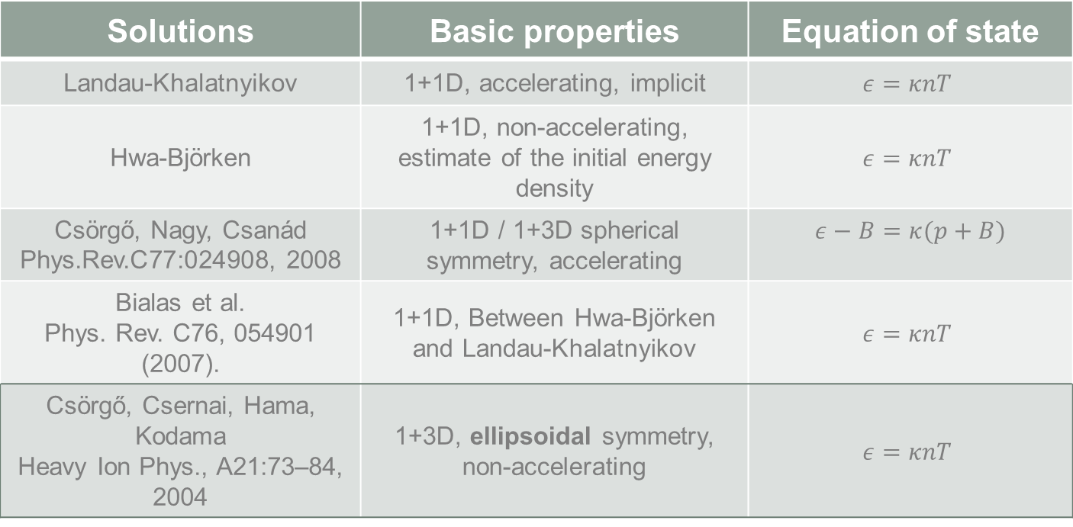
1.
2. Hydrodynamics
3.
4.
Some known solutions:
Solutions | Basic properties | Equation of state
Landau-Khalatnyikov | 1+1D, accelerating, implicit | $$ε=κnT$$
Hwa-Björken | 1+1D, non-accelerating, estimate of the initial energy density | $$ε=κnT$$
Csörgő, Nagy, Csanád Phys.Rev.C77:024908, 2008 | 1+1D / 1+3D spherical symmetry, accelerating | $$ε−B=κ(p+B)$$
Bialas et al. Phys. Rev. C76, 054901 (2007). | 1+1D, Between Hwa-Björken and Landau-Khalatnyikov | $$ε=κnT$$
Csörgő, Csernai, Hama, Kodama Heavy Ion Phys., A21:73–84, 2004 | 1+3D, ellipsoidal symmetry, non-accelerating | $$ε=κnT$$

Slide 9
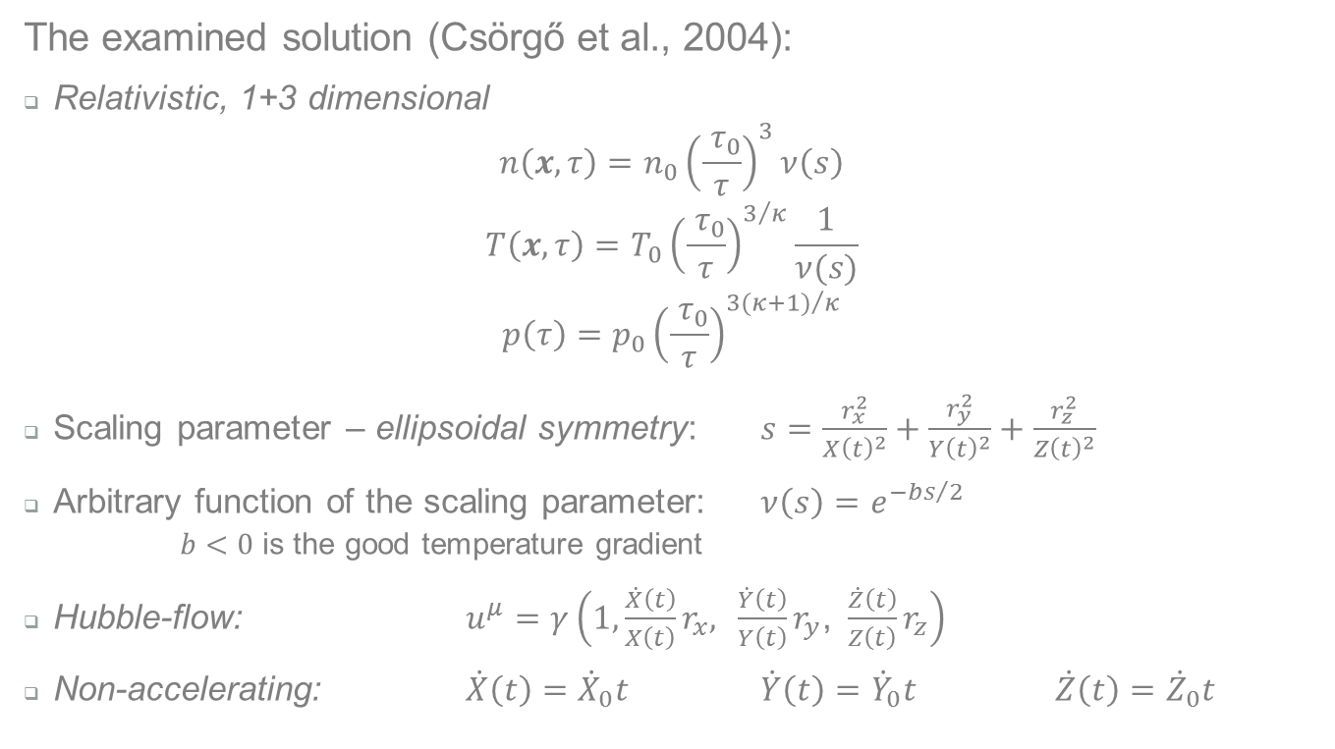
1.
2. Hydrodynamics
3.
4.
The examined solution (Csörgő et al., 2004):
Relativistic, 1+3 dimensional
$$n\left(x,τ\right)=n_{0}{\left(\frac{{ τ}_{0}}{τ}\right)}^{3}ν\left(s\right)$$
$$T\left(x,τ\right)=T_{0}{\left(\frac{{ τ}_{0}}{τ}\right)}^{3/κ}\frac{1}{ν(s)}$$
$$p\left(τ\right)=p_{0}{\left(\frac{{ τ}_{0}}{τ}\right)}^{{3(κ+1)}/κ}$$
Scaling parameter – ellipsoidal symmetry: $s=\frac{r_{x}^{2}}{X{\left(t\right)}^{2}}+\frac{r_{y}^{2}}{Y{\left(t\right)}^{2}}+\frac{r_{z}^{2}}{Z{\left(t\right)}^{2}}$
Arbitrary function of the scaling parameter: $ν\left(s\right)=e^{−{bs}/2}$
  $b<0$ is the good temperature gradient
Hubble-flow: $u^{μ}=γ\left(1,\frac{\dot{X}\left(t\right)}{X\left(t\right)}r_{x}, \frac{\dot{Y}\left(t\right)}{Y\left(t\right)}r_{y}\text{,} \frac{\dot{Z}\left(t\right)}{Z\left(t\right)}r_{z}\right)$
Non-accelerating: $\dot{X}\left(t\right)={\dot{X}}_{0}t$ $\dot{Y}\left(t\right)={\dot{Y}}_{0}t$ $\dot{Z}\left(t\right)={\dot{Z}}_{0}t$

Slide 10
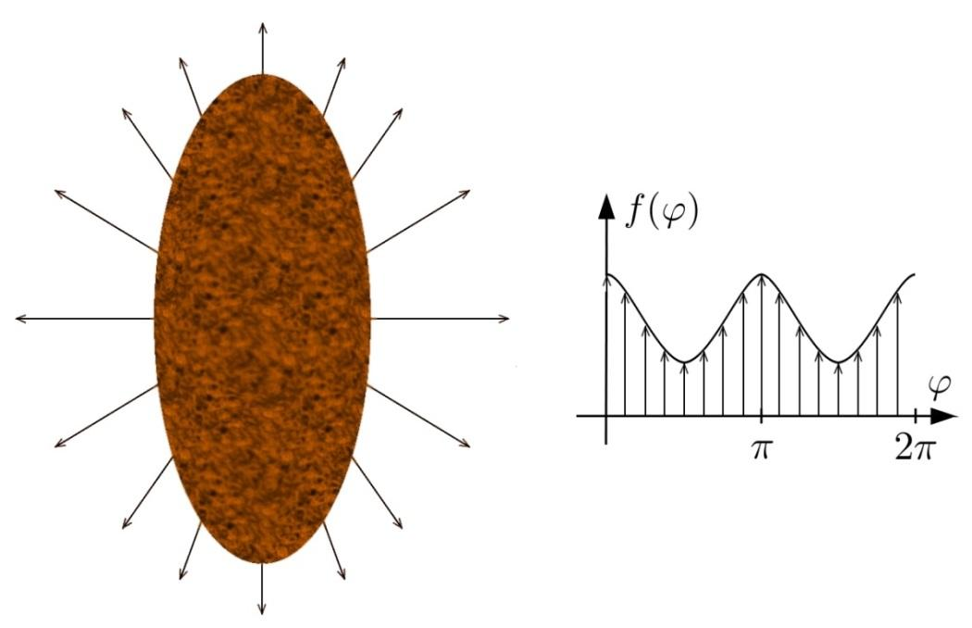
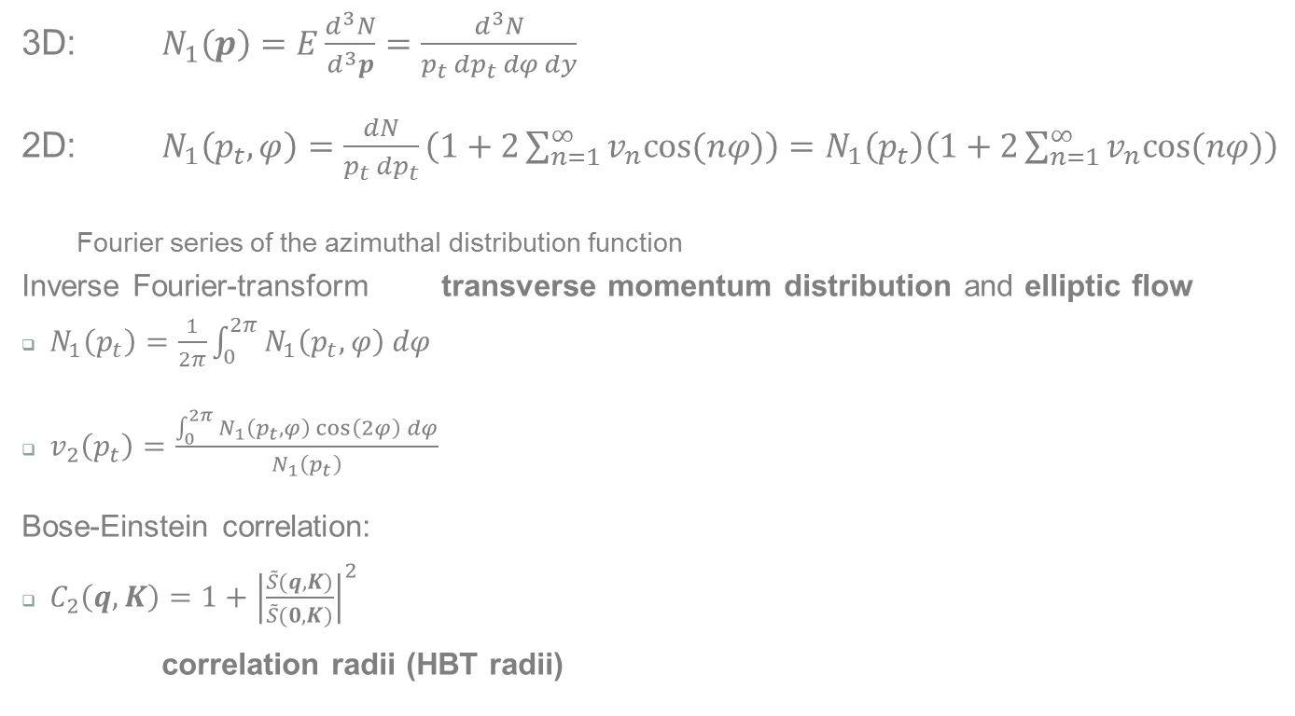

1.
2.
4.
3. Observables
3D: $N_{1}\left(p\right)=E\frac{d^{3}N}{d^{3}p}=\frac{d^{3}N}{p_{t} dp_{t} dφ dy}$
2D: $N_{1}\left(p_{t},φ\right)=\frac{dN}{p_{t} dp_{t}}\left(1+2\sum_{n=1}^{∞}{v_{n}cos⁡(nφ)}\right)=N_{1}\left(p_{t}\right)\left(1+2\sum_{n=1}^{∞}{v_{n}cos⁡(nφ)}\right)$
Fourier series of the azimuthal distribution function
Inverse Fourier-transform transverse momentum distribution and elliptic flow
$N_{1}\left(p_{t}\right)=\frac{1}{2π}\int_{0}^{2π}{N_{1}\left(p_{t},φ\right) dφ}$
$v_{2}\left(p_{t}\right)=\frac{\int_{0}^{2π}{N_{1}\left(p_{t},φ\right)\cos\left(2φ\right) dφ}}{N_{1}\left(p_{t}\right)}$
Bose-Einstein correlation:
$C_{2}\left(q,K\right)=1+{\left|\frac{\tilde{S}(q,K)}{\tilde{S}(0,K)}\right|}^{2}$
correlation radii (HBT radii)
$y$ – rapidity
($E dy=dp_{z}$)

Slide 11
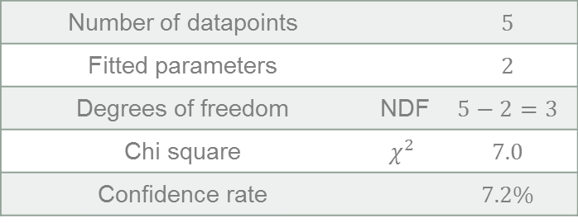
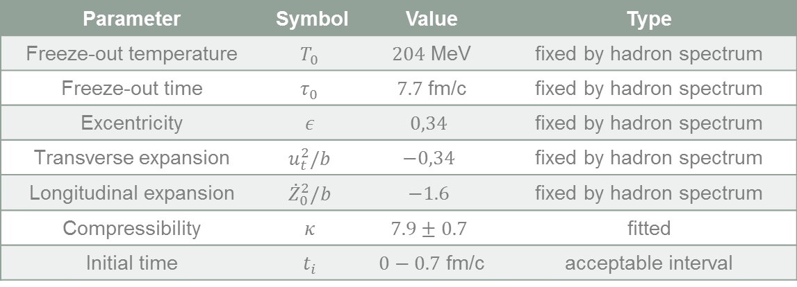
1.
2.
3.
4. Comparing to data
Parameter | Symbol | Value | Type
Freeze-out temperature | $$T_{0}$$ | $204$ MeV | fixed by hadron spectrum
Freeze-out time | $$τ_{0}$$ | $7.7$fm/c | fixed by hadron spectrum
Excentricity | $$ε$$ | $$0,34$$ | fixed by hadron spectrum
Transverse expansion | $$u_{t}^{2}/b$$ | $$−0,34$$ | fixed by hadron spectrum
Longitudinal expansion | $${\dot{Z}}_{0}^{2}/b$$ | $$−1.6$$ | fixed by hadron spectrum
Compressibility | $$κ$$ | $$7.9±0.7$$ | fitted
Initial time | $$t_{i}$$ | $0−0.7$ fm/c | acceptable interval
Fixed by hadron spectrum fit: (M. Csanád – M. Vargyas: Eur.Phys.J., A44:473–478, 2010.)
Number of datapoints |  | $$5$$
Fitted parameters |  | $$2$$
Degrees of freedom | NDF | $$5−2=3$$
Chi square | $$χ^{2}$$ | $$7.0$$
Confidence rate |  | $$7.2\%$$
Properties of the fit:

Slide 12
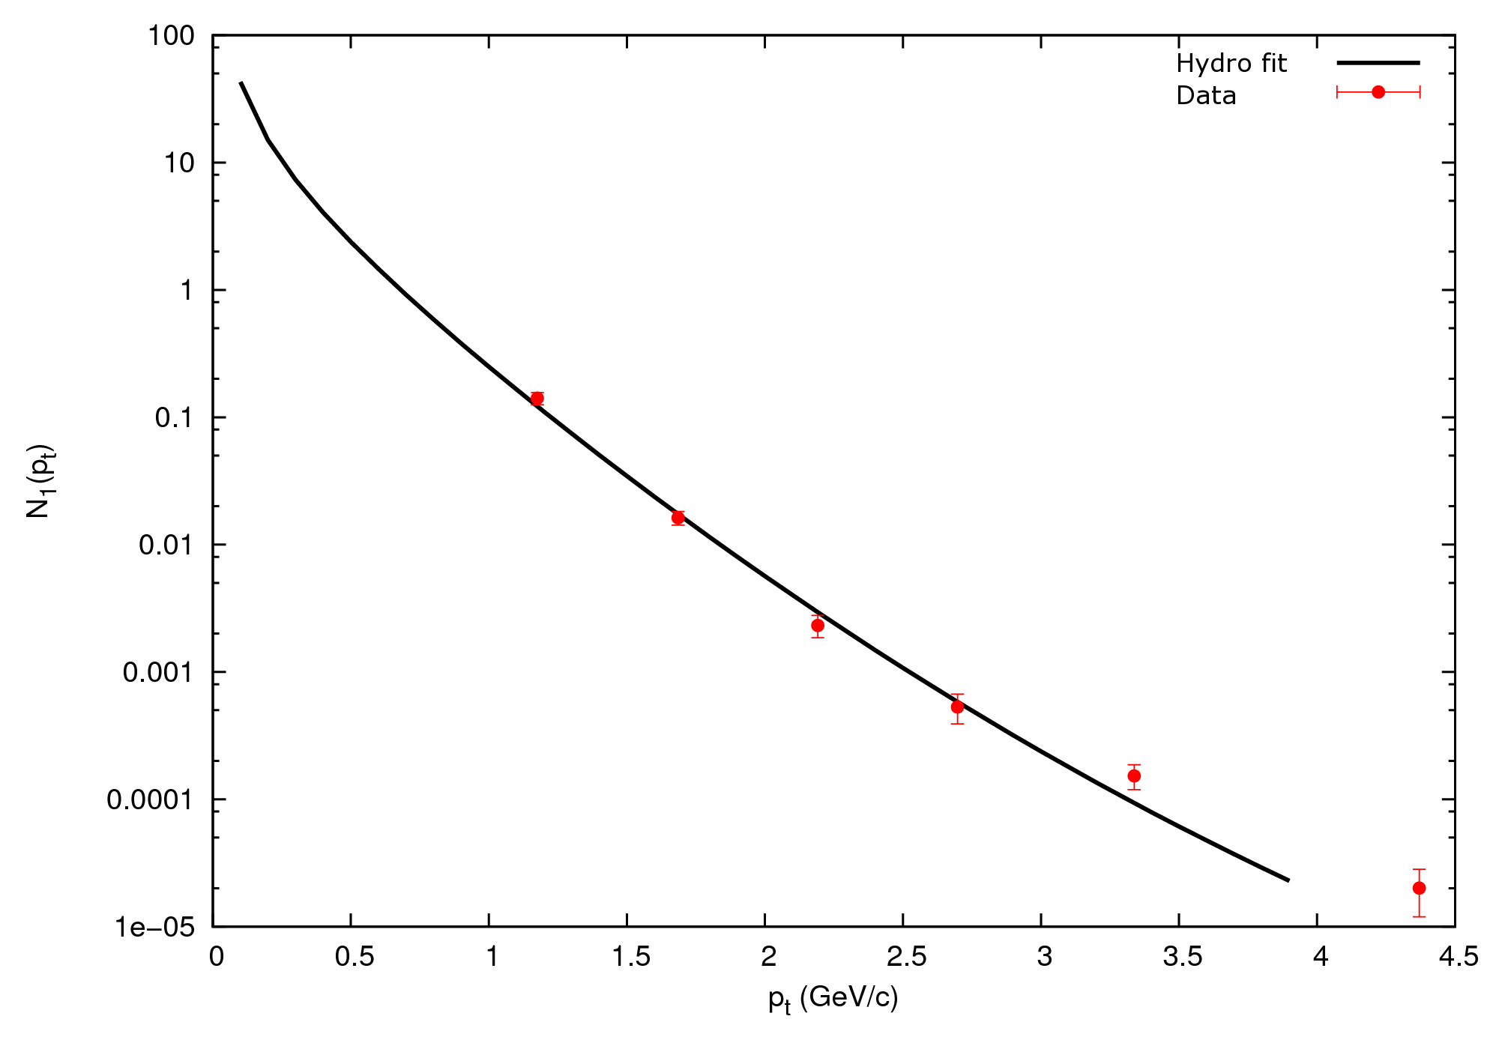
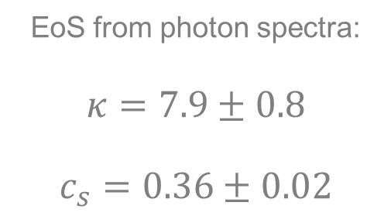
Photon momentum distribution
Fitting $N_{1}\left(p_{t}\right)$ to 0-92% centrality PHENIX data:
EoS from photon spectra:
$$κ=7.9±0.8$$
$$c_{s}=0.36±0.02$$

Slide 13
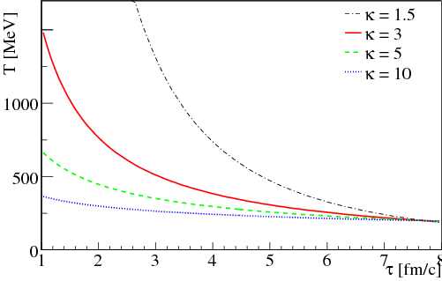

QGP initial temperature
With $κ$ and $t_{\text{initial}}$, hydro gives us the initial temperature:
$$T_{i}>507±12 \text{MeV}$$
Determined from photon spectra
Fixed from hadronic observables

Slide 14
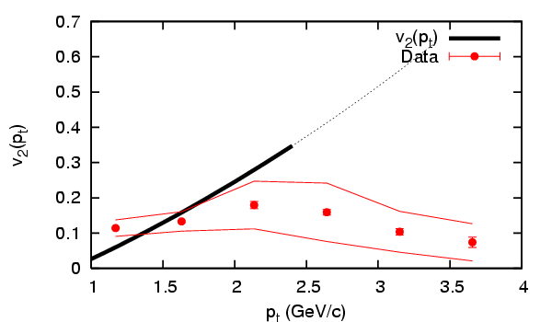
Photon elliptic flow
Elliptic flow from PHENIX data [arXiv:1105.4126]:
  Many models fail
  Non-hydro effects from 2 GeV
  Sign change possible

Slide 15
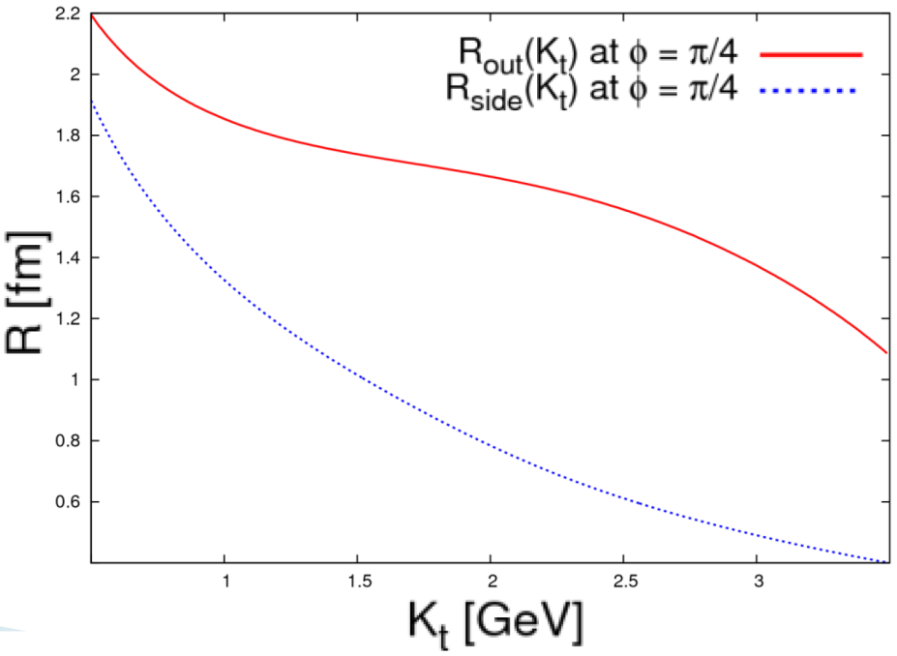
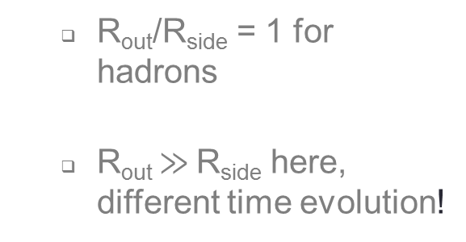
Bose-Einstein correlation
HBT radii at freeze-out time ($τ_{0}$):
  R_{out}/R_{side} = 1 for hadrons
  R_{out} $≫$R_{side} here, different time evolution!

Slide 16
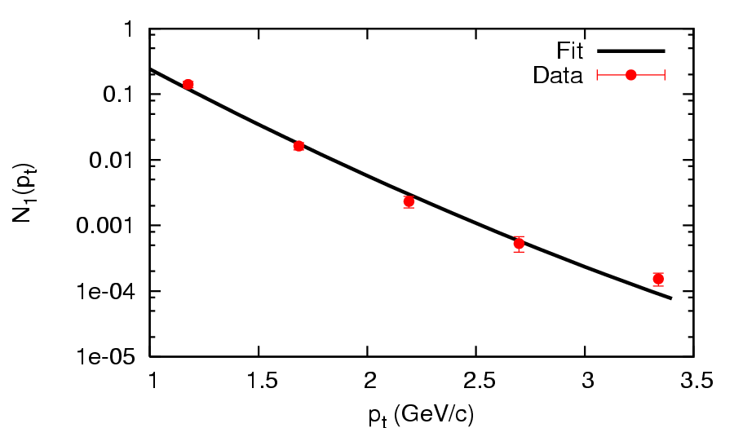





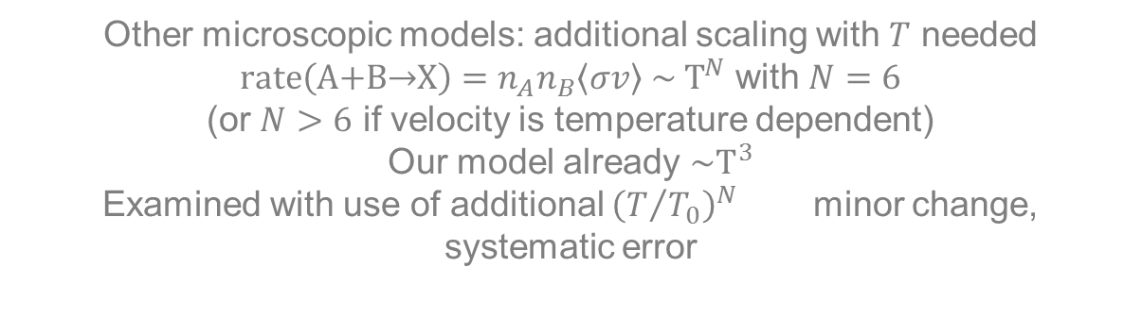
Further analysis
Other microscopic models: additional scaling with $T$ needed
$\text{rate}\left(\text{A}\text{+}\text{B}\text{→}\text{X}\right)=n_{A}n_{B}\left\langle σv\right\rangle \sim T^{N}$ with $N=6$
(or $N>6$ if velocity is temperature dependent)
Our model already $\sim T^{3}$
Examined with use of additional ${\left(T/{T_{0}}\right)}^{N}$ minor change, systematic error
N=0
N=2
$$c_{s}=0.36±{0.02}_{stat}±{0.04}_{sys}$$
$$T_{i}>507±{12}_{stat}± {90}_{sys}\text{MeV}$$
N=1
N=3

Slide 17

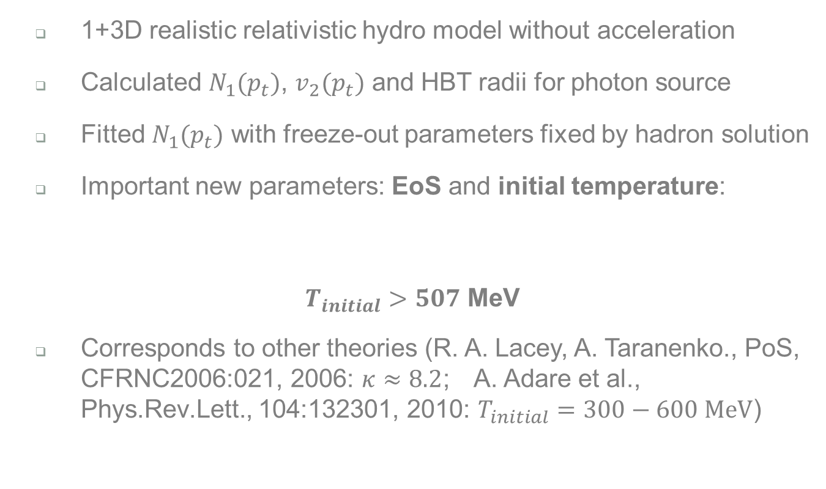
Summary
  1+3D realistic relativistic hydro model without acceleration
  Calculated $N_{1}(p_{t})$, $v_{2}(p_{t})$ and HBT radii for photon source
  Fitted $N_{1}(p_{t})$ with freeze-out parameters fixed by hadron solution
  Important new parameters: EoS and initial temperature:
$T_{initial}>507$ MeV
  Corresponds to other theories (R. A. Lacey, A. Taranenko., PoS, CFRNC2006:021, 2006: $κ≈8.2$; A. Adare et al., Phys.Rev.Lett., 104:132301, 2010: $T_{initial}=300−600 \text{MeV}$)
$$c_{s}=0.36±{0.02}_{stat}±{0.04}_{sys}$$

Slide 18
Thank you for your attention!

Slide 19
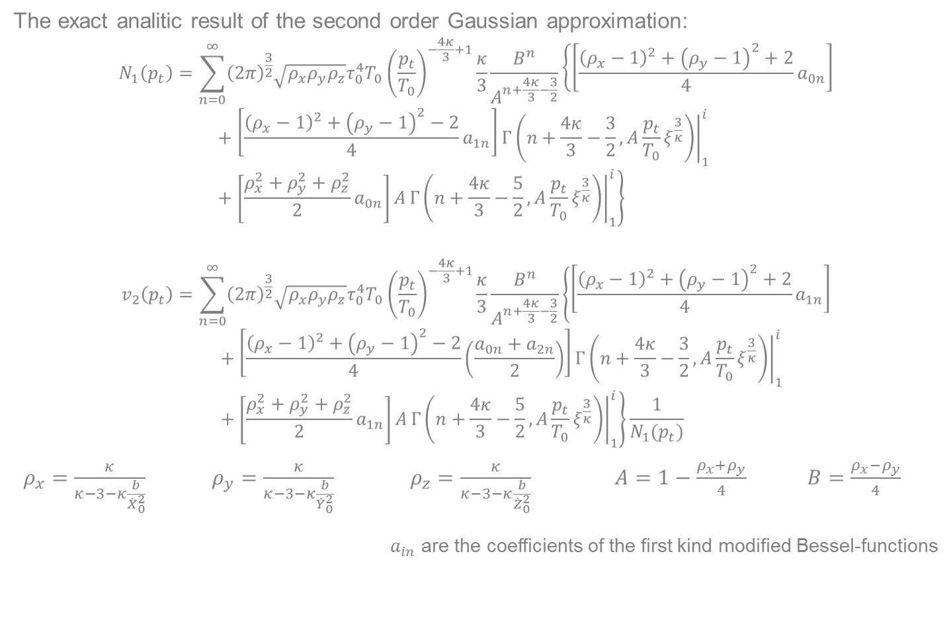
The analytic solution
The exact analitic result of the second order Gaussian approximation:
$$N_{1}\left(p_{t}\right)=\sum_{n=0}^{∞}{{\left(2π\right)}^{\frac{3}{2}}\sqrt{ρ_{x}ρ_{y}ρ_{z}}τ_{0}^{4}T_{0}{\left(\frac{p_{t}}{T_{0}}\right)}^{−\frac{4κ}{3}+1}\frac{κ}{3}\frac{B^{n}}{A^{n+\frac{4κ}{3}−\frac{3}{2}}}\left\{\left[\frac{{\left(ρ_{x}−1\right)}^{2}+{\left(ρ_{y}−1\right)}^{2}+2}{4}a_{0n}\right]\right.}+\left[\frac{{\left(ρ_{x}−1\right)}^{2}+{\left(ρ_{y}−1\right)}^{2}−2}{4}a_{1n}\right]{\left.Γ\left(n+\frac{4κ}{3}−\frac{3}{2},A\frac{p_{t}}{T_{0}}ξ^{\frac{3}{κ}}\right)\right|}_{1}^{i}+\left[\frac{ρ_{x}^{2}+ρ_{y}^{2}+ρ_{z}^{2}}{2}a_{0n}\right]\left.A{\left.Γ\left(n+\frac{4κ}{3}−\frac{5}{2},A\frac{p_{t}}{T_{0}}ξ^{\frac{3}{κ}}\right)\right|}_{1}^{i}\right\}$$
$$v_{2}\left(p_{t}\right)=\sum_{n=0}^{∞}{{\left(2π\right)}^{\frac{3}{2}}\sqrt{ρ_{x}ρ_{y}ρ_{z}}τ_{0}^{4}T_{0}{\left(\frac{p_{t}}{T_{0}}\right)}^{−\frac{4κ}{3}+1}\frac{κ}{3}\frac{B^{n}}{A^{n+\frac{4κ}{3}−\frac{3}{2}}}}\left\{\left[\frac{{\left(ρ_{x}−1\right)}^{2}+{\left(ρ_{y}−1\right)}^{2}+2}{4}a_{1n}\right]+\left[\frac{{\left(ρ_{x}−1\right)}^{2}+{\left(ρ_{y}−1\right)}^{2}−2}{4}\left(\frac{a_{0n}+a_{2n}}{2}\right)\right]{\left.Γ\left(n+\frac{4κ}{3}−\frac{3}{2},A\frac{p_{t}}{T_{0}}ξ^{\frac{3}{κ}}\right)\right|}_{1}^{i}+\left[\frac{ρ_{x}^{2}+ρ_{y}^{2}+ρ_{z}^{2}}{2}a_{1n}\right]A\left.{\left.Γ\left(n+\frac{4κ}{3}−\frac{5}{2},A\frac{p_{t}}{T_{0}}ξ^{\frac{3}{κ}}\right)\right|}_{1}^{i}\right\}\frac{1}{N_{1}(p_{t})}\right.$$
$ρ_{x}=\frac{κ}{κ−3−κ\frac{b}{{\dot{X}}_{0}^{2}}}$ $ρ_{y}=\frac{κ}{κ−3−κ\frac{b}{{\dot{Y}}_{0}^{2}}}$ $ρ_{z}=\frac{κ}{κ−3−κ\frac{b}{{\dot{Z}}_{0}^{2}}}$ $A=1−\frac{ρ_{x}+ρ_{y}}{4}$ $B=\frac{ρ_{x}−ρ_{y}}{4}$
$a_{in}$ are the coefficients of the first kind modified Bessel-functions

Slide 20
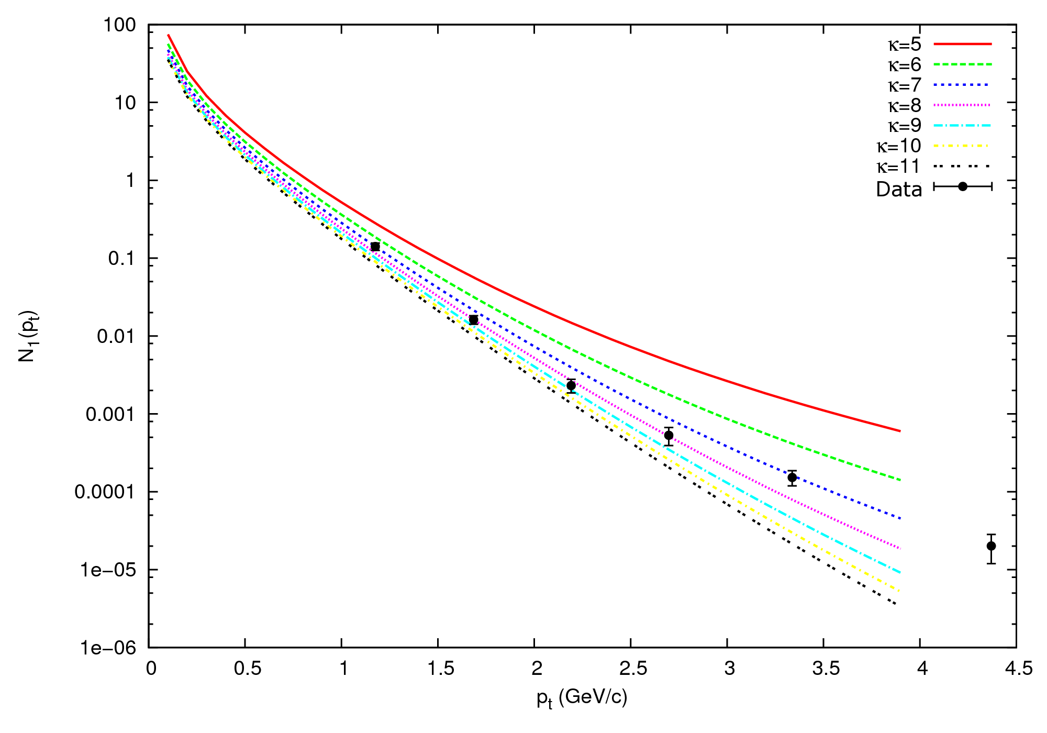
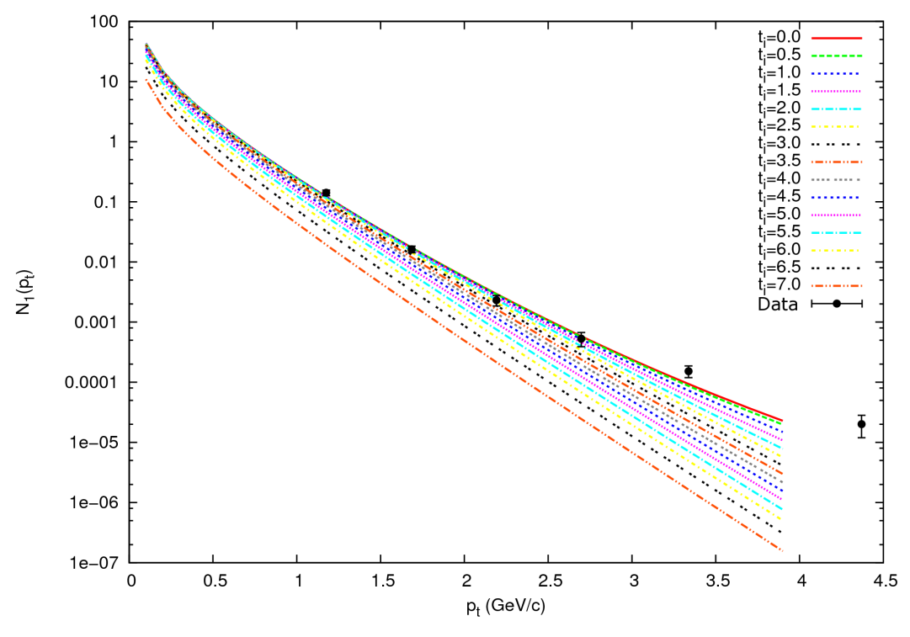
Dependencies of N₁(p_{t})
Small dependence on initial time
Sensitivity to EoS

Slide 21
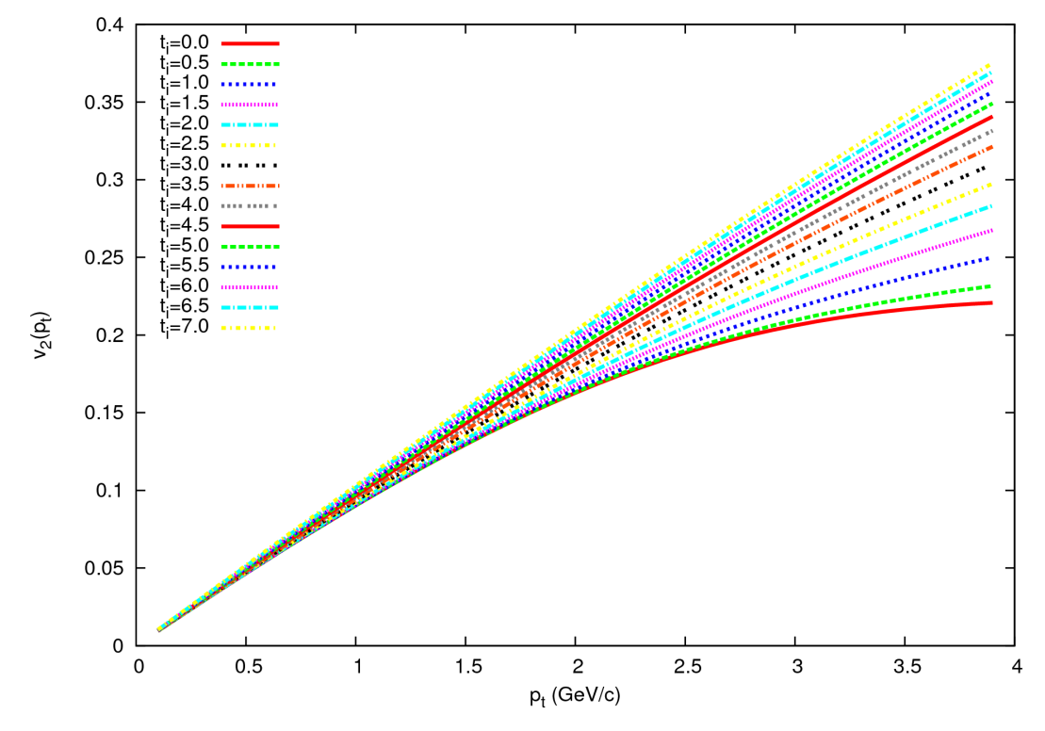
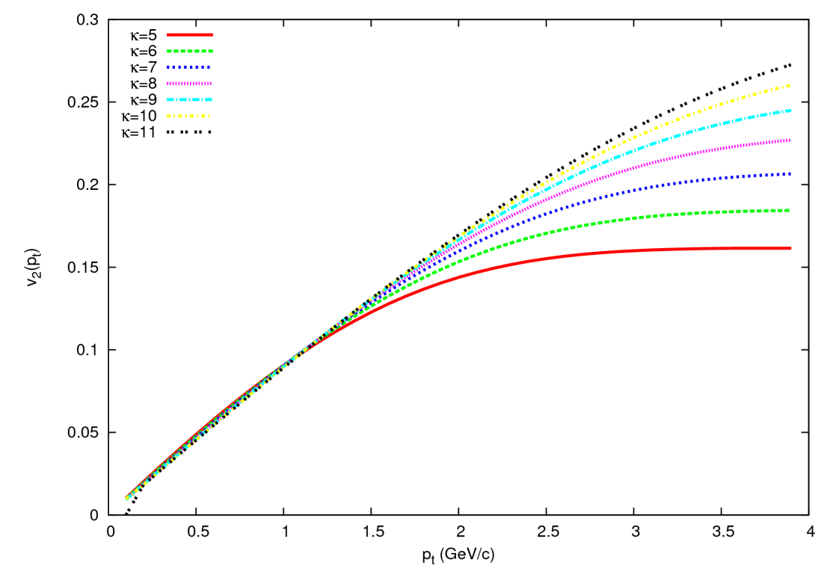
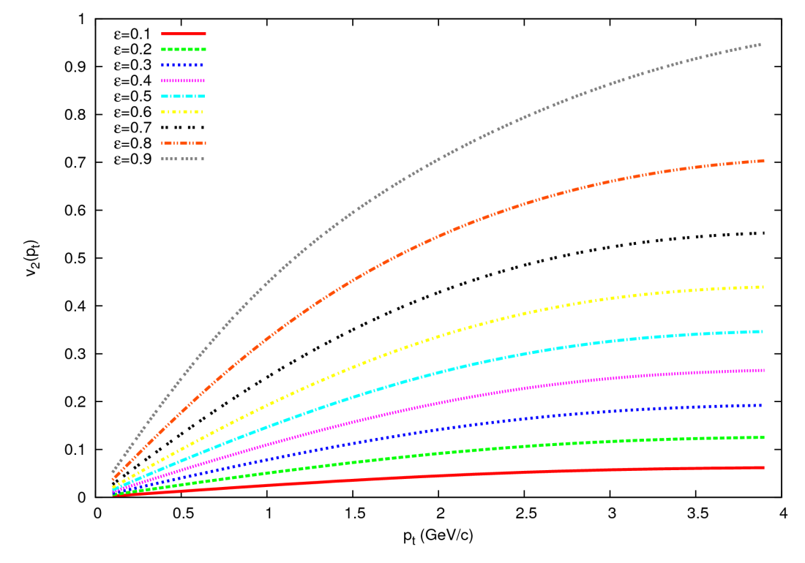
Initial time
EoS
Eccentricity
Dependencies of v₂(p_{t})

Slide 22
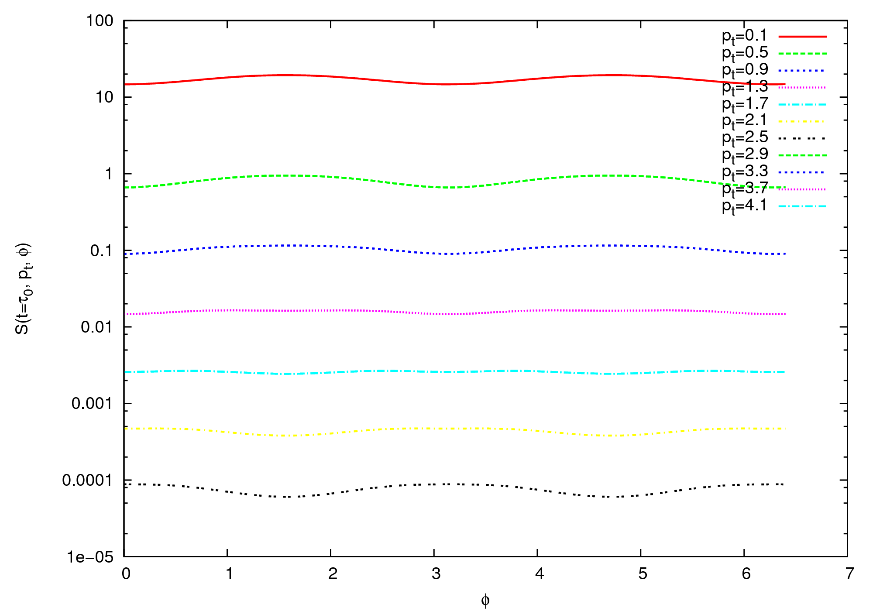
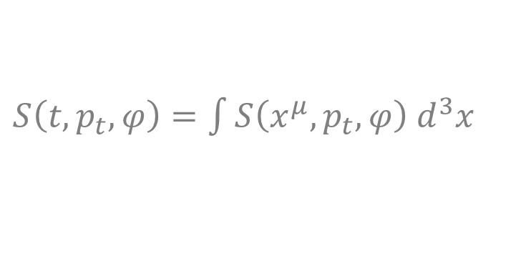
Sign change of v₂ at low p_{t}-s
$S\left(t,p_{t},φ\right)=\int{S\left(x^{μ},p_{t},φ\right) d^{3}x}$

Slide 23
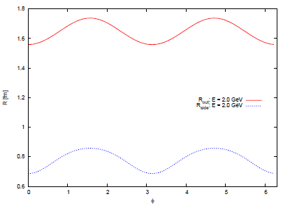
Azimuthal dependence of HBT radii

