Slide 1

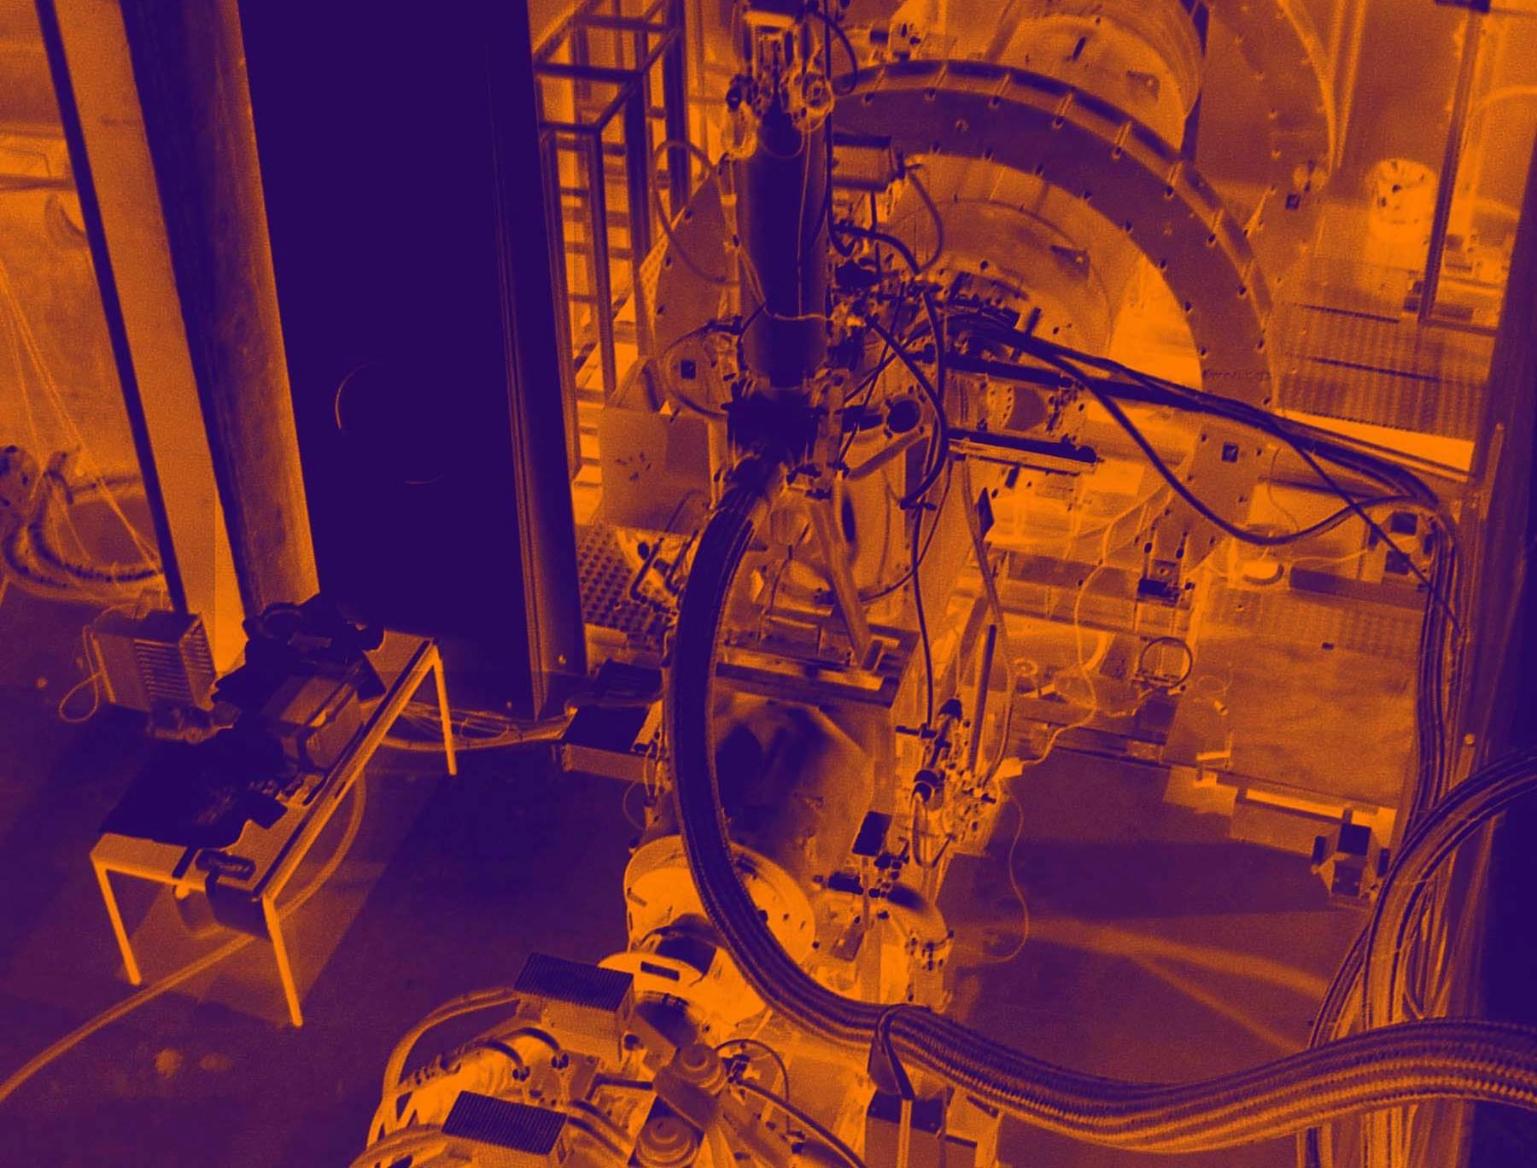
L O I
Summary of
Beam
Considerations

Slide 2
Where We Stand & What is Realistic
Concerning a Mu3e Beam Line at PSI
Brief Overview & Expectation for next few years –
Questions Addressed:
Proton Beam Intensity development
PSI beam lines
Possible Target E re-design project
Long-term plans
Implications for Mu3e
Manpower
πE5 Example layout

Slide 3
What Beam-Intensity do we need?
Recapitulating from last Presentation
From popular Theory: Br(μ→eγ) ~ 200x Br(μ→e)
Br(μ→eγ) ~ 150x Br(μ→3e)
Based on Sensitivity aim of MEG O(10⁻¹³) then must aim for
Sensitivity(μ→3e ) better than 10^{-15 → -16}
Conclusion
need muon beam intensities ~ GHz for experimental Sensitivity O(10⁻¹⁶)
Since World’s highest intensity muon beams at PSI with currently O(10⁸) Hz
- ONLY a staged approach possible for Mu3e (availability, MEG-upgrade & time
for new concepts)
Phase 1 Sensitivity O(10⁻¹⁵) with R_{µ}~ few 10⁸Hz
Phase 2 Sensitivity O(10⁻¹⁶) with R_{µ}≥ 10⁹Hz

Slide 4
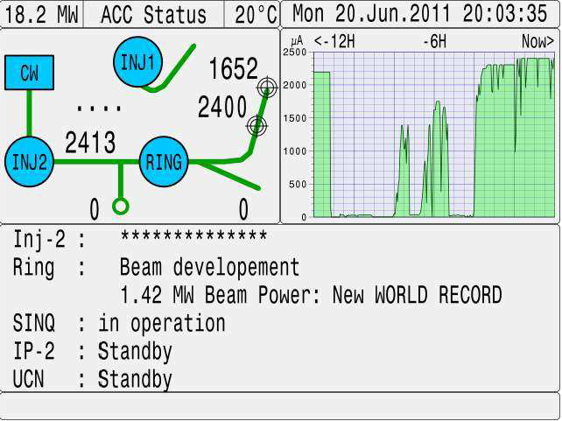
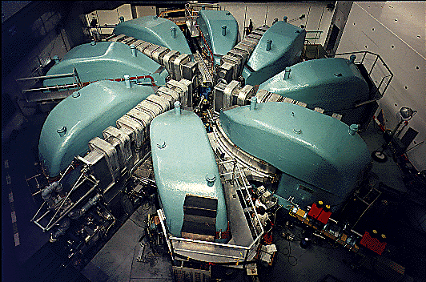
Proton Intensity- What can we Expect?
1) Proton Beam Intensity
PSI proton accelerator facility is expected to upgrade it’s intensity slowly
INJ. II RF-upgrade 2013 -2016:
Currently 2011 – 2.2 mA routine operation (cooling-water problems > 2.2mA routine)
Tg E collimator limitations at 2.5 mA, voltage limitation 1 RF-cavity ring
Next year 2012 – 2.2mA routine operation likely with 2.4mA tests only
Post 2012 – going from possible 2.3 mA – 3mA MAX. 3mA Prob. Not before 2016!

Slide 5
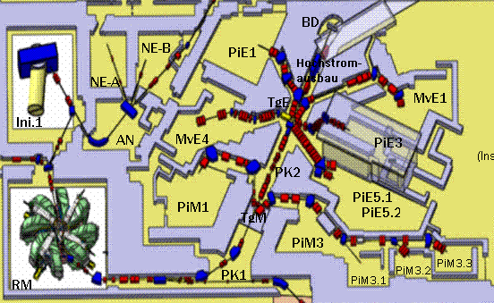
What Beam Lines for a Phase1 Experiment
Here only Target E viable
&
Highest intensity μ-beams
LEMS (90°), πE3(90°), πE5 (165°)
[@2mA 4cm]
4⋅10⁸ μ⁺/s
Not Viable
μSR facility
Large phase
space
~1⋅10⁸ μ⁺/s
~6⋅10⁷ μ⁺/s
µSR High-field
facility
πE5 only viable solution for Target E
Main Questions that arise:
Availability of πE5
MEG Plans
Magnet plans Mu3e
MEG data-taking 2012 + upgrade plans started
µ-Lamb shift Exp. Beam wanted 2013
MEG startup again prob. 2014? DT 2014-2015?
V. Problematic if Mu3e phase 1 2014-2016!!!
Mu3e Meeting Heidelberg December 2011

Slide 6
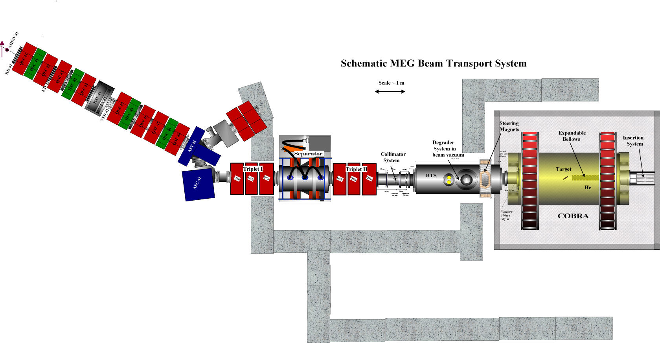

πE5 Possibilities
Mu3e
Mu3e
πE5-part
Mu3e purely schematic example – not optical solution
‘’Z-branch’’ – standard MEG with double dipole + at least double quad-doublet version
last doublet/triplett not shown
‘’U-branch’’ – double dipole + double quad-doublet (less DOF)
last doublet/triplett not shown
Mu3e Meeting Heidelberg December 2011

Slide 7
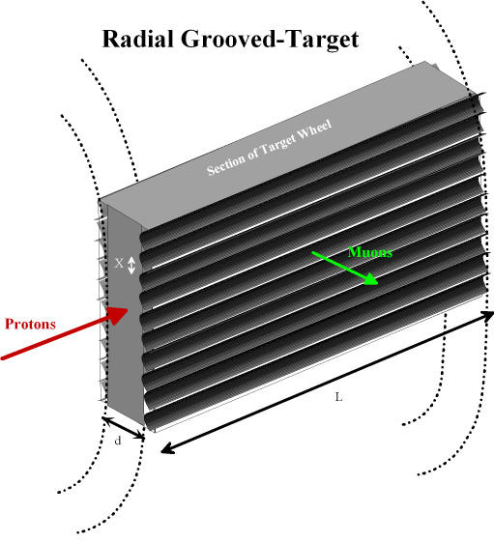
Phase I
What can one realistically expect?
Ans.)
Proton beam current max 2.3 mA? (guess)
PiE5 as previously shown ~ 1.4⋅10⁸ Hz
6cm Target E previous ~ 1.8⋅10⁸ Hz
Re-design Tg E + previous ~ 3⋅10⁸ Hz at 2.3 mA
MAX Possible for this scenario
Target E re-design needs engineering work + development
Have idea of ‘’Radial Grooved Wheel Target’’
Should give O(50%) increase in muon flux
Conclusion for Phase I:
Can expect muon intensity between
(1.4 – 3)⋅10⁸ Hz for I_{P}= 2.3mA
or (1.8 – 4)⋅10⁸ Hz for I_{P}= 3mA
Other possibilities:
Solenoidal extraction instead of quads
At entrance to PiE5 – win max 30% (guess)
Target E region change – solenoid extraction
huge effort not feasible for Phase I?
Mu3e Meeting Heidelberg December 2011

Slide 8
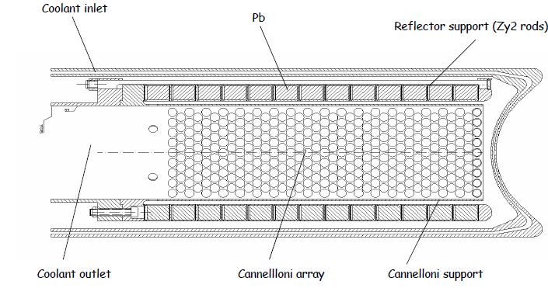
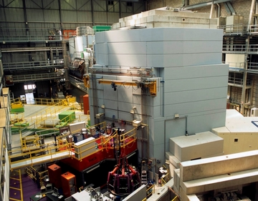
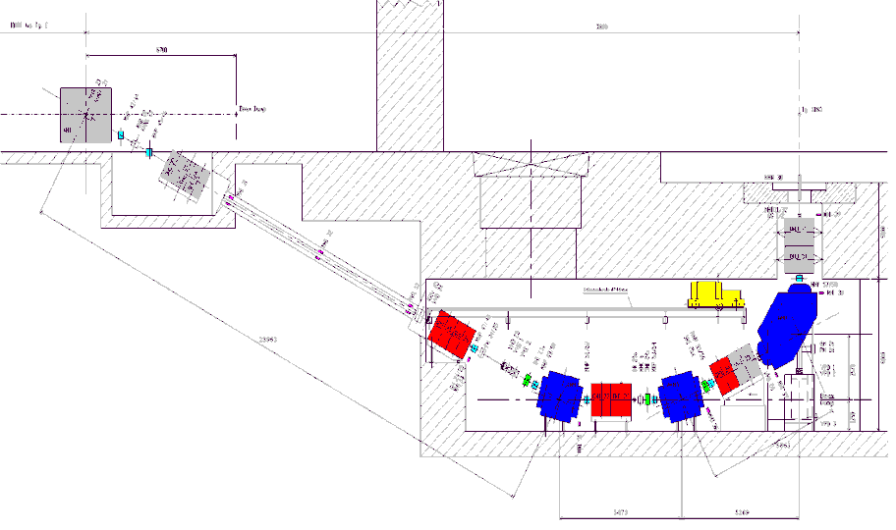
Possible Phase II Solution
My solution: go away from Target E & use SINQ Target (Spallation neutron source)
as a surface muon production target! - definite advantages
SINQ Target
Protons
SINQ
SINQ
First simulations confirm initial calculations
Conservative Estimate
SINQ expected max. Surface Muon Rate
N _{(suface muons)} ~ (7 ± 3)⋅ 10¹⁰ s⁻¹ at 3 mA on Tg E.
NOT before 2016/2017
protons
muons
Mu3e Meeting Heidelberg December 2011

Slide 9
Implications for Mu3e LOI
Definitely must reckon with a 2-Stage
Intensity Scenario Phase I & Phase II
Only feasible Area with sufficient rate available at PSI is the PiE5 Area
Must seriously consider time-scale for Phase I & sharing possibility
other projects MEG-upgrade & Lamb-shift Exp.
Must seriously Consider Mu3e Magnet
.
Phase I Must find solution for Mu3e Beam Line in front-area PiE5
Mu3e Meeting Heidelberg December 2011

Slide 10
Manpower Beam Development
First-order see that this could be managed by PSI as in principle experts at Lab:
MEG Beam Line Expertise (P-RK)
Magnet Group
Spallation Neutron Target Design Group (M. Wohlmuther)
Secondary Beam Line production target Group
Primary Beam Dynamics Group
Infra-structure Groups
The above expertise + application for PhD position to Swiss National Science Foundation
SNSF in form of a combined Mu3e ‘’SINERGIA’’ Request – which should be discussed as
next step to LOI by Mu3e Swiss Partners
Important - Discussion of Realistic Time-scale for Both Phases + Magnet possibilities
Mu3e Meeting Heidelberg December 2011

