Slide 1
Simulation packages and Review of Codes
Alexej Grudiev
CERN, BE-RF

Slide 2

Packages for computer simulations of electromagnetic EM fields and more
CST
HFSS
COMSOL
ACE3P
GdfidL

Slide 3
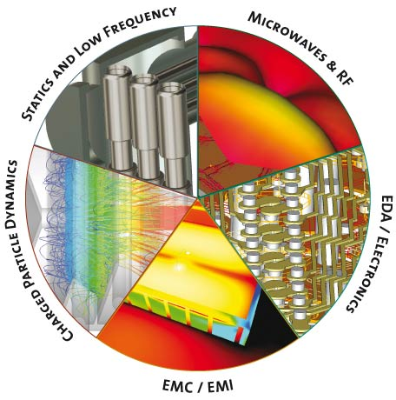
CST Studio Suite
CST STUDIO SUITE:
- CST MWS
- CST DS
- CST EMS
- CST PS
- CST MPS
- CST PCBS
- CST CS
- CST MICROSTRIPES
- Antenna Magus

Slide 4
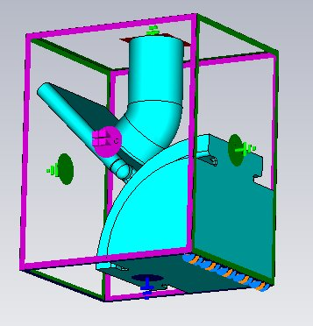
CST: All(?) you need in one package
Powerful and user-friendly Input:
Probably the best time domain (TD) solver for wakefields or beam coupling impedance calculations (MAFIA)
  Beta < 1
  Finite Conductivity walls
Once geometry input is done it can be used both for TD and FD simulations
Moreover using Design Studio (DS) it can be combined with the other studios for multiphysics and integrated electronincs simulation, but this is relatively fresh fields of expertise for CST
Accelerator physics oriented post processor, especially in MWS and PS
Enormous progress over the last few years compared to the competitors.
Courtesy of Igor Syratchev
An example of what can be solved easily on a standard PC

Slide 5
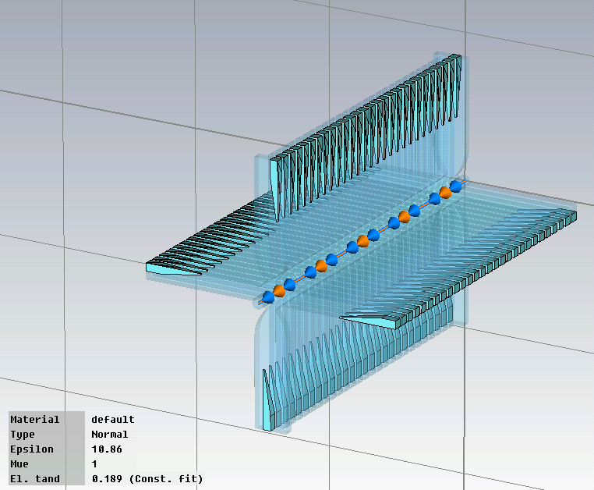
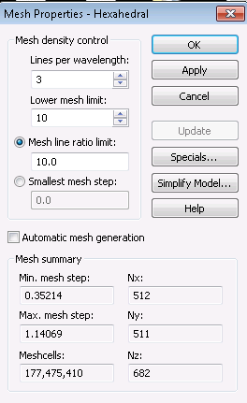
CST (examples)
Two examples of what can be solved on bigger PC:
128 GB of RAM and 24 CPUs
CLIC accelerating structure from Cu with
HOM damping loads from SiC
(frequency dependent properties)
Giovanni De Michele

Slide 6
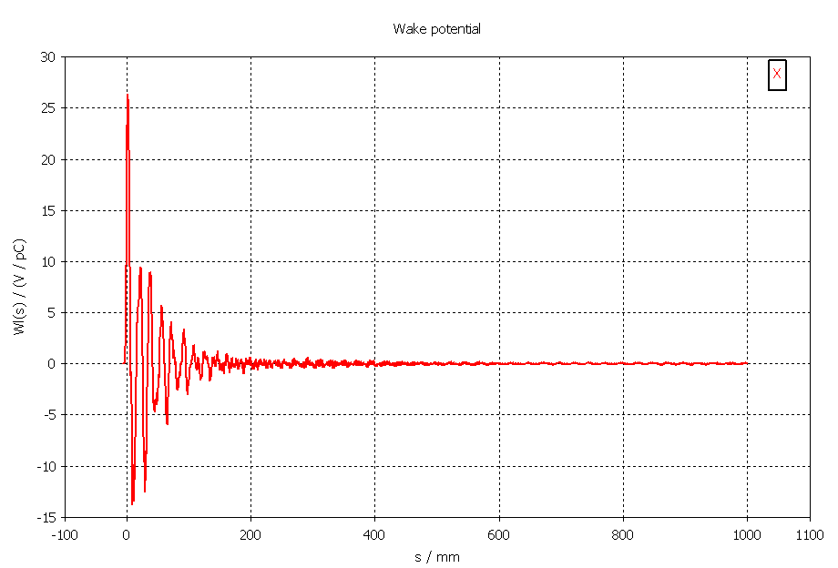
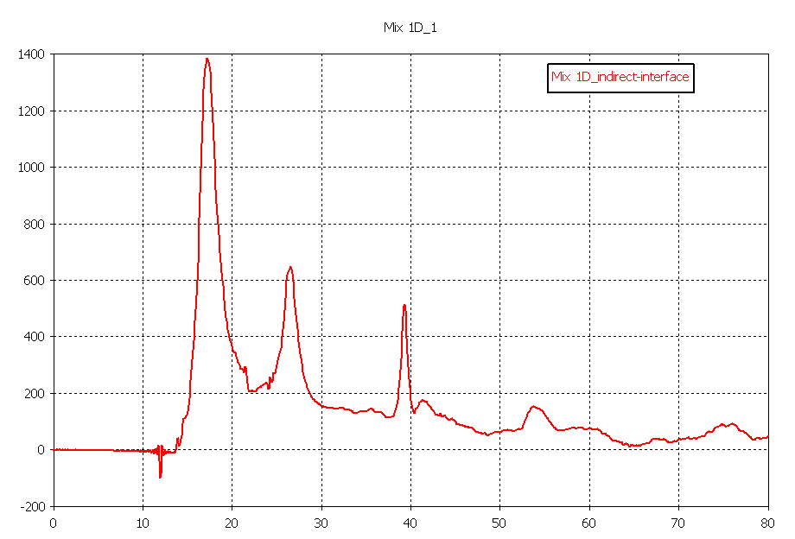
CST (examples)
Wx [V/pC]
Transverse wake at offset of 0.5 mm
Zx [Ω]
s [mm]
Transverse beam couping impedance at offset of 0.5 mm
f [GHz]

Slide 7
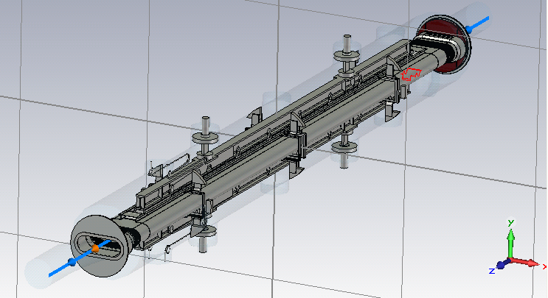
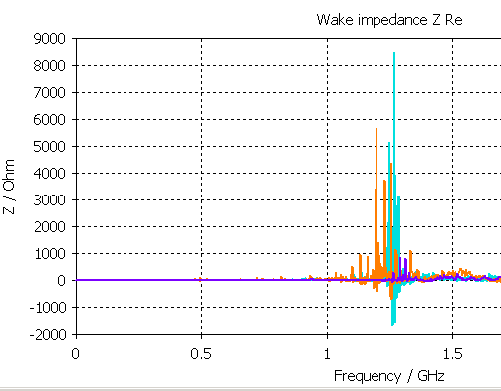
CST (examples)
LHC TDI 5m long with ferrite
Benoit Salvant

Slide 8
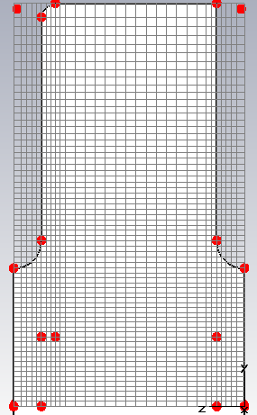
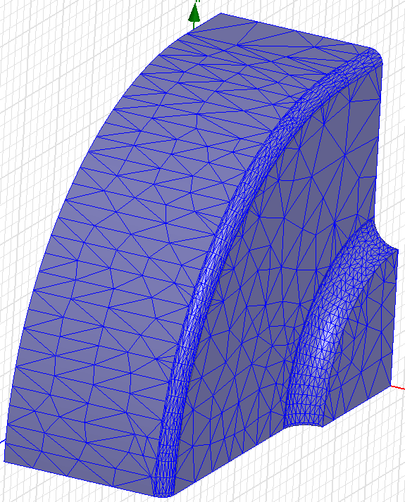
CST MWS: Comparison with HFSS
(Praveen Ambattu, Vasim F. Khan)
Property | MWS (PEC) | HFSS (Cu)
Freq, GHz | 11.9941 | 11.9959
Q_{Cu} | 6395 | 6106
R_{t}/Q, Ohm | 54.65 | 53.78
E_{surf}/E_{t} | 3.43 | 3.28
H_{surf}/E_{t} | 0.0114 | 0.0106
Mesh view
MWS
HFSS
MWS used Perfect Boundary Approximation, 134,912 hexahedra per quarter (lines/lamda=40, lower mesh limit=40, mesh line ratio limit=40)
HFSS used 8,223 tetrahedra per quarter (surface approximation= 5μm, aspect ratio=5)

Slide 9
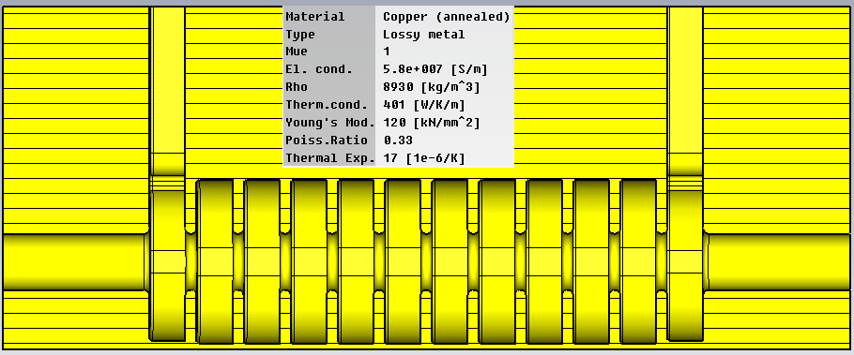
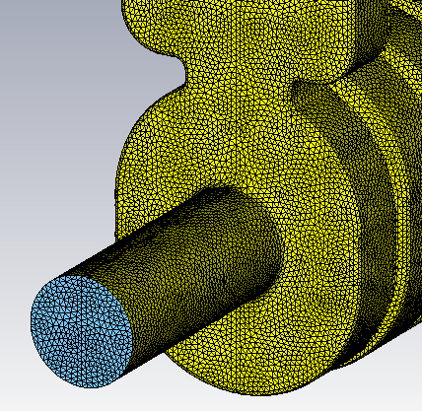
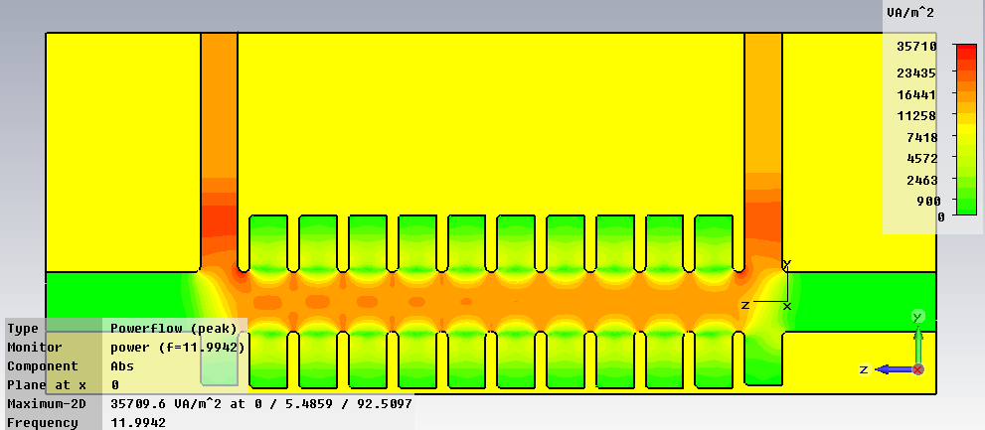
CST MWS: Example. S-parameters in CLIC Crab cavity
Mesh view
(Praveen Ambattu)

Slide 10
CST: Shortcomings
Cartesian mesh: Especially in FD can results to less accurate calculations of frequency, Q-factor, surface fields compared to tetrahedral mesh (HFSS, COMSOL, ACE3P). Tetrahedral mesh became available only recently but it is improving very rapidly.
Boundary conditions can be set only in Cartesian planes
No Field Calculator (HFSS)
From three eigenmode solvers only one takes into account losses but it is iterative and very slow
...
With a great help of Andrei Lunin

Slide 11
HFSS: Still an excellent tool for FD
High-Performance Electronic Design
    Ansoft Designer
    ANSYS HFSS
    ANSYS Q3D Extractor
    ANSYS SIwave
    ANSYS TPA
Electromechanical Design
    ANSYS Multiphysics
    ANSYS Maxwell
    ANSYS Simplorer
    ANSYS PExprt
    ANSYS RMxprt
Product options
    AnsoftLinks for ECAD
    AnsoftLinks for MCAD
    ANSYS Distributed Solve
    ANSYS Full-Wave SPICE
    ANSYS Optimetrics
    ANSYS ParICs
HFSS was and I think still is superior tool for FD simulations both S-pars and eigenmode, though CST shows significant progress in the recent years
Automatic generation and refinement of tetrahedral mesh
Most complete list of boundary conditions which can be applied on any surface
Ansoft Designer allows to co-simulate the pick-up (antenna), cables plus electronics and together with versatile Optimetrics optimise the design of the whole device
Last year HFSS become a integral part of ANSYS – reference tool for thermo-mechanical simulations -> multiphysics
Last year time-dependent solver has been released

Slide 12
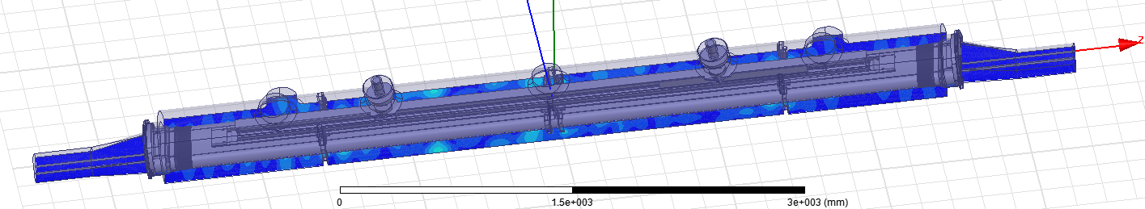
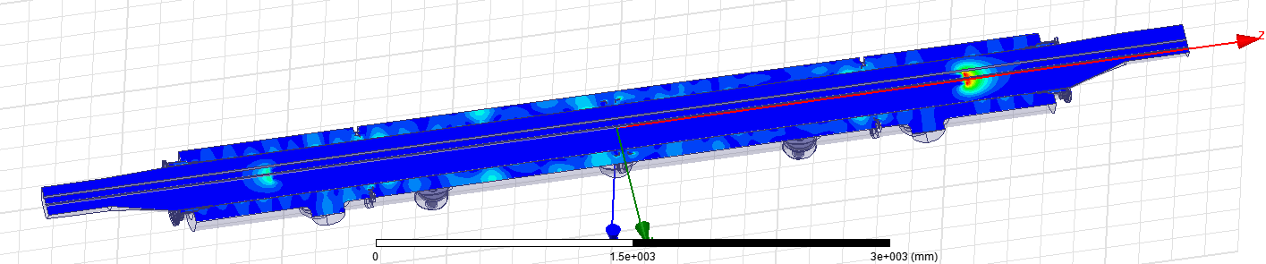
HFSS (examples, eigenmode)
LHC TDI 5m long beam dump:
One of the most dangerous eigenmodes at 1.227 GHz, Q = 873,
Tetrahedral mesh with mixed order (0th , 1st , 2nd) elements: Ntetr = 1404891
Solution obtained on a workstation with 128 GB of RAM,

Slide 13
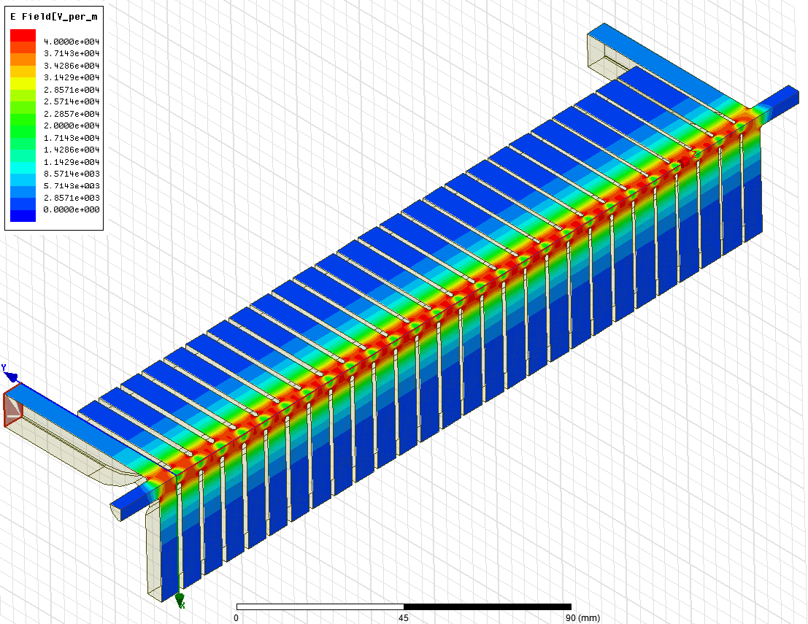
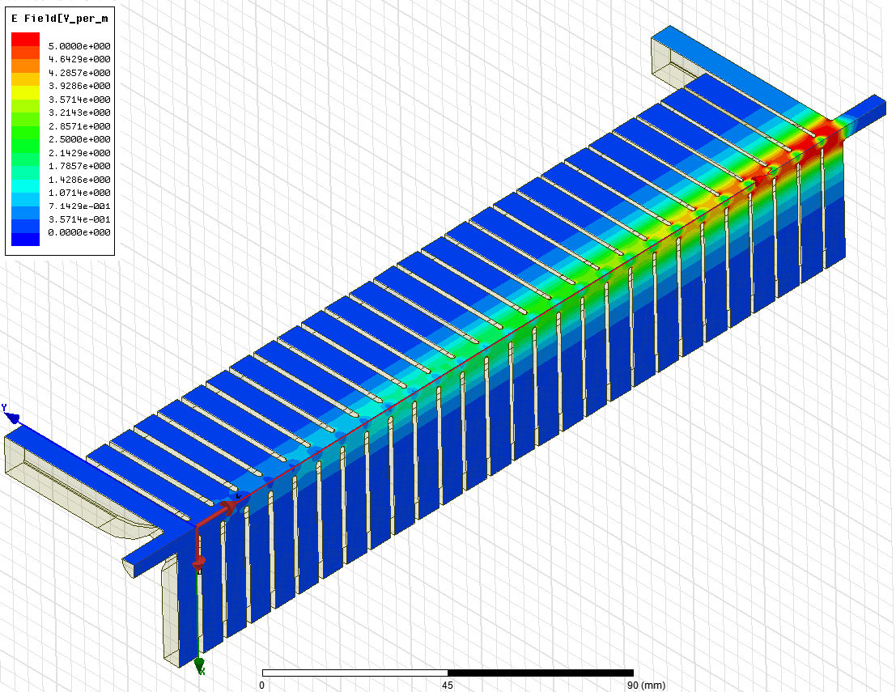
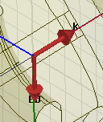
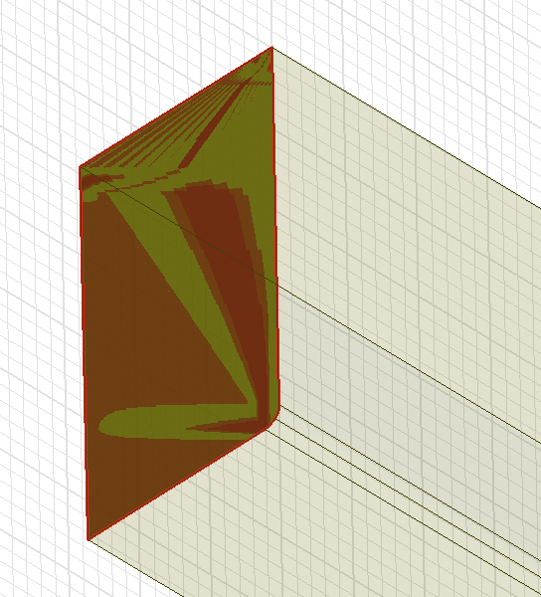
HFSS (example, S-parameters)
Port excitation
Incident plane wave excitation
O. Kononenko
O. Kononenko
Inverse FFT

Slide 14
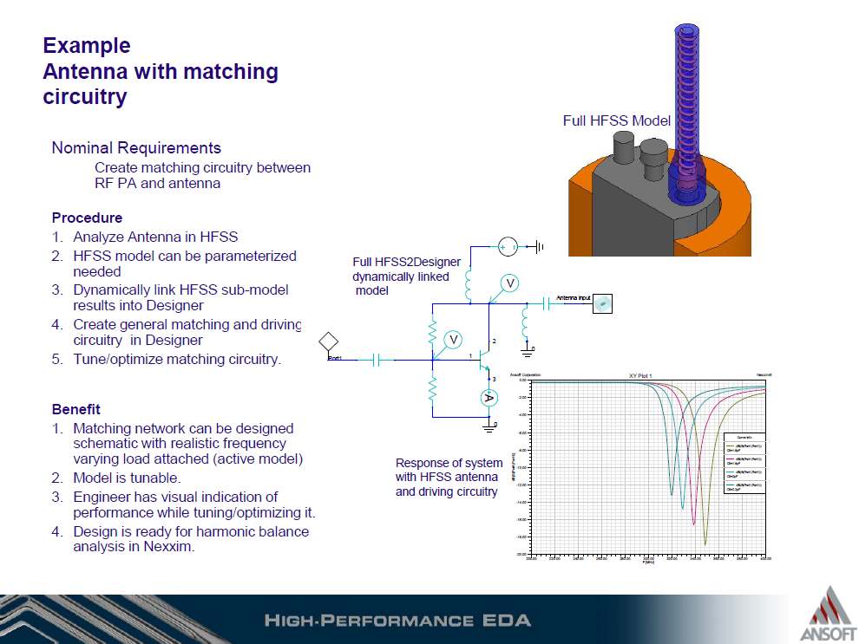
HFSS example

Slide 15
HFSS: shortcomings
No possibility to simulate particles
Automatic mesh is not always perfect, but it has improved after adoption by ANSYS
TD and multiphysics are only recently implemented, but thermo-mechanics from ANSYS is a reference by itself
...

Slide 16
GdfidL: Parallel and easy to use tool
bruns@gdfidl.de
The GdfidL Electromagnetic Field simulator
GdfidL computes electromagnetic fields in 3D-structures using parallel or scalar computers.
GdfidL computes
Time dependent fields in lossfree or lossy structures. The fields may be excited by
  port modes,
  relativistic line charges.
Resonant fields in lossfree or lossy structures.
The postprocessor computes from these results eg. Scattering parameters, wake potentials, Q-values and shunt impedances.
Features
GdfidL computes only in the field carrying parts of the computational volume. For eg. waveguide systems, this makes GdfidL about three to ten times faster than other Finite Difference based programs.
GdfidL uses generalised diagonal fillings to approximate the material distribution. This reduces eg. the frequency error by about a factor of ten.
For eigenvalue computations, GdfidL allows periodic boundary conditions in all three cartesian directions simultaneously.
GdfidL runs on parallel and serial computers. GdfidL also runs on clusters of workstations.
Availability
GdfidL only runs on UNIX-like operating systems.
Price
The price for a one year license for the serial version of GdfidL (including support) starts at 10.000 Euro .
The price for a one year license for the parallel versions starts at 20.000 Euro.
Access to a powerful cluster where GdfidL is installed on costs 9.000 Euro per year.
Powerful Syntax Material Approximation Absorbing Boundary Conditions Periodic Boundary Conditions

Slide 17
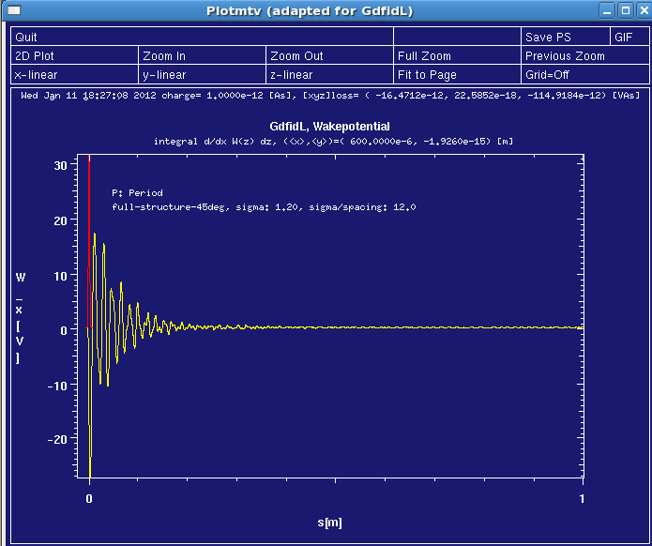
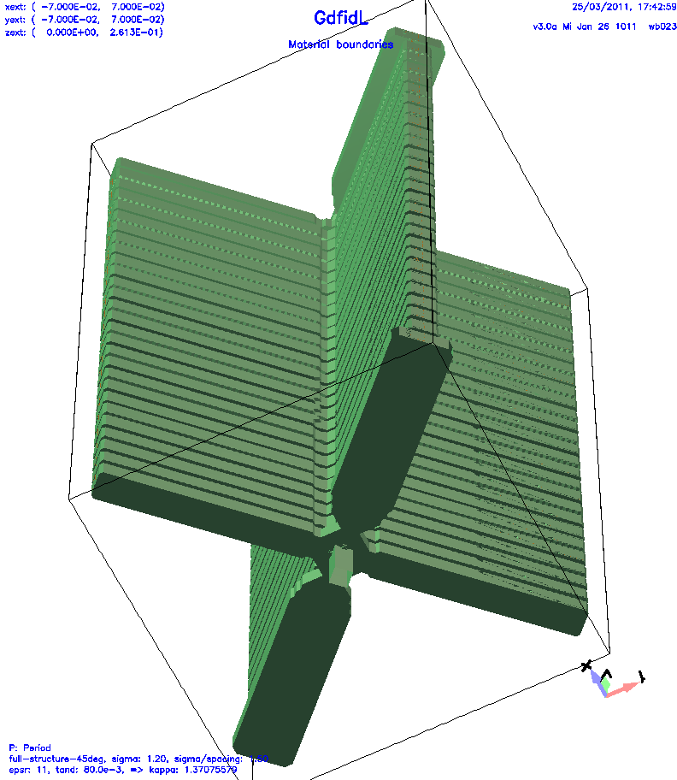
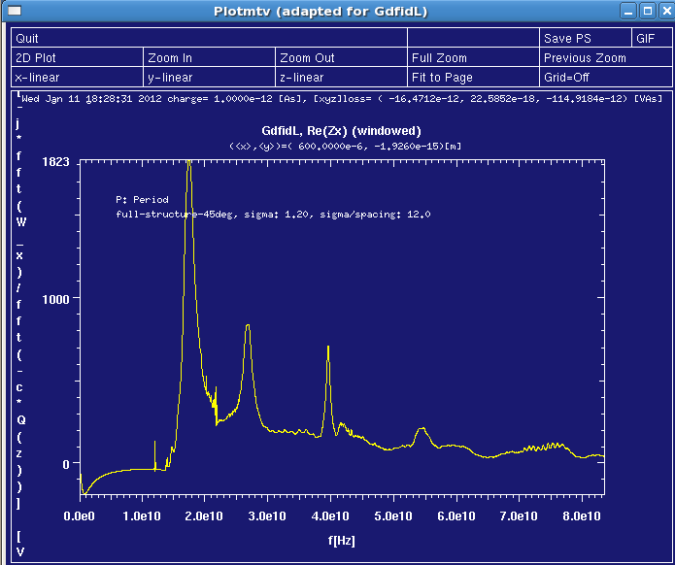
GdfidL (example)
CLIC accelerating structure from Cu with
HOM damping loads from SiC
(frequency dependent properties)

Slide 18
GdfidL: shortcomings
Available only under UNIX-like systems
Geometry input is limited
It is ‘one man show’
...

Slide 19
COMSOL: pioneer in multiphysics
COMSOL Multiphysics®
AC/DC Module |  | Heat Transfer Module |  | CFD Module |  | Chemical Reaction Engineering Module |  | Optimization Module® |  | LiveLink™ for MATLAB® |  | CAD Import Module
RF Module |  | Structural Mechanics Module |  | Microfluidics Module |  | Batteries & Fuel Cells Module |  | Material Library |  | LiveLink™ for SolidWorks® |  | LiveLink™ for SpaceClaim®
MEMS Module |  | Geomechanics Module |  | Subsurface Flow Module |  | Electrodeposition Module |  | Particle Tracing Module |  | LiveLink™ for Pro/ENGINEER® |  | LiveLink™ for Creo™ Parametric
Plasma Module |  | Acoustics Module |  |  |  |  |  |  |  | LiveLink™ for Inventor® |  | LiveLink™ for AutoCAD®

Slide 20
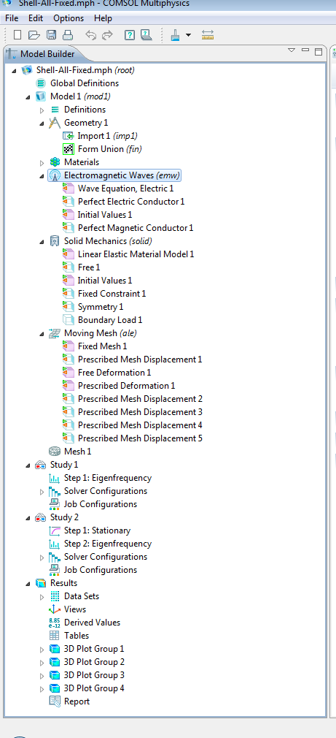

COMSOL: example df/dp Calculation
Electromagnetic Waves
Solid Mechanics
Solving only for the Cavity Vessel
Applying the proper fixed constraints, symmetries, displacements, and boundary load
Applying the prober boundary conditions
Solving only for the RF domain
Moving Mesh
Solving for all domains
Applying the proper prescribed and free mesh deformation/displacement
Mohamed Hassan
EM
Eigen frequency simulation to find the resonant frequency (f₀)
Solid
Mechanics
Find the deformation under given pressure load (P_{L})
Moving Mesh
Update the mesh after deformation
EM
Eigen frequency simulation to find the resonant frequency after deformation (f_{p})
Three Multiphysic Modules
Two Simulation Studies
Study₁
Eigen-frequency (to find f₀)
Study₂
Stationary (solving only for solid mechanics and moving mesh)
Eigen-frequency (to find f_{p})
$\frac{df}{dp}$=$\frac{fp−f0}{PL}$

Slide 21
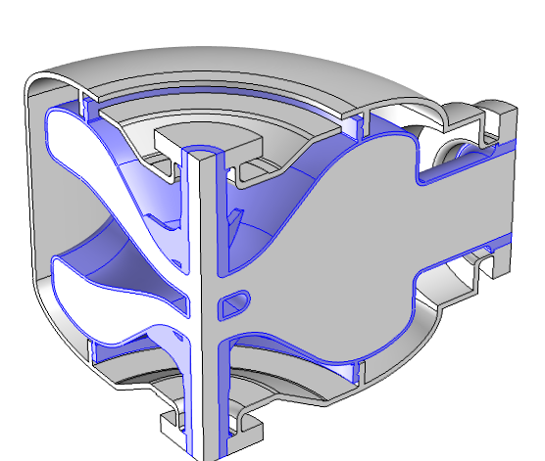
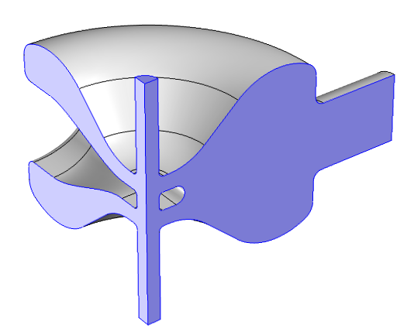
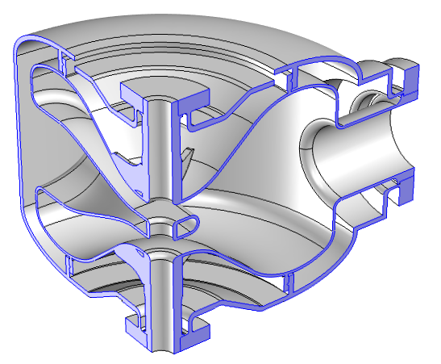
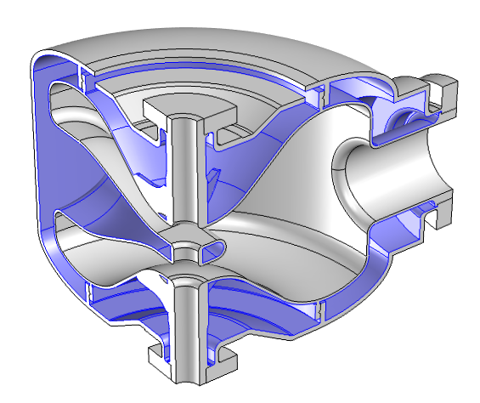
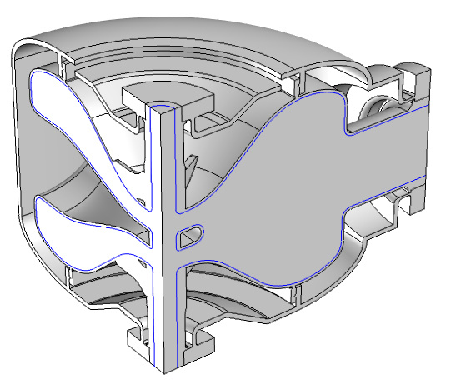
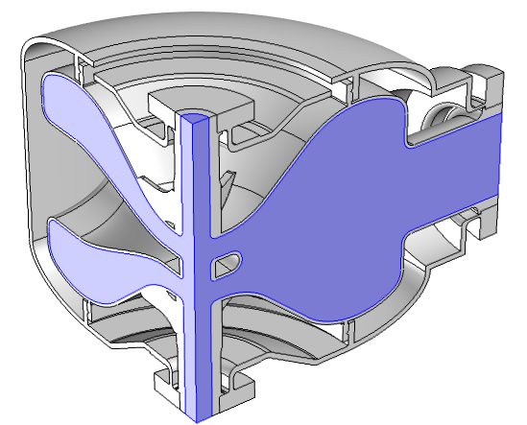

Example
Stainless Steel Vessel
Mohamed Hassan
PEC
RF Domain
Electromagnetic Waves
PMC
  Solving only for the RF domain
  Applying the prober boundary conditions
Niobium Shell
Fixed Constraint
Symmetry Boundaries
Solid Mechanics
  Solving only for the Cavity Vessel
  Applying the proper fixed constraints, symmetries, displacements, and boundary load
Pressure Boundary Load
Moving Mesh
Solving for all domains
Applying the proper prescribed and free mesh deformation/displacement
dx=0
dy=0
Prescribed Displacement
dx
Free Deformation
Prescribed Displacement u,v,w
Prescribed Deformation u,v,w
dz=0

Slide 22
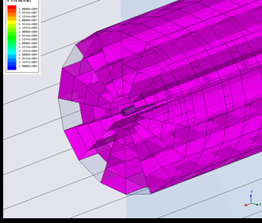
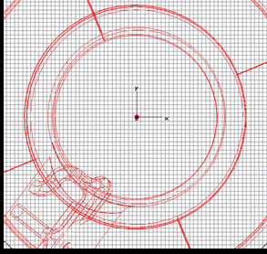
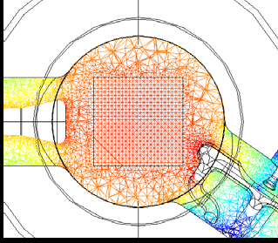
COMSOL: example
Meshes used for RF kick simulations : a ) HFSS , b ) CST MWS, c) COMSOL
a)
b)
c)
A. Lunin, et. al., FINAL RESULTS ON RF AND WAKE KICKS CAUSED BY THE COUPLERS FOR THE ILC CAVITY, IPAC10, Kyoto, Japan
‘Highly regularized tetrahedral mesh can be built by versatile COMSOL mesh generator’
‘Well parallelized, direct method for eigenmode calculations with losses and smooth surface fields’
Andrei Lunin

Slide 23
COMSOL: shortcomings
Geometry input is limited
Port excitation mode description is not convenient
S-parameter solver is not convenient
Postprocessing is not well developed at least for what concerns accelerator physicists and engineers
Andrei Lunin

Slide 24
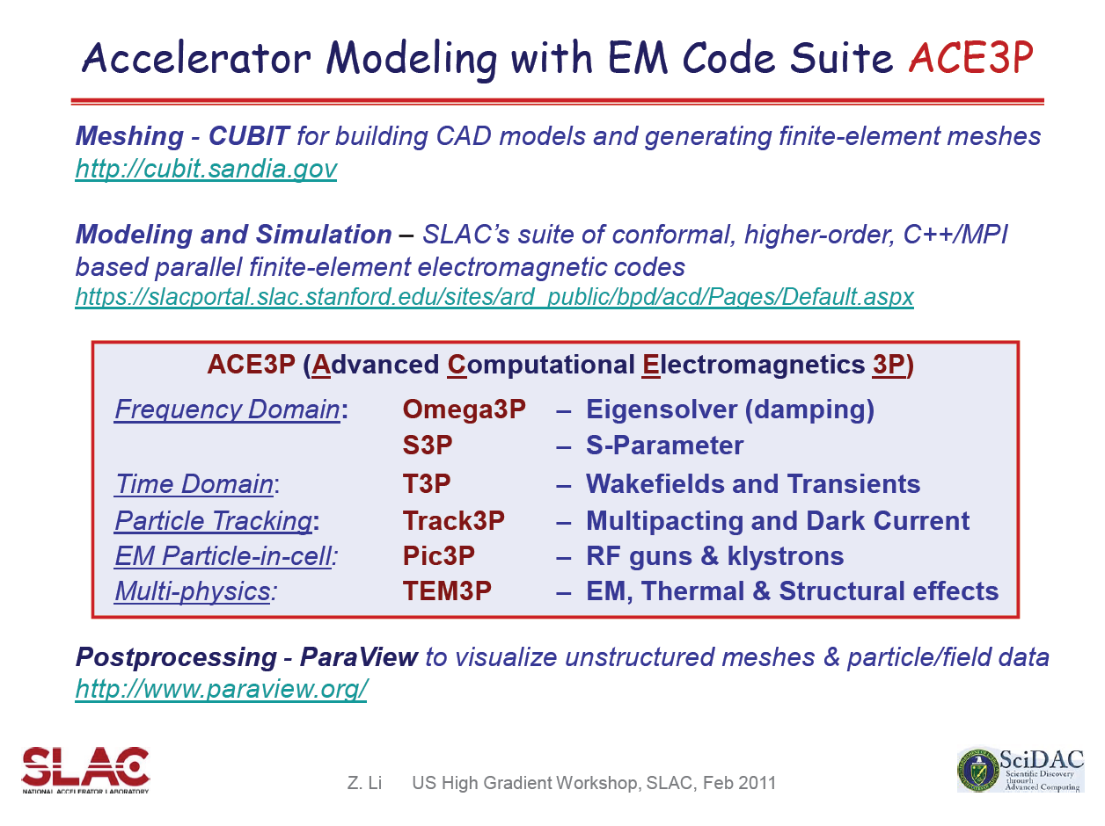
ACE3P

Slide 25
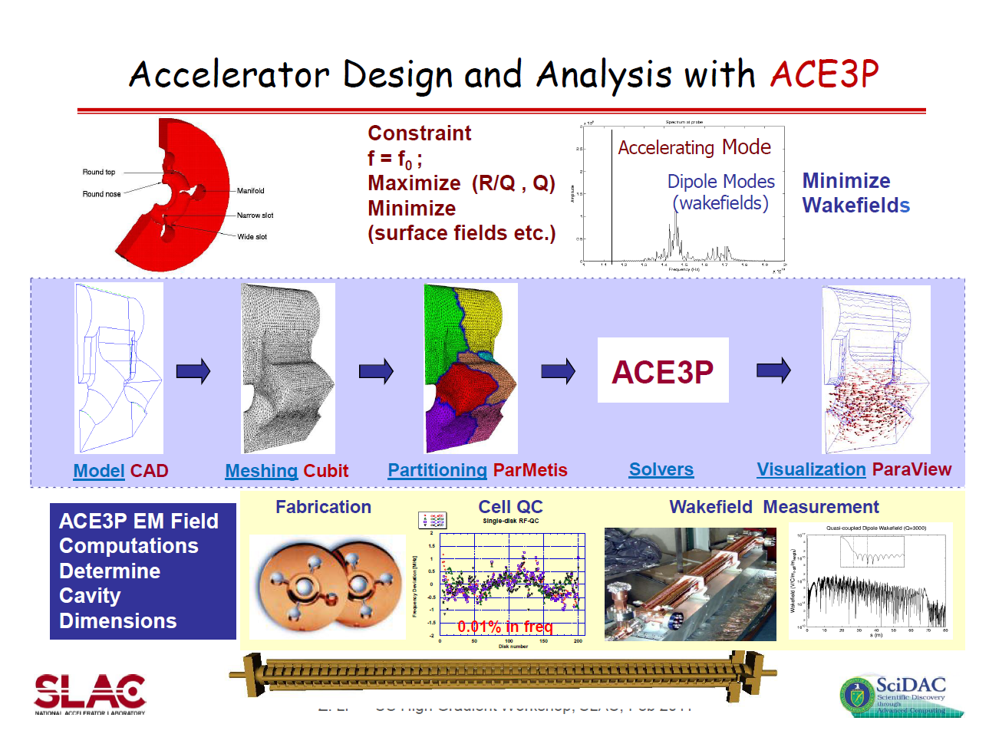

Slide 26
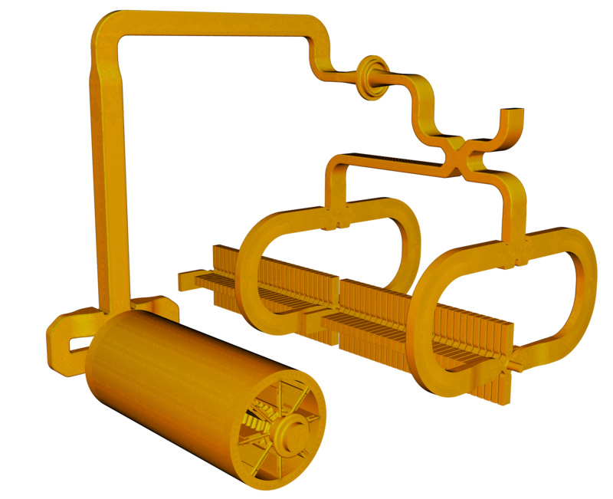
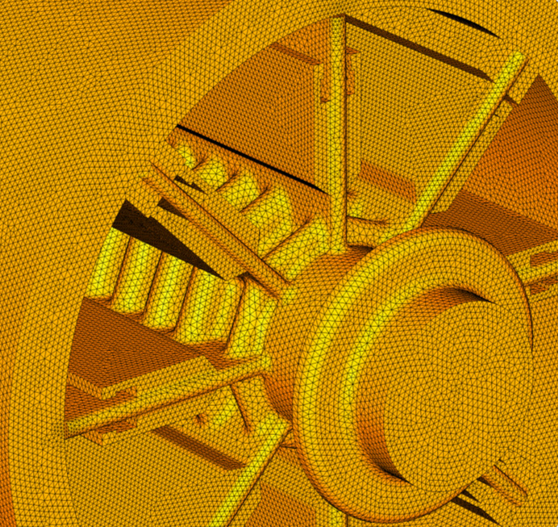
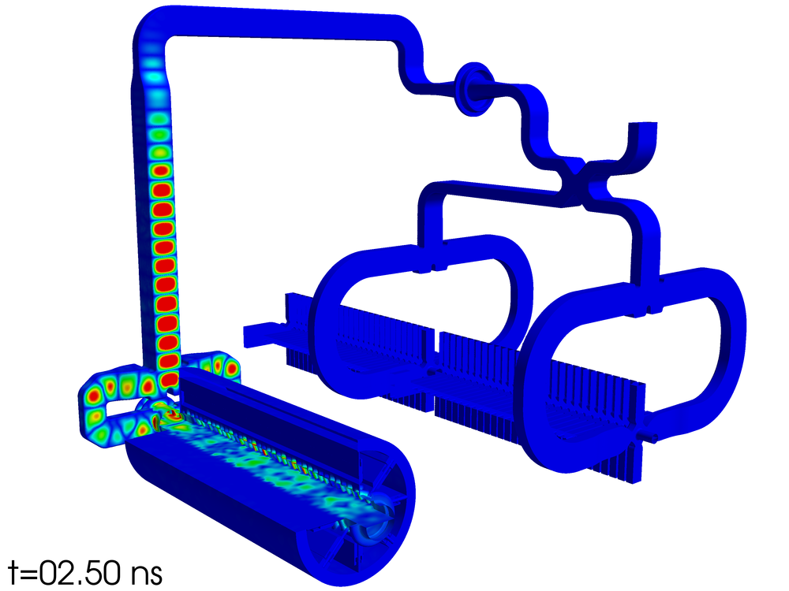
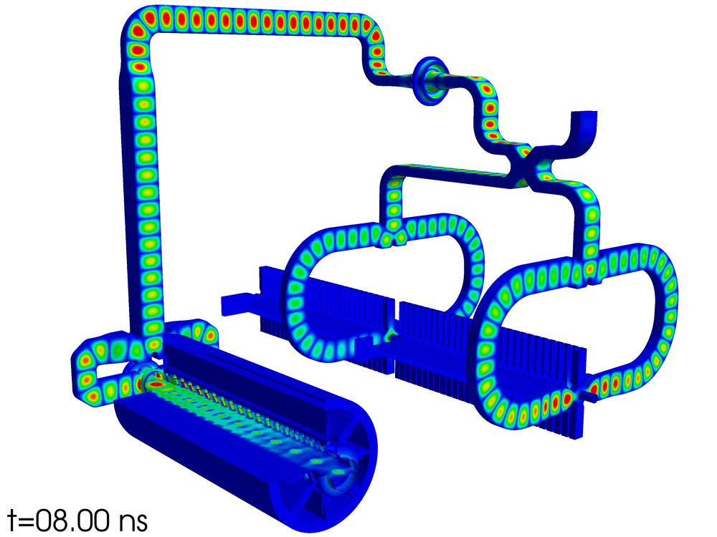
ACE3P: example
waveguide
CLIC two-beam module rf circuit
AS
AS
PETS
Arno Candel et. al., SLAC-PUB-14439

Slide 27
ACE3P: shortcomings
Very complex package to use. It is not user-friendly at all and requires a lots of time to invest before it can be used efficiently
It is not a commercial product -> no manual reference, limited tech support. No it is an open source.
...

Slide 28
Summary
CST
Larger objects in TD
Better FD calculations,
3D EM + circuit co-simulation,
RF + thermal + structural
More multiphysics
GdfidL
ANSYS HFSS
COMSOL
Accurate solution for very larger objects in TD and FD
ACE3P

