Slide 1
Can the proton injectors meet the HL-LHC requirements after LS2?
H.Bartosik, C.Bracco, O.Brüning, C.Carli, H.Damerau, R.Garoby, S.Gilardoni, B.Goddard, S.Hancock, K.Hanke, V.Kain, M.Meddahi, B.Mikulec, Y.Papaphilippou, G.Rumolo, E.Shaposhnikova, R.Steerenberg, M.Vretenar

Slide 2
Contents
What are the HL-LHC requirements for after LS2*?
Reminder of present proton injector chain performance
Limitations and mitigations in the injector chain
  Space charge, electron cloud, beam loading, longitudinal stability, TMCI
Expected performance after LS2
  Areas still requiring performance improvement
Unknowns, risks and remaining issues
Conclusion
*to date, only ‘final’ HL-LHC requirements after LS3 have been discussed, not LS2: The question of what LHC can accept LS2 – LS3 is not addressed.

Slide 3
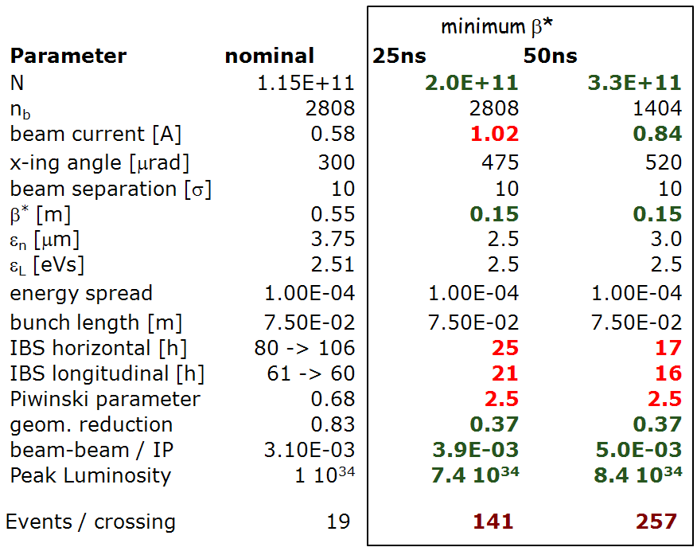
Requirements from HL-LHC
Target: 250-300 fb⁻¹ per year
at LHC collision
O.Brüning, HI-LUMI event 16-18 November 2011

Slide 4
Required parameters through injector chain
With these LHC numbers what are required main parameters for (L4) PSB, PS and SPS, for 25 and 50 ns?
Depend on emittance blowup and beam loss. Assumptions made:
  PSB inj-extr: 5% emittance blowup, 5% beamloss
  PS inj-extr: 5% emittance blowup, 5% beamloss
  SPS inj-extr: 10% emittance blowup, 10% beamloss (including scraping)
  LHC inj-flat top: 10% emittance blowup, 10% beamloss
Total assumed beamloss 27% (PS injection to LHC flat-top), and total emittance growth 33% (or Δε ≈0.7 um with 2.5 um in LHC)
  For comparison, 2011 operation saw 13% beamloss (PS injection to LHC flat-top), with Δε 0.4 – 0.5 um (to SPS extraction), and Δε 0.5 – 0.6 um LHC

Slide 5
Required parameters through injector chain

Slide 6
2011 to post-LS2
  2011 was excellent: 1.5e11 with 2.5 um for 50 ns (at LHC flat-top)
  Around 1.1 e11 with 2.8 um for 25 ns, extracted from SPS
Large improvement is required for either 25 or 50 ns beam!

Slide 7
Limits: space charge/brightness
PSB: ε_{xy} [um] ≈ -0.42 N_{b} [e12] / ΔQy, with 160 MeV injection
  Confident to run with ΔQy ≈ -0.3 (and maybe even higher...-0.5??)
  Brightness 14e11 p+/urad, or 1.7 um for 2.4e12 p+
PS: ε_{xy} [um] ≈ -0.26 N_{b} [e12] / ΔQy - 0.38, with 2 GeV injection
  Confident to run with ΔQy ≈ -0.26
  Brightness ~12e11p+/urad (2.0 um /2.4e12 p+)
  Cannot digest fully what PSB can provide
SPS: ε_{xy} [um] ≈ -1.22 N_{b} [e12] / ΔQy, with Q20 optics at 26 GeV
  Can hope to run with ΔQy ≈ -0.15 (single bunch brightness)
  Gives 1.2e11 p+/urad or 1.6 um for 2.0e11 p+
For 25 ns: suggests limit will be PS, as PSB delivers more than PS can digest (although ΔQ above -0.26 maybe possible, depending on time at injection)
For 50 ns: PS could deliver 1.0 um for 2.0e11, so limit in SPS

Slide 8
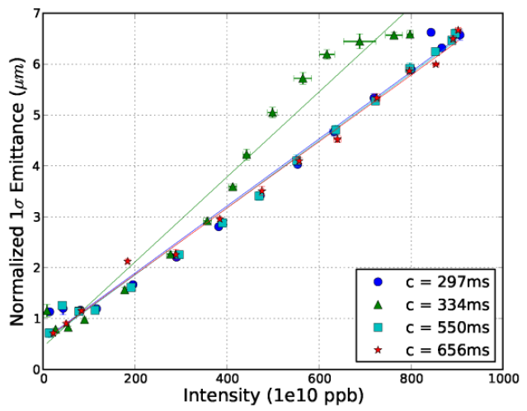
PSB brightness/SC limit
Expected PSB brightness limit at injection energy of 160 MeV
Tune spreads calculated from Laslett formula give -0.3 as a conservative limit, and then extrapolate observed brightness behaviour to 160 MeV
V-plane
B.Mikulec et al., ATS Note 013,2012
PSB not expected to be a limit for 50 ns beam, and
prospect to run with ΔQ above -0.3 for 25 ns
50 MeV injection

Slide 9
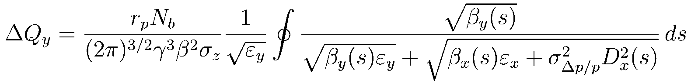
PS brightness/SC limit
Expected PS brightness limit at injection energy of 2 GeV (h=7, no compression,
bunch length 160 ns, dp/p = 0.0013)
PS at limit for 50 ns beam, while for 25 ns HL-LHC
requirement is 41% above its brightness limit…

Slide 10
SPS brightness/SC limit
Expected SPS brightness limit at injection energy of 26 GeV (Q20)
Single bunch….reached ΔQ_{y} -0.19 in MD with Q20 from Laslett formula
Q20 single bunch
Vertical plane
SPS at limit for 25 ns beam, while for 50 ns HL-LHC
requirement is 28% above brightness “limit”

Slide 11
Other limitations
SPS TMCI : single bunch
  With Q20 looks like being above ~3.6e11 per bunch (Q’=0)
PS longitudinal coupled bunch instability
  One turn delay feedback should increase limits from present ~1.7e11 to about 3e11 p+/b
  Much more of an issue for performance reach with 50 ns
PS beam loading in 10,20,40 MHz RF systems
  Limited by transient phase for splitting – will suffer in splitting quality – more critical for 50 ns beam
  Limit expected to be ~3e11 per bunch, for 25 and 50 ns spacing
  PS-SPS transfer parameters – studies ongoing

Slide 12
SPS longitudinal instabilities
Longitudinal stability: 25 ns beam unstable at 2-3e10 p+/b
  Presently mitigated with long. emittance blowup (0.6 eVs) and 800 MHz
Need ≥0.9 eVs for 25 ns stability with x2 nominal I_{b} (Q26)
  Maybe gain from lower impedance (200 MHz and kickers), x2 800 MHz V
  Would be very beneficial to transfer longer (e.g. 1.8 ns) bunches to LHC (but need to mitigate capture losses in LHC) -> MD
  Q20: instability thresholds higher, but need smaller ε_{l} to get same bunch length for given V_{RF}
After upgrade, expect x2 intensity possible wrt 2011
  2.3e11 p+/b for 25 ns, and >3.4e11 p+/b for 50 ns
  Main unknown is beam stability with high intensity (combination of single- and coupled-bunch effects)

Slide 13
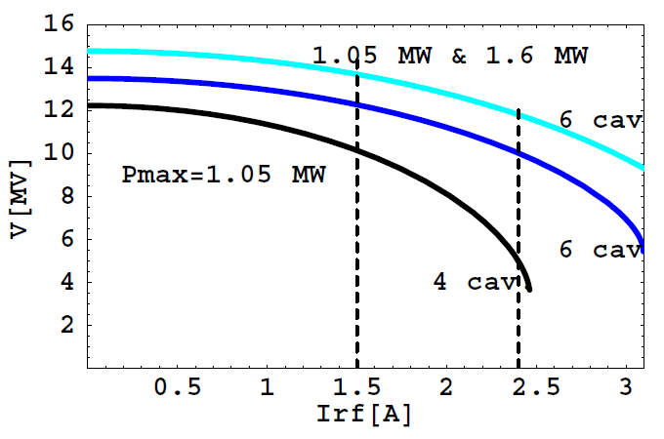
SPS beam loading
SPS 200 MHz: x2 power, 4→6 (shorter) cavities, -20% impedance
  Will allow 10 MV at extraction for 3 A RF current (now 1.5 A)
  Need to operate existing power plants in pulsed mode (0.75→1.05 MW)
After upgrade: same voltage available as now (if pulsed) for 2.3e11 p+/b (25 ns) and 4.6e11 p+/b (50 ns).
  With larger emittance more V_{RF} needed for same bunch length
  Will anyway have 10% longer bunches for 2x nominal I, with 10 MV
E.Shaposhnikova

Slide 14
‘Operational’ limitations
Mainly in SPS (to date)
  Heating of extraction kickers: should be ‘solved’ with final shielded MKE in LS1. Expect limit to be at least twice present beam power
  ZS sparking: interference with slow extracted FT beams. Difficult to solve – ‘ppm’ main voltage modulation being studied. Last resort is ZS off and retracted during LHC beam, which strongly impacts beam to North Area
  Outgassing of dump and impact on injection kickers MKP vacuum: extra differential pumping and sectorisation planned. Effect is mainly a limitation for scrubbing and setting up, rather than LHC filling

Slide 15
ecloud
PS: observed but not yet a limitation.
  Studies are ongoing to investigate HL-LHC regime
  Mitigations being investigated (coating, double bunch rotation, …)
SPS: presently major performance limit (beamloss, vacuum, ecloud instability and incoherent emittance growth):
  More serious for 25 ns beam
  Expected to be removed when machine is aC coated (LIU baseline)
  Scrubbing for 25 ns will be tough…StSt chambers, OP limitations…
  HBW feedback could cure vertical single bunch ECI
J.M.Jimenez

Slide 16
25 ns after LIU upgrade
Limit is 2.3e11 p+/b in 3.6 um at SPS extraction (1.6e11 in 2.3 um)
Fundamental limit: space charge in PS

Slide 17
50 ns after LIU upgrade
Limit is 2.7e11 p+/b in 2.7 um at SPS extraction (closer to HL-LHC requirement)
Limited by longitudinal instabilities in PS and SPS, and by brightness in SPS

Slide 18
‘Conceivable’ improvements?
Reduce losses (and SPS blowup) even further?
  Will be real challenge to achieve with x2 beam intensities
  Consider as “stretch” goal - also for HL-LHC…!
2.3e11, 3.2 um
at SPS extraction
(1.7e11/2.3um)
2.8e11, 2.6 um
at SPS extraction
Stretch

Slide 19
Hope for 25 ns?
Increasing PS space charge limit from -0.26 to -0.32?
  Maybe sufficient if losses + blowup at “stretch” levels
  Would give potential for 2.1e11 in 2.3 um from SPS
  180 ns bunches in h=7 to lower space charge by 12%?

Slide 20
Otherwise for 25 ns…
  If losses + blowup remain as now estimated:
  Need to increase PS ΔQ limit from -0.26 to -0.37 (!) and PSB ΔQ limit from -0.30 to -0.36
  PSB could be OK, PS seems out of reach

Slide 21
Hope for 50 ns?
Longitudinal stability in PS: would need 3.7e11 p+/b
  If losses + blowup can be brought to “stretch” levels, could then dream of 3.4e11, 3.2 um extracted from SPS
  But requires 20% improvement in PS long. stability reach (on top of the factor ~2 assumed possible wrt today!!).

Slide 22
Otherwise for 50 ns….
If PS longitudinal stability limit is ~3e11 p+/b
  Could reach 2.8e11, 2.3 um extracted from SPS, if SPS ΔQ reaches -0.17, and losses + blowup at “stretch” levels
  Means SPS multibunch at single bunch brightness limit…

Slide 23
Table of dreams?
25 ns | Ib [e11] | Exy [um] | scaled Ib^2/Exy
HL-LHC target (LHC flat-top) | 2.0 | 2.5 | 1.00
LIU scenario (SPS extraction)
LIU baseline (>LS2) | 2.3 | 3.6 | 0.92
+ "stretch" blowup/losses (>LS3) | 2.3 | 3.3 | 1.00
+ PS ΔQ to -0.32, PSB DQ to -0.31 (>LS3) | 2.1 | 2.3 | 1.20
50 ns | I [e11] | Exy [um] | scaled Ib^2/Exy
HL-LHC target (LHC flat-top) | 3.3 | 3.0 | 1.00
LIU scenario (SPS extraction)
LIU baseline (>LS2) | 2.7 | 2.7 | 0.74
+ "stretch" blowup/losses (>LS3) | 2.8 | 2.5 | 0.86
+ PS longitudinal stability 3.7e11 (>LS3) | 3.4 | 3.2 | 1.00
+ SPS ΔQ to -0.17 (>LS3) | 3.4 | 2.8 | 1.14

Slide 24
Timeline
PSB H⁻ injection could be available
PSB-PS transfer 1.4 GeV → 2 GeV
Chamonix 2012
Linac 4 ready
LS1 for injectors
LS2 for injectors
2012
2013
2014
2015
2016
2017
2018
2019
Length of LS2: minimum 12months
  Required by SPS 200 MHz
  18 m if new 850 kW cooling not ready 2016
2019 commissioning: several months
SPS aC coating, 200 MHz power upgrade completed
Injectors commissioned

Slide 25
Re-commissioning after LS2
Will not be “plug n play” to recover pre-LS2 performance
Three ‘new’ injectors to startup, together
  PSB: new ramp to 2 GeV, (maybe) new H- injection at 160 MeV, new RF, new instrumentation, new beam transfer
  PS: new 2 GeV injection, new longitudinal FB, new instrumentation
  SPS: (probably) rebuilt after ecloud coating (744 MBs, 216 MQs), ‘new’ RF 200 MHz, new high bandwidth FB, new orbit and BLM system, new scraper and TL collimators
Normal startup: 1-2 weeks per machine
Must count months per machine to recover pre-LS2 performance
  A concrete LS2 plus commissioning plan to work on (in 2012)
Will certainly take period LS2-LS3 to reach baseline LIU goals

Slide 26
Unresolved questions/issues
Electron cloud
  aC coating or scrubbing (+HBW damper) in SPS?
  Potential issue with aC of unexplained high vacuum pressure
  Is ecloud going to be an issue in PS?
Can Q20 be deployed operationally in SPS after LS1?
  Need to still solve some issues
  Need to get experience if we have any hope to push to required levels
Prospects for increasing (already ambitious) target for PS longitudinal stability?
Prospect for PS exceeding -0.26 in space charge tune shift?
  Resonance compensation studies, longer bunches from PSB?

Slide 27
Conclusions (I)
For HL-LHC era, requirements are challenging
  25 ns: need x2 present intensity, x2 present brightness
  50 ns: need x2.3 present intensity, 50% above present brightness
Baseline LIU does not reach HL-LHC ‘point-like’ requirements.
To even get close:
  Need all planned upgrades to be fully effective, and to approach single bunch limits with multi-bunch operation
  Need “stretch” loss/blowup levels in injectors, with HL-LHC ≤10% blowup, and losses of around 3%...
Limits are different for 25 and 50 ns production
  PSB performance sufficient with 160 MeV injection for both
  25 ns: PS space charge tune shift (2 GeV injection fixed by PSB).
  50 ns: brightness in SPS, PS longitudinal stability, PS beamloading

Slide 28
Conclusions (II)
Not totally impossible to approach HL-LHC request, providing
  Losses and blowup can eventually be reduced to “stretch” levels
  PS can run with higher space charge tune shift, nearer ΔQ ≈ -0.32
  PS longitudinal stability can improve significantly above present expectation (today at 1.7e11, LIU baseline 3e11, need 3.7e11)
  SPS can increase brightness limit, to ΔQ ≈ -0.17
Realistic time for re-commissioning after LS2 to be foreseen

Slide 29
Question: can the proton injectors meet the HL-LHC requirements after LS2?
Answer: “No. Not after LS2, but maybe after LS3”
Interaction between HL-LHC and LIU teams is mandatory: 2nd joint meeting on March 30 at CERN

