Slide 1
R2E – Experience and Outlook for 2012
M. Brugger for the R2E Project
!!! Many Thanks To Everybody !!!
Specials: M. Calviani (MCWG) & G. Spezia (RadWG)

Slide 2
Overview
2011 radiation levels -> 2012
Mitigation measures:
  applied prior 2011
  ‘on-the-fly’ during the year
  xMasBreak
Observed failures during 2011
What’s to be expected for 2012
What do we need to learn in 2012

Slide 3
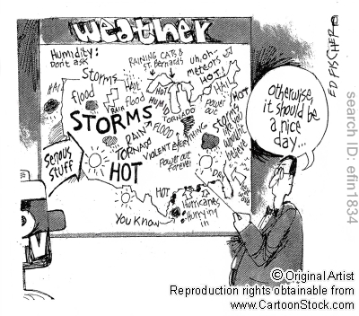
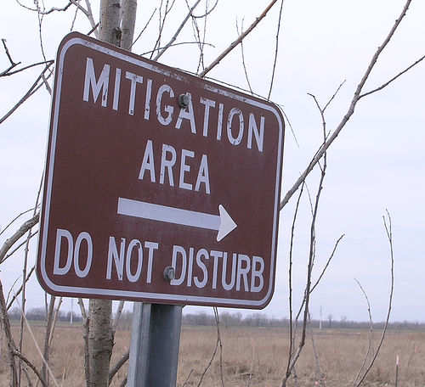
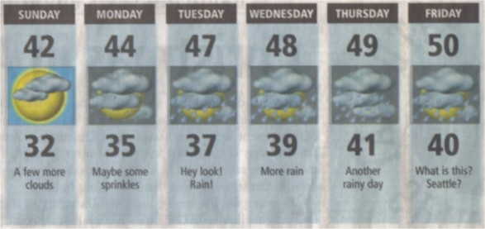

A look back – And Forward
2010
2011
2012
Nominal
Ultimate
HL-LHC

Slide 4
2011 LHC Operation & Scaling
Integrated Luminosity:
ATLAS/CMS: 5.6 fb⁻¹ in 2011 – 10x to nominal (50fb⁻¹)
LHCb: 1.2 fb⁻¹ in 2011 – ~2x to nominal
–> LS2: upgrade to ~10 fb⁻¹?
Energy scaling:
(3.5-7TeV): P1/5/7/8 – 1.5x
Intensity and distribution of collimation losses:
#ofProtons on Collimators – ~10x to nominal (?)
IR7/3 sharing of proton losses: (?)
Loss distribution within IR7 (?)
Beam-gas (radiation levels in the ARC):
@25ns operation (10-100x to be understood)

Slide 5
2012 More Details
2012: ~3x (if no actions!)
Point-1/5 UJs + RRs:
Failures scale with integrated luminosity
BUT: UJ14/16 shielding with the aim of being at least compatible with present operation + additional relocations and patches
US85:
Failures scale with integrated luminosity
BUT: additional relocations with the objective of reducing downtimes
UJ76, RR73/77
Failures scale with collimation losses
DS/ARC:
Failures scale with leakage from experiments (luminosity) as well as collimation losses and beam-gas
2012: max 1.5x
2012: ~3x (loss distribution?)
2012: ~3-5x (scrubbing?)

Slide 6
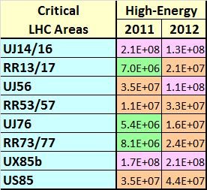
Confidence in our Predictions
Operational Parameters
Very good agreement!
& Extrapolation
(based on measurements)
Area | FLUKA 2011 (HEH/cm²) | Measured 2011 (HEH/cm²)
UJ14/16 | ~1.5*10⁸ | ~2*10⁸
RR13/17 | ~3*10⁷ | 7.0*10⁶
UJ56 | 5*10⁷-10⁸ | 3.5*10⁷
RR53/57 | ~3*10⁷ | 1*10⁷
UJ76 | ~4*10⁶ | 5*10⁶
RR73/77 | ~2*10⁶ | ~8*10⁶
UX85B | ~3*10⁸ | 2*10⁸
US85 | ~7*10⁷ | 3.5*10⁷
TCL open?
TCL open?
Shielding +
‘relaxed’ settings
© M. Calviani & MCWG

Slide 7
Beam-Gas & Collimation Losses
Beam-Gas: 25ns + average pressures in the DS/ARC
Defines radiation levels in the ARC
Important long-term impact for QPS, Cryo, PCs, BI
Possibly lower average pressure than assumed so far
25ns scrubbing run can clarify situation
Dedicated time at ‘stable’ conditions
Ramp in energy required
Collimation Losses
Tight collimator settings -> to be analyzed in detail
IR3 and IR7 integrated loss sharing to be checked!
(possible impact not only on R2E !)

Slide 8
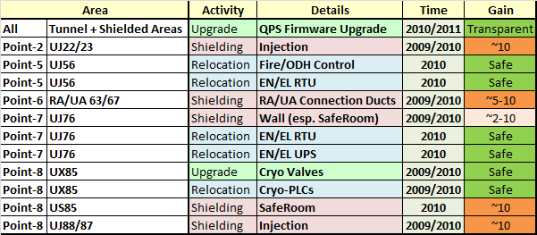
Mitigation Measures < 2011
Following original priority list
Improving the situation in most critical areas
Very effective combined with 2011 patches and anticipated actions (see later)

Slide 9
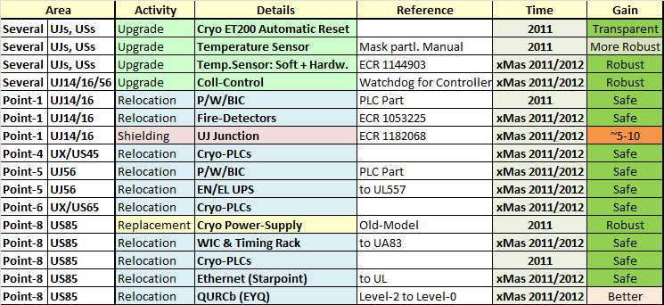
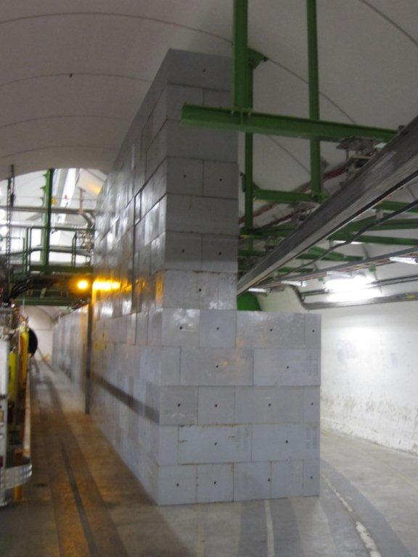
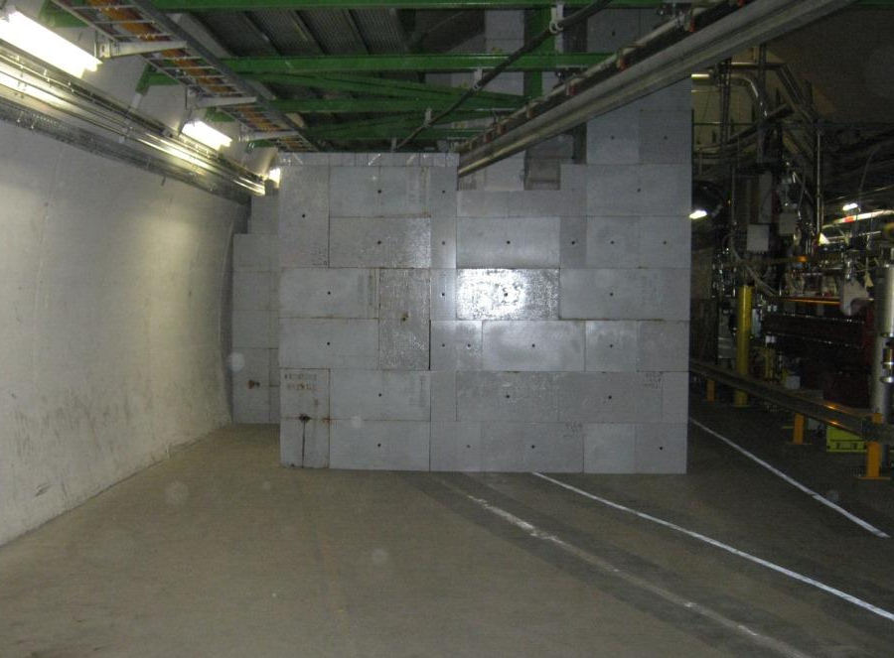
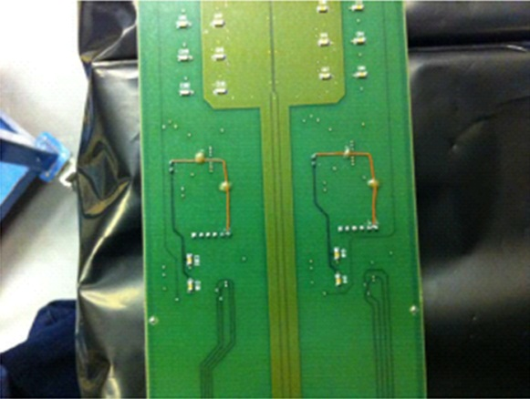
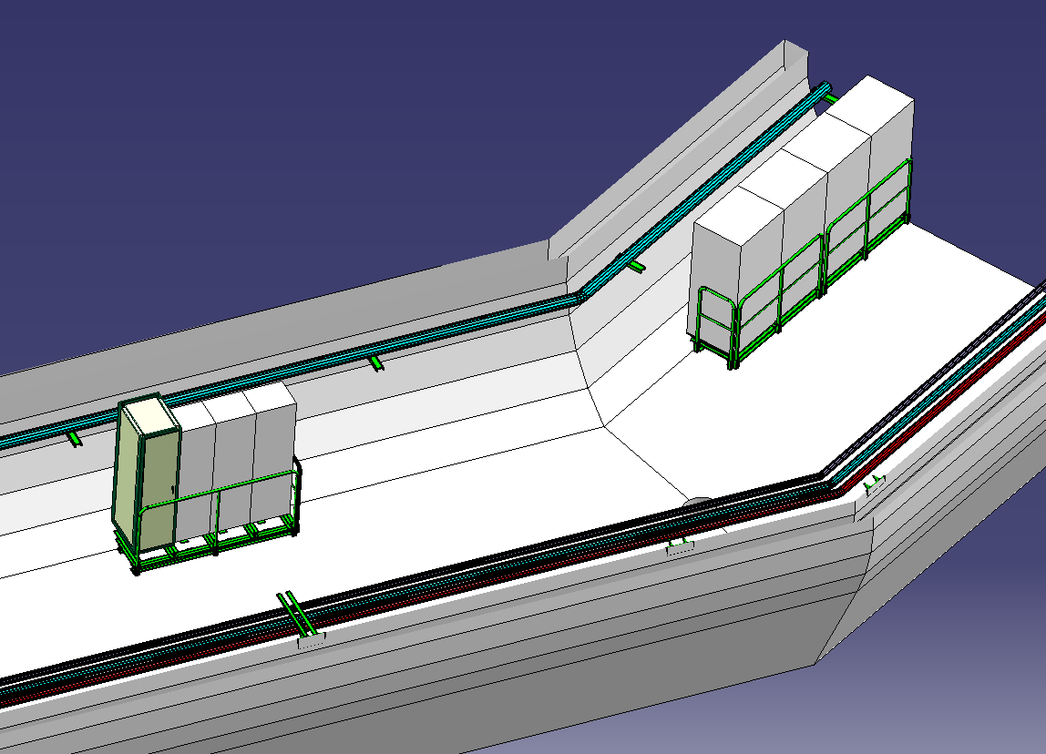
Mitigation Measures 2011+xMas
See Talk from A.L. Perrot S05

Slide 10
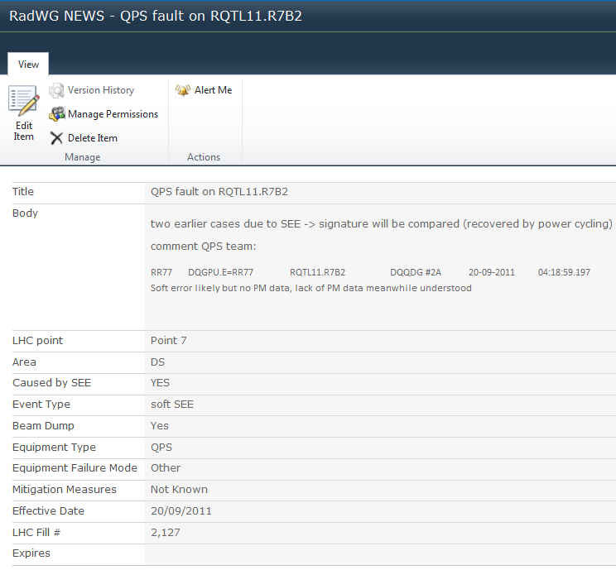
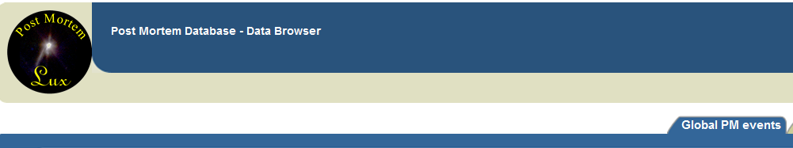
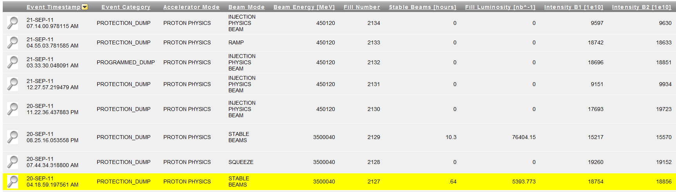
Analysis of SEE induced Failures
Weekly R2E Shift
eLogBook + 8:30h
Equipment Groups
DBs
Rad WG web site-Detail
Post Mortem Database
Link with the fill number
Details on radiation failure

Slide 11
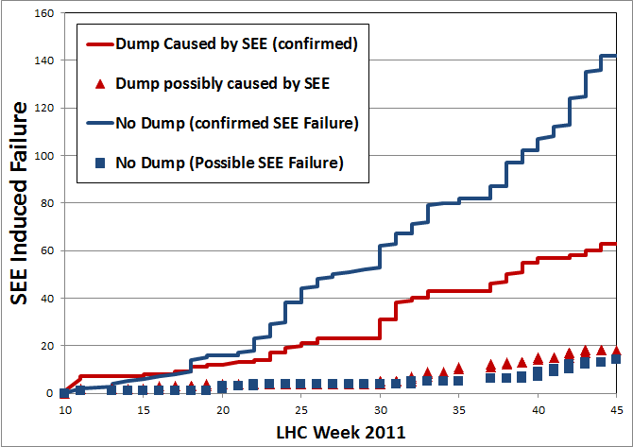
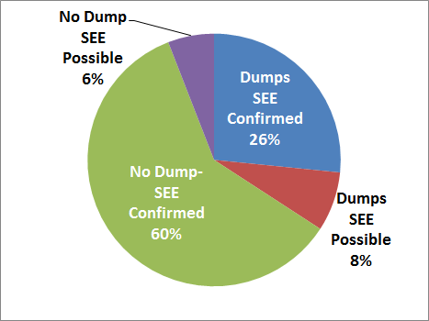
Failures during 2011 operation
Events to be confirmed represent a relatively small fraction
Increase of the “no dump events”
  consequence of patch solutions (QPS + Cryo)

Slide 12
Failures during 2011 operation
only areas with more than 3 events
DS Events dominated by QPS
Shielded area: UJ14/16 most critical
  ~50 events in total [in UJ14/16!]
  ~25 Beam Dump

Slide 13
A Closer Look
In the following slides we’ve a more detailed look on the systems most affected during 2011
QPS
Cryogenics
Power-Converters
Collimation Control
B/P/WIC Machine Interlock Systems
EN/EL (UPS)
Access Control (PAD/MAD)

Slide 14

Failures during 2011 operation
QPS
  Location: Tunnel, UJs/RRs at Point 1, 5 and 7
  Failure types (protection function never at risk!):
  ISO150, μFIP, IPQ protection, 600A protection, DQQBS
  Mitigation:
    all ISO150 mitigated (not dump, only access!)
    (no impact, still final work during LS1)
    many events (mostly transparent) in 2011
    auto-power-cycle (“BricoFIP”) and long-term nanoFIP
    few events (mostly transparent) in 2011
    new radiation tolerant IPQ system (TS1 installation poss.)
    6 events (mostly transparent) in 2011
    new radiation tolerant for 600A protection (mid 2012?)
    11 events (mostly transparent) in 2011
    Firmware upgrade for DQQBS (splices) [IP1/5 DS @xMas]
    8 events (mostly transparent) in 2011
See Talk from R. Denz S06
© J. Palluel

Slide 15
Failures during 2011 operation
Cryogenics
  Location: UJs at Point 1, 5 and 7
  Failure types:
    PLC failures
    Current lead temperature readings
    Current lead valves
    24 VDC
  Mitigation:
    PLC relocations (6 events happened in 2011)
    ET200 Auto-Reset (9 events happened in 2011)
    Switch to old power-supply (2 events happened in 2011)
    Mask of wrong temperature reading
    [xMasBreak soft- & hardware modification]
    (8 events happened in 2011)
See Talk from L. Tavian S05

Slide 16
Failures during 2011 operation
Power Converters
  Location: Tunnel, UJ14/16,
  RR (Point 1/5/7), UJs/UA (Point 2/8)
  Failure types: 600A Aux Power Supply
  ( 7 Destructive events), Filter corruption FGC (3-4), 120A Voltage Source (1-2),
  4/6/8kA Voltage Source (1)
  Mitigation:
    Digital filter improvement FGC
    (2011 + Christmas break)
    Shielding UJ14/16 (Christmas break)
    Auxiliary Power-Supply Patch (2012)
    Re-Design/Relocation (LS1 and beyond)

Slide 17
Failures during 2011 operation
Collimation Control
  Location: UJs at Point 1 and 5
  Failure types: abnormal reboot of the controller, memory corruption, power supply failure
  Mitigation:
    Survey of stuck bit-watchdog (Christmas break) –
    4 events happened in 2011 – can lead to dumps in 2012
    Shielding of the UJ14-16 (Christmas break) –
    7/8 events happened in 2011
    Power supply redundancy in UJ14/16/56
    (on hold due to problem with delivered controller card)
    3 events happened in 2011
    Relocation (Long Shutdown 1)

Slide 18
Failures during 2011 operation
B/P/WIC – Machine Interlock Systems
  Location: UJ at Point 1 and 5
  (and injection line in 2010)
  Type of failure: PLC communication lost, Deported I/O, (BIS [VME based] no problems)
  Mitigation:
    Relocation of the WIC from TI2/8– no more errors
    Relocation from UJ14/16 – no more errors
    Relocation from UJ56 US85
    (Christmas break [BIS prep. UJ56])
    No more SEE induced events expected

Slide 19
Failures during 2011 operation
EN/EL equipment
  Location: UJ56, US85
  Type of failure: UPS system
  (destructive failures)
  Mitigation:
    Relocation from UJ56 (Christmas break)
    Relocation from US85 (LS1)
    New Type (esp. for REs) will be
    tested at H4IRRAD in 2012

Slide 20
Failures during 2011 operation
Access System (PAD/MAD)
  Location: Access to UJ14 and UJ16
  Type of failure: Block of the access system,
  iris scan
  General problem with end-of-life equipment in other points
  (part of) events in UJ14/16 ( and UJ23/87)
  are likely to be radiation related
  Mitigation :
    Shielding of the UJ14-16 (Christmas break)
    Relocation from Point1 (LS1)

Slide 21
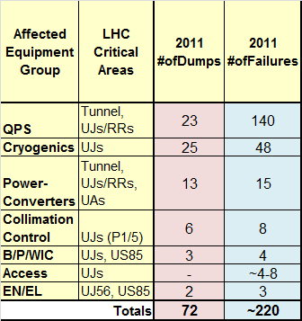
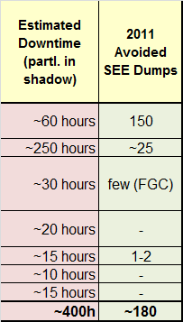
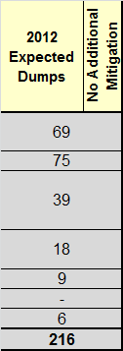
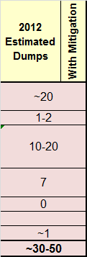
What do we expect for 2012
xMas-Mitigation crucial
Patches to continue during 2012
Particular emphasis (analysis) of ‘new’ failures

Slide 22
Conclusions
2011: ~70 dumps events
  Predicted ~100 in Chamonix 2011
  Good agreement (considering 2011 patch solutions)
2012: ~30-50 dump events expected
  Mitigation actions (patch solutions, shielding and relocation) were/are crucial to reduce dump events
  Failure estimation has uncertainty factors
    Beam gas effect
    Collimation losses
    Equipment failure types not yet appeared
TS a lot to be done! (c.f. Anne-Laure’s talk)
>LS1: benefit from relocation and shielding
+ new developments

Slide 23
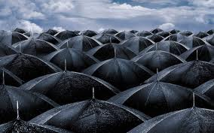
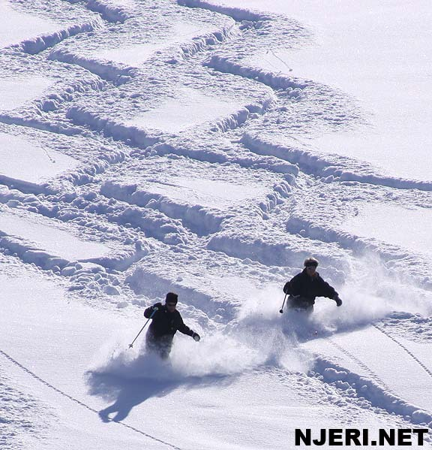


Thank You

Slide 24
Conclusions
2011: ~70 dumps events
  Predicted ~100 in Chamonix 2011
  Good agreement (considering 2011 patch solutions)
2012: ~30-50 dump events expected
  Mitigation actions (patch solutions, shielding and relocation) were/are crucial to reduce dump events
  Failure estimation has uncertainty factors
    Beam gas effect
    Collimation losses
    Equipment failure types not yet appeared
TS a lot to be done! (c.f. Anne-Laure’s talk)
>LS1: benefit from relocation and shielding
+ new developments

Slide 25
BACKUP

Slide 26
What’s about Ion Operation
Analysis based on RadMons & BLMs
(A. Nordt & MCWG)
Losses during ion operation in the DS are equal and partly dominate respective radiation levels
  P1/5: about factor of 2-5 (2011, nominal ~1:1?)
  P3: factor of 10-15 higher (momentum losses)
  P7: factor 2-3 (2011, nominal ~1:1?)
Point-2: Ions only, values comparable to P1/5
Dose/Fluence range (max P1/5): 5-200Gy, 5x10⁹ – 10¹¹cm⁻²
Affected cells: 9-13 (very localized)
TCL currently open (P1/5)!
Additional RadMon coverage foreseen (>LS1)

Slide 27

R2E Mitigation Strategy
1st Safety Critical
Immediate Relocation
2nd Shielding
“Fast” & Global Improvement
Highest Impact on Operation:
Relocation
Shielding
3rd Most Sensitive
Relocation
Shielding
New Design
4th Remaining

Slide 28
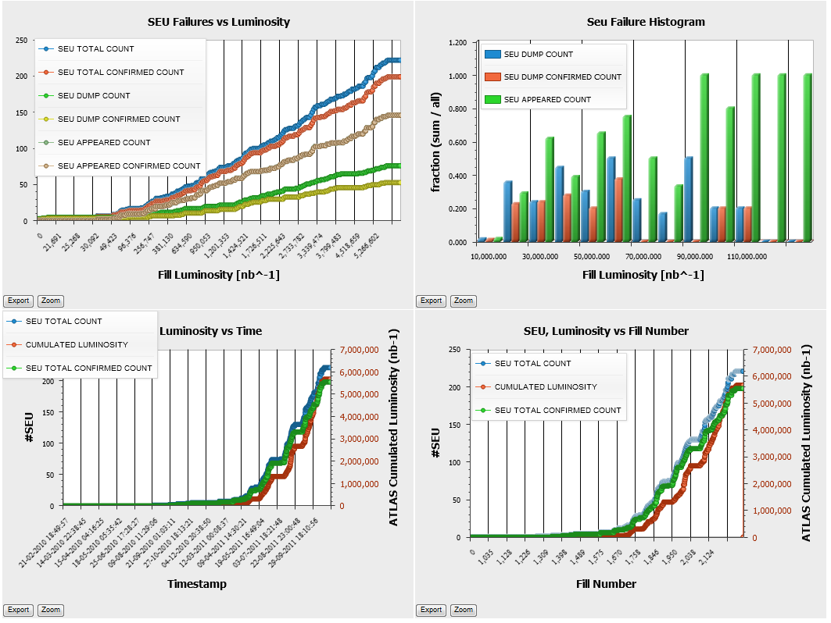
Statistics through PM-DB
  !!! Many thanks to R.M. Leszko & M. Zerlauth !!!

Slide 29
Mitigation Measures 2011
Mitigation Measures during 2011
Type | Est. Gain
QPS firmware | -150 events
Cryo power supply | -3 events
Cryo automatic reset | -9 events
Cryo Temperature reading | -8 events
Cryo relocation
B/P/WIC relocation

Slide 30
What do we expect for 2012
Equipment | Equipment failure mode | Failures 2011 |  | Possible dumps in 2012
 |  | Dump | UJ P1 | Without 2011 + xMasBreak Actions | With Mitigation Actions
B/P/WIC | PLC communication lost |  |  | 0 | 0
Collimation | controller | 1 | 5 | 2 | 1
 | Power supply | 3 | 2 | 4 | 1
Cryo | Temperature reading | 7 | 0 | 21 | 0
 | ET200S | 12 | 8 | 16 | 0
 | Power supply + PLC | 11 | 0 | 33 | 1
EN/EL | UPS | 2 | 0 | 6 | 1
EPC | Power supply crash | 7 | 2 | 15 | 15
 | FGC error/reset | 4 | 1 | 10 | 0
QPS | DAQ mitigated | no dump |  |  | 20 (assumption: mitigation actions will allow a gain of 2.5 )
 | Other DAQ | no dump
 | DAQ microfip | no dump
 | DQQDG | 10 | 5 | 17
 | DQQDI | 6 | 3 | 10
 | nQPS DQQBS | 6 |  | 18
 | nQPS comm problem
 | nQPS ok-lost
Other | - |  |  |  | 5
TOTAL |  | 69 | 26 | 150 | 45

Slide 31
Failures during 2011 operation
 | UJ14 UJ16 | RR Point1 | UJ-RR Point5 | US85 | UA23 UA87 UJ43 | UX45 UX65 | Total
Power Supply-PXI | 2 |  | 1 |  |  |  | 3
Power Converter | 2 | 2 |  |  | 3 |  | 8
EN/EL |  |  | 2 | 1 |  |  | 3
CRYO | 2 |  |  | 4 |  | 3 | 9
Destructive events
  23 over 60 confirmed beam dump

Slide 32
Destructive events 2012
 | Total
Power Supply-PXI | 0-1
Power Converter | 10-12
EN/EL | 1-2
CRYO | 1-2
Considering
UPS relocation from Uj56
Cryo relocation fromUS85
Double power supply for PXI
Shielding UJ14/16
  TOTAL 15-18
    It is a rough estimation

Slide 33
Failures during 2011 operation
QPS and Cryo - (high number of parts and more exposed)
Failures on other equipment can rise up during next year operation

Slide 34
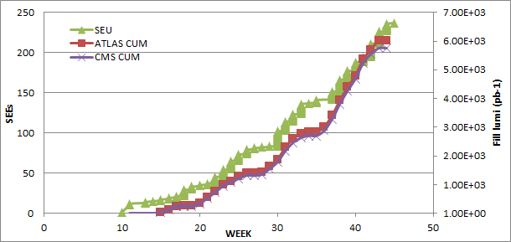

Slide 35
Mitigation Measures in 2011
QPS – firmware upgrade (ISO150) almost 100 events avoided since then
Cryo – PLC removed from US85
Cryo (via EN/EL) – Replacement of power supply with old models – 4 events happened in 2011
Cryo – Automatic Reset of PLC (TE/CRG) 9 (Dump)events avoided since then;
Cryo – Temporary mask (Software) of the false reading of the temperature sensors – 8 (Dump) events avoided since then
P/W/BIC – Relocation of the equipment from UJ14/16 – 3 events happened in 2011

Slide 36
Mitigation Measures at xMas
QPS – hardware updates (see details in the dedicated talk)
Cryo – Hardware modifications to fix the false temperature readings (5 events in 2011)
Cryo (EN/ICE) – PLC relocation at point 4, 6, 8 (8 events in 2011)
Collimation – Power supply redundancy; survey of stuck bits (3-5 events in 2011)
B/P/WIC – Relocation of the equipment from UJ56 and US85 (5 events happened in 2011)
Other relocation of Fire Detectors Equipment
Shielding of the area UJ14/16 →radiation reduced by a factor 2 in 2012. The factor 2 takes into account Shielding efficiency and radiation level increase
We can say: ~20 Dumps of 2011 will be avoided

Slide 37
Downtime due to Failures
A preliminary analysis was done taking into account
  RadWG list PM database and e-logbook entries
  Time interval between beam fills
  Manual iteration of cases
A detailed list is available and will be iterated with equipment owners (for Chamonix)
Dump (confirmed): ~350h
Required access (not dump and not in the shadow of another access): ~50h
Unconfirmed cases: additional increase of ~100h
Most impacted:
  Cryogenics: long downtimes due to PLCs
  QPS: number of events

Slide 38
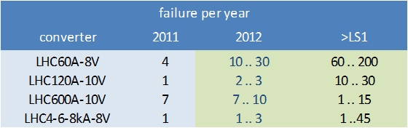
Power-Converter Failures 2011
FGCs highest priority
Destructive failures on auxiliary power-supply (600A)
-> patch required during 2012
Low radiation levels in the ARC (most units of 60A)
H4IRRAD observations are coherent

