Slide 1
Machine Protection System - reminder
MPS response in 2011
Dependability of MPS backbone
Issues and areas of upcoming improvements
MPP/rMPP and ramping intensity in 2012

Slide 2
LHC Machine Protection System
Interlock conditions
24
~ 20000
~ 1800
~ 3500
~ few 100
~ few 100
MPS ‘backbone’ consists of magnet and beam interlock system, LBDS, active detection systems (BLM, BCM, QPS, SIS,…), injection protection, collimation,…
Additional inputs from many equipment systems to preventively dump beams
In total many 10.000 interlock conditions
MPS backbone

Slide 3

LHC MPS over time
nQPS /
MPS architecture is constantly evolving
In addition every year some 100 major changes to operational systems that require tracking and follow-up (threshold changes, maintenance/replacement of components, R2E, operational tools, procedures,…)
Special physics/MD runs require particular attention
Courtesy of B.Todd

Slide 4
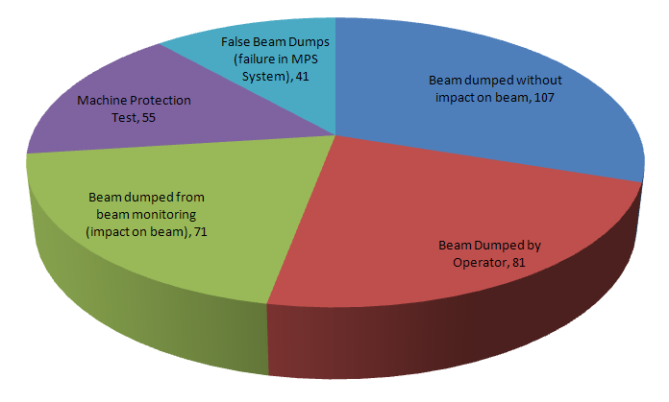
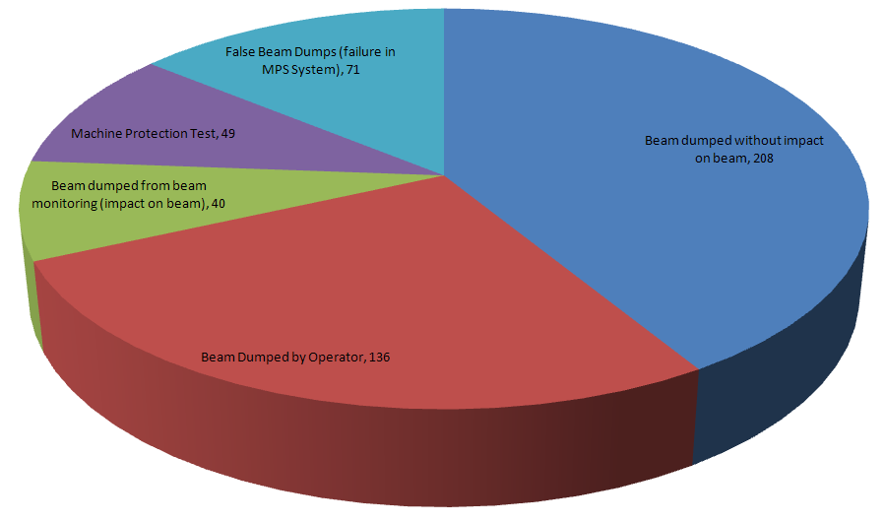

Review of Protection dumps
1200 beam dumps were cleanly executed during 2011 (-10% wrt to 2010 )
40% more successful ramps to 3.5TeV
~ Factor of 3 less dumps caused by beam losses, orbit changes,… -> confirm 2010/11 improvements
No beam induced quench with >100MJ beams @ 3.5TeV in 2011 (including all ‘quench’ tests)
No equipment damage observed (apart from kicker erratic causing damage in SDD calibration of ALICE)
MPS response of all dumps from 3.5TeV meticulously analyzed and validated – Initiating system always identified, but sometimes not fully clear why it triggered (‘spurious’ triggers, SEUs,…)
Beam dumped without beam
losses and orbit changes, 107
Beam dumped without beam
losses and orbit changes, 208
2010
2011
Nota bene: All statistics only counting fills with E > injection
4

Slide 5
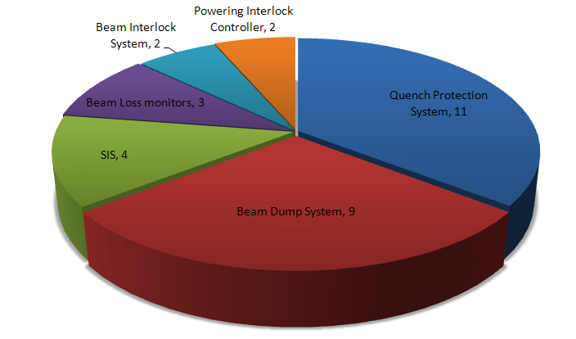
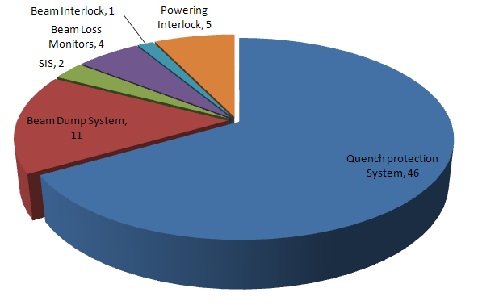
Dependability of MPS backbone
Complexity and high level of safety in MPS systems comes at certain cost, i.e. false positives
False triggers of most MPS backbone systems remained (surprisingly) constant with time
95% of false dumps in 2011 above injection energy (< thresholds,…)
Increase of false positives from QPS + interlock to large extend due to R2E -> See talk of R.Denz
5 possible SEUs
22 confirmed SEUs
+ ‘environment’ related triggers
2010 : 8% of fills dumped due to MPS
2011 : 12.6% of fills dumped due to MPS
7.7% not accounting for SEUs

Slide 6
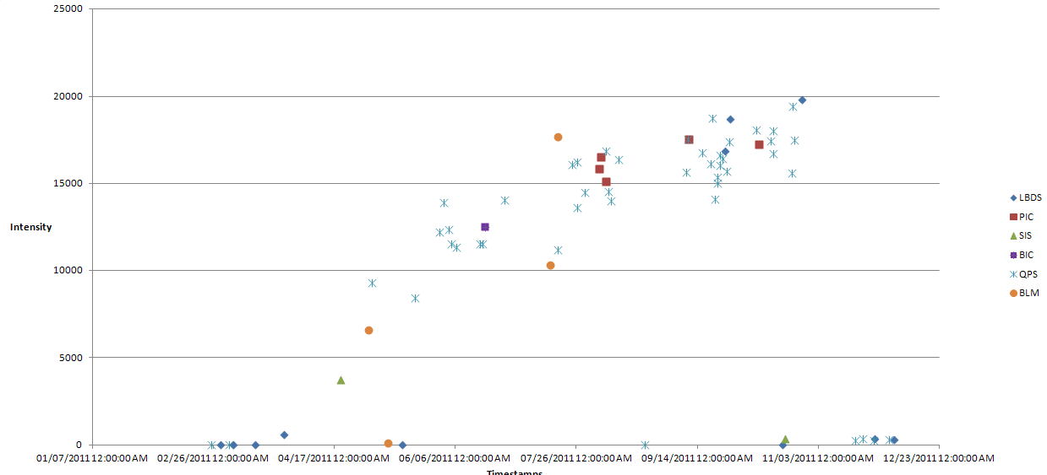
False Beam Dumps from MPS
Occurrence of false dumps of some systems clearly related to increasing beam intensities
Clear effect of intensity/integrated luminosity on QPS/PIC/…!
HW faults in Q10.L2 with ions
High local activation
Time
6

Slide 7
Beam dumps by beam monitoring
Some 40 dumps in 2011 by beam monitoring indicate possible improvements of redundant active detection
Mostly slow losses, caused by Vacuum activities, Feedback issues and beam instabilities
Very well protected by BLMs (and QPS), but E>, <β* means tight collimator settings, lower BLM threshold Maintain current good level of orbit stability -> additional interlocks for orbit corrector current and DIDT
EVENT_TIMESTAMP | ENERGY | MPS_DUMP_CAUSE | MPS_DETECTION | COMMENT
21-NOV-11 08.53.39 | 3499920 | Orbit Feedback | BLM | Unstable OFB in squeeze with gain increase by a factor of 10
04-NOV-11 10.00.29 | 726600 | Orbit Feedback | OP dump | Wrong OFB Parameter ORBIT_REF CHANGING_TIME (1s instead of 680s)
03-NOV-11 02.57.45 | 3500040 | Beam Loss | BLM | Beam Loss during aperture measurements
17-OCT-11 06.58.51 | 3500040 | Transv. beam instability | SIS | High Losses due to bad tune signal (end of ramp and squeeze without QFB)
28-SEP-11 08.56.30 | 1773720 | Transv. beam instability | SIS | OFB problems during ramp
28-SEP-11 08.52.30 | 629280 | Transv. beam instability | SIS | OFB not sending correct trims
20-SEP-11 07.44.34 | 3500040 | Beam Loss | BLM | QFB dragged tune of B2H on resonance
11-SEP-11 04.50.52 | 3500040 | Beam Loss | BLM | Vacuum spike
11-SEP-11 02.56.59 | 3500040 | Beam Loss | BLM | Vacuum spike
25-JUL-11 02.32.30 | 3500040 | Beam Loss | BLM | Orbit oscillations and consequent losses during optimisation
24-JUL-11 03.12.35 | 3500040 | Beam Loss | BLM | Vacuum spike
23-JUL-11 10.14.12 | 3500040 | Beam Loss | BLM | Vacuum spike
09-MAY-11 01.07.45 | 3500040 | Transv. beam instability | BLM | Beam instability after quench test (ADT picking up wrong tune)
08-MAY-11 06.22.17 | 3500160 | Beam Loss | BLM | Beam instability in B2V at end of coupled bunch instability MD
28-APR-11 09.20.22 | 3500160 | Beam Loss | BLM | Vacuum spike
25-APR-11 08.40.04 | 3500040 | Beam Loss | BLM | Vacuum spike
20-APR-11 02.26.26 | 2930880 | Transv. beam instability | BLM | Horizontal beam instability with 2-3 s risetime
16-APR-11 11.58.41 | 3500040 | FB 2 | SIS | Orbit reference change applied in 1s instead of 385s, excursion in B2H
14-APR-11 05.37.30 | 3500160 | Transv. beam instability | BPM6 | Beam instability during IP scan
Nota bene: Not showing dumps of BPM in IR6 following too low bunch intensity (x4) & UFO dumps (x17 - see T.Baer)

Slide 8
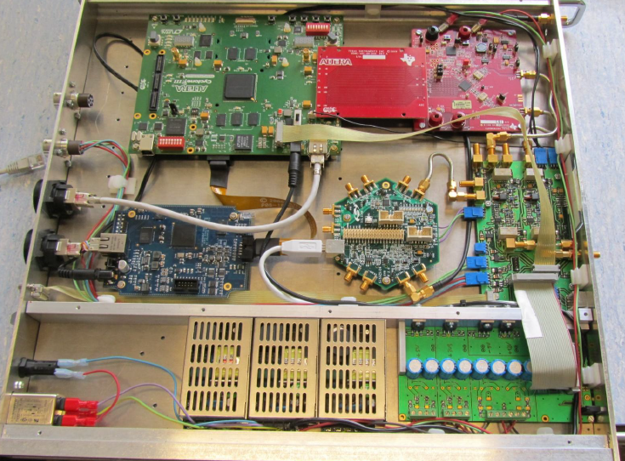
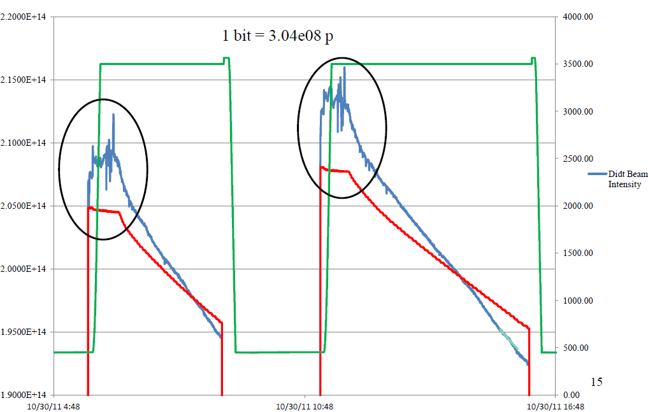
DIDT
Beam Current Change Monitor was vital part of MPS systems for e.g. HERA
Proposed for use in LHC MPS in 2005 (EDMS Doc. 359172)
With HERA like system, changes of < 0.1% of total beam current could be captured in 10 turns
BI started development (with DESY consultancy) mid 2010, for deployment end 2011 + 2012 run
First system installed and data recorded, but showing not understood effects of bunch length,…?
Important to validate and finish soon, as such system adds layer of protection when probing quench/UFO limits with > BLM thresholds
DIDT
BCT
First system now installed in IR4
First measurements during proton runs
Courtesy of M.Pfauwadel, D.Belohrad

Slide 9
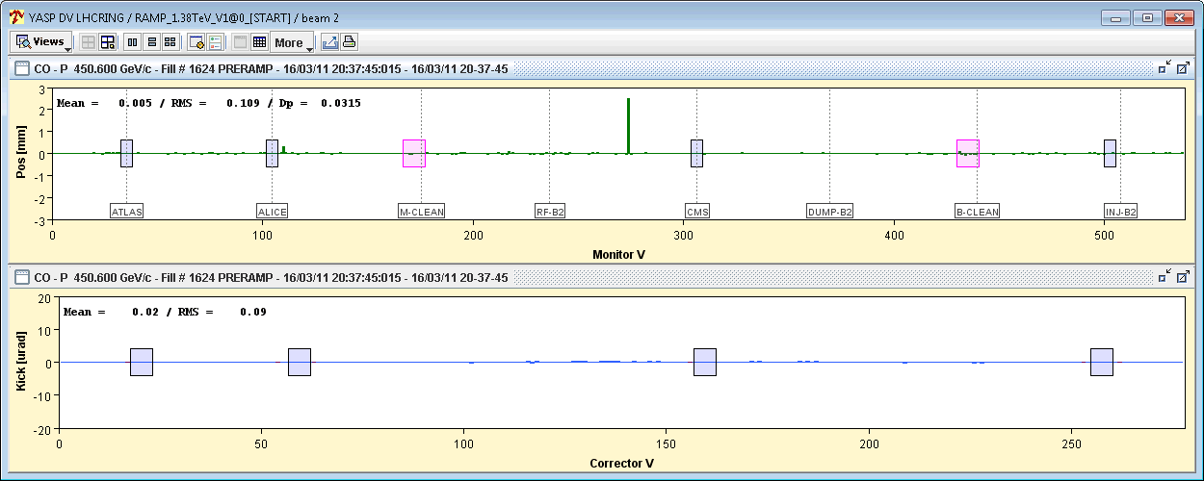
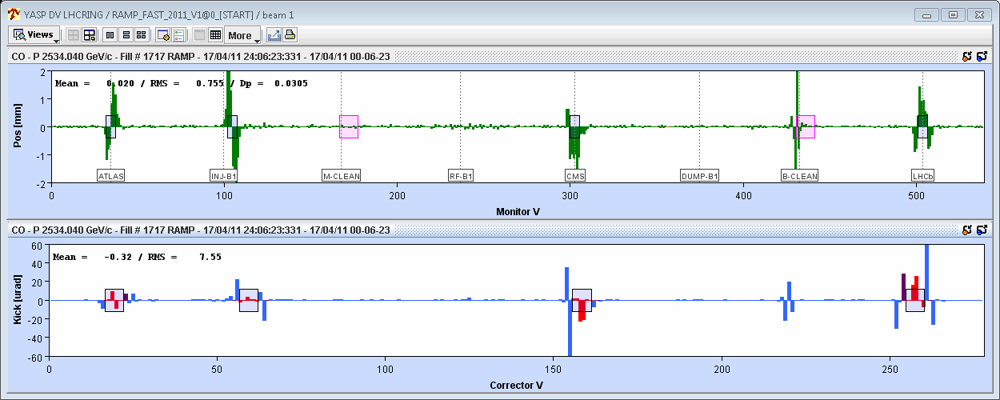
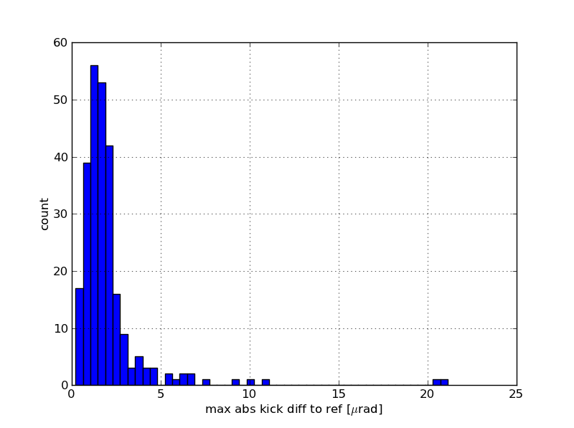
Work ongoing: Novel PC Interlock System
In addition to existing SIS interlocks at injection, ramp, squeeze and SB, new SW interlock system monitoring PC currents to protect against operations- and feedback- failures
Redundant to SIS for arcs, adds protection for LSS 1/2/5/8 due to capability of tracking bump shape amplitude/variations
Key interest for all other (non-COD) converters where currently no current tracking is done
Currently under commissioning and testing, after initial experience connection to BIS
B1, V
Distribution of RT max kick difference to BP reference during ramp
1 bad BPM
Fill 1717: Bump >2mm
during ramp in IR7
Courtesy of K.Fuchsberger

Slide 10
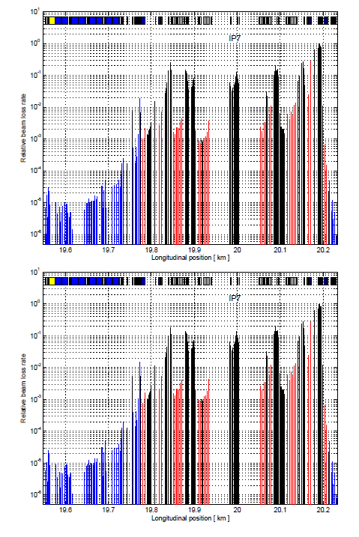
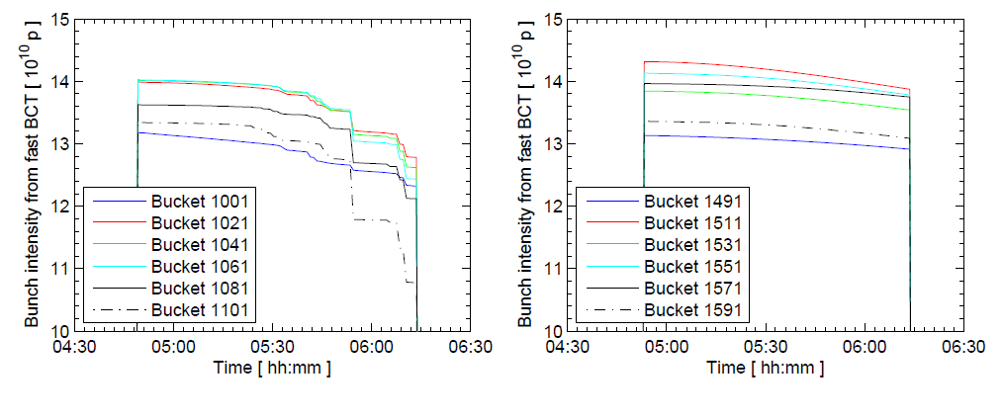
Other improvements for 2012 - ADT
Considerable work went into finalization and commissioning of transverse damper
MDs demonstrated selective and very deterministic bunch blow-up
Allows for abort gap cleaning and increased efficiency when performing loss-maps, quench MDs,…
System fully operational for both beams, should become default procedure as of start-up 2012 onwards
ADT blow up
3rd order resonance
Blow up of selected bunches during MD (left)
and unaffected bunches (right)
Loss-maps performed with ADT
and 3rd order resonance method
Courtesy of W.Hofle

Slide 11
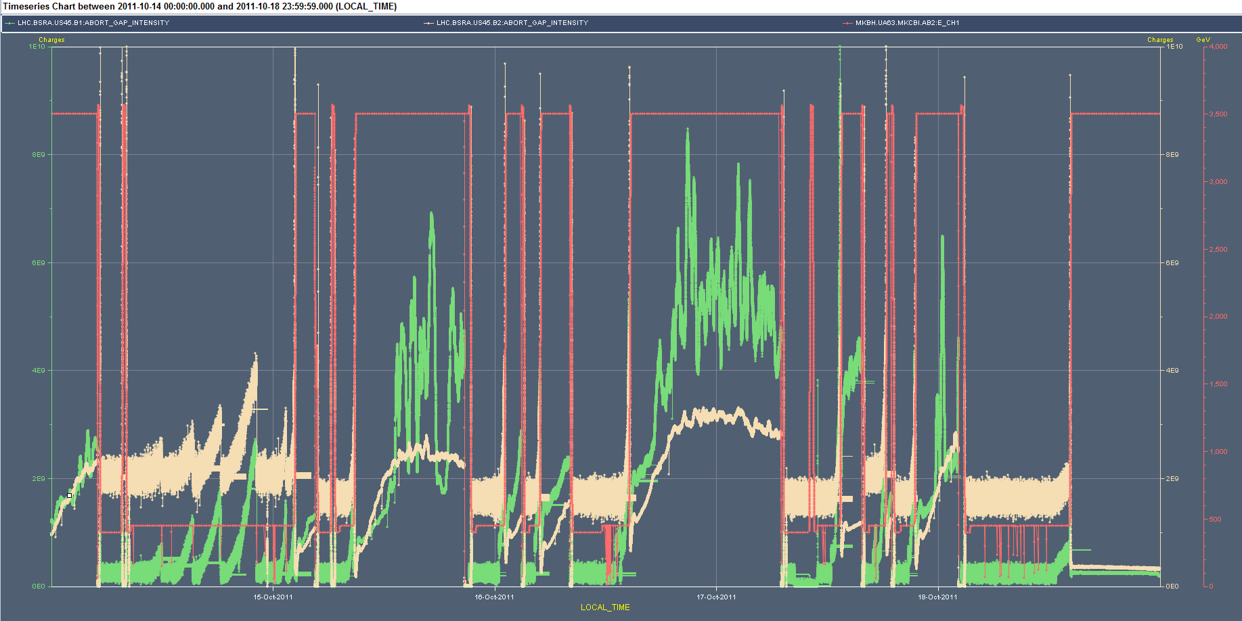
Other improvements for 2012 - Abort Gap cleaning
New procedure to be applied to proton running, from start-up 2012 onwards
Cleaning ideally left on all the time, but currently costs of a few percent in luminosity
If AGC switched on with too large abort gap population (~1e12), losses on the TCP risk to dump the beam at worst moment
Cleaning always to be applied simultaneously to both beams
Towards fully automated cleaning after LS1:
  -> Need Improved ADT HW + improved reliability of BSRA
I_{ag} > 1e10 p+: LHC announcer to ask for abort gap cleaning to be activated, first at 50% then 100%
I_{ag} < 4e9 p+: Switch cleaning off
I_{ag} > 1e11 p+ AND I_{ag} < 1e12 p+ : Manually dump the beams
I_{ag} > 1e12 p+: Logically one should never arrive here
Don’t touch. Wait for decay below
1e12 p+ and dump the beams
1e10
Cleaning at 3.5TeV
4e9
Courtesy of J.Uythoven

Slide 12
Other improvements for 2012 - RP review
Following discussion in Evian/Chamonix 2011, procedure for ‘non-working dump trigger’ has been prepared and will be implemented and commissioned for 2012 start-up
  Sequence of actions to be taken by operations to force beam dump at different levels in case of equipment/controls malfunctioning
Issue with RP movements on 6/11/2011 stopped RP operation in 2011 and triggered review between TOTEM/ALFA, Collimator and MPS experts
Identified actions include
  additional FLUKA studies for worst case failure scenarios
  Implementation and commissioning of new state machine
  New key panel to allow bypassing of position readings only when RP are in home position and motor power disabled (https://edms.cern.ch/document/1183242/1)
  Improvements to mitigate cross-talk between stopper signals
  Improved diagnostic and monitoring of all thresholds and limits
All changes will be fully re-commissioned before operation of RPs will be allowed in 2012
1e10
Very few occasions with AG population > 1e10

Slide 13
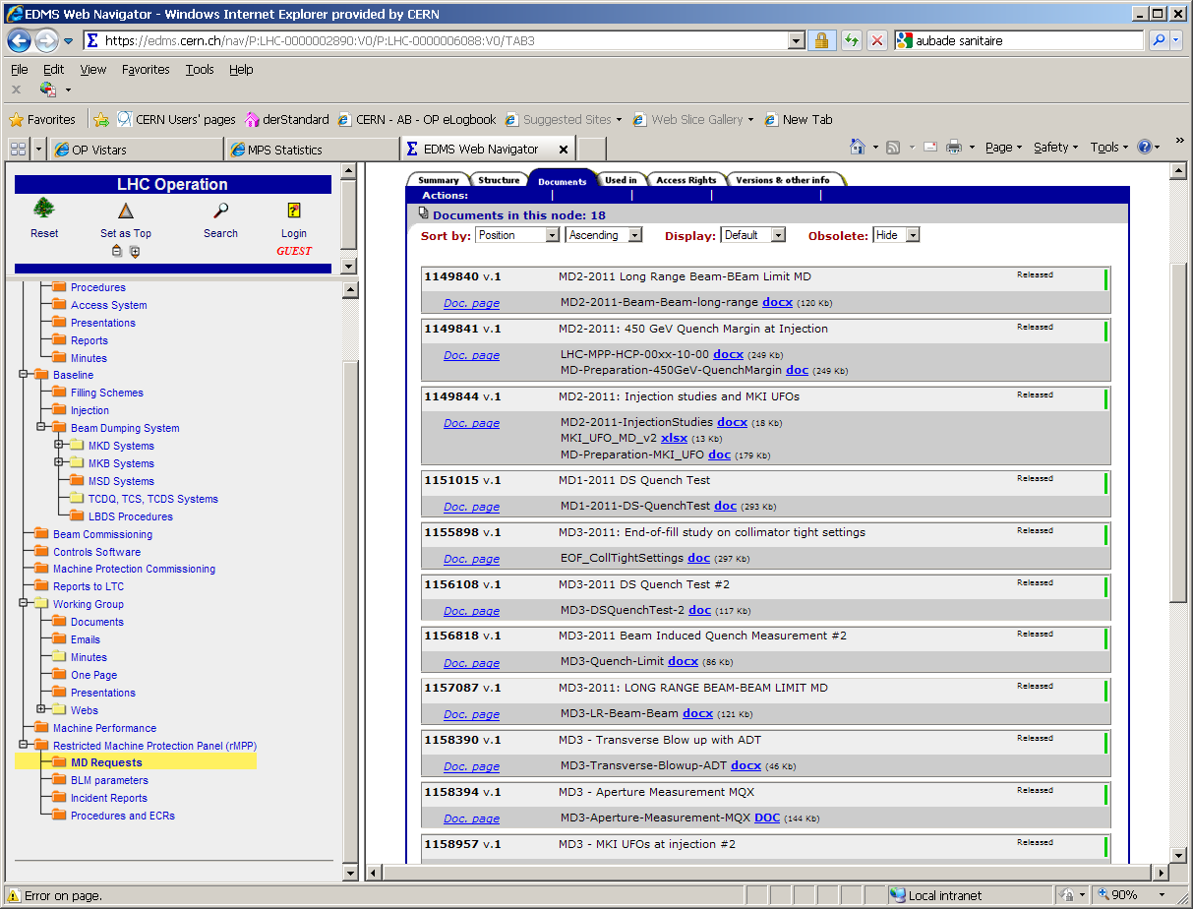

Machine Developments
Machine Developments per definition explore new machine and machine protection territory!
MD requestors demonstrated responsibility in proactively providing the required MP documents
More than 20 documents approved through EDMS for MD periods in 2011
Preparation phase has proven very useful for MD and Machine Protection teams and often increased the efficiency of the MDs
To be made better for 2012:
rMPP classification of requests + preparations of documents tbd more timely before the MD
Certain flexibility wrt to agreed procedure was useful to increase efficiency (BFPP test, ion quench tests,…) but must not become the default

Slide 14
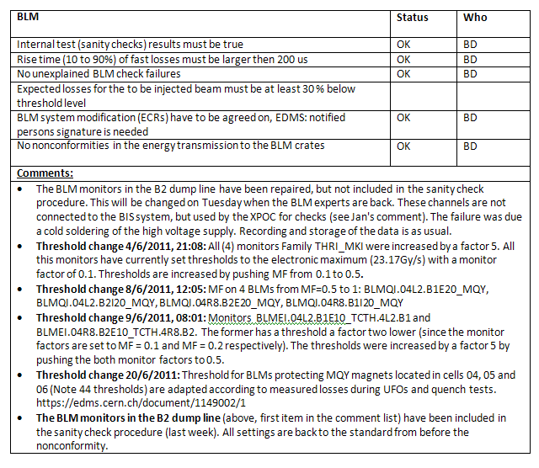
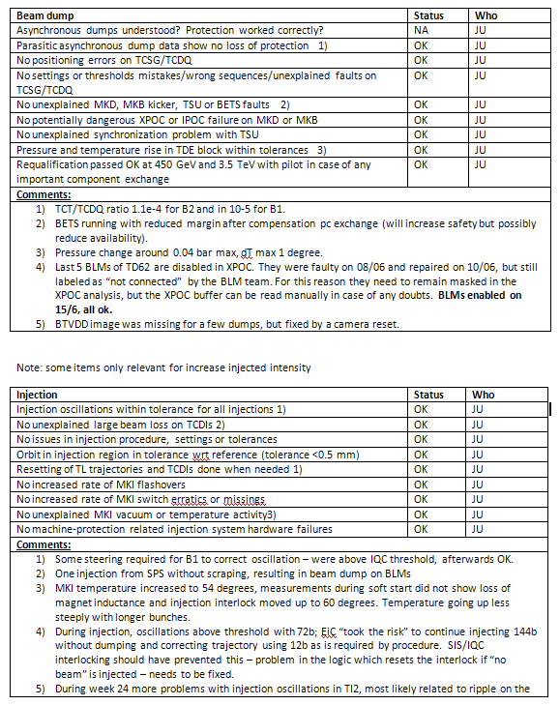
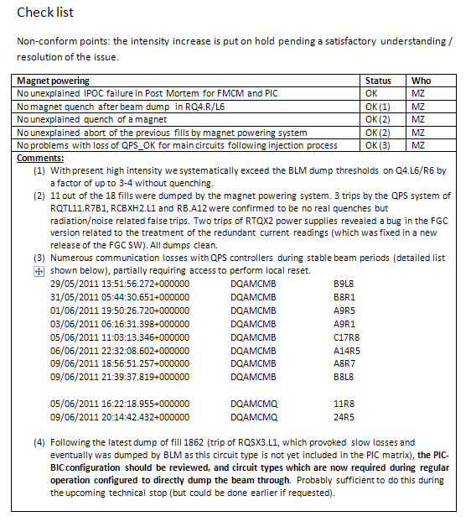
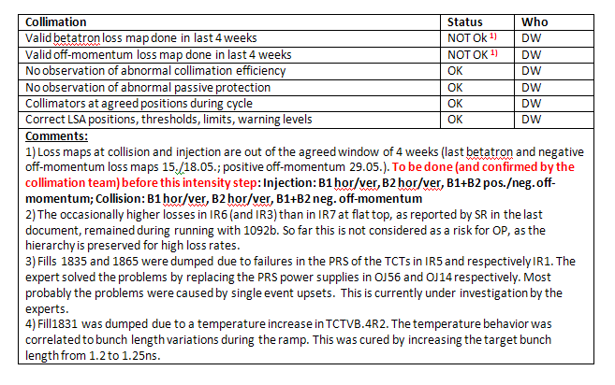
Role of MPP and rMPP
Scientific work on MP issues done by MPP, preparing the arguments for decision
rMPP gathers main players in operation and protection to agree on the way to proceed and operational envelope
Final decision by LMC
Propose to continue with this structure for 2012 run, re-discuss after LS1
Improvements for 2012
  Formalise ‘standard’ ramp-up
  after TS
  Checklists: after the steps with
  624b, 840b and 1092b
  @ 1380b once every 14 days

Slide 15
Intensity ramp-up in 2011 and 2012
Majority of Machine protection tests done with SBF <= 3 nom bunches, requiring relatively little time during ramp-up
Main driving factor was machine availability up to 768b, initial steps to 912 b and 1092 b set off UFOs, vacuum activities and SEU
Risk with faster intensity ramp up is not risk with machine protection, but effect of decreasing the efficiency
Balanced approach to intensity increase allows for probing and resolving of upcoming issues while maintaining certain integrated luminosity (<β*, new collimator settings, < orbit tolerances will need time to master)
Reduce to 7 steps in 2012
  3b for MPS
  2-3 fills and 4-6 hours with 48b, 84b, 264b and 624b (cycle validation)
  3 fills and 20 hours with 840b, 1092b, 1380b (lumi related problems)

Slide 16
Summary
LHC Machine Protection Systems have been working well during 2011 run thanks to a lot of loving care and rigor of operation crews and MPS experts
Ever more failures are captured before effects on beam are seen (no losses or orbit movements)
Still no quenches with circulating beam (with ~ 100MJ per beam and 10mJ for quenching a magnet)
Additional active protection will provide further essential redundancy for next years of running (DIDT, PC interlock…)
Maintaining present good level of orbit stability is a primary importance when moving to <β* + tight collimator settings
Still we have to remain vigilant to maintain current level of safety of MPS systems while increasing efforts on increasing MPS availability

Slide 17
Thanks a lot for your attention
17

