Slide 1

MD Plans in 2012
The LHC MD coordination team
R. Aβmann, Frank Zimmermann, Giulia Papotti
LHC Performance Workshop, Chamonix, 7.2.2012

Slide 2

http://www.cern.ch/lhc-md
LHC-MD web site holds detailed info, ATS MD notes by the teams, MD requests, LSWG minutes and presentations, ...
Here I will be generic, focusing on issues relevant for this meeting!

Slide 3
Achievements → 2011 MD Notes
BI MD studies on August 25th 2011, D. Belohrad et al, CERN-ATS-Note-2011-130 MD
End-of-fill study on collimator tight settings , R. Assmann et al, CERN-ATS-Note-2011-125 MD
Optics measurement and correction close to the half integer resonance, R. Calaga et al,CERN-ATS-Note-2011-124 MD. - 2011.
Results of long range beam-beam studies and observations during operation in the LHC, Alemany et al, CERN-ATS-Note-2011- 120 MD
IR1 and IR5 aperture at 3.5 TeV, C. Alabau Pons,,CERN-ATS-Note-2011-110 MD
Beam parameters observations during a high pile-up collisions fill, G. Trad et al, CERN-ATS-Note-2011-105 MD
Longitudinal Oscillations with Batch Injection in the LHC, T. Argyropoulos et al, CERN-ATS-Note-2011-031 MD
Dependence of single beam lifetime on bunch length, P. Baudrenghien et al, CERN-ATS-Note-2011-083 MD
Tight collimator settings with beta* = 1.0 m, R. Assmann et al, CERN-ATS-Note-2011-079 MD.
R2E-related MD: slow controlled losses for RadMon/BLM cross-checks , M. Calviani et al, CERN-ATS-Note-2011-070 MD
BI MD Studies on June 29th 2011, D,Belohrad et al.CERN-ATS-Note-2011-069 MD
Quench Margin at Injection, W. Bartmann et al, CERN-ATS-Note-2011-067 MD
MKI UFOs at Injection, T. Baer et al, CERN-ATS-Note-2011-065 MD
MD on Injection Quality – Longitudinal and Transverse Parameters , L. Drosdal et al, CERN-ATS-Note-2011-063 MD
Improving LHC Collimator Setup Efficiency at 3.5 TeV, Assmann et al, CERN-ATS-Note-2011-062 MD
IR3 combined cleaning test at 3.5 TeV, R. Assmann et al, CERN-ATS-Note-2011-061 MD.
LHC Transvers Profile Monitors studies (MD on May 6th, 2011), E. Bravin et al, CERN-ATS-Note-2011-049 MD
Transverse coupled-bunch instability rise times in the LHC at injection and top energy, N. Mounet et al, CERN-ATS-Note-2011- 035 MD
Head-on beam-beam tune shifts with high brightness beams in the LHC, R. Alemany et al, CERN-ATS-Note-2011-029 MD
Test of luminosity levelling with separated collisions , R. Alemany et al, CERN-ATS-Note-2011-028 MD
50 and 75 ns operation in the LHC: Vacuum and Cryogenics observations, G. Arduini et al, CERN-ATS-Note-2011-046 MD
BPM Offset Determination by Sinusoidal Quadrupole K-modulation, T. Baer et al, CERN-ATS-Note-2011-043 MD
The Achromatic Telescopic Squeezing (ATS) MD part I, S. Fartoukh et al, CERN-ATS-Note-2011-033 MD
Summary of MD on nominal collimator settings, R. Assmann et al, CERN-ATS-Note-2011-036 MD
Un-squeeze to 90 m, H. Burkhardt et al, CERN-ATS-Note-2011-032 MD
Collimator losses in the DS of IR7 and quench test at 3.5 TeV, R. Assmann et al,CERN-ATS-Note-2011-042 MD
Studies of longitudinal single bunch stability, T. Argyropoulos et al, CERN-ATS-Note-2011-041 MD
TI8 shielding studies and angular alignment of TDI and TCDQ, W. Bartmann et al, CERN-ATS-Note-2011-040 MD

Slide 4
Achievements → 2011 MD Notes
BI MD studies on August 25th 2011, D. Belohrad et al, CERN-ATS-Note-2011-130 MD
End-of-fill study on collimator tight settings , R. Assmann et al, CERN-ATS-Note-2011-125 MD
Optics measurement and correction close to the half integer resonance, R. Calaga et al,CERN-ATS-Note-2011-124 MD. - 2011.
Results of long range beam-beam studies and observations during operation in the LHC, Alemany et al, CERN-ATS-Note-2011- 120 MD
IR1 and IR5 aperture at 3.5 TeV, C. Alabau Pons,,CERN-ATS-Note-2011-110 MD
Beam parameters observations during a high pile-up collisions fill, G. Trad et al, CERN-ATS-Note-2011-105 MD
Longitudinal Oscillations with Batch Injection in the LHC, T. Argyropoulos et al, CERN-ATS-Note-2011-031 MD
Dependence of single beam lifetime on bunch length, P. Baudrenghien et al, CERN-ATS-Note-2011-083 MD
Tight collimator settings with beta* = 1.0 m, R. Assmann et al, CERN-ATS-Note-2011-079 MD.
R2E-related MD: slow controlled losses for RadMon/BLM cross-checks , M. Calviani et al, CERN-ATS-Note-2011-070 MD
BI MD Studies on June 29th 2011, D,Belohrad et al.CERN-ATS-Note-2011-069 MD
Quench Margin at Injection, W. Bartmann et al, CERN-ATS-Note-2011-067 MD
MKI UFOs at Injection, T. Baer et al, CERN-ATS-Note-2011-065 MD
MD on Injection Quality – Longitudinal and Transverse Parameters , L. Drosdal et al, CERN-ATS-Note-2011-063 MD
Improving LHC Collimator Setup Efficiency at 3.5 TeV, Assmann et al, CERN-ATS-Note-2011-062 MD
IR3 combined cleaning test at 3.5 TeV, R. Assmann et al, CERN-ATS-Note-2011-061 MD.
LHC Transvers Profile Monitors studies (MD on May 6th, 2011), E. Bravin et al, CERN-ATS-Note-2011-049 MD
Transverse coupled-bunch instability rise times in the LHC at injection and top energy, N. Mounet et al, CERN-ATS-Note-2011- 035 MD
Head-on beam-beam tune shifts with high brightness beams in the LHC, R. Alemany et al, CERN-ATS-Note-2011-029 MD
Test of luminosity levelling with separated collisions , R. Alemany et al, CERN-ATS-Note-2011-028 MD
50 and 75 ns operation in the LHC: Vacuum and Cryogenics observations, G. Arduini et al, CERN-ATS-Note-2011-046 MD
BPM Offset Determination by Sinusoidal Quadrupole K-modulation, T. Baer et al, CERN-ATS-Note-2011-043 MD
The Achromatic Telescopic Squeezing (ATS) MD part I, S. Fartoukh et al, CERN-ATS-Note-2011-033 MD
Summary of MD on nominal collimator settings, R. Assmann et al, CERN-ATS-Note-2011-036 MD
Un-squeeze to 90 m, H. Burkhardt et al, CERN-ATS-Note-2011-032 MD
Collimator losses in the DS of IR7 and quench test at 3.5 TeV, R. Assmann et al,CERN-ATS-Note-2011-042 MD
Studies of longitudinal single bunch stability, T. Argyropoulos et al, CERN-ATS-Note-2011-041 MD
TI8 shielding studies and angular alignment of TDI and TCDQ, W. Bartmann et al, CERN-ATS-Note-2011-040 MD
Acknowledgements to the many, many colleagues who proposed the MD’s, performed them and analyzed results!

Slide 5
2011 MD Lessons
Presented in various talks, so I do not repeat it here
  see Monday + Tuesday sessions
  A lot of “surprising” and “not surprising” good news identified.
Example of lessons taken already during 2011 run:
  Increase of bunch currents and decrease of emittance after review of MD results in “mini-Chamonix” meeting July 2011.
  Decrease of beta* from 1.5m to 1.0m in early September 2011.
  No full re-setup of collimation / MP during year, except IR changes.
  Feed forward of MD results into operational settings (BI, RF, …).
  Delay of LS1 collimation upgrade for the IR3 dispersion suppressors.
Full safety guaranteed with up to 110 MJ beams – not a single close call or accident (not even accidental quench):
  During MD execution.
  For machine changes fed forward into operation.

Slide 6
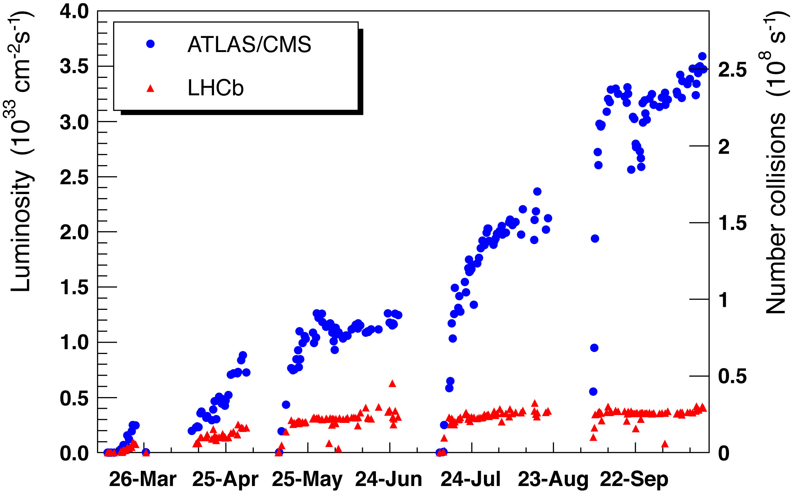
p-p Peak Luminosity in 2011
β*: 1.5m → 1.0m
ε 
i_{bunch} 
TS
MD
Intensity ramp to 1380b
TS
MD
TS
MD
Figure Jörg Wenninger

Slide 7
p-p Peak Luminosity in 2011
β*: 1.5m → 1.0m
There would have been much less integrated luminosity without machine improvements after we reached 1380b (end of June)
22 days of beam time for machine studies were well invested.
Thanks for support from all involved, including the LHC experiments.
ε 
i_{bunch} 
TS
MD
Intensity ramp to 1380b
TS
MD
TS
MD
Figure Jörg Wenninger

Slide 8
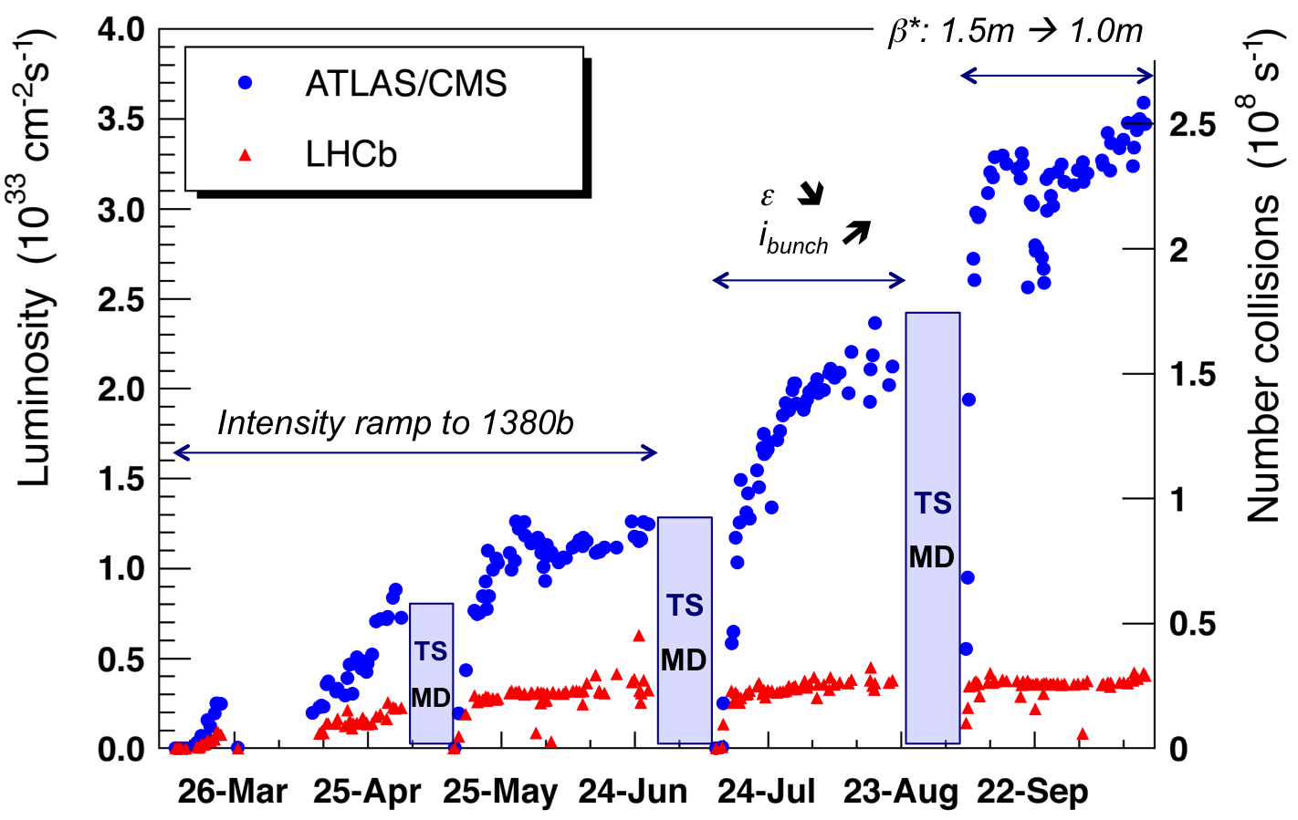
…2012 even better (based on 2011 MD results)
β*: 0.6 m
tight collimation
≈ 5 × 10³³ cm⁻² s⁻¹
2012 proposal
A very efficient way to increase integrated luminosity:
Increase peak luminosity!

Slide 9
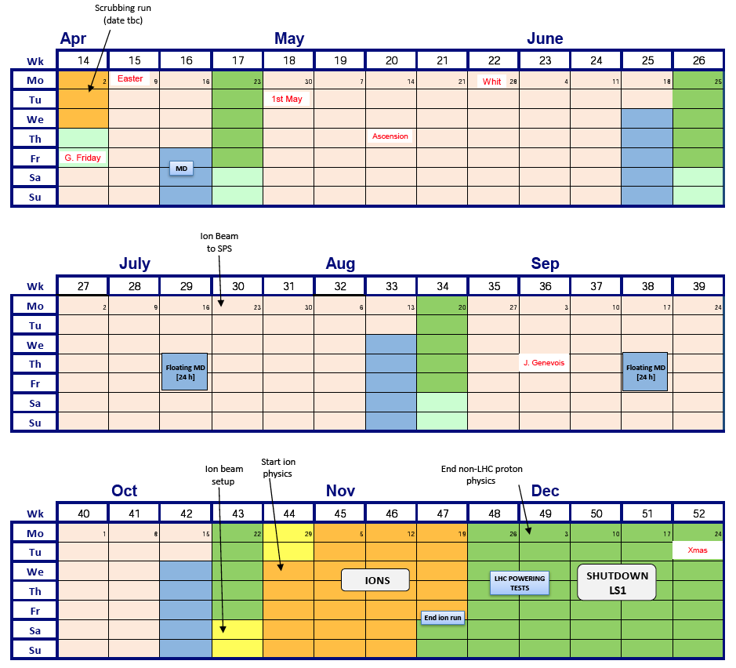
LHC Schedule 2012

Slide 10
MD Time Scheduled in 2012
22 days allocated to machine development in 2012.
4 long MD blocks to technical stops (executed just before):
  1 block of 3 days ➔ 9 shifts of 8h
  3 blocks of 5 days ➔ 45 shifts of 8h
2 blocks of floating MD’s, not coupled to technical stops:
  2 blocks of 2 days ➔ 12 shifts of 8h
Total available: 66 shifts ~50-60 MD’s
420 h (with 80% efficiency)
Will continue the way we organized last year.
  Make sure that this time is used efficiently and according to the priorities approved by the LHC Machine Committee (LMC).

Slide 11
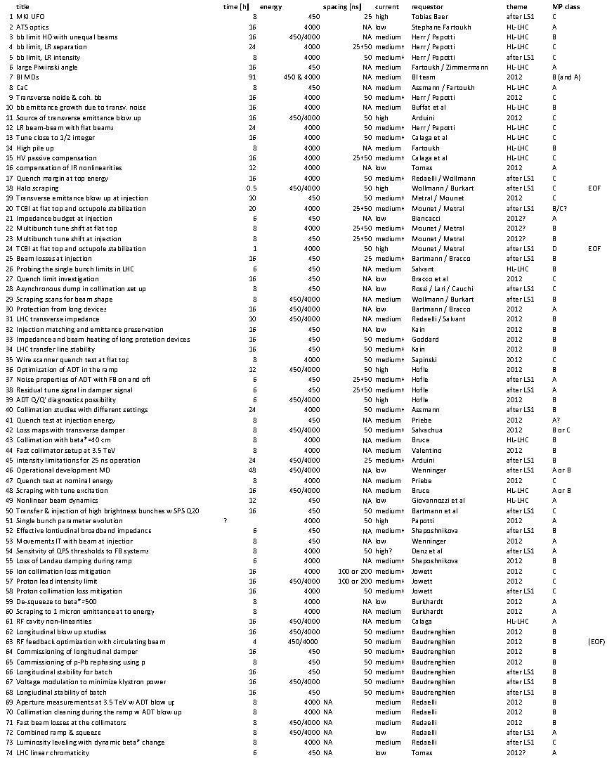
2012 MD requests
MD requests for 2012 submitted
in November & December 2011
76 requests in total
total time requested: 913.5 h
available time: 420 h
Slide Frank Zimmermann, Evian 2011

Slide 12
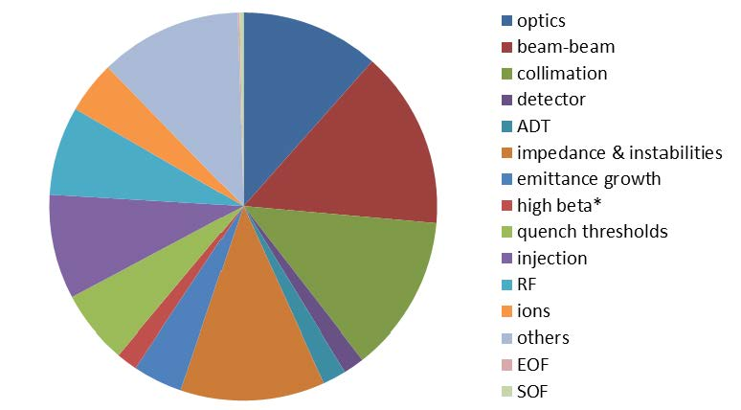
Distribution of MD Requests
Slide Frank Zimmermann, Evian 2011

Slide 13
Limiting Time Availability and Priorities
Not enough MD time to do everything in 2012.
In the following propose a list of MD goals for 2012 that we ask comments and feedback on:
  Has been discussed in LHC Study Working Group
  What is missing? What should be removed? Input on priorities?
Three categories:
  MD’s for operation and physics.
  MD’s for future running.
  MD’s with lower priorities (scheduled if time allows).
This is still preliminary!

Slide 14
Operation & Physics I
Understand beam heating effects around the LHC ring.
  Establish limits for safe intensity without hardware damage.
  Requires identification of critical locations → see report by Vincent Baglin.
  Requires temperature sensors at critical locations.
Understand & optimize transverse emittance growth:
  Measure beam-beam emittance growth due to transverse noise.
  Noise properties of transverse damper (ADT): FB on and off.
  Optimization of ADT in ramp.

Slide 15
Operation & Physics II
Demonstrate RF setup for proton-lead physics:
  → Ramp many bunches.
  → Prepare ion physics run at end of year.
Establish an LHC optics with a beta* of 500 m.
  Depends on physics priorities.
  Prepare for small angle physics runs after LS1.

Slide 16
Operation & Physics III
Understand and optimize longitudinal beam dynamics in LHC:
  Understand longitudinal impedance in LHC.
  Study voltage modulation (→ minimize transient power loads)
  Optimize bunch length blow-up (→ minimize heating effects).
  Set up longitudinal damper.
Establish automatic and very fast collimator setup:
  Setup rate should reach 9 Hz (~10 times faster).
  Hope to achieve maximum during commissioning.

Slide 17
Operation & Physics IV
Calibrate and optimize LHC beam instrumentation:
  Special fills (MD) for cross-calibration
Compatibility tune and ADT:
  Establish residual tune signal in damper signal and provide to tune feedback.
  ADT Q/Q’ diagnostics compatibility.
Equalize beta* in ATLAS and CMS:
  Automatic K modulation for beta*.

Slide 18
Future Running I
Characterize future operation with 25ns:
  Establish reliable nominal injection with 288b batches.
  Establish nominal intensity of 2808 bunches with 25ns at injection: 2808 x 1.2e11 (if safe for beam heating)
  Ramp as many batches as possible: ramp at least 288b (25ns) for peak current within 3 μs → demonstrate the safe RF operation with 200 kW klystron power.
  With ramp of 25ns batches determine UFO scaling.
  Understand LR beam-beam limit for 25ns: reduce crossing angle for 25ns fill, observe losses.

Slide 19
Future Running II
Quantify required tolerances for non-linearities in LHC:
  What do we really need for upgrade specifications (e.g. for 11T dipoles)?
  Minimize cost of upgrades by only asking for required features.
Show feasibility very small beta* / very high pile-up:
  Test ATS optics to 10 cm beta*
  Set up collimation for beta*=40 cm and flat machine (ATS pre-squeeze).
  Demonstrate pile-up of 90-110.
  Establish chromatic limits in LHC collimation and MP: When do we need an ATS optics?
  Test Large Piwinski Angle.

Slide 20
Future Running III
Verify and check the transverse impedance limits of the LHC:
  Impedance from the machine parts (collimators etc…)
  Limitations in octupole and ADT stabilization (profit from much more correcting power at 3.5 TeV) for acceptable emittance growth.
  Verify 7 TeV collimation settings (“super-tight”)
Show feasibility of flat beam optics in the LHC:
  With standard or ATS optics.
  Option to increase luminosity and to reach 5e34 lumi after LS1 at 6.5 / 7 TeV, before HiLumi upgrade?

Slide 21
Future Running IV
Establish benefits of the ½ integer tune working point:
  Demonstrate more room for LR beam-beam → lower crossing angle → lower beta*.
Study and improve LHC injection limitations:
  Check solutions for transfer line stability.
  Injection into LHC with Q20 optics in the SPS.

Slide 22
Proposed Criteria for Lower Priority
Sufficiently conclusive results in 2011.
  e.g. collimation efficiency
MD studies that are becoming operational tools for 2012 commissioning.
  e.g. aperture
  e.g. ADT blow-up
Studies on damaged devices.
  e.g. TDI impedance, of course assuming full commissioning of these critical devices.
Studies without impact on 2012 performance, that can be performed efficiently at 6.5 / 7 TeV in 2014.
  e.g. detailed study of 7 TeV quench margin and required BLM thresholds.

Slide 23
Lower Priority MD’s I (schedule as time permits)
Additional data for UFO’s at MKI’s at injection energy:
  MKI has minor influence on UFO extrapolation to high energy. Triggered by injection pulsing…
  Hardware investigations ongoing.
  Better to focus on UFO’s in arcs and other locations?
Experimental benchmark on 7 TeV quench limits: Quench test on C14R2 at 4 TeV and in DS’s.
  Several tests performed and data is on disk.
  No issues in operation so far.
  For adjusting BLM thresholds for 6.5/7 TeV: Possibly more efficient to do direct measurements after LS1 (with improved interconnects)?

Slide 24
Lower Priority MD’s II (schedule as time permits)
Proton performance reach from beam losses:
  Several conclusive tests performed on collimation performance and losses in cold magnets.
  Collimation upgrades in DS’s of IR3 delayed as a result.
  No limitation in sight for 4 TeV physics.
  Extrapolate results to nominal/ultimate performance at 7 TeV.
Understand Pb intensity and luminosity limitations and mitigation (orbit bumps).
  Several conclusive tests performed on collimation performance and losses in cold magnets.
  Achieved very high ion losses in some cold magnets, much higher than physics induced losses.
  Comfortable…

Slide 25
Lower Priority MD’s III (schedule as time permits)
LHC aperture measurements:
  Will be used as operational technique in commissioning.
Studies on TDI impedance:
  We know that impedance deteriorated.
  We know that there is hardware damage.
  Lessons are of limited value.
  Include as a priority into general survey of beam-induced heating.
Controlled beam blow-up with ADT:
  Will be used as operational technique in commissioning.

Slide 26
Operation & Physics: 9 major MD goals proposed.
  Understand beam heating effects around the LHC ring.
  Understand & optimize transverse emittance growth.
  Demonstrate RF setup for proton-lead physics.
  Establish an LHC optics with a beta* of 500 m.
  Understand and optimize longitudinal beam dynamics in LHC.
  Establish automatic and very fast collimator setup.
  Calibrate and optimize LHC beam instrumentation.
  Compatibility tune and ADT.
  Equalize beta* in ATLAS and CMS.
Future running: 7 major MD goals proposed.
  Characterize future operation with 25ns.
  Quantify required tolerances for non-linearities in LHC.
  Show feasibility very small beta* / very high pile-up.
  Verify and check the transverse impedance limits of the LHC.
  Show feasibility of flat beam optics in the LHC.
  Establish benefits of the ½ integer tune working point.
  Study and improve LHC injection limitations.
Reduced priority MD’s: 7 goals. To be scheduled as time allows.
Summary MD Plans
(for discussion)

