Slide 1

Consolidation of splices [Second LHC Splices Review Nov 2011]
  Consolidation of the main arc splices
  Consolidation of the DFBA splices
  Other splices ?
Special interventions
  Exchange of cryomagnets
  Consolidation of connection cryostats
  Installation of the remaining pressure relief devices
  In-situ repair (Issues on circuits and on cryomagnets)
Organisation of the consolidation of the SC magnets & circuits
Planning, Resources
Open issues
  Reinforcement of spider insulation
  Diodes
  CSCM
  Radioprotection
  New thermal shield design
Conclusions
Work presented here is the continuation of the tremendous and detailed work done by F Bertinelli
Consolidation of the LHC SC magnets and circuits during LS1

Slide 2
Consolidation of the main splices
Second LHC Splices Review (Nov 2011)
The Review committee:
George Ganetis / BNL
Claude Hauviller / CERN
Toru Ogitsu / KEK
Jim Strait / Fermilab : Chairperson
Howard Pfeffer / Fermilab
Pierre Vedrine / CEA Saclay
Chen-yu Gung : ITER
General mandate:
The TE Department Head confirms the composition of the Review Committee with the general mandate “to review CERN’s plans and consolidation actions concerning the superconducting splices in the LHC machine for 7 TeV operation”.
Specifically:
• To work in close liaison with the CERN Splices Task Force, Chairperson JPh Tock.
• To consider all splices over complete circuits, within and between equipment.
• To ensure “best practice” knowledge existing in world Laboratories and Industries has been duly considered.
• To ensure that an integrated, systems approach is being followed, covering both electrical and mechanical issues, neighboring systems, operations, …
The splices TF members:
Antonio Perin
Arjan Verweij
Cedric Garion
Christian Scheuerlein
Delio Duarte Ramos
Francesco Bertinelli
Frederic Savary
Gerard Willering
Herman ten Kate
Jean-Philippe Tock
Nuria Catalan Lasheras
Paolo Fessia
Said Atieh
Serge Mathot
Stefano Sgobba
40 participants
4 departments
16 presentations
18 (+30 old) recommendations
Mandate of the second review: To (re)assess:
− the final design for the consolidation of the main 13 kA interconnection splices
− the status and risk analysis of all superconducting splices in LHC
− the quality control procedures and plans
− the update of the plans for the work organization, quality control, resources, schedules
Third review: Production Readiness Review : September 2012
Fourth review: Quality Audit : March 2013
https://indico.cern.ch/conferenceDisplay.py?confId=157231

Slide 3
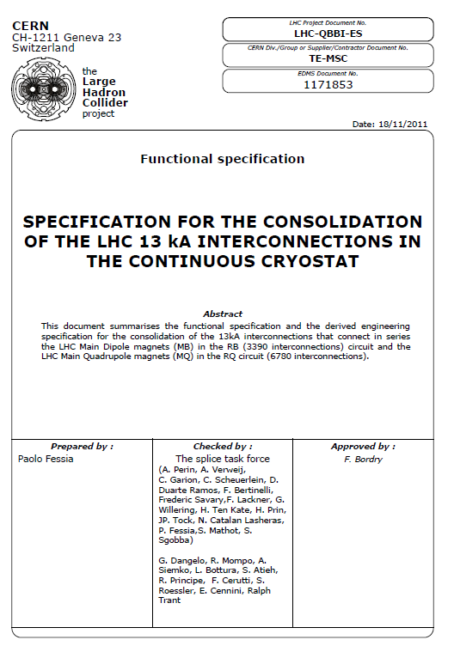
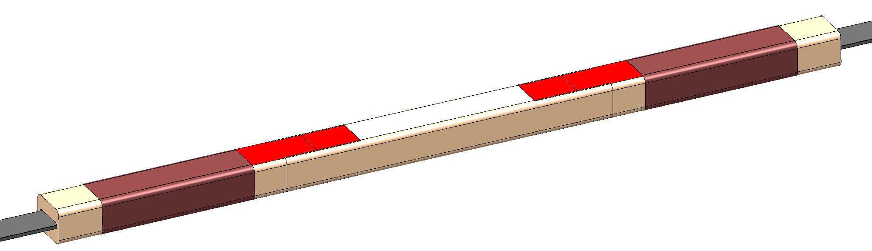
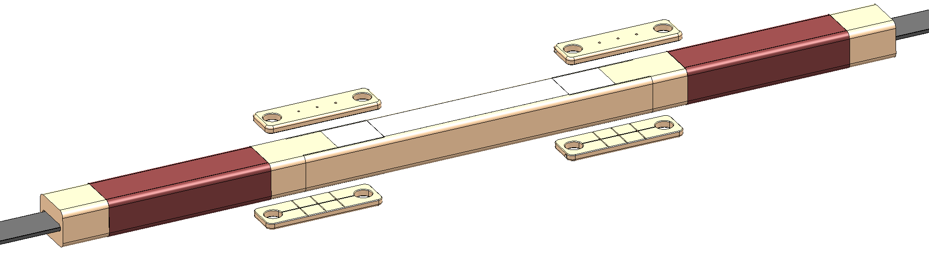
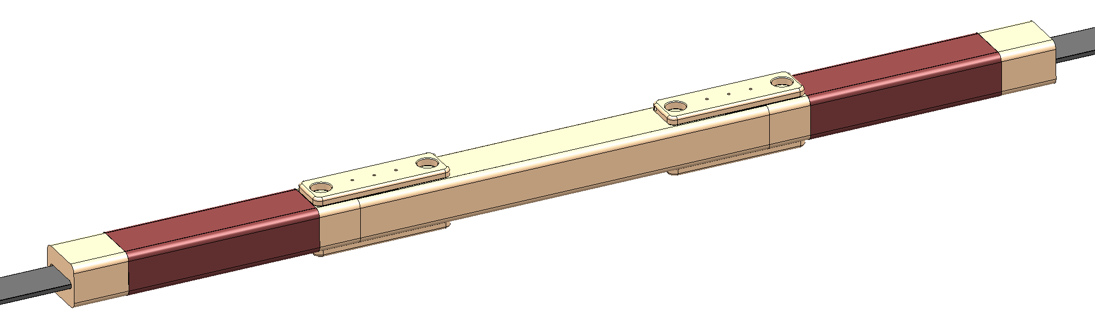
Consolidation of the main splices
What’s new since Chamonix 2011?
1. Functional specification has been edited [P Fessia: EDMS 1171853]
2. The consolidated “shunt” design has been endorsed by the Review Committee
“The design of the shunts and the techniques for soldering them across the joints are well done and have been fully tested under an array of conditions.
This appears to meet all requirements

Slide 4
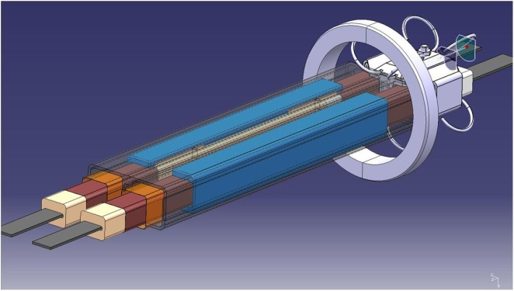
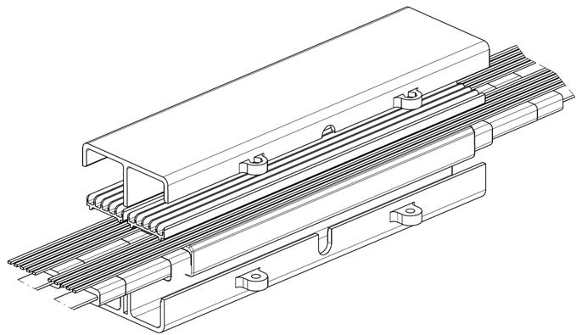
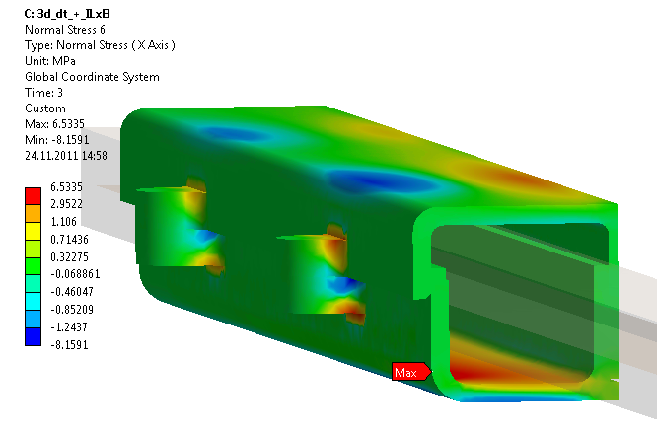
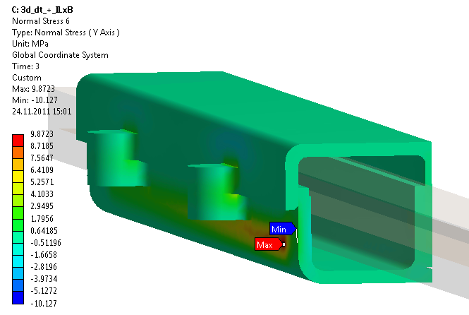
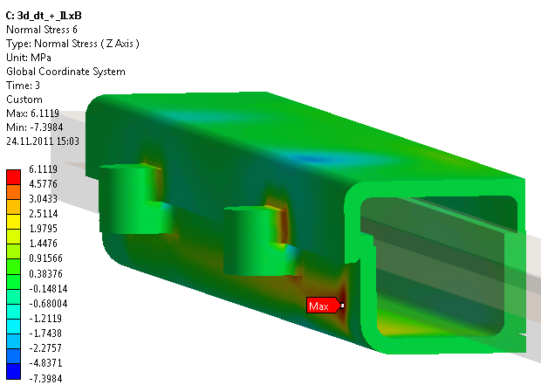
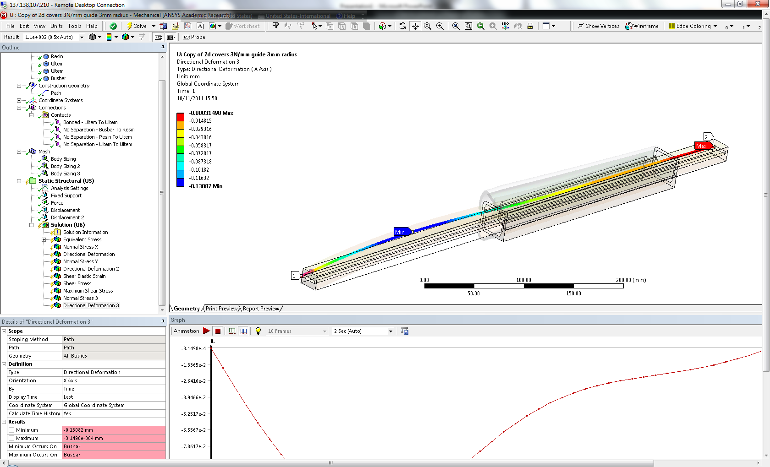
Consolidation of the main splices
Courtesy:
H Prin
F Lackner
What’s new since Chamonix 2011?
3. Design ALMOST final
Insulation cover was to be finalised at the time of the review, now, final concept is available
“This is a clever design which provides the required functionality in the presence of non-negligible splice-to-splice dimensional variations. However, the precise implementation of this scheme still needs to be developed”
The insulation cover must be adequate to reduce the mechanical stresses on the splices and the shunts so that they do not degrade over time.
Modeling of shunt insulation cover is not yet sufficient to show that it is effective as a mechanical constraint, and we have doubts that the existing cover design is adequate.
Insulation cover; Stress induced by electromagnetic forces and the thermal contraction 295K to 1.9K:
σx [MPa]= +6.5 / -8.1
σy [MPa]= +9.8 / -10.1
σz [MPa]= +6.1 / -7.3
σeq [MPa]= 8.63

Slide 5
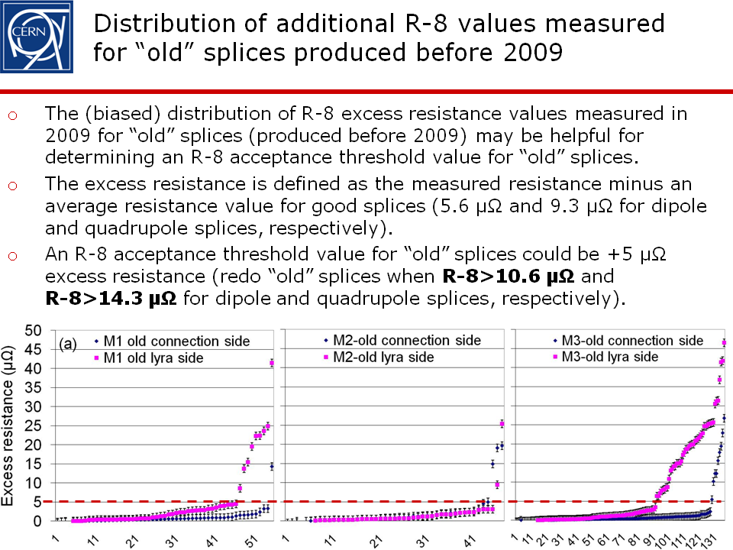
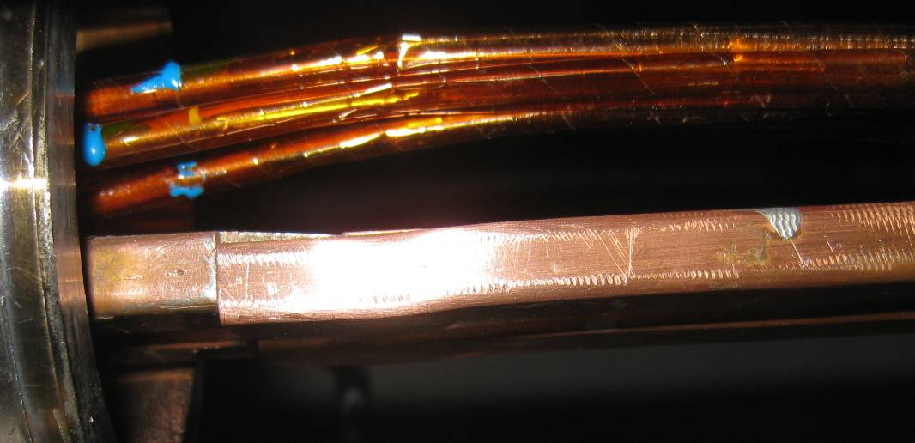
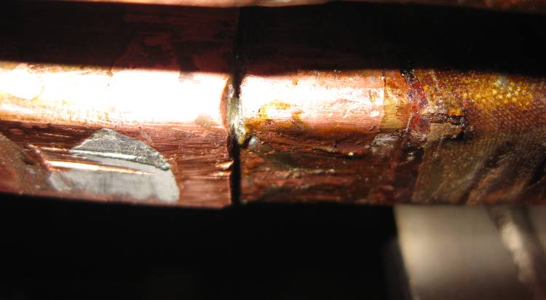
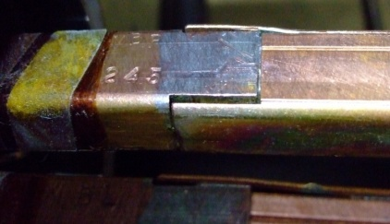
Consolidation of the main splices
Courtesy C Scheuerlein
What’s new since Chamonix 2011?
4. The splices “rebuilt” criteria were found adequate:
  R8_excess > 5 μ Ω (RT measurements)
  Outlying splices resistance at 1.9 K [Max 123 splices to repair ≈ 1%]
  Go/no-go gauges for geometrical defects
  To ensure optimum shunt install-ability
  Visual inspection based on a library of defects
  or obvious lack of mechanical strength
Step between U-piece and busbar
Redoing a splice requires resources, time and generates some risks
⇒ Avoid it if not necessary
Gap between U-piece and BB stabiliser
Gap between U-piece and busbar tongue

Slide 6
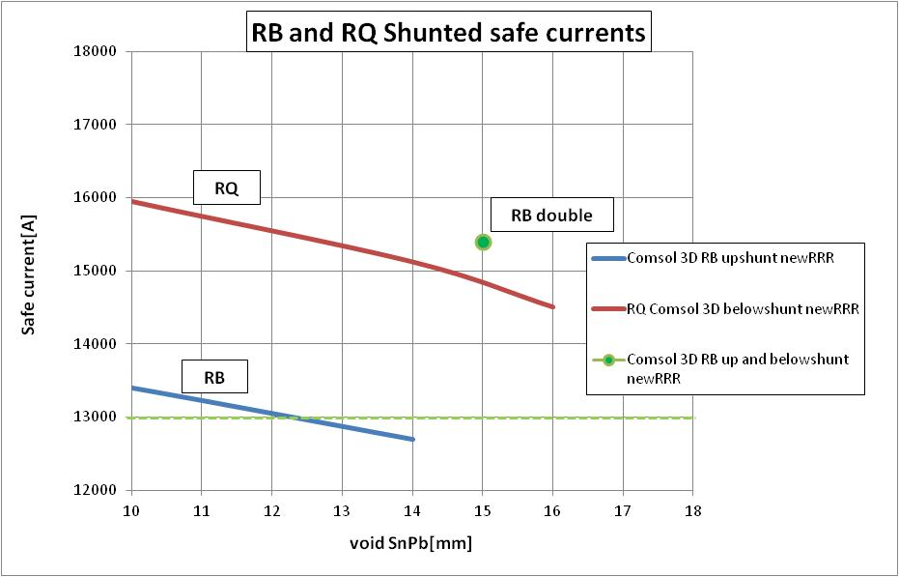
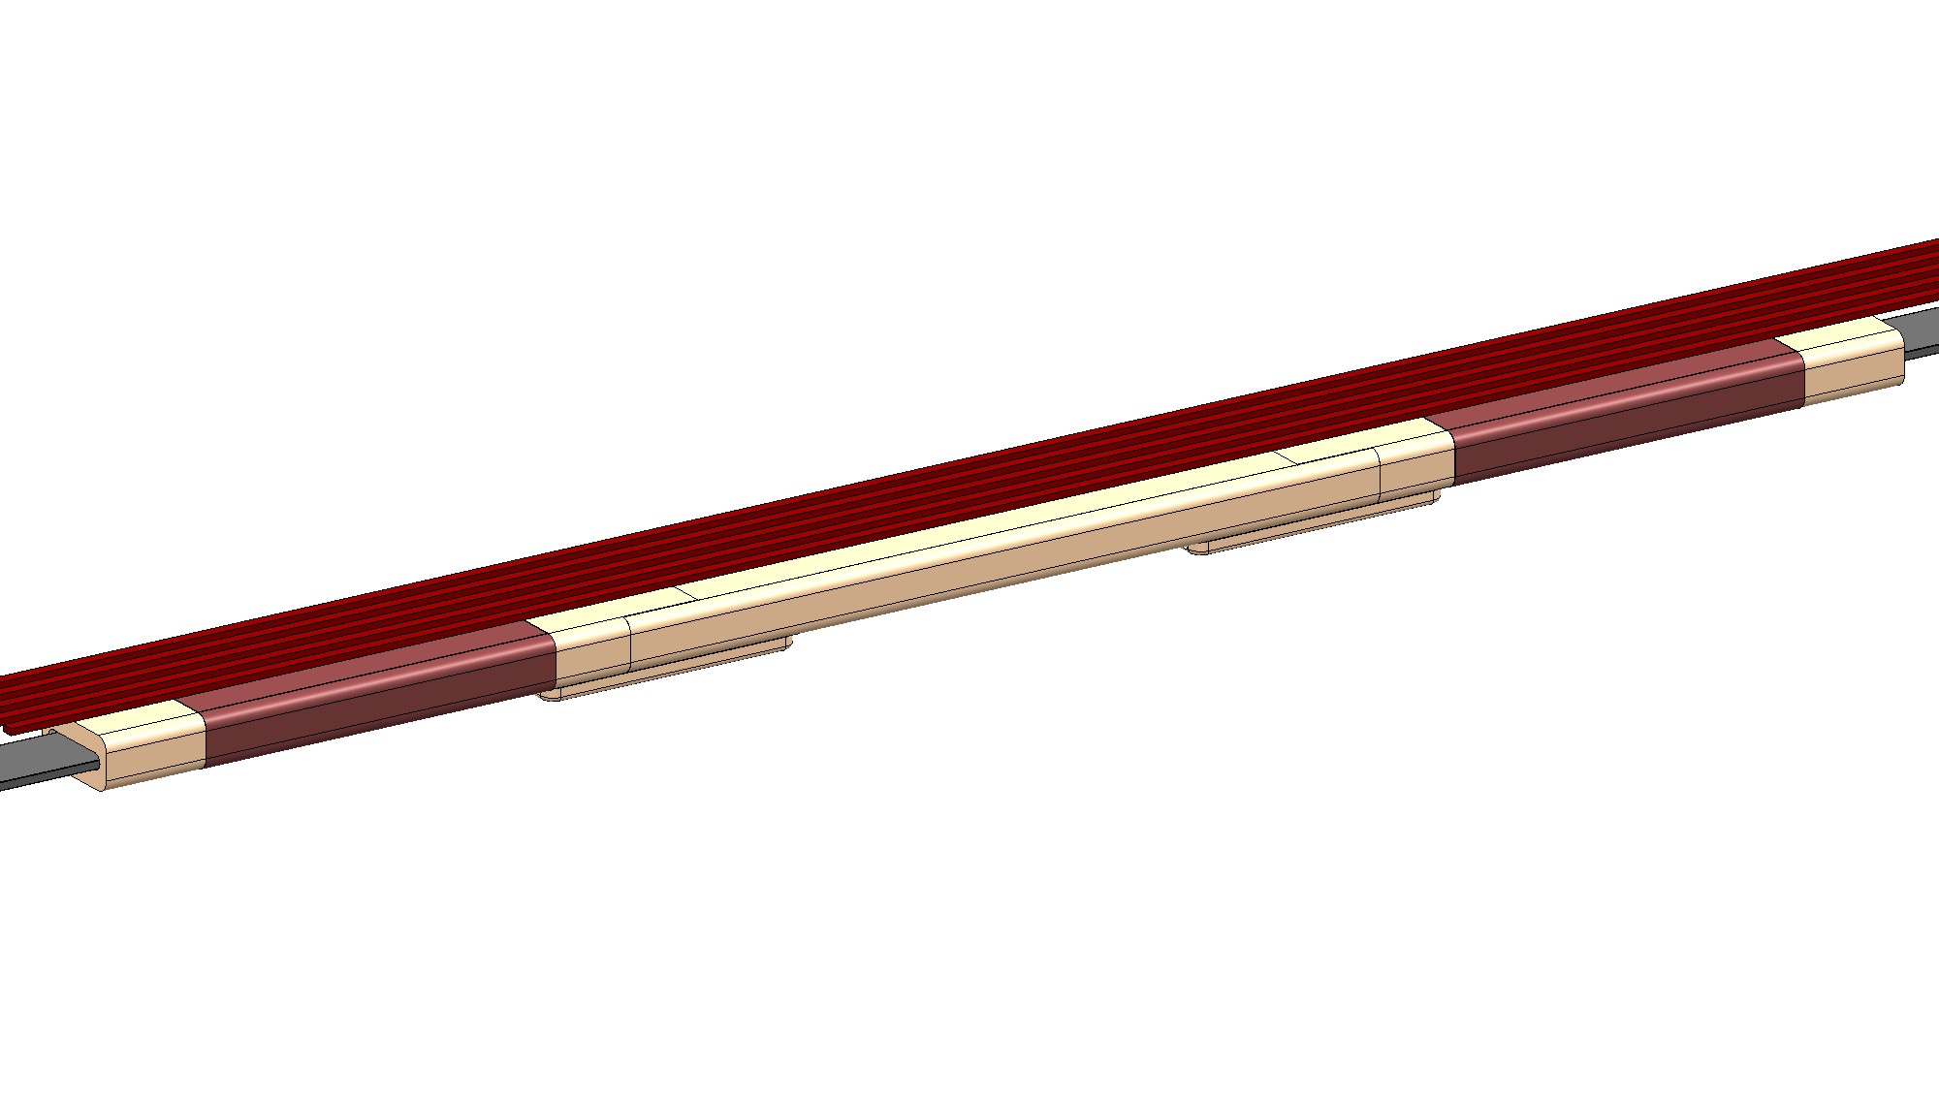
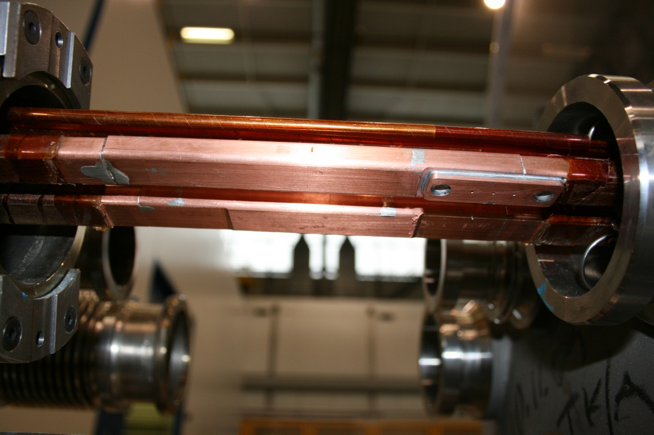
Consolidation of the main splices
What’s new since Chamonix 2011?
5. The endorsement of installing a single shunt on the RQ BB is conditioned to compensatory measures:
Rev 1 Rec 3.1: “The Committee recommends that a double shunt be applied to the quad bus”
See further presentation by R. Denz: QPS upgrade and machine protection during LS1
Rev 2: Rec 1) “If a single shunt is to be used on the quadrupole bus, then the following criteria must be met:
- The “rebuilt” criteria are met
- Clamp is effective in limiting the deflection and stress on splice, to prevent the future degradation of the copper stabilizer connection
- Energy extraction time constant is reduced to ≤ 20 sec
- Shunt is soldered properly and QC of the shunt is done correctly”
“Deal between redundancy and margin”
The safe operating current as a function of the defect length of the shunt solder

Slide 7
Consolidation of the DFBA splices
Reference: (https://indico.cern.ch/conferenceDisplay.py?confId=157231)
DFBA Consolidation scenarios, A. Perin, 2nd LHC Splices review
It has been decided to consolidate the 13 kA splices inside the DFBAs (23.11.2011 EDMS: 1173236)
Same standard as the magnet to magnet ones
Same crew for the repair of splices
Important differences exist wrt to the arc splices so specific design has to be quickly initiated
2 out of 16 DFBAs will be very difficult to repair in-situ
Failure in the DFBA would lead to a very long repair time
Mock-ups are necessary to define and test tooling and procedures
Rev 2 Recommendations:
- Apply shunts to the 13 kA splices in all DFBAs, including the most difficult circuits. Repair these joint up to the same standards and based on the same designs as in the magnet to magnet interconnect. Splice repairs should be done by the same crew that repairs the magnet to magnet interconnects.
-Investigate methods and/or procedures that would lower the risk of repair of the two DFBAs that require re-location to perform the work
Task | Group in charge
Project management and coordination with the magnet splice consolidation. Global follow-up | TE-CRG
Mockups, mechanical interventions, cutting, tooling | TE-CRG
Busbar work: busbar machining, soldering, insulation,.. | TE-MSC
Welding, welding tooling, welding inspection | EN-MME
Splice Quality Control | TE-MSC
Reclose vacuum envelope | TE-CRG
Quality Assurance & documentation | TE-CRG
Huge technical developments to carry out NOW

Slide 8
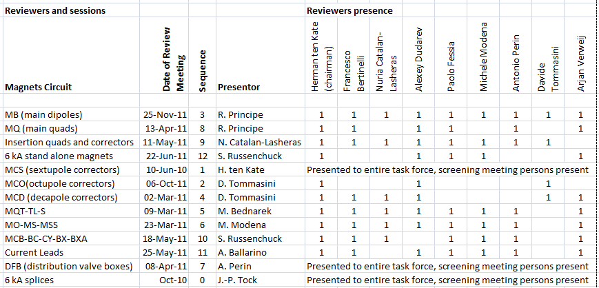
Other splices? Other issues?
Pool of experts lead by H Ten Kate screened all electrical superconducting magnet circuits in the LHC from + current lead to - current lead (Report: EDMS: 1176186)
24 “practical” recommendations formulated.
Most of them are accepted in full and being executed.
Others still require further study to come to a final assessment to allow a management decision.
High risk issues concern mainly 13kA splices in standard interconnects; diodes mechanical connections; 13kA splices in the DFBA areas and current leads.
Low risk issues concern the correctors circuits where less energy is available for creating damage provided no main circuits are harmed
Rev 2 Rec 8: Provide sufficient resources to make splice measurements on the inner triplet and matching section circuits well before the beginning of the long shutdown.
On-going : TE-MPE
Rev 2 Rec 12: Continue to explore ways to insulate the spider from ground potential and to increase the creep path of the buss to metal support of the spider.
Rev 2 Rec 13: Continue to explore external methods to insulate the lyras from ground potential
On-going : TE-MSC : See later (open issue)
On one hand, LS1 is the last chance to make a massive consolidation but on the other hand, priorities have to be defined in view of the limited time and resources available

Slide 9
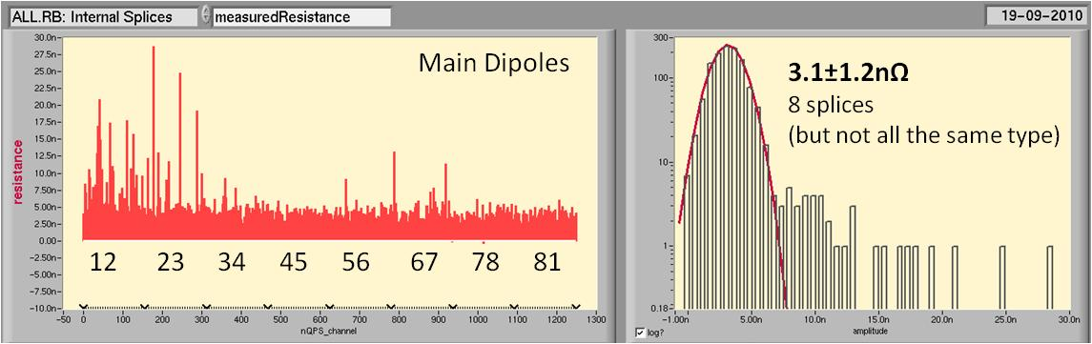
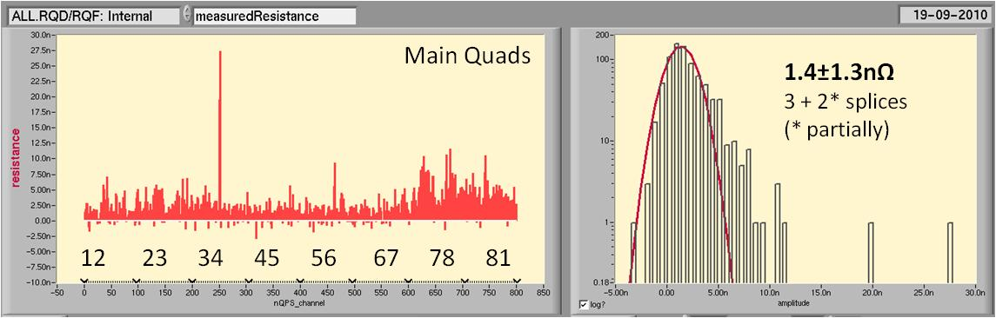
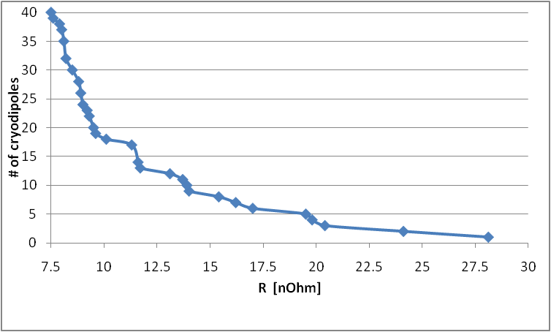
Exchange of cryomagnets with high inner splices resistance
# to exchange (proposal)
+ 8 dipoles (4A&4B) in (S12&23) & 1 SSS (in S34)
+ Test programme
⇒ Reduction by 50 % of inner resistance
Chamonix 2011
From Zinur Charifoulline
Dipoles
Quads
Should have been disconnected for installing the collimators in DS IR3
So extra work

Slide 10
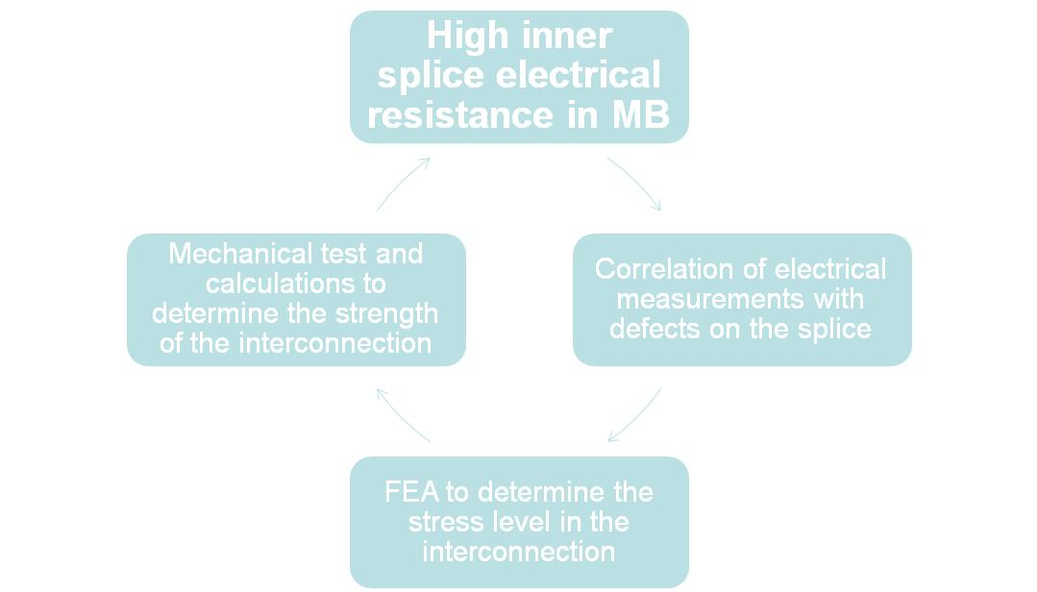
Exchange of cryomagnets with high inner splices resistance
High inner splices resistance
Test programme
https://espace.cern.ch/lhcsplices/Meeting%2054/default.aspx
Courtesy S Izquierdo Bermudez (TE-MSC-LMF)
Number of magnets to be changed for a certain resistance threshold
R>20nΩ: 1MBA + 2 MBB
R>15nΩ: 4MBA + 4 MBB
R>10nΩ: 6MBA + 14 MBB
(lim. spec.)
R>7nΩ: 13MBA + 26 MBB
The high resistance values can be justified by:
Very short interconnection length -> FEA to determine the impact in terms of mechanical stress
Presence of oxide in the cable

Slide 11
Exchange of cryomagnets with high inner splices resistance
High inner splices resistance
Test programme
https://espace.cern.ch/lhcsplices/Meeting%2054/default.aspx
Courtesy S Izquierdo Bermudez (TE-MSC-LMF)
Several samples were studied
The influence of the overlap length is determined.
A too small overlap length is one possible cause of high resistance and so lack of mechanical strength.
There could be other causes.
The electrical resistance is the only accessible value.
The forces applied on the splices are depending on the location of the soldered portion. The worst case is at the extremity, where the value can be 10 times larger than if is in the middle.
The contribution of the copper pieces is not taken into account (favorable). This could explain why, despite some high resistance splices, there is no issue detected neither in the LHC nor during the test in SM18.
Conservative approach is kept.
Correspond to the max left in LHC after LS1
Rupture traction force at RT and 4.3K at as function of the electric resistance of the splices. Cable 02 measurements taken form C. Scheuerlein and S. Heck

Slide 12
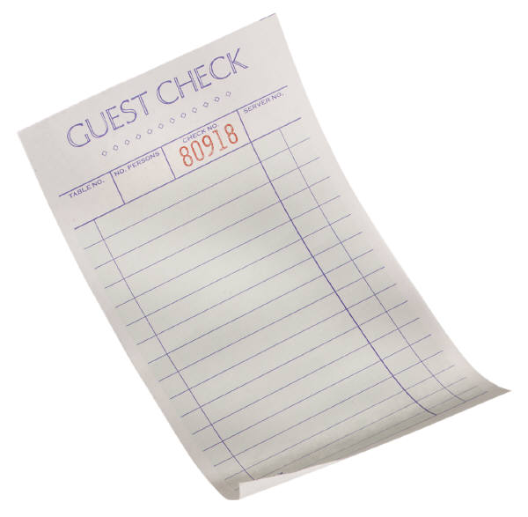
Exchange of cryomagnets with high inner splices resistance
The bill
Task force conclusion
endorsed by TE management
8 MB
1 SSS
Extremely conservative approach used for the test and computations
No sign of degradation noticed neither in LHC nor in SM18
Leaving in the LHC cryodipoles with an excess resistance > 14 nOhm total [Corresponding to 8 cryodipoles] is too risky.
There is a very limited risk in leaving cryodipoles with an excess resistance > 7 nOhm total) [Corresponding to 20 cryodipoles].
The present baseline presents a small acceptable risk.
The analysis on the removed magnets will bring more information, allowing to complement the present statistics (8 more magnets with high inner resistance wrt to the 3 available so far) and consequently support the definition the strategy for LS2.

Slide 13
Exchange of cryomagnets for electrical integrity issue
Cryodipole | Issue | NCR | Present solution | LS1 intervention
2007 (B21L8) | QH damaged | 1017215/925045 | 2 LF QH replace 1 HF QH | Replace cryodipole
2138 (B31R4) | QH damaged | 1061212 | 2 LF QH replace 1 HF QH | Replace cryodipole by 1061
2214 (C17R4) | QH damaged | 961338 | 2 LF QH replace 1 HF QH | Replace cryodipole by 1132
2413 (A22R1) | QH damaged | 1004191 | 2 LF QH replace 1 HF QH | Replace cryodipole by 2171
1372 (C32R1) | QH circuit | 1004185/947915 | 2 LF QH replace 1 HF QH | Will be repaired in-situ
3708 (A21L3) | QH circuit | 942550 | 2 LF QH replace 1 HF QH | Will be repaired in-situ
2395 (C15R1) | QH circuit | 1004184/947913 | 2 LF QH replace 1 HF QH | Replaced for high inner splice resistance
1007 (B30R7) | Low voltage withstand | 1060444 | OK up to 1.6 kV (>4 TeV) | Try to fix in-situ, if not replace cryodipole Spare will be prepared
The bill
8 13 MB
1 SSS
X

Slide 14
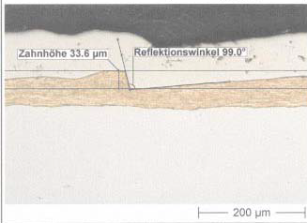
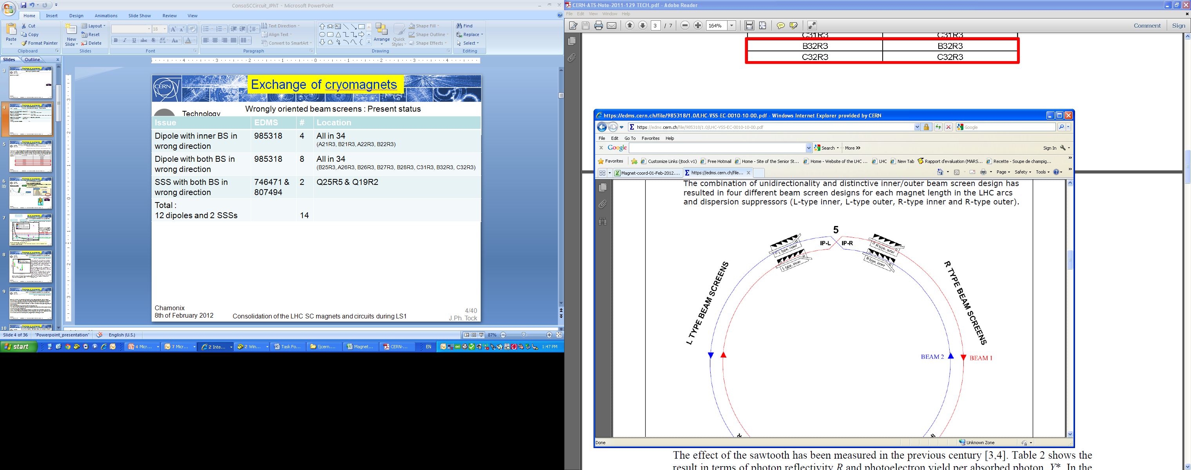
Exchange of cryomagnets with wrongly oriented beam screens
Issue | EDMS | # | Location
Dipole with inner BS in wrong direction | 985318 | 4 | All in 34 (A21R3, B21R3, A22R3, B22R3)
Dipole with both BS in wrong direction | 985318 | 8 | All in 34 (B25R3, A26R3, B26R3, B27R3, B28R3, C31R3, B32R3, C32R3)
SSS with both BS in wrong direction | 746471 & 807494 | 2 | Q25R5 & Q19R2
Total : 12 dipoles and 2 SSSs |  | 14
Figure 1: Sawtooth produced by Heraeus (courtesy I. Collins).

Slide 15
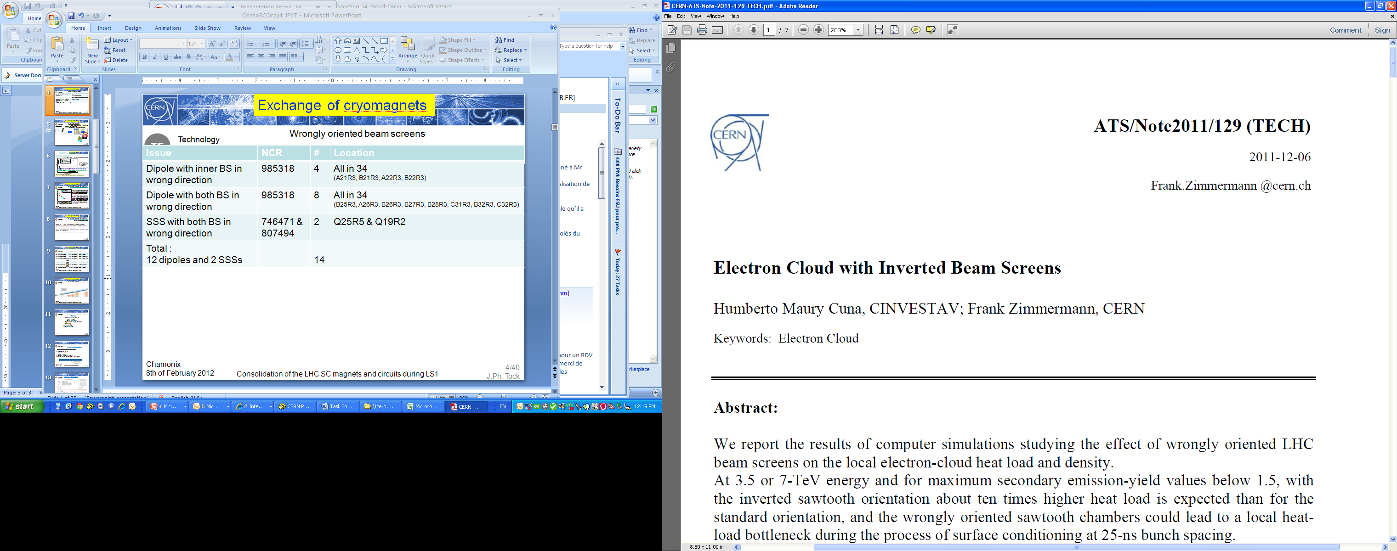
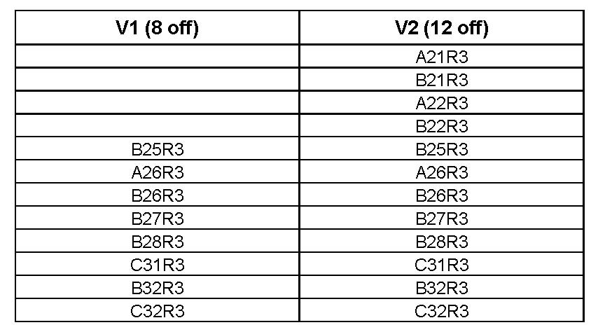
Exchange of cryomagnets with wrongly oriented beam screens
Impact was evaluated
At 3.5 or 7-TeV energy and for maximum secondary emission-yield values below 1.5, with the inverted sawtooth orientation about ten times higher heat load is expected than for the standard orientation, and the wrongly oriented sawtooth chambers could lead to a local heatload bottleneck during the process of surface conditioning at 25-ns bunch spacing
The bill
13 15 MB
1 SSS
X
Recommendation: correcting the inner and outer beam-pipe sawtooth orientation at least for two dipole magnets in cells 26 and 32 R3, so that,no half-cell will contain more than one cryodipole (out of three) with the wrong orientation of the beam screen.
Chamonix
8th of February 2012

Slide 16
Exchange of cryomagnets for beam optics reasons
As in Chamonix 2011
Wrong SSS types (S34):
[LHC-LQA-EC-0004 M Modena]
2 circuits are degraded (one is missing)
(Q23,27,28,32 R3)
  MQS: Q23,27 [with jumpers and vacuum barrier]
  MO: Q28,32
The bill
15 MB
1 4 SSS
X
Q5L8 : Warm corrector installed (78)
RCBCHS5.L8B1 NC 831927
To be replaced by a new Q5 L8
Baseline:
Replace Q23, Q27 R3 (first priority)
Replace Q5 L8 (second priority)
Postpone replacement of Q28 & Q32 R3 to LS2 if need confirmed
Chamonix
8th of February 2012

Slide 17
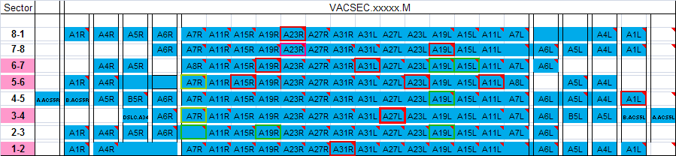
Exchange of cryomagnets because of leaks ?
The bill
15 MB
4 SSS
For each leak, the subsector is localised
Experience so far has shown that it was always possible to repair in-situ, without exchanging
Only one really non acceptable leak (sector 34)
All known leaks will be searched and fixed if possible
Chamonix
8th of February 2012

Slide 18
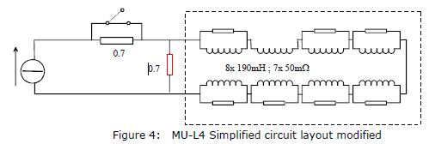
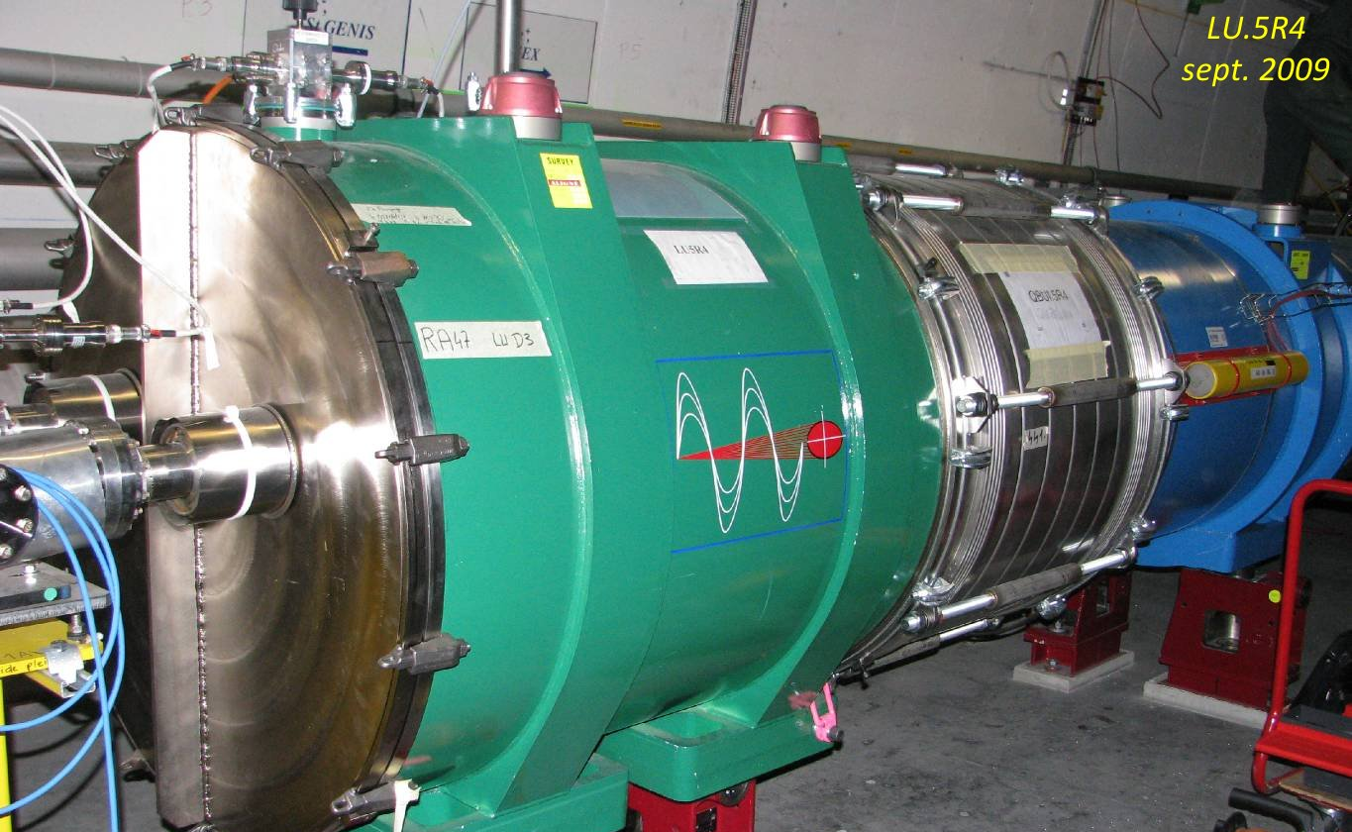
Exchange of cryomagnets : the undulator
RU.L4 | RU.R4
EC 988910: one missing resistor / External resistor added | NC 1061232 Problem with DCCT that creates a fake DIDT and a fake U_res. Inductive correction disabled in the QPS
No training quench | 3 training quenches in 2008 (422, 445, 450 A)
Operate @ 400 A | Operate @ 400 A
0.2 A/s | 0.08 A/s
The bill
15 MB
4 SSS
No undulator
Spare cold mass is available
Cryostat components under procurement for cold test in SM18
Universal spare will be available
Extensive testing in 2012
Impact on operation to be assessed by BE
Decision on replacement to be taken in 2012, before LS1
Chamonix
8th of February 2012

Slide 19
Exchange of cryomagnets: Summary
Reason | dip | SSS | Tot | Remark
High inner splice R | 8 | 1 | 9 | For possible low mechanical strength (2336-2395)
Damaged QH circuit | 4 | 0 | 4 | 7 in total but 3 can be repaired in-situ (IFS)
Wrongly oriented BS | 2 | 0 | 2 | Out of 12 dip and 2 SSSs
Restore RQS in 34 | 0 | 2 | 2 | EDMS 103939 (Q23 & 27R3)
Low voltage withstand | 1(0) | 0 | 1(0) | 1.6 kV instead of 1.9 kV, maybe in-situ repair : beginning of LS1
Replace RCBCHS5.L8B1 | 0 | 1 | 1 | Q5 L8 / NC 831927 / 2nd priority
Leaks | 0 | 0 | 0(1) | Hopefully repairable in-situ or acceptable
Undulator | (1) | 0 | 0 | To be decided in 2012
 | 15 | 4 | 19
New
New
New
The bill
15 MB
4 SSS
19 cryomagnets

Slide 20
Exchange of cryomagnets: Preparation of spares
Problem type | # | Assigned (Ready)
DIPOLES
Electrical | 5 | 5 (4)
Beam Screens | 2 | To be assigned by MEB
Inner Resistance > 15ȠΩ | 8 | To be assigned by MEB
TOTAL | 15
QUADRUPOLES
No MQS | 2 | 2 (Cold Test to perform)
Q5.L8 | 1 | To assembly
Q7.R3 (Inner Res 26.9ȠΩ) | 1 | To assembly
TOTAL | 4
Dipoles
Spares: | 44 | A type: | 21
 |  | B type: | 23
Tested OK: | 33 | With cryostat: | 25 | A type: | 14
 |  |  |  | B type: | 11
 |  | Without cryostat: | 8 | A type: | 3
 |  |  |  | B type: | 5
 |  | Ready to cold test: | 2 | A type: | 1
 |  |  |  | B type: | 1
 |  | To be repaired: | 9 | A type: | 3
 |  |  |  | B type: | 6
Dipoles: 7 A type – 8 B type
Quadrupoles:
Q5.L8 and Q7.R3 are being assembled
230 (with MQS) is cryostated, to cold test
233 (with MQS) is repaired, to be cryostated
Courtesy A Musso(TE-MSC-CMI

Slide 21
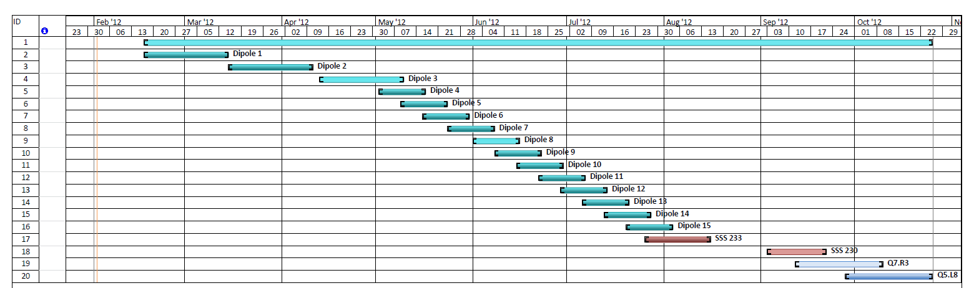
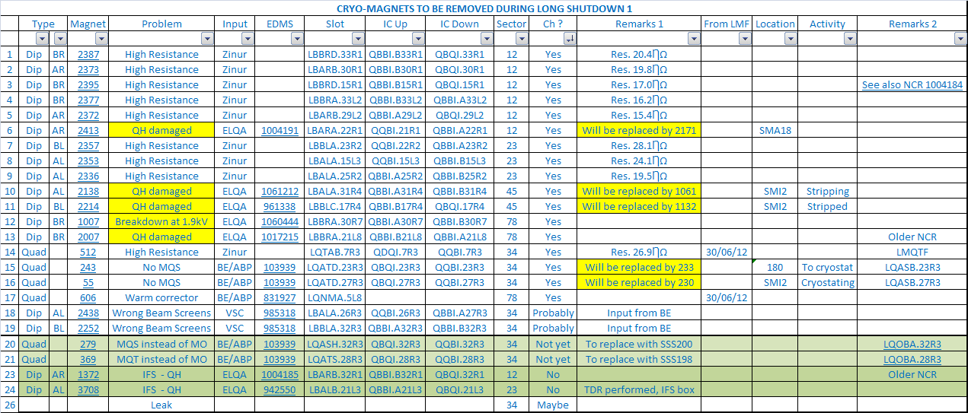
Exchange of cryomagnets: SMI2 schedule (2012)
Groups: TE-MSC / TE-VSC
15 Arc-Dipoles
2 Arc-SSS
2 MS-SSS
Undulator not included
Cryomagnets coordination workspace : https://espace.cern.ch/cryomagnet-coordination/default.aspx
Courtesy A Musso(TE-MSC-CMI

Slide 22
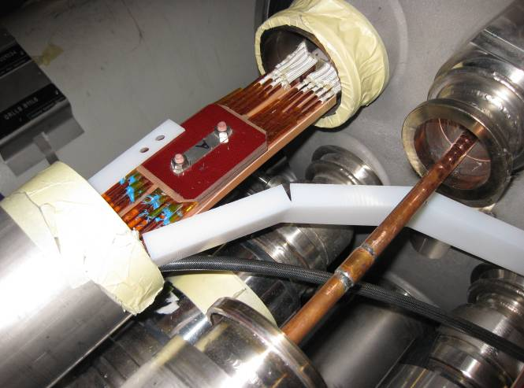
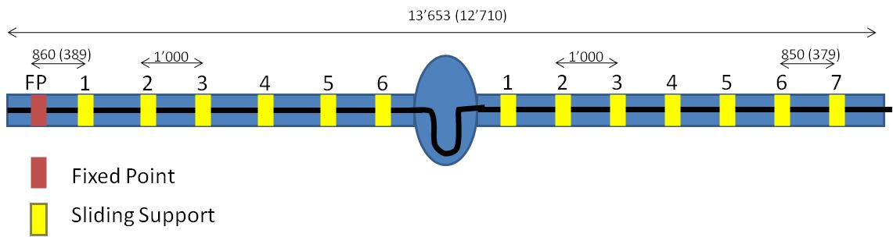
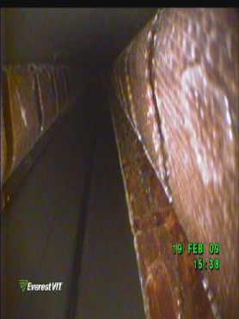
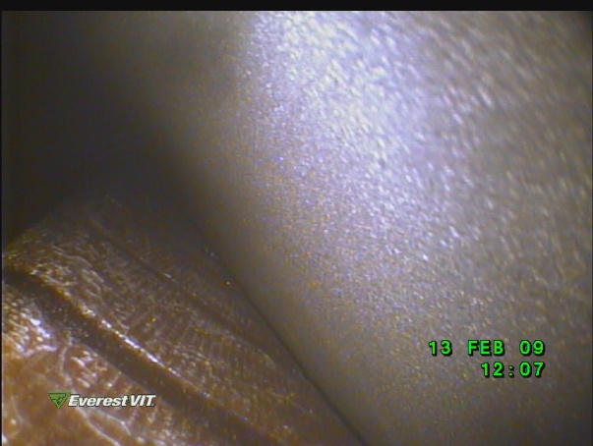
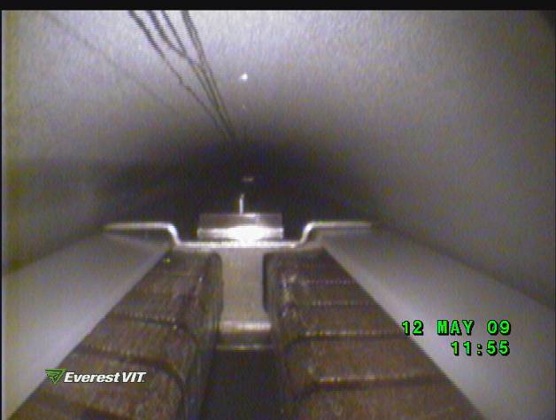
Consolidation of the connection cryostats
Details in ECR: LHC-LE-EC-0003
The proposed plan is :
Measure and if necessary consolidate the CC 11L8
Consolidate the CC in 11L3 & 11L1
Measure / inspect all the CCs to check no displacement
No info on 11L8 !
Risk of short to ground on main BB due to supports displacement
Addition of extra insulation to go up to ultimate energy
Chamonix
8th of February 2012

Slide 23
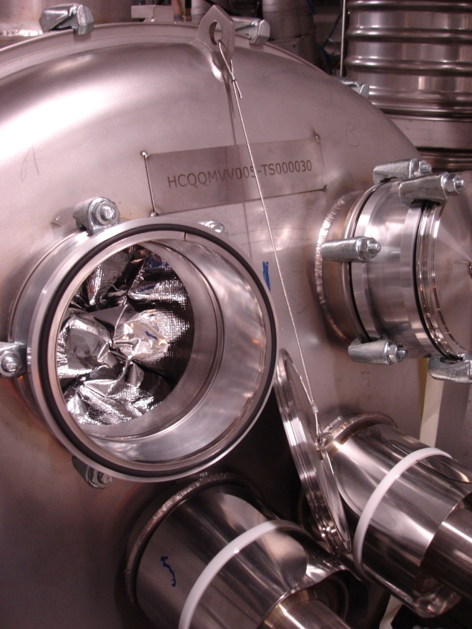
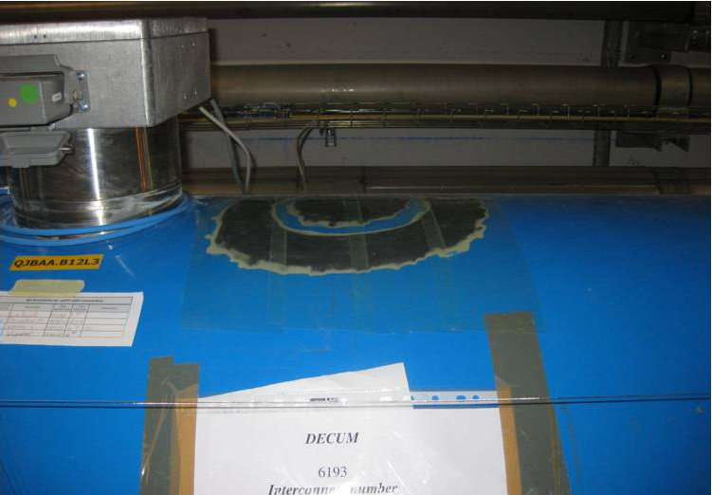
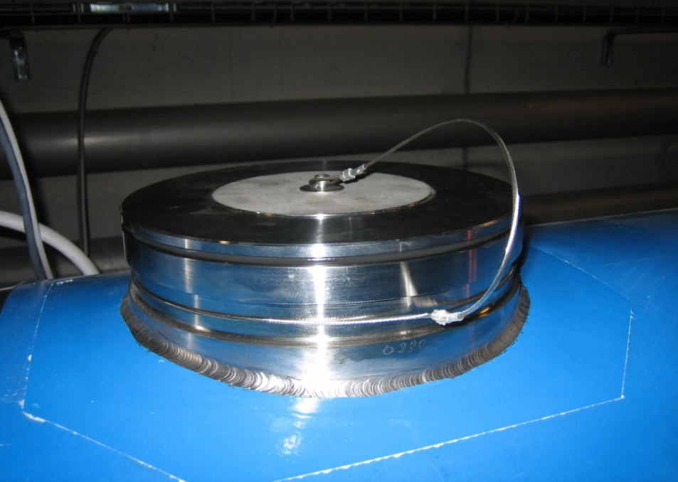
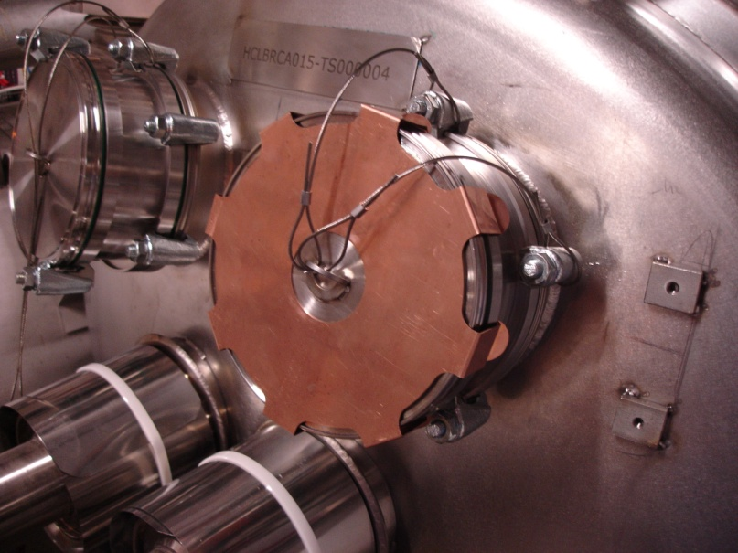
Installation of the remaining pressure relief devices (DN200/160)
To be installed on cryodipoles (DN200) during next shutdown in 23, 45 (part), 78 & 81: ≈ 600 units and on 2 SAM (DN160)
Self reclosing valves will be installed
(See M Jimenez’s presentation)
Chamonix
8th of February 2012

Slide 24
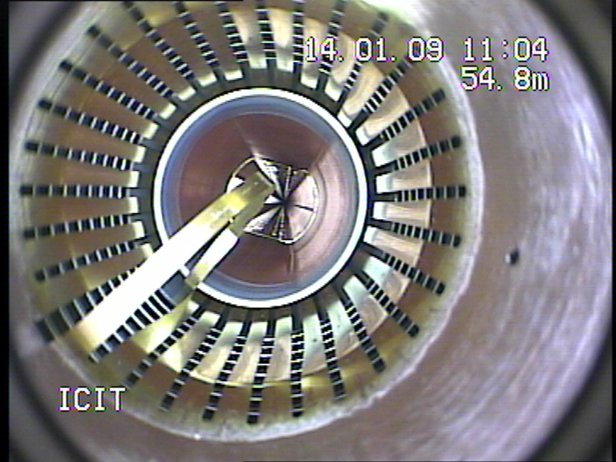
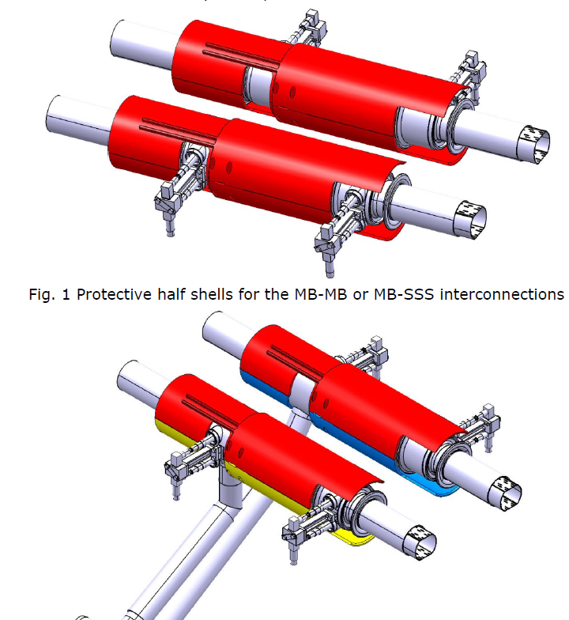
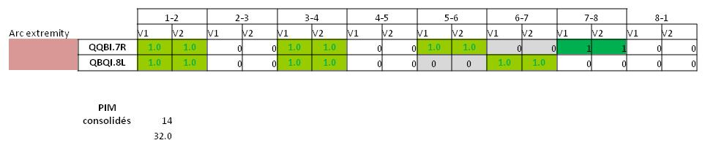
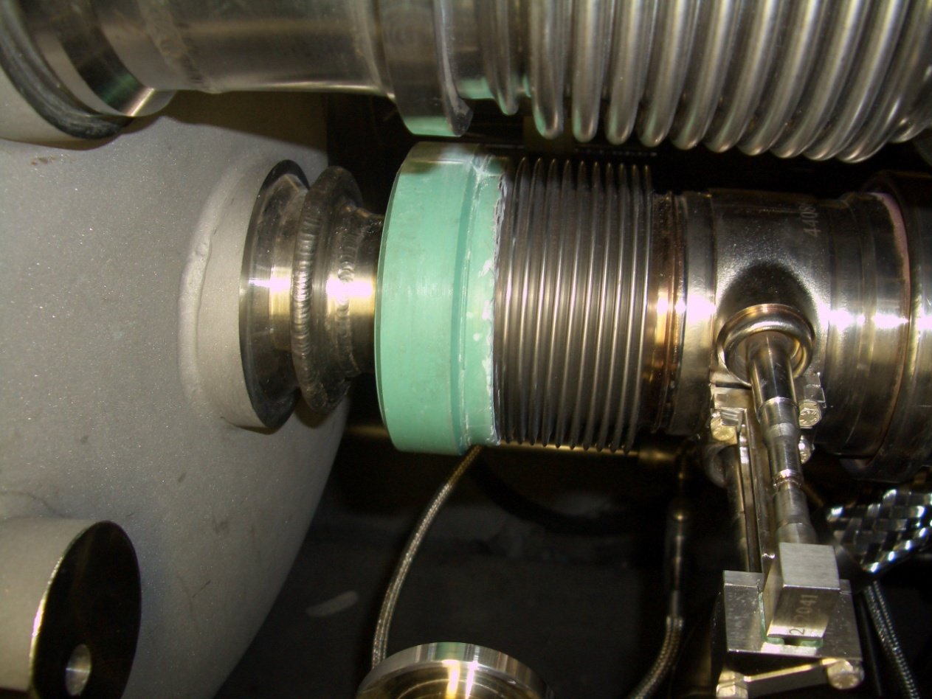
In-situ repair :
Installation of beam lines protection shells
PIMs :
Tot about 45
Details in ECR: LHC-QBBI-EC-0001
Buckled during warm-up : based on last warm-up after SSS displacement :
≈ 14-18 (RF ball test)
Heavily damaged : ≤ 10
Preventive replacements :
  + Arc extremities 18/32 in baseline
Nested bellows : None planned
Inspection at the opening of the interconnections
Chamonix
8th of February 2012
QBQI.10L5, NCR 831037, nested bellows V2
Courtesy C Garion (TE-VSC)

Slide 25
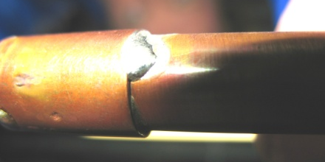
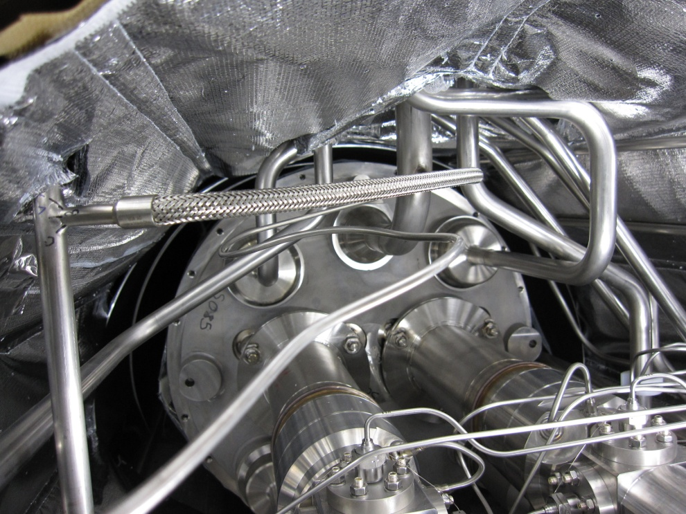
In-situ repair :
Leaking Y-lines
Consolidation of SAM Helium level gauges
Details in ECR: LHC-LQN-EC-0001
It is planned to consolidate the 2 known cases (S78:17-19R7 & S81:19-22R8)
It is planned to consolidate the 2 last ones: Q6R2&L8 [Support from MME]
Chamonix
8th of February 2012

Slide 26
Known Circuits Issues
References Chamonix 2011:
“Which systems (except main circuits) should be commissioned/tested for 7TeV operation before the long shutdown?”, M Pojer
“What needs to be done to reach beam energy above 3.5 TeV? Commissioning of essential magnet powering and machine protection systems.” N Catalan Lasheras
Circuit | Issue | Action LS1 | Remark
RD2.R8 | 4 training quenches up to 6.8 TeV eq. | None
RQ4.L8 | 7/8 quench heaters Can be used as is | None | NC 832580 & 1020189
RQX.R1 | Weak insulation on QH | Intervention in-situ by QPS team? | NC 1017174/ Increase C / decrease V to get the same protection level
RCO.A78B2 | Resistive splice | Investigation and possible repair in-situ by SIT | NC 1029807 Quenched @ 55A Condemned presently
RCO.A81B2 | CL and coil resistance | Investigation and possible repair in-situ by SIT | NC 955048 Open between B12L1 and B11L1 Condemned presently
RQT12.R7B1 | R > nom, increasing | Dedicated test, and possible repair | NC 1027412, to monitor
RQTL10.R7B1 | R > nom, increasing | Dedicated test, and possible repair | NC 1026729, to monitor
RCBCHS5.L8B1 | R = 22 nOhm (too high) | Cryomagnet will be replaced | NC 831927 (See previously)
RCOSX3.L1 | Circuit open | Investigation and possible repair in-situ by SIT | NC 948545
Chamonix
8th of February 2012

Slide 27
Known Circuits Issues
Courtesy M Pojer
Training (2-quenches rule was introduced to shorten commissioning)
    RCD.A45B1 - NC 1035252 - quenched twice (at 300 and 391 A); limited to 400 A
    RCD.A56B2 - NC 1026728 - quenched twice (at 479 and 496 A); limited to 450 A
    RCD.A81B1 - NC 1043522 - quenched twice (at 351 and 484 A); limited to 450 A
    RQTL11.L2B2 - NC 1020622 - quenched (544.85 A); limited to 500 A
    RQTL11.R5B1 - NC 1027448 - quenched twice (at 501 and 492 A); limited to 450 A
    RQTL11.R5B2 - NC 1027413 - quenched twice (at 550 and 533 A); limited to 450 A
    RQTL11.L6B1 - NC 1026809 - long training (353, 292, 340, 350, 384 A); limited to 300 A
    RQTL11.L6B2 - NC 1026747 - long training (267, 348, 384, 354, 382 A); limi); limited to 200 Ated to 300 A
    RQTL8.L7B1 - NC 1046464 - quenched twice (at 240 and 257 A
    RQTL9.R3B2 - NC 1046992 - quenched at 359, 399.9 and 396.1 A; limited to 400 A
    RQT13.L5B1 - NC 1060679 - this magnet shows a strange behavior; I_PNO reduced to 400 A
    RCBCV5.R5B2 - NC 1029792 - quenched twice (at 69.4 and 76.9 A); limited to 72A
    RCBCH7.R3B1 - NC 1046994 - quenched twice (at 98 and 95 A); limited to 80 A
    RCBYH4.R8B1 - NC 1051795 - quenched at 55.6 A; limited to 50 A
    RCBYV5.L4B2 - NC 1049055 – 3 quenches w.o. training (63.3, 65.7 and 64.7 A); limited to 50 A
    RCSSX3.L1 - NC 1053719 - the circuit trips when it reaches 62.9 A; this has been proven 4 times (circuit is now locked)
    RCBYHS5.R8B1 - NC 1063839 - circuit quenches when coming down from +-nominal current to zero; the control of the current also shows high instability (see EDMS 1053978)
    RCBYHS4.L5B1 - NC 1053709 - circuit can not handle di/dt : weak magnet known since 2008 (see MP3 meeting 4/11); tested with reduced I_PNO up to 60 A and OK so new I_PNO defined at 50 A
600 A
RQTL8.L7B1 showed detraining:
+ 300A/245A in 2008, 240A/257A in 2009
80-120 A
Chamonix
8th of February 2012

Slide 28
Known Circuits Issues
Courtesy M Pojer
Splices, shorts and open circuits (investigations to be carried on)
    RQT12.R7B1 - NC 1027412 - high splice resistance after PNO test
    RQTL10.R7B1 - NC 1026729 - magnet resistance slightly outside limits (202nΩ per splice) and increasing from last year
    RCBCH6.L2B2 - NC 1020424 - cold part of the circuit appears too resistive (about 10 mΩ)
    RCBCV6.L2B1 - NC 1020423 - cold part of the circuit appears too resistive (about 10 mΩ)
    RCBCH7.L2B1 - NC 1084848 - slightly high resistance measured (3.04mΩ instead of 3mΩ) RCBCV7.L2B2 - NC 1084849 - slightly high resistance measured (3.04mΩ instead of 3mΩ)
    RCBH31.R7B1 - NC 1017094 - the Hi current lead resistance (DFLDS.31R7.2) is too high (1.14e-3 Ω) and coil seems to be too resistive
Chamonix
8th of February 2012

Slide 29
Known Circuits Issues
Strategy :
Test circuits before LS1 to identify real limitations to go to 7 TeV
Perform extra diagnostics at cold and at warm
Define real operation requirements for these circuits
Repair if possible and needed
Add warm corrector (As done in 5L8) if possible
NB Exchange of more cryomagnets will be almost impossible
A lot of work !
Unknown Non-conformities
Chamonix
8th of February 2012

Slide 30
Organisation Chart
Long Shutdown 1
F. Bordry
Consolidation of the superconducting magnets and circuits: JPh Tock
Open/Close IC [DN200]
A Musso (X) #30
Main arc splices cons. “The train”
F Savary (H Prin) #52
Quality Assurance
R Ostojic (X) #39
Opening/ Closure of IC
Partial and complete
W bellows & ther. shields
Installation of DN200
Electrical QC: #17
C Scheuerlein (P Thonet)
Welding QC: JM Dalin # 6
Beam vacuum QC: C Garion #6
Open/close IC QC: D Bodart #6
QA manager support : M Struik
Audits (TBD)
Sleeves cutting (JM Hubert)
BB surfacing (M Dumas)
Shunt installation (M Pozzobon)
Insulation (M Parent)
Splice de-&resoldering [15%]
(D Etiembre / L Favier)
Special interventions “SIT”
N Bourcey (G Maury) #15
Cryomagnets exchange
Connect. Cryostat cons.
PIMs
Specific issues
Heavy NC
TIG welding [EN-MME] S Atieh (X) #18
ELQA [TE-MPE]
K Dahlerup
(G D’Angelo) #23
Leak Test [TE-VSC]
P Cruikshank (X) #19
- Orbital & manual
DFBA [TE-CRG]
A Perin (X) [#12 (TBC)]
Continuity
HV test
Beam lines
Cryogenics lines
Insulation vacuum
Splices and BB
Project Office M Pojer (X) #11
Radiation protection
Safety, Access
General logistics
Pressure test
Coordination with
Survey, BLM, Instrumentation, Transport, LS1 planning, QPS, cryogenics,…
Test teams on a chain of IC
Reporting tools
Chamonix
8th of February 2012

Slide 31
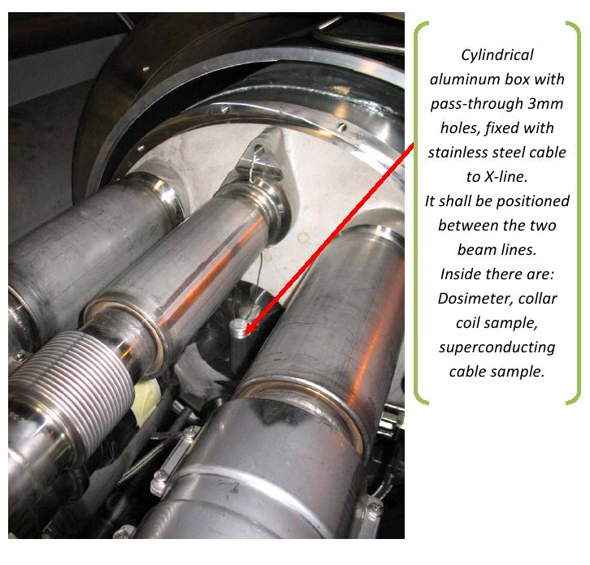
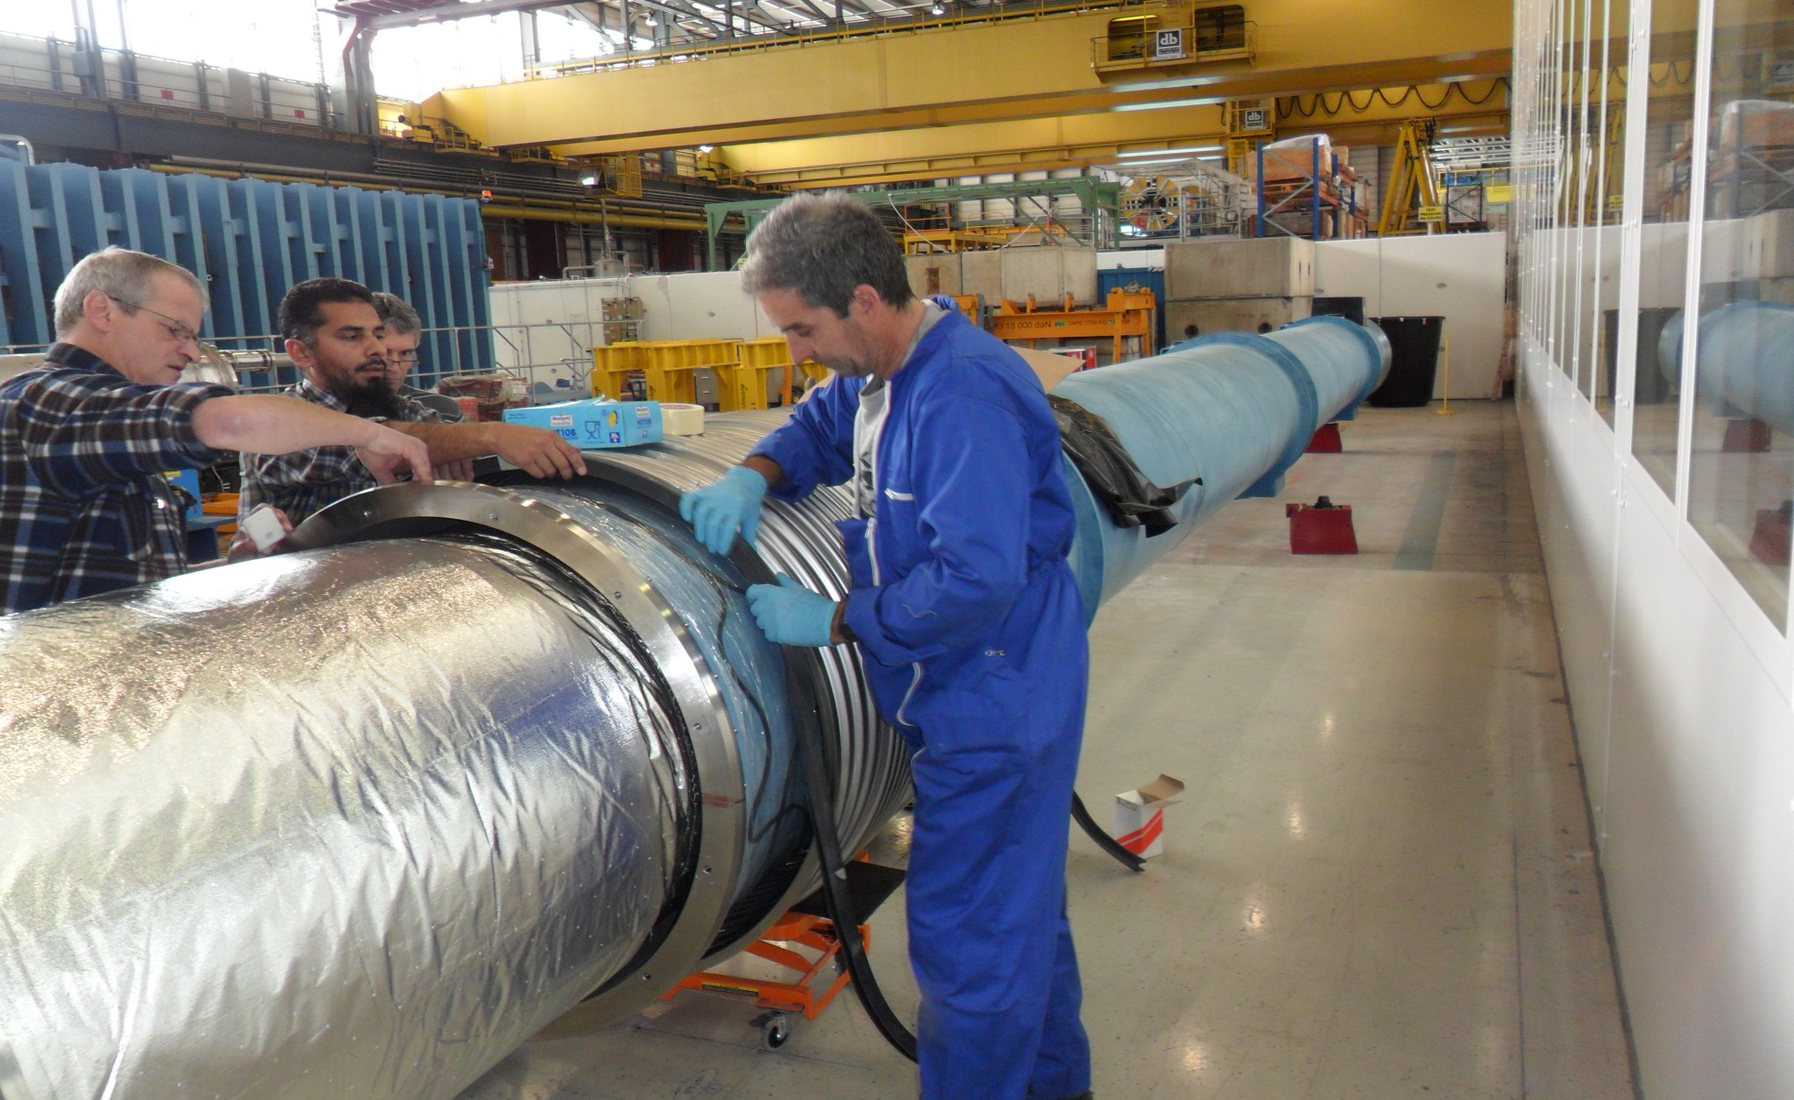
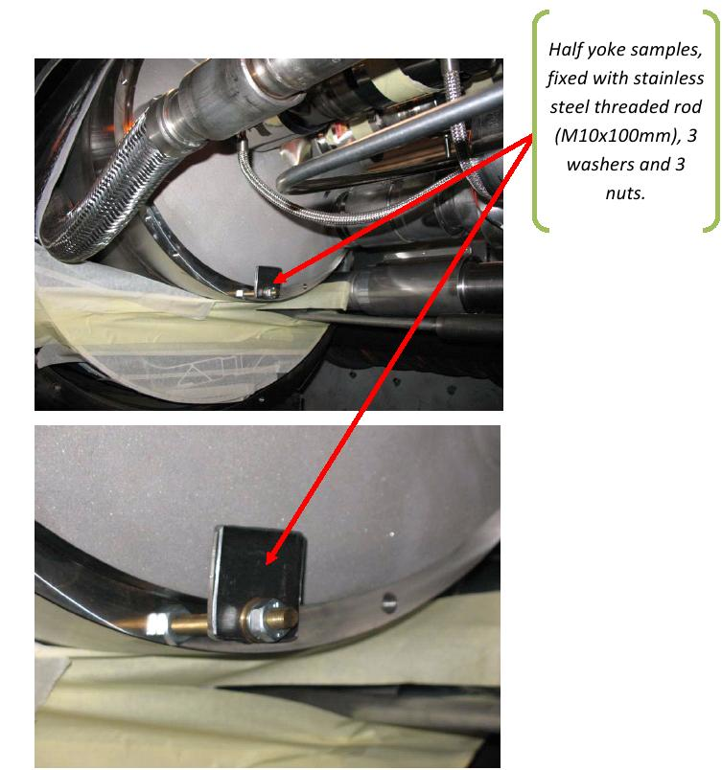
Detailed roles
Open interconnections for :
  Consolidation of main splices
  Installation of DN200
  Partial opening first
  Recovery of RP samples (LHC-LI-EC-0001)
  Support to special interventions
Install DN200 (3,5 sectors)
Reclose interconnections
Open/Close IC [DN200]
A Musso #30
Opening/ Closure of IC
Partial and complete
W bellows & ther. shields
Installation of DN200
Chamonix
8th of February 2012

Slide 32



Main arc splices cons. “The train”
F Savary (H Prin) #52
Detailed roles
Sleeves cutting (JM Hubert)
BB surfacing (M Dumas)
Shunt installation (M Pozzobon)
Insulation (M Parent)
Splice de-&resoldering [15%]
(D Etiembre / L Favier)
Local activities (on one IC)
Desoldering / Resoldering is an optional action :
15 % of the splices based on strict criteria: + R @ 1.9K
+ R_8 @ RT
+ Geometry [Shunt install-ability]
+ Visual inspection
Chamonix
8th of February 2012

Slide 33

Main arc splices cons. “The train”
F Savary (H Prin) #52
Detailed roles
Sleeves cutting (JM Hubert)
BB surfacing (M Dumas)
Shunt installation (M Pozzobon)
Insulation (M Parent)
Splice de-&resoldering [15%]
(D Etiembre / L Favier)
Under TE-MSC-MNC responsibility during LS1
Developments by LMF, training and transfer of know-how in 2012
Chamonix
8th of February 2012

Slide 34



Main arc splices cons. “The train”
F Savary (H Prin) #52
Detailed roles
Sleeves cutting (JM Hubert)
BB surfacing (M Dumas)
Shunt installation (M Pozzobon)
Insulation (M Parent)
Splice de-&resoldering [15%]
(D Etiembre / L Favier)
QC
Visual inspection, photos
R_RT-top-side
R_8/R_16
27120 in the arc interconnections
Chamonix
8th of February 2012

Slide 35


Detailed roles
TIG welding
[EN-MME-AF]
S Atieh (X) #18
Welding QC
[EN-MME-MM]
JM Dalin # 6
All TIG welding
-orbital and manual
    -all lines (M mainly)
Ensure availability and maintenance of tooling
Qualification of welders
Coordination of the team
Provide support to DFBA team
Provide support to special team
(SAM, …)
And its associated QC
Visual inspection
Audits
Off-line samples
…
Chamonix
8th of February 2012

Slide 36

Detailed roles
Special interventions “SIT”
N Bourcey #15
Was covered in previous slides
Polyvalent team
Will intervene on heavy NC to avoid slowing down the work of the main train
Cryomagnets exchange
Connect. Cryostat cons.
PIMs
Specific issues
Heavy NC
DFBA
A Perin [#12 (TBC)]
Splices and BB
SHM to HCM connection
CL (pigtail) to busbar connection
For the 16 DFBA, a first analysis shows that the splices in 14 of them can be consolidated "in situ". SHM-HCM splices of two DFBAs (1 in DFBAP and 6 in DFBAK) cannot be accessed "in situ" for consolidation.
Chamonix
8th of February 2012

Slide 37
Detailed roles
The QA manager will:
Coordinate QA activities
Ensure that an adequate level of Quality Assurance is applied, especially in terms of traceability (MTF) and documentation
Ensure a timely management of the non-conformities, minimizing the impact on the overall schedule
Ensure that production parameters are analysed in time to give an early warning in case of drift.
Identify as early as possible critical issues that could jeopardize the consolidation work
Quality Assurance
R Ostojic #39
Electrical QC: C Scheuerlein #17
-Welding QC: JM Dalin
Beam vacuum QC: C Garion
Protection and inspection of Bellows, PIMs
Endoscopy of beam lines
Open/close IC QC: D Bodart
Visual inspection
Protection of critical surfaces
-QA manager support
Tooling, inspection, reporting
-Audits
Leak Test [TE-VSC]
P Cruikshank (X) #19
ELQA [TE-MPE]
K Dahlerup
(G D’Angelo) #23
Beam lines
Cryogenics lines
Insulation vacuum
Continuity
HV test
Chamonix
8th of February 2012

Slide 38
Start at P5 / clockwise
5
4
6
Cryo-dipole
SSS
High inner splice
Highest leak
Electrical integrity issue
Critical reversed beam screen
3
Beam optics
7
SAM (He, DN160)
Y-lines repair
CC Consolidation / Inspection
DN 200 installation
Triplet braid (End of LS1 for rad prot)
Circuit and splices issues
Spread all around : work on leaks, PIMs,
2
8
1
Goal : Special interventions completed before the train arrives : To be checked
Chamonix
8th of February 2012
38/40
J.Ph. Tock

Slide 39

Global Planning
Rate: 4 weeks for each activity so 53 IC/week
Dimensioned to 60 IC/week: 10% margin
Remember : Series installation at 30 IC/week !
Preliminary powering tests
Warm-up
Opening
Splice consolidation
(incl. internal leak tests)
Closure
Leak tests (Ins vacuum)
Preparation for cool-down
Cool-down
ELQA@cold
Powering tests
14 months
Consolidation of main splices in 4 sectors in parallel (13 km)
1st sector cold tested (2nd one), one year after the start of LS1 !
Courtesy K Foraz

Slide 40



Detailed schedule
Courtesy R Principe
Chamonix
8th of February 2012

Slide 41

Courtesy : A Musso : Project Responsible
J Pereira Lopes: Implementation & S/W development
APRIL 2012 :
Database design and performance study
JULY 2012
Web setup and programming
AUGUST 2012
Test and debugging
SEPTEMBER 2012
Code revision and training
NOVEMBER 2012
Production
Web interface from LHC tunnel during LS1 allows:
  Real-time tasks advancement recording (easier coordination)
  Team and tooling traceability for each single task
  Fast reaction in case of NCR’s
  MTF traceability when needed
WISH during LS1 requires:
  3G data connection (checked with IT experts, this is the best in terms of speed, cost, installation time)
  Tablets (or laptop) for team leaders
  Website specification (work already started)
http://www.youtube.com/watch?v=kVnYkJg-0Rk
Chamonix
8th of February 2012
IT infrastructure needed
Minimum:

Slide 42
Resources
Current estimate for IC/magnet work (IC train, SIT, DN200):
  ~220 persons needed (was ~200 in Chamonix 2011 !)
  + 12 for DFBA, +5 for TIG welding, -3 DS Coll, + 1 (+2 mag exch), +X due to update of procedures, …
  ~80 % are identified (but not all at CERN and experienced)
  Still unknowns (DFBA, NC, undulator, open issues,…)
One collaboration (#39) with a NMS was identified but is reducing to 12 (TBC)
  27 persons to find (Other collaboration or FSU)
Contribution from CERN groups outside TE under finalisation (Keep commitment) and also from other TE groups (EPC, VSC, MPE, CRG,…)
  BE-OP
  EN-MME
Chamonix
8th of February 2012

Slide 43
Resources
LHC LS1
SC magnets
(#220)
EN
(#24)
BE
(#15)
TE
(#134)
PH
(#7)
Not ID
(#40)
Chamonix
8th of February 2012

Slide 44




Open issue : The spider insulation
Courtesy H Prin
More info: LHC Splices Review 2 : https://indico.cern.ch/conferenceDisplay.py?confId=157231
?
Risk if BB insulation is damaged
Implementation
Heating during welding (~300°C)
Friction during cooling
Fixation to the flange
Behavior during quench
Reliability in time
Remnant in the cryogenics filters
Insertion of dielectric foils between the M-Lines and the spider legs, fixed to the M-line flanges
No procedure defined yet (on-going)
Not decided yet (Splices TF)
Be sure that increase of reliability is not offset by a drawback
44

Slide 45



Open issue : The diodes
Courtesy F Savary and the diodes WG …
More info: https://edms.cern.ch/cedar/plsql/navigation.select_tree?cookie=10793751&p_node_id=1119199397&p_open_node_id=1554670541
The diode stack and its 3 contacts (dipole)
Primarily, bolted contacts with 4 M6 + helicoil, 1 washer, 5.5 Nm
Later, 4 M6 + helicoil, 4 spring washers, 10 Nm
Diode compressed to 40 kN by a stack of spring washers
R_{Bus-bus}
(‘half moon’)
Diode box, He content:∼5 l
All copper parts are
Ni-plated, 2-3 µm
except ½-moon on the magnet side that is Ag-coated, ~1 µm
Lower diode bus bar
Upper Heat Sink
R_{HS-bus}
Voltage taps on the diode
Lower Heat Sink
R_{Diode-HS}
45

Slide 46

Open issue : The diodes
Courtesy F Savary and the diodes WG …
Brief history:
High resistances measured incidentally in the diode circuits in Sector 5-6 (during the technical stops) during “Quench propagation tests”
Working Group on Diodes with members from MPE and MSC to conduct off-line (outside the LHC machine) testing of the diode leads is active since early September 2011
Reporting : 1 interim (15.11. 2011), TE-TM (5.12. 2011), LMC (7.12.2011)
Comprehensive analysis of the measurements data available from Frascati & Bloc-4 (series production) and more recently from SM18 (spare diodes and diodes from sector 3-4)
Instrumented diodes tested at 4 K in SM18 between late November 2011 and now
Chamonix
8th of February 2012

Slide 47

Open issue : The diodes
Courtesy F Savary and the diodes WG …
Chamonix
8th of February 2012
47

Slide 48
Open issue : The diodes
Courtesy F Savary and the diodes WG …
Impact on LS1:
Typical “training” behavior of the diode circuits observed in Sector 5-6 in 2011 and during the LHC construction confirmed in very recent tests at 4 K in SM18
The recent tests in SM18 show that the typical “training” behavior is a characteristic of the diode to heat sink contact. However this behavior is still not explained. This is not an issue for the LHC operation as the heat sink works fine, i.e. the T peak is limited to 180 K
The other contacts (heat sink to bus and bus to bus, i.e. ½ moon for the dipole and connection pad for the quad) work fine and show low R at cold during the tests. In the worst case the T peak does not exceed 90 K
No massive intervention during LS1, local inspections could be scheduled (beg of LS1)
Possible extra tests on cryomagnets that will be removed (TBC)
However, we will check some isolated cases, e.g. D16R5 a [Behaviour not understood yet]
Further tests :
Test of 2 quadrupole diodes fully instrumented
Test of 2 dipole diodes fully instrumented, MDA 1267 et MDA 778 already tested and stored in the mean time without specific precaution
Possibly, test of bolted contact samples (without diode stack)
Change surface conditions at the diode to heat sink contact, e.g. roughness, coating (silver-tin or gilding in lieu of nickel plating)
…
Chamonix
8th of February 2012
48

Slide 49
Open issue : The CSCM
Courtesy H Thiesen et al
At 20 K, reproduce quench conditions but without energy stored in magnet (bypass circuits)
Measure not all splices but the worst one in a sector
Requires modification of critical systems :
QPS, EE, PIC, PC
Necessary cryogenics conditions can be provided
Extremely small risk to damage a splice or a DFBA CL
Requires time and resources
Review report :
“The CSCM may be useful to qualify the upgraded 13 kA joints at the 7 TeV level. This use of the CSCM will have to be evaluated in order to understand its operation at higher current levels of 9-10 kA, than the 6kA level that have been anticipated up to this point”
Recommendations:
“Since alternatives are not present other than to accept the risk of not having tested certain parts of the circuits, the use of the CSCM to qualify entire circuits for 12-13 kA level is highly recommended “
Was reported at LMC on 7.12.2012 (R Schmidt)

Slide 50
Open issue : The CSCM
LHC Splices Review 2:
Action : TE-EPC/MPE
Rev 2 Rec 7: Consider the utility and practicality of utilizing the CSCM for periodic “requalification” tests of the main (quadrupole) bus circuit
Comment:
CSCM is not an obviously useful test if it cannot be run at full current (due to nonlinearities of the problem). But one could consider utilizing this test with the (quadrupole) bus, which can be run at full current, and in which there is less redundancy and therefore greater risk in the repaired joints (only one shunt planned). This could be done periodically over the life of the LHC. However, we don’t have sufficient information to make a definitive recommendation
Would be a possible compensatory measures for very inaccessible splices
Type test before LS1 on at least one sector
Systematic test after consolidation
Periodic test later ?

Slide 51
Open issue : The CSCM
Courtesy H Thiesen et al
Proposal :
Use this method to qualify the consolidation of the splices (And also other parts of the 13 kA SC circuits) for 7 TeV operation
And validate the whole bypass circuit
Planning:
+ Approval in March 2012
+ Type test to be done in one sector at the end of the run (4 weeks)
In sector 34 in January 2013
+ CSCM campaign at the end of LS1
+ Impact 4 weeks if 8 sectors [Could be 0 if last sector(s) not tested]
Note:
CSCM would be a tool to qualify the main SC circuits for 7 TeV operation (deviation from the original goal).
Necessary conditions to be updated

Slide 52

Open issue : Radioprotection
Courtesy C Adorisio & S Roesler
More info : LHC Splices Review 2, November 28-30, 2011 https://indico.cern.ch/conferenceDisplay.py?confId=157231
Rev 1 Rec II.5.3: The Splices Task Force should consider the potential hazards for workers associated to the utilization of lead-containing solder, and work with the Safety Commission to plan the work to minimize or eliminate this risk
Barely begun. This is important, since in the original design of the LHC the use of lead-containing solder was rejected on safety grounds
OK: Action F Savary (TE-MSC) and T Otto (DSO): On-going
Rev 1 Rec II.5.2: Radiation safety issues related to the splice repair work should be evaluated and considered in any decision to extend the current run
CLOSED (see next slide)
Aspect to be followed-up and organised:
Detailed estimates
Verification on samples
RP inspector at the opening of the interconnections

Slide 53

Open issue : Radioprotection
Courtesy C Adorisio & S Roesler
More info : LHC Splices Review 2, November 28-30, 2011 https://indico.cern.ch/conferenceDisplay.py?confId=157231
Only Radiation Workers are allowed to access the LHC tunnel and to work on radioactive equipment. Personal dosimeter is mandatory for every worker:
  Companies from Member States: as reminded in the offer, they have to follow their own national legislation in matters of Radiation Protection, that also requires a dosimeter issued by their home country.
  Institutes: they have to follow their own national legislation in matters of Radiation Protection, that may requires a dosimeter issued by their home country.
  Every worker will get a CERN dosimeter.
Any material removed from the LHC tunnel has be treated as radioactive material and has to be traced (TREC traceability system).
Despite low residual dose rates, components might become “radioactive” according to CERN regulations and dissipation or incorporation of this radioactivity must be prevented (ALARA principle):
  use methods which avoid creation of small particles or dust, e.g., (if possible) avoid grinding and similar methods:
  contain any radioactivity, e.g., by using special vacuum cleaners, by protecting work site with plastic foils, etc.
SMI2 to become a radioactive workshop

Slide 54



Open issue : New thermal shield design
Courtesy A Musso
Why ?
To avoid blockage (2008-09)
To avoid MLI ignition and fire
To minimize the intervention time now
and in the future (ALARA, $$$)
There is margin on the heat load
Goals
Minimise the welds (hence grinding)
Keep acceptable thermal performance
New connection method (hinge, snap fastener, clamp)
Thermal modeling
Test of fixation system
What’s next ?
Define new solution
Model it, test it (samples and mock-ups)
Choose the best compromise
Document it and have it approved
(ECR by March/April 2012)
54

Slide 55
CONCLUSIONS
Decisions in 2012:
  DFBA consolidation (What, How,…)
  Reinforcement of spider insulation (Yes?, How,…)
  New thermal shield design
  Known circuit non-conformities (Confirmed, How, What, Impact/Need,…)
  Undulator replacement (Yes or No)
  CSCM (Go ahead?)
  Diodes (Intervention ? Not massive)
From LHC splices review:
  (Too) ambitious schedule (12 IC/day)
  Training will be challenging (2/3)
  2012 will be a key year for preparation
  No contingency in resources and schedule
Chamonix
8th of February 2012

