Slide 1
LHC Magnet Powering
Failures in Magnet Powering as f(Time, Energy and Intensity)
Past/future improvements in main systems
Conclusion

Slide 2
LHC Magnet Powering System
Interlock conditions
24
~ 20000
~ 1800
~ 3500
~ few 100
~ few 100
~ few 100
HTS temperature interlock
~ few 100
Access vs Powering
1600 electrical circuits (1800 converters, ~10000 sc + nc magnets, 3290 (HTS) current leads, 234 EE systems, several 1000 QPS cards + QHPS, Cryogenics, 56 interlock controllers, Electrical distribution, UPS, AUG, Access)
6 years of experience, since 1st HWC close monitoring of availability
Preventive beam dumps in case of powering failures, redundant protection through BLM + Lifetime monitor (DIDT)
Interlocks related to LHC Magnet Powering

Slide 3
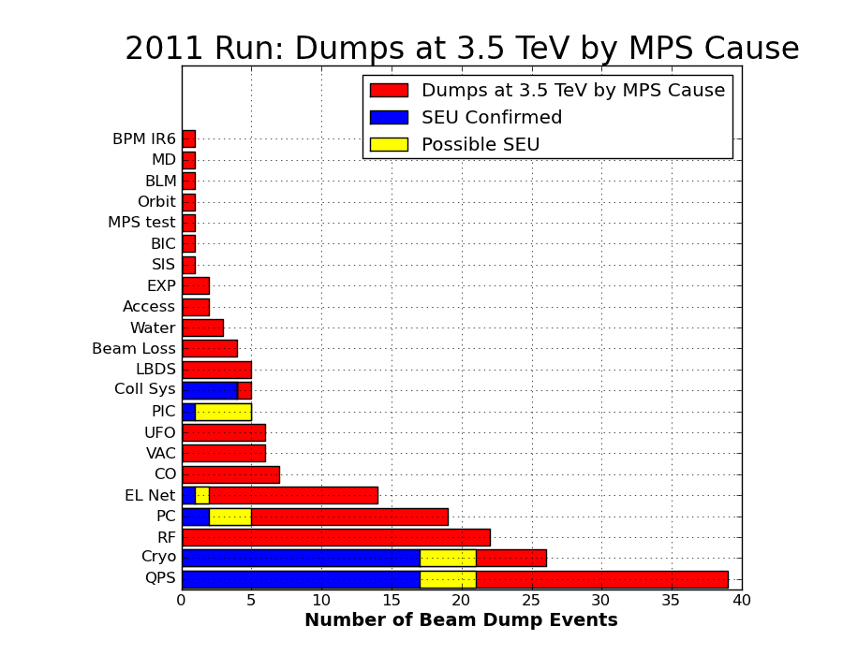
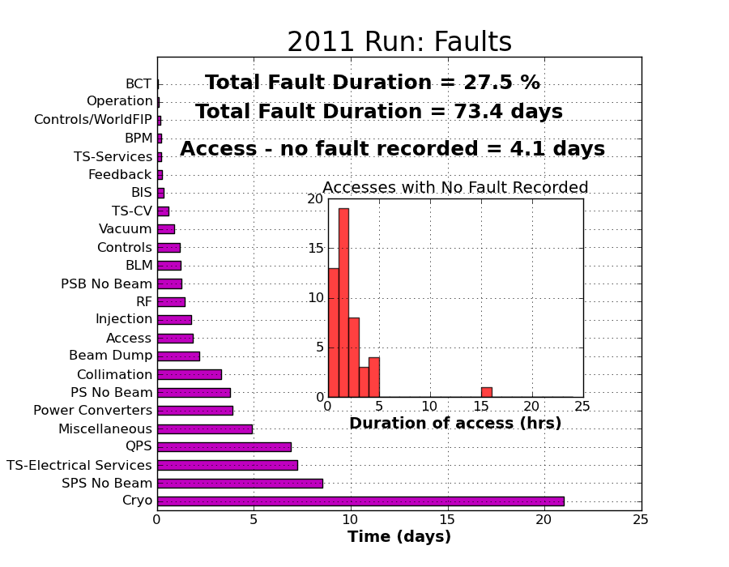
What we can potentially gain…
Magnet powering accounts for large fraction of premature beam dumps (@3.5TeV, 35% (2010) / 46% (2011) )
Downtime after failures often considerably longer than for other systems
“Top 5 List”:
    1st QPS
    2nd Cryogenics
    3rd Power Converters
    4th RF
    5th Electrical Network
Potential gain:
~35 days from magnet powering system in 2011
With 2011 production rate (~ 0.1 fb⁻¹ / day)
At 200kCHF/hour (5 MCHF / day)
Courtesy of A.Macpherson
3

Slide 4
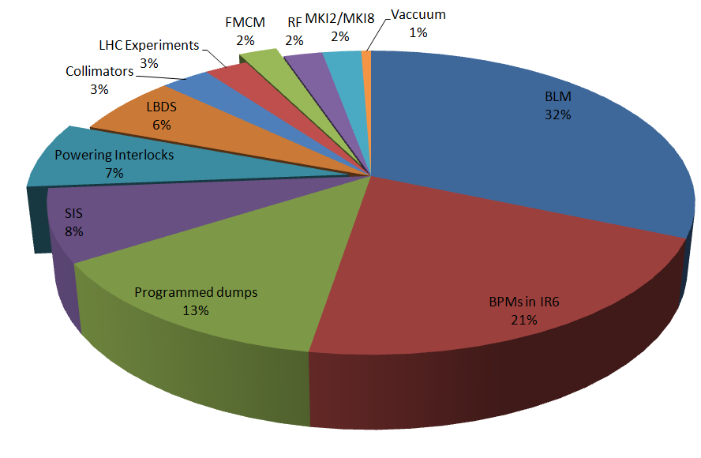
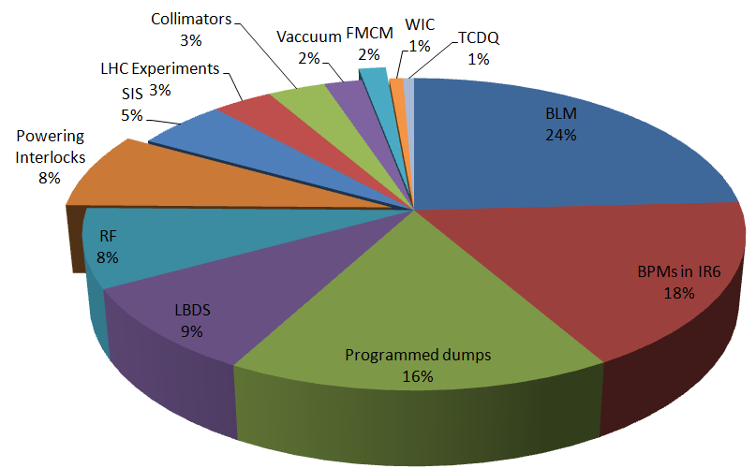
Energy dependence of faults
Strong energy dependence: While spending ~ twice as much time @ injection, only ~ 10 percent of dumps from magnet powering (little/no SEU problems, higher QPS thresholds,….)
2010
2011
@ injection twice as many dumps wrt to 3.5TeV
@ injection 20% more dumps wrt to 3.5TeV
4

Slide 5
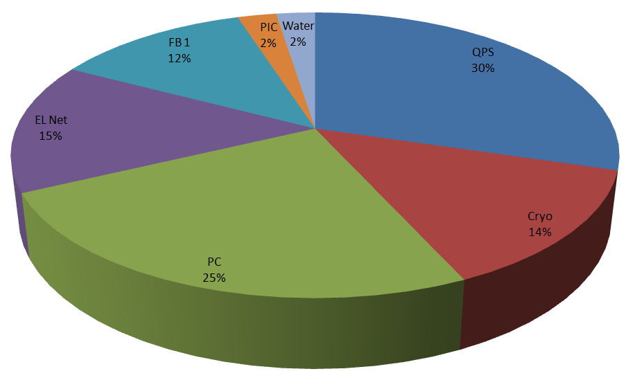
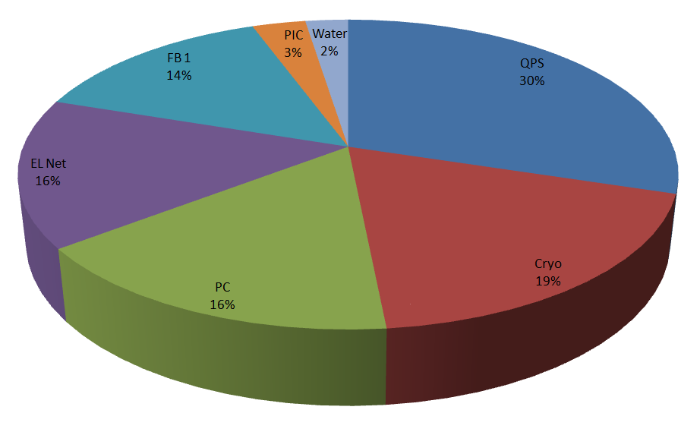
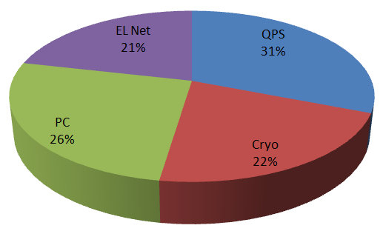
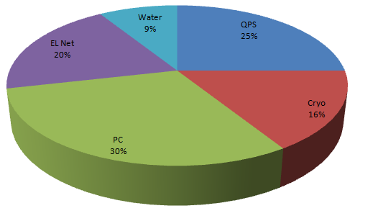
Energy dependence of faults
Dumps from Magnet Powering @ 3.5TeV
Dumps from Magnet Powering @ injection
2010
2011
@ injection: 7+2
Approximately same repartition of faults at different energies between the main players
5

Slide 6
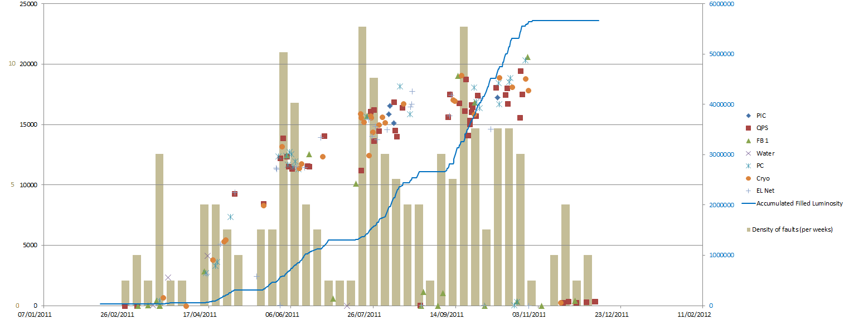
Dependence of faults on intensity
Beam Intensity [1E10 p] / # fault density
Strong dependence of fault density on beam intensity / integrated luminosity
Peak of fault density immediately after TS?
Much improved availability during early months of 2011 and ion run -> Confirm potential gain of R2E mitigations of factor 2-3

Slide 7
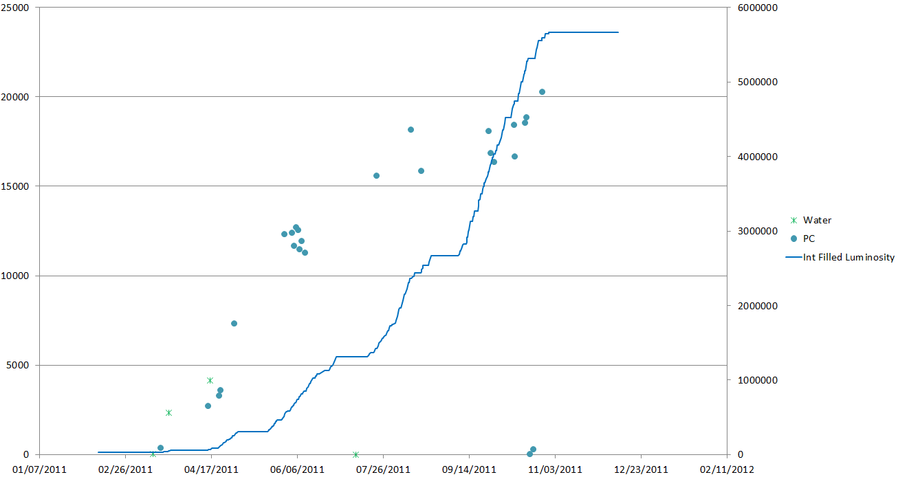
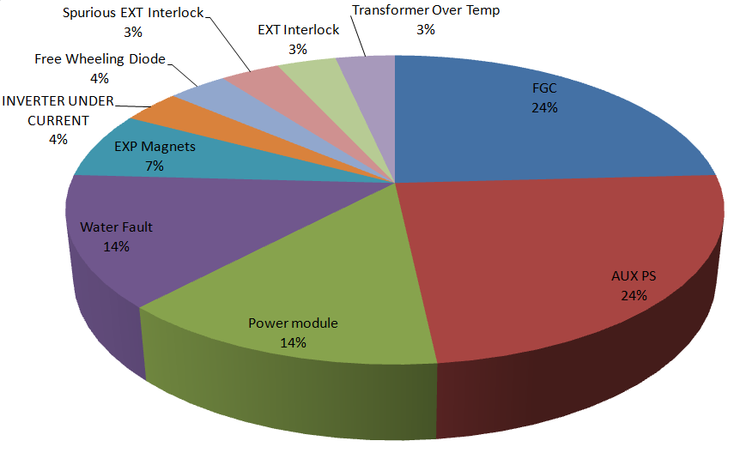
Power Converters - 2011
Several weaknesses already identified and mitigated during 2011
  Re-definition of several internal FAULT states to WARNINGs (2010/11 X-mas stop)
  Problems with air in water cooling circuits on main dipoles (summer 2011)
  New FGC software version to increase radiation tolerance
  Re-cabling of optical fibers + FGC SW update used for inner triplets to mitigate problem with current reading
Current reading problem in inner triples
Total of 26 recorded faults
(@ 3.5TeV in 2011)

Slide 8
Power Converters – after LS1
FGC lite + rad tolerant Diagnostics Modules to equip all LHC power converters (between LS1/LS2)
Due to known weakness all Auxiliary Power supplies of 60A power converters will be changed during LS1 (currently done in S78 and S81), solution for 600A tbd
Study of redundant power supplies for 600A converter type (2 power modules managed by a single FGC) also favorable for availability
Operation at higher energies is expected to slightly increase the failure rates
  Good news: Power converter of ATLAS toroid identical to design used for main quadrupoles RQD/F + ATLAS solenoid to IPD/IPQ/IT design
  Both used at full power and so far no systematic weakness identified
Remaining failures due to ‘normal’ MTBF of various components

Slide 9
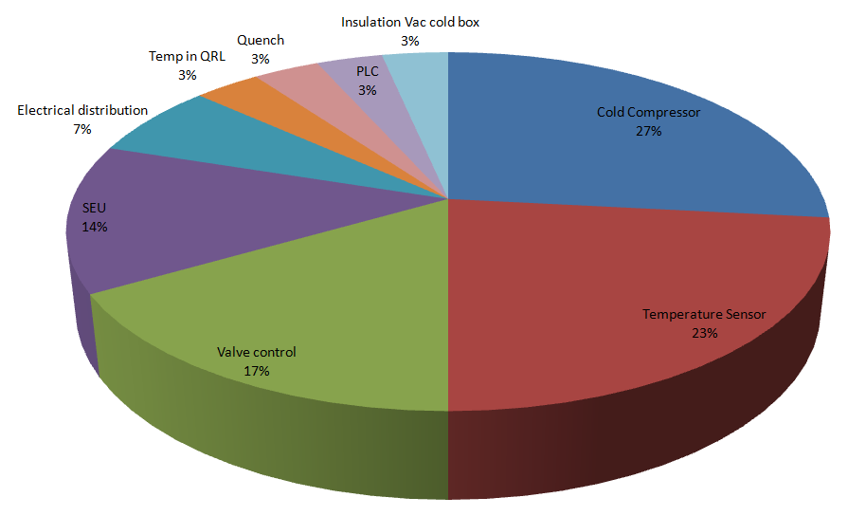
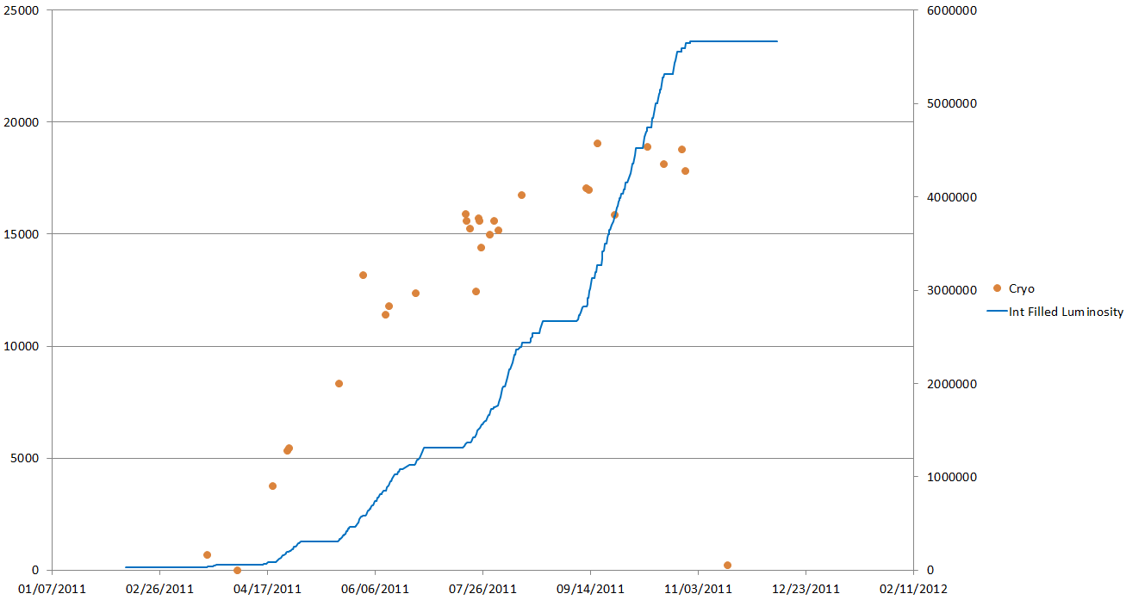
CRYO
Majority of dumps due to quickly recoverable problems
Additional campaign of SEU mitigations deployed during X-mas shutdown (Temperature sensors, PLC CPU relocation to UL in P4/6/8 – including enhanced accessibility and diagnostics)
Redundant PLC architecture for CRYO controls prepared during 2012 to be ready for deployment during LS1 if needed
Few occasions of short outages of CRYO_MAINTAIN could be overcome by increasing validation delay from 30 sec to 2-3 minutes
Long-term improvements will depend on spare/upgrade strategy
See Talk of L.Tavian
SEU problems
on valves/PLCs…
Total of 30 recorded faults
(@ 3.5TeV in 2011)

Slide 10
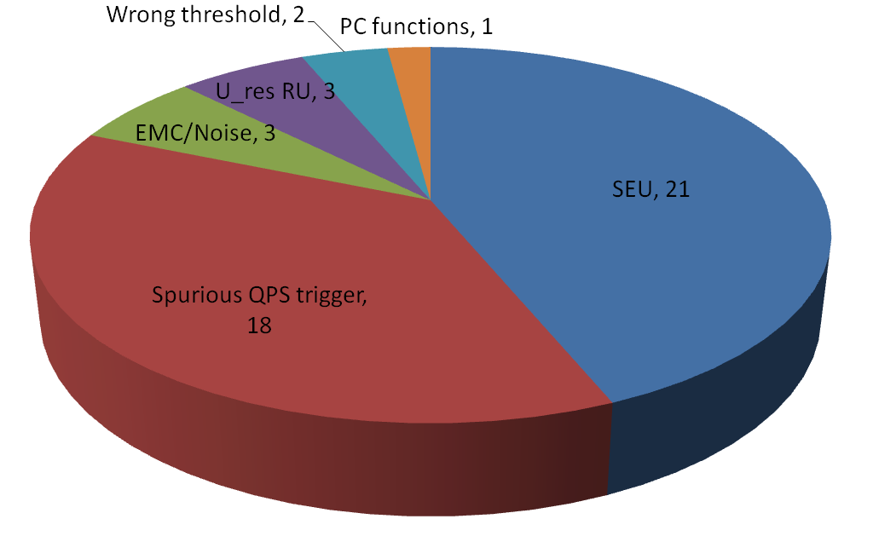
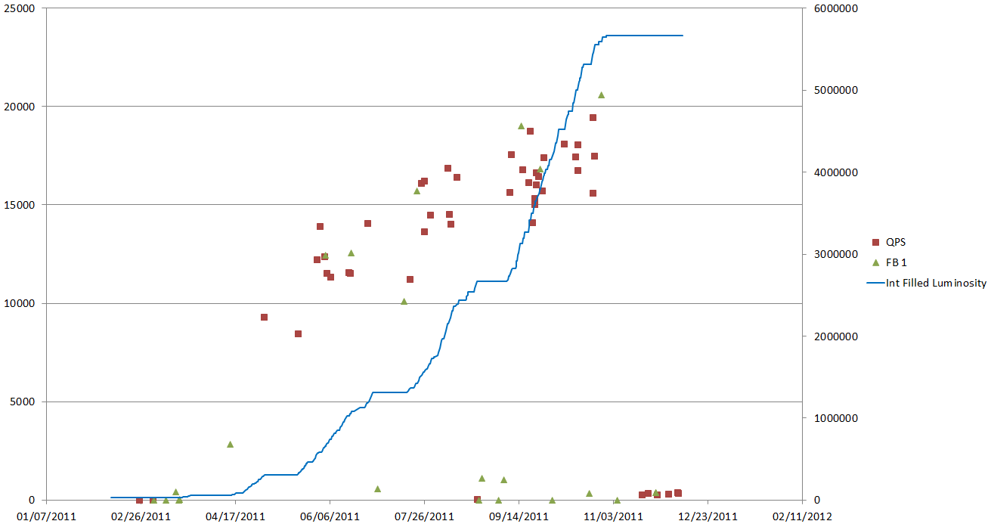
QPS
QPS system to suffer most from SEU -> Mitigations in preparation see talk R.Denz
QFB vs QPS trips solved for 2011 by threshold increase (needs final solution for after LS1)
Several events where identification of originating fault was not possible -> For QPS (and powering system in general) need to improve diagnostics
Threshold management + additional pre/post-operational checks to be put in place
See Talk of R.Denz
RAMP
SQUEEZE
Total of 48 recorded QPS faults + 23 QFB vs QPS trips
(@ 3.5TeV in 2011)
MDs

Slide 11
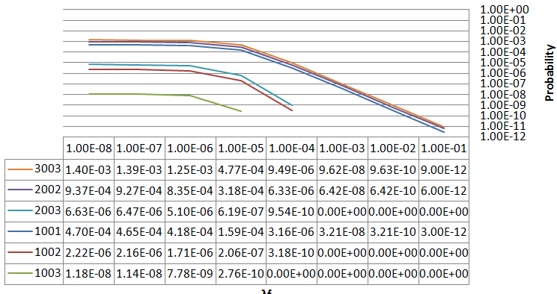
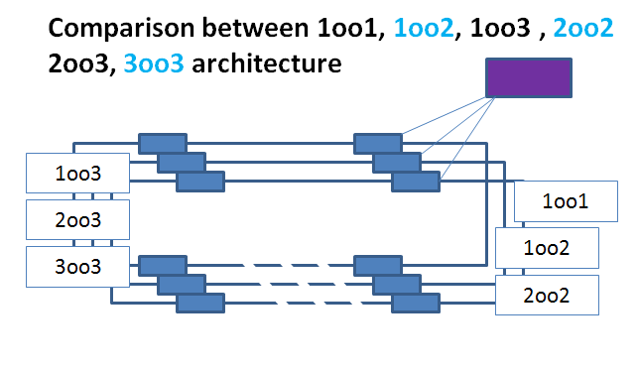
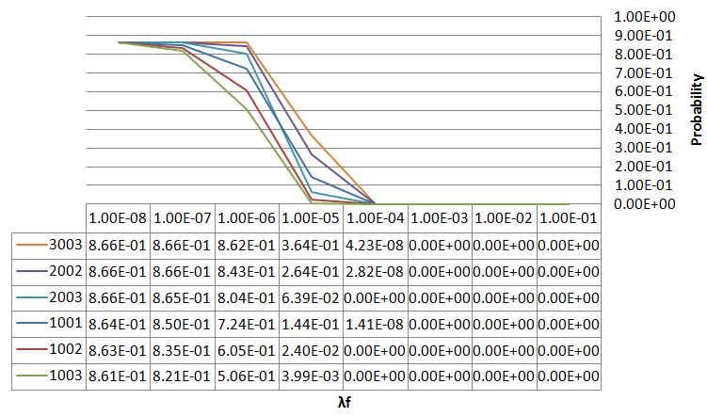
QPS
As many other protection systems, QPS designed to maximize safety (1oo2 voting to trigger abort)
Redesign of critical interfaces, QL controllers, eventually 600A detection boards, CL detectors, … in 2oo3 logic, as best compromise between high safety and availability
-> Additional mitigation for EMC, SEUs, ….
Availability
Safety
Courtesy of S.Wagner

Slide 12
Interlock Systems
Total of 5 recorded faults (@ 3.5TeV in 2011)
HTS temperature interlock
Access vs Powering
36 PLC based systems for sc magnets, 8 for nc magnets
Relocation of 10 PLCs in 2011 due to 5 (most likely) radiation induced (UJ14/UJ16/UJ56/US85)
FMECA predicted ~ 1 false trigger/year (apart from SEUs no HW failure in 6 years of operation)
Indirect effect on availability: Interlocks define mapping of circuits into BIS, i.e.
  All nc magnets, RB, RQD, RQF, RQX, RD1-4, RQ4-RQ10 dump the beam
  RCS, RQT%, RSD%, RSF%, RQSX3%, RCBXH/V and RCB% dump the beam
  RCD, RCO, ROD, ROF, RQS, RSS + remaining DOC do NOT directly dump the beam

Slide 13
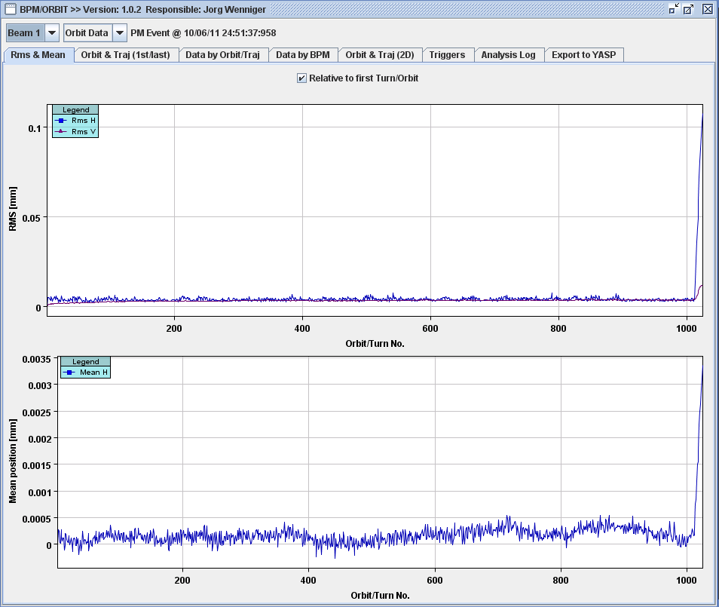
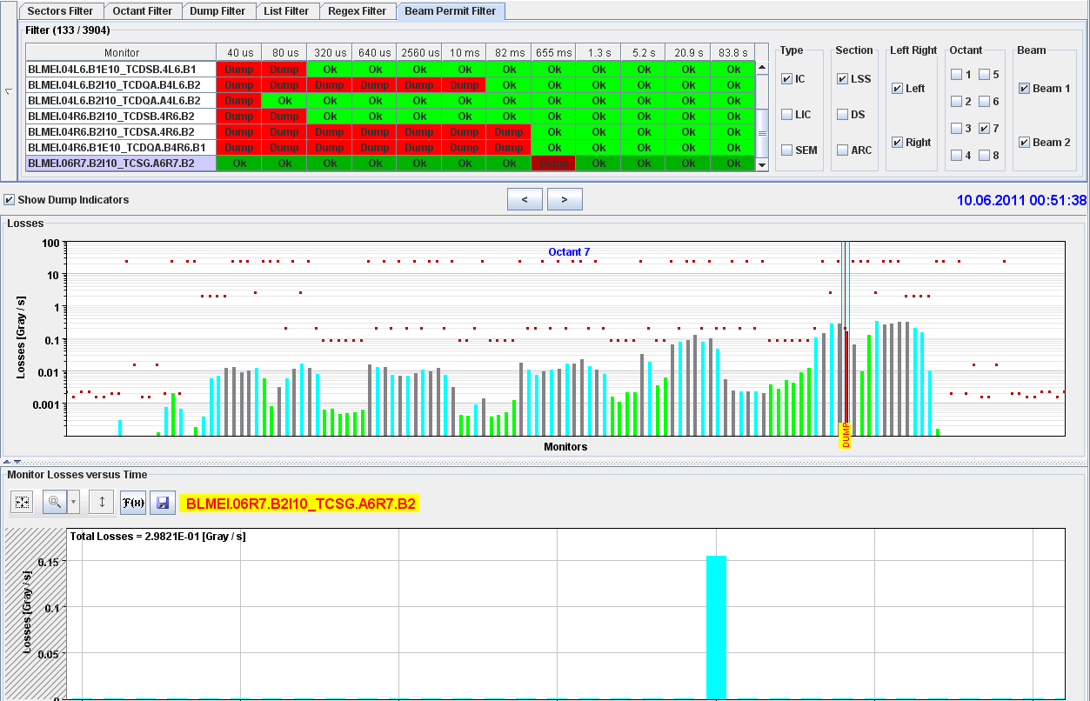
Interlock Systems
Powering interlock systems preventively dump the beams to provide redundancy to BLMs
Currently done by circuit family
Seen very good experience, could rely more on beam loss monitors, BPMs and future DIDT?!
(-) Failure of 600A triplet corrector RQSX3.L1 on 10-JUN-11 12.51.37 AM dumped on slow beam losses in IR7 only 500ms after trip
Fast Orbit
Changes
in B1H

Slide 14
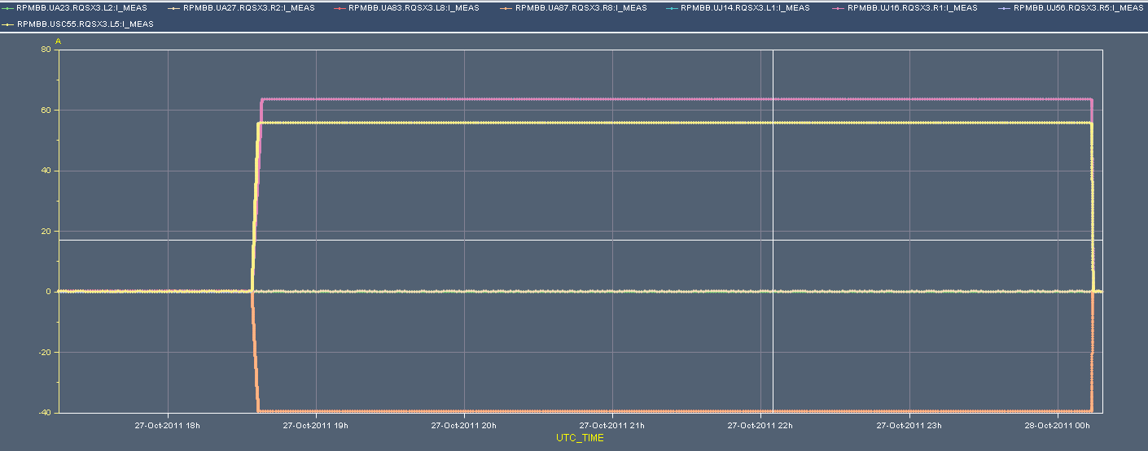
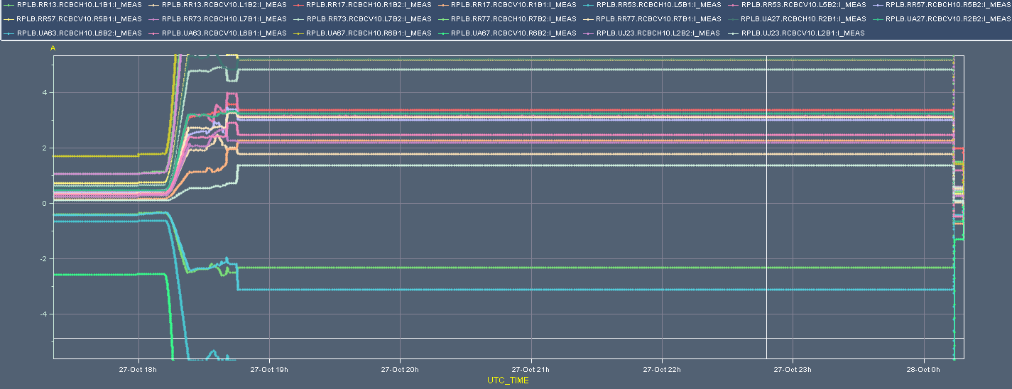
Interlock Systems
(+) RQSX3 circuits in IR2 currently not used and other circuits operate at very low currents throughout the whole cycle
With E>, β*< and tight collimator settings we can tolerate less circuit failures
Change to circuit-by-circuit config and re-study circuits individually to allow for more flexibility (watch out for optics changes!)
RQSX3
20A
2A
RCBCH/V10

Slide 15
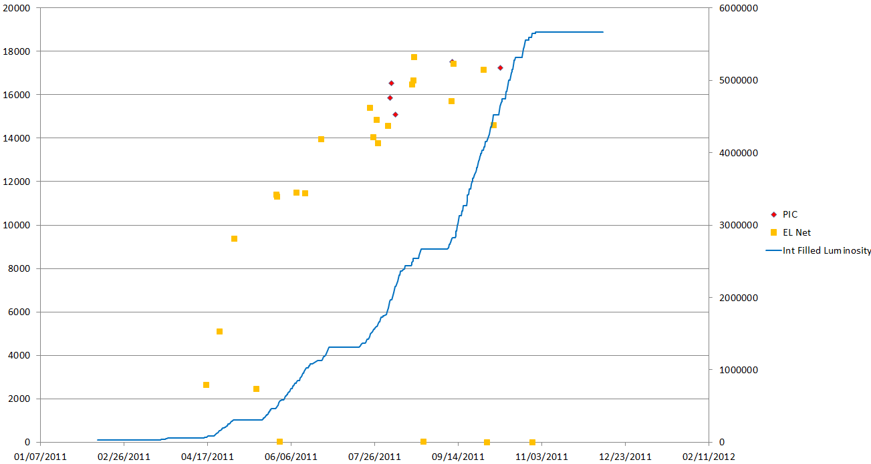
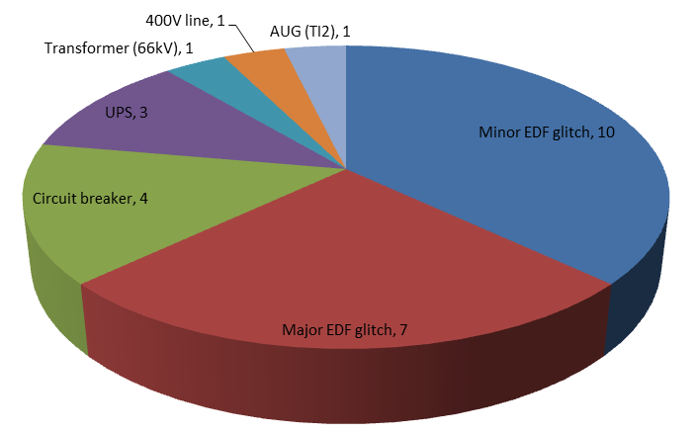
Electrical Distribution
Magnet powering critically depends on quality of mains supply
> 60% of beam dumps due to network perturbations originating outside the CERN network
Usual peak over summer period
Few internal problems already mitigated or mitigation ongoing (UPS in UJ56, AUG event in TI2, circuit breaker on F3 line feeding QPS racks)
Peak period
in summer…
Total of 27 recorded faults (@ 3.5TeV in 2011)

Slide 16
Typical distribution of network perturbations
Perturbations mostly traced back to short circuits in 440kV/225kV network, to >90% caused by lightning strikes (Source: EDF)
Duration [ms]
Warm magnet trips
Trip of nc magnets
Majority of perturbations
1phase, <100ms, <-20%
Variation [%]
No beam in SPS/LHC, PS affected
No beam in SPS/LHC, PS affected
No beam, no powering (CRYO recovery)
No beam, no powering in LHC (during CRYO recovery)
EXP magnets, several sectors, RF,…tripped
Trip of EXP magnets, several LHC sectors, RF,…
Major perturbations entail equipment trips (power converters,…)
Minor perturbations caught by protection systems (typically the Fast Magnet Current Change Monitor), but not resulting in equipment trips

Slide 17
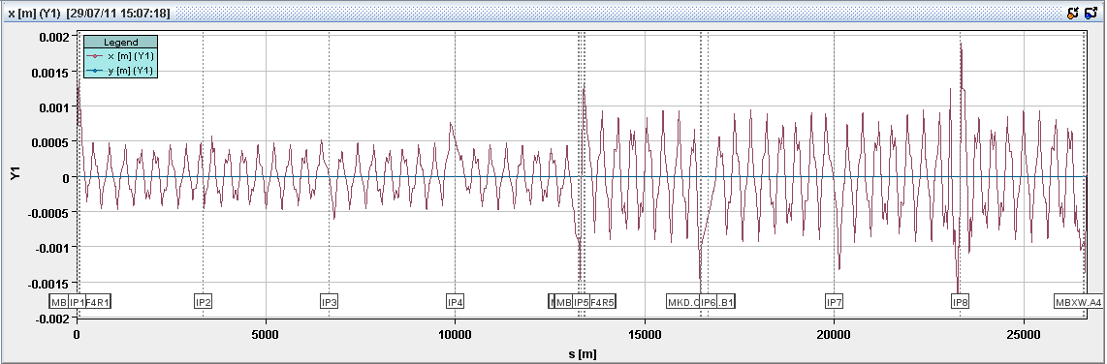
Why we need the FMCMs?
FMCMs protect from powering failures in circuits with weak time constants (and thus fast effects on circulating beams)
Due to required sensitivity (<3•10E-4 of nom current) they also react on network perturbations
  Highly desirable for correlated failures after major events, e.g. side wide power cut on 18th of Aug 2011 or AUG event 24th of June 2011 with subsequent equipment trips
  Minor events where ONLY FMCMs trigger, typically RD1s and RD34s (sometimes RBXWT) are area of possible improvements
MKD.B1
Simulation of typical network perturbation resulting in current change RD1.LR1 and RD1.LR5 +1A
(Collision optics, β*=1.5m, phase advance IP1 -> IP5 ≈ 360° )
Max excursion (arc) and TCTH.4L1 ≈ 1mm, excursion MKD ≈ 1.6mm
Courtesy of T.Baer

Slide 18
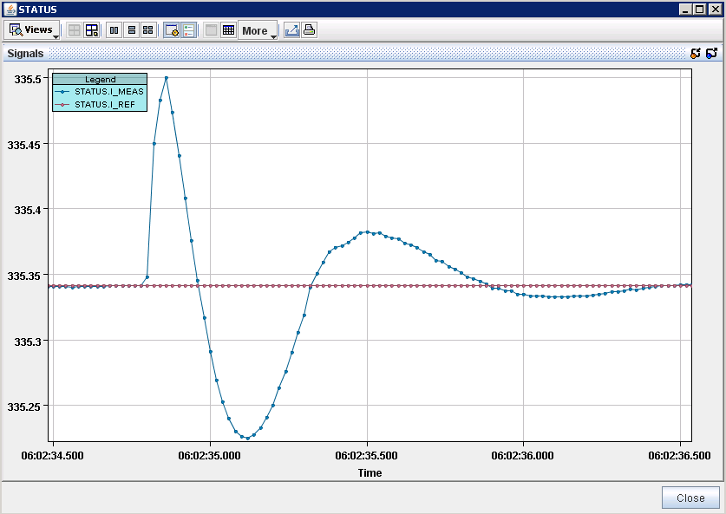
Possibilities to safely decrease sensitivity?
Increase thresholds within the safe limits (e.g. done in 2010 on dump septa magnets, EMDS Doc Nr. 1096470)
  Not possible for RD1/RD34 (would require threshold factor of >5 wrt to safe limit)
Improving regulation characteristics of existing power converter
  EPC planning additional tests during HWC period to try finding better compromise between performance and robustness (validation in 2012)
  Trade off between current stability and rejection of
  perturbations (active filter)
Changing circuit impedance, through e.g. solenoid
  Very costly solution (>300kEuro per device)
  Complex integration (CRYO, protection,…)
  An additional 5 H would only ‘damp’ the
  perturbation by a factor of 4
Replace the four thyristor power converters of RD1 and RD34 with switched mode power supply
  Provides complete rejection of minor network perturbations (up to 100ms/-30%)
  Plug-and play solution, ready for LS1
Network perturbation as
seen at the converter output
0.15A
500ms

Slide 19
Conclusions
All equipment groups are already undertaking serious efforts to further enhance the availability of their systems
Apart from a few systematic failures, most systems are already within or well below the predicated MTBF numbers, where further improvements will become very costly
Failures in magnet powering system in 2011 dominated by radiation induced failures
Low failure rates in early 2011 and during ion run indicate (considerable) potential to decrease failure rate
Mitigations deployed in 2011 and X-mas shutdown should reduce failures to be expected in 2012 by 30%
Mid/long-term consolidations of systems to improve availability should be globally coordinated to guarantee maximum overall gain
  Similar WG as Reliability Sub Working Group?

Slide 20
Thanks a lot for your attention
20

