Slide 1


Accelerating Science and Innovation
PLHC 2012
Opening Talk
R.-D. Heuer, CERN Vancouver, June 4, 2012
Notes:
1

Slide 2

“Discovery” of Standard Model
Past few decades
At the energy frontier through synergy of
hadron - hadron colliders (e.g. Tevatron)
lepton - hadron colliders (HERA)
lepton - lepton colliders (e.g. LEP, SLC)

Slide 3
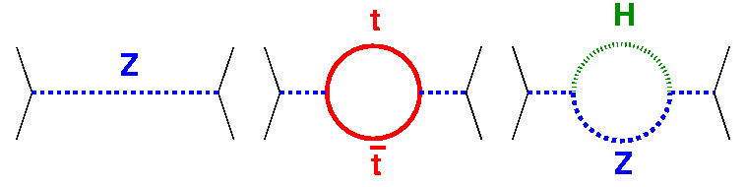
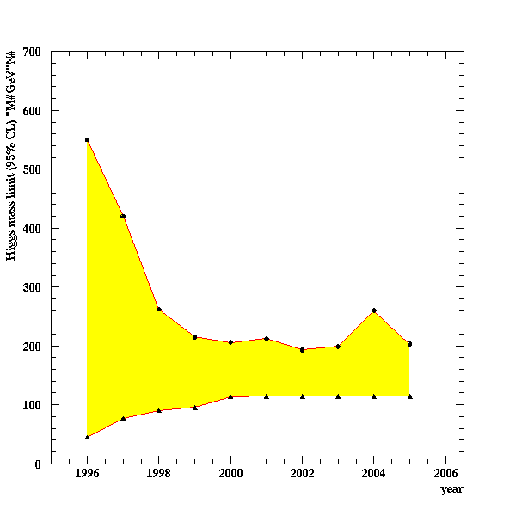
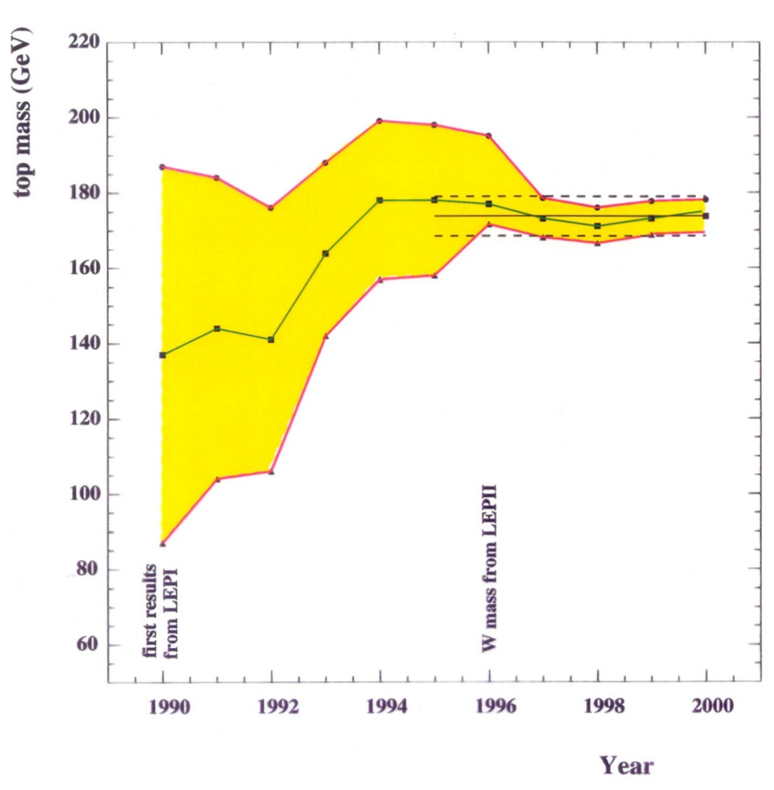
Test of the SM at the Level of Quantum Fluctuations
prediction of the range
for the Higgs mass
LEP: indirect determination of the top mass
LEP
possible due to • precision measurements • known higher order electroweak corrections

Slide 4
HERA: Impact on PDF
a………………………………………………………………………………...a

Slide 5
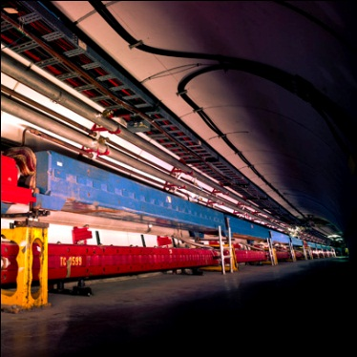
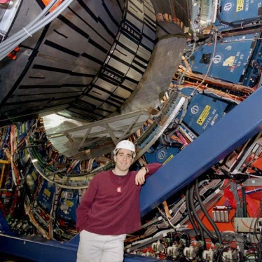
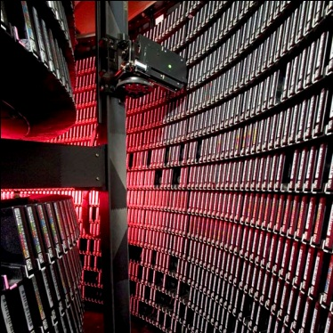
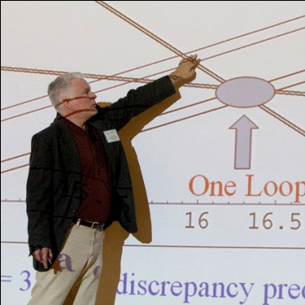
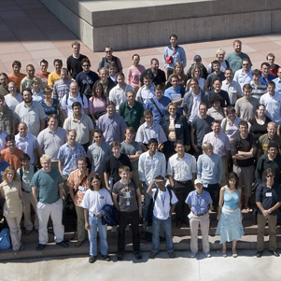
Completion of an era: Tevatron
Accelerator Innovations
  First major SC synchrotron
  Industrial production of SC cable (MRI)
  Electron cooling
  New RF manipulation techniques
Detector innovations
  Silicon vertex detectors in hadron environment
  LAr-U238 hadron calorimetry
  Advanced triggering
Analysis Innovations
  Data mining from Petabytes of data
  Use of neural networks, boosted decision trees
  Major impact on LHC planning and developing
  GRID pioneers
Major discoveries
  Top quark
  B_{s} mixing
  Precision W and Top mass → Higgs mass prediction
  Direct Higgs searches
  Ruled out many exotica
The next generation
  Fantastic training ground for next generation
  More than 500 Ph.D.s
  Produced critical personnel for the next steps, especially LHC

Slide 6
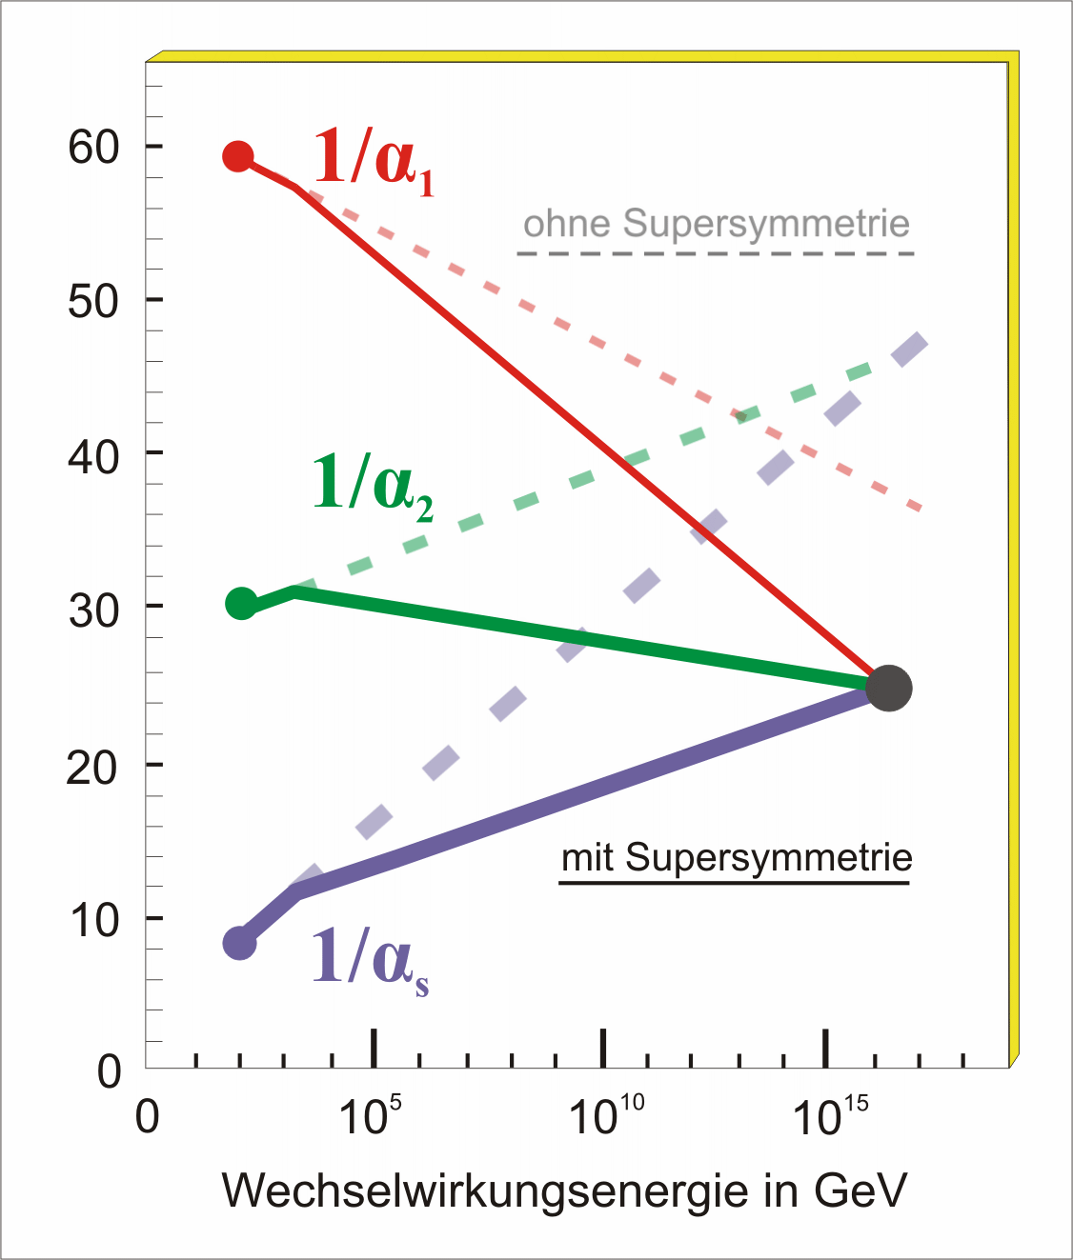
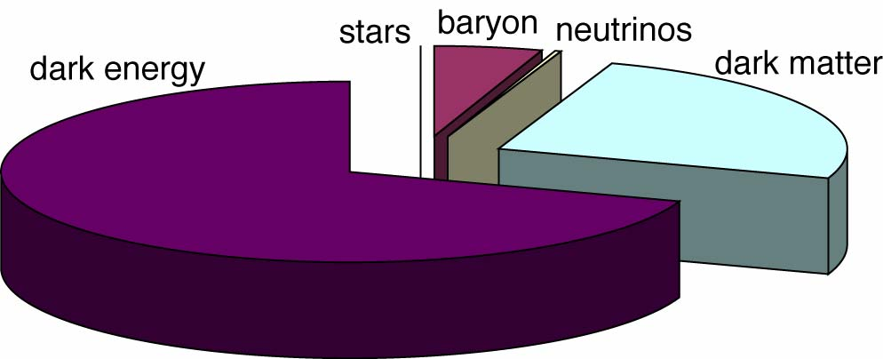
Key Questions of Particle Physics
origin of mass/matter or origin of electroweak symmetry breaking
unification of forces
fundamental symmetry of forces and matter
where is antimatter
unification of quantum physics and general relativity
number of space/time dimensions
what is dark matter
what is dark energy
For most questions:
new particles should appear
at TeV scale or below
→ territory of the LHC

Slide 7
Exciting Times
‘Today’
At the energy frontier, the LHC brings us
into unexplored territory:
Excellent progress
Accelerator – Experiments – Grid Comp.

Slide 8
Key message
LHC and the Standard Model
Finding the Higgs: Discovery
Excluding the SM-Higgs: Discovery
Reminder:
LHC is poised to clarify the mechanism by which elementary particles acquire mass

Slide 9
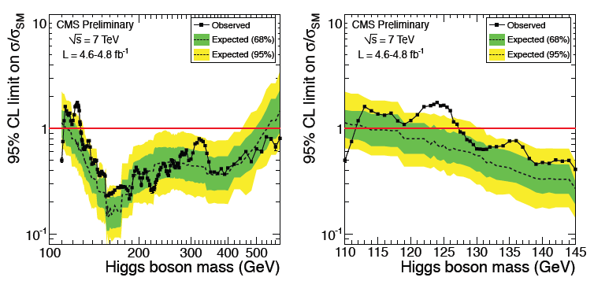
New Combination
It took ~30 years to experimentally restrict the SM Higgs mass to be above 114 GeV
CMS and ATLAS independently eliminated another ~475 GeV of the range in 2011
Expected exclusion 114.5 - 543 GeV
Observed exclusion 127.5 - 600 GeV

Slide 10

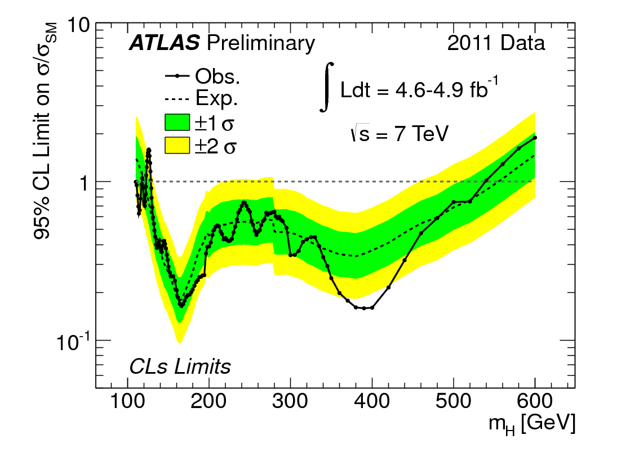
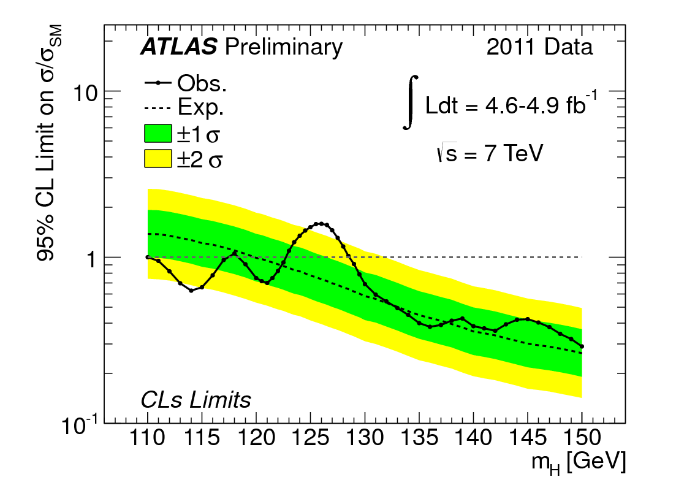
T
ATLAS: Combining all (12 !) channels together, full 2011 dataset
Excluded at 95% CL
110 < m_{H} < 122.5 GeV (except 117.5-118.5)
129 < m_{H} < 539 GeV
Expected if no signal
120-555 GeV
Excluded at 99% CL
130 <m_{H} < 486 GeV
Tevatron also sees enhancement in this
mass region in the decay mode H→bb
NEW: full
2011 dataset

Slide 11

Higgs-Boson at 7 TeV
Status ~ today
SM Higgs boson excluded with 95% cl
up to a mass of 600 GeV
except for the window 122.5 to 127.5 GeV
“interesting fluctuations” around masses
of 124 to 126 GeV

Slide 12
Higgs-Boson at 7 and 8 TeV
Status ~ today
SM Higgs boson excluded with 95% cl
up to a mass of 600 GeV
except for the window 122.5 to 127.5 GeV
“interesting fluctuations” around masses
of 124 to 126 GeV
2012 run:
8 TeV, expect ~15/fb
SM-Higgs Boson up to a mass of some 600 GeV will either be discovered or ruled out until end 2012

Slide 13
What about Physics
beyond the Standard Model ?

Slide 14

Supersymmetry
So far no excess in missing energy events,…,
go beyond CMSSM, consider pMSSM

Slide 15
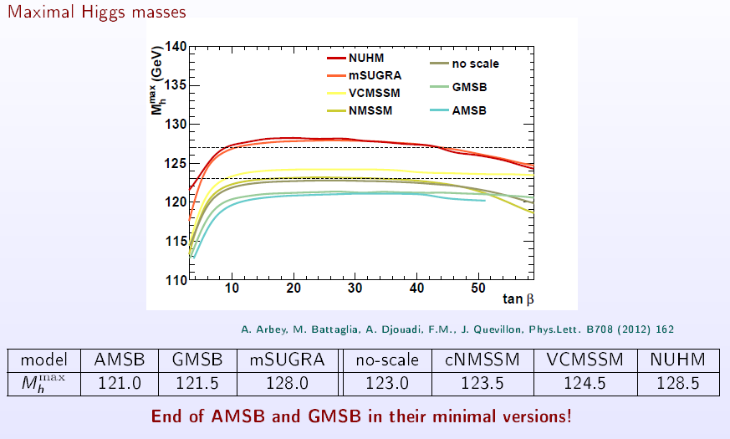
SUSY requires a low mass Higgs Boson
with severe constraints on the max. mass value
Mahmoudi
Within the constrained MSSM models we have crossed the border of excluding gluinos and squarks up to 1TeV and beyond. The air is getting thin for constrained SUSY. …..
. . . but potential for discovery of SUSY sizeable at all LHC energies
Higgs mass of 125 GeV severe constraint on all models!

Slide 16
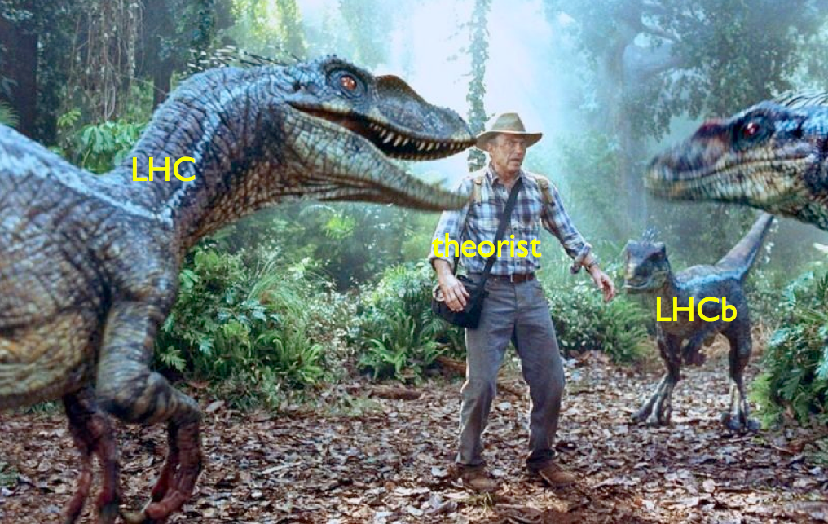
LHC and Theory…
Murayama, ICFA Seminar, 2011 CERN

Slide 17
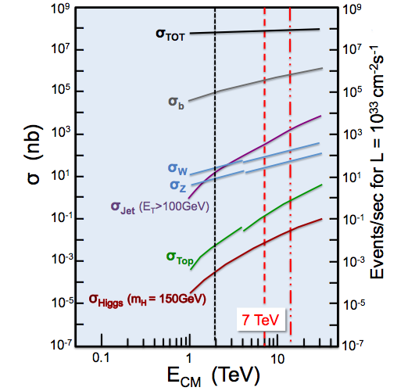

The 2011 and 2012 run …
Search for physics beyond SM
Discovering new particles
Making precise measurements of
properties of known particles/forces:
e.g. B_{s} → μ⁺μ⁻
….in 2012 already
over 4/fb delivered
→ will enter new territory !

Slide 18
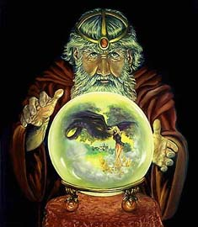
The predictable future: LHC Time-line
2009
Start of LHC
Run 1: 7 and 8 TeV centre of mass energy, luminosity ramping up to few 10³³ cm⁻² s⁻¹, few fb⁻¹ delivered
LHC shut-down to prepare machine for design energy and nominal luminosity
2013/14
Run 2: Ramp up luminosity to nominal (10³⁴ cm⁻² s⁻¹), ~50 to 100 fb⁻¹
2017/18
Injector and LHC Phase-I upgrades to go to ultimate luminosity
Study of the properties of the Higgs Boson
or
Other ew symmetry breaking mechanism
and
Physics beyond the Standard Model
Run 3: Ramp up luminosity to 2.2 x nominal, reaching ~100 fb⁻¹ / year accumulate few hundred fb⁻¹
~2021/22
Phase-II: High-luminosity LHC. New focussing magnets and CRAB cavities for very high luminosity with levelling
Run 4: Collect data until > 3000 fb⁻¹
2030

Slide 19
Key message
LHC
There is a program at the energy frontier with the LHC for at least 20 years:
7 and 8 TeV
14 TeV design luminosity
14 TeV high luminosity (HL-LHC)

Slide 20
beyond LHC ?
Notes:
20

Slide 21
Road beyond Standard Model
Next decades
At the energy frontier through synergy of
hadron - hadron colliders (LHC, HE-LHC?)
lepton - hadron colliders (LHeC ??)
lepton - lepton colliders (LC (ILC or CLIC) ?)
LHC results will guide the way at the energy frontier

Slide 22
High Energy Hadron – Hadron Collider
HE - LHC
Study of New Physics Phenomena
main challenge: High-Field Magnets

Slide 23
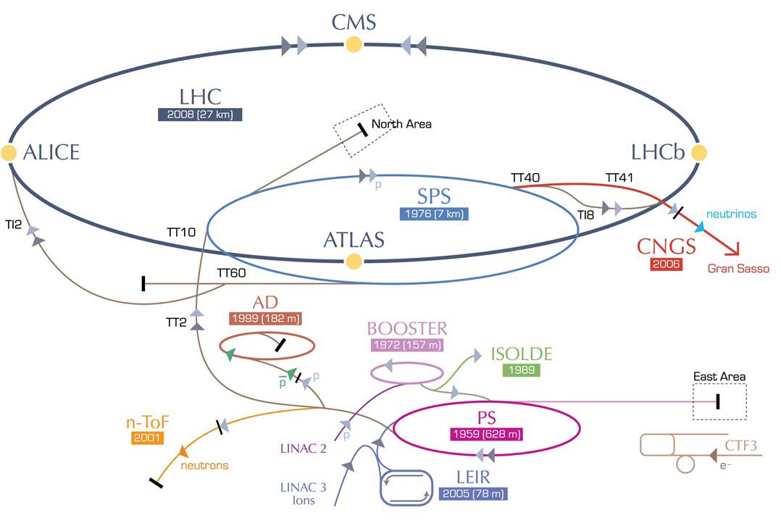
HE-LHC – LHC modifications
HE-LHC
2030-33
SPS+,
1.3 TeV, 2030-33
2-GeV Booster
Linac4

Slide 24
Lepton – Hadron Collider
LHeC
QCD, Leptoquarks?

Slide 25

LHeC options: RR and LR
RR LHeC:
new ring in
LHC tunnel,
with bypasses
around
experiments
RR LHeC
e-/e+ injector
10 GeV,
10 min. filling time
LR LHeC:
recirculating
linac with
energy
recovery,
or straight
linac
Frank Zimmermann, UPHUK4 Bodrum 2010

Slide 26
Lepton – Lepton Colliders

Slide 27
Linear Colliders: ILC / CLIC
Both projects are global endeavours
Wide range of Physics Topics, e.g.
Higgs (self) couplings
Z, W, Top studies
new physics phenomena

Slide 29
Key message
High Priority Items for Linear Collider Projects
ILC and CLIC projects → LC project
Construction Cost
Power Consumption
Value Engineering

Slide 30
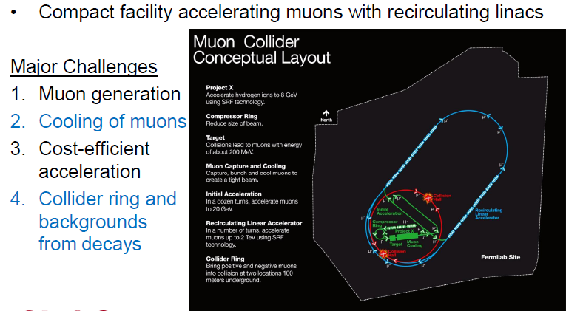
Muon Collider
Higgs Boson properties

Slide 31
Key message
All projects need continuing accelerator and detector R&D;
All projects need continuing attention concerning a convincing physics case;
close collaboration exp-theo mandatory
so that the right decision can be made when the time comes to identify the next energy frontier accelerator (collider).
Today, we need to keep our choices open.

Slide 32
Choices ?
• Rich variety of projects under study
at the energy frontier
and the intensity frontier
• Global – Regional – National Projects
→ Need to present and discuss all these projects in an international context before making choices
→ Need to present physics case(s) always taking into account latest results at existing facilities
→ Need to present (additional) benefits to society from the very beginning of the project

Slide 33
from Choices ? to Choice !
Update of the European Strategy for Particle Physics in 2012/13
- Several Meetings with international participation
→ bottom-up process: community input requested
1st open meeting September 2012, Cracow
- Finalization: May/June 2013
Started with the ICFA Seminar 3-6 October 2011 at CERN
Use as 1st step to harmonize globally Particle Physics Strategy

Slide 34
CERN today….into the future
CLIC conceptual design report by 2012
Participation in all LC activities
LHeC conceptual design report early 2012
R&D for high-field magnets (towards HE-LHC)
Generic R&D (high-power SPL, Plasma Acc)
Participation in Neutrino-Projects studied
Position CERN as Laboratory at the energy frontier

Slide 35
CERN: opening the door…
Membership for Non-European countries
New Associate Membership defined
Romania, Israel, Serbia in accession to membership
Negotiations concerning membership ongoing with Cyprus, Slovenia, and Turkey
Several countries expressed interest in Associate Membership
CERN participation in global projects independent of location

Slide 36
Exciting Times
Today
…. and I wish you
an exciting conference

