Slide 1


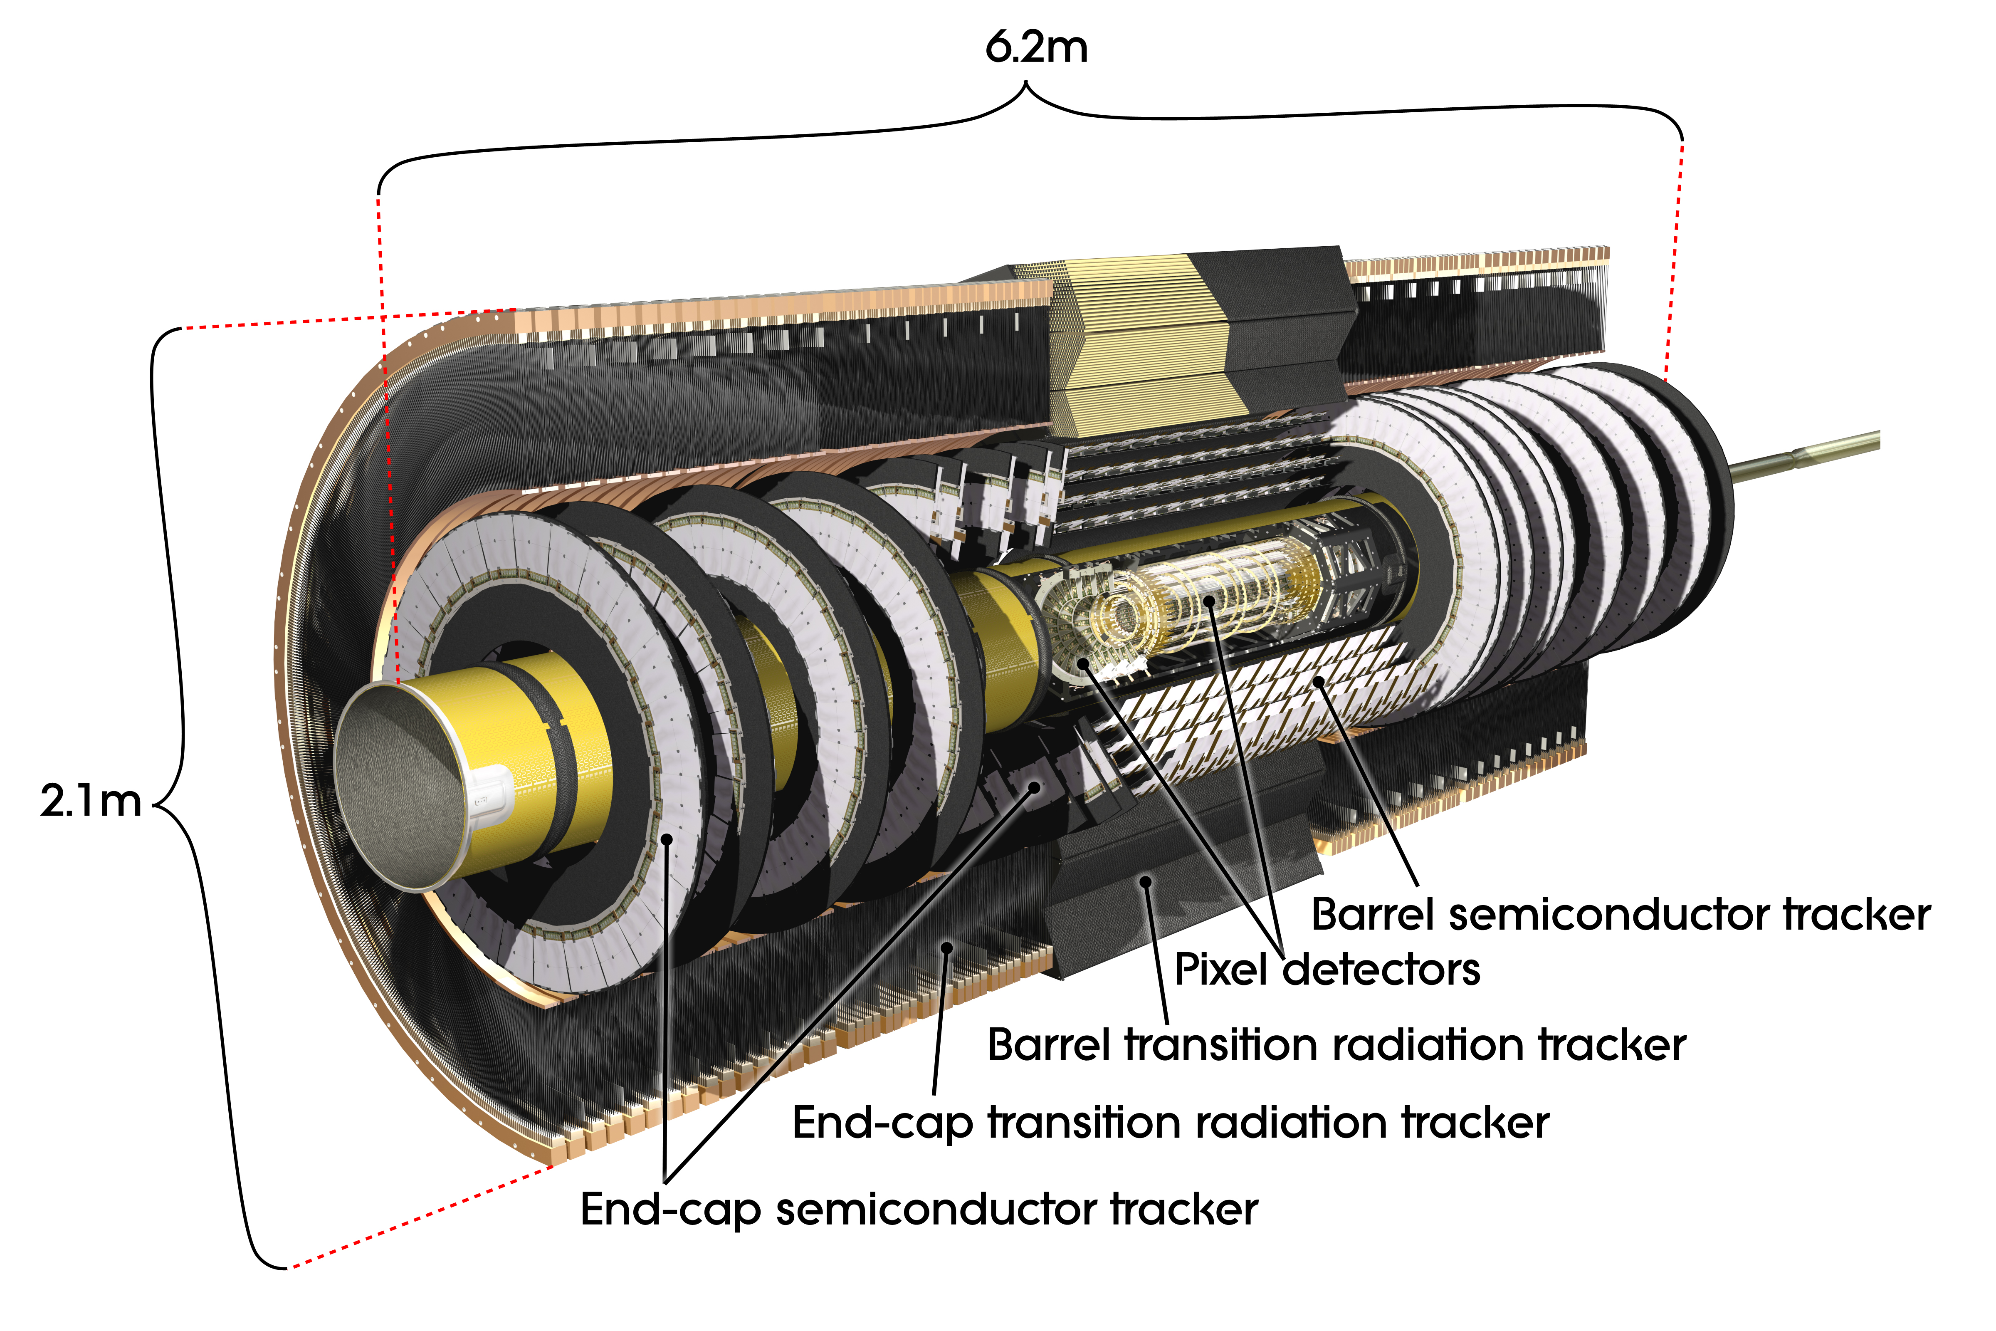
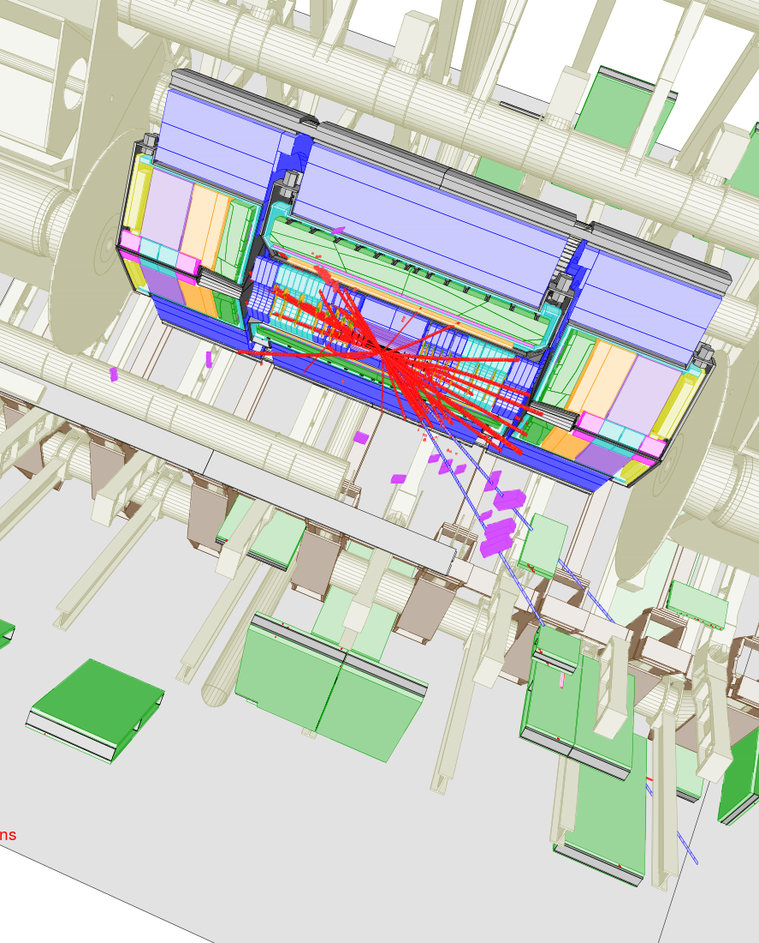
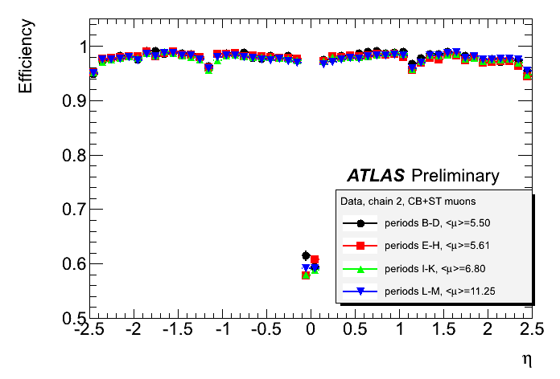
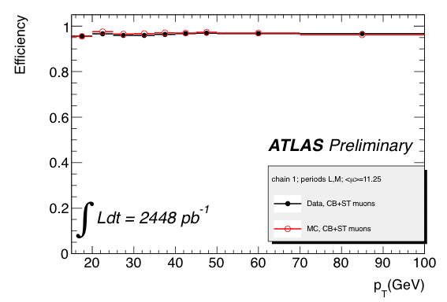
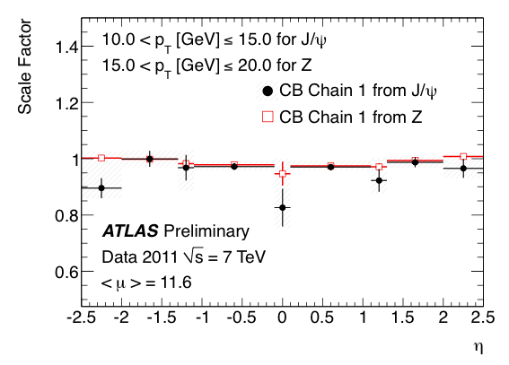
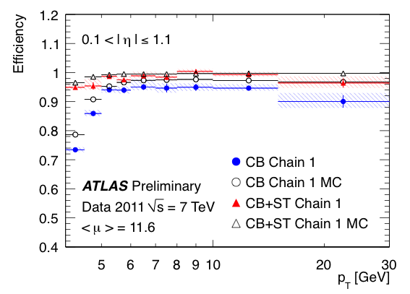
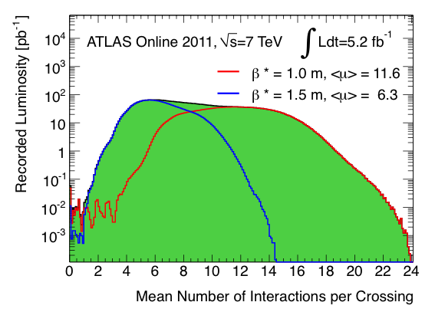
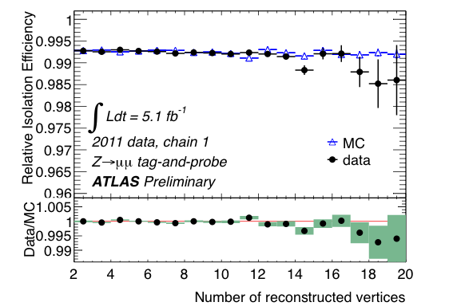
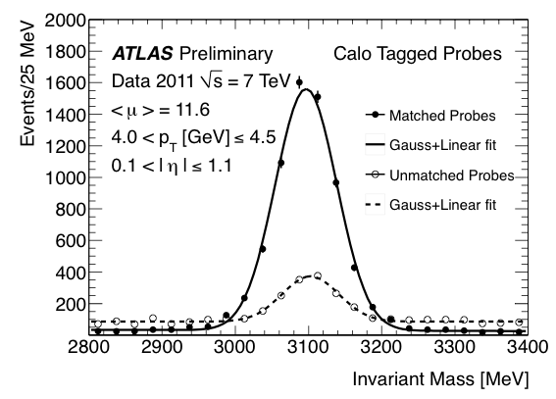
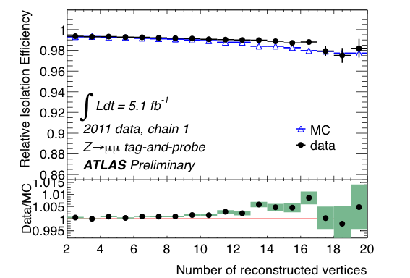
ATLAS Muon Reconstruction Efficiency
William Spearman
Harvard University
On behalf of the ATLAS Collaboration
Abstract
ATLAS Inner Detector
Di-muon decays of J/ψ mesons and Z bosons have been used to study the muon reconstruction and identification efficiency of the ATLAS detector as a function of the muon transverse momentum, from p_{T}=4 GeV to p_{T}=100 GeV, and the number of inelastic collisions per event. The results show a steep efficiency turn-on curve reaching its plateau value of 100% at p_{T} ~ 6 GeV and no dependence of the muon reconstruction efficiency on the of pile-up. The studies also reveal that the use of inner detector tracks allows us to distinguish between isolated muons and non-isolated muons produced in jets with high separation power even at the highest pile-up levels.
  ATLAS Inner Detector
  The pixel detector provides precise vertexing.
  The semiconductor tracker (SCT) provides precise momentum measurement.
  The transition radiation detector (TRT) gives additional R – ϕ information and improves momentum resolution.
  Together these systems provide precise momentum and vertex information.
  Inner Detector (ID) Track
  Uses the inner detector to measure particle momentum and position.
  Calorimeter-Tagged (calo-tagged) Muon
  An inner detector track with energy deposition in the calorimeter consistent with the ionization of a muon.
Efficiency from J/ψ and Z Events
  Tag and Probe
  Select events with a triggered muon and a track the invariant mass of which is consistent with a resonance, J/ψ or Z, decaying to muons.
  If the triggered muon is well reconstructed, select it as the tag.
  The track becomes the probe.
  The Efficiency is the number of reconstructed probes (matched) divided by the total number of probes (matched+unmatched).
J/ψ → μμ Event Display
ATLAS Muon Spectrometer
    ATLAS Muon Spectrometer
    Triggering and ϕ-positioning is provided by the RPC (in Barrel) and TGC (in Endcap).
    Precision positioning (in η) comes from the MDT and CSC.
    Together the MDT, CSC, RPC, and TGC provide muon reconstruction for all ϕ and |η| < 2.7.
    Stand Alone Muon Spectrometer (MS) Track
    Reconstructed muon using only the muon spectrometer.
  Combined (CB) Muon
    A MS Track matched to and statistically combined with an ID track (for Chain 1).
    The most accurate measurement of the momentum and position of a muon.
  Segment Tagged (CB+ST) Muon
    An ID track matched to segments in the muon spectrometer.
J/ψ Invariant Mass Peak
The event display shows two muons with p_{T} of 28 GeV and 15 GeV consistent with a boosted J/ψ decay. The separation, Δr, for such events is relatively small but to avoid a trigger bias a Δr cut is used to prevent the two muons from appearing in the same trigger Region of Interest (ROI).
Muon p_{T} Thresholds for 2011 ATLAS analyses
    Υ(1S) Cross-Section
    Segment-Tagged Muon
    SUSY 3l+E_{T}^{miss}
    Combined Muon
    SM WZ
    Segment-Tagged Muon
    SM WW → lνlν
    Combined Muon
0
5
10
15
20
25
30
    H → ZZ → 4l
    Segment-Tagged Muon
    H → WW → lνlν
    Combined Muon
    Z’ → μμ
    Combined Muon
Low p_{T} Muon Efficiency: J/ψ
High p_{T} Muon Efficiency: Z
Combined and Combined + Segment Tagged Efficiency
Combined + Segment Tagged Efficiency
Below 30 GeV: muon efficiencies and scale factors measured using J/ψ Tag and Probe.
Tag: Chain 1 combined muon.
Probe: a calorimeter-tagged muon from the barrel region.
Efficiency: plateau at p_{T} ~ 6 GeV.
Above 15 GeV: muon efficiencies and scale factors measured using Z Tag and Probe.
Tag: Chain 1 combined muon.
Probe: a calorimeter-tagged muon.
Efficiency: little variation with p_{T}.
Pile-up in 2011
Z & J/ψ Comparison
Mean Number of Interactions per Crossing
    Pile-up Conditions in 2011
    In 2011, p-p collisions have a center of mass energy of 7 TeV.
    The beam was squeezed in September (β* = 1.5 m to β* = 1.0 m) leading to a higher mean number of interactions per crossing.
    Blue line: operating conditions before September.
    Red line: operating conditions after September.
    Efficiency Dependence on Run Period in 2011
    Efficiency is relatively stable versus run period.
    This indicates minimal dependence on detector operating conditions and pile-up.
Efficiency vs η
For Different Run Periods
Scale Factor vs η Comparison between J/ψ and Z
Isolation Efficiency
Muon isolation is required by many physics analyses. As a result measuring the muon isolation scale factors is necessary to properly model the effect of isolation cuts.
Track Isolation: Little pile-up dependence.
Calorimetric Isolation: Some pile-up dependence but good agreement between data and MC.
Track Isolation
Σp_{T}(ΔR<0.3)/p_{T}<0.15
Calorimeter Isolation
Pile-up corrected ΣE_{T}(ΔR<0.3)/p_{T}<0.14
    Scale Factors for Z and J/ψ
    Compares the p_{T} region 10 GeV – 15 GeV from J/ψ tag and probe to the 15 GeV – 20 GeV region from Z tag and probe.
    Scale factors from September – October 2011 shown.
    Agreement within systematic errors.
PLHC 2012 4-9 June, Vancouver

