Slide 1
Progress Report of R&D for CERN-KEK Collaboration
Tatsushi NAKAMOTO
KEK
CERN-KEK collaboration: Magnet R&D Review at CERN, Dec. 13, 2011.

Slide 2
Participants / Collaborators
KEK: M. Iio, N. Kimura, T. Nakamoto, T. Ogitsu,
K. Sasaki, K. Tsuchiya, Q. Xu, X. Jin,
A. Yamamoto, M. Yoshida,
NIMS: N. Banno, A. Kikuchi, T. Takeuchi
In collaboration with:
CERN: L. Rossi, L. Bottura, E. Todesco, G. de Rijk et al.
LBNL: G. Sabbi, S. Caspi et al.
Fermilab: M. Lamm, A. Zlobin, E. Barzi, R. Yamada
CEA/Saclay: B. Baudouy et al.

Slide 3
Contents
RHQ-Nb₃Al development
  Summary of Development, Judgment
  R&D in JFY2011 (Ta, Cu matrix and others)
Subscale Magnet Development
Conceptual Design of D1 for HiLumi LHC Upgrade
Neutron Irradiation
Radiation Resistant Materials Development
Stress/Strain Dependence Study
Procurement of Nb3Sn-bronze Cable
Summary

Slide 4
REMINDER
Slides from the Meeting in Dec. 2010

Slide 5
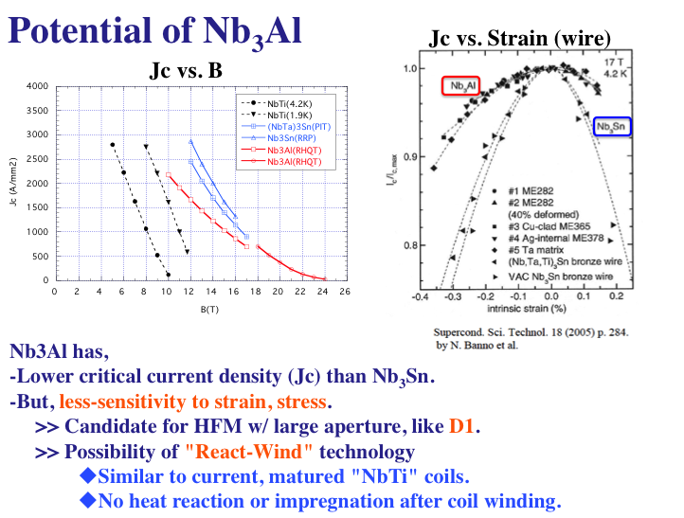
from the Meeting Dec. 2010

Slide 6
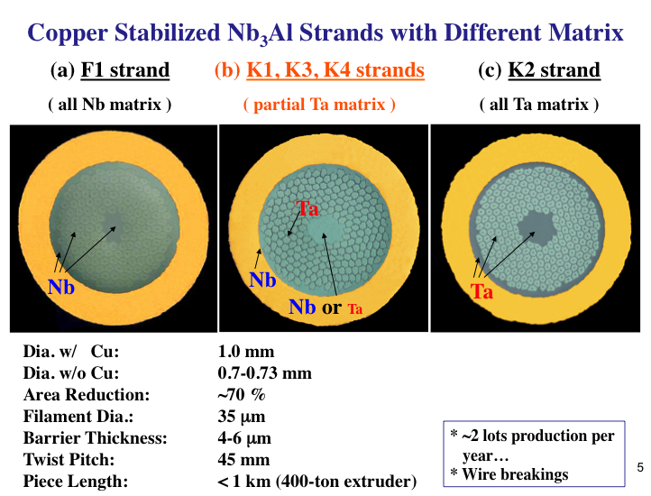
from the Meeting Dec. 2010

Slide 7
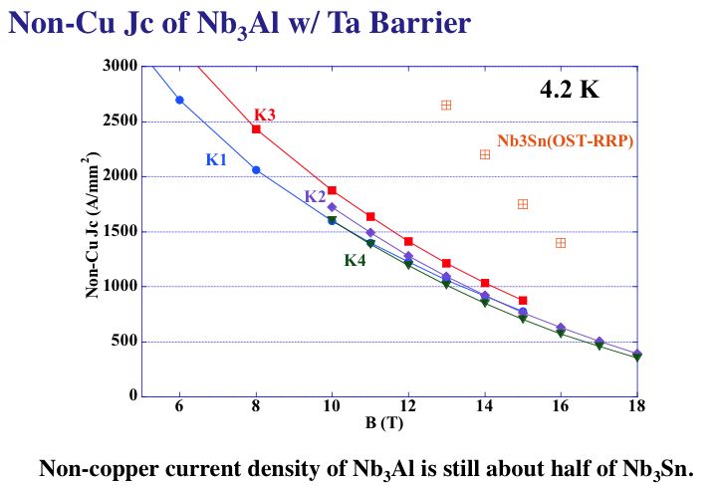
from the Meeting Dec. 2010

Slide 8
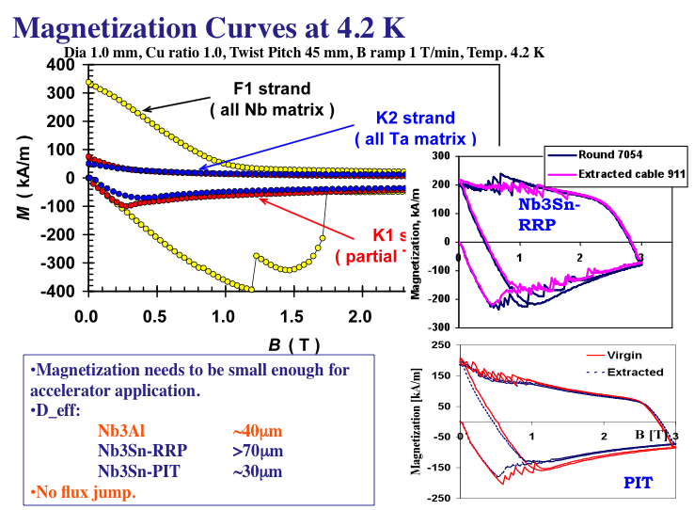
from the Meeting Dec. 2010
45μm

Slide 9
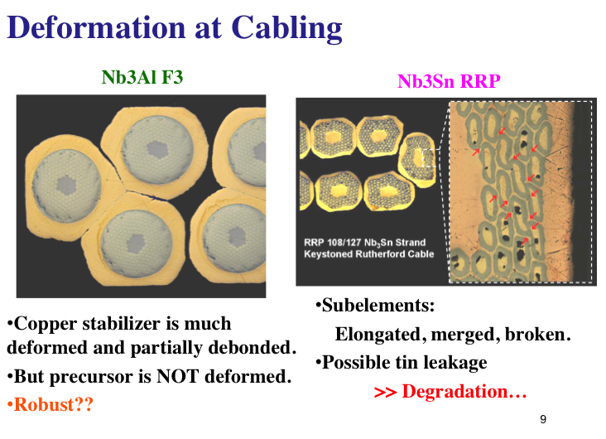
from the Meeting Dec. 2010

Slide 10
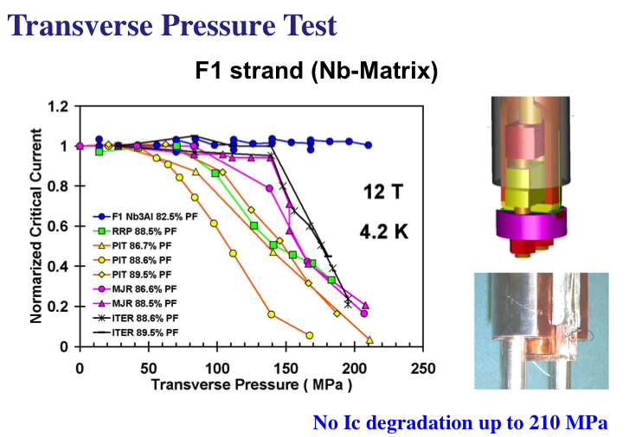
from the Meeting Dec. 2010

Slide 11
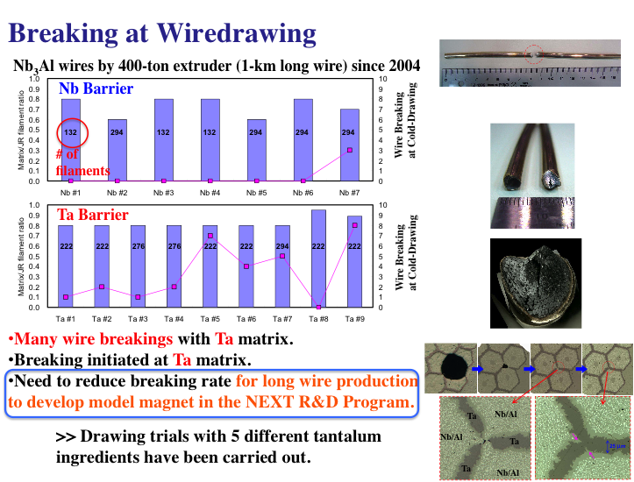
from the Meeting Dec. 2010

Slide 12
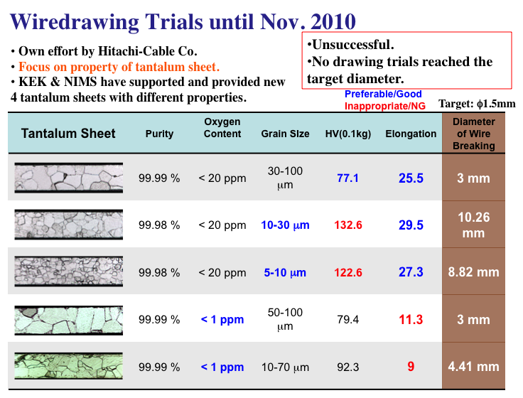
from the Meeting Dec. 2010

Slide 13
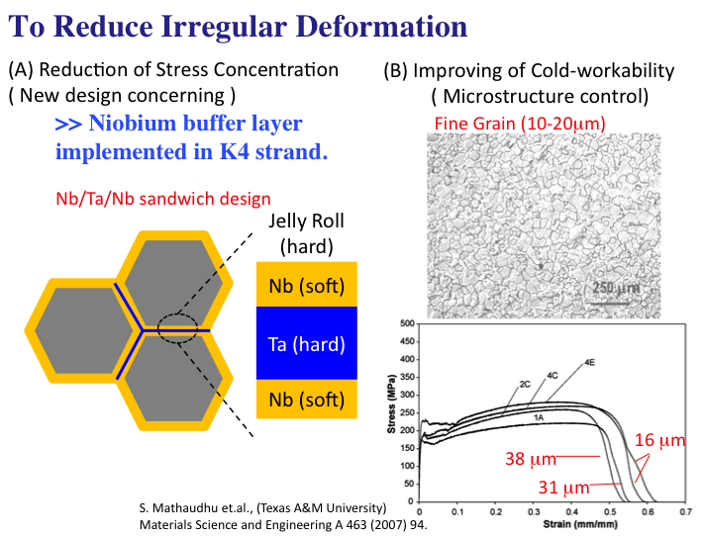
from the Meeting Dec. 2010

Slide 14
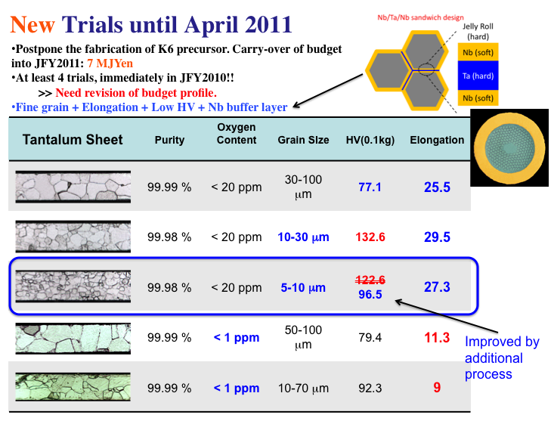
from the Meeting Dec. 2010

Slide 15
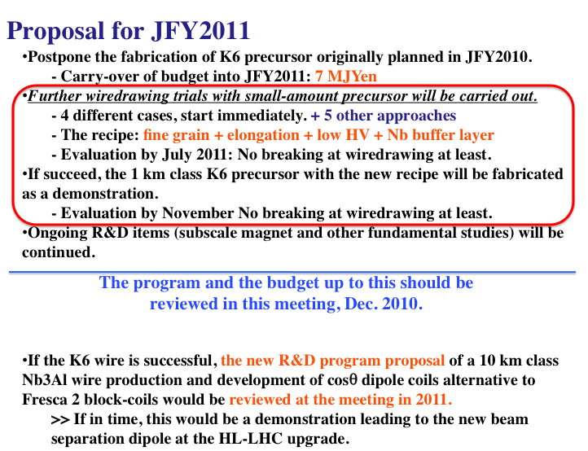
from the Meeting Dec. 2010

Slide 16
Report of the Last Wiredrawing Trial in JFY2010

Slide 17
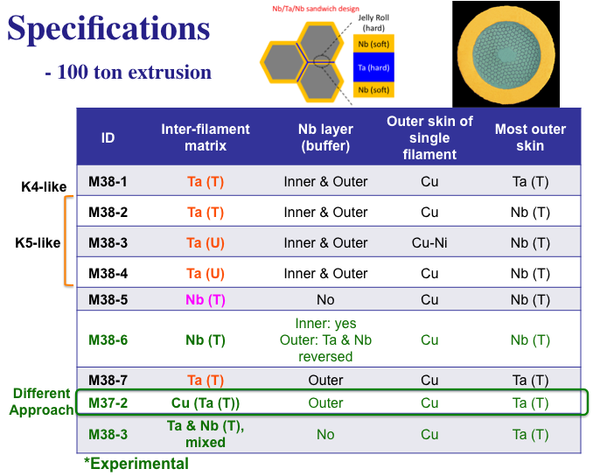
from the Meeting May 2011

Slide 18
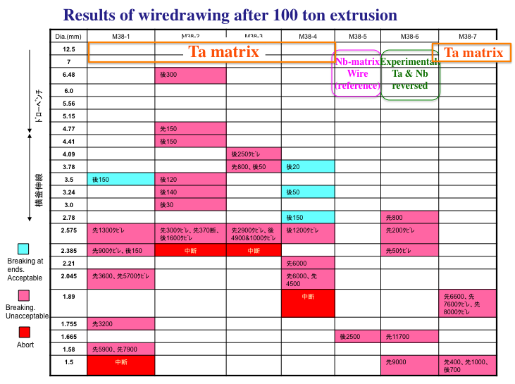
from the Meeting May 2011

Slide 19
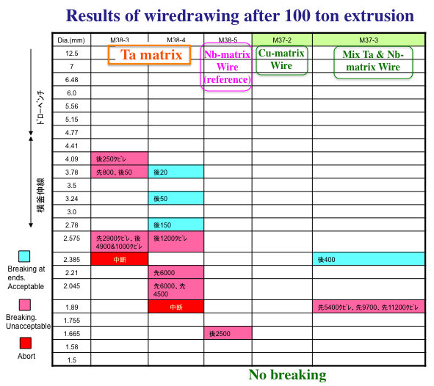
from the Meeting May 2011

Slide 20
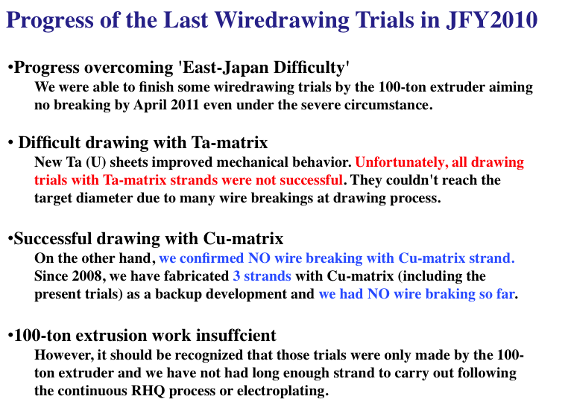
from the Meeting May 2011

Slide 21
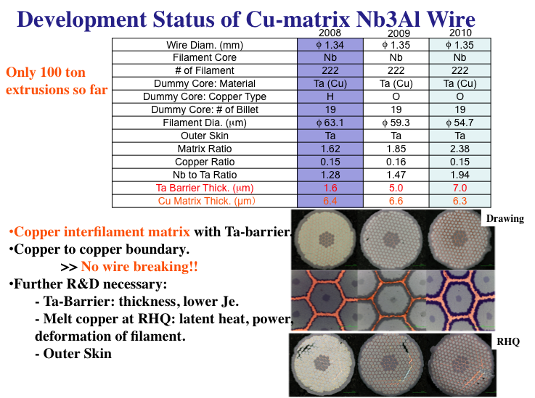
from the Meeting May 2011

Slide 22
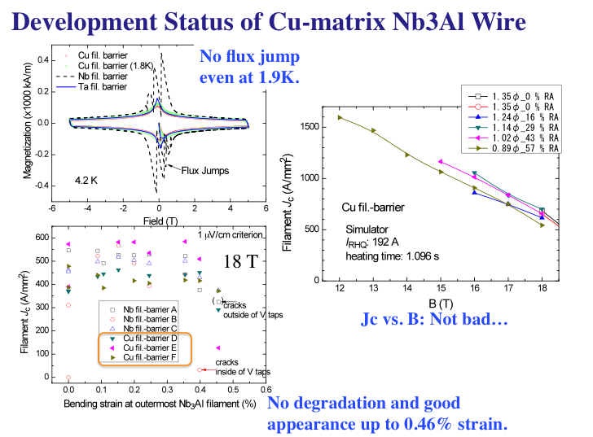
from the Meeting May 2011

Slide 23
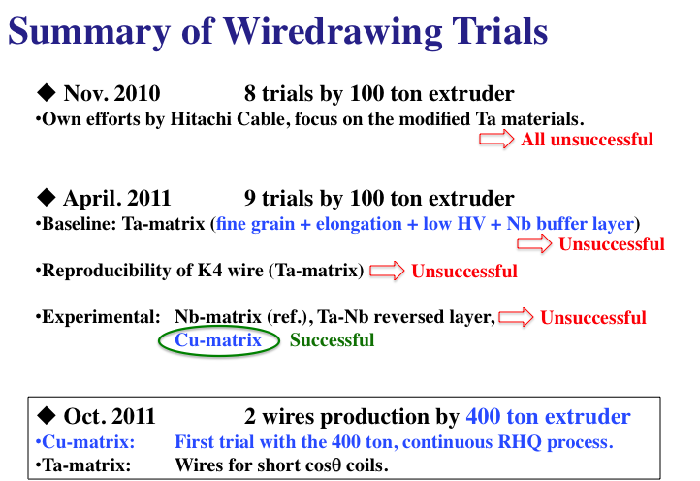
from the Meeting May 2011

Slide 24
Summary of RHQ-Nb₃Al Development
Non copper Jc: 1200 A/mm² @12 T, 800 A/mm² @ 15T
  Still half of Nb₃Sn-RRP
Magnetization: D_{eff}= 40 μm and no flux jump
  Better than Nb3Sn-RRP (D_{eff} >70 μm)
Stress sensitivity: No degradation up to transversal compressive stress of 210 MPa.
Robustness: No degradation after cabling
Technology development of reel-to-reel electroplating
Difficulty in wiredrawing process

Slide 25
Judgments
We will not give up the Ta-matrix strand, but further basic R&D on Ta material must be required to improve wiredrawing property.
  -Staying at fundamental research with < 400 ton extruder.
The Cu-matrix strand shows much better performance in wiredrawing. But, a longer wire processed by a continuous RHQ facility should be necessary.
  - We would like to proceed with the 1-km class (400 ton extrusion) Cu-matrix strand development.
  - This development will be covered by NIMS at this time.
Even though RHQ-Nb3Al superconductor has a potential to be utilized for the high field accelerator application, it is clear that a series of long wire production will not be possible in next a few years and a RHQ-Nb3Al model magnet cannot be developed by 2015. Unfortunately, this means that RHQ-Nb3Al will NOT be a candidate for the HiLumi-LHC upgrade.

Slide 26
R&D status of Nb3Al wire in JFY2011 as a fundamental study
- Own efforts (internal budget) by NIMS and KEK -

Slide 27
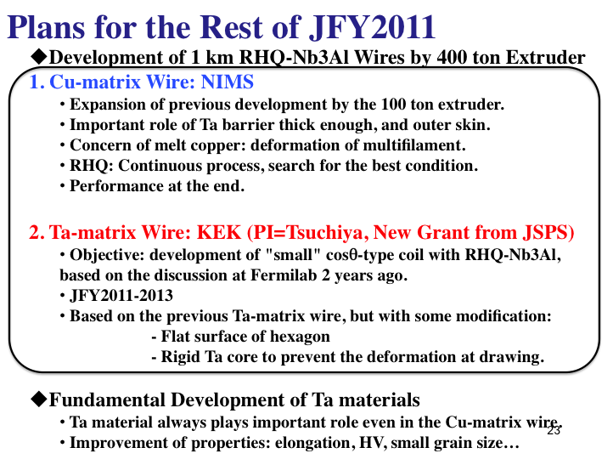
from the Meeting May 2011

Slide 28
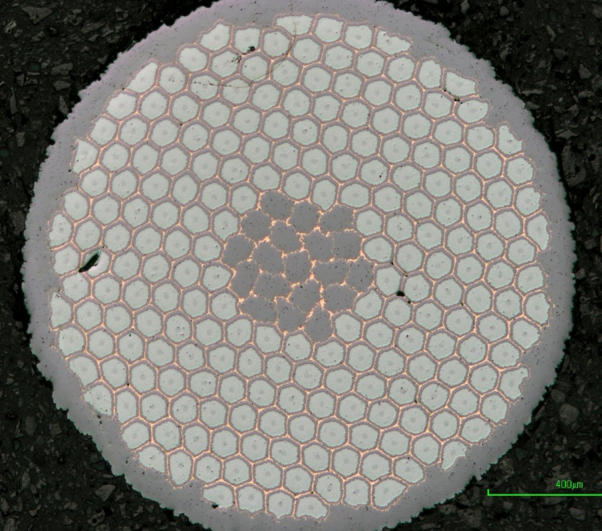
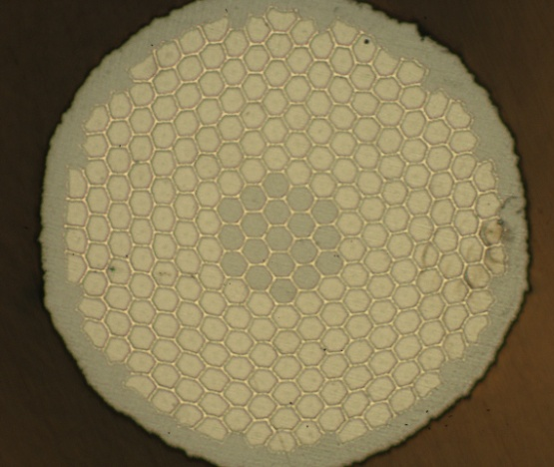
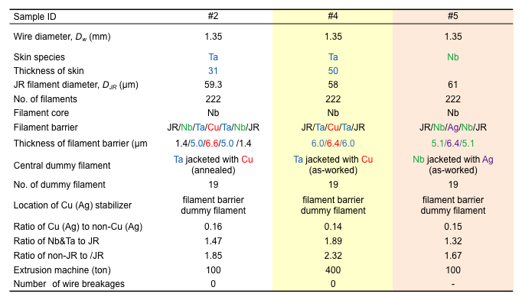
Development of Non-Ta Matrix Wire
2011
2011
#4 (2011)
Confirmation of reel-to-reel RHQ treatability for Cu filament-barrier wire.
Confirmation of uniform superconducting properties along a long-length wire.
#5 (2011)
Reduction of a ratio of Nb&Ta to JR by replacing of Cu with Ag and removing off Ta layer.

Slide 29
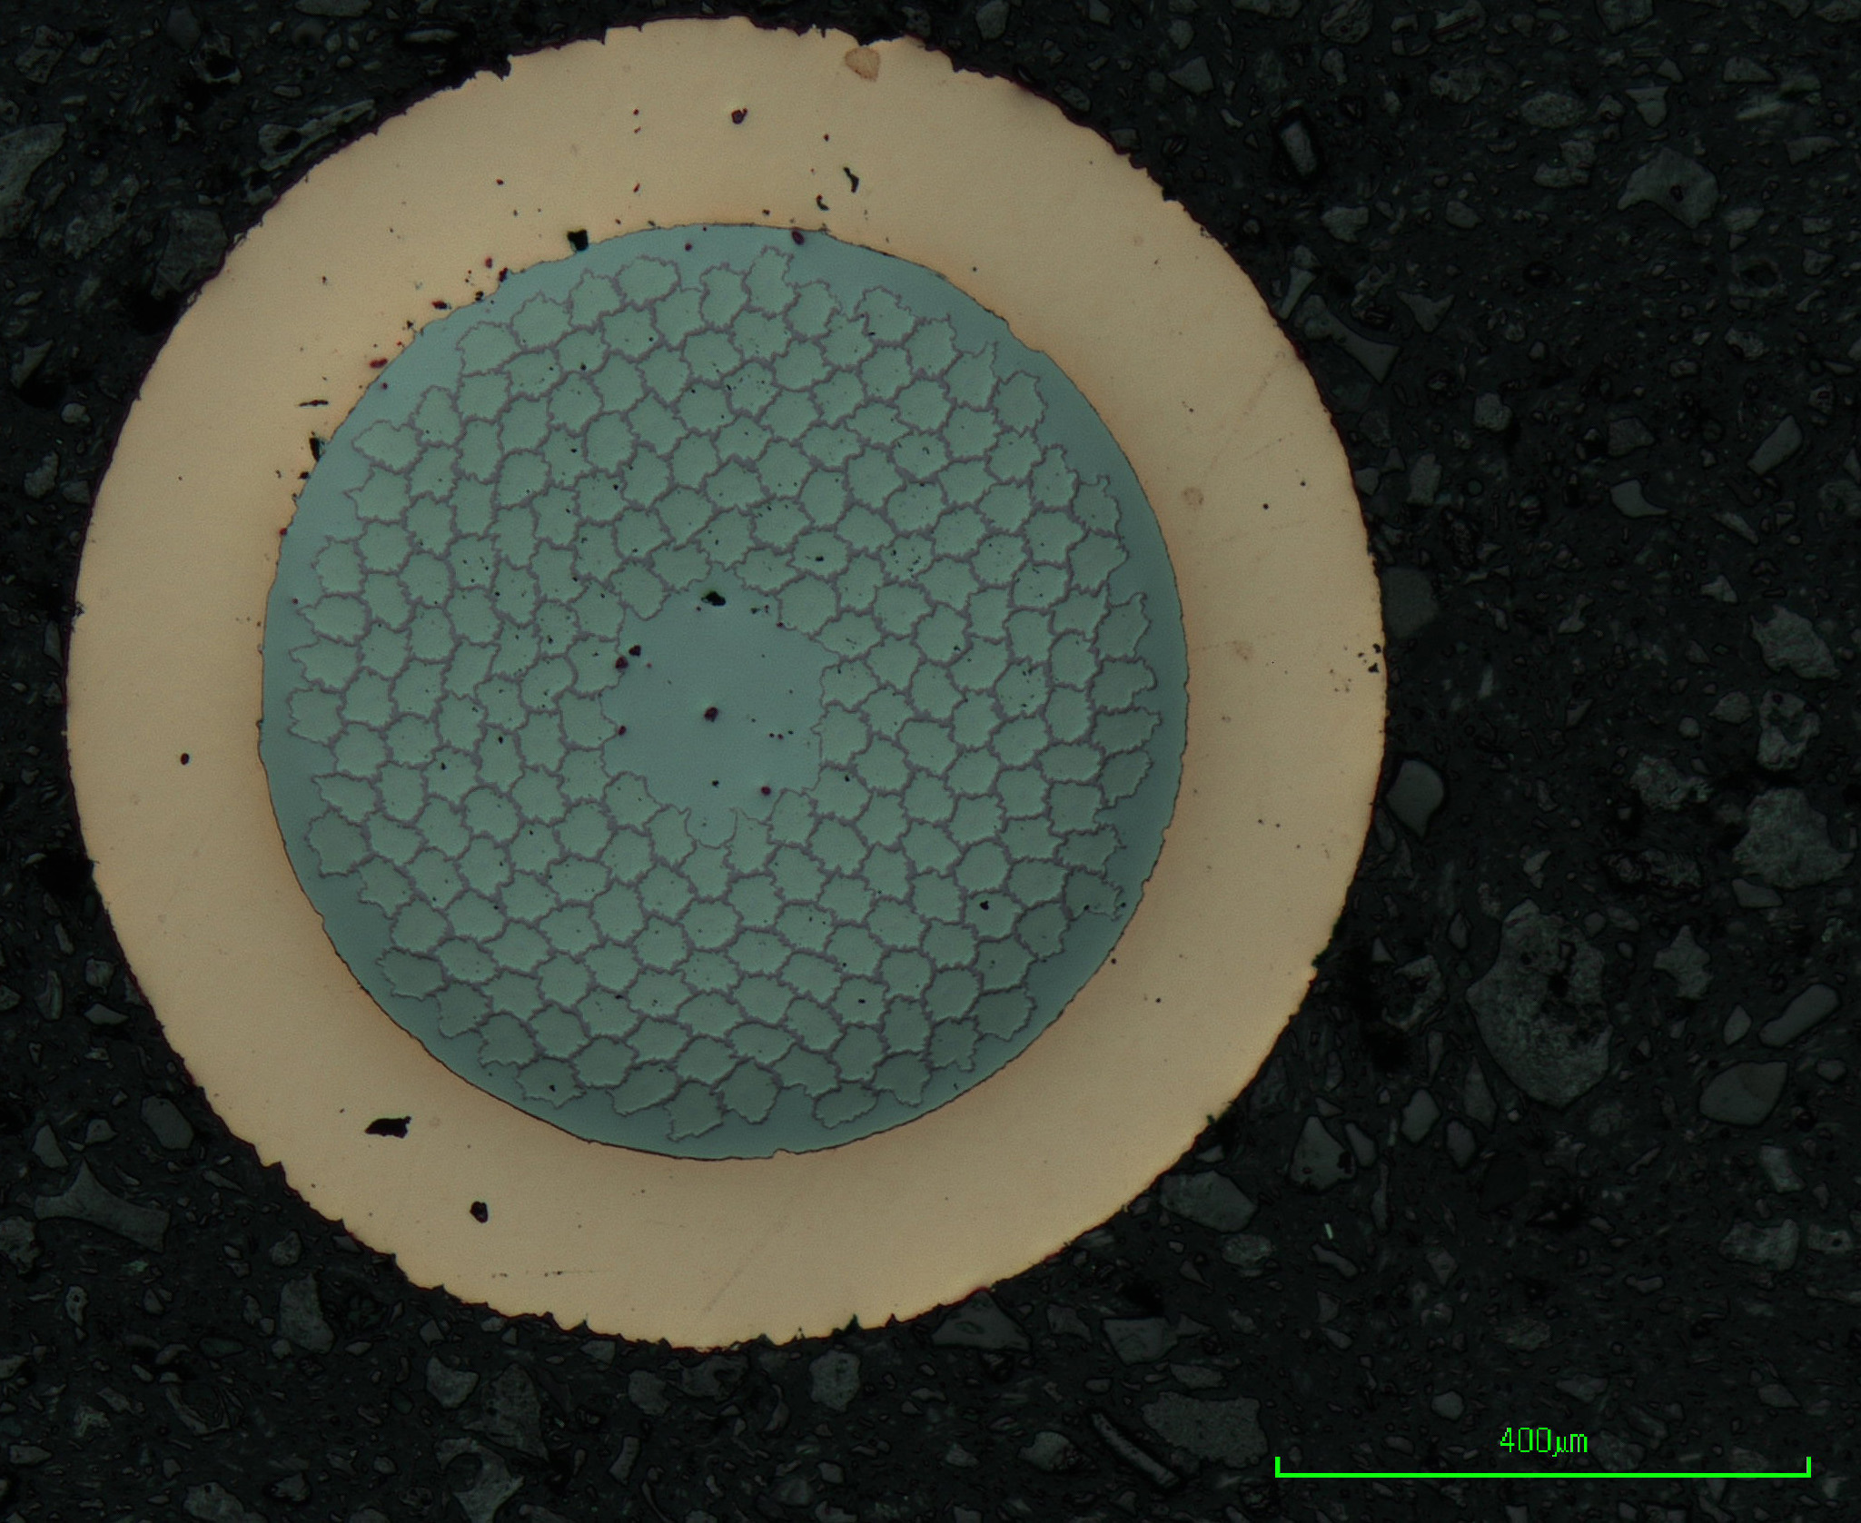
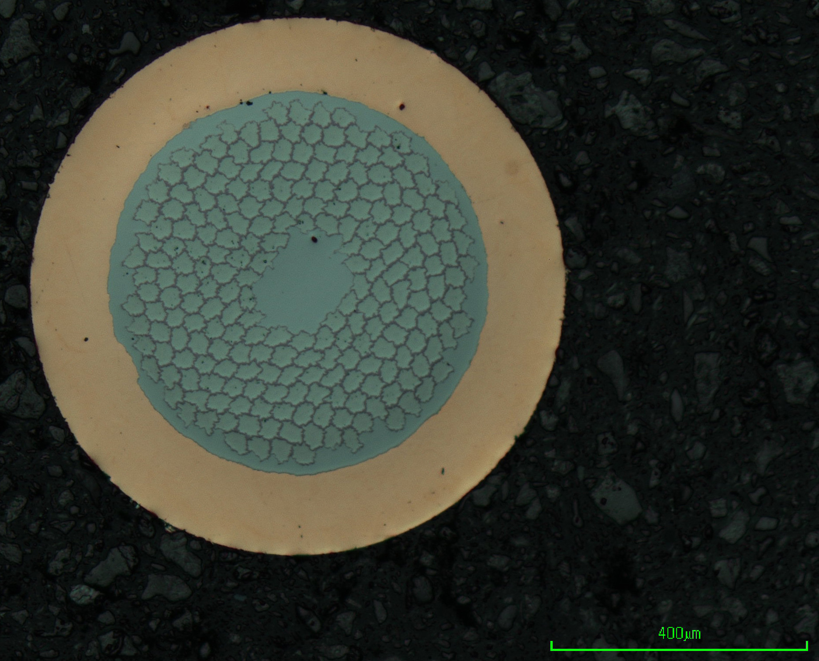
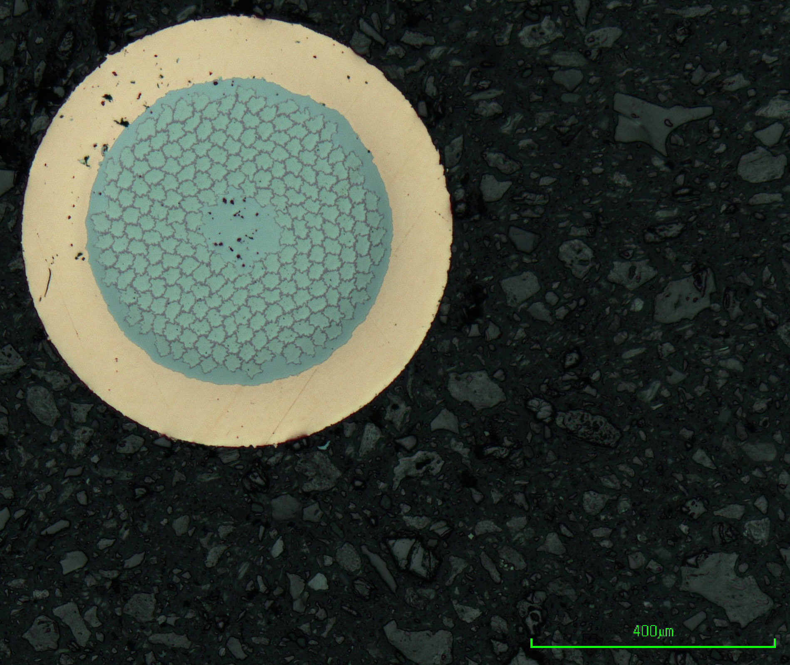
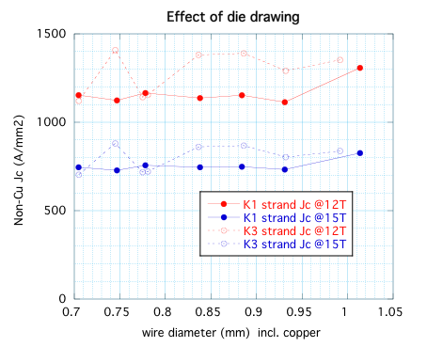
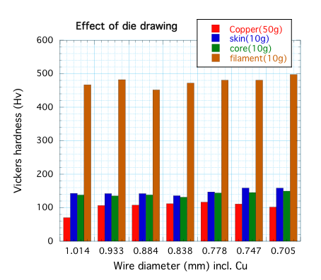
Study for die-drawing of copper plated Nb3Al wire
Motivation: Rutherford cable made from 1.0 mm dia. strands is fairly stiff and not easy to wind a coil.
→ Smaller dia. strand will relax the stiffness. Die-drawing would be one method for reducing the size of the strand.
0.99 mm dia.
0.83 mm dia.
0.70 mm dia.
Jc
HV
K1 strand

Slide 30
Contents
RHQ-Nb₃Al development
  Summary of Development, Judgment
  R&D in JFY2011 (Ta, Cu matrix and others)
Subscale Magnet Development
Conceptual Design of D1 for HiLumi LHC Upgrade
Neutron Irradiation
Radiation Resistant Materials Development
Stress/Strain Dependence Study
Procurement of Nb3Sn-bronze Cable
Summary

Slide 31
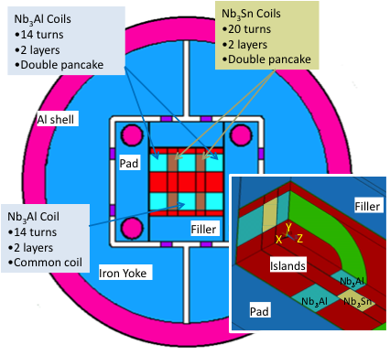
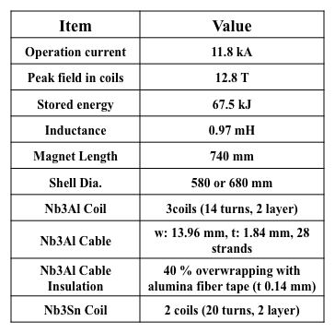
13 T Nb₃Al/Nb₃Sn Hybrid Sub-scale Magnet
*Technology Transfer from LBNL.
*Cabling at Fermilab.
Load lines
To demonstrate feasibility of Nb₃Al cable.
Key design points
- The common coil concept, and the shell structure,
- 3 Nb₃Al coils & 2 LBL-Nb₃Sn coils to increase peak field.
A good lesson to build A15 SC magnet.

Slide 32
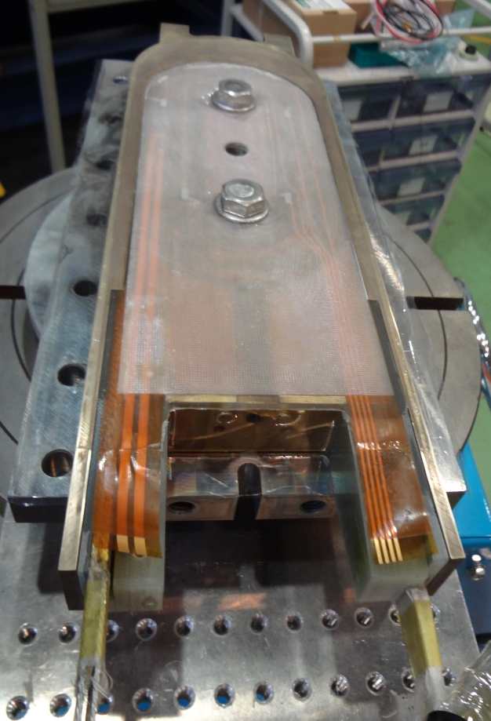
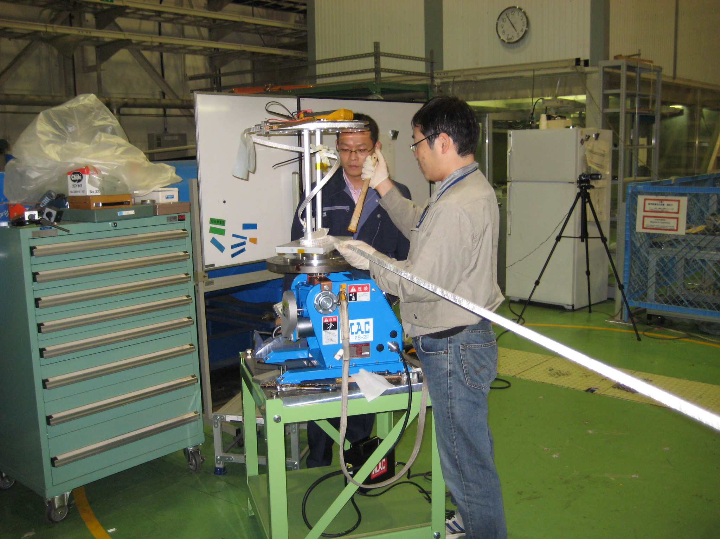
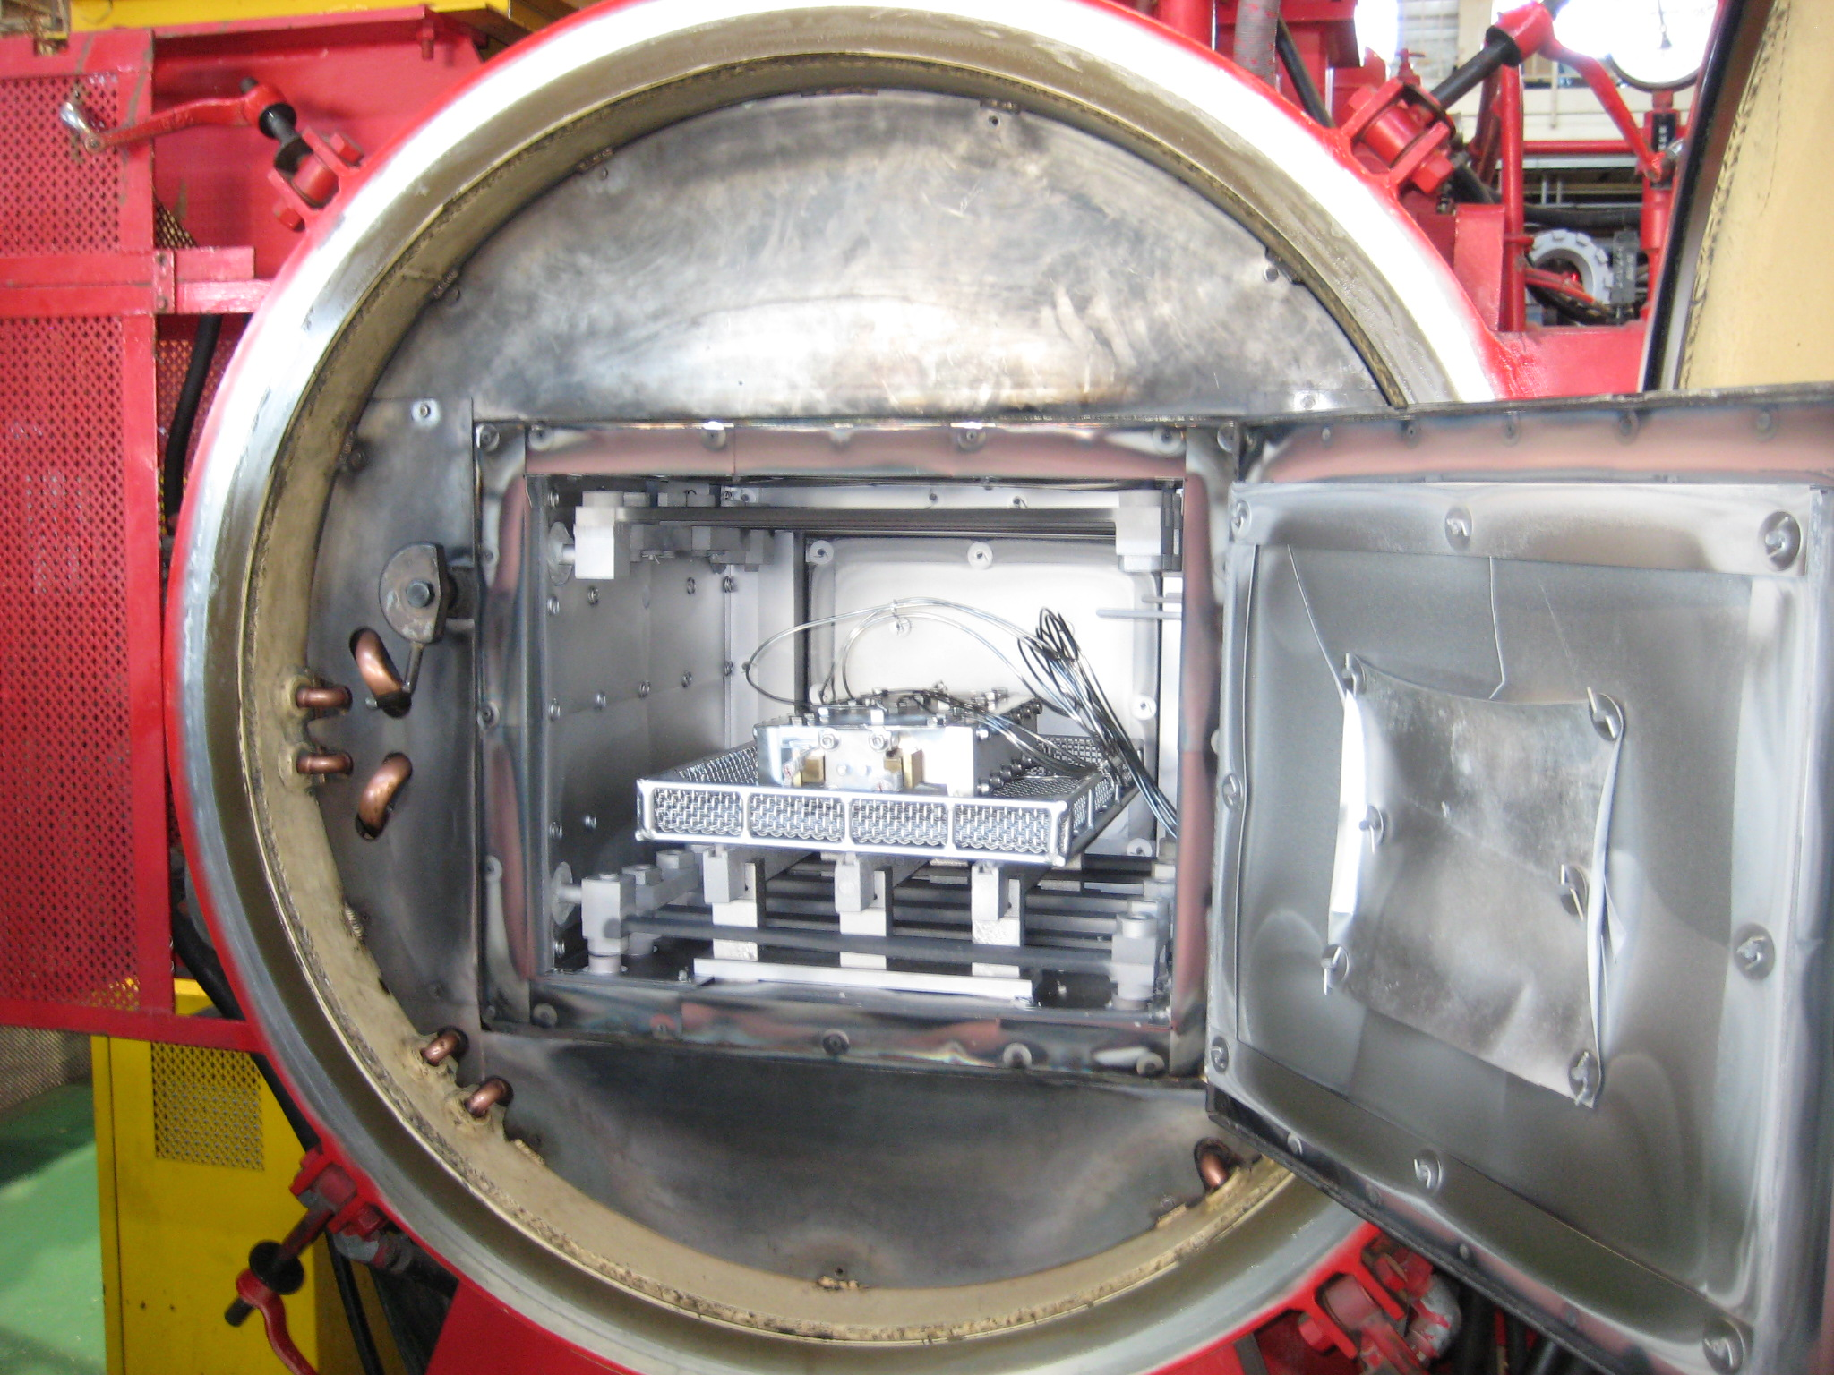
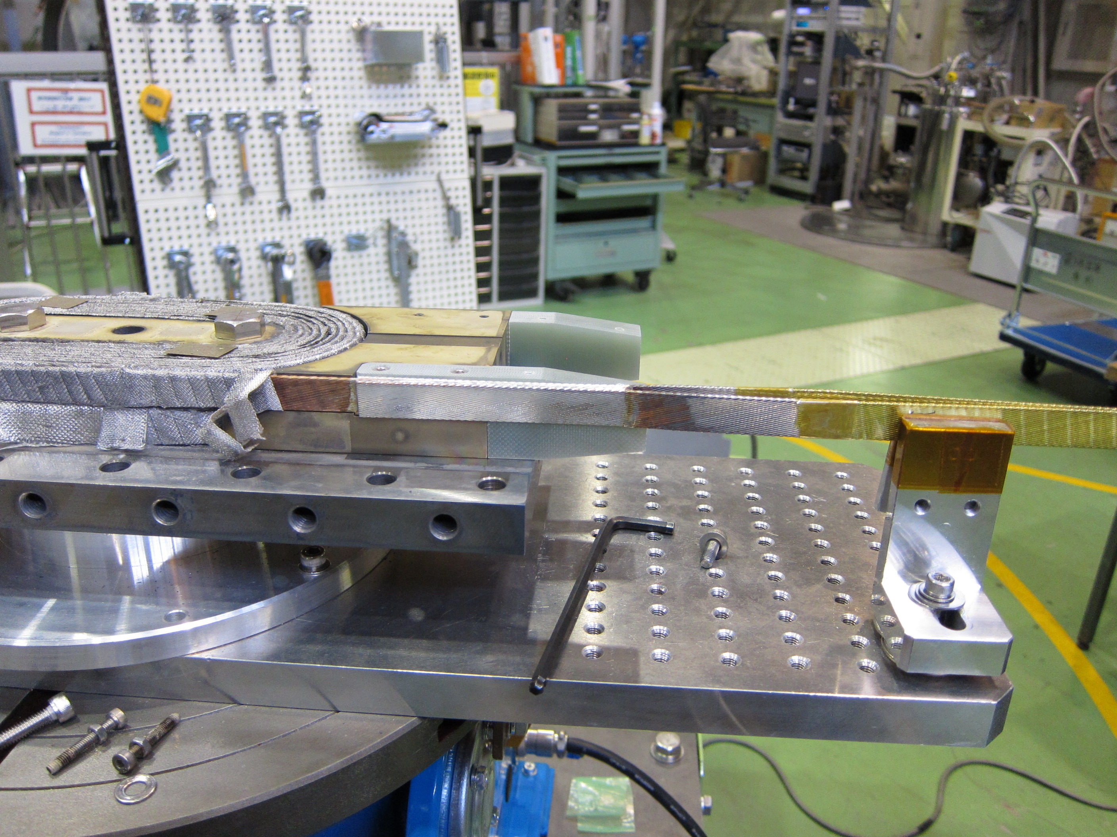
Present Status
The 1st Nb₃Al coil (K1) was completed in July, but…
  A number of popup in the cable before winding.
  Decision to use the cable as is.
  The 1st coil used for mechanical measurement.
Heat treatment of the 2nd coil (K4) was completed and impregnation will be made in Dec. No serious problem occurred so far.
Fabrication of the 3rd coil will be followed shortly.
The magnet assembly and test with 2 Nb₃Al coils and 2 Nb₃Sn coils (LBNL) configuration will be made in July 2012.
The RHQ process of the last strand (K5) will be made in Dec. Further drawing and electroplating will be completed by March 2012. But, an issue of cabling…

Slide 33
Contents
RHQ-Nb₃Al development
  Summary of Development, Judgment
  R&D in JFY2011 (Ta, Cu matrix and others)
Subscale Magnet Development
Conceptual Design of D1 for HiLumi LHC Upgrade
Neutron Irradiation
Radiation Resistant Materials Development
Stress/Strain Dependence Study
Procurement of Nb3Sn-bronze Cable
Summary

Slide 34
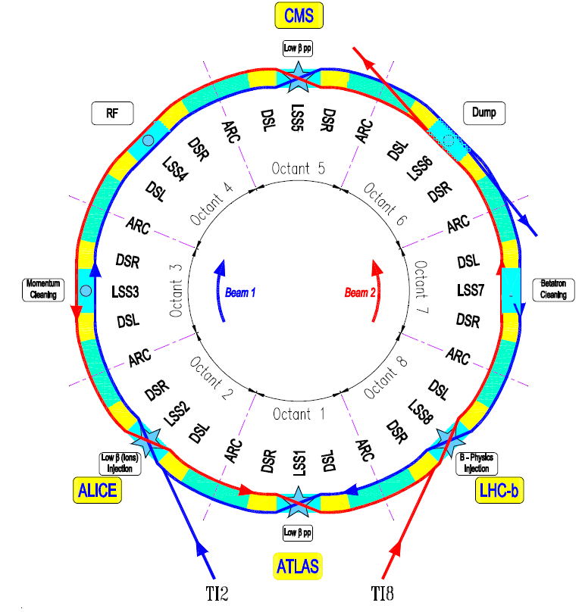
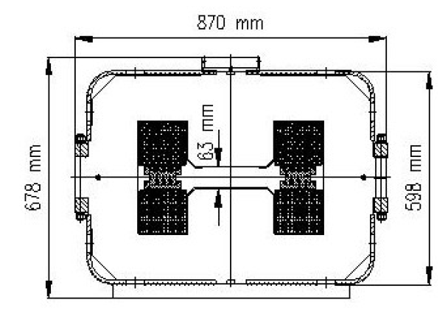
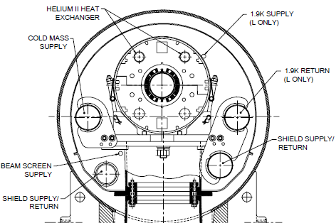
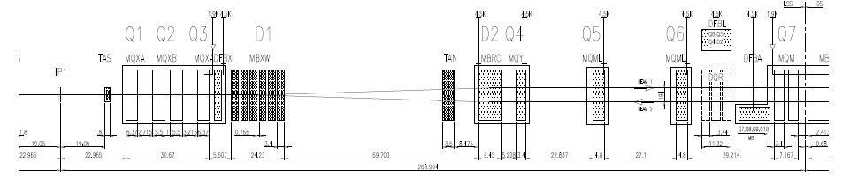
Objective: New D1 for HiLumi LHC Upgrade
Inner triplet quadrupoles (Q1-Q3) will be upgraded to have a large aperture and higher field.
>> Replacement of the current warm magnet modules D1 (nominal field 1.28T) at IR1 & IR5 by large-aperture radiation hard superconducting magnets.
Schematic layout of the LHC
Current D1 (MBXW) at IR1 & IR5
Current D1 (MBX) at IR2 & IR8
Schematic layout of the right side of IR1 (ATLAS)

Slide 35
Conceptual Design Study for D1 by KEK
Engagement in WP3(Magnets) of FP7-HiLumi LHC.
Q. Xu (KEK) stationed at CERN for 6 months/y from March 2011.
  close communication with E. Todesco.
  travel covered by Japanese grant.
Design for a large aperture dipole (φ180 mm) with RHQ-Nb3Al cable. (- Sep. 2011): canceled.
Design for a large aperture D1 dipole (φ130 & 150 mm) with NbTi cable for LHC Main Dipole as a baseline. (Nov. 2011 - )

Slide 36
Guideline of the new D1 magnet design
Coil ID: 150 mm for the 140 mm triplet
130 mm for the 120 mm triplet
(guess given by R. De Maria)
Integrated field: 40 Tm, 50% larger than today (given by R. De Maria)
Operational margin: 70 % of the loadline (lot of radiation, margin needed)
T_{op}: 1.9 K
Coil lay out: Two layers of 15 mm cable (thick coil to have larger field, lower stress, lower current density)
Conductor: Nb-Ti is baseline, ITER TF Nb₃Sn (Br) also considered.
Field homogeneity: ~ 10⁻⁴ at 2/3 bore radius
Cold mass OD: 570 mm (same as MB)
>> Fringe fields can be an issue.
Radiation, energy deposition
  "order of 10 MGy, 10²¹ /m², 10 W/m" (??) at 3000 fb⁻¹
Choices to be done:
  Support structure: Collaring yoke structure, or Shell-based structure.

Slide 37
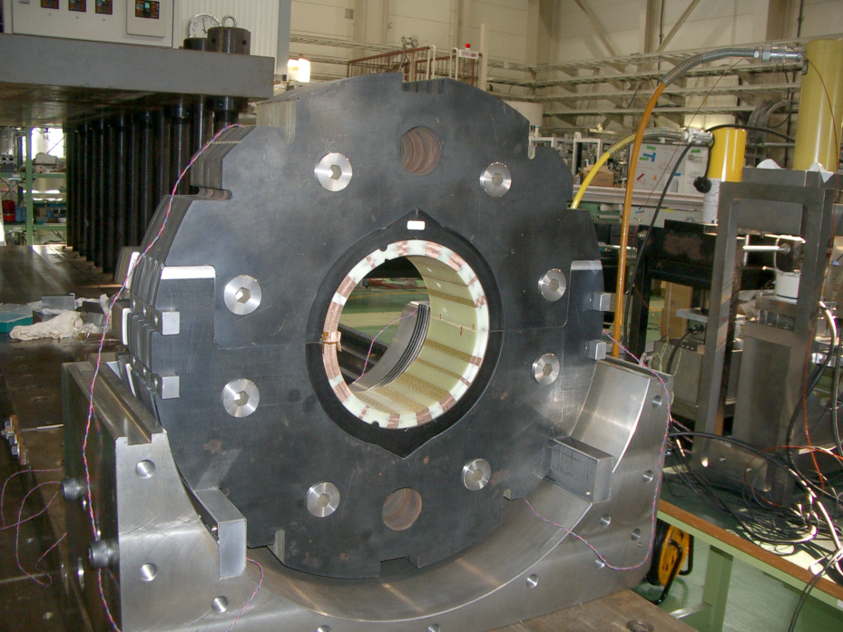
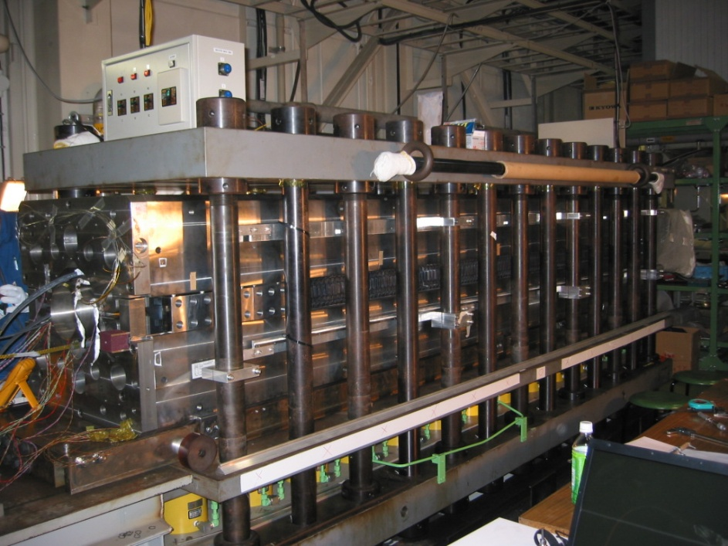
Resource and Constraint
NbTi SC cable for MQXC (leftover of the LHC main dipole cable with new insulation system enhancing cooling capability) is the baseline.
Reuse of tooling, jigs, and facilities of the J-PARC SC Combined Function Magnets.
Yoke OD of 550 mm, same as the LHC main dipole. Yoke inner shape could be modified.
Press jig for collaring-yoke (3.6 m long) can be used as is.
2300 ton hydraulic press

Slide 38
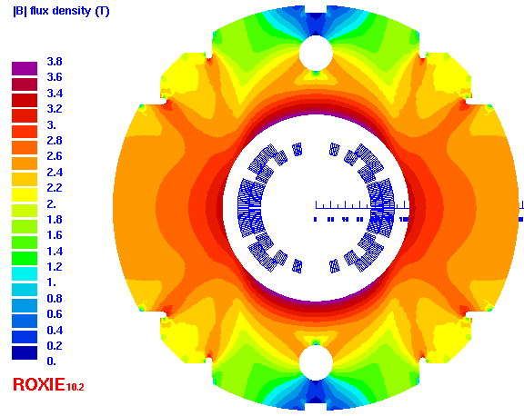
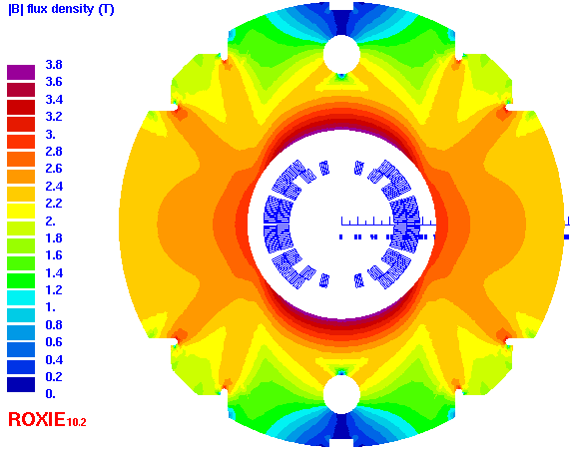
Design with NbTi LHC dipole inner cable
Bore diameter 150 mm
Item | Value |  | Ratio
Bore diameter | 150 mm (MBXE) | 130 mm (MBXD) | 1.15
Nominal field (dipole) | 6.35 T | 6.48 T | 0.98
Operating current | 9.3 kA | 9.2 kA | 1.01
Field homogeneity | <0.01% (R_{ref}=50/43 mm) |  | /
Peak field in the coil | 7.06 T | 7.08 T | 0.997
Load line ratio at 1.9 K (Inner / Outer layer) | 70% / 63.7% | 70% / 64.8% | 1
Stray field @ 0.5 m from center | 102 mT | 64 mT | 1.6
Inductance (low/nominal) | 16.1/13.6 mH/m | 12.8/10.6 mH/m | 1.28
Stored energy | 588.1 kJ/m | 448.6 kJ/m | 1.31
Peak field/central field | 1.11 | 1.09 | 1.02
Lorenz force X/Y | 2.1/0.97 MN/m | 1.96/0.86 MN/m | /
Average coil stress in mid plane | 71 MPa | 57 MPa | 1.25
Outer diameter of iron yoke | 550 mm |  | /
Strand diameter | 1.065 |  | /
Supercon. current density | 1000 A/mm² | 989 A/mm² | 1.01
Bore diameter 130 mm

Slide 39
Design with NbTi LHC dipole inner cable
Transfer function of the 2 cases with the collar width of 20 mm.
The dependence of b₃ on the operating current caused by iron saturation and filament magnetization.
Bore diameter: 130 mm
Bore diameter 150 mm
Collar thickness 20 mm
Bore diameter 130 mm
Collar thickness 25 mm
Bore diameter 130 mm
Collar thickness 20 mm

Slide 40
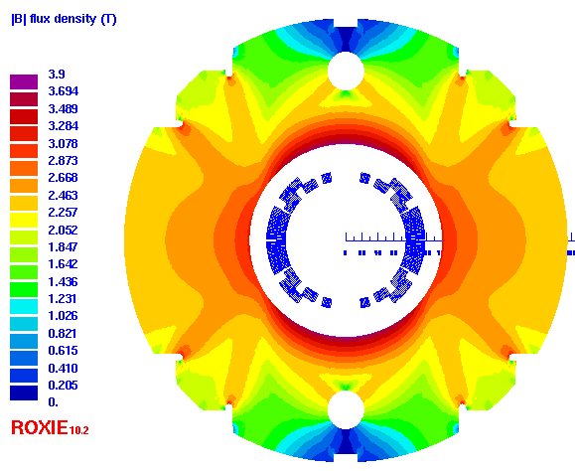
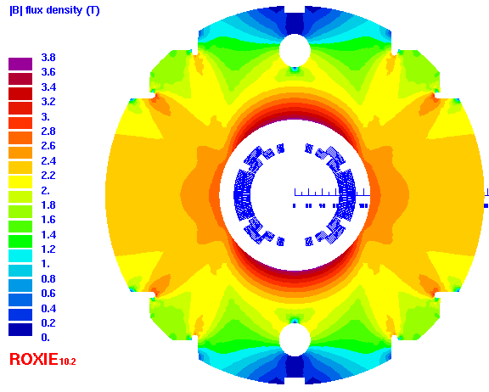
Alternative design with bronze Nb₃Sn ITER TF strand
-6 T field with 22 mm coil width-
Bore diameter 150 mm
Item | Value |  |  | Ratio
Bore diameter | 150 mm (MBXE) |  | 130 mm (MBXD) | 1.15
Nominal field (dipole) | 6.19 T |  | 6.31 T | 0.98
Operating current | 7.1 kA |  | 7.0 kA | 1.01
Field homogeneity | <0.01% (R_{ref}=50/43 mm) |  |  | /
Peak field in the coil | 7.02 T |  | 7.04 T | 0.997
Load line ratio at 1.9 K (Inner / Outer layer) | 70.4% / 64.5% |  | 70.1% / 64.8% | 1
Stray field @ 0.5 m from center | 76 mT |  | 40 mT | 1.9
Inductance (low/nominal) | 23.1 / 20.1 mH/m |  | 18.0 / 16.3 mH/m | 1.23
Stored energy | 507 kJ/m |  | 399 kJ/m | 1.27
Peak field/central field | 1.13 |  | 1.12 | 1.01
Lorenz force X/Y | 1.92/0.87 MN/m |  | 1.78/0.77 MN/m | /
Average coil stress in mid plane | 103 MPa |  | 86 MPa | 1.2
Outer dia. of iron yoke | 550 mm |  |  | /
Strand diameter | 0.82 |  |  | /
Cu/Non-Cu ratio | 0.97 |  |  | /
Cable dimension / insulation | 11.0* 1.48mm² / 0.15 mm (radial) 0.15 mm (azimuthal) |  |  | /
No. of strands | 26 |  |  | /
Keystone angle | 1.2 ° |  |  | /
Supercon. current density | 1033 A/mm² | 1018 A/mm² |  | 1.01
Bore diameter 130 mm

Slide 41
Alternative design with bronze Nb₃Sn ITER TF strand
-6 T field with 22 mm coil width-
Transfer function of the 2 cases with the collar width of 20 mm.
The dependence of b₃ on the operating current caused by iron saturation and filament magnetization.
Bore diameter
130 mm
Bore diameter: 130 mm Collar thickness 27 mm
Bore diameter 130 mm Collar thickness 20 mm

Slide 42
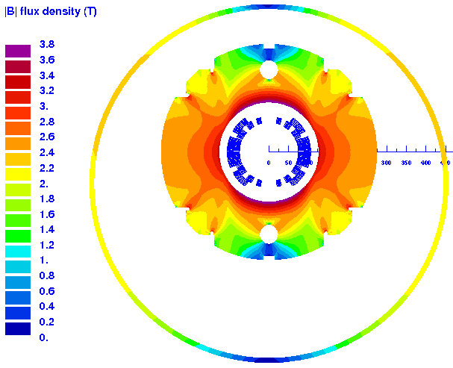
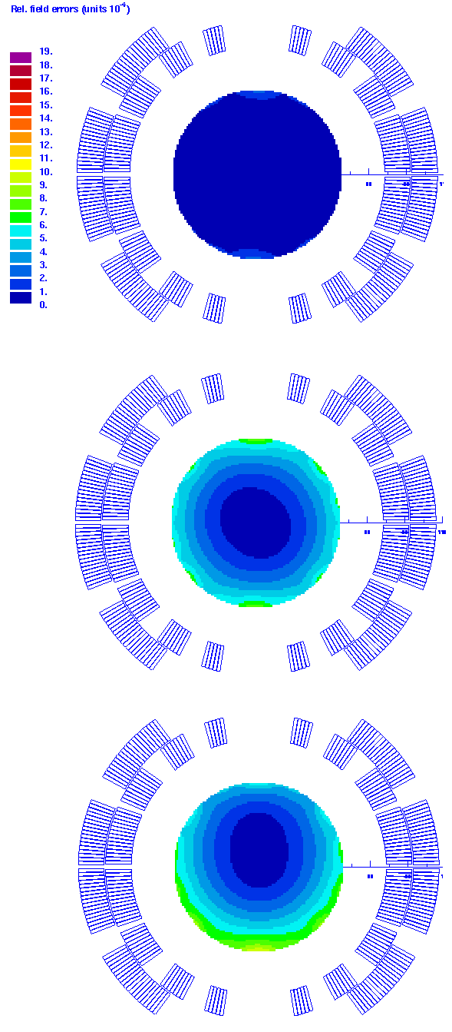
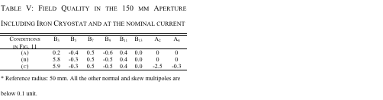
Issue: Stray field of the magnet
(A) Optimized without iron cryostat
(B) With an centered iron cryostat.
(C) With an off-centered iron cryostat.
Stray field will be issues of environment.
Magnetic force between the cold mass and the iron cryostat must be considered.
Off-centered cold mass position in the current MB cryostat affects the field quality.

Slide 43
Contents
RHQ-Nb₃Al development
  Summary of Development, Judgment
  R&D in JFY2011 (Ta, Cu matrix and others)
Subscale Magnet Development
Conceptual Design of D1 for HiLumi LHC Upgrade
Neutron Irradiation
Radiation Resistant Materials Development
Stress/Strain Dependence Study
Procurement of Nb3Sn-bronze Cable
Summary

Slide 44
Neutron Irradiation of Stabilizer at Low Temperature
Electrical resistivity ρ of stabilizers (aluminum, copper) is one of the most sensitive property in the SC magnet materials with respect to the radiation.
  Induced resistivity is remarkable at LT.
  Recovery effect starts at 20 K or higher.
The induced ρ by the radiation will compromise the quench stability and protection scheme (I.e. very high temperature after quench).
  Crucial study for magnets in high radiation area such as inner triplet magnets for HiLumi LHC Upgrade.
Anneal effect and full-recovery during warm-up to RT would be expected in aluminum, but only 80-90% recovery in copper (??).
Questions to be studied:
  Samples from the practical SC wire/cable: RRR of 100 to 500.
  Degradation may start even below 10²⁰ n/m² ?
  Fluence threshold ?
  Full recovery by full thermal cycle?
  Accumulated resistivity after multiple irradiation?

Slide 45
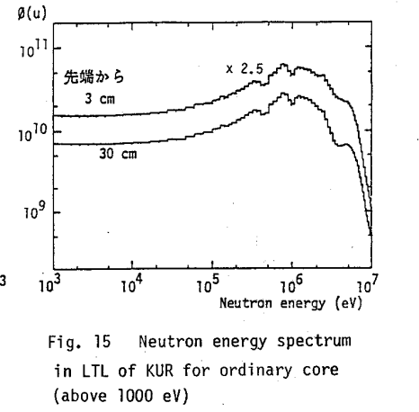
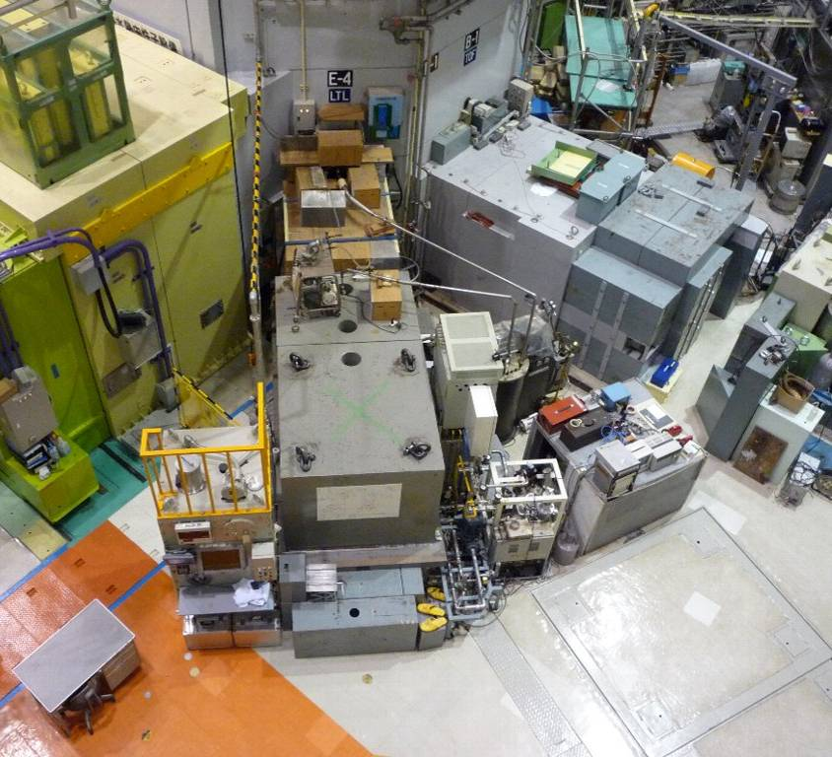
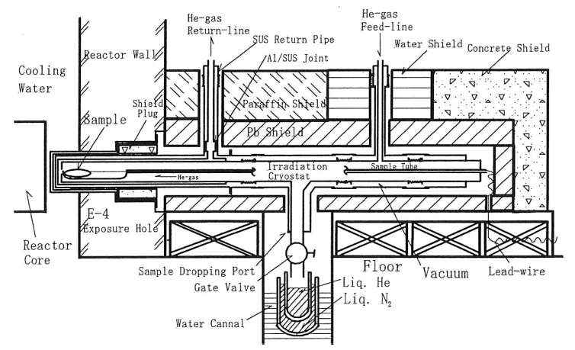
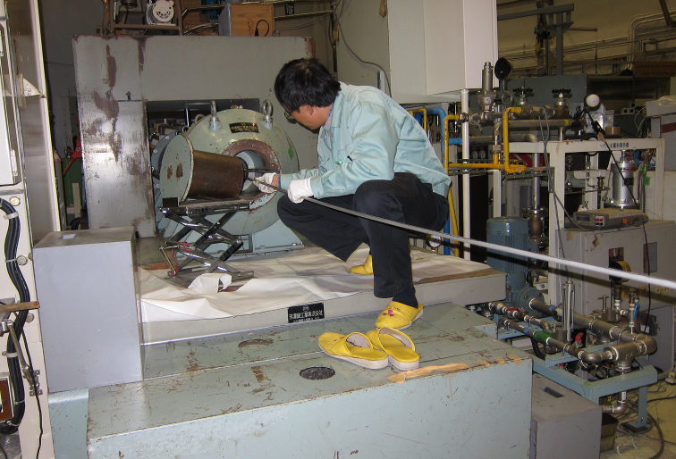
Neutron Irradiation at KUR
Synergy R&D with COMET-Mu2e, etc.
Kyoto Univ. Research Reactor Institute
５MW max. thermal power
Irradiation cryostat close to reactor core
Sample cool down by He gas loop: 10K – 20K
  Fast neutron flux (En>0.1MeV): 1.4x10¹⁵ n/m²/s@1MW
0.1MeV
KUR-TR287 (1987)
M. Okada et al., NIM A463 (2001) pp213-219
reactor
Cryogenics
Irradiation Cryostat and Shield

Slide 46




Sample and Measurement
Wire EDM
Aluminum:
  Cut by EDM from Al stabilized NbTi cable.
  5N Al + Cu(20ppm), Mg(40ppm) with 10% cold work. RRR of ~500.
  1mmx1mmx70mm, L_{v-taps} =45 mm
Copper:
  Provided by Hitachi Cable. Material for SC wire. RRR of ~300.
  φ1mmx60mm, L_{v-taps} =32 mm
5N Aluminum (for reference):
  Provided by Sumitomo Chemical. RRR of ~3000.
  φ1mmx60mm, L_{v-taps} =32 mm
4 wire resistance measurement by nano-voltmeter: Keithley 6221+2182A
Thermometers: CERNOX CX-1050-SD, TC (AuFe-Chromoel)
Neutron fluence determined by Ni foil activation method.
Aluminum sample
Copper and 5N-Aluminum samples

Slide 47

Result: Δr_{irr} for Aluminum
M. Yoshida et al., ICMC2011
Resistance (μΩ)
Fast neutron exposure at 12K @1MW*45 hrs (Nov. 2010)
Resistance was measured in situ.
Resistance increased in proportional to neutron fluence in the range of 10¹⁹-10²⁰ n/m²
  No threshold at low neutron fluence
Observed Δρ_{irr} = 0.056 nΩ.m for 2.3x10²⁰ n/m² (>0.1MeV)
  Fairly good agreement with the previous work.
    Present work: Δρ_{irr}/ Φ_{tot}= 2.4x10⁻²² nΩm³ (RRR 500, 2.3x10²⁰ n/m²)
    Previous: Δρ_{irr}/ Φ_{tot}= 1.9x10⁻²² nΩm³ (RRR 2000, 2x10²² n/m²)

Slide 48

Result: Δr_{irr} for Copper
*TC reading includes the offset of +1K.
Reactor ON
Fast neutron exposure at 14K @1MW*52 hrs (Sep. 2011)
Resistance increased in proportional to neutron fluence in the range of 10¹⁹-10²⁰ n/m²
  No threshold at low neutron fluence
Observed Δρ_{irr} = 0.022 nΩ.m for 2.7x10²⁰ n/m² (>0.1MeV)
  Agreed with the previous work within a factor of 2.
    Present work: Δρ_{irr}/ Φ_{tot}= 0.82x10⁻²² nΩm³ (RRR 300, 2.7x10²⁰ n/m²)
    Previous: Δρ_{irr}/ Φ_{tot}= 0.58x10⁻²² nΩm³ (RRR 2000, 2x10²² n/m²)

Slide 49

Result: Δr_{irr} for 5N-Aluminum
*TC reading includes the offset of +1K.
Reactor ON
Fast neutron exposure at 14K @1MW*52 hrs (Sep. 2011)
Resistance increased in proportional to neutron fluence in the range of 10¹⁹-10²⁰ n/m²
  No threshold at low neutron fluence
Observed Δρ_{irr} = 0.064 nΩ.m for 2.7x10²⁰ n/m² (>0.1MeV)
  Agreed with the previous work within a factor of 2.
    Present work: Δρ_{irr}/ Φ_{tot}= 2.4x10⁻²² nΩm³ (RRR 3000, 2.7x10²⁰ n/m²)
    Previous: Δρ_{irr}/ Φ_{tot}= 1.9x10⁻²² nΩm³ (RRR 2000, 2x10²² n/m²)

Slide 50

Result: Anneal and Recovery for Aluminum
Resistance (μΩ)
Reactor ON
A thermal cycle to RT right after the 1st irradiation (2.3x10²⁰ n/m²) in Nov. 2010.
  Before irradiation: 3.0 μΩ @10K
  After irradiation: 5.7 μΩ @12-15K
  After TC: 3.0 μΩ @12K
Full recovery of Δρ_{irr} was confirmed.

Slide 51
Discussion
Materials | Aluminum |  |  |  | Copper
 | Horak | Guinan | Present | Present | Horak | Guinan | Present
RRR | 2286 | 74 | 450 | 3007 | 2280 | 172 | 319
T_{irr} (K) | 4.5 | 4.2 | 12 | 14 | 4.5 | 4.2 | 14
Netutron Source | Reactor | 14 MeV | Reactor | Reactor | Reactor | 14 MeV | Reactor
Φ_{tot} (n/m²) (>0.1MeV) | 2 x 10²² | 1-2 x 10²¹ | 2.3 x 10²⁰ | 2.7 x 10²⁰ | 2 x 10²² | 1-2 x 10²¹ | 2.7 x 10²⁰
Δρ_{irr}/ Φ_{tot} x10⁻³¹(Ωm³) | 1.9 | 4.09 | 2.4 | 2.4 | 0.58 | 2.29 | 0.82
Recovery by thermal cycle | 100% | 100% | 100% | TBD | 90% | 80% | TBD
Degradation rate (Δρ_{irr}/ Φ_{tot} ) seems to be higher in 14 MeV neutron irradiation. Evaluation using a appropriate scaling such as DPA will be necessary.
Present work shows that difference in RRR of Al doesn't influence the degradation rate.
For copper, degradation rates (Δρ_{irr}/ Φ_{tot} ) are ranged from 0.58 to 2.29 10⁻³¹ Ωm³. What if SC cables with the initial RRR of 200 are irradiated to 10²⁰ or 10²¹ n/m²?
  10²⁰ n/m² : RRR of 160 – 190
  10²¹ n/m² : RRR of 50 – 120
Recovery by annealing in cooper sample and its multiple irradiation are planned in 2012.

Slide 52
Contents
RHQ-Nb₃Al development
  Summary of Development, Judgment
  R&D in JFY2011 (Ta, Cu matrix and others)
Subscale Magnet Development
Conceptual Design of D1 for HiLumi LHC Upgrade
Neutron Irradiation
Radiation Resistant Materials Development
Stress/Strain Dependence Study
Procurement of Nb3Sn-bronze Cable
Summary

Slide 53





Development of Radiation Resistant Materials
Synergy development with J-PARC beam line magnets and COMET-Mu2e.
New Cyanate Ester base resin for accelerator HFM application (LHC upgrade)
  60 Cyanate Ester / 40 Epoxy
  low viscosity, reaction < 150 °C
  pot life: 24hr@ 60 °C, < 20 cP
Development of insulation coating technologies on metallic parts (i.e. end spacers, wedges)
  Ceramic spray
  Polyimide coating by Vapor Deposition Polymerization technology.
Materials development using BT (Bismale-imide Triazine) resin and Cyanate Ester/Epoxy resin.
  Necessary for the new D1!!
  Prepreg tape (curing at 150 °C)
  GFRP
BT resin: e irradiation
(T. Sasuga, Polymer Vol. 27, 1986, 681)
Plan: Gamma-ray irradiation at JAEA-Takasaki

Slide 54
Contents
RHQ-Nb₃Al development
  Summary of Development, Judgment
  R&D in JFY2011 (Ta, Cu matrix and others)
Subscale Magnet Development
Conceptual Design of D1 for HiLumi LHC Upgrade
Neutron Irradiation
Radiation Resistant Materials Development
Stress/Strain Dependence Study
Procurement of Nb3Sn-bronze Cable
Summary

Slide 55




Stress/Strain Issues in High Field Magnet
Local strain at cross over of Rutherford-type A15 SC cable in the magnet?
Effect of mechanical reinforcement by resin impregnation?
For A15 SC and HTS
Neutron diffractometer at J-PARC with 10-stack cable sample under various loads is a nice tooling to study …

Slide 56



Neutron Diffraction Measurement at J-PARC
Synergy R&D with JAEA, Tohoku Univ.
Severe damage of the BL-19 at J-PARC MLF due to disaster of the earthquake March 11 2011. Repair work will be finished by March 2012.
Beam commissioning of J-PARC has started in Dec. 2011.
Proposal of beam time (2012A) for the commissioning of the cryogenic load frame with Nb3Al and Nb3Sn wires has been submitted.
Preliminary measurement of Nb3Sn-PIT wire was performed in Feb. 2011. Further research plan will be discussed with C. Scheuerlein from CERN in Feb. 2012.
Neutron diffractometer at J-PARC MLF BL-19 (TAKUMI).
A cryogenic load frame (4 K, 50 kN) has been developed.
Diffraction peaks of RHQ-Nb₃Al at 4 K for commissioning.

Slide 57


Matrix Dependence on Residual Strain of Nb3Al
3 different matrix wires: All Ta, Ta+Nb, All Nb
No copper stabilizer
Residual strain induced by different thermal contraction and rigidity of composites.
Example of multi-peak analysis.
ε (%)
ε (%)

Slide 58


In-situ neutron diffraction of Nb3Al at 800 °C
Sample (20mm, 12 pieces)
Infrared heater in vacuum
RT - 800°C / 1 hr, at 800 °C 11 hr, 800 °C – RT.
Nb3Al phase generation during heat reaction at 800 °C
Warm-up
Hold at 800 °C
320 peak intensities normalized by Cu-220 peak.
A15 phase seems to be generated instantly right before or at 800 °C.
Generation rate during holding at 800 °C is small (or even zero).

Slide 59


Jc Dependence of Axial Tensile Strain
In collaboration with High Field Lab. in IMR-Tohoku Univ.
RHQ Nb3Al
Jc under axial tensile stress at 18 T.
Strain gages on wire.
K2
K3
Irreversible damage at 0.3 to 0.35 %.
No degradation (almost constant) up to 0.25 %: different behavior with Walter Spring.

Slide 60
Contents
RHQ-Nb₃Al development
  Summary of Development, Judgment
  R&D in JFY2011 (Ta, Cu matrix and others)
Subscale Magnet Development
Conceptual Design of D1 for HiLumi LHC Upgrade
Neutron Irradiation
Radiation Resistant Materials Development
Stress/Strain Dependence Study
Procurement of Nb3Sn-bronze Cable
Summary

Slide 61
Procurement of Nb3Sn Bronze Cable
Strand: 10 km long. For ITER-TF but w/o chromeplating. Leftover for ITER production.
Rutherford-Cable: 24 strands. 400 m long. Parameters proposed by Hitachi Cable.
  Facility is not appropriate for the cabling with "accelerator quality". Less dimension accuracy.
  In-house trial by Jan. 2012. If successful, 400 m long cabling will be followed.
  If trial fails, cabling might be made in different vendor. (Furukawa?)
  Possibility of cabling in CERN??
The 400 m long cable will be used for
  Degradation due to cabling,
  Dimension measurement before/after H.T.
  10 stack mechanical measurement,
  Subscale coil winding.

Slide 62
Contents
RHQ-Nb₃Al development
  Summary of Development, Judgment
  R&D in JFY2011 (Ta, Cu matrix and others)
Subscale Magnet Development
Conceptual Design of D1 for HiLumi LHC Upgrade
Neutron Irradiation
Radiation Resistant Materials Development
Stress/Strain Dependence Study
Procurement of Nb3Sn-bronze Cable
Summary

Slide 63
Summary I
KEK and NIMS has developed RHQ-Nb3Al superconductors for high field accelerator application for about 10 years. While the non-copper Jc still stays at about half of Nb3Sn-RRP, the RHQ-Nb3Al shows better magnetization behavior and mechanical robustness.
However, breaking at wiredrawing is the critical issue. The Ta-matrix wire has been our baseline for the development, but not successful so far. While the Cu-matrix wire shows much better performance in wiredrawing, demonstration of a long wire processed by a continuous RHQ facility should be necessary.
  Even though RHQ-Nb₃Al superconductor has a potential to be utilized for the high field accelerator application, it was judged that RHQ-Nb₃Al will not be ready for the HiLumi-LHC upgrade.
  Wire development with small amount as a fundamental R&D will be continued.

Slide 64
Summary II
A 13T hybrid subscale magnet has been developed to demonstrate feasibility of Nb3Al cable. Serious strand pop-up occurred in K1 cable and the coil will not be used for the magnet assembly. K4 coil fabrication has been successful so far and will be impregnated soon. K3 coil will be followed. Magnet assembly and cold test with 2 Nb3Al coils and 2 Nb3Sn coils will be carried out by summer 2012.
Conceptual design of a large aperture dipole magnet for beam separation (D1) was started. Q. Xu sent to CERN has been intensively engaged in this task. The following items should be carefully considered:
  Stress management,
  Radiation resistant material,
  Cooling capability with superfluid helium for large energy deposition by radiation,
  Iron saturation effect on field quality and stray field in the off-centered cryostat,
  Reuse of tooling, jigs, and facility for J-PARC SCFM.

Slide 65
Summary III
The neutron irradiation tests at KURR for stabilizers (copper, aluminum with RRR of 300 or better) were successfully performed. The results of the degradation rate are consistent with the previous work within a factor of 3. More accurate comparison should be made with an appropriate scaling such as DPA. In terms of copper sample, recovery behavior and damage accumulation after thermal cycle to RT will be tested 2012.
Radiation resistant material development has been started for prepreg tape, GFRP. Baseline materials are BT(Bismaleimide Triazine) resin and Cyanate Ester resin. Development of insulation coating on metal parts has been started as well.
Study on strain behavior of A15 type superconductors is underway by using facilities of J-PARC pulsed neutron source and HFM lab at Tohoku Univ.

Slide 66
Accounting of CERN-KEK Collab.
(Unit: JYen)
 |  | JFY 2009 Closing | JFY 2010 Closing | JFY 2011 As of Today | JFY 2011 Prediction
Magnet R&D | Jigs, Yoke, Shell |  | 2,088,790 | 2,377,581 | 2,377,581
 | Coil | 3,816,210 | Own Effort | 1,927,800 | 2,449,627
 | PS, DAQ, Cryostat | 2,414,430 | 0 | 0 | Own Effort
Wires and cable for the magnet | Further processes for the previous year's precursor | 6,226,080 | Carry over 2.5MJYen | 2,500,000 | 2,500,000
 | Precursor (1 km) | 6,636,000 | Carry over 7.0MJYen | 0 | To be canceled
 | Cabling | Fermilab Collab. | Fermilab Collab. | - | -
 | consumable | 1,273,125 | 4,470,046 | 261,647 | 261,647
 | Long wire production R&D | 0 | 5,899,950 | Own Effort | Own Effort
Fundamental Study | 15T Solenoid, Jc Stress Depend. | 13,488,300 | 0 | 0 | Own Effort
 | Thermal conductivity meas. | 3,777,900 | 155,400 | 0 | Own Effort
 | Cyanate ester resin, Gamma ray irradiation | 1,102,668 | 247,594 | 1,721,357 | 1,721,357
 | Neutron diffraction, Strain Study | 10,124,887 | 1,725,484 | 536,573 | 536,573
 | Short strand R&D | 4,326,272 | 1,447,793 | 0 | 0
 | Fellow | - | - | 3,713,541 | 6,900,000
Travel Expenses |  | 814,128 | 4,464,943 | 1,353,215 | 1,753,215
Total |  | 54,000,000 | 20,500,000 | 14,391,714 | 18,500,000
Total 93 MJYen for JFY2009-2011
(Initial proposal was 105 MJYen)

Slide 67
Appendix

Slide 68
Parameters for ITER Bronze Wire

Slide 69

Appendix: Slides from Dec. 2008

Slide 70

Appendix: Slides from Dec. 2010

Slide 71

Appendix: Slides from Dec. 2010

