Slide 1
R&D Plan Proposal for CERN-KEK Collaboration
Tatsushi NAKAMOTO
KEK
CERN-KEK collaboration: Magnet R&D Review at CERN, Dec. 13, 2011.

Slide 2
Future LHC Upgrades and Collaboration Frameworks
Next Slides
Time Scale
Current R&D Collaboration Framework:
  NbTi, A15 SC
  High Field ~ 13 T
  Radiation Resistant
2020
HiLumi LHC Upgrade
Another R&D Collaboration Framework:
  HTS
  High Field ~ 20 T
2030?
HE LHC Upgrade

Slide 3
New Grants Approved and New R&D Plan
"Strategic Young Researcher Overseas Visit Program for Accelerating Brain Circulation" (Prof. K. Tokushuku, KEK) for JFY 2010-2012 was approved.
  Covering travel expenses to/at CERN for Q. Xu as well as relevant supervisors (A. Yamamoto, T. Nakamoto, others).
In July 2011, a new Japanese research grant (KAKENHI) related to the LHC experiment until 2016 was approved for a research consortium including KEK.
  “Development of high field accelerator magnet” is one of the research subjects in this project and about 10 MJYen per year will be provided until JFY2015 (totally 50 MJYen for 5 years).
Support from Cryogenics Science Center at KEK and D.G.
  e.g.) Repair of a power supply. Renovation of test stand for the subscale magnet (17 MJYen) in Dec. 2011.
Combining with the CERN-KEK collaboration budget (71 MJYen remaining), we would like to propose ”Development towards the D1 beam separation dipole magnet for the HiLumi LHC upgrade” and "Fundamental R&D for high field, radiation resistant accelerator magnets".

Slide 4
Development towards the D1 Beam Separation Dipole Magnet
Mainly covered by CERN-KEK budget
Participation of KEK (beneficiary w/o funding) to EC-FP7: HiLumi LHC.
Conceptual Design of NbTi (or Nb3Sn) magnet for the D1 beam separation dipole under high radiation environment.
  Conceptual design for HiLumi LHC by Q. Xu stationed at CERN with a support of Japanese grant.
  NbTi is a current baseline. Final choice of the conductor (NbTi or Nb₃Sn) in the middle of 2012.
Engineering design as a cooperative work with an industry (multiple years) will be followed.
Specification: 40 Tm, 130-150 mm single aperture, modest field (6 T).
Issues to be solved
  stress management in a large aperture coil,
  radiation resistance (~10²² n/m², several 10 MGy),
  cooling capability with HeII under large energy deposition (~100 W),
  iron saturation on field quality.

Slide 5
Development towards the D1 Beam Separation Dipole Magnet (continued)
Deliverables: Design study report. Engineering design including a set of drawings for the cold mass fabrication.
  Note: Performance evaluation of the model magnet is absolutely necessary before starting construction of the production magnets. However, development and test of the 1.5 m long model magnet CANNOT be made within the current budget and resources. Therefore, we would like to request a NEW BUDGET to the Director Generals of KEK and CERN to complete the model magnet program including the conceptual design study, engineering design, construction and testing of the model magnet. A cross-sectional mechanical model (0.2 m long) including the practice coil fabrication would be made within the current budget.
Cost effective development by reuse of jigs, tooling and facilities of the J-PARC SCFM.

Slide 6
Fundamental R&D for High Field, Radiation Resistant Accelerator Magnets
Mainly covered by the Japanese grant, resources
Most of the following items are continuation of the current activity.
Magnet assembly and testing of a hybrid (Nb₃Al and Nb₃Sn) sub-scale magnet at KEK.
  4 coils & 5 coils configurations
  Completion of K5 strands and cabling
Fundamental study on Nb₃Sn-bronze strand/cable
  Back up for the D1 model with NbTi
  degradation by cabling, mechanical property with 10 stack samples, sub-scale magnets.
Stress/strain dependence study at the neutron diffractometer at J-PARC and the High Field Lab. in Tohoku Univ.
Support to develop RHQ-Nb₃Al
  Cu-matrix wire: demonstration of continuous RHQ process,
  Ta-matrix wire: improvement of wire breaking
  Development of a mirror quadrupole magnet with the RHQ-Nb3Al cable in collaboration with Fermilab.

Slide 7
Fundamental R&D for High Field, Radiation Resistant Magnet (continued)
Radiation resistant materials development
  Radiation resistant resin (BT, Cyanate Ester) for prepreg tape, GFRP.
  Insulation coating on metal parts: polyimide, ceramic spray
  Gamma-ray irradiation test (RT, LN2??) at JAEA-Takasaki
Low temperature neutron irradiation test at KUR
  Stabilizer (cooper, aluminum) for superconductor
  recovery behavior (annealing effect)

Slide 8
R&D Plan and Budget Proposal
Mainly covered by CERN-KEK budget
Unit: kJYen
 |  | 2011 | 2012 | 2013 | 2014 | 2015 | item total
D1 model development | conceptual design | 1.2 FTE Grant | 1.2 FTE Grant | 1.2 FTE Grant |  |  | 3.6 FTE year
 | engineering by industry |  | 10000* | 10000* | 10000* | 9000* | 39000
 | fellow/CAD engineer |  | 7000 | 7000 | 7000 | 7000 | 28000
 | hardware | - | - | - | - | - | (81000)
 | insulated NbTi cable |  |  |  |  |  | 5000
 | Cold Test |  |  |  | - | - | (20000)
 | Travel |  | 1000 | 1000 | 1000 | 1000 | 4000
 | sub-total (money transfer from CERN) |  | 18000* | 18000* | 18000* | 17000* | 71000
Fundamental R&D | radiation resistant materials | 3000+1000 |  | 1000 | 2000 | 2000 | 9000
 | irradiation test (gamma rays, neutron, LN2) | 0 + (4000) |  | (4000) | (4000) | 0 | (12000)
 | stress/strain study for A15, HTS | 1000 + 1000 |  | 1500 | 1500 | 1000 | 6000
 | thermal cond. study | 0 + 2000 |  | 500 | 500 | 500 | 3500
 | RHQ-Nb3Al Sub-scale magnet | 0 + 7500 |  | 4000 | 500 | 500 | 12500
 | Nb3Sn Sub-scale magnet | 6000 + 2000 |  | 2000 | 1500 | 1000 | 12500
 | RHQ-Nb3Al SC | 0 + 500 |  | 4000 | 0 | 0 | 4500
 | Travel | 0 + 1000 |  | 1000 | 1000 | 1000 | 4000
 | sub-total | 25000 |  | 14000 | 7000 | 6000 | 52000
Total |  | 43000* |  | 32000* | 25000* | 23000* | 123000
*Profile is not clear yet.
Not included.
Mainly covered by Jap. grants.
To be provided by CERN
Not included.
Not included.
Additional budget to complete the program: 113 MJYen

Slide 9
Future LHC Upgrades and Collaboration Frameworks
Time Scale
Current R&D Collaboration Framework:
  NbTi, A15 SC
  High Field ~ 13 T
  Radiation Resistant
2020
HiLumi LHC Upgrade
Another R&D Collaboration Framework:
  HTS
  High Field ~ 20 T
2030?
HE LHC Upgrade

Slide 10
R&D Collaboration in Another Framework
In collaboration with Kyoto University and other institutes, KEK is developing fundamental technologies of accelerator magnets using HTS tapes for cancer therapy and accelerator driven sub-critical reactor.
KEK will keep this effort in future and the technology will be extended to a high field accelerator magnet development that may contribute HE-LHC.
KEK has discussed with CERN to be an associate partner (no obligation) of Eucard2 for HE-LHC.

Slide 11
Summary
New Japanese grants approved regarding HiLumi LHC upgrade. In combination with the CERN-KEK budget, development towards the beam separation dipole magnet (D1) is proposed as a main item of the collaboration in JFY2012-2015.
  Participation of KEK (non-beneficiary) to EC-FP7: HiLumi LHC.
  Design study report will be the deliverable.
  Apart from this, we would like to request the additional budget (~110 MJYen), which is necessary to complete the model magnet development and its performance evaluation.
Fundamental R&D for high field, radiation resistant accelerator magnets is also proposed. New materials development for the D1 is included.
To carry out the R&D program above, the money transfer of 8 MJYen for JFY2012 is requested. In 4 years until JFY 2015, a total amount of money transfer will be ~71 MJYen (= 831,310.52 CHF).
A new R&D collaboration for development of high field accelerator magnets using HTS technology towards HE-LHC has been discussed between CERN and KEK.

Slide 12
Appendix

Slide 13
Some information and comments
Remaining amounts in the account T290320 is 831,310.52 CHF as of Sep. 29, 2011. >> 71,000 kJYen
Cost estimates from the industry is the following.
Yoke dies modification + New set of collar dies >> 25,000 kJYen added in "Materials".
For the cold test at KEK, some renovation cost will be necessary. It is still possible to carry out the cold test at CERN instead of KEK.
Unit: kJYen
 | 1st estimate by an industry | revision by TN at 11 Nov., 2011
Material | 35480 | 60480
Assembly | 31860 | 16764
Test | 1770 | 1770
Design | 78890 | 39445
Administration | 37000 | 14495
Discount | -30000 | -13000
Tax | 7750 | 5498
Total | 162750 | 125452

Slide 14
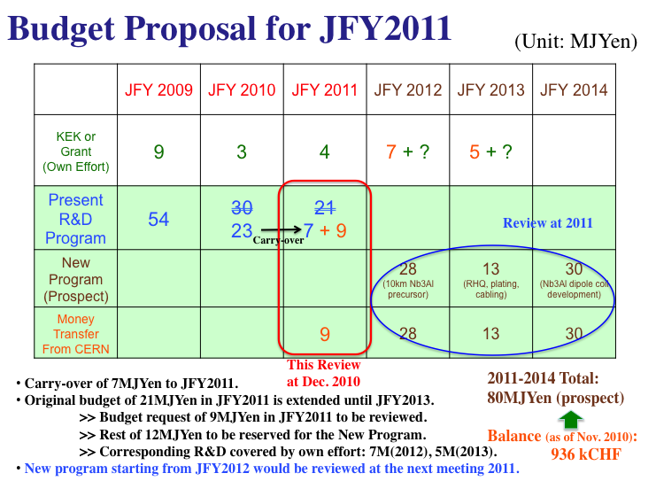
Appendix: Slides from Dec. 2010

Slide 15
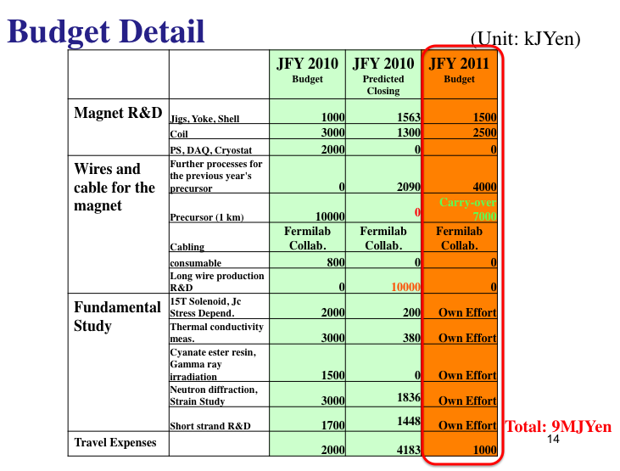
Appendix: Slides from Dec. 2010

