Slide 1
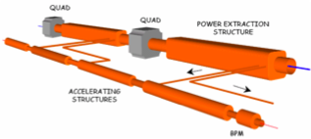
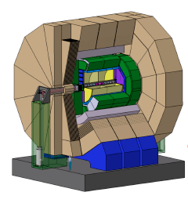
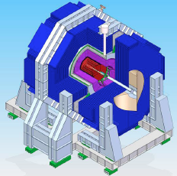
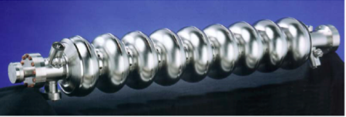
KEK/Japan – CERN Collaboration on Linear Collider Studies
Collaboration on LC detector and physics study
Collaboration on CLIC/ILC machine study
  Status of CDR
  Highlights of ongoing collaboration
Plans at CERN in the coming years

Slide 2
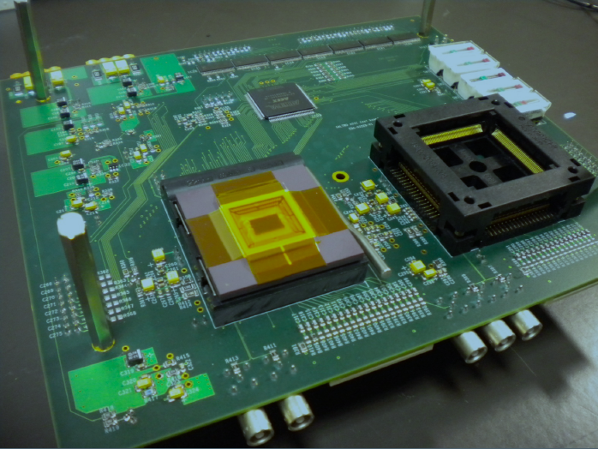
ILD detector concept studies
Physics, event generation + grid
LCFI flavour tagging for LC
Active, though informal, collaboration between KEK and CERN on Linear Collider Detectors. For ILC and CLIC, based on ILD detector concept.
Collaboration based on mutual interest.
Particular mention of collaboration:
Various editors of the CLIC physics&detector CDR editing:
A. Miyamoto (KEK), Y. Makida (KEK), T. Matsuda (KEK), T. Takeshita (Shinsu Univ.)
Collaboration on physics studies, event generation, and grid production at KEK and CERN:
A. Miyamoto (KEK), T. Tanabe (Univ. of Tokyo)
Common LCFI flavour tagging package for Linear Collider:
By Univ. of Tokyo (T. Tanabe, T. Suehara), KEK, etc.
R&D on Linear Collider TPC with GEMs and Pad readout
SAltro16 electronics: K. Fujii (KEK), T. Matsuda (KEK) et al.

Slide 3
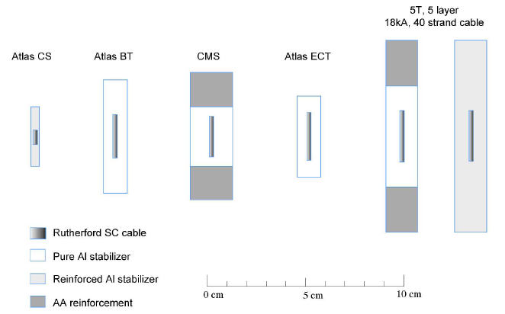
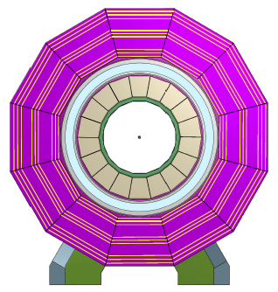
Detector magnet system R&D
ILD detector solenoid
4 Tesla, 3.4 m inner bore
Collaboration with KEK on:
  Common R&D on reinforced superconductor for ILC and CLIC detector solenoid.
  Expert contribution from KEK highly appreciated (A. Yamamoto, Y. Makida)
  Development of materials for conductor reinforcement
  Extrusion test of a large reinforced conductor KEK ATLAS-type (done in 2011) => tests are ongoing.

Slide 4
Accelerator Collaboration with KEK
Key topics:
  X-band structure development and testing (T. Higo et al.)
  ATF2-3 activities (N. Terunuma, J. Urakawa, T. Tauchi, …)
Collaborations within the CLIC- ILC working group framework
  General Issues (K. Yokoya et al.)
  Sources (T. Omori et al.)
  Damping ring beam dynamics (K. Kubo et al.)
  Beam dynamics from damping ring to IP (K. Kubo et al.)
Generic (often informal) collaborations on many fundamental topics
  Recent CAIN vs. GUINEA-PIG benchmarking (K. Yokoya)
  Electron cloud (K. Ohmi et al.)
  Two-stream instabilities (K. Ohmi, K. Oide et al.)
  Coherent synchrotron radiation (K. Oide et al.)
    Super-KEKB and CLIC damping ring have similar (potential) problem
  BDS + Collision Point (T. Tauchi)

Slide 5
CLIC Accelerator CDR Status
Had defined feasibility issues
All have been addressed
Great progress
Certainly more work for the future
Will turn into performance issues
Accelerating structure
Drive beam generation
PETS
Two beam module
Drive beam deceleration
Very grateful for help of N. Toge in editing the report
Main beam emittance generation and preservation, focusing
Alignment and stabilisation
Machine protection/operation
Experimental conditions
CDR is progressing
drafts of all chapters
most are submitted as final and with editors

Slide 6
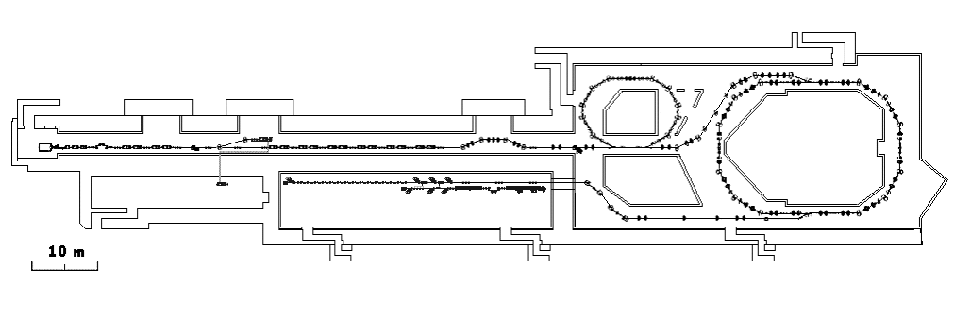
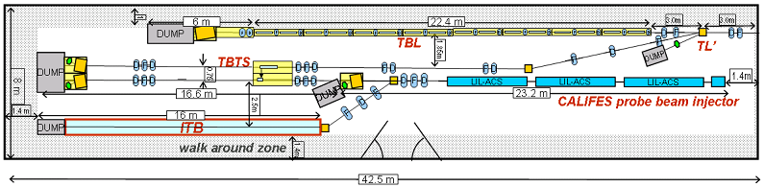
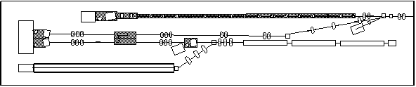
CLIC Test Facility (CTF3)
Delay Loop
Combiner ring
150 MeV e-linac
Thermionic source
3.5 A – 1200 ns
Photo injector
Experimental area
28 A - 140 ns
TBTS (two-beam test stand)
power transfer to main beam
module design
TBL (test beam line)
drive beam stability during deceleration

Slide 7
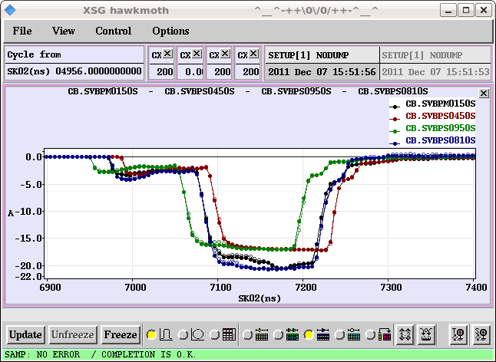
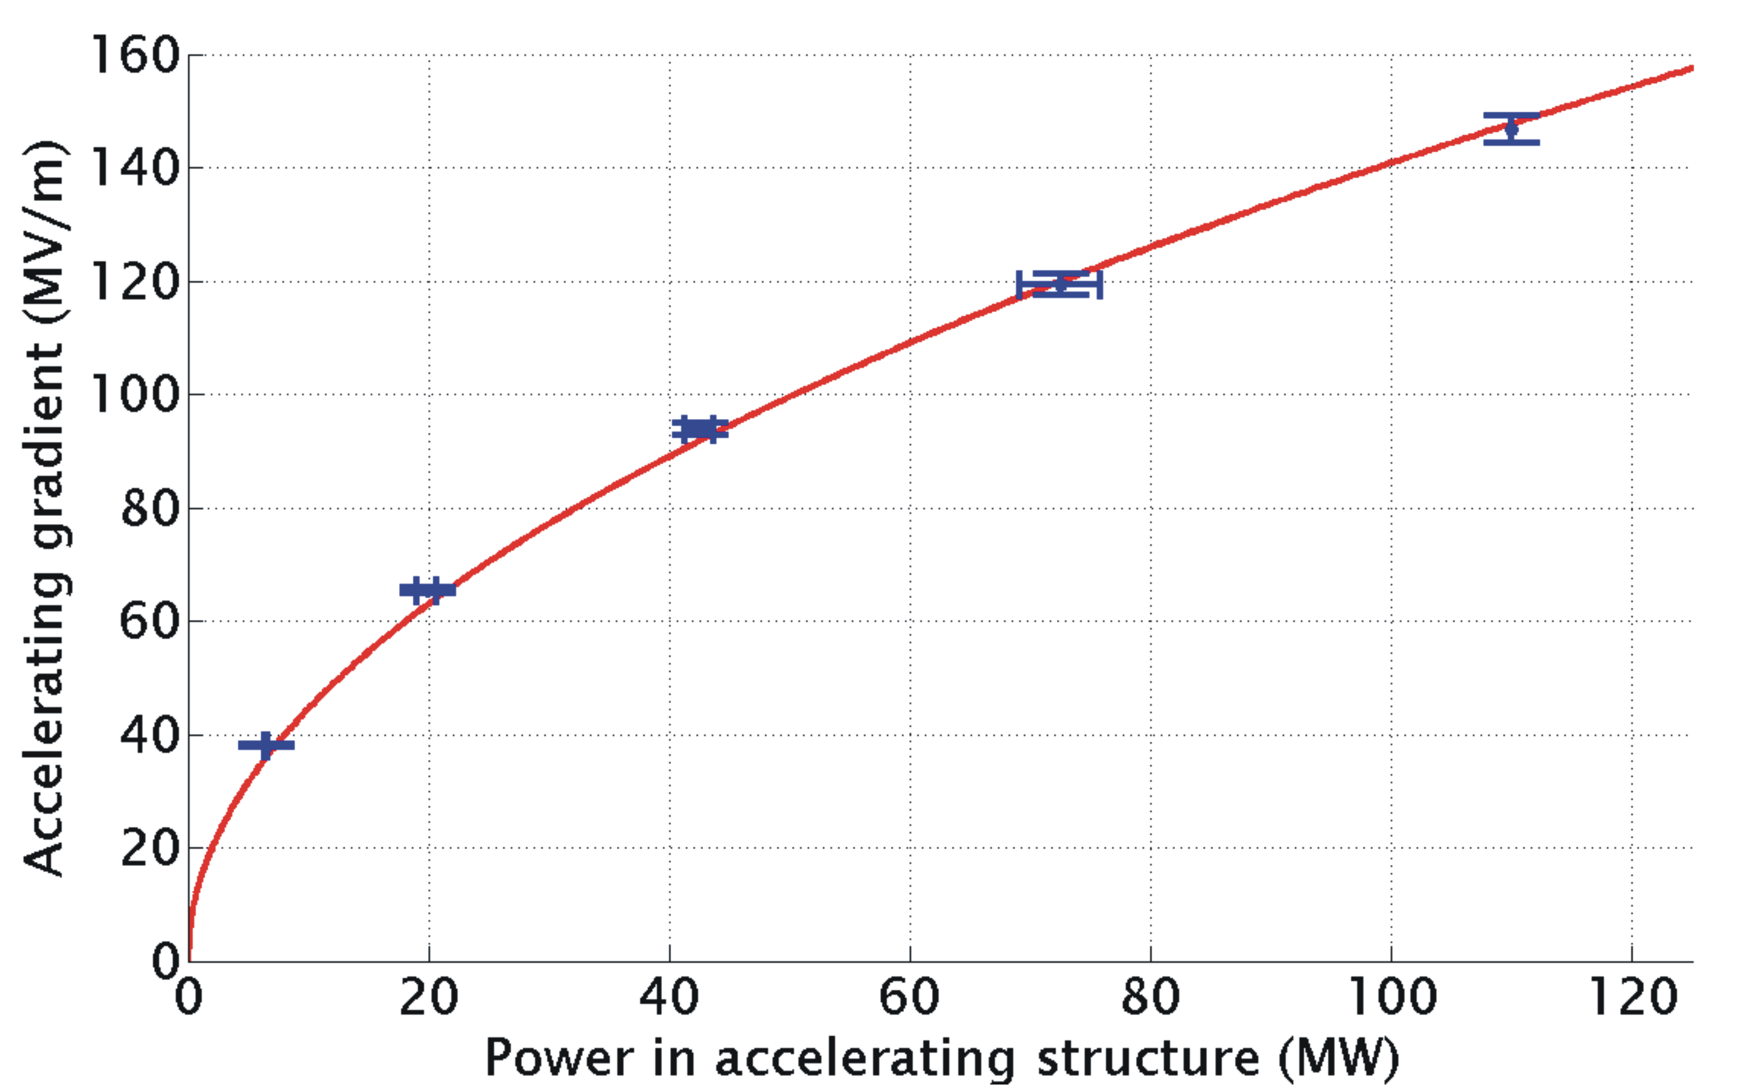
TBTS and TBL Results
Maximum gradient 145 MV/m
Consistency between
produced power
drive beam current
test beam acceleration
Total power produced ~500MW
Deceleration 27MV
(of 117MeV beam)

Slide 8
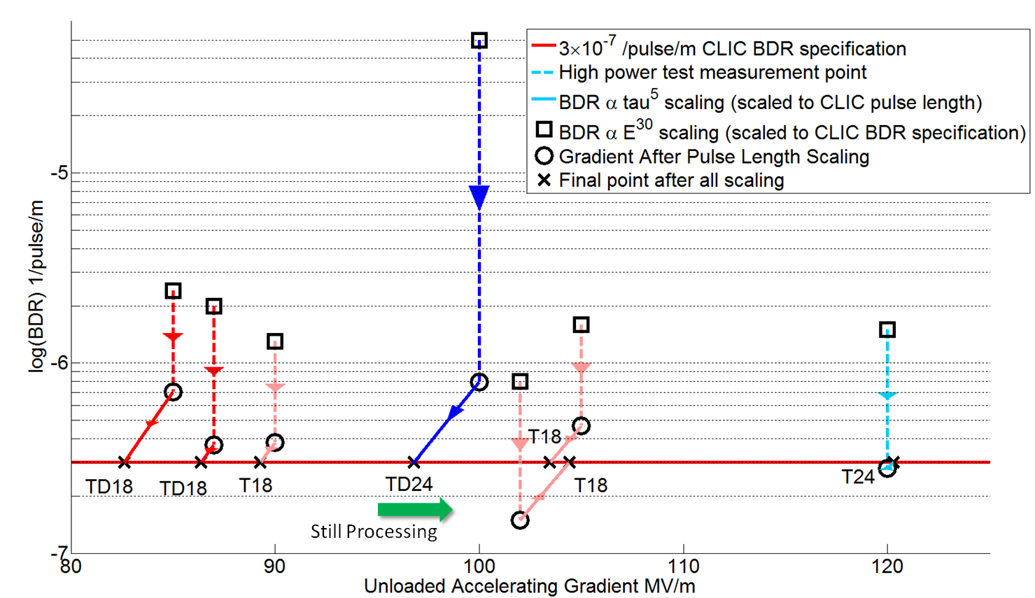
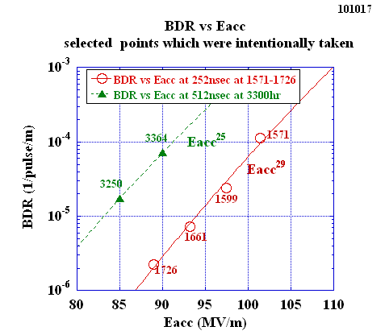

KEK’s Fundamental Contributions to 100 MV/m Accelerating Structures
International Workshop on
Breakdown Science and High Gradient Technology
April 18-20, 2012 at KEK
Fabrication – 6/7 of the above tests, with all best results achieved with KEK-coordinated machining of structures.
Testing – 4/7 with best performance of all categories of structures in tests made in NEXTEF at KEK.
High-gradient science – Extensive measurements of high-gradient rf instrumental in developing theory.

Slide 9
ATF 2
We are impressed how quickly ATF2 is recovering
We had proposed a number of topics for future collaboration
Currently our main focus is on
Small beam size (optics design / tuning)
Ground motion and feedback/feedforward studies
  Equip magnets with ground motions sensors and correlate magnet and beam motion
  Detailed study of expected correlation by Yves Regnier
  LAPP already bought sensors
  Will need 6 Hz operation and little beam jitter
New extraction kicker for ATF
  Kicker design being finalised, prototype in 2012
  Adaptive adder
    Small scale protype next year
    Full system ready in mid to end of 2013, second system maybe in summer 2014

Slide 10
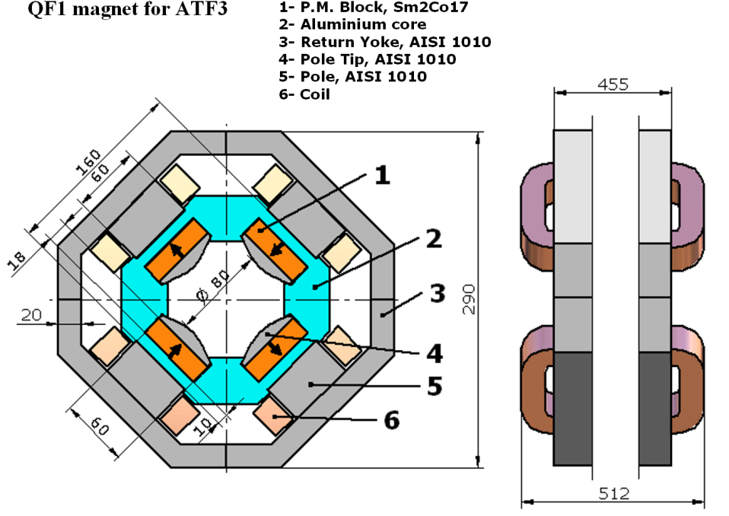
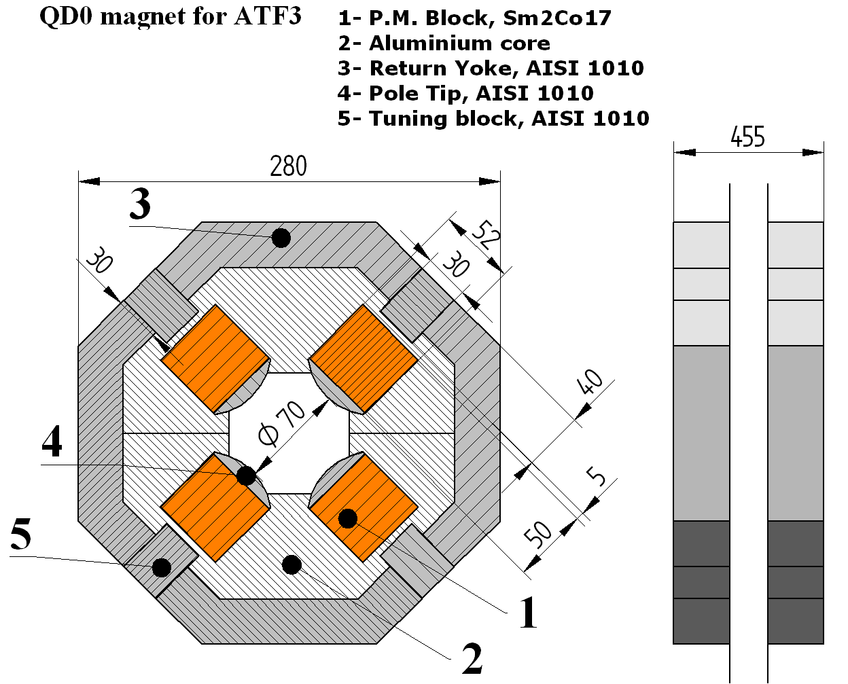
QF1 and QD0 Magnets for ATF2/ATF3
Study (E. Marin) shows
would profit from re-ordering quadrupoles
a better final doublet
 | QF1 | QD0
Aperture radius | 40 mm | 35 mm
Magnet length | 512 mm | 475 mm
Yoke height ×width × length | 290 mm × 290 mm × 455 mm | 280 mm × 280 mm × 455 mm
Effective length | 474 mm | 473.1 mm
Nom. field gradient at Z=0 mm | 6.9 T/m | 12.5 T/m
Nom. Integrated field gradient | 3.27 T | 19.2 T
Tuning range | 9.2% | 7%
Gradient tuned by | Coils | Movable blocks
Coil parameters
Number of turns per pole | 35
Conductor size | 4 mm × 4 mm
Current | ± 20 A
Max. current density | 1.2 A/mm²
Cooling | Air, natural convention
M. Modena designed new magnets
can be built on request
delivery spring/summer 2013

Slide 11
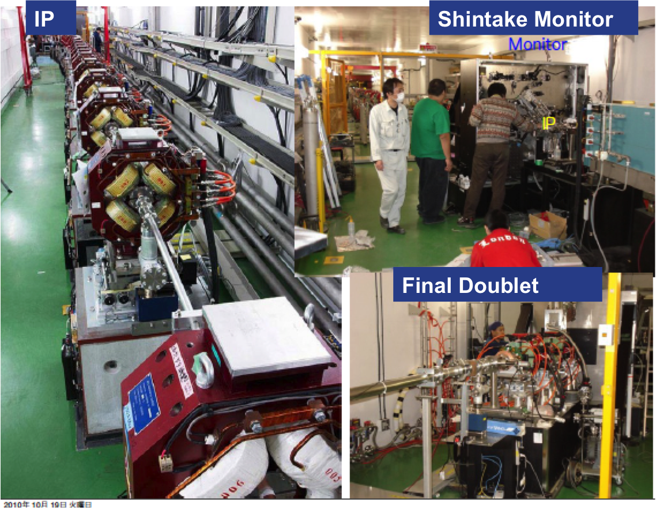
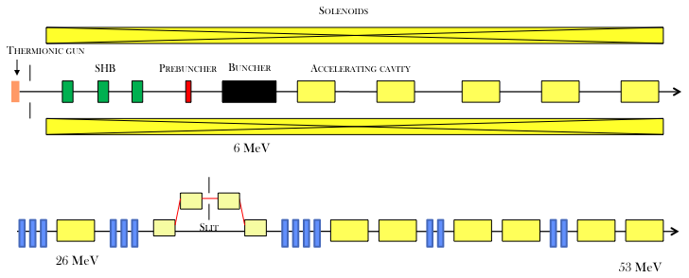
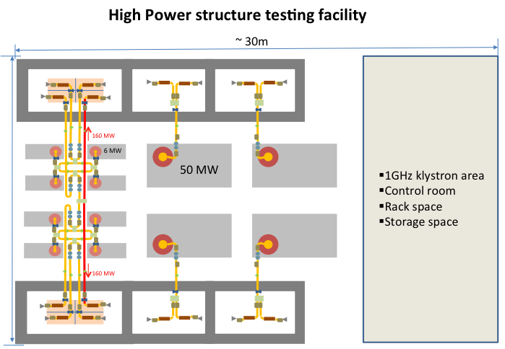
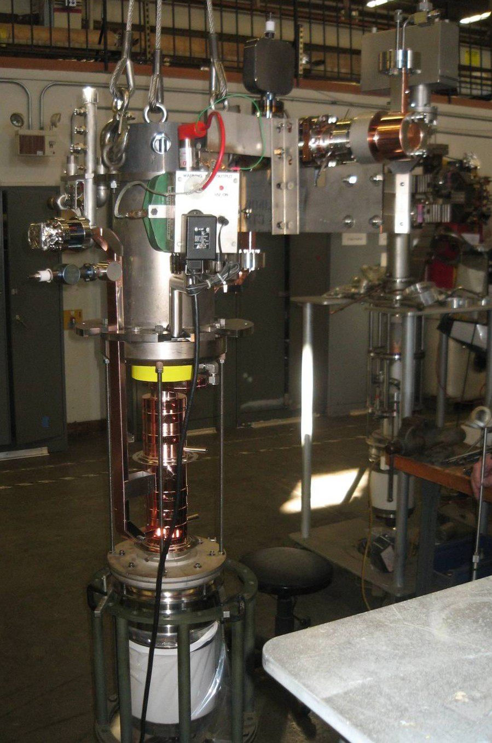
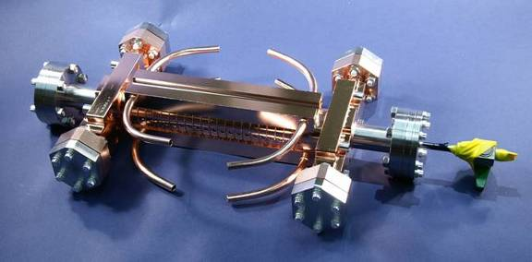
Objectives and Plans for 2012-16
Notes:
Add some info about space at CERN

Slide 12
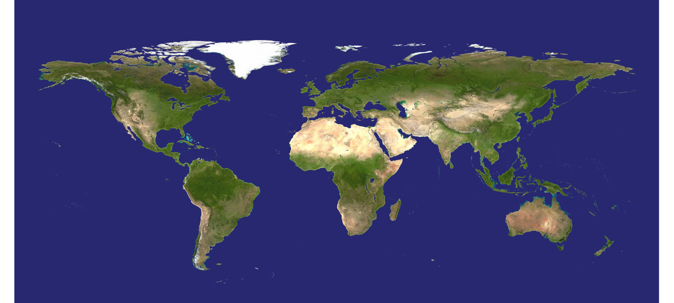























Several others in the process of being added or being linked to the CLIC efforts through common technical developments
World-wide CLIC&CTF3 Collaboration
CLIC multi-lateral collaboration - 43 Institutes from 22 countries
ACAS (Australia)
Aarhus University (Denmark)
Ankara University (Turkey)
Argonne National Laboratory (USA)
Athens University (Greece)
BINP (Russia)
CERN
CIEMAT (Spain)
Cockcroft Institute (UK)
ETH Zurich (Switzerland)
FNAL (USA)
Gazi Universities (Turkey)
Helsinki Institute of Physics (Finland)
IAP (Russia)
IAP NASU (Ukraine)
IHEP (China)
INFN / LNF (Italy)
Instituto de Fisica Corpuscular (Spain)
IRFU / Saclay (France)
Jefferson Lab (USA)
John Adams Institute/Oxford (UK)
Joint Institute for Power and Nuclear Research SOSNY /Minsk (Belarus)
John Adams Institute/RHUL (UK)
JINR (Russia)
Karlsruhe University (Germany)
KEK (Japan)
LAL / Orsay (France)
LAPP / ESIA (France)
NIKHEF/Amsterdam (Netherland)
NCP (Pakistan)
North-West. Univ. Illinois (USA)
Patras University (Greece)
Polytech. Univ. of Catalonia (Spain)
PSI (Switzerland)
RAL (UK)
RRCAT / Indore (India)
SLAC (USA)
Sincrotrone Trieste/ELETTRA (Italy)
Thrace University (Greece)
Tsinghua University (China)
University of Oslo (Norway)
Uppsala University (Sweden)
UCSC SCIPP (USA)

Slide 13
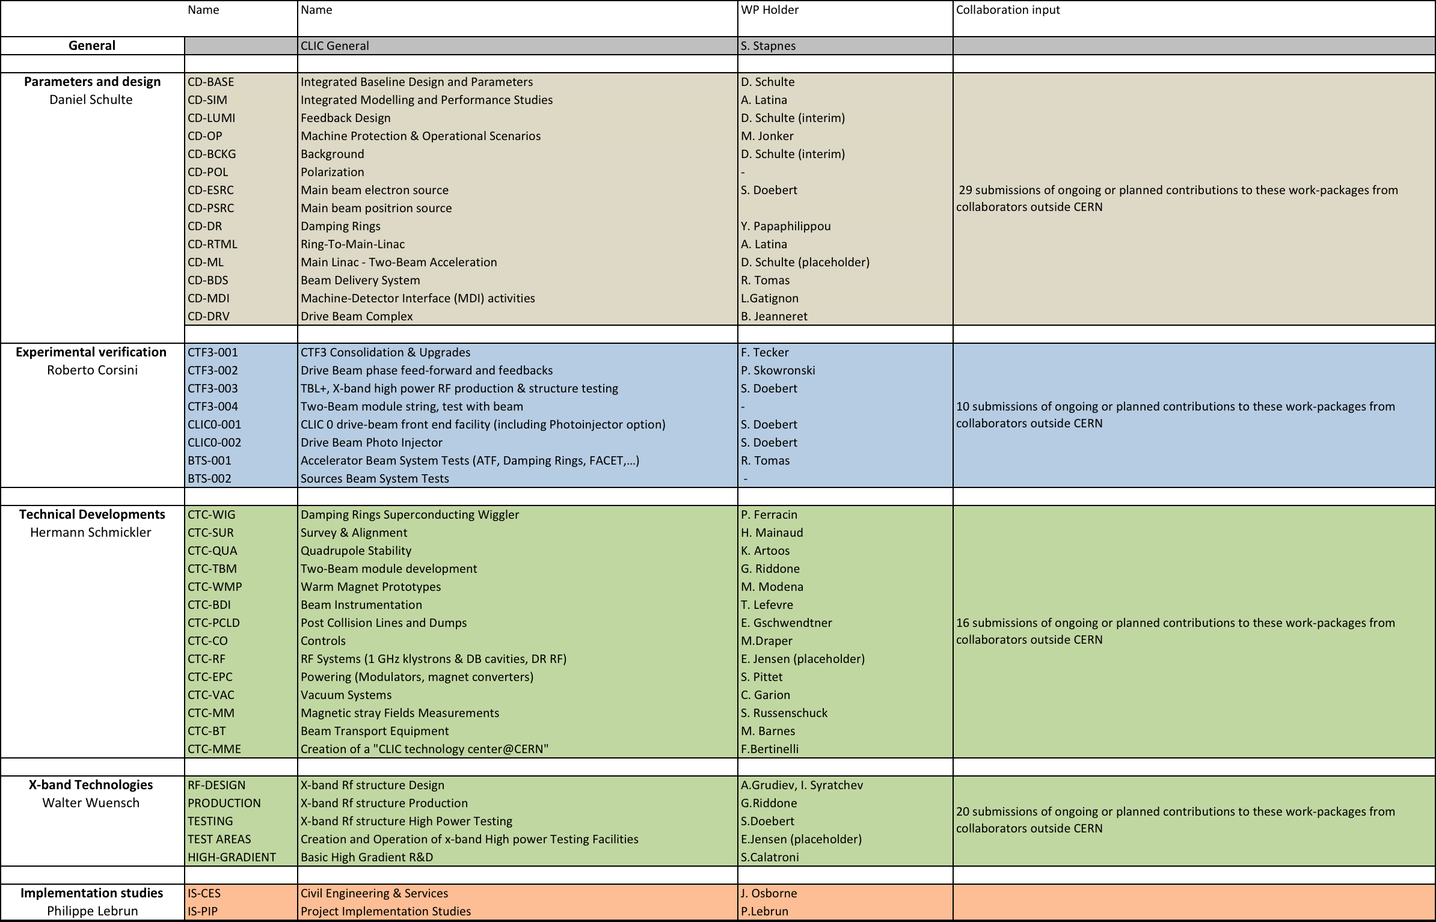
Work-Packages and Responsibilities
The programme combines the resources of collaborators inside the current collaboration, plus several new ones – and also involves around 20 CERN groups:
Have ~75 submitted descriptions of ongoing or planned efforts linked to these work-packages 2012-16 from groups outside CERN (result of CLIC working meeting 3-4.11: https://indico.cern.ch/conferenceOtherViews.py?view=standard&confId=156004 (still open for more interests)
5 from KEK
Description of contributions, link-persons, planned personnel and material resources at home and at CERN for the period

Slide 14
Conclusion
Have strong collaboration between KEK and CERN on different R&D topics
  Profits for CERN
    X-band accelerating structure tests and expertise
    ATF/ATF2
    Detectors
    Positron source studies
    Intellectual exchange
    …
  Can hopefully also bring some profits for KEK
Should continue and deepen the effort

