Slide 1
A global view of the LS1 timeline in the injector chain
IEFC Workshop 2012
Session 5

Slide 2
Outline
LS1 in the LHC
  The key drivers
  LHC timeline
  LHC skeleton schedule
LS1 in the injector chain
  What is the injector chain?
  The key drivers
  PS Booster
  PS
  SPS
  Injector chain timeline
Critical path works
Constraints
Conclusions

Slide 3
The Time line for the LHC
Time key drivers in LHC machine
  Superconducting circuits consolidation
  Radiation To Electronics R2E
  Maintenance
  …. And many other activities (already > 100 entries in the db for LHC machine)
20 months from Beam OFF to Beam ON
  Actual total duration agreed between experiments and machine
    LHC machine: 20 months
    ALICE: 12 months (up to 15 months)
    ATLAS: 15 months (but from April 2013)
    CMS: 20 months
    LHCb: 12 months
Courtesy K. Foraz

Slide 4
One typical sector
Powering and ELQA tests prior to Warm-up (4+4 d)
  qualify circuits except mains to 7TeV
  fault localization..
  CSCM (1 sector)
Warm-up: incl. vacuum leak tests at 80K (1wk) to localize leaks
Maintenance & consolidation
Preparation for &
cool-down
Powering tests
Courtesy K. Foraz

Slide 5
Skeleton schedule – Physics to physics
PT
PT
PT
PT
PT
PT
Warm-up
Warm-up
PT
PT
Warm-up
Warm-up
Warm-up
Warm-up
-> 10K
Warm-up
Cryo Maint.
CSCM preparation
Splices
CSCM
Splices
Warm-up
Splices
Splices
Cryo Maint.
Splices
Splices
Splices
Splices
Cryo Maint.
Cryo Maint.
Cool-down
Cool-down
Powering Tests
Cool-down
Cool-down
Cool-down
Powering Tests
Powering Tests
Powering Tests
Powering Tests
Cool-down
Powering Tests
Cool-down
Cool-down
Powering Tests
Powering Tests
Cold check-out & Beam Commissioning
Physics
Courtesy K. Foraz

Slide 6
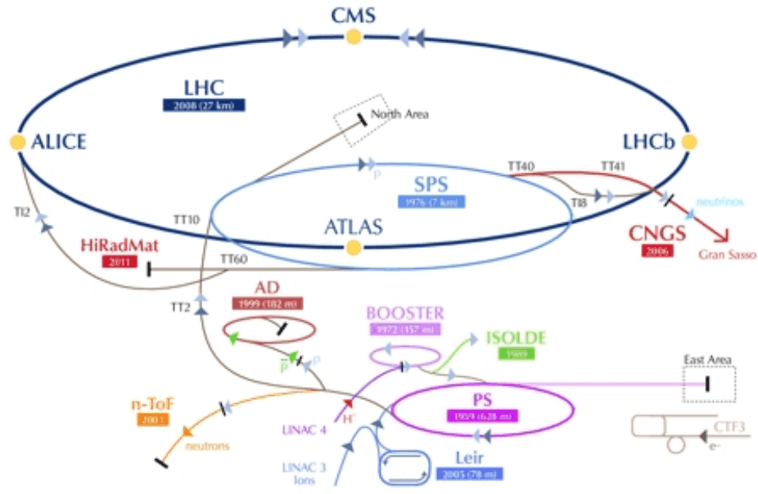
The injector chain
The injector chain is the machines and transfer lines that feed the beam from its inception up until the LHC.
  Protons
    LINAC 2
    PS Booster
    PS
    SPS
  Ions
    LINAC 3
    LEIR

Slide 7
Key drivers for LS1 in the injector chain
Several years of very short winter stops.
  Only enough time for the bare minimum of maintenance.
Essential consolidation works required.
No physics in 2013
  The LHC can not run without the injector chain, but the injector chain can run without the LHC.
Duration can not exceed LS1 of the LHC.
Physics in 2014!!!!!

Slide 8
PS Booster key dates
Description | Date
End of Physics | End November 2012
Pre-LS1 hardware test period | December 2012
Start of general maintenance and work period | January 2013
End of general maintenance and works period | End January 2014
Closure of PS Booster | End January 2014
new access system commissioning | February 2014
Cold checkout and Start up | March 2014
PS Booster ready for Beam | April 2014

Slide 9
Known major works in the PS Booster
Installation of interlocks
Upgrade of the RF systems
Installation of the new access systems
Survey alignment maintenance
Cooling and ventilation maintenance & renovation
....

Slide 10
PS key dates
Description | Date
End of Physics | End November 2012
Pre-LS1 hardware test period | December 2012
Start of LS1 works | Beginning January 2013
End of LS1 works | End January 2014
Closure of the PS | End January 2014
New access system commissioning | February 2014
Shutdown Hardware test period | March 2014
Operation Cold Checkout | April 2014
PS ready with Beam | May 2014

Slide 11
Known major works in the PS
Upgrade of the RF systems
Installation of the new access systems
Renovation of the PS vacuum control system
Survey alignment maintenance
Measurement in the vertical and radial and realignment.
Cooling and ventilation maintenance & renovation
Improve the radiation shielding over the PS and Septum 16 (12 months)

Slide 12
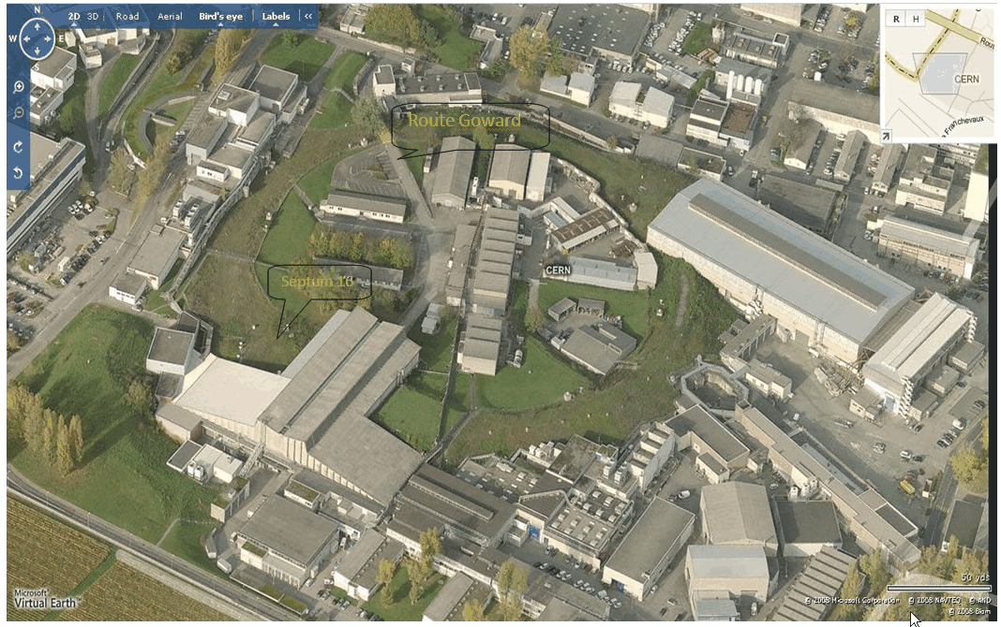

Slide 13
SPS LS1 Key Dates
Description | Date
End of Physics | End November 2012
Pre-LS1 hardware test period | December 2012
SPS open for General maintenance and works | January 2013
Start of SPS dedicated project phase | February 2013
End of SPS dedicated project phase | End December 2013
SPS open for General maintenance and works | December 2013 to End February 2014
SPS Closure | End February 2014
Cold checkout and Start up | March/April/May 2014
SPS ready with Beam | June 2014

Slide 14
General maintenance works in SPS
(at start & end of LS1):
It is too early to give details on what will be done during the general shutdown periods of LS1, this work will include:
  Machine Cool-down at START of LS1
  Radiation Surveys
  Lift maintenance
  Magnets works (repair and replace etc)
  UA9 works in BA5
  General Safety inspections
  Lighting campaigns
  Vacuum maintenance
  CV maintenance
  Access systems
By concentrating the maintenance works into periods at the beginning and end of the LS1 will help to minimise any conflicts with larger projects and also help to free up personnel for the LHC.

Slide 15
Known Major “Project” Works in the SPS
TE/EPC
  Consolidation of 18kV transformers
EN/EL
  Replacement of irradiated cables in BA1
  Replacement of irradiated cables in BA2
  De-cabling campaign in BA5
  Installing new Fibres in BA5
BE/RF
  RF upgrade project in BA3
BE/ABP
  tilt, vertical and radial alignment of quads
TE/MSC
  Installing new coated magnets in BA5
EN/CV
  Major upgrades to cooling systems at BA3

Slide 16
2012 |  | SPS |  |  |  |  |  |  |  |  |  |  | PS |  |  |  |  |  |  | PS Booster |  |  |  |  | LINAC 2 | LINAC 3 | LINAC 4
 |  | BA1 | BA2 | BA3 | BA4 | BA5 | BA6 | BA7 | TI2 | TI8 | BA80 |  | Sector 1 | Sector 2 | Sector 3 | Sector 4 | Sector 5 | Sector 6 |  | Sector 1 | Sector 2 | Sector 3 | Sector 4
 | Nov.
 | Dec.
2013 | Jan.
 | Feb.
 | Mar.
 | Apr.
 | May
 | Jun.
 | Jul.
 | Aug.
 | Sept.
 | Oct.
 | Nov.
 | Dec.
2014 | Jan
 | Feb.
 | Mar.
 | Apr.
 | May.
 | Jun.
Pre-LS1 hardware test period
Pre-LS1 hardware test period
Pre-LS1 hardware test period
Christmas Break
Duration of the injector chain shutdown!!
End of beam
13 Months PS and Booster
14 months SPS
Closure of the injector chain
Machine ready with beam
Injector chain ready for physics
Christmas Break
Cold checkout and start-up
Cold checkout and start-up
Cold checkout and start-up

Slide 17
2012 |  | SPS |  |  |  |  |  |  |  |  |  |  | PS |  |  |  |  |  |  | PS Booster |  |  |  |  | LINAC 2 | LINAC 3 | LINAC 4
 |  | BA1 | BA2 | BA3 | BA4 | BA5 | BA6 | BA7 | TI2 | TI8 | BA80 |  | Sector 1 | Sector 2 | Sector 3 | Sector 4 | Sector 5 | Sector 6 |  | Sector 1 | Sector 2 | Sector 3 | Sector 4
 | Nov.
 | Dec.
2013 | Jan.
 | Feb.
 | Mar.
 | Apr.
 | May
 | Jun.
 | Jul.
 | Aug.
 | Sept.
 | Oct.
 | Nov.
 | Dec.
2014 | Jan
 | Feb.
 | Mar.
 | Apr.
 | May.
 | Jun.
RF Upgrade
EN/EL De-cabling campaign
Normal LINAC 2 shutdown maintenance works
LINAC 4 Commissioning
Christmas Break
General shutdown works
SURVEY
Tilt and vertical : Quads
Renovation of the PS Vacuum control system
TE/MPE Installation of interlocks
Set up of Argon and Xenon Beam (phase 1)
Irradiated cables
BE/ABP
BE/ABP
BE/ABP
TE/EPC Consolidation of 18kV transformers
Irradiated cables
Cooling & Ventilation maintenance & renovation
GS/ASE installation of new access system
Set up of Argon and Xenon Beam (phase 2)
RF upgrade of systems
BE/ABP (Survey)
Alignment maintenance
EN/EL new optical fibre infrastructure
BE/ABP (Survey)
Measurement in vertical and radial and realignment
General shutdown works
Christmas Break
GS/ASE Access system commissioning
Cold checkout and start-up
Cold checkout and start-up
Cold checkout and start-up

Slide 18
Critical path works
The installation of the new access system in the PS complex.
RF upgrade work in the PS complex and the SPS.
Consolidation of the 18kV transformers in the SPS.

Slide 19
Constraints
Will the start of LS1 move?
  “A strategy to optimise LHC running to deliver the maximum possible amount of data in 2012 before the LHC goes into a long shutdown to prepare for higher energy running. The data target for 2012 is 15 inverse femtobarns for ATLAS and CMS, three times higher than in 2011.”
Normal physics in 2014
Manpower and resources
  Do we have enough to cover the injector chain AND the LHC?

Slide 20
Conclusions
The injector chain LS1 schedule is VERY tight!
The injector chain can provide beam for physics from June 2014 onwards. AND NOT BEFORE!!!
This planning is still at its very early stages.
A more detailed schedule will be worked on by the machine technical coordinators over the next few months.

Slide 21
The End
Thank you

