Slide 1

LHC Beams Production
Losses and impact on NON-LHC physics
Rende Steerenberg
With the help of:
Hannes Bartosik, Karel Cornelis, Heiko Damerau, Detlef Küchler, Gabriel Metral, Bettina Mikulec, Yannis Papaphilippou
With thanks to the OP-teams and Machine supervisor teams
IEFC Workshop 2012
7 – 9 March 2012

Slide 2
Content
The LHC beams produced
LINAC2 & PSB
The PS
The SPS
Super Cycles and N0n-LHC physics
Conclusions
LHC BEAMS PRODUCTION

Slide 3
The LHC Beams Menu
There are at least 10 flavours of LHC beams that have been produced in the injectors, not all beams are readily available.
 | Overview of LHC beams
 | PSB extraction |  |  |  | PS extraction |  |  | SPS extraction
 | Ip / ring | ɛ_{h} and ɛ_{v} | nb | nb | Ip / bunch | ɛ_{h} and ɛ_{v} | nb | Ip / bunch | ɛ_{h} and ɛ_{v} | ɛ_{longit} | nb
 | [x10¹¹] | [mm ∙ mrad] | batches | bunches | [x10¹¹] | [mm ∙ mrad] | bunches | [x10¹¹] | [mm ∙ mrad] | [eVs] | bunches
 |  | 1σ, norm. |  |  |  | 1σ, norm. |  |  | 1σ, norm.
LHCPROBE | 0.05 - 0.2 | ≤ 1 | 1 | 1 | 0.05 - 0.2 | ≤ 1 | 1 | 0.05 - 0.2 | ≤ 1 | ≤ 0.3 | 1
LHCPILOT | 0.05 | ≤ 2.5 | 1 | 1 | 0.05 | ≤ 3 | 1 | 0.05 | ≤ 3.5 | ≤ 0.8 | 1
LHCINDIV | 1.2 | ≤ 2.5 | 1 | 1 to 4 | 1.2 | ≤ 3 | 1 to 4 | 1.2 | ≤ 3.5 | ≤ 0.8 | 1, 4 or 16
LHCINDIV (HI) | 2.5 | - | 1 | 1 to 4 | 2.5 | - | 1 to 4 | 2.5 | - | ≤ 0.8 | 1, 4 or 16
LHC150 | 5 | < 1.5 | 1 | 6 | 1.2 | < 2 | 12 | 1.1 | < 2.5 (1.6) | ≤ 0.8 | 1 - 4 x 12
LHC100 | Is being reviewed
LHC75 (SB) | 11 | 1.5 | 1 | 6 | 1.3 | 1.8 | 24 | 1.2 | 2 | ≤ 0.8 | 1 - 4 x 24
LHC50 (SB) | 24 | 3.5 | 1 | 3 x 2 | 1.75 | 3.5 | 36 | 1.45 | 3.5 | ≤ 0.8 | 1 - 4 x 36
LHC50 (DB) | 10 | 1.4 | 2 | 4 + 2 | 1.6 | 1.6 | 36 | 1.5 | 1.9 | ≤ 0.8 | 1 - 4 x 36
LHC25 (DB) | 16 | 2.5 | 2 | 4 + 2 | 1.3 | 2.5 | 72 | 1.1 5 | 3.5 | 0.7 | 1 - 4 x 72
LHC BEAMS PRODUCTION
The ones used are:
  LHCPROBE
  LHCINDIV (normal and high intensity)
  LHC50 (DB) with 12 and 36 bunches
  LHC100 for p-pb collisions (low int.)
  LHC25 (mainly for scrubbing and MD’s)
Considered no longer necessary:
  LHCPILOT
  LHC50 (SB)
  LHC75
  LHC150

Slide 4
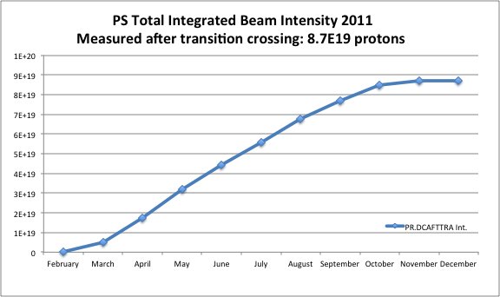
How much protons were produced
LHC beams represent less than 1% of the total intensity produced by the PS.
8.7x10¹⁹ of which ~7.5x10¹⁷
for LHC beams to SPS
LHC BEAMS PRODUCTION
To put this in perspective 7.5x10¹⁷ is less than 1 year of integrated PS extraction losses on the present CNGS beam.
Due to their low emittances the LHC beams generate little uncontrolled losses in the whole accelerator chain.
The majority of the losses are voluntary to tailor the beam to the required characteristics.

Slide 5
Content
The LHC beams produced
LINAC2 & PSB
The PS
The SPS
Super Cycles and N0n-LHC physics
Conclusions
LHC BEAMS PRODUCTION

Slide 6
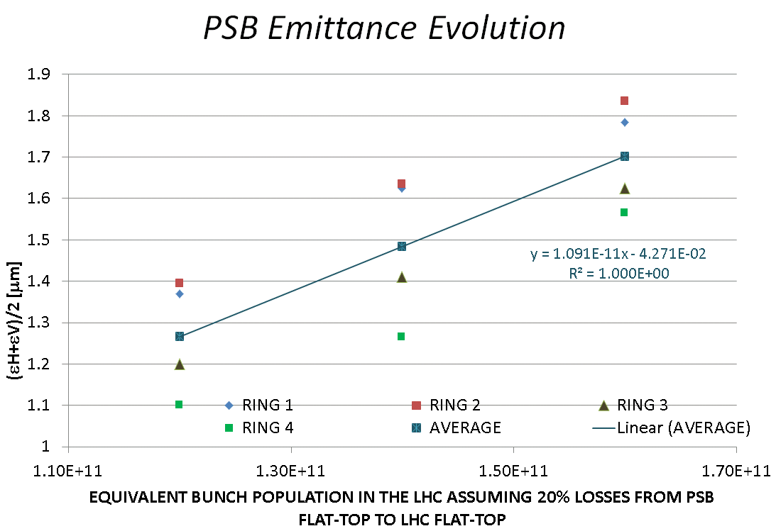
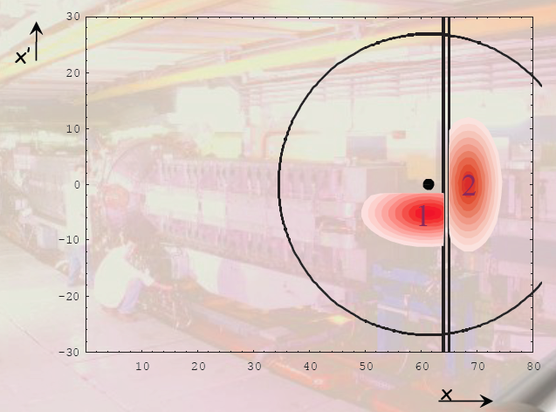
LINAC2 and PS Booster Injection
LINAC2 will work around 165 mA.
  Tests to run at 175 mA showed too little gain in brightness.
The PS Booster uses at present a multi turn injection.
  Intrinsically lossy (50 MeV).
  ε_{h} + ε_{h} = f (intensity).
LHC BEAMS PRODUCTION
Courtesy of PSB team

Slide 7
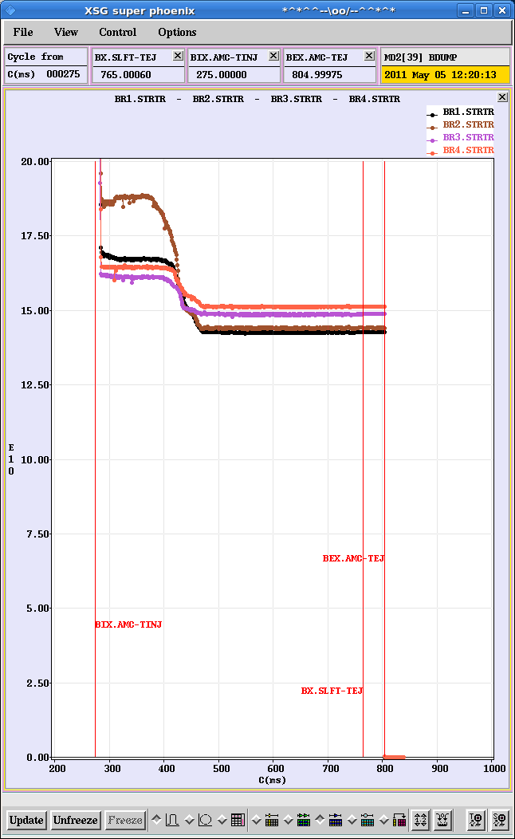
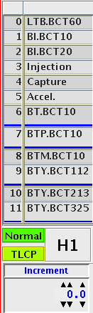
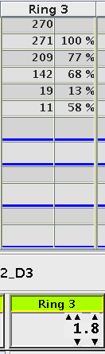
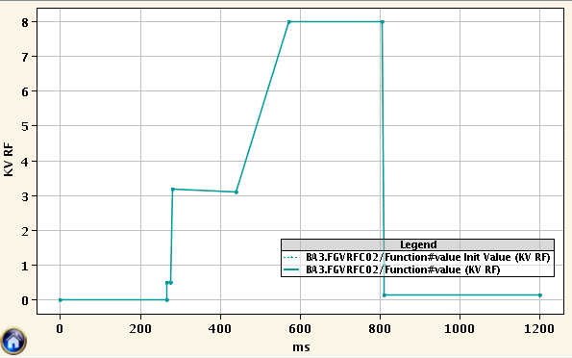
PSB LHCINDIV Beam
Injection: ~1.2x10¹² protons.
Intentionally badly captured (reduced long. Acceptance).
Additional longitudinal shaving, reduces intensity from ~2x10¹¹ to ~0.2-1.2x10¹⁰ protons:
  Starts at ~350 ms after start of cycle.
  Duration: ~70 ms (depending on final intensity requirement).
Beam Current Transformers
Operation Display
LHC BEAMS PRODUCTION
Long. shaving
Capture
RF voltage function Ring 3
Long. shaving

Slide 8
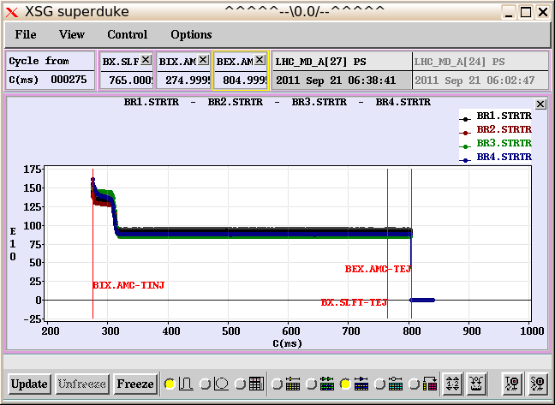
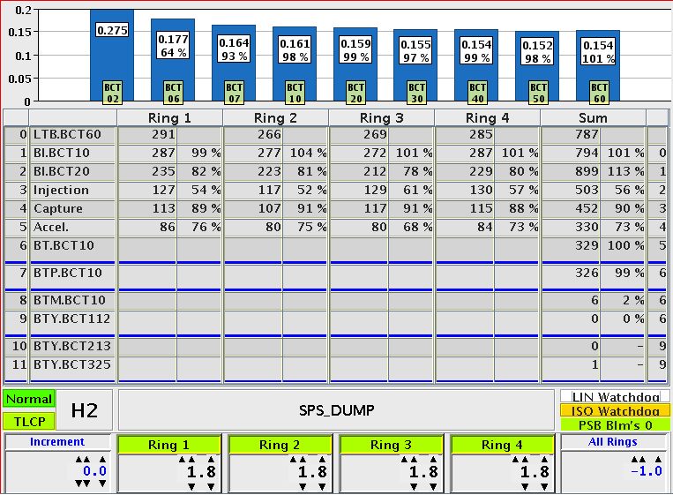
PSB LHC 50 ns beam
Injection: ~1.5x10¹² protons.
Transverse shaving reduces intensity to 8.5x10¹¹ protons:
  starts at 305 ms after start of cycle.
  Duration: ~10 ms.
Beam Current Transformers
Operation Display
LHC BEAMS PRODUCTION
Injection
Trans. shaving

Slide 9
Content
The LHC beams produced
LINAC2 & PSB
The PS
The SPS
Super Cycles and N0n-LHC physics
Conclusions
LHC BEAMS PRODUCTION

Slide 10
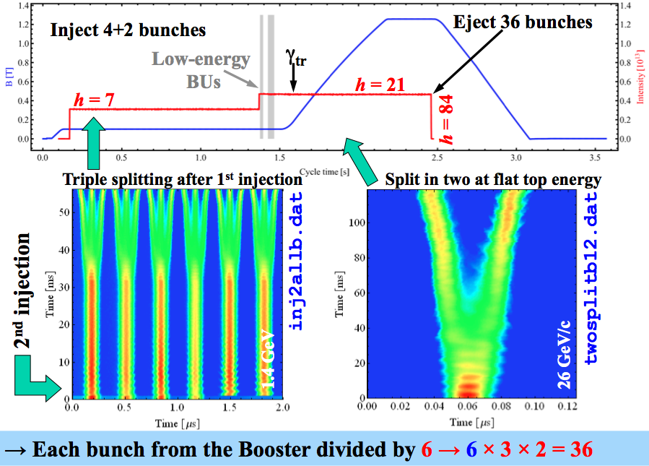
LHC 50 ns Double Batch Production
Double batch injection from PSB.
Single Bunch per PSB ring:
  1st batch → 4 bunches.
  2nd batch → 2 bunches.
Triple splitting in PS.
Acceleration.
Double splitting in PS.
Bunch rotation in PS.
ɛ_{Long final} = ɛ_{Long init} x 2.33/6.
Ɛ_{h/v} < Ɛ_{nom} and well preserved.
LHC BEAMS PRODUCTION
Potential issues:
  Space charge at injection.
  CBI after γ-jump → ɛ_{Long}, τ_{bunch}, bunch-to-bunch intensity variations (feedback available).
  Satellites in kicker gap.
Courtesy of H. Damerau

Slide 11
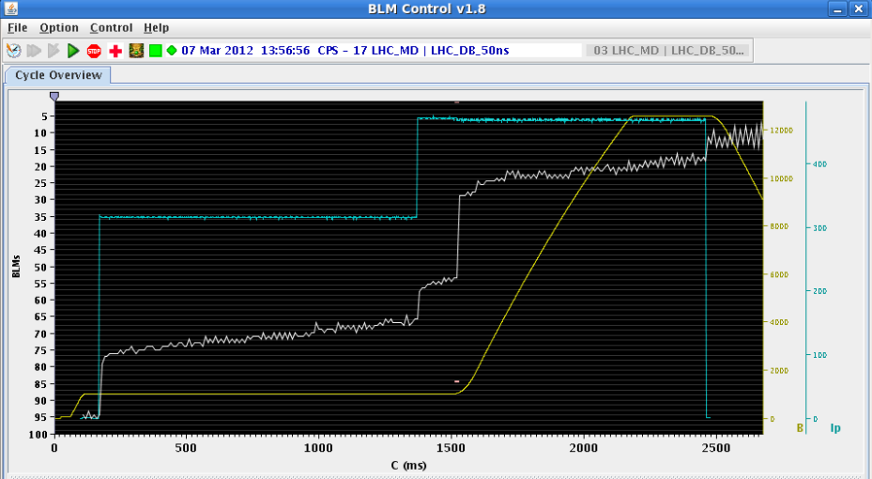
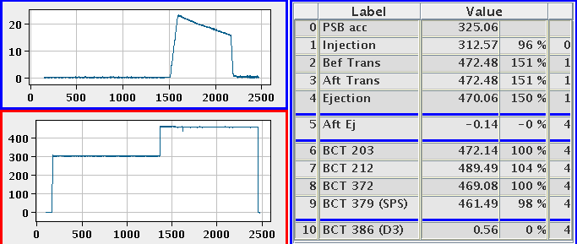
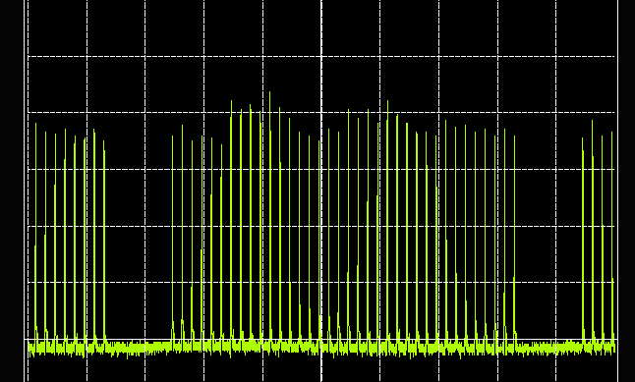
Loss Sources of the LHC 50 ns beam
Slow losses more or less constant along the cycle.
No noticeable additional losses during RF manipulations.
Low Energy
B increase
Arbitrary units
Extraction
LHC BEAMS PRODUCTION
1st injection
2st injection
Operation Display
Wall Current Monitor last turns
Very good transmission efficiency

Slide 12
Improved Operability
The 50 ns double batch beam only became really operational in 2011.
Two dedicated users for 12 and 36 bunch version were introduced:
  More cycles/beams to maintain (identical).
  Improved stability/reproducibility.
  Reduced switching time.
Continuous improvement on the RF beam control system improved stability.
The Operations teams became more and more autonomous in adjustments and optimization.
LHC BEAMS PRODUCTION

Slide 13
Content
The LHC beams produced
LINAC2 & PSB
The PS
The SPS
Super Cycles and N0n-LHC physics
Conclusions
LHC BEAMS PRODUCTION

Slide 14
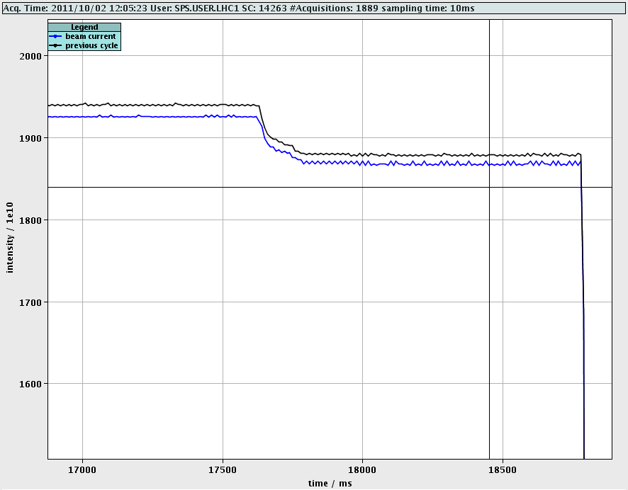
LHC Beams and Losses in the SPS
During setting up and LHC filling preparation the beam is systematically dumped at 450 GeV on the TIDV.
A few % of the beam is systematically scraped away.
LHC BEAMS PRODUCTION
During 2011 run, new scrapers were used in LSS1 instead of the old ones in LSS5.

Slide 15
LHC Beams in SPS compared to FT and CNGS
 | Total accelerated | dumped | scraped | Total cycle losses
FT | 5.85 x 10¹⁸ | 4 x 10¹⁷ | 0 | 9 x 10¹⁷
CNGS | 4.82 x 10¹⁹ | 6 x 10¹⁷ | 0 | 2.5 x 10¹⁸
LHC cycles | 7.3 x 10¹⁷ | 5.8 x 10¹⁷ | 1 x 10¹⁶ | 5 x 10¹⁵
LHC BEAMS PRODUCTION
Although much less protons are accelerated on LHC type cycles, the amount of protons on the beam dump is comparable to CNGS.
With the scrapers in LSS1, the lost beam is mainly intercepted by TIDH and TIDV.

Slide 16
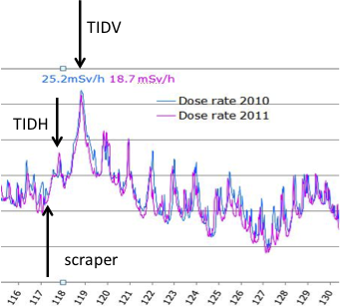
Impact of Scraper on the Radiation in LSS1
Comparison between 2010 (no scraper) and 2011 (scraper) surveys shows little impact from the scraper losses on LSS1 radiation levels.
LHC BEAMS PRODUCTION

Slide 17
Impact of LHC Filling on SPS Physics 1/2
In 2011, the FT cycle was kept during the LHC filling, but the CNGS duty cycle was reduced from 65% to 15%.
With the very intense 50 ns beam at the end of 2011, the ZS suffered from sparking and the voltage had to be reduced so that slow extraction was off during LHC filling.
If ZS sparking problem persists with high intensities, we can consider removing the FT cycle out of the filling super cycle in 2012.
LHC BEAMS PRODUCTION

Slide 18
Impact of LHC Filling on SPS Physics 2/2
Removing the FT cycle from the SC has some undesired operational consequences :
  The NA users will clearly have less beam.
  During the LHC filling, the NA timing events will have to continue.
  For the super cycle with FT, they want the NA timing events only during FT cycle.
  Interlocks will have to be disabled during LHC filling and re-enabled for FT physics.
  Fooling around with timing events and interlocks will increase the risk of mistakes and damage. Work on sequencer tasks to reduce those risks is ongoing.
  The FT cycle is not very demanding for PS and PSB (only two short cycles in 15.6 seconds). Taking it out will have certainly an effect on PS and PSB users.
LHC BEAMS PRODUCTION

Slide 19
Transmission in the SPS with Q20
Higher transmission (less losses) with Q20 low gamma transition optics compared to nominal optics due to:
  Higher stability → low chromaticity sufficient.
  Smaller sextupole gradients for chromaticity correction due to higher dispersion.
Injection to the LHC (at least in MD) to be tried this year.
LHC BEAMS PRODUCTION
Q20 – low γ_{t} optics
50 ns LHC beam

Slide 20
Content
The LHC beams produced
LINAC2 & PSB
The PS
The SPS
Super Cycles and N0n-LHC physics
Conclusions
LHC BEAMS PRODUCTION

Slide 21
Parallel Versus Dedicated Filling
Assumption: 2 hours filling per 24 hours.
During parallel filling (~ 8.5% of the time):
  NA physics can continue, provided ZS does not spark.
  CNGS reduced from ~65% to ~15% duty cycle.
  ISOLDE reduced from ~37% to ~34% duty cycle.
  TOF and EAST no notable change.
  AD not affected.
During dedicated filling (problematic for SPS ZS too):
  No NA physics, no CNGS.
  ISOLDE from ~37% to ~39%.
  TOF reduced from ~8% to ~6%.
  EAST reduced from ~30% to ~10%.
  AD not affected.
Relatively little impact for majority of the PS/PSB users, but….
LHC BEAMS PRODUCTION

Slide 22
Impact of High Intensity LHC Beams on NA
For intensities > 1.4x10¹¹ ppb the SPS ZS voltage will have to be reduced → no NA physics possible:
  During parallel and dedicated filling.
  Also during the parallel MD’s with high intensity LHC beams.
  No NA cycle results in a major reduction for EAST in PS, but more or less neutral for ISOLDE.
LHC filling represents ~ 8.5% of the time.
Parallel MD’s:
  Only during day time (~ 40% of the time).
  Assume ¼ of all parallel MD’s to use high intensity LHC beams (~ 10% of the time).
This means a reduction of ~ 20% in the NA beam time.
LHC BEAMS PRODUCTION

Slide 23
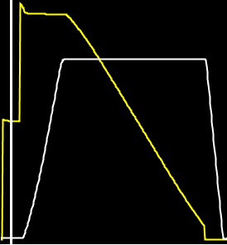
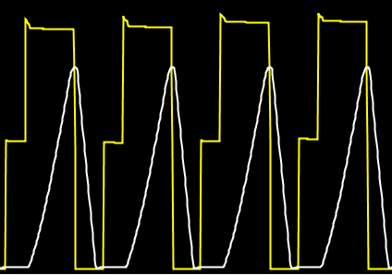

A Super Cycle Example
CNGS
CNGS
CNGS
CNGS
SPS
Fixed target
physics
LHC BEAMS PRODUCTION
EA
EA
EA
EA
PS
DIRAC
DIRAC
DIRAC
DIRAC
DIRAC
nTOF
nTOF
Removing the Fixed target cycle has knock-on effects in the PS and possibly in the PS booster.
  EAST (DIRAC) will suffer.
  Reshuffling will distribute the burden.

Slide 24
Content
The LHC beams produced
LINAC2 & PSB
The PS
The SPS
Super Cycles and N0n-LHC physics
Conclusions
LHC BEAMS PRODUCTION

Slide 25
Conclusions & Questions
The number of protons produced for LHC is less than 1% of the total amount of protons produced.
The LHC beam sizes are small:
  Therefore they produce few losses.
  The majority of the losses are made “on purpose” to obtain the correct beam characteristics.
  Many of them are at low energy, apart from SPS scraping and beam dumping.
  Other beam loss sources on LHC beams are actually due to equipment failures (see G. Metral talk earlier).
LHC beam with 1.4x10¹¹ ppb means no NA.
  This results in approximately 20% less FT physics time.
Are there mitigation measures for ZS sparking ?
LHC BEAMS PRODUCTION

