Slide 1

ISOLDE feed-back on ALARA process
AP.Bernardes on behalf EN-STI-RBS team
IEFC - 07 March 2012

Slide 2
OUTLINE
Introduction to ISOLDE target Area
ALARA principle
ALARA implementation for EN/STI/RBS
Feed-Back
Conclusion
07/03/2012 - IEFC

Slide 3
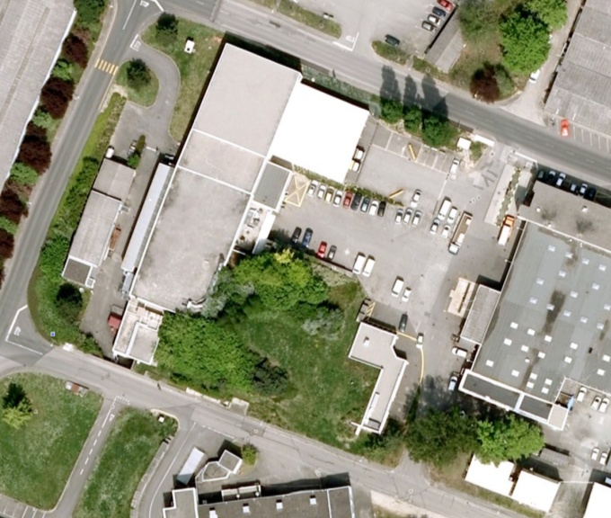
Isolde area :
Isolde Experimental hall 170
Isolde Target Area 179
Route Democrite

Slide 4
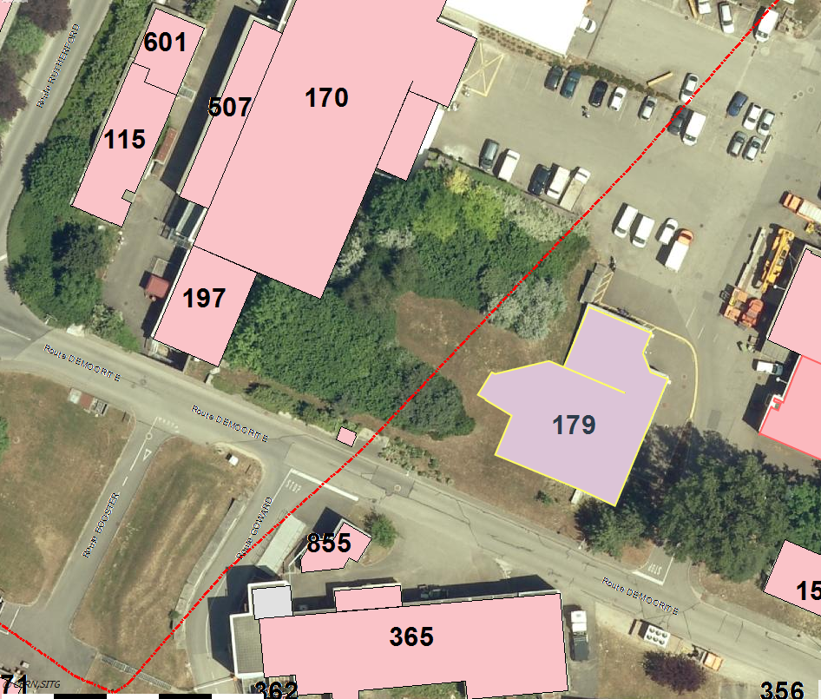
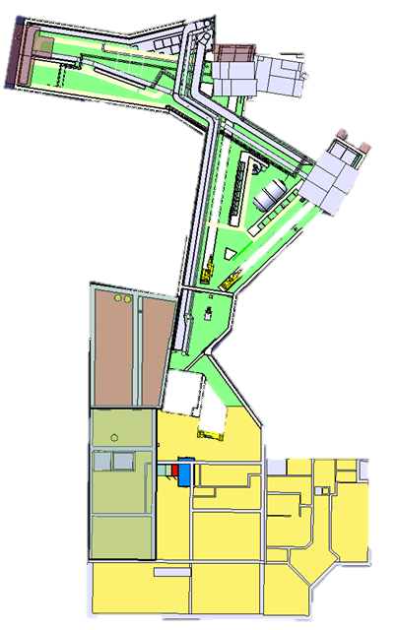




Slide 5
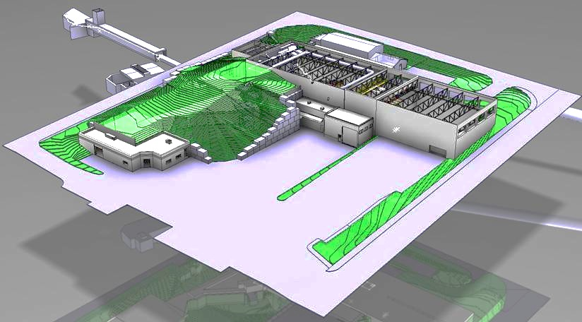

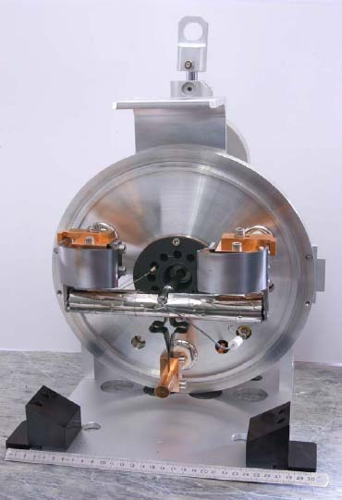
On-Line Isotope Mass Separator
Protons from Booster
1.4GeV@2μA
Picture from V.Barozier

Slide 6
On-Line Isotope Mass Separator
- High dose rate
- Contamination
ALARA level II or III
Picture from V.Barozier

Slide 7
OUTLINE
Introduction to ISOLDE primary Area
ALARA principle
ALARA implementation for EN/STI/RBS
Feed-Back
Conclusion
07/03/2012 - IEFC

Slide 8
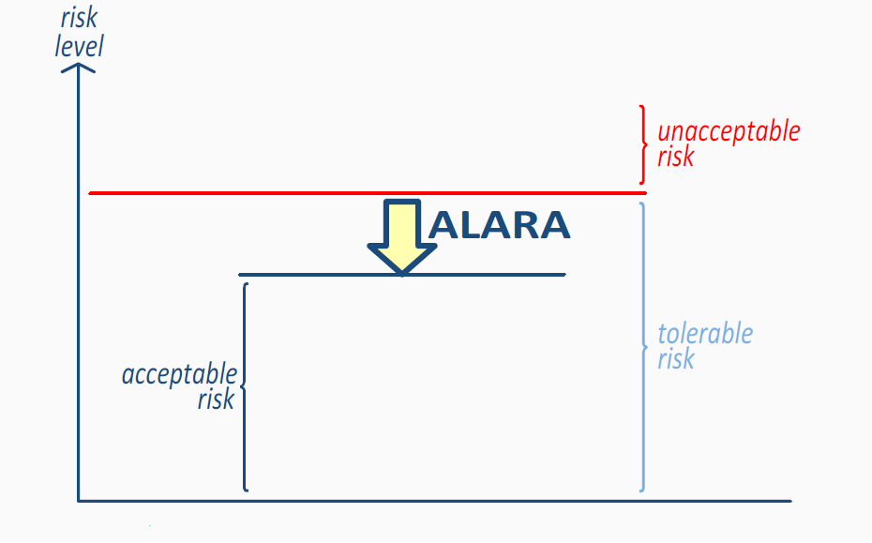
ALARA
ALARA Principle
ALARA principle (As Low As Reasonably Achievable)
Optimisation process
Reduction of individual and collective doses
RPE course extract

Slide 9
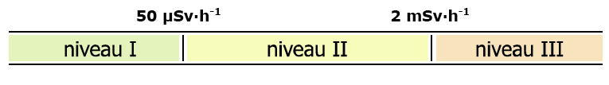
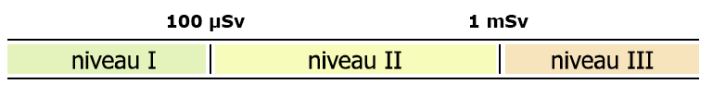
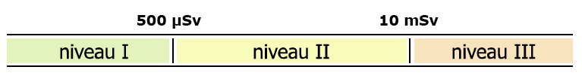


ALARA Principle
CERN ALARA criteria
5 Criteria defined in EDMS 810176 “Critères et exigences ALARA”
ISOLDE
Dose rate (H)
Individual Dose (H_{i})
Collective Dose (H_{c})
Atmospheric Contamination (CA)
Surface Contamination (CS)

Slide 10
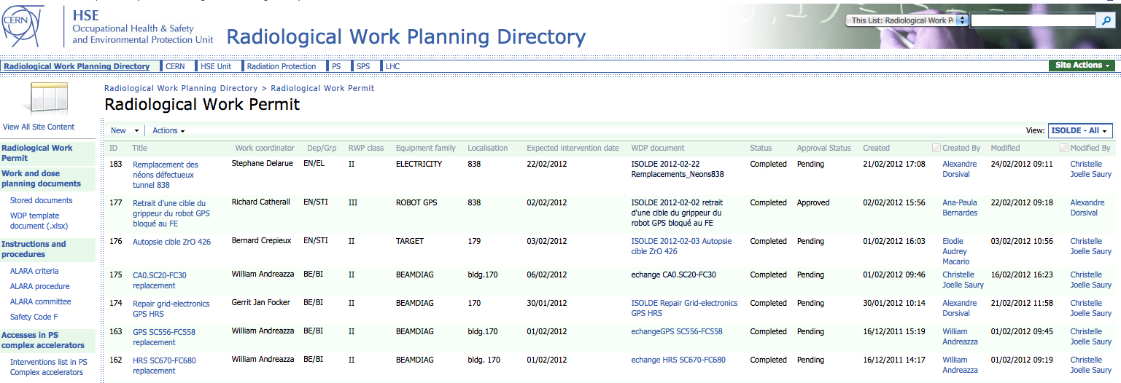
ALARA Principle
ALARA tools at CERN (DGS-RP site: https://espace.cern.ch/rpps/wdp/default.aspx)

Slide 11
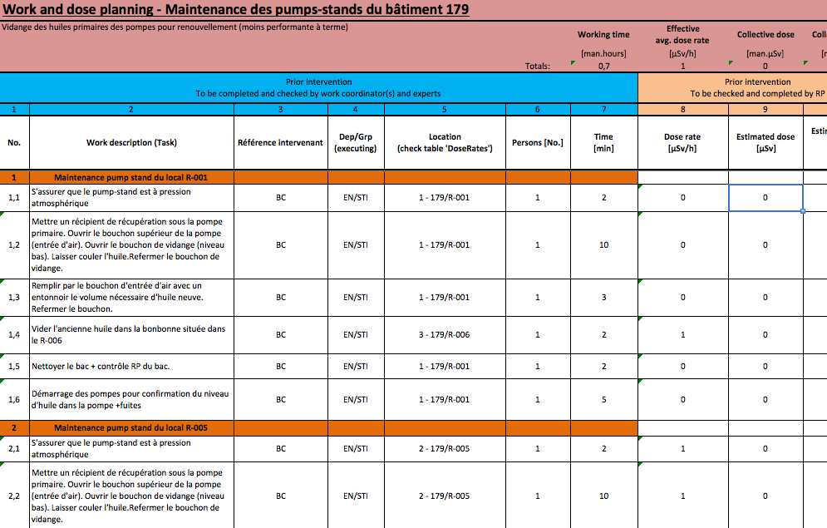
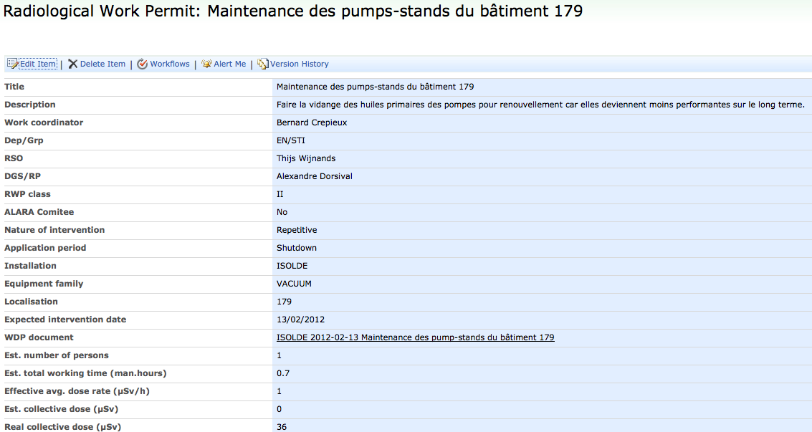
ALARA Principle
ALARA tools at CERN (DGS-RP site: https://espace.cern.ch/rpps/wdp/default.aspx)
WDP: Work and Dose Planning (define which ALARA level I, II or III)
RWP: Radiological Work Permit (As well called DIMR “Dossier d’Intervention en Milieu Radioactif”)

Slide 12
Number of ALARA at CERN since 2010
Data extracted from RWP directory (https://espace.cern.ch/rpps/wdp/default.aspx)
ALARA Principle
47 %
80%
Data based on WDP/RWP stored on RWP Sharepoint directory

Slide 13
OUTLINE
Introduction to ISOLDE primary Area
ALARA principle
ALARA implementation for EN/STI/RBS
Feed-Back
Conclusion
07/03/2012 - IEFC

Slide 14
EN/STI/RBS ALARA Implementation
ALARA at ISOLDE
ALARA Level I : Formal WDP is optional
ALARA level II : Radiological Work Permit and Work and Dose Permit → Submitted to DGS/RP
ALARA level III :
- RWP and WDP done → Submitted to DGS/RP
- Presentation of ALARA principle during ENTM in presence of EN safety Officers (RSO and DSO)
- Approval request at the ALARA level III committee

Slide 15

EN/STI/RBS ALARA Implementation
RWP and WDP
ALARA level III committee
Identification of different scenarios
Test of the different scenarios identified or suggested
Specific equipment development

Slide 16
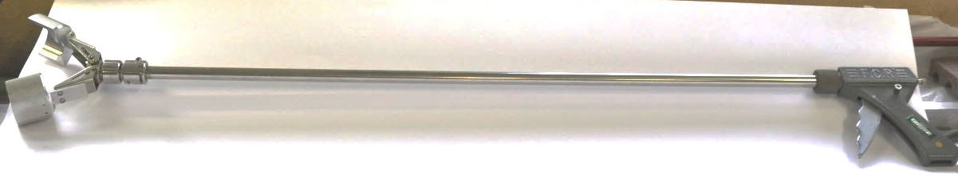
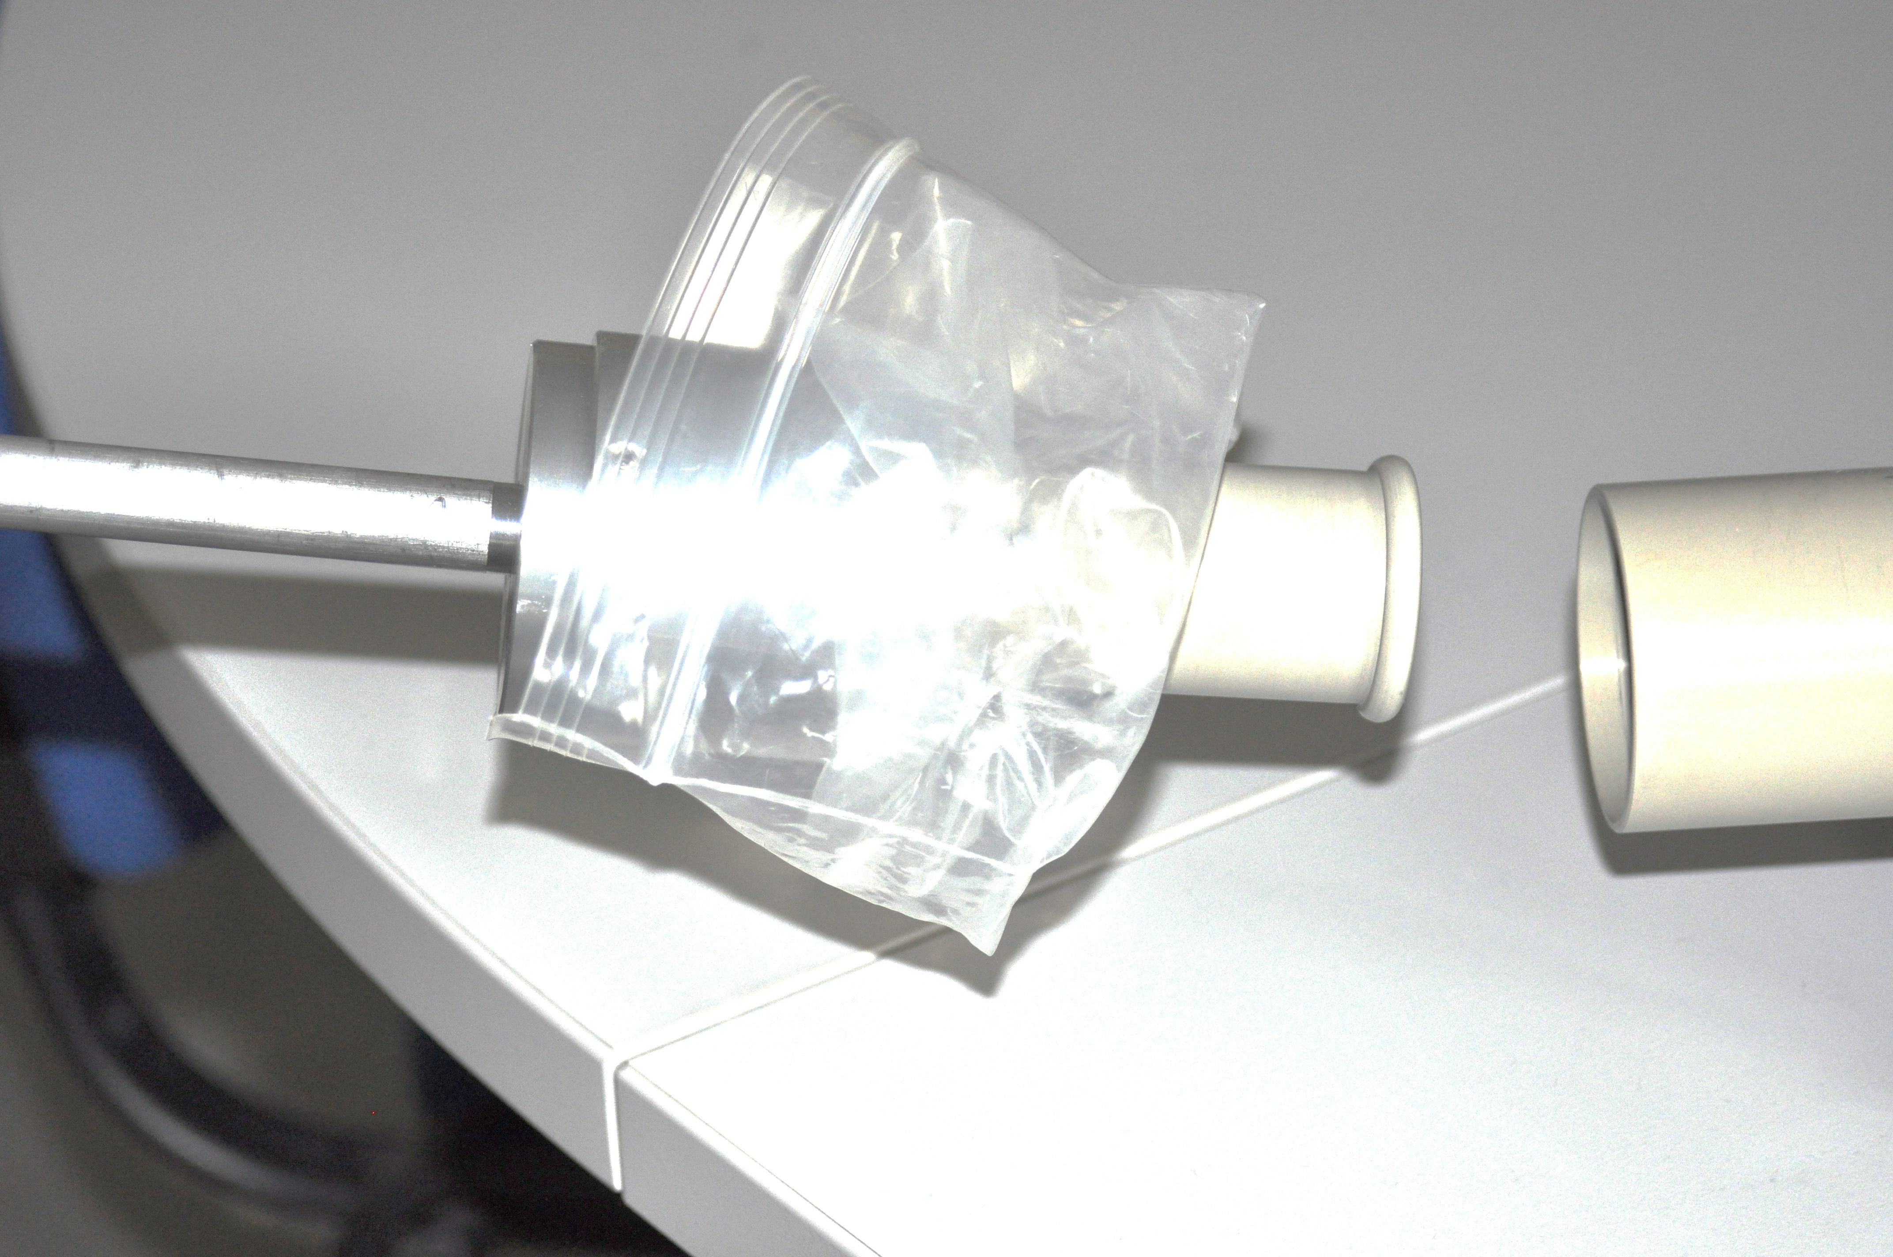
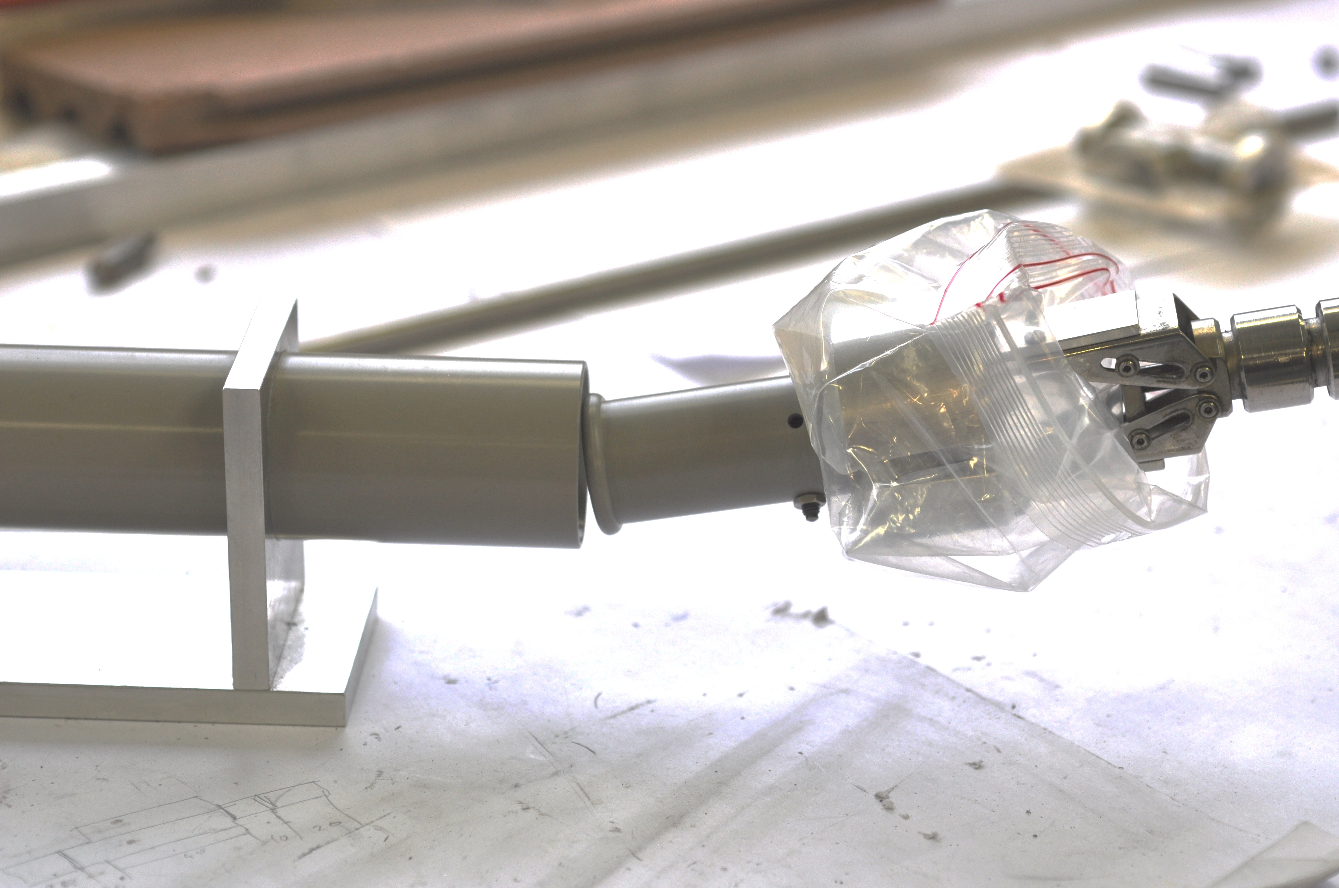
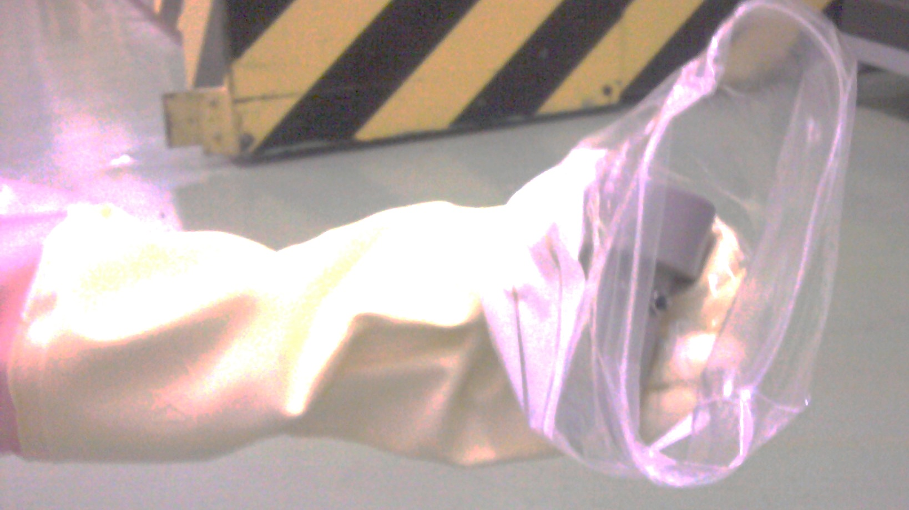
Shut-down 2008-2009
Extraction electrode changed manually –
Dosimeter ring: 4.5 mSv (finger contact limit value = 500 mSv)
Shut-Down 2009 -2010
Specific tool development on RP demand
Feed-back 2011 higher risk of dropping the electrode
Shut-down 2011-2012
Tool improvement to reduce the risk of dropping the electrode
Example 1: Specific equipment development

Slide 17
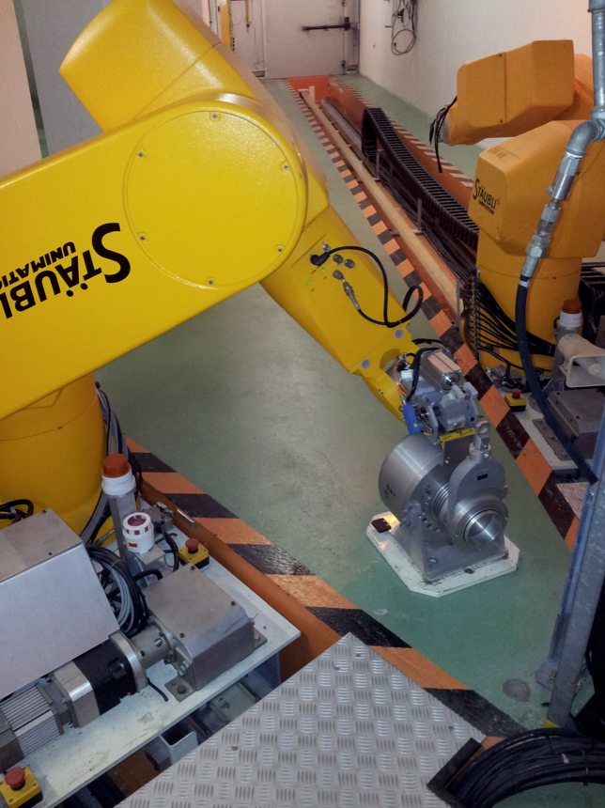
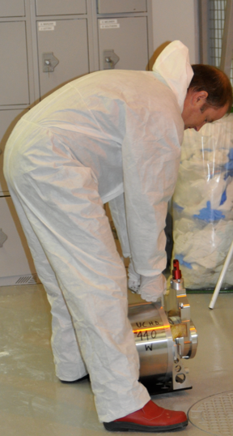
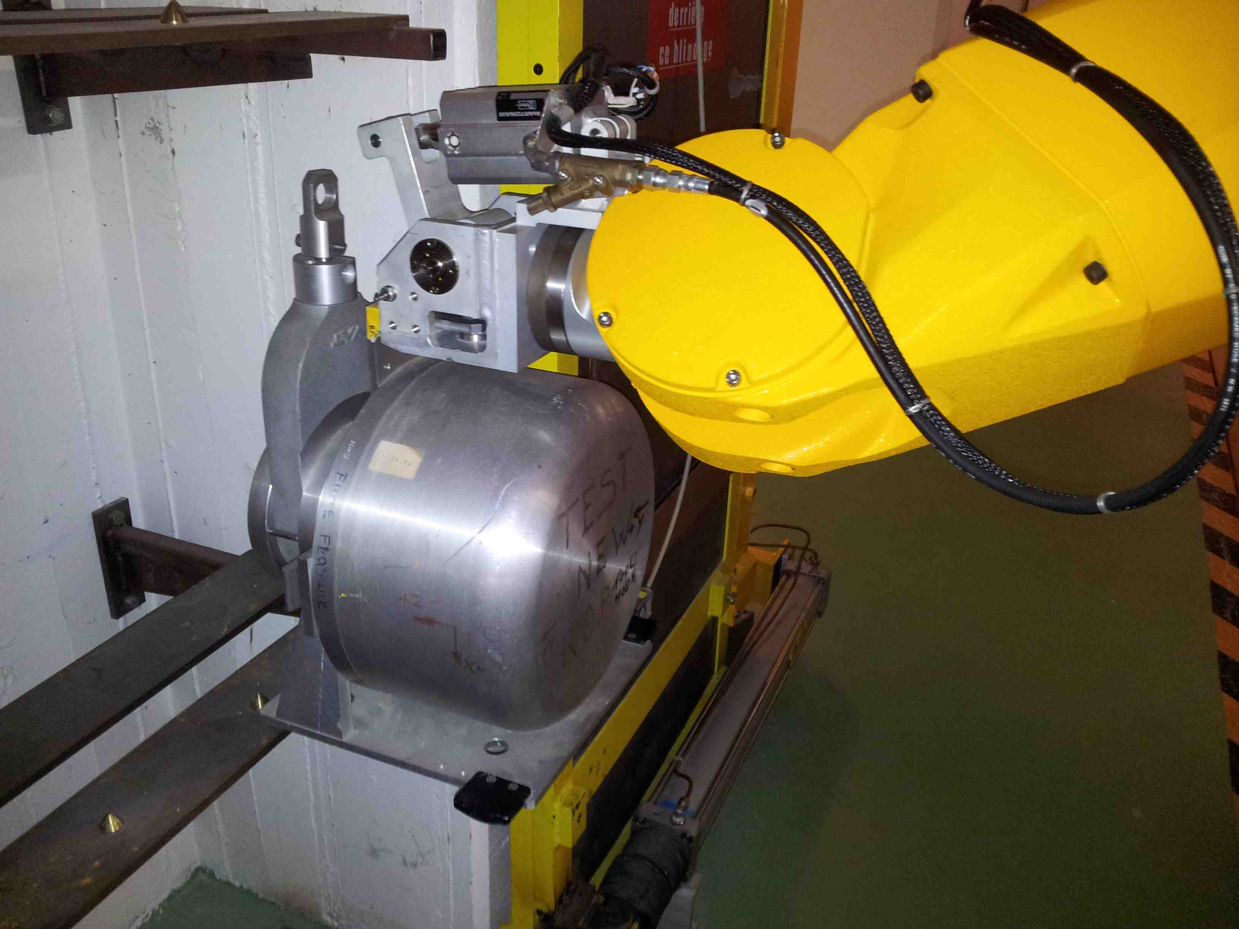
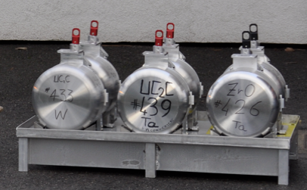
Targets handled by hand
537 μSv recorded
Before shut-down 2011
Targets handled by hand and by robot
239 μSv recorded
Shut-down 2012
Targets handled by robot only
Dose phase I << 239 μSv
After LS1
Shut-down 2014
Example 2 : Specific equipment investment

Slide 18
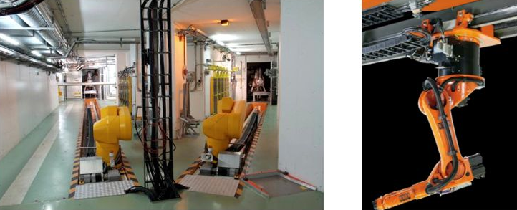
Thanks to the collaboration of EN/HE/HT
Example 2 : Specific equipment investment

Slide 19
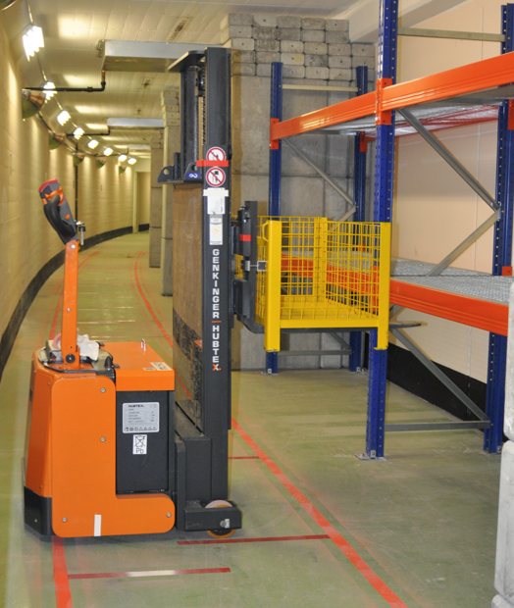
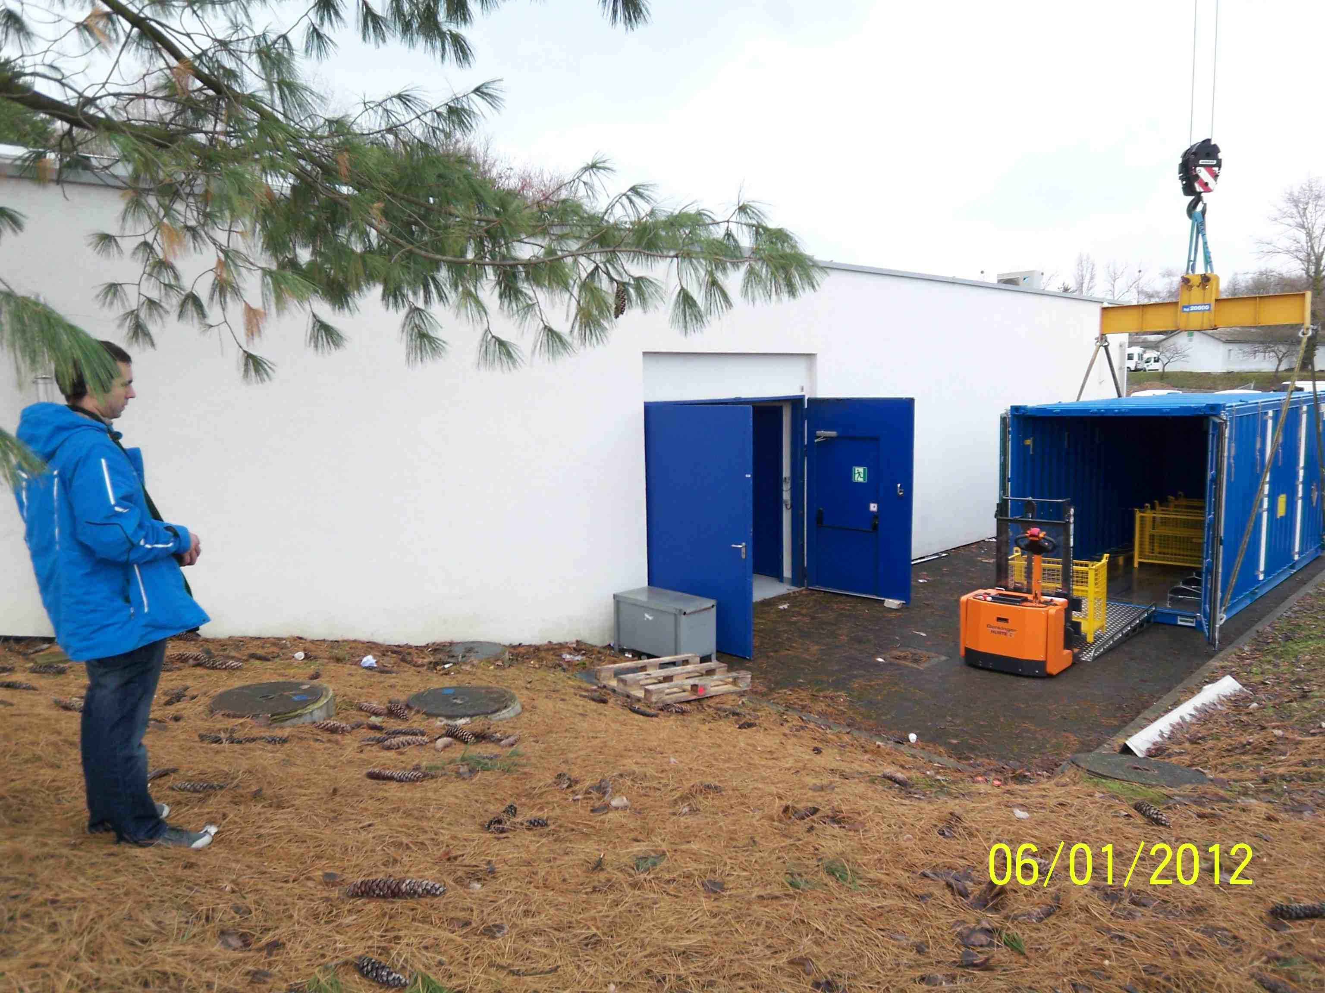
5 m
Example 3 : Specific equipment development and investment

Slide 20
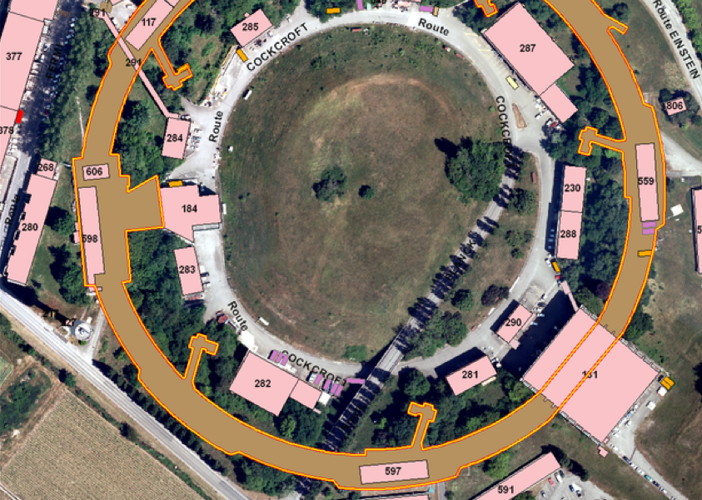
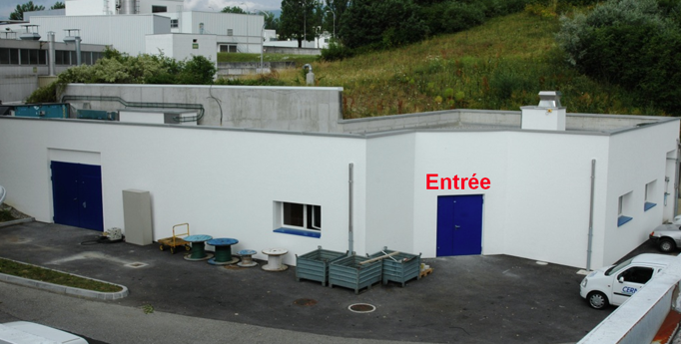
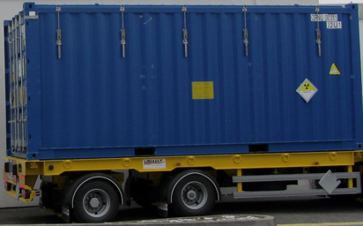
EN/STI/RBS ALARA Implementation
Example 4 : ISOLDE target transport during shut-down
ISR 3
Several option were possible
179 building

Slide 21
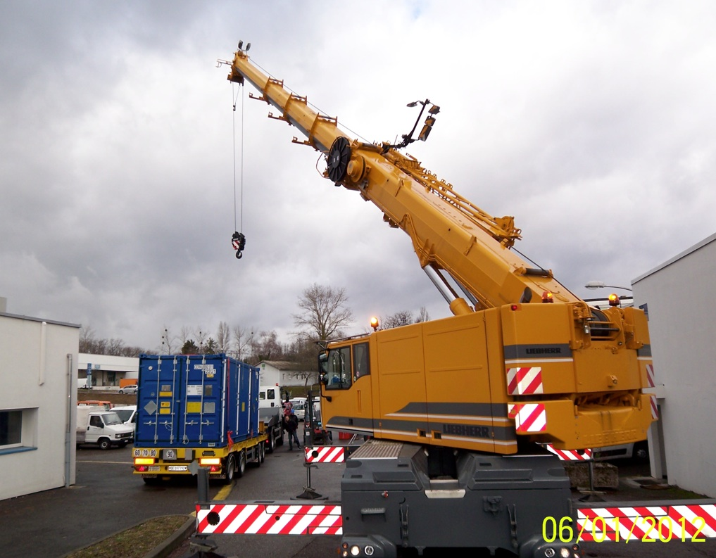
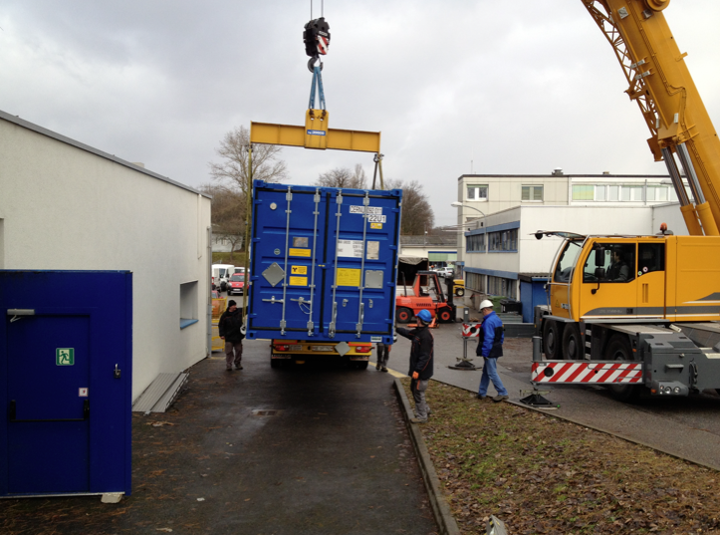
Option N°1: Transport 179 to ISR3
Container located at ground level
Thanks to the collaboration of EN-HE-HH and DGS-RP

Slide 22
Option N°1A: Transport 179 to ISR3
Target box handled with remote handling device
Estimated collective dose :
≈ 290 man.µSv
5 m
Thanks to the collaboration of EN-HE-HH and DGS-RP

Slide 23
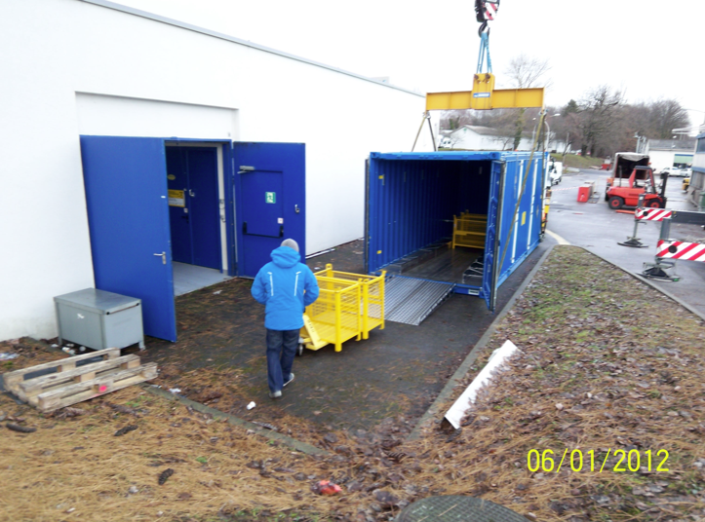
Option N°1B: Transport 179 to ISR3
Target box handled with pallet truck
Estimated collective dose :
≈ 290 man.µSv
Thanks to the collaboration of EN-HE-HH and DGS-RP

Slide 24
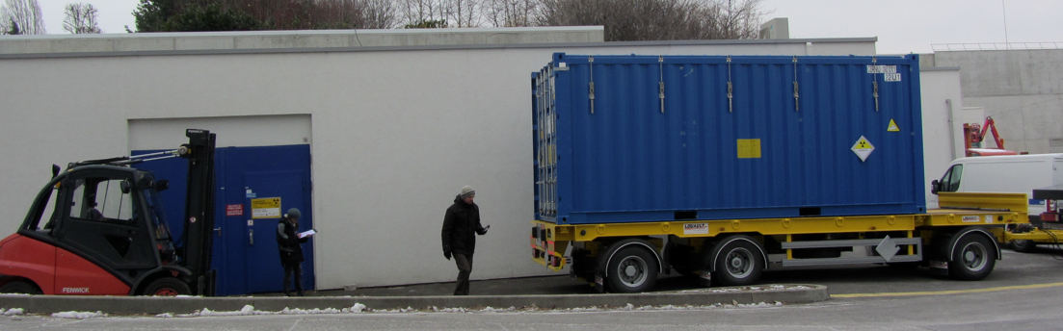
Option N°2: Transport 179 to ISR3
Container on trailer
Thanks to the collaboration of EN-HE-HH and DGS-RP

Slide 25
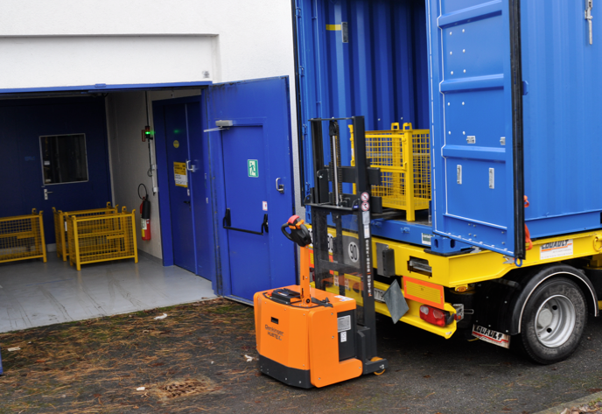
Option N°2A: Transport 179 to ISR3
One target box handled with remote handling device with class A container on truck
Estimated collective dose :
≈ 190 man.µSv
8 transports needed. Handling of one box at a time
Thanks to the collaboration of EN-HE-HH and DGS-RP

Slide 26
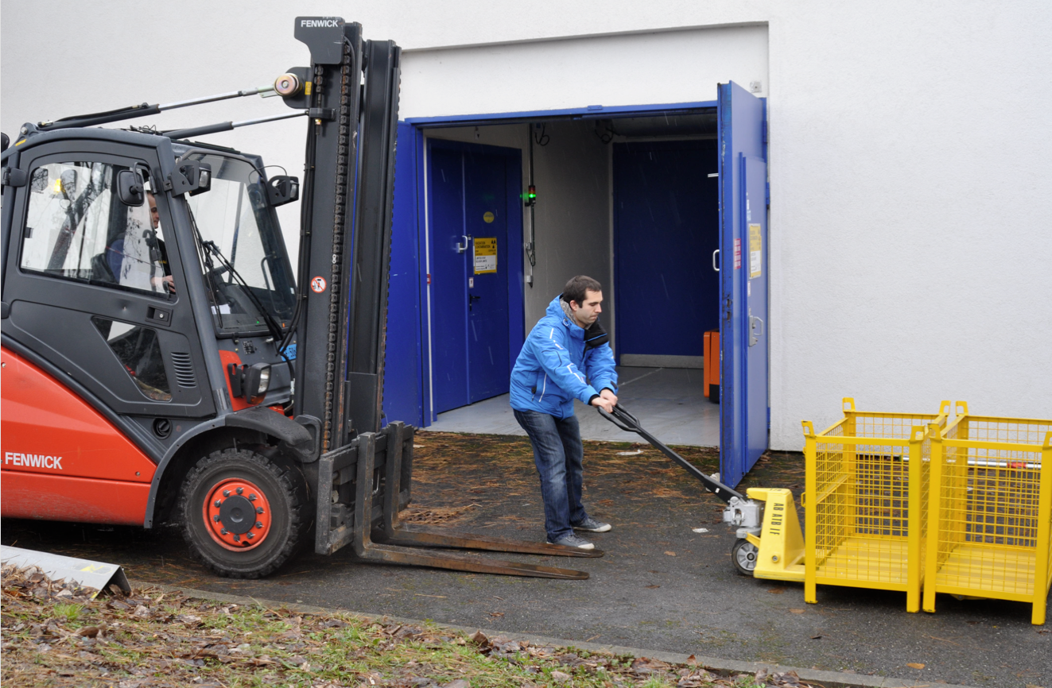
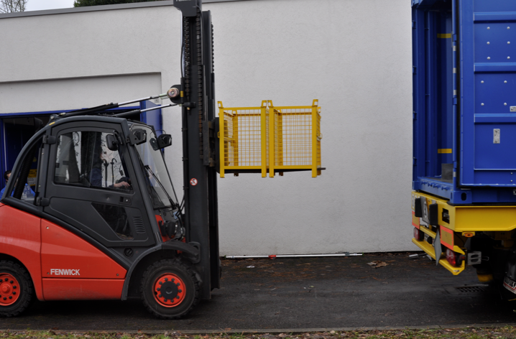
Option N°2B: Transport 179 to ISR3
Target boxes handled with forklift
Estimated collective dose :
≈ 120 man.µSv
Thanks to the collaboration of EN-HE-HH and DGS-RP

Slide 27
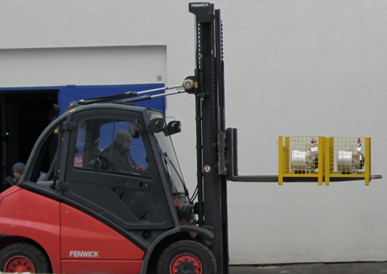
Simulation results
Intervention description | Estimation
Target box handled with remote handling device | ≈ 290 man.µSv
Target box handled with pallet truck | ≈ 290 man.µSv
2 target boxes handled with remote handling device with class A container on truck | ≈ 160 man.µSv
Target boxes handled with forklift | ≈ 120 man.µSv
≈ Expected dose save 150µSv compare to 2011
≈ In reality 90 µSv saved compare to 2011

Slide 28
RWP and WDP
ALARA level III committee
Test of the different scenario :
1 day coordination
2 x 1 day for rehearsal and preparation
  2 person from DGS/RP
  3 person from EN/STI
  4 person from EN/HE
Equipment investment
Equipment development

Slide 29
OUTLINE
Introduction to ISOLDE primary Area
ALARA principle
ALARA implementation for EN/STI/RBS
Feed-Back
Conclusion
07/03/2012 - IEFC

Slide 30
Feed-Back
ALARA tools feed-Back : WDP
Proposition from ARWG (Alara Review Working Group) under preparation
WDP very appropriate, very practical, simple
Good help for the optimisation process, useful to compare different scenarios
WDP not appropriate for operation with only contamination. WDP should not be requested in that case.

Slide 31
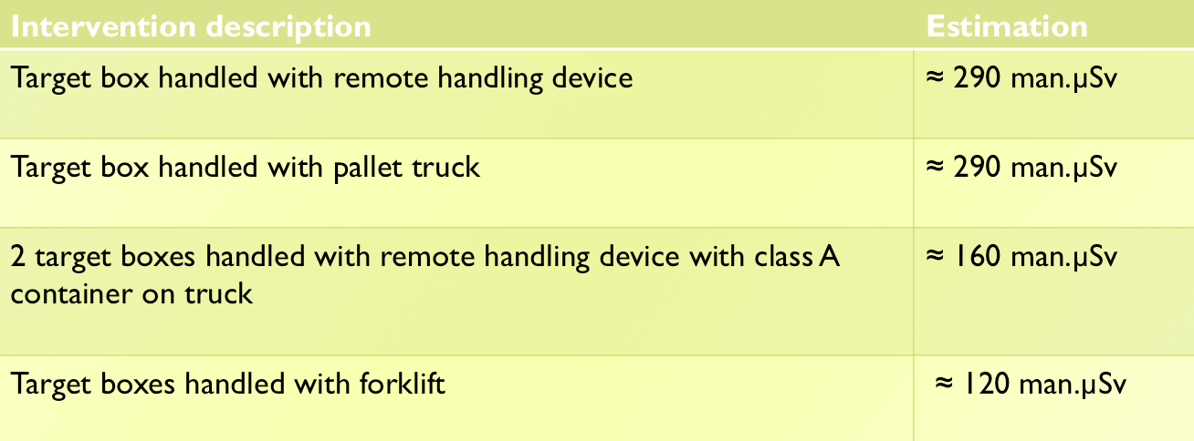
Feed-Back
Other ALARA Feed-back
→ People should be encouraged to give realistic numbers on the WDP and not to over estimate the dose or time to allow optimisation to take place
Comparative approach
→ Tolerance of 150% is used by ISOLDE - Feed-back by RP welcome to explain difference and investigate if future changes are needed

Slide 32
Feed-Back
ALARA tools feed-Back : RWP
Proposition from ARWG (Alara Review Working Group) under preparation
RWP good summary of the operation
Process of approval not defined, not clear
Follow-up of recommendations and comments not pratical, recommendation may appear at different places

Slide 33
Feed-Back
ALARA criteria
Criteria should be considered as a help to assess the severity of the operation perhaps not as a management tool, or as an approval process definition
Director for Accelerators and Technology
authorisation
Section or group leader involvement
No management involvement
Dose rate (H)
Individual Dose (H_{i})
Proposition from ARWG (Alara Review Working Group) under preparation
Collective Dose (H_{c})
Atmospheric Contamination (CA)
Surface Contamination (CS)
II and III operation may be very similar

Slide 34
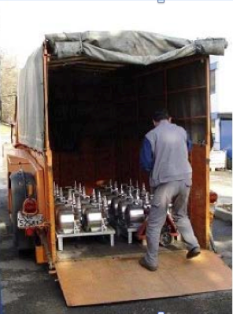
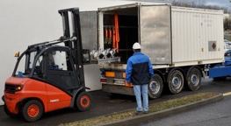
Feed-Back
Other ALARA Feed-back
ALARA reasonable should not be forgotten
Acceptance by the management to increase the collective dose of the operation to secure transport by using a container type A on road and to reduce the consequences of a road accident
Transport with “surbaissé”
80 µSv measured
Until shut-down 2010
Transport with container type A on trailer
Measured 302 µSv
Shut-down 2011

Slide 35
Conclusion
ALARA very good principle – Request resources and investment
WDP very useful
RWP to be improved
RP participation very important and very much appreciate
Improvement of ALARA criteria on going thanks to ARWG (Test in field before validation of new approach very much appreciated)
Help to users on recommendations and feed-back follow-up (tool?) would be very much appreciated → ARWG proposition under preparation

