Slide 1
Ion sources, Linac3, LEIR
D.Manglunki
Special acknowledgements to C.Carli & D.Küchler
List of actions and planning of implementation
Studies
Impact on other users
Performance for LHC and other users in the different scenarios
Potential risks

Slide 2
Scope
 | LHC | SPS fixed target
2012 | Pb-p | Be (fragmented Pb)
2013 | LS1
2014 |  | Primary Ar
2015 | Pb-Pb | Primary Xe
2016 | Pb-Pb | Primary Pb
2017 | Pb-p | “
2018 | LS2
2019 | Pb-Pb | Primary Pb
2020 | Pb-p | “
2021 | Ar-Ar | “
2022 | LS3
2023 | HL Pb-Pb (& d-Pb?) | ???
Studies and upgrades needed in Linac3 and LEIR, in view of the LHC and SPS fixed target programmes:
  Ar and Xe
  HL Pb-Pb
Medical ions only mentioned

Slide 3
Possible route to 50ns
Design current from Linac 3 (~50μA)
LEIR
  Produce 2 bunches of ~10⁹ Pb⁵⁴⁺ in same emittance (i.e. twice today)
PS gymnastics
  Batch compression to 100ns h = 16 -> 18 -> 21
  (no need for new cavities, 10MHz system exists)
  Splitting h = 21 -> 42
  (20MHz system exists but V_{RF} acceptance to be checked)
  4 bunches > 1.4 x10⁸ Pb⁸²⁺ into SPS
12 SPS injections spaced by 50ns
  Similar bunch quality as present beam
  48 bunches of ~1.4x10⁸ Pb⁸²⁺
  Transverse emittances ~0.85μm
  But with 50ns spacing and hopefully less spread in bunch population
  Note: longer LHC injection time

Slide 4
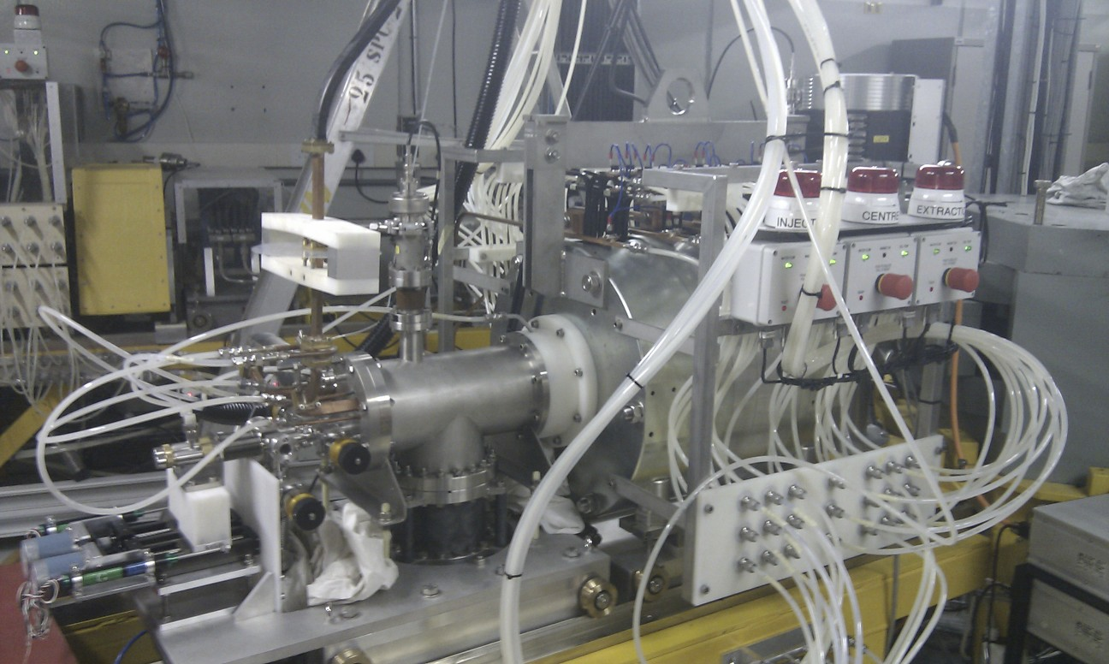
ECR ion source: studies of Ar and Xe
Since 2010: Collaboration with
iThemba laboratory (South Africa)
  Identical ECR source preparing Ar
  and Xe
  Expect results by end 2012
  Training expert from iThemba
  on “afterglow mode” at CERN
  in 2012, will provide additional
  manpower during ion run
2013: asked for “derogation” from LS1
  Source + RFQ + Linac will run for 2x13 weeks to prepare Ar and Xe at CERN, explore parameter space, and generally get operational confidence in new species
2014: Ar run alone for SPS
2015: Xe run before LHC Pb run
Currently no schedule for other species

Slide 5
ECR ion source
Design current out of Linac3 (50μA) needed for HL-LHC after LS3…source?
All improvements of 2011 (new connection of intermediate electrode, new gas feedback loop, new oven filling scheme) towards better reliability, stability, and shorter filling time. Future improvements should aim at increasing the intensity without sacrificing the stability.
Plasma chamber coating
  Aluminium chambers gave a high intensity but a terrible beam stability, while the stainless steel chamber delivers a much better beam stability, hence the idea of coating a stainless steel chamber with Al, combining the advantages of both chamber types.
  Will need time for testing the chamber
18GHz tests
  Did not give expected (150%) results, conversion into spare for 14.5GHz

Slide 6
Linac 3
Design current out of Linac3 (50μA) needed for HL-LHC after LS3
  Is Linac3 the bottleneck? Can it transmit a higher intensity from the source?
Multiple charge acceleration
  RFQ/Linac can in principle accelerate Pb²⁸⁺ and Pb³⁰⁺ in addition to Pb²⁹⁺, then strip to Pb⁵⁴⁺
  First (limited) tests at CERN date from 2001-2003 (transmission of Pb²⁸⁺ through Linac3 tuned to Pb²⁷⁺ acceleration)
Faster Linac repetition rate
  Currently 5Hz but 10Hz design (no HW limitation in principle)
  ECR source is already pulsing at 10Hz
  Possibility to double rep rate, and thus number of injections, but cooling in LEIR has to follow

Slide 7
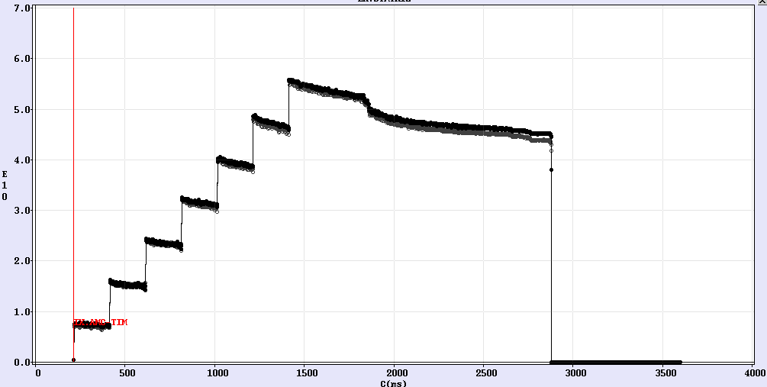
LEIR loss at the beginning of the ramp
Limitations due to direct space charge?
  limit with irregular lattice lower than
  expected
How small are emittances after cooling?
  should we make them larger?
Impact of Bdot
  should we accelerate faster to decrease time spent with bunched beams at low energy?
  or slower to reduce dynamic effects?
Instabilities?
  probably not an issue with present intensities
… a lot of studies with beam

Slide 8
LEIR Instrumentation & operation
SEMs with electronics to see the injected beam
  matching and emittance measurements of the injected beam
Scrapers for emittance measurements
  Need refurbishing of controls hardware, and writng an emittance measurement application
Make BIPM measurements Operational
  Still a specialist tool for the moment
Modify security chain
  Allow injection of ions into LEIR even during PS access
Increase ECOOL’s electron current
  to compensate increased LINAC3 repetition rate

Slide 9
LEIR: other ion species
Proposal by JINR (I. Meskov) for recombination tests with lower Pb charge states
  Help us understanding recombination process
Ar and Xe to provide beams for SPS fixed target (and LHC in 2021)
  Program different magnetic cycles (started in 2011)
Ions of interest for medical studies (C, O)
  significantly higher energies per nucleon in case of fully stripped ions at the end of Linac3 (up to 430 MeV/nucleon with a new main power supply) Radio-protection issues to be studied. (Concrete ceiling?)
  Reimplementation of a slow ejection
  New ejection channel in section 40
  Note: Higher electron currents would also be beneficial for light ions (Slower cooling time for lower charge)

Slide 10
The four options for deuterons
ALICE will tell by the end of 2012 if d-Pb is requested after LS3
Option 1: New source, LEBT and RFQ; re-use Linac3 IH for final energy
Option 2: New source, LEBT and RFQ, which goes to final energy
Option 3: Completely new linac (5?)
Option 4: Cyclotron

Slide 11
Conclusions
LHC and SPS fixed target programmes, as currently defined until LS3 are manageable with a single source
Ar and Xe will be available after LS1
Present performance needs at least doubling for HL-LHC
  Although 10 years from now, no guaranteed route exists
No current schedule for medical ions
  Scheduling problem especially with a single source
  Study of medical ions in injector chain would make them available for fixed target SPS experiments (but currently no request for O, C…)
Deuterons would need a large investment

Slide 13
The four options for deuterons
ALICE will tell by the end of 2012 if d-Pb is desirable after LS3
Option 1: New source, LEBT and RFQ; re-use Linac3 IH for final energy
  re-use of existing hardware
  RFQ needs to go only to 250keV
  switchyard needed to combine the two low beam lines in front of the IH structure
  space very limited in the Linac3 hall for new hardware
  ion current limitation due to space charge limit of the IH structure
  new radioprotection policy needed due to possible activation at final energy
  installation and commissioning only during period when Linac3 does not deliver beam

Slide 14
The four options for deuterons
Option 2: New source, LEBT and RFQ, which goes to final energy
  no limitation due to IH structure
  higher intensities possible
  deuterons and heavy ions can run in parallel
  RFQ becomes very long and expensive
  New location needed
  No use of existing hardware

Slide 15
The four options for deuterons
Option 3: Completely new linac (5?)
  no limitations due to IH structure
  higher intensities possible
  design can be optimized for intensity and also for the injection energy into LEIR
  deuterons and heavy ions can run in parallel
  no use of existing hardware
  new location needed

Slide 16
The four options for deuterons
Option 4: Cyclotron
  no limitations due to IH structure
  design can be optimized for intensity and also for the injection energy into LEIR
  a cyclotron for this energy range is very compact
  could be placed near to LEIR injection
  deuterons and heavy ions can run in parallel
  no use of existing hardware
  new location needed
  new technology not common at CERN

Slide 17
Possible scheme for 2015
Nb of bunches
Pb ions /
(future) LHC bunch
Harmonic number / Frequency
7 injections
LEIR
(9 10⁸ Pb ions / 3.6 s)
2
2
16–18-21
PS batch compression
bunch spacing = 100ns
2
-169
SPS at extraction,
after 12 transfers from PS,
Batch spacing = 200 ns ( resp 150ns)
1.4 10⁸
24
200 MHz
1.2 10⁸
LHC at injection,
after 19 (resp 22) transfers from SPS
~460
(530)
400 MHz
β* = 0.5 m -> L = 2.5x10²⁷ cm⁻² s⁻¹
(resp L= 3.0x10²⁷ cm⁻² s⁻¹)

Slide 18
p-Pb 200ns scheme in 2012
Nb of bunches
1.5 10¹⁰
Harmonic number / Frequency
PSB
(3 10¹⁰ protons)
2
2+1
9-10
PS batch compression
bunch spacing = 200ns
2
20-21
-84
1.2 10¹⁰
SPS at extraction,
after 12 transfers from PS,
Batch spacing = 225 ns minimum
24
200 MHz
note: minimum batch spacing of 225ns dictated by protons injection at 26GeV/c
Nb of bunches
Harmonic number / Frequency
LEIR
(9 10⁸ Pb ions / 3.6 s)
2
2
16–14-12-24
PS batch expansion
bunch spacing = 200ns
2
24-21
-169
1.4 10⁸
SPS at extraction,
after 12 transfers from PS,
Batch spacing = 225 ns minimum
24
200 MHz

Slide 19
p-Pb 100ns scheme in 2012
Nb of bunches
3 10¹⁰
Harmonic number / Frequency
PSB
(6 10¹⁰ protons )
2
9-10
PS batch compression
+splitting ;
bunch spacing = 100ns
4
20-21
-84
1.2 10¹⁰
SPS at extraction,
after 12 transfers from PS,
Minimum batch spacing = 225 ns
48
Note: minimum batch spacing of 225ns dictated by protons injection at 26GeV/c
Nb of bunches
4.5 10⁸
Harmonic number / Frequency
LEIR
(9 10⁸ Pb ions / 3.6 s)
2
2
PS batch compression
+splitting ;
bunch spacing = 100ns
16–14-12-24
4
24-21
-169
1.4 10⁸
SPS at extraction,
after 12 transfers from PS,
Minimum batch spacing = 225 ns
48
200 MHz

