Slide 1
Detector Movement System
Andrew Cunningham

Slide 2
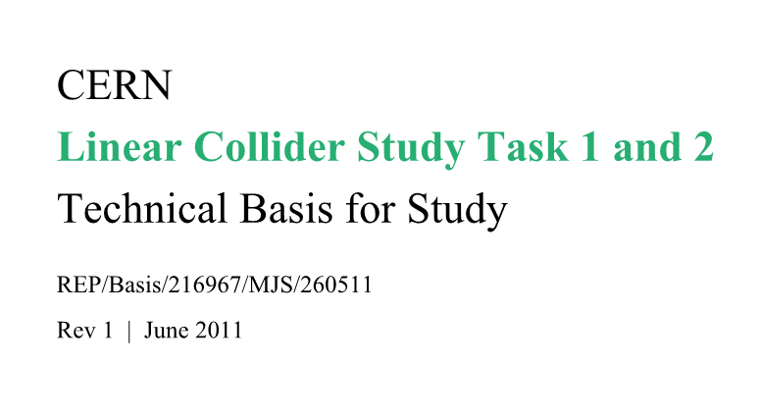
Summary of Requirements

Slide 3
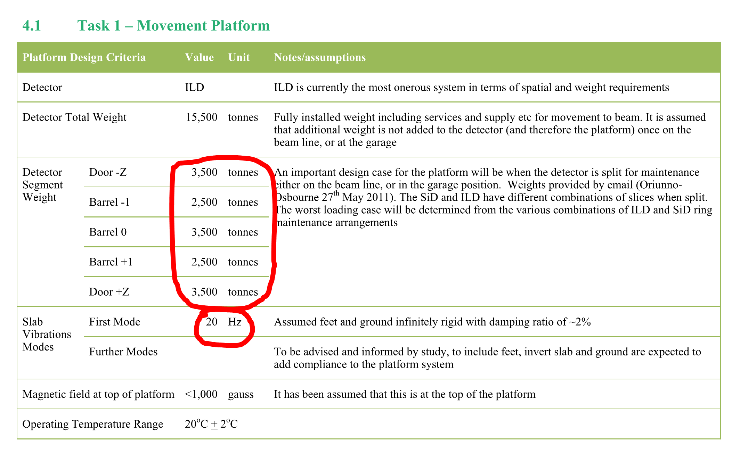
Summary of Requirements

Slide 4
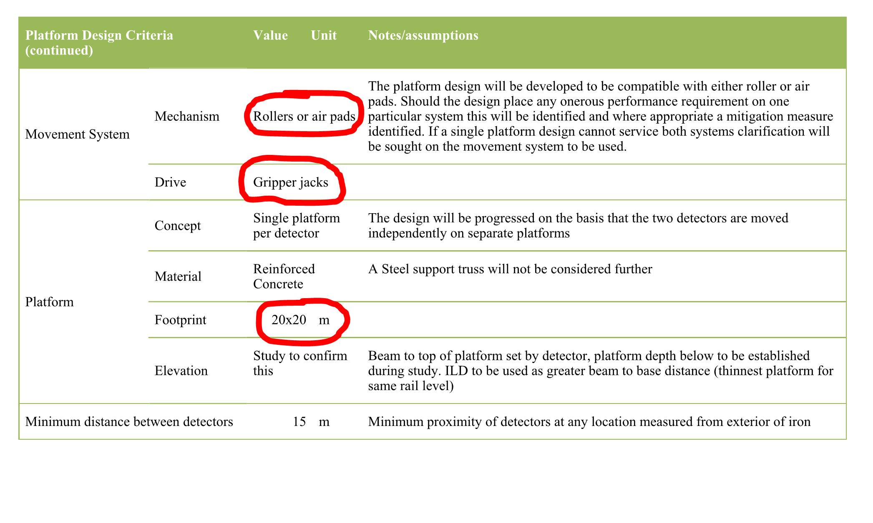
Summary of Requirements

Slide 5
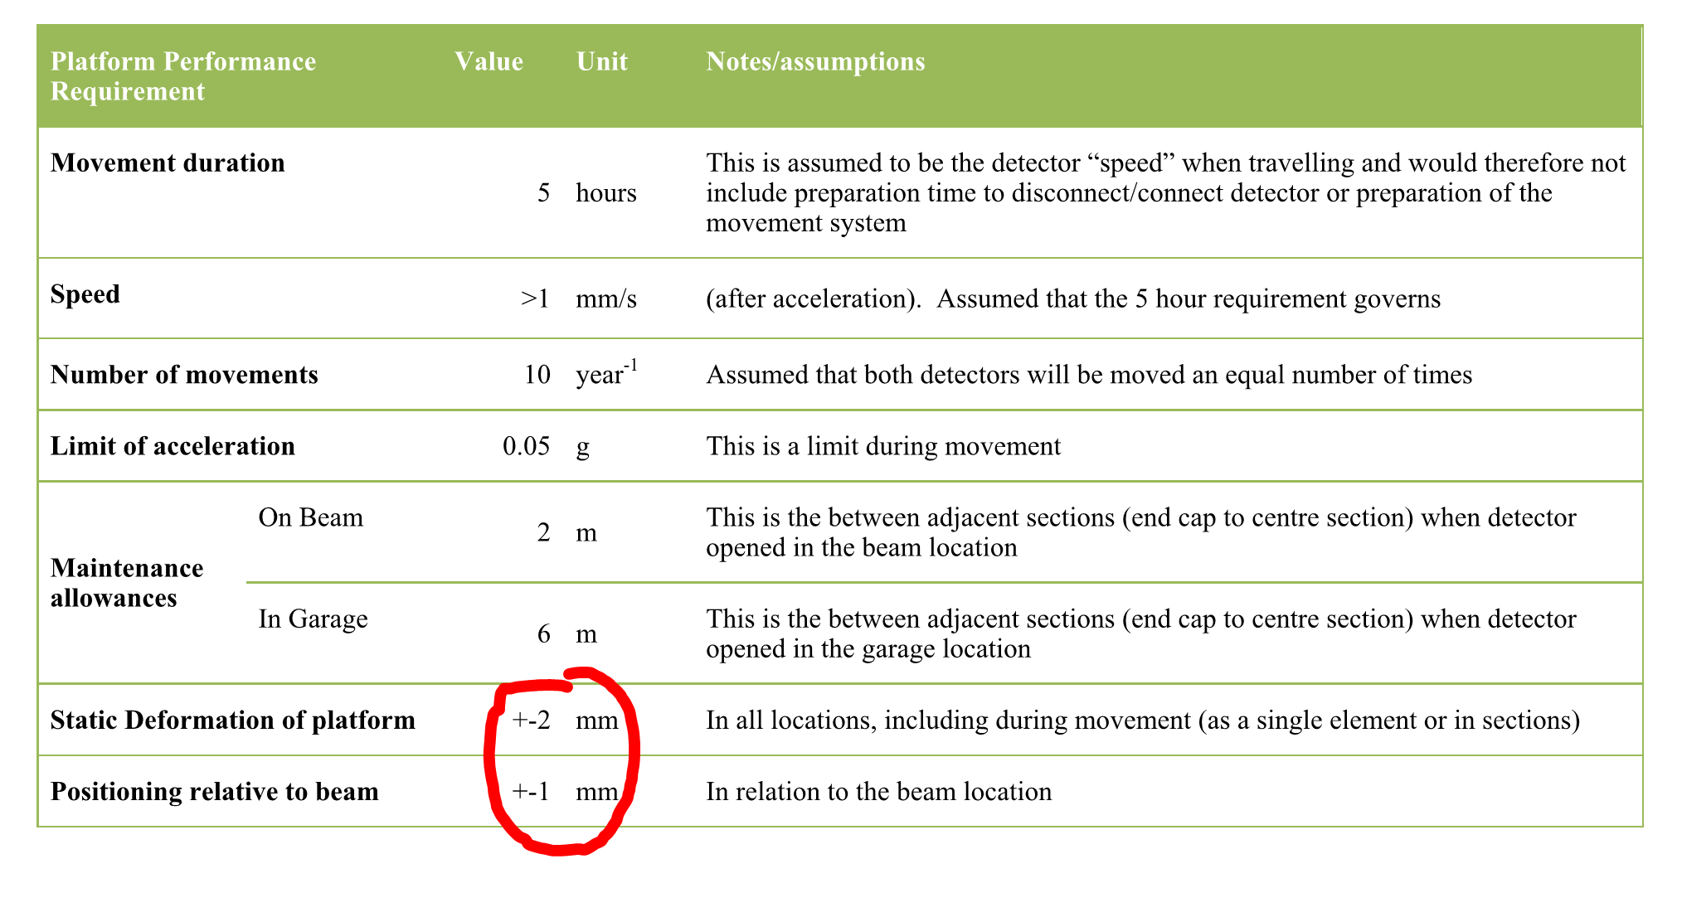
Summary of Requirements
Limited to under the footprint of the detector.
n/a when un-slicing

Slide 6
Top Loads on the Slab

Slide 7
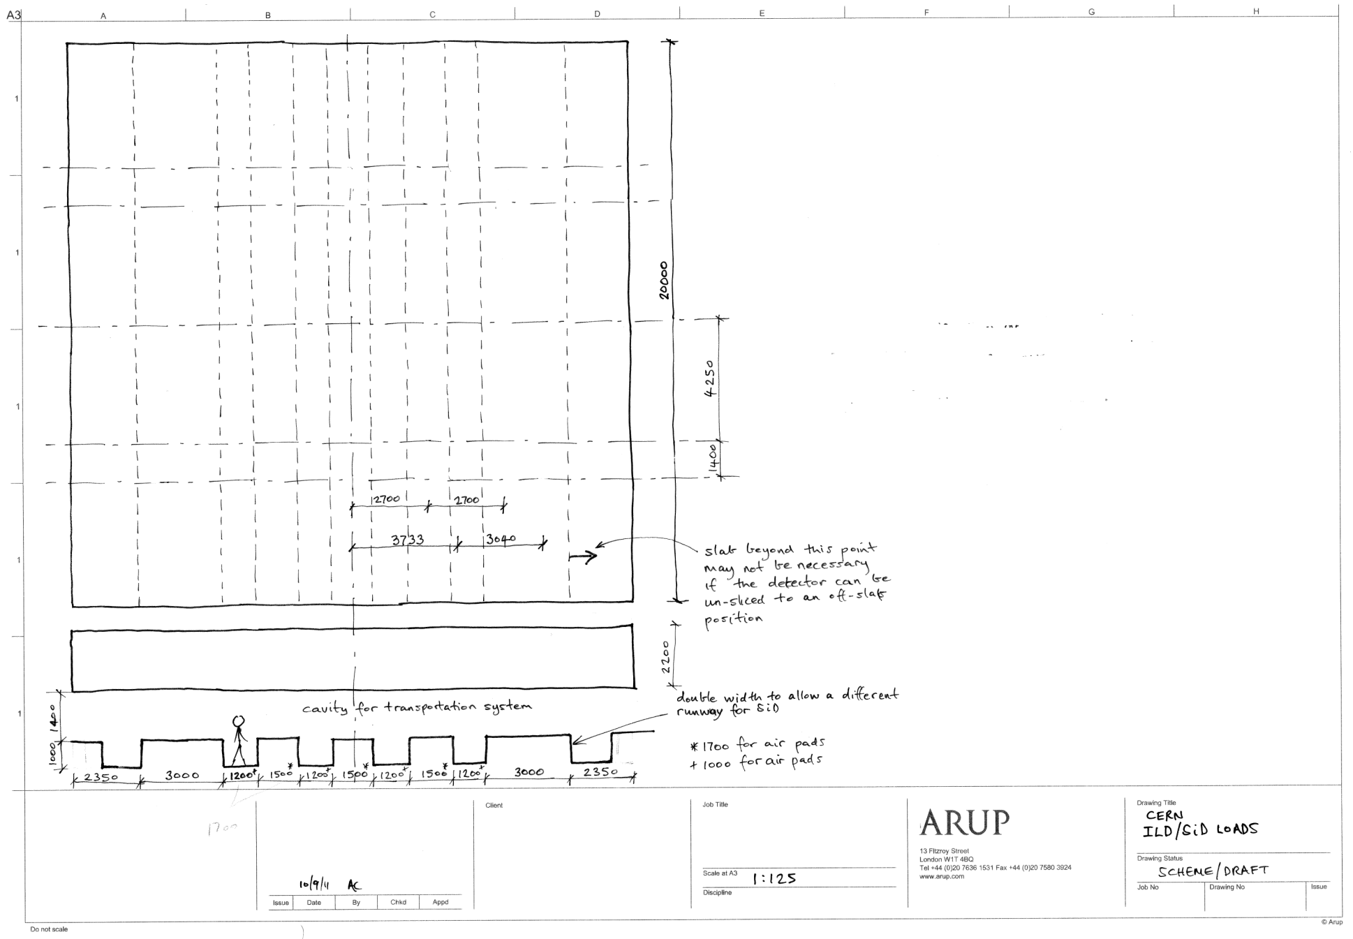
ILD top loads when moving/closed
Direction of travel
17.5MN
12.5MN
17.5MN
12.5MN
17.5MN
3500
ILD loads when moving/closed
Position of permanent support for ILD (preliminary)
17.5MN
12.5MN
17.5MN
12.5MN
17.5MN

Slide 8
ILD top loads when un-slicing
12.5MN
12.5MN
17.5MN
12.5MN
12.5MN
Direction of travel
5MN
5MN
ILD loads when moving/closed
5MN
5MN
Position of permanent support for ILD (preliminary)
4750
Range of positions (assumed 2000)
12.5MN
12.5MN
17.5MN
12.5MN
12.5MN

Slide 9
Slab Flex with ILD
A lot of slab is outside the permanent supports and the detector envelope (is it all necessary?) – N/A for displacement limits
The top loads change position significantly during un-slicing – displacement limit not applicable when un-slicing

Slide 10
SiD top loads when moving/closed
2100
25MN
25MN
Direction of travel
SiD loads when moving/closed
Position of permanent support for SiD
25MN
25MN

Slide 11
SiD top loads when un-slicing
6775
3700
2100
12.5MN
12.5MN
Direction of travel
2000
2000
6.25MN
6.25MN
6.25MN
6.25MN
4700
SiD loads when un-slicing
represents range of positions
Position of permanent support for SiD
(preliminary)
6.25MN
6.25MN
6.25MN
6.25MN
12.5MN
12.5MN
2200 ILD
3800 Sid

Slide 12
Slab flexure critical – but what is its definition?
Design using +/-2mm over slab – UNDER DETECTOR
If the slab was smaller eg. 14x14m would it still be +/-2mm
If yes, can we not just apply the +/-2mm over that part of the slab which is under the detector? – YES
Does +/- 2mm mean that some part can go up by 2mm and some down by 2mm => 4mm amplitude?
Is the deflection limit to be applied during un-slicing? - NO

Slide 13
Slab Flex Analysis

Slide 14
A refined support system for ILD
Step 1: ILD Slab on permanent supports
Step 2: Put ILD(closed) loads on top of slab
Step 3: Jack onto transportation system
Step 4: Consider un-slicing – not now subject to deflection limits

Slide 15
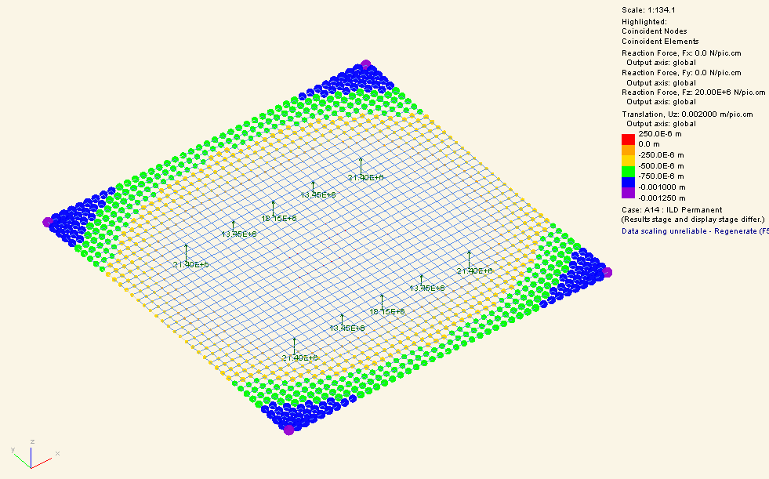
Step 1: ILD Slab on permanent supports
Slab on permanent supports (directly under the top loads for ILD closed)
The top surface of the slab can be defined as level and perfectly flat at this stage in its life
But note this is a long term load case and the value will increase with creep - ongoing
Model summary:
E = 32GPa
Slab 20x20mx2.2m
Load = Slab self weight
Flexure = 0.25mm up to 1.25mm down = 1.5mm amplitude
Displacement under footprint of slab +/- 0.15 mm

Slide 16
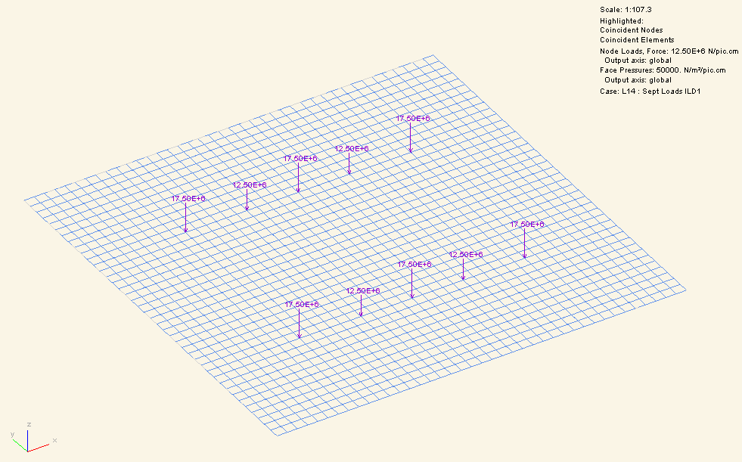
Step 2: Put ILD(closed) loads on top of slab
This has negligible displacement effect because the loads are (nearly) directly above the supports

Slide 17
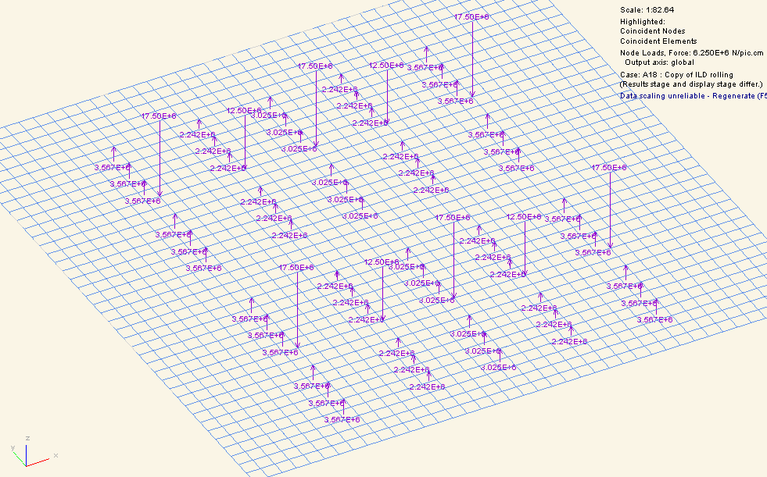
Step 3: Jack onto transportation system
ILD (closed) effect upon top surface of jacking onto the transportation system (jack config 1)
Model summary:
E = 32GPa
Slab 20x20mx2.2m
Load = Slab self weight + ILD (closed) top loads
See next slide for displacement as a result of step 3

Slide 18
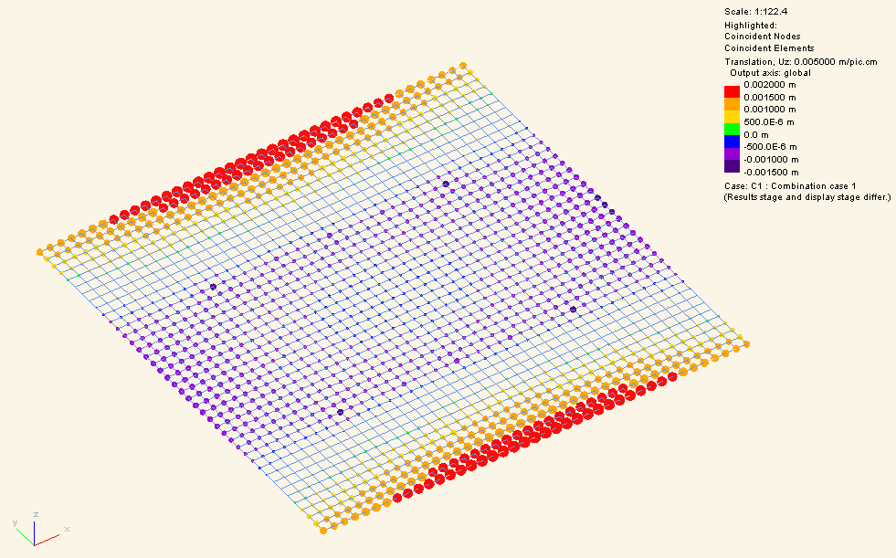
Step 3 (continued)
ILD (closed) effect upon top surface of jacking onto the transportation system (jack config 1)
Flexure = +1.9mm to -1.0mm
This meets the +/- 2mm tolerance
Note if the slab were smaller the reported deflection would drop significantly.
Displacement under footprint of slab +0, -0.7mm down
Model summary:
E = 32GPa
Slab 20x20mx2.2m
Load = [Slab self weight + ILD (closed) top loads + jack supports] – [Slab self weight on permanent supports]

Slide 19
Step 1: SiD Slab on permanent supports
Slab on permanent supports (directly under the top loads for ILD closed – so we use same tracks as ILD)
The top surface of the slab can be defined as level and perfectly flat at this stage in its life
But note this is a long term load case and the value will increase with creep - ongoing
Model summary:
E = 32GPa
Slab 20x20mx2.2m
Load = Slab self weight
Flexure = 0.25mm up to 1.25mm down = 1.5mm amplitude
Displacement under footprint of slab +/- 0.15 mm

Slide 20
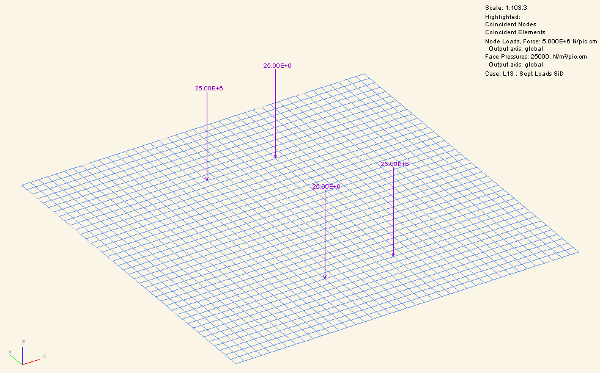
Step 2: Put SiD(closed) loads on top of slab
This has negligible displacement effect because the loads are (nearly) directly above the supports

Slide 21
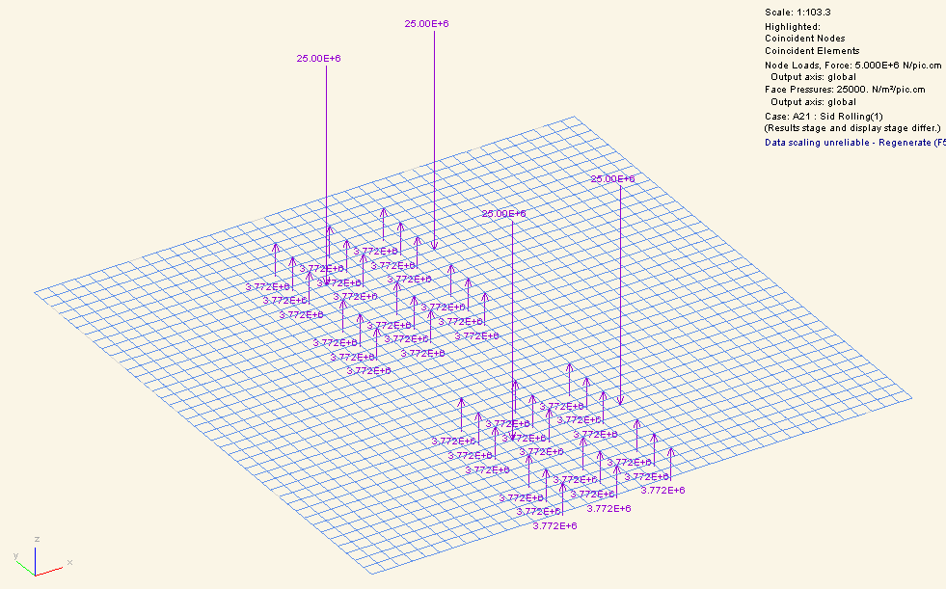
Put SiD(closed) moving on transportation system
Model summary:
E = 32GPa
Slab 20x20mx3.8m
Load = Slab self weight + SiD (closed) top loads
See next slide for displacement as a result of these loads

Slide 22
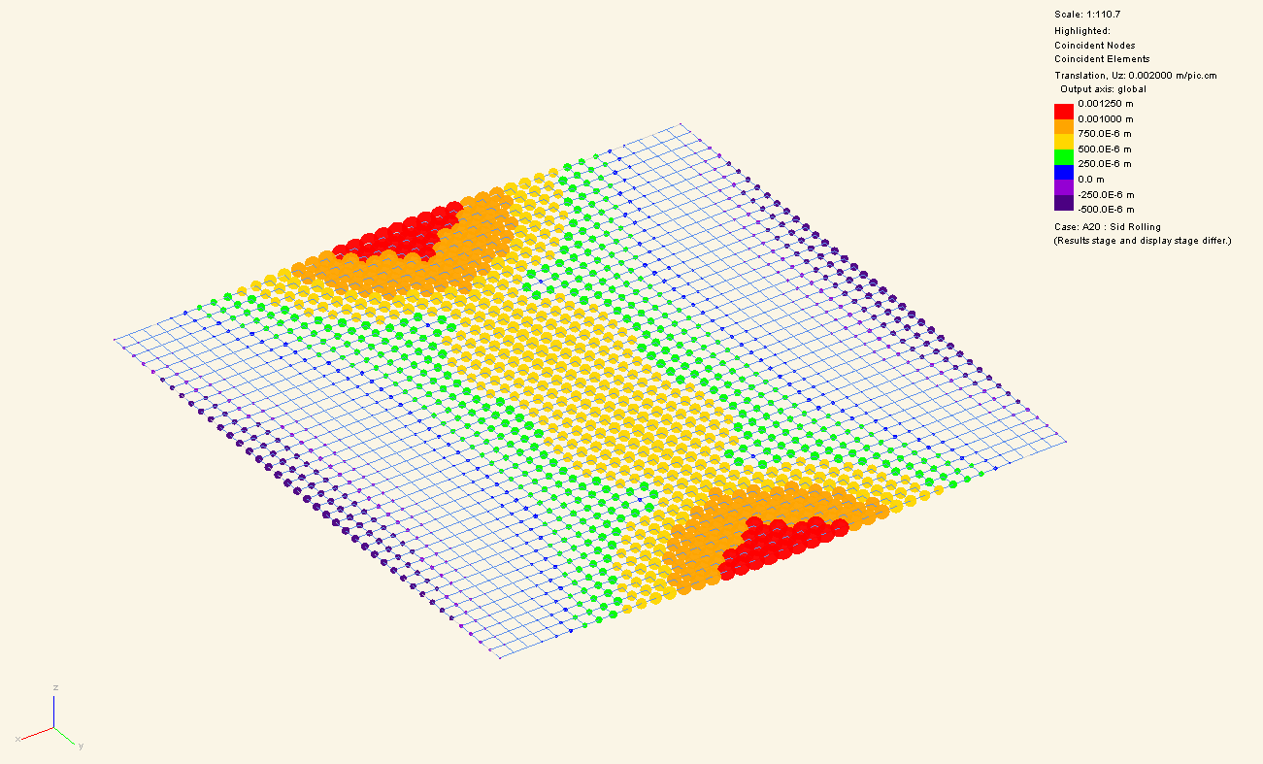
Put SiD(closed) moving on transportation system
0.7mm under detector

Slide 23
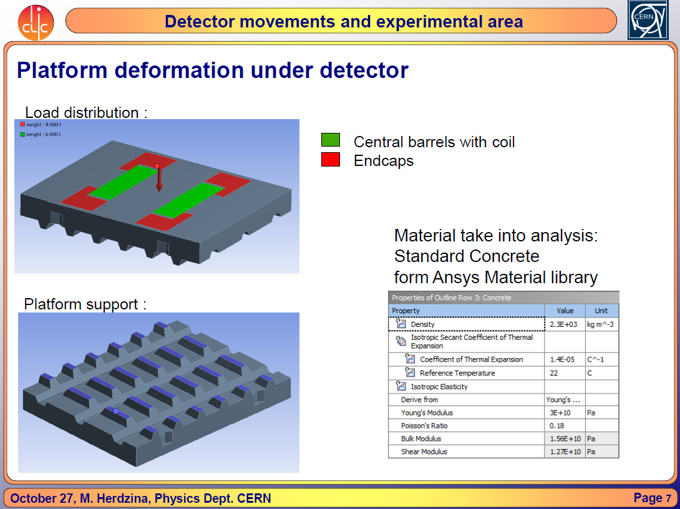
Analysis from Granada

Slide 24
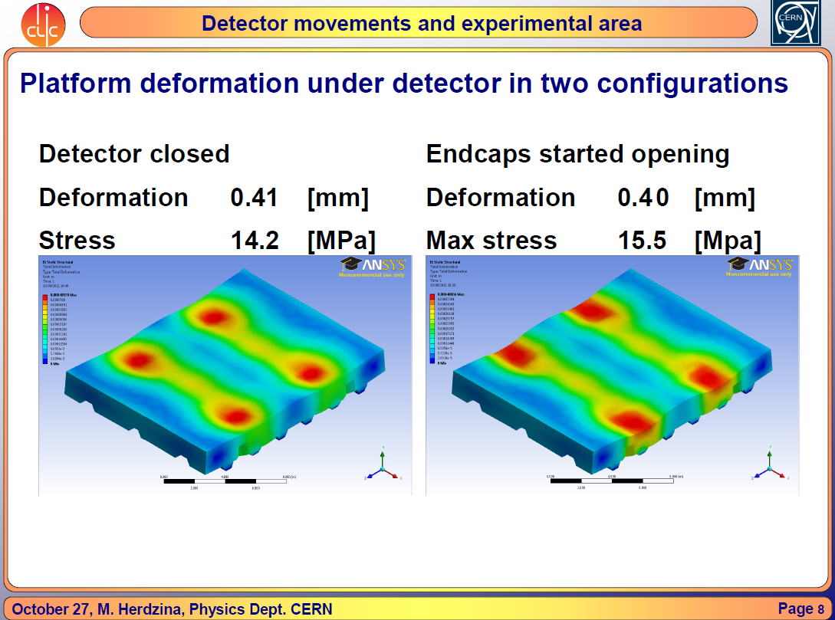
Analysis from Granada

Slide 25
Un-slicing
Un-slicing causes top loads to move away from the permanent supports.
Because of this, un-slicing would cause displacement limits to be exceeded if supported only by the permanent supports. Displacement limits N/A

Slide 26
Conclusion on ILD movement
Can achieve disp limits of +/-2mm when moving
Limits n/a when un-slicing
But props/shims will be needed under tracks when un-slicing to avoid a step

Slide 27
Support System During Movement

Slide 28
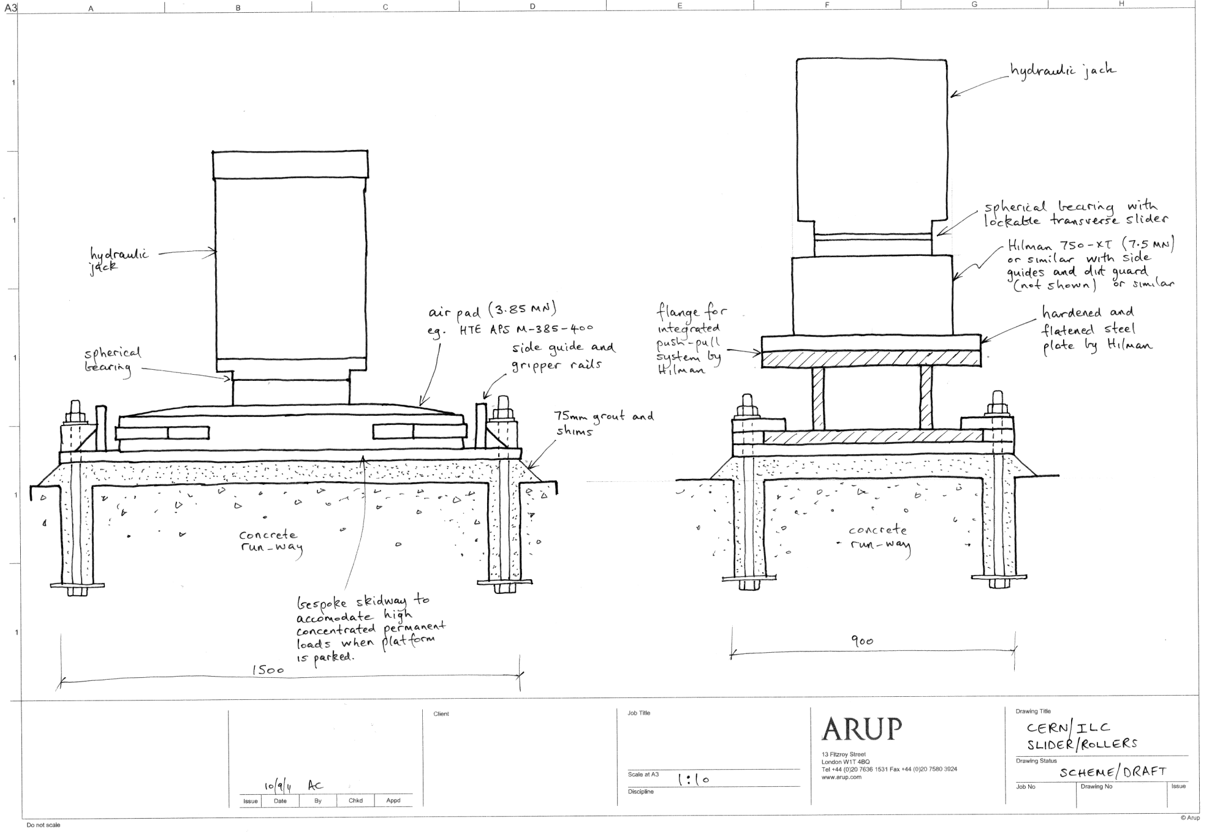
Pads and Rollers

Slide 29
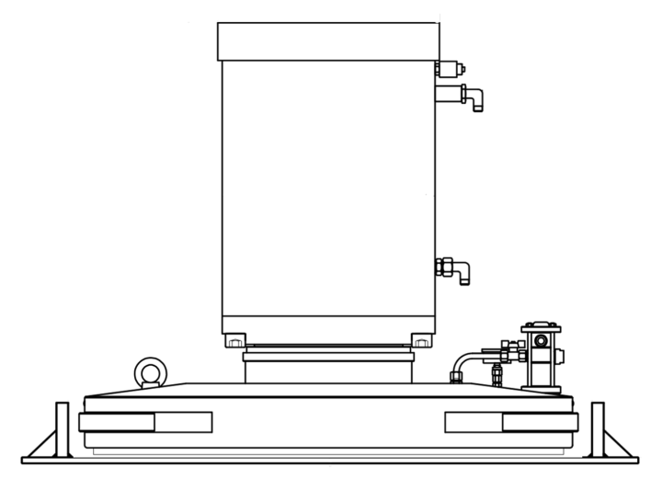
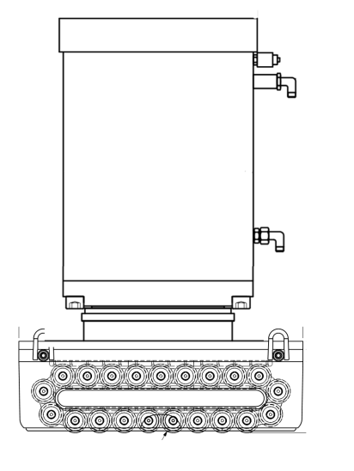
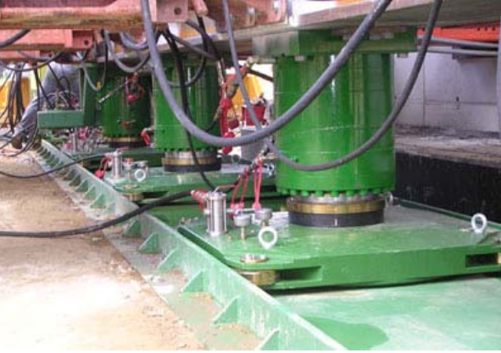
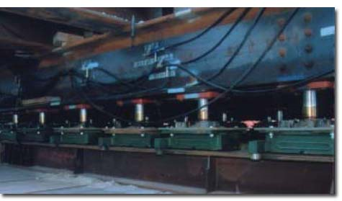
The movement support system
Air pads or rollers

Slide 30
Meeting with Hilman Rollers 15 Sept 2011
Self-driven rollers now available presently in use in the nuclear industry;
Heavy version to be confirmed (only 100 tonne presently available);
Hilman advised 3% friction for internal use;
Hilman provide a suitable hydraulic push-pull system
  Awaiting details from Hilman;
Hilman provide a lateral slider (necessary for final lateral adjustment)
  This locks during main movement but can be unlocked to allow lateral adjustment. Awaiting details from Hilman.

Slide 31
Comparison ot the two
Air pads or rollers
Pads | Rollers
Min 50 required | Min 18 required
No hardened track->can accommodate minor steps | Specialist hardened and flattened track
Design for 1% friction | Design for 3% friction
Pressure infrastructure | Larger propulsion infrastructure
Run-away | Higher friction ->less run-away
Extra complication of air system

Slide 32
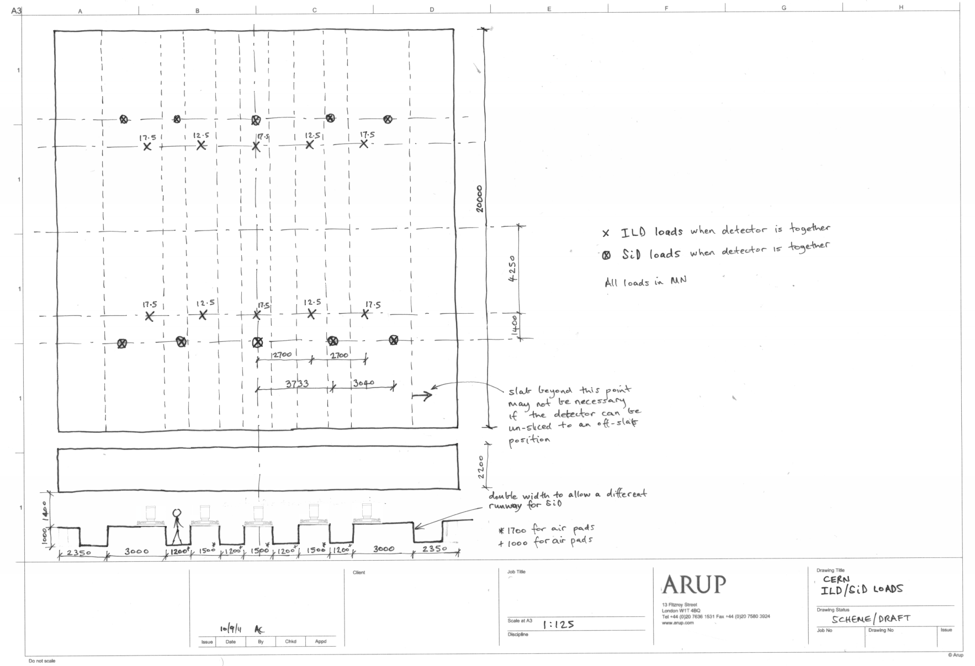
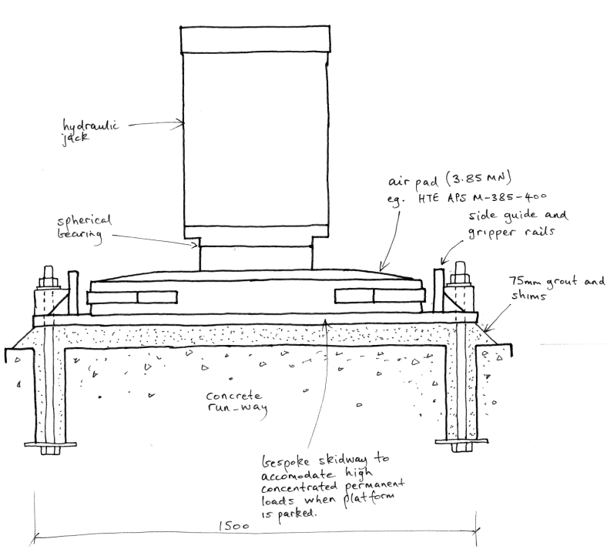
The movement support system – ILD, Airpads
Direction of travel
Permanent support (moves with slab)
Air pad

Slide 33
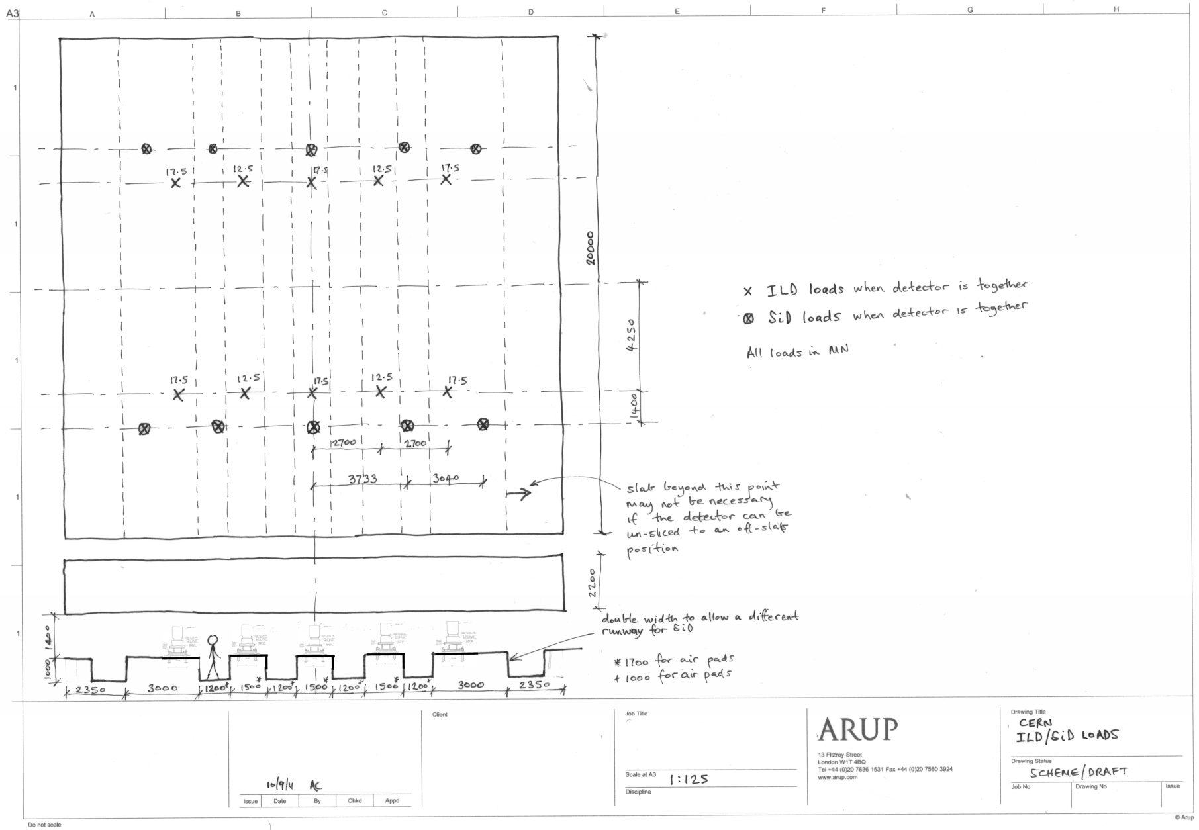
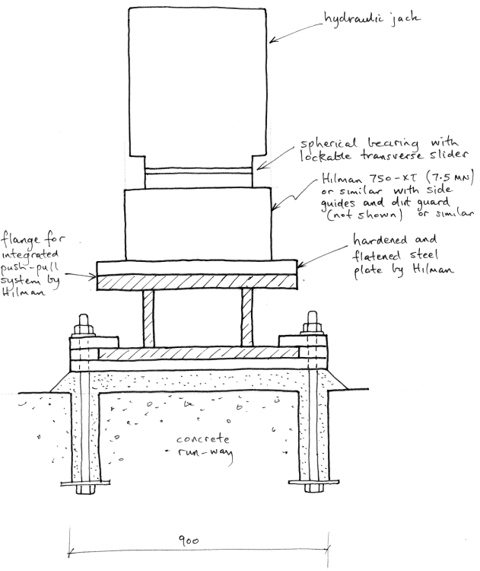
The movement support system – ILD, Rollers
Direction of travel
Permanent support (moves with slab)
Hilman roller

Slide 34
The movement support system – SiD, Airpads
Direction of travel
Permanent support (moves with slab)
Note full length needed for pads
Air pad
3800

Slide 35
The movement support system – SiD, Rollers
Direction of travel
Permanent support (moves with slab)
Slab could be a little shorted than with air pads
Hilman roller

Slide 36
Slab Construction

Slide 37
The Drive System

Slide 38
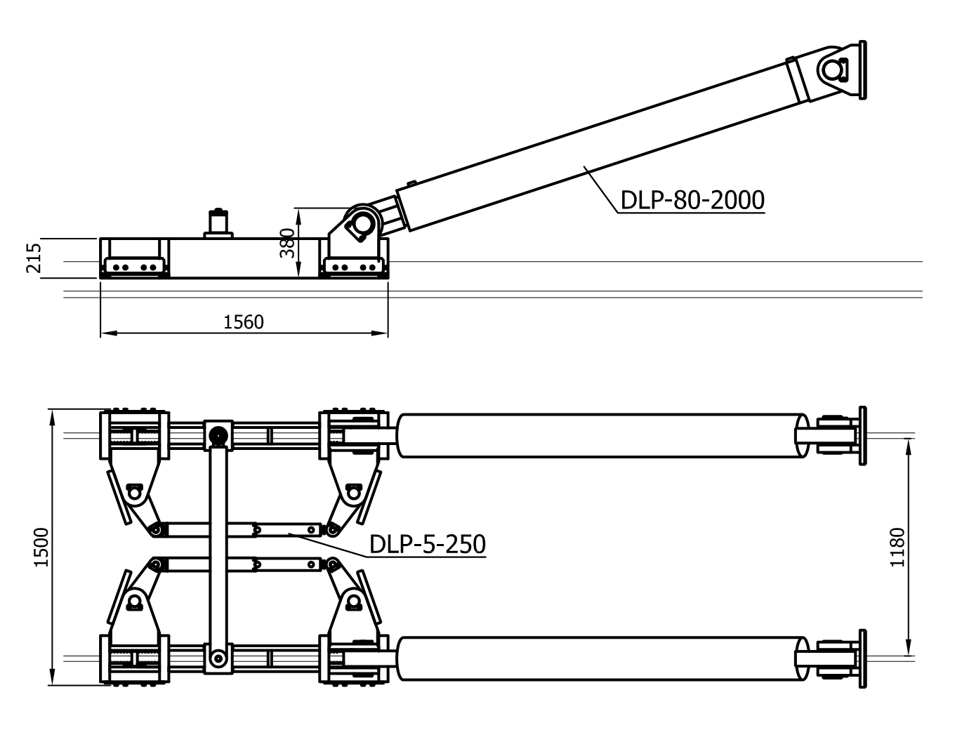
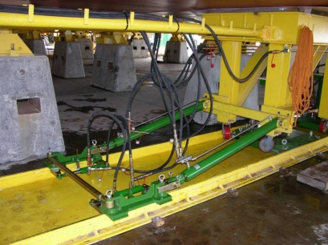
The movement drive system for pads
Grip jack 2No. PPU-160 (1.6MN capacity each) with air pads. Larger system required for Rollers.
Photo of smaller unit in use

Slide 39
The movement drive system for rollers
Awaiting response from Hilman following meeting with Hilman 15 Sept 2011
Two options being available:
  Hydraulic push-pull details similar to that for air pads;
  Self-driven Hilman rollers (awaiting confirmation on capacity)

Slide 40
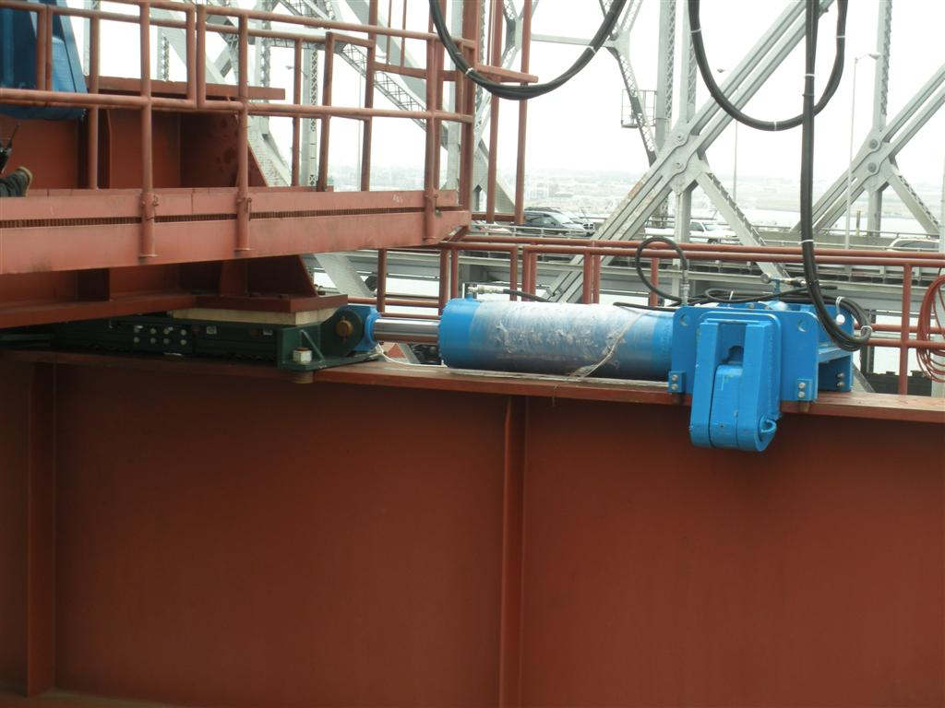
The movement drive system for rollers – Lateral Slide
`

Slide 41
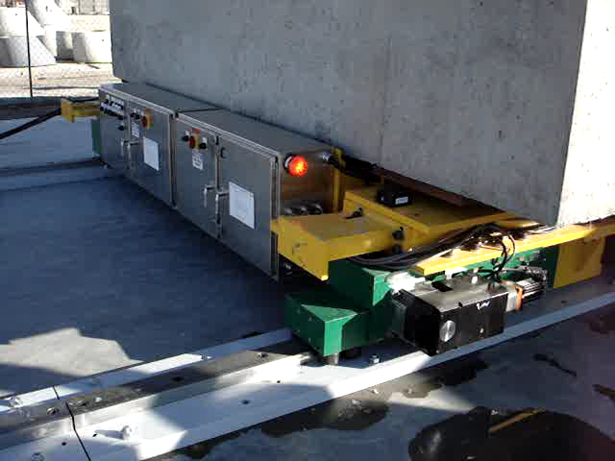
The movement drive system for rollers – Lateral Slide

Slide 42
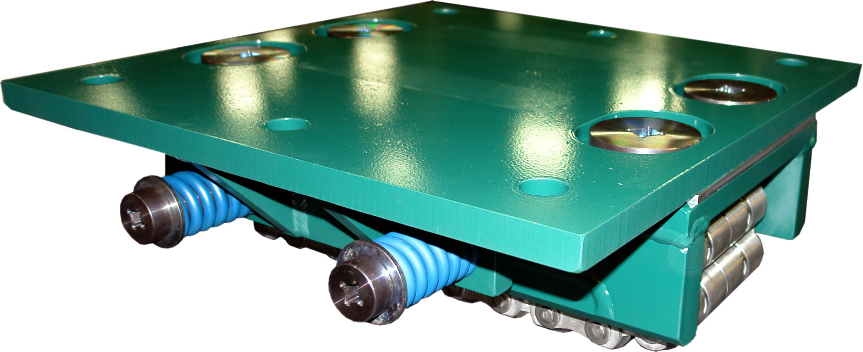
The movement drive system for rollers – Lateral Slide
PTFE layer
Note that stiction could cause accel > 0.

Slide 43
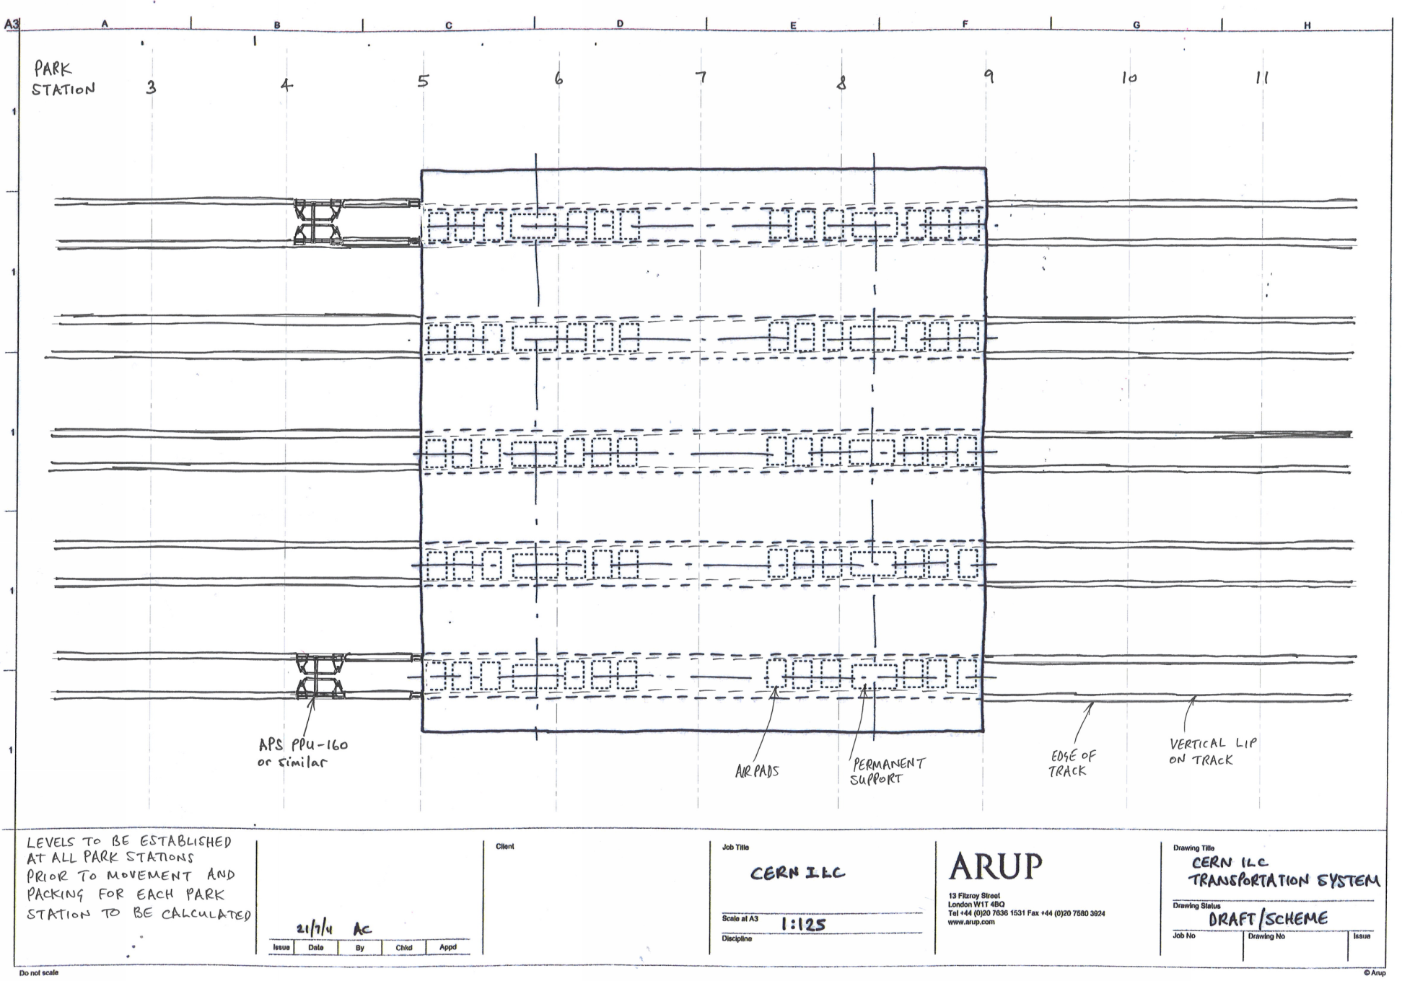
Movement Drive System
Note position of tracks is superseded by drawings on previous slides
NTS

Slide 44
Movement Drive System
Pair of hydraulic rams allow rotational correction
Control system to avoid on-plan rotation
Bar code encoder or laser to tell the control system how much each side of the slab has moved
Lateral guides to be investigated

Slide 45
The final positioning system

Slide 46
The final positioning system
Strand jack pair with tensioned cable-feed
Degree of freedom | Methodology
x, Rzz | Push pull system
z, Rxx, Ryy | Pack adjustment under slab
y (air-pads) illustrated | Lateral pull with strand jacks whilst air pads are active
y (rollers) illustrated | Lateral pull with strand jacks whilst the lateral slider (on the roller) is un-locked
y
z
x
Direction of primary travel
Note, Rxx is rotation about the x-axis, etc

Slide 47
Conclusions
ILD ok to jack and move on 2.2m slab with pads or rollers
SiD ok to jack and move on 3.8m slab with pads or rollers
To mitigate this some ways forward are:
  Jacking and packing if the invert does flex (to keep the slab permanent supports plane)
  Provide 50mm packing from the start to allow the height to be reduced
Displacement criteria not applicable when un-slicing
Some slab is not necessary if un-slicing to an off-slab position is possible

Slide 48
Further Questions
Will we know the exact lateral position before the move?
Or might we need to put the slab in position and then discover that it needs to move laterally?

