Slide 1
Task 2 Cavern Study
Ground model and 3D cavern layout
Matt Sykes
Eden Almog
Alison Barmas
Yung Loo
Agnieszka Mazurkiewicz
Franky Waldron
5 December 2011

Slide 2
Requirements Document
Matt Sykes

Slide 3
This presentation…
General Overview
Task 2 Study Summary
Stress analysis and ground yield
Construction sequence
CERN Molasse Geological model
Short term behaviour – Small strain stiffness
2D Finite Element analysis of interaction cavern
3D bedded-spring model of interaction cavern
Conclusions and recommendations

Slide 4
General Overview

Slide 5
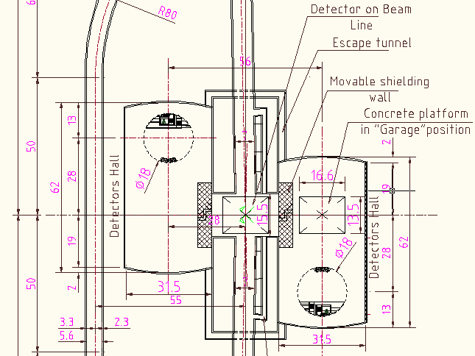
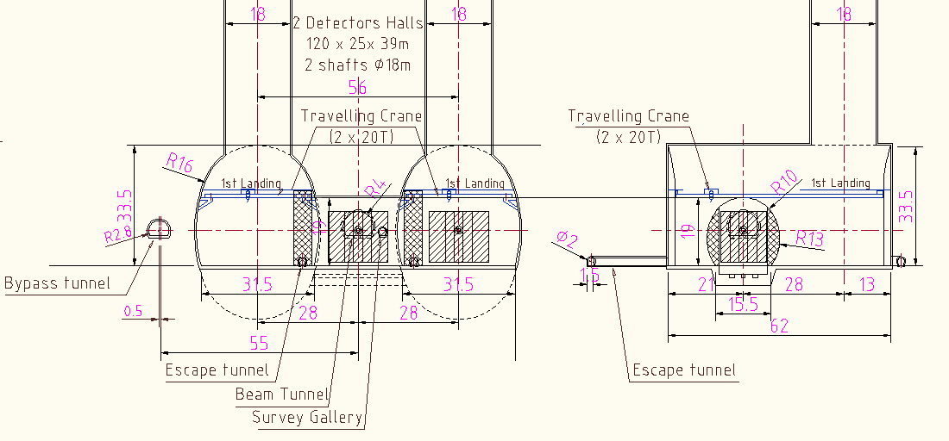
CLIC
Geometry
(G)

Slide 6
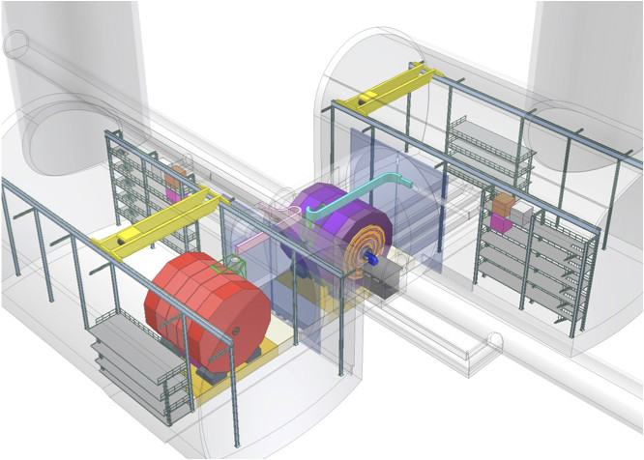
Beam Line.
15,000t detector on a slab and movement system.
Detector moves 15 times per year from beam into “garage position”
Garage Cavern & Access Shaft
Interaction Region (“IR”)

Slide 7
How do we limit cavern invert deflection to less than 0.5mm (creep and absolute)
(Controlled by ground yield and invert stiffness)
Is cavern geometry:
Feasible for working concept?
Influencing yield at IR?
Slab deflection limited to 2mm
(20m by 20m concrete slab)

Slide 8
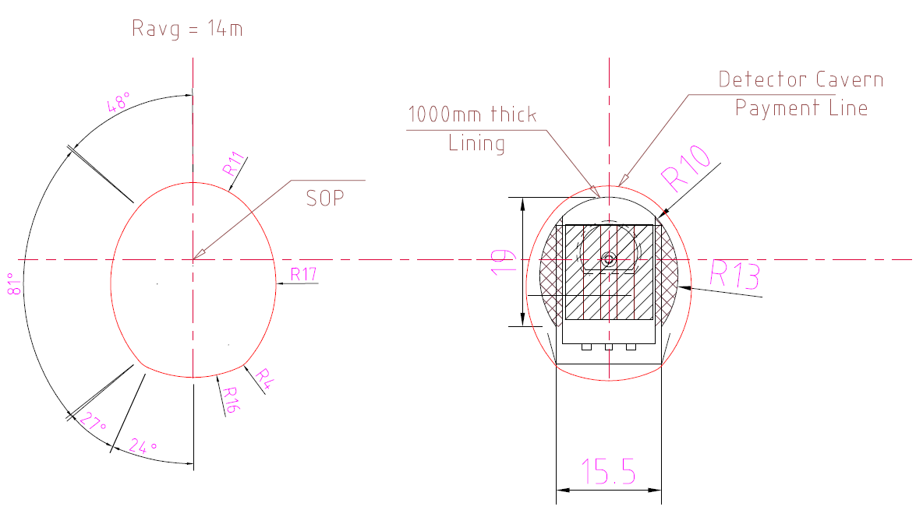
Interaction Cavern Outline Geometry (G)

Slide 9
Task 2 – September Presentation
Compile Geotechnical Database
Review Monitoring Data
Review Geotechnical Testing Data
Review Previous Experience
Geological correlation between CERN sites
Completed
Geotechnical Review
Underway
Not Started
Geometry
3D Stress Analysis
Estimated Support Pressure
Conservative 2D FE Model
Sequenced Excavation 2D FE Models:
* Transfer cavern first
* Transfer cavern after service caverns
Yield Control by Cavern Construction Sequence
Pillar Option
Cavern Design

Slide 10
Task 2 – Study Summary
Compile Geotechnical Database
Review Monitoring Data
Review Geotechnical Testing Data
Review Previous Experience
Geological model and correlation between CERN sites
Secondary Consolidation (Creep and Swelling)
Completed
Geotechnical Review
Underway
Not Started
Geometry
3D Stress Analysis
Estimated Support Pressure
Conservative 2D FE Model
Sequenced Excavation 2D FE Models
Yield Control by Cavern Construction Sequence
Optioneering Design (e.g. Pillar, piling, post-tension)
3D bedded spring model
Cavern Design

Slide 11
Stress Analysis and Ground Yielding

Slide 12
Boundary Element Modelling (3D Stress Analysis)
Linear elastic stress analysis in Examine3D.
Indication of how stress manifests at the interaction of the cavern’s boundary and the ground.
Analyses carried out comparing Layout G and a layout where the caverns are pushed apart by 5m.
Effective strength criteria used to estimate rock mass yielding.

Slide 13
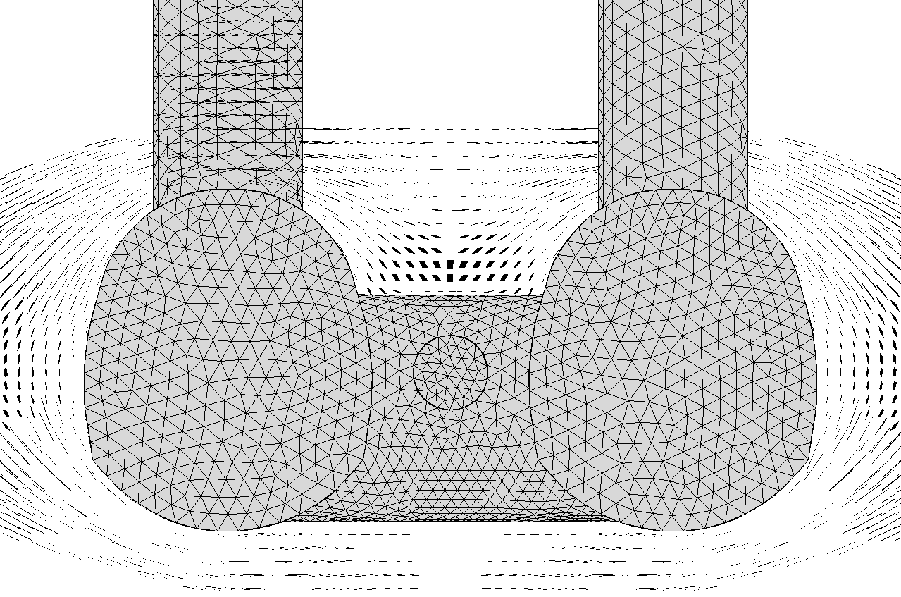
Layout G – Principal Stress Trajectories
Increased stress on interaction cavern crown due to arching effects – heavy support and increased yielding

Slide 14
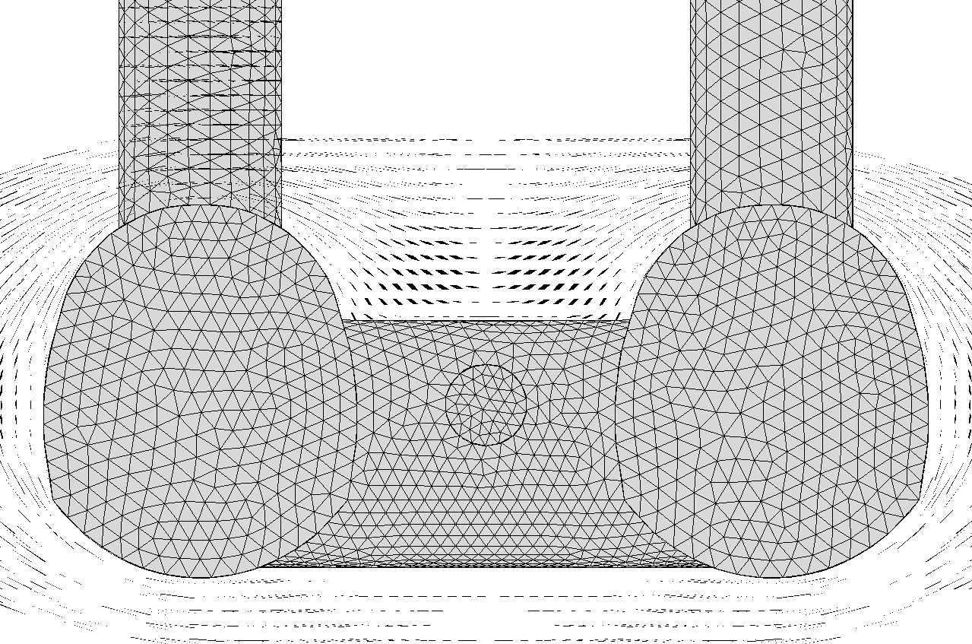
Layout G + 10m – Principal Stress Trajectories
Arching effects diminished with separation distance– reduced support and yielding

Slide 15
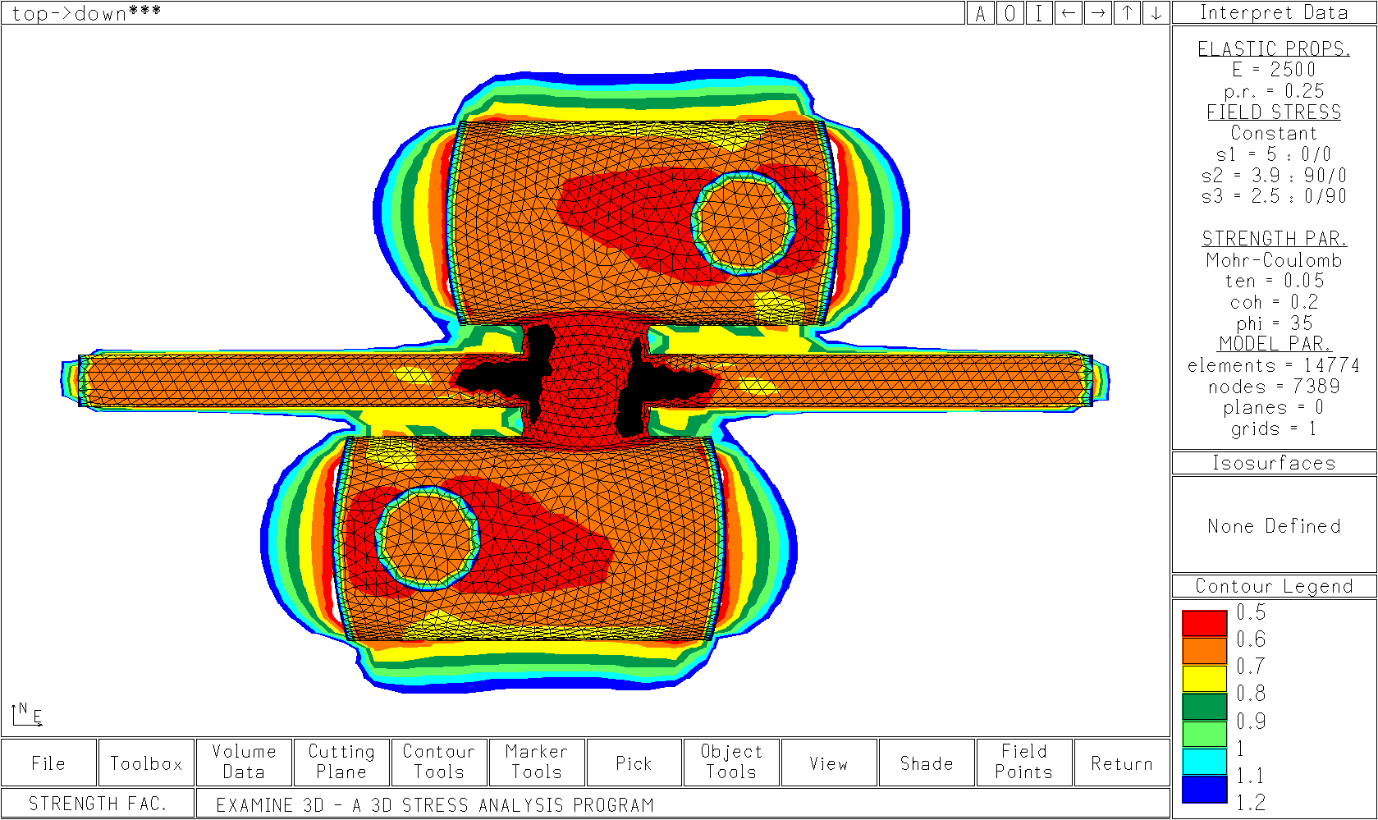
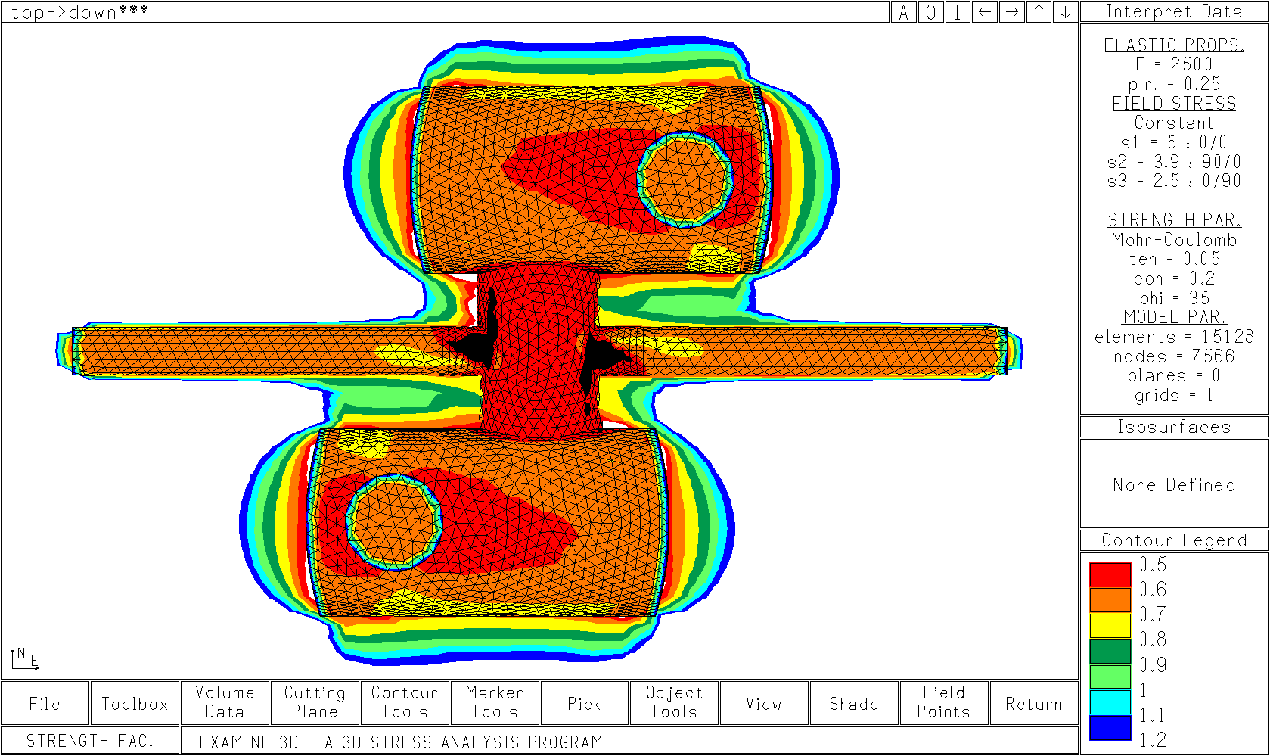
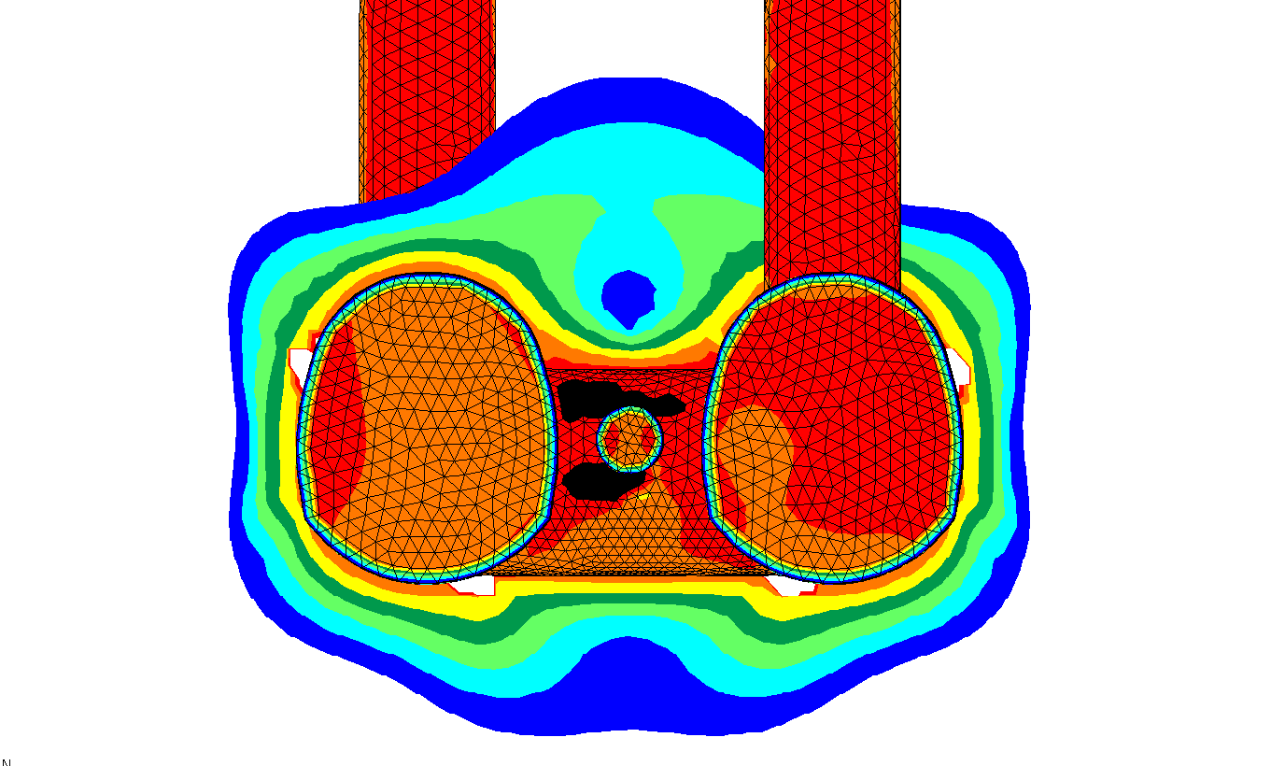
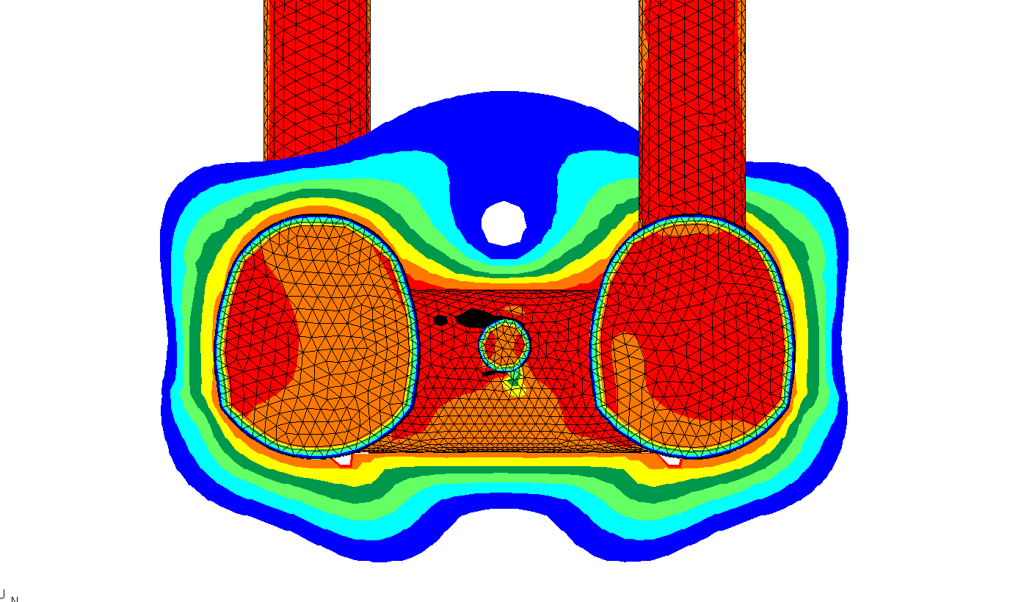
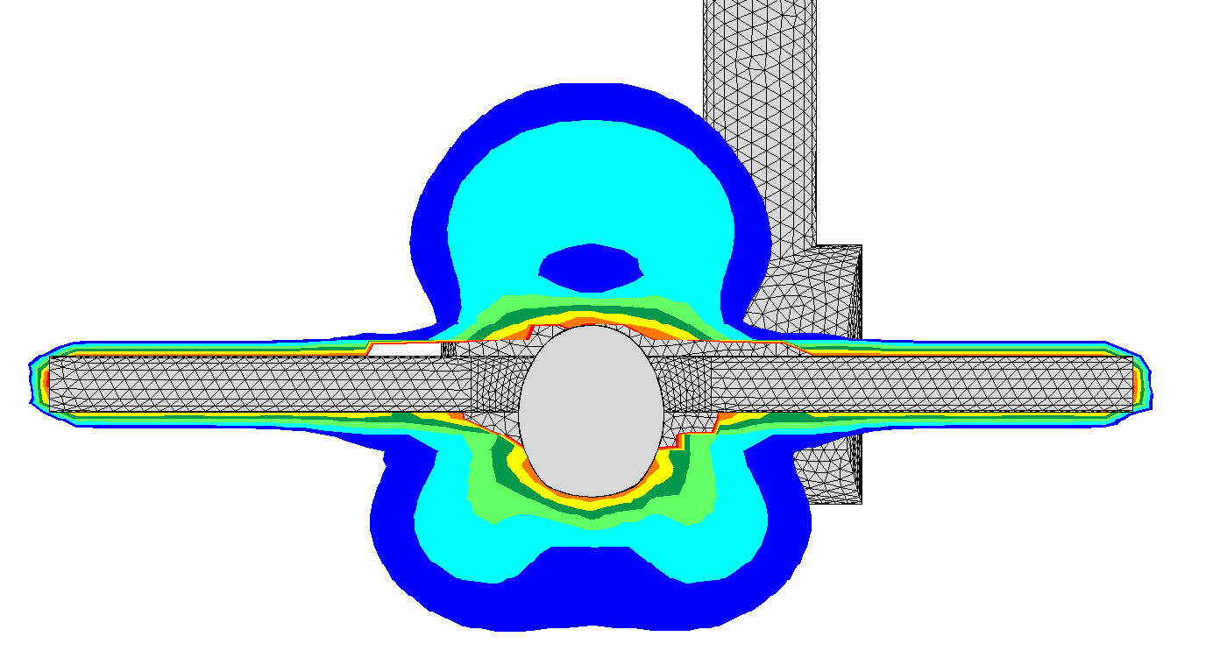
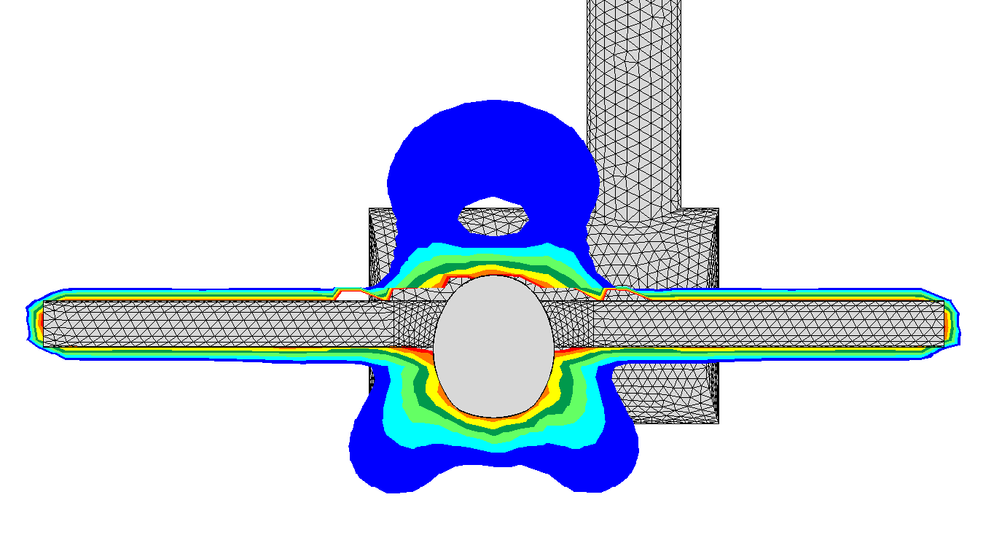
Contours of Overstress
Geometry G
Geometry G + 10m
Mobilised Strength
(overstressed when < 1)
Notes:
Need to explain colours. The differences are not very clear or persuasive.
What strength critirion is used? Cu or c’ fi’?

Slide 16
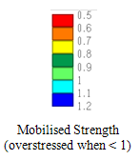
Layout G

Slide 17
Layout G + Interaction Cavern Enlargement

Slide 18
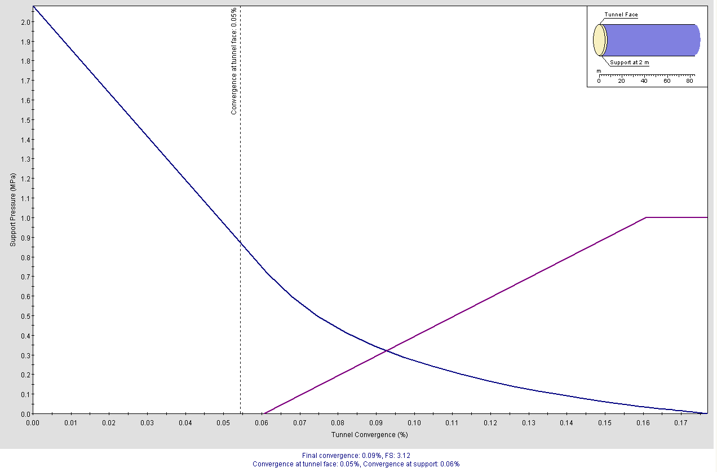
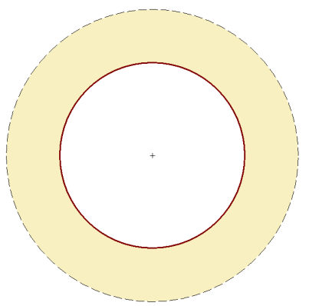
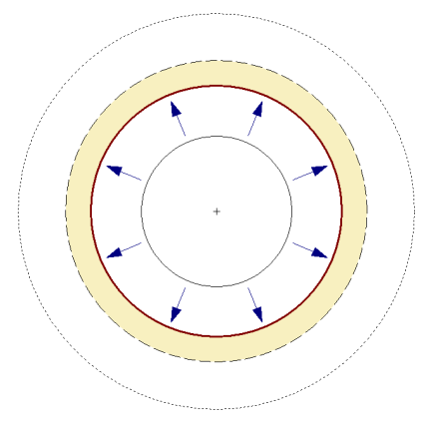
SCL Support Design
No Support
EDZ = 8m beyond lining
Convergence = 0.18%
1MPa Support @2m (CMS)
EDZ = 3m beyond lining
Convergence = 0.09%
Ground Response Curve
(GRC)
Plastic Deformation (Yield)
Support System (based on CMS design)

Slide 19
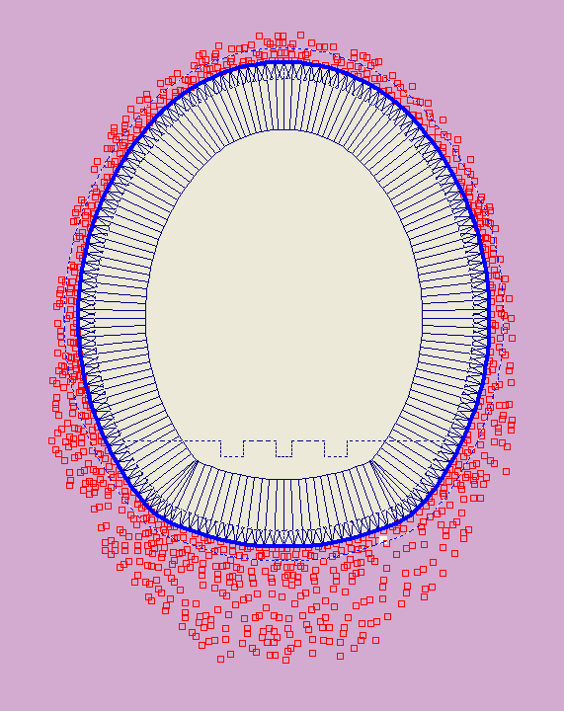
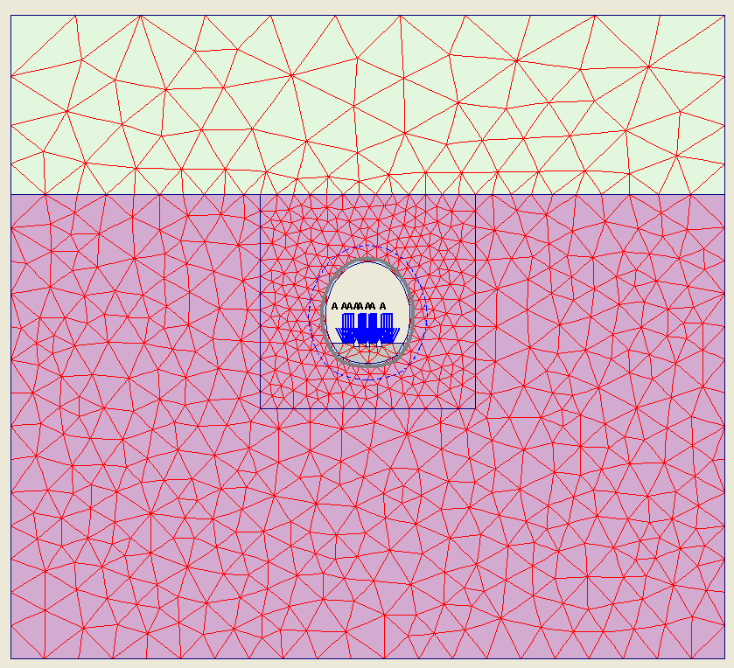
Conservative 2D FE analysis
Primary Lining
Plastic
Yielding
Moraine Gravel
E’ = 50MPa
50m
30m
1MPa Support
Pressure
Molasse Formation
E’ = 3GPa

Slide 20
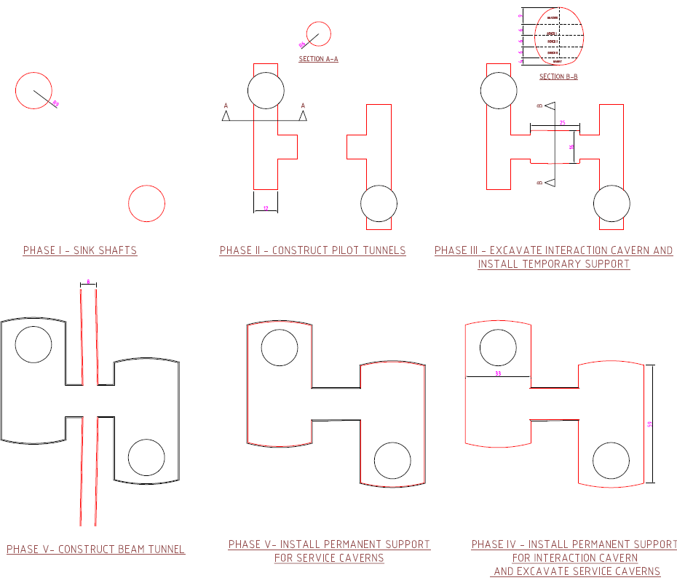
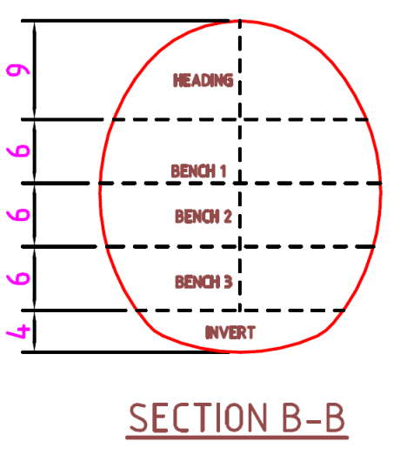
Construction Sequence

Slide 21
Ground Model Development
Alison Barmas/ Yung Loo/ Franky Waldron

Slide 22
Outline
Review of new data - Geoconsult Report & GSG Face log data
Influence of Geological interpretation to the Cavern Design
Geophysical Interpretation using Point 5 data
Interpretation of small strain stiffness from P-wave data
Recommendations

Slide 23
CMS Point 5 Data Sources
CERN reports for Point 5 (CMS) including borehole logs, in situ and laboratory testing
Geoconsult (May 2003) Geological Factual Report and shaft and face logging
Published geotechnical literature for the correlation of down hole geophysics in Sedimentary basin deposits
DataPlot and RockWorks15 for 3D modelling of the available geophysics data

Slide 24
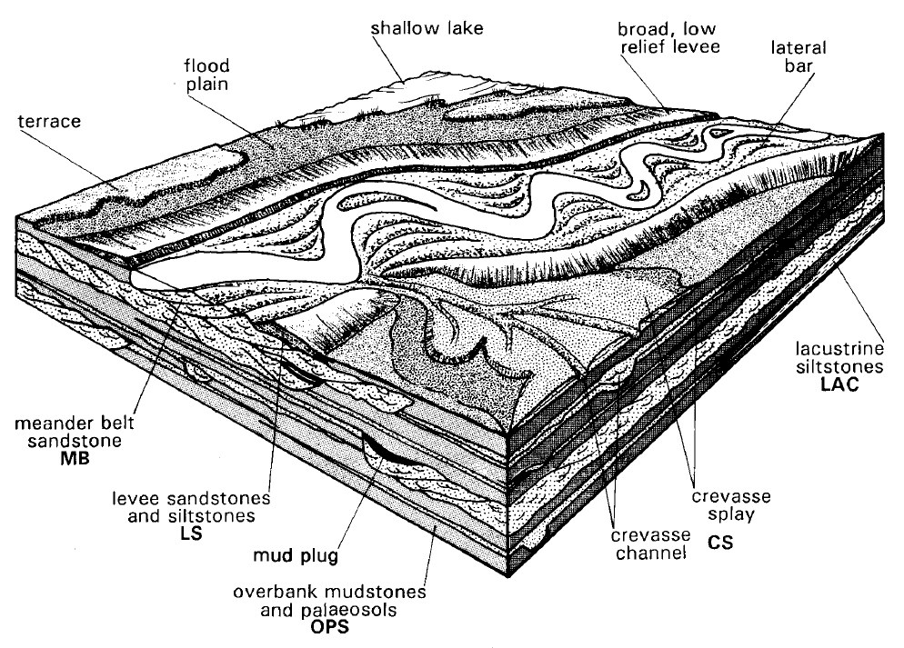
Depositional Environment
Lateral and vertical variability
Paleosols (Calcareous)
Potential Marker beds
Conceptual model reflected by face logging
Notes:
Depositional History predicted for SST channels, CERN Mudrocks within the Molasse – intercalations SST/ Grumeleuse
Fix model and variability in your mind so as to have a context for later analysis
Point out key features SSt lenses sinuous deposits/ fine bedding non continuous layers
Note paleosol horizons

Slide 25
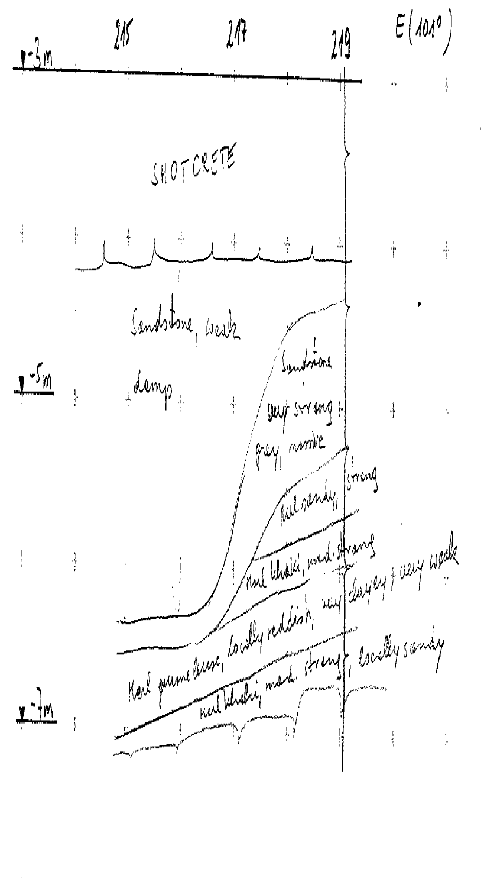
Confirmation of Depositional Features
- Examples from Point 5 GSG Face logs
Sandstone Channels
Pillar Ch. 215 – 219m
Notes:
Confirmation of features predicted by the Conceptual Model

Slide 26
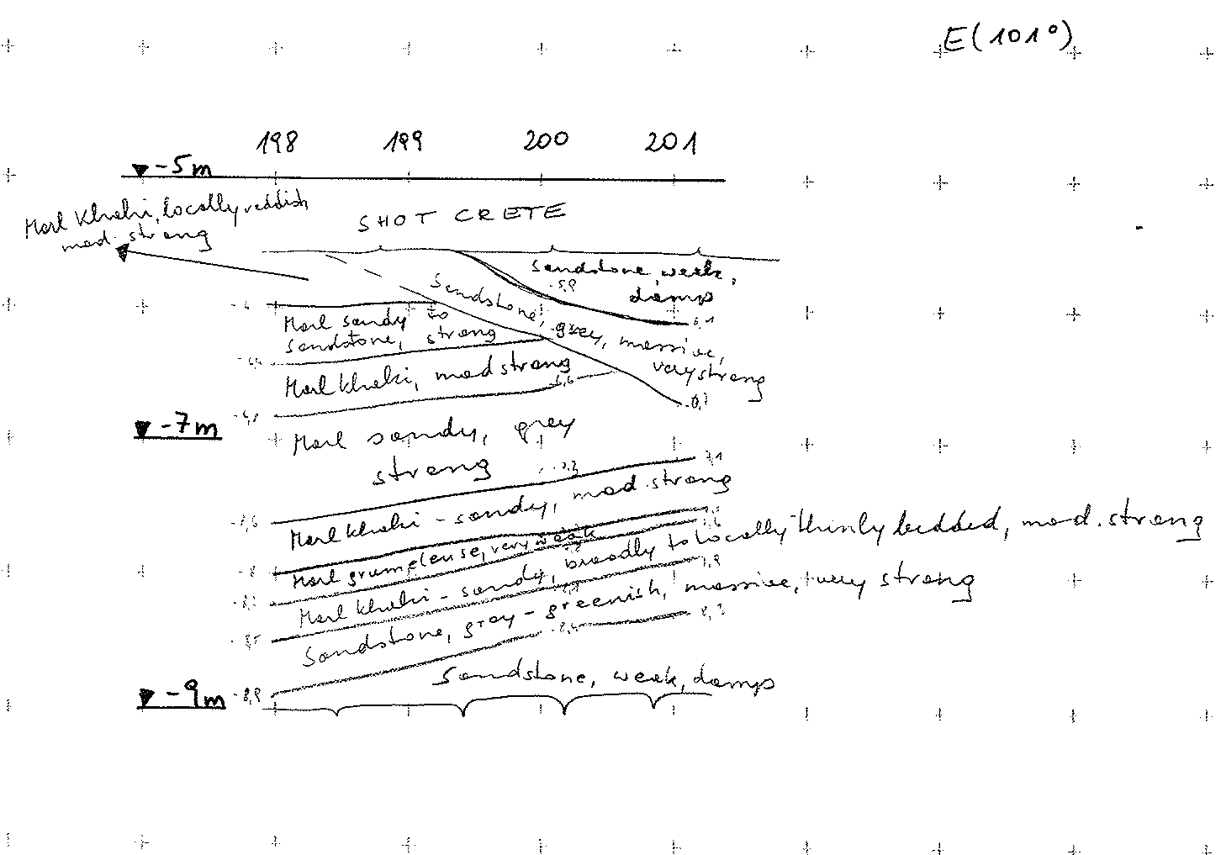
Confirmation of Depositional Features
- Examples from Point 5 GSG Face logs
Variable Dip of bedding &
Cross- bedding
Intercalations of thinly bedded SST/ Grumeleuse deposits
Pillar Ch. 198-201m
Notes:
Discuss examples in relation to the depositional environment

Slide 27
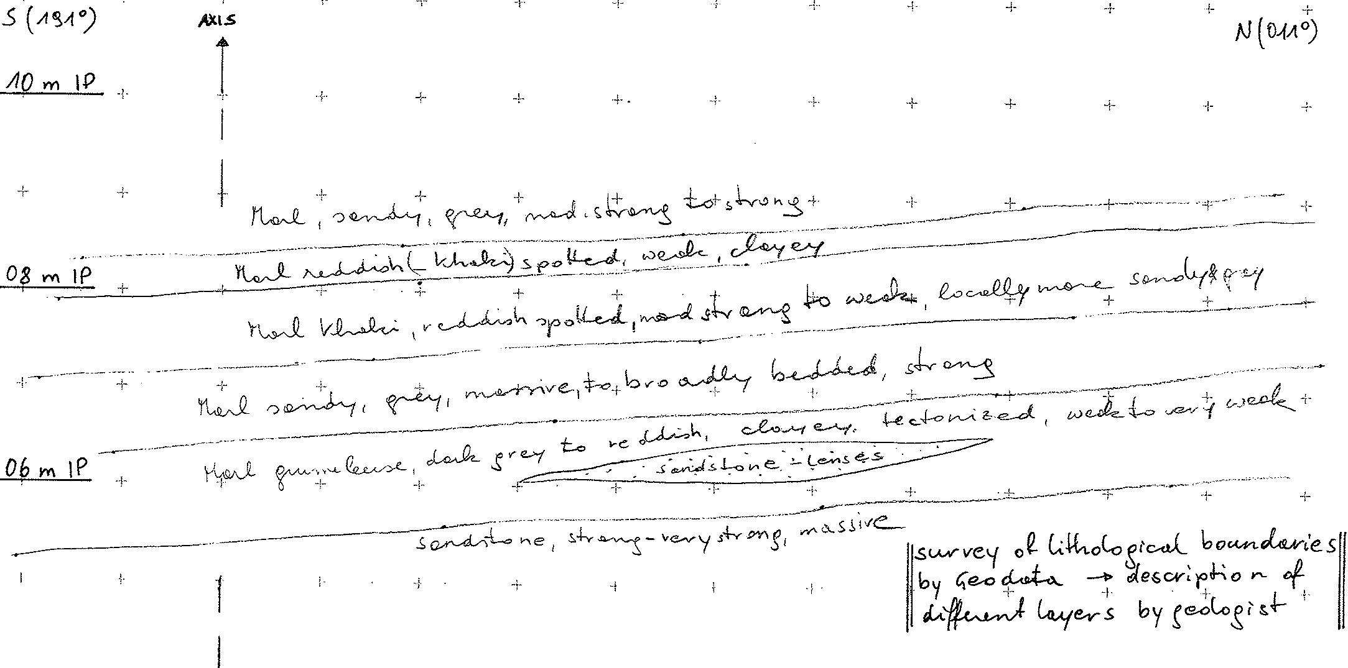
UCX 55 West Head Wall - Chainage 170.5 – 172.5
Sandstone lenses

Slide 28
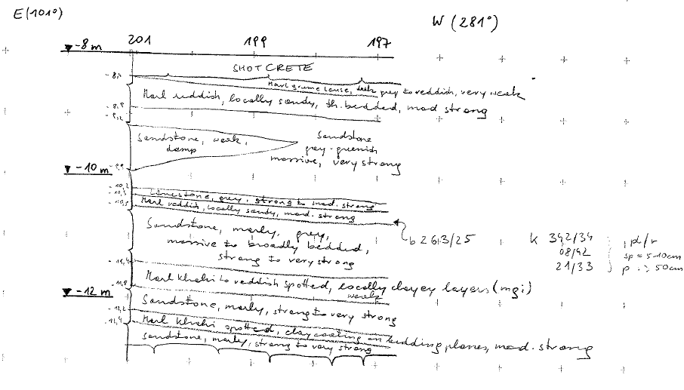
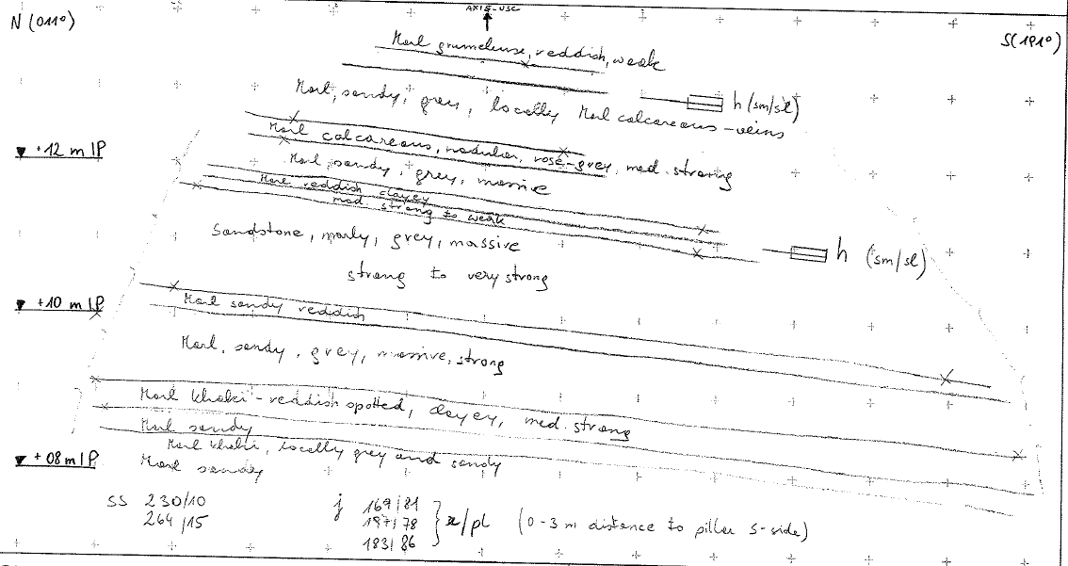
Confirmation of Depositional Features
Pillar Ch. 187-201m
Calcareous Horizons/ Paleosol development
USC 55 Ch. 197.51m
Notes:
Discuss potential as marker beds
Note bed orientation

Slide 29
Calcareous & “Limestone” from Point 5 BH data
Data shows an approximation of the top and base of calcareous horizons from BH descriptions
Anomalies? or inadequate data?
Elevation mEL
Borehole No.

Slide 30
Geoconsult Report and Face mapping
Key Comments:
Allocation of strength parameters to the stratigraphical layers is different from predictions
Rock mass has a pronounced Time dependent behaviour

Slide 31
Geoconsult Report and Face mapping
Details:
Detailed geological mapping from excavations shows the encountered
strength parameters differ from borehole predictions.
Rock mass less competent than predicted
Anticipated SST layers were not the expected quality & actually marly SST/ sandy MARL (questions the reliability of borehole logs to verify geophysics).
Anticipated SST encountered as lenses not as persistent layer
(as we predicted in CSM from depositional environment)
Marl Grumeleuse layers in sidewalls were thicker than anticipated and poorer quality
How does this affect the approach to the design?

Slide 32
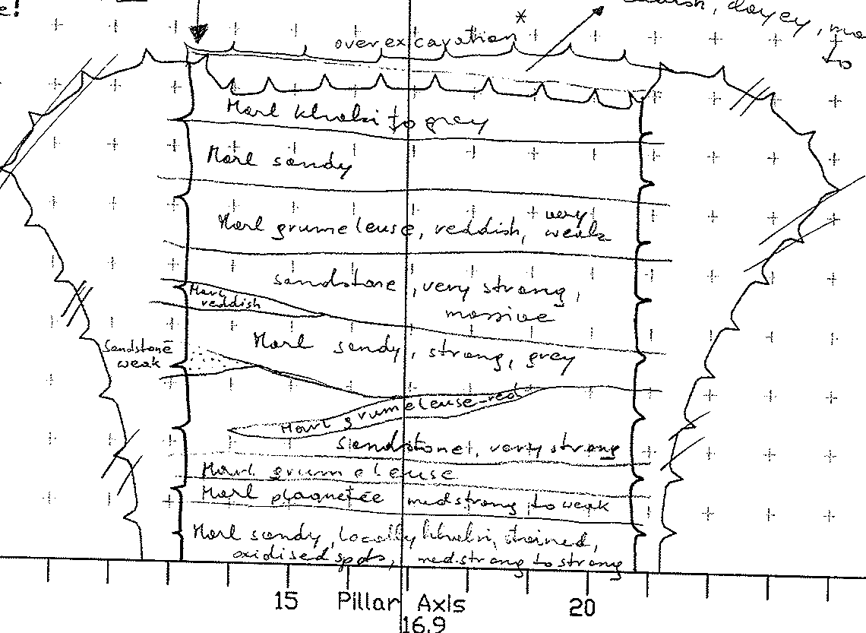
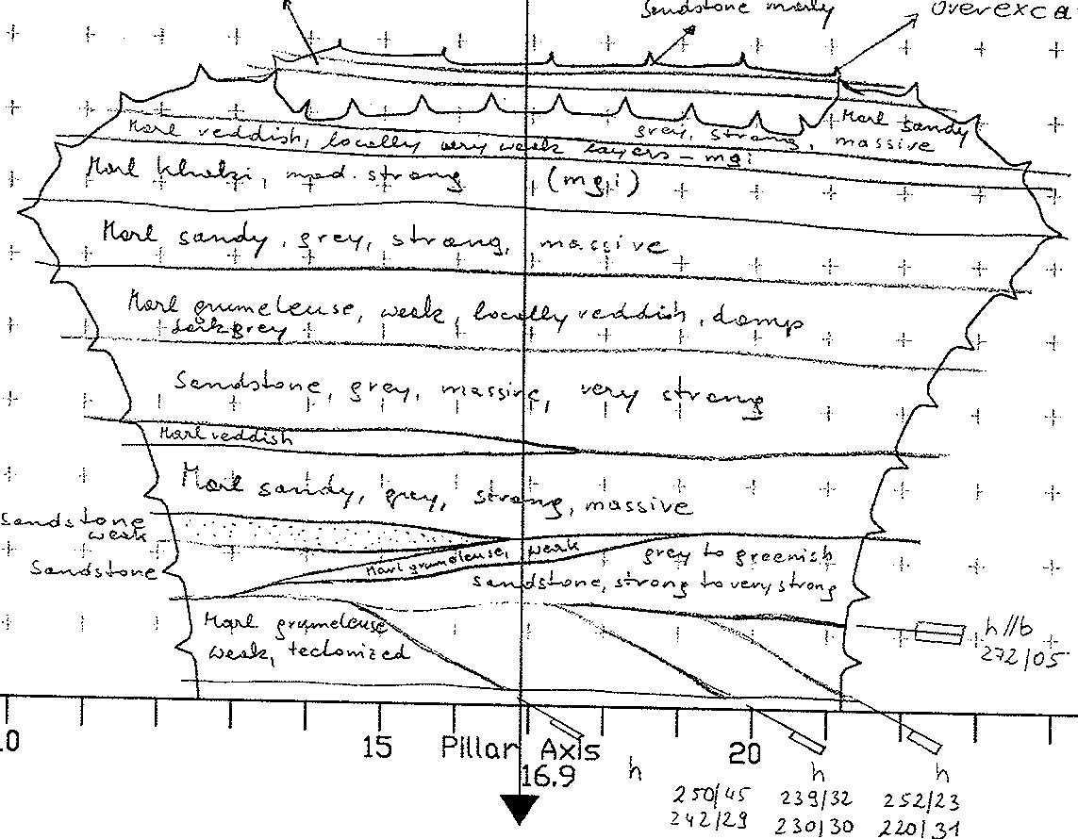
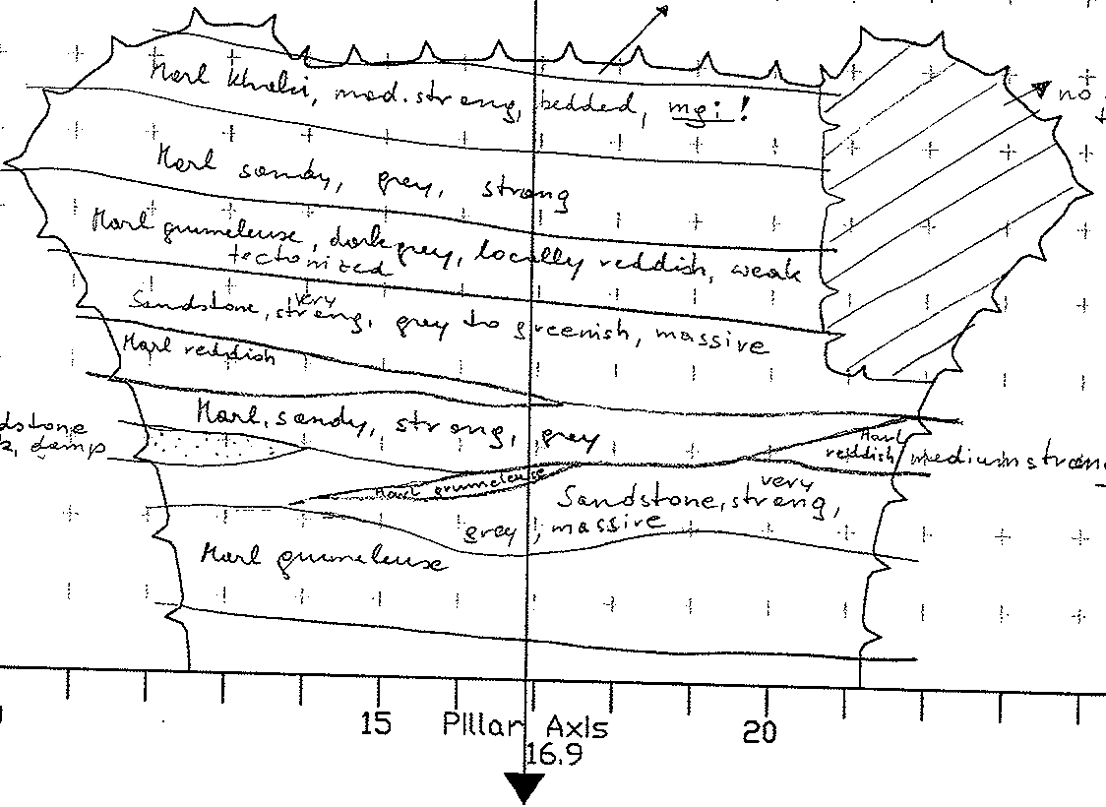
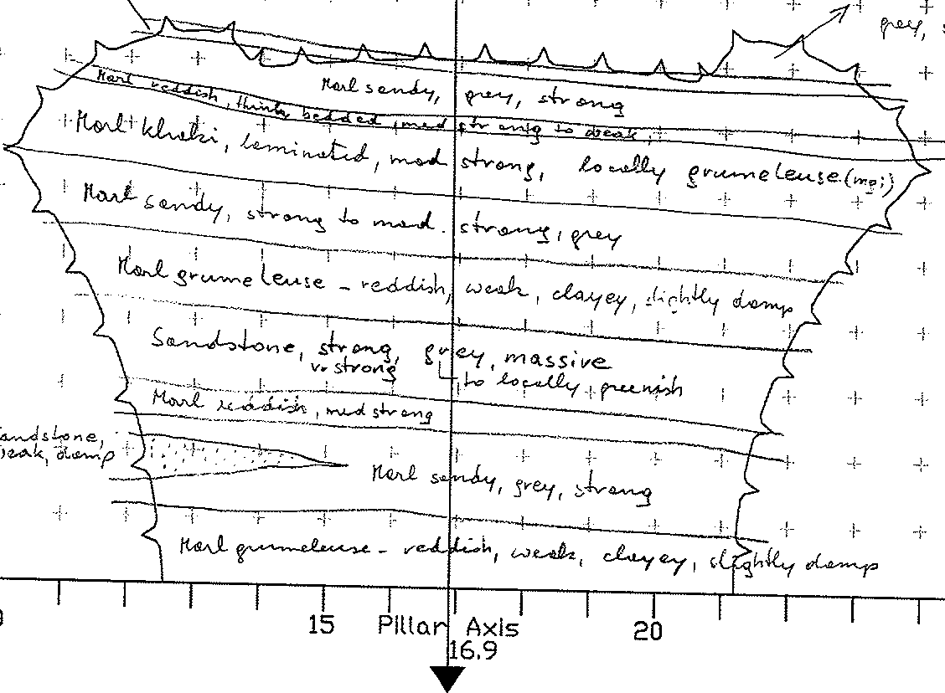
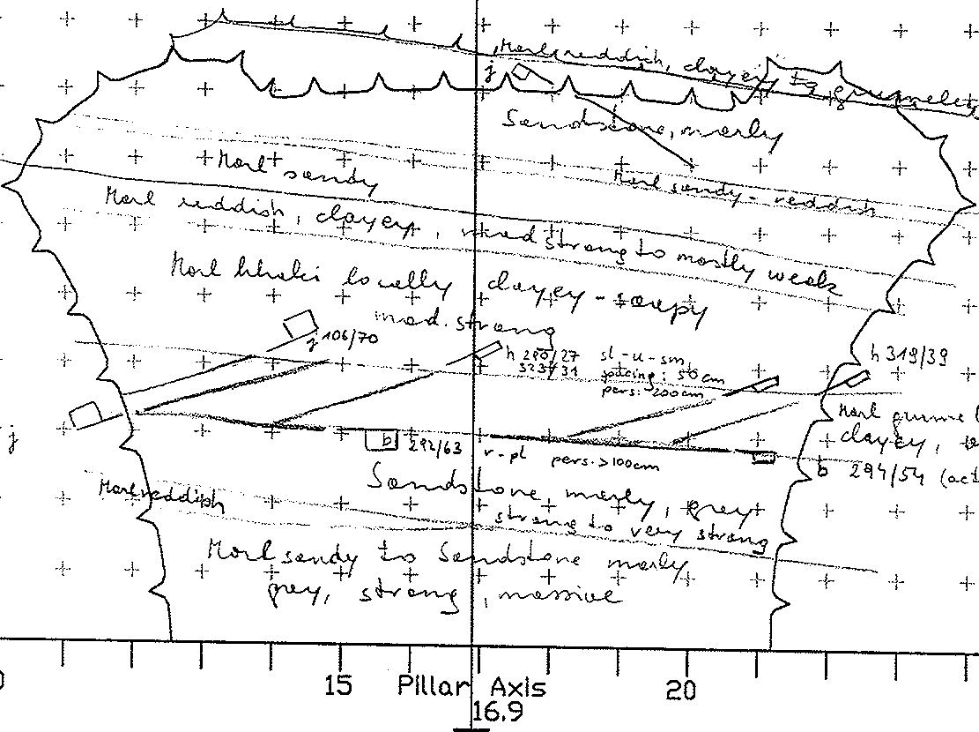
Pillar Example of Lateral Variability over ~35m
Weak SST
~10m
~3m
Marl Grumeleuse
Sensitivity analysis to assess impact on the cavern invert
-what can be tolerated?
Ch. 226.6m Ch. 217.5m
10m
~3m
~14m
Ch 220.5 Ch. 207.5m Ch .193m
Notes:
Side wall conditions vary and invert conditions vary in this example within 33.6m
Feasible variations within an equivalent length of cavern to that proposed
Relate to Eden’s comments on the potential for yielding / control EDZ
Optomise the tunnel depth & account for variability by undertaking sensitivity analysis

Slide 33
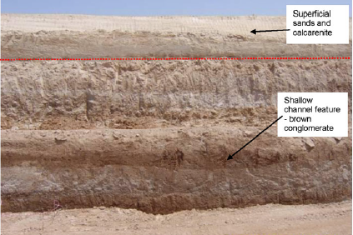
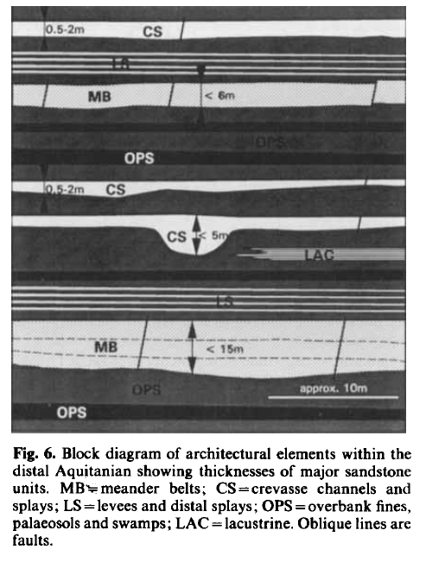
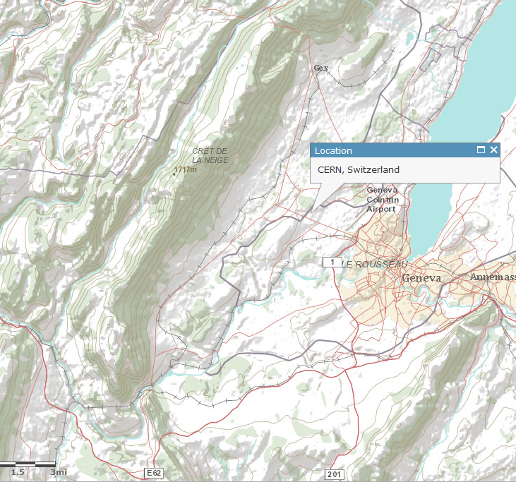
Cavern design approach must account for Scale
Optimise depth & invert conditions
Target the detail!
?
?
Notes:
Current position – we have a regional understanding
Detail is critical – optimise geological conditions to minimise EDZ
BH stick models misleading – need to understand and model the variability and integrate it early in the design process then supplement and verify with detailed site specific data

Slide 34
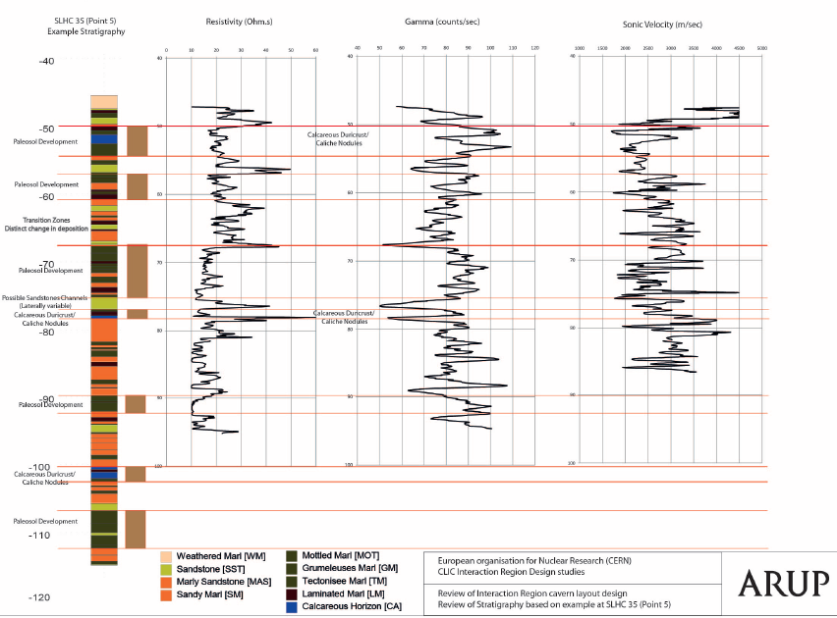
Geological Interpretation with scale
Regional
Large scale understand the Depositional Environment
Local
Develop Conceptual Model from existing Site Data/ Plan Site Selection
Site
Specific
Characterisation of stratigraphy and Engineering parameters from detailed investigation using a suite of boreholes, in-situ and laboratory testing and monitoring.
Micro
Optimisation of depth and invert conditions based on interpretation and influence of mineralogy/ sedimentary structure/ lithofacies models and predicted behaviour
Target the detail!
Favourable stress orientation for caverns
Development of 3D Conceptual model to include all new data sets
Set-up 3D Conceptual model (Elevation data, existing information for planning SI)
Predict behaviour, sedimentary structure and variability
Model affects of large scale variability in terms of the affect on cavern feasibility
.. verification during excavation!

Slide 35
Geophysical Interpretation

Slide 36
Initial approach to geophysics in July …
Notes:
Resistivity sonde induces a current in the rock; variations in formation resistance occur due to changes in porosity and mineralogy of the rock. Gamma logging detects the natural emission of gamma radiation from radioactive isotopes (e.g. potassium) within the structure of clay minerals.

Slide 37
Geophysical Interpretation at CMS Point 5
Electrical Resistivity
Natural Gamma
Gamma-Gamma
Sonic velocity
Stratigraphy
Sub-surface structure
Density
Medium-energy gamma rays using Compton scattering method.
Small Strain Stiffness
Measurement of P-waves
Characterisation of Seismic Facies
Resistivity – depth profile
Determination of proportion of clay/ alteration zones
Different aims
Complimentary tools
Create sections from digitised data from 7 boreholes BH30 to BH36
3D RockWorks Model of Data for each method
Notes:
We have modelled all methods but for the purposes of today’s presentation we are focusing on Natural gamma to illustrate lithology which can be closely linked with resistivity outcomes and the use of Sonic velocity to characterize the small strain stiffness
Combination of methods to form a tool kit different aims

Slide 38
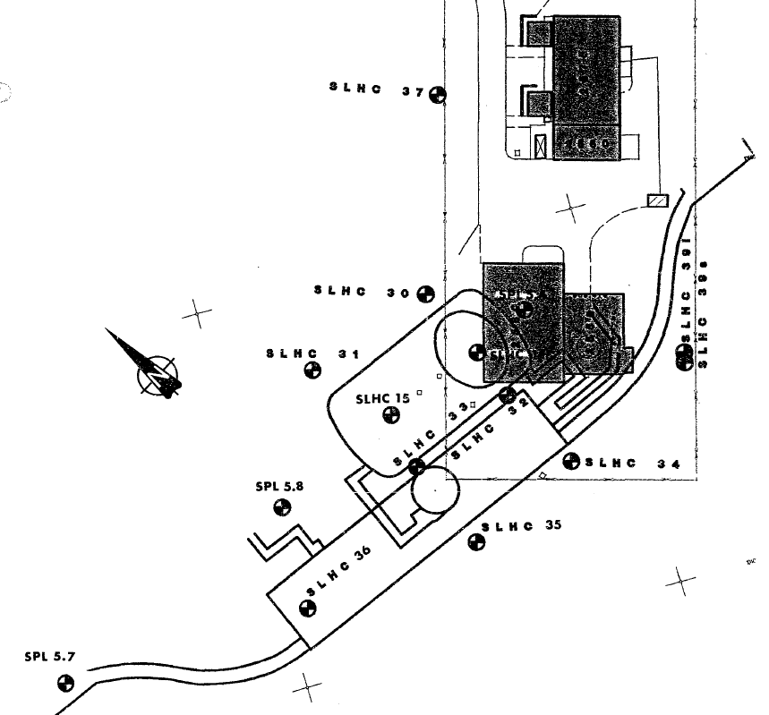
Plan of Point 5 BHs showing analysis sections
Boreholes with Geophysical Data
A
C
B
A
C
B

Slide 39
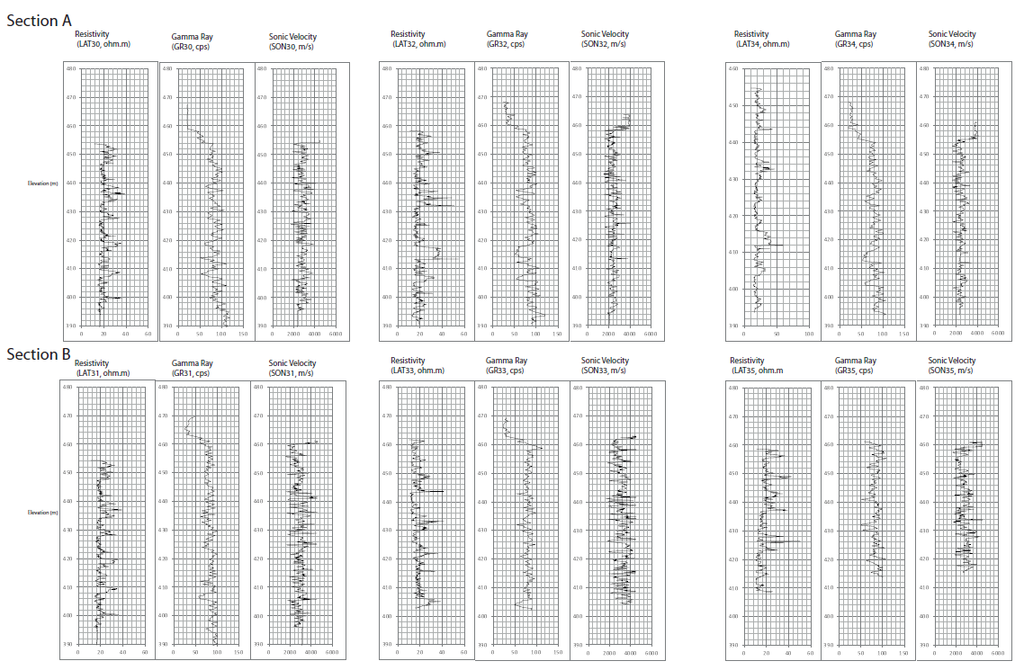
Geophysical Data for Point 5 A-A & B-B

Slide 40
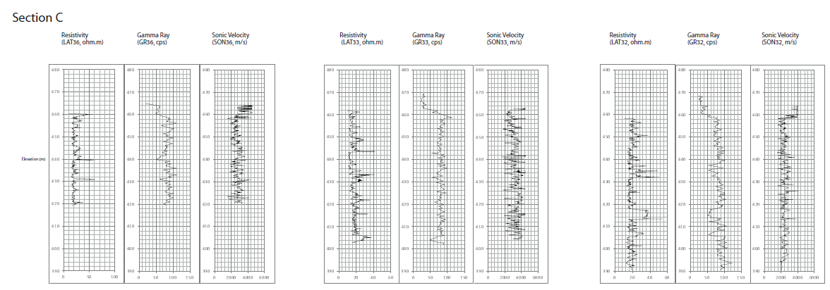
Geophysical Data for Point 5 C-C
Difficult to visualise variations

Slide 41
Natural Gamma in Rockworks
Evaluate stratigraphy

Slide 42
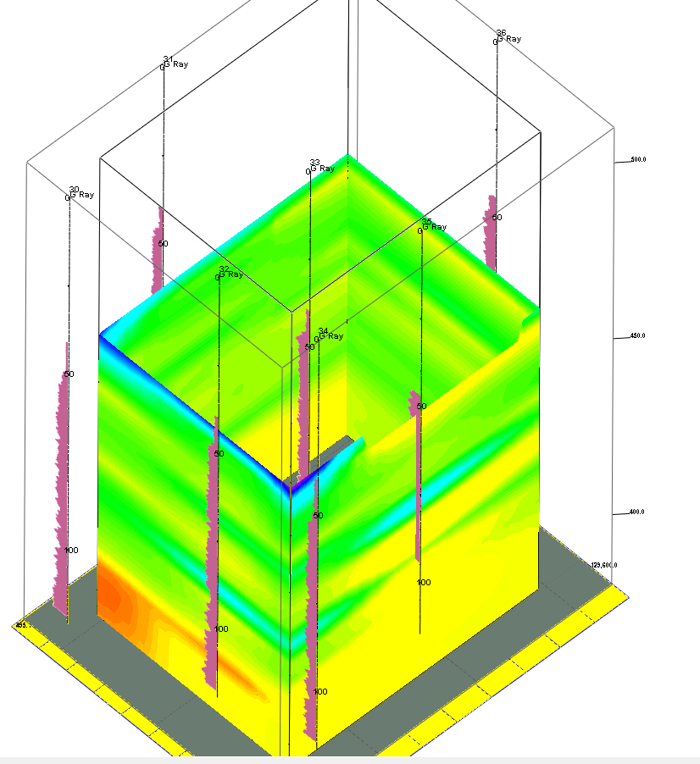
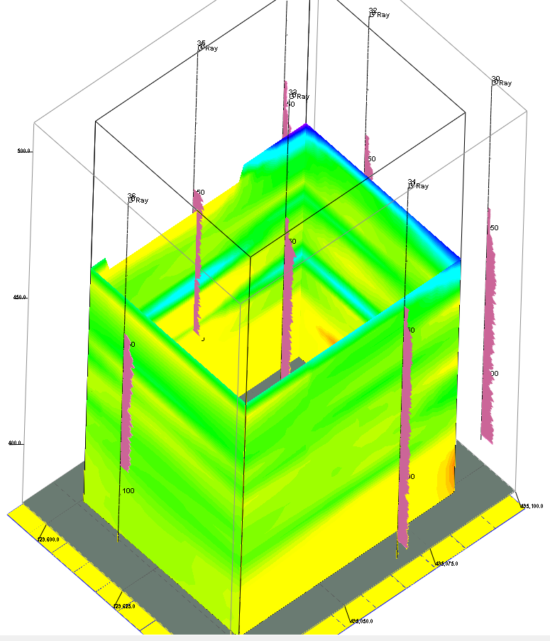
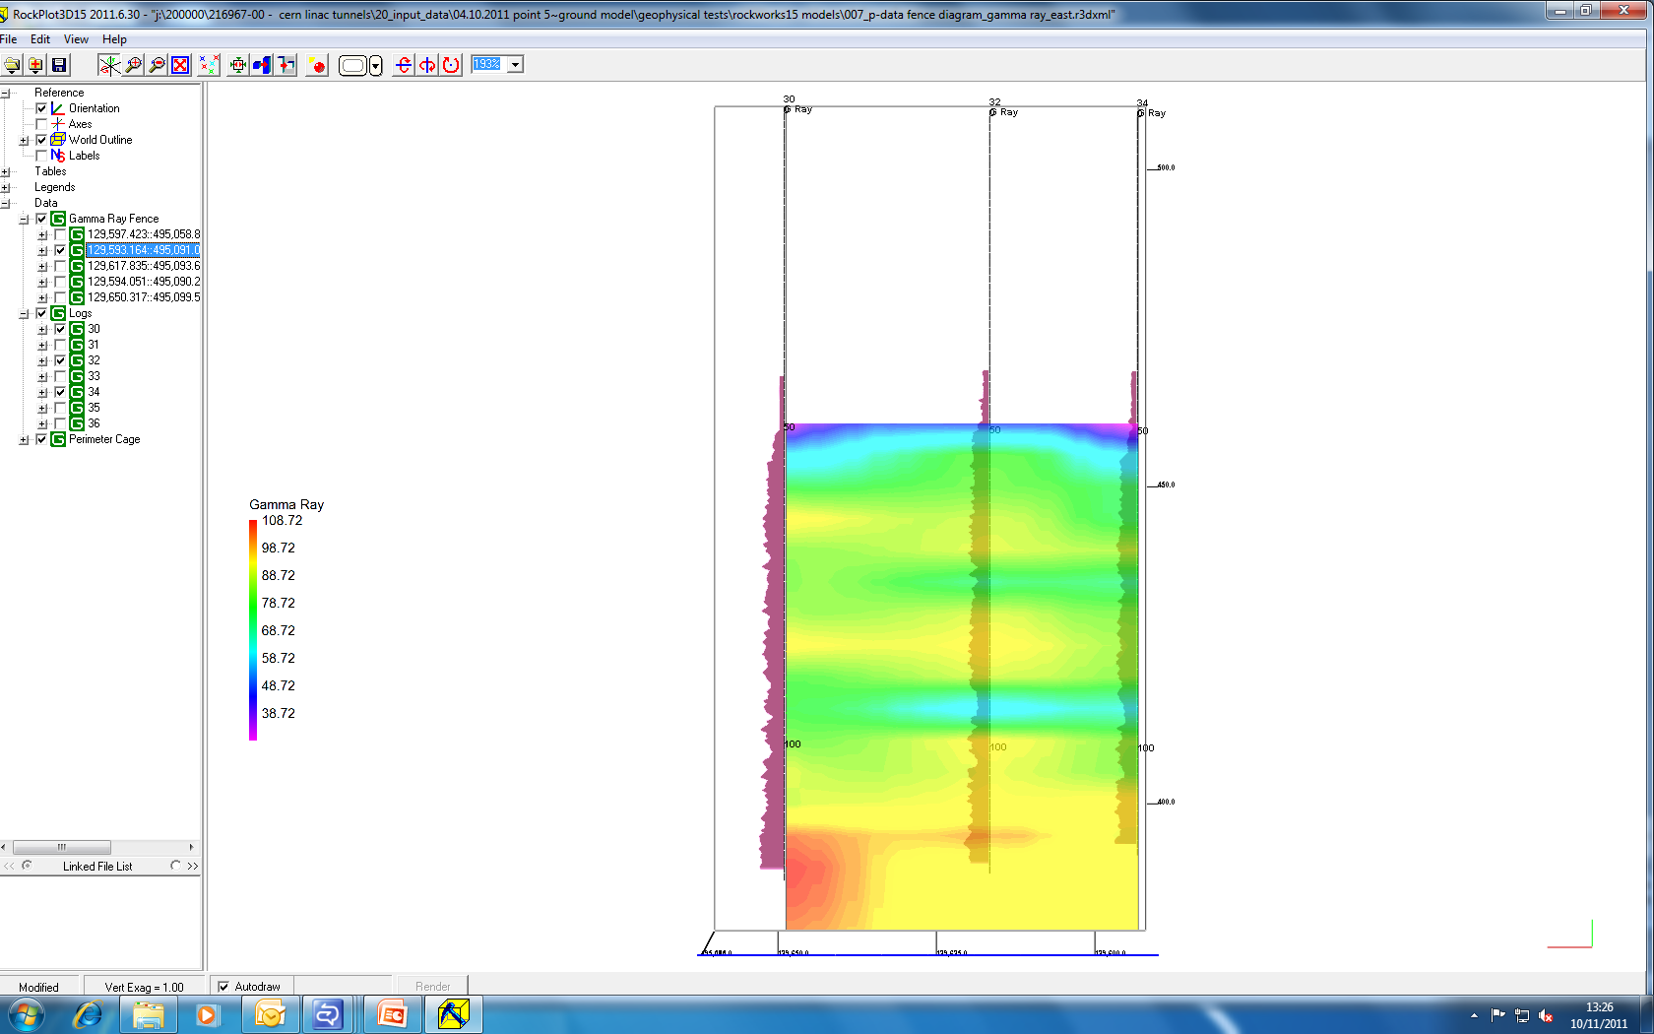
Natural Gamma model slides
Increase in Clay content
Identification of lenses/ bedding structure
Notes:
Explain a bit about rock works – interpolation between boreholes
Some degree of overlap as we expect due to thinly bedded nature of sediments and intercalations
Think back to face mapping examples
What is the influence of individual boreholes – lack of lateral spread/ no. Of boreholes

Slide 43
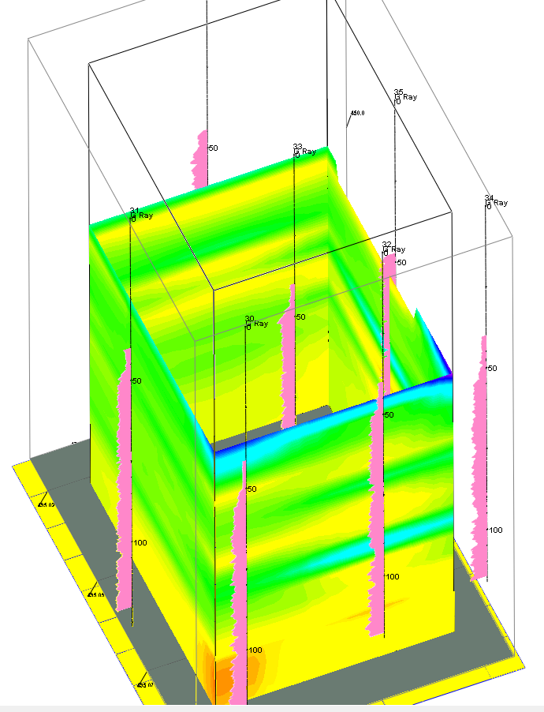
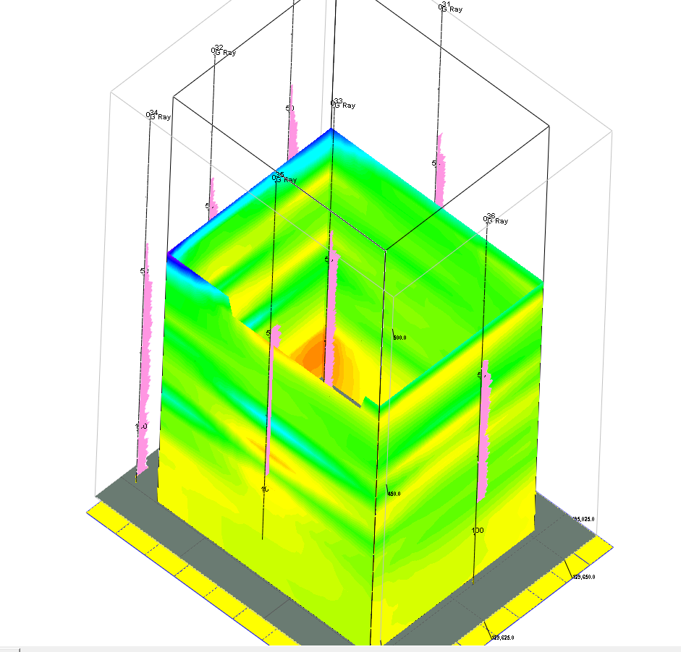
Natural Gamma model slides

Slide 44
Limitations
Quality of data
(correlations/ digitizing)
Amount of Data (no. Of BHs)
accuracy of interpolation between boreholes / edge effects/ change in detail of results/ incorporate cross hole data in future
Persistence of horizons
lack of confidence in BH descriptions
BUT it can be achieved ...
Notes:
A powerful tool with the right data

Slide 45
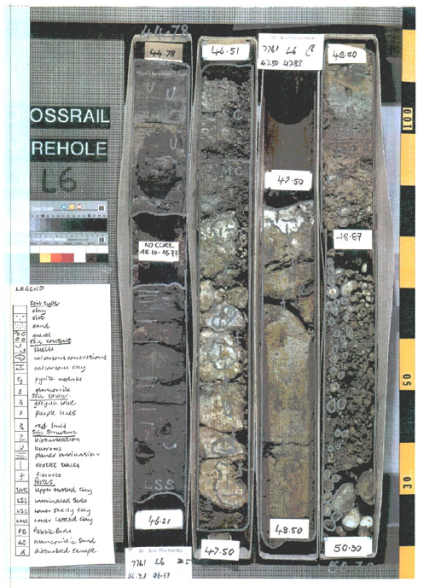
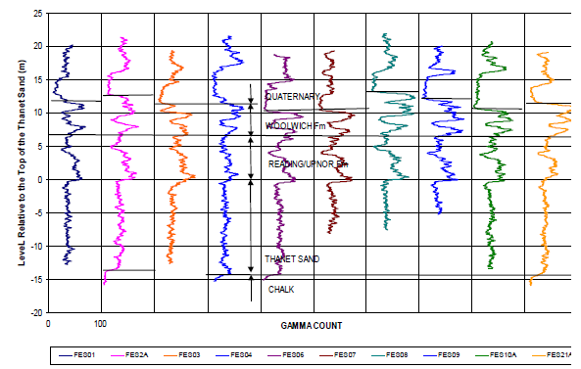
Stratigraphy - what detail are we looking for?

Slide 46
Sonic Logging in RockWorks
P-wave output to determine seismic facies

Slide 47
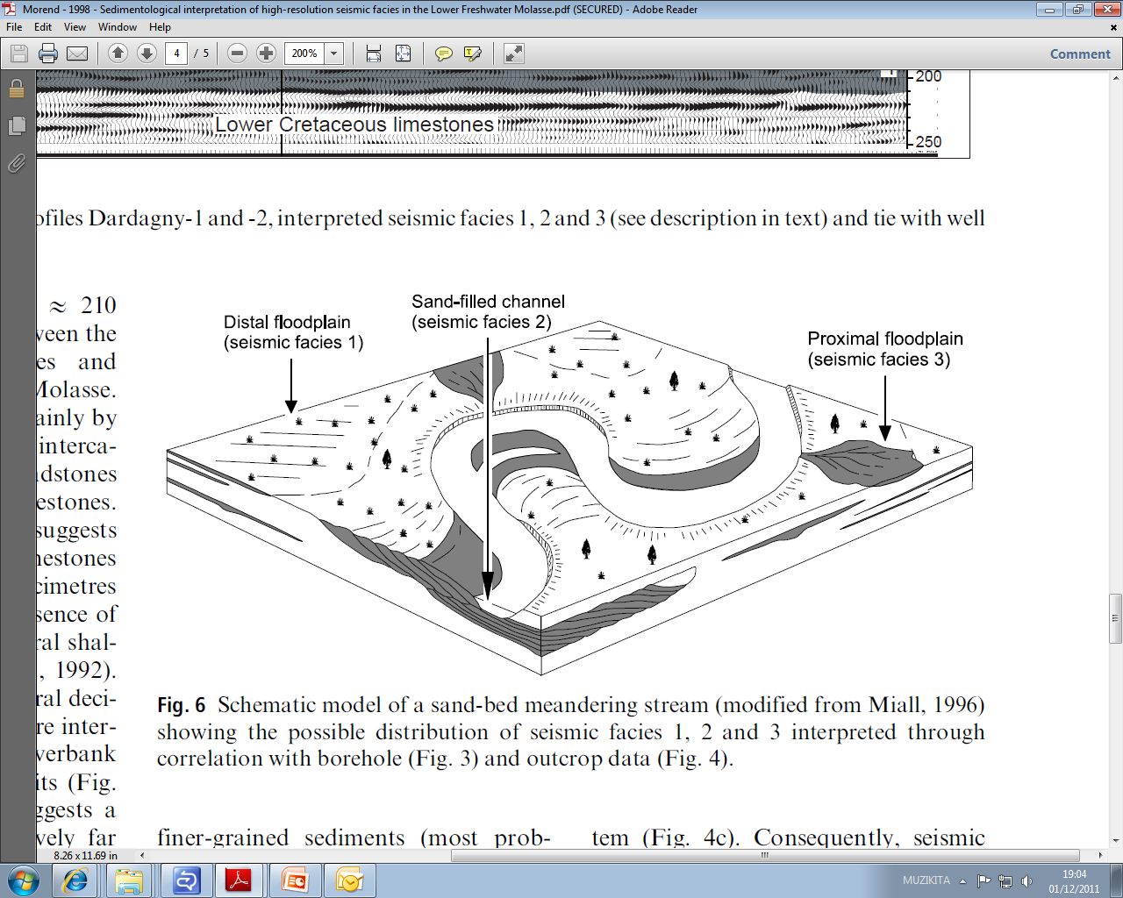
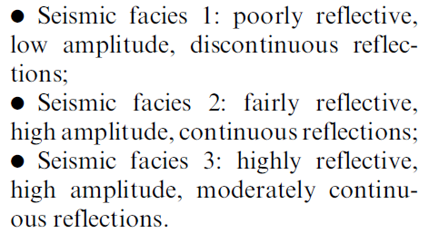
Seismic Facies
Example in Lower Freshwater Molasse From Morend, Pugin and Gorin (1998)
Characterise facies based on reflection
Can attribute small strain stiffness to seismic facies models using P-wave correlations
Add stratigraphy model from natural Gamma, Resistivity and Boreholes
Notes:
Understand scale i.e. Something harder – better reflection
Taking conceptual model and looking at seismic facies not lithofacies
Characterise ground by strength of reflection

Slide 48
Seismic Limitations
Intercalated/ thinly bedded deposits can be difficult to pick up using Vp depending on resolution of data
Seismic resolution often thinner than bedding thickness/ lithological change
Limited ability to develop ‘signature’ values for each lithology
materials can vary within the same range hence adoption of a statistical mean for development of parameters at this stage.

Slide 49
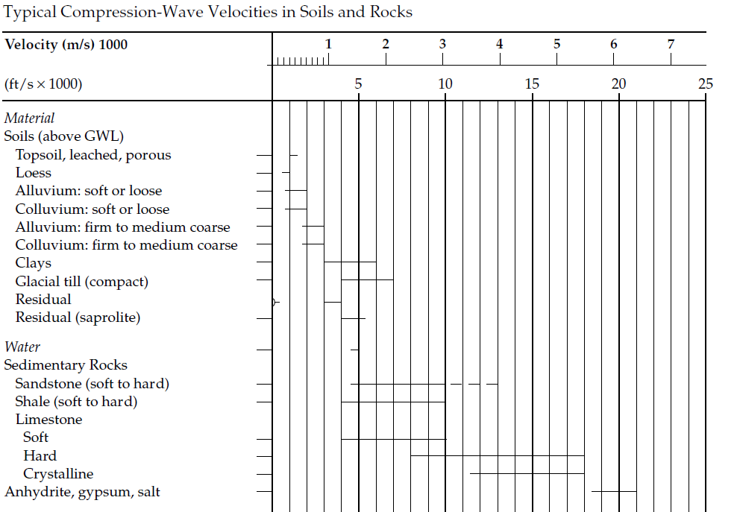
Typical P-Wave Velocities
Vp (km/s)
 | BH31 | BH32 | BH33 | BH34 | BH35 | BH36
Mean | 2.9 | 2.9 | 3.3 | 2.6 | 2.9 | 2.8
MAX | 4.1 | 4.6 | 4.5 | 3.4 | 4.3 | 4.5
MIN | 1.8 | 1.6 | 1.7 | 1.6 | 1.9 | 1.5

Slide 50
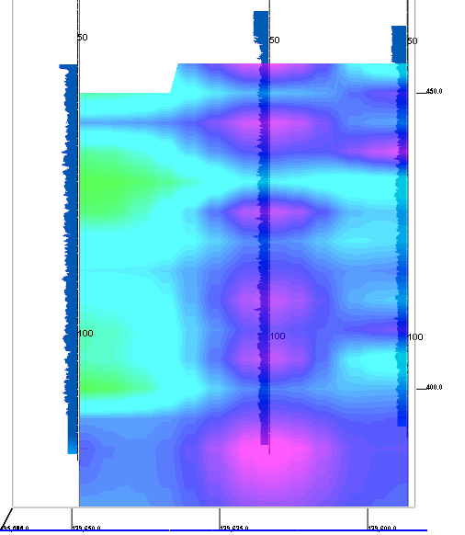

Sonic Velocity – Section A
SLHC 30
SLHC 32
SLHC 34
(m/s)

Slide 51
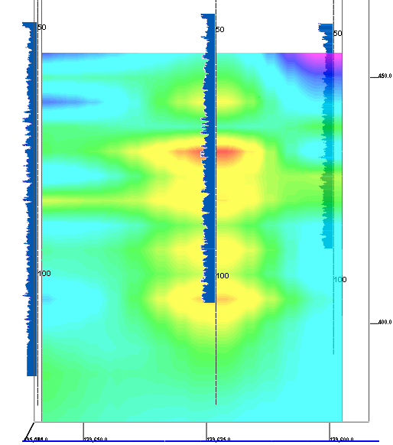
Sonic Velocity – Section B
SLHC 31
SLHC 33
SLHC 35
(m/s)

Slide 52

Sonic Velocity – Section C
SLHC 36
SLHC 33
SLHC 32
(m/s)

Slide 53

(m/s)

Slide 54

(m/s)

Slide 55

(m/s)

Slide 56

(m/s)

Slide 57

(m/s)

Slide 58

(m/s)

Slide 59

(m/s)

Slide 60

(m/s)

Slide 61

(m/s)

Slide 62

(m/s)

Slide 63

(m/s)

Slide 64

(m/s)

Slide 65

(m/s)

Slide 66

(m/s)

Slide 67

(m/s)

Slide 68

(m/s)

Slide 69

(m/s)

Slide 70
Small Strain Stiffness

Slide 71
Statistical Approach for Small Strain Stiffness
Calculation of small-strain stiffness from Sonic Velocity Data (using Barton 2002)
Determination of Conservative Assessed Mean (CAM)
Current approach to analyse range and CAM for Geotechnical & Structural Models
(Example for BH 30 using Barton 2002) | Vp m/s | Emass Small strain Young’s Modulus (Gpa)
CAM | 2606.6 | 5.2
Mean | 2871.5 | 6.5
Standard Dev. | 441.6 | 2.1
Maximum | 4094.5 | 15.8
Minimum | 1756.7 | 2.6

Slide 72


Looking East
(Gpa)

Slide 73
Conclusions & Further Ideas
Assess sensitivity of design to thickness and frequency of weak/ grumuleuse horizons
Targeted geophysics at Calcareous horizons as potentially most laterally persistent horizons - marker beds.
Optimisie tunnel depth following site selection based on Detailed logging and Geophysical models.
Development of 3D Model for interpretation all data sets
Use of Seismic data to define critical small strain stiffness to predict yield behaviour in Geotechnical & structural models

Slide 74
2D FE Geotechnical Modelling
Eden Almog

Slide 75


Stress History and Ground Parameters
Assumed stress path:
Stage | Name | Cavern Depth (m) | Soil Effective Weight (kN/m^3) | Vertical Effective Stress (kPa)
1 | Deposition of Molasse Rocks (2km) | 2060 | 16 | 33000
2 | Erosion | 60 | 16 | 1000
3 | Assumed deposition of 20m Moraine deposits | 80 | 11 | 1200
Simulated Current Stress State
Soil mass parameters:
Ko = 1.1 – 1.5 depending on Moraine deposition history
Name | γ | k | ν | E_{mass}‘ (LB) | c' | φ'
 | [kN/m^3] | [m/s] | [ - ] | [kN/m^2] | [kN/m^2] | [ ° ]
Molasse Rock Mass | 23 | 1.00E-09 | 0.2 | 2800000 | 220 | 35
Moraine Gravel | 23 | 1.00E-05 | 0.25 | 50000 | 0.01 | 35

Slide 76

Detailed 2D FE Analysis
Pressure relief
holes (pore-water
-pressure reduction)
Sequential
Excavation
Other features:
Molasse drained behaviour with steady state seepage forces
Stress relaxation per stage
Shotcrete hardening with time

Slide 77


Example – Top Heading Excavation
Ground water modelling
Reduced pore-pressure around excavation to minimise yielding
Low permeability coupled with relatively high stiffness with slow construction require drained analysis (little excess pore pressures)
Steady state seepage but with very low flow rate due to low permeability

Slide 78



Example – Top Heading Excavation
Ground Yielding
Full face heading excavation is conservative
Radial support minimises yielding.
Most yielding occurs at invert and can be reduced by further sequencing and curvature
Shear strains values acceptable and no slip surfaces generated (global FoS = 3.5)

Slide 79

Example – Top Heading Excavation
Ground Deformations
Invert deformations are in accordance with measured displacements at CMS.
Maximum tunnel convergence = 0.2% which is acceptable

Slide 80



2D Invert Deformations
3mm
3mm
Longitudinal: 3.3mm / 16.6m = 0.2mm/m x 20m = 4mm/20m > 0.5mm/20m.
Transversal: 3.3mm-3 mm / 13.5m = 0.023 x 20 = 0.45mm/20m < 0.5mm/20m.
Unacceptable invert deformation in longitudinal direction. Highlights the need to consider 3D structure effects

Slide 81
3D Bedded Spring Model
Agnieszka Mazurkiewicz

Slide 82

3D Finite Element Analysis
Structural Design
Lining
Thickness: 1.0m
Concrete C50/60
Interaction Cavern
3D-model comprises:
Lining
Invert Slab
Invert Slab
Thickness: 5.6m
Concrete C50/60

Slide 83


Ground Pressure (Including Stress Arching)
Max Horizontal Pressure: 1090 kPa
Max Vertical Pressure: 770 kPa

Slide 84

Moving Slab Distributed Load
800 kPa
Moving slab distributed load applied in the middle of the cavern span
13.5m
15.5m

Slide 85

Boundary Conditions
Springs represent ground stiffness
Radial Springs
Tangential Springs
Lining
Pinned connection at
interaction cavern and the service caverns interface

Slide 86
Boundary Conditions
Three following ground stiffness has been investigated in order to evaluate the ground-structure interaction:
2D FE non-linear model stiffness:
      Radial Springs: 100 kPa/mm
2x FE model stiffness
      Radial Springs: 200 kPa/mm
3x FE model stiffness
      Radial Springs: 300 kPa/mm

Slide 87



Serviceability Limit State Analysis
Invert Slab Deformed Shape
Ground Pressure + Moving Slab +
+ Self Weight
Final Deformation

Slide 88


Longitudinal Cross Section
2D FE model stiffness | 2x FE Stiffness | 3x FE Stiffness
1.6 mm | 1.4 mm | 1.2 mm

Slide 89


Lateral Cross Section
2D FE model stiffness | 2x FE Stiffness | 3x FE Stiffness
1.55mm | 1.5mm | 1.44mm

Slide 90
Conclusions and Recommendations

Slide 91
Interaction Cavern – Conclusions & Recommendations
Assuming a conservative “full face” construction sequence invert static deformations exceed acceptable limits.
This depends on extent of yielding around cavern during construction (i.e. EDZ). An appropriate construction sequence should limit this.
EDZ expected to be larger than the simulated in the 2D FE models due to 3D stress arching resulting from service caverns.
Construction of shaft and interaction cavern prior to service caverns sequence would limit soil yielding at the invert.
But...significant support will be required!
Alternatives to consider...

Slide 92

Revision G
Caverns Moved Closer
~20m separation
Concrete Pillar, separation governed by detector proximity
High Stress around IR
Notes:
Need to comment on construction sequence?

Slide 93

Potential Advantages:
Reduces lining stress around caverns
Slab foundations likely to be extremely stiff
Vertical walls at IP, machine/detector interface can be optimised
Slab size potentially independent of detector width
Minimum travel time and umbilical lengths
A
Section A-A
A

