Slide 1
Interaction Region Studies for a Linear Collider at CERN
- Detector ‘push-pull’ slab design
- Cavern assessment
Matt Sykes

Slide 2
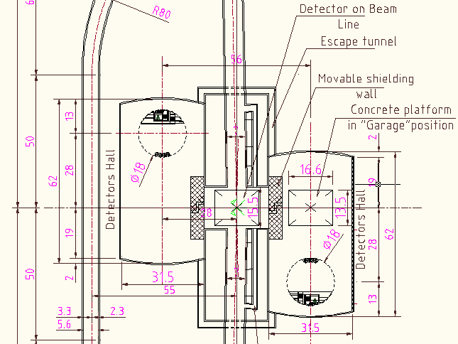
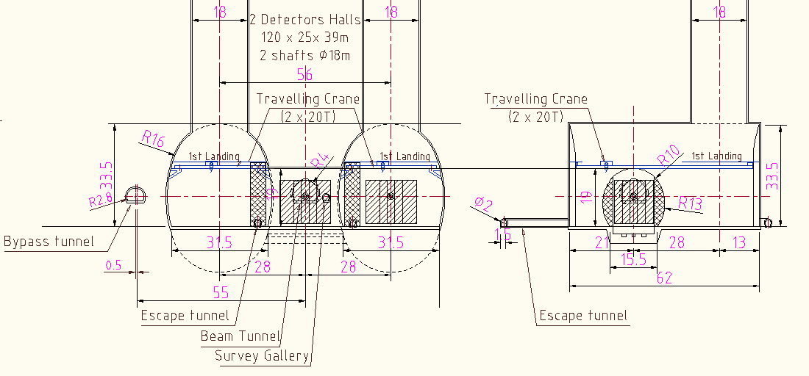
CLIC
Geometry
(G)

Slide 3
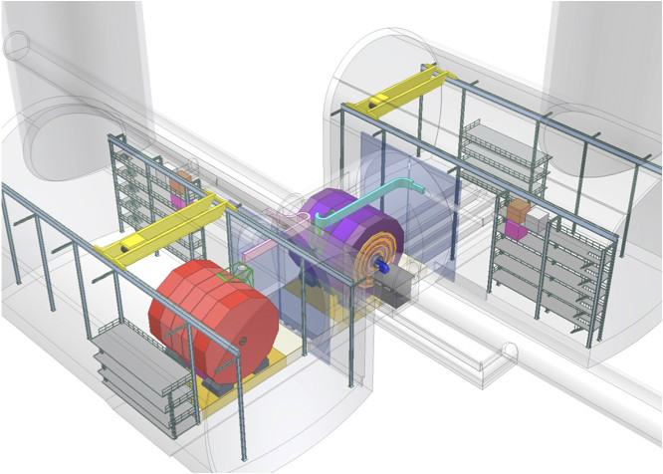
Beam Line.
15,000t detector on a slab and movement system.
Detector moves 15 times per year from beam into “garage position”
Garage Cavern & Access Shaft
Interaction Region (“IR”)

Slide 4
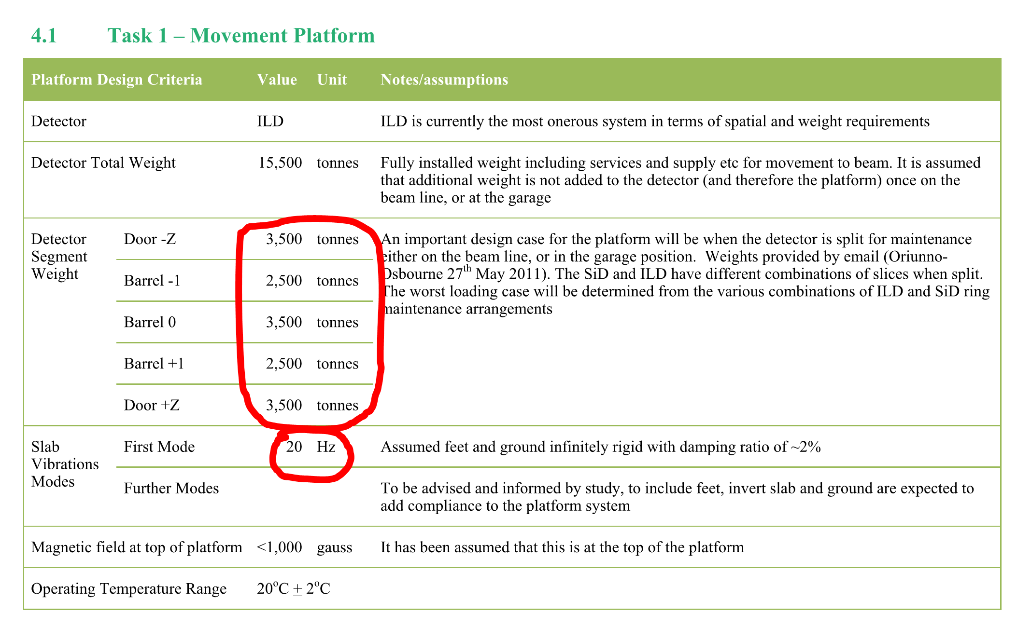
Summary of Requirements

Slide 5
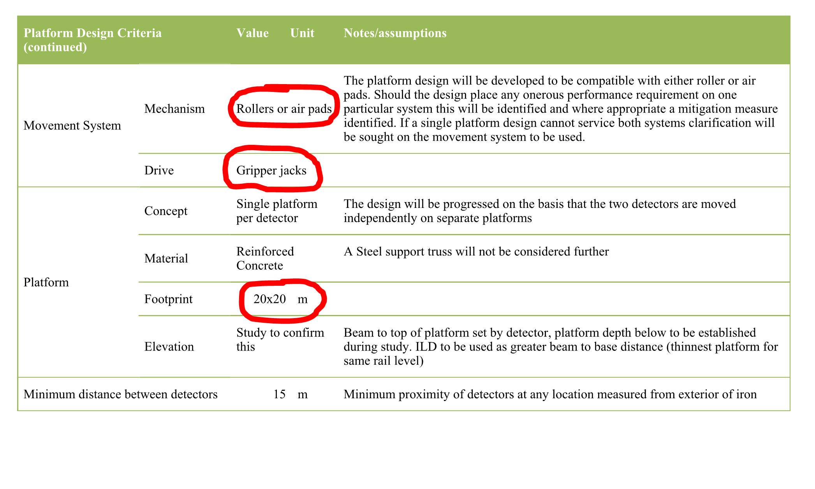
Summary of Requirements

Slide 6
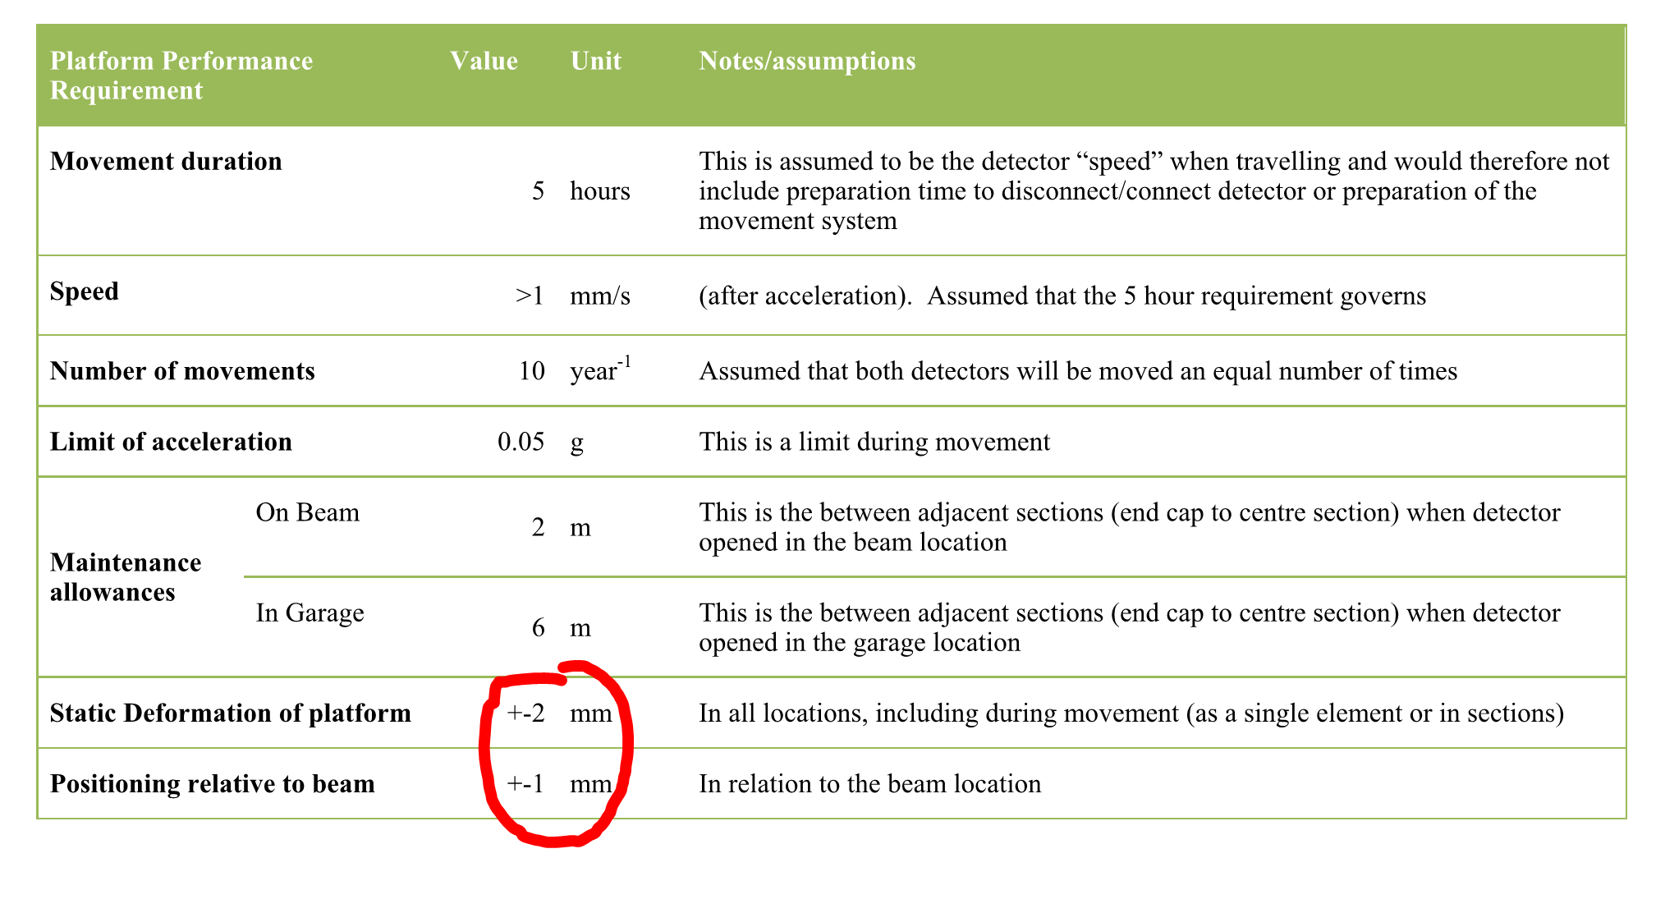
Summary of Requirements
Limited to under the footprint of the detector.
n/a when un-slicing

Slide 7
Slab flexure critical – but what is its definition?
Design using +/-2mm Under Detector
Deflection limit Not applied during un-slicing

Slide 8
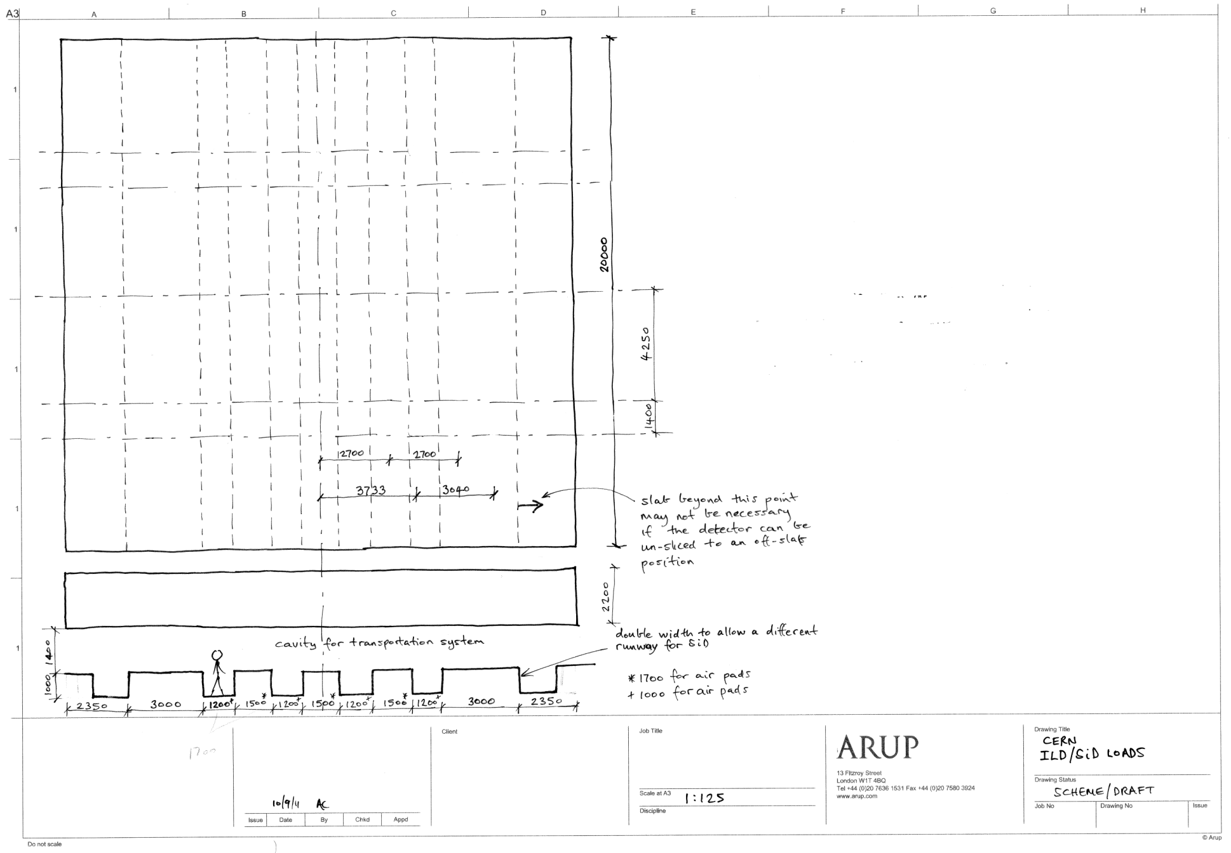
ILD top loads when moving/closed
Direction of travel
17.5MN
12.5MN
17.5MN
12.5MN
17.5MN
3500
ILD loads when moving/closed
Position of permanent support for ILD (preliminary)
17.5MN
12.5MN
17.5MN
12.5MN
17.5MN

Slide 9
ILD top loads when un-slicing
12.5MN
12.5MN
17.5MN
12.5MN
12.5MN
Direction of travel
5MN
5MN
ILD loads when moving/closed
5MN
5MN
Position of permanent support for ILD (preliminary)
4750
Range of positions (assumed 2000)
12.5MN
12.5MN
17.5MN
12.5MN
12.5MN

Slide 10
SiD top loads when moving/closed
2100
25MN
25MN
Direction of travel
SiD loads when moving/closed
Position of permanent support for SiD
25MN
25MN

Slide 11
SiD top loads when un-slicing
6775
3700
2100
12.5MN
12.5MN
Direction of travel
2000
2000
6.25MN
6.25MN
6.25MN
6.25MN
4700
SiD loads when un-slicing
represents range of positions
Position of permanent support for SiD
(preliminary)
6.25MN
6.25MN
6.25MN
6.25MN
12.5MN
12.5MN
2200 ILD
3800 Sid

Slide 12
A refined support system for ILD
Step 1: ILD Slab on permanent supports
Step 2: Put ILD(closed) loads on top of slab
Step 3: Jack onto transportation system
Step 4: Consider un-slicing – not now subject to deflection limits

Slide 13
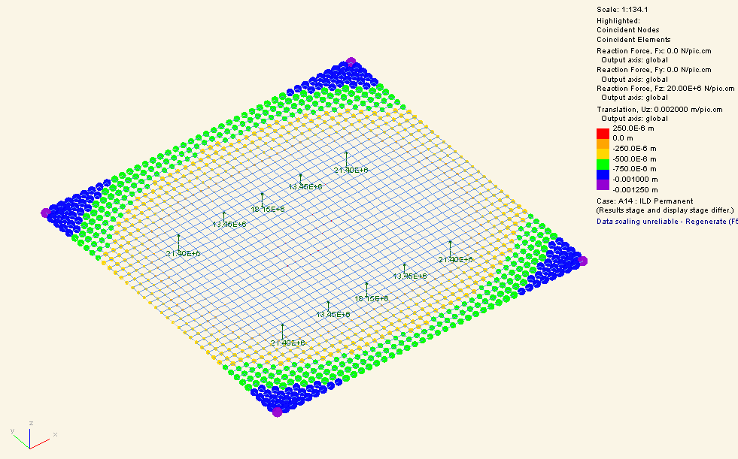
Step 1: ILD Slab on permanent supports
Slab on permanent supports (directly under the top loads for ILD closed)
The top surface of the slab can be defined as level and perfectly flat at this stage in its life
But note this is a long term load case and the value will increase with creep - ongoing
Model summary:
E = 32GPa
Slab 20x20mx2.2m
Load = Slab self weight
Flexure = 0.25mm up to 1.25mm down = 1.5mm amplitude
Displacement under footprint of slab +/- 0.15 mm

Slide 14
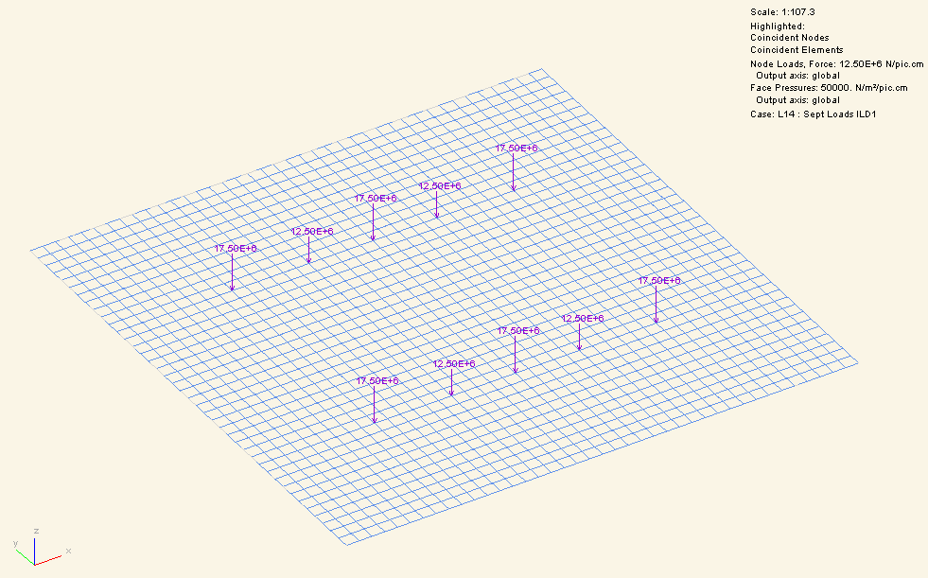
Step 2: Put ILD(closed) loads on top of slab
This has negligible displacement effect because the loads are (nearly) directly above the supports

Slide 15
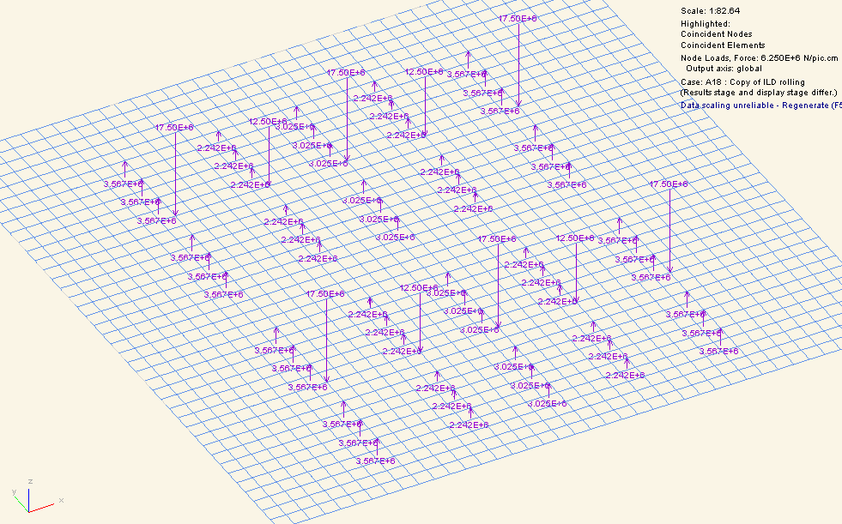
Step 3: Jack onto transportation system
ILD (closed) effect upon top surface of jacking onto the transportation system (jack config 1)
Model summary:
E = 32GPa
Slab 20x20mx2.2m
Load = Slab self weight + ILD (closed) top loads
See next slide for displacement as a result of step 3

Slide 16
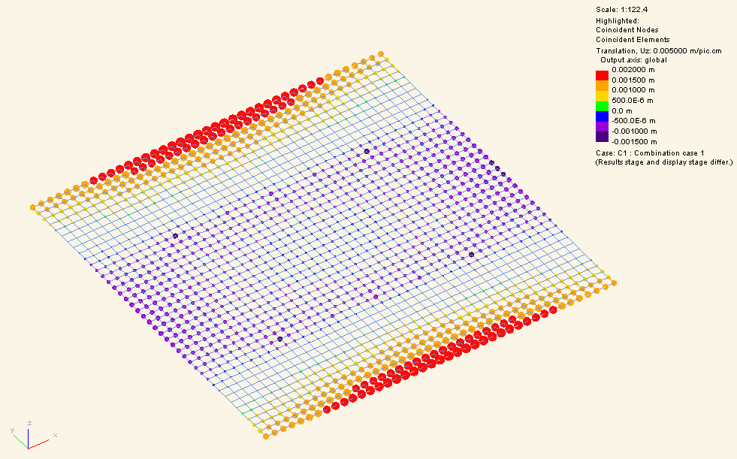
Step 3 (continued)
ILD (closed) effect upon top surface of jacking onto the transportation system (jack config 1)
Flexure = +1.9mm to -1.0mm
This meets the +/- 2mm tolerance
Note if the slab were smaller the reported deflection would drop significantly.
Displacement under footprint of slab +0, -0.7mm down
Model summary:
E = 32GPa
Slab 20x20mx2.2m
Load = [Slab self weight + ILD (closed) top loads + jack supports] – [Slab self weight on permanent supports]

Slide 17
Step 1: SiD Slab on permanent supports
Slab on permanent supports (directly under the top loads for ILD closed – so we use same tracks as ILD)
The top surface of the slab can be defined as level and perfectly flat at this stage in its life
But note this is a long term load case and the value will increase with creep - ongoing
Model summary:
E = 32GPa
Slab 20x20mx2.2m
Load = Slab self weight
Flexure = 0.25mm up to 1.25mm down = 1.5mm amplitude
Displacement under footprint of slab +/- 0.15 mm

Slide 18
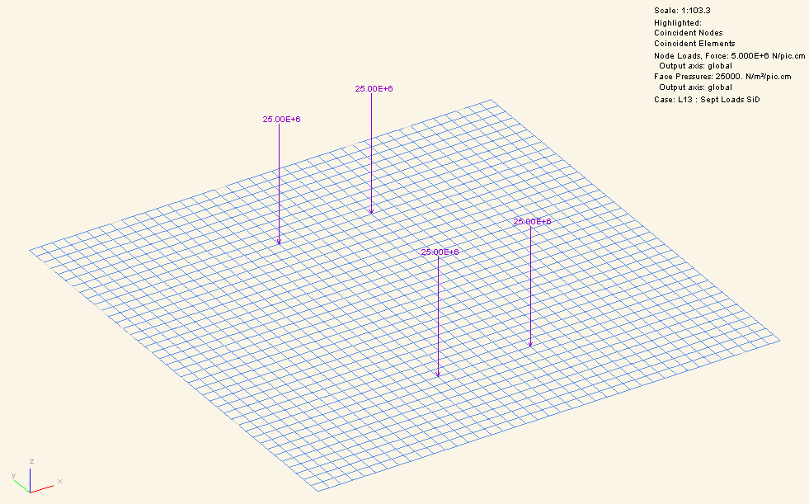
Step 2: Put SiD(closed) loads on top of slab
This has negligible displacement effect because the loads are (nearly) directly above the supports

Slide 19
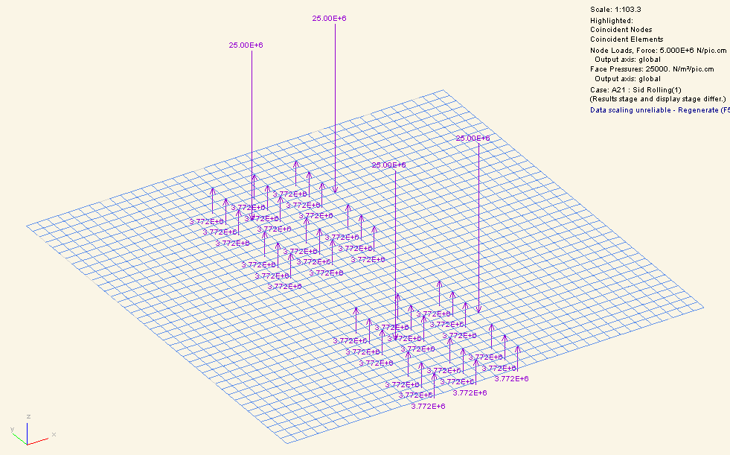
Put SiD(closed) moving on transportation system
Model summary:
E = 32GPa
Slab 20x20mx3.8m
Load = Slab self weight + SiD (closed) top loads
See next slide for displacement as a result of these loads

Slide 20
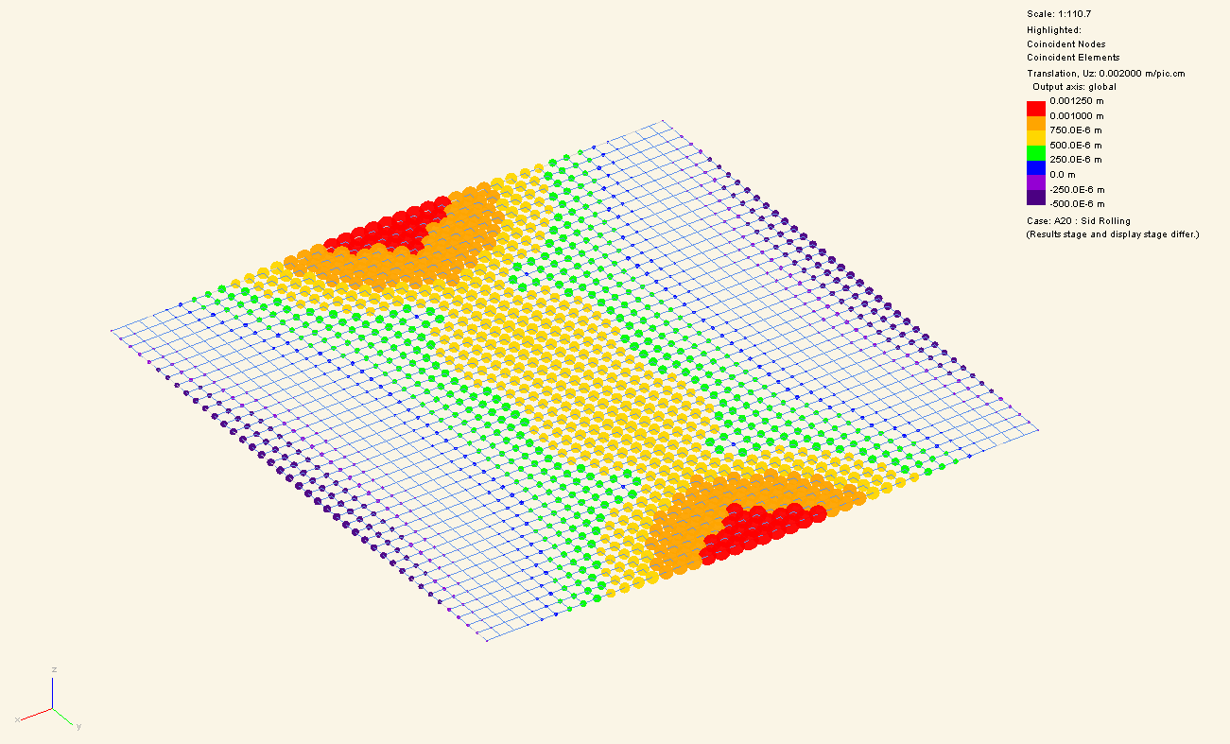
Put SiD(closed) moving on transportation system
0.7mm under detector

Slide 21
Un-slicing
Un-slicing causes top loads to move away from the permanent supports.
Because of this, un-slicing would cause displacement limits to be exceeded if supported only by the permanent supports. Displacement limits N/A

Slide 22
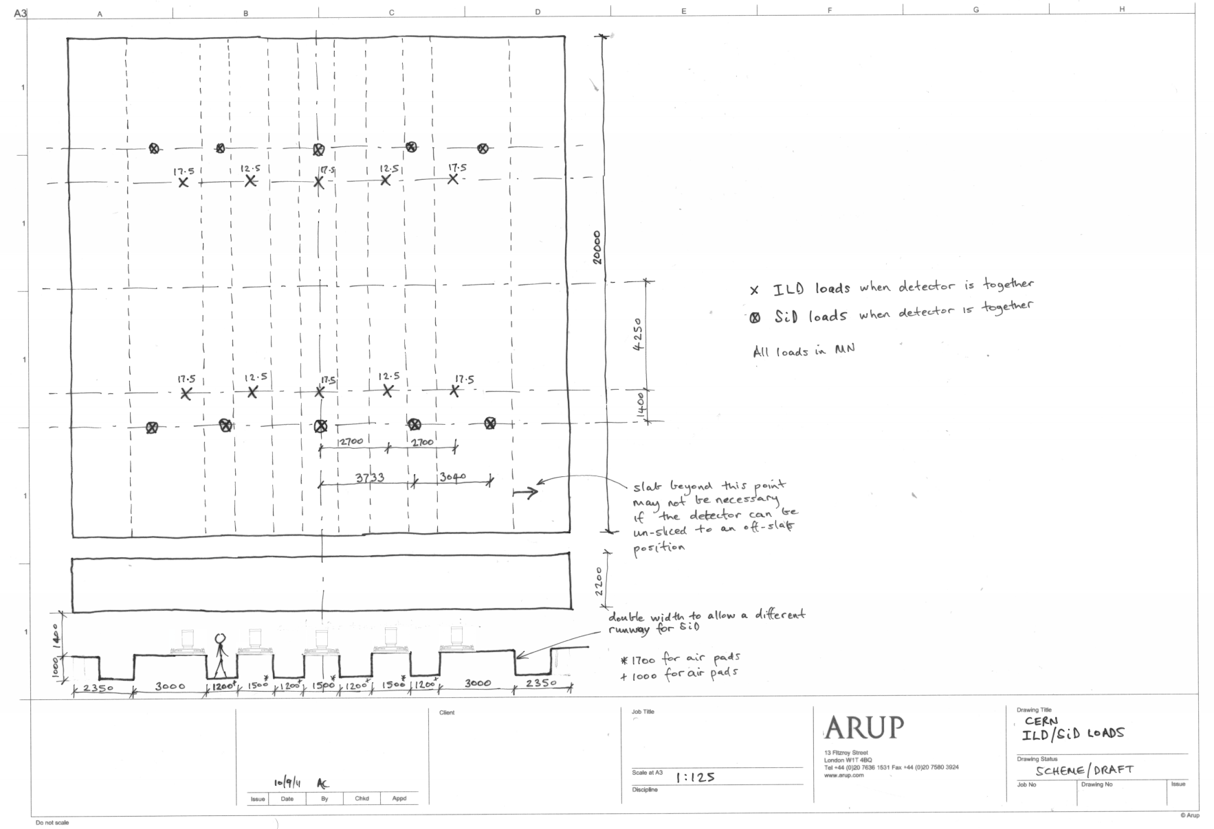
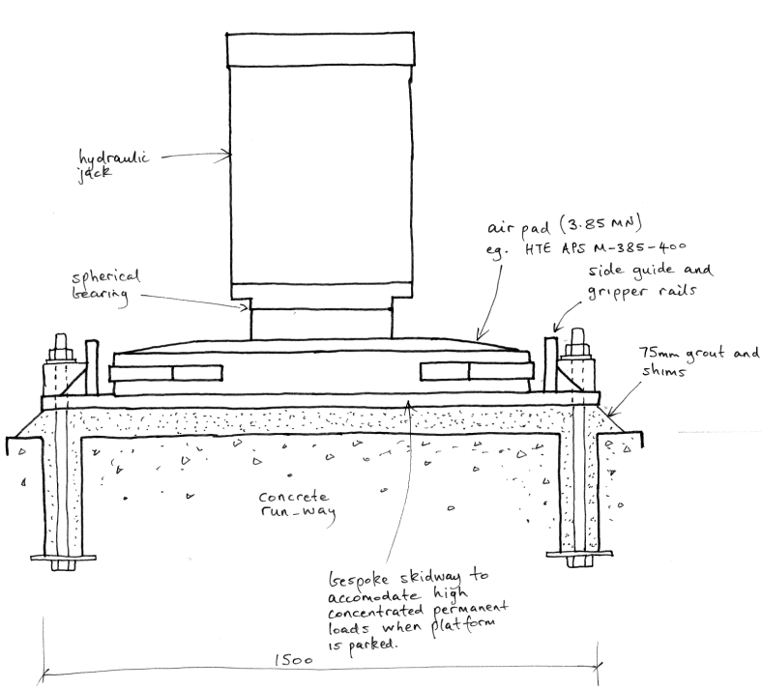
The movement support system – ILD, Airpads
Direction of travel
Permanent support (moves with slab)
Air pad

Slide 23
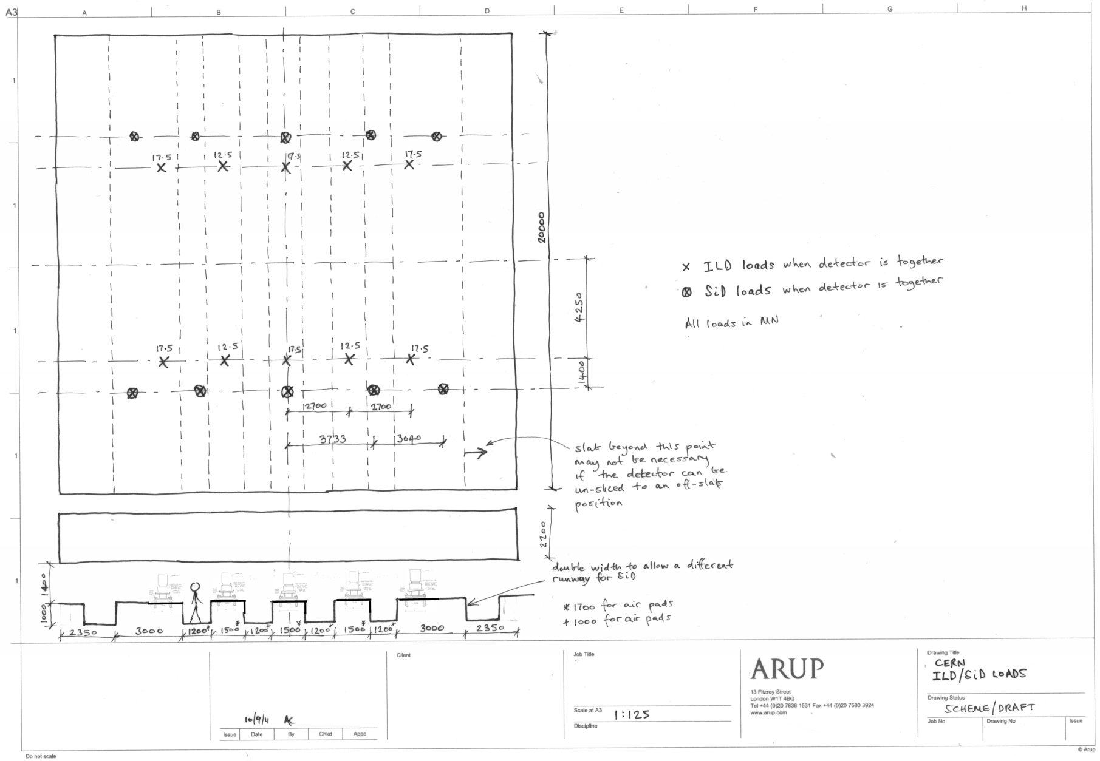
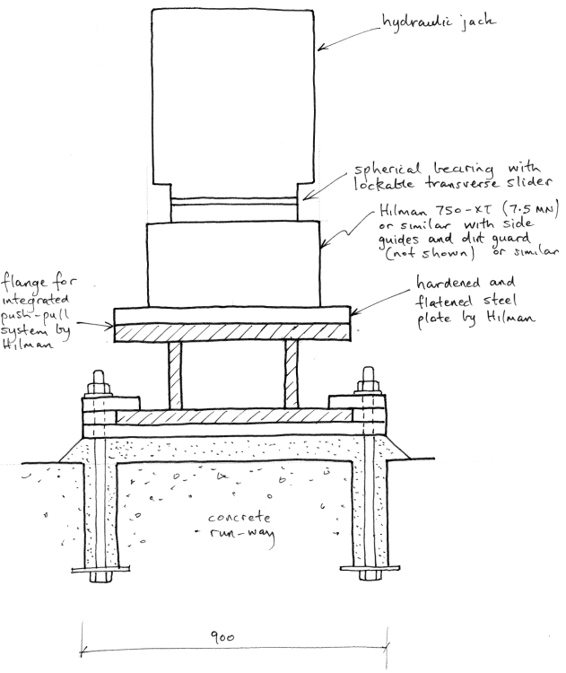
The movement support system – ILD, Rollers
Direction of travel
Permanent support (moves with slab)
Hilman roller

Slide 24
The movement support system – SiD, Airpads
Direction of travel
Permanent support (moves with slab)
Note full length needed for pads
Air pad
3800

Slide 25
The movement support system – SiD, Rollers
Direction of travel
Permanent support (moves with slab)
Slab could be a little shorted than with air pads
Hilman roller

Slide 26
Conclusion on ILD movement
Moving the Detector
Can achieve disp limits of +/-2mm when moving
  ILD on 2.2m slab with pads or rollers
  SiD on 3.8m slab with pads or rollers
  Design works with pads and rollers, choice outside scope of assessment
Recommended Contingency/Studies
  Jacking and packing if the invert does flex (to keep the slab permanent supports plane)
  Provide 50mm packing from the start to allow the height to be reduced
  Evaluate slab final positioning systems (eg PTFE sliding surface)
  Movement system not examined in detail (stick-slip accelerations require evaluation, 0.05m/s²)
Un-slicing
Limits exceeded when un-slicing……..but not applicable
But props/shims will be needed under tracks when un-slicing to avoid a step
BUT
Conclusions above dependent on invert flex ----- Displacement limit of ~0.5mm

Slide 27
How do we limit cavern invert deflection to less than 0.5mm (creep and absolute)
(Controlled by ground yield and invert stiffness)
Is cavern geometry:
Feasible for working concept?
Influencing yield at IR?
Slab deflection limited to 2mm
(20m by 20m concrete slab)

Slide 28
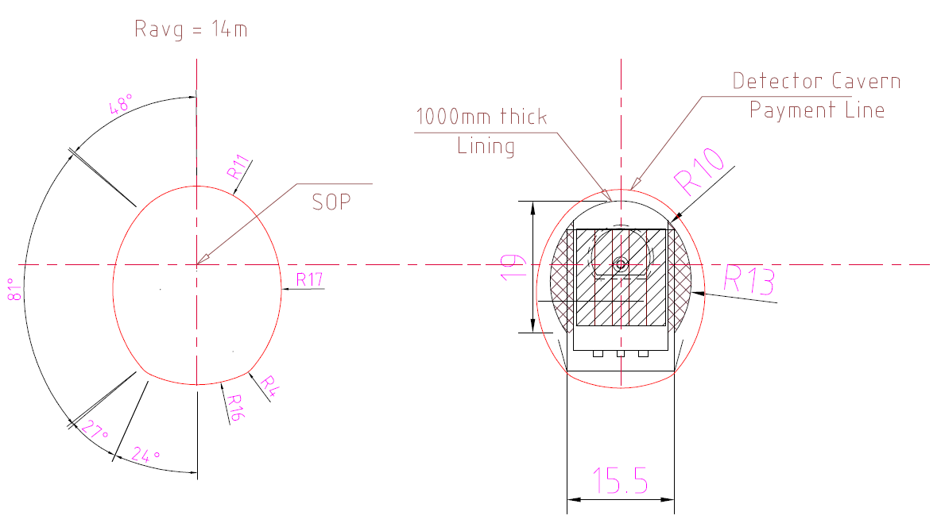
Key Issues for Invert Performance
What are the important characteristics of the ground?
What is stress state in ground after construction?
How will ground yield as a result?
What are the invert displacements?

Slide 29
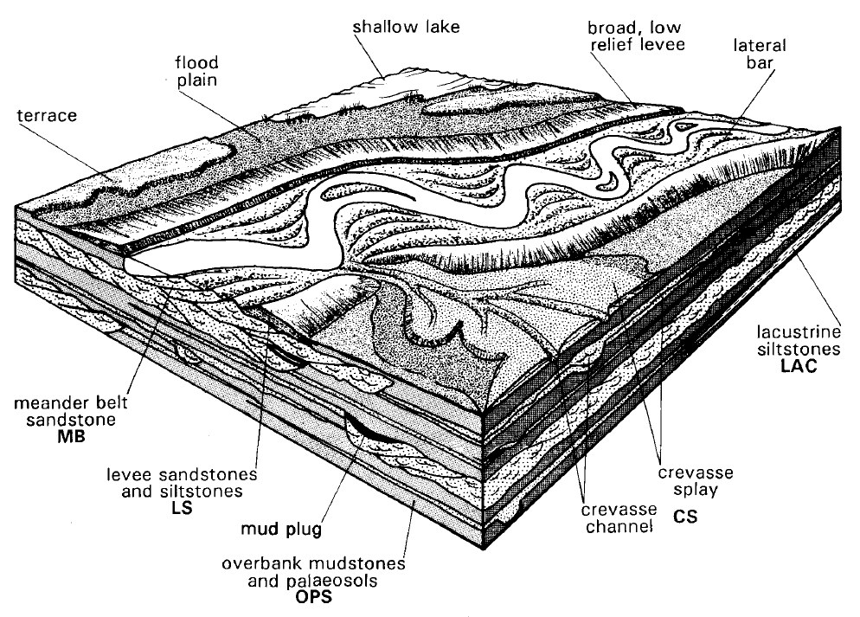
Depositional Environment
Lateral and vertical variability
Notes:
Depositional History predicted for SST channels, CERN Mudrocks within the Molasse – intercalations SST/ Grumeleuse
Fix model and variability in your mind so as to have a context for later analysis
Point out key features SSt lenses sinuous deposits/ fine bedding non continuous layers
Note paleosol horizons

Slide 30
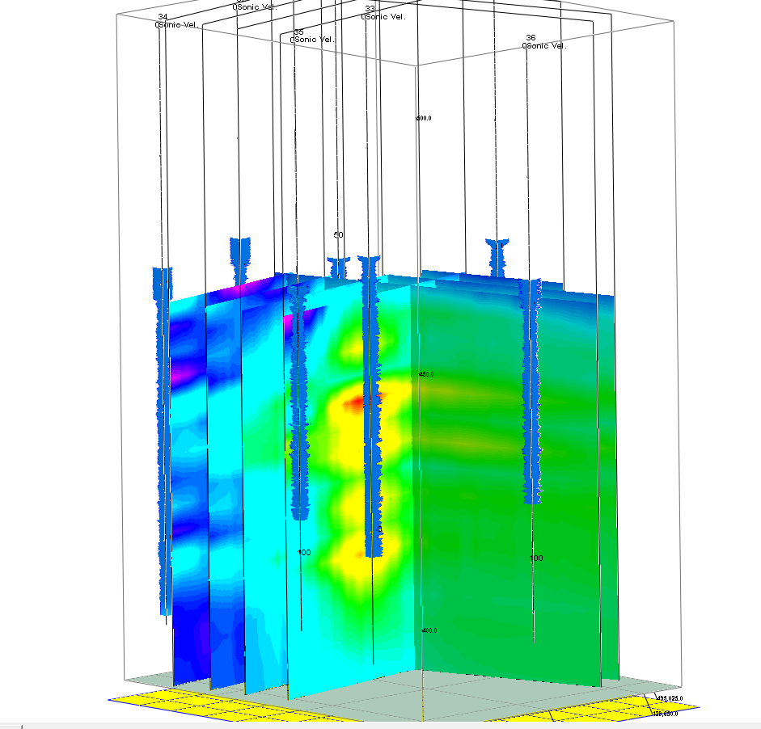
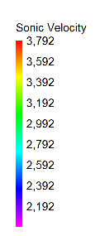
New Assessment of Existing Information
(m/s)

Slide 31
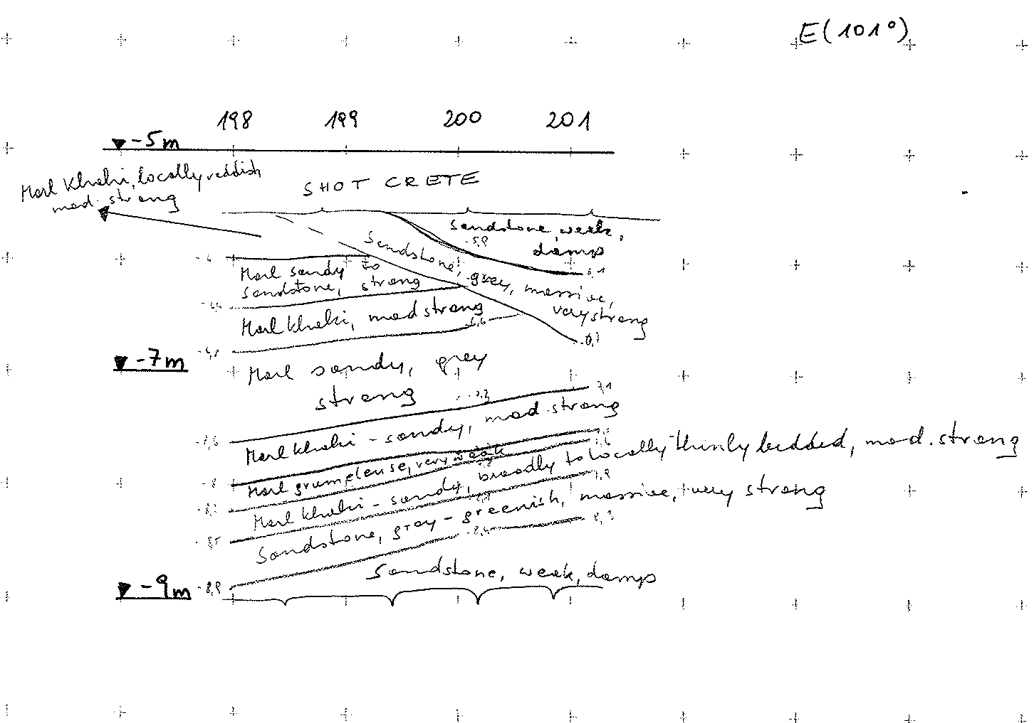
Confirmation of Depositional Features
- Examples from Point 5 GSG Face logs
Variable Dip of bedding &
Cross- bedding
Intercalations of thinly bedded SST/ Grumeleuse deposits
Pillar Ch. 198-201m
Notes:
Discuss examples in relation to the depositional environment

Slide 32
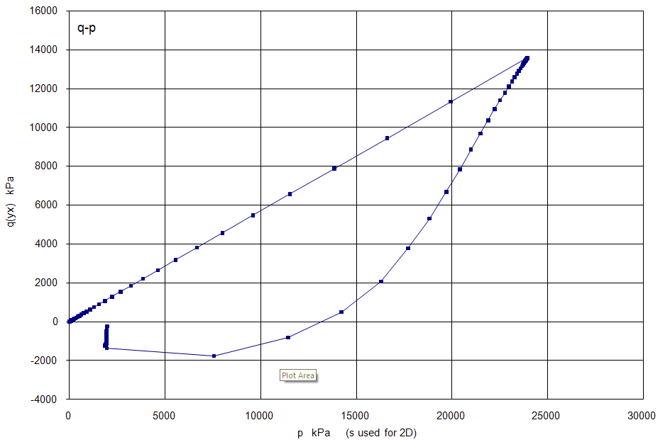
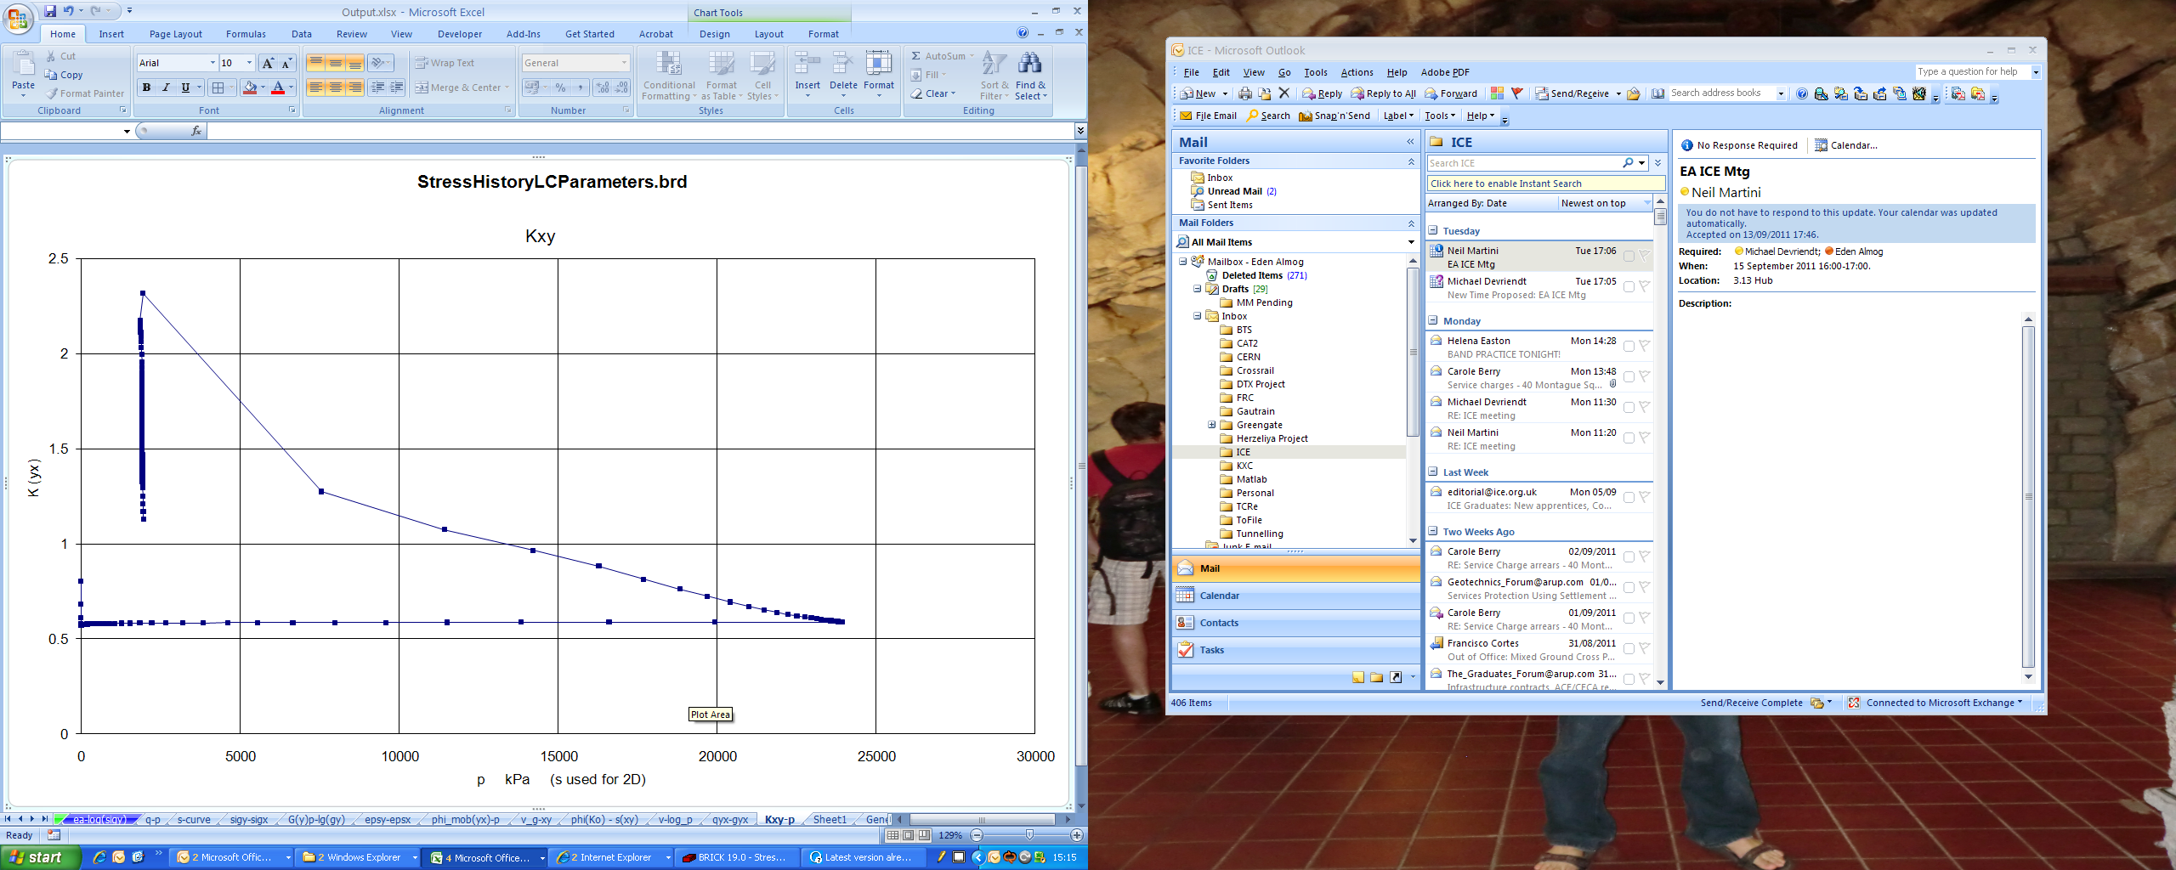
Stress History and Ground Parameters
Assumed stress path:
Stage | Name | Cavern Depth (m) | Soil Effective Weight (kN/m^3) | Vertical Effective Stress (kPa)
1 | Deposition of Molasse Rocks (2km) | 2060 | 16 | 33000
2 | Erosion | 60 | 16 | 1000
3 | Assumed deposition of 20m Moraine deposits | 80 | 11 | 1200
Simulated Current Stress State
Soil mass parameters:
Ko = 1.1 – 1.5 depending on Moraine deposition history
Name | γ | k | ν | E_{mass}‘ (LB) | c' | φ'
 | [kN/m^3] | [m/s] | [ - ] | [kN/m^2] | [kN/m^2] | [ ° ]
Molasse Rock Mass | 23 | 1.00E-09 | 0.2 | 2800000 | 220 | 35
Moraine Gravel | 23 | 1.00E-05 | 0.25 | 50000 | 0.01 | 35
Note: small strain stiffness/creep not known

Slide 33
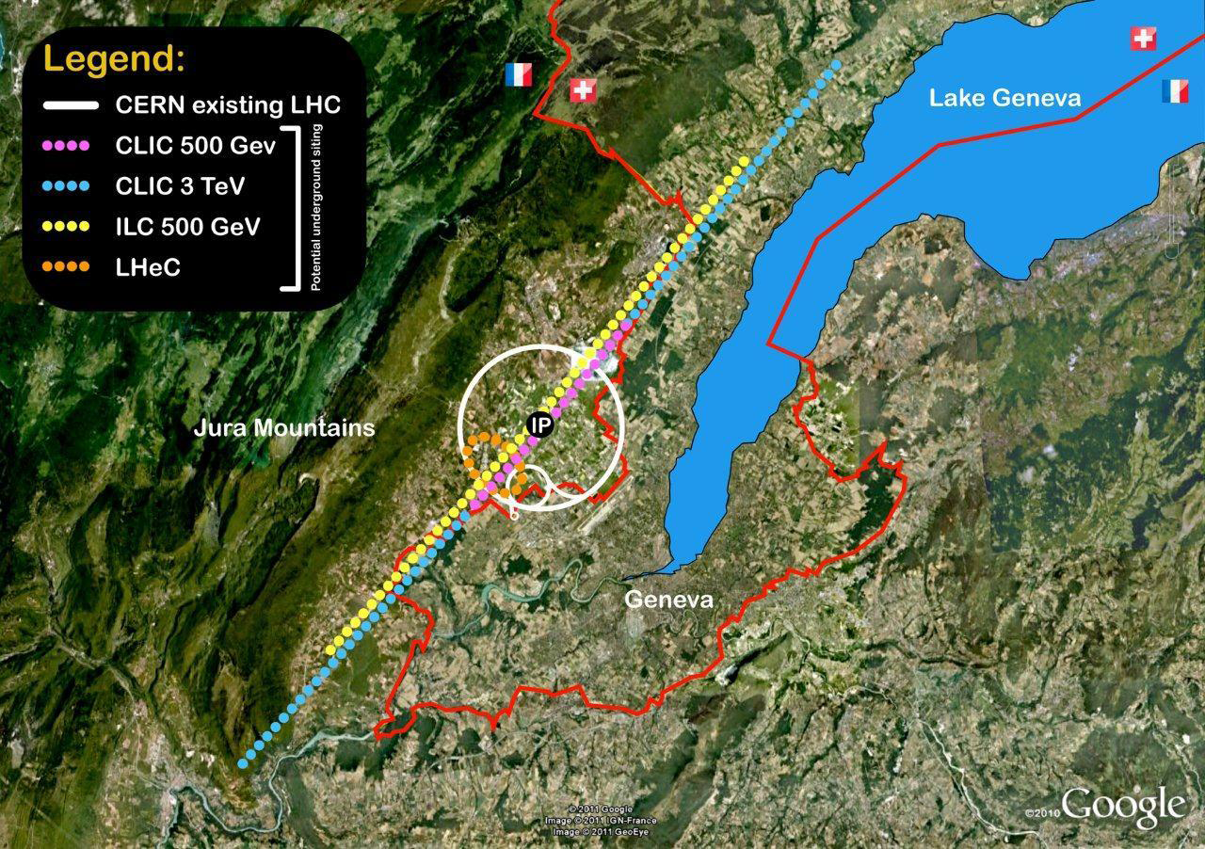
Regional Stress Regime
“Regional” Stress

Slide 34
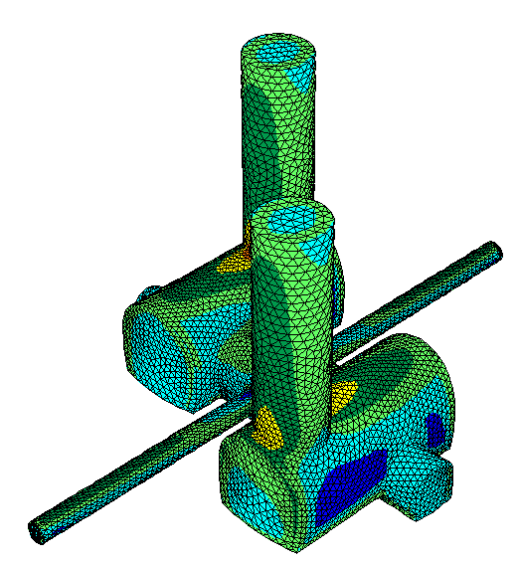
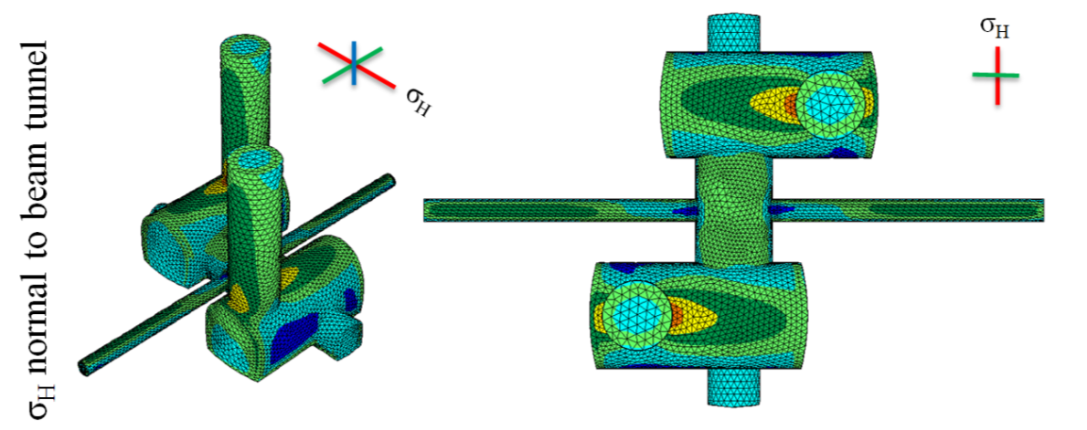
Likely Stress Trajectory at Cavern

Slide 35
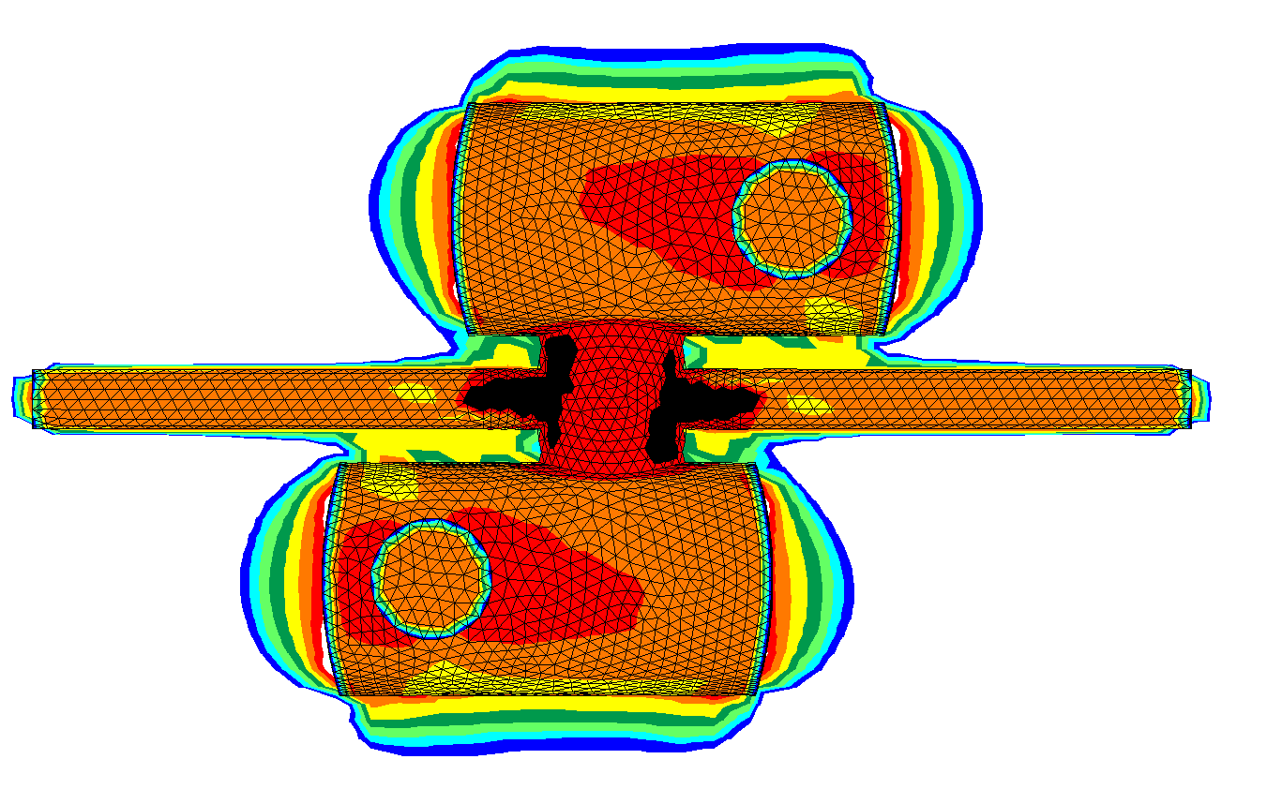

Layout G

Slide 36
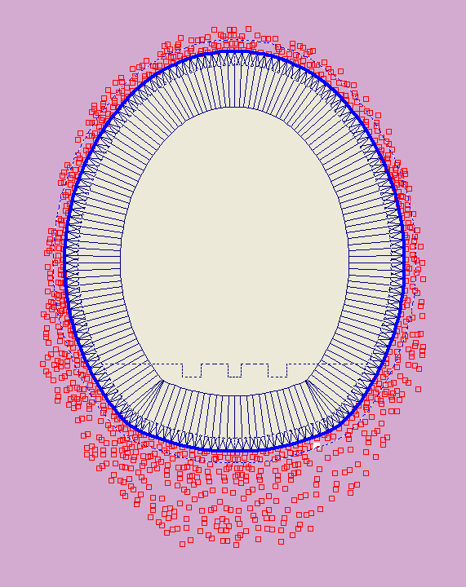
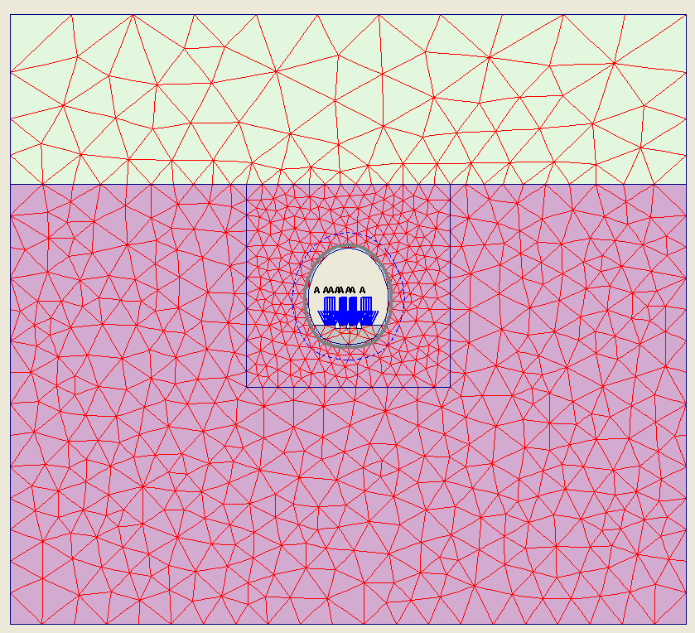
2D FE analysis
Primary Lining
Plastic
Yielding
Moraine Gravel
E’ = 50MPa
50m
30m
1MPa Support
Pressure
Molasse Formation
E’ = 3GPa
Lining support assumed to be same as UXC55 Cavern

Slide 37
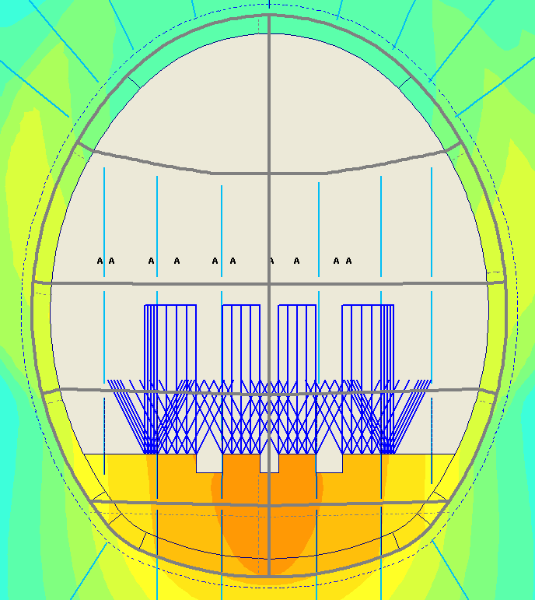
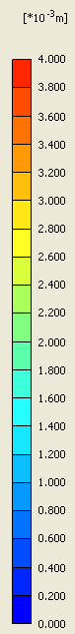
2D Invert Deformations
Longitudinal: 3.3mm / 16.6m = 0.2mm/m x 20m = 4mm/20m > 0.5mm/20m.
Transverse: 3.3mm-3 mm / 13.5m = 0.023 x 20 = 0.45mm/20m < 0.5mm/20m.
“Static” analysis carried out, existing data did not allow small strain stiffness, creep and cyclic deformation

Slide 38
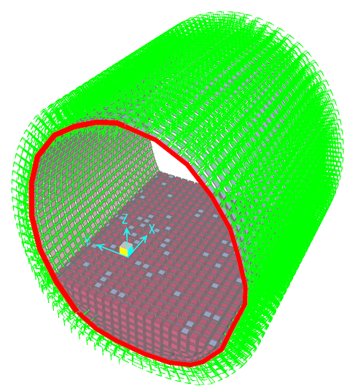
Boundary Conditions
Springs represent ground stiffness
Radial Springs
Tangential Springs
Lining
Pinned connection at
interaction cavern and the service caverns interface

Slide 39
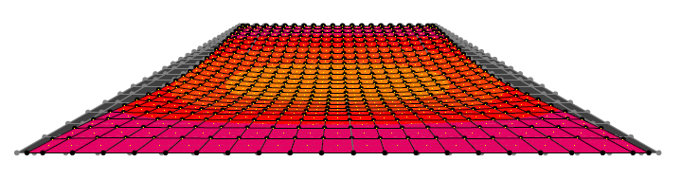
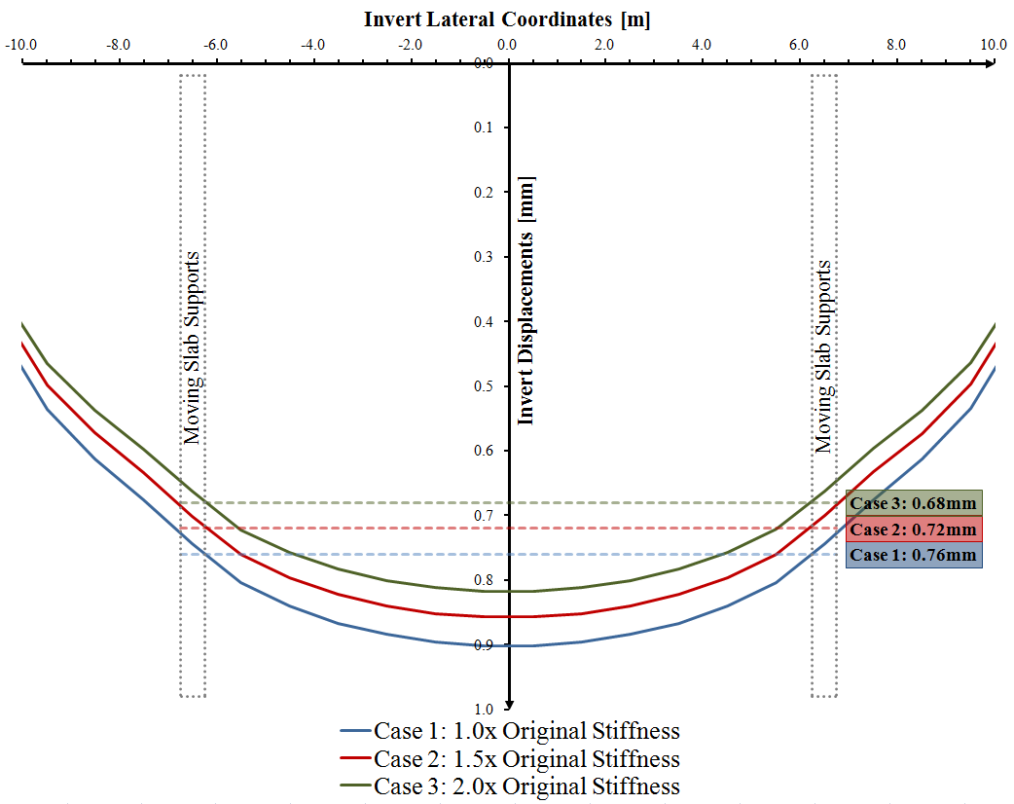

Slide 40
Conclusions
Slab
Slab design for loads can be achieved for rollers and air pads
Stick-slip accelerations need review for movements systems and slab final positioning
Cavern
Performance of invert under loading is marginal in CERN geology, given sequence reviewed
Invert performance highly dependent on:
  Geology – detailed and focussed SI required
  In situ stress – verification of local variation
  Construction sequence – to minimise disturbance
Long term and cyclic displacement and creep not yet understood

Slide 41
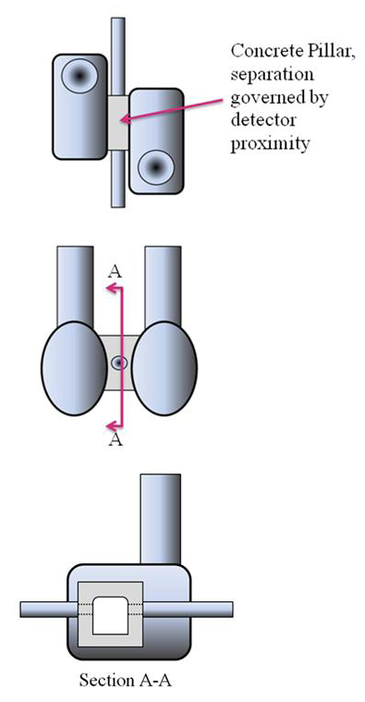
Recommendations
Focus investigations
  Seismic logging and 3d interpretation to select best horizon
  Small strain stiffness
  Sampling for creep evaluation
Provide contingency design for:
  Cavern support and sequencing (IR first)
  Increase separation between Garage Caverns
  Piling the cavern invert slab
  Concrete pillar between caverns
  Stiffer slab to allow more invert flex

Slide 42
Further work
Ongoing commission with Fermilab
  Desk study
  Cavern design Assessment
  Costing
  IR cavern performance assessment
Initiating internal dialogue with Arup’s Tokyo Office

