Slide 1
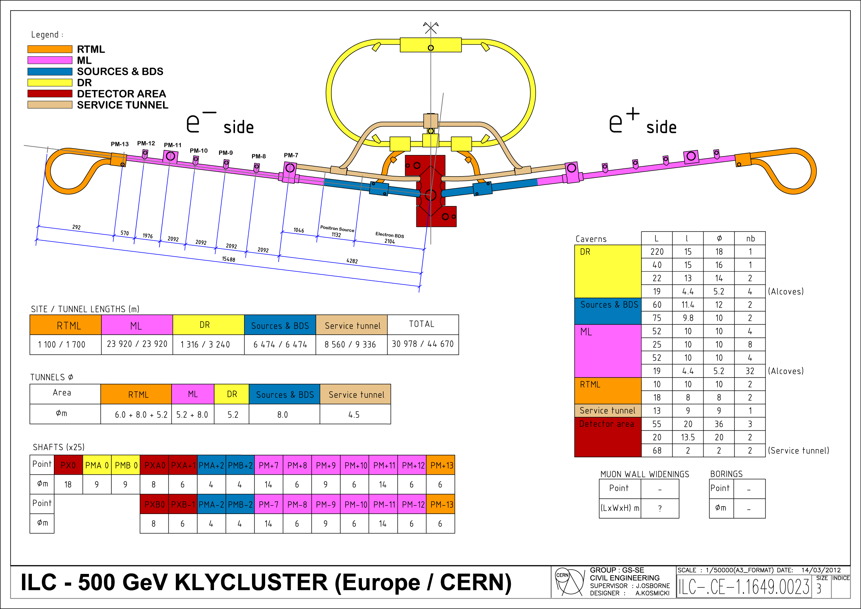
ILC EUROPE (CERN) TDR cost estimates
Civil Engineering layout for CERN Klycluster needs to
be updated to ensure it is consistent with Lattice files
and FNAL 2d drawings.
This drawing should be ‘approved’ ready for costing
by mid-April (Korea)
Civils costs ready by mid May (AMBERG)
Europe Scheduling exercise (Martin Gastal & Katy Foraz) needs advancing in parallel to feed into this costing exercise
Handling & Installation studies (Keith Kershaw & Fred Asiri) : studies have just ‘re-started’. These costs will be based on RDR CERN layout.
Survey & Alignment (Helene Mainaud Durand) : Update of RDR costs. (Not a cost driver).
John Osborne - CERN

