Slide 1


WP3:
Development of radiation-hard high-density electronics and interconnection with sensors
Talent
Norbert Wermes, University of Bonn

Slide 2
Objectives
WP3: Development of radiation-hard high-density electronics and interconnection with the sensors: design, prototyping and testing of ASIC mixed circuit analogue-digital chips, the assembly of highly integrated modules and implementation of quality-assurance protocols for the production of high-reliability pixel detector modules. Associated Partners IBA, CNM and CIVIDEC host secondments and provide courses and coaching on bump bonding, sensors and electronics for beam instrumentation.

Slide 3
WP3
Optical data transmission (Wuppertal)
3D integration of (bumped) chips (and sensors) -> modules
  CMOS ICs (Bonn)
  - very deep submicron (65 nm),
  - vias first → new CMOS technologies
  3D post processing and testing (IZM, Bonn) – ICs and modules

Slide 4
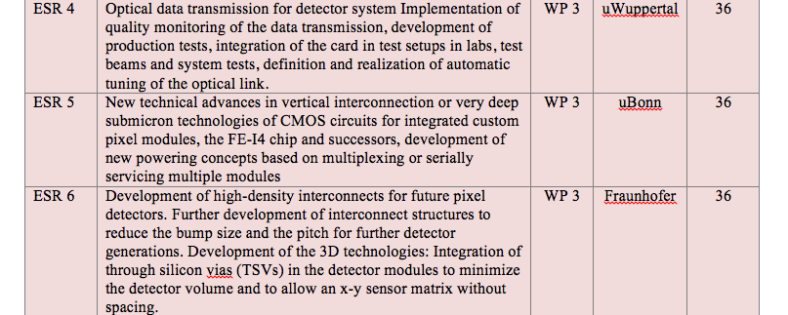
Partners and Fellows
3 ESRs (3 years) at 3 institutions (Wuppertal/Bonn/IZM Berlin)

Slide 5
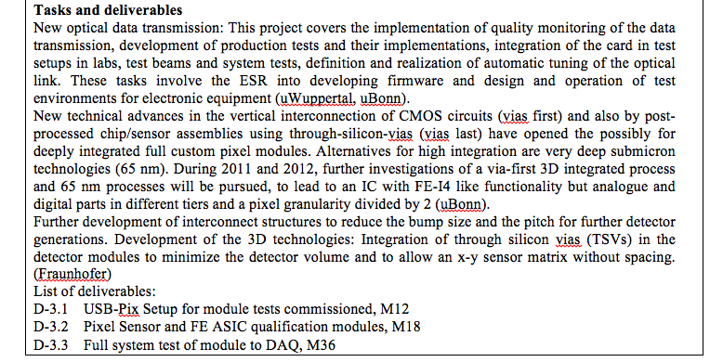
ESR4
ESR5
ESR6

Slide 6
ESR4: R&D for Improved Data Links
This research project focuses on the optical data transmission between detector systems and readout electronics.
The ATLAS IBL data link is the starting point
  learning about the functionality
  system aspects (lab, test-beam, system test, detector commissioning) when connecting the chain together
  learning about the detector requirements on the link
Knowledge about electronics and optics will be gained, including modern FPGA techniques
This will be the basis for driving the link components towards higher requirements for upcoming detector systems:
  optical components (laser / PiN diodes) need to be more radiation hard, deliver higher bandwidth, use less power and space
  electronics will change architecture and follow the increased requirements of the detector systems
Off-detector
electronics
fibres
On-detector
components
cables
Detector
Typ. data link
structure

Slide 7
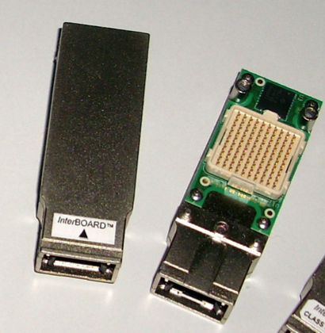
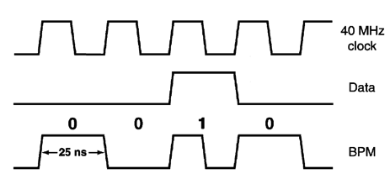
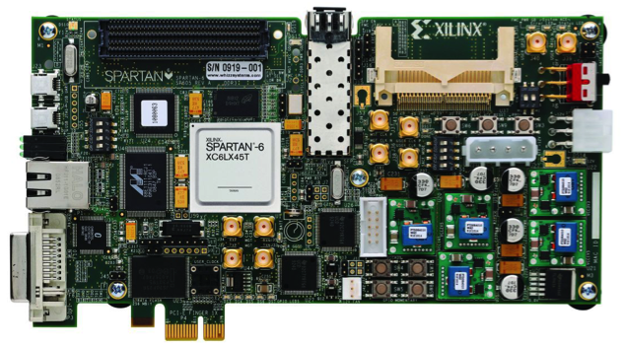
ESR4: Research Items
Based on the gained experience with the existing links, research focuses will be:
  optical components and systems – to improve their properties, bandwidth (160 Mb/s → 5 Gb/s), radiation tolerance, cooling and packaging, multichannel vs. single channel links …
  study transmission protocols to be used in data transmissions – reliability and bandwidth
  development of new readout electronics in modern architectures (i.e. PC standards)
  realize link prototypes (electronics and optics) to test and prove the improvements
The candidate is expected to have a Master degree in the field of physics or electronics engineering
Skills in working with electronics and doing systematical studies are useful
The candidate will gain experience about readout systems, optical components, and hardware programming
The candidate will be based in Wuppertal, but the work will be performed in collaboration with German and international groups and institutes having close contact to industry, too.
Optical components
Data encoding
FPGA evaluation board

Slide 8
ESR5: IC dev. and 3D integration
FE-I4 Chip as starting point and working horse for
  development of a testing environment for chips and
  modules (USBpix)
  module building and integration
    building of qualification modules
    building of a serially powered full stave
  building of qualification modules
  full system (IBL) test to DAQ
  3D integration (post processing)
    through silicon vias and post processing (with IZM)
    merging of FE-I4 with monolithic pixel sensors
  further chip development towards
    very deep submicon technologies (65 nm)
    3D CMOS integration (Tezzaron/Chartered)

Slide 9
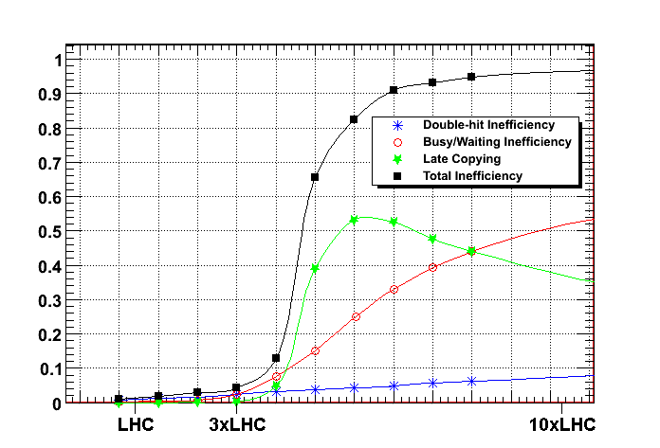
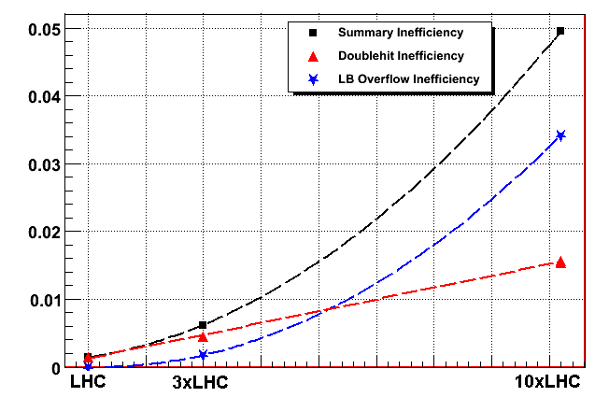
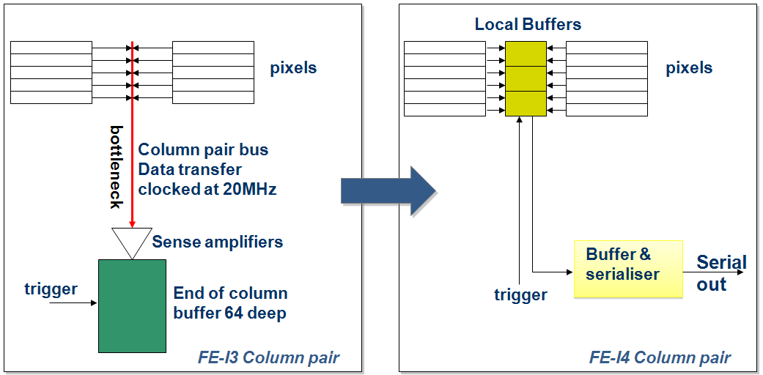
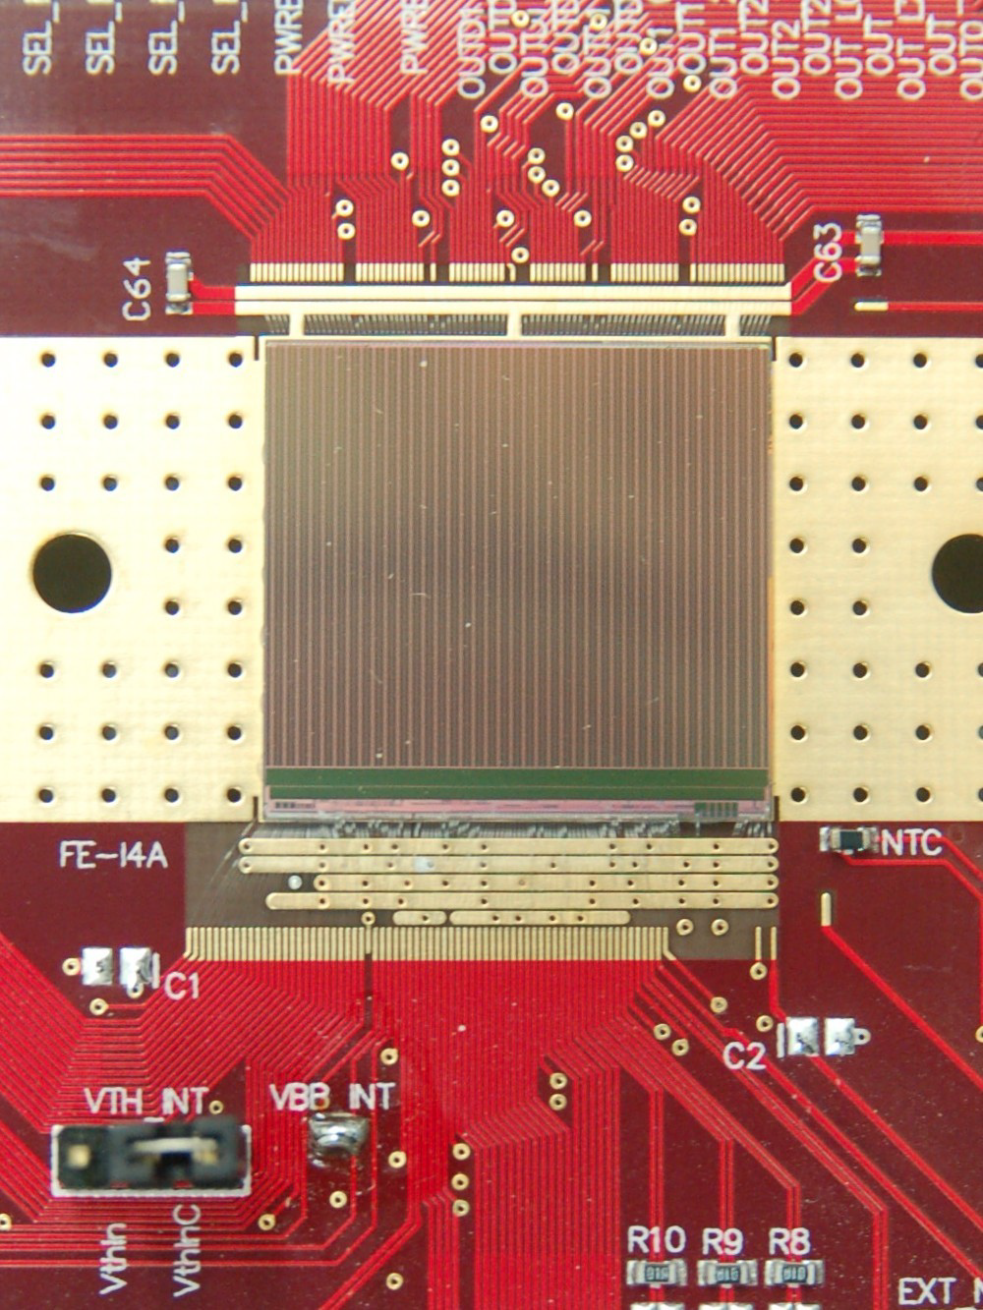
sLHC data rates
Hit inefficiency rises steeply with
the hit rate
Bottleneck: congestion in double
column readout
more local in-pixel storage (130 nm !)
>99% of hits are not triggered
⇒ don’t move them -> not blocking
1-ε
ATLAS
pixel chip
FE-I3
sLHC
architecture
FE-I4
D. Arutinov
( = 3 MHz / mm²)
rate or L
20.2 mm
FE-I4
prototype
16.8 mm
FE-I4
Bonn
CPPM
Genova
LBNL
NIKHEF

Slide 10
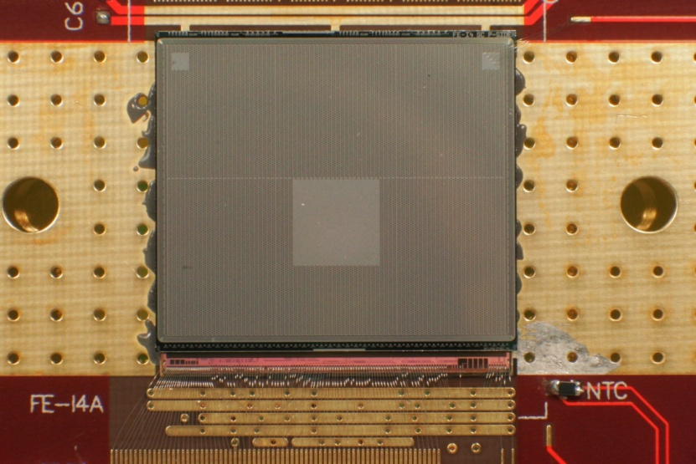
FE-I4
19.0 mm
successor of current (50 x 400 µm²) FE-I3
for new IBL
  smaller pixels (50 x 250 µm²)
  lower noise and threshold operation
  higher data rate compatibility
column drain architecture
with local hit storage
IBM 130 nm
array size: 80 col. x 336 rows
26880 pixels, 7x10⁷ transistors
average hit rate @ 1% inefficiency
= 400 MHz/cm²
max. trigger rate: 200 kHz
FE-I4A works, FE-I4B back from foundry: Nov. 2011, tested ~ok
FE-I4
FE-I3
FE-I3
20.2mm
FE-I3
FE-I3
FE-I3
FE-I3
FE-I4

Slide 11
FE-I3 ↔ FE-I4
 | FE-I3 | FE-I4
Pixel size [µm²] | 50x400 | 50x250
Pixel array | 18x160 | 80x336
Chip size [mm²] | 7.6x10.8 | 20.2x19.0
Active fraction | 74% | 89%
Analog current [µA/pix] | 26 | 10
Digital current [µA/pix] | 17 | 10
Analog Voltage [V] | 1.6 | 1.4
Digital Voltage [V] | 2.0 | 1.2
Total power [µW/pix] | 75 | 26
Pseudo-LVDS out [Mb/s] | 40 | 160
FE-I4 collaboration:
Bonn: D. Arutinov, M. Barbero,
T. Hemperek, A. Kruth,
M. Karagounis.
CPPM: D. Fougeron, M. Menouni.
Genova: R. Beccherle, G. Darbo.
LBNL: S. Dube, D. Elledge,
M. Garcia- Sciveres, D. Gnani,
A. Mekkaoui.
Nikhef: V. Gromov, R. Kluit, J.D. Schipper.
20.2mm
~200μm
7.6mm
IBM reticule
active
~19 mm
8mm
active
16.8mm
2.8mm
~2mm
FE-I3 74%
FE-I4 ~89%

Slide 12
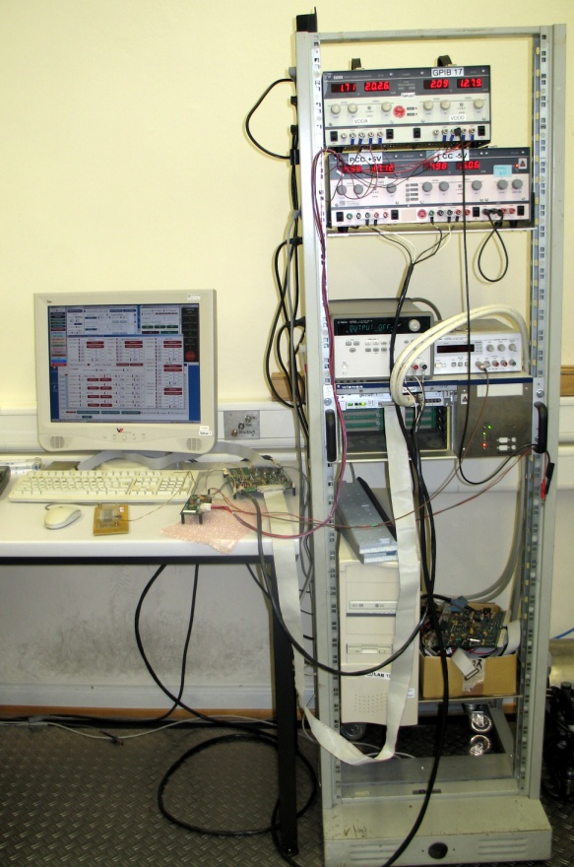
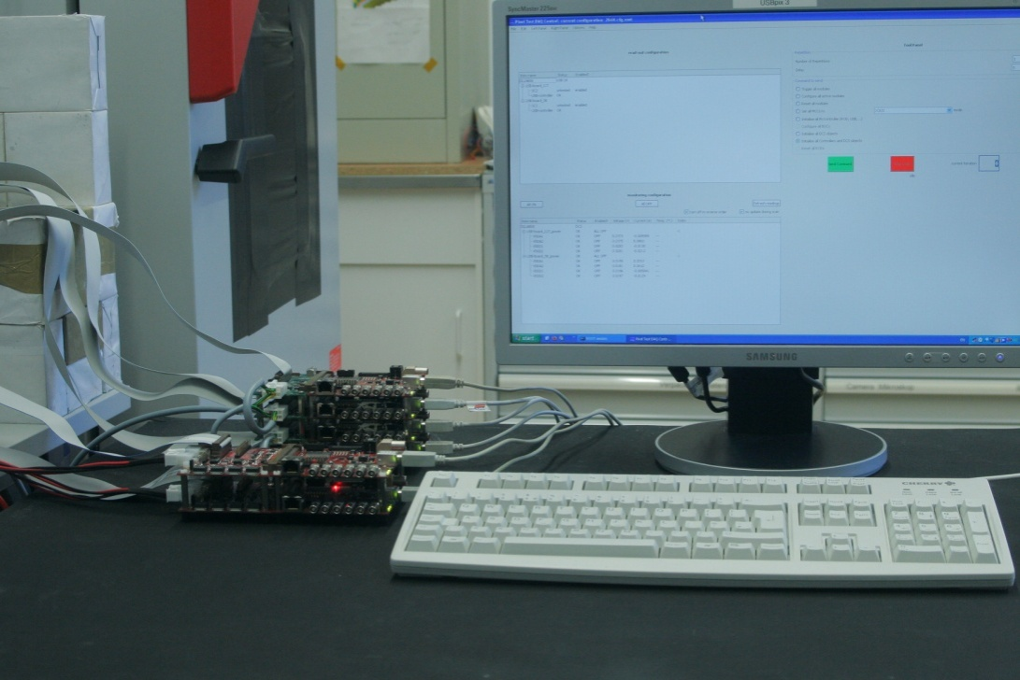
TESTS:TDAQ → USBpix
new readout and test system for
FE-I4 ICs
FE-I4 wafers
FE-I4 module assemblies
testbeam operation
Turbo
DAQ
System
(VME based)
TPLL
TPCC
6 x USBpix systems (with monitor)
Notes:
TurboDAQ: 4 single chip FE-I3
USBpix: pro board 1 single chip FE-I3 oder FE-I4 (Abbildung 4x FE-I3 und 2x FE-I4)

Slide 13
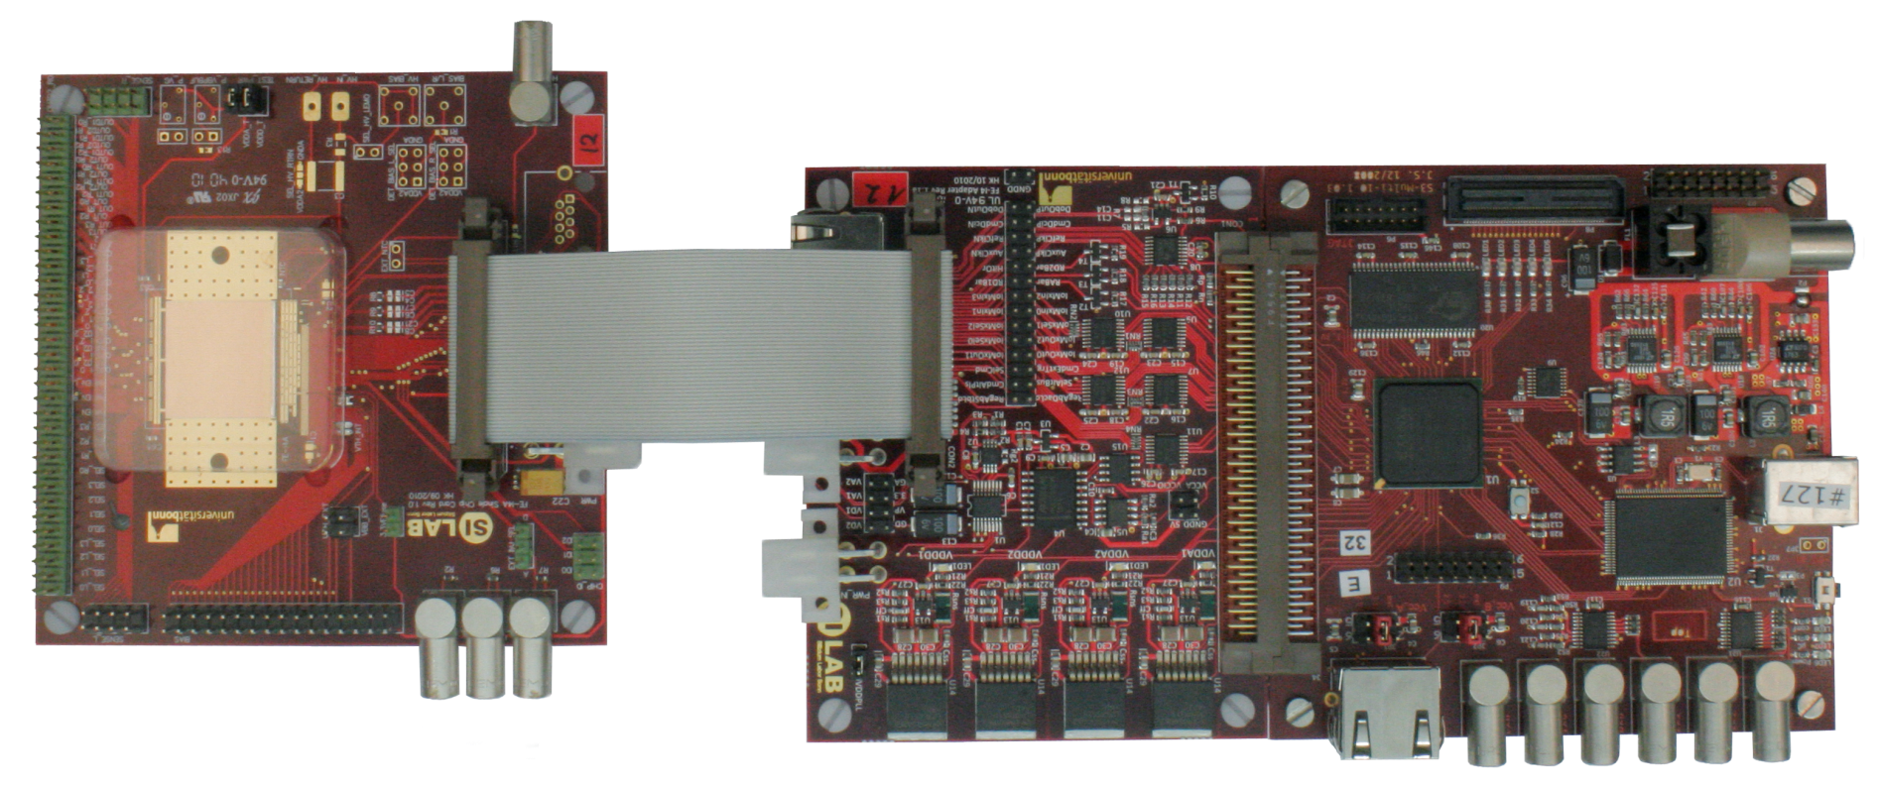
USBpix with FE-I4 (details)
Single Chip Card
Adapter Card
Multi-IO Board
LVDS
FE-I4
SRAM
for data
FPGA
Microcontroller
RJ45 Connector to TLU
Notes:
USBpix consists of a Multi-IO-Board with Spartan 3 FPGA and USB connection to PC and a Single Chip Adapter Card for certain Chip (FE-I3 / 4)
+ Singlechip mounted on a single chip card

Slide 14
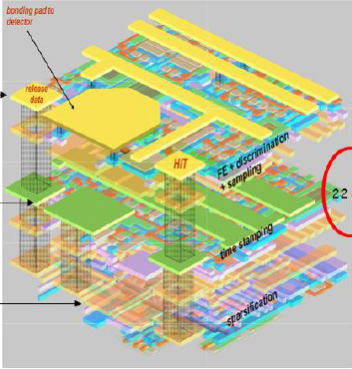
3D integration … a hot topic
“vias first” … various CMOS layers
prototypes
with
OKI
MIT LL
Tezzaron/
Chartered
3D integration promises
higher granularity
lower power
large active over total area ratio
low mass
dedicated technology for each functional layer

Slide 15
CMOS vias first …
sensor
              Tezzaron/Chartered 0.13 um Process
              Large reticule (25.76 mm x 30.26 mm) 12 inch wafers
              vias: 1.6 x 1.6 x 10 µm, 3.2 µm pitch
              missing bonds: < 0.1 ppm
Back Side Metal
Super Contact
Tier 1
(thinned wafer)
analog
M1
M2
M3
M4
M5
M6
Bond Interface
M6
M5
M4
M3
M2
M1
Tier 2
digital
Super Contact

Slide 16
Wafer-Level Stacking
Oxide
Silicon
Dielectric(SiO2/SiN)
Gate Poly
STI (Shallow Trench Isolation)
“Super-Contact”
W (Tungsten contact & via)
Al (M1 – M5)
Cu (M6, Top Metal)

Slide 17
Next, Stack a Second Wafer (thin)

Slide 18
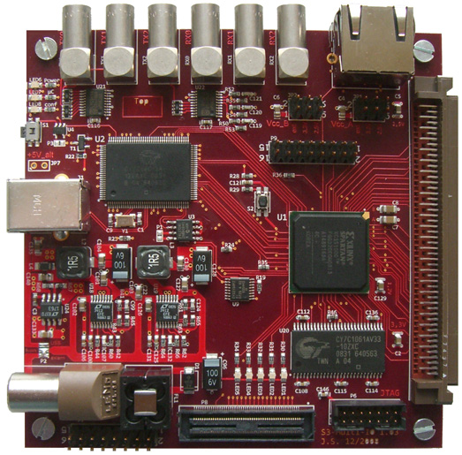
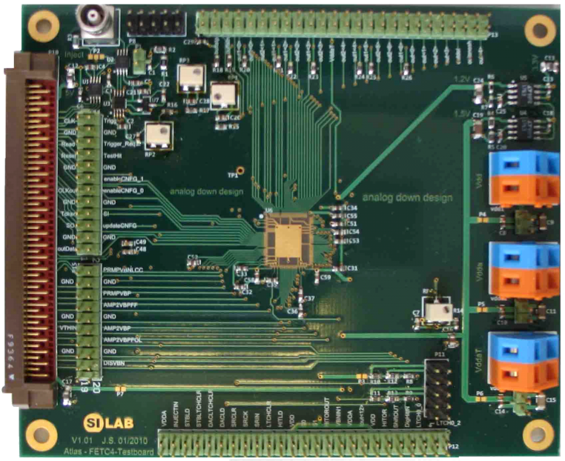
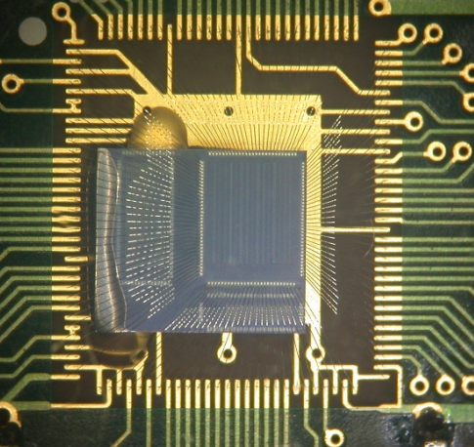
First ATLAS 3D CMOS structures …
3D CMOS chip FETC4 bonded and tested.
PC
FETC4
still some severe problems
  mostly alignment issues
analog tier thinned down to 12µm and operated stand alone
shows same noise behavior as un-thinned 2D
Notes:
Chips were bonded on the specially designed pcbs and fpga bor was used to establish connection between chip and PC where testing software was installed. Since separate tiers were available quite a while ago there was time to test separate analog and digital chips. This particular tiers are also functional separately. Now the most interesting and important test was the simpliest one. To inject signal from the input of the analog tier, which should be amplified by the analog pixel,sent through the intertier bond interface to the digital tier, and finally stored inside digital tier and read out by the software. This test would be a direct indication of good and prooper bonding of the wafers. Next slide

Slide 19
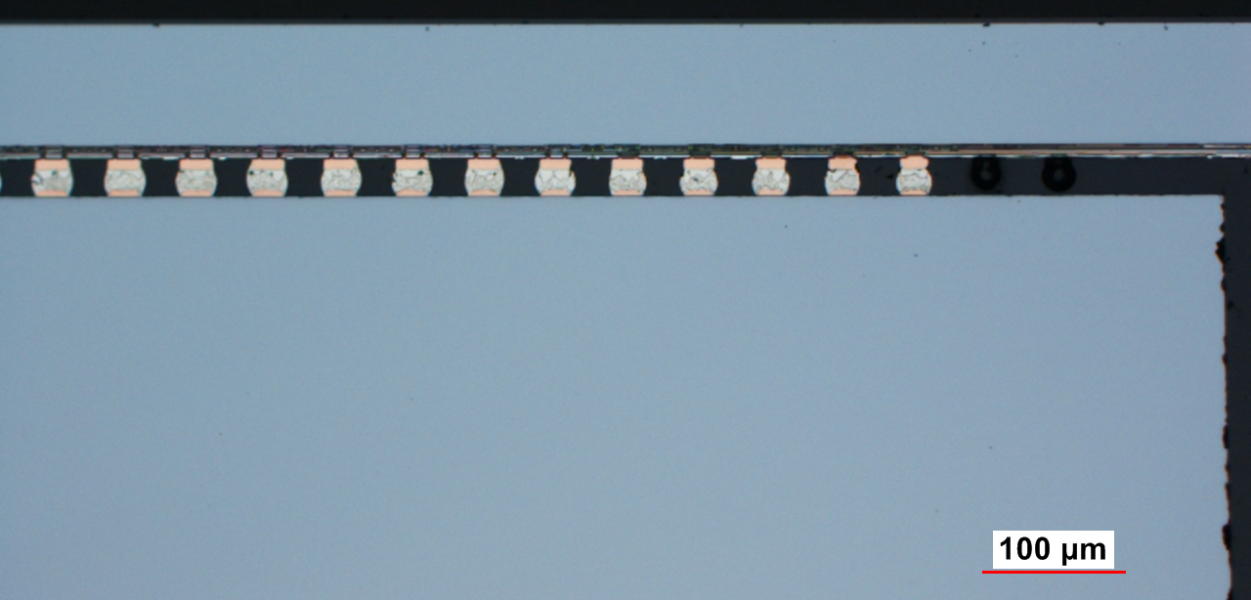
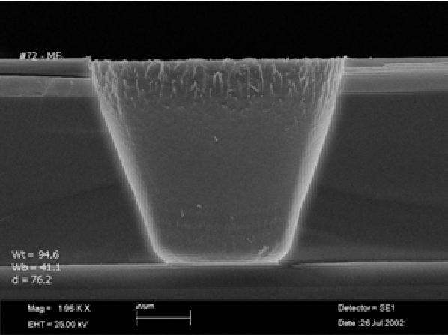
vias last … post processing
exploit: 3D integration for hybrid pixels, through silicon vias, wafer to wafer connection
Through Silicon Vias (TSVs)
(FhG IZM Berlin / UBonn)
gain ~ 1% x/X₀ in ATLAS with
90 µm bumped FE-I4 chip
thin Al flex
serial powering
TSV and backside metal routing
90 µm
aggressive reduction in material

Slide 20

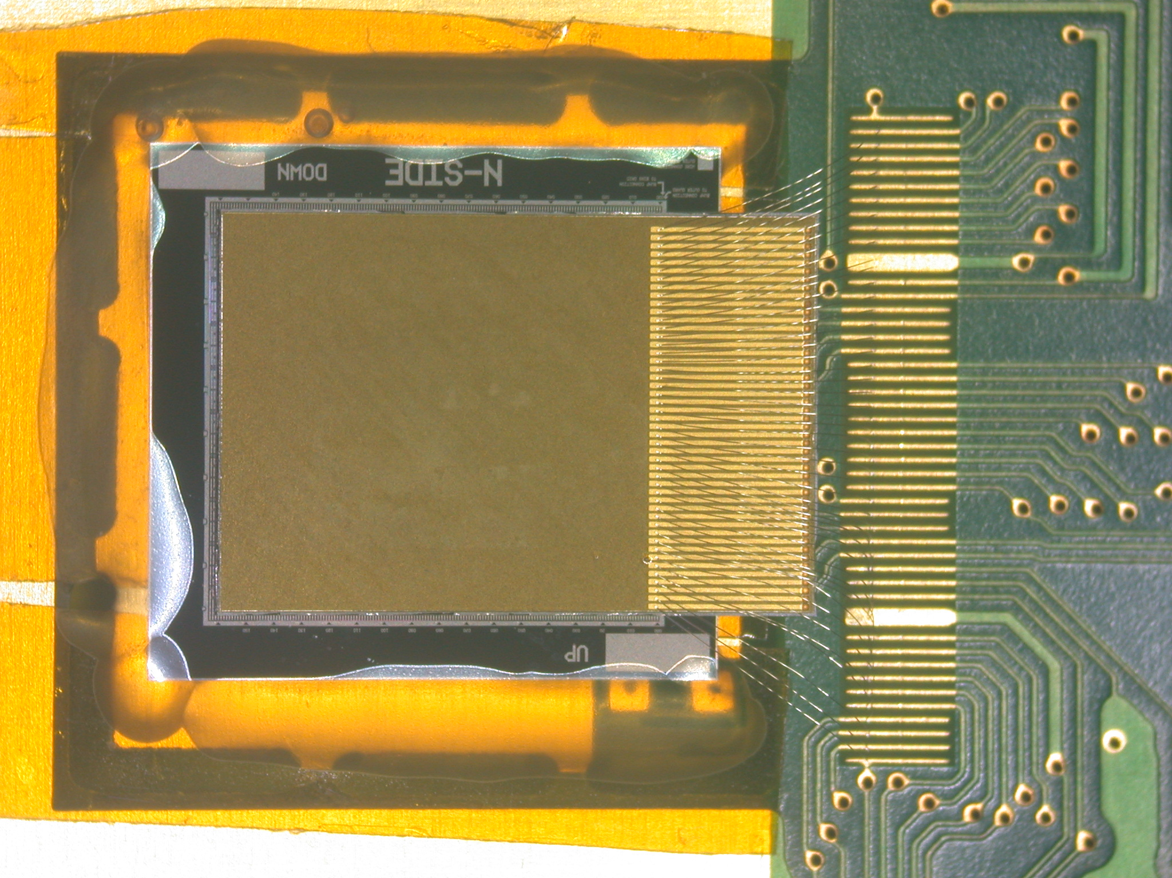
Proof of principle demonstration
ATLAS FE-I3 chip-sensor module
operated
through TSV and backside re-routing
Source scan with Am-241 source
souce hits
backside
of
FE-chip

Slide 21
ESR5: tasks and opportunities
design, prototyping and testing of ASIC mixed circuit analog/digital chips, and/or the design and assembly of highly integrated modules and the implementation of quality-assurance protocols for the production of high-reliability pixel detector modules.
new technical advances in vertical interconnection or in very deep submicron technologies of CMOS circuits for integrated custom pixel modules, the FE-I4 chip of the ATLAS pixel detector at CERN and its successors, or the development of new powering concepts based on multiplexing or serially servicing multiple modules are possible research directions.

Slide 22
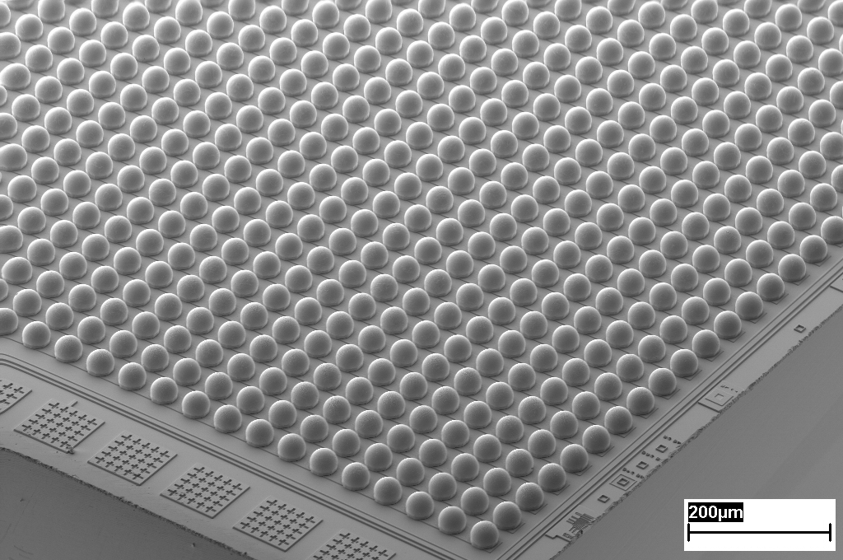
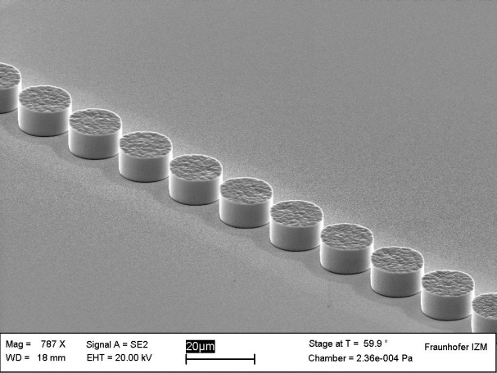

ESR6: Advanced interconnects
Further development of interconnect structures to reduce the bump size and the pitch for further detector generations
25µm bumps / 55µm pitch
Tasks:
design of small size interconnection structures
Investigation of material requirements
Process development and prototyping
Development of modified assembly technologies for small size interconnection structures
Reliability investigation
10µm pillars / 20µm pitch

Slide 23
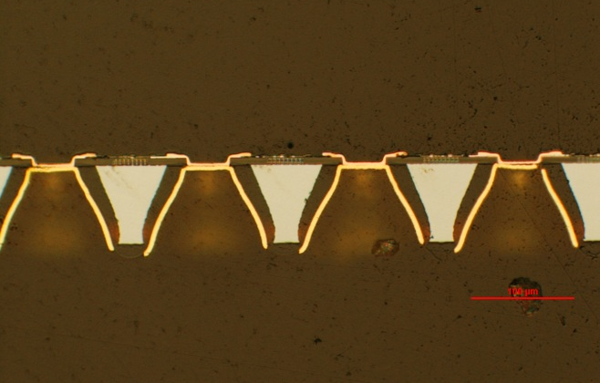
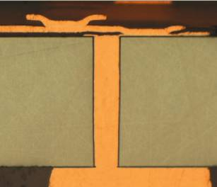
ESR6: Through Silicon Vias
Development of the 3D technologies: Integration of through silicon vias (TSVs) in the detector modules
Tapered TSVs in ATLAS FE-I2 ROC
Tasks:
design of TSV structures and implementation into ASIC design
Development of readout-chip wafer adapted TSV-process chain
TSV Processing of readout-chip wafer
Process development of modified assembly technologies for thinned TSV-ROC chips
Manufacturing of prototypes
Reliability investigation
Straight sidewall TSVs for interposer

Slide 24
ESR6: Researcher Fellowship
Fellowship Description
The main objective of this research fellowship is design of interconnection and TSV structures, process development on wafer level, manufacturing of prototypes and reliability investigation of assembled modules. The investigation of requirements for small size interconnection structures as well as the development of adapted bonding technologies are possible fields of study. Another task will be the integration of TSVs process into module fabrication to form 3D integrated pixel detector modules.
Academic Requirements
Eligible applicants for this Fellowship (equivalent to a PhD position) must be in possession of a Master degree in the field of microsystem technology, electronics engineering or comparable fields.

Slide 25
Conclusions
WP3 (electronics) already well underway
ESR4, ESR5, ESR6
will find plenty of opportunity to
contribute to this research

