Slide 1
Quiescent Observation of Bioluminescence in the Deep Sea
J. Brunner
24/05/2012

Slide 2
Motivation - Specifications
Quiescent Observation
  in its natural environment
  undisturbed by noise, light or turbulences
  Non-distructive (leave them alive !)
Deep Sea
  At least 2000m below surface
Self triggering system
  Bioluminescence light itself must trigger the readout
  Permanent connection to the shore station
  Automatic data transfer to shore station

Slide 3
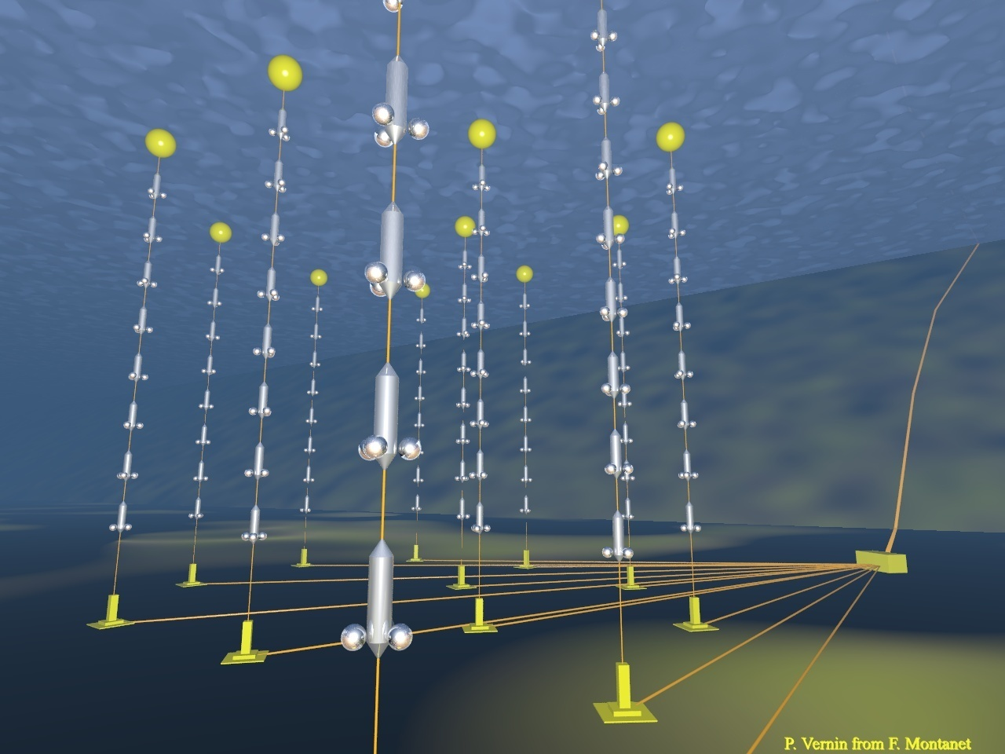
ANTARES – a deep sea cabled network
885 PMTs
12 lines
25 storeys / line
3 PMTs / storey
2500m
40 km to
shore
450 m
Junction
Box
70 m
Interlink cables

Slide 4
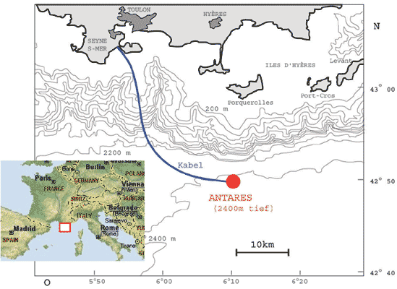
ANTARES location
Mediterranean Sea
Depth: 2475m

Slide 5
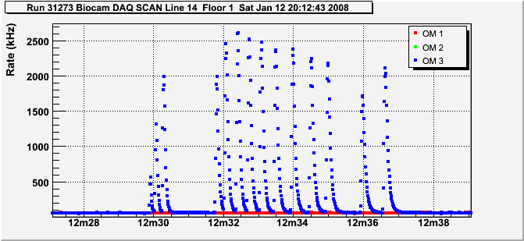
Real events from ANTARES photomultipliers
Bioluminescent organisms exist at the ANTARES site
ANTARES
ANTARES
Literature

Slide 6
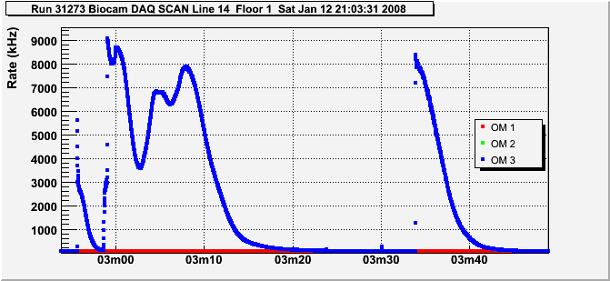
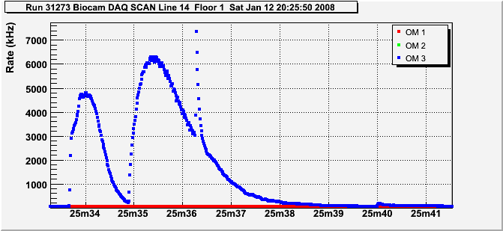
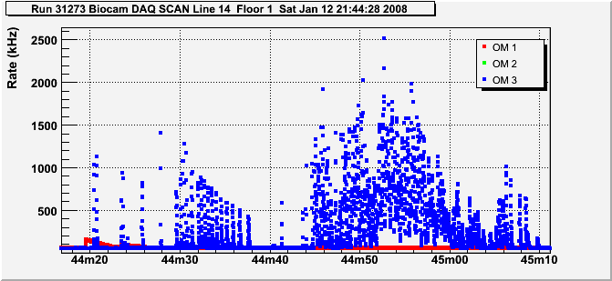
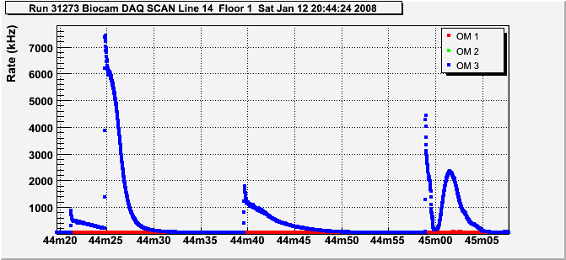
Some more examples of bioluminescence bursts
Try to add spatial information to these counting rates → deep sea cameras

Slide 7
Instrumentation line (IL07)
ANTARES

Slide 8
Installation of cameras on IL07
Cameras on floor 1 and floor 5 together with an OM and an ADCP
Floor 1
  2400 m below surface
  80m above sea floor
Floor 5
  2200 m below surface
  270m above sea floor

Slide 9
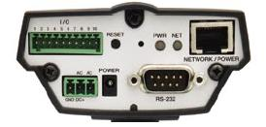
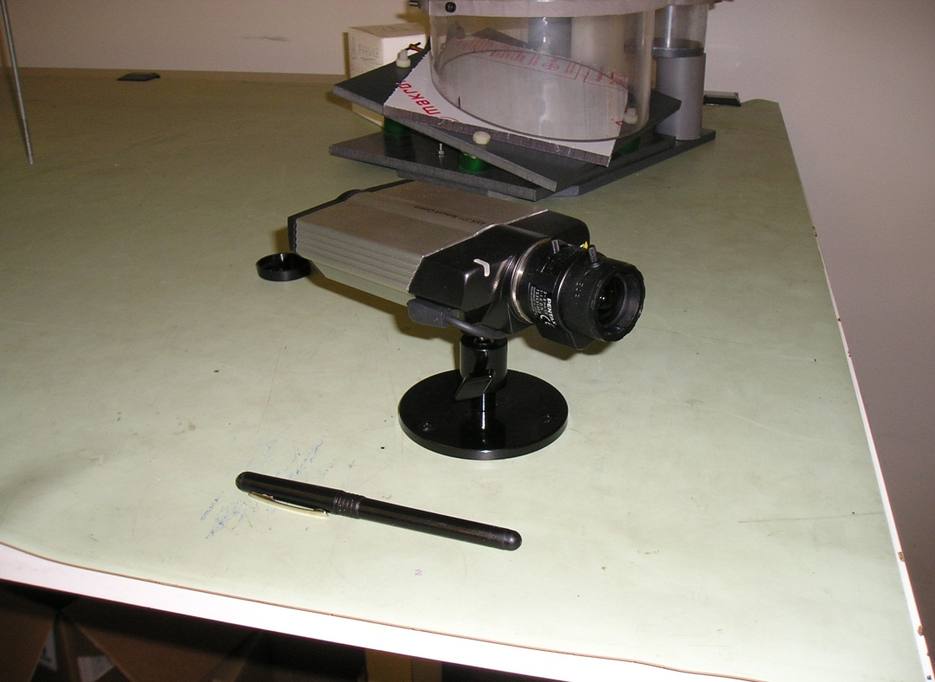
Camera
Data output
Ethernet
AXIS221 videosurveillance
Night view capabilities
View field up to 90 degree
Sensitive into infrared
View field & focus can be set manually
Diaphragm & exposure time automatically / remotely controlled
Control of external device
Power 12-24V, 5W

Slide 10
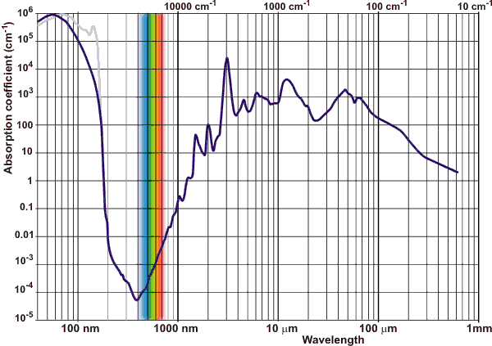
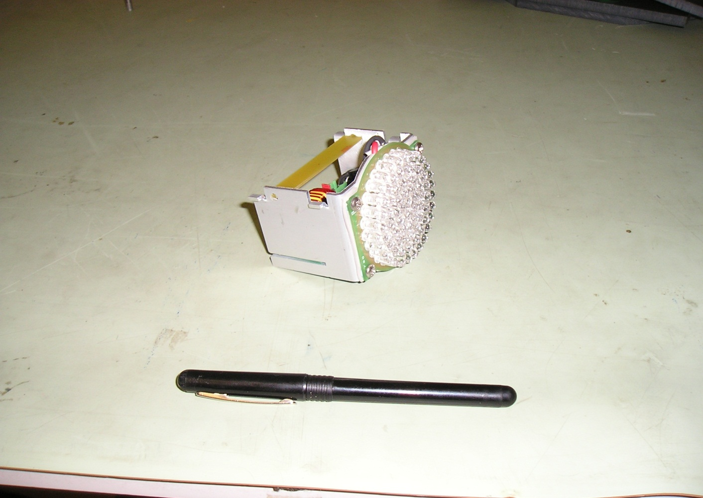
IR Source
Absorption in water less than 1m – no interference with PMTs on other lines
~60 LED 850nm
Can be controlled (switched ON/OFF) by camera

Slide 11
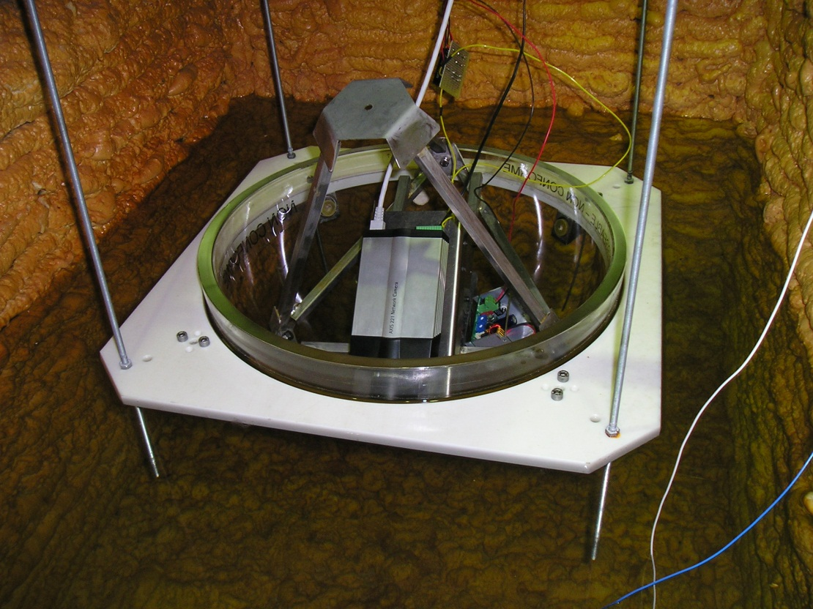
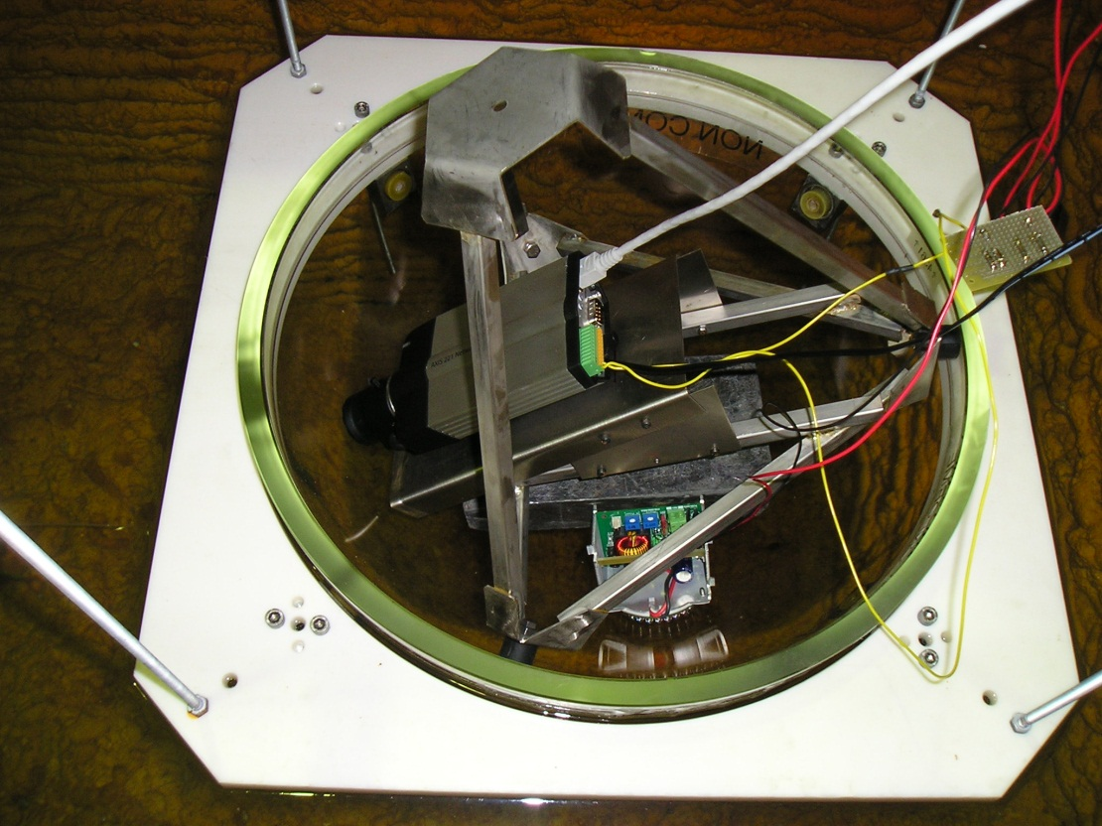
Mechanics & Electronics @ CPPM
Test setup for water tests
Final mechanics frame to hold camera
And IR source (not yet mounted)

Slide 12
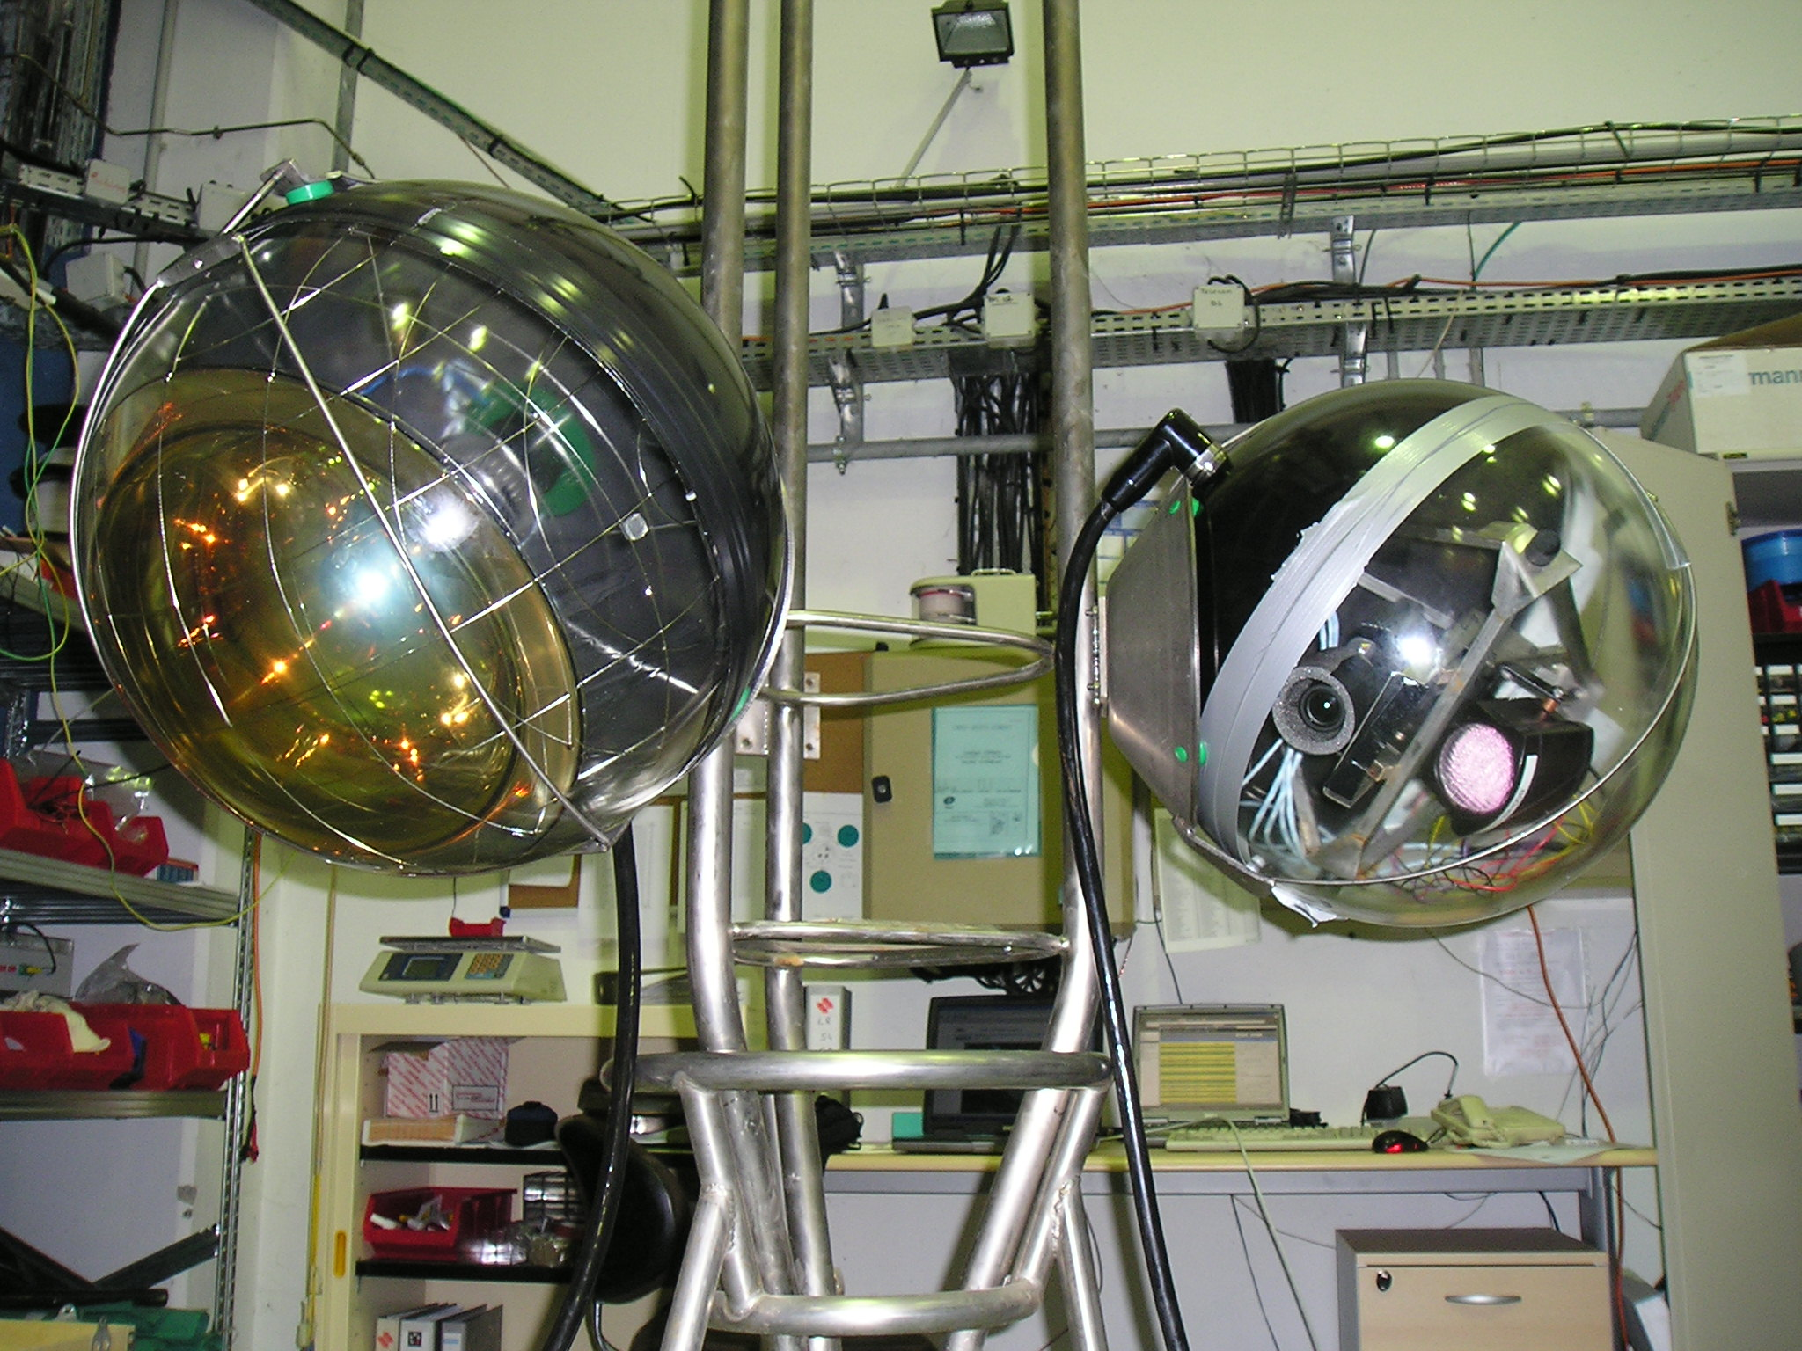
Mounting on OMF (floor 5)
Try to maximize overlap of field of view between camera and OM

Slide 13
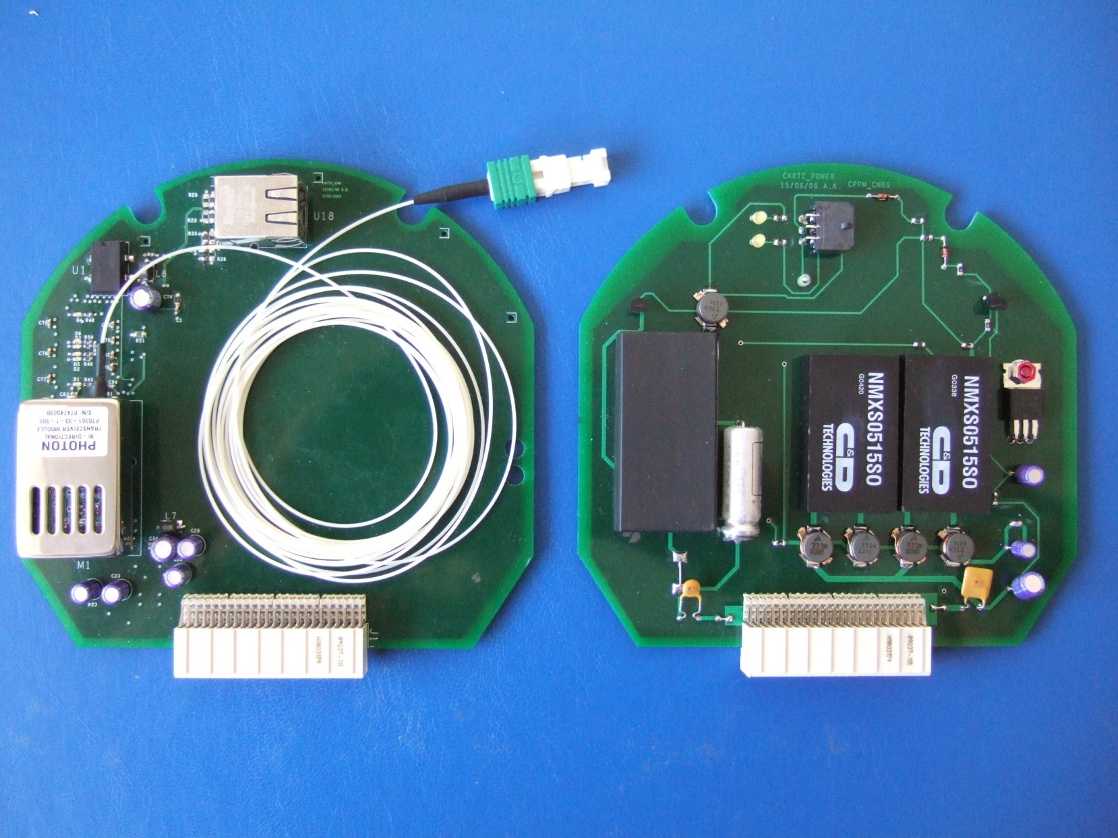
Electronics from CPPM
CAMETH
CAMPOW
Conversion of Ethernet signals
From electric to optic
Power supply and IR control

Slide 14
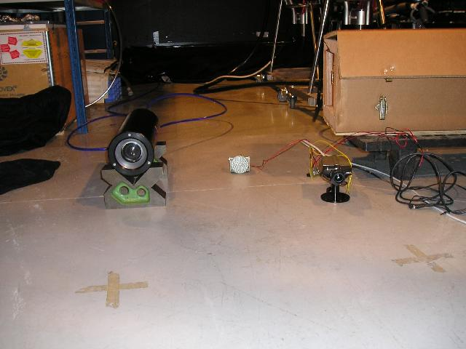
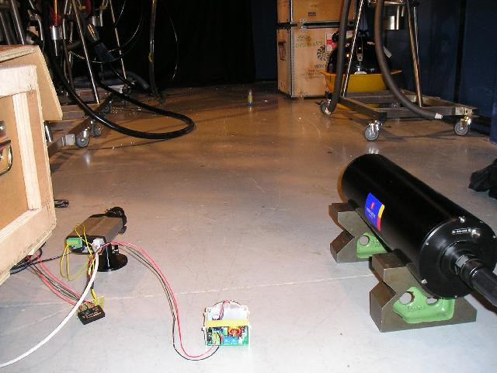
Combined tests with ISIT
Bacteria sample
ISIT IR AXIS
ISIT : intensified silicon intensifier tube
University Aberdeen
1995, 20,000 Euro
Claimed sensitivity ~ 10⁻⁶ lux

Slide 15
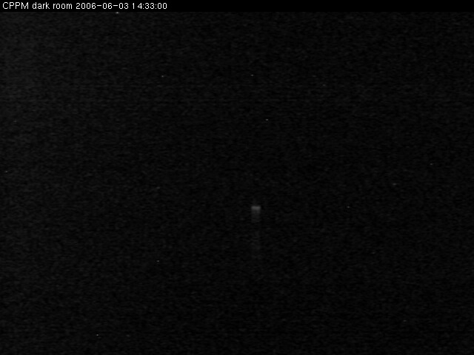
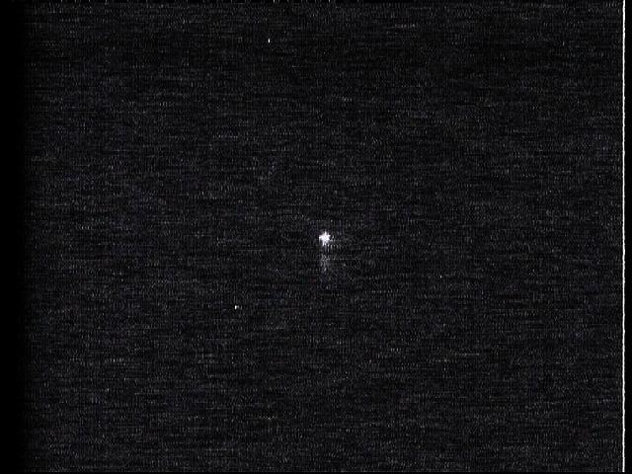
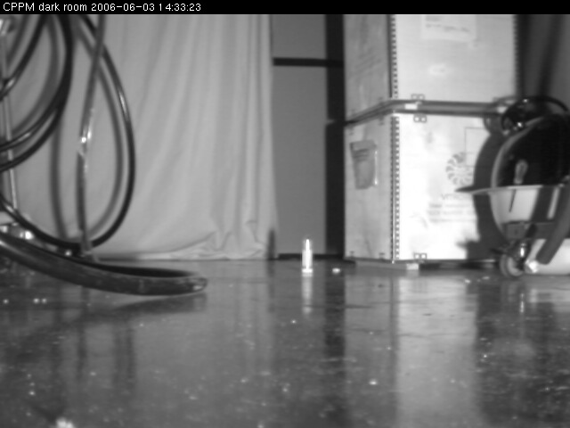
Combined tests with ISIT
AXIS
ISIT
AXIS, IR ON
Bacteria sample

Slide 16
Calibration with laser
100-1000 Hz
laser
OM
Splitter
16x
Geometrical factor 0.1
Integration variable
Camera
1cm²
lens
Diffuser

Slide 17






Calibration with laser
AXIS 1sec
AXIS 1/25sec
ISIT 1/25 sec
3.10⁻⁵ lux
3.10⁻⁶ lux
ISIT ~ factor 20 more sensitive ; AXIS better resolution
Missing sensitivity can be compensated by longer exposure time
Worst case scenario : isotropic light (as from K40)
PMT 1MHz = 10⁸ photons/m²/sec = 3 10⁻⁸ lux
Expect to see pointlike signals at few tens of MHz depending on geometry

Slide 18
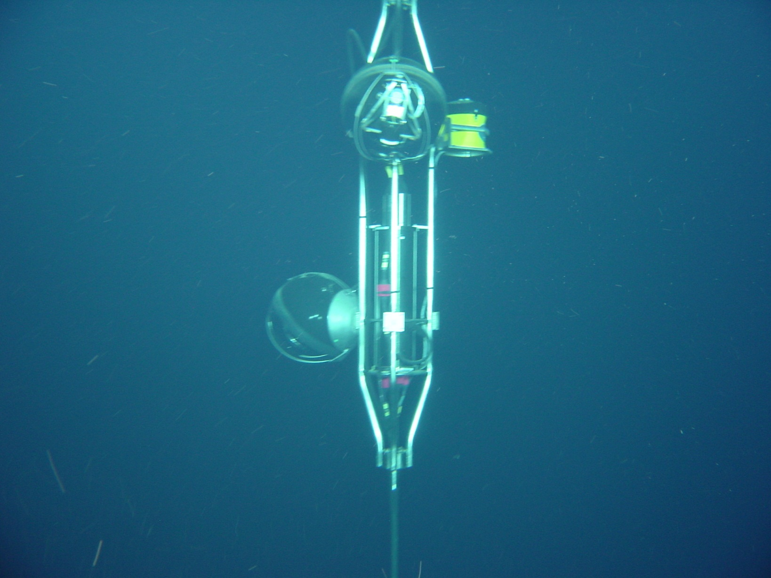
Dec 2007 July 2007
Floor 1
Floor 5
Camera
ADCP
Camera
ADCP
OM
OM

Slide 19
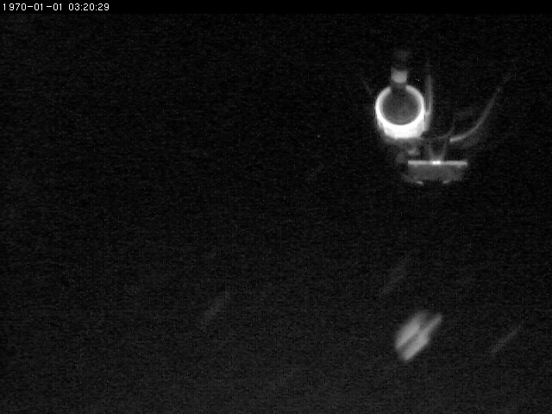
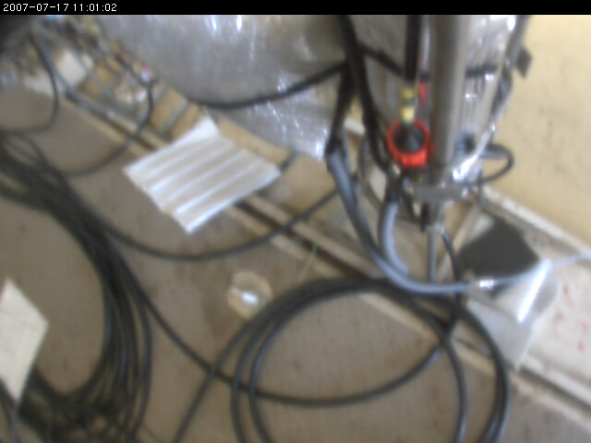
Test Images
Camera at Floor 1 has storey structure in field of view
Can serve as scale to estimate size and distance of objects

Slide 20
Camera Operation
Since early 2008 cameras are permanently active at the ANTARES site
Deployment
33 months of standard operation
IL07 disconnection
2007
2008
2009
2010
2011
Commissioning
ebCMOS camera
installation

Slide 21
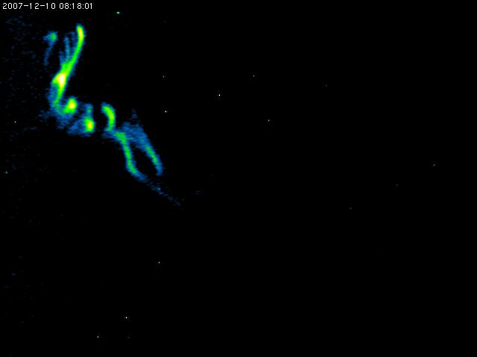
Early image 2sec exposure

Slide 22
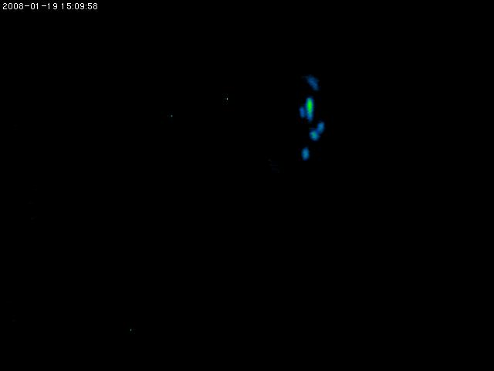
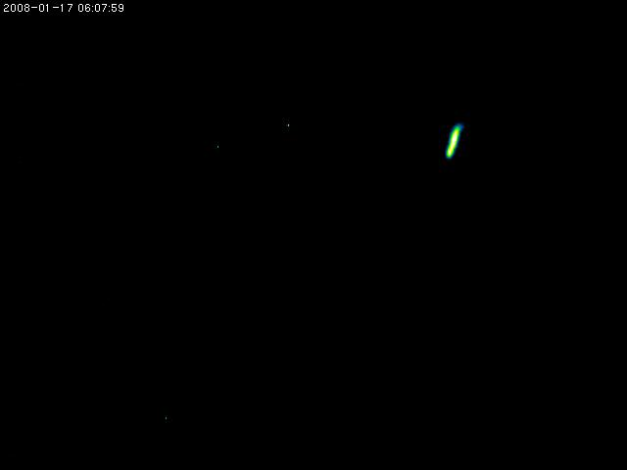
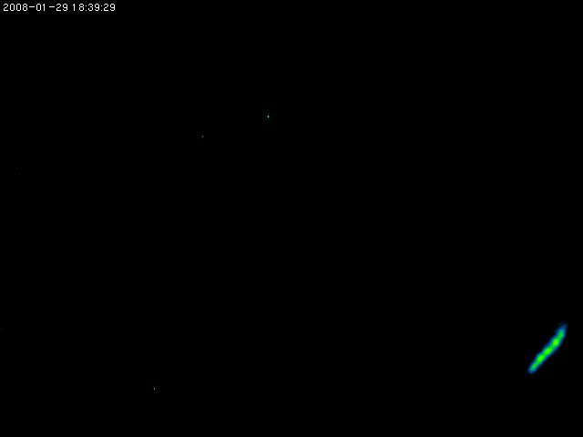
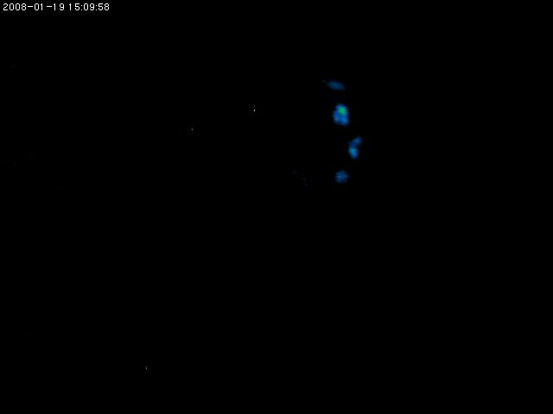
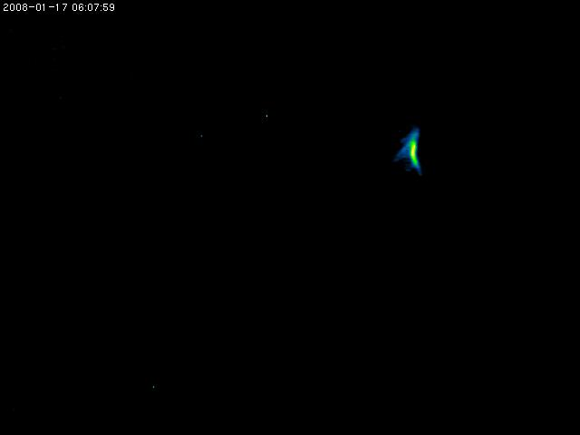
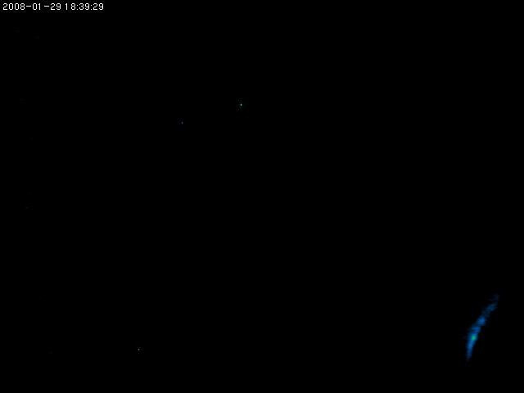
Sequences of 2 images: 0.2 sec exposure each

Slide 23
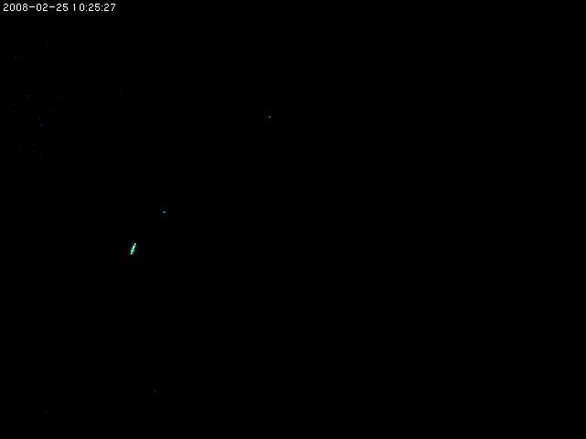
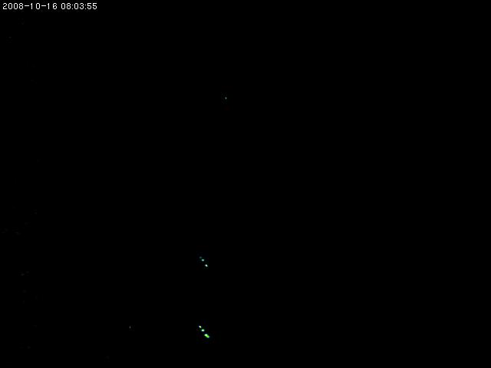
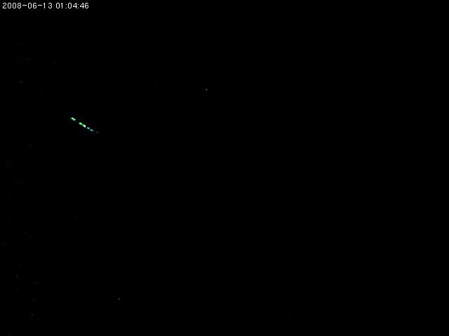
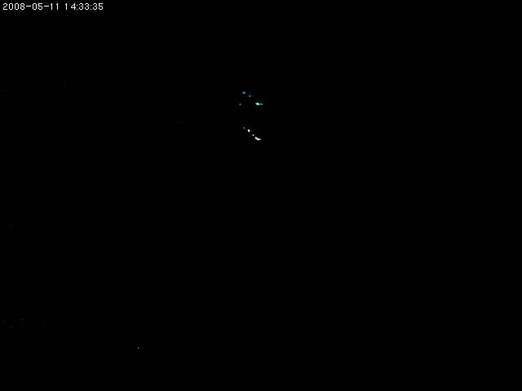
Examples of short flashes
visible only on one or two single image of 100 msec

Slide 24
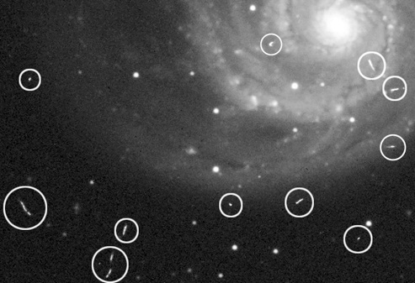
Galaxy on CCD
Standard Astrophotography
Long exposure time
Same structures !
Traces from charged particles
Remnants from Cosmic ray showers

Slide 25
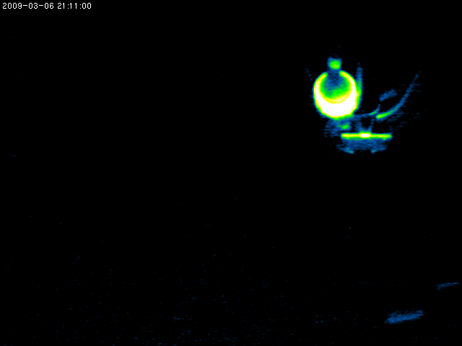
Passing object illuminated in IR light

Slide 26

Small bright object

Slide 27

Extended object

Slide 28

Dancing Spots

Slide 29
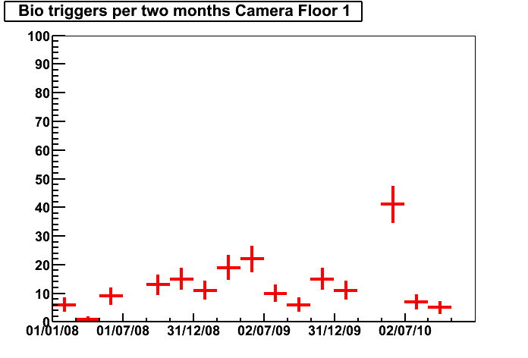
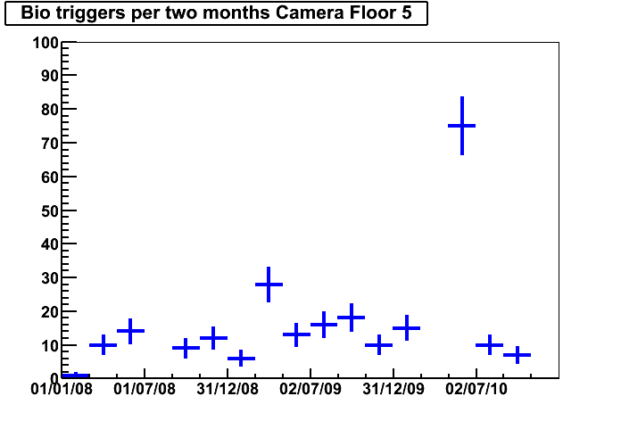
Trigger statistics
2008 2009 2010
?
2008 2009 2010
?
44 83 64
Total per year
46 91 107
4.9 6.9 8.0
Rate per month
5.1 7.6 13.4
Activity varies between years and also between seasons
Shallower camera has more trigger in periods of high activity

Slide 30
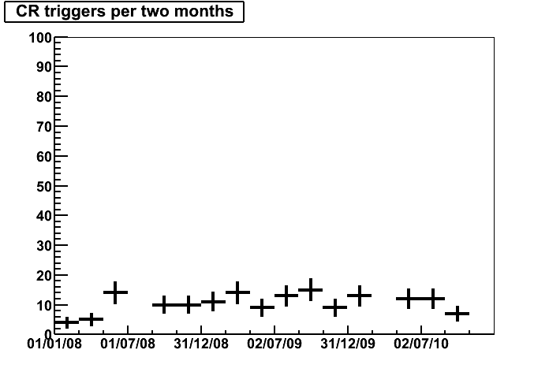
Bioluminescence versus Cosmic Rays
2008 2009 2010
?
2008 2009 2010
?
43 71 44
Total per year
46 91 107
4.8 5.9 5.5
Rate per month
5.1 7.6 13.4
CR events do not show seasonal or year dependent variations
No CR events on camera 1
  more stringent trigger due to storey visibility in field of view

Slide 31
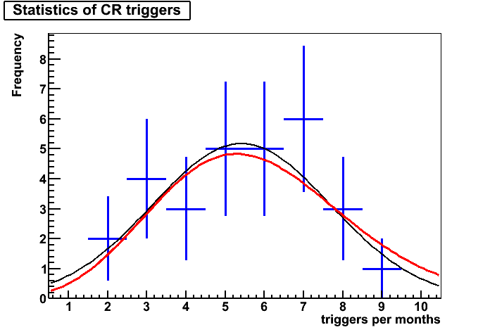
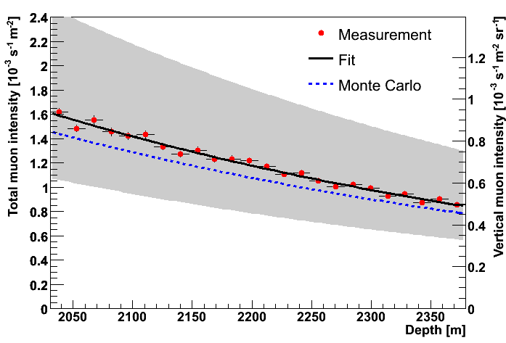
Particle physics with cameras
Sanity check:
CR frequency is compatible with Poisson-fluctuating constant rate (red) or Gauss-Fit (black)
Total Mean Rate : 5.4 events / month
ANTARES measurement of depth dependent muon rate (E > 4 GeV)
R = 0.3 events / month / cm²
An effective surface of only 4x4 cm² around CCD sufficient to match the numbers !
Lower energy muons, delta-electrons spallation neutrons also help

Slide 32
Summary IL07 cameras
Concept has been proven
Successful data taking for almost 3 years
435 biolum triggers accumulated
Full analysis ongoing
Next Step
Improve performance by applying new technologies
Design of next generation deep sea camera

Slide 33
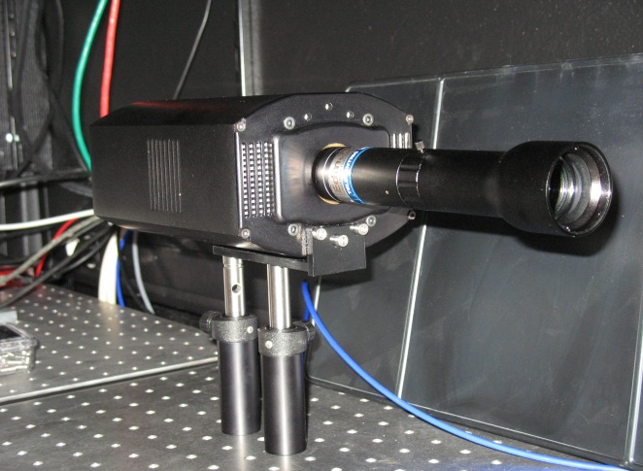
New Biocam Project team
IPNL ebCMOS group
R. Barbier, T. Cajgfinger, P. Calabria, E. Chabanat, D. Chaize, P. Depasse, A. Dominjon, C. Guérin, J. Houlès, D. Quang Tuyen, L. Vagneron
CPPM Antares/Biocam
M. Ageron, M. Billault, J. Brunner
DT-INSU
K. Bernardet, C. Gojak, Y. Lenault, K. Mahiouz
Detector R&D in collaboration with IPHC Strasbourg and PHOTONIS

Slide 34
New camera location
Module attached to
Secondary Junction Box
ANTARES

Slide 35
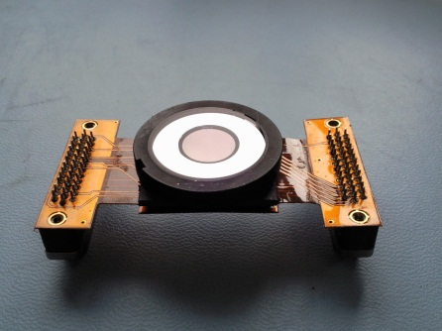
ebCMOS working principle
γ
400x400 CMOS chip
  10 μm pitch
  detection size : 4x4 mm²
gain with HV 2-4 kV
  1 photon gives 1 photoelectron
  E=2-4 keV detected in CMOS
  multiplication gain 300 with CCE about 60%
  single photon sensitivity
S20 cathode
  20% quantum efficiency around 500 nm
  wavelength sensitivity from green to blue, strongly decreases going to red
photocathode
vaccum
HV
photoelectrons
E
< 1 mm
thinned CMOS
carrier

Slide 36
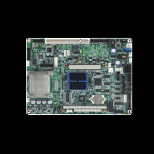

schematic view
Ethernet+ PS
SJB
Ethernet+ PS
Embedded Computer
MII
SSD
Camera
Sea floor

Slide 37
operating mode
record data without any additionnal light : bioluminescence observation
continuous readout can’t be stored (400x400 pixels @ 62.5 fps with 1 byte/pixel give 600 MB/min or 80 Mbits/s) we share the network bandwidth with other measurements on the MII
gain (HV) is ON and continuous readout is buffered on local disk untill some trigger occurs, then the circular buffer is read out while signal remains above the threshold
the trigger is very simple : if photons number exceeds 14, event is stored. no assumption on the size or the form of the signal.
everything is dropped except 5 s before trigger and 15s after the object comes out the field of view
typical event : 5s, 50 MBytes

Slide 38
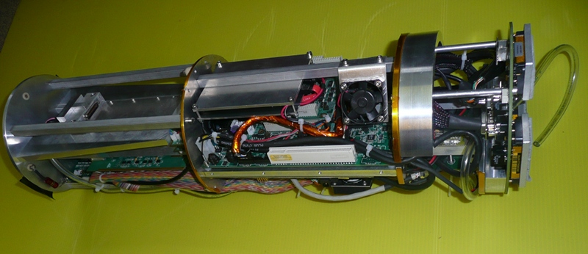
General View
Integration into standard ANTARES pressure resistant electronics cylinder

Slide 39
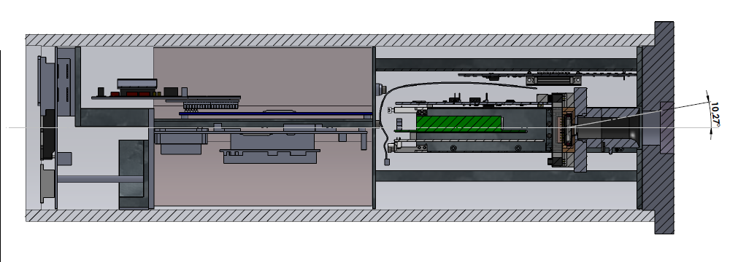
DAQ System
lens
Power Supply part
Single Board Computer
ebCMOS
detector working temperature = 15°C thanks to peltier cooling
test without cooling shows a stabilized temp. of 18°C

Slide 40
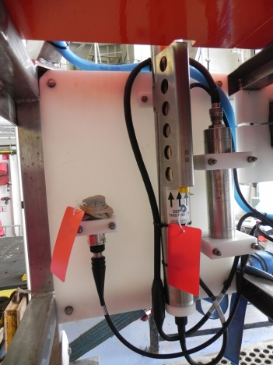
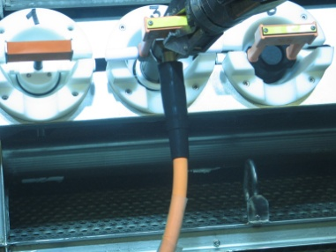
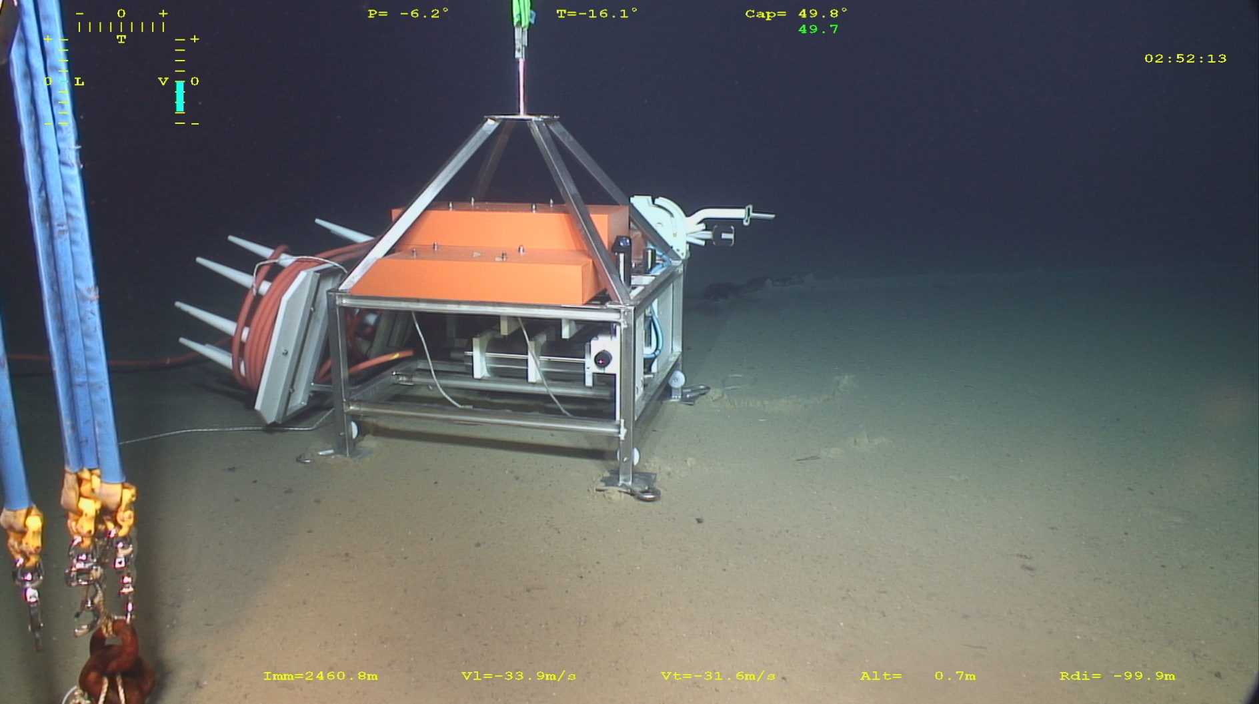
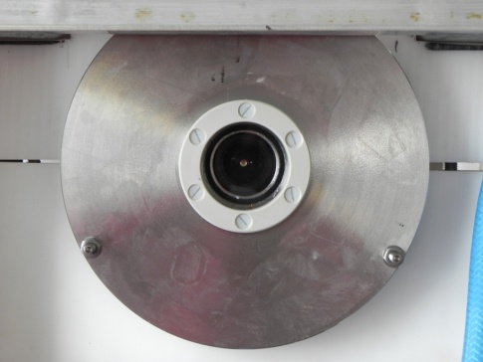



Instrumented Interface Module
C.Gojak, K.Mahiouz, Y.Lenault, K.Bernardet, Z.Hafidi (DT INSU)
CDC Connector for extension
Interlink Cable
O2, CTD, P
BioCam
Electronic Container
Turbidity
Courantometer

Slide 41

Final integration into MII module
60 cm long
diameter 15 cm

Slide 42
Camera Operation
Since early 2008 cameras are permanently active at the ANTARES site
Deployment
33 months of standard operation
IL07 disconnection
2007
2008
2009
2010
2011
Commissioning
ebCMOS camera
installation

Slide 43

photons reconstruction
photoelectron pattern
  1 central seed Q>3
  30% of pixels > 50% Qseed
  50% of pixels > 30% Qseed
a single hot pixel is not identified as a photoelectron
fake photons & hot pixels efficiently suppressed

Slide 44

Triggering & Images
Typical image from integration of 200 frame
Total ~5000 photons
Typical image
Trigger on only 14 photons (!)
Majority single frame triggers from ion feedback
Per month 150 genuine biolum events
About 20 x more triggers than for earlier cameras

Slide 45

Bright Event

Slide 47
Summary
More than 4 years data from 3 cameras accumulated
Analysis ongoing
  Correlation with environmental parameters
  Fits to time sequences of total amplitudes
  Identification of spatial patterns
Next steps → tomorrow talk by R. Barbier

Slide 48
END

Slide 49

how to be sure we don't see noise
13000 dark events
0.78 p.e. per frame
every ~200 frames, we do observe a ~10 p.e. signal which comes from an ion feedback reaching the cathode → real threshold @ 14 photoelectrons
5 p.e. threshold can be obtained with temporal filtering or ion feedback identification
single pe peak
ADCU

Slide 50
Results
biocam is fully fonctionnal since middle of december
about 30 events occurs (1 to 10 sec. duration)
photon counting imaging experiment :
→ p.e. position (X,Y) at time t
(it's the new contribution from this biocam version)
→ Number of p.e. vs time
different kinds of recorded events
event typology | fixed | moving
constant | ✔ | ✔
flashing | ✔

Slide 51
what we see
20-30 photons signal is too low to
build an image, this is integrated over
200 frames.
more to see on videos ...
main features:
  about 15 pixels central part
  about 120 pixels halo part
assumption : object is very close to lens,
even may strike the glass window and thus give
luminescence. so the object is not well focused
(dmin=30cm)
the order of magnitude of the object size is mm

Slide 52


most frequent event
sudden event of 20-30 photons per frame
relative slow decay 1-2 s
more statistics needed

Slide 53


flashing events

Slide 54


Slide 55


Slide 56


