Slide 1
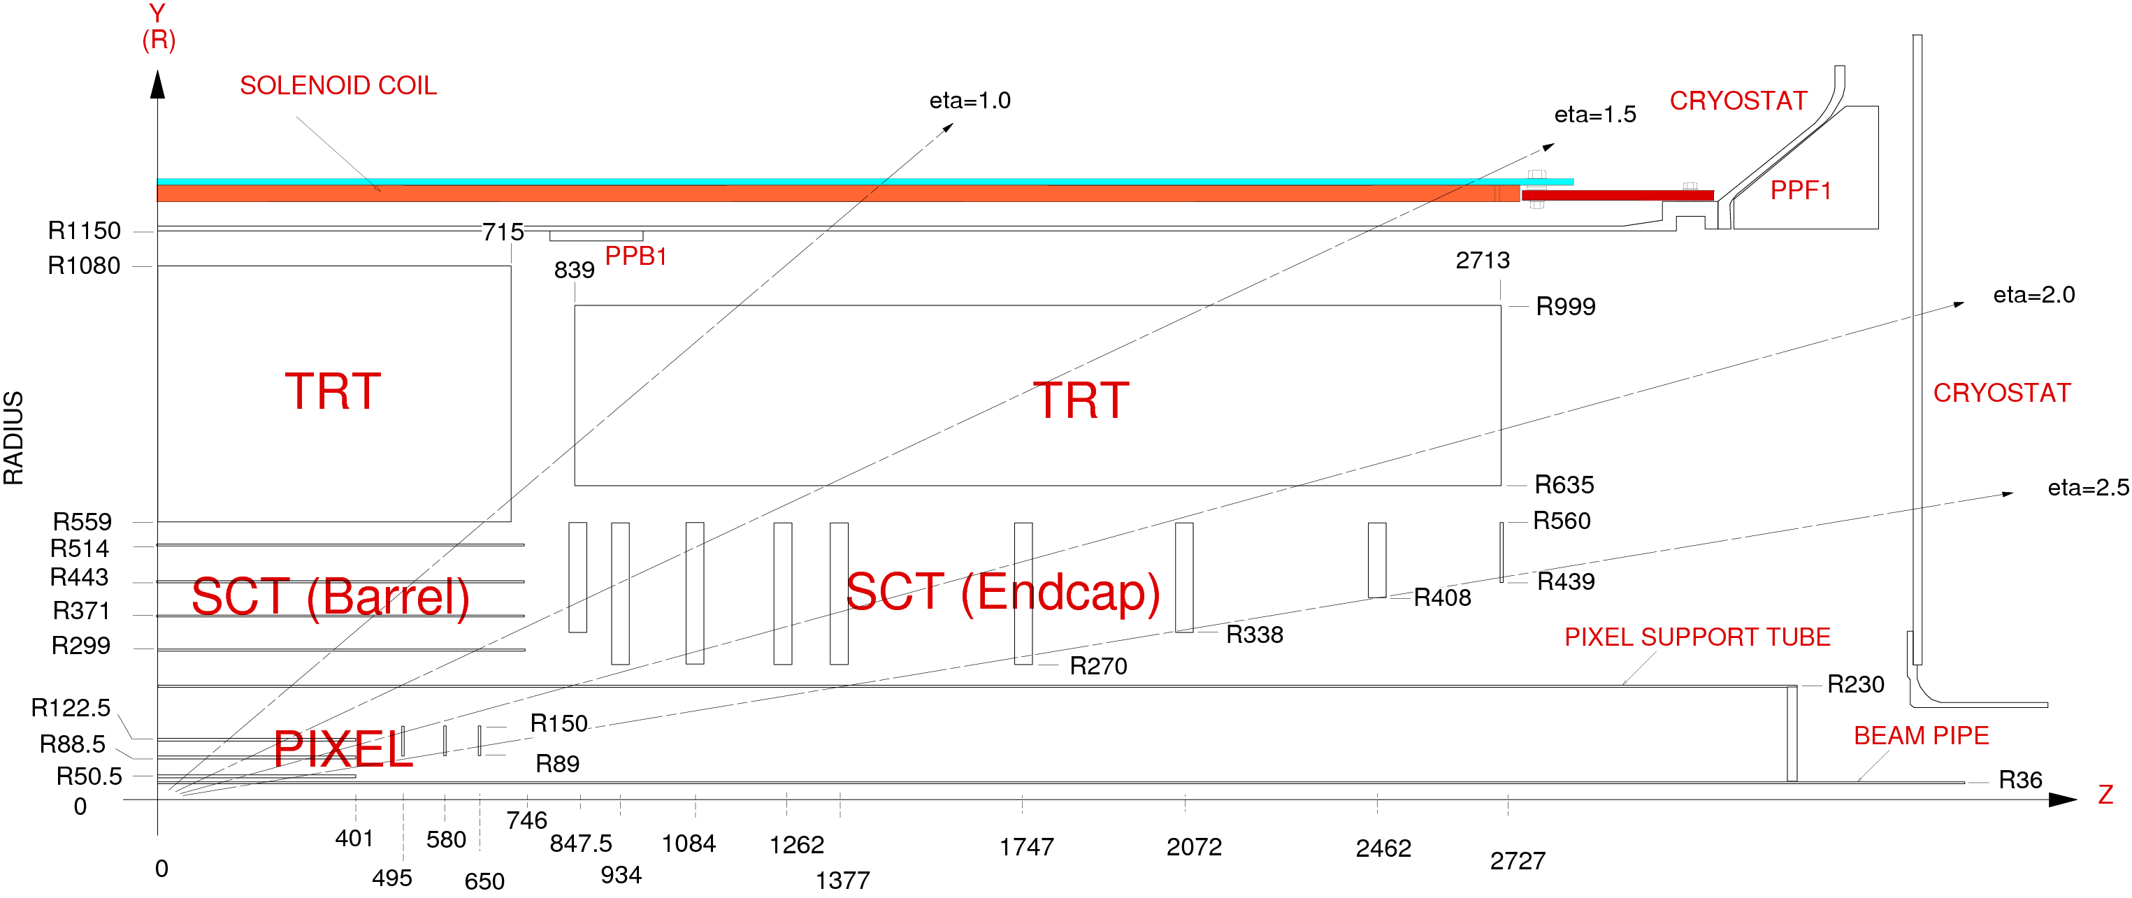
Current ATLAS Inner Tracker Layout
ID TDR
0.61%
r=30cm
Pixels: 1.8 m², ~80M channels
SCT: 61 m², ~6.3M channels
TRT straws: ~400k channels
Mean Occupancy in Innermost Layer of Current SCT
Pixels (50 μm × 400 μm): 3 barrels, 2×3 disks 5cm < r < 15cm
Pattern recognition in high occupancy region
Impact parameter resolution (in 3d)
Radiation hard technology: n⁺-in-n Silicon technology, operated at -6°C
Strips (80 μm × 12 cm) (small stereo angle): “SCT” 4 barrels, 2×9 disks
pattern recognition 30cm < r < 51cm
momentum resolution
p-strips in n-type silicon, operated at -7°C
TRT 4mm diameter straw drift tubes: barrel + wheels 55cm < r < 105cm
Additional pattern recognition by having many hits (~36)
Standalone electron id. from transition radiation

Slide 2
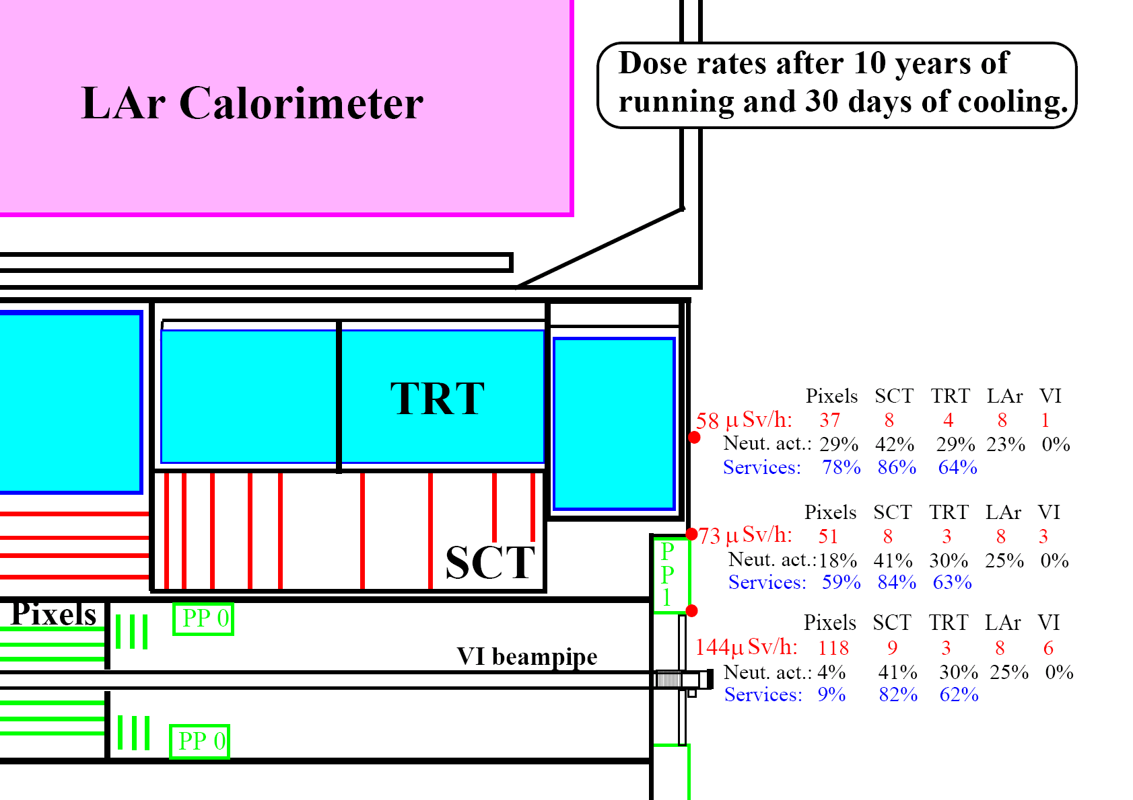
Requirements to reuse much of ATLAS (including services) and the levels of activation anticipated, greatly complicate upgrade tracker installation
(Existing tracker cables only rated to 500V but replacement would require dismantling of significant parts of the muon system)

Slide 3
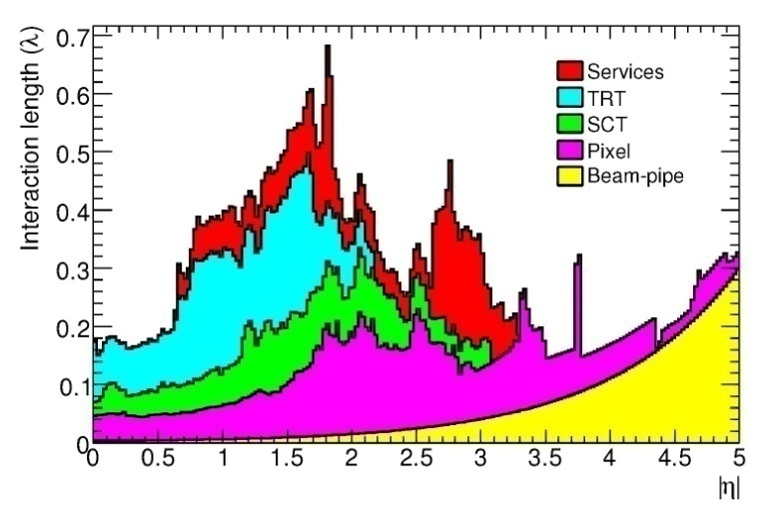
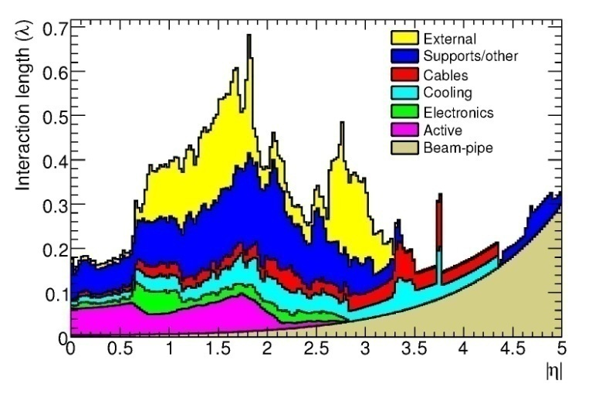
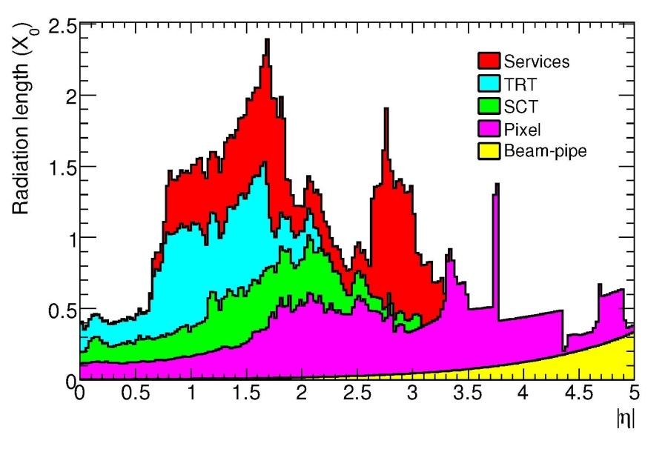
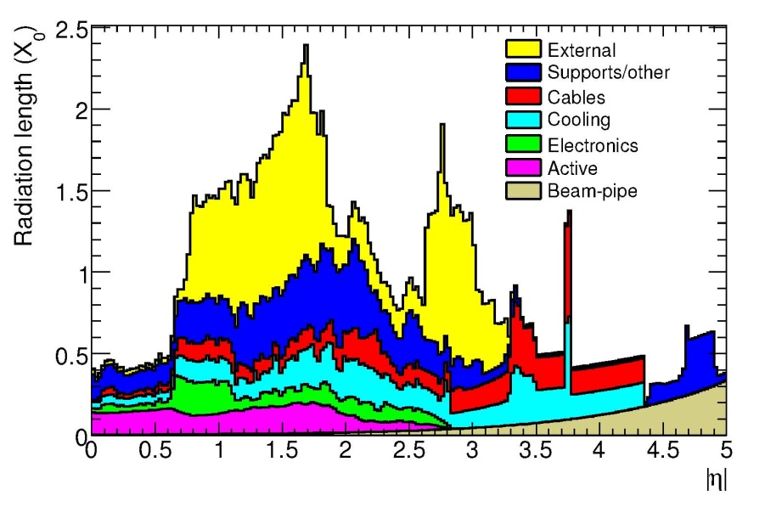
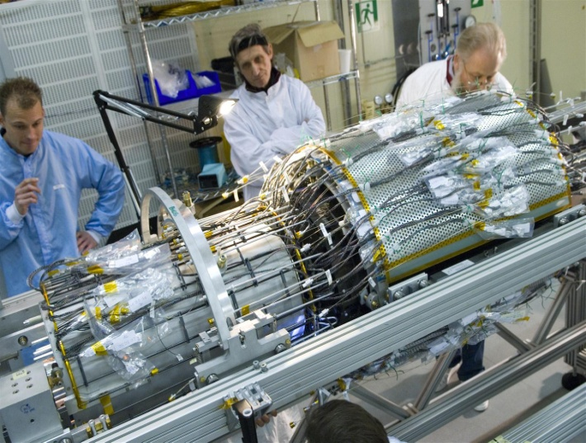
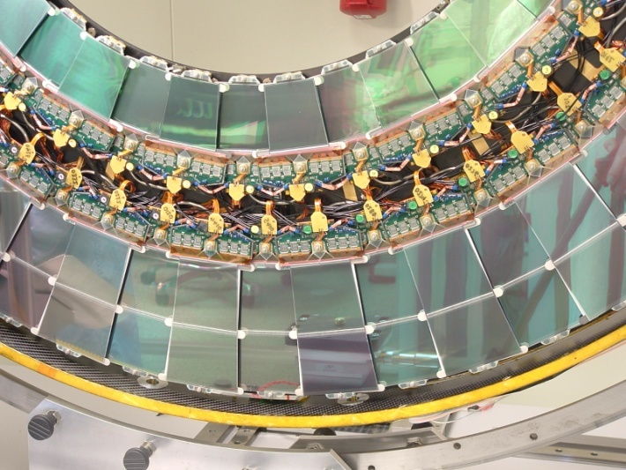
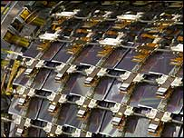
Material Estimates for Current Inner Detector
https://twiki.cern.ch/twiki/bin/view/Atlas/AtlasTechnicalPaper

Slide 4
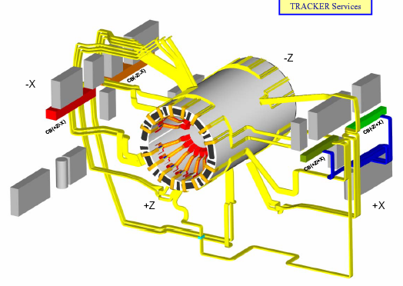
CMS Tracker Services
Major constraint on upgraded system
  Complex, congested routes
  Heat load of cables must
  be removed
  P_{cable} = R_{cable}(P_{FE}/V_{s})²
  Cable voltage drops
  exceed ASIC supply
  voltages
    limited tolerance
    to voltage excursions
Installation of services was one of the most difficult jobs to complete CMS
It will probably be impossible to replace cables and cooling for SLHC
P_{FE} ≈ 33kW I=15,500A P_{S} = 300kVA
Geoff Hall
Vertex 2008
4
Notes:
4

Slide 5
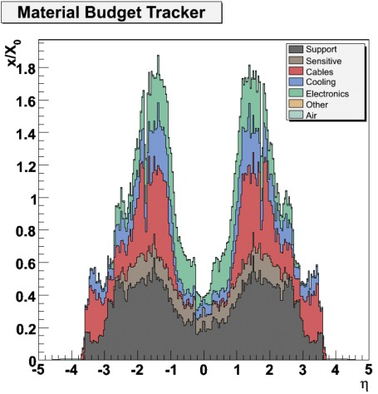
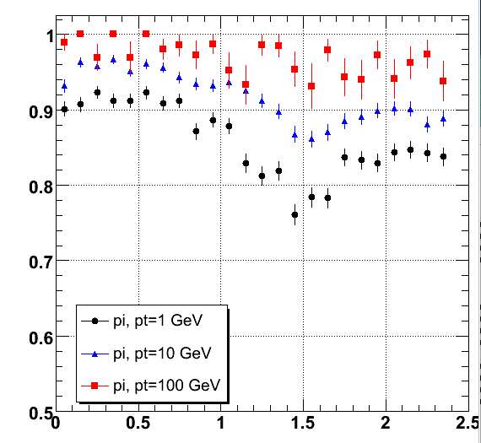
Material in Existing CMS Tracker
Pion track finding efficiency vs η
Improved tracking algorithms recover losses
η
Reducing power would be beneficial
  can routing improve?
Present power requirements
  inner microstrips: 400 W.m⁻²
  pixels: ~2700 W.m⁻² (pre-rad)
Geoff Hall
Vertex 2008
5
Notes:
5

