Slide 1
Strongly Interacting Matter at High Energy Density
From ALICE to the LHeC
(Opportunities for UK Nuclear Physics)
Roy Lemmon
Nuclear Physics Group
STFC Daresbury Laboratory

Slide 2
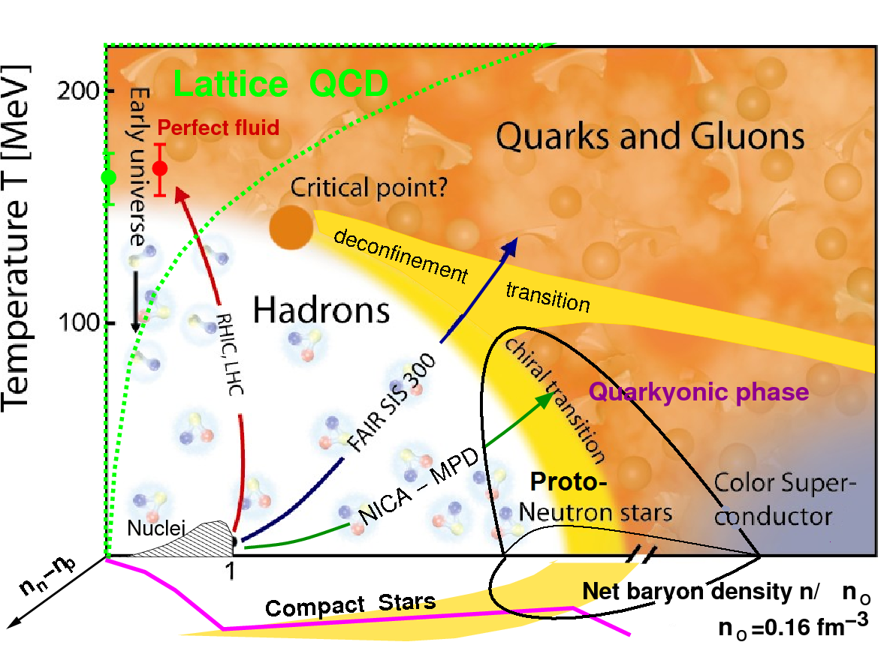
The Phase Diagram of Strongly Interacting Matter
Equation of State (EOS): relationship between Energy, Pressure, Temperature, Density and Isospin Asymmetry of Nuclear Matter

Slide 3
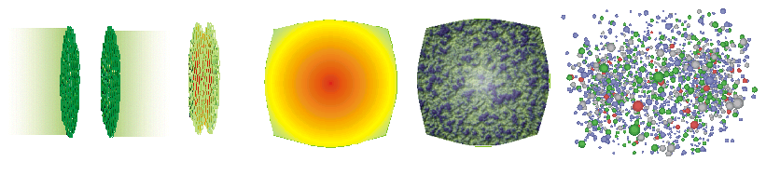
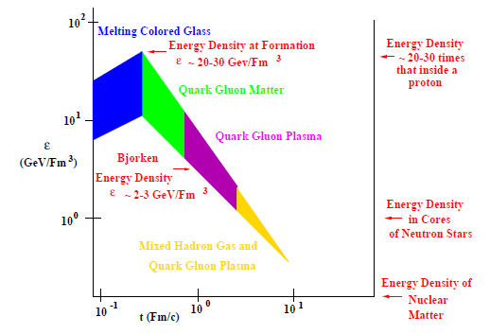
Heavy Ion Collisions: from the CGC to the QGP
CGC
Initial Singularity
Glasma
sQGP
Hadron Gas

Slide 4
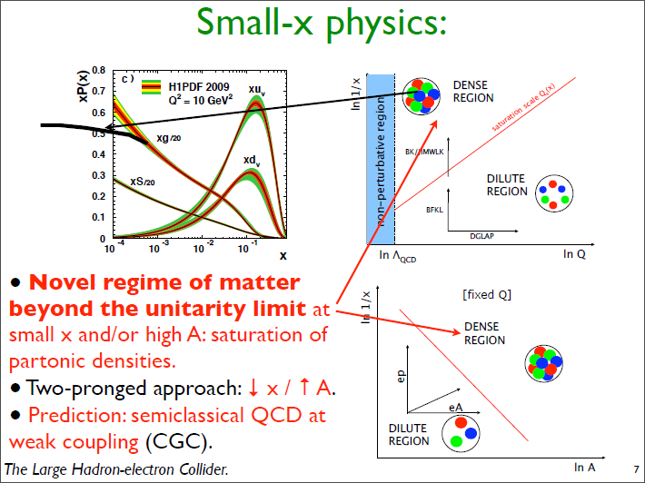

Slide 5
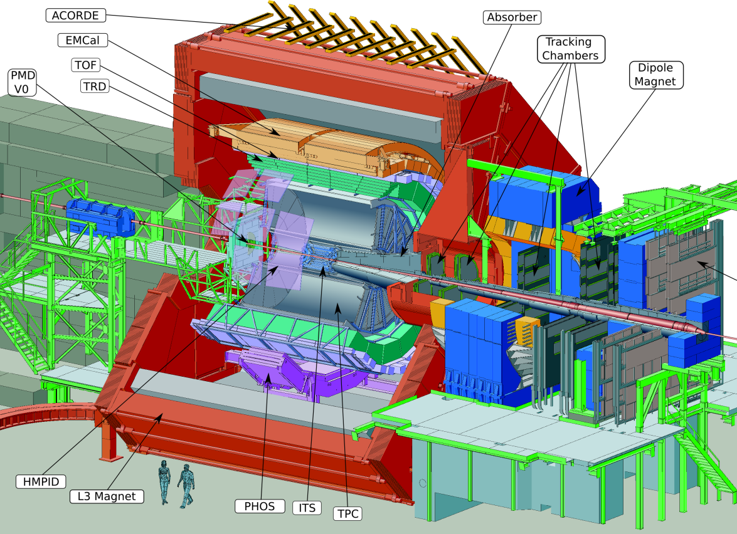
The ALICE experiment
Dedicated heavy ion experiment at LHC
Study of the behavior of strongly interacting matter under extreme conditions of high energy density and temperature
Proton-proton collision program
    Reference data for heavy-ion program
    Genuine physics (momentum cut-off < 100 MeV/c, excellent PID, efficient minimum bias trigger)
Barrel Tracking requirements
Pseudo-rapidity coverage |η| < 0.9
Robust tracking for heavy ion environment
  Mainly 3D hits and up to 150 points along the tracks
Wide transverse momentum range (100 MeV/c – 100 GeV/c)
  Low material budget (13% X₀ for ITS+TPC)
  Large lever arm to guarantee good tracking resolution at high p_{t}
PID over a wide momentum range
Combined PID based on several techniques: dE/dx, TOF, transition and Cherenkov radiation

Slide 6
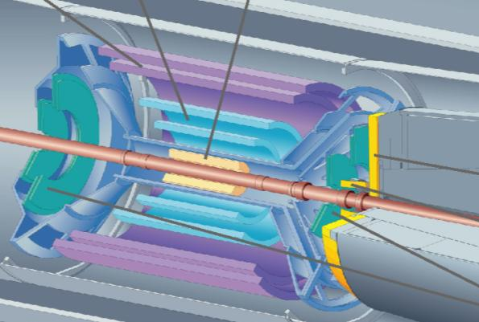
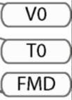

ALICE
Central Barrel
2 π tracking & PID
Δη ≈ ± 1
Detector:
Size: 16 x 26 meters
Weight: 10,000 tons
Collaboration:
> 1000 Members
> 100 Institutes
> 30 countries
6

Slide 7
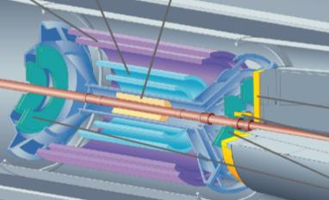
The ALICE Inner Tracking System
ITS: 3 different silicon detector technologies
The ITS tasks in ALICE
Secondary vertex reconstruction (c, b decays) with high resolution
  Good track impact parameter resolution < 60 µm (rφ) for p_{t} > 1 GeV/c in Pb-Pb
Improve primary vertex reconstruction, momentum and angle resolution of tracks from outer detectors
Tracking and PID of low p_{t} particles, also in stand-alone
Prompt L0 trigger capability <800 ns (Pixel)
Measurements of charged particle pseudo-rapidity distribution
  First Physics measurement both in p-p and Pb-Pb
Detector requirements
Capability to handle high particle density
Good spatial precision
High efficiency
High granularity (≈ few % occupancy)
Minimize distance of innermost layer from beam axis (mean radius ≈ 3.9 cm)
Limited material budget
Analogue information in 4 layers (Drift and Strip) for particle identification in 1/β² region via dE/dx
Strip Drift Pixel

Slide 8
Physics Motivation for ITS Upgrade
Heavy quarks (charm and beauty) are particularly powerful probes of the QGP
The ITS Upgrade will focus on:
  Study of the quark mass dependence of in-medium energy loss, by measuring the nuclear modification factors R_{AA} of the p_{t} distributions of D and B mesons separately
  Study of the thermalization of heavy quarks in the medium, in particular by measuring the baryon/meson ratio for charm (Λ_{c}/D) and for beauty (Λ_{c}/B), and the elliptic flow for charm mesons and baryons
Conceptual Design Report is written. Under review.
Technical Design Report by end of 2012.

Slide 9
Design goals
1. Improve impact parameter resolution by a factor of ~3
Identification of secondary vertices from decaying charm and beauty
increase statistical accuracy of channels already measured by ALICE:
  e.g. D⁰, BD₀, BJ/ψ, Be
measurement of new channels not accessible with present ITS:
  e.g. charmed baryon Λ_{c} , Λ_{b}
2. High standalone tracking efficiency and p_{t} resolution
Online selection of event topologies with displaced vertices at L2 (~100 ms)
  impact parameter of displaced tracks, distance between secondary and primary
  vertices, pointing angle
  + PID
Reconstruct charm and beauty with ITS+TRD tracking and TOF PID
3. Fast readout
readout of Pb-Pb interactions at 100 kHz and pp interactions at 2MHz
4. Fast insertion/removal for yearly maintenance
possibility to replace non functioning detector modules during yearly winter shutdown

Slide 10
ITS upgrade key requirements
7(9) silicon layers (r=2.2- 50 cm) to cover from IP to TPC (xx m²)
3 innermost layers made of pixels, outer layers either pixels or double sided strips
Hit density ~ 100 tracks/cm² in HI collisions
Readout time < 20 µs
High resolution low-mass pixel layer close to IP (r=2.2 cm)
Pixel size ~ 20-30 µm (rϕ), σ(rϕ)~4-6 µm
Material budget X/ X₀ ~ 0.3-0.5% per layer
Power consumption < 250 mW/cm²
PID with strips detectors
Radiation tolerant design (innermost layer) compatible with
685 krad/ 10¹³ n_{eq} per year

Slide 11
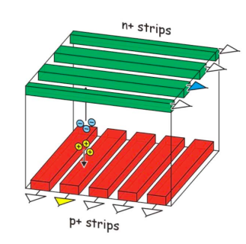
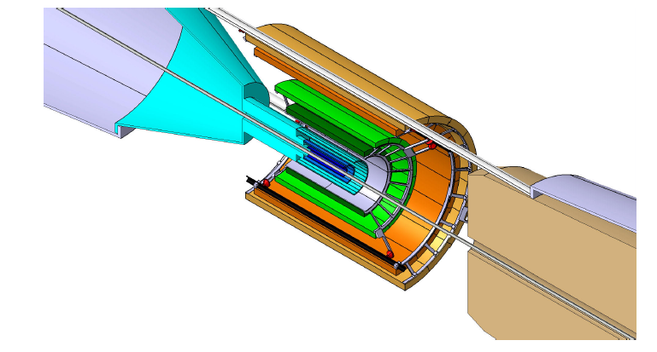
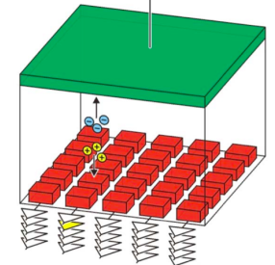
Upgrade options
Two design options are being studied
7 layers of pixel detectors
  better standalone tracking efficiency and p_{t} resolution
  worse PID (or no PID)
3 innermost layers of pixel detectors and 4 outermost layers of strip detectors
  worse standalone tracking efficiency and momentum resolution
  better PID
Option B
4 layers of strips
Option A
7 layers of pixels
3 layers of pixels
Pixels: O( 20 µm x 20 µm )
Pixels: O( 20 µm x 20 µm )
Strips: 95 µm x 2 cm, double sided

Slide 12
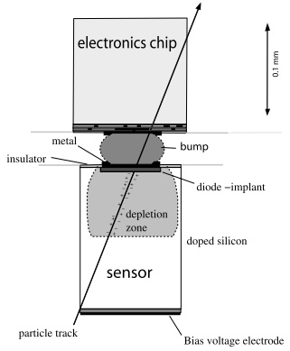
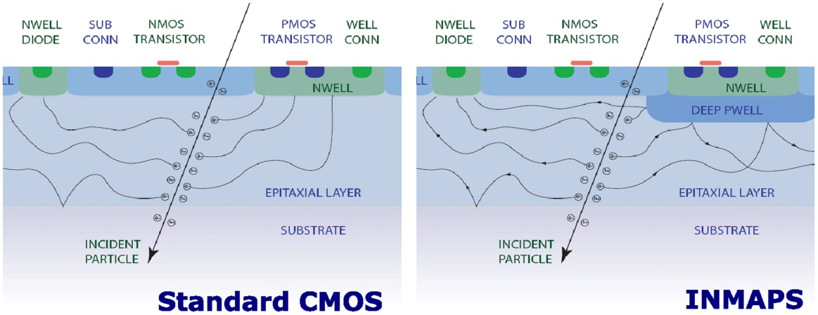
Pixel Technologies
Hybrid pixels
  State-of-the art in LHC experiments
  2 components: CMOS chip and high-resistivity (~80 kΩcm) sensor connected via bump bonds
  Optimize readout chip and sensor separately with in-pixel signal processing
  Charge collection by drift
  Possible to operate in high radiation environment at room temp. (several 10¹⁴ n_{eq})
Monolithic pixels
  Made significant progress, soon to be installed in STAR (Heavy Flavor Tracker)
  all-in-one, detector-connection-readout
  sensing layer (moderate resistivity ~1kΩcm epitaxial layer) included in the CMOS chip
  Charge collection by diffusion (MAPS), but some develop. based on collection by drift.
Figure - Rossi, L., Fischer, P., Rohe, T. & Wermes, N. (2006). Berlin: Springer.
Figure Stanitzki, M. (2010). Nucl. Instr. and Meth. A doi:10.1016/j.nima.2010.11.166

Slide 13

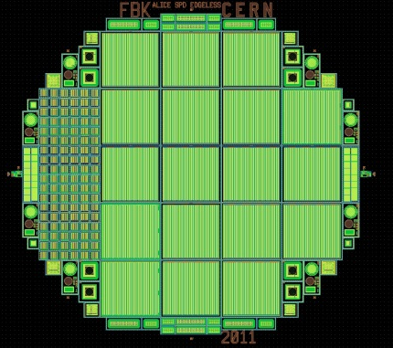
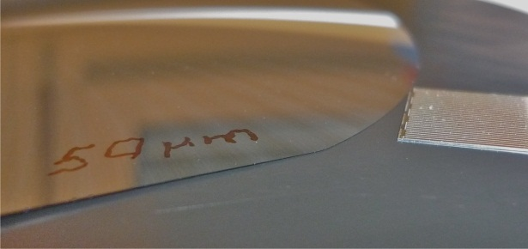
Hybrid Pixels and Ongoing R&D
Limit on pixel size given by current flip chip bonding technology ~ 30 µm
Material budget target X/ X₀ < 0.5% ( 100 µm sensor, 50 µm chip)
High S/N ratio, ~ 8000 e-h pairs/MIP  S/N > 50
Edgeless sensors to reduce insensitive overlap regions (~ 20µm)
Power/Speed optimization possible (shaping time O(µs)) to reduce power budget
  Possible to operate at room temperature in high radiation environment: demonstrated up to several 10¹⁴ n_{eq}
Cost driven by micro bump-bonding of sensor to readout chip
  Could be considered for the three innermost layers
R&D:
  thinning
  edgeless detectors
  Low-cost bump bonding
  lower power FEE chip
Thinning tests (dummies)
150 µm ASIC + 100 µm sensor
90 µm epitaxial sensor
wafer with edgeless layout

Slide 14
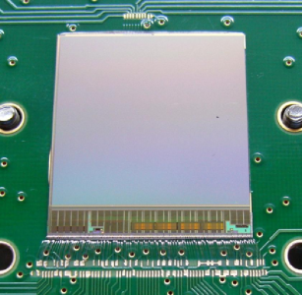
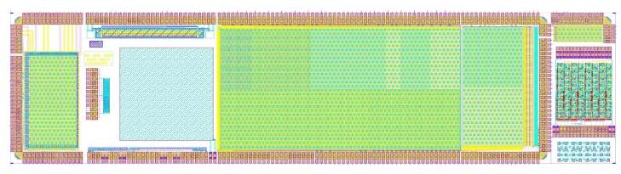
Monolithic Pixels - MIMOSA
State-of-the-art architecture (MIMOSA family - Strasbourg) uses rolling-shutter readout
  Continuous charge collection (by diffusion) inside the pixel
  Pixel matrix read periodically row by row: column parallel readout with end of column discriminators (integration time ≡ readout period )
  Typical integration time 20μs – 200μs
Pixel size ~ 20 µm
Low power consumption: only two rows are powered at time
Material budget target < 0.3 % X0 (50 µm chip)
Soon to be installed in STAR (HFT detector)
R&D for ITS upgrade: MISTRAL ≡ MImosa Sensor for the TRacker of ALICE
  further development of the low-power rolling shutter architecture of ULTIMATE
    reduce readout time by a factor 4-8 (parallel rolling-shutter scheme)
    improve radiation resistance by a factor 10:
    AMS 0.35μm  TowerJazz 0.18μm
    Target power consumption: < 250 mW / cm²
ULTIMATE sensor for STAR HFT
First exploratory submission – Oct 2011

Slide 15
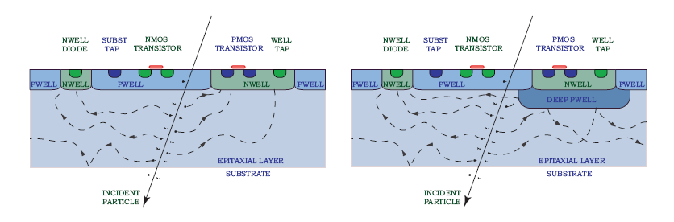
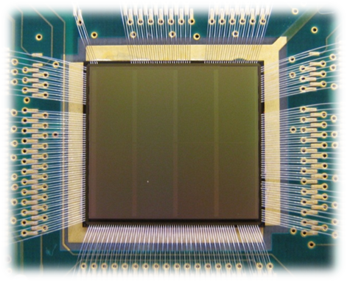
Monolithic Pixels - INMAPS
In-pixel signal processing using an extension (deep p-well) of a triple-well 0.18μm CMOS process developed by RAL in collaboration with TowerJazz (owner of the technology)
  Standard CMOS with additional deep p-well implant
  100% efficiency and CMOS electronics in the pixel.
  charge collection by diffusion
  optimize charge collection and readout electronics
  separately
New development dedicated to ITS upgrade starts in 2012
(UK ARACHNID Collaboration)
  Verify radiation resistance
  Reduce power consumption exploiting
  detector duty cycle (5% for 50 kHz int. rate)
  Develop fast readout
TPAC 1.0 (168 x 168 pixels; 50μm pixel
79.4 mm²; 8.2 million transistors)

Slide 16
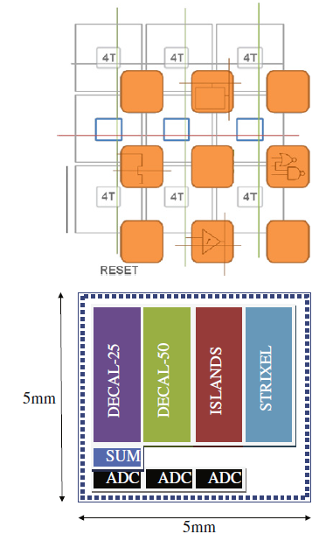
UK ARACHNID Collaboration
CHERWELL
Joint nuclear and particle physics PRD
Queen Mary, Birmingham, Bristol, Daresbury and Rutherford
Fully funded with ∼£0.5M over 18 months from Jan 2012
CHERWELL pixel tracking chip demonstrator:
  low power, low noise, no inactive area
  rolling shutter architecture, correlated double sampling (CDS) and a Four-Transistor (4T) front end
  four pixel designs
  48 columns, 96 pixels per column
  25 x 25 μm or 50 x 50 μm pixels
  embedded electronic “islands”
  10-bit ADC either at end of column or in-pixel
Characterisation of CHERWELL sensor
  lasers, radioactive sources
Radiation hardness testing
  irradiation in laboratory with X-rays, sources
  CERN: proton beams
Testbeam Performance
  CERN and DESY (EUDET telescope): pion beams
Incorporate all previously developed technology into new ARACHNID sensor design, focussed on specifications of two specific projects:
  ALICE ITS Upgrade
  SuperB vertex detector
Collaboration with CERN now in place to produce ARACHNID sensor as prototype for ITS Upgrade sensor by end 2012.

Slide 17
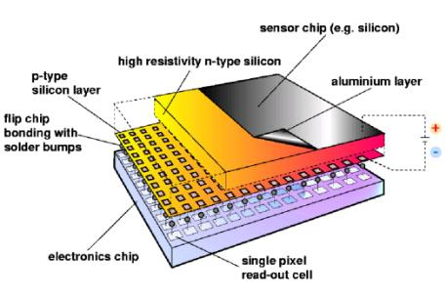
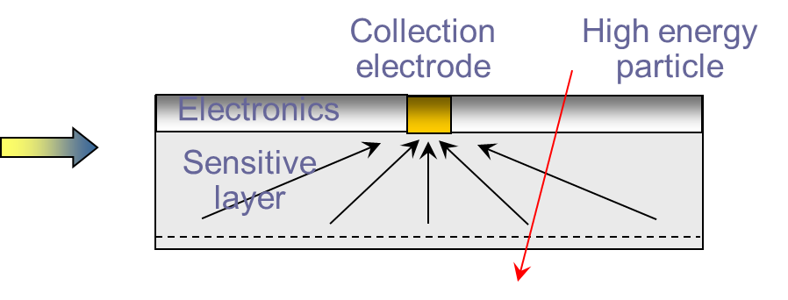
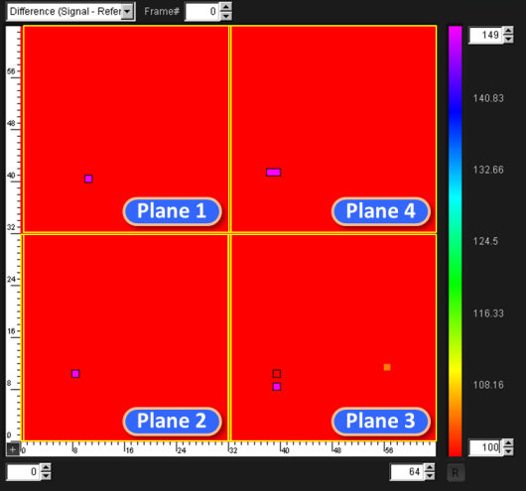
Monolithic Pixels – Le Pix
LePIX: monolithic detectors in advanced CMOS
Scope:
  Develop monolithic pixel detectors integrating readout and
  detecting elements by porting standard 90 nm CMOS to wafers
  with moderate resistivity.
  Reverse bias of up to 100 V to collect signal charge by drift
Key parameters:
  Very large signal to noise ratio
  Low power (target) < 30mW / cm²
  Fast processing: full matrix readout at 40MHz
Track in telescope of 4 planes
(beam test at PSI – Nov 2011)

Slide 18
Some Conclusions / Observations
The LHeC offers compelling opportunities to study strongly interacting matter at high energy density
This is a natural, and necessary, extension of the programme underway using heavy-ions at the LHC
A large European (and worldwide) nuclear physics community can therefore become engaged in these studies, in particular those from ALICE
The present UK involvement in ALICE is modest. However ...
The UK nuclear physics community now has a major opportunity to lead the ITS Upgrade of ALICE, and its physics, via its world-leading MAPS technology
This could potentially position the UK nuclear physics community as a leader in the physics of the LHeC
The UK nuclear and particle physics community could then collaborate in the building of the LHeC tracker, for example ...
Caveat: I am not implying MAPS is the technology of choice for the LHeC

