Slide 1
Upgrading ATLAS for the Coming Two Decades
Liverpool LHeC Meeting
16/12/11
Tony Affolder, Phil Allport, Henry Brown, Sergey Burdin, Gianluigi Casse, Valery Chmill, Peter Cooke, John Carroll, Paul Dervan, Derek Evans, Dean Forshaw, Ashley Greenall, Tim Jones, Barry King, Mike Lockwood, Kevin McCormick, Adrian Pritchard, George Sim, Paul Sinclair, Peter Sutcliffe, Ilya Tsurin, Mark Whitley, Mike Wormald
LHC Long-term Planning
ATLAS Upgrade Strategy
Required Tracker Performance
Prototype Studies and Measurements
Conclusions
1

Slide 2
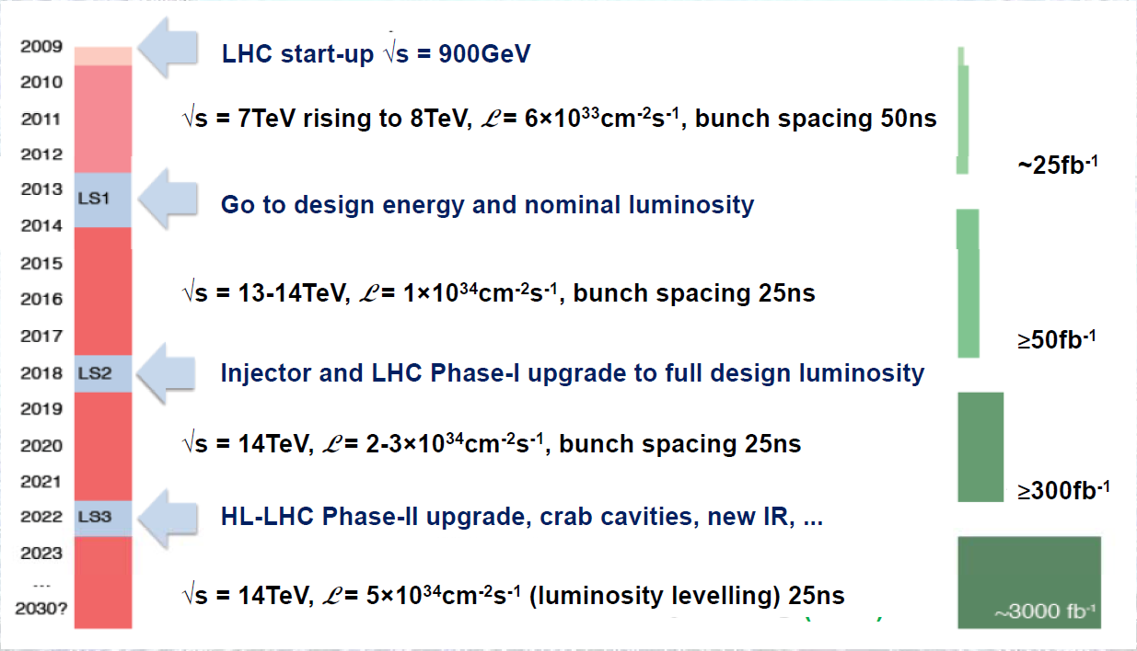
Possible 20 Year LHC Schedule

Slide 3
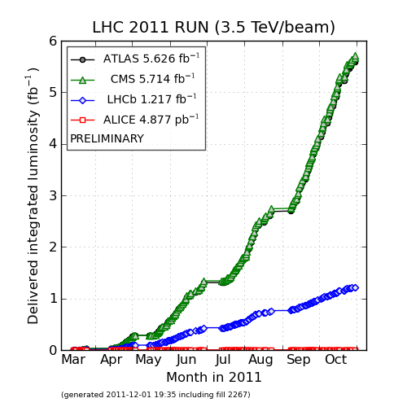
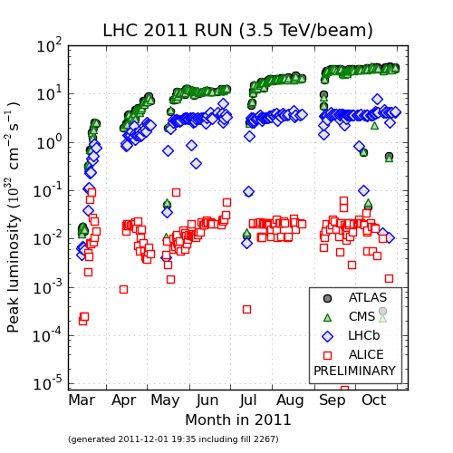
LHC Performance this Year
6 fb⁻¹ Down, 2994 fb⁻¹ To Go

Slide 4
Phase-0 (installation 2013-14)
New Aluminum beam pipes to prevent activation problem and reduce BG
New Insertable pixel B-Layer (IBL) (drives shutdown schedule)
New pixel services (nSQP) (→ pending decision by mid 2012)
New small Be pipe
New evaporative cooling plant for Pixel and SCT + IBL CO₂ cooling plant
Replace all calorimeter Low Voltage Power Supplies
Finish the installation of the EE muon chambers staged in 2003 + additional chambers in the feet (new electronics) and elevators region
Exchange all broken TGCs where possible
Consolidate part of the LUCID system
Upgrade the magnets cryogenics with a new spare main compressor and decouple toroid and solenoid cryogenics
Add specific neutron shielding ( behind end-cap toroid, USA15)
Revisit the entire electricity supply network (UPS,…)
Repairs and maintenance work in general !!!
Preparations for Phase I upgrade (moveable b-pipe, AFP prototypes,… )
MBTS removal and possible replacement

Slide 5
ATLAS Pixel ASIC Developments
FE-I3
Not possible to simply put existing front-end ASICs and sensors at reduced radii.
4
1
3
2
FE-I3 is also not radiation hard enough for r = 3.7cm
FE-I4
Flex
Improvements:
Pixel size from 50x400 -> 50x250
Improved electronics for high radiation + high event rates
Active area increased from up to ~90%
FE-I4B delivery begun and results so far look very promising
Sensor
4
1
3
FE-Chip
2

Slide 6
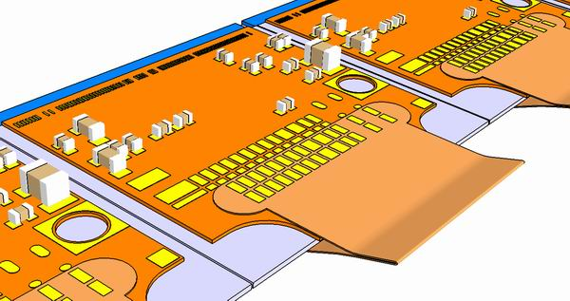
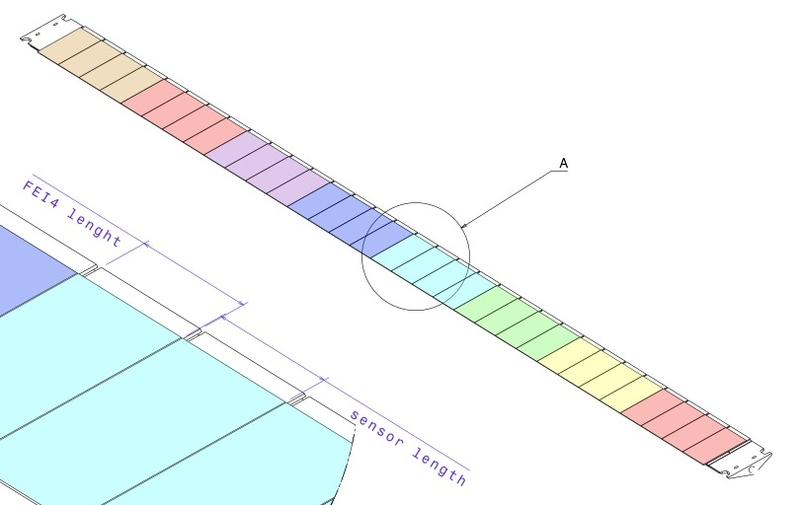
Towards a Final IBL MoU
Following sensor review and panel recommendations
  Plan for planar/3D mixed scenario – sensors ordered keeps also full planar possible
Final MoU is in preparation
  IBL Cost will stay the same (7.4 MCHF) – diamond beam monitor (0.35 MCHF) added into the MoU (IBL technology spin-off and covered by “technology option” with available resources within interim-MoU)
  Time critical contracts have been placed: FE-I4A/B, sensor production, bump-bonding, beam-pipe
Stave: 32 x FEI4
3D
Scenario (50/50):
50% Planar
50 % 3D
Flex Hybrid
Planar
3D
3D
Planar
Scenario (25/75):
75% Planar
25% 3D
Module:
Sensor + 1x or 2x FEI4
3D

Slide 7
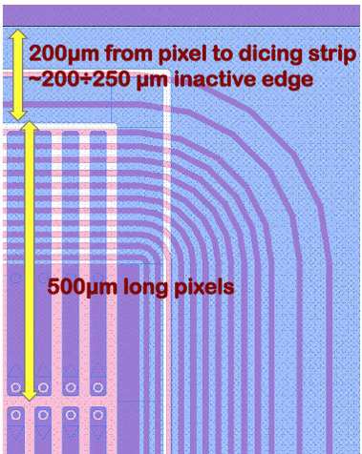
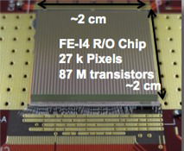
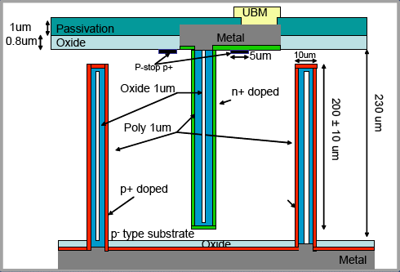
IBL Pixel Module Charge Collection
SCC61: Planar 6x 10¹⁵ n_{eq}cm⁻²
SCC97: 3D CNM 6x 10¹⁵ n_{eq}cm⁻²
Very promising results for HL-LHC requirements

Slide 8
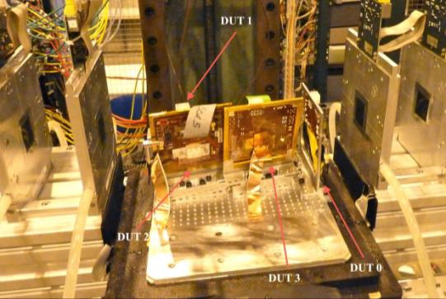
ATLAS PPS/IBL Test beams
Test beams:
CERN SPS – Protons and pions ~25GeV
DESY - Electrons 4-6 GeV
Different variations on sensors and manufacturer looked at with varying conditions:
- Magnetic field
- Various DUT (device under test) angles
BEAM
High Eta
High eta runs, started and will be continued in test beams in 2012
Tracks in IBL will be mostly High Eta
Problems for Planar and 3D designs
Co-ordinate extraction depends on charge collection through detector bulk, which will vary with irradiation.

Slide 9
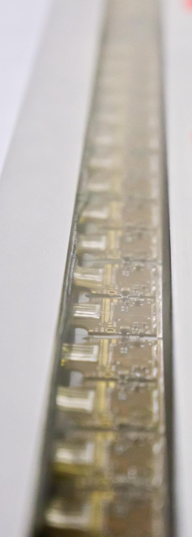
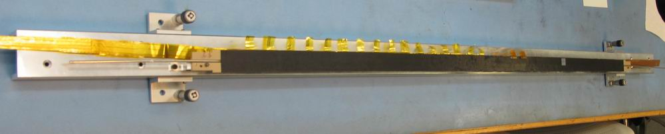
IBL staves
Two major areas: Bare stave and Flex circuit
  Flex review in September -> chosen baseline
  Pre-production flex submitted – expect back end January
  Bare stave designs agreed with pre-production of 10 at IVW
  Finalized building and QA of flex on stave with good results
  Expect first final staves with flex in February
IBL Integration on surface SR1
  Qualification of first staves
    Setup in SR1 for stave tests in preparation
  System test for IBL
  Integration tooling for IBL progressing
Pre-production modules (40 planar + 20 3D)
  Use FEI4A with production sensors for module assembly qualification
  Use those modules for first staves under production condition and with full QA (stave-0)

Slide 10
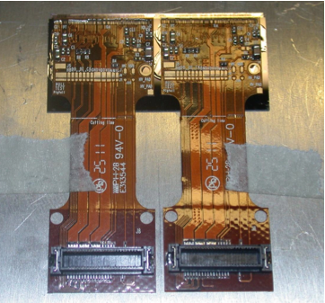

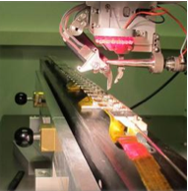
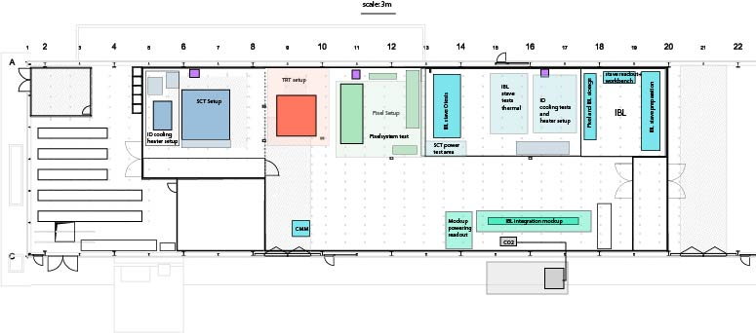
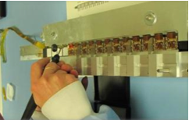
Stave “-1” and Stave 0 Tests
Setup full stave test area now in SR1 – System test from Chip to off-detector: with Stave “-1” : ASIC loaded stave
  9 digital modules, prototype flex, final bare stave
  Oct-Jan ‘12: Stave “-1” digital module testing
Goal First complete chain test of module, flex stave to power and off-detector read-out system
Stave 0 (fully functional modules on final stave):
  Mar-April’12: Stave 0: full IBL FEI4B modules
  Apr/May onwards: start production with full QA
Double chip modules

Slide 11
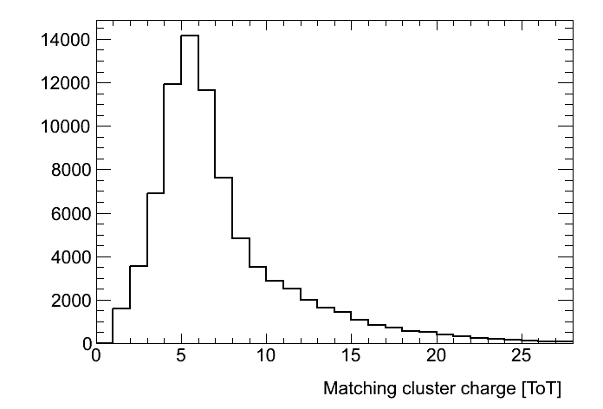
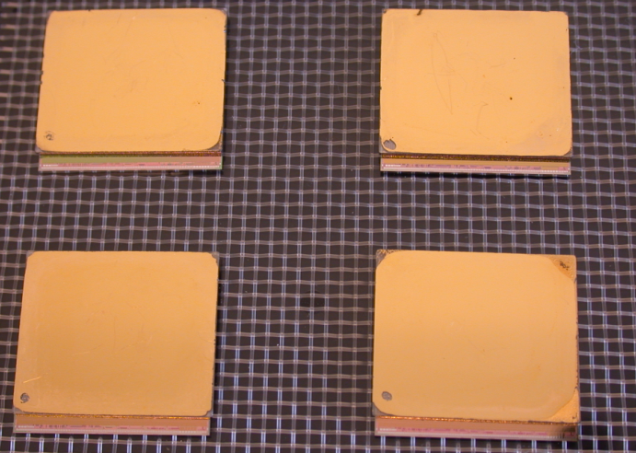
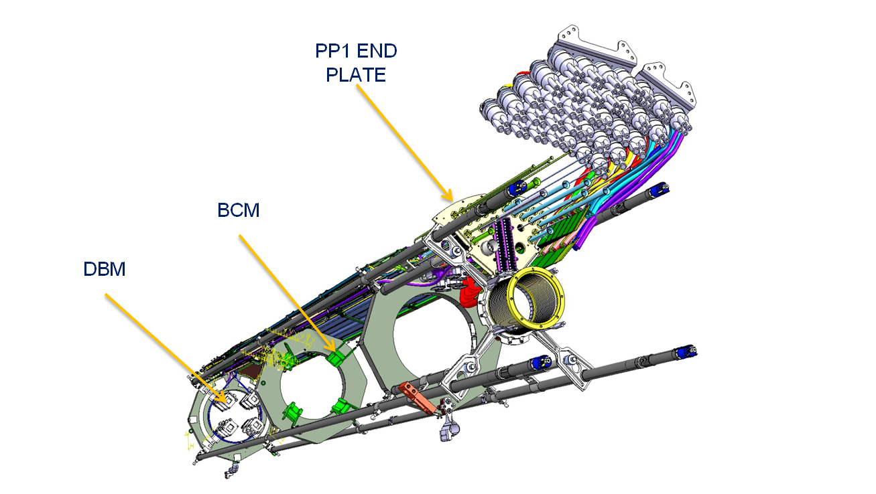
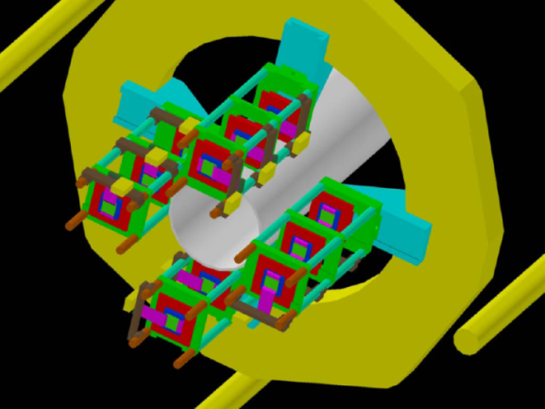
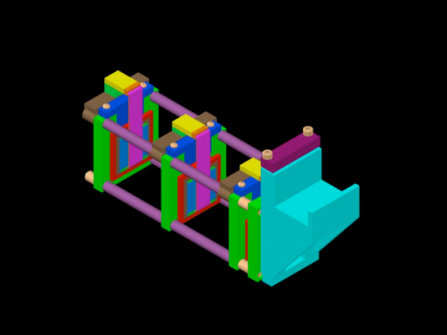
Diamond Beam Monitor (DBM)
Improve on existing diamond BCM in terms of segmentation, acceptance and occupancy capability
Four DBM modules built at IZM
  21x18 mm² pCVD diamond from DDL
  FE-I4 ATLAS IBL pixel chip
  336x80 = 26880 channels, 50x250 μm²
Test-beam and lab-tests very encouraging
DBM integration progressing well
  Service definition and routing
  Mechanics and cooling

Slide 12
Phase-I (installation in or before LS2)
  New muon small wheels with more trigger granularity and trigger track vector information
  Fast track trigger (FTK) using SCT and pixel hits (input to LVL2) expected installation before LS2
  Higher-granularity calorimeter LVL1 trigger and associated front-end electronics
  Topological trigger processors combining LVL1 information from different regions of interest (improvements starting well before LS2)
  Adapt central LVL1 trigger electronics to new needs
  New diffractive physics programme detector stations planned at ~210 m (full 3D edgeless and timing detectors, to start taking data before LS2)
  New Tiles crack-gap scintillators and some new trigger electronics
  Adapt if proven necessary HLT hardware (in particular network) to the new needs/conditions

Slide 13
Phase-II (installation 2022-23)
  New Inner Detector (strips and pixels) − very substantial progress in many R&D areas
  New LAr front-end and back-end electronics
  New Tiles front-end and back-end electronics
  TDAQ upgrade
  TAS and shielding upgrade
  Various infrastructure upgrades
  Common activities (installation, safety, …)
  New FCAL ?
  LAr HEC cold electronics consolidation ?
  L1 track trigger (possible role of gas detectors) ?
  Muon Barrel and Large Wheel system upgrade ?
  LUCID upgrade ?

Slide 14
First Phase II Cost Estimate (CORE Accounting ie Deliverables)
https://edms.cern.ch/document/1164765/1

Slide 15
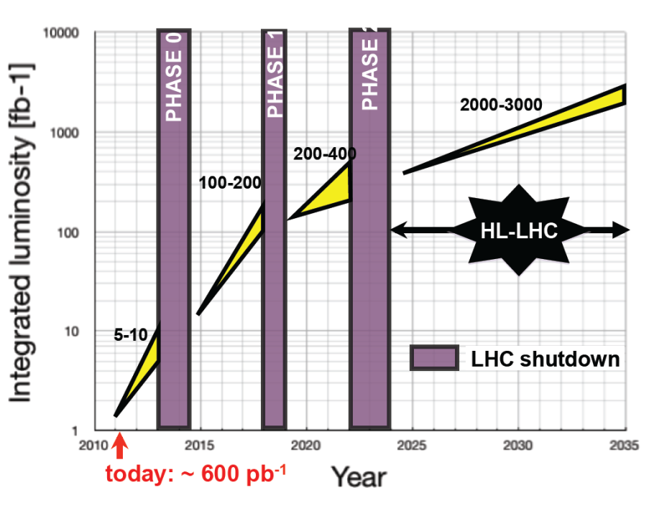
HL-LHC Performance Goals
Leveled peak luminosity: L = 5 ×10³⁴ cm⁻² sec⁻¹
Virtual peak luminosity: L = 10 ×10³⁴ cm⁻² sec⁻¹
w/o luminosity
leveling 10⁻³⁵
with luminosity
leveling 5.10⁻³⁴
Integrated luminosity: 200 fb⁻¹ to 300 fb⁻¹ per year
Total integrated luminosity:
: ca. 3000 fb⁻¹
Finally look to double the energy (HE-LHC)
16.5+16.5 TeV proton collider in the LHC tunnel
LHCC meeting, CERN, 14 June 2011
Oliver Brüning BE-ABP
15

Slide 16
Upgrading the General Purpose Detectors
To keep ATLAS and CMS running beyond ~10 years requires tracker replacement
Current trackers designed to survive up to 10Mrad in strip detectors ( ≤ 700 fb⁻¹)
For the luminosity-upgrade the new trackers will have to cope with:
  much higher integrated doses
  (need to plan for 3000 fb⁻¹)
  much higher occupancy levels (up
  to 200 collisions per beam crossing)
  Installation inside an existing
  4π coverage experiment
  Budgets are likely to be such that replacement trackers, while needing higher performance to cope with the extreme environment, cannot cost more than the ones they replace
  To complete a new tracker for ~2020, require Technical Design Reports by 2014/15
(Note the ATLAS Tracker TDR: April 1997; CMS Tracker TDR: April 1998)

Slide 17
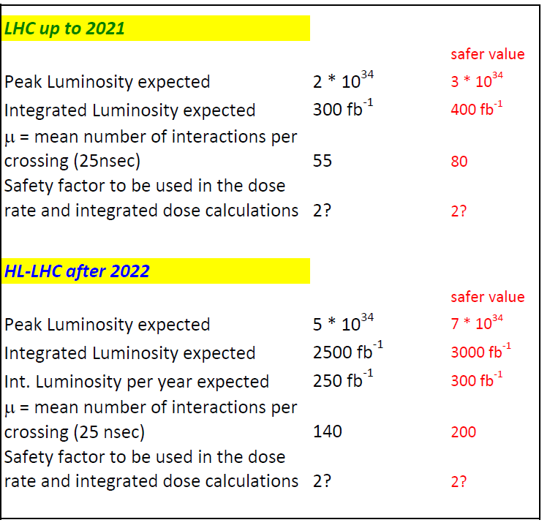
Draft Target Specifications
Plan for occupancy numbers based on this (see µ values below)
Plan integrated dose figures based on this
µ values going with the peak luminosity figure if achieved with 25ns beam crossing
When we calculate the dose figures which are used to specify the radiation hardness of components which can be reliably tested for post-irradiation performance (eg ASICs, silicon sensors, diamond, ...) apply this safety factor to the dose calculations in setting the radiation survival specification
(Still under discussion)

Slide 18
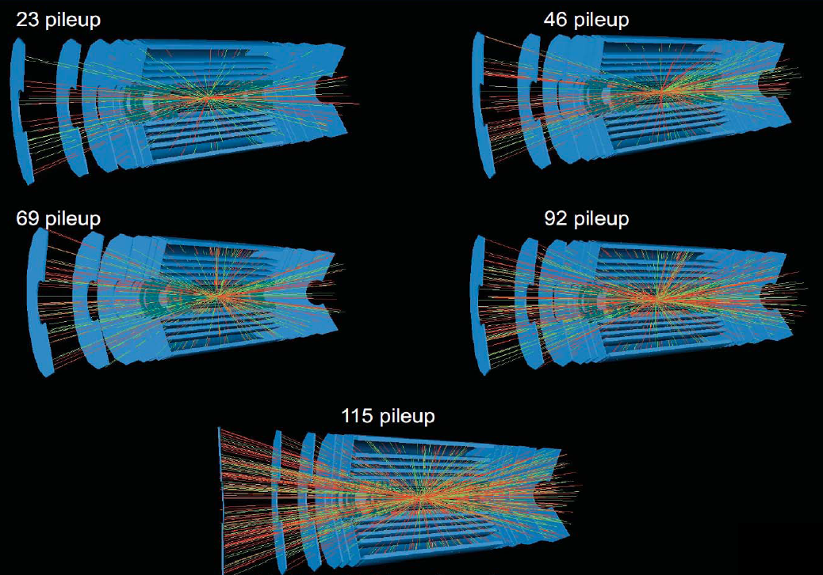

Slide 19
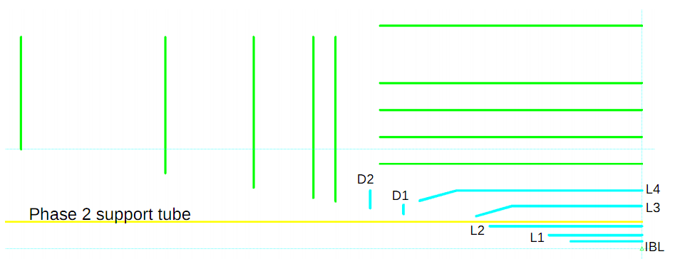
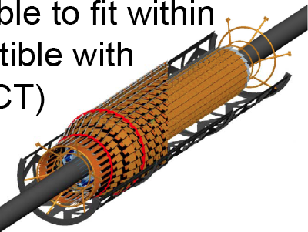
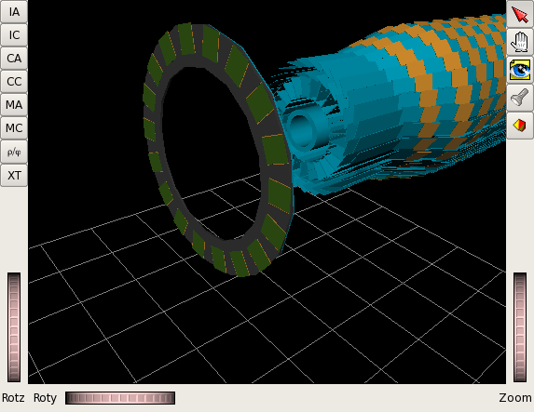
Phase II: Inner Tracker with Alternatives
All silicon new tracker with finer (1/5th) strip granularity
Conical pixel structures proposed to avoid very large incidence angles in forward direction while avoiding “services wall” in detector acceptance

Slide 20
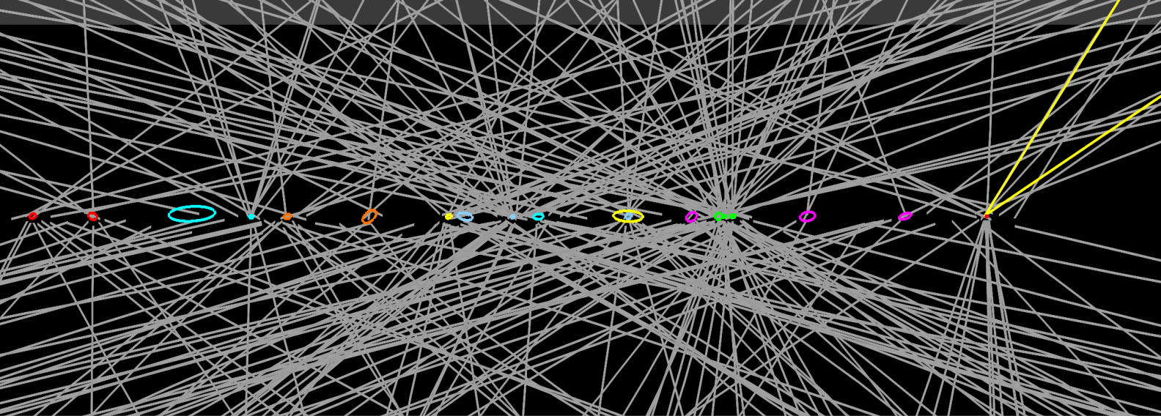
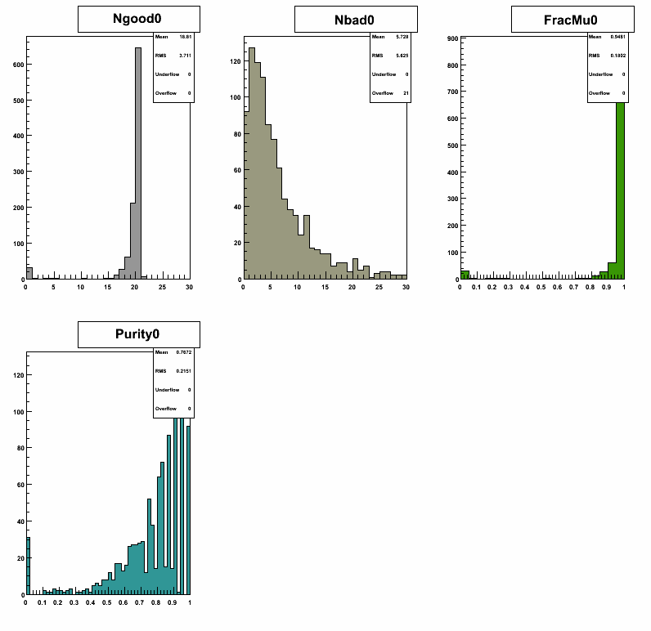
New Vertexing Tools
The Challenge: Number of Reconstructed Tracks:
5 Pileup. ~ 40
50 Pileup. ~ 200
100 Pileup. ~ 450
150 Pileup. ~ 700
200 Pileup. ~ 1500
400 Pileup. ~ 4000
Z→ μμ
Data: 20 pile-up
... goal is to reconstruct the vertices corresponding to each of these
events to ascertain how well the “interesting physics” can be
extracted from the background.
Strategy:
1. Use clusters in the Z impact parameter distribution of tracks
as seeds for Primary Vertex finding.....
2. Fit vertices for tracks which are close together in Z.
Most times the
“physics” vertex
does contain the
correct tracks.
Vertex contaminations
from other tracks
relatively low
up to ~200 pileup.

Slide 21
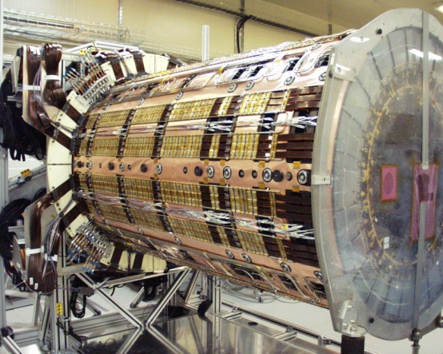
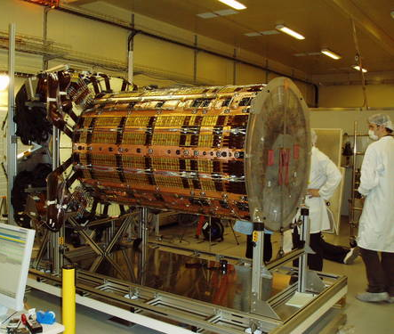
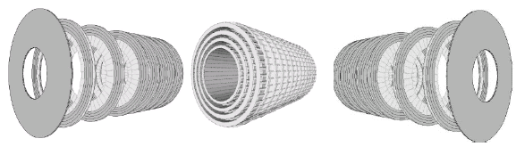
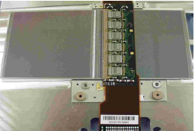
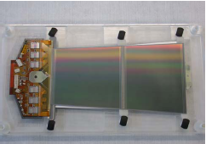
Current ATLAS SCT Module Designs
ATLAS Tracker Based on
Barrel and Disc Supports
Effectively two styles of double-sided modules (12 cm long)
each sensor ~6cm wide (768 strips of 80μm pitch per side)
Hybrid cards carrying read- out chips and multilayer interconnect
circuit
Sensor
Sensor
Sensor
Sensor
Barrel Modules Forward Modules
(Hybrid bridge above sensors) (Hybrid at module end)

Slide 22
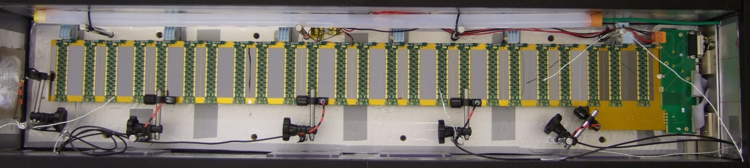
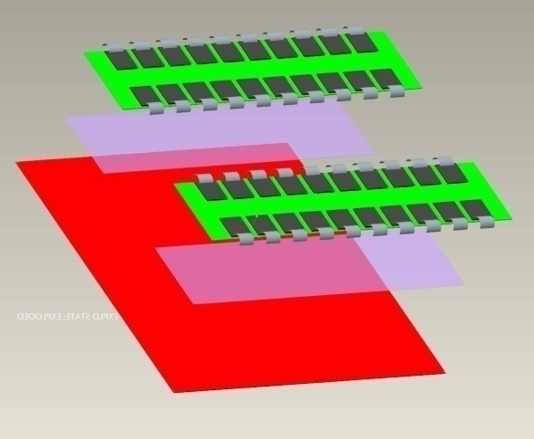
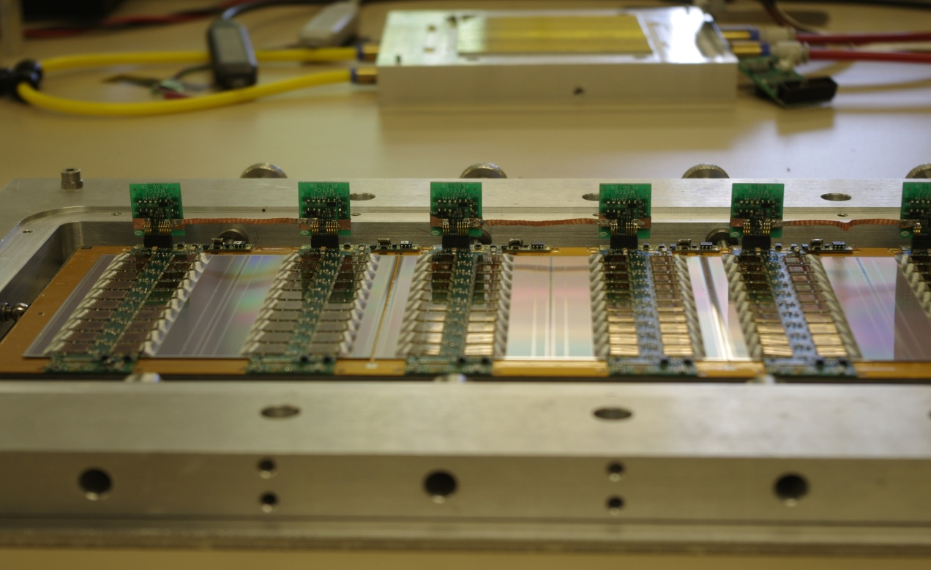
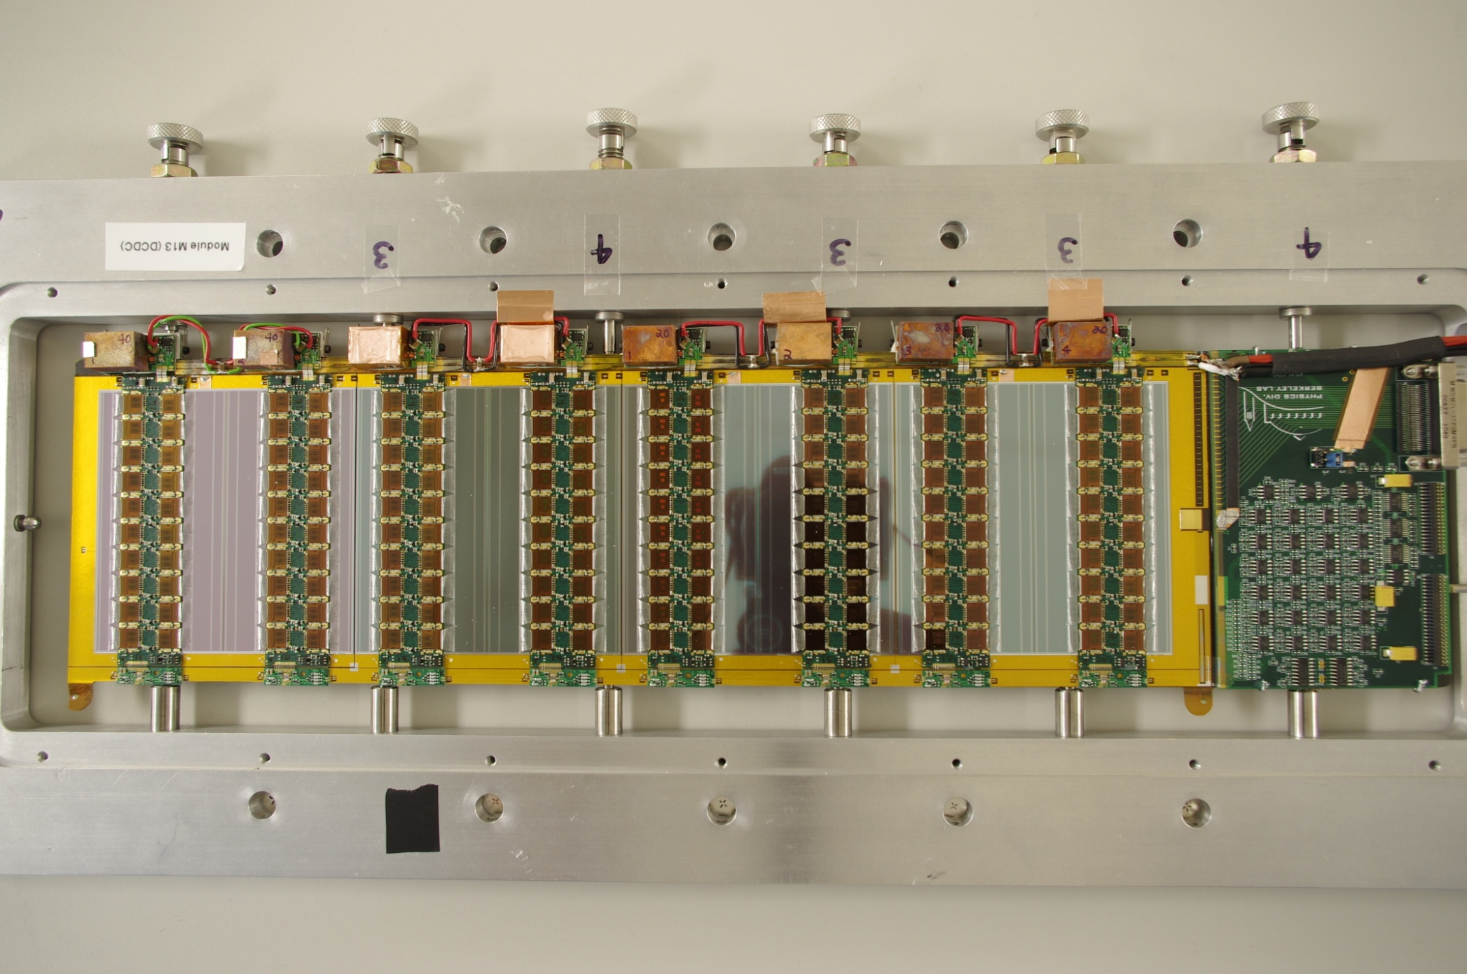
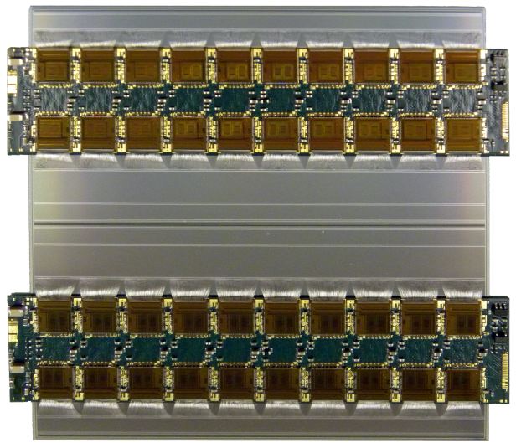
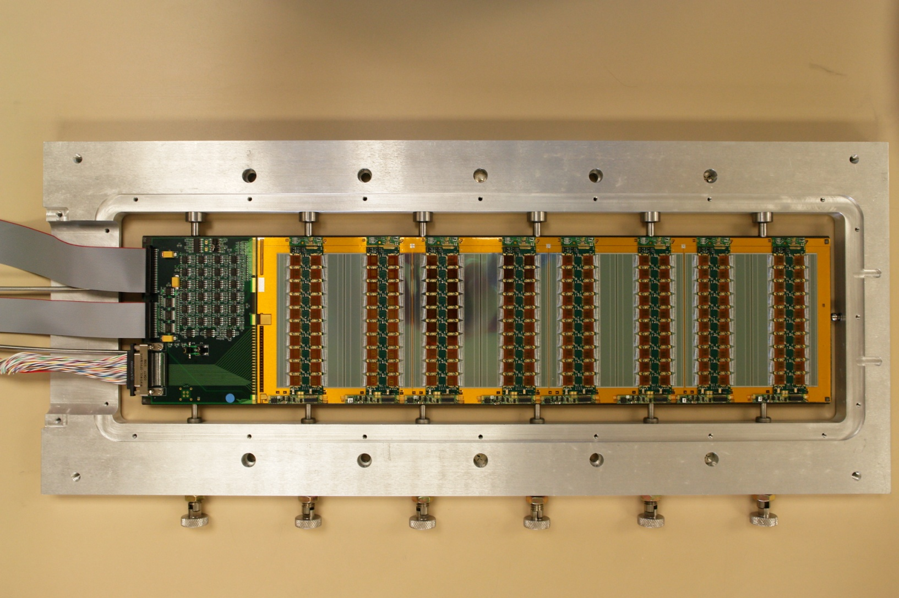
Stave Prototypes and Powering Concepts
Concept based on single-sided modules sandwiched around a carbon fibre core with integrated cooling and bus-tape (more similar to current pixels)
tested
Full Length 12 Module Mock-up Stave
Targets low
mass and
large-scale
production
0V
2.5V
5V
7.5V
10V
12.5V
Glue
←9 .75cm→
Glue
Serial Powered Chain of Hybrids
4 module fully
working SP stave
built and tested
Extra Noise compared to Reference Data
Shield | H0 | H1 | H2 | H3
100μm Cu | 62 | 60 | 11 | 26
140μm Cu | 58 | 46 | 8 | 24
 | ENC | ENC | ENC | ENC
Liverpool Hybrid and Module Design
H0
H1
H2
H3
DC-DC Stavelet (CF core made at Liverpool)
Both powering schemes can be made to work in this configuration

Slide 23
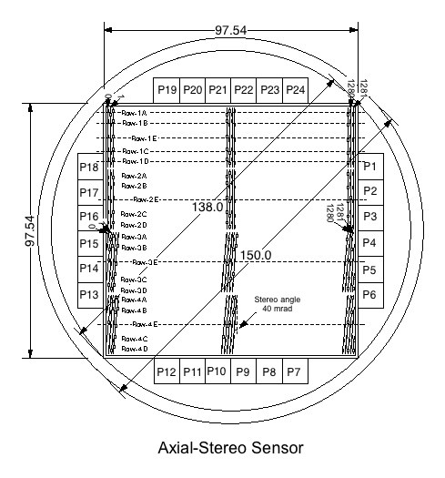

ATLAS Large Area Strip Sensors
Collaboration of ATLAS with Hamamatsu Photonics (HPK) to develop 9.75x9.75 cm² n⁺-strip in p-type substrate devices (6 inch wafers) for strip regions
  4 segments (2 axial, 2 stereo), 1280 strip each, 2.45cm long, 74.5 μm pitch, ~320 mm thick
  FZ1 <100> and FZ2 <100> material studied
  Miniature sensors (1x1 cm²) for irradiation studies
Axial
Stereo
>150 full-size sensor prototypes delivered and characterized to final specifications
  Inter-strip capacitance & resistance, coupling capacitance, depletion voltage, leakage currents and polysilicon resistors qualified
Use of p-type silicon for high radiation environments pioneered by Liverpool with Micron Semiconductor (UK) Ltd and CNM Barcelona

Slide 24
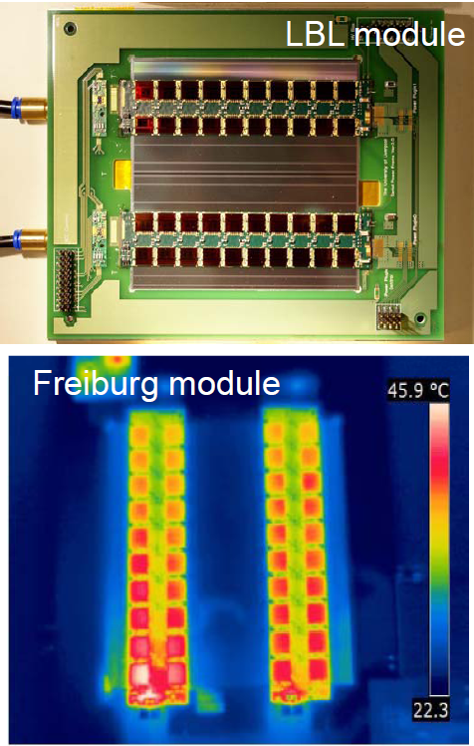
Module Assembly Progress
 | Mechanical Chip Gluings | Mechanical Wirebonding | Electrical Chip Gluings | Electrical Wirebondings | Electrical Testing | Mechanical Assemblies | Mechanical Wire Bondings | Electrical Assemblies | Electrical Wire Bonding | Electrical Testing | Produed Modules
Cambridge | ✓ | ✓ | ✓ | ✓ | ✓ | ✓ | ✓ | ✓ | ✓ | ✓ | 1
DESY | ✓ | ✓ | ✓ |  | ✓ | ✓ | ✓ | ✓
Freiburg | ✓ | ✓B ✓EC | ✓ | ✓ EC ✓B | ✓ | ✓ | ✓ | ✓ | ✓ | ✓ | 3
Glasgow | ✓ | ✓ |  |  | ✓ |  |  |  |  | ✓
LBL |  |  |  |  | ✓ | ✓ | ✓ | ✓ | ✓ | ✓ | 1
Liverpool | ✓ | ✓ | ✓ | ✓ | ✓ | ✓ | ✓ | ✓ | ✓ | ✓ | 26
Santa Cruz | ✓ | ✓ | ✓ | ✓ | ✓ | ✓ | ✓ | ✓ | ✓ | ✓ | 1
Tooling for all sites designed by and provided from Liverpool

Slide 25
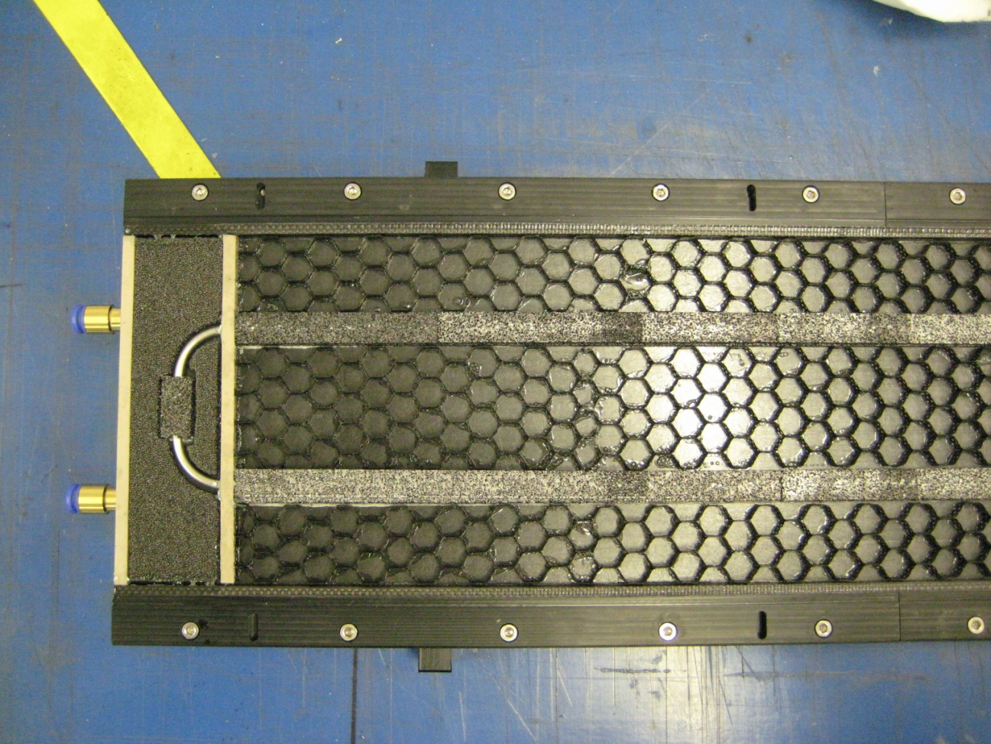
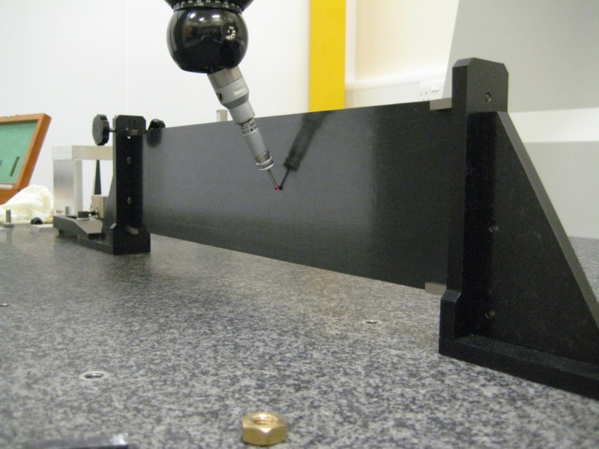
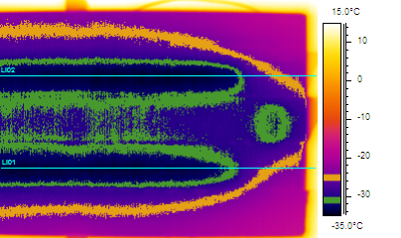
Stavelet Construction – Electrical Module Programme
-25°C
-32°C
-25°C

Slide 26
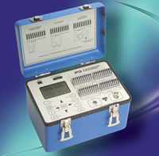
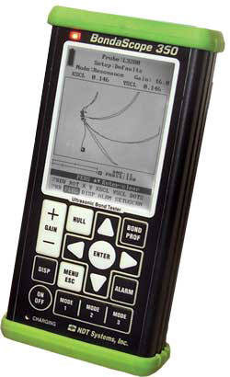
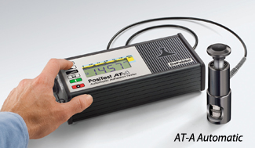
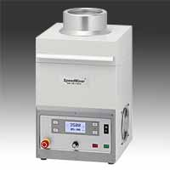
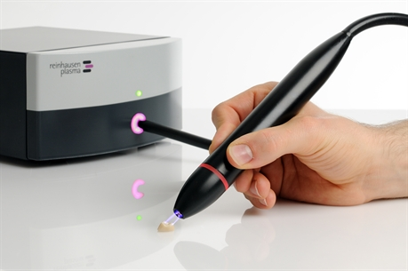
Liverpool Infrastructure Investment
Strain Measurement (Vishay P3)
  CTE of CF structures
  CTE of BN filled Hysol
Advanced NDT Bondascope
  Pitch-catch for face sheet to honeycomb bond quality
  Resonance for face sheet de-lamination
PosiTest Pull-off Adhesion Tester
  Adhesive bond tensile strength
Dual Axis Centrifugal glue mixer
  Improved glue quality / minimal trapped air
Piezo-brush
  Cold active plasma surface treatment

Slide 27
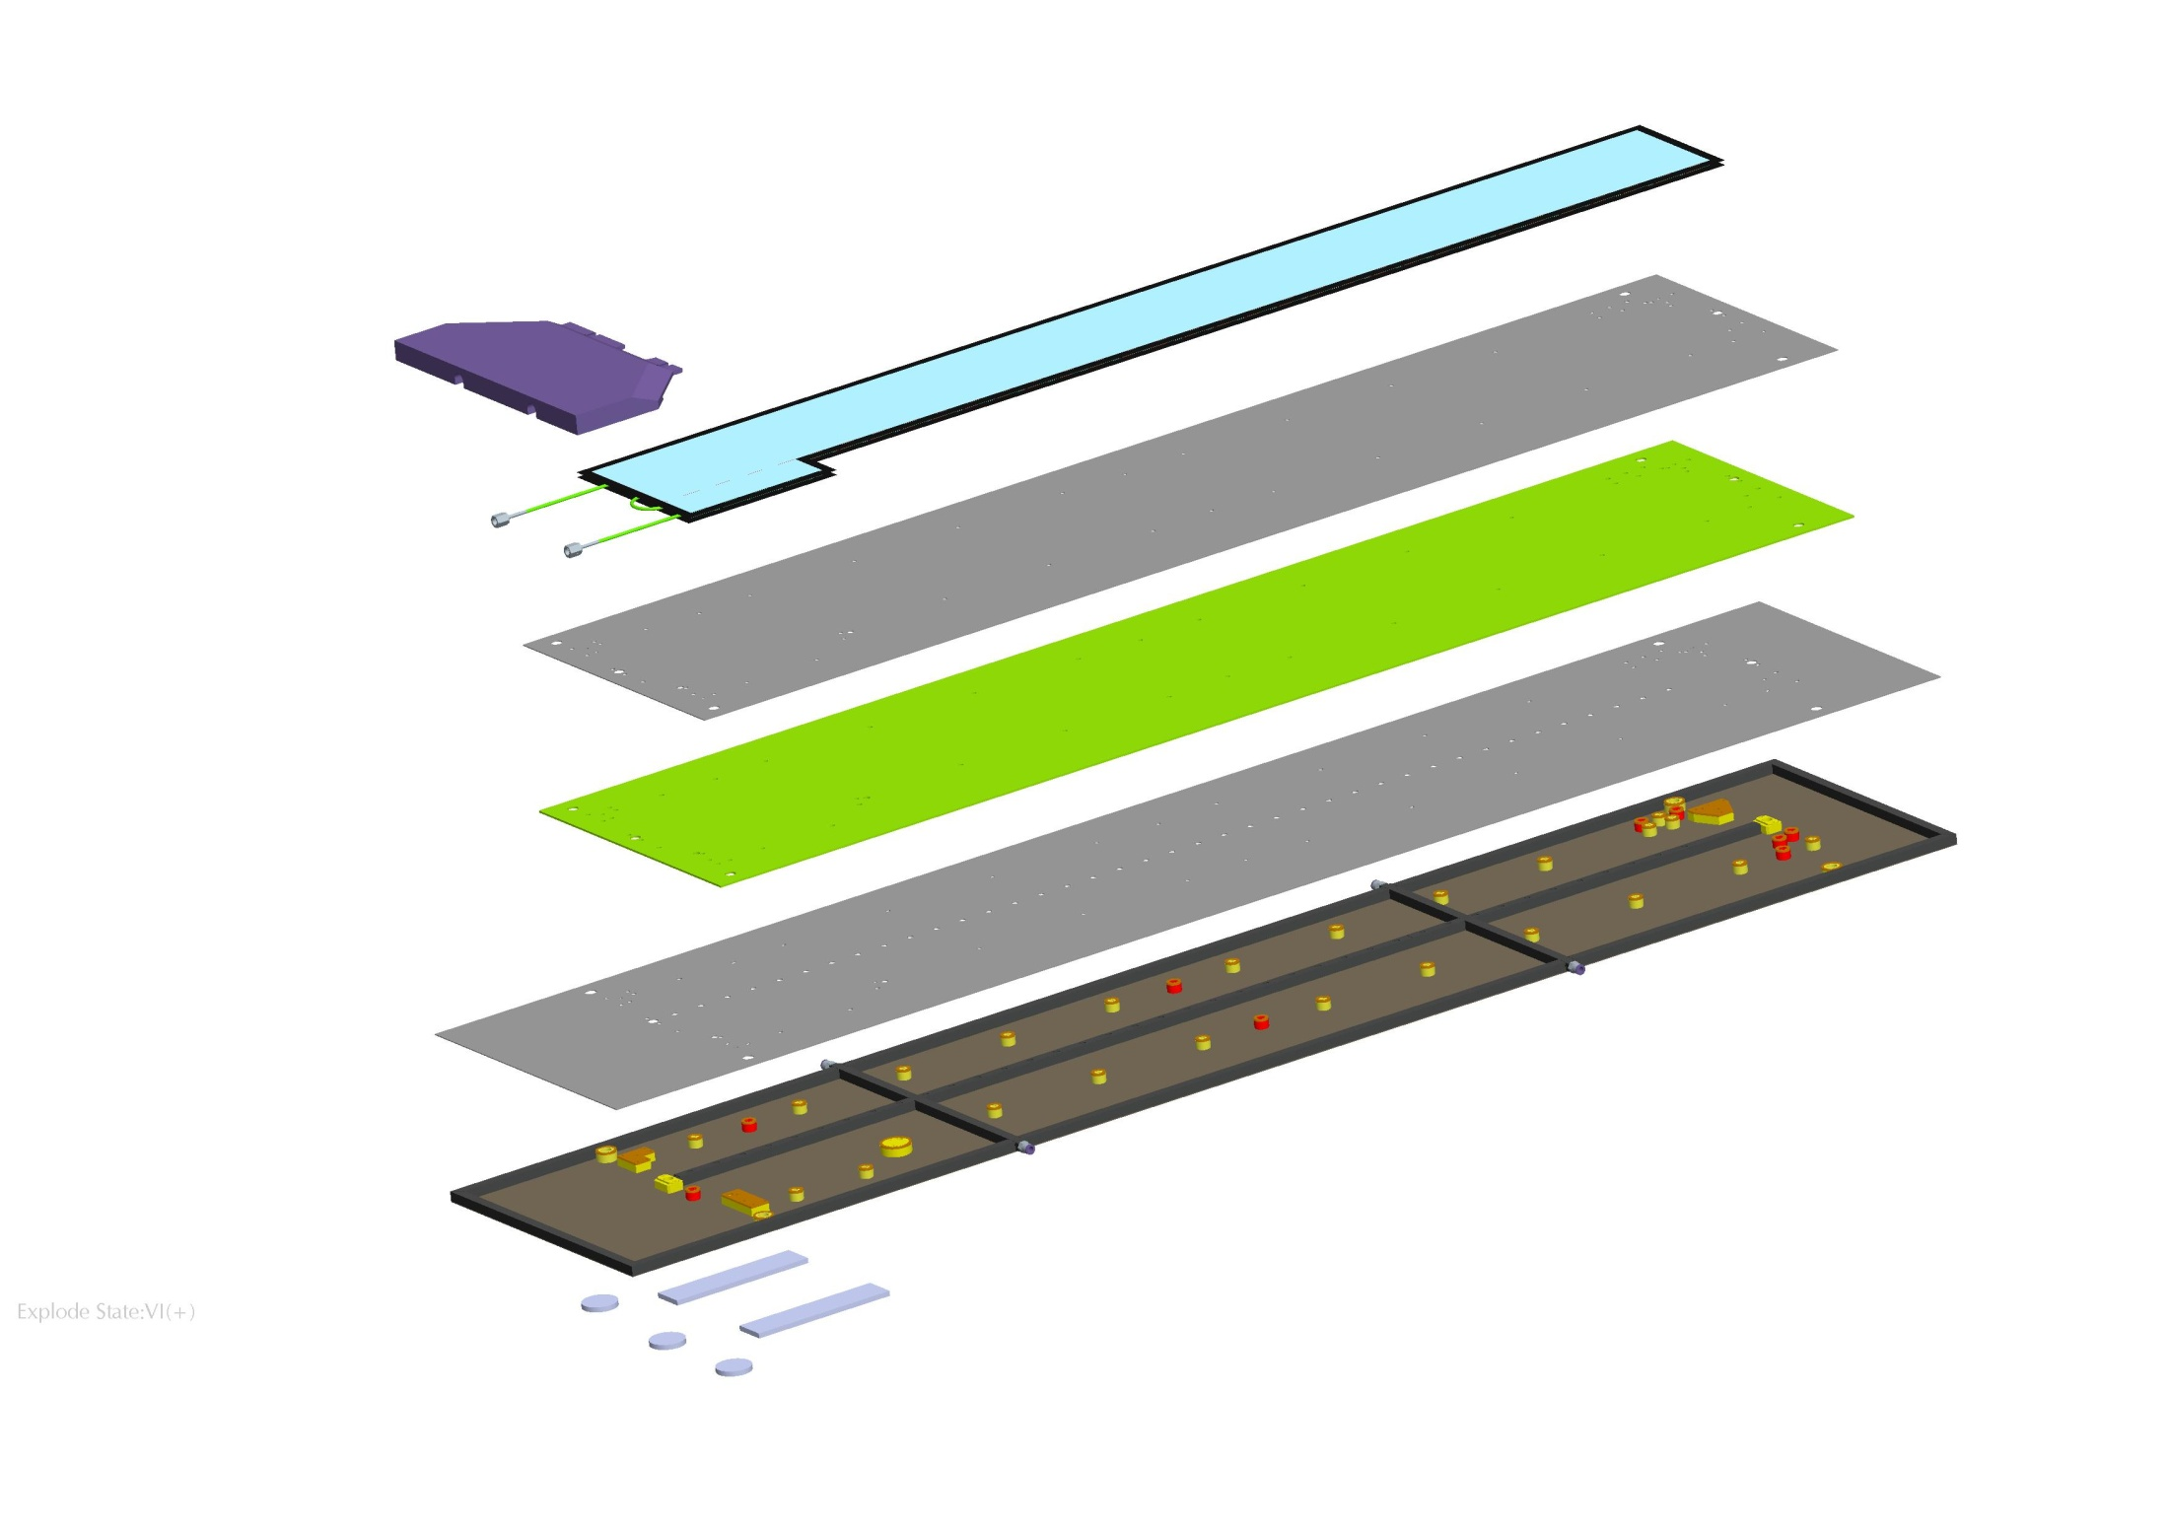

Stave Mechanics Prototyping Plans for 2012
Co-curing of full length face sheets
New CF stave assembly tooling
  Development of stavelet tooling
  Design by John Carroll
  Manufacture by Liverpool Workshop
  Stave Assembly
3-stave Sector Prototype
  Liverpool commitment
    CF shell
    Assembly
Module Mounting
  Investigate the use of the large CMM for module mounting
    Granite due for delivery Feb
    New camera and optics received

Slide 28




Radiation Background Simulation
At inner pixel radii - target survival to 2-3×10¹⁶ n_{eq}/cm²
For strips 3000fb⁻¹
×2 implies survival required up to ~1.3×10¹⁵ n_{eq}/cm²

Slide 29
Geometry Choices
Bias Ring
n-in-n
p-in-n
  Least expensive
  Single-sided processing
  Available from all foundries
  Most experience in production
    All strips at CMS/ATLAS/ALICE, Tevatron, b-factories, …
n-in-p
  ~50% less expensive than n-in-n
  Single-sided processing
  More suppliers (including Hamamatsu)
  Limited production experience
    1 VELO module installed, spare system under construction
  As radiation hard as n-in-n
Guard Ring
SiO₂
n⁺
p-spray/stop
n⁻ bulk
p⁺
Al
Bias Ring
Bias Ring
n-in-p
n-in-n
  Most expensive
  Double-sided processing
  Limited suppliers
  Some experience with “large” scale production
    CMS/ATLAS pixels, LHCb VELO
  Much more radiation hard than p-in-n
Guard Ring
Bias Ring
p-in-n
Guard Ring
Guard Ring
SiO₂
SiO₂
p⁺
n⁺
p-spray/stop
n⁻ bulk
p⁻ bulk
Al
n⁺
p⁺
Al
A. Affolder - PSD08, 1st-5th September 2008, Glasgow, Scotland
29

Slide 30
P-strip vs. N-strip Readout
Effect of trapping on the Charge Collection Efficiency (CCE)
Q_{tc} ≅ Q₀exp(-t_{c}/τ_{tr}), 1/τ_{tr} = βΦ.
t_{C} is collection “time”, τ_{tr} is effective trapping time
“New” n-in-p geometry
“New” n-in-n geometry
( after type inversion)
“Standard” p-in-n geometry (after type inversion)
p⁺
n⁺
Un-depleted
e⁻
p⁻
p⁻
h⁺
Un-depleted
n⁺
p⁺
Type inversion turns lightly doped material to “p” type
Holes collected
Deposited charge cannot reach electrode
  Charge spread over many strips
  Lower signal
Electron collected
  Higher mobility and ~33% smaller trapping constant
Deposited charge can reach electrode
A. Affolder - PSD08, 1st-5th September 2008, Glasgow, Scotland
30

Slide 31





Charge Collection Studies
RD50
Unannealed
Neutrons
900 V
900 V
Unannealed
26 MeV Protons
All n-strip readout substrates studied become more and more similar with irradiation. This is true after neutron, proton and pion irradiations and with Hamamatsu and Micron devices.
Micron Neutrons: A. Affolder, et. al., Nucl. Instr. Meth. A, Vol. 612 (2010), 470-473.
Micron 26 MeV Protons: A. Affolder, et. al., Nucl. Instr. Meth. A, Vol.623 (2010), 177-179.
HPK Neutrons: K. Hara, et. at., Nucl. Inst. Meth. A, Vol. 636 (2011) S83-S89.
HPK 26 MeV Protons: New and unpublished

Slide 32


n-in-p Planar FZ Sensor Irradiations
Strip Detectors after irradiation with different particle types and from different suppliers, all behave very consistently at high doses.
500V looks comfortable in terms of signal/noise at doses up to the highest expected in the strip region.
(see next slide)
Strip
Doses
500V
Pixel
Doses
1.3×10¹⁵n_{eq}cm⁻²

Slide 33




Strip Module Irradiation
Irradiated at CERN-PS irradiation facility
  Module biased, powered, and clocked during irradiation
  Total dose of 1.9x10¹⁵ n_{eq} cm⁻² achieved
    Max predicted fluence for barrel modules is 1.2x10¹⁵ n_{eq} cm⁻²
Sensor and module behave as expected
  Noise increase consistent with shot noise expectations
  Would like to study further the noise as a function of voltage, currents and effects in chip settings
Need to be able to put module in place where people can safely test it- hopefully building 180 will be ready soon!!
AL Foil
AL Foil
Noise | Column 0 | Column 1
Pre-Irrad | 610 e⁻ | 589 e⁻
Post-Irrad | 675 e⁻ | 650 e⁻
Difference | 65 e⁻ | 61 e⁻
Expected | 670 e⁻ | 640 e⁻
Pre-irradiation
Post-irradiation
Motorized, Cooled Irradiation Stage

Slide 34



n-in-p Planar FZ Sensor Irradiations
Strip
Doses
900V
Higher voltages and thinner sensors allow even higher doses to be survived
1.3×10¹⁵n_{eq}cm⁻²
Pixel
Doses

Slide 35




Micron n-in-p Irradiated FE-I3 Pixel Package
Silicon sensor
Heat sink added to pixel board
Measurements pre-irradiation and at doses of 4×10¹⁵ n_{eq} cm⁻² and 9×10¹⁵ n_{eq} cm⁻² all show no evidence of edge breakdown at 500V.
FE-I3 ASIC surprisingly robust but number of dead channels does increase at doses well above design target.
Bump bond connection
Readout chip
After irradiation to 1.5 ×10¹⁶ p/cm²
At CERN PS (9×10¹⁵ n_{eq} cm⁻²) peak charge at 500V is ~4000e
(Threshold 3500e -26°C, I_{b} 44uA)
I. Tsurin – ATLAS UK Planar Pixel Sensor R&D Meeting, 16 Sept 10

Slide 36


Pixel Sensors for the ATLAS Upgrade
“Quad” tiles (Micron Semiconductor)
IBL tiles (Micron Semiconductor)
10x10 cm² strip detector design submitted to e2v

Slide 37






Active p-type Foundries for HEP
Producers | Wafer Size | Thicknesses | Productions
 | 4”/6” | 150/300/500 | ATLAS pixels, LHCb pixels, RD50
 | 6” | 320/150 | ATLAS pixels/strips, CMS pixels/strips
 |  |  | ATLAS endcap strips, RD50
 | 6” | 300 | ATLAS barrel strips
 | 4” | 285/200/150 | ATLAS pixels, CMS pixels, RD50
 |  |  | ATLAS pixels
 | 6” | 100/200/300/500 | ATLAS pixels, RD50
 | 6” | 150/75 | ATLAS strips/pixels

Slide 38

e2v: New to Deep Depletion HEP Devices
STFC funded joint proposal between e2v Technologies plc and Liverpool Particle Physics to adapt high yield CCD processing technologies to HEP applications
e2v offer production capability better suited than many other European suppliers to the (>20,000 6” wafer) requirements for full tracker replacement at HL-LHC
Both RD50 capacitively-coupled, polysilicon biased miniature micro-strip detectors and FE-I3 ATLAS pixel ASIC compatible arrays manufactured and tested
Full-size (10cm×10cm) ATLAS HL-LHC module compatible sensor designed and in production
Pixels
Miniature
Microstrips

Slide 39
e2v: Miniature Microstrip Prototyping
A number of processing and design variations have been explored (SiO₂ Si₃N₄ insulation, implant energy and high temperature diffusion, isolation doses and technology,...)
Good results from the start, with main emphasis to improve pre-irradiation high-voltage leakage currents
Post-irradiation results compatible with other suppliers

Slide 40
n-in-p Planar FZ Sensor Irradiations
e2v Preliminary
500V
Pixel
Doses
1.3×10¹⁵n_{eq}cm⁻²
Gianluigi Casse and Tony Affolder,

Slide 41
n-in-p Planar FZ Sensor Irradiations
e2v Preliminary
900V
1.3×10¹⁵n_{eq}cm⁻²
Pixel
Doses
Gianluigi Casse and Tony Affolder,

Slide 42
Conclusions
Planning is in place at the LHC for a programme going forward two decades, with even energy doubling as a further upgrade path if physics requires it (also LHeC)
The future programme at the energy frontier requires a further factor of 10 in radiation tolerance compared with the already extreme requirements of the LHC
Detectors have been fabricated and tested after irradiation to doses compatible with HL-LHC operation and sufficient signal for efficient operation is found for detectors with n-implant read-out
Many aspects of R&D being undertaken at Liverpool and we can offer expertise in a number of areas in silicon strip and pixel module design and manufacture

Slide 43
Back-up Material

Slide 44
New ID challenges
Silicon sensors have to maintain adequate performance after accumulated radiation levels 10 times higher than the requirements of the present Tracker. Thus higher granularity and thinner sensors are required everywhere, and radically different options may be useful for the innermost pixel layers
More advanced ASIC technologies have to be used. The main challenges are to cope with the high instantaneous rates in the inner pixel layers, to limit the power consumption with the higher granularity, and to implement the new trigger functionality
Novel powering schemes have to be employed to reduce the cross section of conductors
inside the tracking volume and take full advantage of the lower operating voltage of the front-end ASICs, while remaining within the constraint of the existing supply cables
More efficient cooling methods have to be used to reduce the mass of cooling pipes and heat exchangers, as well as the mass flow of the coolant, and to cope with the constraints from the existing pipes
High-speed data links are required to handle the increased data volume generated by the increased granularity and by the trigger output, and still maintain compatibility with the installed optical fibers
Novel module concepts and electronics architectures need to be developed to implement on-detector data reduction, which allows the trigger functionality to be implemented while maintaining the bandwidth at an acceptable level

Slide 45
Geometry Choices
Bias Ring
n-in-n
p-in-n
  Least expensive
  Single-sided processing
  Available from all foundries
  Most experience in production
    All strips at CMS/ATLAS/ALICE, Tevatron, b-factories, …
n-in-p
  ~50% less expensive than n-in-n
  Single-sided processing
  More suppliers (including Hamamatsu)
  Limited production experience
    1 VELO module installed, spare system under construction
  As radiation hard as n-in-n
Guard Ring
SiO₂
n⁺
p-spray/stop
n⁻ bulk
p⁺
Al
Bias Ring
Bias Ring
n-in-p
n-in-n
  Most expensive
  Double-sided processing
  Limited suppliers
  Some experience with “large” scale production
    CMS/ATLAS pixels, LHCb VELO
  Much more radiation hard than p-in-n
Guard Ring
Bias Ring
p-in-n
Guard Ring
Guard Ring
SiO₂
SiO₂
p⁺
n⁺
p-spray/stop
n⁻ bulk
p⁻ bulk
Al
n⁺
p⁺
Al
A. Affolder - PSD08, 1st-5th September 2008, Glasgow, Scotland
45

Slide 46
P-strip vs. N-strip Readout
Effect of trapping on the Charge Collection Efficiency (CCE)
Q_{tc} ≅ Q₀exp(-t_{c}/τ_{tr}), 1/τ_{tr} = βΦ.
t_{C} is collection “time”, τ_{tr} is effective trapping time
“New” n-in-p geometry
“New” n-in-n geometry
( after type inversion)
“Standard” p-in-n geometry (after type inversion)
p⁺
n⁺
Un-depleted
e⁻
p⁻
p⁻
h⁺
Un-depleted
n⁺
p⁺
Type inversion turns lightly doped material to “p” type
Holes collected
Deposited charge cannot reach electrode
  Charge spread over many strips
  Lower signal
Electron collected
  Higher mobility and ~33% smaller trapping constant
Deposited charge can reach electrode
A. Affolder - PSD08, 1st-5th September 2008, Glasgow, Scotland
46

Slide 47





n-in-p Planar Sensors at Extreme Doses
1 and 2x10¹⁶ n_{eq} (innermost pixel layers at HL-LHC)
Trap-to-band tunnelling
Impact ionisation

Slide 48
Heavily Irradiated Micron n-in-p Pixel Sensor IV
Thermistor glued to surface of detector and covered to reduce the coupling to air
Found a 7 degree increase in sensor temperature during run at -15 C
After correcting the current point-by-point with standard temperature correction, all curves are consistent and straight
Previous planar p-type power over-estimated at 900 V by a factor of 2

Slide 49




Charge Multiplication Studies
RD50
full charge collection (300 μm)
full charge collection
(140 μm)
300 µm
Blue empty symbols: Liverpool
Black filled symbols: Ljubljana
More than 100% charge collection seen at high bias voltages after irradiation for both n-in-p strips and EPI
  Multiplication is consistent with high fields at implants
    Multiplication largest at segmented implant
  Current also correlated with charge as expected

Slide 50

Edge-TCT Measurements
RD50
Micron; FZ n-p, neutrons 5e15 cm⁻²
Micron; FZ n-p, neutrons 5e15 cm⁻²
v_{e}+v_{h}[arb.]
Active base
Micron; FZ n-p, neutrons 5e15 cm⁻²
Sensor sensitive over entire depth at all bias voltages after high fluences (>5×10¹⁵ n_{eq} cm⁻²)
  Fields are larger than expected from assumption of intrinsic carrier concentration in “non-active” region.
  At 5×10¹⁵ n_{eq} cm⁻² can be as high as 1 V/mm at 1000 V.
At higher fluences and bias voltages charge multiplication seen
  The relative importance of the active base vs. charge multiplication depends on fluence/bias voltage
Multiplication
750 V
G. Kramberger – 5th Trento Workshop, 24 - 26 February 2010, Manchester, UK
A. Affolder – VERTEX 2011, 19-24 June 2011, Rust, Austria

Slide 51



3000fb⁻¹: Inner Pixel Charge Collection
V_{bias} fixed at 150V
Planar
3D
Pixel and miniature strip planar silicon detectors irradiated to HL-LHC inner layer doses of 2×10¹⁶n_{eq}cm⁻² (D. Muenstermann)c
3D strip read-out detector signal vs dose (R. Bates)
Diamond
Diamond detector charge collection distance vs dose (H. Kagan)

Slide 52




Alternative Technologies to Planar Silicon
3D Sensors with Doped Through Silicon Columns
Planar CVD Diamond: Poly-crystalline or Single Crystal
Diamond
Leakage current, -10ºC, 10¹⁶ n_{eq}/cm²
V_{bias} fixed at 150V
Trap-to-band tunnelling
Impact ionisation
Charge multiplication
Annealing time

Slide 53
e2v: Device Design and Processing
An example of studies looking at the impact of the capacitive dielectric is varying from a “standard” 300nm SiO₂ and150nm Si₃N₄ to either all oxide or 125nm SiO₂ and150nm Si₃N₄ (“thin film”). These results for first iteration of devices.

Slide 54
e2v: Device Design and Processing
“Std” (300nm SiO₂ and150nm Si₃N₄) or “SiO₂ only” (300nm) or “thin film” (125nm SiO₂ and150nm Si₃N₄). I(V) after highest dose (4× 10¹⁵n_{eq}cm⁻²):
Oxide only gives best results before and after irradiation

Slide 55

Co-cured tape / facesheets and Classical Laminate Theory
Co-curing tape to face sheet minimises mass
BUT differential CTE means co-cured facesheets deform
  Can we calculate deformation?
  Can we calculate the stresses and are they safe?
Measure strain on top and bottom surfaces of 0/90/0+tape laminate vs temperature and compare with prediction from CLT
CLT and measurements agree well!
0/90/0 + tape
90/0/90 + tape
0/90
0
0/90/0

