Slide 1
Prioritization of Cabling Needs
P. Bonnal
with inputs from J.-C. Guillaume, P. Lelong and D. Ricci
P.Bonnal
LIU-PSB meeting 2012-01-12

Slide 2
Prioritization of Cabling Needs
IEFC Meeting held on Friday 16th December:
Critical cable areas in SPS and PS complex (D. Ricci)
“difficulty / impossibility to add new cables”
The issue:
New cables to be pulled
  Using existing routes
  Through new routes (PSB area ↔ MPSB)
Already unused cables to be removed
Future unused cables to be removed
Crowded cables areas

Slide 3
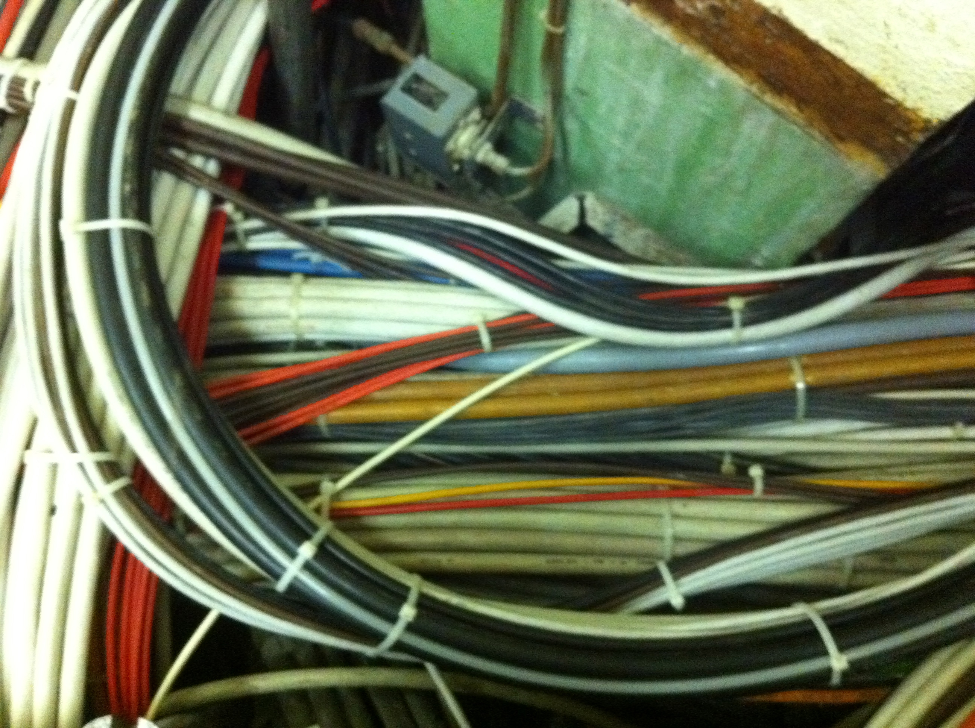
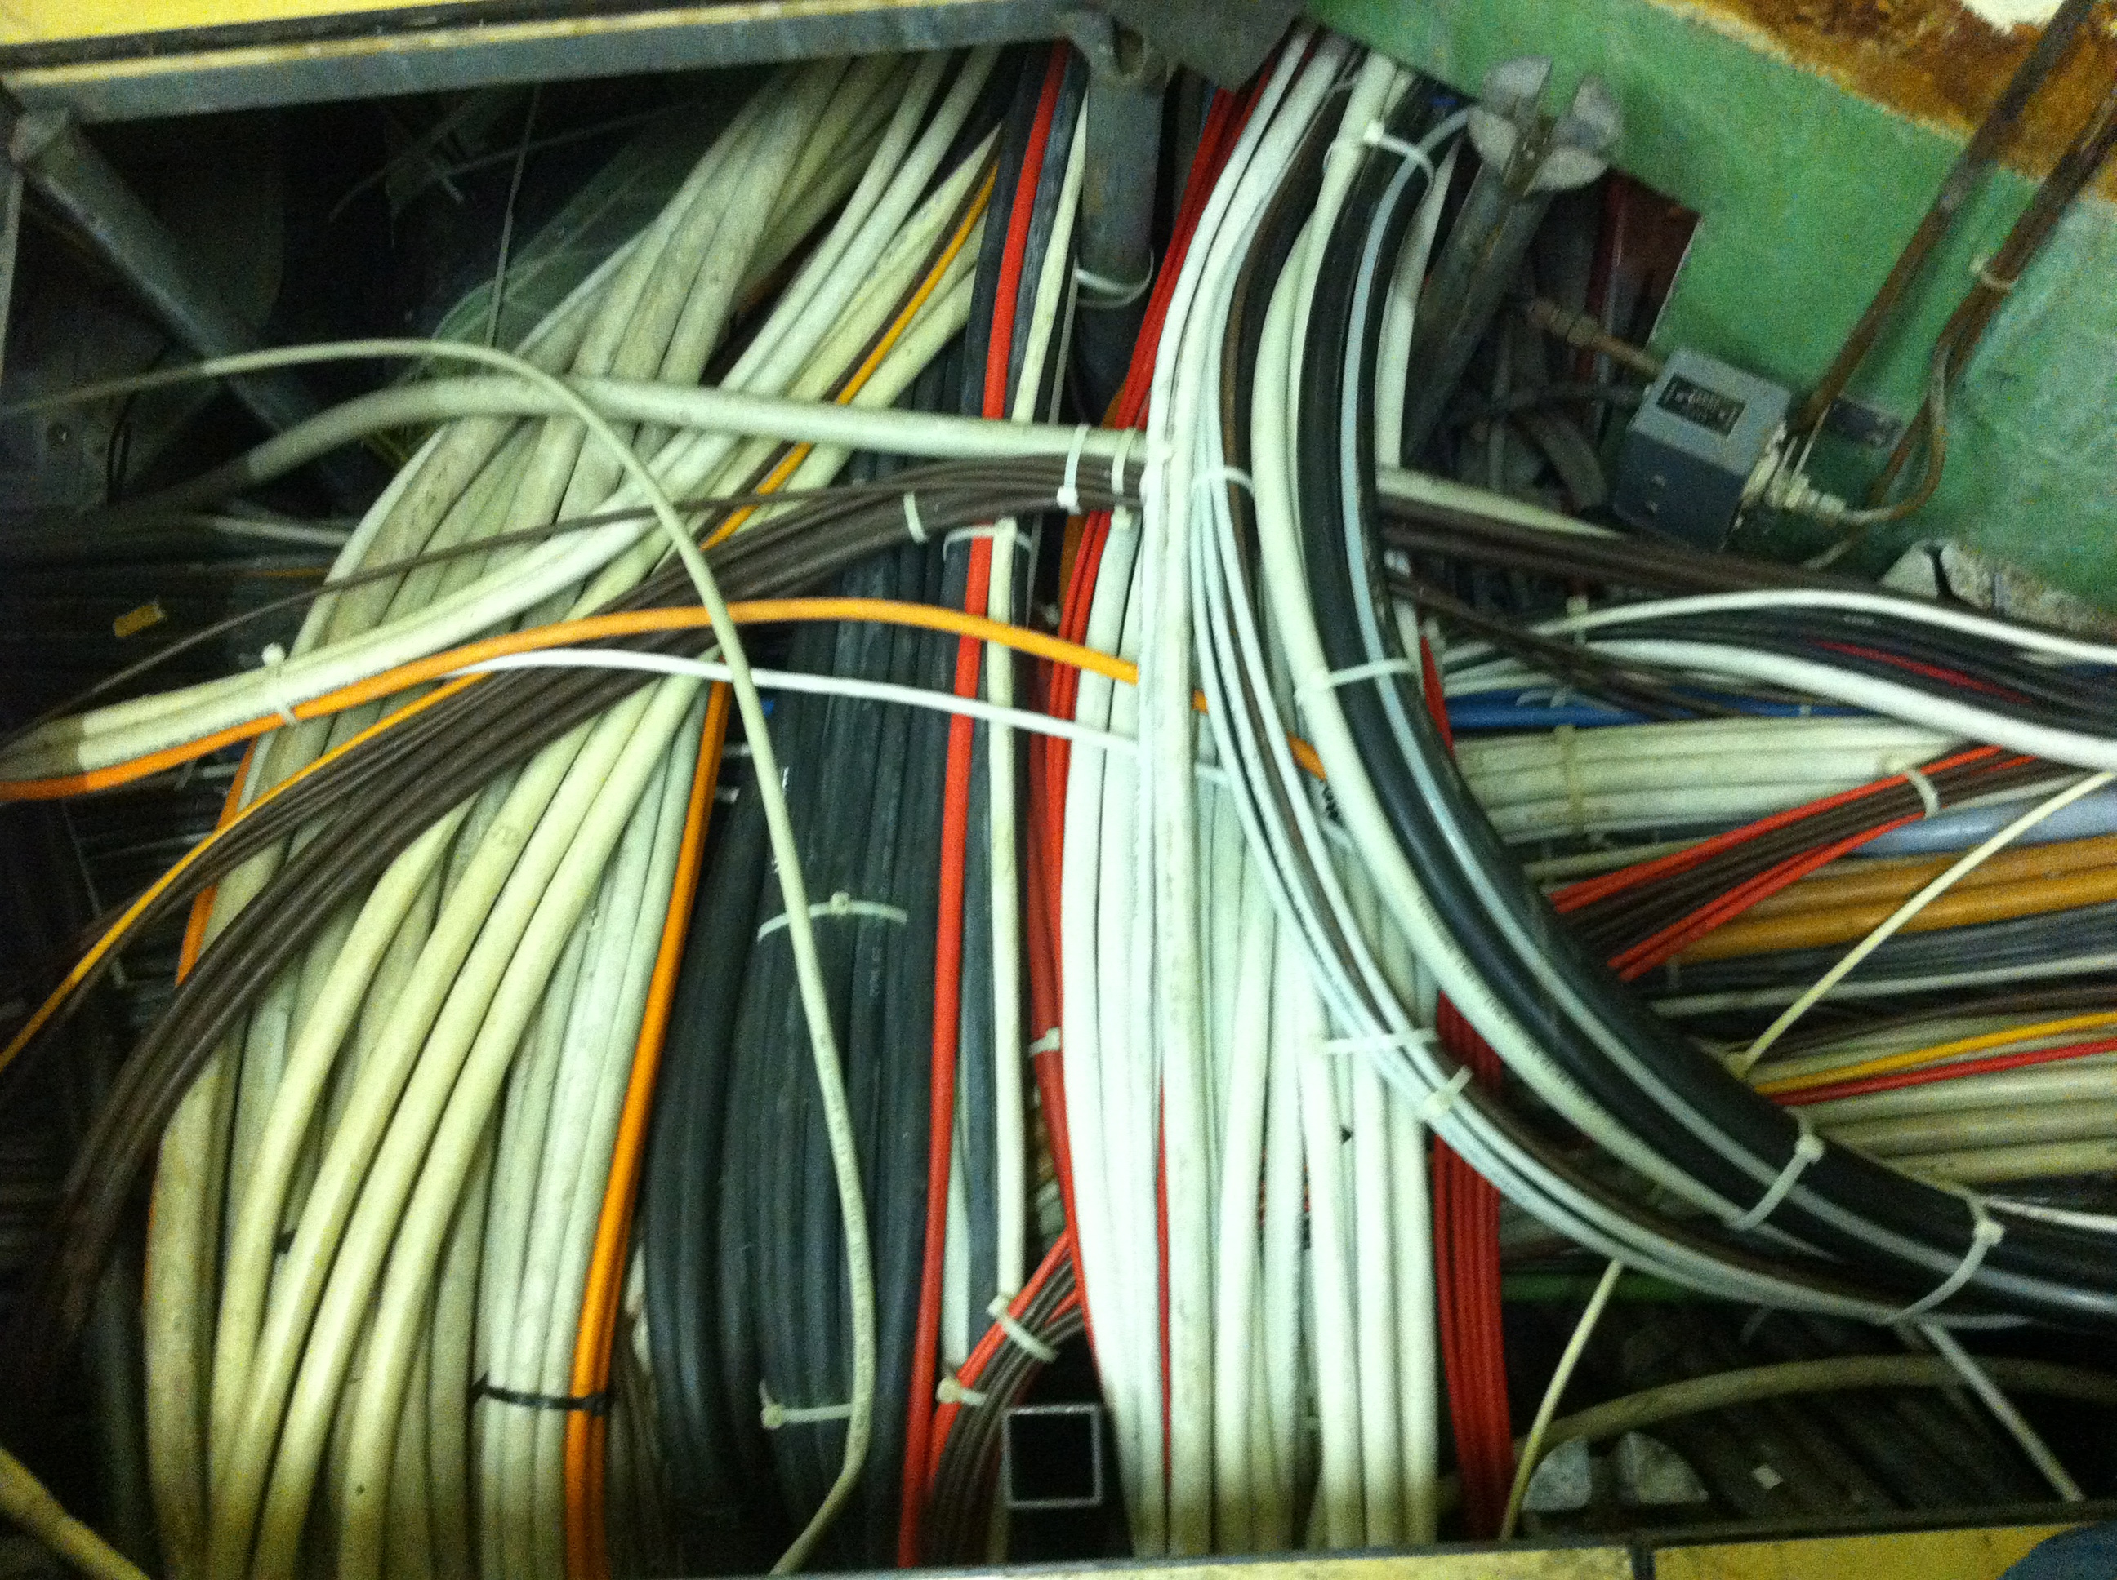
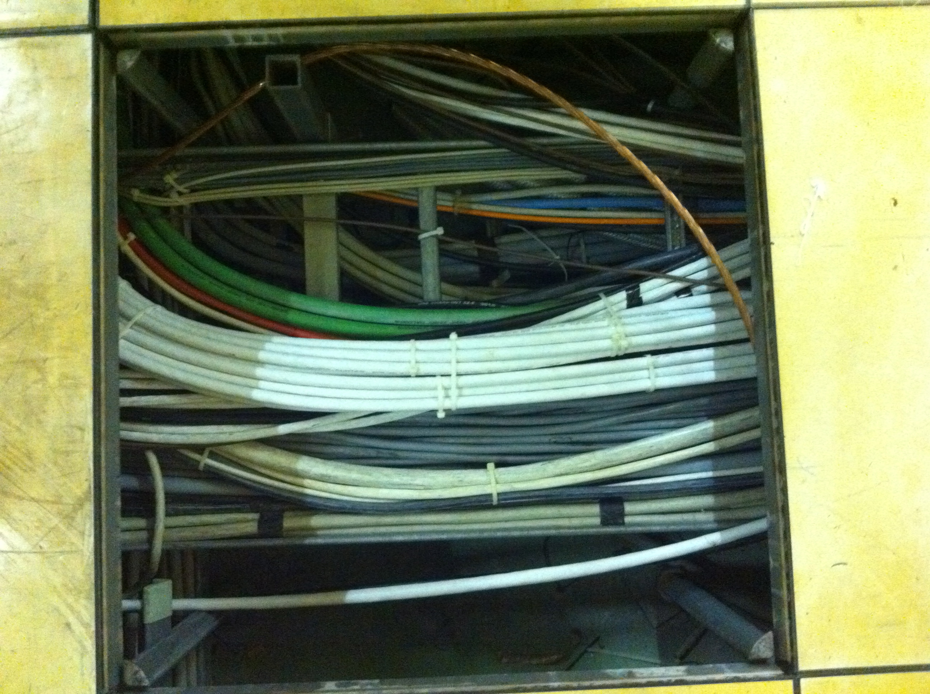
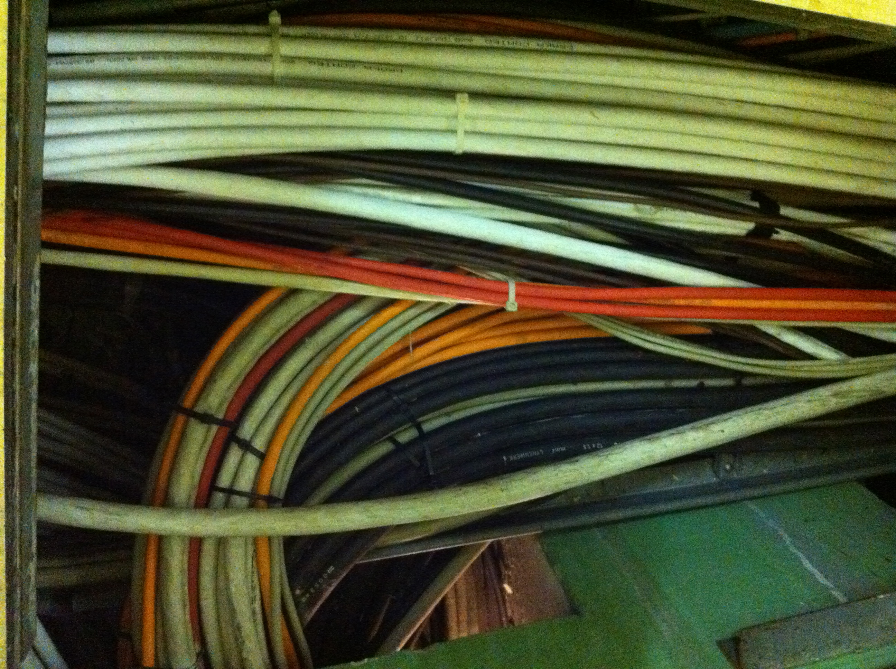
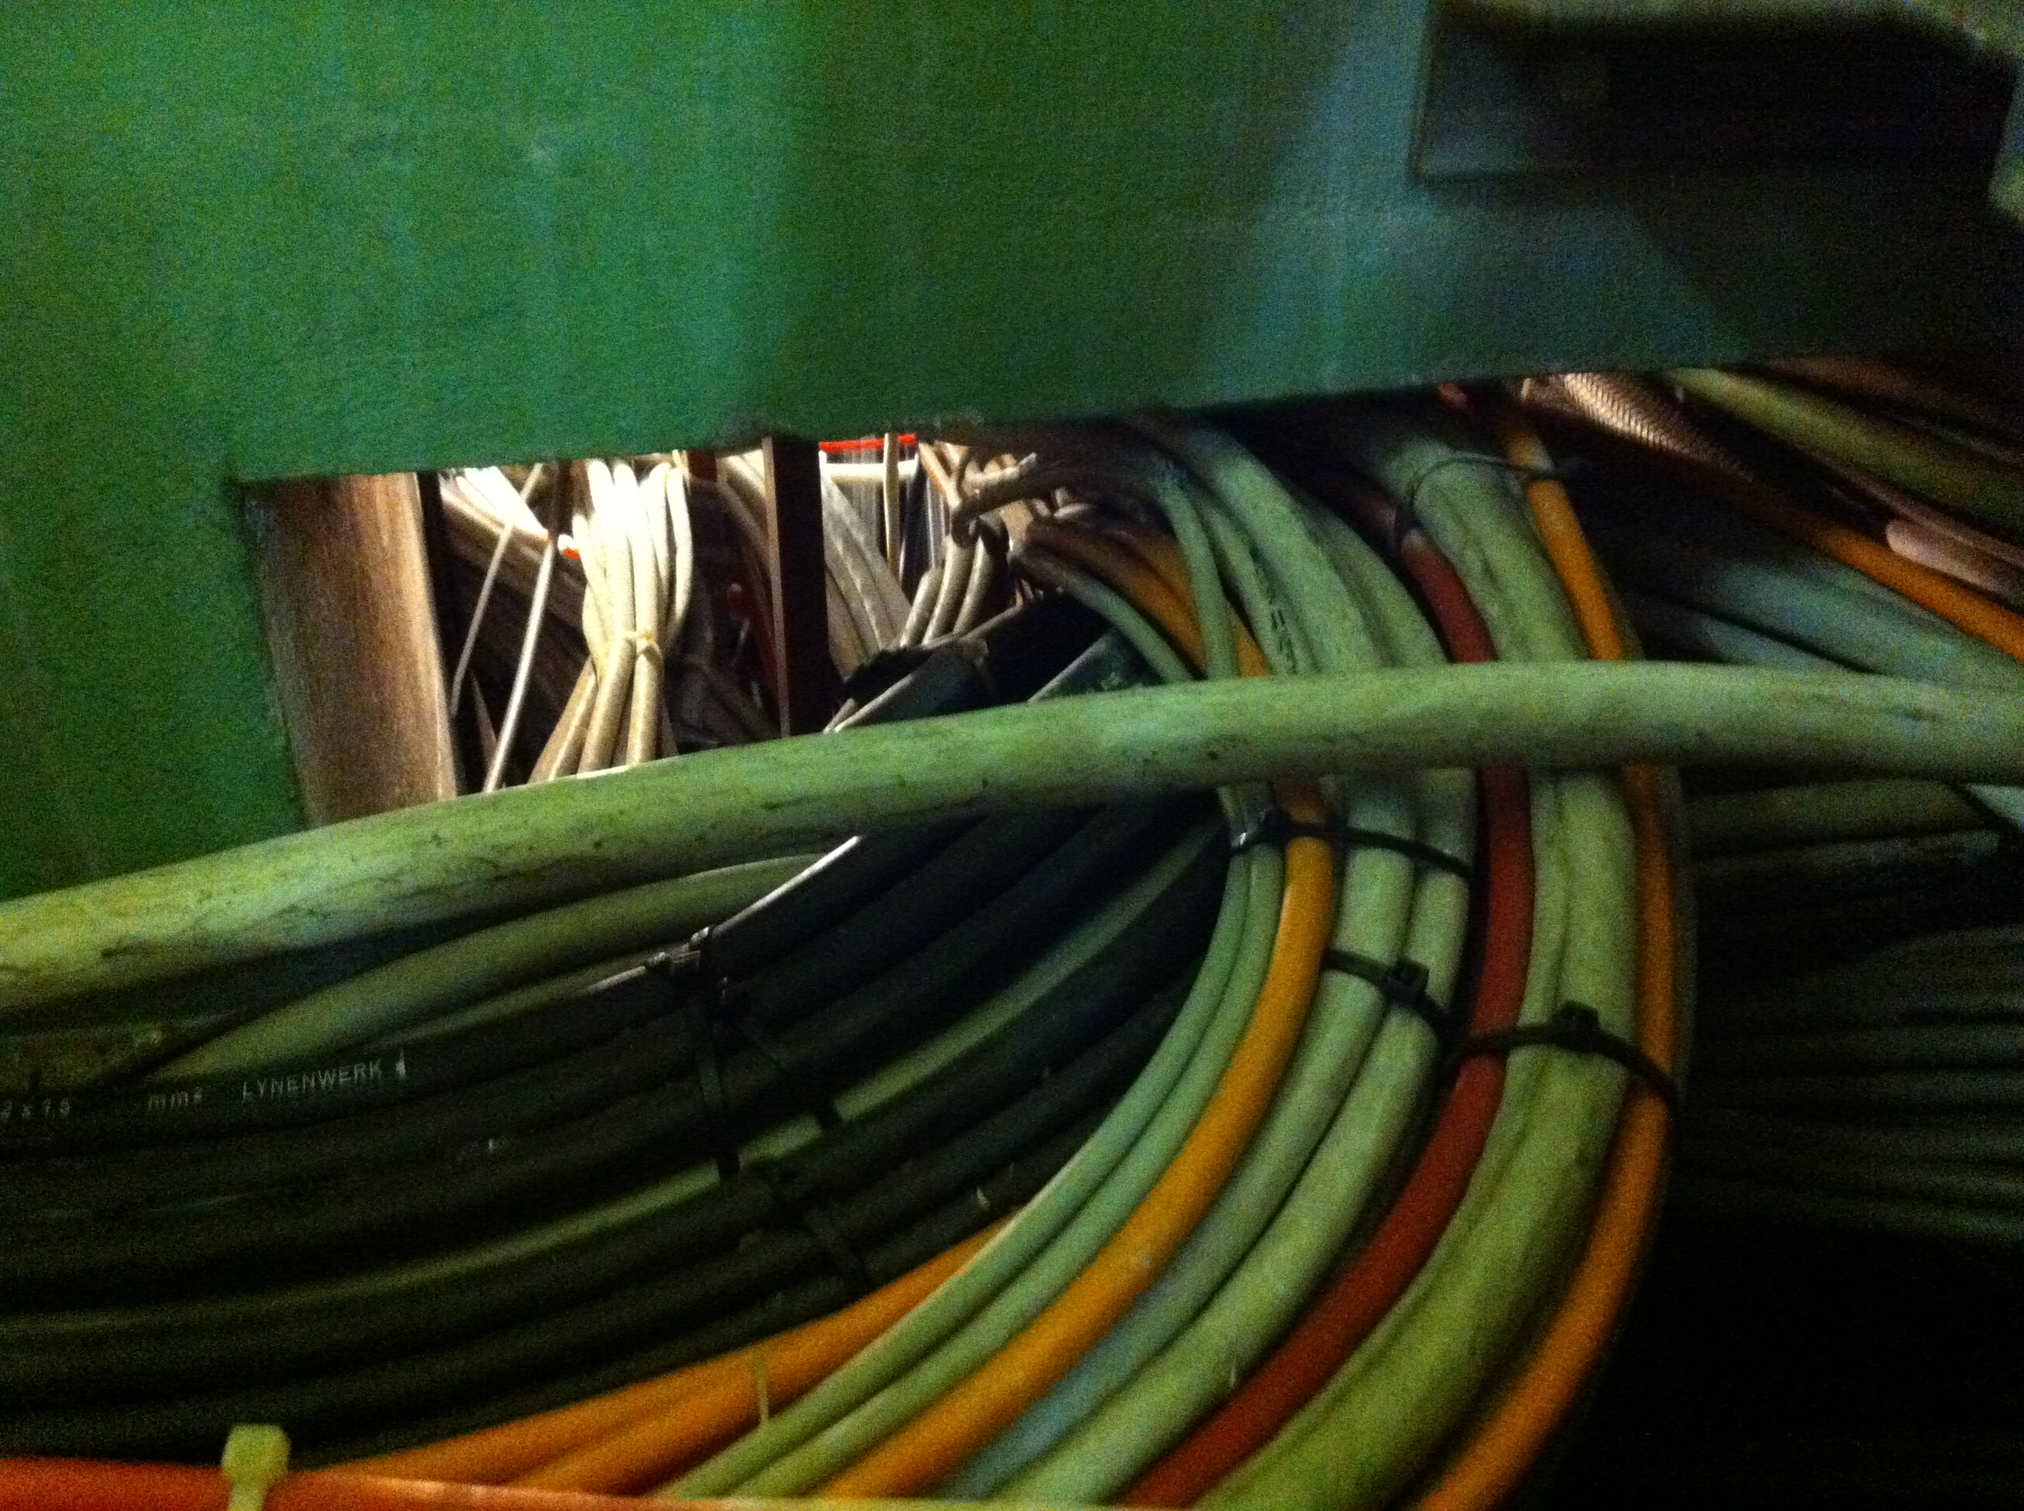
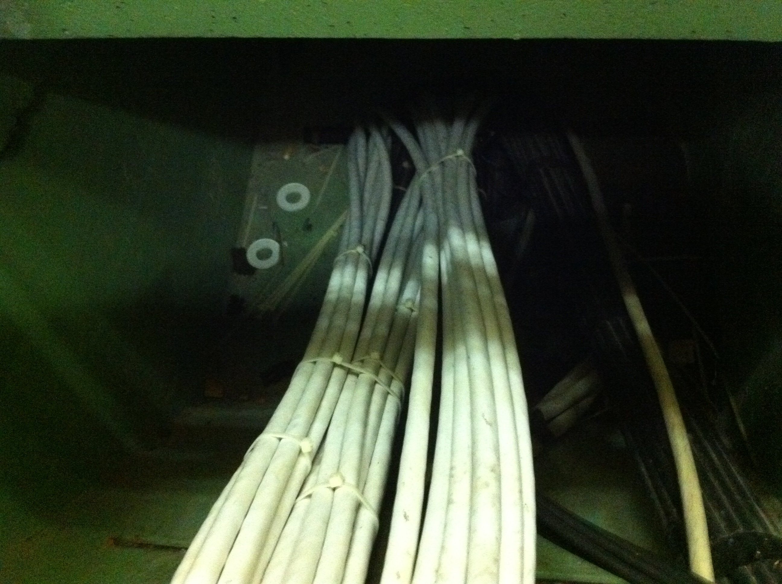
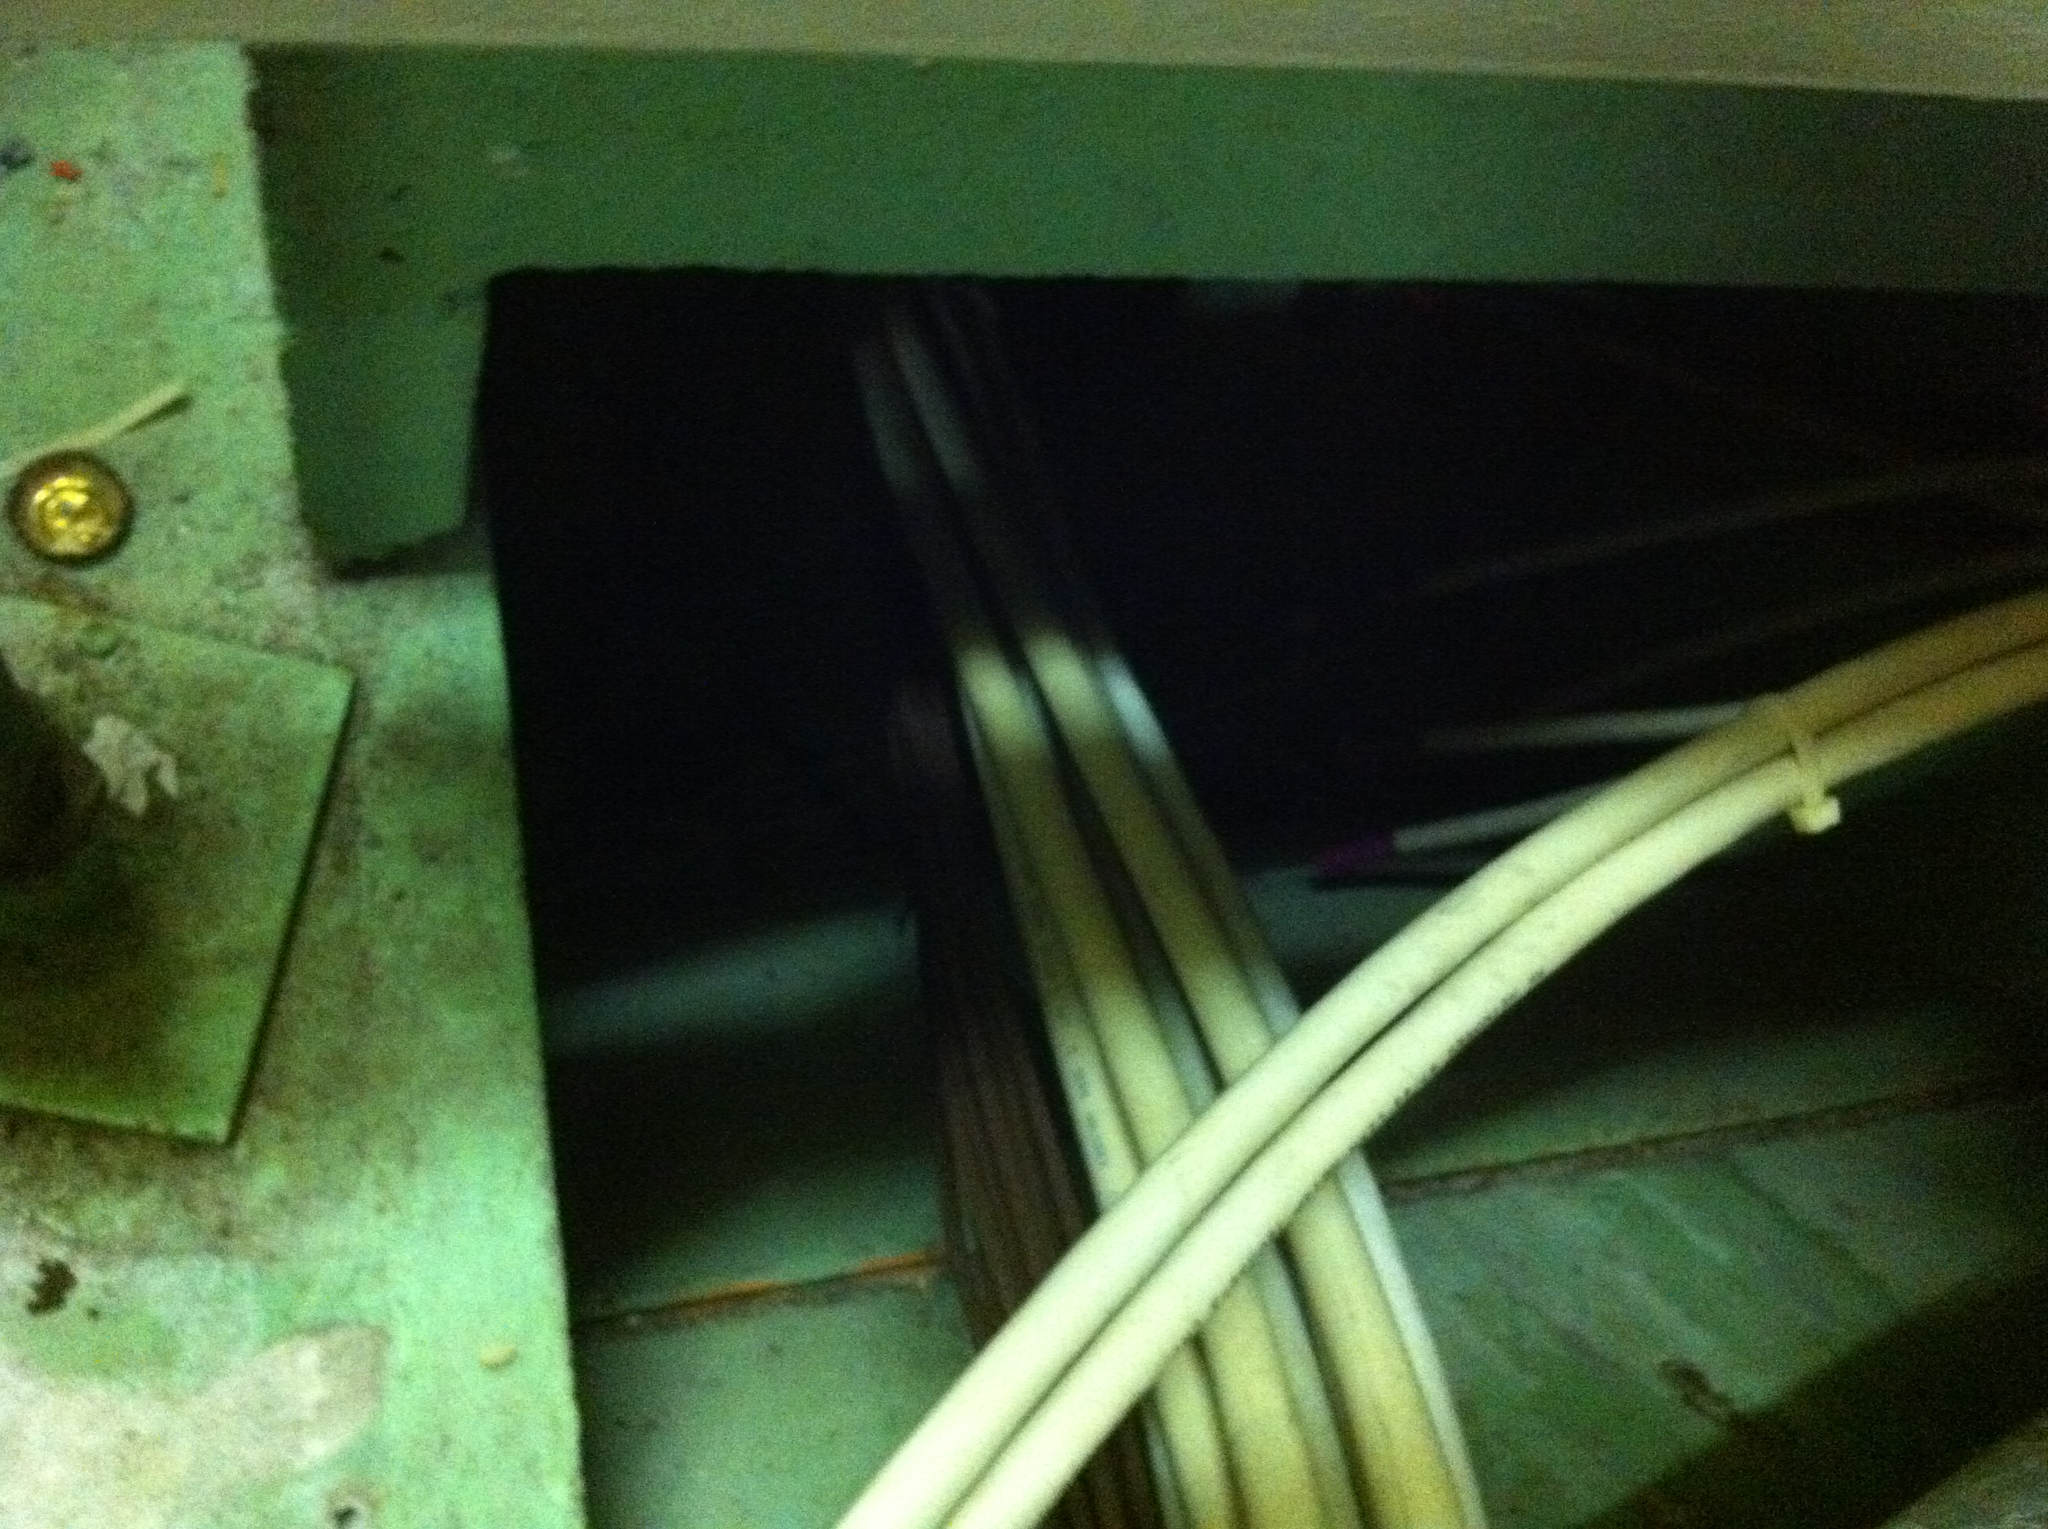
A few pictures (Wed. 21st December)

Slide 4
Prioritization of Cabling Needs → ideas
Prelim. discussion with J.-C. Guillaume, P. Lelong and D. Ricci :
Possible strategies:
  Removing all cables then (re)pulling all cables → LHC
  Removing some cables, pulling new cables… repeating
  Removing all unused cables in one campaign LS1
  then pulling all new and reused cables in LS1
  Removing all unused cables in one campaign
  then pulling all cables in LS1 and SD 14-15
  Removing all unused cables in one campaign
  then pulling all cables in LS1, SD 14-15 and SD 15-16
  …

Slide 5
Prioritization of Cabling Needs → ideas
Prelim. discussion with J.-C. Guillaume, P. Lelong and D. Ricci :
Issue #1 → Existing databases:
  Before 1989 : paper listings ; routing unknown
  After 1989 : in EL Cablothèque
Issue #2 → Cable marking
Issue #3 → Cables to remove
Issue #4 → Cables to pull
Issue #5 → Work optimization (remove then re-pull)
Issue #6 → Possible civil works required
Issue #7 → EN-EL workload (already 8 projects on-going)

Slide 6
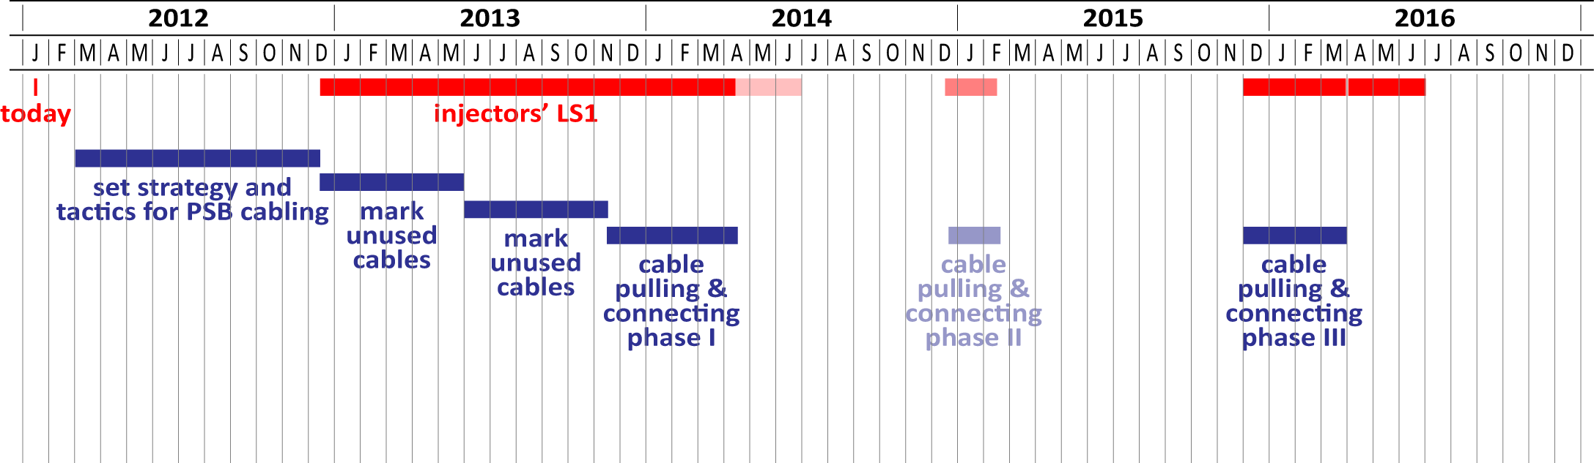
Prioritization of Cabling Needs → ideas
Prelim. discussion with J.-C. Guillaume, P. Lelong and D. Ricci :
Strategy to be set-up → PSBU meeting → end of February ?
In favor of a single cable removal campaign → LS1 ?
Possible schedule:

Slide 7
Preparatory works
Identifying all new vs. old equipment ☞ on-going
and associated cabling requirement
☞ schematic layout required ☞ to initiate soon
Identifying cables that are/will be useless
Identifying new cables that need to be pulled
Identifying rather crowded cables areas
Optimizing cable routes
Marking then removing these useless cables
Re-pulling useful removed cables + pulling of new cables

