Slide 1
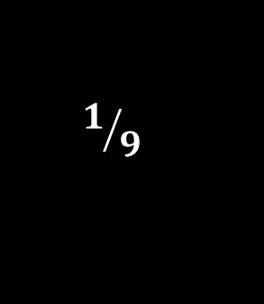
Analysis Summary
V. Blackmore
CM32, RAL, 10/02/12
$$1/9$$

Slide 2
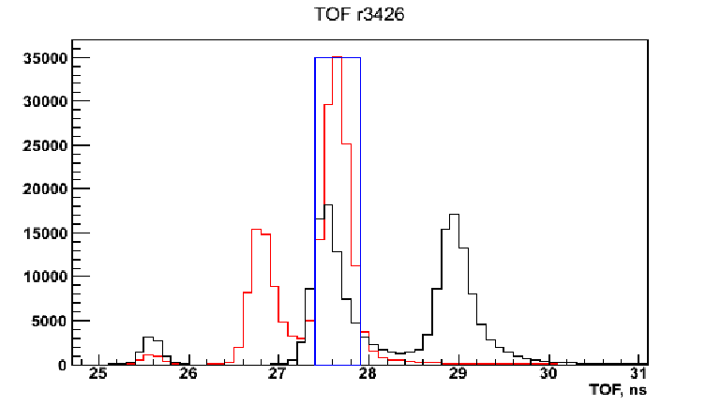
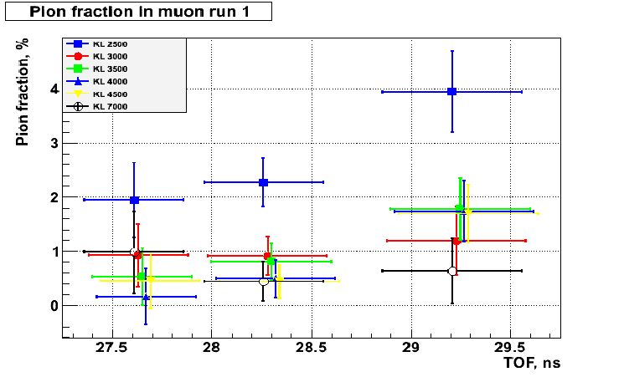
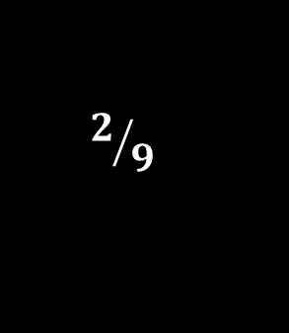
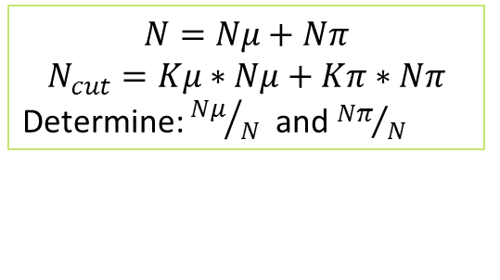
π-μ Beam Contamination
Developed two techniques for determining the amount of
π-contamination in our μ beam.
  The Time-of-Flight (TOF) of muons and pions can coincide in different runs. Compare the overlap between muon and pion peaks in pion runs:
M. Bogomilov, D. Orestano, A. Blondel, Y. Karadzhov
$$N=Nμ+Nπ$$
$$N_{cut}=Kμ∗Nμ+Kπ∗Nπ$$
Determine: ${Nμ}/N$ and ${Nπ}/N$
$$2/9$$

Slide 3
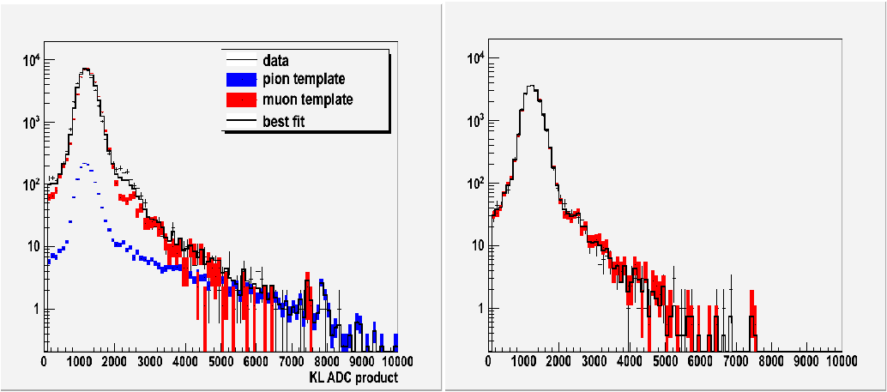

π-μ Beam Contamination
Developed two techniques for determining the amount of
π-contamination in our μ beam.
  Or: extract templates for muons and pions in fixed TOF windows from the pion runs.
  Fit the fraction of muons and pions in muon runs within the same TOF window.
M. Bogomilov, D. Orestano, A. Blondel, Y. Karadzhov
~96% m
~4% p
~100% m
~0% p
$$3/9$$
Very promising technique!

Slide 4
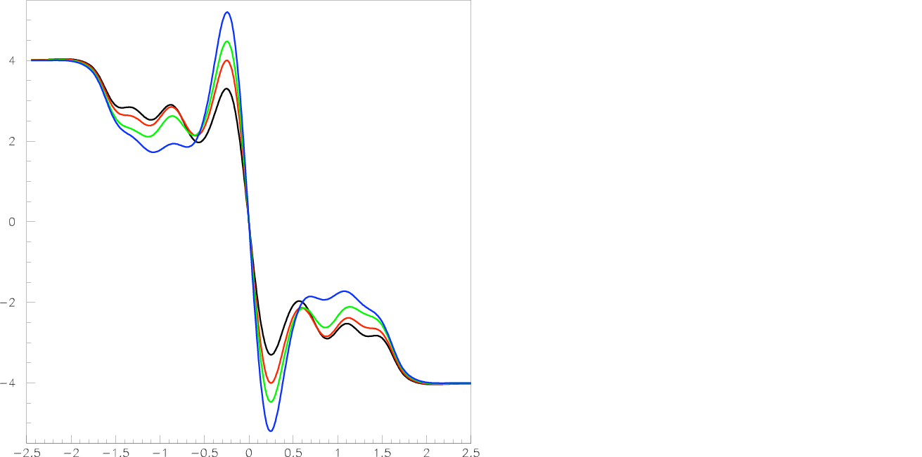
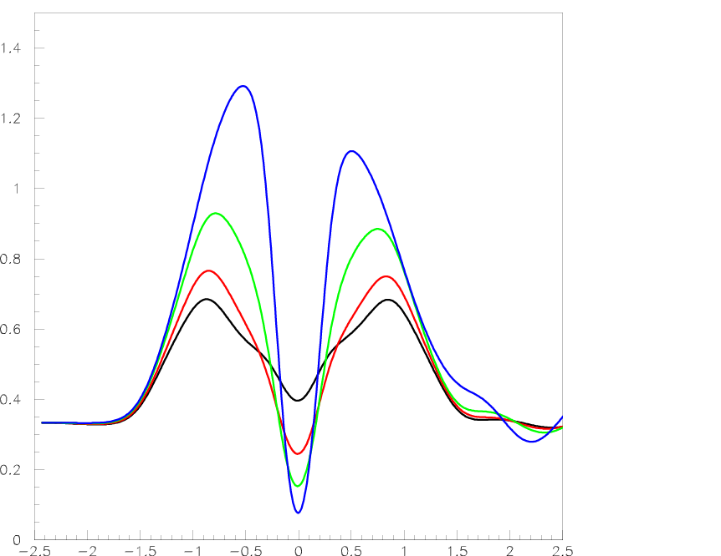

The Optics of Step IV
U. Bravar, P. Snopok
MICE Note 88 revival (U. Bravar, 2004)
  Optics solutions for MICE Steps IV, V and VI for ‘old’ coil parameters. Much has changed re: coil parameters.
  Solutions are compatible with coil limitations, are periodic (can be extended to future steps), and are scalable.
Tested the various TRD-based Step IV configurations in MAUS, making sure there is a match.
Next, rematching Step IV using the as-built coil dimensions.
B_{z} (T)
β (mm)
$$4/9$$
z (m)
z (m)

Slide 5
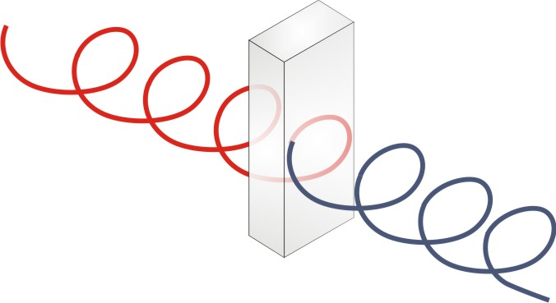
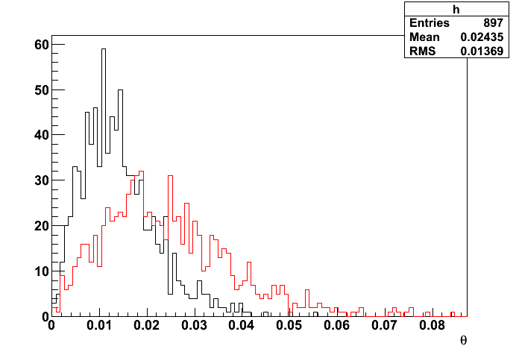
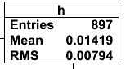
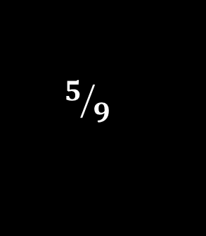
Multiple Scattering and the MICE Tracker
T. Carlisle
Scattering angle measured in tracker through AFC + LH₂
No Smear
Amount of smearing needs more thought!
→ It could be an overestimate.
Simulate μ down the channel, inc. absorbers.
Re-simulate through empty channel: Upstream to downstream, downstream to upstream.
Calc. angle between them → scattering angle.
Do this with and without smearing the ‘tracker’ reconstruction.
Can measure multiple scattering with the tracker.
Smear
10 20 30 40 50 60 70 80
 | No Smear | Smear | PDG | Paraxial beam
No AFC | 1.04e-9 | 3.01e-4
AFC (windows) | 7.55e-5 | 3.84e-4
LH₂ | 2.6e-4 | 7.8e-4 | 6.6e-4 | 2.37e-4
LiH | 4.6e-4 | 7.7e-4 | 1.15e-3 | 6.39e-4
$$5/9$$

Slide 6
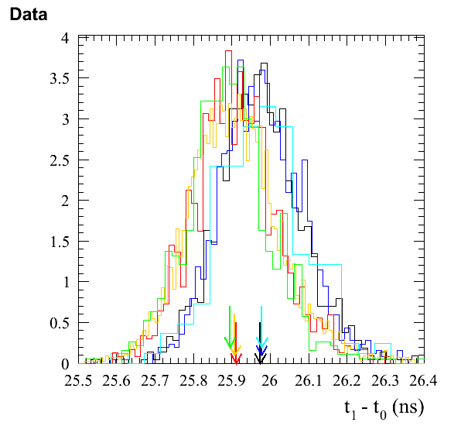
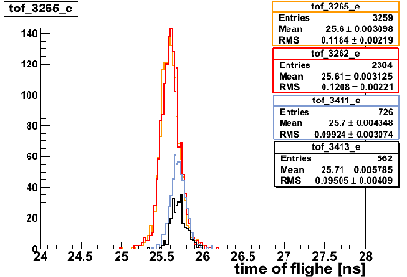
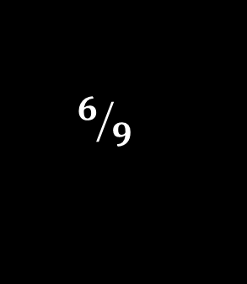
e⁺e⁻ Puzzle
The problem →
Y. Karadzhov
The problem: TOF between e⁺ and e⁻ is different.
Investigated in Dec. run.
Variation in the number of particle triggers/spill introduces a difference in the measured TOF of e⁺ and e⁻ (~100ps) despite identical beamline settings.
Now this is a “rate effect” problem!
$$6/9$$

Slide 7
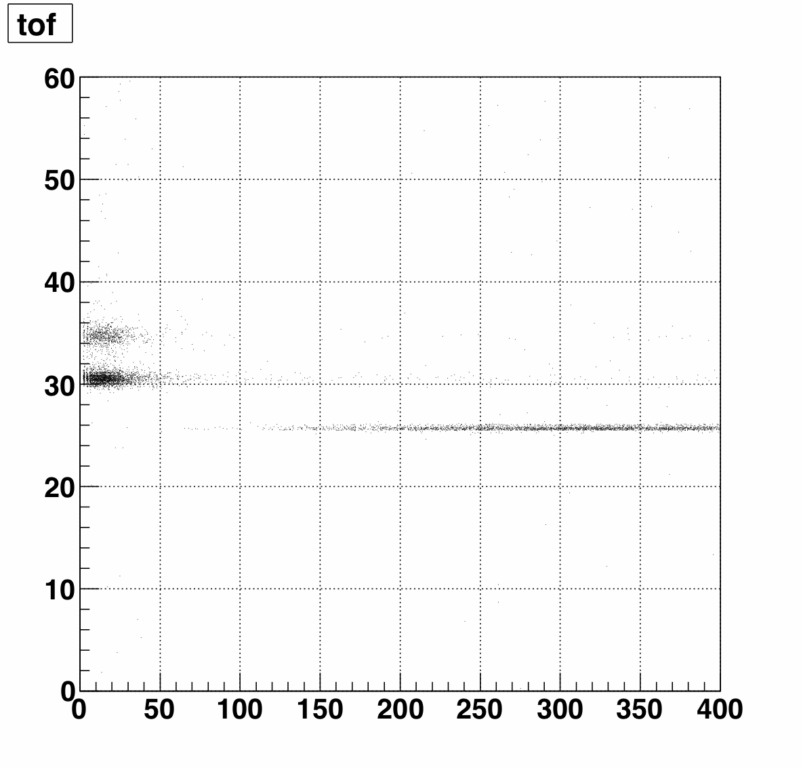
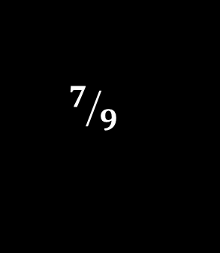
CKOV
L. Cremaldi
MAUS CKOV software is taking shape.
Dec. run processed soon.
Particles are well-separated in time distribution
  Currently, momentum cuts made ‘by eye’
Looking promising!
Below Ckov threshold
Electrons always
above threshold.
1-2 pe
pion
muon
>40 pe
electrons
$$7/9$$

Slide 8
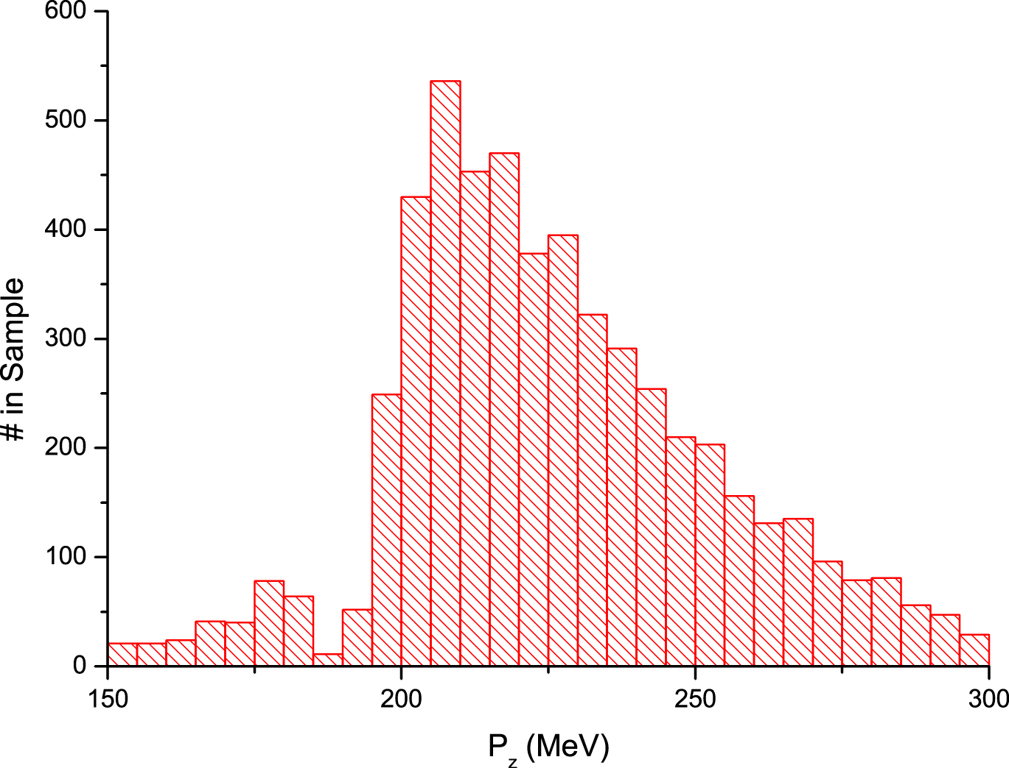
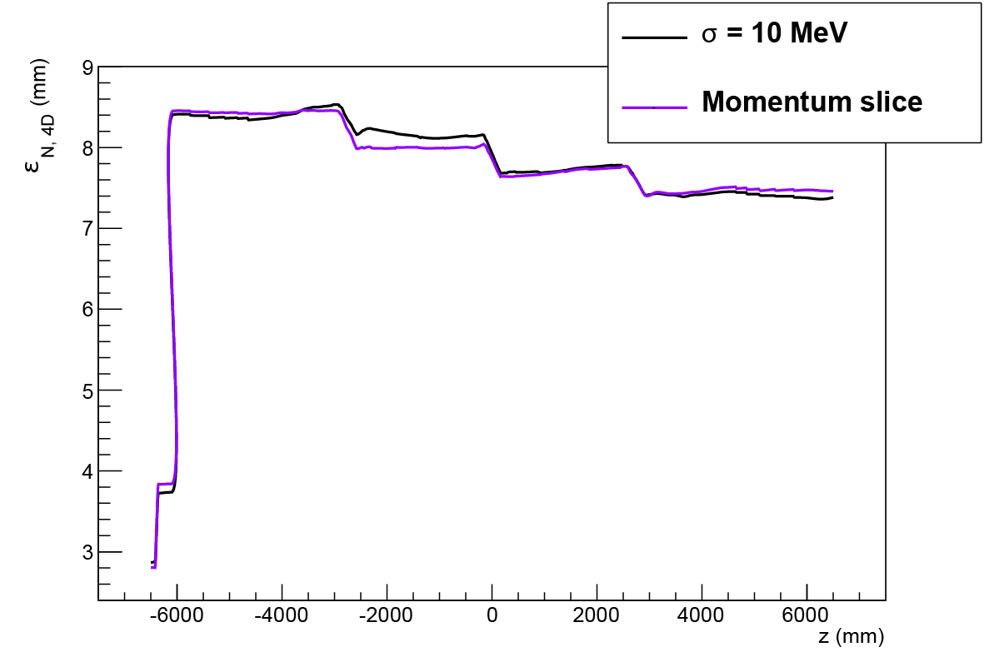
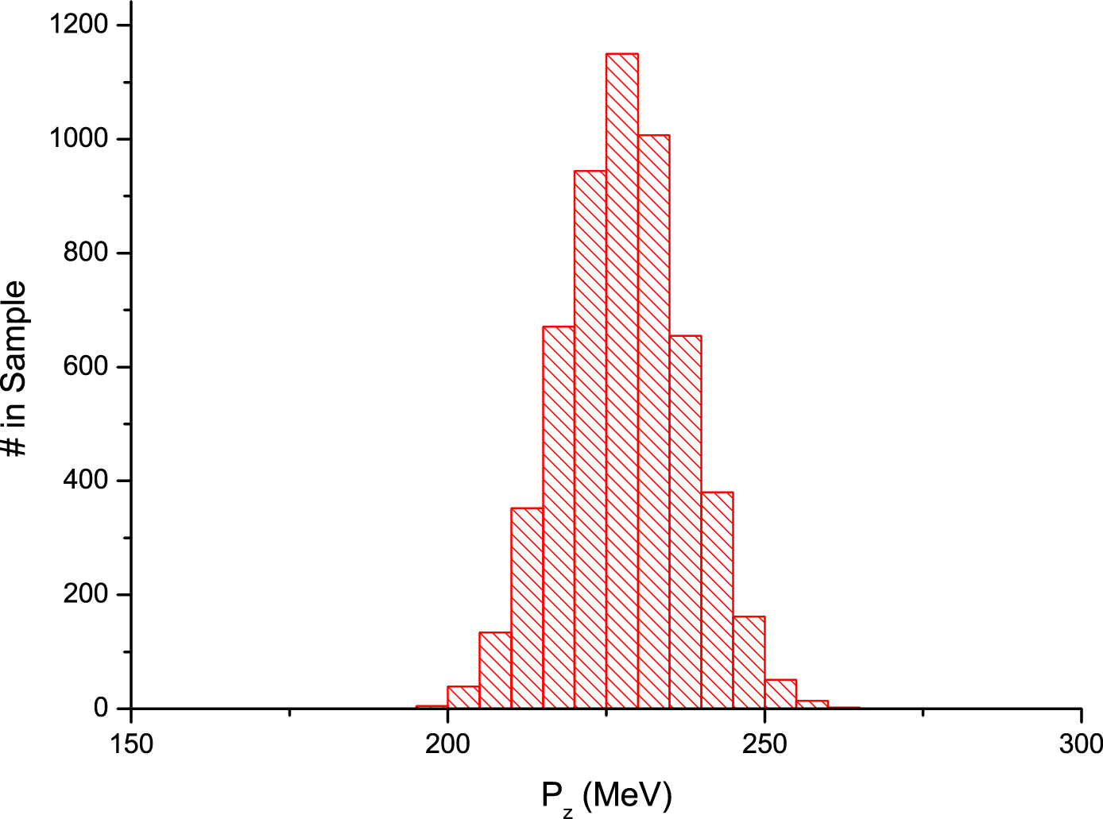

Step I Beams
V. Blackmore
Simulations of Step I (i.e. real muons!) through cooling channel show cooling.
Lots of work to do studying the beam behaviour.
$$8/9$$

Slide 9

Analysis Group Summary
Analysis Group was rebooted in Nov.
  Fortnightly meetings (everyone is welcome!)
  Many topics since November: Online reconstruction, run plans, CKOV performance, e⁺e⁻ puzzle, π−μ separation, magnetic fields analysis, optics, multiple scattering in Steps IV & V, particle rates through the EMR, Step I beams, TOF pulse height – many analysis topics!
Already have some excellent results (Bogomilov) and some very promising avenues to chase for Step IV (Bravar, Carlisle).
Plus we can all rest easy knowing our electrons/positrons aren’t disobeying relativity (Karadzhov)!
Many more topics being explored.
Watch this space.
$$9/9$$

