Slide 1


Overview of the PicoSEC Project
Etiennette Auffray,
Network Coordinator
CERN PH-CMX

Slide 2
Aim of project
PicoSEC-MCNet Project :
Pico-second Silicon photomultiplier-Electronics- & Crystal research-Marie-Curie-Network
A multi-site Network to provide training to young researchers in a multidisciplinary R&D project geared to develop a new class of ultra-fast photon detectors in Positron Emission Tomography (PET)
and high energy physics (HEP).

Slide 3











PicoSEC : A Multisite Network
11 Partners from 6 different European countries: 7 academia and 4 companies

Slide 4
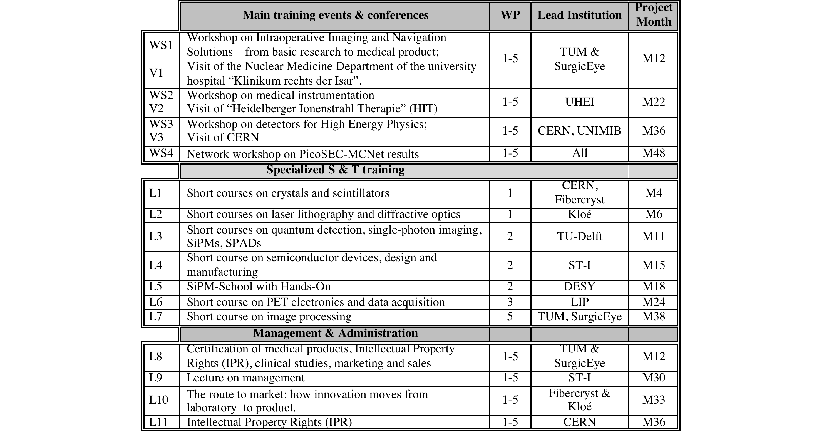
PicoSEC : A training program
15 scheduled network training events :
4 workshops, 7 scientific trainings,
4 management and administration + local trainings

Slide 5
PicoSEC : For young researchers
22 job opportunities : 18 Early Stage Researchers, 4 Experienced Researchers

Slide 6
PicoSEC : For young researchers

Slide 7
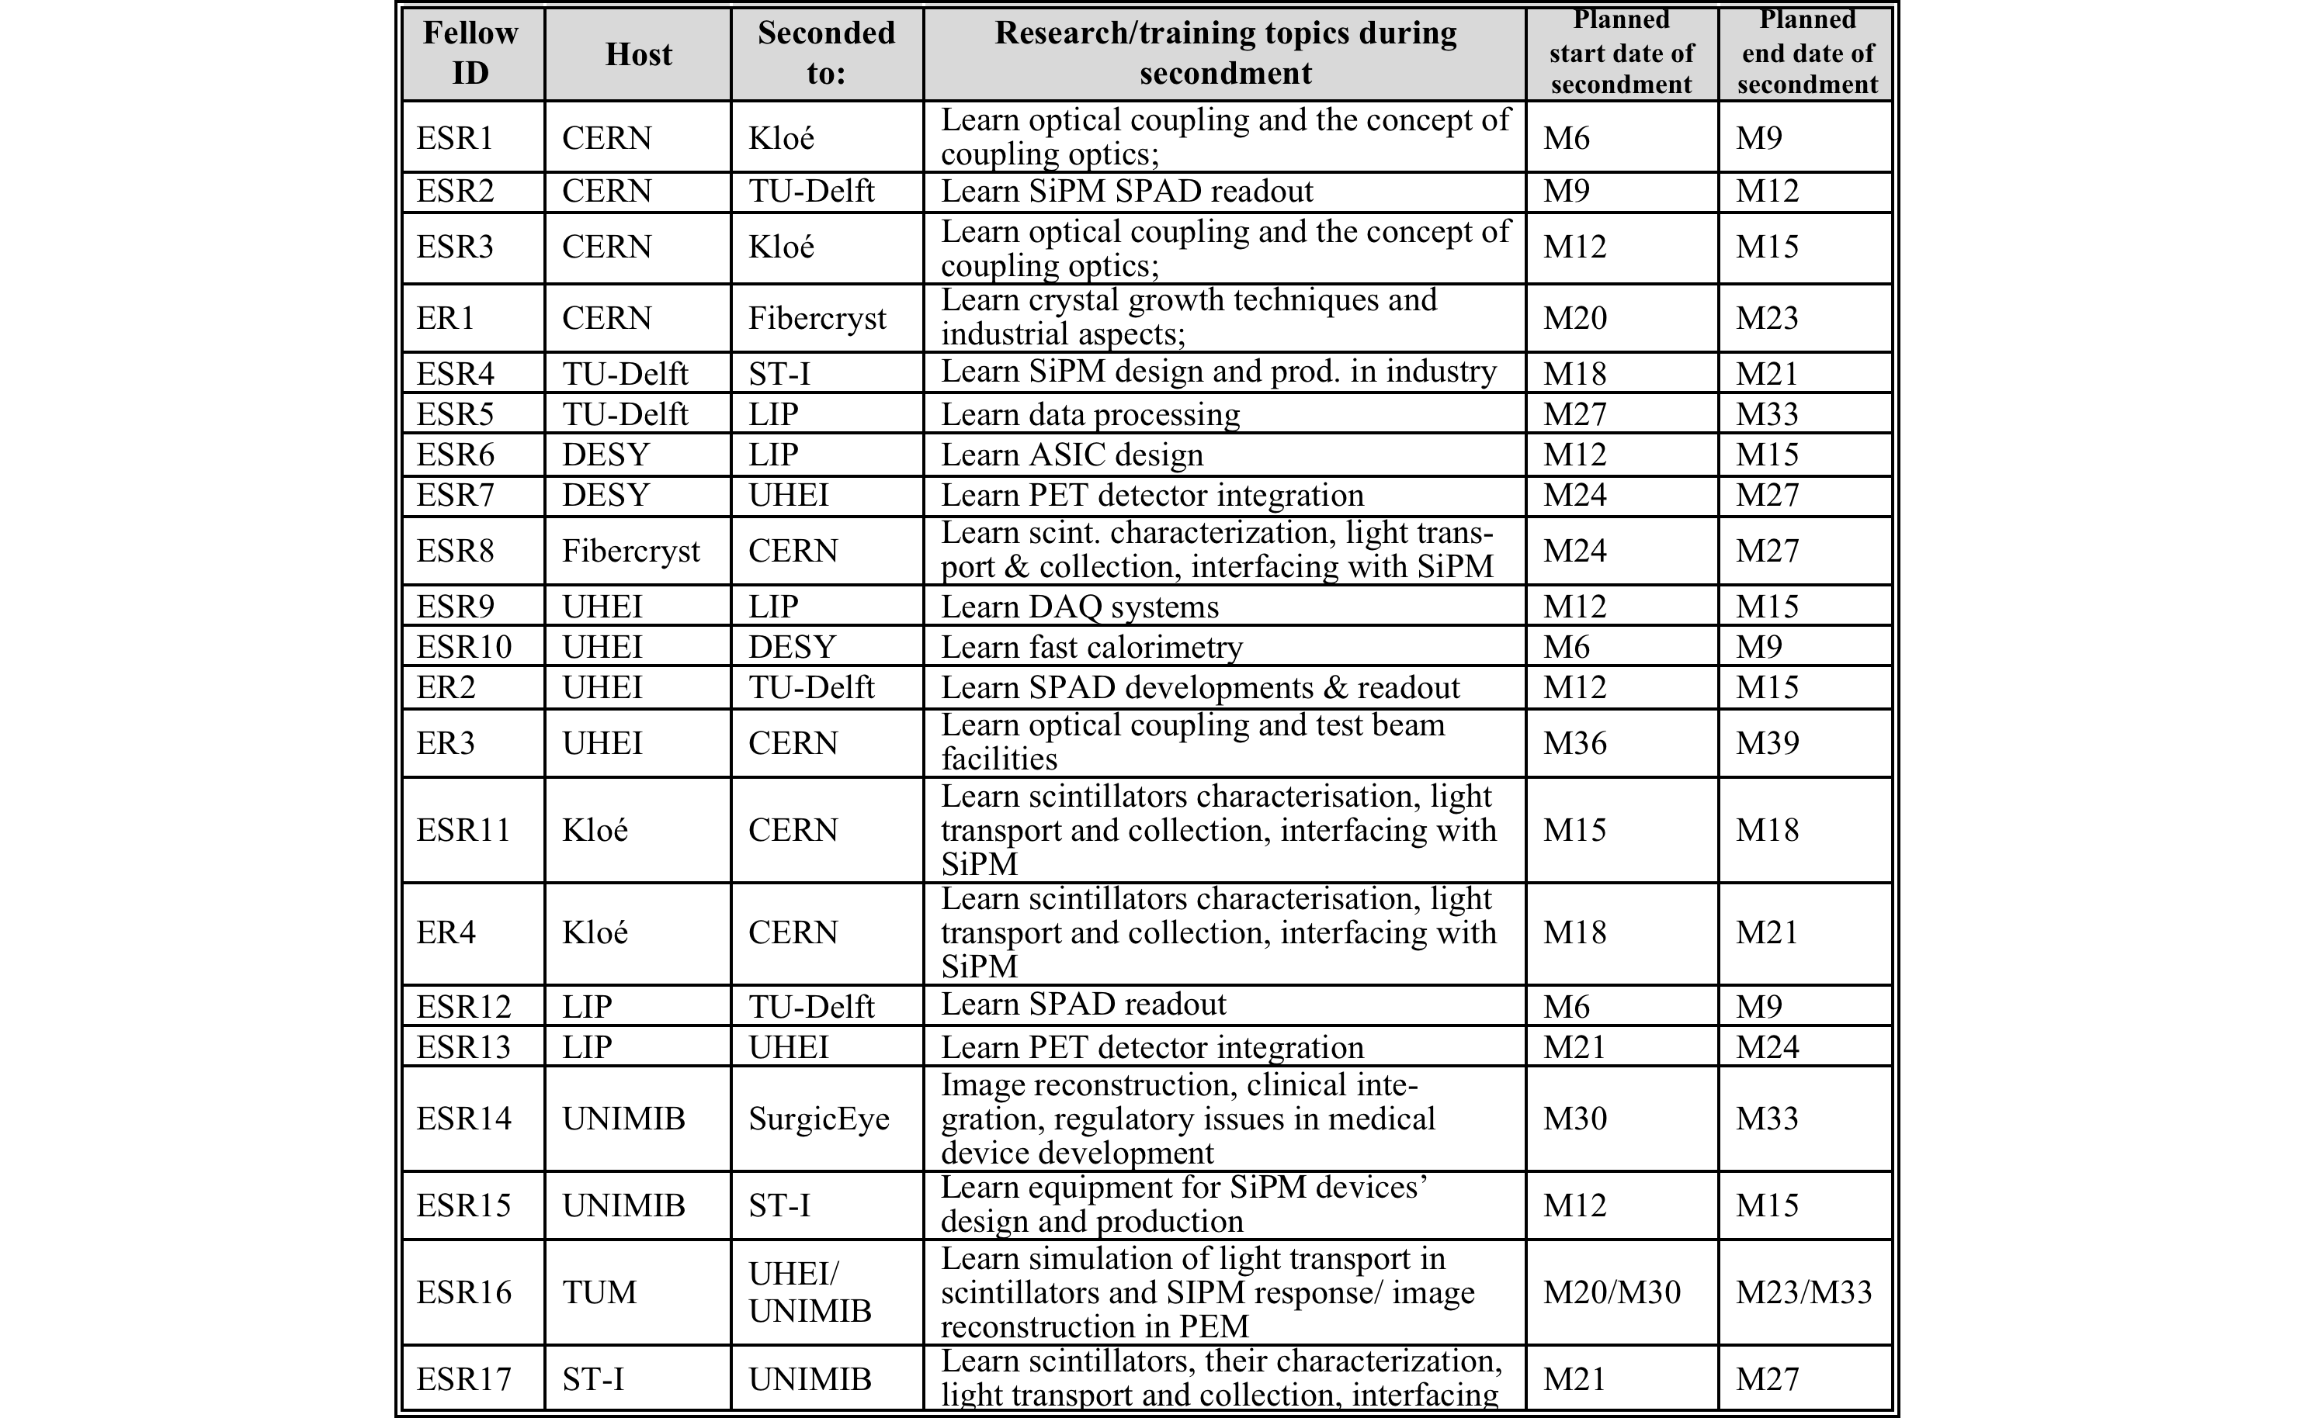
PicoSEC : Mobility
Each student will spend at least 3 months in partner institutes

Slide 8
PicoSEC : Scientific Program
The core activity of PICOSEC is detector developments for
  TOF-PET applications with fast time resolution (200ps) in close relation with the
  FP7-EndoTOFPET project from detector components to image reconstruction;
  Calorimetry in particle physics experiments: HLLHC, ILC, CLIC.
Fields of activity
  Scintillators and optics for fast timing;
  Photodetectors, particularly silicon photomultipliers (SiPMs) and SiPM derivatives;
  Electronics and data acquisition systems;
  Detector integration and prototyping;
  Endoscopic instrumentation;
  Calorimetry in high energy physics;
  Tracking and image reconstruction (hardware and software).
Work organised in 5 WPs

Slide 9
PicoSEC : Work packages
WP1 : Scintillators & optics for fast timing : CERN, Milano, Fibercryst, Kloé
  Develop and optimize scintillators and optical systems such that the light loss from the scintillating medium to the photodetector becomes a minimum.
  Produce and evaluate the best optical components for use in fast, high time resolution, photodetectors for high energy physics and medical imaging (TOF-PET) aiming to achieve a coincidence time resolution of less than 200ps FWHM.
  Identification of the most appropriate scintillator material and optimization of scintillator production parameters in terms of shape, optical quality, doping and cost.
  Improvement of light transport in and light extraction from the scintillator.
  Design, production and characterization of the light-coupling system for the most efficient light transfer between the crystals and the photodetector.
WP2 : Photodetectors for fast timing :Delft, CERN, Milano, ST-Microelectronics
  Develop a special SiPM chip (SPAD array) with high spectral sensitivity (centered around 400-500nm) and ultrafast response time where each SPAD is read out individually yielding a time resolution of <100ps FWHM, measured on chip;
  Design pixel geometries for matching the crystal fiber matrix with the SPAD array;
  Evaluate the timing performance of devices with laser-excited fibers and/or other techniques;
  Evaluate standard SiPMs for use in TOF-PET in terms of time resolution

Slide 10
PicoSEC : Work packages
WP3 : Electronics & Data Acquisition : LIP, DESY, UHEI
  Acquire base knowledge in electronics for signal processing and data acquisition in PET and calorimeter detectors.
  Design and test prototypes of ASICs for time and energy measurement of radiation pulses detected with scintillators and SiPMs.
  Design and evaluation of high-performance DAQ system prototypes for TOF-PET and calorimetry.
WP4 : Detector Integration & Prototyping : UHEI, DESY, CERN
  Build and test combined scintillator/SiPM systems including readout and data acquisition.
  Test of timing response and performance of the combined systems w.r.t applications in TOF-PET and fast calorimeter systems.
  Build demonstrator prototypes for the endoscopic TOF-PET probe and calorimetry with fast scintillator-based detectors and SiPM readout
WP5: Image Reconstruction, Tracking/Navigation, Hardware & Software :
TUM, SurgicEye
  Provide tracking solutions for flexible endoscopy and endoscopic imaging devices, and evaluate their robustness and accuracy.
  Based on tracking and imaging data, reconstruct volumes of interest from flexible endoscopic detectors.
  For orientation, guidance to specific regions of interest, and, where appropriate, through specific scanning protocols, provide navigation solutions.

Slide 11
PicoSEC : Milestones
Scientific Milestones

Slide 12
PicoSEC : Milestones
Training, Outreach, Management Milestones

Slide 13
PicoSEC : Management
SUPERVISORY BOARD
(Chair Elected by Board)
One Representative per Partner
EXECUTIVE COMMITTEE
(Chair: Network Coordinator)
Network Coordinator & Deputy
Training Coordinator
Administrative Support
Project (WP-) Leaders
CERN ITN support team
Administrative
Financial
legal
Meetings, Workshops
Research Projects (WP-
Leaders)
Today, we need:
to elect :
Chair of the Supervisory Board
and to nominate :
the Deputy Coordinator,
the Training Coordinator.

Slide 14
Status of Recruitment
All applications are centralised in the ERT system at CERN.
  CERN checks the eligibility of all applicants.
All posts have been published on the PicoSEC website, CERN’s ERT pages, Euroaxess and several other networks.
Deadline extended until January 31.
At this time: < 5 applications/per post → Need more advertising
Recruitment between February & March in each institute:
Most of the students could start beginning of April/May.
Propose to have a “Student Welcome” event during the first Network training in Lyon on scintillators in Spring 2012 (mid-June)
All ESRs have to be recruited before end of October 2012 (end of 1st year of the project)

Slide 15
Training
Individual training (specific for each student):
  Research program;
  Local training in each institute;
  Participation in specific courses and/ or conferences.
Training organized by the network
  All PicoSEC network students should participate;
  Open also to students not being members of the PicoSEC network.

Slide 16

Communication
PicoSEC Logo:
PicoSEC public web site : http://www.cern.ch/picosec
Indico zone (private, need to register on indico): http://indico.cern.ch/categoryDisplay.py?categId=3893
Mailing lists : picosec-members@cern.ch, picosec-SB@cern.ch, picosec-EC@cern.ch

Slide 17
Outreach & Dissemination
Dissemination
  Publications in scientific journals;
  Presentations at conferences and workshops;
  Important to mention the project in all published documents.
Outreach
  Project website,
  Brochure,
  Articles in information bulletins of participating partners, or webpages,
  Pro-active participation in outreach events for the general public.
  All students are expected to participate in all outreach activities.

Slide 18
Objectives of today’s meeting
Introduce project participants
Setting up project management and organization
Preparation of a project plan
  Recruitment
  Training
  Milestones, objectives, and deliverables

Slide 19
Welcome to the PicoSEC project!
Wish you a successful collaboration!

