Slide 1
PicoSEC Activities at CERN
E. Auffray, PH-CMX

Slide 2
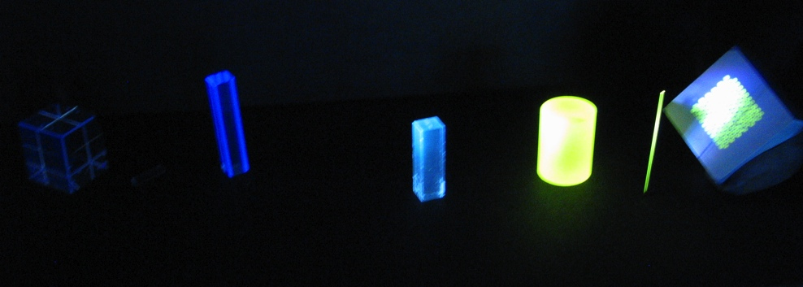
WP1 : Crystal & Optics
Characterization of scintillating crystals and fibers
  Optical, scintillation, radiation hardness properties
Understanding and improvement of light transport & collection
  Ray tracing simulation
  Surface treatment
  Development of photonic crystals, optical components

Slide 3
WP2 : Photodetectors
Characterization of different types of SiPM
Performance studies of crystal & SIPM
  Light yield, energy resolution, timing performance
Optimization of crystal-photodetector coupling

Slide 4
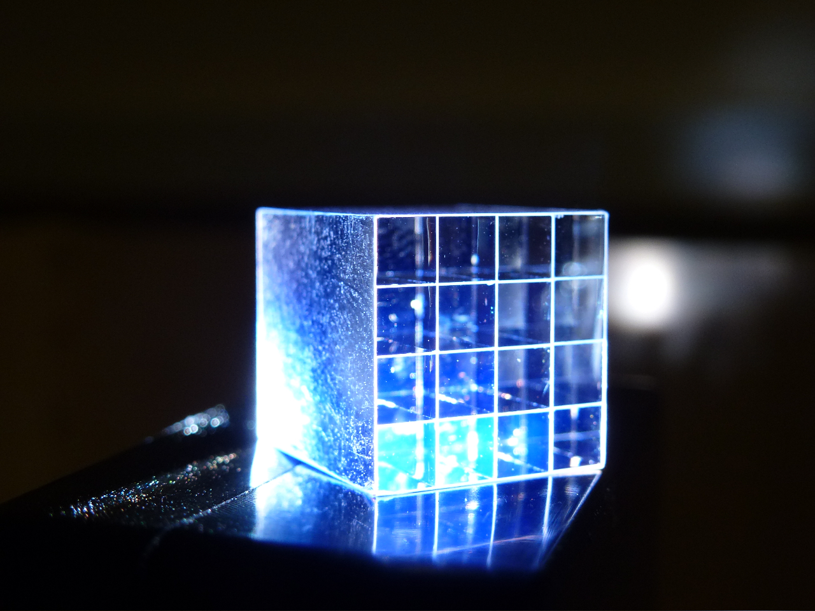
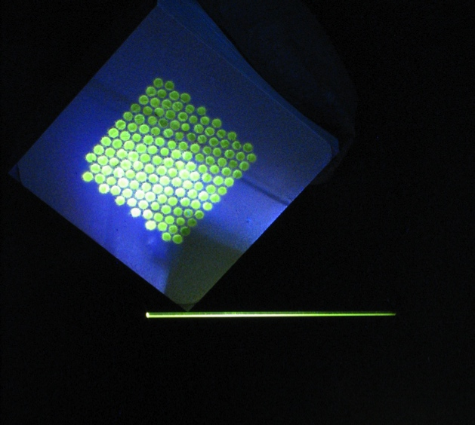
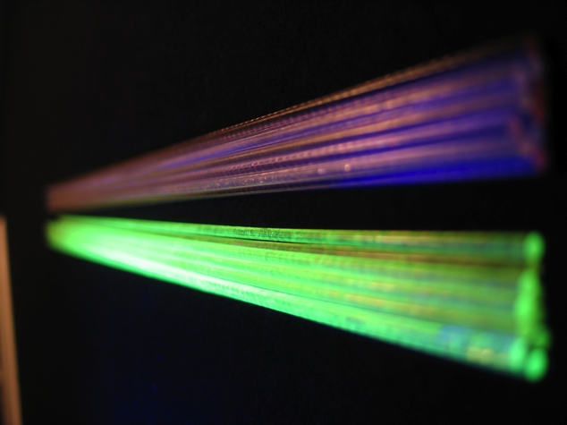
WP4 : Detector integration & Prototyping
Design and realization of detector matrices (Xtal + photodetector) for PET and calorimetry
Test performances in test beam

