Slide 1

Concluding Remarks
Markus Friedl
(HEPHY Vienna)

Slide 2

What is left to say?
Thank you all for making this meeting a success!
Enjoy the rest of your stay in Vienna and have a safe trip home
We’d like to ask for feedback to improve future meetings: http://survey.hephy.at/index.php?sid=78663&lang=en

Slide 3

BaBar & Belle // SuperB & Belle II
I often heard the term “friendly competitors” – what does it mean?

Slide 4
Some Thoughts On Competition
History tells that competition promotes progress
This is also true for economy – monopoly vs. open economy
An extreme example:
  In my youth (telecom monopoly) landline telephony costs were O(10) times higher than now – despite inflation!
The good thing is: our goal is not financial profit, but scientific knowledge available to mankind
As we do not need to hide any business secrets: We can and shall freely talk and learn from each other – that’s why we are here ☺
I do hope we continue this friendly spirit!

Slide 5
Meeting Dinner: Heuriger 10er-Marie
“Heuriger” is a tavern where wine-farmers sell their own wine
Literally, it means “of this year” and denotes the most recently harvested wine
Technically speaking, this is almost impossible:
  Wine grapes are normally reaped in October
  It takes 1~2 months to convert to wine
But why is it called “10er-Marie”?

Slide 6

10er-Marie
Founded in 1740
At that time located in a suburb with address “Alt-Ottakring No. 10” → “10er” (the 10th)
The wine-farmer had a beautiful daughter who made the place very popular → “Marie” (Mary)
Even after Mary moved out and the place
was run by her brother, the name remained
Since then, visited by numerous famous
persons, e.g. Franz Schubert

Slide 7
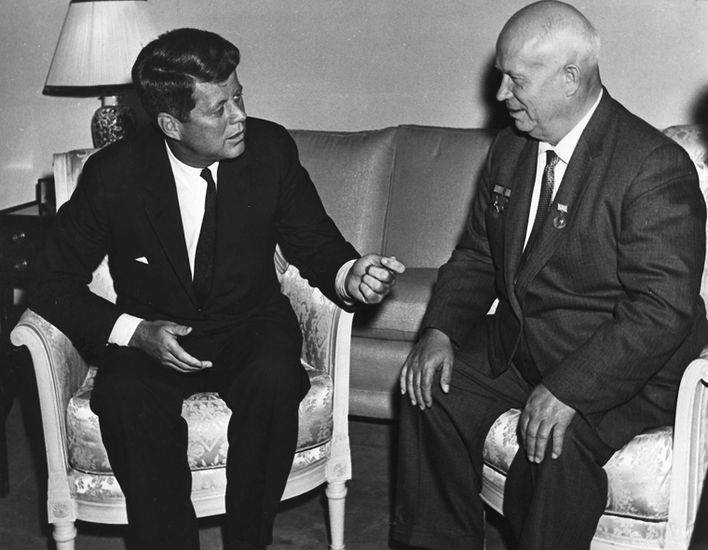
Vienna: Reconciliation between West & East
1961: John F. Kennedy & Nikita Khrushchev

Slide 8
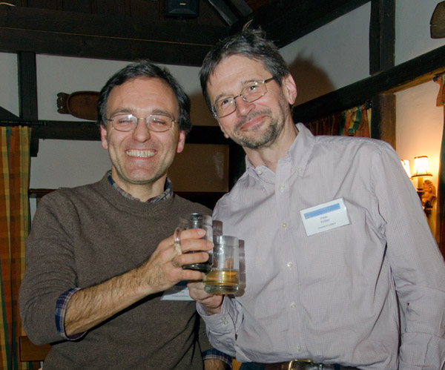
Vienna: Brotherhood of West & East
Notice the progress:
They are much closer & happier!
2012: Francesco Forti & Peter Krizan

