Slide 1
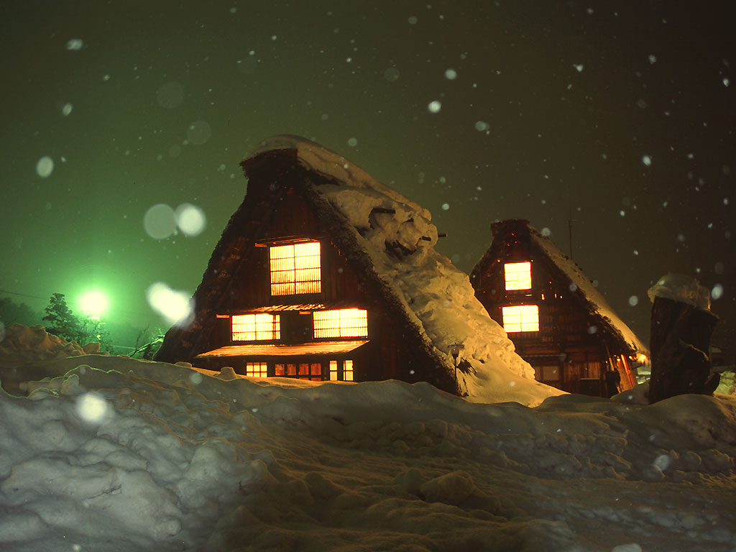
Simulation on beam loss from radiative Bhabha process
Y. Funakoshi
KEK

Slide 2
Cross section and lifetime

Slide 3
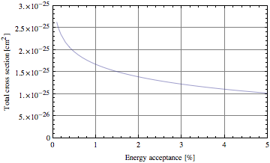
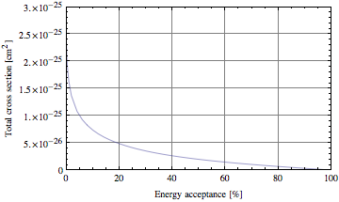
Total cross section
Correction from finite beam size is included.
σ(ε>1.5%)= 1.55 x 10⁻²⁵ cm²
σ(ε>5.0%)= 1.05 x 10⁻²⁵ cm²
σ(ε>20%) = 0.51 x 10⁻²⁵ cm²
σ(ε>50%) = 0.20 x 10⁻²⁵ cm²
Assuming particles are lost with energy loss of ε>1.5%,
Beam lifetime = 30.15 min. (L=8x10³⁵ /cm²/s, Ib=3.6A, LER case)
Loss rate 1.99mA/s

Slide 4
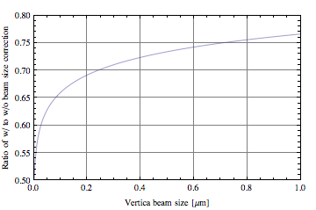
Correction for cross section due to finite beam size
Energy acceptance = 1.0%
~60nm (SuperKEKB, κ=0.4%)

Slide 5
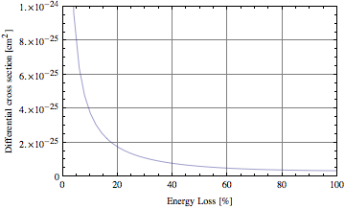
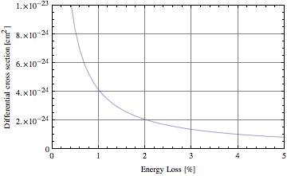
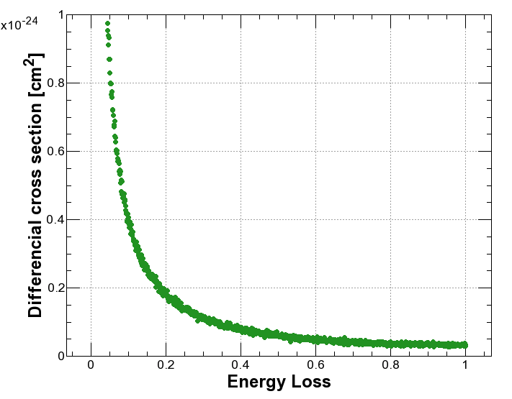
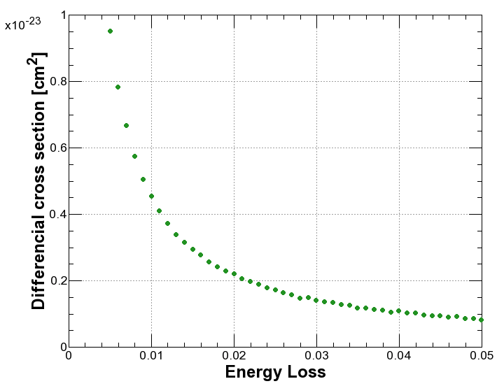
Differential cross section
Analytical formula
Histogram in the simulation

Slide 6
Beam Loss Processes
 | LER beam lifetime
Touschek effect | ~10 min.
Beam-Gas Coulomb scattering | ~30 min.
Radiative Bhabha | ~30 min.

Slide 7
Method of simulation

Slide 8
Beam loss simulation (radiative Bhabha) recent update
Physical aperture
  QC1 (final focus quad) 10.5mm -> 13.5mm
  Movable collimators for the purpose of reducing the Touschek and beam-gas background
Lattice
  Latest lattice: lerfqlc1633_3(LER), herfqlc5605(HER)
Generator
  BBbrems + beam sizes
  Handmade generator to reproduce the energy loss distribution of the analytical formula + beam sizes
Tracking simulation
  Using SAD (1 turn tracking)

Slide 9
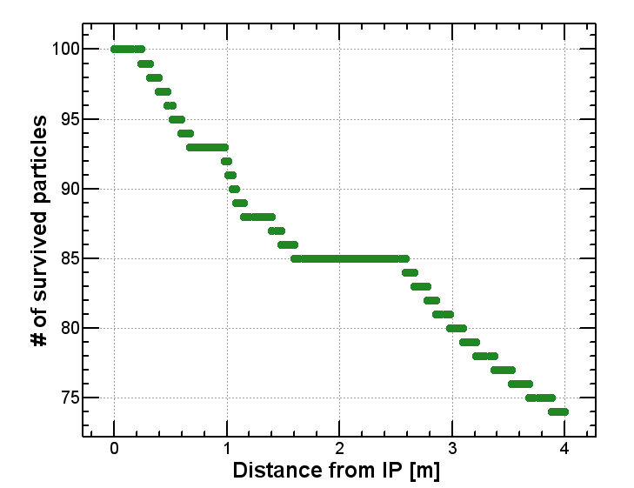
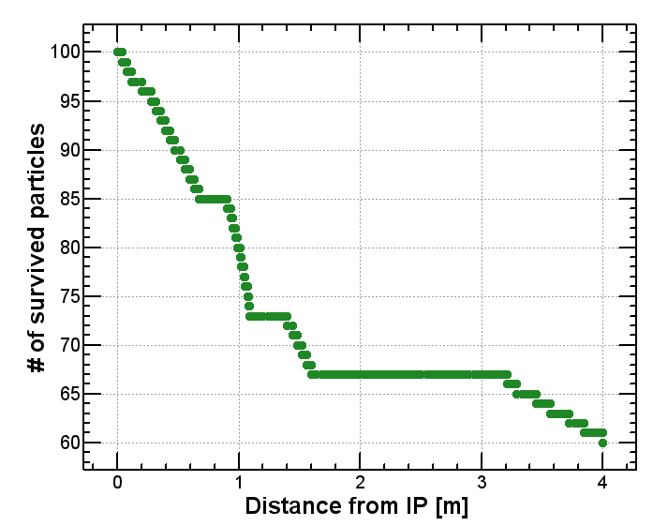
Beam Loss within 4m from IP
One turn tracking with a large energy deviation
(100 particles Δp/p =0, -1, …,-99%)
No COD
With COD (iBump x and y)
Particles are lost, when they lose more
than 75% of their energy.
Particles are lost, when they lose more
than 60% of their energy.

Slide 10
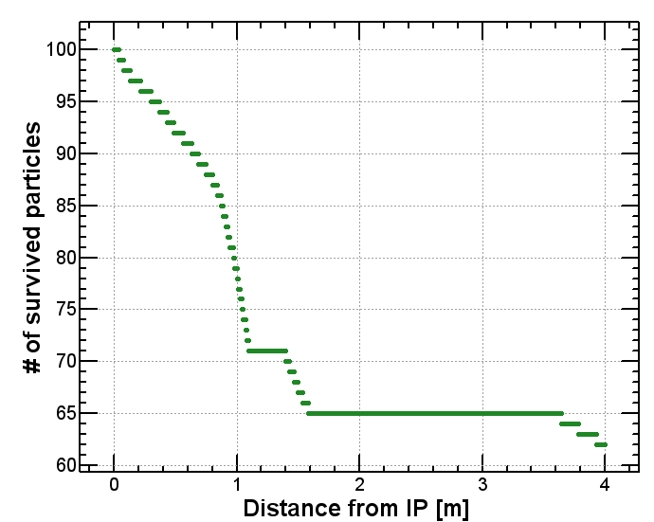
Beam Loss within 4m from IP
One turn tracking with a large energy deviation
(100 particles Δp/p =0, -1, …,-99%)
lerfqlc_1604
lerfqlc_1633_3
Particles are lost, when they lose more
than 74% of their energy.
Particles are lost, when they lose more
than 62% of their energy.

Slide 11
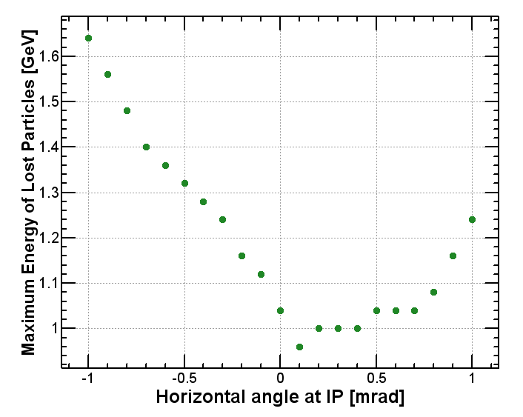
Maximum energy of survived particle at s = 4m
LER: fqlc1604
σ_{x}’* = 0.45 mrad
Effect of horizontal angle at IP
It is importance to consider the angular distribution of beam.

Slide 12
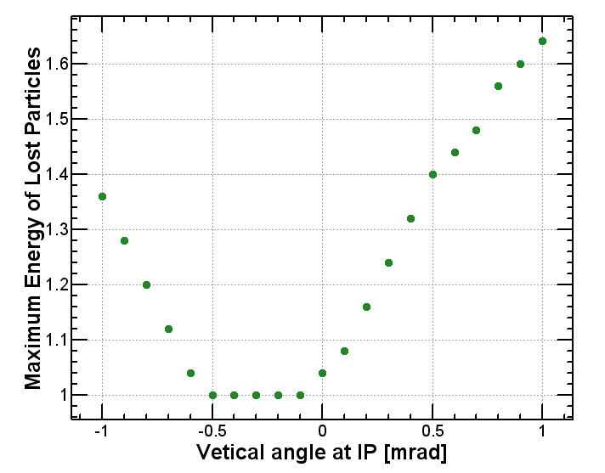
Maximum energy of survived particle at s = 4m
LER: fqlc1604
σ_{y}’* = 0.18 mrad
Effect of vertical angle at IP

Slide 13
IP machine parameters
 | KEKB |  | SuperKEKB
 | LER | HER | LER | HER
ε_{x} | 18nm | 24nm | 3.2 | 5.0
ε_{y} | 0.15nm | 0.15nm | 8.6pm | 13.5pm
κ | 0.83 % | 0.62% | 0.27% | 0.25%
β_{x}* | 120cm | 120cm | 32mm | 25mm
β_{y}* | 5.9mm | 5.9mm | 0.27mm | 0.31mm
σ_{x}* | 150μm | 150μm | 10μm | 11μm
σ_{x}’* | 120μrad | 120μrad | 450μrad | 320μrad
σ_{y}* | 0.94 μm | 0.94μm | 48nm | 56nm
σ_{y}’* | 0.16mrad | 0.16mrad | 0.18mrad | 0.22mrad
iBump horizontal offset |  | +/- 500μm |  | +/- 30μm?
iBump vertical offset |  | +/- 150μm |  | +/- 7.5μm?
iBump vertical angle |  | +/- 0.4mrad |  | +/- 0.4mrad?

Slide 14
Generator
Handmade generator
  Beam sizes
  To reproduce the energy loss of the analytical formula
BBbrems
  Distribution of scattering angles are automatically included.
  Spread of particle distribution corresponding to beam sizes is artificially added.
  Two different sets of distributions
    E_lab < 2 GeV (~80,000 events LER, ~27,000 events HER)
    E_lab < 3 GeV (~1,800,000 events LER, 270,000 events HER) Simulation is on the way

Slide 15
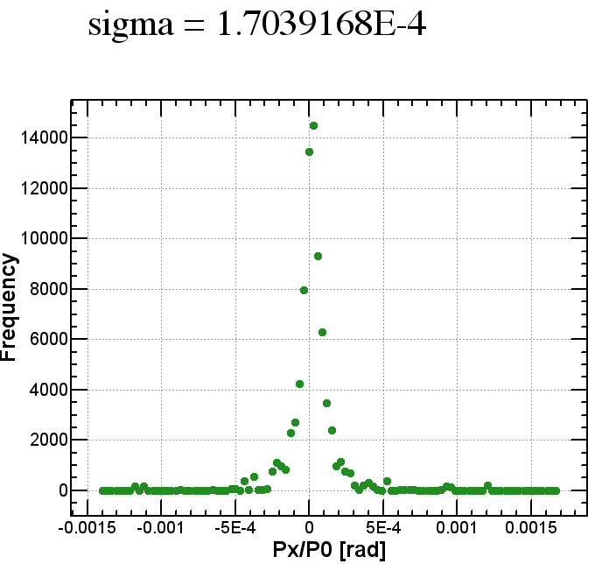
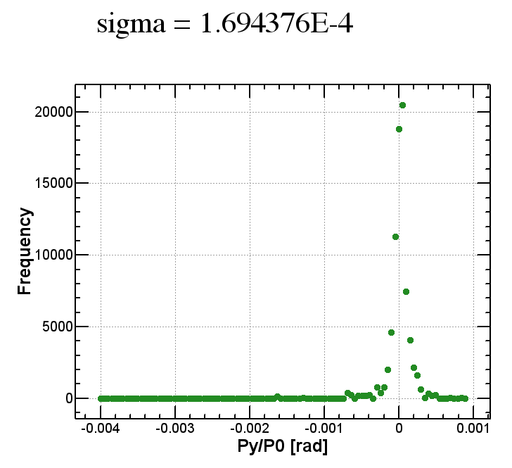
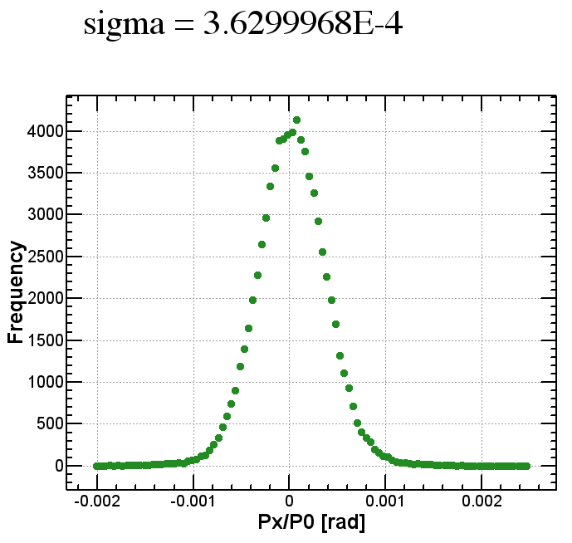
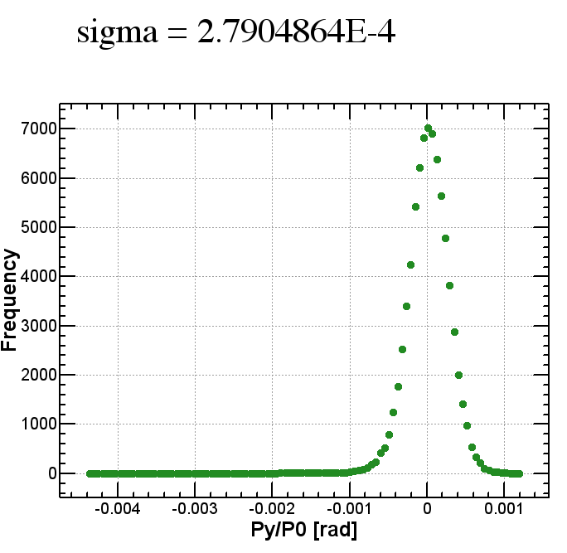
Scattering angle distribution (BBbrems)
cf. σ_{x}’* = 0.45 mrad
cf. σ_{y}’* = 0.18 mrad
BBbrems
BBbrems
Bbbrems
+ beam angular divergence
Bbbrems
+ beam angular divergence

Slide 16
Simulation results

Slide 17
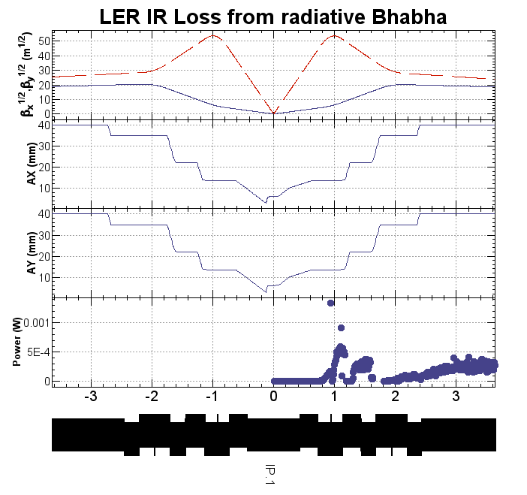
LER: Data of BBbrems (10/38 of total events)
Aperture
horizontal
Aperture
vertical
e⁺
Loss power / element
Within |z|<4m,
Loss rate: 6.0 GHz
Power loss: 0.56W
Effective loss rate: 0.87GHz (4GeV)
CoordinateBeamLoss2012_2_6_18_2_39.dat

Slide 18
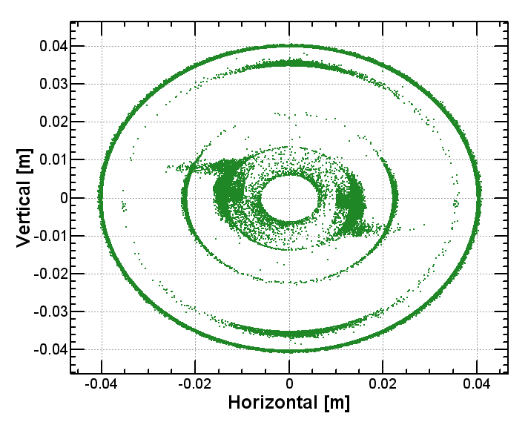
Transverse coordinates of lost particles

Slide 19
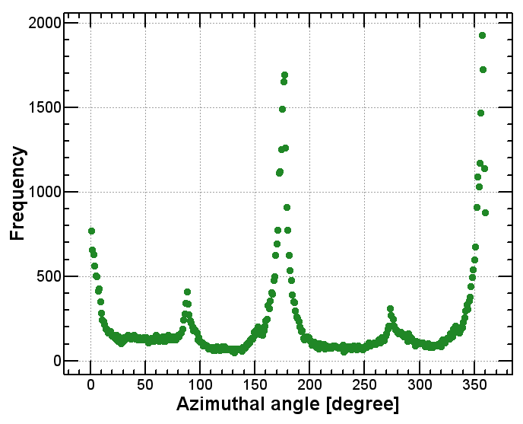
Angular distribution of lost particles
Zero denotes outside of horizontal plane.

Slide 20
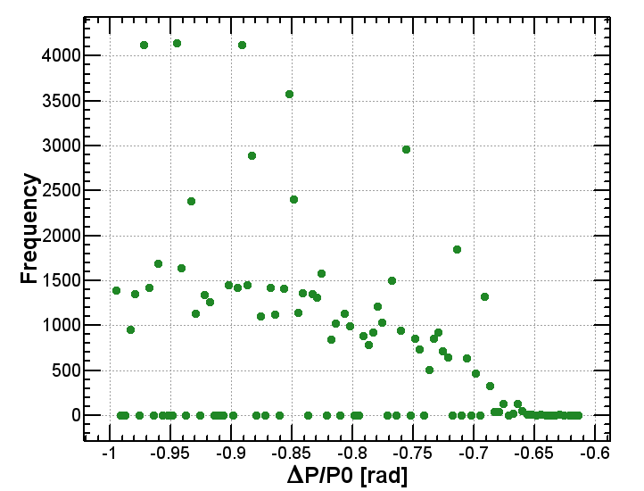
Energy distribution of lost particles

Slide 21
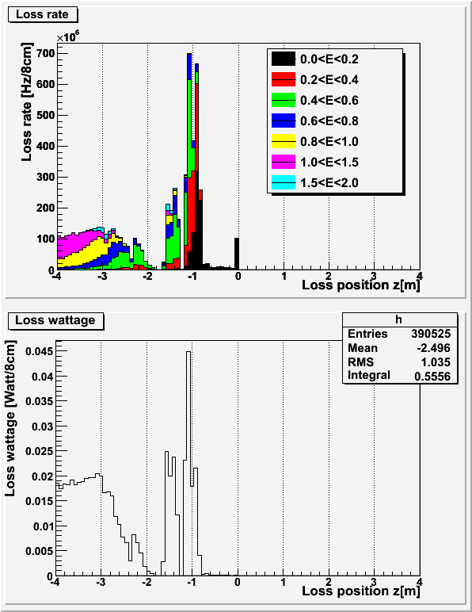
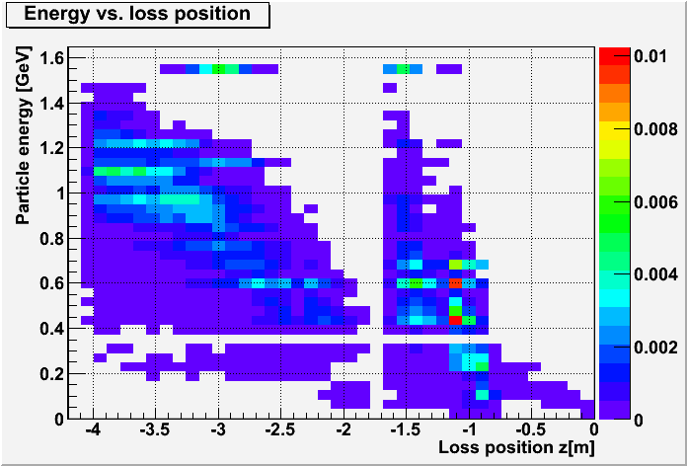
Radiative Bhabha LER
H. Nakayama
W
e+
e+
Within |z|<4m,
loss rate: 6.0 GHz(0~1.4GeV)
loss wattage: 0.55 W
e+
(Equivalent to 0.86GHz of 4GeV e-)
Loss wattage: we assume all energy of beam particle is deposited at the loss position.

Slide 22
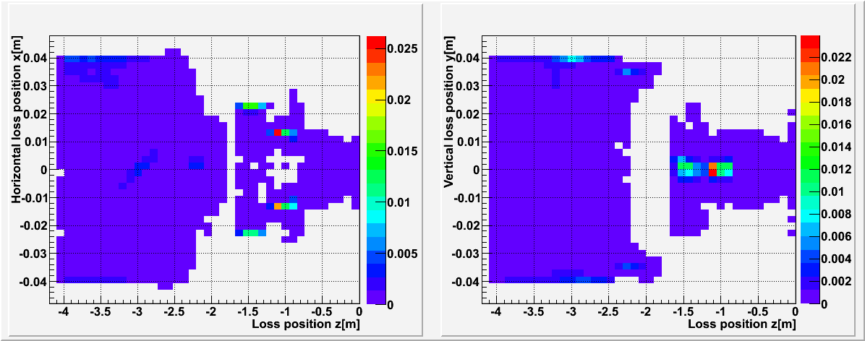
Radiative Bhabha LER (contd.)
H. Nakayama
x-z plane
W
y-z plane
W
e+
e+
Horizontally lost at z=-1m

Slide 23
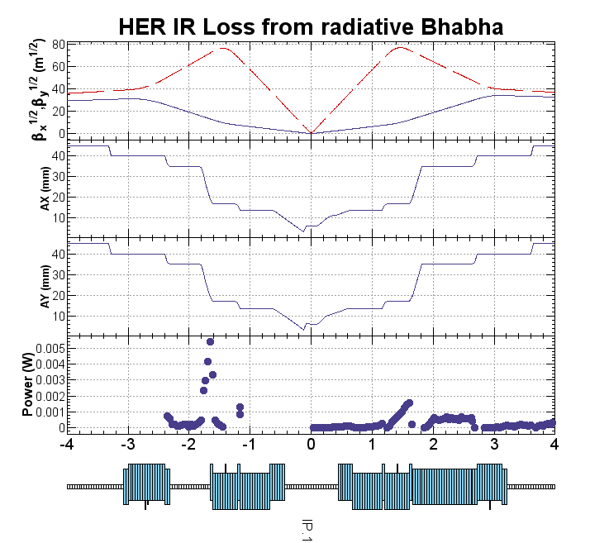
HER handmade generator
Aperture
horizontal
Aperture
vertical
e⁻
Loss power / element
0.80W
0.76W
Within |z|<4m,
Loss rate: 6.5 GHz
Power loss: 1.56W
Effective loss rate: 1.4GHz (7GeV)
CoordinateBeamLoss2012_2_7_14_54_47.dat

Slide 24
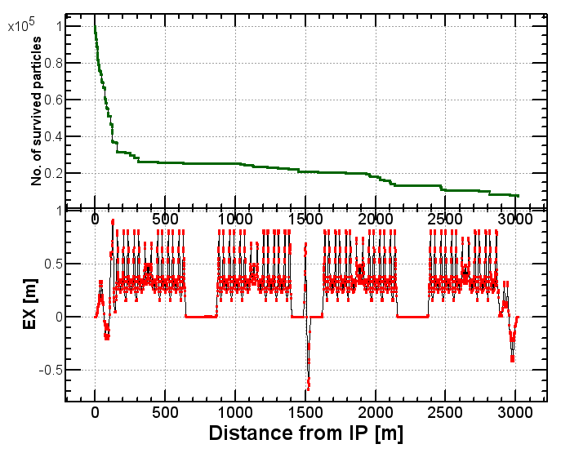
HER: handmade generator
0.01 < ΔE < 1
CoordinateBeamLoss2012_2_7_14_54_47.dat

Slide 25
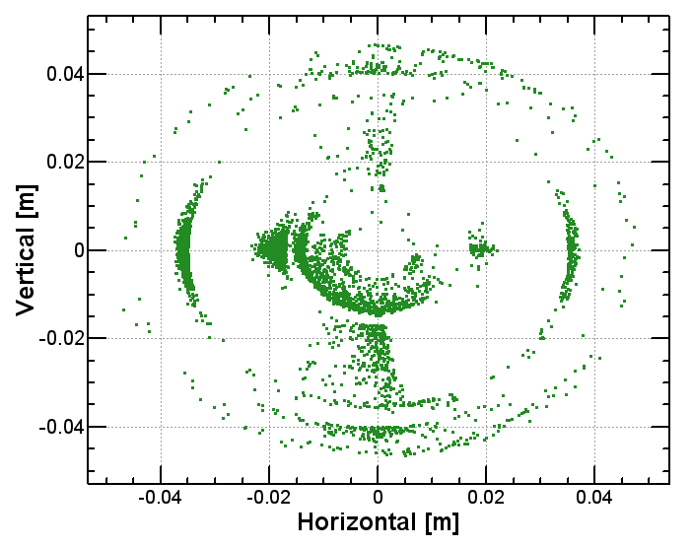
Transverse coordinates of lost particles -4m < s < 4m

Slide 26
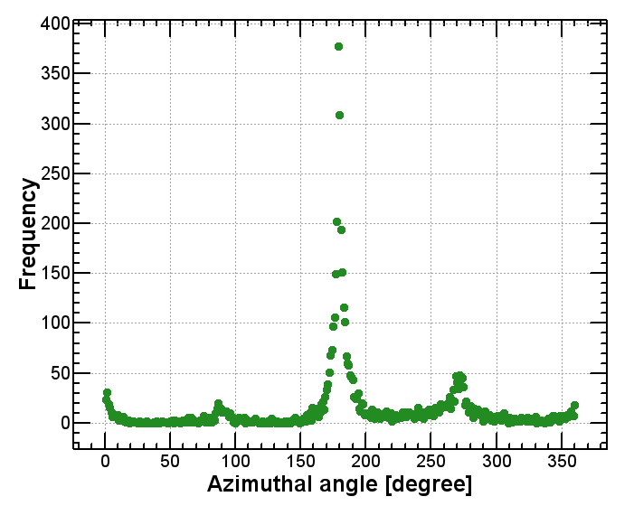
Angular distribution of lost particles
-4m < s < 4m

Slide 27
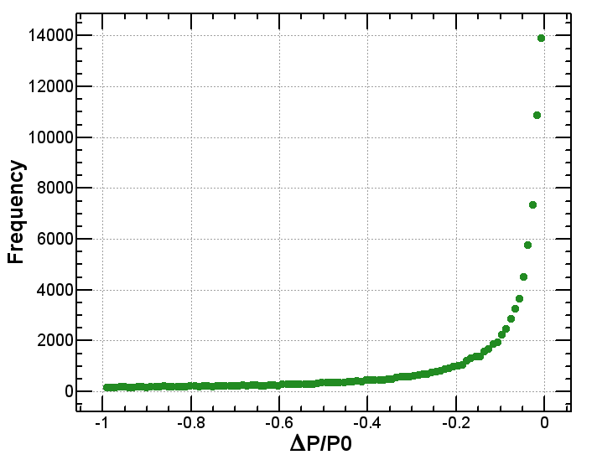
Energy distribution of initial events

Slide 28
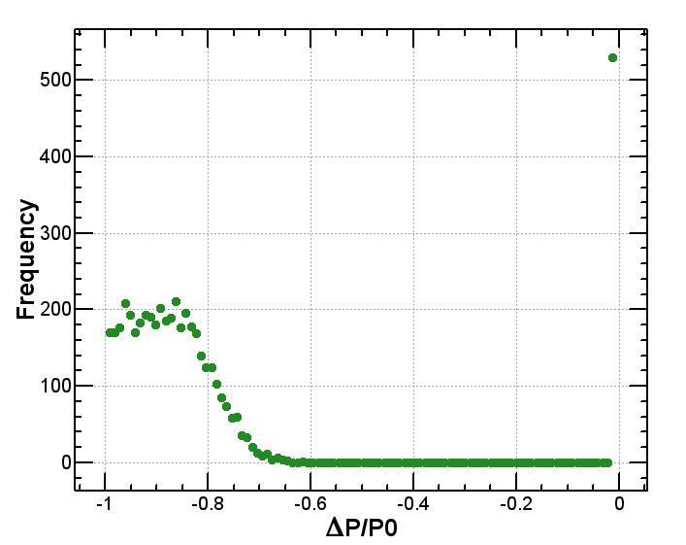
Energy distribution of lost particles
-4m < s < 4m
What is this?

Slide 29
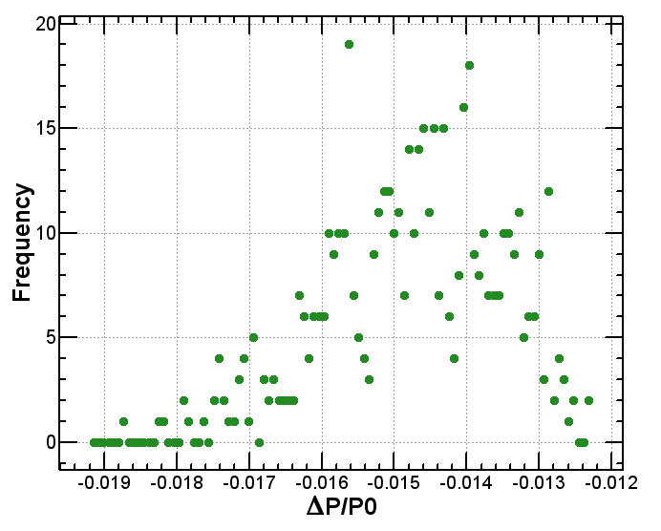
Energy distribution of lost particles
-4m < s < 0m
The energy loss of the particles which are lost after almost one turn is very small.

Slide 30
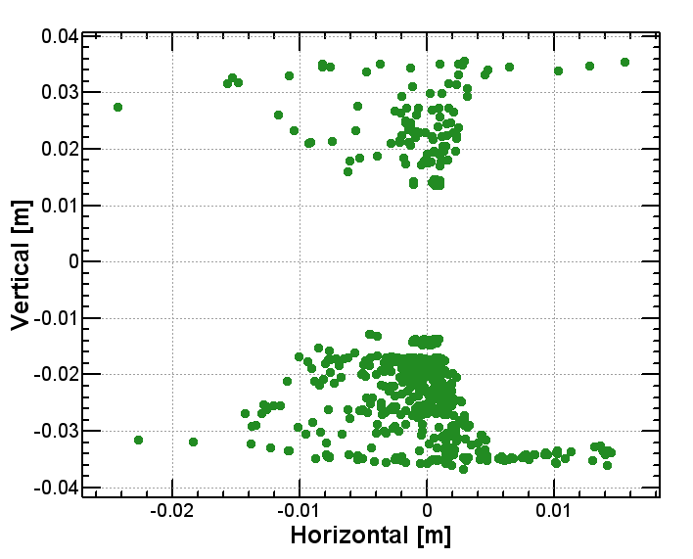
Transverse coordinates of lost particles -4m < s < 0m

Slide 31
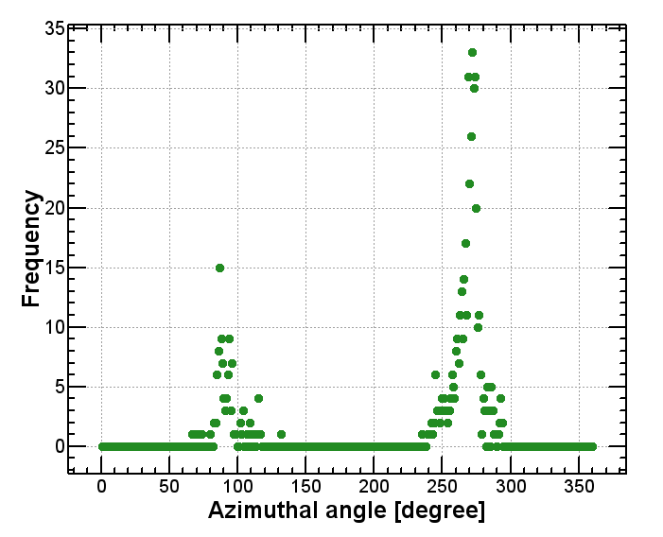
Angular distribution of lost particles
-4m < s < 0m

Slide 32
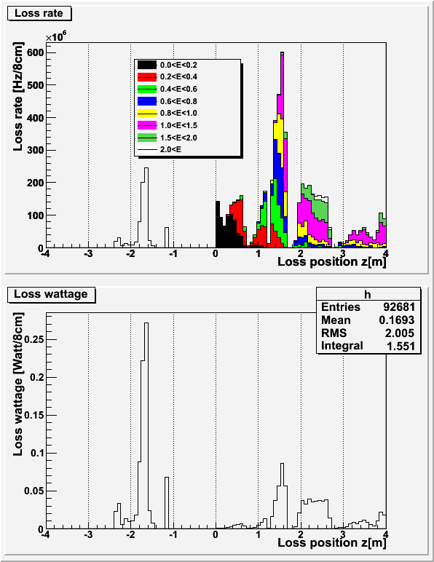
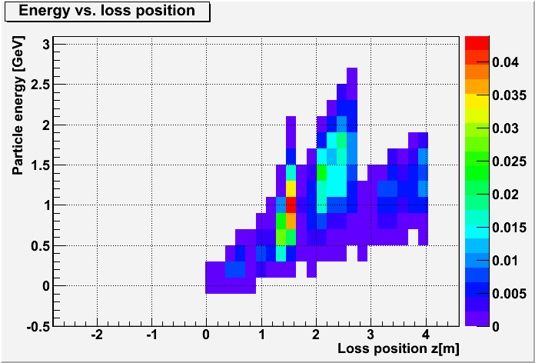
Radiative Bhabha HER
H. Nakayama
W
e-
e-
1-turn loss
(7GeV)
Within |z|<4m,
loss rate: 5.8 GHz(0~2GeV)
loss wattage: 0.75 W
e-
(Equivalent to 0.68GHz of 7GeV e-)
1-turn loss at z=-1.8m
0.72GHz, 0.8W
Loss wattage: we assume all energy of beam particle is deposited at the loss position.

Slide 33
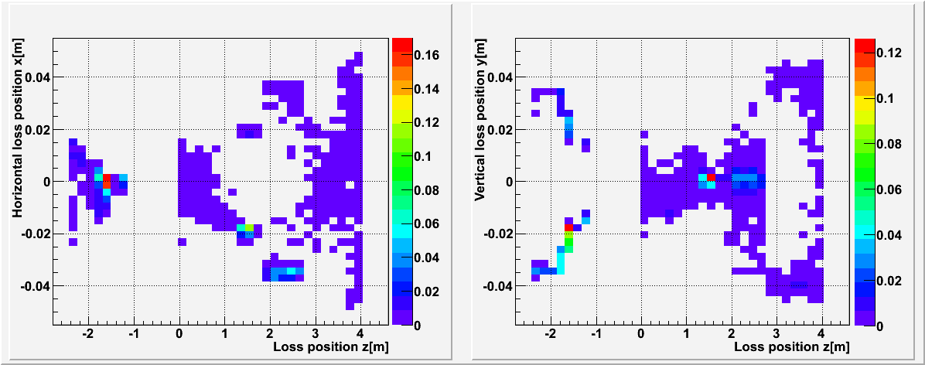
Radiative Bhabha HER (contd.)
H. Nakayama
x-z plane
W
y-z plane
W
e-
e-
e-
Horizontally lost at z=1.5m
Vertically lost after 1 turn at z=-1.8m

Slide 34
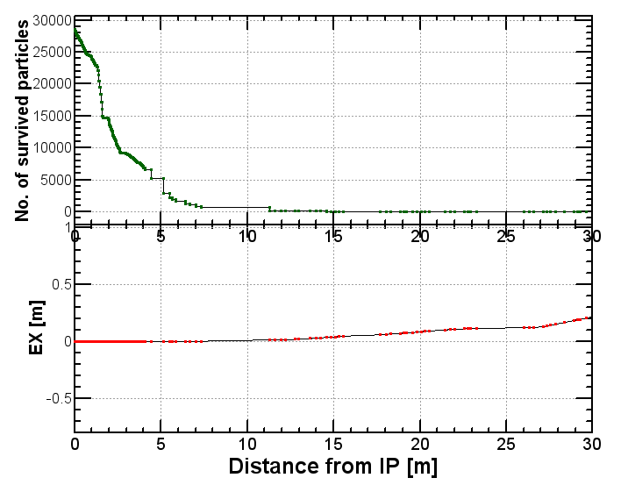
HER: Beam loss with data of BBbrems
Eb < 2GeV
All particles are lost within 15m from IP
CoordinateBeamLoss2012_2_7_13_51_6.dat

Slide 35
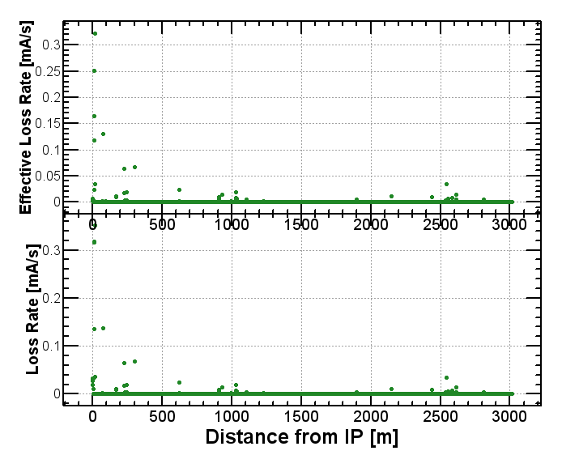
LER: Beam loss around the ring (lerfqlc_1633_3)
Beam loss [mA/m/s]

Slide 36
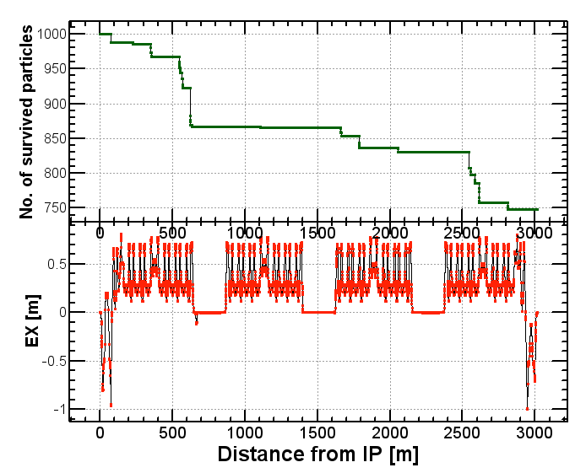
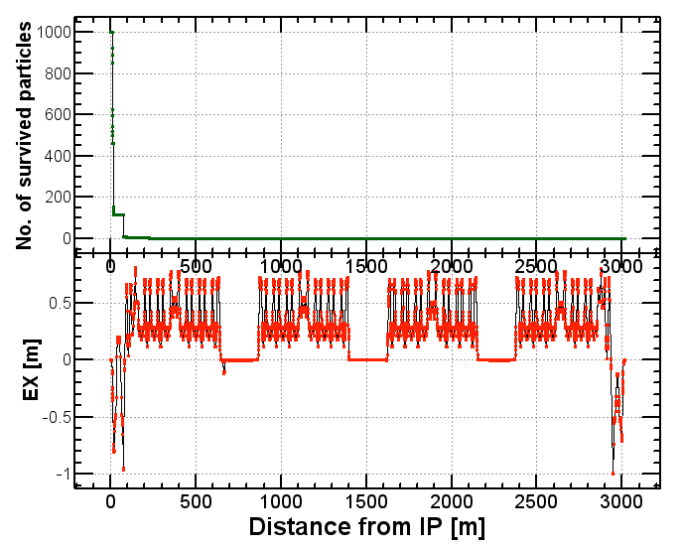
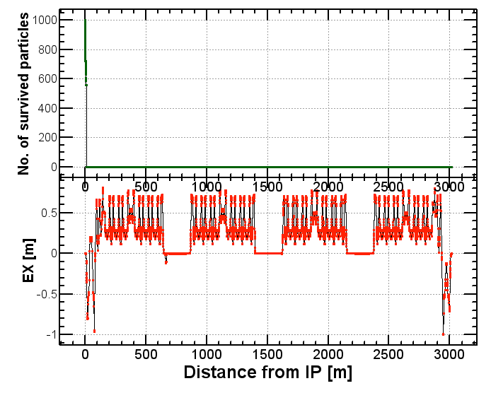
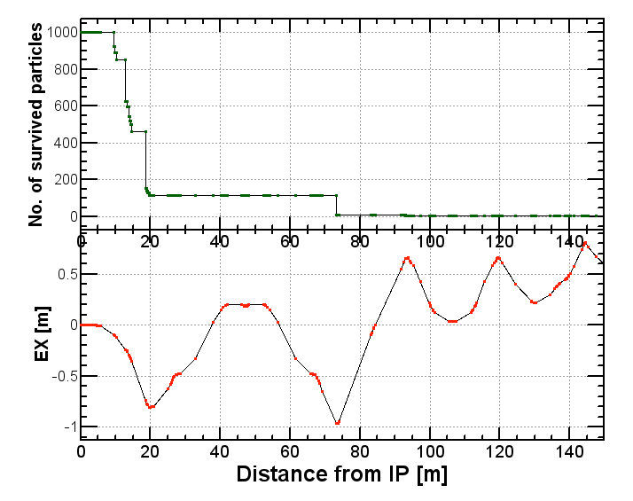
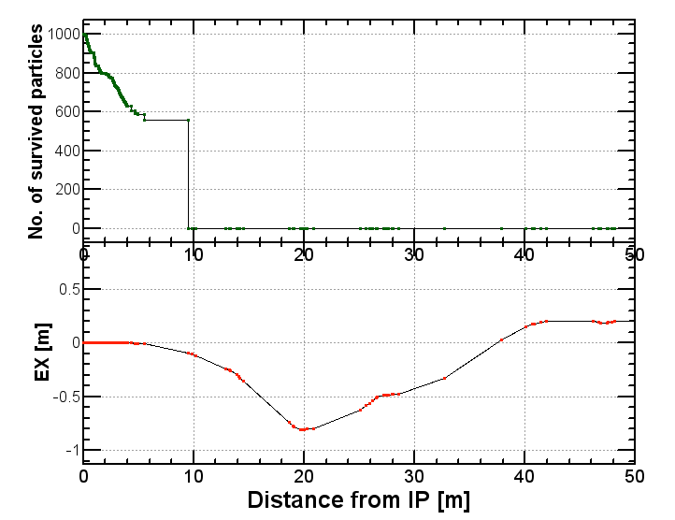
No COD (lerfqlc_1604.sad)
0.2% < ΔE < 4%
4% < ΔE < 40%
40% < ΔE
No beam loss after one turn
Loss Rate = 116.5GHz
Effective Loss Rate = 91.3GHz
BG Rate in IR (< 4m) = 8.01GHz
Effective BG Rate in IR (< 4m) = 1.18GHz

Slide 37
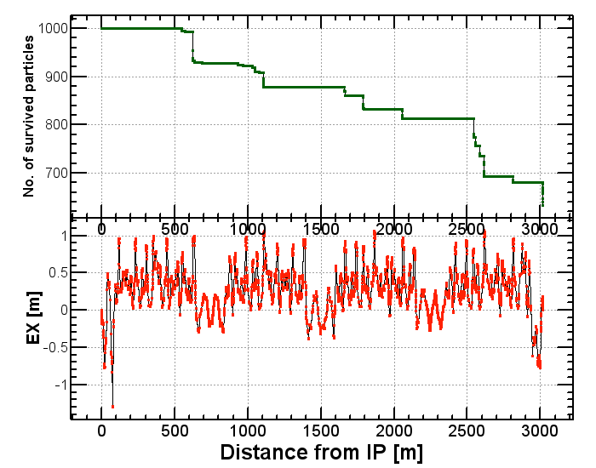
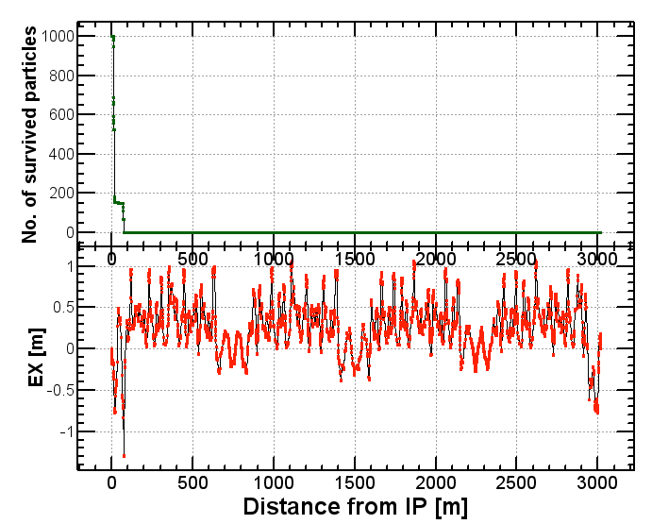
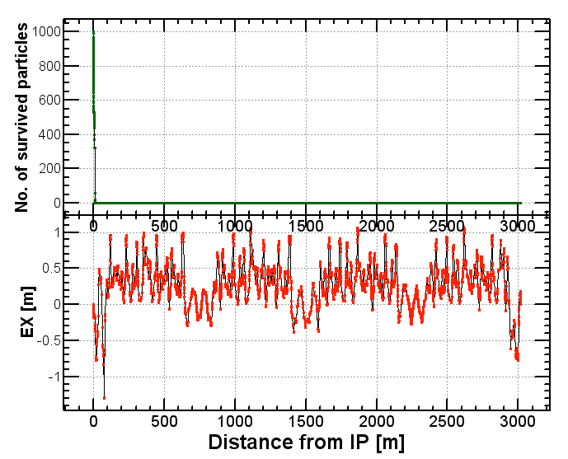
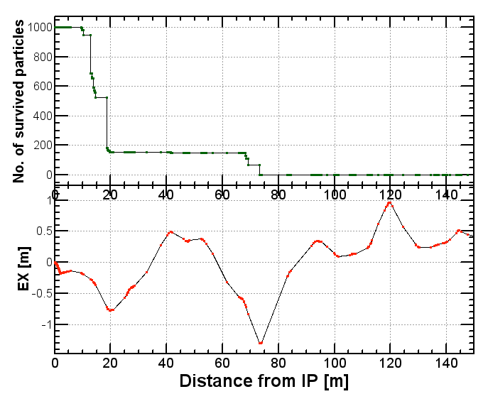
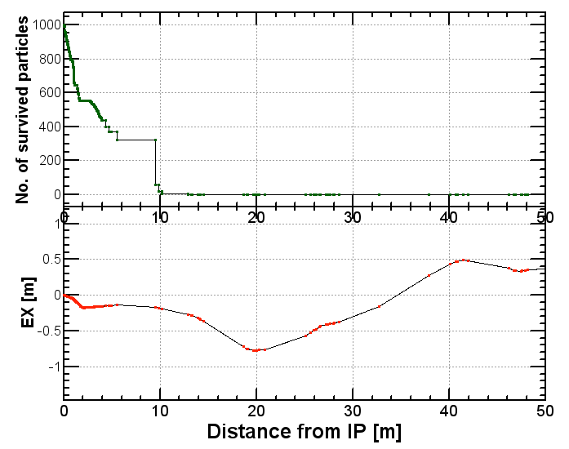
With COD Δx’=5σ_{x}’Δy’=5σ_{y}’
(lerfqlc_1604.sad)
0.2% < ΔE < 4%
4% < ΔE < 40%
40% < ΔE
Large amount of beam loss after one turn
Total loss Rate = 121.7GHz
Effective loss Rate = 101.7GHz
Particel Loss Rate in IR (< 4m) = 12.2GHz
Effective Loss Rate in IR (< 4m) = 2.59GHz
Particel Loss Rate in IR (> -4m) = 4.1GHz
Effective Loss Rate in IR (>- 4m) = 4.0GHz

Slide 38
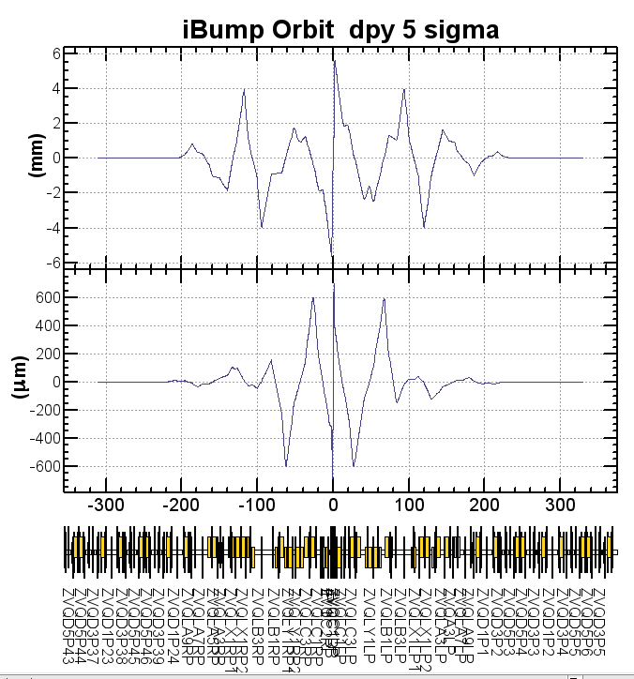
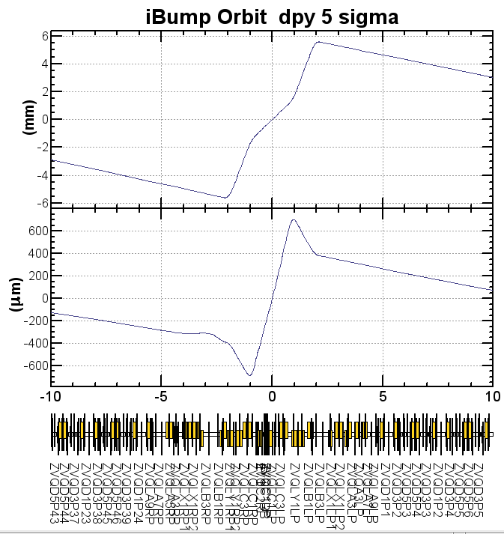
LER iBump orbit Δx’=5σ_{x}’Δy’=5σ_{y}’
iBump is used for maintaining an optimum beam collision.

Slide 39
Summary
The beam loss from radiative Bhabha process has been simulated.
Latest results on beam loss in IR (± 4m from IP) are 0.56W (LER) and 1.56W (HER).
  Coordinates of lost particles are transferred to Nakayama-san for Belle II background simulation.
In case of HER, we found that the particles which loss 1 ~ 2% of their energy are lost after almost one turn travelling around the ring.
Similar loss was found also in LER with large COD (closed orbit distortion).

Slide 40
Works to be done
Tracking with larger number of samples
To consider the method to reduce particle loss after one turn mainly in HER
To check if there are multi-turn loss with beam-beam effects
More systematic study on the effect of closed orbit distortion

Slide 41

Y. Ohnishi
x : positive=ring outer, y: positive=downward
inner
lower
upper
inner
lower

Slide 42

Y. Ohnishi
x : positive=ring outer, y: positive=downward
lower
upper
inner
upper
inner

