Slide 1
How to handle downtime
P. Saiz
D. Collados, B. Gaidioz, M. Lamanna, P. Mendez,
R. Santinelli, A. Sciaba,

Slide 2
How to deal with downtimes
Announcements
Display
Action
Service reliability
Types of downtime
Open questions

Slide 3


Announcements
Site admin registers in GOCDB
OSG sites use OIM
In both systems:
  Service vs Site
  Not possible to specify VOs
  VO criticality
CIC portal
  Mails to VO mailing lists
  RSS Feeder
    ATLAS prodsys dashboard, SAM
Mail from site administrator to email list

Slide 4
Display
GOCDB, OIM
LHCb: google calendar
Dashboard interfaces
  Prodsys, SAM, SSB
  Only for past downtimes
CMS requested an interface to see downtimes
  Take LHCb’s idea?

Slide 5
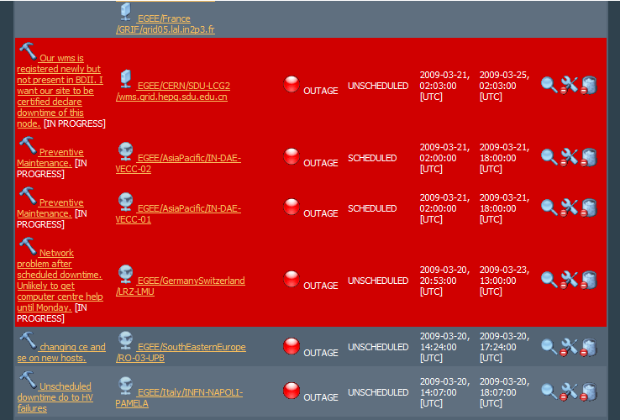
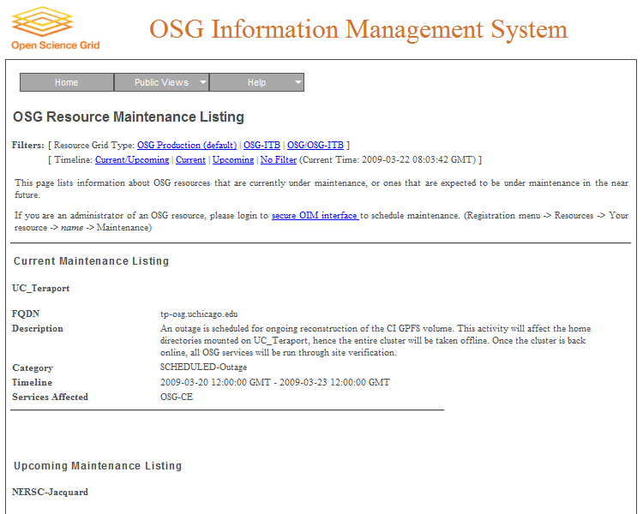
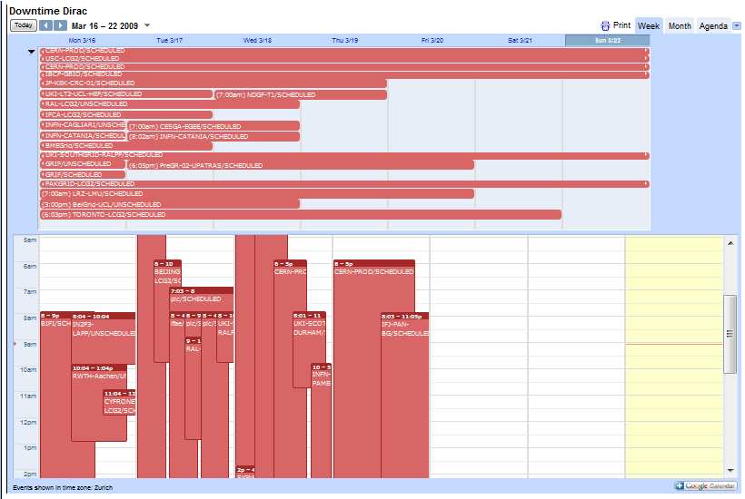
Display examples

Slide 6
What do the experiments do?
ALICE
  No specific action
ATLAS
  Defined manual procedure (see Graeme’s talk)
CMS
  Site removed from CRAB
  Site commissioning updated (taking days before the downtime)
LHCb
  Site blacklisted in DIRAC
  To put it back in production requires manual intervention

Slide 7
Downtime vs. Down
If there are several instances of a service, which state has priority?
  Current Gridview definition
If a site defines an instance always in ‘Maint.’
  Service reliability → 100%!!
Instance A \ Instance B | OK | Maint. | Down
OK | OK | OK | OK
Maint. | OK | Maint. | Maint.
Down | OK | Maint. | Down

Slide 8
Types of downtime
Scheduled
  Already understood
    Downtime < 4 hrs AND notification > 24 hours before
    Downtime > 4 hrs AND notification > 1 week
Unscheduled
  Treated as ‘scheduled’
At risk
  What to do?

Slide 9
Some questions
Is the current system good? Yes
Can we improve it? Yes!
Can we combine GOCDB and OIM?
  SAM does it
Why do VOs need mail from site admins?
Better display?
  Use LHCb google calendar?
Include criticality per VO?
Is ‘Downtime’ more important than ‘Down’?
  Or than ‘OK’
More automatic actions from the experiments?
  Removing sites from production, adding them again...
How to deal with different types of downtime?

Slide 10
URLS
GOCDB downtime
  https://goc.gridops.org/downtime
OIM downtime
  http://oim.grid.iu.edu/pub/maintenance/show.php
CIC Portal:
  https://cic.gridops.org/
LHCb google calendar
  http://lhcbweb.pic.es/DIRAC/LHCb-Production/visitor/web/External/display?site=calendar

