Slide 1
Outlook
Tord Ekelöf
Uppsala University

Slide 2
Grand H⁺ plan
General strategy
First achieve discovery of H⁺ – could become the first definite discovery of BSM physics
Then, like for Hº, make precision measurements of the H⁺ mass, total width, spin, couplings => indication of specific BSM scenario
Sequence of contributions from accelerators
B-superfactories provide indirect H⁺ detection
LHC provides first direct detection of light H⁺ and (after upgrade) of heavy H⁺
e+e- colliders provide direct even higher mass H⁺ discovery and high precision H⁺ measurements

Slide 3
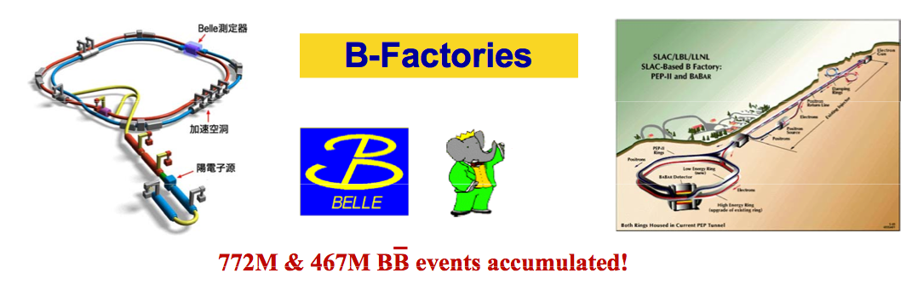
Indirect H+ detection

Slide 4
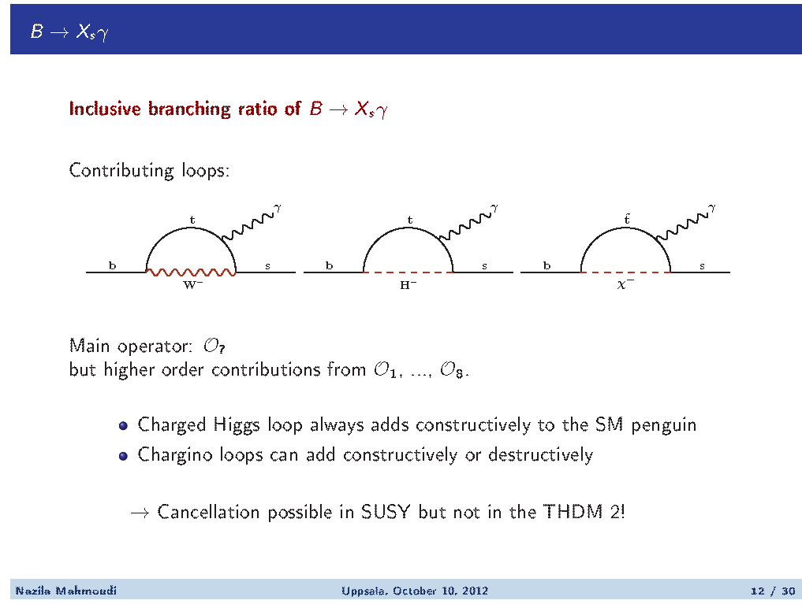
1.

Slide 5
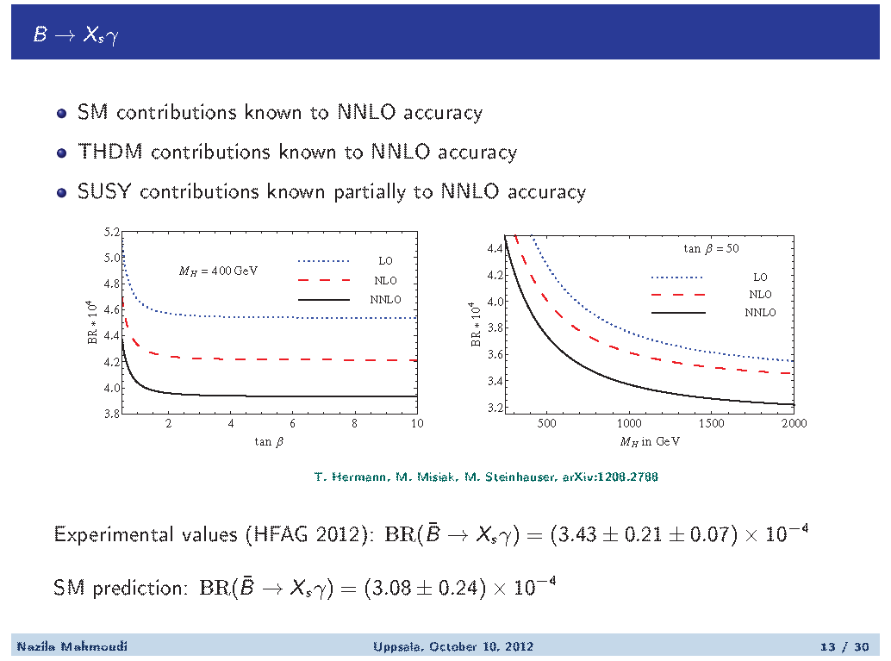

Slide 6
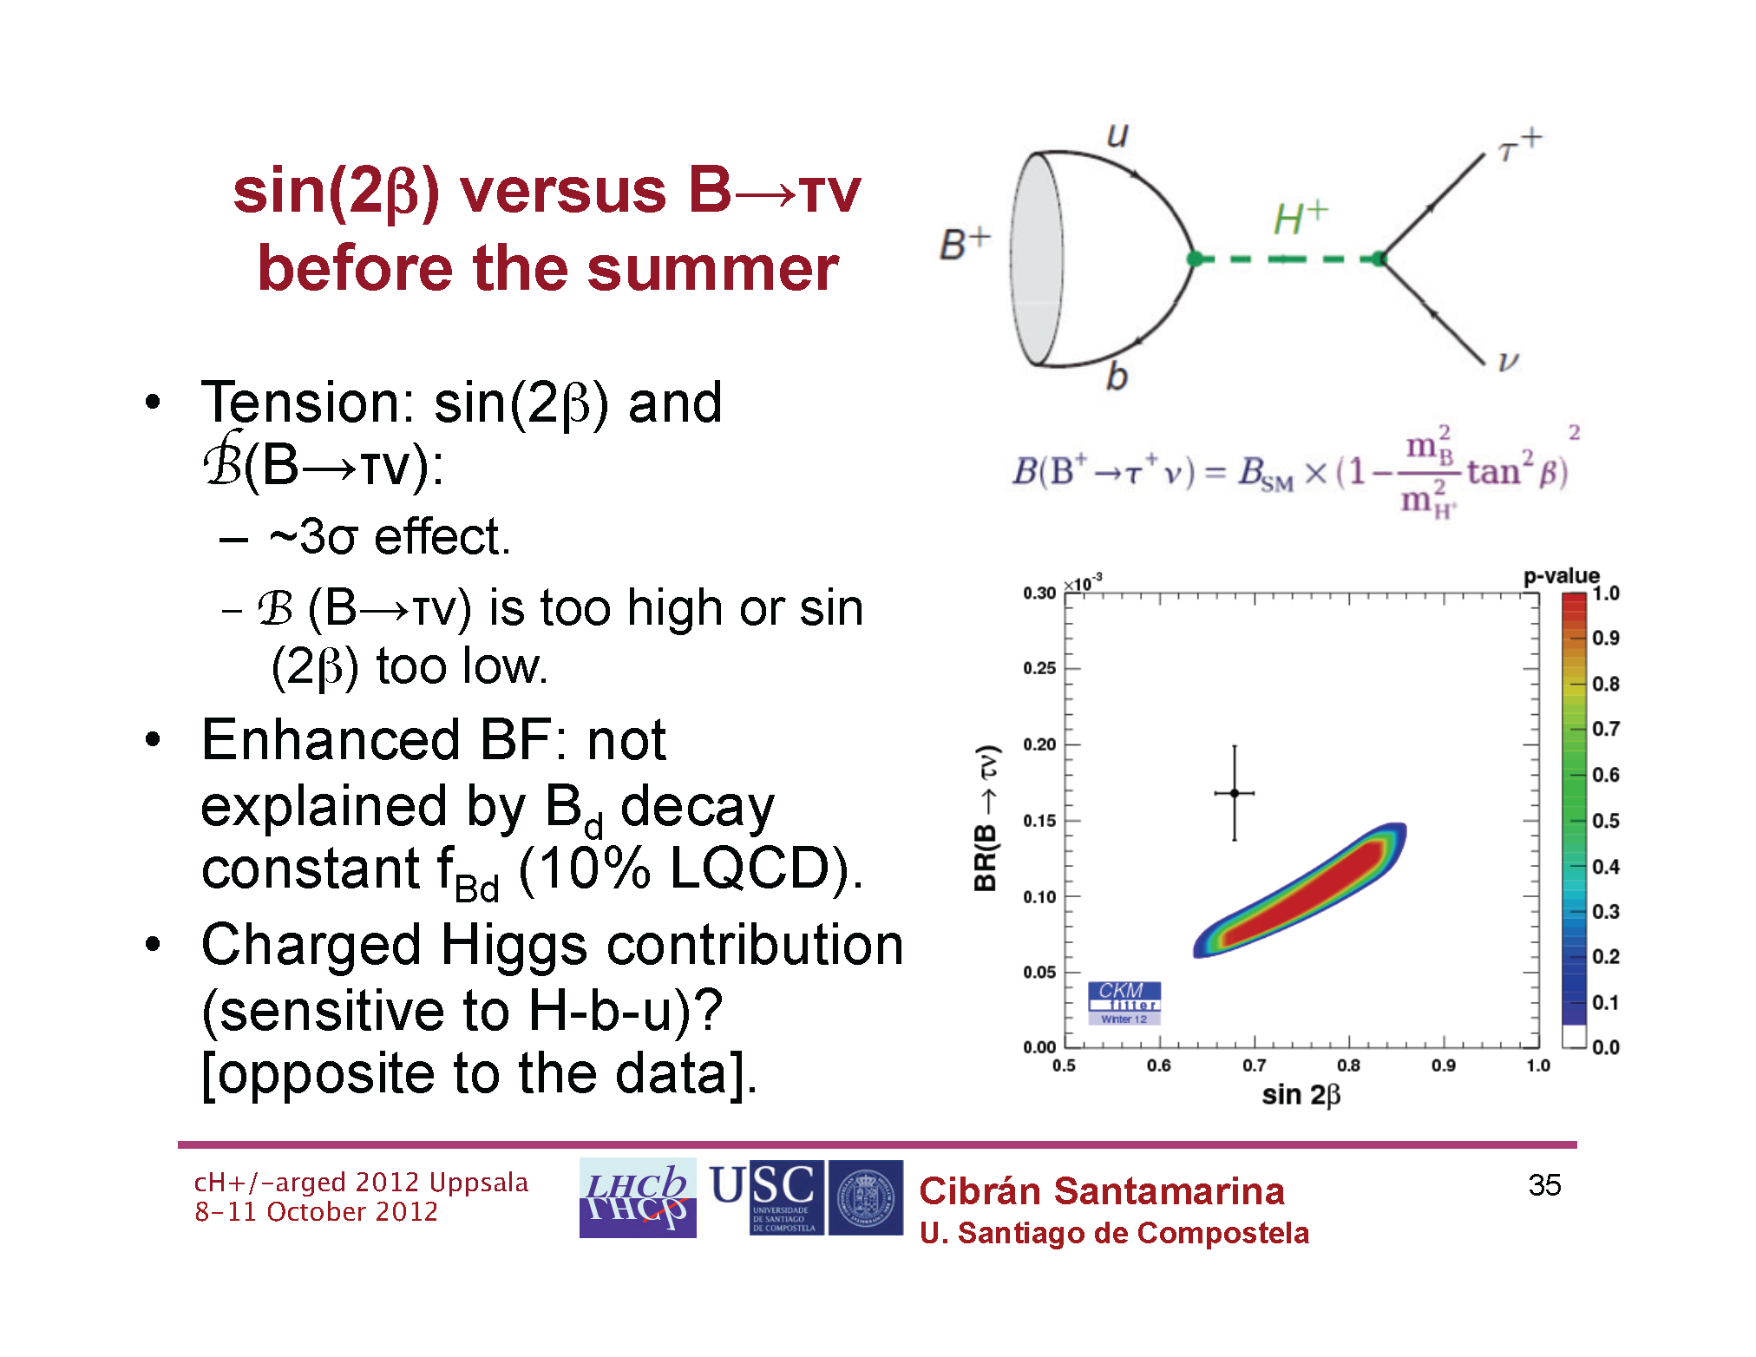
2.

Slide 7
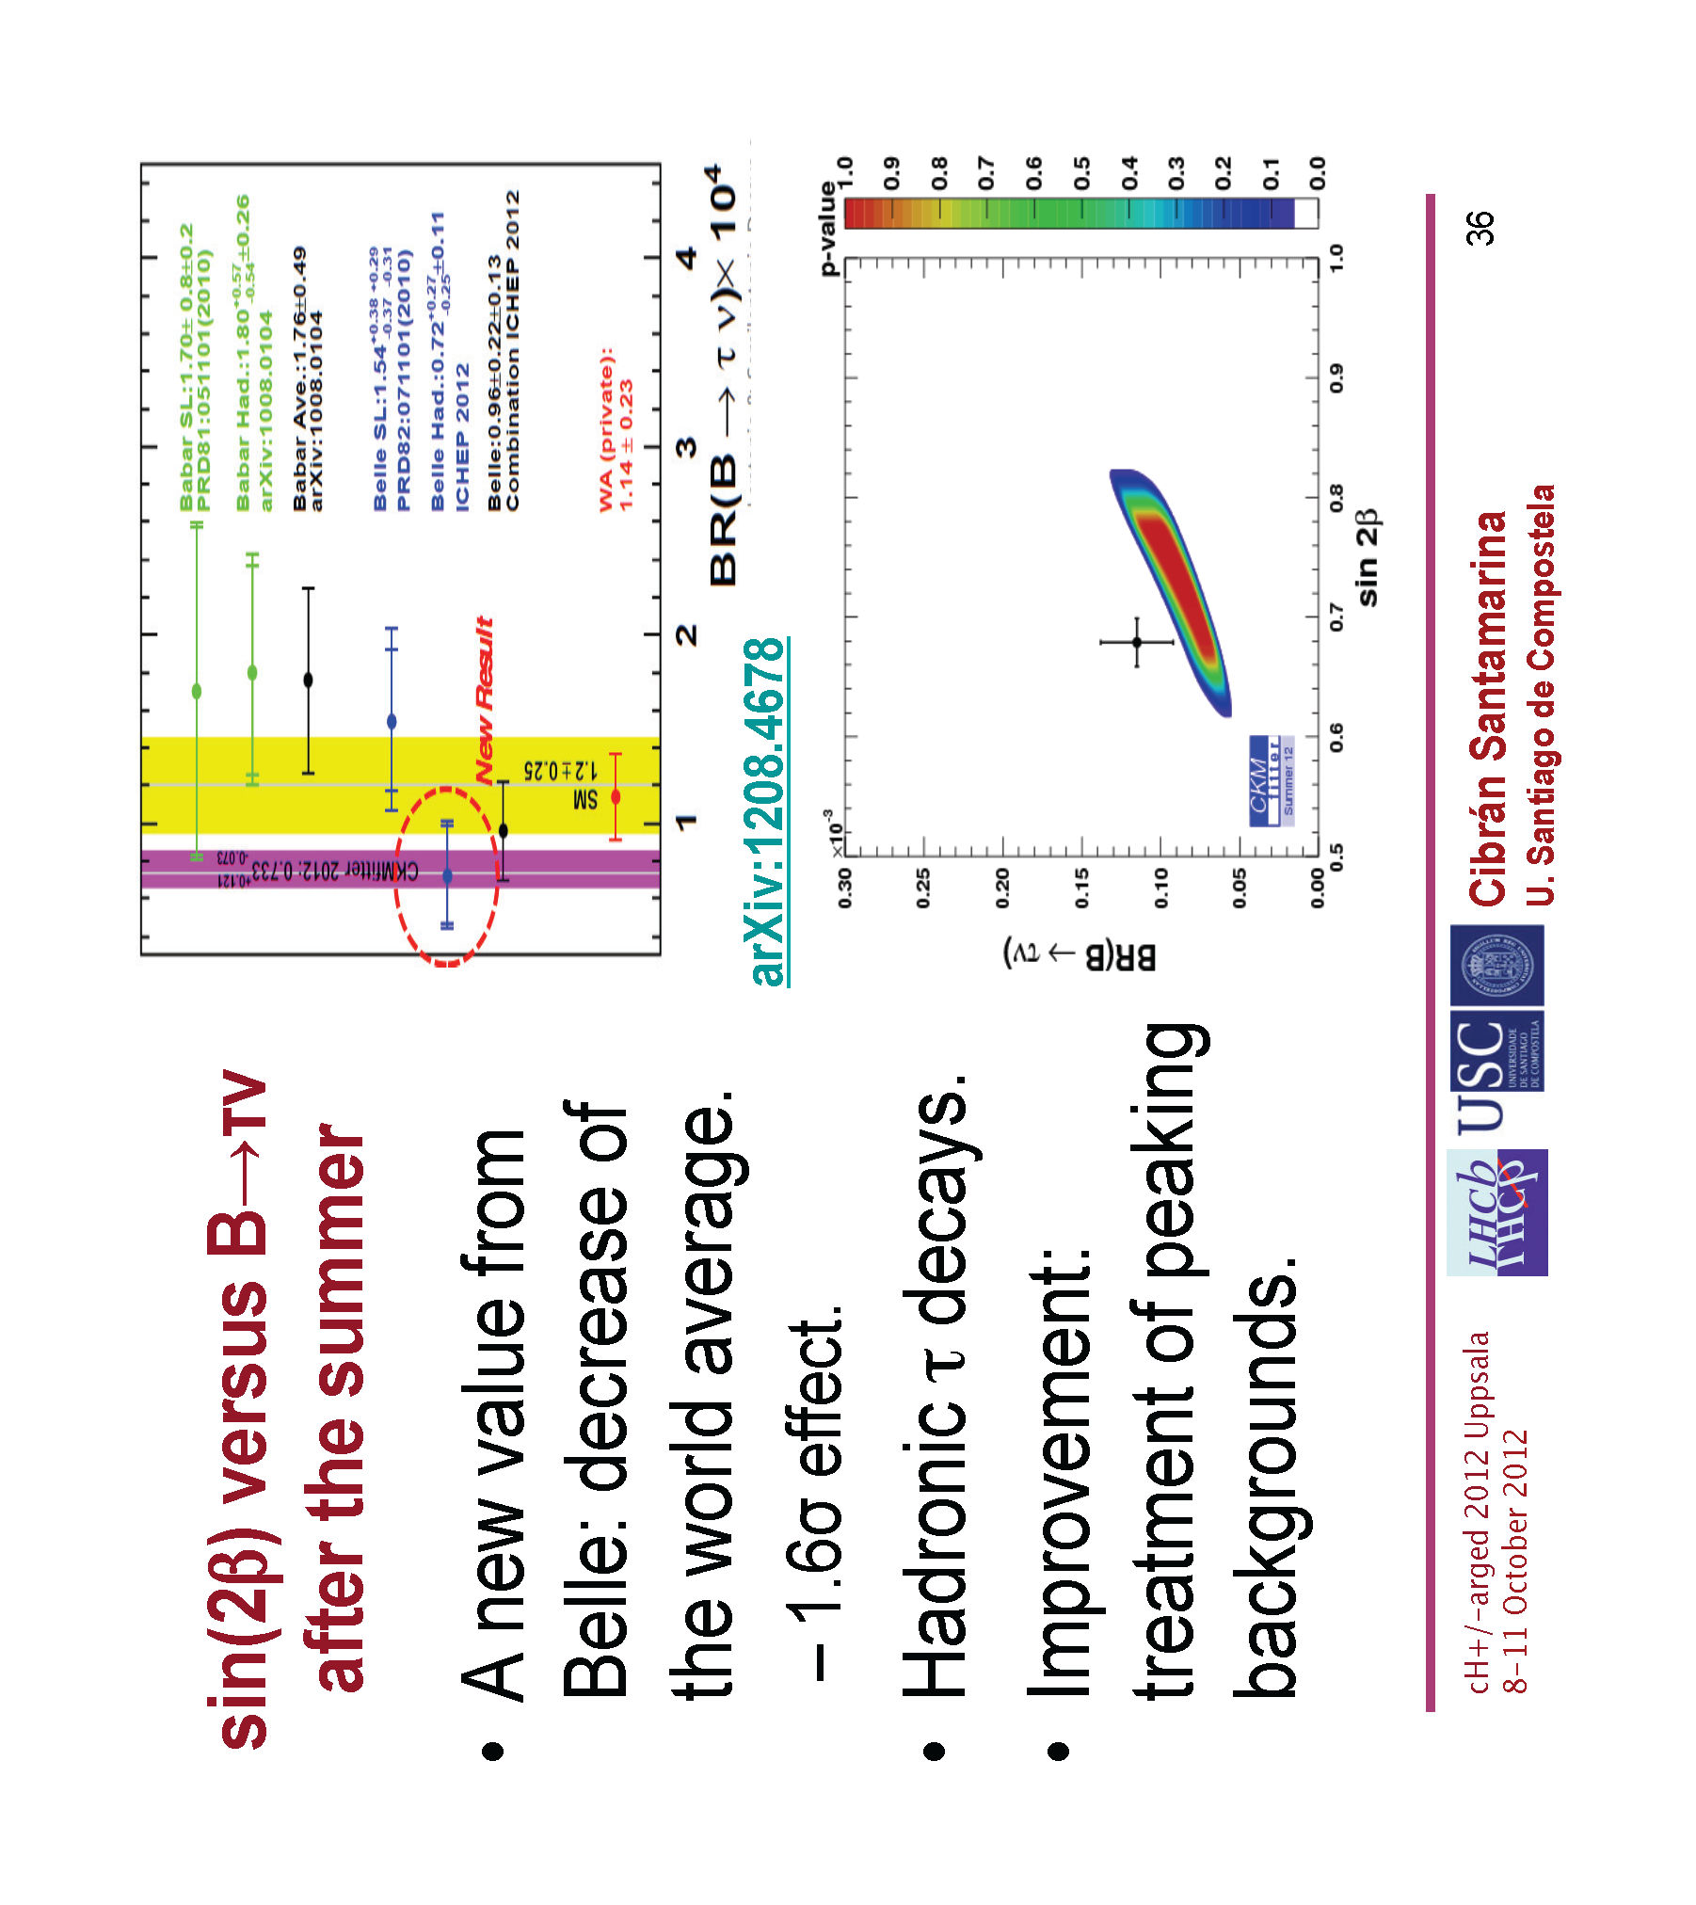

Slide 8
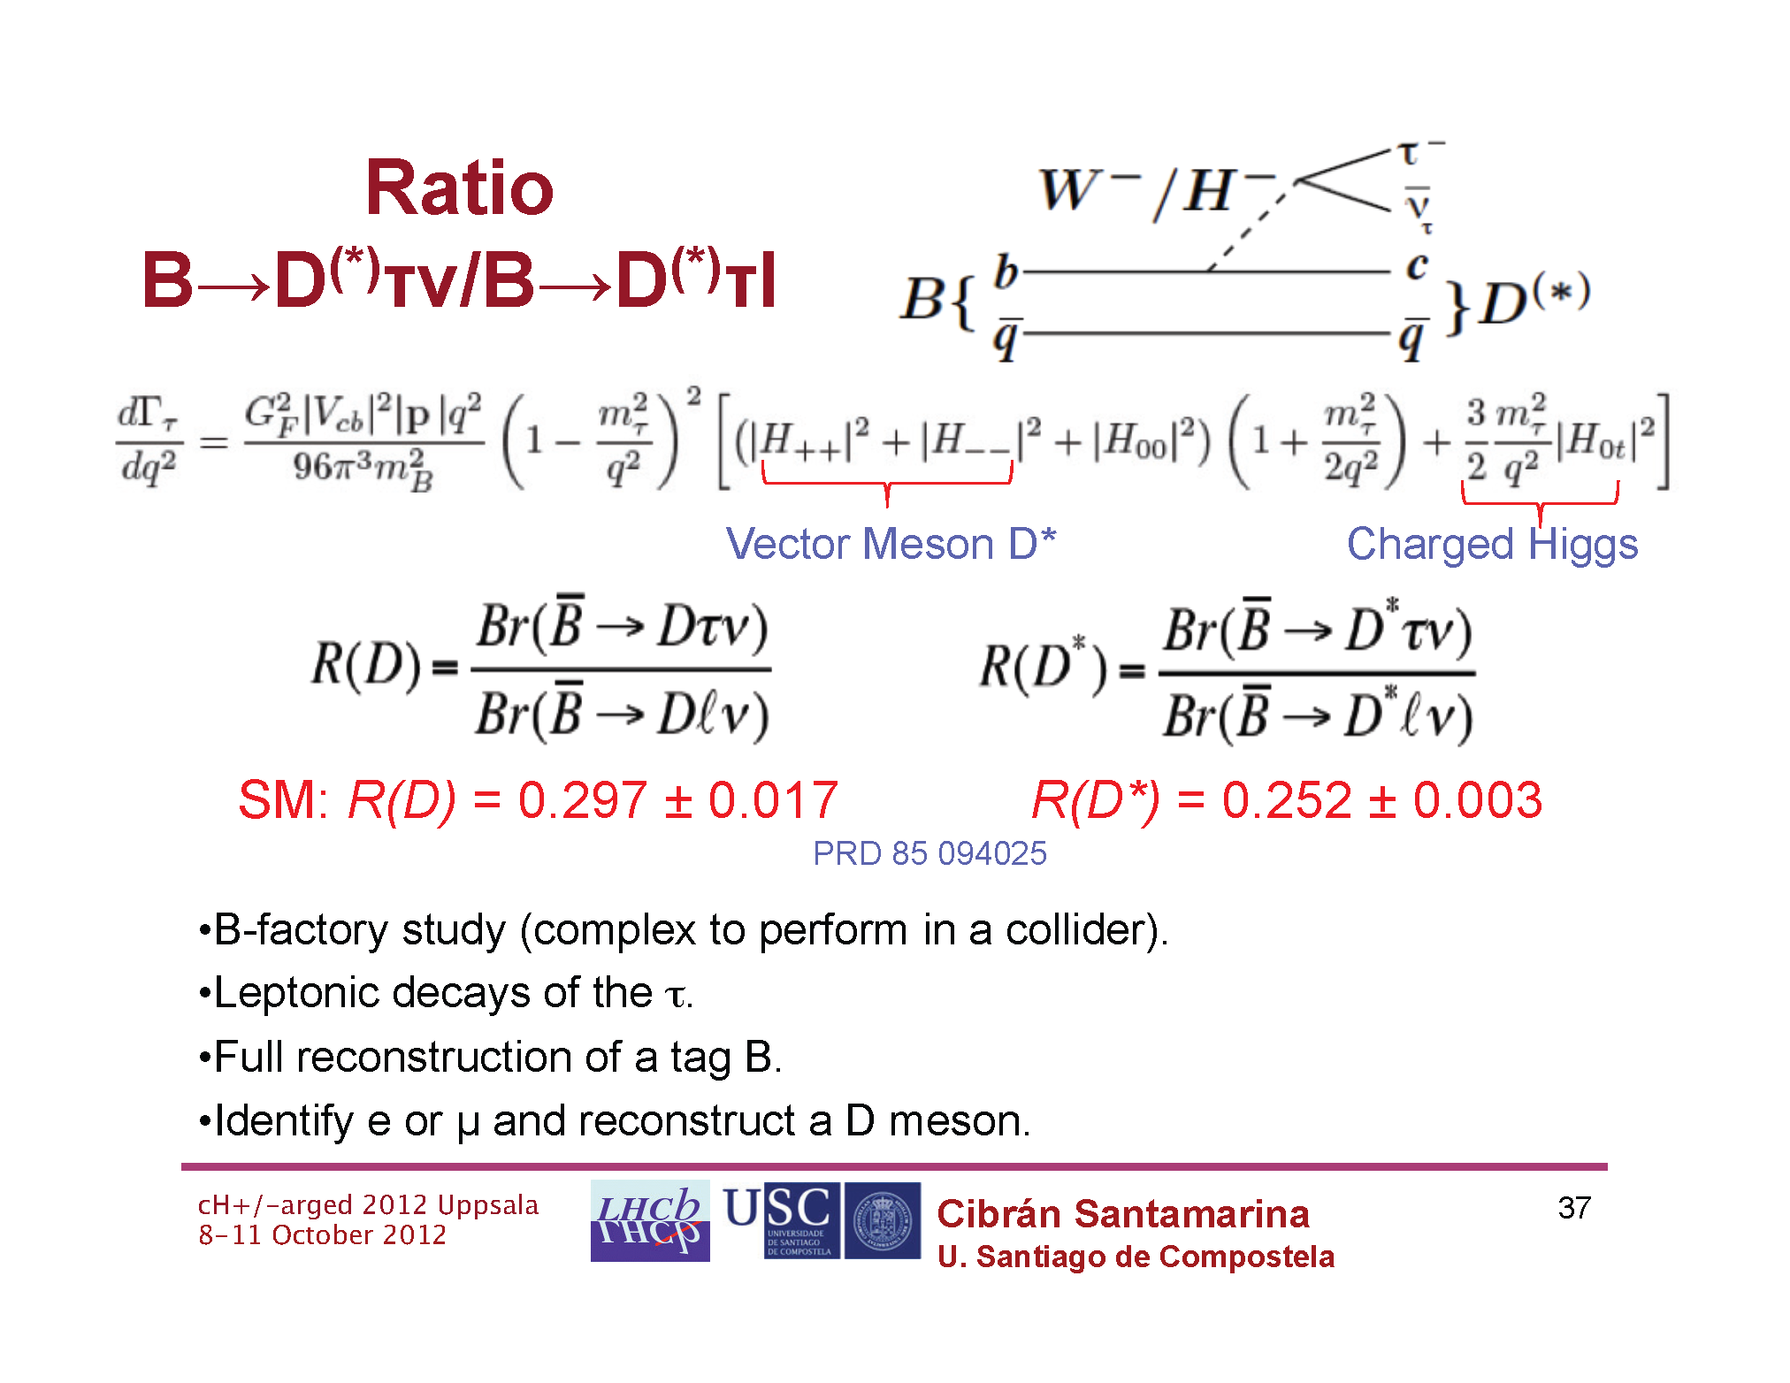
3.

Slide 9
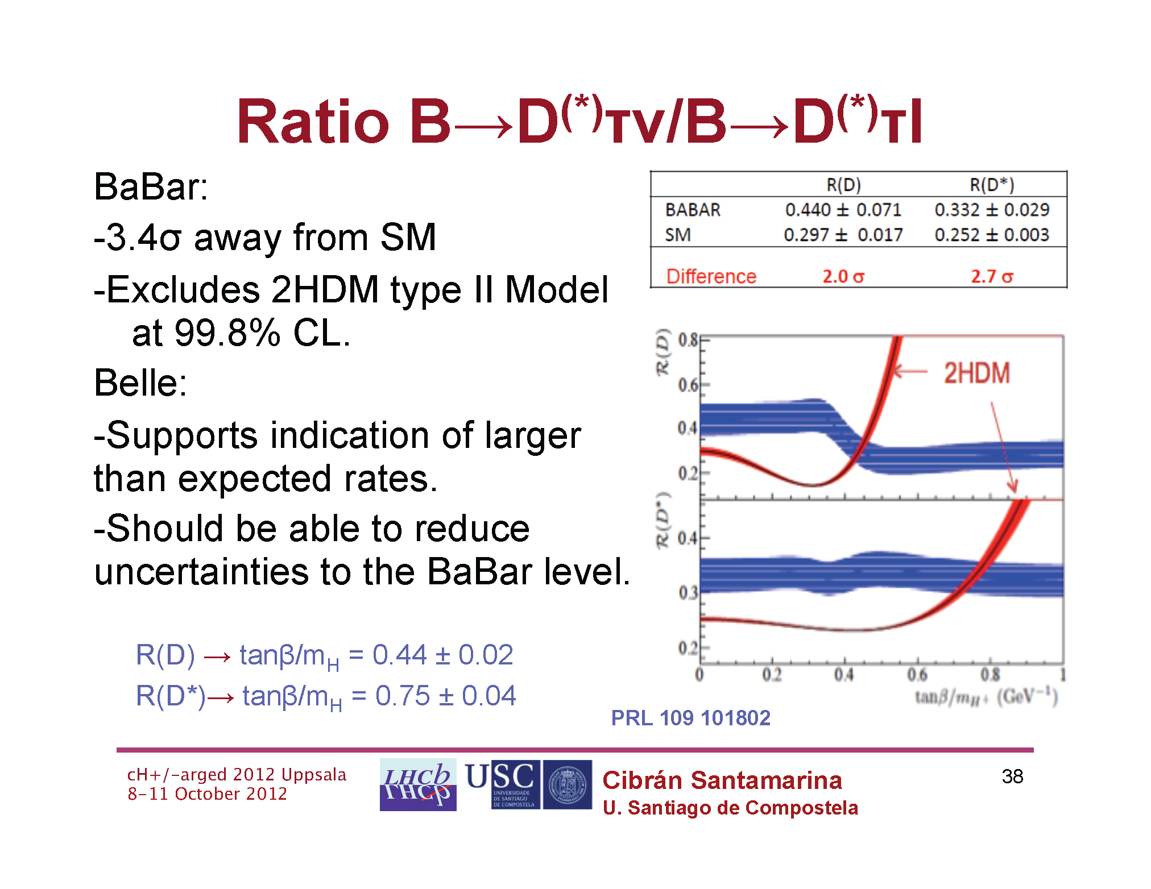

Slide 10
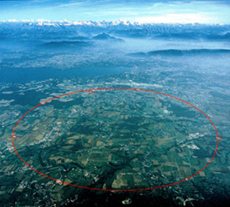
LHC

Slide 11
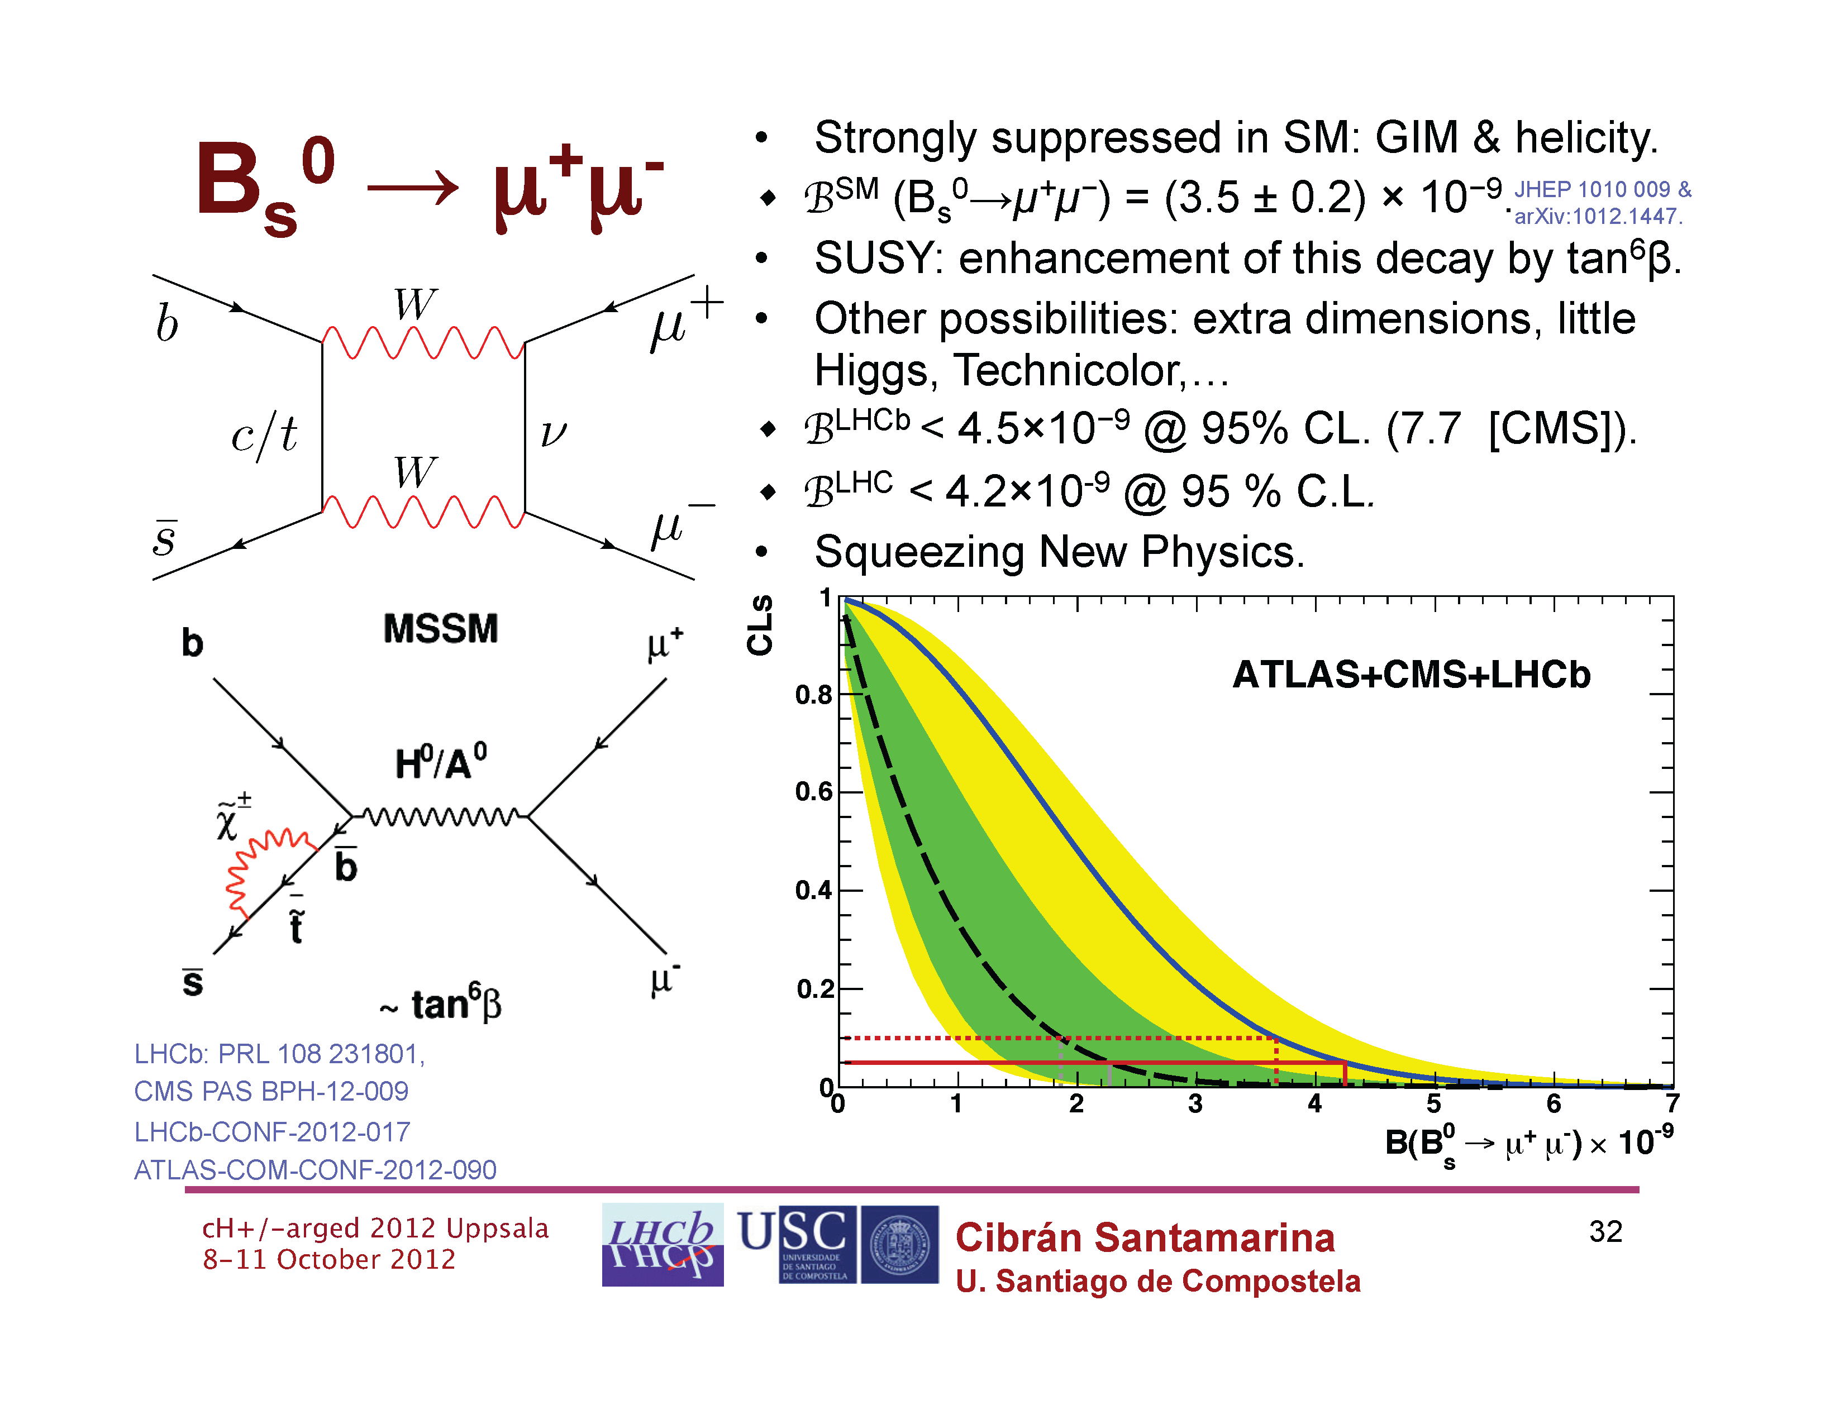
4.

Slide 12
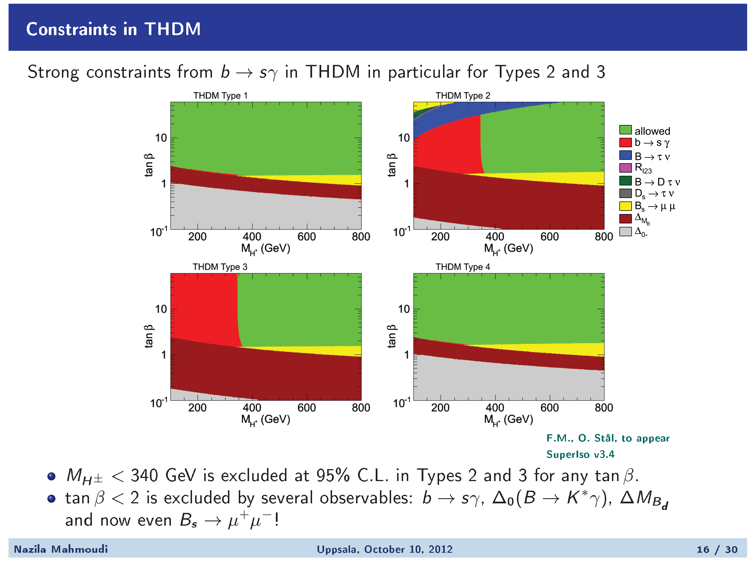
1.
2.
3.
4.

Slide 13
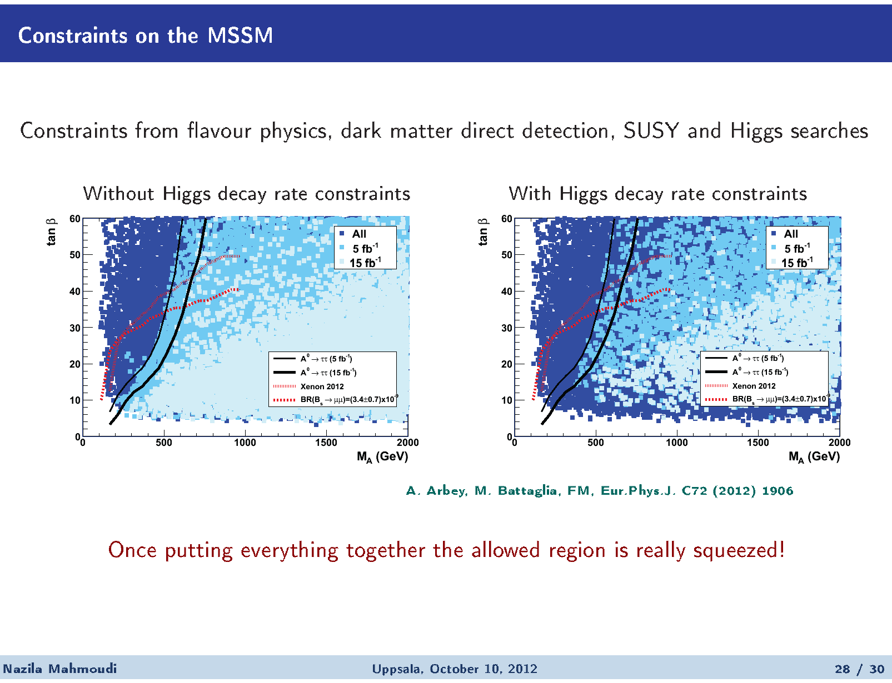

Slide 14
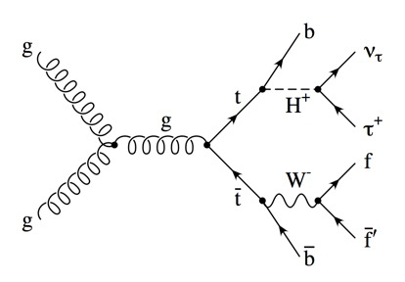
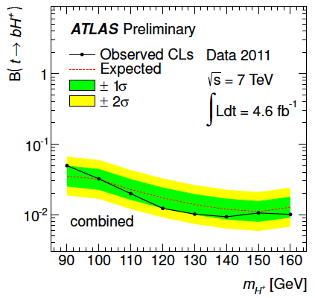
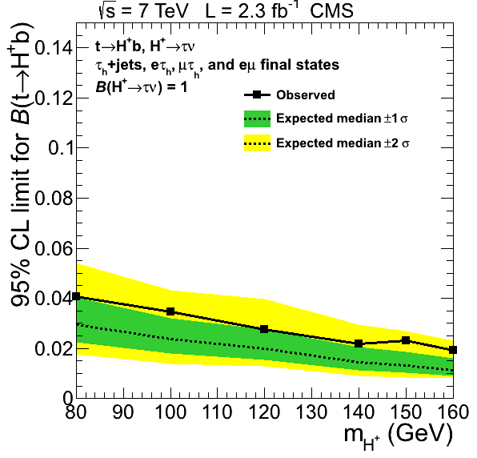
LHC direct searches
Upper limits on B(t->bH⁺)
(s)
(c)

Slide 15
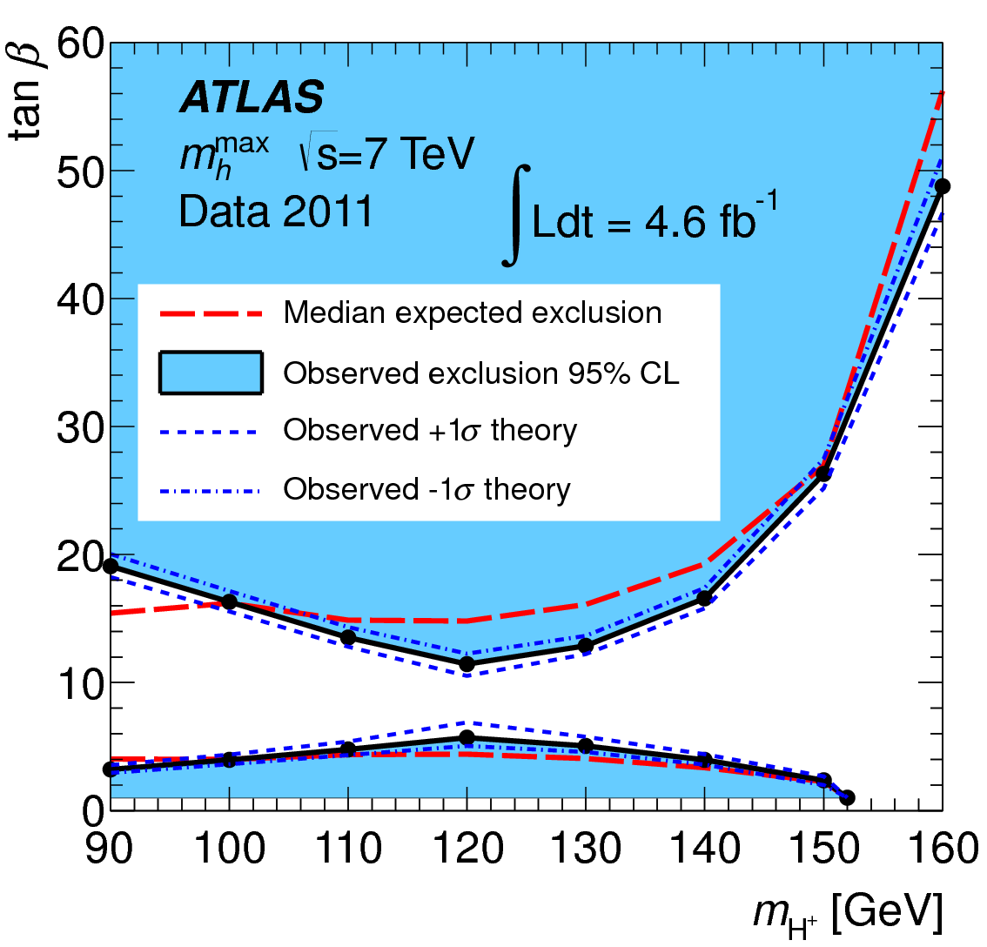
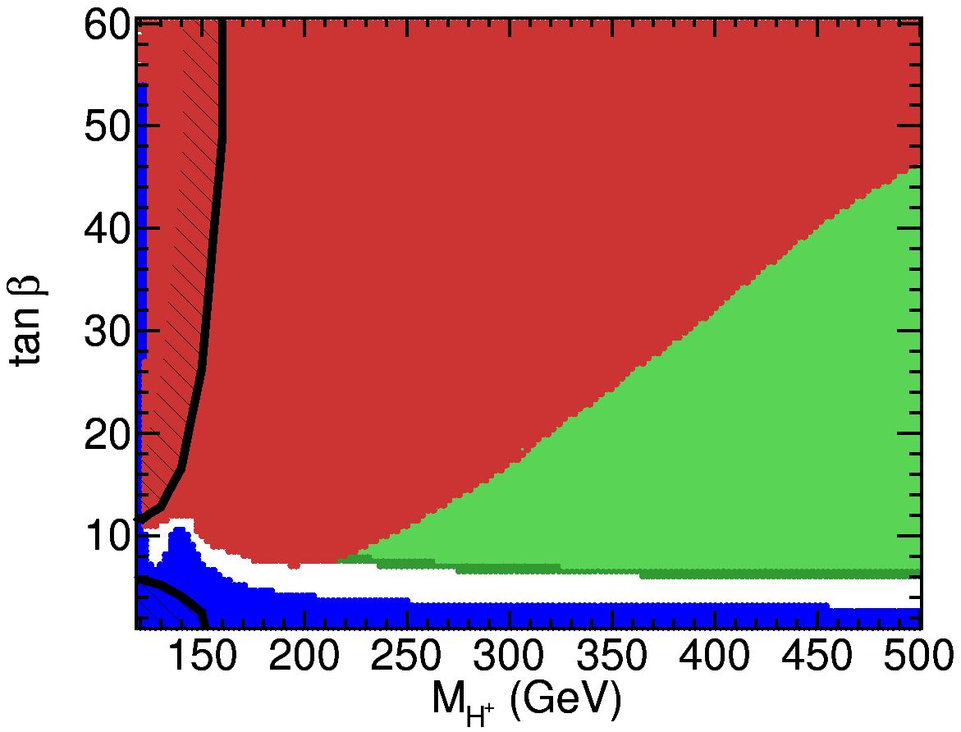
Constraints on MSSM parameter space from
H⁺ and Hº-> τ⁺τ⁻ searches at LHC
Upper limit on tan β ? M_{h}-max, X_{t}=-2TeV
Excluded by
H/A->ττ searches
Allowed
Allowed with
Hº =125 Gev
Allowed
Allowed
LEP
LEP
Excluded by H+ searches
2012-10-11
H+2012 Outlook Tiord Ekelof Uppsala University
15

Slide 16

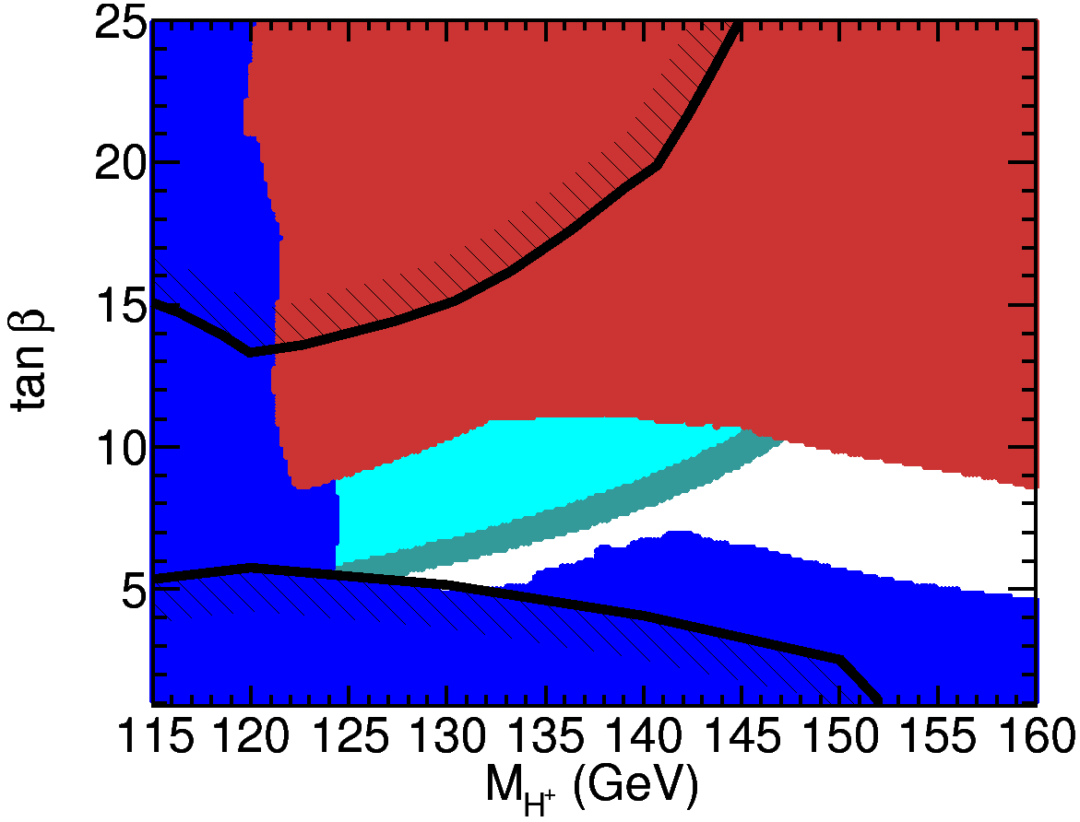
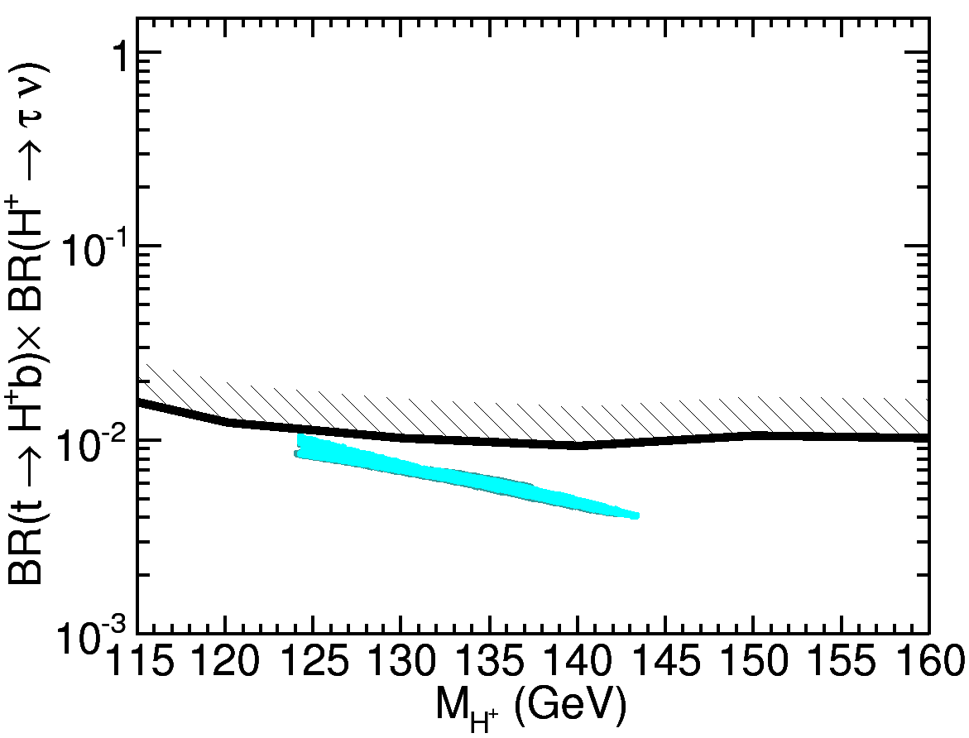
Alternative MSSM interpretation: M_{H} = 126 GeV
M_{H} = 125.7+-2.6 GeV
ATLAS/CMS exclusion
LEP exclusion
ATLAS Direct H+

Slide 17
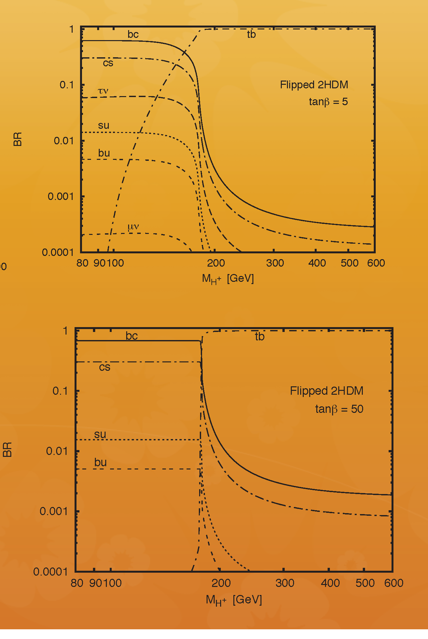
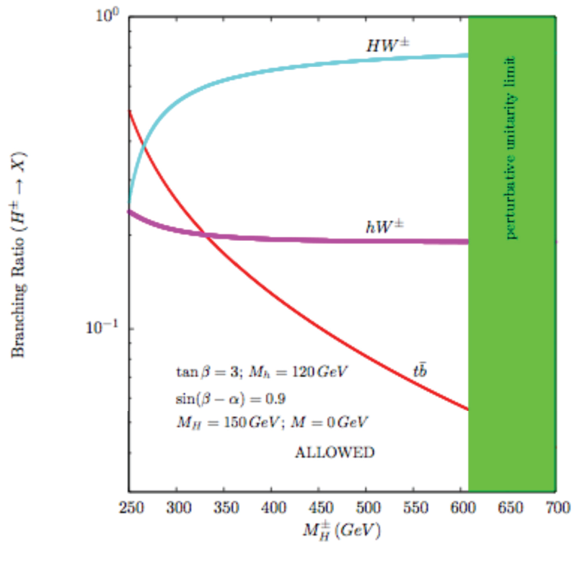
Sofar we have been looking for
the light H+ decaying to τν_{τ} and cs
and the heavy H+ to tb
In the Flipped Model the light H+
Decays predominantly to bc
And the heavy Higgs could in certain
Models decay to HºW⁺ or hºW⁺
And this morning we heard about H+->cs, cb, ts, W gamma, WZ from Jaime Hernández so we need to keep an open mind as to what H+ decay states to look for….

Slide 18
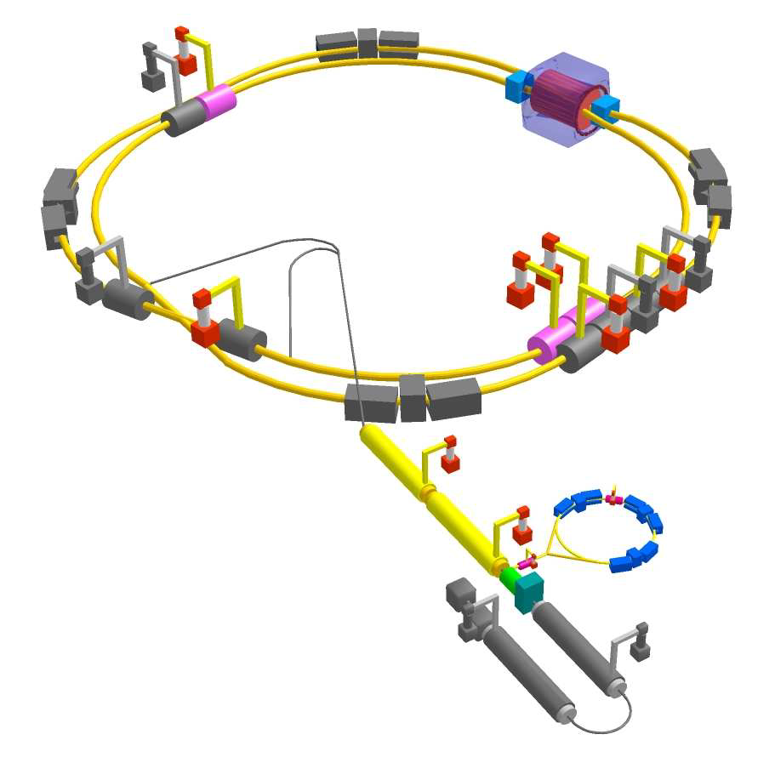
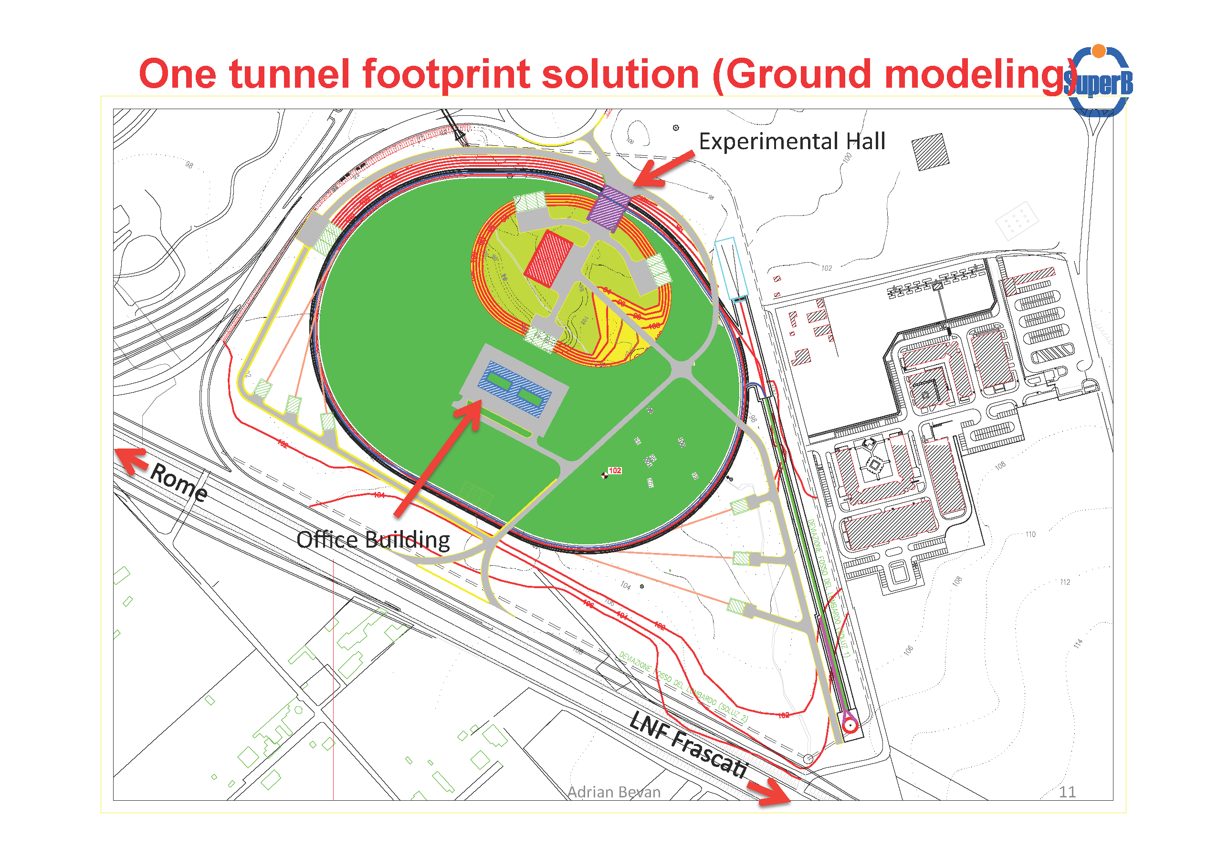
Super B factories
SuperKEKB
Japan
SuperB
Tor Vergata
Italy

Slide 19
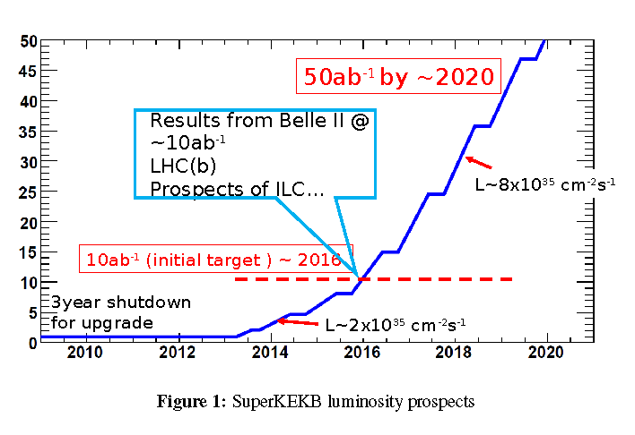

Slide 20
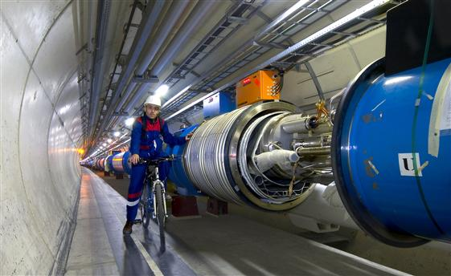
LHC upgrade to L=5*10³⁵cm⁻²s⁻¹ and √s=13-14 TeV

Slide 21
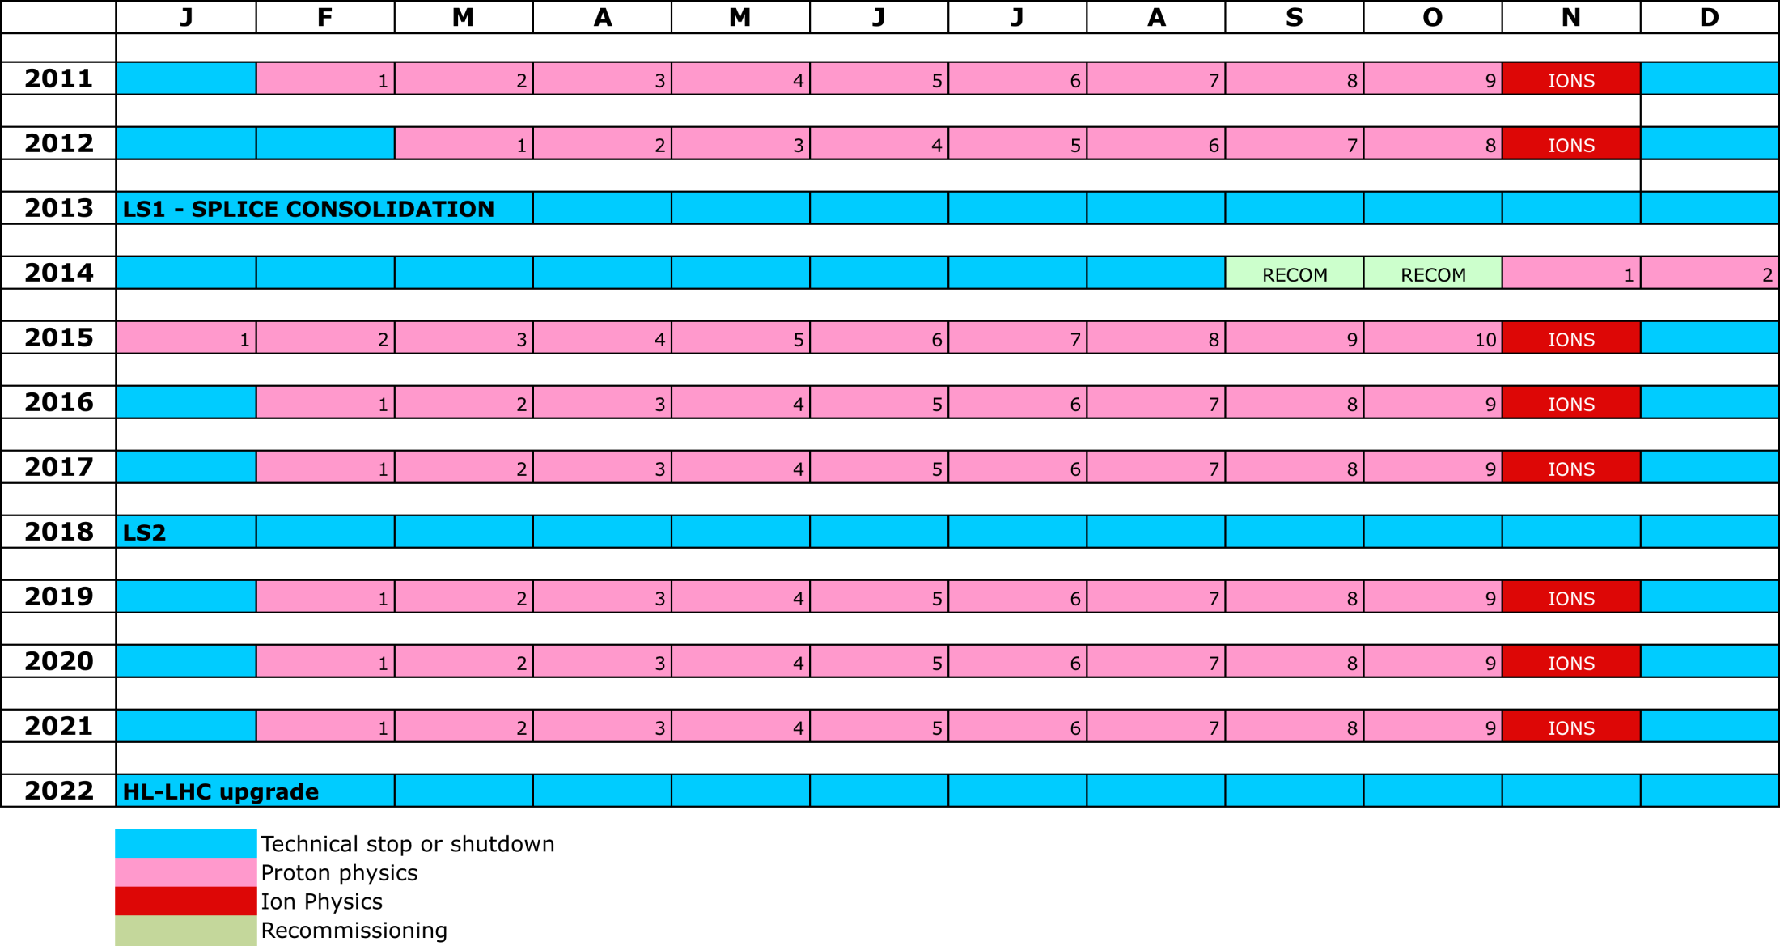
LHC 10 year plan
LS1
PHYSICS AT 6.5/7 TeV
≈ 300 fb⁻¹
at 6.5-7 TeV
LS2
“ULTIMATE” PHYSICS
LS3
HL-LHC
~3000 fb⁻¹
at 6.5-7 TeV
NB: not yet approved

Slide 22
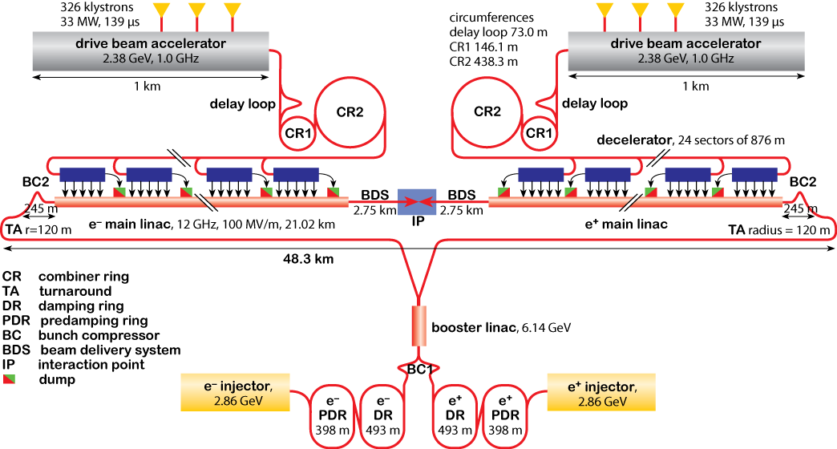
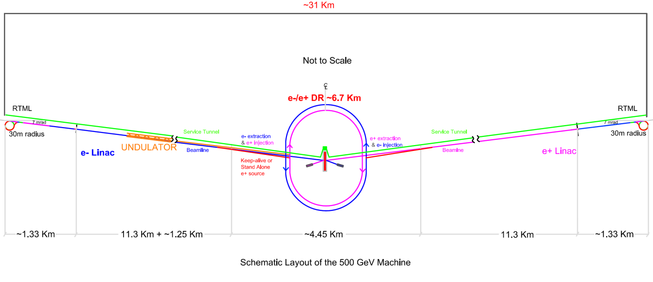
Overall Layout of CLIC (3 TeV)
ILC Schematic

Slide 23
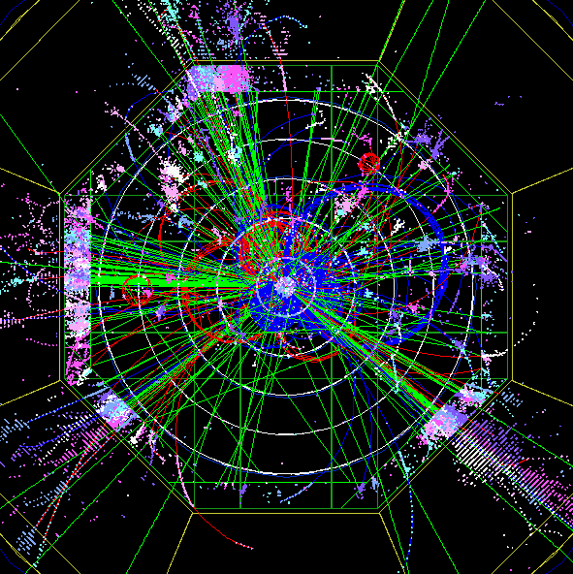
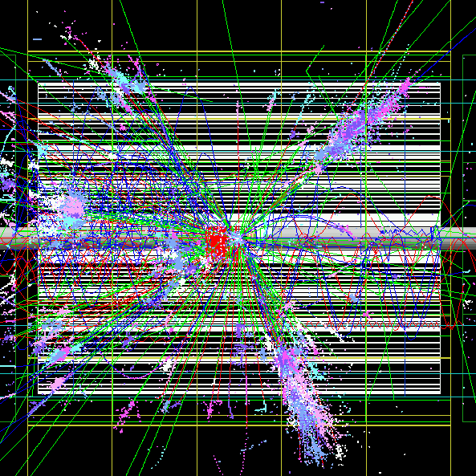
Start from analysis of H+H- for CERN-2004-005 CLIC Physics Report
later extended and published as Coniavitis & Ferrari, PRD 75 (2007) 015004
e+e- → H+H- → tbtb

Slide 24
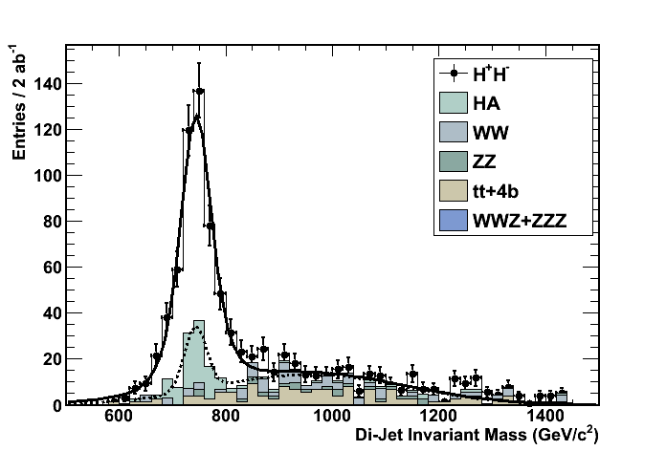
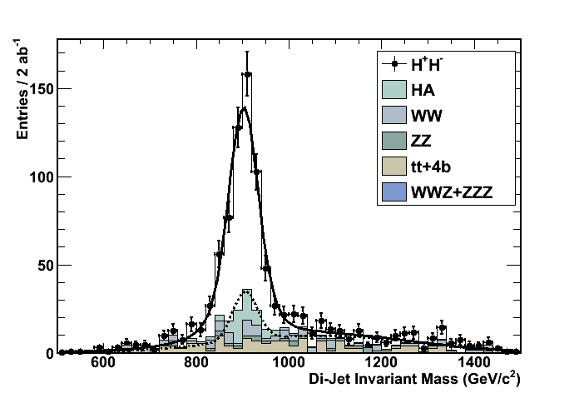
H+ Mass and Width Reconstruction:
Kinematic Fit with Equal Mass Constrain,
anti-kt semi-exclusive jet clustering
Signal + SM Bkg
6-par Fit
MH = (744.3+/-2.0 (stat)) GeV
Γ_{H} = (17.0+/-4.7) GeV
Signal + SM Bkg
6-par Fit
MA = (901.4+/-1.9 (stat)) GeV
Γ_{H} = (18.9+/-4.4) GeV

Slide 25
We have this year made a discovery of a new boson, the recordings of which we are now poised to investigate thoroughly over the next two years.
This investigation will add new momentum to our research because it will not be based on speculation but on high statistics, precise experimental observations.

Slide 26
What new discoveries may be waiting, beyond the detailed investigation of the properties of the Higgs-like boson, we do not know, but many of our earlier assumptions will have to be abandoned and new ideas will appear as a consequence of what detailed properties of the Higgs-like boson we find.
Because of this year’s discovery we currently live in new times in which new knowledge about the fundamental properties of matter may soon be gained.

Slide 27

There is a good chance that the detailed analysis in 2013 and 2014 of the some 2*25 fb⁻¹ to be collected at LHC before the end of 2012 LHC run will lead to a significant change of the current landscape in High Energy Physics by the autumn 2014.
We hope to see you all back in Uppsala for the Charged Higgs Workshop in autumn 2014.
4

